Slide 1
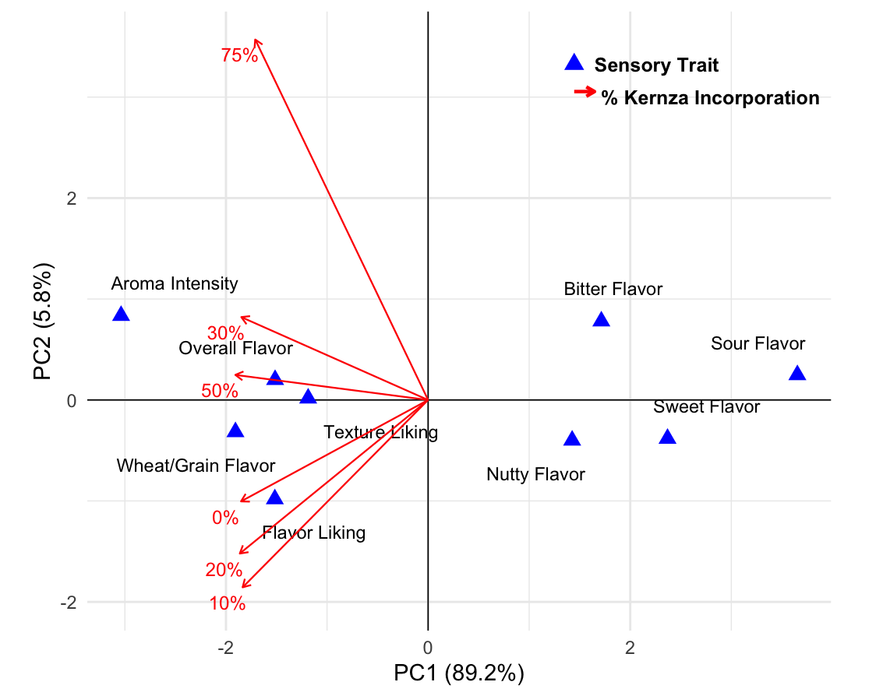
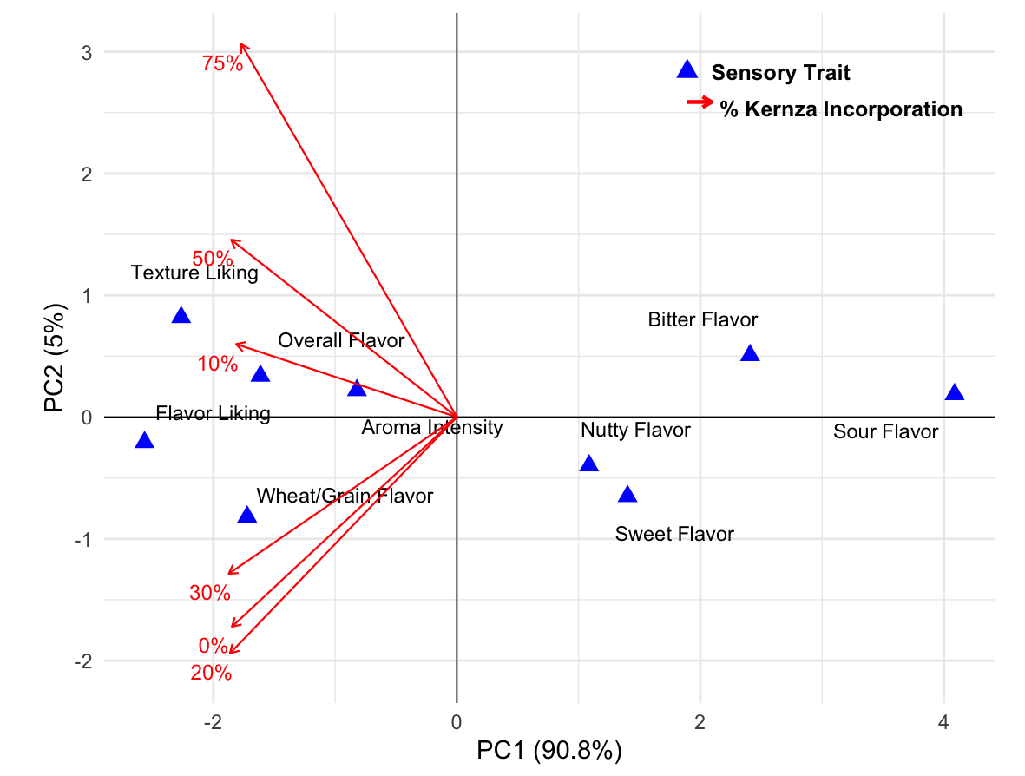
A
B
Figure 3. PCA plot of sensory traits and Kernza® levels for (A) flatbreads and (B) biscuits.

