Slide 1
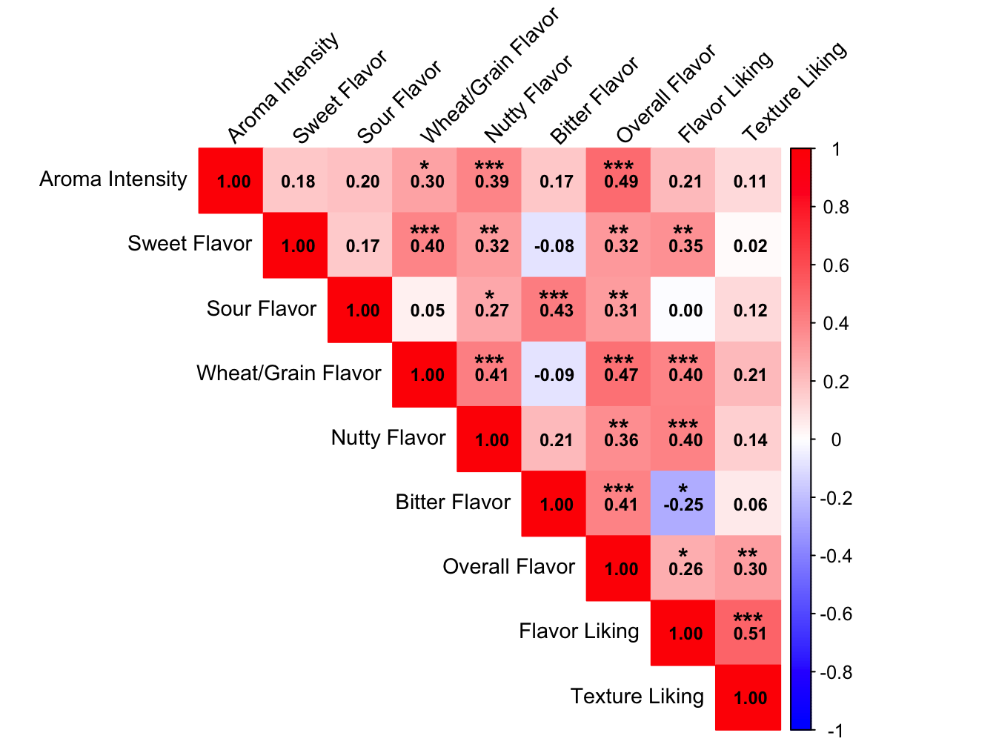
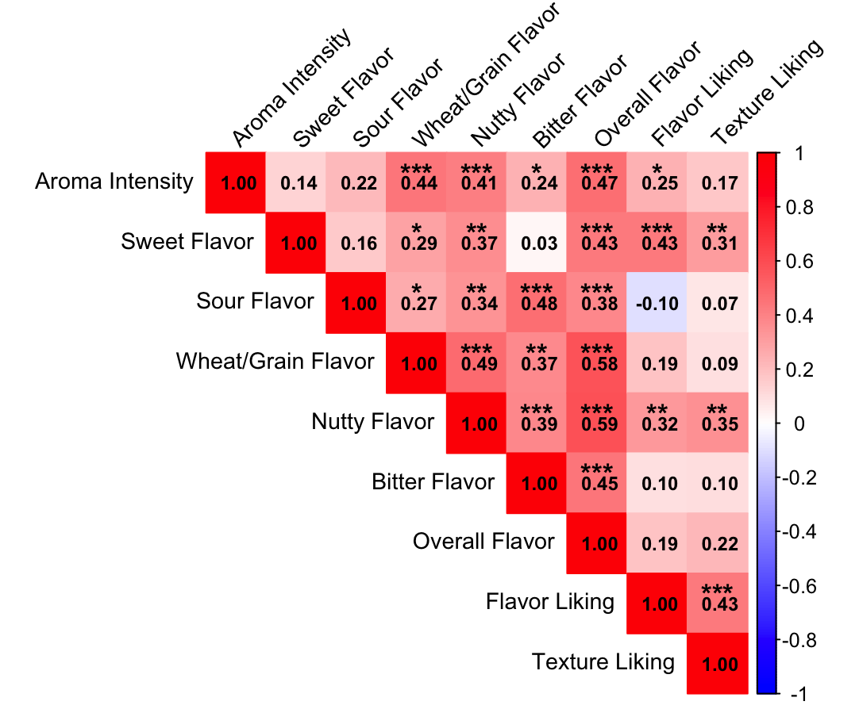
A
B
Figure 4. Correlation among sensory traits for (A) flatbreads and (B) biscuits. Asterisk represents significance (* p < 0.05, ** p < 0.01, *** p < 0.001).

