Slide 1
nuts
&
Bolts
Designing an on-farm research experiment
Sam Corcoran
UMass Extension Event - July 12, 2016

Slide 2
SIHERC
State the question – what do I want to or need to know?
Investigate the known body of information – what is the gap in knowledge?
Hypothesis – what do I expect to happen? Why?
Experiment – how can I test my hypothesis and answer my question?
Results – what information have I produced? How can I display/communicate it?
Conclusion – what is the big picture from the results? What should I do next?

Slide 3
STATE THE QUESTION
“S” DOESN’T STAND FOR SEMANTICS

Slide 4
Work backwards to choose the question – consider observations & needs
  I’ve noticed…I have less pathogen pressure after a mustard cover crop
  I wonder… if I can direct seed instead of transplant fava beans and get the same yields
  How can I…maximize nutrient capture from fall applied manure
  Why is it…two neighboring fields yield so differently when treated the same
  Is there an effect of...converting a conventional tillage field to conservation tillage
  Why am I doing this? WHAT’S THE POINT?

Slide 5
Consider the desired outcome, but avoid “outcome driven” questions.
  Poor question: “I know some people use oats as a cover crop. How much nitrogen do oats supply to my summer squash?”
    What if oats don’t supply much nitrogen at all? What if oats reduce N availability?
    Doesn’t leave room for an experiment; there is nothing to manipulate.
    This is a closed idea
      Leave the question “open ended”

Slide 6
Consider the desired outcome, but avoid “outcome driven” questions.
  Better questions:
    “How do fall planted oats affect in-season cash crop N needs compared to [using no fall cover crop], [other grasses], [non grass cover crops], [spring planted oats]?”
    “I know cover crops can supply nitrogen to cash crops. What fall planted cover crop or cover crop mix will provide the most nitrogen to my spaghetti squash?”

Slide 7
Consider the desired outcome, but avoid “outcome driven” questions.
  Bigger ≠ Better? “Are fall planted or spring planted cover crops, or a combination of both, most efficient at providing N to the following cash crop? Is there any difference? Are different cover crops better suited to different planting times or combinations? Does the cash crop affect what cover crops I should use?”
  This could be your life’s work!
WORK
WORK
REWARD
REWARD

Slide 8
Avoid bias. Use clear language.
  A. What’s wrong with this question? “How can I suppress weeds better than by using Round Up?”
    What does “better” mean?
    Round Up specifically or herbicide in general
      Can we use a different chemical?
    Are we looking for an alternative for
      Environmental reasons
      Economic reasons
      Because we don’t think it works that well
    What if there isn’t anything more effective?
    This is a closed/constricted question

Slide 9
Avoid bias. Use clear language.
  B. How can we improve/rewrite the previous question?

Slide 10
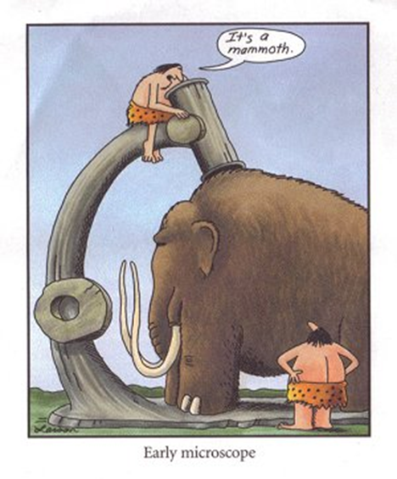
Investigate

Slide 11
What do we know? What don’t we know?
What new information is your experiment going to answer? Refine your question.
  Difference between “trying something new” on your farm and truly “experimenting”.
    Be clear about your goal.
  Seeking a grant? Avoid creating redundant information.

Slide 12
What do we know? What don’t we know?
If it hasn’t been done in your region, soil type, topography, the crop you are working with, etc, it’s not redundant
If the results haven’t been repeated, it’s not redundant

Slide 13
What do we know? What don’t we know?
You can seek to disprove “known” information or tweak/improve previous work

Slide 14
What do we know? What don’t we know?
Rephrase or refine your question if needed.
Lather, rinse, repeat.
Use the known body of information to instruct your hypothesis and design your exp.

Slide 15
Desired outcome: I want to spend less money and time applying herbicide, and my customers want low spray products.
Question: Is there an economically efficient alternative to conventional herbicide that doesn’t sacrifice yields and isn’t excessively time consuming?
Known info: Solarization can reduce the seedbank, conservation tillage avoids turning up new weed seeds, cover crops like tillage radish suppress fall and early spring weeds, tine weeding can help manage weeds once the cash crop is planted. No one method works as well as conventional herbicide.
Unknown: Can I use a combination of these methods to get a similar results to herbicide? If the weed suppression is similar, is the expense associated with extra time/materials equal to the cost savings?

Slide 16
HYPOTHESIS
OPINION MEETS FACT
THEY LIVE HAPPILY EVER AFTER (UNTIL THE RESULTS)

Slide 17
Informed Guess
Based on what you know from your observations, prior knowledge, and investigation of the current knowledge
  What do you expect or think will occur?
Must be testable – this inherently means measurable.
“Tomatoes should only be planted after mustard greens.”
    Variables: this hasn’t left anything test or manipulate. What is it being compared to, and what is the criteria to verify this statement?
C. This could be changed to make it a testable hypothesis. How?
Tomatoes planted after mustard greens will be less susceptible to Phytophthora infection, because the mustard will suppress the pathogen in the soil.

Slide 18
Informed Guess
D. Write your own hypothesis for our herbicide question
My example: A combination of spring solarization, fall planted tillage radish, and conservation tillage will provide comparable weed suppression to conventional herbicide, and the increased cash crop value will offset the expenses of cover crop seed and solarization material.

Slide 19
Informed Guess
  Set in stone. Never change it if results don’t support.
    It doesn’t matter if you are “wrong” or “right”.
    You can change your hypothesis in a future experiment.
  Null Hypothesis: Turns out my treatments had no effect.
    Ex: H: I hypothesize honey bee colonies will experience increased survival rates over the winter if they have mushroom tea instead of sugar water. R: Drinking mushroom tea instead of sugar water didn’t change survival rates.
  You don’t “prove” your hypothesis. You just don’t “disprove” it, or you support your idea and it’s likelihood of occurring. Karl Popper’s example:
    H: All swans are white. R: You see 1,000,000 white swans. 100 years after you die someone sees 1 black swan.
    It only takes one to prove something “wrong”, it doesn’t matter how many times something is “right”.

Slide 20
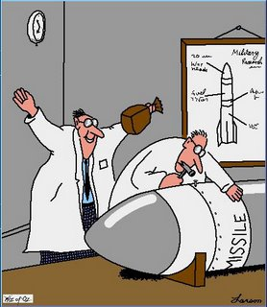
Experiment

Slide 21
Details
Do you have the basic EQUIPTMENT and space
  Nuts. I don’t have a no-till planter, but I can borrow my neighbor’s tine weeder and try that instead.
    New hypothesis: A combination of spring solarization, fall planted tillage radish, and conservation tillage tine weeding will provide comparable weed suppression to conventional herbicide, and the increased cash crop value will offset the expenses of cover crop seed and solarization material.
      Do you still think this hypothesis is accurate?
      Yes, I still think this can work. If the results are promising, I can look into a no-till planter in the future.
  Select the LOCATION of the experiment carefully.
    Don’t put the experiment in your worst field unless that’s the point.
    Experiments are investments. You get out what you put in.

Slide 22
Variables
Independent Variable – this is what you manipulate; aka TREATMENTS
More than one independent variable = interactions
Limit independent variables to avoid very complicated experiments

Slide 23
Variables
Ex: What is the effect of mustard seeding rate and time of incorporation on suppressing disease and increasing yield?

Slide 24

Variables
Independent Variable – this is what you manipulate; aka TREATMENTS
More than one independent variable = interactions
Limit independent variables to avoid very complicated experiments
Mastermind approach – change one thing at a time

Slide 25
Variables
Independent Variable – this is what you manipulate; aka TREATMENTS
More than one independent variable = interactions
Limit independent variables to avoid very complicated experiments
Mastermind approach – change one thing at a time
Dependent Variable – this is what you sample to see the effects of your manipulation
You can have multiple dependent variables (Ex: What is the effect of mustard seeding rate and time of incorporation on suppressing disease and increasing yield?)

Slide 26
Controls
How will you know if what you did worked/resulted in the desired effect?
Negative control – no treatment.
Ex: What is the effect of mustard seeding rate and time of incorporation on suppressing disease and increasing yield?
E. In mustard example: leave soil bare, or plant non-biofumigation crop. Using both would be best. Why?
  Bare soil – shows the baseline if you do nothing
  Non BF crops shows it’s an effect of BF, not an effect of “just” a CC
Positive control – guaranteed desired outcome. In mustard example: spray fungicide.

Slide 27
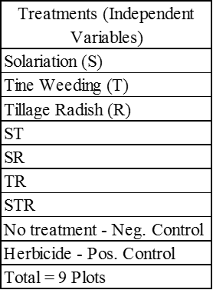
Treatments (Independent Variables)
F. Our Weed Control Experiment :
What are the treatments if we remove solarization?
T
R
TR
Neg Control
Pos Control
5

Slide 28
Treatments (Independent Variables)
  Revised Hypothesis: A combination of solarization, fall planted tillage radish and conservation tillage tine weeding will provide comparable weed suppression to conventional herbicide, and the increased cash crop value will offset the expenses of cover crop seed and solarization material.
    Do you have confidence in your new hypothesis?
      Revise the question
      Change the hypothesis
      Redesign the experiment
      Stick with the original plan
    I don’t agree with my new hypothesis. I don’t think this revised experiment will answer my question. I’m going to keep the 9 plot project (7 treatments, 2 controls).

Slide 29
Sample Collection
  What samples will you take to:
    Test your hypothesis
    Answer your question
    Think in terms of dependent variables
  How often do you need to take them?

Slide 30
Sample Collection
  A combination of spring solarization, fall planted tillage radish, and tine weeding will provide comparable weed suppression to conventional herbicide, and the increased cash crop value will offset the expenses of cover crop seed and solarization material.
  G: For our herbicide question: what samples should you take (see list in handout)
  H. How often /when should you take them?
    Weeds (#, biomass, % cover ?) – fall, spring, summer
    Cover crop biomass - fall
    Cash crop yield - summer
    Economics - throughout

Slide 31
Replications
  Once isn’t proof.
  Repeat the experiment to:
    minimize chances of random, normal field variation impacting results (reduce noise)
    verify results are consistent
  Repeat:
    Side by side in one field (at least four replications)
    In multiple fields or multiple farms
    Over multiple years (2 minimum)
    You must be able to reproduce your results.

Slide 32
Replications
  Randomize treatments within Rep (see instructions in handout)

Slide 33
Replications
  Randomize treatments within Rep (see instructions in handout)
  Complete random block designs – the Classic Academic Design
    Preferred for statistics
    Account for unavoidable field variation. Ex: drainage, wind, microbial community
      the variation within one block is less than the variation between blocks
      each block (replication) should be fairly uniform
      randomization with each block removes bias
    May not be feasible to accommodate the experimental design. Ex: equipment, need for large space for multiple samples, planting date or tillage experiments
    More difficult to plant, manage, sample

Slide 34
Replications
  Randomize treatments within Rep (see instructions in handout)

Slide 35
Replications
  Randomize treatments within Rep (see instructions in handout)
  Strip designs – the Classic On-Farm Design
    Another form of random block design
    Easier to plant and get equipment in and out of
    Shares short comings to complete random block in terms of
      Pesticide & herbicide drift
      Run off experiments
      Shade experiments etc

Slide 36
Replications
  Randomize treatments within Rep (see instructions in handout)

Slide 37
Replications
  Randomize treatments within Rep (see instructions in handout)
  Split plot – the Makes-My-Life-Easier Design
    Simplifies space driven treatments
      Ex. tillage & fertilizer applications – few large sections vs. many small sections
      Ex. herbicide & pesticide application – same as above & minimize risk of drift

Slide 38
Replications
Adding replications means taking and processing more samples.
  Weeds: fall, spring, summer: 3 sampling times X 9 plots X 4 reps = 108 samples
  Cover crop biomass: fall: 1 sampling time X 4 plots X 4 reps = 16 samples
  Yield: mid-summer: 1 sample time X 9 plots X 4 reps = 36 samples
  Per Year: 160 samples
  Two Year Exp: 320 samples
      Plus economic data (costs, savings, profits)

Slide 39
Plot Size
  Accommodate equipment
  Enough room for multiple samples
    How big will your biomass and yield samples be?
    Don’t take yield samples where you harvested cover crops or weeds for biomass samples
  Buffer space in each plot, and around the whole experiment
    Reduce edge effects
      Shading of taller plants
      More light if nothing planted next door
      Herbicide or pesticide drift (you’ll need a bigger buffer for this)

