Slide 1
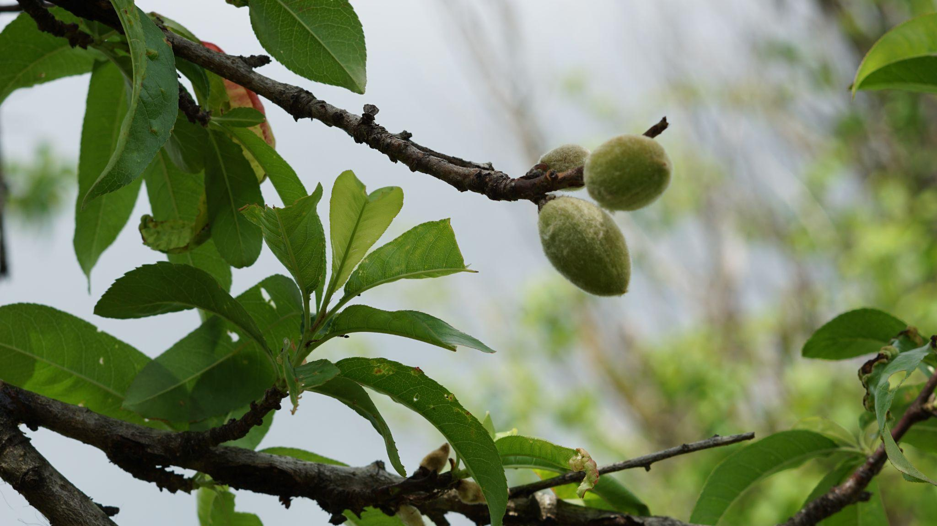

Orchard Planting
4-H Workshop
Worksheets

Slide 2

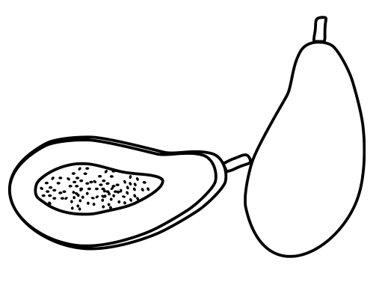
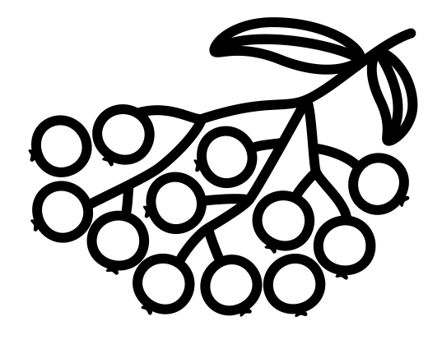
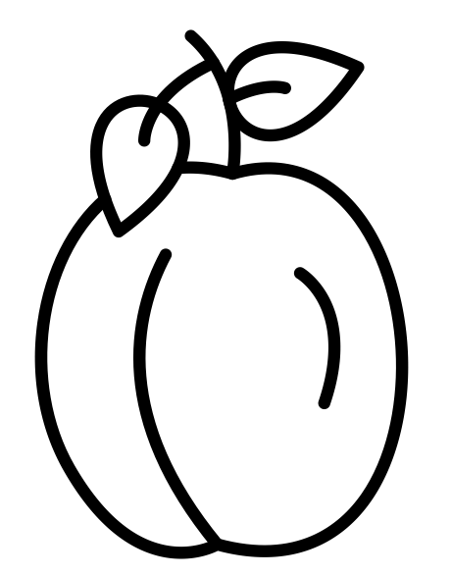

Apple
PawPaw
Elderberry
Plum
Blackberry
Timing
Early spring
Early spring
Early spring
Early spring
Early spring
Light
Full Sun
Full Sun
Full Sun
Full Sun
Full Sun
Space
between plants
10 feet
8-12 feet
4 feet
8 feet
3 feet
Space
between rows
18 feet
15-20 feet
10-12 feet
16 feet
8-12 feet
Pollination
More than one cultivar
More than one cultivar
More than one cultivar
More than one cultivar
Self-pollinate

Slide 3
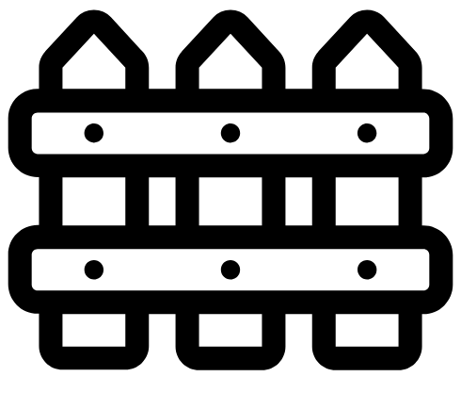


How much space does each plant need?
How much space between rows?
How much space between each tree?

Slide 4
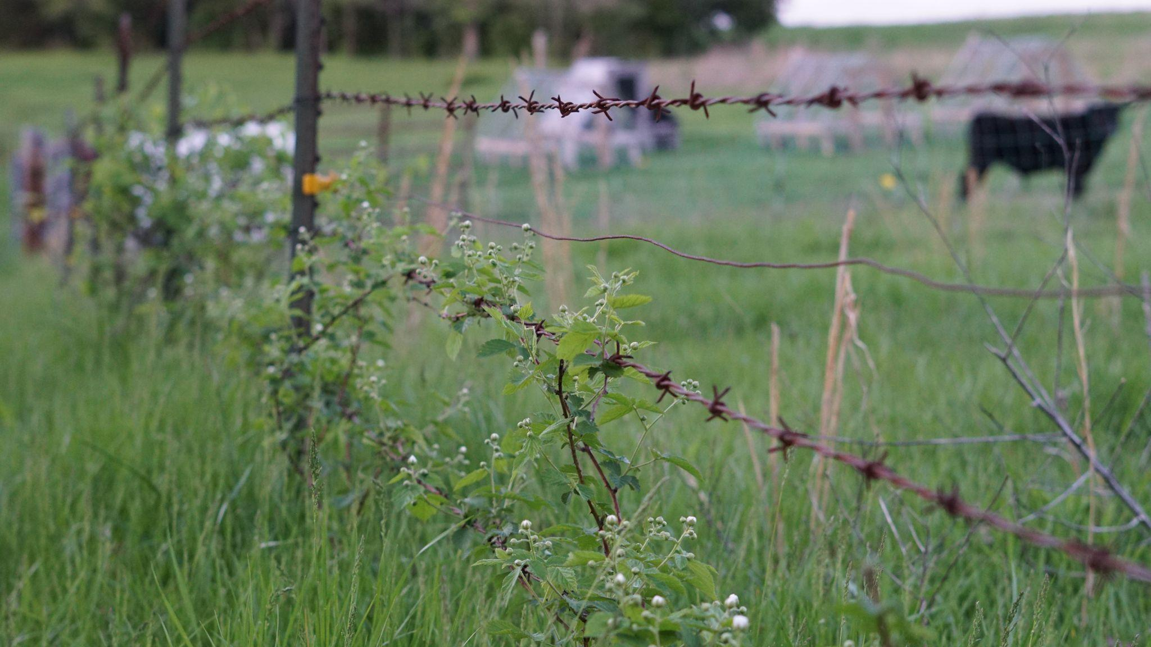



www.niederfarms.com
@niederfarms
This material is based upon work that is supported by the National Institute of Food and Agriculture, U.S. Department of Agriculture, under agreement number 3002-11032-00099876 through the North Central Region SARE program under project number FNC22-1386. USDA is an equal opportunity employer and service provider. Any opinions, findings, conclusions, or recommendations expressed in this publication are those of the author(s) and should not be construed to represent any official USDA or U.S. Government determination or policy.

