Slide 1
Valerie Dantoin
Sustainable Food and Agricultural Systems Associate degree program
Valerie.dantoin@nwtc.edu

Slide 2
Healthy Living soil
grows good food
And does not become a pollutant
Using nature’s wisdom to connect the dots

Slide 3
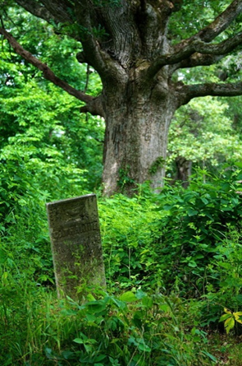
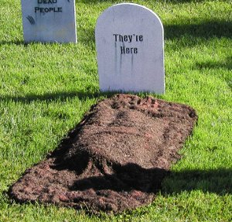
Soil
The interface between the living and the dead
Resurecction: one body’s corpse becomes another body’s life

Slide 4
Soil: when we eat plant or animal life arising from soil, we bring the external environment intimately inside of us, through a tube called guts.
What was external and dead becomes incorporated and … alive again.
SOILS R US

Slide 5
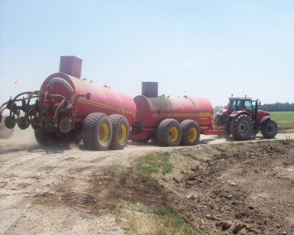
Soil structure is fragile and easily crushed
Yet we run all over it with really heavy machinery

Slide 6
We’ve been treating our soil like dirt
Just a physical structure to hold a plant in place while we add nutrients to the soil to make the plant grow.

Slide 7
Soil sediment & Nutrient runoff
Bay of Green Bay after a spring rainstorm

Slide 8
Soil – splashes up and off fields

Slide 9
Studies in our region show that on average:
- 70% of the problem erosion and nutrient runoff occur
in just 17 days in spring
when there is no crop growing
to cover and protect the soil

Slide 10
Unprotected, newly planted fields cause the problems.

Slide 11
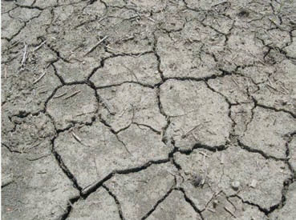
Erosions and flooding are a result of upstream fields’ inability to soak up rains
This happens when annual crops like corn and soybeans are grown year after year on the same field with no rest.

Slide 12
Soil and sediment are often laden with manure and nutrients
And this results in nutrient overloads, specifically phosphorus in water

Slide 13
“Pardon me oh thou bleeding piece of earth that I am meek and gentle with these thy butchers” - Shakespeare

Slide 14
We’ve been treating our soil like dirt
We have not taken care of it nor the organisms that inhabit the soil.
The soil is connected to microbes, roots, plants, and us in ways we have not begun to imagined
Is a degraded ecosystem outside reflected in degraded ecosystems inside us?
How do we begin treating the soil and ourselves better?

Slide 15
Keep the soil covered year round

Slide 16
Balance soil Health – don’t forget the biology!
D
I
V
E
R
S
I
T
Y
D
I
V
E
R
S
I
T
Y
BIOLOGICAL
PHYSICAL
CHEMICAL

Slide 17
Keep living roots in the soil year-round

Slide 18
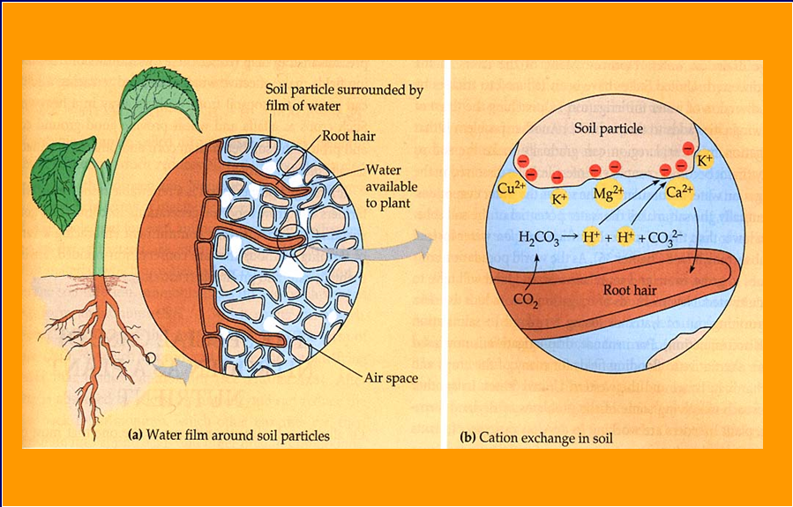
Roots need pores: air space, & water space. Do not crush!

Slide 19
Texture: Pore & Surface Area in Sand, Silt & Clay
Know your soil structure. We are on a lot of clay in our area. Tiny pore spaces!

Slide 20
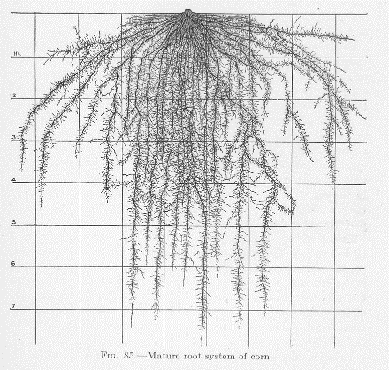
Up to 60% of Photosynthetic Carbon is sent to the roots
Antioxidants
Simple & Complex Acids
Complex Carbohydrates
Proteins
Essential Oils
Chelating Agents
Microbial Stimulants
Secondary Metabolites

Slide 21
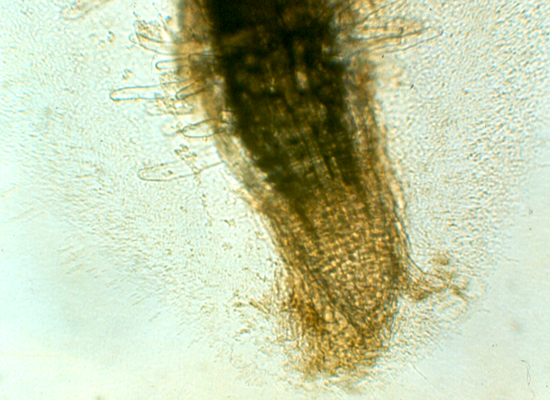
Root Tips Exude good things into the nearby soil

Slide 22
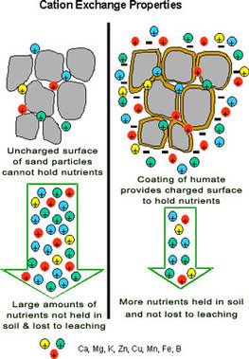
Cation Exchange
Microbes and other “soil livestock” make glues and glomulins that bind soil particles together and provide aggregate structure

Slide 23
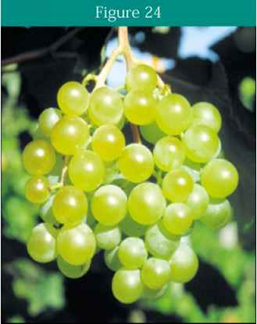
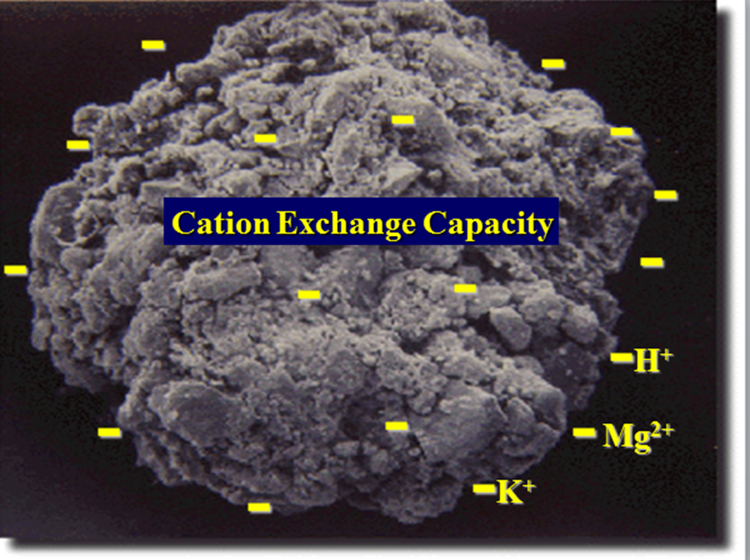
The more structure, the more pore space

Slide 24
The Rhizosphere: “The Nectar of Roots”
Sugars (fructose, glucose, ribose, etc)
Up to 27 amino acids
Nucleotides, flavones, phenolics
Lipids, mucilage, gums, resins
Water soluble/ 3-5X non-water soluble/ 8-10X volatile
Hundreds of compounds; Thousands of combinations

Slide 25
Rhizosphere
1-5% of Soil Volume
1-5mm from Root Surface
Microbial Population 10-100X Higher than Other soil
Microbes Only Occupy 7-15% of Actual Root Surface
Up to 25% (+) Plants Photosynthetic Energy

Slide 26
Glomualin Properties
Doesn’t Dissolve in Water
Resistant to Decay (“PVC”) 10-50 years
Glue Soil Aggregates
Insulates VAM Hyphae from Nutrient Loss
Average 27% of Organic Soil Carbon
100’s of Meters of Hyphe per tsp. of soil equals large amounts glomalin
25% more Weight than Humic Acid

Slide 27
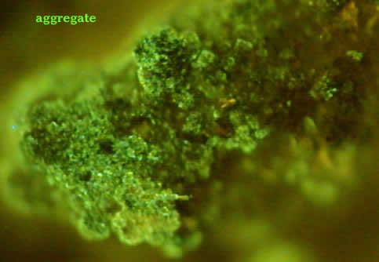
CRUMB STRUCTURE REQUIRES BIOLOGY

Slide 28
For EVERY 1% Increase in OM:
Additional 4.5 gallons of water stored per top 12” soil per square yard;
Equal to: Additional 18,000 gallons per Acre

Slide 29
Loss of Humus = Drought!
3% Loss of OM = Loss of 54,000 gallons of water per acre

Slide 30
FORMULA FOR SOIL BUILDING – increase OM!
Adequate Liming & Light Fertilizing
Grazing to Produce Manure
Compost manure
Plow Down of Cover Crops (Legumes)
Tight Rotations, with Small Grains
Mowing For Mulch
Hay/Weeds Allowed to Grow; Mowed 2X/Summer
Will Help Raise Yields on Poor Fields 500% Within (1) Year
Chokes Out Weeds

Slide 31
USDA estimates for the value of organic matter
The top six inches of soil in an acre weighs 2 million pounds
If SOM is 1% of that then it weighs 20,000 pound
In that 20,000 pounds there are:
nutrient | pounds | Price/pound | value
Nitrogen | 1,000 | $0.50 | $500
phosphorus | 100 | $0.70 | $70
potassium | 100 | $0.40 | $40
sulfur | 100 | $0.50 | $50
carbon | 10,000 | $4.00/T | $20
Value of | 1% SOM nutrients | per acre | = $680

Slide 32
Even if you don’t care about soil
Your bottom line will increase by $680 for every 1% increase in soil OM.
If you raise your SOM from 2% to 4% that equals $1,360 per acre
Also, SOM is like a sponge, it soaks up and holds rains and releases it during dry times. Likewise, it sops up extra water in wet periods and give the roots pore space to breathe. Your crop yields will increase from this alone.

Slide 33
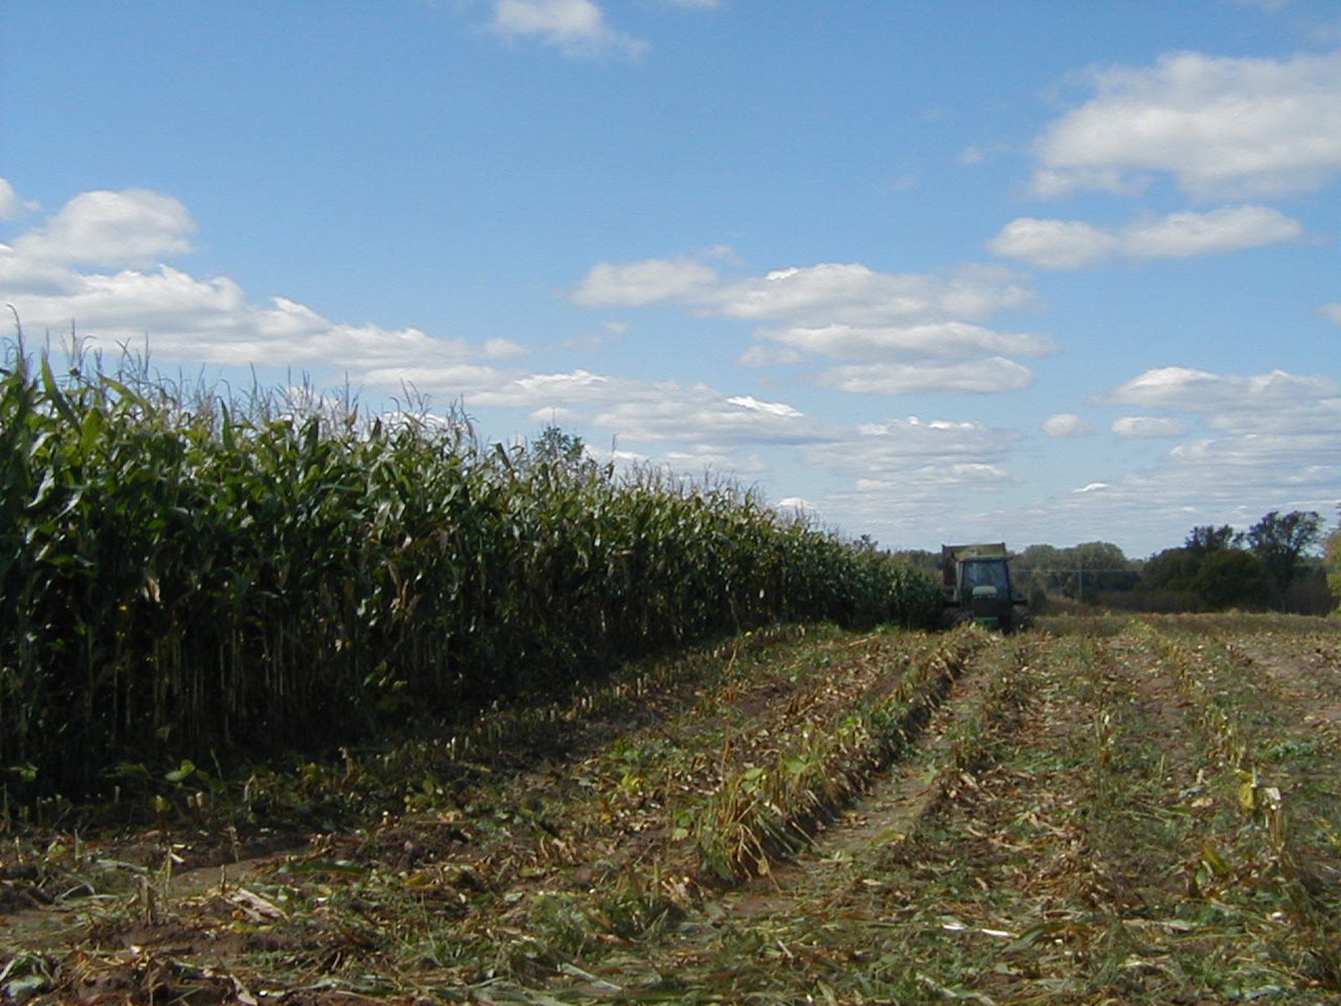
Our organic corn meets county averages every year
In drought years and wet years it beats the county averages because of the resiliency the OM affords the soil.

Slide 34
Keeping the land covered with perennial plants all year long is ideal for raising OM.
The Best Solution is Managed Grazing

Slide 35
Cover crops – sewn after corn harvest keep the soil covered!
Tough in the upper Great Lakes due to a shorter growing season.
The more diverse the cover crops or pasture, the better.
Some guys have up to 16 plant species in their mixes.

Slide 36
Grow your own Nitrogen, don’t buy it!
When organic farmers can improve their soils by increasing organic matter, they make more nitrogen available to their plants.
Organic farmers do this by increasing the soil “livestock” – the micro and macro fauna that lives below the soil surface. These soil livestock concentrate N in their bodies and become a slow release form of nitrogen. They are little gummy bears of delight.

Slide 37
Nitrogen Fertilizers
Nitrogen is very abundant in the earth’s atmosphere.
Nitrogen is not a limiting factor in normal plant growth. Plants have grown for millions of years with only the N that naturally cycles through the soil. (forests.)
It is only in high production systems of modern agriculture that nitrogen becomes a limiting factor.

Slide 38
Nitrogen Cycle
fixation
NH4
Mineralization
NO3

Slide 39
Nitrogen Cycle
To FIX atmospheric nitrogen takes a lot of energy:
Lightning
Manufacturing
Symbiotic soil bacteria
This is why nitrogen fertilizer is expensive
Industrially fixed nitrogen adds 10 million tons of N2 to the atmosphere every year!
Industry fixes several times more N than natural systems
fixation
NH4
Mineralization

Slide 40
Nitrogen Cycle
organic farmers
use
MANURE
BACTERIA
Green Manures
No synthetic N
Green Manure
fixation
NH4
Mineralization
NO3

Slide 41
Organic farmers grow our own nitrogen
A “per acre furrow slice” of soil contains about 1000 lbs of nitrogen for each 1% of organic matter (OM) measured in the soil.
Most is in the fixed form. About 20-30 lbs of N are mineralized each year for the plant to use for each 1% of OM.
A soil with 3.5% OM may contain 3,500 lbs of fixed nitrogen and 105 lbs of available N.

Slide 42
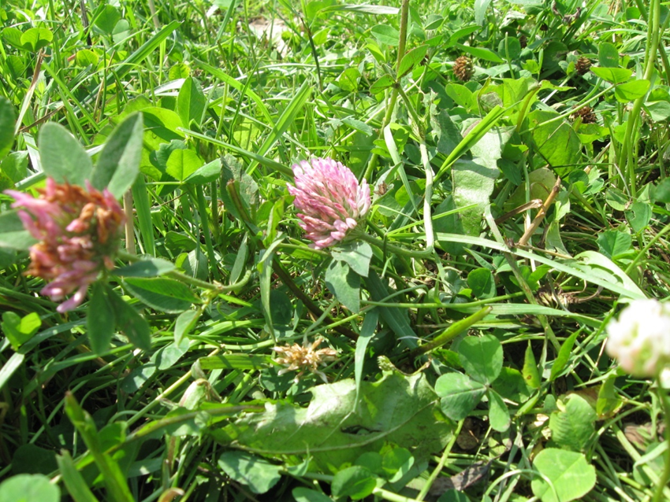
Nitrogen fertilizers
Nitrogen Fertilizers | % N | Cost/ton
Compost | 1.5
Cow manure | 5
Horse Manure | 6
Pig Manure | 6
Sheep Manure | 8
Poultry Layer Litter | 5
Poultry Broiler Litter | 3
Green Manure | 17
Mined Chilean Nitrate | 15
Fish Emulsion | 5
Tankage | 6.5
Fish Meal | 9
Blood Meal | 13
Ammonium Sulfate | 20
Ammonium Nitrate | 33
Urea | 43
Legumes fix nitrogen

Slide 43
Nitrogen sources on our farm used to grow organic corn
All is very slow release nitrogen.
source | amount | Pounds N
Green manure plow down | 10 inches high = 500 lbs DM x 15% N | 55
Cow manure | 20 T raw, wet = 2.5 T dry x 1% N | 50
Mineralized from 3.5% OM | 105 pounds per acre furrow slice | 105
Purchased poultry litter | 500 lbs/A x 5% N | 25
 | total | 220

Slide 44
Nitrogen value
Poultry Broiler Litter costs $240/T
If we assign ¼ of the cost to N (the other cost is assigned to P, K and humates) then the cost is about $1.00/lb of nitrogen or just $25/A
We let the microbes do the work of making N from all our homegrown sources so we keep our costs low
Microbes are our most valuable livestock.

Slide 45
We treat the soil well because it’s the right thing to do, not because we expect a payback

Slide 46
Connect the nodes and strands
“We abuse land because we see it as a commodity belonging to us. When we see land as a community to which we belong, we may begin to use it with love and respect.”
― Aldo Leopold

