Slide 1
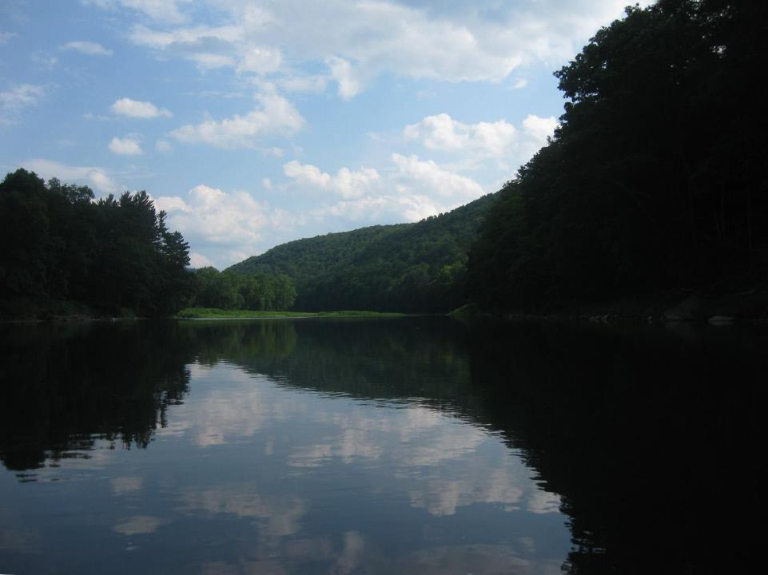
Delaware Valley Ramps
Sustainably Managing Ramp Lands
On the Delaware River
North of Equinunk, PA.

Slide 2
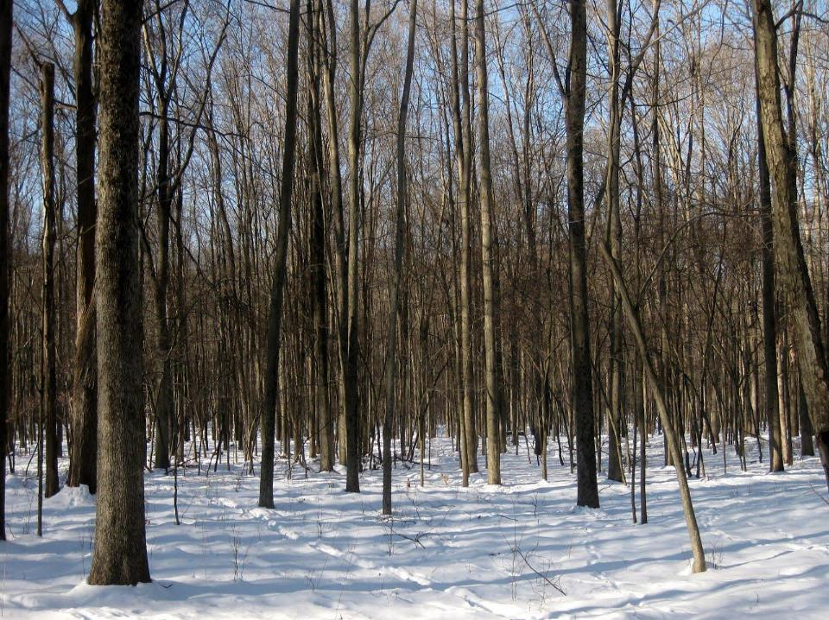
The Property
20 acres of mature sweet decidiuous hardwoods Delaware River Valley properties

Slide 3
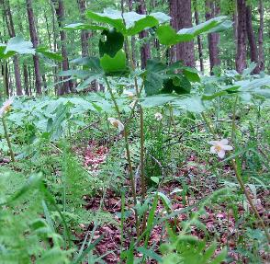
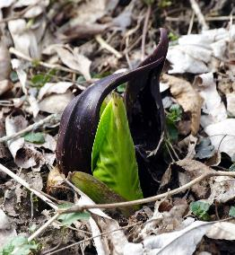
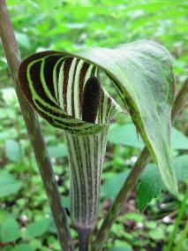
The Property
Habitat includes Mayapples, Trillium, Trout Lilies and Jack-in-the-Pulpit throughout and Skunk Cabbage in the lowest areas,
Invasives include knotweed, garlic mustard, burdock and multiflora rose.

Slide 4
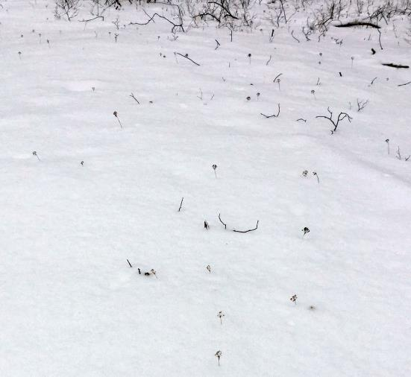
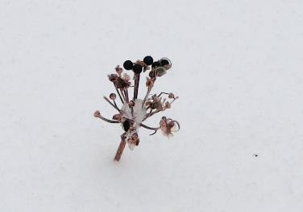
Late Winter - Ramp seed heads in the snow

Slide 5
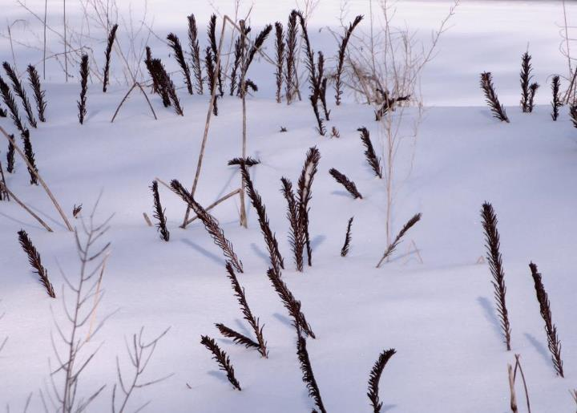
Late Winter - Fertile fronds of Ostrich Fern

Slide 6
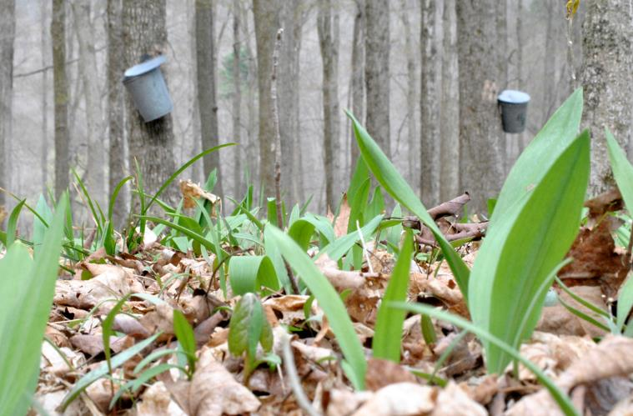
Early Spring - Ramp sprouts under maple buckets

Slide 7
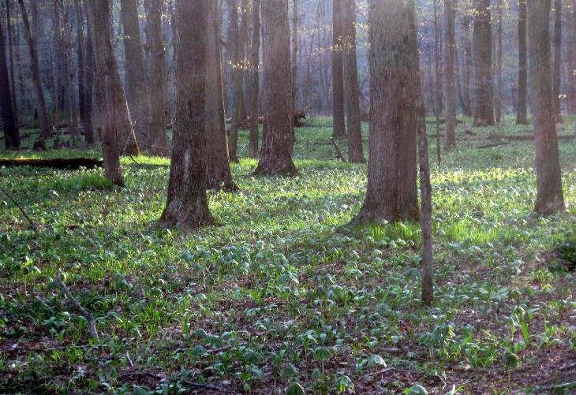
Early Season - Green carpet of ramps

Slide 8
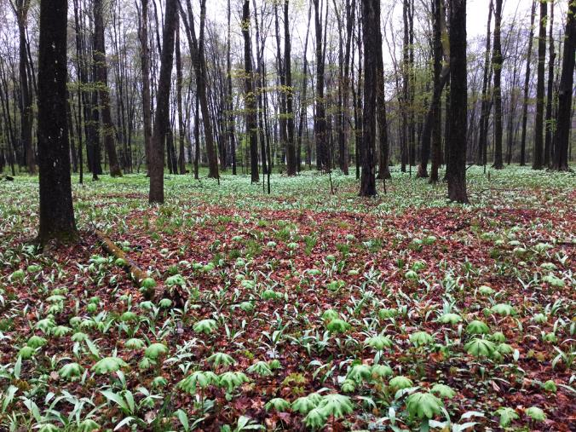
Prime Season Green - carpet of ramps and may apples

Slide 9
Ramps harvested and sold to restaurants and distributors in the Upper Delaware River Watershed and NYC
The business started in 2007 with sales to a few restaurants in Brooklyn
Over the years sales grew to include restaurants, CSAs and distributors in NYC and the Upper Delaware Region
Marketing was word of mouth
Resisted shipping around the country as orders came in from as far away as Seattle
Largest volume year was 2020 when restaurants were closed but CSAs were rapidly expanding members who wanted fresh food during the pandemic
Still maintain a few small wholesale accounts

Slide 10
Ramps U-Pick
In 2022 we pivoted the business to an experiential model
We market to individuals and families. They purchase tickets to come and harvest up to 3 lbs of ramps on the property at a scheduled time
4 week season, 10 people per 2.5 hour time slot, 3 days a week.
Tools and training provided including washing and storing ramps. Tastes of ramp dishes and recipes provided
It was a big success, we are repeating for the third year in 2024

Slide 11
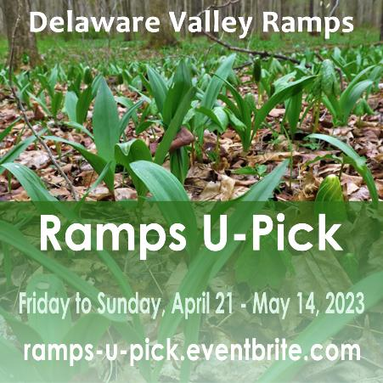
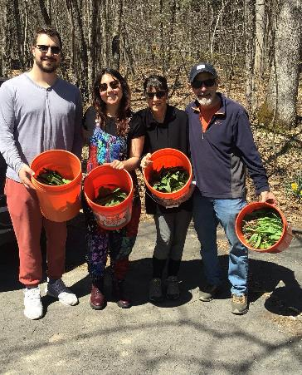
Ramps U-Pick

Slide 12
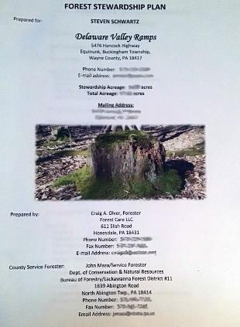
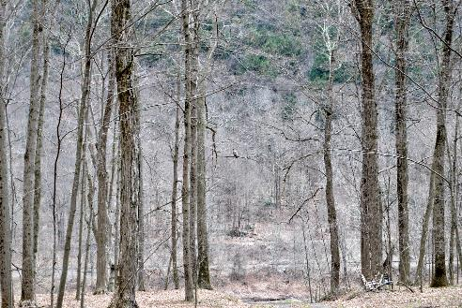
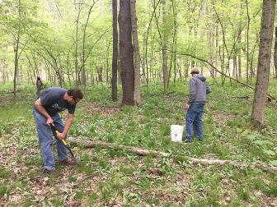
Managing Ramp Lands – Forest Canopy

Slide 13
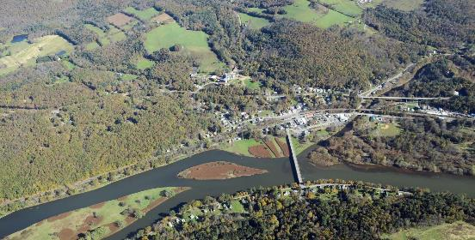
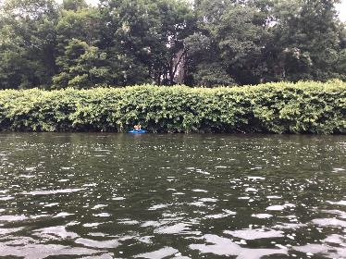
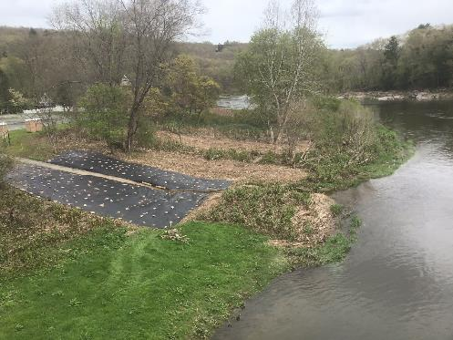
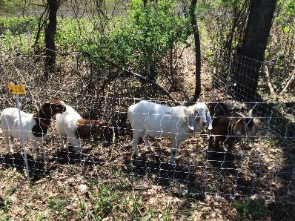
Managing Ramp Lands – Battling Invasives

Slide 14
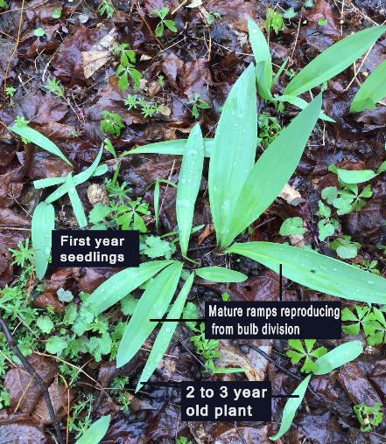
Managing Ramp Lands – Propagating New Ramp Plots
Ramps are propagated by bulb division, seed germination and transplants
A healthy ramp patch has both seed germination and bulb division
Recent research shows that about 40% of plants harvested for study on DVR property were polymorphic, meaning they were the result of seed germination
Establishing new ramp plots through transplanting dormant bulbs is most effective

Slide 15
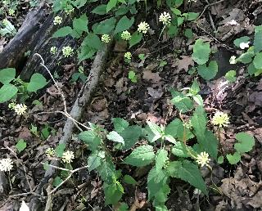
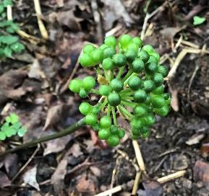
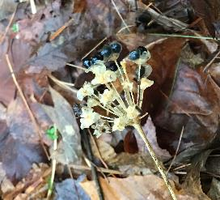
Managing Ramp Lands – Propagating New Ramp Plots from Seeds
Rampant ramp flowers
Ramp fruits
Ramp seeds

Slide 16
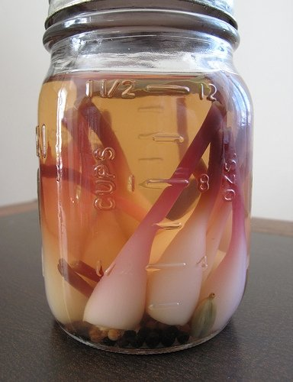
NE SARE Grant for Ramp Sustainability Trial: Replanting Root Plates
In commercial and consumer ramp processing, leaves are often trimmed to use in one set of preparations and bulbs are trimmed of their root plate to use in other preparations.
The root plate is then discarded.
Some have suggested that the root plate may contain enough viable material to regenerate into a plant that can subsequently be harvested or left to mature into its reproductive state in 4 to 5 years.

Slide 17
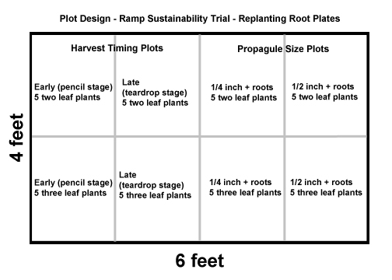
NE SARE Grant for Ramp Sustainability Trial: Replanting Root Plates

Slide 18
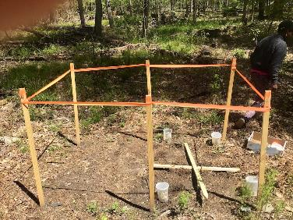
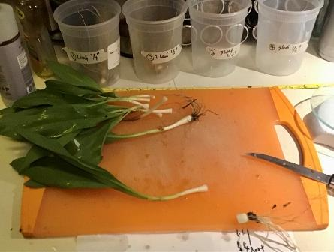
NE SARE Grant for Ramp Sustainability Trial: Replanting Root Plates

Slide 19
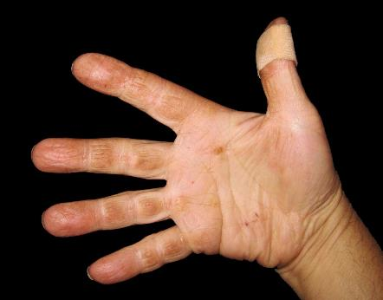
Delaware Valley Ramps
5476 Hancock Hwy.
Equinunk, PA
18417
570 224 0580
info@delawarevalleyramps.com
www.delawarevalleyramps.com
https://ramps-u-pick.eventbrite.com
All content and images copyright 2007-2024, Delaware Valley Ramps, except where noted.

