Slide 1
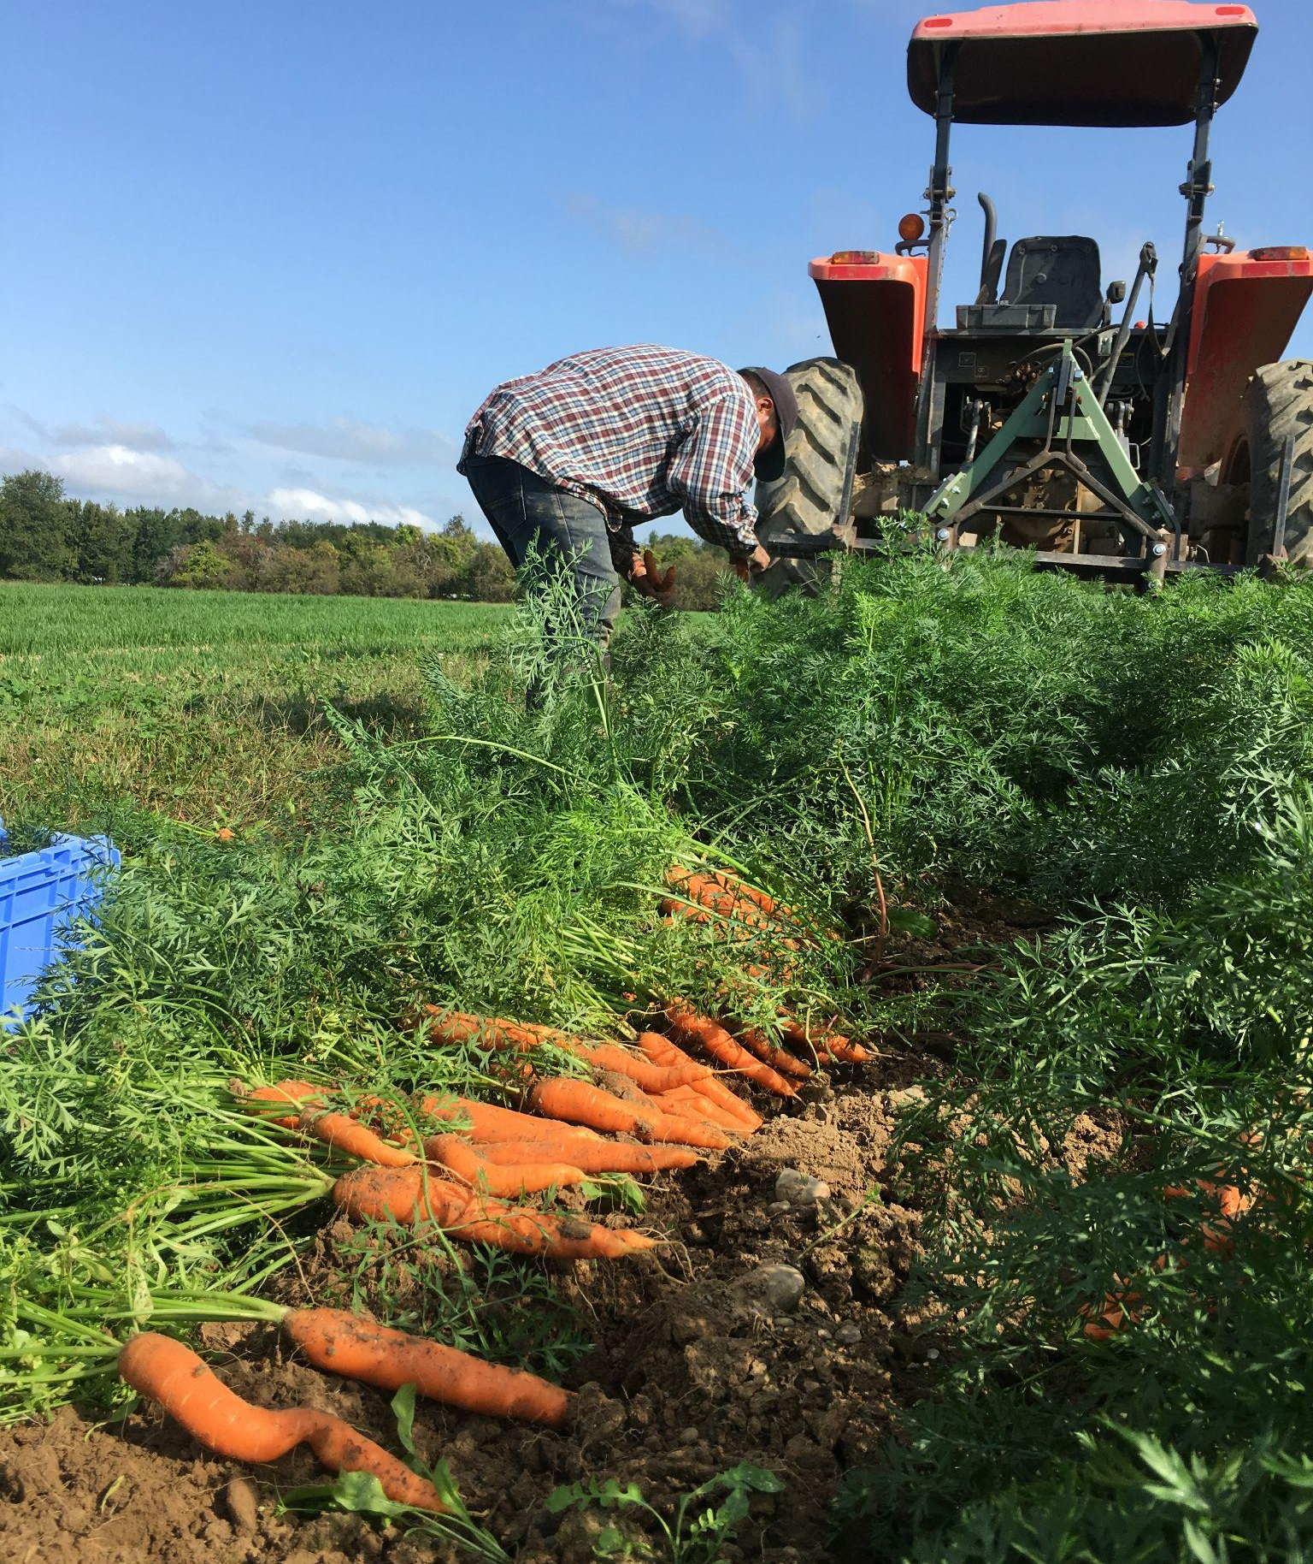
SARE Farmer grant:
Clean, Consistent Carrot
Plantings
Hearty Roots Farm
Clermont, NY

Slide 2
Project timeline:
Issue:
In-row hand weeding in organic carrots was too time consuming and inefficient.
Proposed solution:
Apply finished compost in strips on bed top and seed carrots directly into compost strips, to reduce weeds in row.
Trial:
We trialed two different compost products (McEnroe and Hudson Soil) and 3 different application rates (1” deep, 2” deep, 3” deep) plus a control.
Result:
There was significant improvement in weed density with the 3” application depth.
Taking into account cost of compost and application, it is a promising alternative to hand weeding.

Slide 3
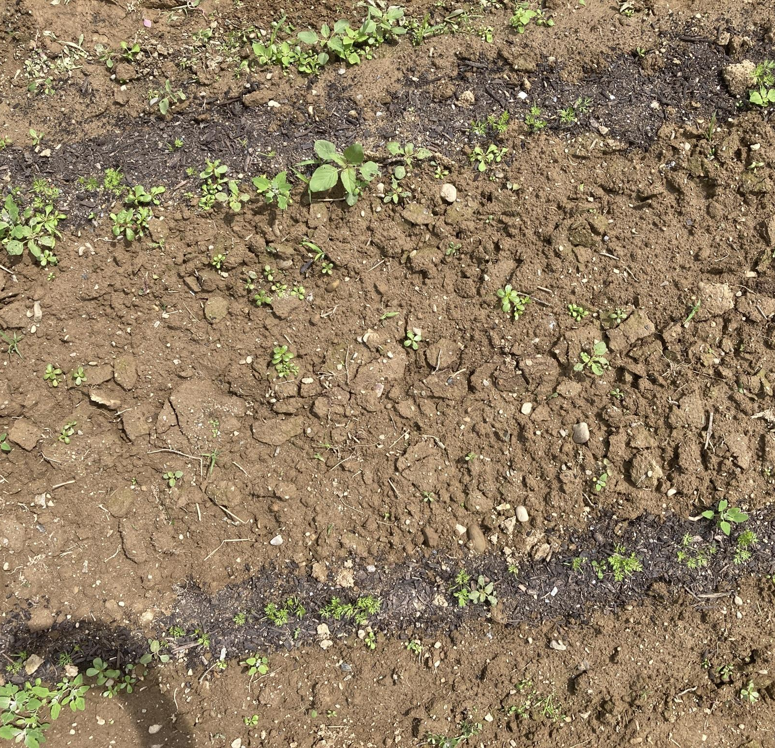
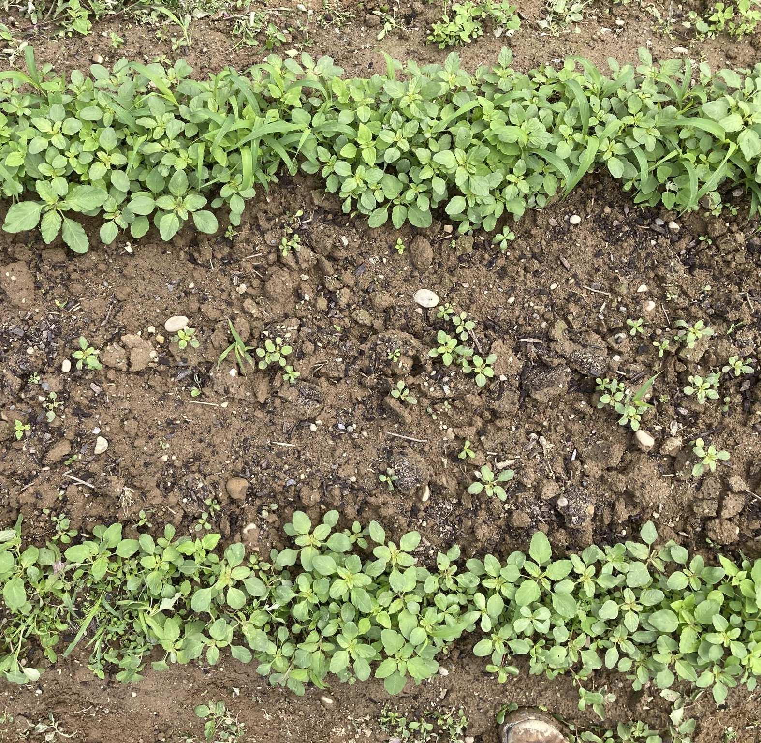
Various treatments were trialed:
Control, 1”, 2” and 3” compost applications
Company Name
Date
3” deep compost application
1” deep compost application

Slide 4
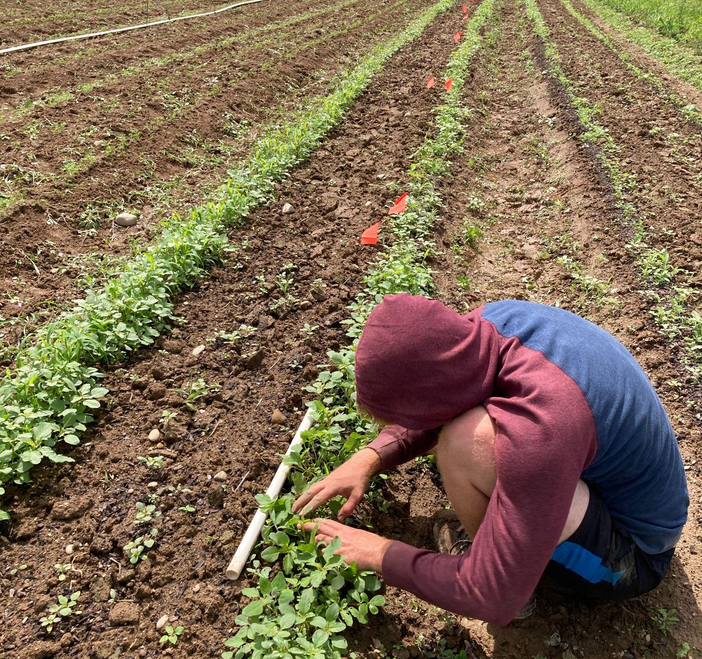
Weeds densities and carrot densities were counted by Ethan Grundberg and staff from Cornell Cooperative Extension

Slide 5
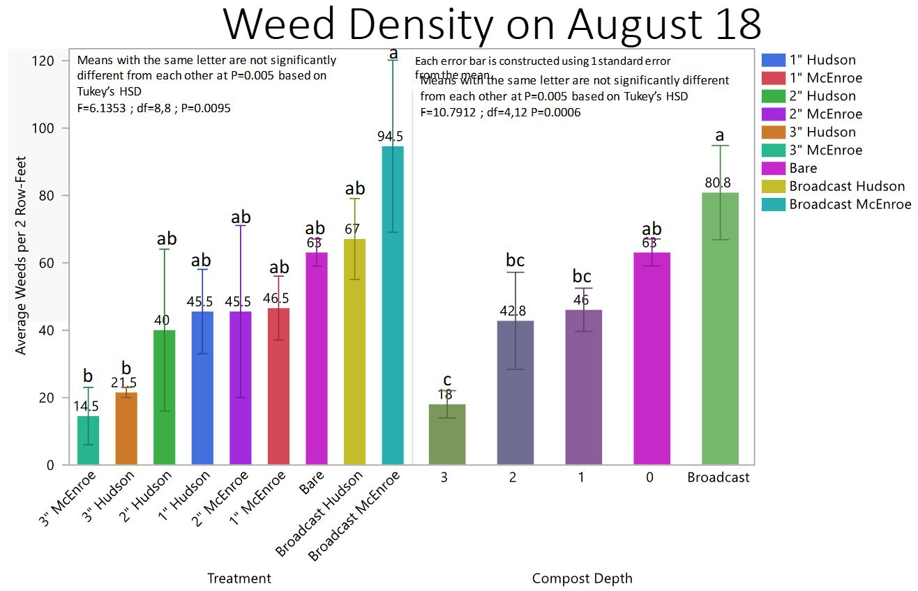

Slide 6
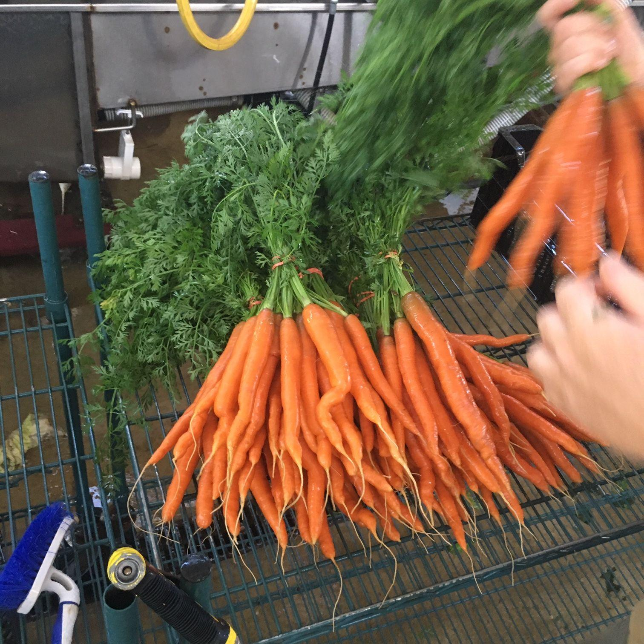
Proposal amount: $19,426
Covered: Cost for time, compost used, Jang seeder, fabrication of tools for compost strip application.
Had some difficulty in 2024 with timing, easy to extend to 2025
We highly recommend SARE farmer grants!
Questions? farm@heartyroots.com

