Slide 1
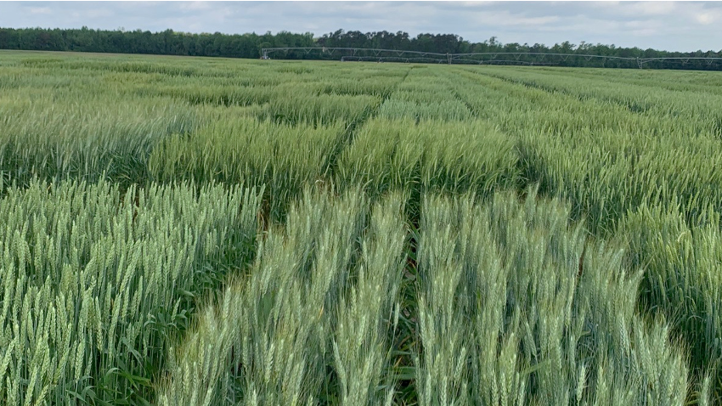



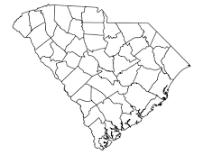
Cereal Grains Breeding & Genetics Program
RICK BOYLES
Plant & Environmental Sciences April 8, 2025
Pee Dee Research & Education Center
John B. Pitner Center
PDREC
Notes:
Established in 1912
~2300 acres, 800+ acres available for cropping research
15 resident faculty positions
Approximately 40 support personnel

Slide 2
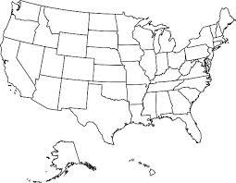




Clemson University Cereal Grains Breeding & Genetics
A dual approach to support crop improvement
Regional improvement zone — Direct gains through targeted breeding
National/international support — Plant genetic resources and discoveries for global impact
Improvement
Partners
1
2
2

Slide 3

Clemson University Cereal Grains Breeding & Genetics
Stakeholder focused approach — a challenge/opportunity is reported from industry and then research aims are generated to address that challenge
How do we develop individualized schemes to:
  make genetic improvements within focal trait(s)?; and
  increase productivity across target environments?
  No current “one size fits all” approach to crop improvement (if there is, I haven’t found it)
Find the best set of tools for the job
Heritable?
Polygenic?
Markers?
Confounding traits?

Slide 4

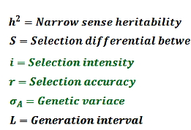
Clemson University Cereal Grains Breeding & Genetics
Injection points of useful genetics or new selection schema
R_{t}
y (t)

Slide 5
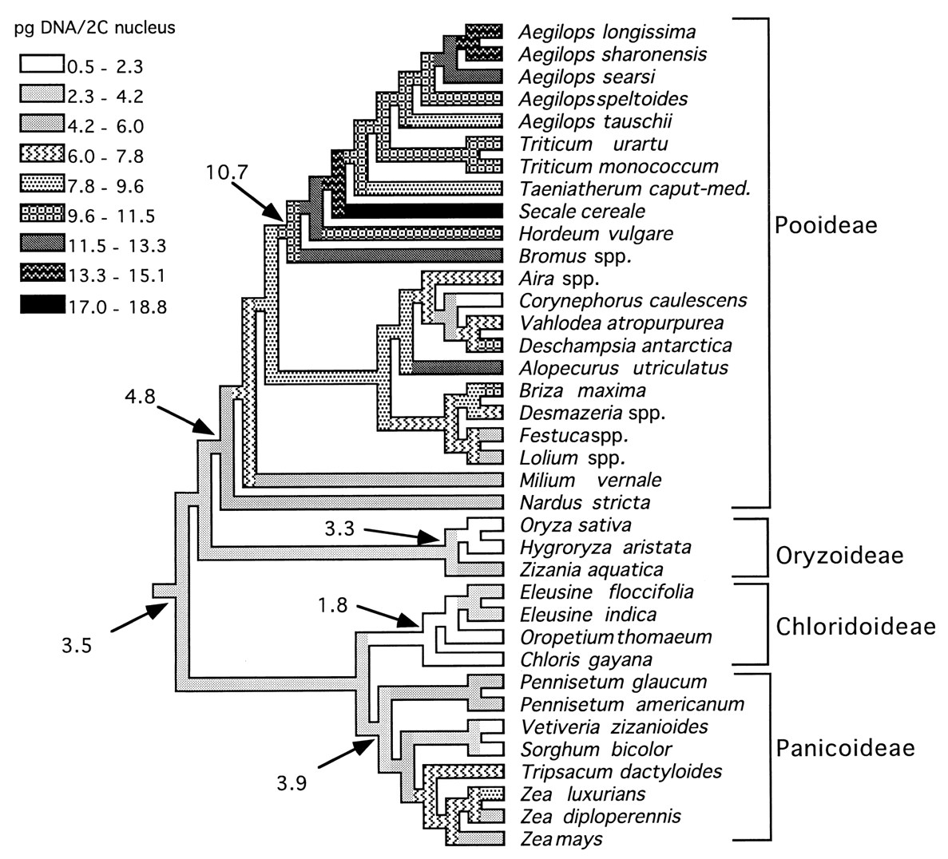
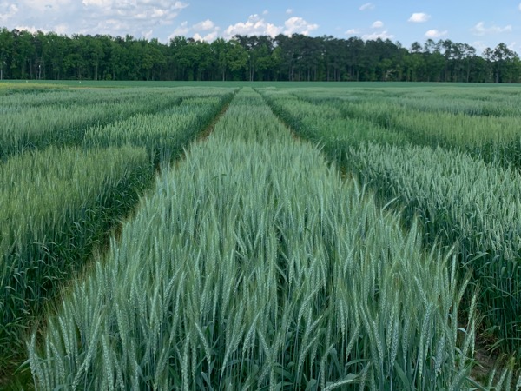
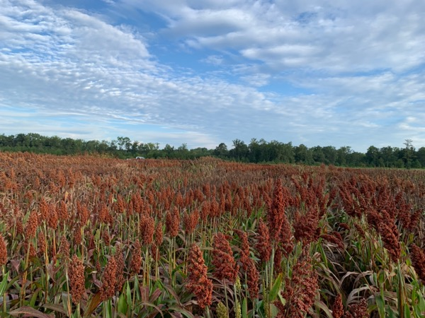
Clemson University
Aegilops speltoides
B
Aegilops taushii
D
T. aestivum
Why work on two of the most divergent cereals in the Poaceae?
Triticum uartu
A
Summer sorghum
Winter wheat
Diploid, 730 Mb genome, 34k genes
Hexaploid, 16 Gb genome, 108k genes
Wheat behaves like a diploid
Genetic resources
Similar focal traits
Food and feed end-uses
Lack of regional industry R&D
Sorghum bicolor
Slide modified from Kellogg, 1998
Notes:
Focal traits— disease res., height, yield components, grain composition
There is plenty of room for improvement across crops.

Slide 6
Quick overview of the program’s breeding pipelines between crops
Pure Line Wheat
Hybrid Sorghum
STANDARD
DH
FEMALE
MALE
Pedigree method
F₁ cross
F₁ cross
F₁ cross
F₁ cross
F₁ cross
F₁ cross
F₂-F₄
F₂-F₄
PARENT
DEVELOPMENT
F₂-F₄
Mass selection
F₂-F₄
Mass selection
F₁ ✕ Maize
F₁ ✕ Maize
Genomic Selection
MAS
Elite male
Elite female
Genomic Selection
MAS
F₅
F₅
✕
GCA
F₅
F₅
✕
BC sterilizations
YIELD TESTING
F₆
DH line
F₆
DH line
F₈
✕
F₆ (300-500 hybrids)
SCA
YIELD TESTING
YIELD TESTING
. . .
. . .
. . .
. . .
. . .
. . .
. . .
. .
Release
Release
Release
A/B
R
Release
Release

Slide 7
Tracking differences for crops across breeding stages
WHEAT
SORGHUM
Variation
Identify useful genotypes, genes through
genomic selection and mapping
High
Incorporate new germplasm via plant introduction
Incorporate new genes via introgression
Evaluate progeny for desirable traits
Advance selections via GS, MAS, or PS
Multiyear yield testing of breeding lines
Testcross selections based on genomic predicted GCA
Evaluate combining ability of F₁ hybrids
Low
RELEASE
License to 3RD party seed companies
Distribute to collaborators

Slide 8
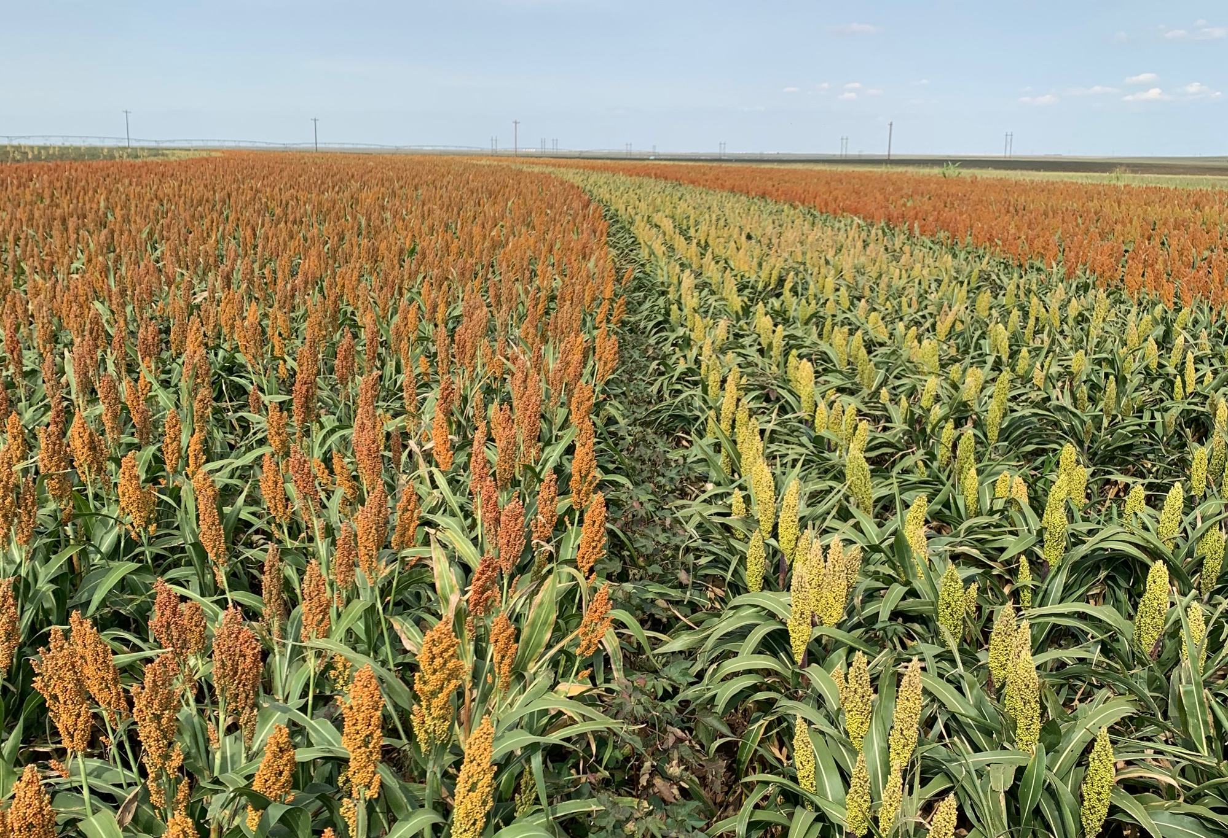
Understanding the long road to commercialization

Slide 9
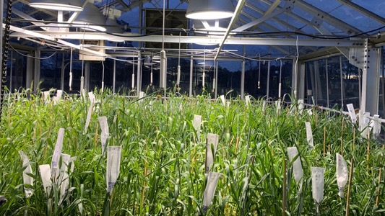
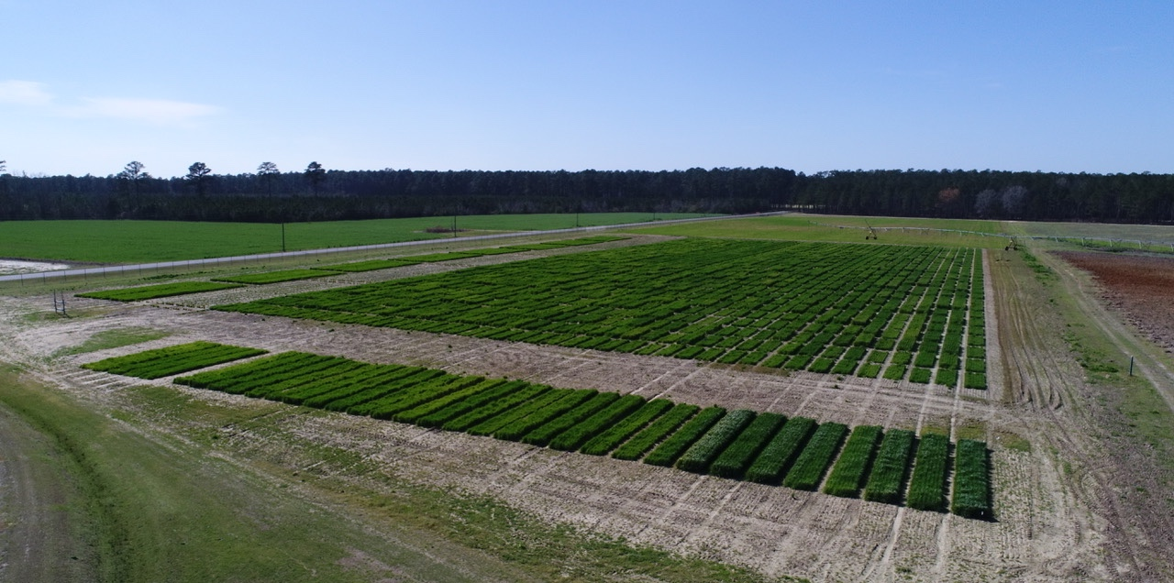
Winter small grains breeding & genetics
    500-800 crosses per year
    30,000 headrows
    5,000 yield plots
    Wheat Rye
    Oats Triticale
    Barley
Seed Increase Strips
SunWheat
KWS
UBWT
Challenge
USSRWWN
GAWN
OVT Conv
OVT Fung
Mixon
Wheat
SunShow
Oats
Image taken by Jonathan Windham on 2/28/23

Slide 10

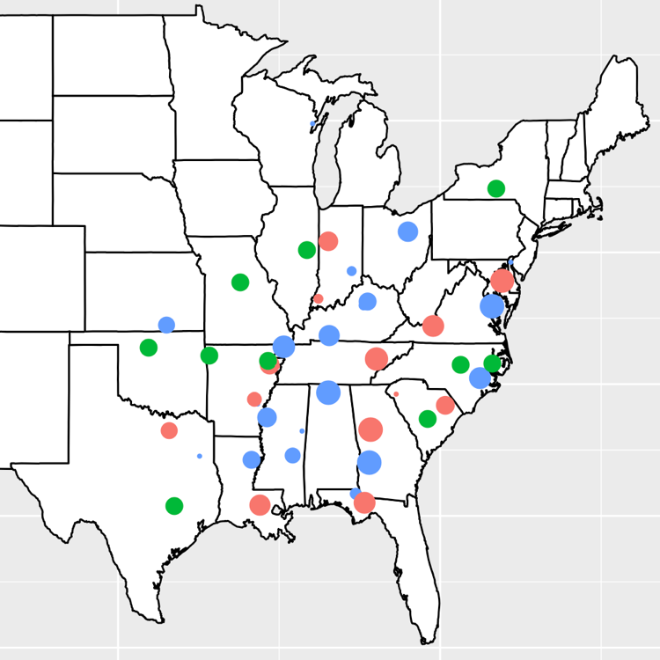
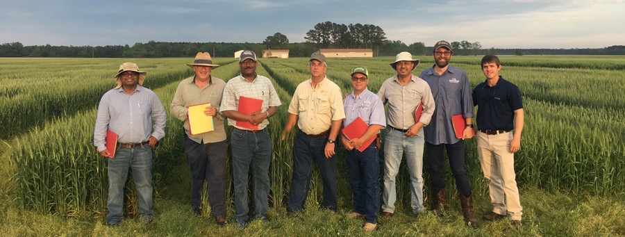
Strong Small Grains Collaborations across the Region
SunGrains: Southeastern University Small Grains Cooperative
Seven land-grant universities in seven states that partner and share resources for variety development
Established in 2005; Clemson rejoined in 2018
Royalty sharing for field testing
Germplasm sharing
Data and technology sharing
Cooperative field testing

Slide 11
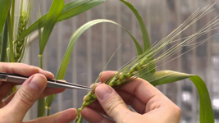
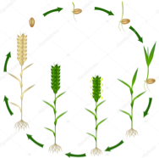
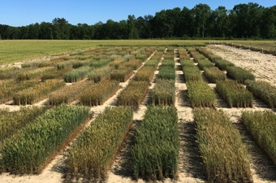
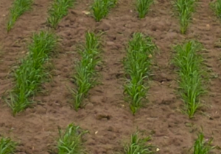
Clemson Wheat Breeding: Early Generations
Winter 2023
F₁ cross
Greenhouse
Single plant harvest
Summer 2023
F₁ growout
Fort Collins
2025-2026
2023-2024
F₄ headrow
SC Field
F₂ bulk
SC Field
F₃ bulk
SC Field
2026-2027
2024-2025
Mass selection
Sing plant selection
F₅ headrow
SC Field
Yield evaluation
2027-2028

Slide 12
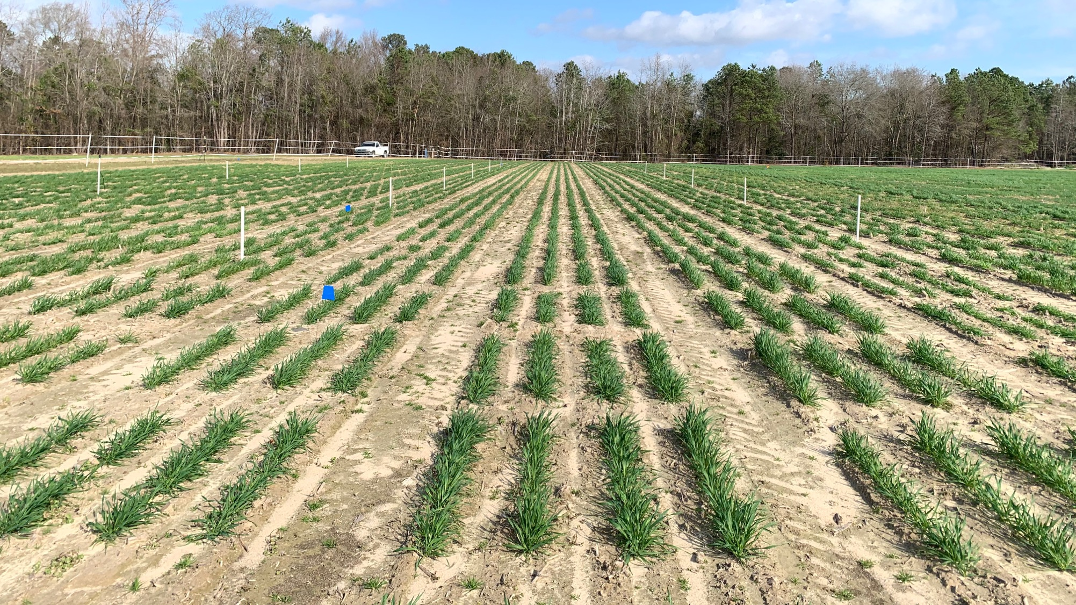
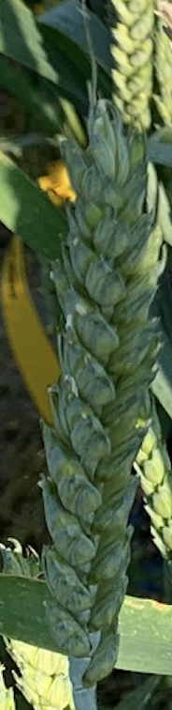
Headrow = head to row

Slide 13
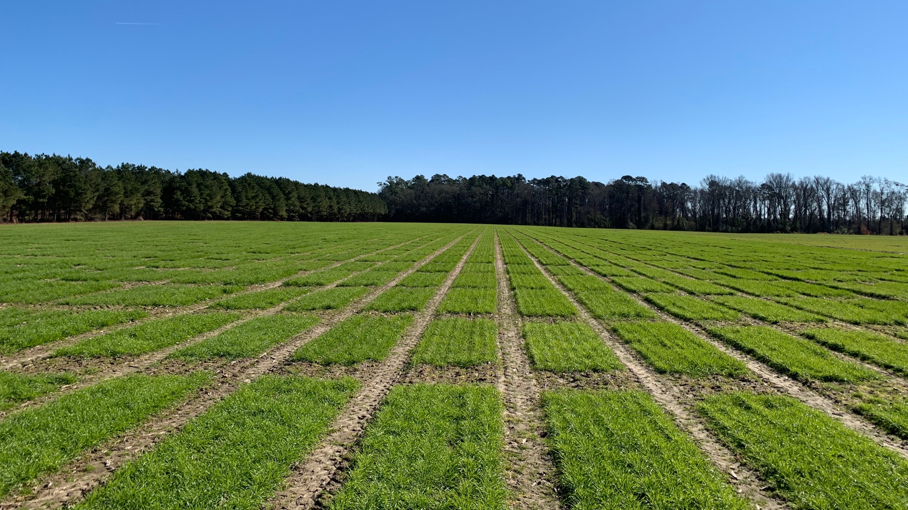
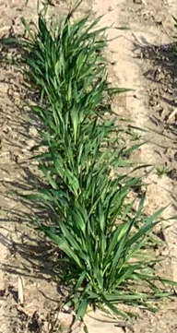
Yield plots at the PDREC in Florence

Slide 14
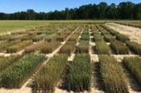
Clemson Wheat Breeding: Evaluation Generations (YTs)
F₆ obs
2027-2028
SunPre
2028-2029
2 locations
1 rep
3-4 locations
1 rep
2032
Begin release process
        Seed purification
        Seed increase
        PVP application
        Registration
SunWheat
2029-2030
GAWN
2030-2031
10-12 locations
2 reps
5-6 locations
2 reps
USSRWWN
2031-2032
15-20 locations
3 reps

Slide 15

Clemson Wheat Breeding: Doubled Haploids
Winter 2023
$$σ$$
F₁ cross
Greenhouse
Summer 2023
Haploid induction
Summer 2023
F₁ growout
Idaho
2023-2024; 2025-2026
Rescue/regeneration
2023-2024
Chromosome doubling
F₂ & F₄ bulk
Pure line increase
2024-2025
2024-2025;
2026-2027
WHAT ARE YOU POTENTIALLY GIVING UP??
F₃ & F₅ headrow
Yield evaluation
2025-2026

Slide 16
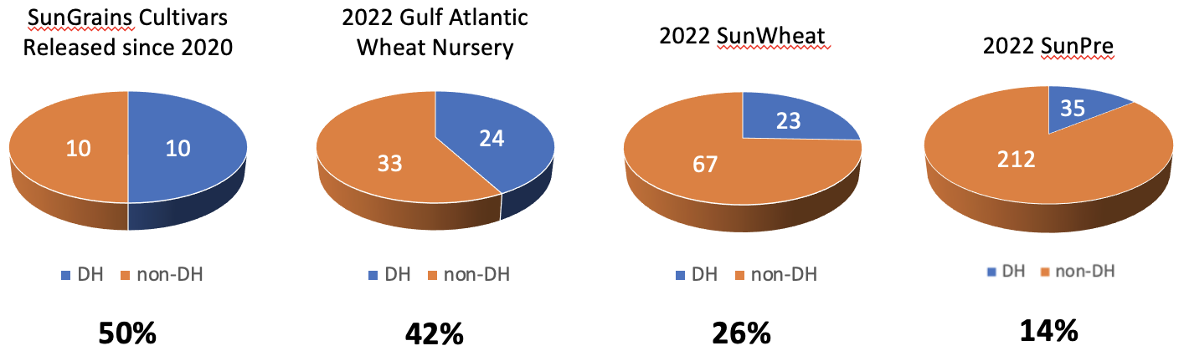
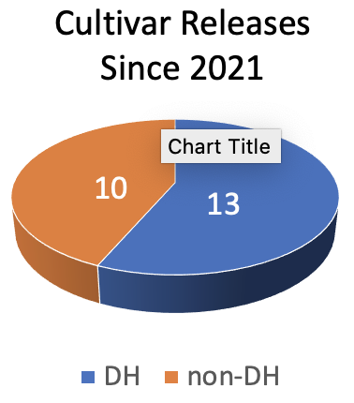
Importance of doubled haploids (DHs) for SRWW
57%
Trailing off of DH representation in regional nurseries

Slide 17
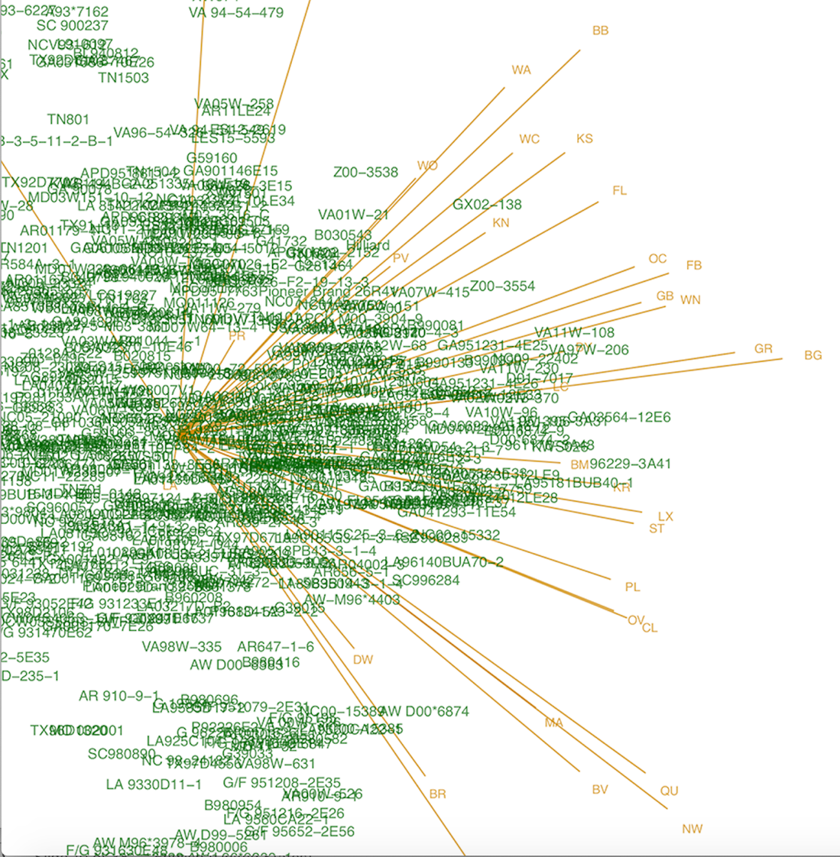
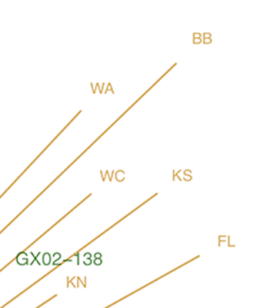
Know your Environments
Blacksburg, VA
Warsaw, VA
Woodford, KY
Kinston, NC
Florence, SC
Knoxville, TN
Boyles et al. 2019 Crop Science

Slide 18
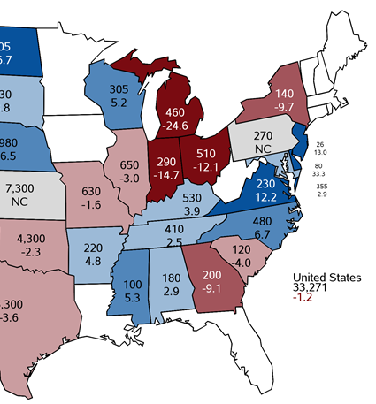
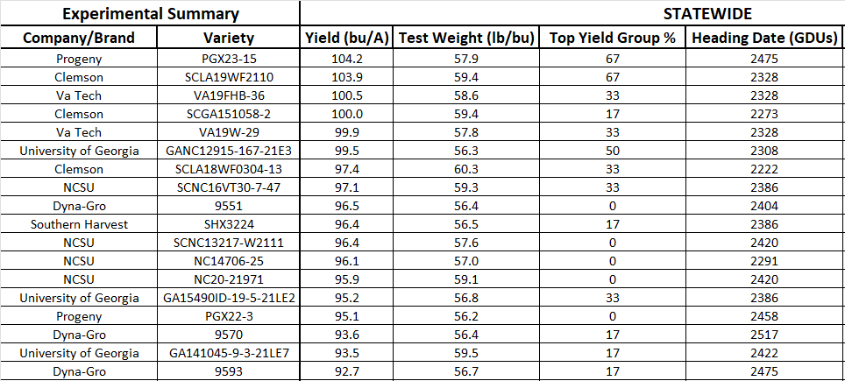
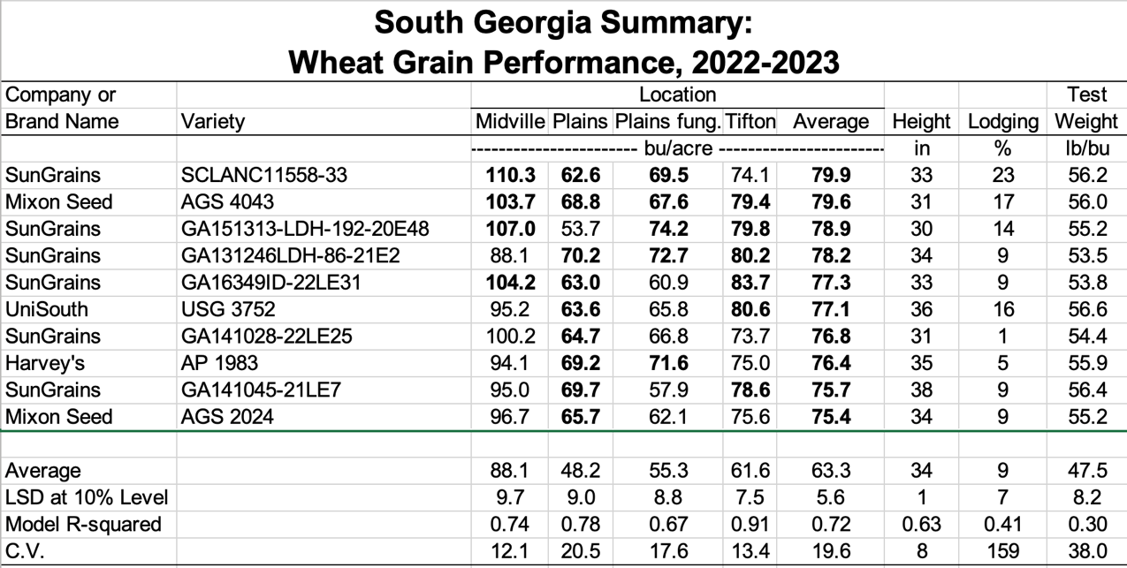
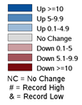
Clemson Wheat Breeding: Transcending State Lines
Kinston, NC
Florence, SC
Florence to Rowland = 35 miles
Winter Wheat Acres
Not estimated
< 5,000
5,000-9,999
10,000-24,999
25,000-49,999
50,000-99,999

Slide 19
Develop robust genetic markers (if needed)
$$σ$$
Kompetitive allele specific PCR (KASP) assay
What does green represent?
Fluorescently labeled primers
maswheat.ucdavis.edu/protocols/TaGW2

Slide 20
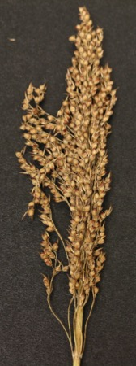
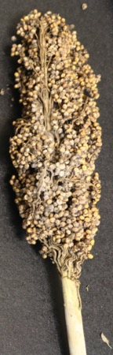
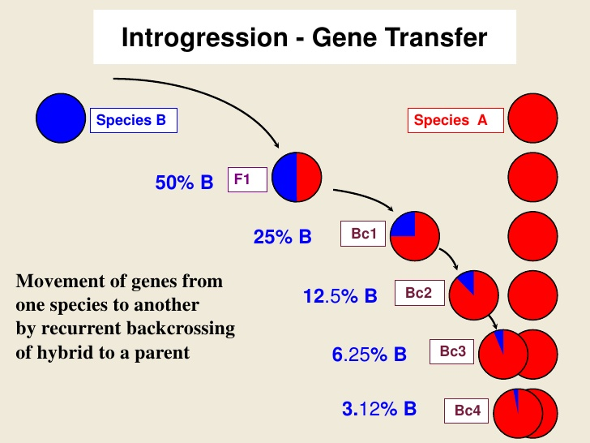
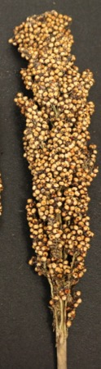
Incorporate new QTL via introgression
Backcrossing (MABC)
Exotic parent (B)
X
Elite parent (A)
X
High yield
Mold susceptible
Low yield
Mold resistant
X
X
X
**3.12% contains the beneficial allele(s)
High yield
Mold resistant

Slide 21
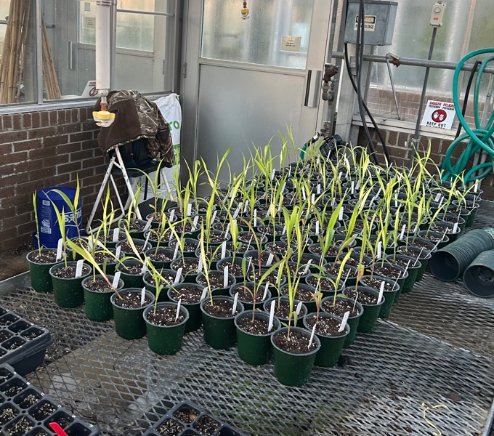
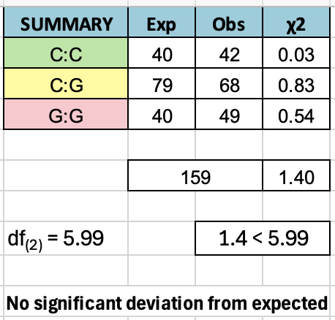
CGBG Program Example
Gene: Sobic.006G030100.3
Allele info: ‘C’ is the resistant allele; ‘G’ is the susceptible allele.
ATTAGACTTCAACCGTGAAGGATTGCCTCTGTTTATCCTGGCTAACTG[G/C]AGAGGTTTCTCTGGTGGACAGAGAGATCTCTTTGAAGGAATTCTTCAGG

Slide 22
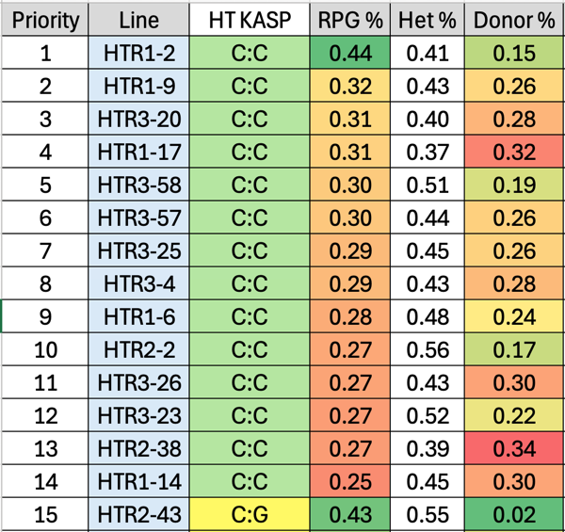
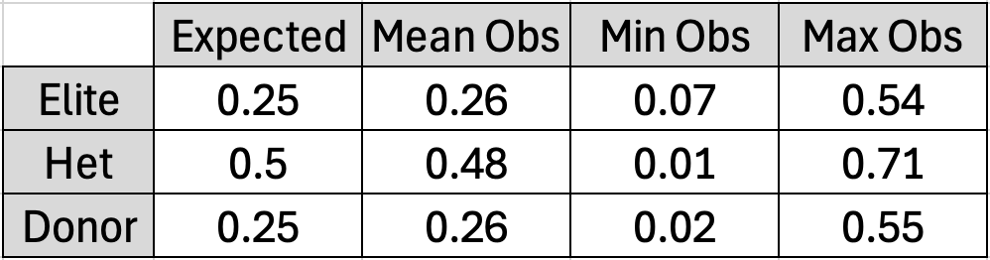
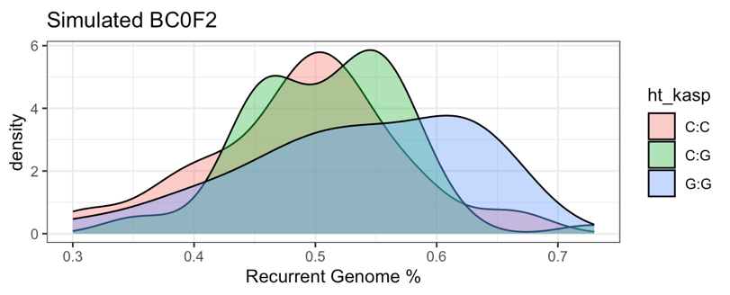
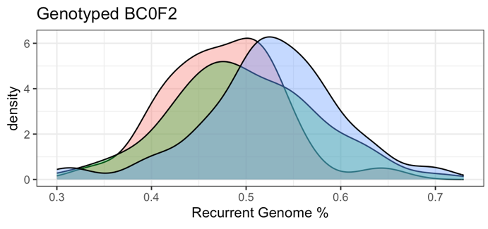
CGBG Program Example
BC₀F₂ Background Selection
*Could almost double the RPG % with markers!
Simulated BC₀F₂
Observed BC₀F₂

Slide 23
Genomic Selection (GS): Quick Reminder
Heffner, Sorrells and Jannink (2009) Crop Science

Slide 24
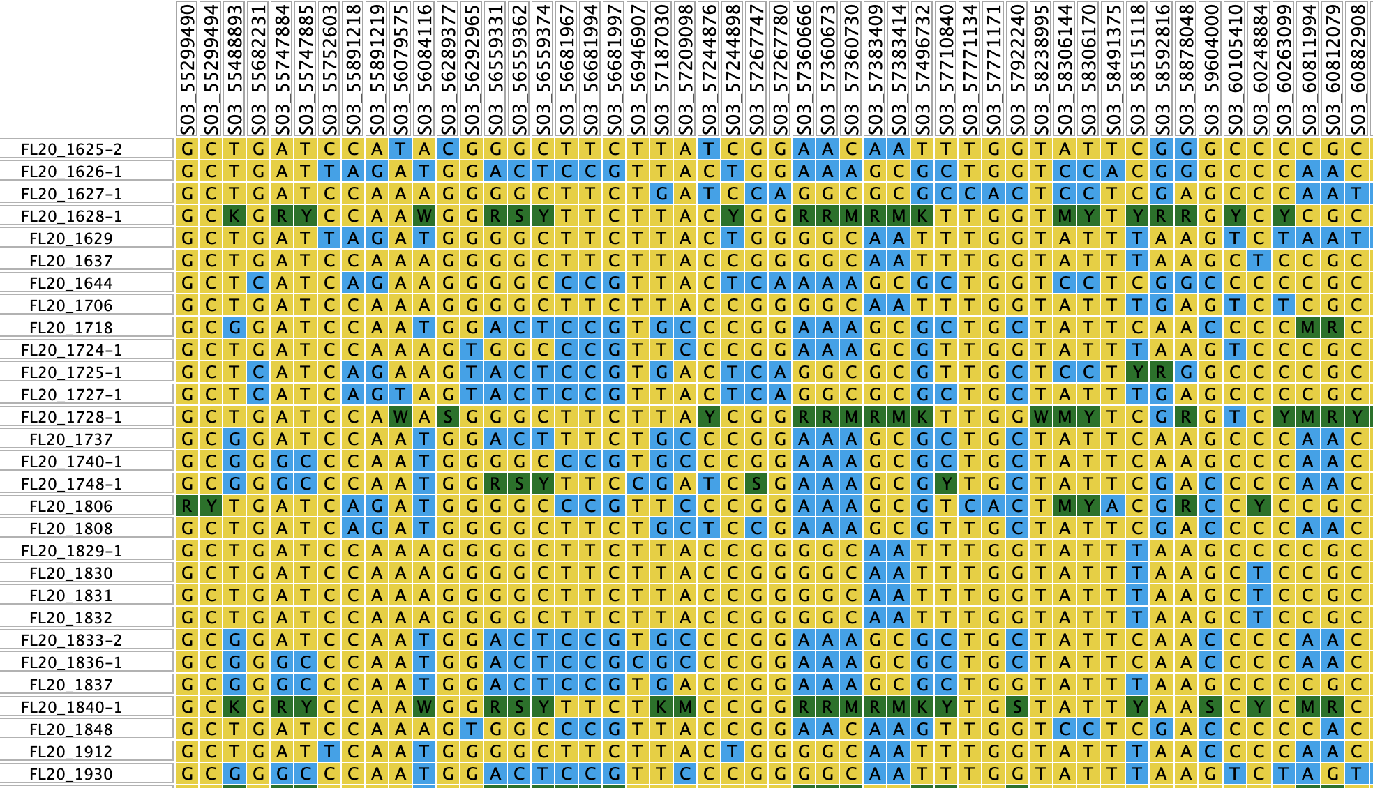
Genotyping-By-Sequencing (GBS) for GS
Use ALL genetic markers to predict line performance (GEBVs)
Assign each marker (i.e., SNP) a small effect based on TP

Slide 25
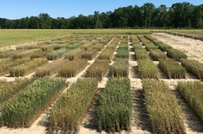
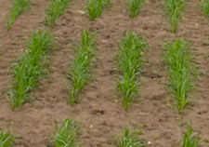

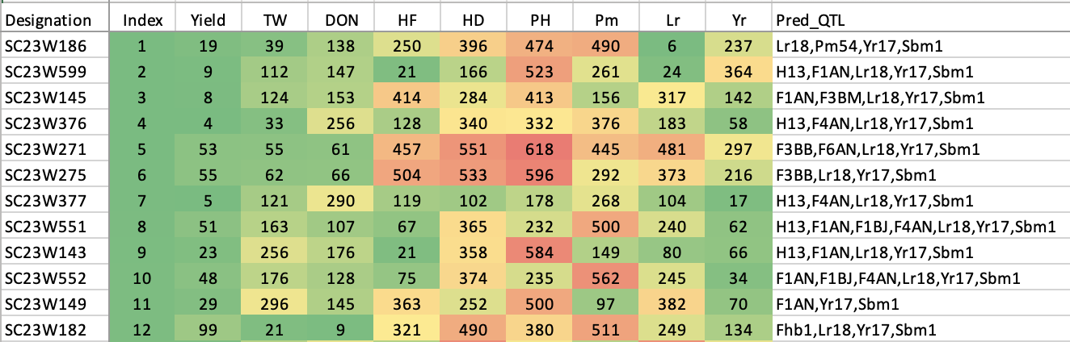
Genomics are significantly assisting in wheat cultivar development
Winter 1
Summer 1
Winters 2-3
Winters 4-5
Winter 6
✸
F₁ cross
F₁ growout
F₂-F₃ bulk selection
F₄-F₅ headrow
F₆ obs/prelims
7 programs; 4,200 lines yr⁻¹; ~30,000 SNPs
FHB resistance marker
FIELD BOOK
T. Rife
Winn et al. (2022) Theor Appl Genet 135:3177-3194

Slide 26
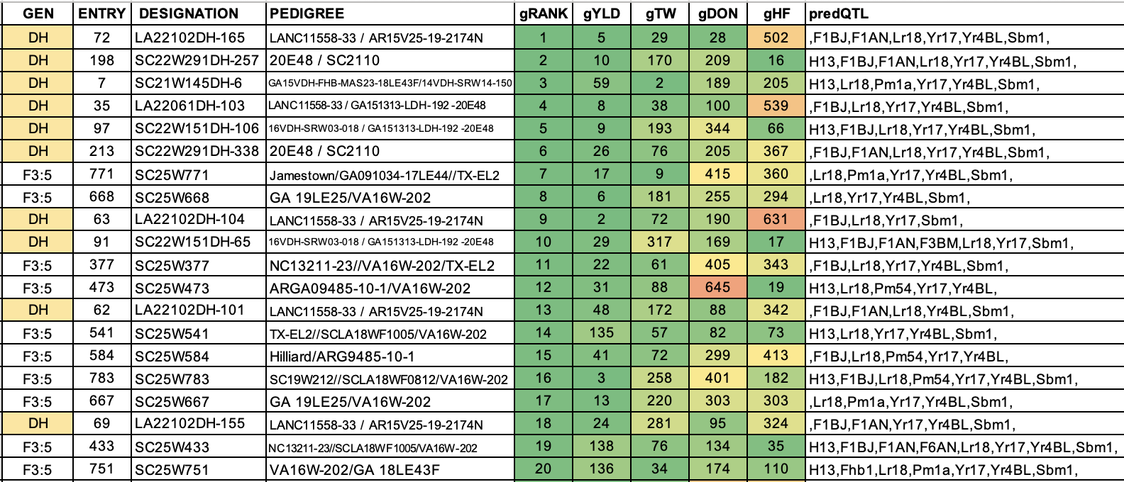
The Challenge of Stacking Favorable Traits and Alleles
GEBV Ranks
GEBV Ranks
QTL Predictions
*
*

Slide 27
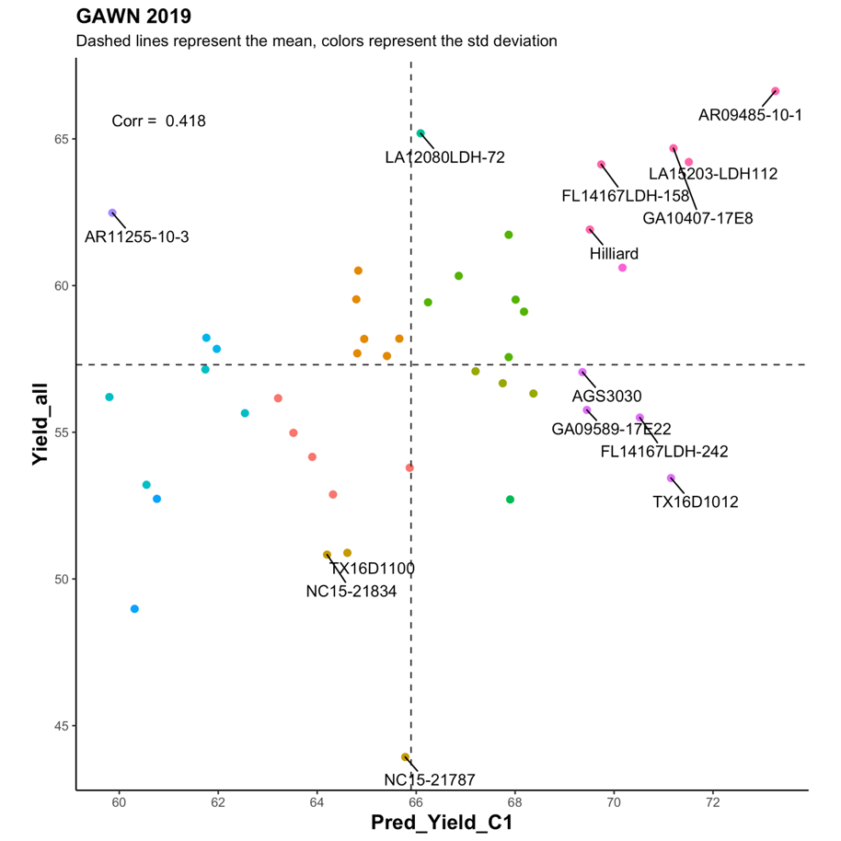
How accurate can GS become?
If GS was 100% accurate
What scares the heck out of plant breeders
  Throwing away good lines
Lyerly et al., unpublished

Slide 28
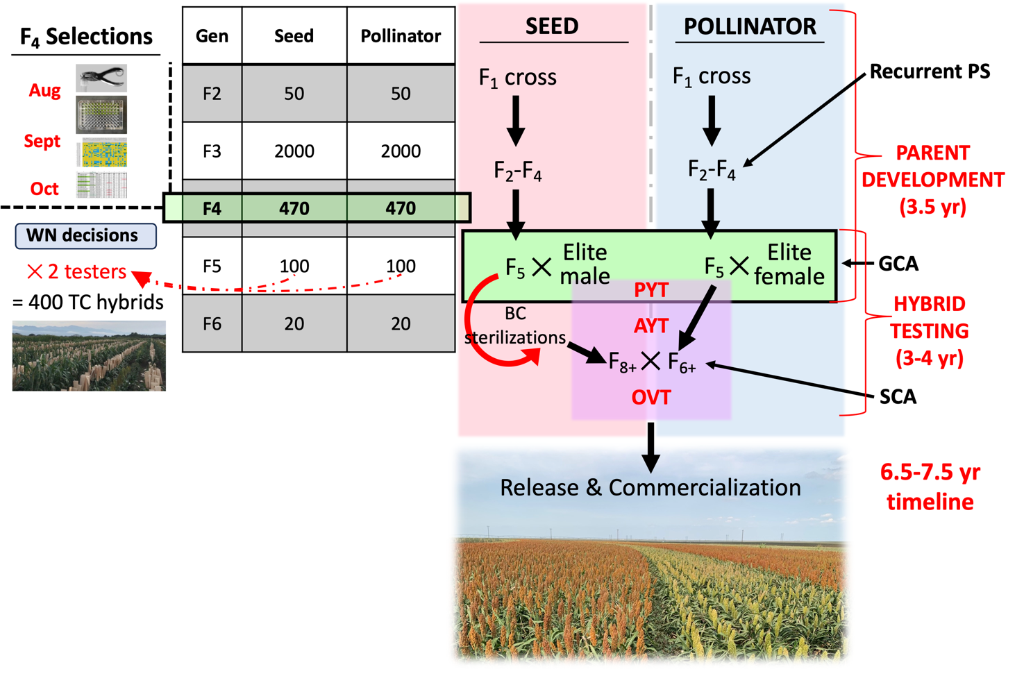
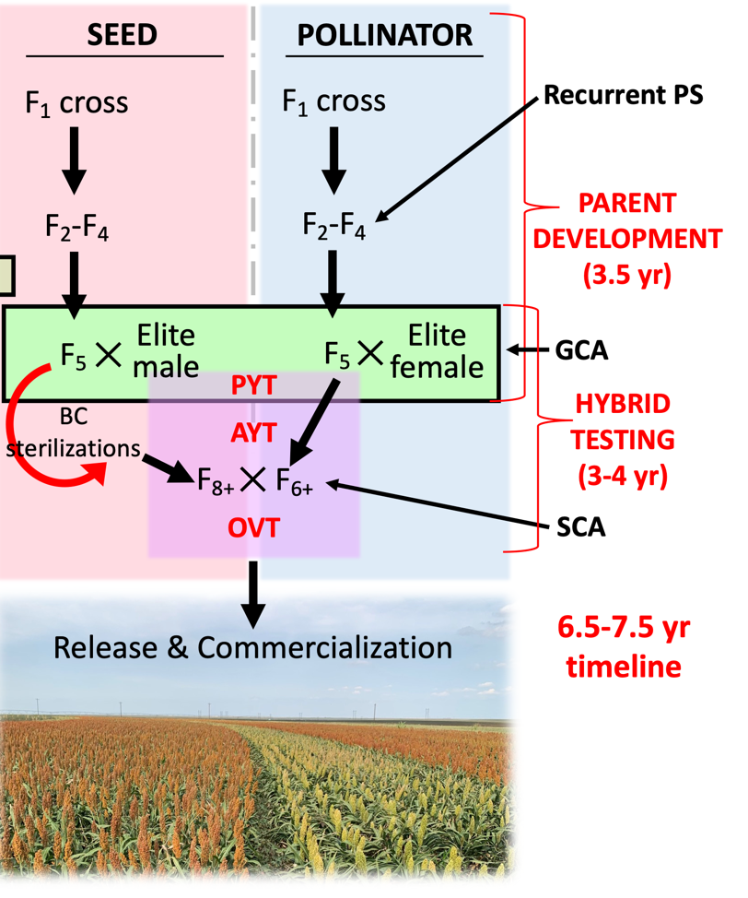
Genomic selection in a hybrid crop: Sorghum
When do we genotype for genomic prediction?

Slide 29
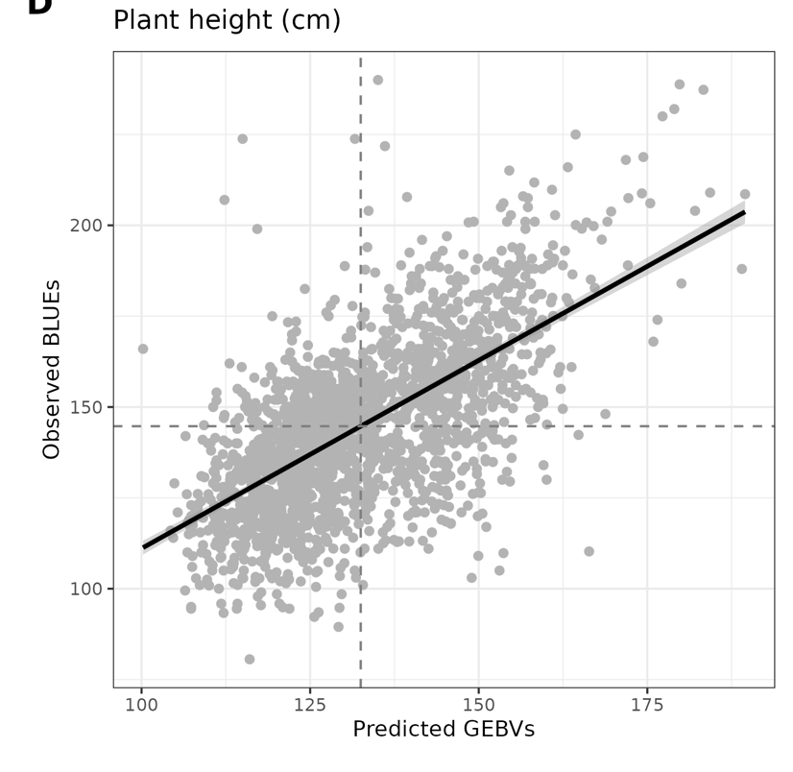
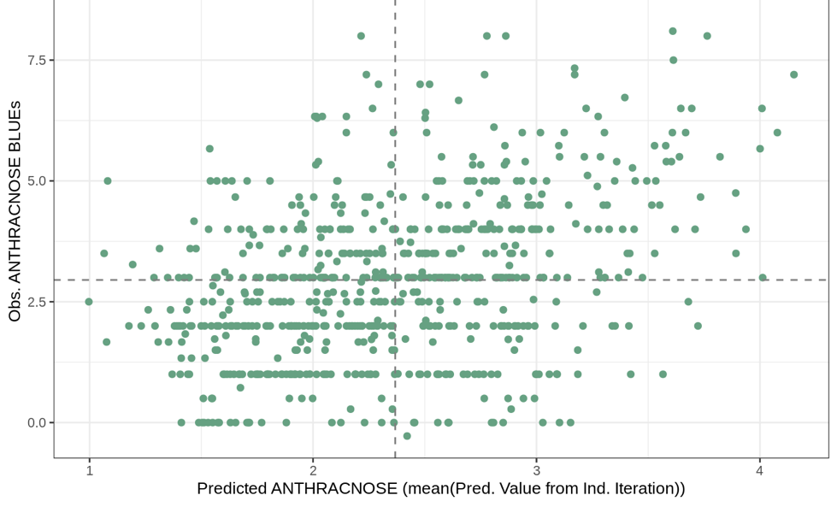
Tandem Selection with Independent Culling
i.e., Genomic Rejection
≤ CSS ‘Launch’ (144.7 cm)
r = 0.64
Anthracnose rating (1-5)
80th perc = 3.1
r = 0.39

Slide 30
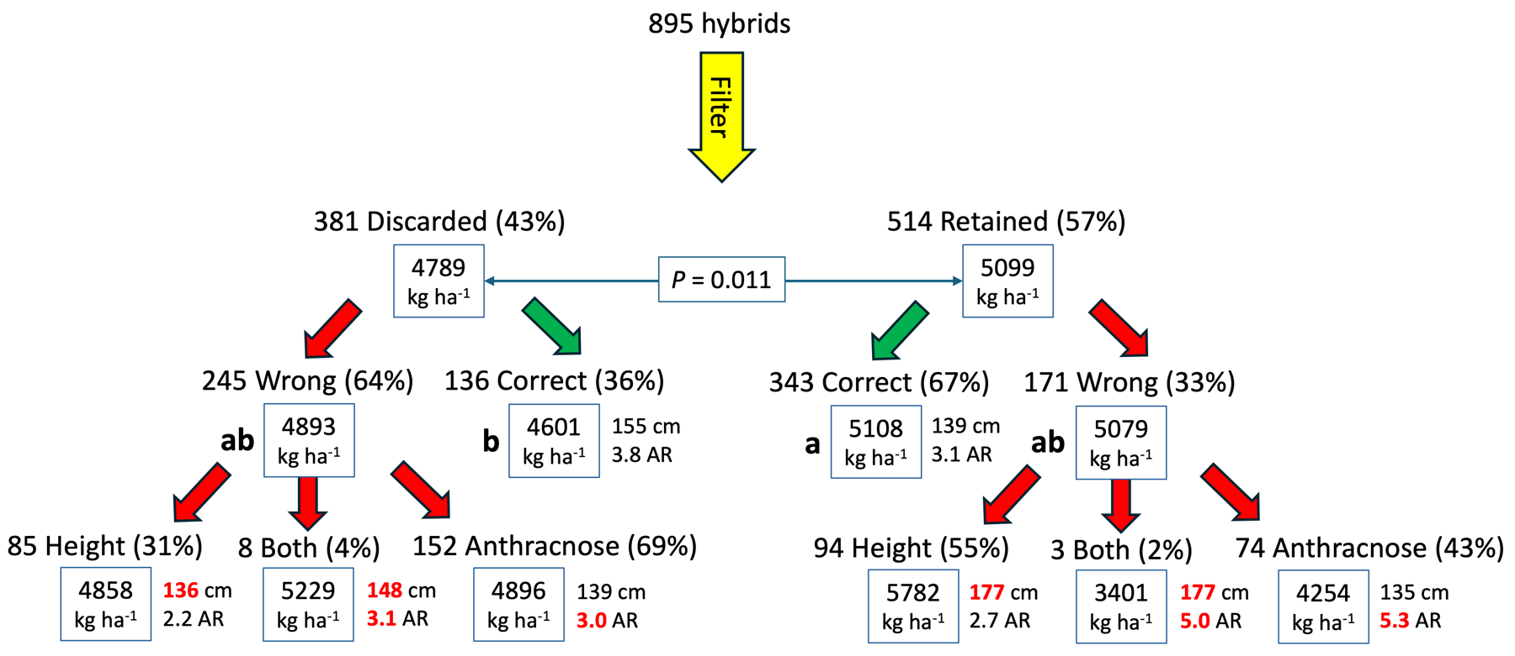
Tandem Selection with Independent Culling

Slide 31

Clemson Winter Small Grains: Crosses Made in the Greenhouse
*including backcrosses
Small Grain 2020 Greenhouse Nursery — Pee Dee REC
www.youtube.com/watch?v=ICEMoje0zZo

Slide 32


Clemson Sorghum Breeding: Crosses Made in the Field
Crosses made in the field (paired rows)
  Hybrid development (A x R)
  Testcrosses
  Sterilizations (A-lines)
  Population development (B- and R-lines)
Sorghum PopDev — Florence (2024)
Sorghum Winter Nursery — Puerto Vallarta (2020)
Where’s AJ?

Slide 33



Shuttle Breeding: Testcross or Advance New Populations
Use second location to get two growing seasons per year
$$σ$$
Puerto Vallarta, Mexico
Sorghum — Tropical
Small Grain — Temperate
Bozeman
Aberdeen
Fort Collins
You are
here

Slide 34



Dedicated disease screening in cereal grains
 | Wheat | Sorghum
Dominant species | F. graminearum | F. verticillioides
Dominant toxin | deoxynivalenol | fumonisin B₁
Food threshold$ | 1 ppm | 4 ppm
Swine threshold$ | 5 ppm | 10 ppm
$Source: U.S. Food & Drug Administration (2010: DON; 2001: FB₁)
FHB risk forecast
April 7, 2025
https://www.wheatscab.psu.edu/

Slide 35




FHB inoculated nursery in Florence, SC
Fusarium head blight (FHB) nursery — Florence, SC
Mist-irrigated wheat scab nursery
Wheat spikes with Fusarium head blight (FHB) symptoms
F. graminearum spores
Scabby maize inoculum

Slide 36


















High resolution, seed level phenotyping for FDK detection
Analysis and Calibration:
Parametric, machine Learning & proprietary imaging algorithms
100 micron measurement accuracy
99.5% repeatable and reproducible results
Slide prepared by Tal Kubi (Vibe IA)

Slide 37

High resolution, seed level phenotyping for FDK detection
Ackerman et al. (2022) Evaluation of Methods for Measuring Fusarium-Damaged Kernels of Wheat. Agronomy 12(2):532.

Slide 38

High resolution, seed level phenotyping for FDK detection
Ackerman et al. (2022) Evaluation of Methods for Measuring Fusarium-Damaged Kernels of Wheat. Agronomy 12(2):532.

Slide 39




Vibe QM3 accuracy
AJ Ackerman
Method | Time | H² | DON corr (r)
Visual | 0:45 | 0.64 | 0.31
Manual | 14:45 | 0.59 | 0.27
Vibe | 1:49 | 0.74 | 0.63
NIRS | 1:45 | 0.52 | 0.31
Florence, SC 2023 FHB nursery
 | FDK | FHB Rating
DON | 0.78 | 0.56
FDK |  | 0.54
Ackerman et al. (2022) Evaluation of Methods for Measuring Fusarium-Damaged Kernels of Wheat. Agronomy 12(2):532.

Slide 40

Sorghum Anthracnose nursery — Florence, SC
R
S
S
S
R
S
R
R
S
R
80 plots deep
S
40 plots wide
R
R
S
S
S
R
Image taken by Joe Roberts on 15 Sept 2021

Slide 41

Sorghum Anthracnose nursery — Florence, SC
0.6m alley
1.2m plot
0.6m alley

Slide 42

Sorghum Anthracnose nursery — Florence, SC
R
S
2-row plot
38 cm (15”)
2-row plot

Slide 43




Sorghum Anthracnose nursery — Florence, SC
UAV imaging to measure disease pressure on 1000s of different sorghum lines

Slide 44



How accurate can we rate anthracnose using drones?
Prediction Accuracy
AR1 ~ 30%
Prediction Accuracy
AR2 ~ 36%
Prediction Accuracy
AR3 ~ 34%
Like most technology, it seems to have a role but it’s not a “silver bullet”

Slide 45

Sorghum Anthracnose Relationship with Grain Yield
n = 547 hybrids

Slide 46

QTL haplotyping with ML
MAS
Genomic selection
Advanced phenomics
Trait introgression
(Selection intensity)
(Accuracy)
(Genetic variation)
(Genetic gain)
(Generation interval)
Doubled haploid technology
Shuttle breeding (i.e., off-season nursery)
Gametocide (CHA)
Speed breeding

Slide 47
Cereal grains breeding and genetics program
Timeline of major events (It’s a year-round process)
January
February
March
April
May
June
July
August
September
October
November
December
Begin wheat crossing in GH; Sorghum WN crossing
Finish wheat crossing in GH; Sorghum WN crossing
Develop scab inoculum and apply to field; Wheat GH harvest
Wheat disease ratings; Wheat selections; WN harvest; Sorghum PL prep
Wheat field note taking; Wheat plot harvest; Sorghum planting
Finish wheat harvest; Process wheat samples; Sorghum field management
Sorghum crossing; Sorghum anthesis data collection; Sorghum selections
Sorghum selection harvest; Sorghum disease ratings
Sorghum yield trial harvest; Process sorghum samples, Wheat PL prep
Wheat PL seed prep; Sorghum WN seed prep; Wheat GH transplanting
Wheat planting; Ship sorghum seed to WN; Update seed inventory
WRITE GRANTS AND PAPERS

Slide 48



Applied Genetics has Enabled Superior Genetics to SE Market
Breeding site in Puerto Vallarta, MX
Commercial production in Sunray, TX
CU16FL159
Hybrid grain sorghum in Williamsburg Co.
40,000 acres in 2024 (SC, GA, NC, VA, MD, PA, AL, TN)
60,000 acres of seed produced in TX for 2024
New release in 2023 (CU19FL427) with aphid resistance
Approaching 60% marketshare in eastern United States
Notes:
$20k that goes back annually to CAFLS/PES/CGBG

Slide 49


Applied Genetics has Enabled Superior Genetics to SE Market
SCLA19WF2110
SCLA0100214

Slide 50





Thank you
Current Members
Carolina Ballén-Taborda, Postdoc Will Stafstrom, Postdoc
Kimberly Baskins, Research Assistant Anto Conti, PhD student
William Caughman, Research Assoc. Alex Celiz, PhD student
Katarina Floyd, Research Assistant Maggie Thomas, MS student
Former Members
AJ Ackerman, PhD graduate
Mary-Frances Behnke, MS graduate
Dawn Hicks, Research Assistant
Ryan Holmes, Research Associate

