Slide 1
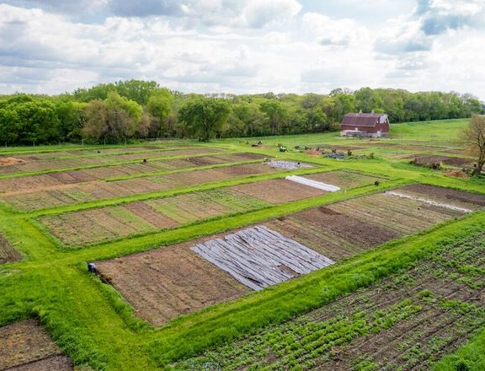
Lutheran Services in Iowa

Slide 2
Global Greens Program
Reconnecting people with the land to achieve physical, mental and financial health.
Community Gardens
Incubator Farm & Land Access
Education & Business Development
Elder Food Box
Regional Program Support & Network Building
Market Access & Technical Assistance

Slide 3
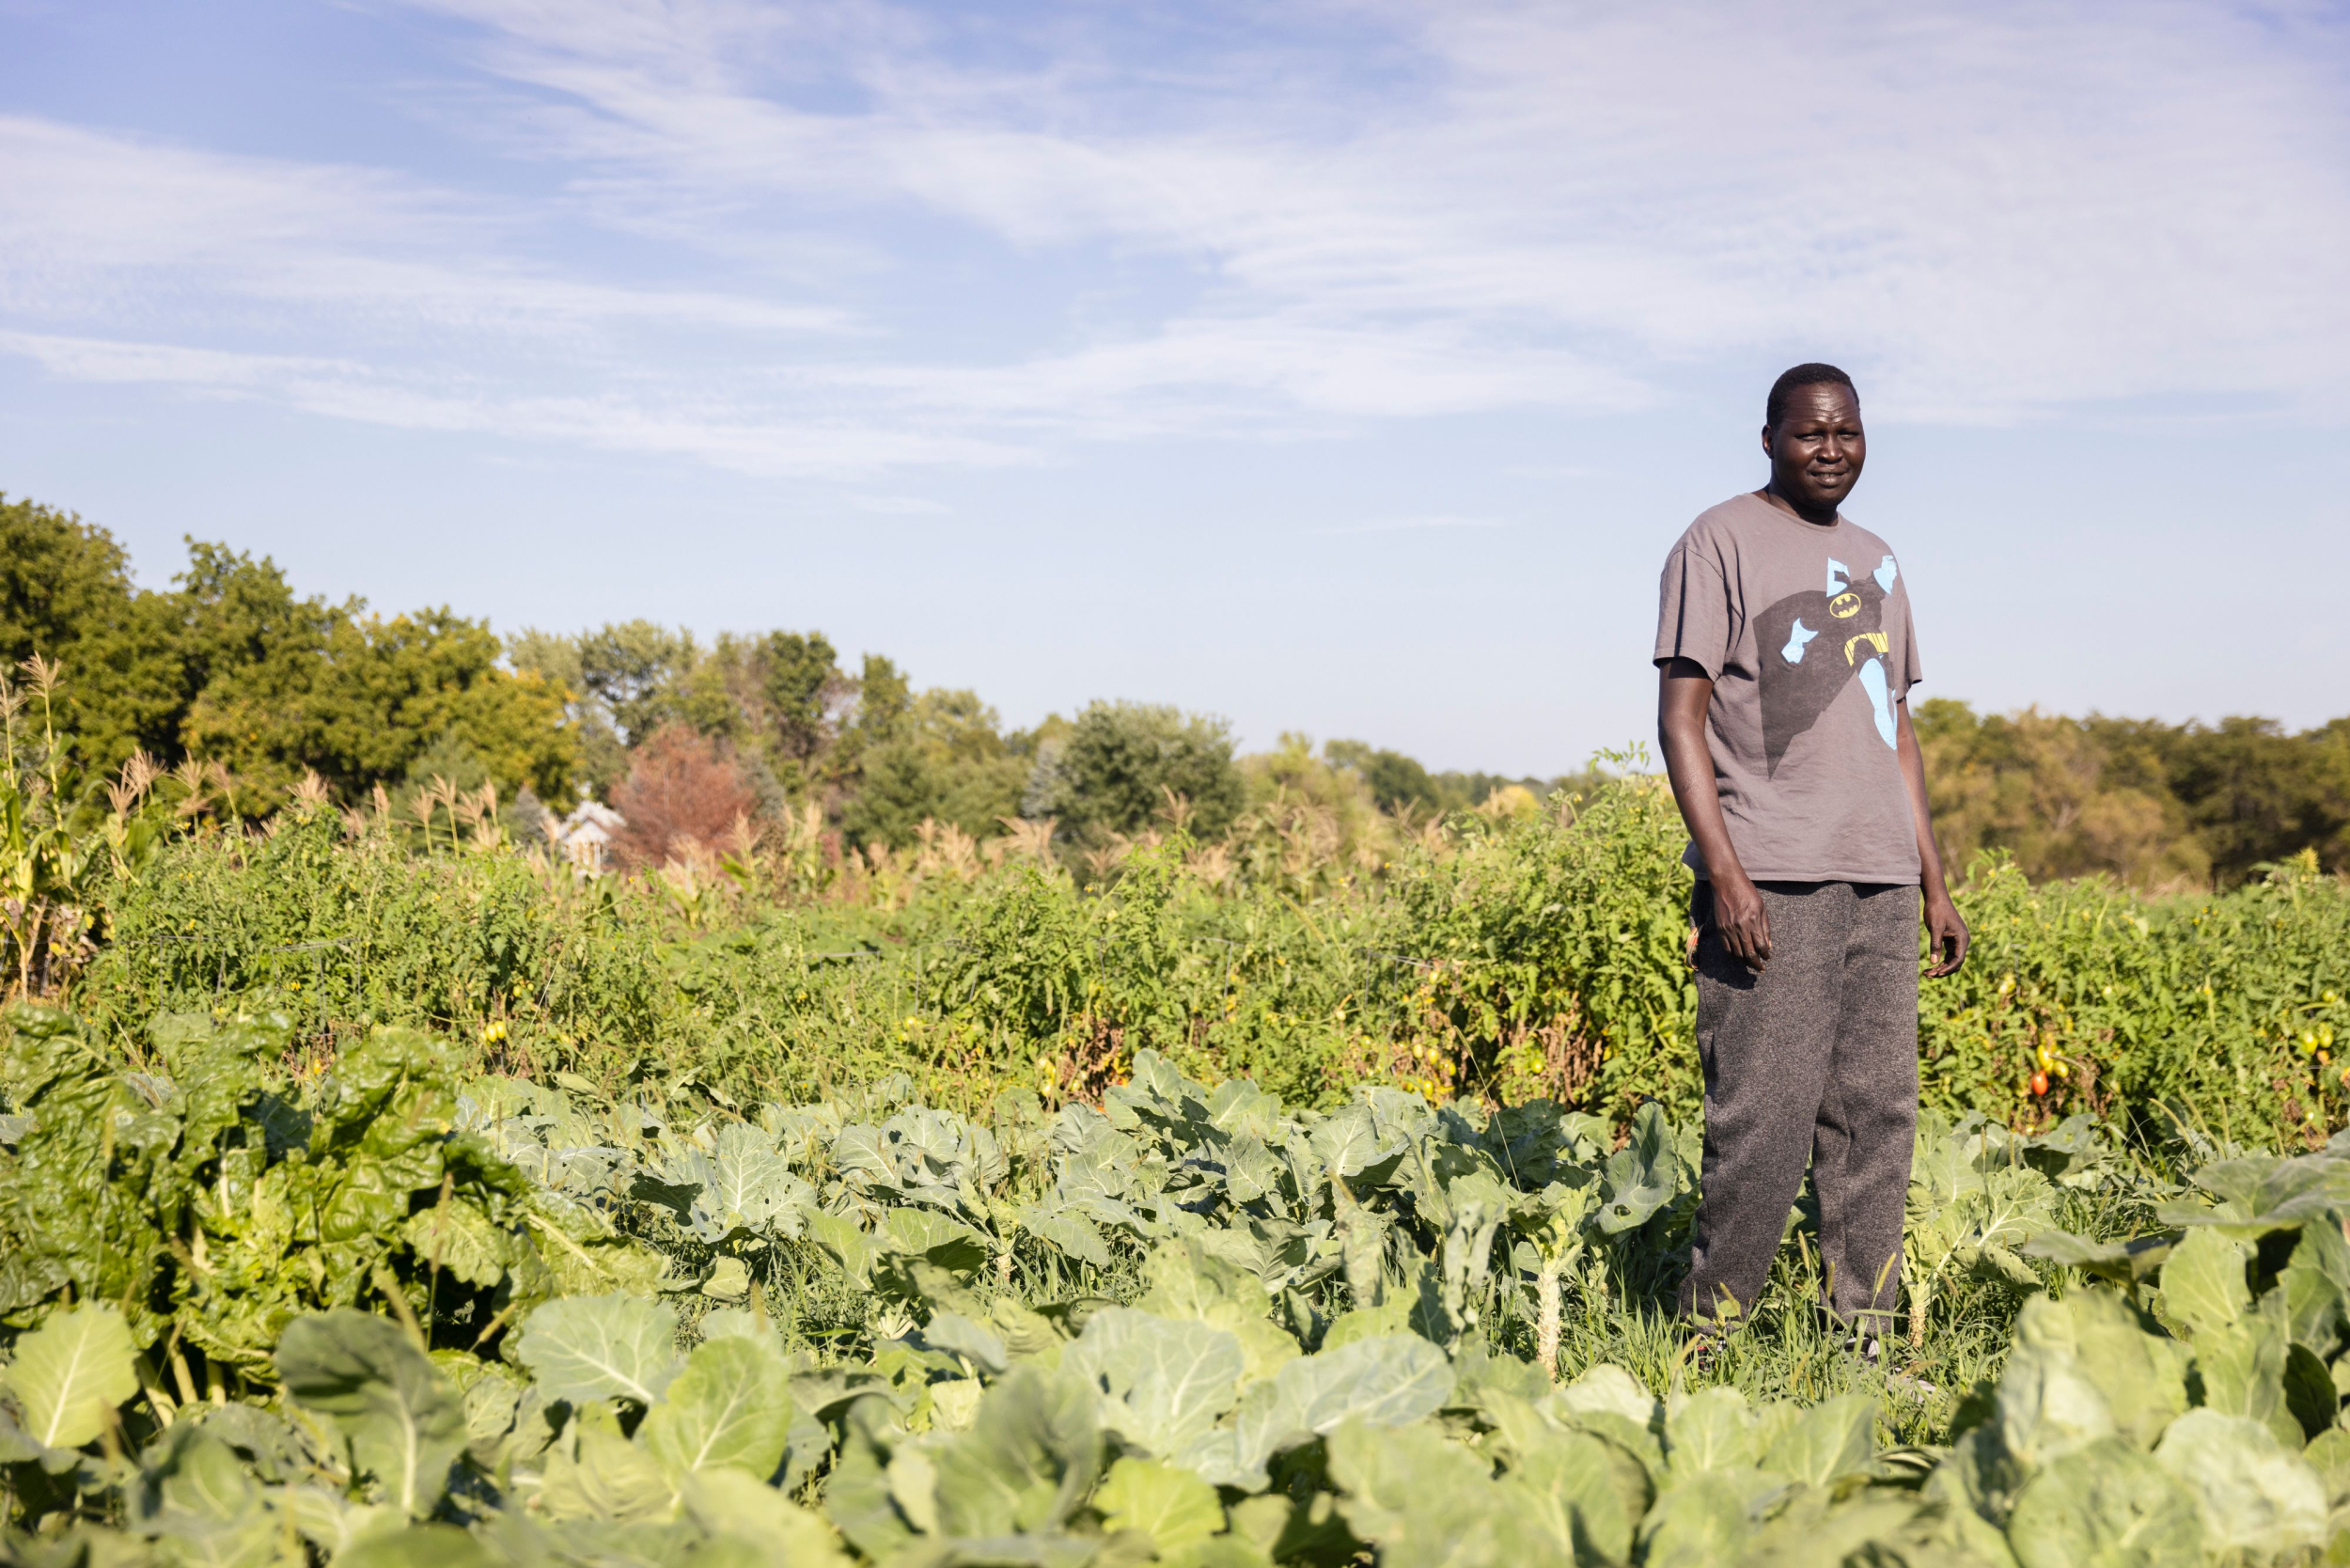
Abraham Ter

Slide 4
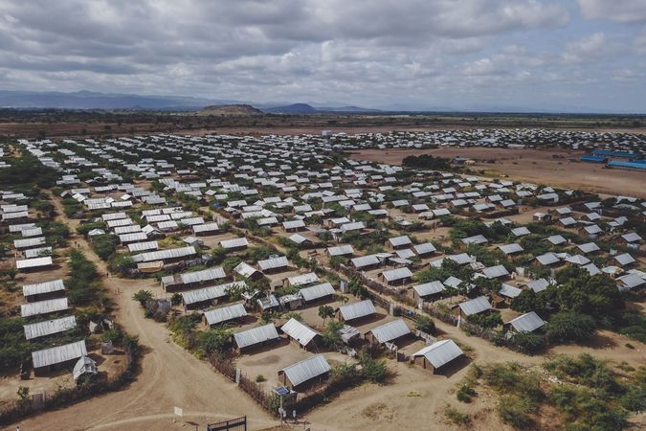
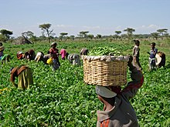
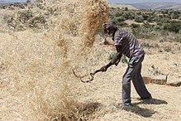
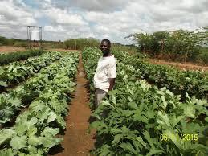
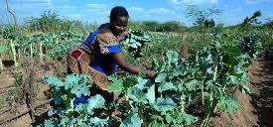
My Journey
Maize, beans,

Slide 5
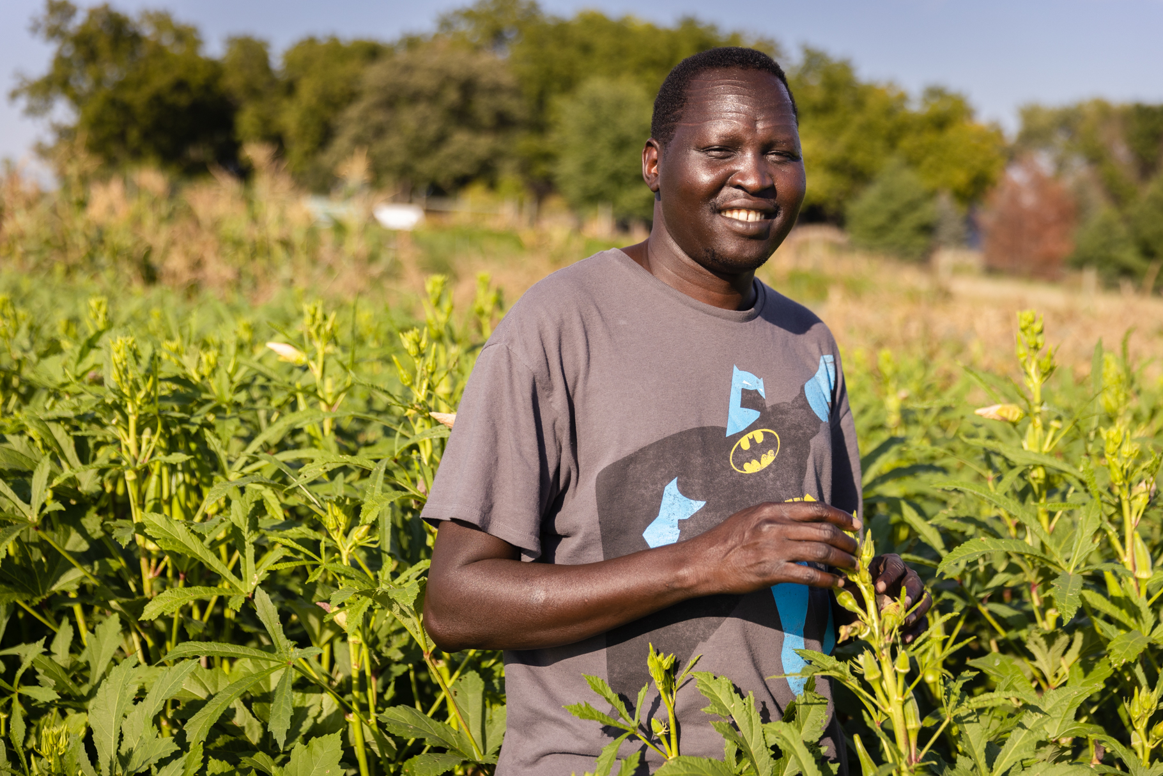
Farming in Iowa

Slide 6
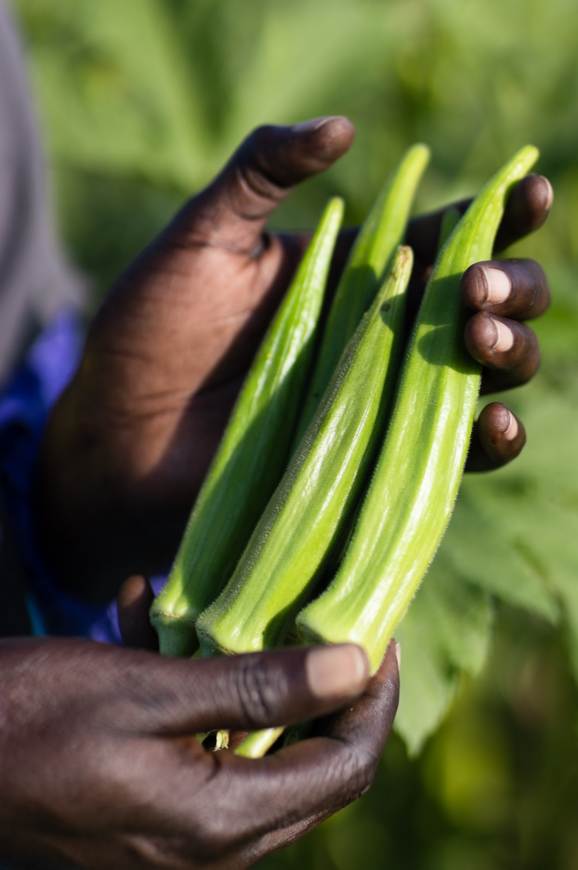
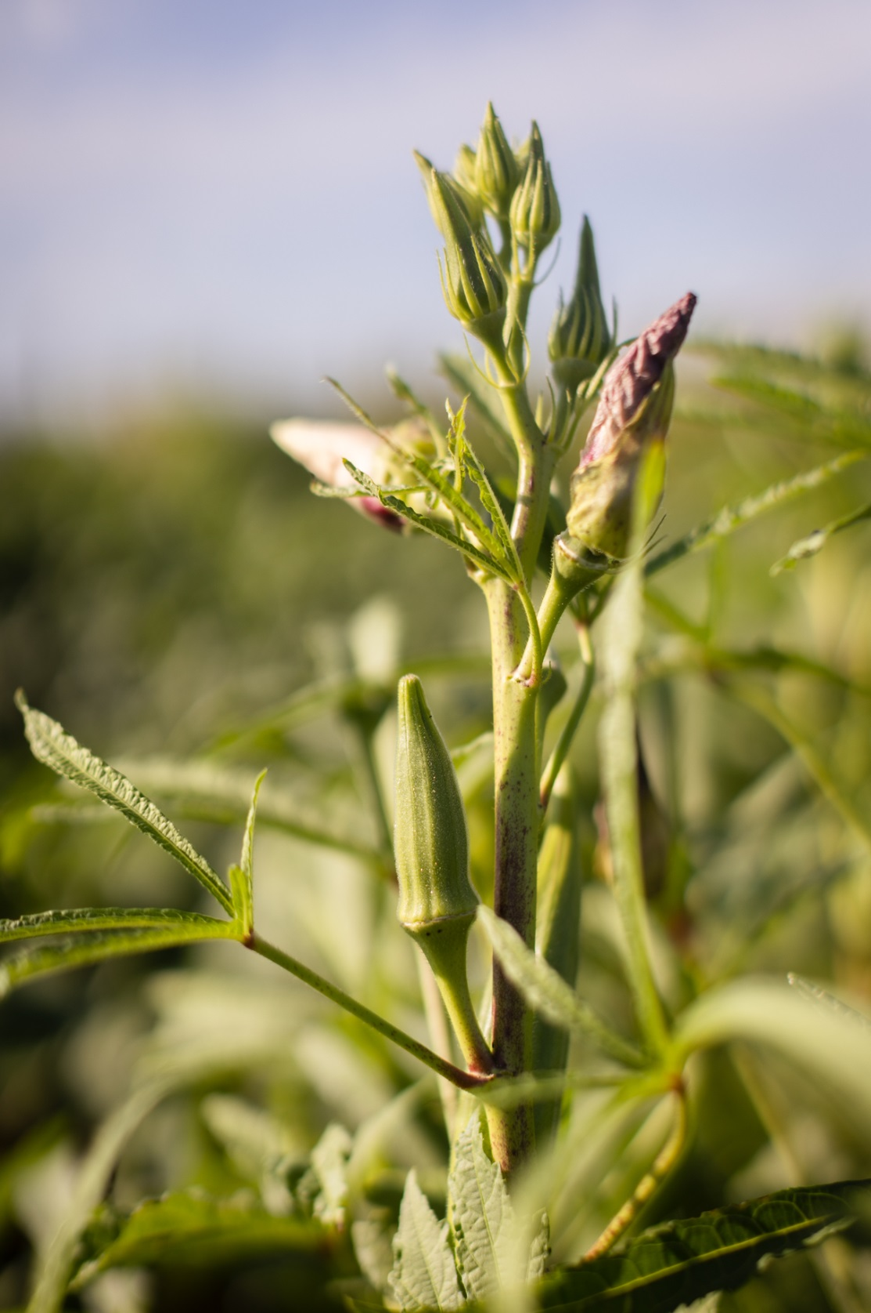

Slide 7
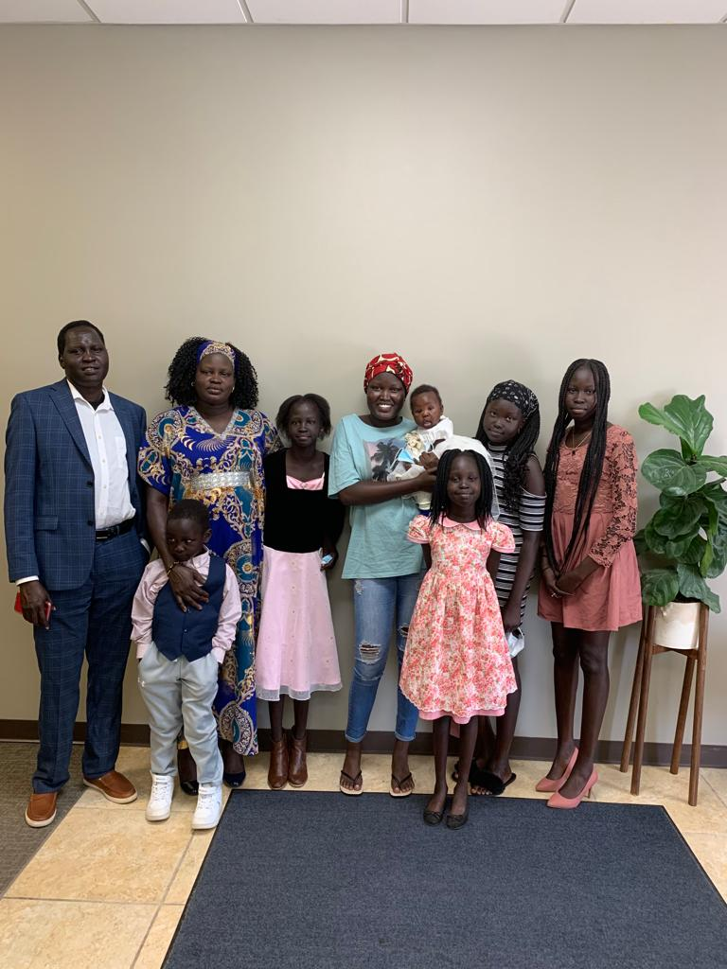
Hopes for the Future

Slide 8
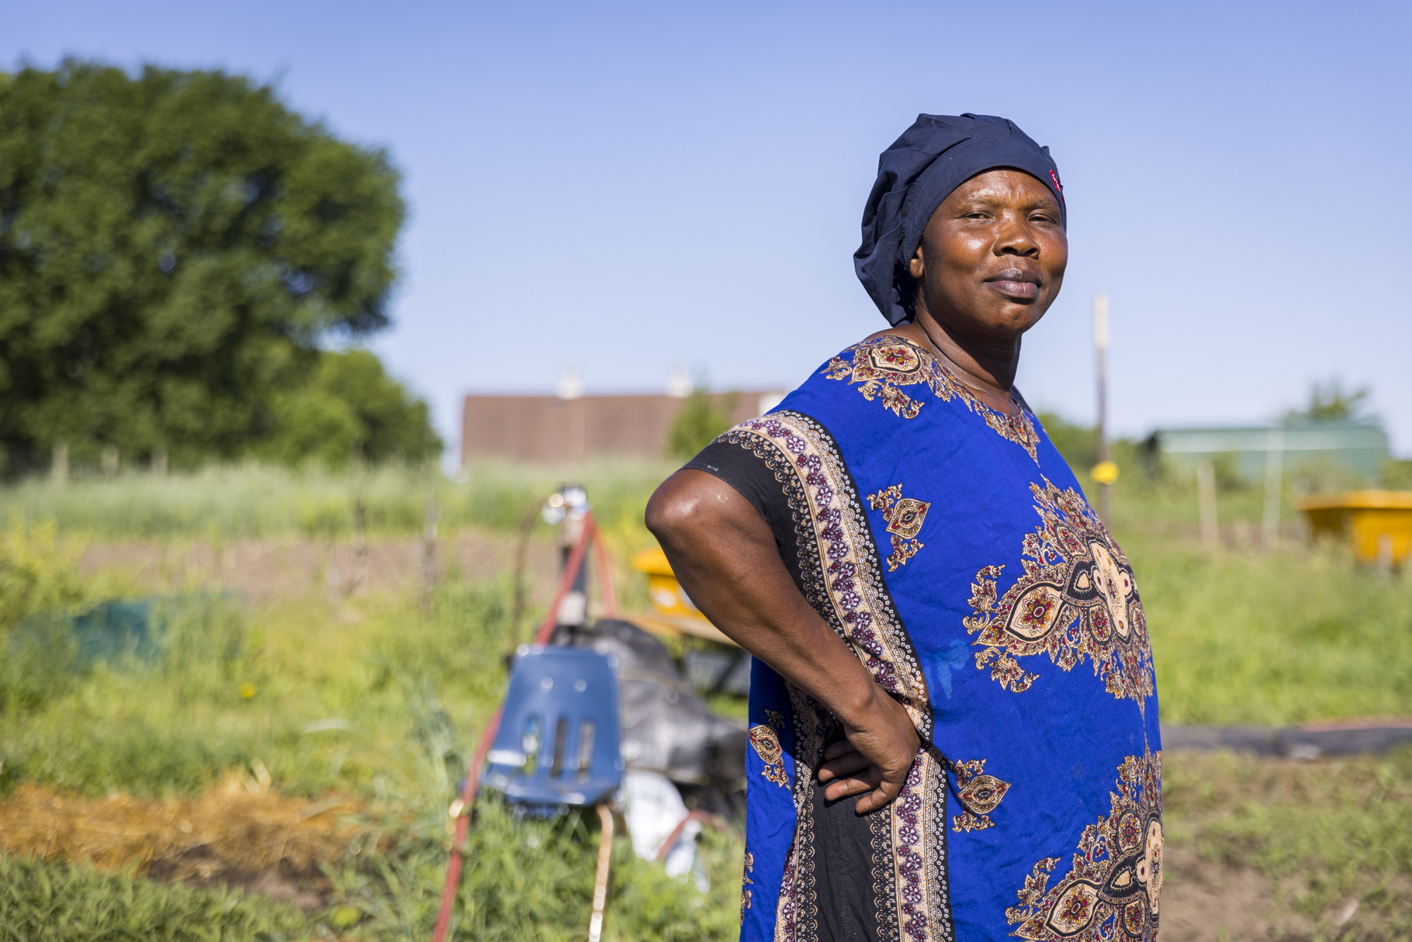
Esta and Renovat

Slide 9
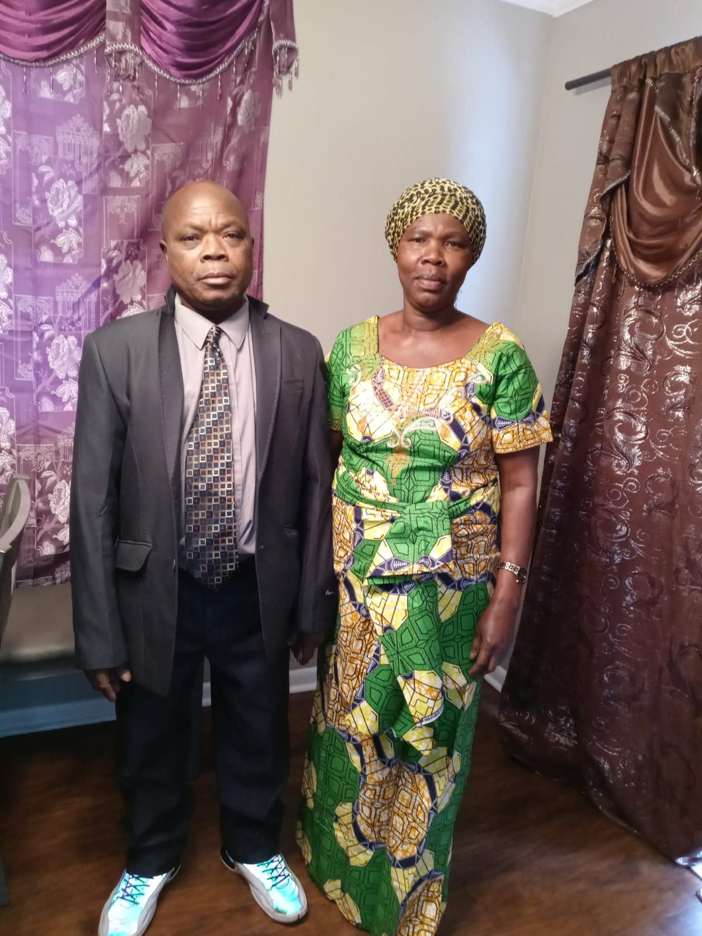
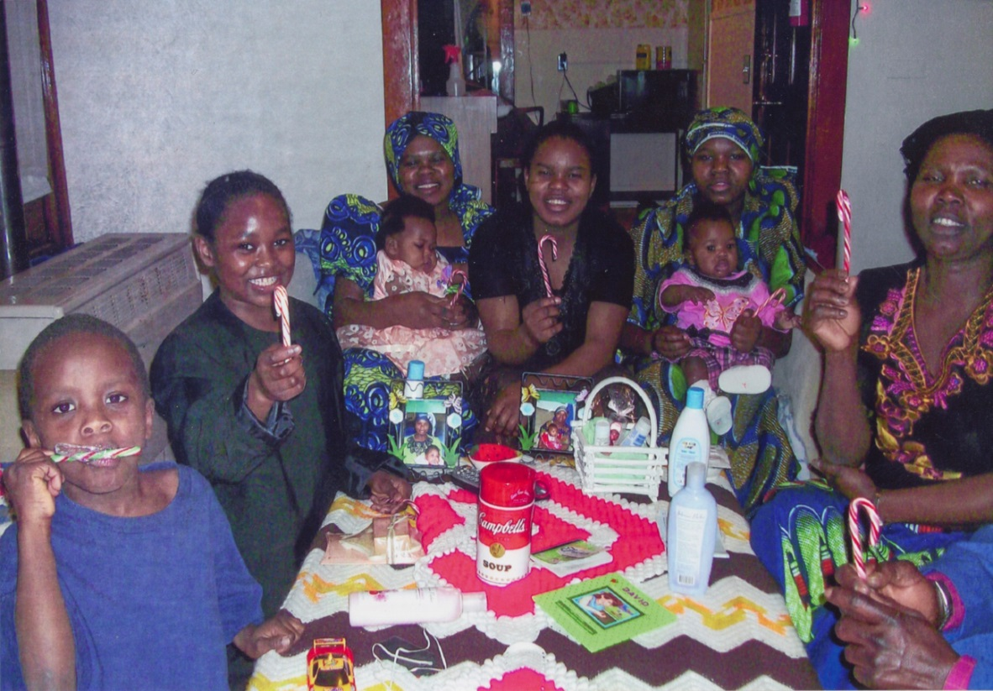
Learning
Family

Slide 10
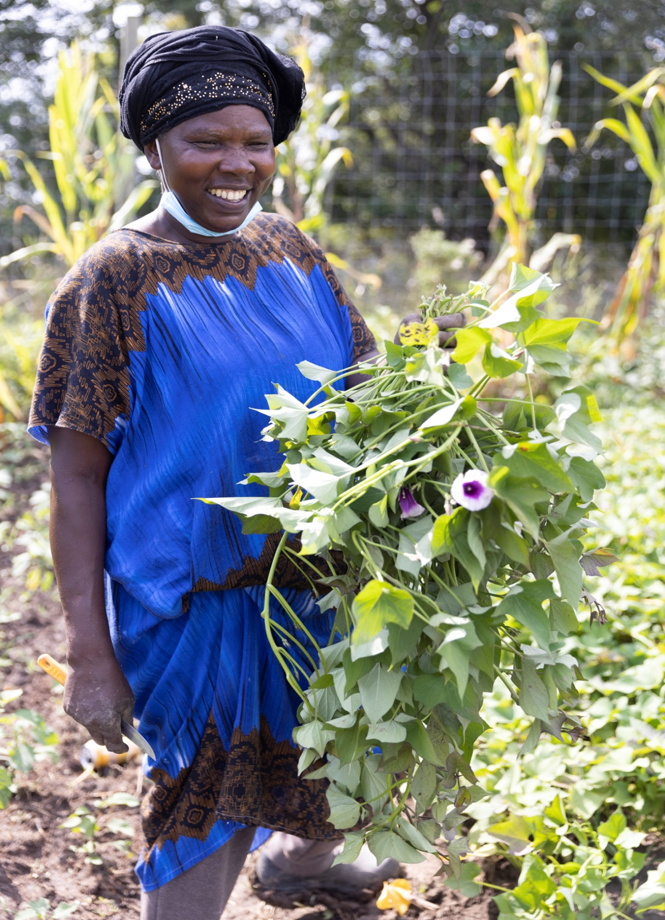
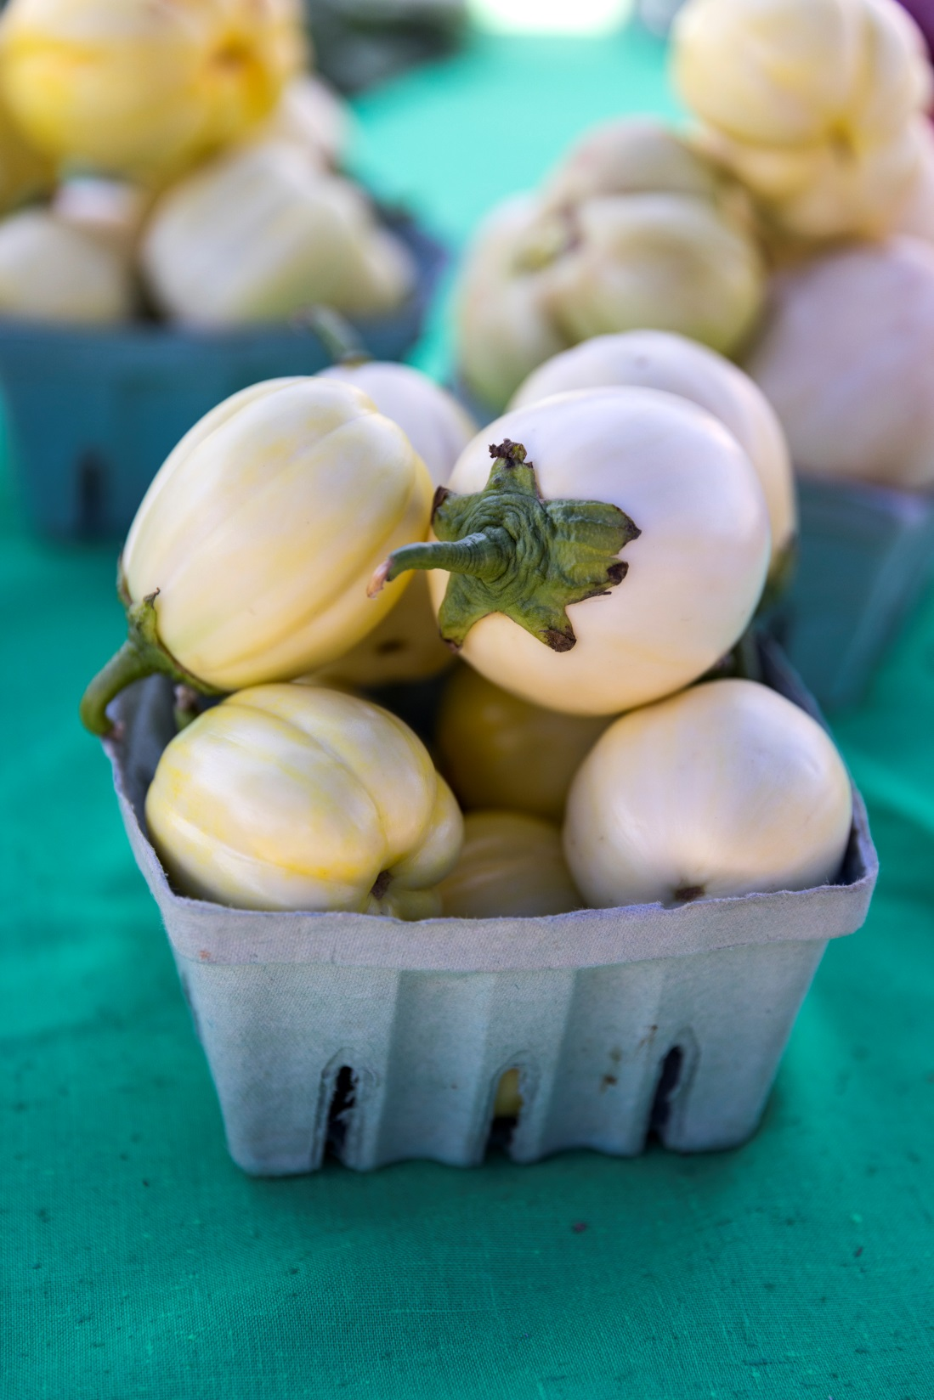
Cultural Vegetables

Slide 11
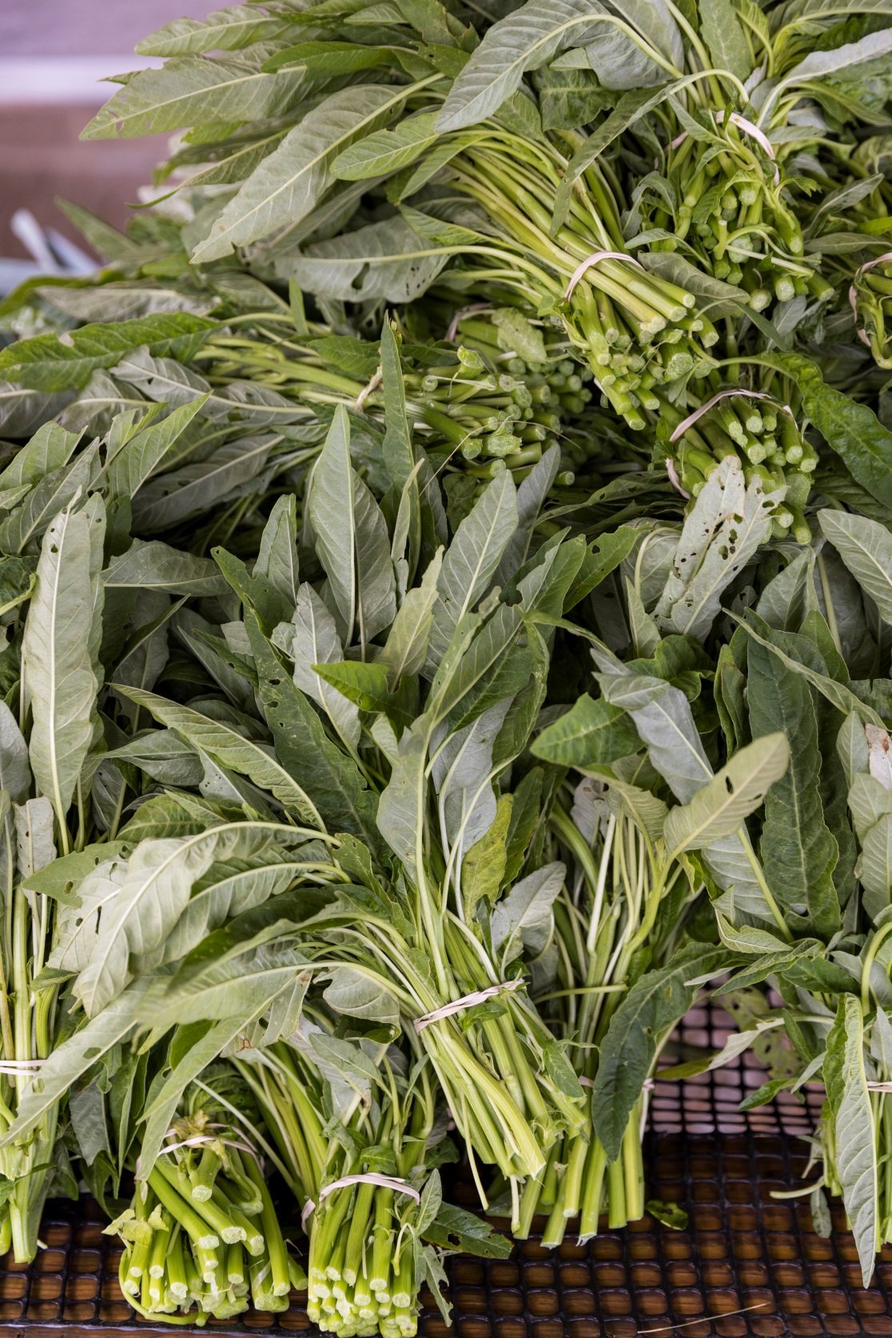
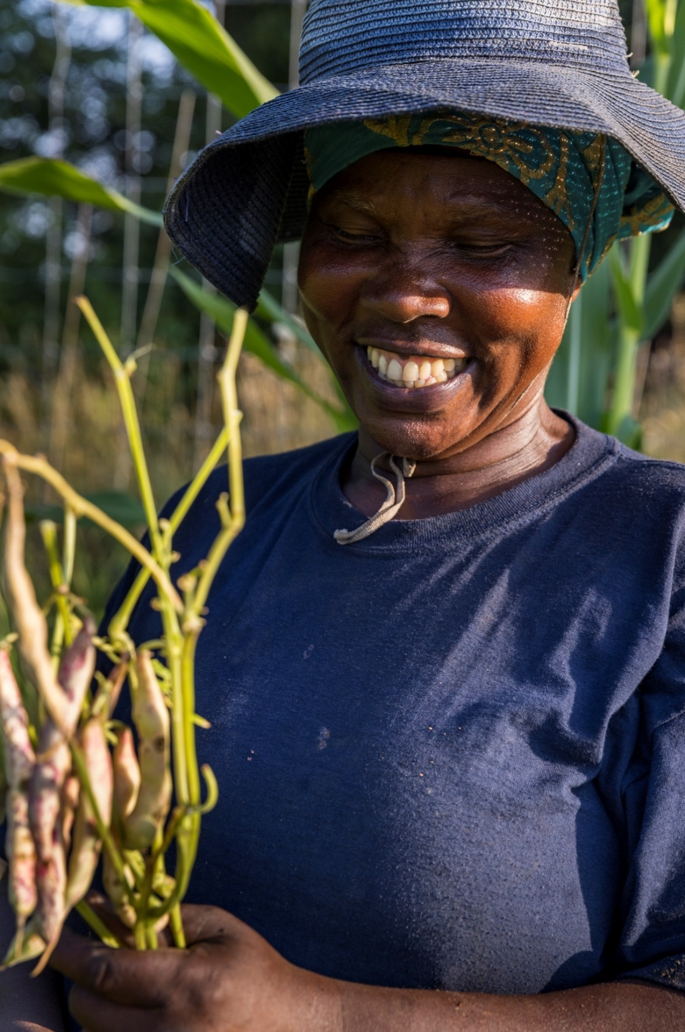
Cultural Vegetables

Slide 12
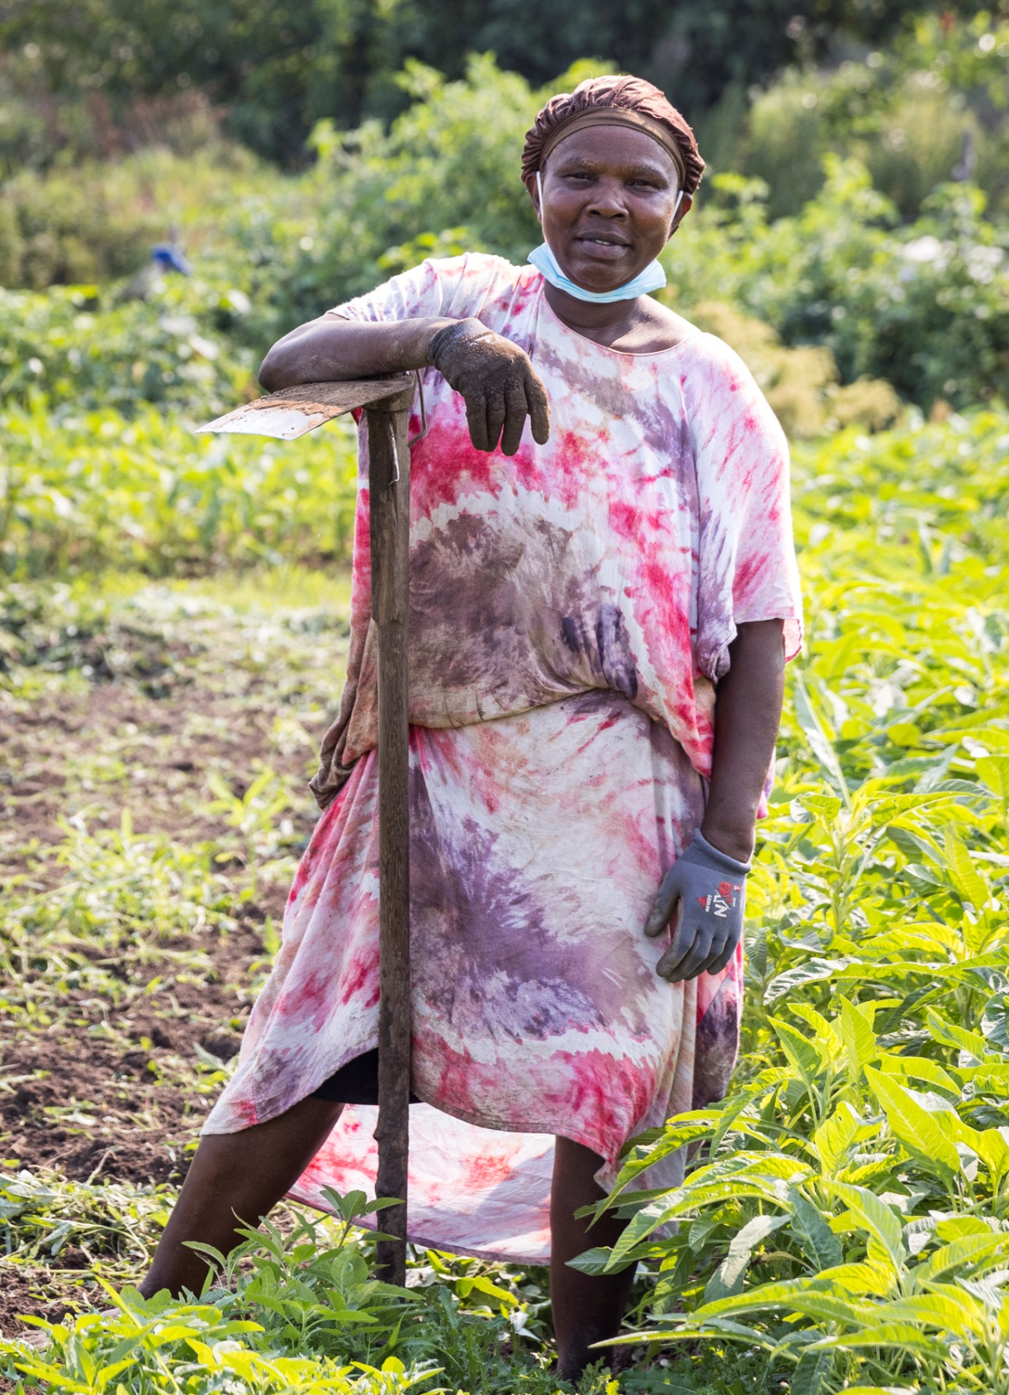
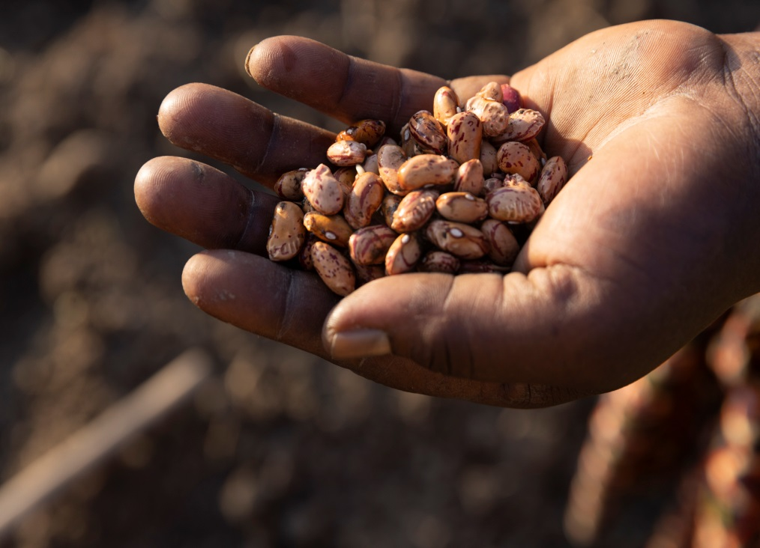
Tools

Slide 13
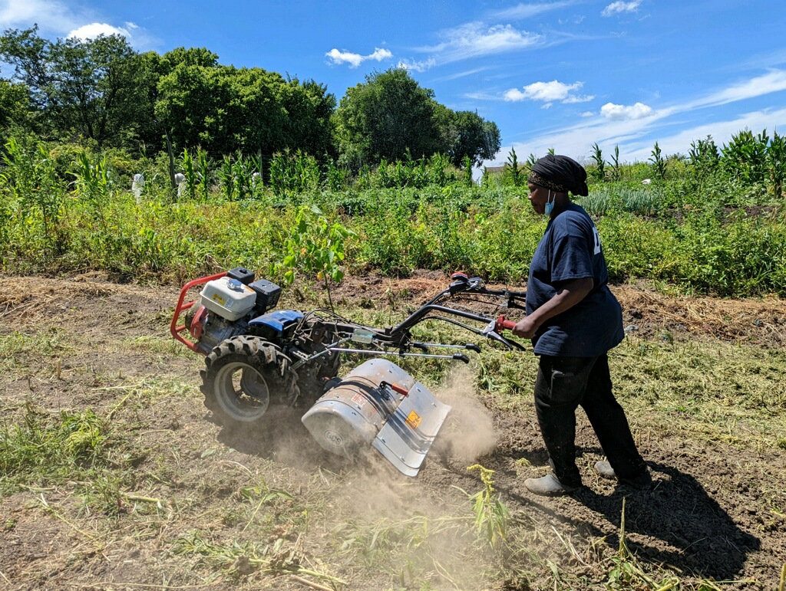
NewTools
New Tools

Slide 14
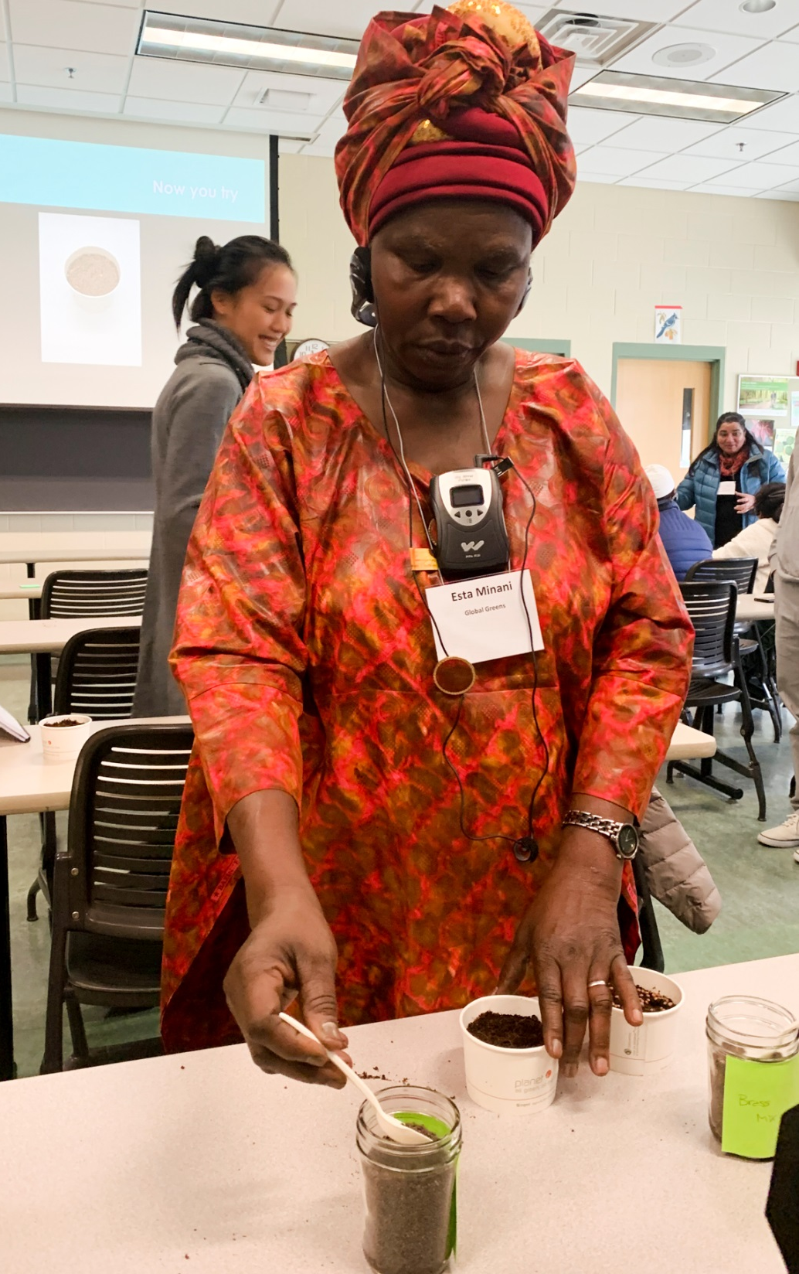
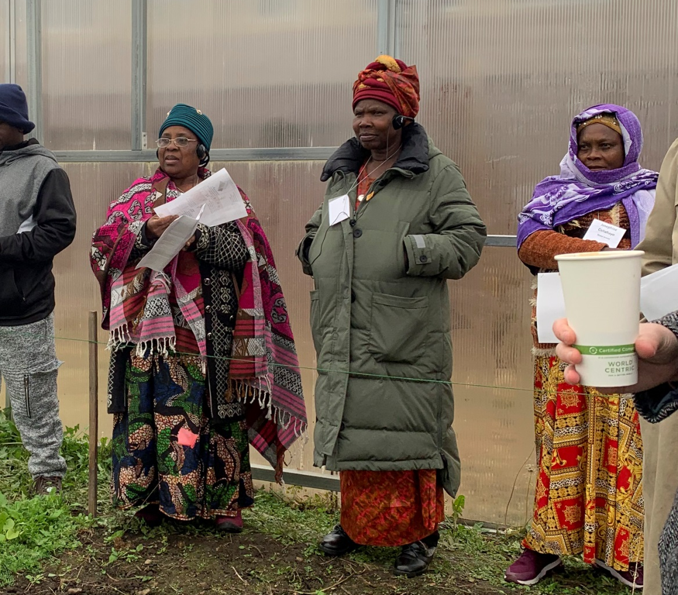
Learning

Slide 15
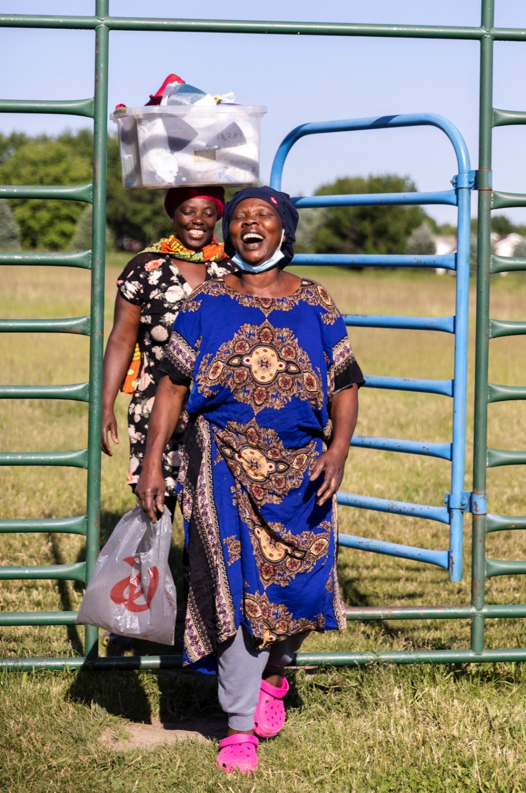
Coming to the farm after work

Slide 16
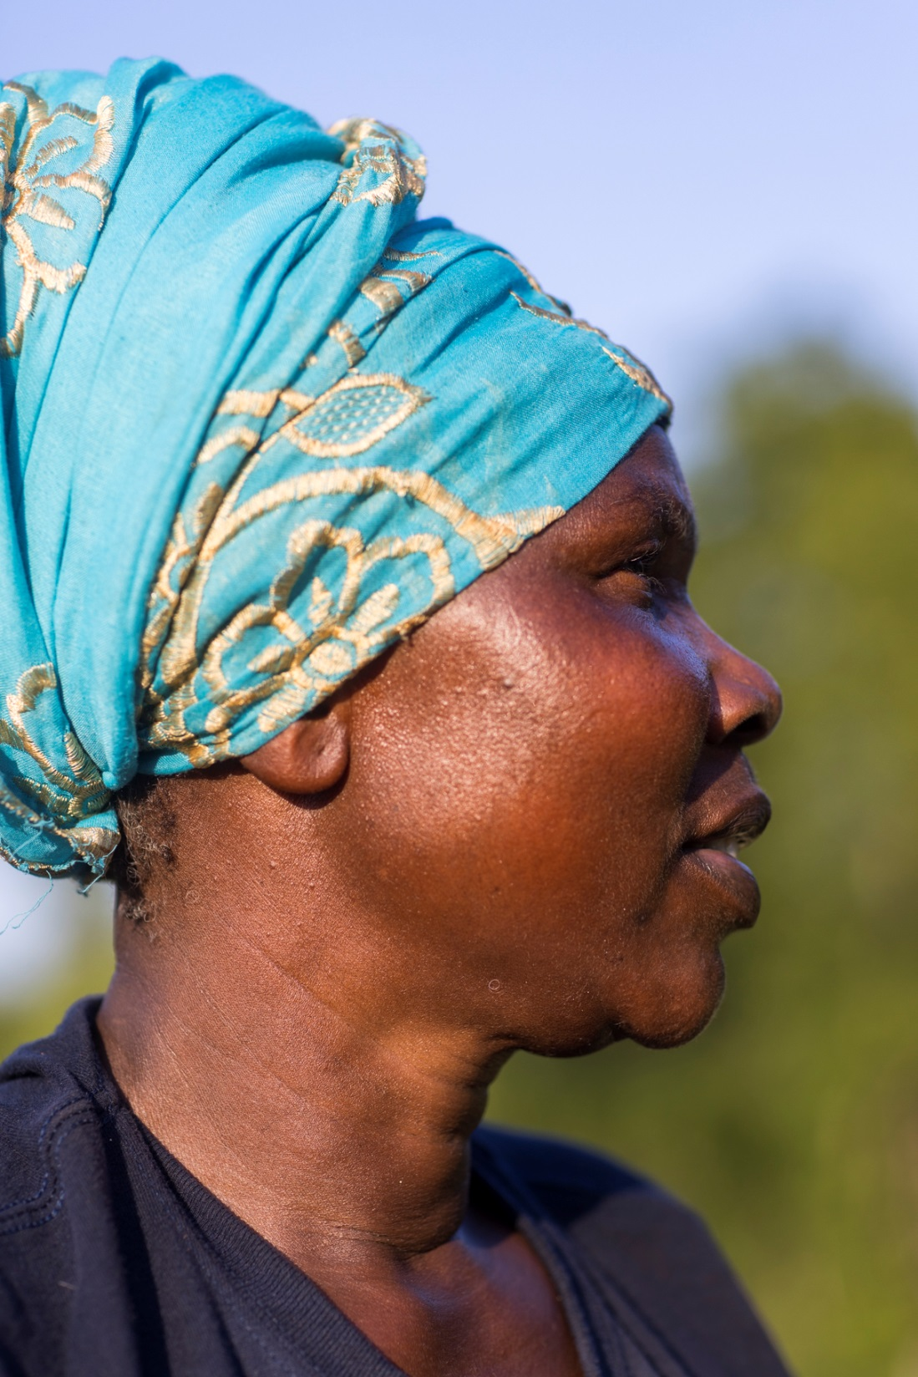
Hopes for the Future

Slide 17
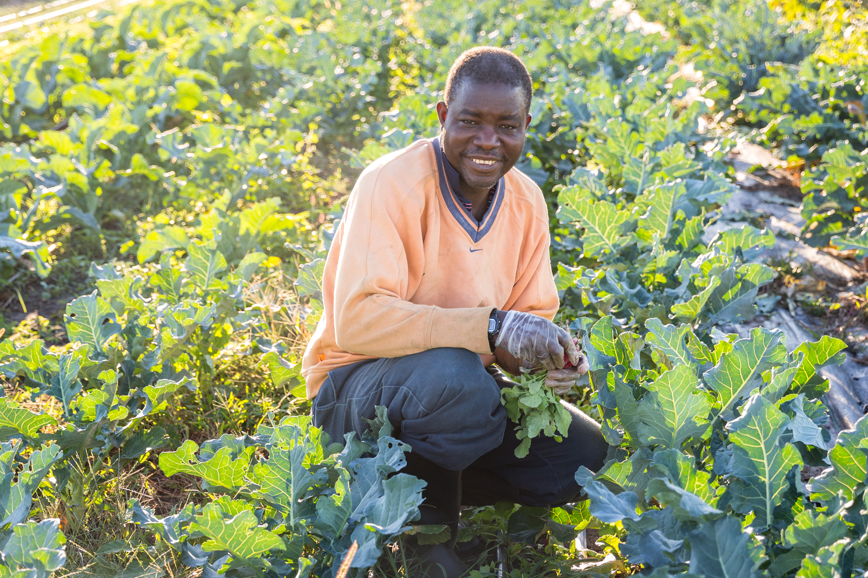
Bizimana Charles
-President: Burundians in Iowa Association
-Farmer
-Community Builder

Slide 18
Journey to Des Moines
Was in country had to move, why I had to move
Reason to become farmer
Once resettled in Des Moines, had jobs I didn’t like. “I was not Free”
We didn’t have the vegetables we needed that we liked to eat from Africa

Slide 19
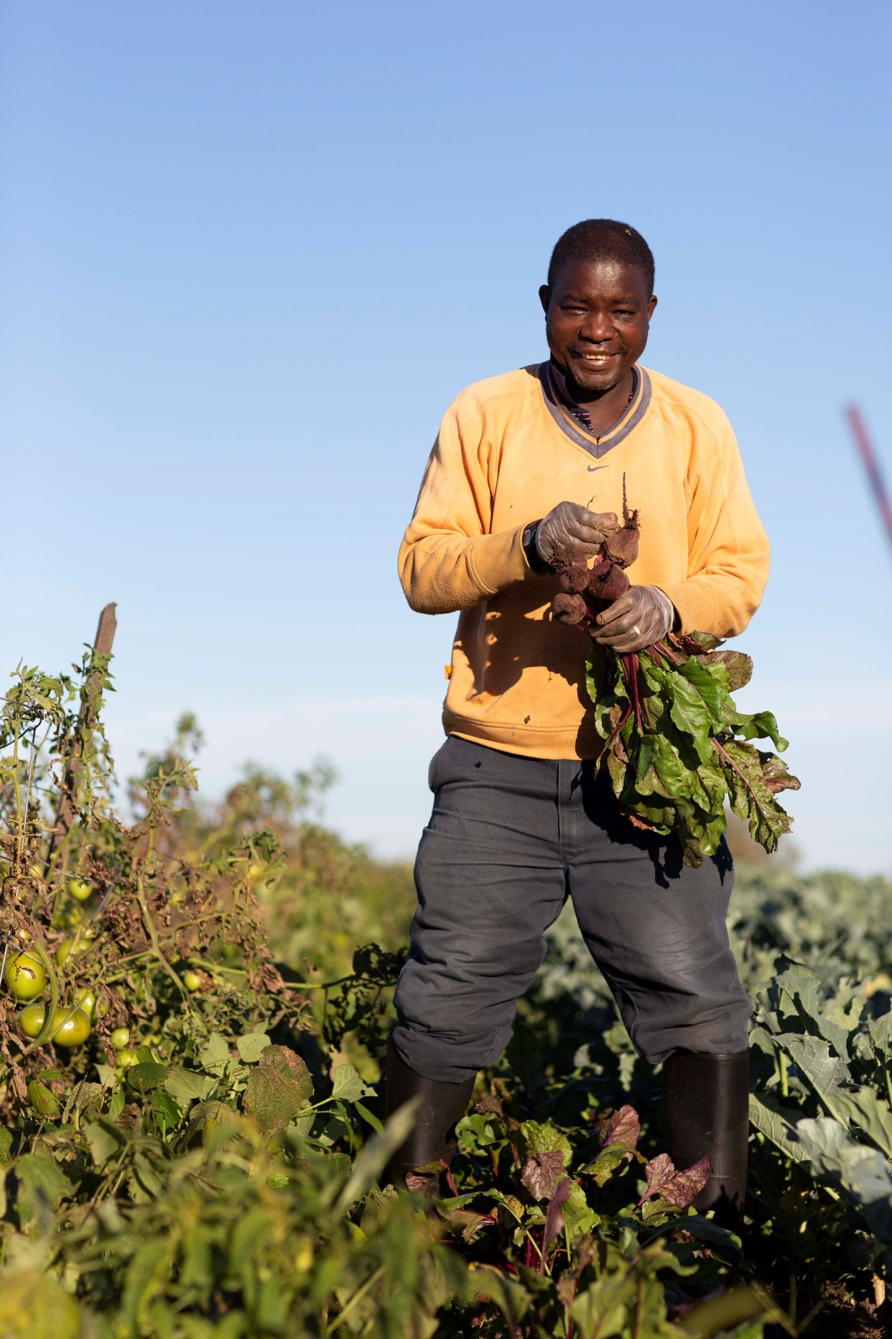
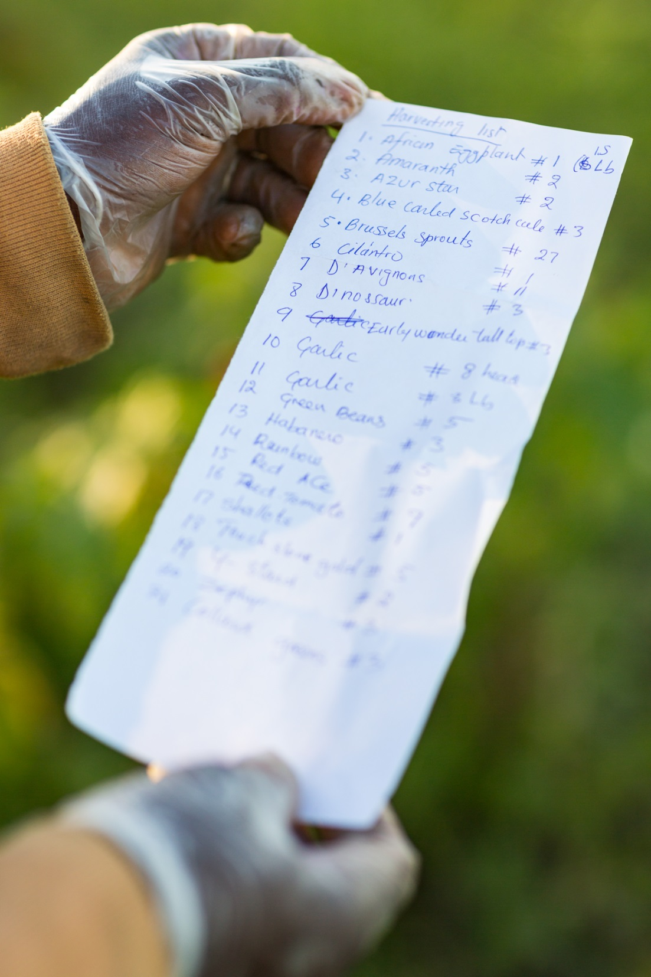
About Me and My Operaton
About me and my Operation

Slide 20
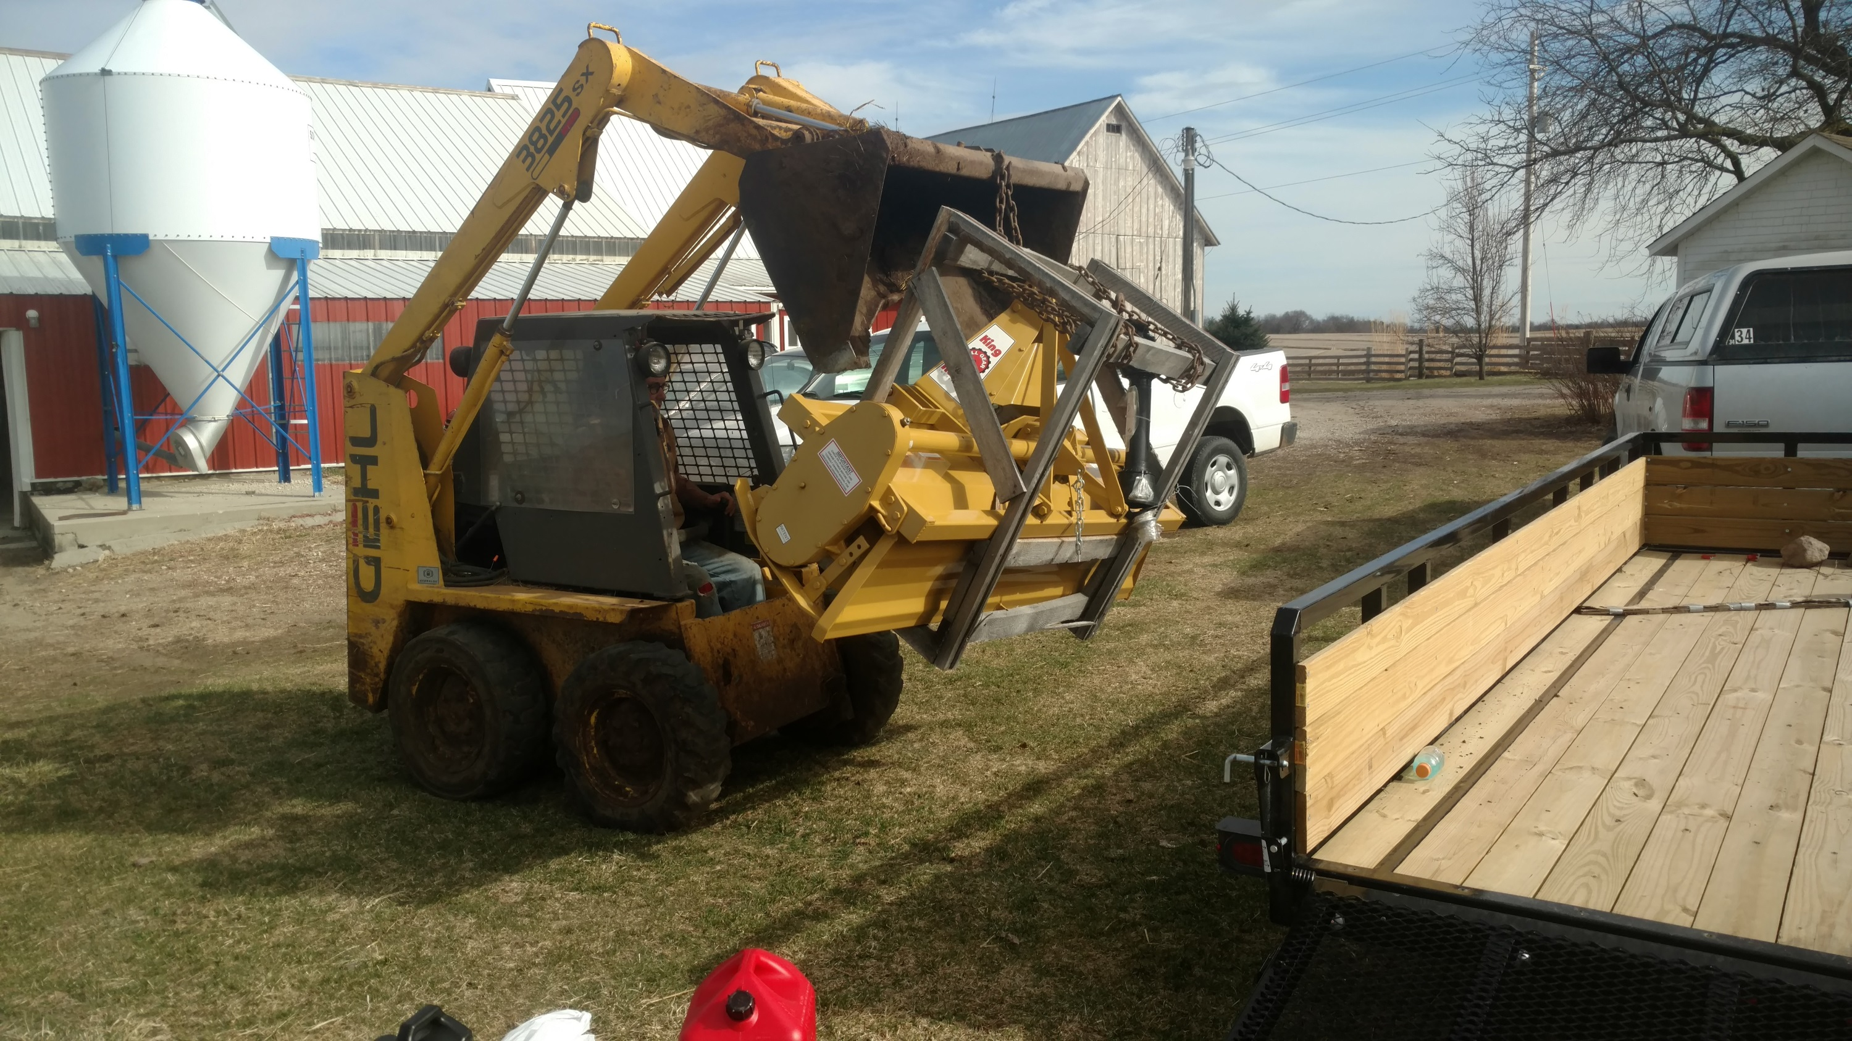
Building Infrastructure

Slide 21
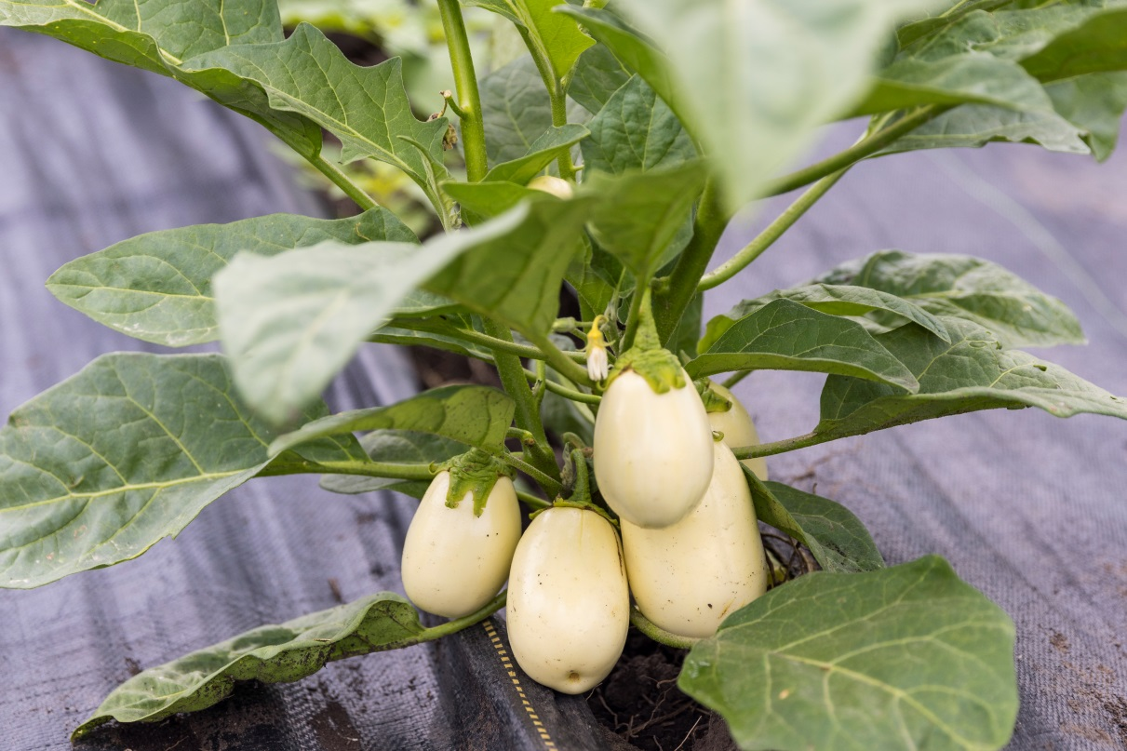
‘African’ Eggplant

Slide 22
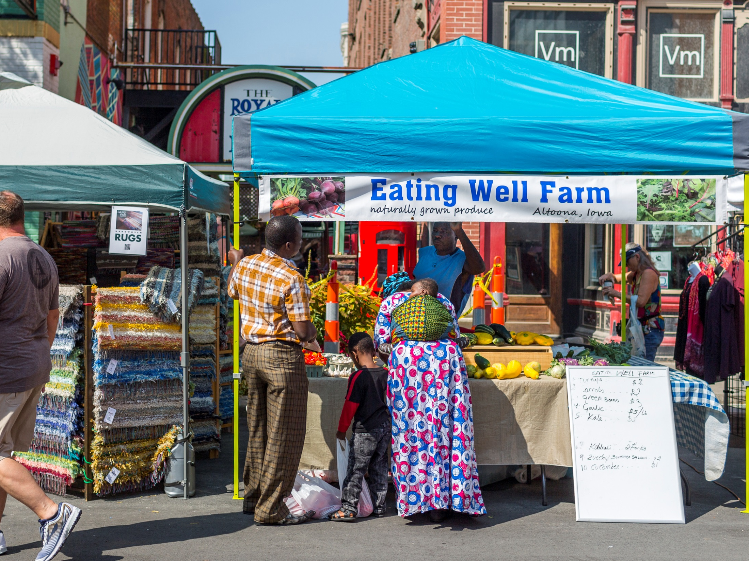
Pic of Fully loaded van
100s of bunches of greens
African eggplant pic
Markets
Markets

Slide 23
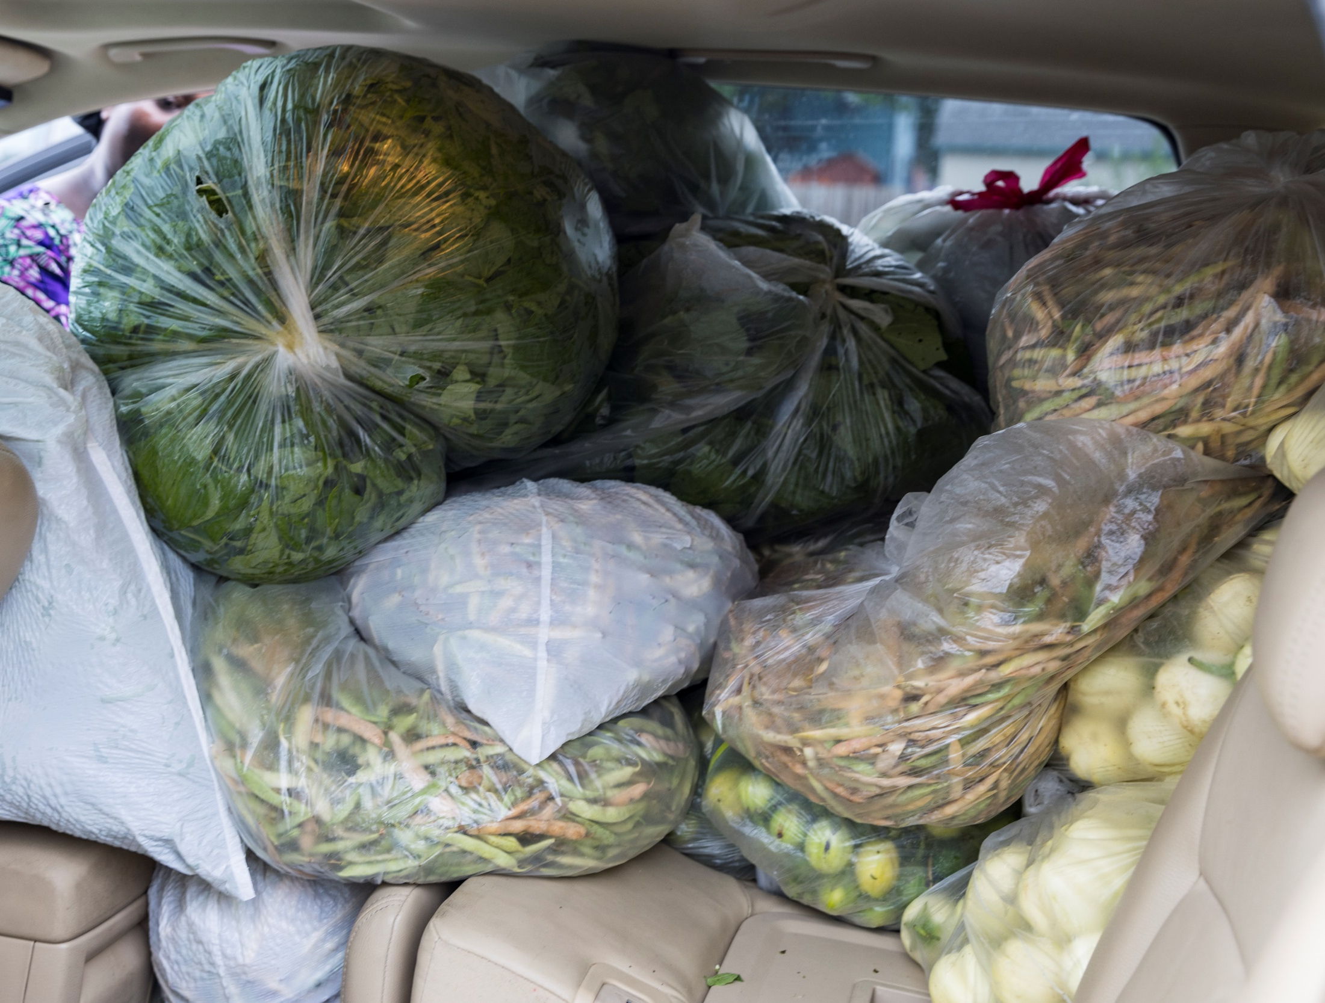
Farmers Market Customers

Slide 24
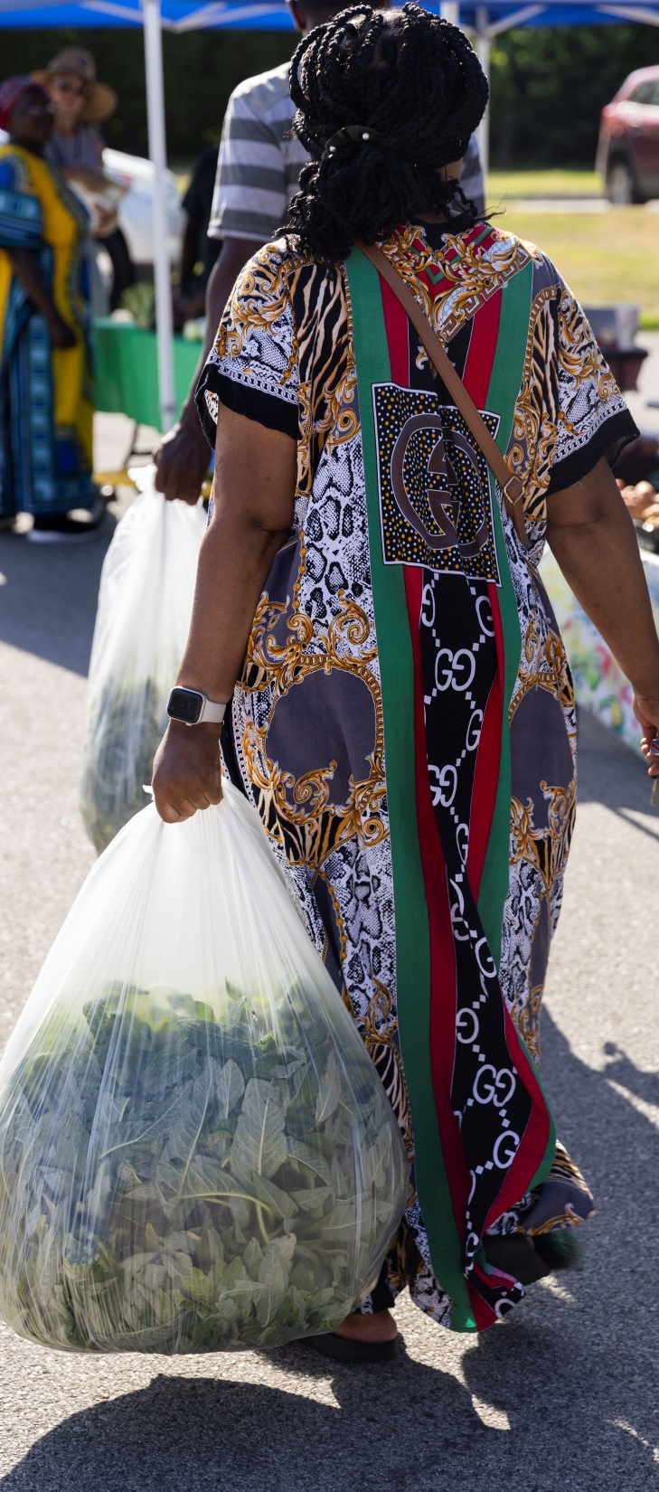

Slide 25
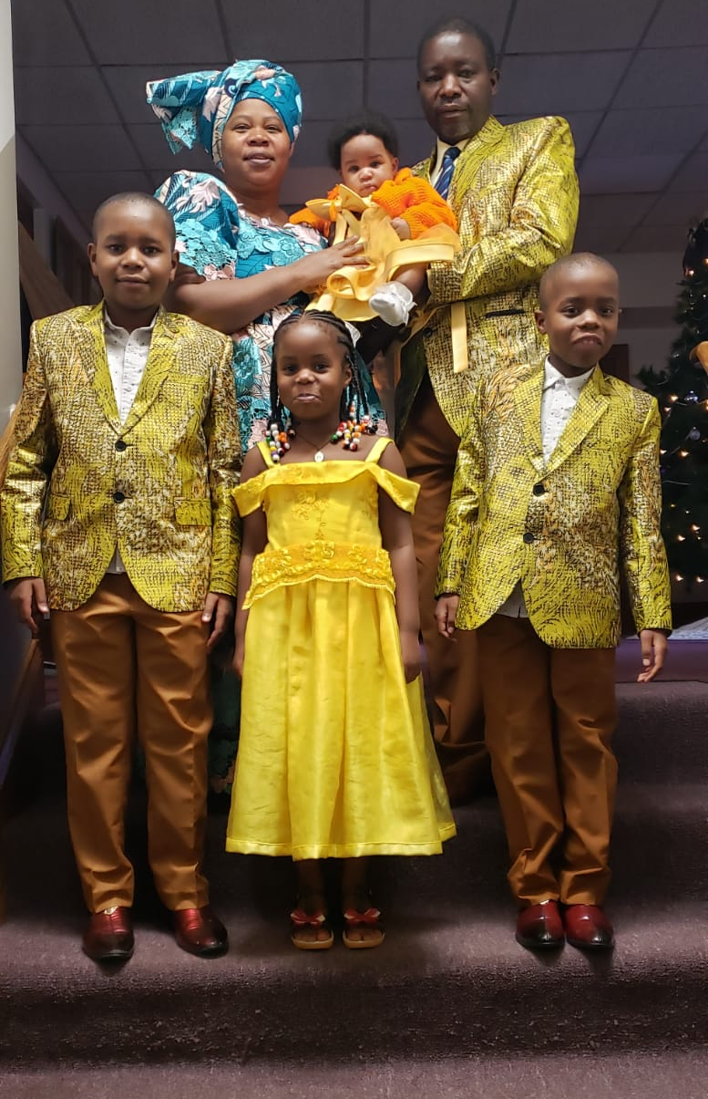
Hopes and Concerns for the Future
Losing land and getting new land
5 year max lease on In Harmony
incubator
Losing time and money every time
I move
Looking for long-term lease or 5
Acres to buy

Slide 26
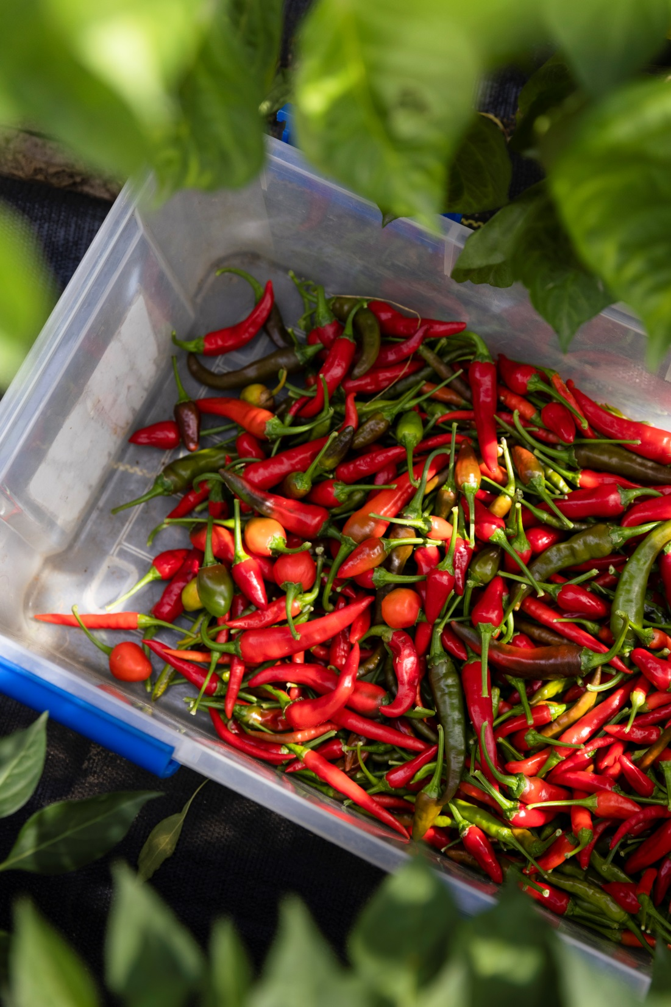
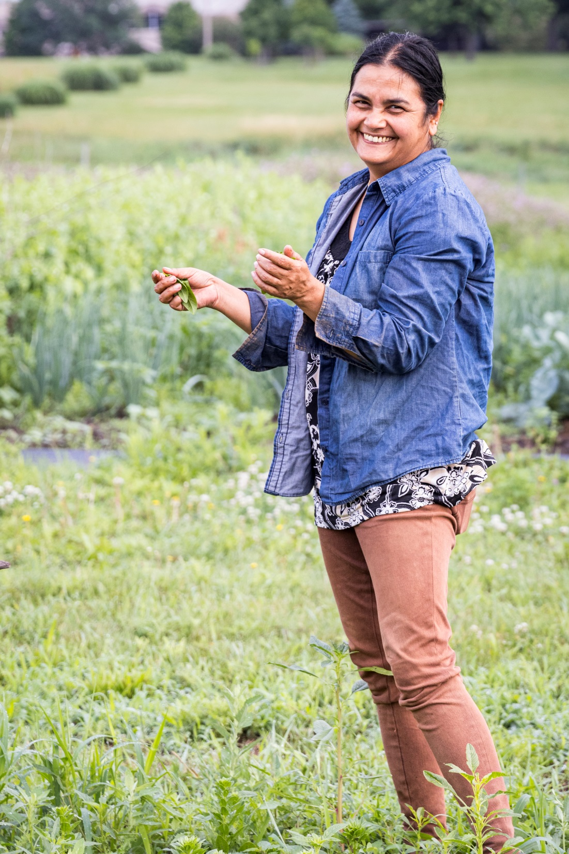
Namaste Garden Tika Bhandari

Slide 27
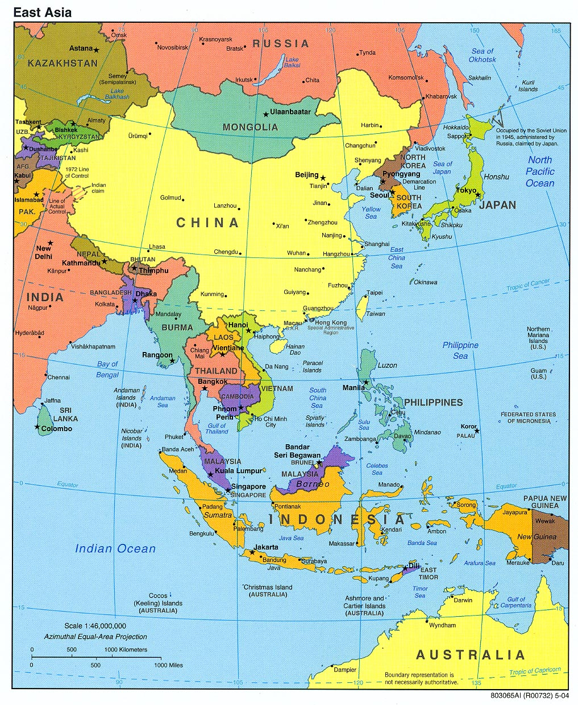

Slide 28
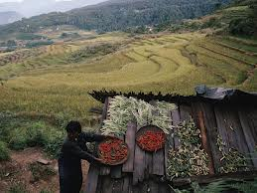
My Dad’s farm in Bhutan
18 acre farm
6 acres of ginger
4 acres of millet and corn
3.9 acres of oranges
3 acres of rice
.5 Acres Betel nut
Rest of land for livestock

Slide 29
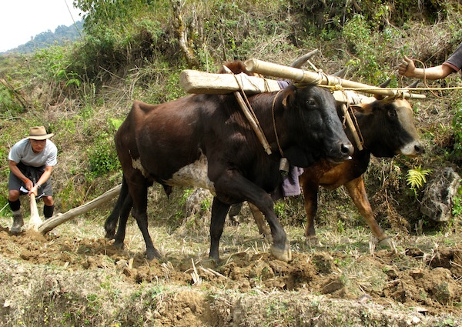

Slide 30
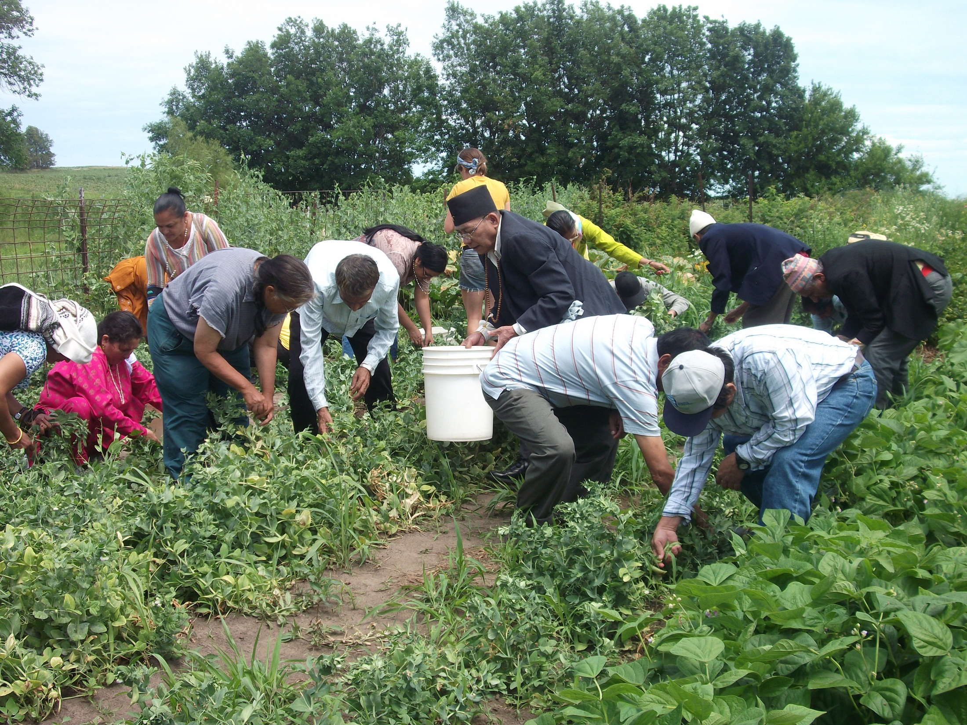

Slide 31
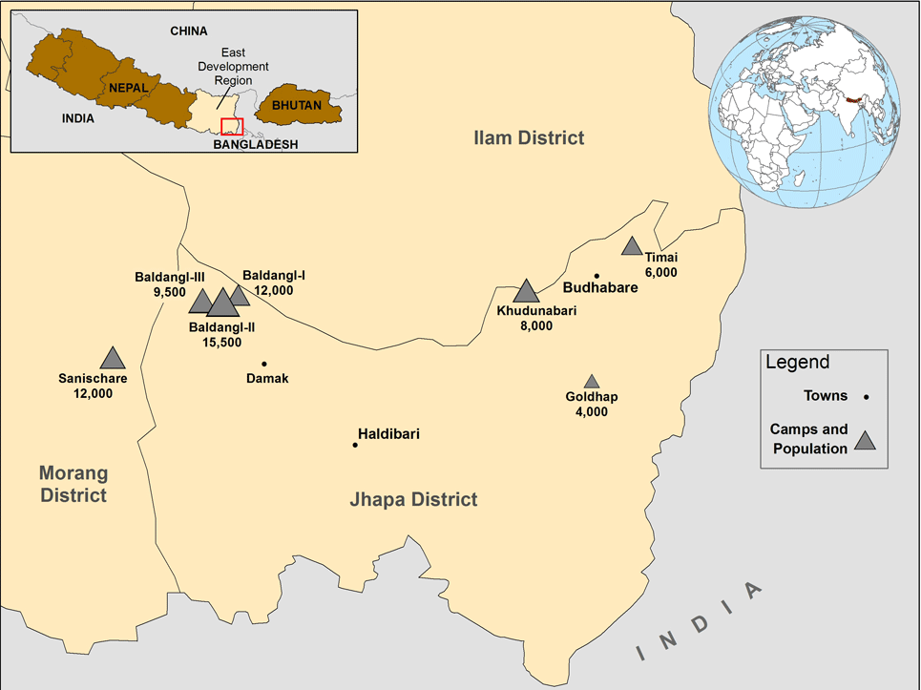
Refugee Camp

Slide 32
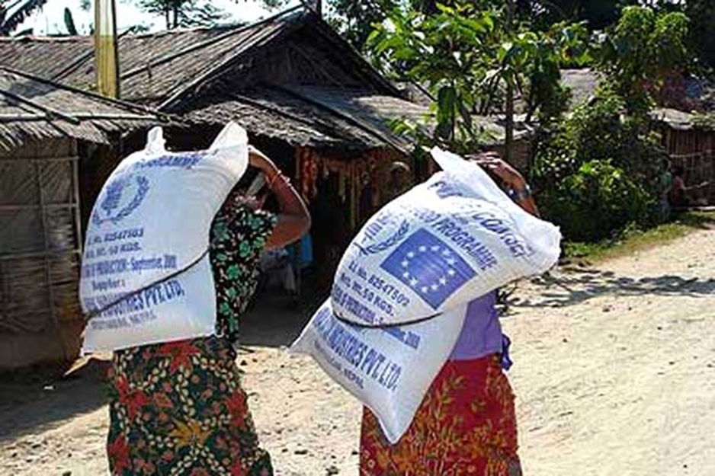
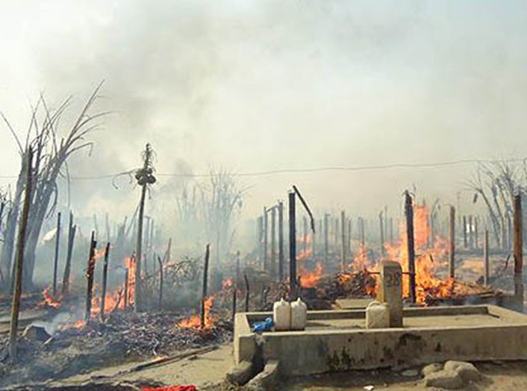
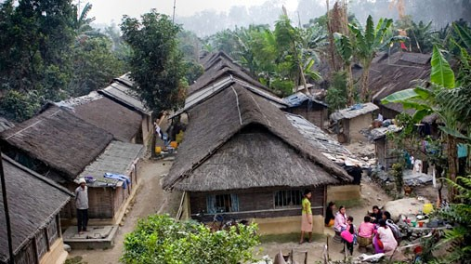
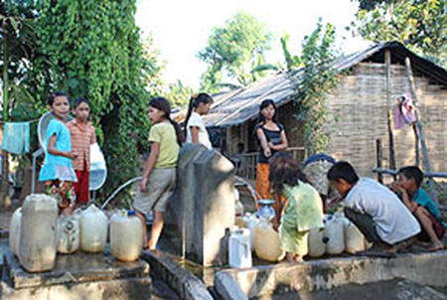
Life in camps

Slide 33
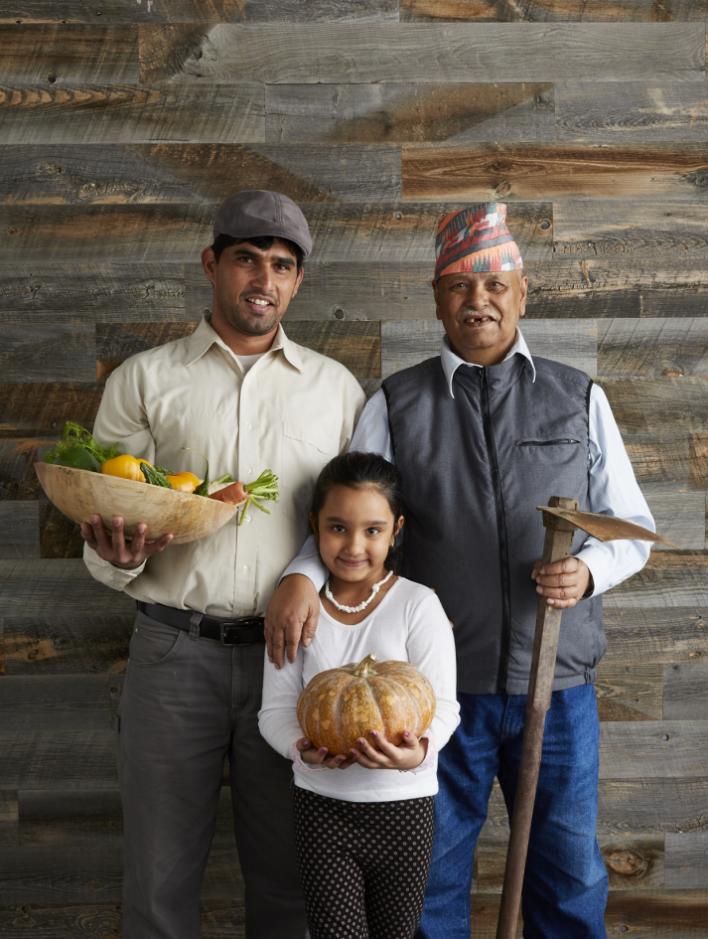
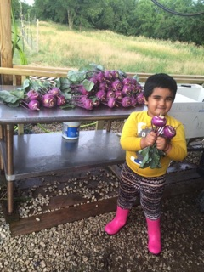
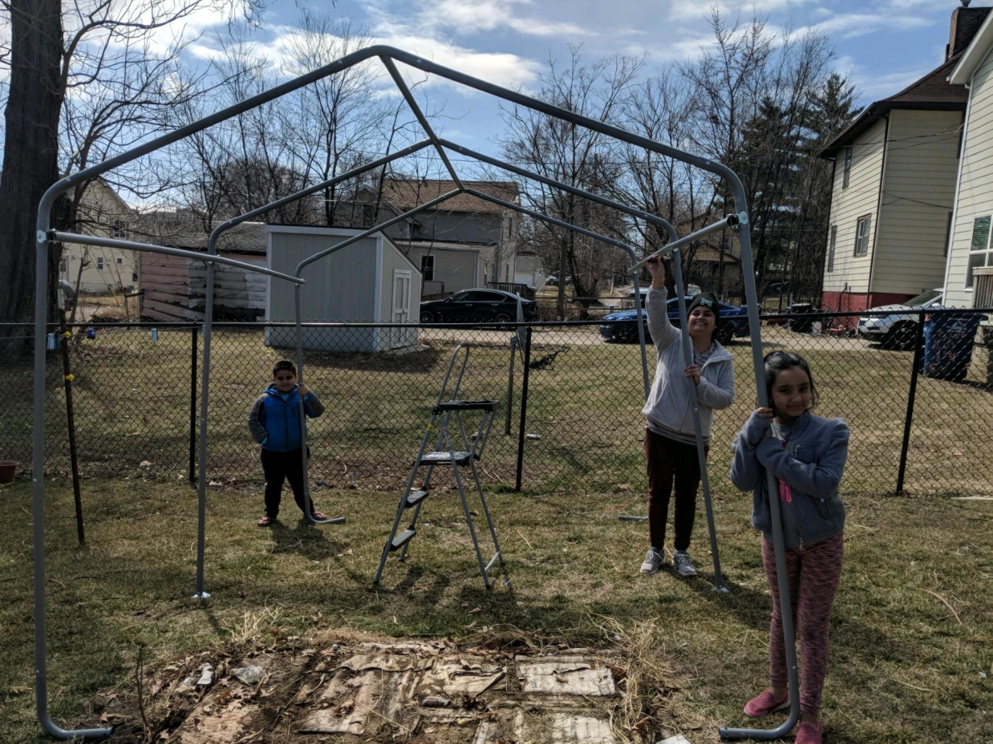
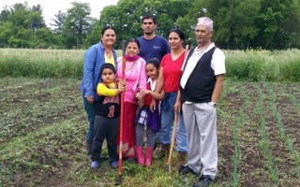
Passing on a Legacy

Slide 34
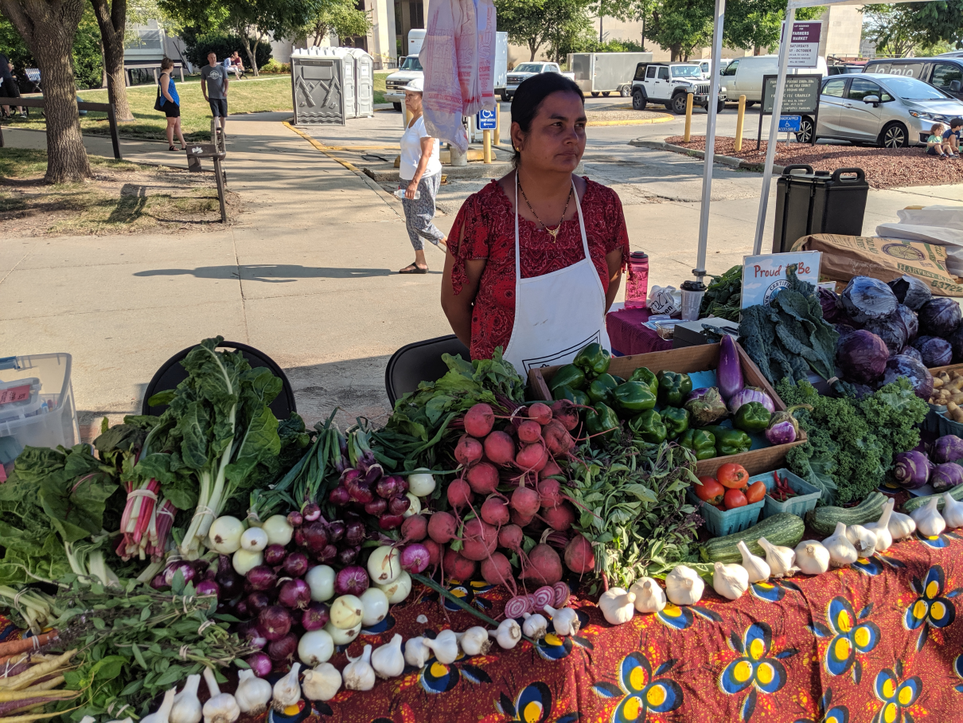
Specialty Crops

Slide 35
Community Impact and Advocacy

Slide 36
Contact Us : globalgreens@lsiowa.org

