Slide 1

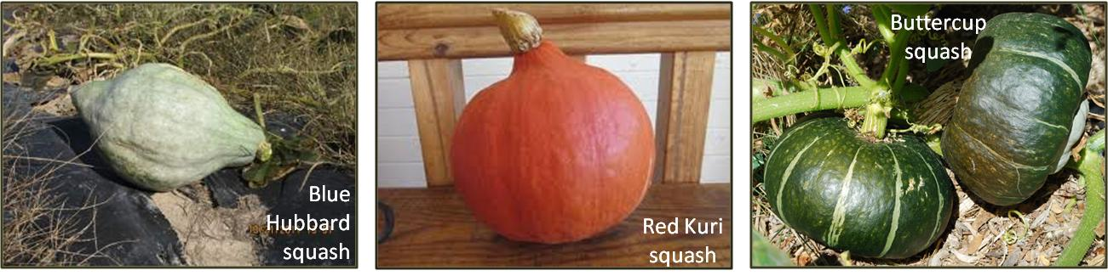
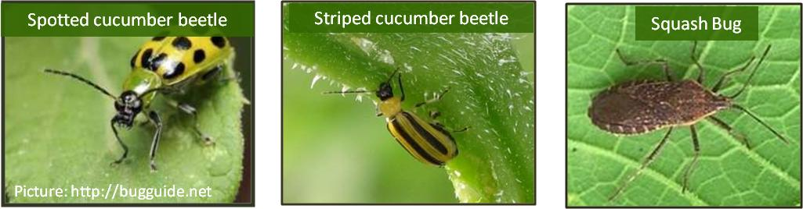
Managing cucurbit insect pests using trap cropping
Jaime Piñero
Lincoln University
Jefferson City, MO 65102
Tel: (573) 681-5522
pineroj@lincolnu.edu

Slide 2

Cultural Controls
Host plant resistance
Crop rotation
Soil quality management
Sanitation
Trap cropping
Farmscaping/habitat manipulation
Cover crops
Use of mulches
Intercropping
Alter planting/harvest dates

Slide 3
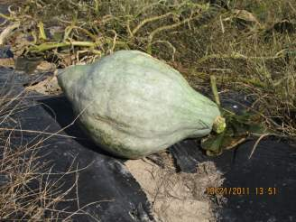
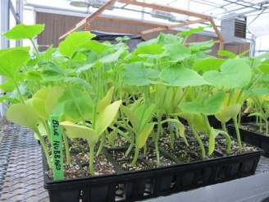
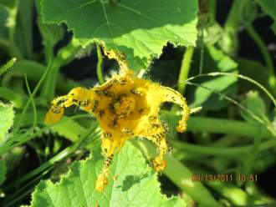
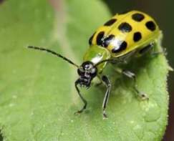
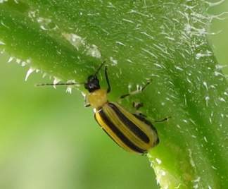
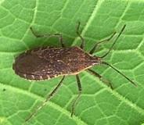
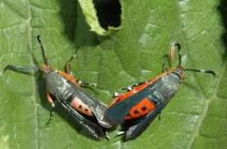
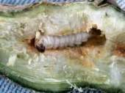
Blue Hubbard squash: An excellent trap crop
Blue Hubbard squash
Very attractive to adult cucumber beetles
Not susceptible to bacterial wilt
Spotted cucumber beetle
Striped cucumber beetle
Squash Bug
Squash Vine Borer
Picture: http://bugguide.net

Slide 4
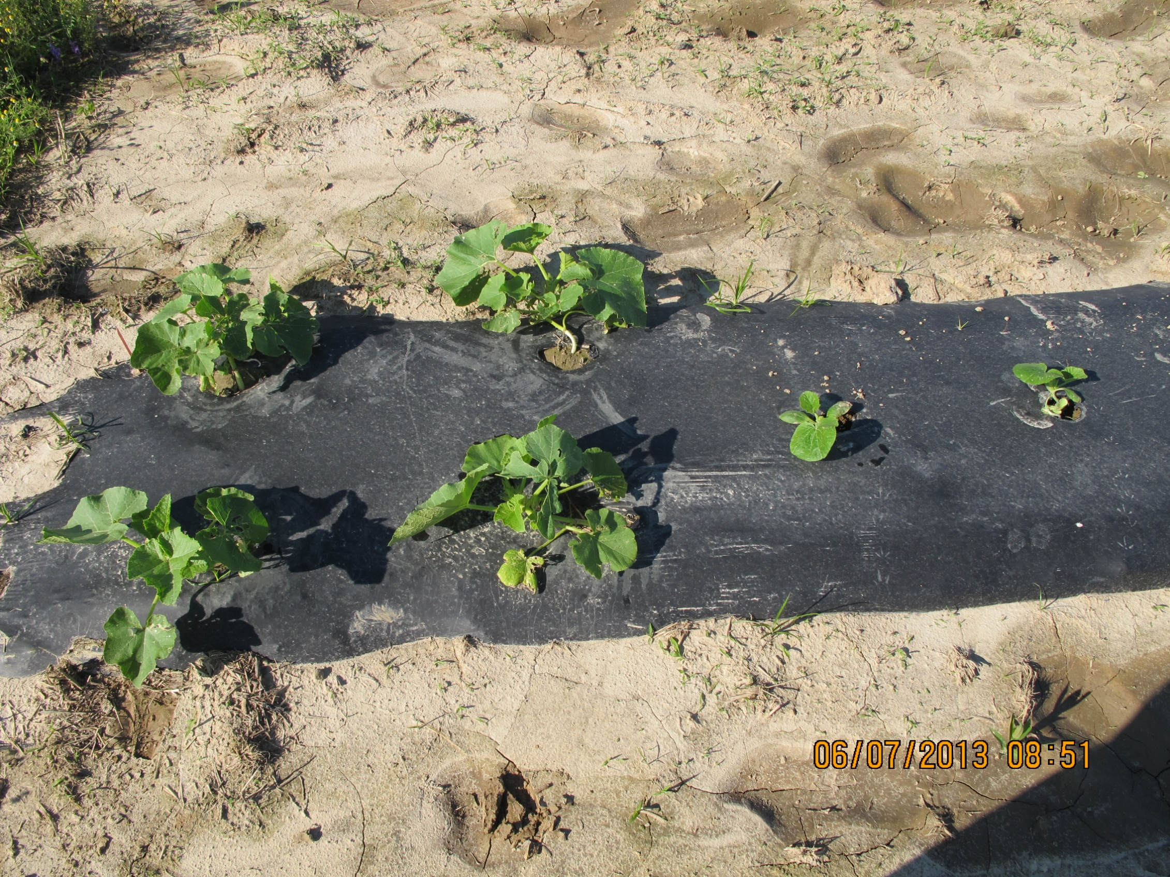
2013 – 2014 Approach:
Trap Crop plants located at the row ends
8 trap crops per row protected 70 Zephyr squash plants (cash crop)

Slide 5
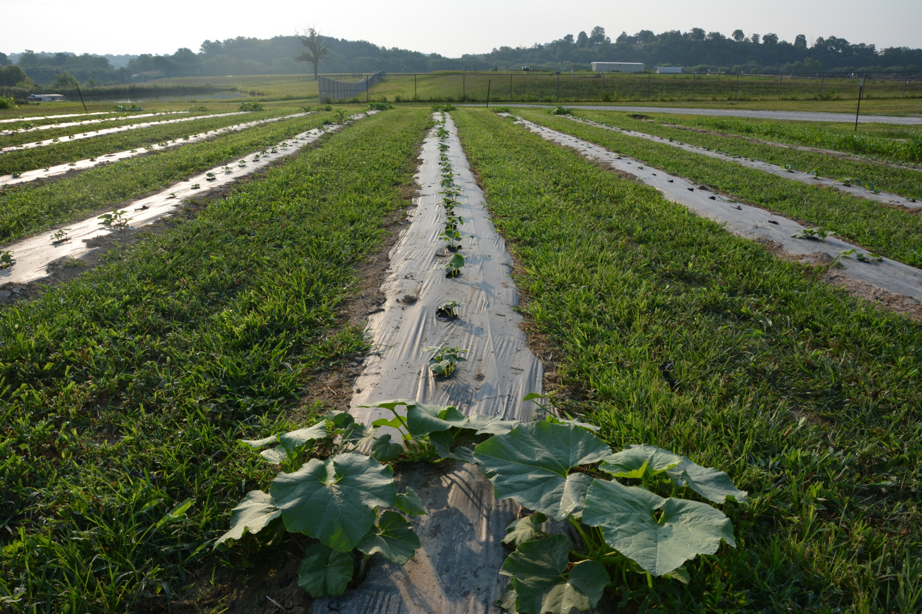

Lincoln University
George Washington Carver Farm
Functions by concentrating and killing the pest in the border area, while reducing pest numbers on the unsprayed cash crop
Plant species or cultivar used needs to be more attractive to pest than crop is
Cash crop
(unsprayed)
Perimeter trap crop (Blue Hubbard squash)
= 20% (usually sprayed)

Slide 6
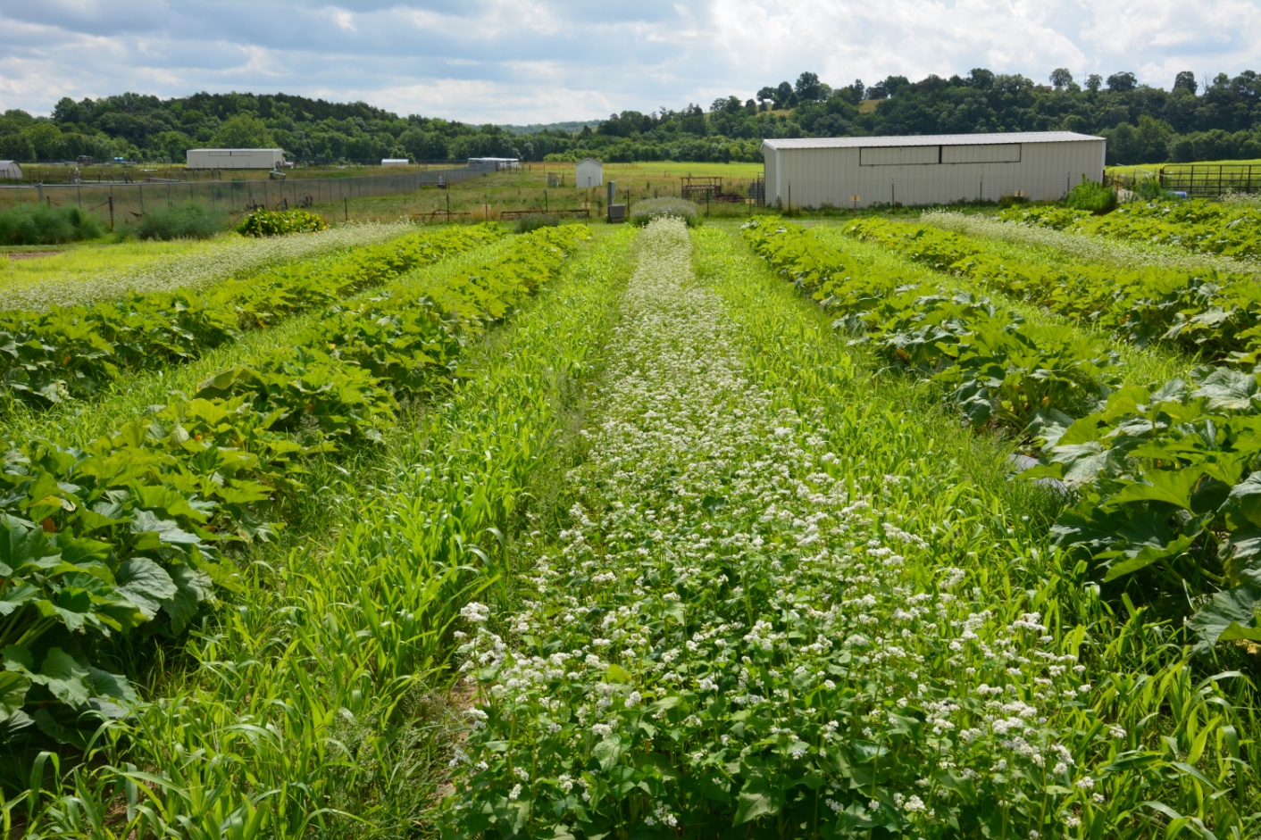
Integrating trap cropping with cover crops for weed suppression and enhanced pollination
Zucchini cash crop with Blue Hubbard as trap crop at row ends
Buckwheat cover crop to suppress weeds and enhance pollinators
Sorghum/sudan grass for weed suppression

Slide 7
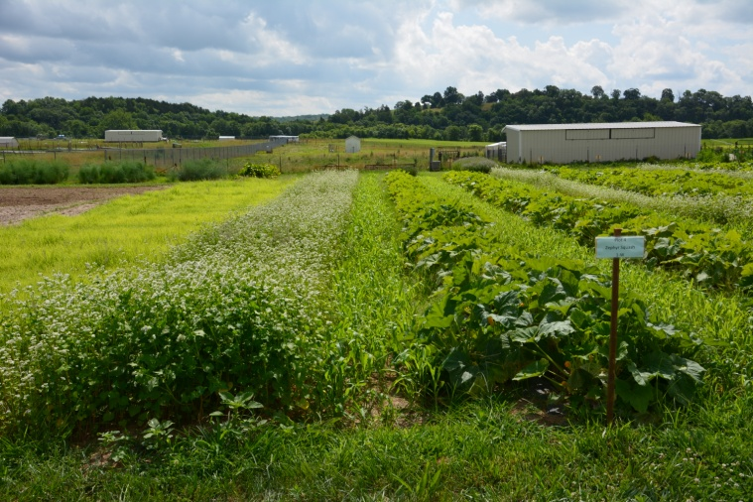
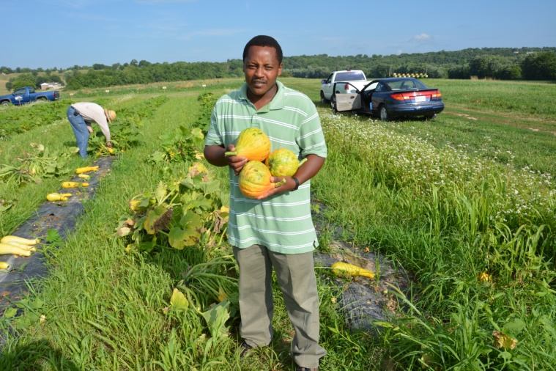
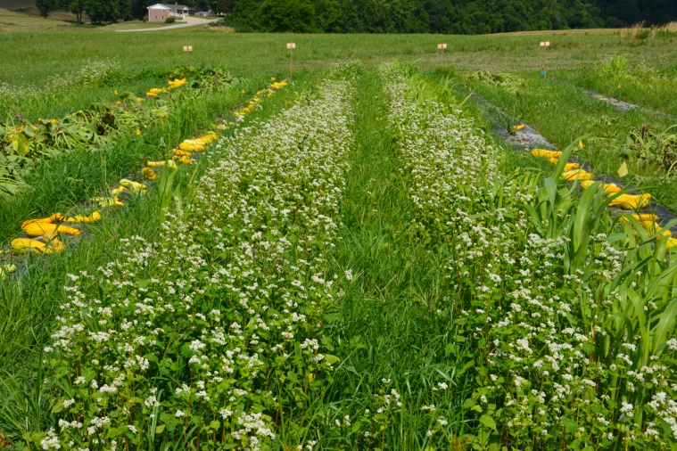
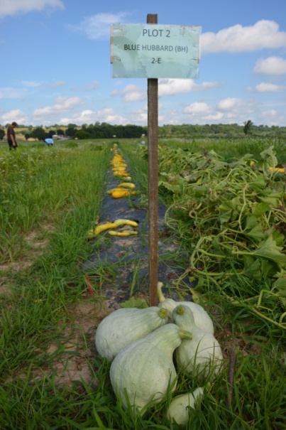
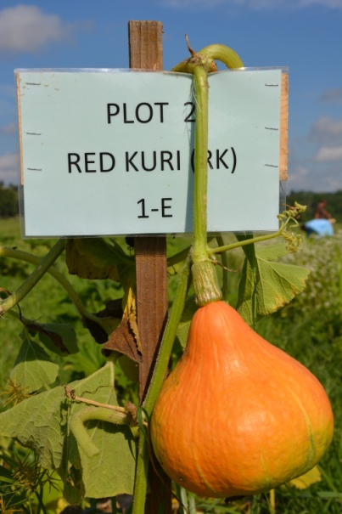
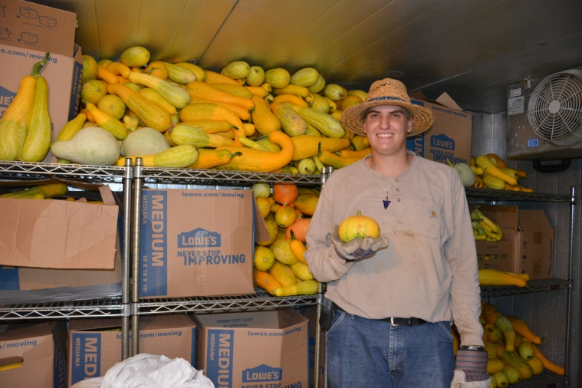
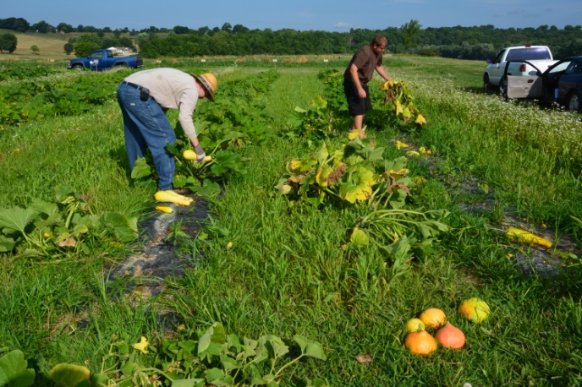
2012-2014: Overall results
Red Kuri Hubbard:
Performed equally well, or better than, Blue Hubbard and Buttercup squash
Most insect pests (squash bugs, spotted and stripped cucumber beetles) were found in trap crop plants
CASH CROPS
NOT SPRAYED

Slide 8
On-farm research

Slide 9
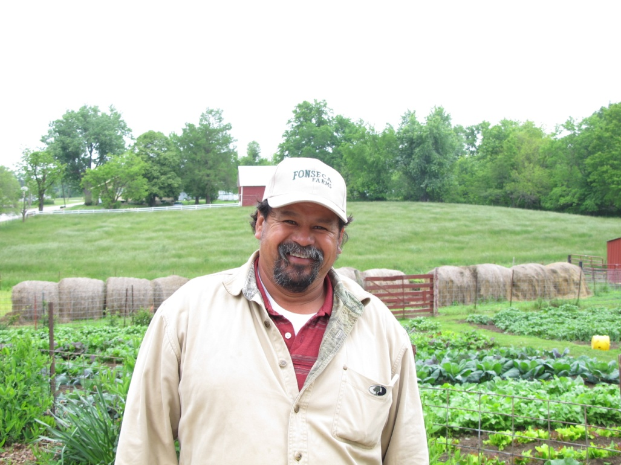
“I became convinced that trap cropping is effective, very simple, and cheap”
Jose Fonseca (Home-Grown Produce, St. Charles, MO)
Jose Fonseca has fully adopted the trap cropping approach for four years in a row (2011-2014)
He has not applied any insecticide to his cucurbits since 2012 (had a 90% reduction in 2011)
Phone call made on 10.30.13
“It worked great in 2013; proof that it works is that in one section of the farm I forgot to plant Blue Hubbard squash and squash bugs killed all my plants”

Slide 10
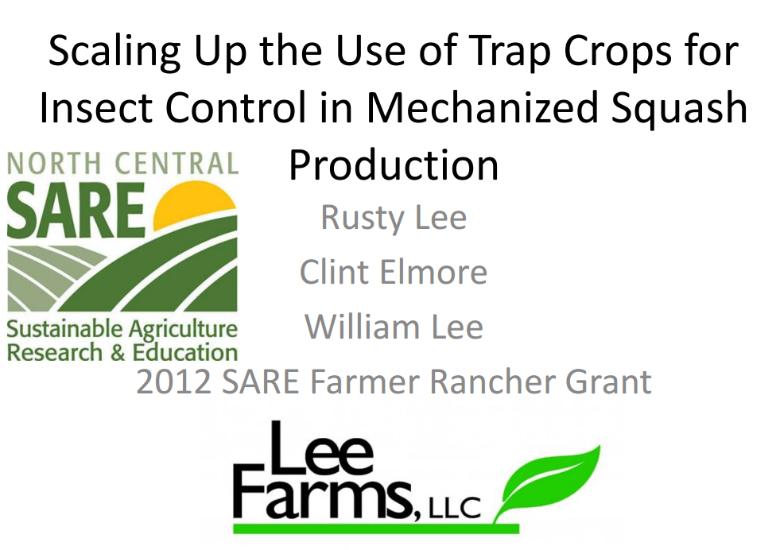
On-farm research

Slide 11
