Slide 1
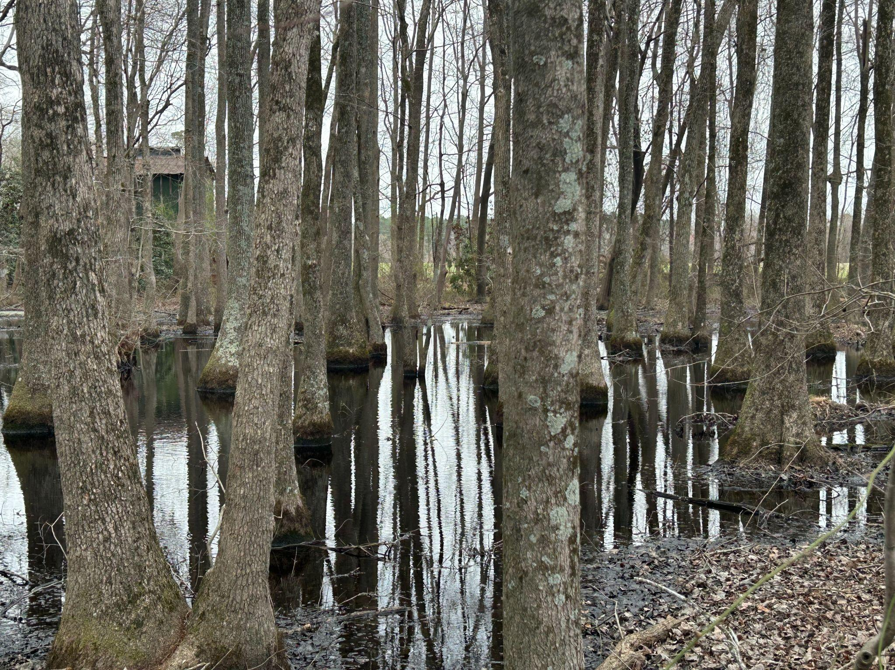
2024 Land Use Update: Wetlands

Slide 2

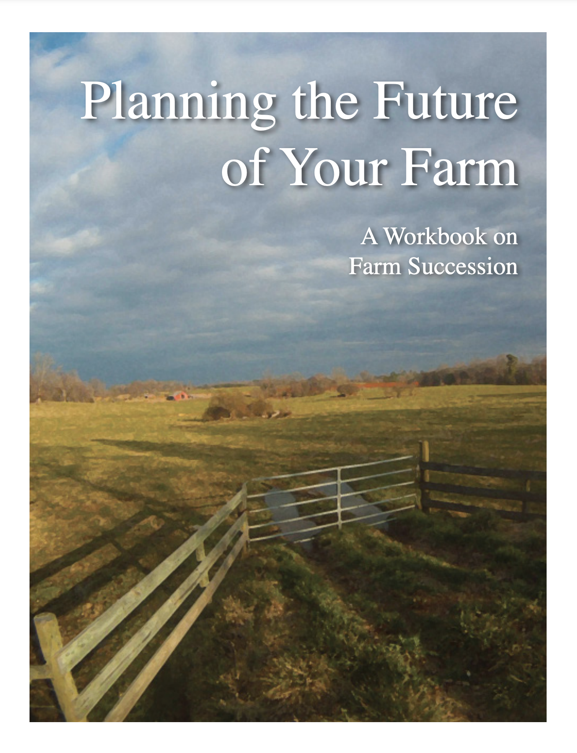
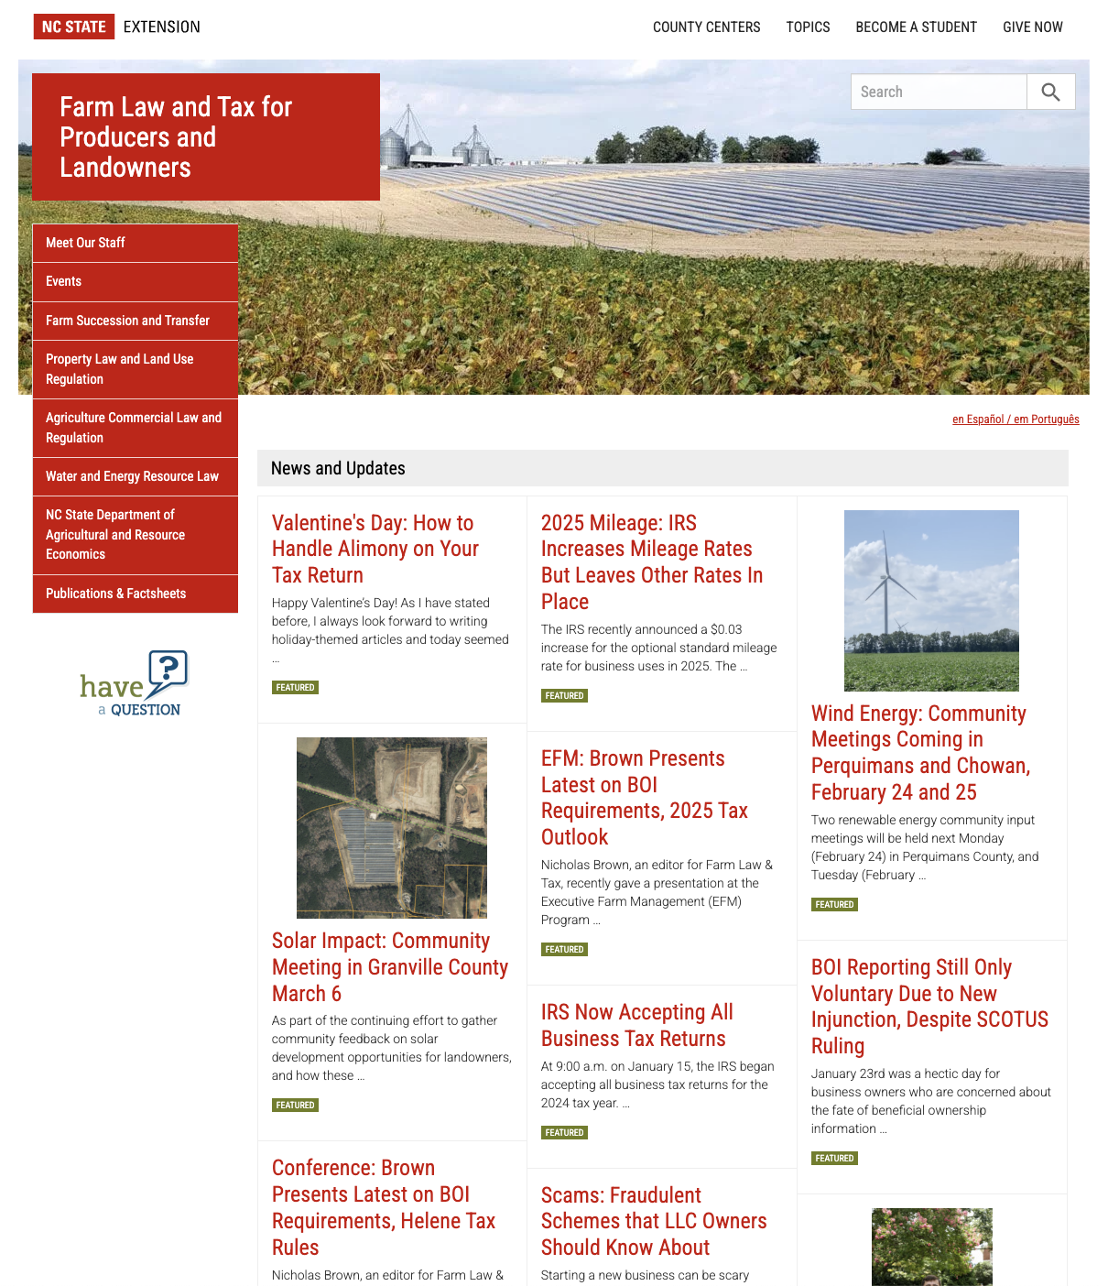
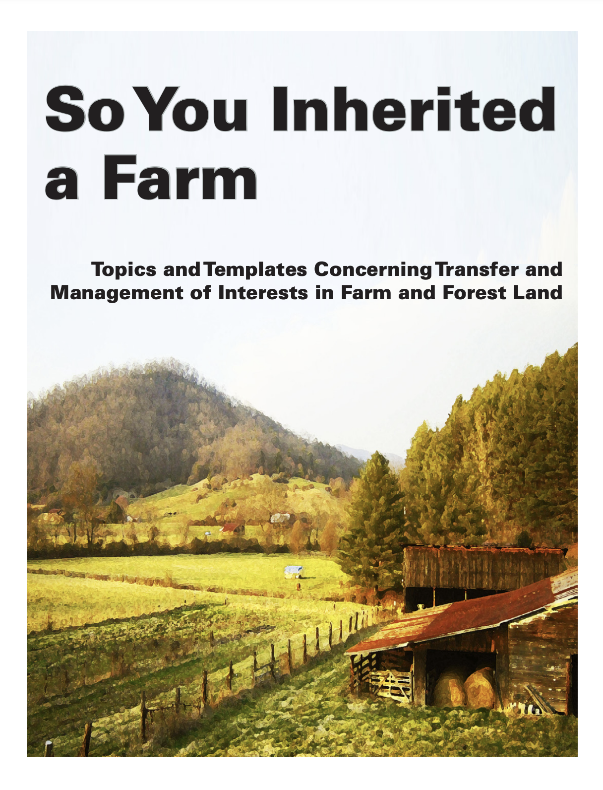
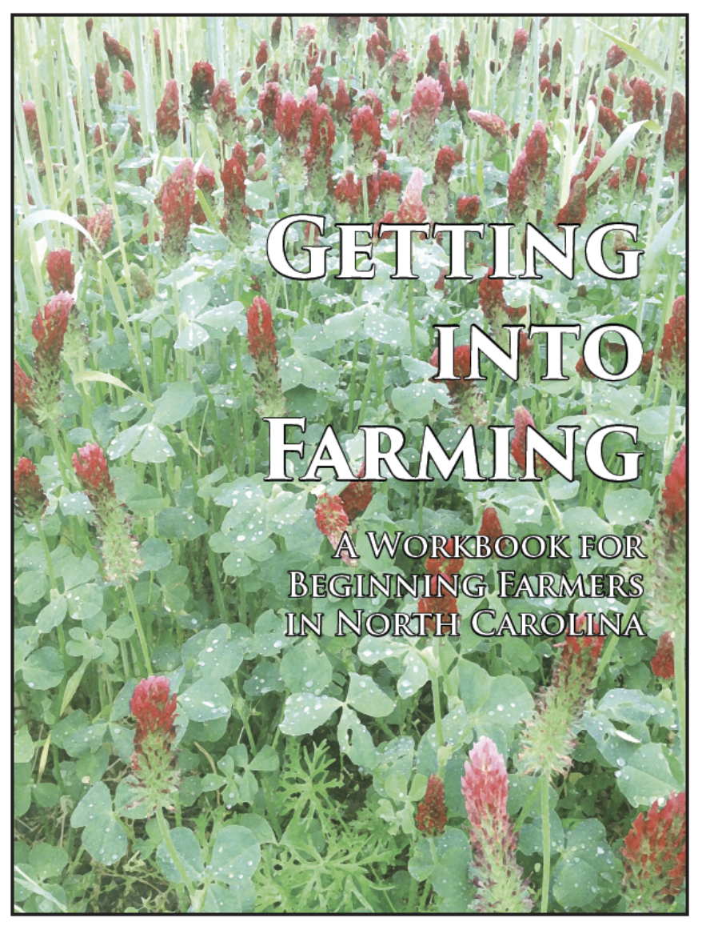

https://farmlaw.ces.ncsu.edu/
This web portal is supported by the Sustainable Agriculture and Resource Education Professional Development Program Land Summit Professional Development grant (Award #531905)

Slide 3
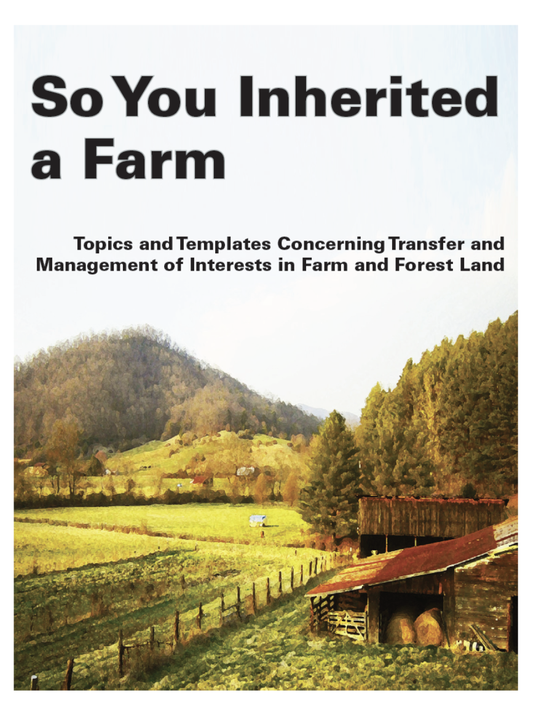
Extension Farm Law Fact Sheets on Property Disposition Decisions
The Verbal (Statutory) Farm Tenancy
The Property Rights of Surviving Spouse
Land Title: Understanding Rights in Property
Present Use Value: Transferring Property Enrolled in Present Use Value Property Taxation
The Last Will and Testament: A Primer
The Basics of Trusts in Farm Succession Planning
Option Agreements for Purchase of Land
Business Entities: Partnerships, Corporations and LLCs
Limited Liability Companies: Steps in Formation
Limited Liability Companies: Operating Agreement Components and Sample Language
Option Agreements for Purchase of Land

Slide 4
Current SCOTUS (6-3)
Six ‘conservative’ judges (appointed by GOP)
Three ‘liberal’ judges (appointed by Democrat)
Spotlight on Justices Alito and Thomas for questionable relationships with benefactors with interests (some direct) before the Court
  Alito tends to lash out in the press
While a conservative majority tends to favor farmers’ general conservatism, it’s not always a vote for agriculture
  e.g. Proposition 12 case
Majority has general skepticism towards authority of bureaucratic state
Majority skeptical of reach of federal jurisdiction, in favor of state sovereignty
Favorable to Fifth Amendment takings claims
  e.g. Cedar Point Nursery v. Hassid, 141 S. Ct. 2063, 2071 (2021)

Slide 5
Recent 5th Amendment Takings Case
Ideker Farms, Inc., et al. v. United States of America, Case No. 14-183L (Federal Circuit)
1940’s Missouri River Bank Stabilization and Navigation Project (BSNP) opens up farmland (free from flooding)
2004 Changes to BSNP to create habitat for listed species under Endangered Species Act causes periodic flooding to farmland (and elsewhere)
Farmers (and others) file a takings claim against US for loss of crops and land devaluation due to flooding
In general, the farmers are awarded compensation
New case accepted to SCOTUS: Richard Devillier v. Texas
May provide a broader look at this Court’s views on inverse condemnation exacerbated by climate change

Slide 6
West Virginia v. EPA, No. 20–1530
(June 30, 2022)
6-3 conservative majority limits Environmental Protection Agency’s authority to regulate carbon emissions under Clean Air Act
Ruled that limitations imposed on utilities from the Obama-era “Clean Power Plan” lacked a clear mandate from Congress
  Court embraces the “major questions doctrine”: issues of “vast economic and political significance” must be clearly mandated by Congress
    an exception to the Chevron deference doctrine
    Reflects a general conservative suspicion of the administrative state making regulatory policy
  SCOTUS majority now decides what is a major question and what is not
Congress responds in Inflation Reduction Act, amends Clear Air Act to state that carbon dioxide is a pollutant under CAA
  clearly signals Congressional policy to move away from fossil fuels
  However, IRA did not directly address the regulatory power over stationary sources at issue in West Virginia v EPA

Slide 7
speaking of Chevron Deference doctrine
From Chevron v NRDC, 467 U.S. 837 [1984]), which defers to agency authority to interpret “vague” statutes with a “reasonable” interpretation
Loper Bright Enterprises, Inc. v. Gina Raimondo
  Federal statute at issue: Magnuson-Stevens Act
  Authorizes the Secretary of Commerce and the National Marine Fisheries Service the power to “implement a comprehensive fishery management program.”
  Fishery plan may require the boat to host an observer to ensure compliance
  Boat is required to pay costs of observer, estimated at $710/day
District Court and DC Circuit Court upheld rule, applied Chevron
Certiorari asks: Repeal Chevron
Argued January 17, 2024 (transcript of oral argument)

Slide 8
The Big Disclaimer
Presentation is for educational and enlightenment purposes only
No statement by Branan (or anyone in Cooperative Extension) should be taken as legal advice
No statement by Branan (or anyone in Cooperative Extension) should be taken as expertise on stream and wetlands jurisdictional determination and delineation
Seek professional input (e.g. consulting forester, referral from North Carolina Association of Environmental Professionals (NCAEP))

Slide 9
Review: Riparian water rights
”Reasonable Use” theory
  Not concerned with which use
  Correlative to all other use (a shared resource)
Associated with ownership of abutting land, not ownership of water itself
  “Usufructurary”: the right to use
Applies to:
  Watercourses (i.e. bed, bank, and flow)
  Underground streams
  Some springs that create a natural watercourse
Notes:
There are two theories of riparian water rights; the natural flow theory and the reasonable use theory. The reasonable use theory does not distinguish the purpose to which the water is being put. It asks only whether the use of the water is reasonable under all of the circumstances. In riparian rights states, the right to use water is a correlative use. That means that is a shared resource. It is a property right; however, unlike the ownership of land that confers both a right of use and a right of possession, a riparian right confers only a right of use.
In natural flow theory jurisdictions, of which there are few or none since the natural flow theory is the older, pre-industrial English common law, one was permitted to use as much water as one wished for domestic uses but was severely limited in the uses that could be made for artificial or commercial purposes. Obviously this rule was incompatible with the needs of the Industrial Revolution that was initially powered by water.
The system of riparian rights applies to natural watercourses, underground streams, and some springs. The system of riparian rights applies to springs that are the source of natural watercourses. For springs the determinative factor is not the source of the spring but whether or not the spring gives rise to a natural watercourse.
A natural watercourse has a well-defined channel with a bed and banks that are capable of retaining water. A natural watercourse has a flow. For seasonal streams the flow does not have to be continuous. Natural lakes are governed by the system of riparian rights. For a riparian right to attach, the landowner’s land must touch the water. A leaseholder steps into the shoes of the landowner and has the same riparian rights as the landowner for the duration of the lease. Riparian rights do not attach to diffuse surface waters that are usually created by precipitation. Riparian rights do not attach to floodwaters, water in artificial channels and ponds, or percolating groundwater.

Slide 10
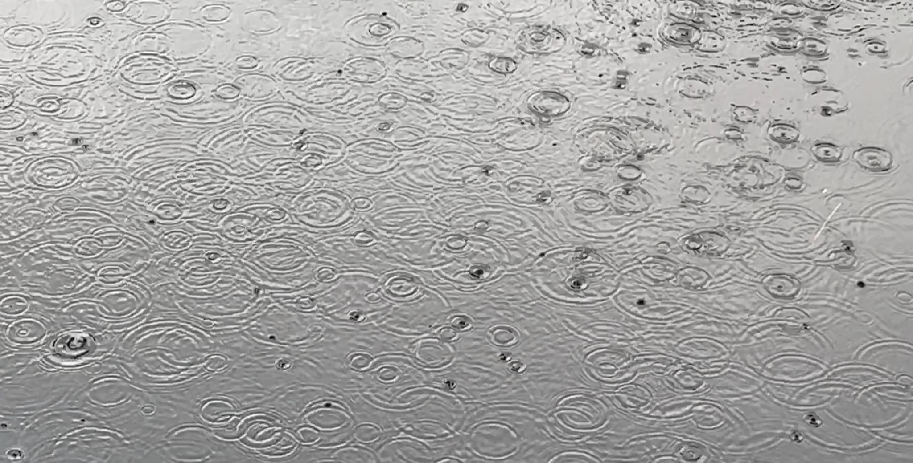
Correlative (riparian) rights not applicable to…
Diffuse surface water (precipitation)
  Water captured by landowner is owned by landowner (does not
have to share)
    i.e. sheet flow pond (cattle tank)
Floodwater – overflow of natural banks
  Some states allow capture of floodwater (NC?)
Percolating groundwater if not source of natural water course
Notes:
Whereas riparian rights are user rights, a landowner an actually own water as well. Ownership of water applies to diffuse flow, or sheet flow, where water flows across the land, not in a channel, from precipitation. A landowner is free to capture this water and may deny it to down-drainage landowners.
Likewise, floodwater that overflows natural banks also generally belongs to the landowner who suffers it, and some states allow capture of floodwater. A landowner can own the water in an artificial channel, so long as it does not support riparian rights downstream.
A landowner may also capture ownership of percolating groundwater, so long as it is not the feed source for a natural watercourse

Slide 11
Diversions of diffuse surface water (runoff)
Civil law rule (old Europe)
  Natural flow, landowner may not change
Common enemy (old England)
  All diversions are allowed
  All retentions allowed (absolute ownership )
Reasonable use (North Carolina)
  Diversions must be reasonable
  Retentions must be reasonable
Notes:
In riparian jurisdictions runoff is subject to one of three rules; the civil law rule, the common enemy rule, or reasonable use. The civil law rule requires that a landowner not change the natural flow of runoff.
Under the common enemy rule all diversions and all retentions are allowed without regard to reasonableness. In the context of retentions this is sometimes called the absolute ownership rule.
In jurisdictions that apply reasonable use, both diversions and retentions must be reasonable. There are jurisdictions such as Virginia and North Carolina that apply the reasonable use rule to diversions and apply the absolute ownership rule to retentions.
In prior appropriation jurisdictions in the Western United States, there is usually an owner of diffuse surface water. The person onto whose land precipitation falls may not have a right to use it.

Slide 12
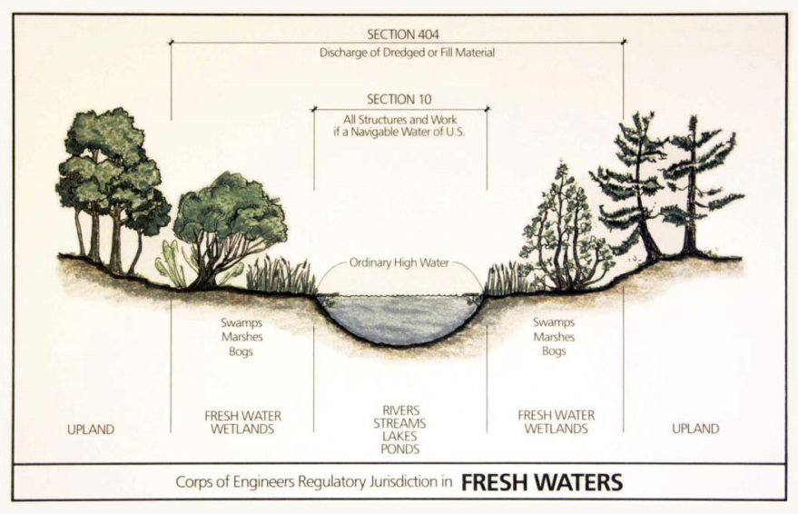
About WOTUS…

Slide 13
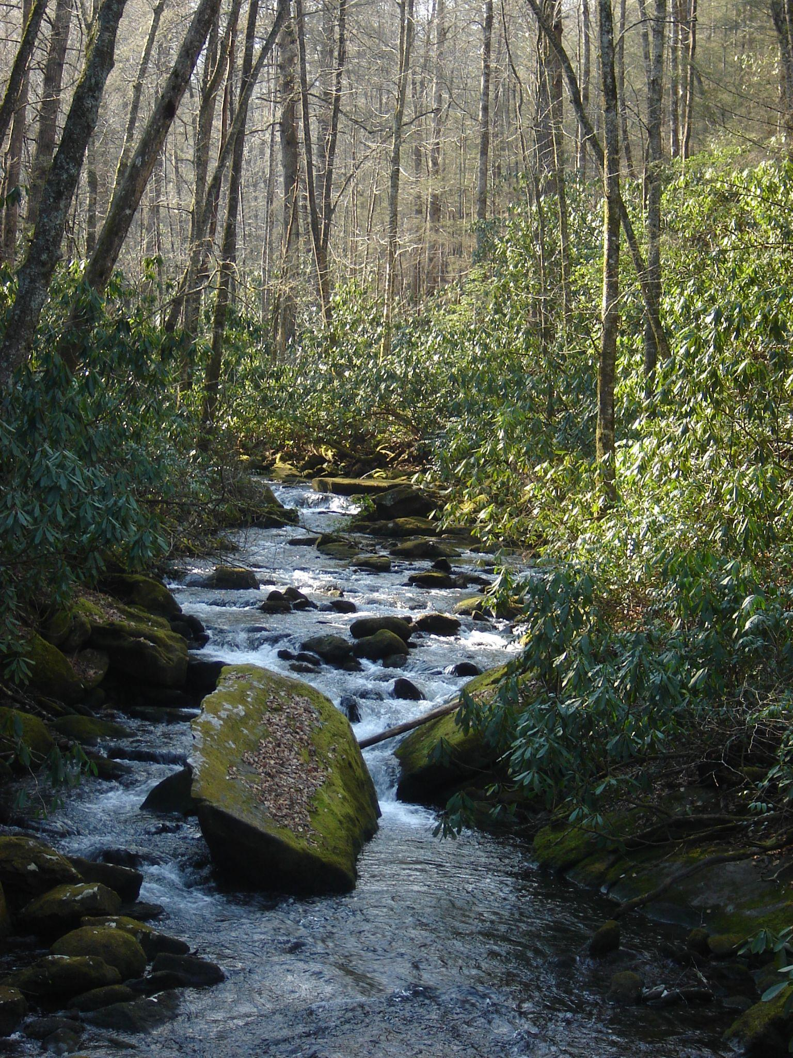
Waters of the United States (“WOTUS”)
The term WOTUS refers to the jurisdiction limit of the Federal government (EPA and ACOE)
  Federal Water Pollution Control Act of 1972 (The Clean Water Act)
  The “outer limits of Congress’ commerce power” (40 FR 37144)
    The extent of US Constitution’s Article I grant of authority (under the Commerce Clause) to Congress to regulate private use of land
FWPCA: “The objective of this chapter is to restore and maintain the chemical, physical, and biological integrity of the Nation’s waters” (33 U.S. Code §1251(a))

Slide 14
The Concept of “Navigability”
Federal CWA: “[N]avigable waters” means the waters of the United States, including the territorial seas.” 32 U.S.C. §1362(7)
  Term is originates with the “navigable in fact” jurisdiction of ACOE under Rivers and Harbors Act of 1899
    keep the waterways clear for water-borne commerce
    “Navigable” as a determination for WOTUS was dropped in 1971 conference on CWA
State (NC) Common Law: “Navigable in Fact” – waterways used in ordinary condition as as highways for commerce (historical use, and recreation)
  Establishes common law standard concerning subsurface ownership
    navigability is a factual inquiry for trespass under state common law
    “The test is ‘the capability of being used for purposes of trade and travel in the usual and ordinary mode ... and not the extent and manner of such use.’" Taylor v. Paper Co., 262 N.C. 452, 456, 137 S.E.2d 833, 836 (1964)

Slide 15
CWA Section | Coverage | Code Section | CFR Part
301 | Effluent Standards | 33 U.S.C. §§ 1311 | 40 C.F.R §125
303 | Water Quality Standards and Plans (including Impaired Water Bodies [“TMDL”) | 33 U.S.C. §1313 | 40 C.F.R. §130
305 | Water Quality Inventory | 33 U.S.C. §1315
306 | Technology Standards of Performance (New and Existing Point Source) | 33 U.S.C. §1316 | 40 C.F.R. §401
307 | Toxic substances and pretreatment | 33 U.S.C. §1317 | 40 C.F.R. §129
402 | National Pollution Discharge Elimination System (NPDES) (Permits for point source) | 33 U.S.C. §1342 | 40 C.F.R. §122
404 | Dredge or Fill Permits (non-point source) | 33 U.S.C. §1345 | 33 C.F.R. §323
505 | Citizen Suits | 33 U.S.C. §1365 | 33 C.F.R. §1365

Slide 16
Agriculture and Forestry largely exempt from CWA…
Agriculture and Forestry largely exempt for ‘normal agricultural activities’ including ‘return flow of irrigation’
  sediment and nutrient (and pesticide) runoff from land in agriculture and forest use is a non-point source
  dredge or filling not considered a normal agricultural or forestry activity
  financial incentives (‘carrots’) through Farm Bill for water quality protection
  note: ditches and tile pipes may be point sources (though exempt from NPDES permit)

Slide 17
Exempt Activities
Established (ongoing) farming, ranching, and silviculture activities such as plowing, seeding, cultivating, minor drainage, harvesting for the production of food, fiber, and forest products, or upland soil and water conservation practices
Maintenance (but not construction) of drainage ditches
Construction and maintenance of irrigation ditches
Construction and maintenance of farm or stock ponds
Construction and maintenance of farm and forest roads, in accordance with best management practices
Maintenance of structures such as dams, dikes, and levees
References: https://www.epa.gov/cwa-404/exemptions-permit-requirements-under-cwa-section-404
33 U.S.C. 1251
40 CFR part 232

Slide 18
WOTUS Regulation and Litigation Timeline
1948 Federal Water Pollution Control Act of 1948, Public Law 80-845, 62 Stat. 1155 (June 30, 1948)
“those waters of the United States which are subject to the ebb and flow of the tide, and/or are presently, or have been in the past, or may be in the future susceptible for use for purposes of interstate or foreign commerce.” 39 FR 12115, 12119 (April 3, 1974)
“isolated wetlands and lakes, intermittent streams, prairie potholes, and other waters that are not part of a tributary system to interstate waters or to navigable waters of the United States, the degradation or destruction of which could affect interstate commerce.” 33 CFR 323.2(a)(5) (1978)
Solid Waste Agency of Northern Cook County v. U.S. Army Corps of Engineers, 531 U.S. 159 (2001): “isolated” ponds are not adjacent
Clean Water Protection Rule
United States v. Riverside Bayview Homes, 474 U.S. 121 (1985): deference to Corps’ “adjacent” definition
1972
1974
1975
1977
1985
1986 (“the 1986 Rules”)
2001
2006
2015
“Wetlands adjacent to waters…”
Rapanos v. United States, 547 U.S. 715 (2006): Scalia: relatively permanent and “continuous surface connection”
Kennedy: significant nexus
Clean Water Act
“normal farming, silviculture, and ranching activities such as plowing, seeding, cultivating, minor drainage, harvesting for the production of food, fiber, and forest products, or upland soil and water conservation practices” exempted from §404 33 U.S.C. 1344(f)
Natural Resources Defense Council, Inc. v. Callaway, 392 F. Supp. 685, 686 (D.D.C. 1975): the term [`navigable waters'] is not limited to the traditional tests of navigability.”
“adjacent” is not defined

Slide 19
WOTUS ‘Wetlands’ Litigation History
U.S. v. Riverside Bayview Homes, Inc. 474 U.S. 121 (1985)
  Where does the land end and the water begin?
  Court defers to Corps “ecological judgement” on definition of adjacent (bordering, contiguous or neighboring)
  Allows that wetlands can be WOTUS
  Did not rule on ‘isolated’ wetlands
Solid Waste Agency of Northern Cook County v. Army Corps of Engineers, 531 U.S. 159 (2001) (SWANCC)
  “It was the significant nexus between the wetlands and “navigable waters” that informed our reading of the CWA in Riverside Bayview Homes.” SWANCC at 167.
  Holding that WOTUS does not extend to isolated ponds
Rapanos v. United States 547 U.S. 715 (2006)
  Two holdings (4-1-4) concerning wetlands
    Plurality (Roberts, Scalia, Thomas, Alito): “surface connection test”
    Concurrence (Kennedy): “significant nexus test”

Slide 20
Justice Scalia (wielding Webster’s Dictionary) in Rapanos writes…
(1) “the phrase ‘waters of the United States’ includes only those relatively permanent, standing or continuously flowing bodies of water forming geographic features that are described in ordinary parlance as streams, oceans, rivers, and lakes”; and
(2) “only those wetlands with a continuous surface connection to bodies that are ‘waters of the United States’ in their own right, so that there is no clear demarcation between waters and wetlands, are adjacent to such waters and covered by the [CWA].”

Slide 21
Justice Kennedy, concurring in Rapanos writes…
“[W]etlands possess the requisite nexus, and thus come within the statutory phrase “navigable waters,” if the wetlands, either alone or in combination with similarly situated lands in the region, significantly affect the chemical, physical, and biological integrity of other covered waters more readily understood as “navigable.” When, in contrast, wetlands’ effects on water quality are speculative or insubstantial, they fall outside the zone fairly encompassed by the statutory term “navigable waters.”

Slide 22
New WOTUS Rules (Biden Admin)
Final Rule became effective March 20, 2023
The “relatively permanent standard” means waters that are relatively permanent, standing or continuously flowing and waters with a continuous surface connection to such waters.
The “significant nexus standard” means waters that either alone or in combination with similarly situated waters in the region, significantly affect the chemical, physical, or biological integrity of traditional navigable waters, interstate waters, or the territorial seas (the “foundational waters”)

Slide 23
Sackett v. EPA Summary
Fundamental Issue: “What did Congress mean by ‘water’ when crafting the Clean Water Act?”
  Congress only has authority pursuant to its ‘interstate commerce clause’ powers, regulating water must equal commerce
  water is traditionally regulated by the states
Majority Opinion (5): Justice Alito, Thomas, Roberts (CJ), Gorsuch, Barrett
  rejection of Rapanos ‘significant nexus’ test
  “States can and will continue to exercise their primary authority to combat water pollution by regulating land and water use.”
Concurring: Justice Thomas and Gorsuch
  conjoins the term “water” with “navigability” in terms of commerce clause authority
Concurring in Judgement Only (4): J’s Kavanaugh, Sotomayor, Jackson, Kagan
  agree that Sackett’s “wetland” parcel not WOTUS
  BUT concerned that decision overturns 45 years of practice
  and too narrowly defines “adjacent”
All agree a ditch connection is insufficient to create ‘surface water’ requirement

Slide 24
Justice Alito: “In sum,…
“...we hold that the CWA extends to only those wetlands that are “as a practical matter indistinguishable from waters of the United States.” … This requires the party asserting jurisdiction over adjacent wetlands to establish “first, that the adjacent [body of water constitutes] . . . ‘water[s] of the United States,’ (i.e., a relatively permanent body of water connected to traditional interstate navigable waters); and second, that the wetland has a continuous surface connection with that water, making it difficult to determine where the ‘water’ ends and the ‘wetland’ begins.”

Slide 25
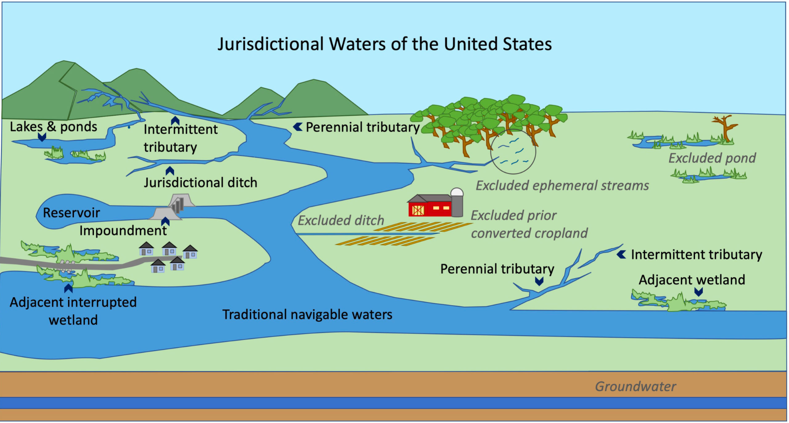
What Waters Are Intended Exempt from CWA §404
?
?
?
?
?
Source: Rural Radio Network, https://ruralradio.com/rrn/news/epa-announces-intent-to-revise-definition-of-wotus/

Slide 26
New WOTUS Rules Issued Following Sackett
Issued by Biden Administration’s Environmental Protection Agency on September 8, 2023
Revised Rules (Red Line Version)
Revised Rules (Explanatory Chart)
In short:
  eliminated the language concerning a “significant nexus,” leaves “relatively permanent” language
  wetlands must have a surface connection with a relatively permanent body (e.g. tributary) that connects to a traditionally navigable water

Slide 27
WOTUS Questions Remain
What does “relatively permanent” mean?
  the terms “ephemeral” or “intermittent” are not addressed…
What does “continuous surface connection” mean?
  what about a connection that goes seasonally dry?
What is a “tributary”?
Did the Biden Administration’s decision to amend its rule without public comment violate Administrative Procedures Act?

Slide 28
Penalties for Violation
Federal enforcement authority (EPA summary)
Under Section 309(g)(2)(A) of the Clean Water Act, Class I civil penalties may not exceed $23,990 per violation, except that the maximum amount of any Class I civil penalty shall not exceed $59,974. Under Section 404(s)(4) of the Clean Water Act, judicially-imposed civil penalties may not exceed $59,974 per day for each violation. (33 CFR § 326.6)
DEQ FAQ on reporting violations

Slide 29
“Certainty”?
The agencies are presently working out how to implement the changes in the field
No landowner should take these changes as:
  a license to self-delineate a wetland or determine its jurisdiction
  a sign that agencies are “backing off” of enforcement
If faced with a landowner who is reluctant to consult directly with Army Corps of Engineers, NRCS or DEQ, suggest they speak with their consulting forester or consult an environmental consultant

Slide 30
Wetlands on farmland are still largely “regulated” by Swampbuster
A reversal of 19th/20th century policy of encouraging draining wetlands for agricultural production
  e.g. NC Drainage Act of 1909 (drainage districts)
Provision in Food Security Act of 1985 (1985 Farm Bill) disqualifying participation in most US farm programs if converting a wetland after December 28, 1985
Introduces “Prior Converted Cropland” (PCC) concept to exempt production on wetlands drained and put into production prior to 1985 Farm Bill
NRCS determines wetland status
  (we believe they use Army Corps’ manual)
The land is already well-mapped (e.g. WRI)

Slide 31
Swampbuster Challenged (and Upheld)
Farmers may request a re-determination each 5 years
  a farmer "may request review of a certification only if a natural event alters the topography or hydrology of the subject land . . . or if NRCS concurs with an affected person that an error exists in the current wetland determination." 7 C.F.R. § 12.30(c)(6)
NRCS is bound to re-determine upon request
  farmer must demonstrate (with report) that land feature is no longer a wetland
Recent case:
  Foster v. The United States Dep't of Agric.
    upholds Swampbuster review provisions
  “The absurd results construction canon supports the validity of the Review Regulation.”
Case appealed to SCOTUS, certioriari not granted
  but familiar question: abandon Chevron doctrine

Slide 32
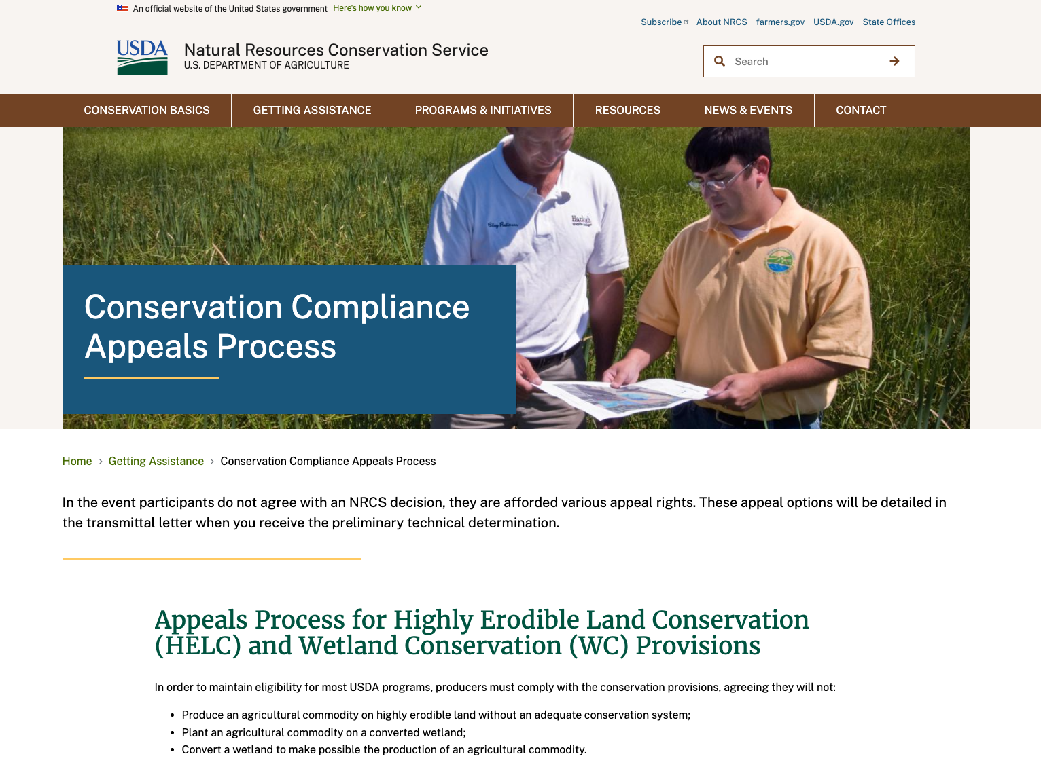
Must appeal an NRCS wetlands determination within 30 days of letter
(appeals portal)

Slide 33
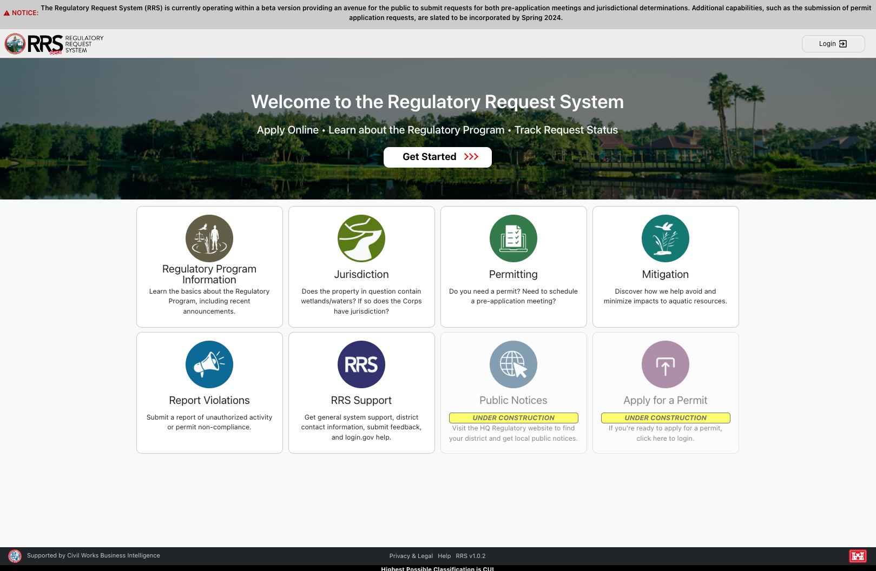
https://rrs.usace.army.mil/rrs

Slide 34
Agricultural Mediation Programs
Created under Agricultural Credit Act of 1987 (born of 80’s farm crisis)
Mediation: dispute resolution by 3d party neutral
  Collaborative agreement, not focused on winning
Programs reauthorized under Farm Bill, provides grant funding for ag mediation as free service
  e.g. NC Agricultural Mediation Program (housed at Western Carolina University)
Existing: adverse letter rulings, wetlands determinations, conservation program compliance
2018 Farm Bill expanded list of ”issues” a farm mediation program may mediate (leases, family succession, etc)

Slide 35
State Regulation of Water

Slide 36
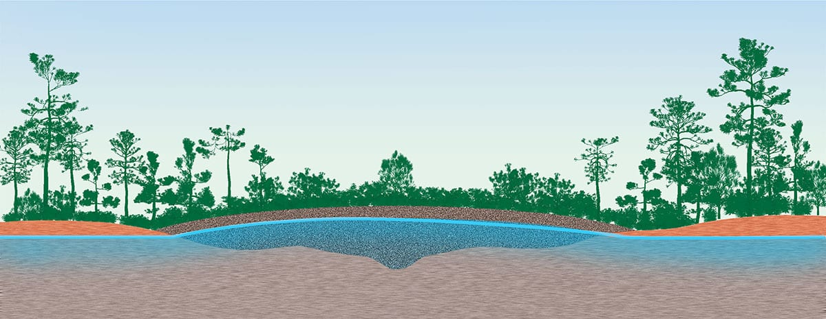
Diagram of Pocosin (example of ‘isolated’ wetland)
Source: Paul Mirocha Design, https://paulmirocha.com/wp-content/uploads/2019/01/Pocosin-Cutaway.jpg

Slide 37
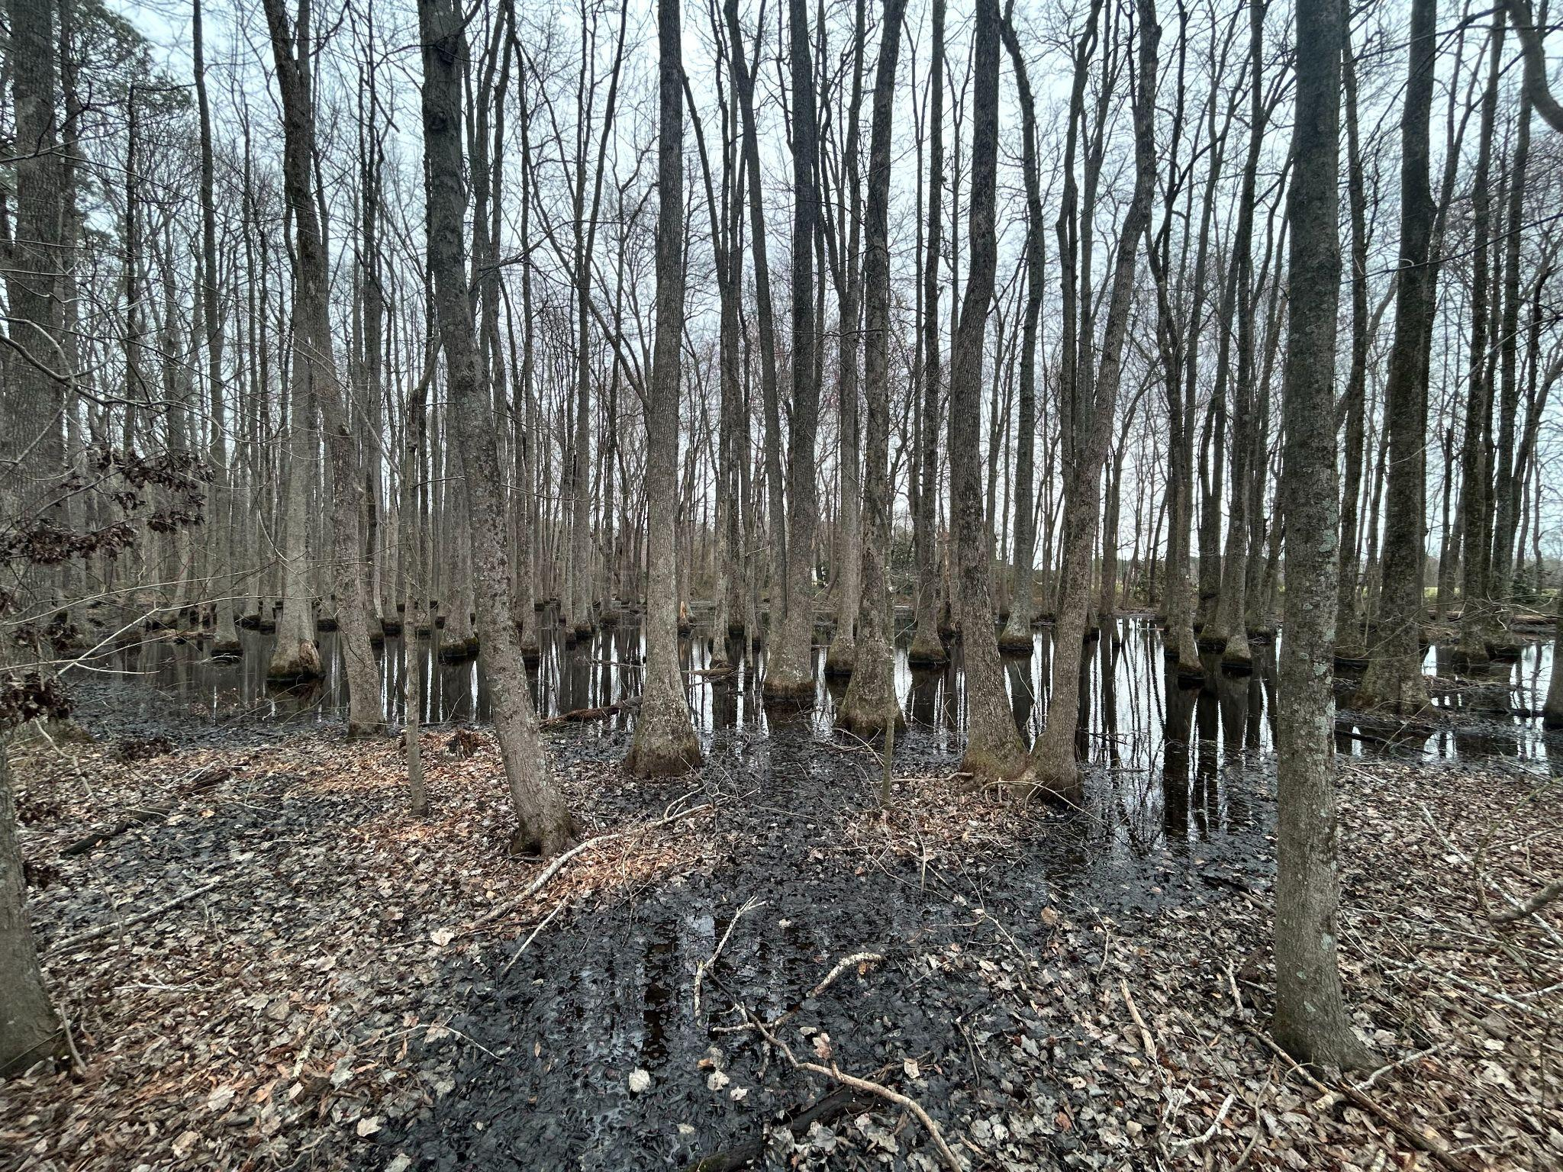
Isolated Wetland(?)

Slide 38
Beyond WOTUS -
NC land disturbance regulation
Sedimentations Pollution Control Act of 1973 (NCGS §113A-50)
Exempt includes
(1) Activities, including the production and activities relating or incidental to the production of crops, grains, fruits, vegetables, ornamental and flowering plants, dairy, livestock, poultry, and all other forms of agriculture undertaken on agricultural land for the production of plants and animals useful to man, including, but not limited to:
a. Forages and sod crops, grains and feed crops, tobacco, cotton, and peanuts.
b. Dairy animals and dairy products.
c. Poultry and poultry products.
d. Livestock, including beef cattle, llamas, sheep, swine, horses, ponies, mules, and goats.
e. Bees and apiary products.
f. Fur producing animals.
g. Mulch, ornamental plants, and other horticultural products. For purposes of this section, "mulch" means substances composed primarily of plant remains or mixtures of such substances.
(2) Activities undertaken on forestland for the production and harvesting of timber and timber products and conducted in accordance with standards defined by the Forest Practice Guidelines Related to Water Quality, as adopted by the Department of Agriculture and Consumer Services.

Slide 39
Beyond WOTUS - NC Isolated Wetlands Regulation
Air and Water Resources, NCGS Article 21 (§ 143-211)
Isolated Wetlands disturbance deemed permitted (15A NCAC 02H .1305)
  one acre coastal region (a)(3)(A)
  one-half acre piedmont region (a)(3)(B)
  one-third acre mountain region (a)(3)(C)
The Status and Trends of Wetland Loss and Legal Protection in North Carolina (Branan, Burchele, Kukri-Fox [NCSU])

Slide 40
Beyond WOTUS - NC Isolated Wetlands Regulation
Air and Water Resources, NCGS Article 21 (§ 143-211)
Isolated Wetlands disturbance deemed permitted (15A NCAC 02H .1305)
  one acre coastal region (a)(3)(A)
  one-half acre piedmont region (a)(3)(B)
  one-third acre mountain region (a)(3)(C)
The Status and Trends of Wetland Loss and Legal Protection in North Carolina (Branan, Burchele, Kukri-Fox [NCSU])

Slide 41
Farm Act of 2023
CLARIFY DEFINITION OF WETLANDS
SECTION 15.(a) Definitions. – For purposes of this section and its implementation, "Wetlands Definition" means 15A NCAC 02B .0202 (Definitions).
SECTION 15.(b) Wetlands Definition Rule. – Until the effective date of the revised permanent rule that the Environmental Management Commission (Commission) is required to adopt pursuant to subsection (d) of this section, the Commission shall implement the Wetlands Definition Rule as provided in subsection (c) of this section.
SECTION 15.(c) Implementation. – Wetlands classified as waters of the State are restricted to waters of the United States as defined by 33 C.F.R. § 328.3 and 40 C.F.R. § 230.3. Wetlands do not include prior converted cropland as defined in the National Food Security Act Manual, Fifth Edition, which is hereby incorporated by reference, not including subsequent amendments and editions.
SECTION 15.(d) Additional Rulemaking Authority. – The Commission shall adopt a rule to amend the Wetlands Definition Rule consistent with subsection (c) of this section. Notwithstanding G.S. 150B-19(4), the rule adopted by the Commission pursuant to this section shall be substantively identical to the provisions of subsection (c) of this section. Rules adopted pursuant to this section are not subject to Part 3 of Article 2A of Chapter 150B of the General Statutes. Rules adopted pursuant to this section shall become effective as provided in Page 26 Session Law 2023-63 Senate Bill 582 G.S. 150B-21.3(b1), as though 10 or more written objections had been received as provided in G.S. 150B-21.3(b2).
SECTION 15.(e) Sunset. – This section expires when permanent rules adopted as required by subsection (d) of this section become effective.

Slide 42
View from the Field
(John Torney, consultant, presentation at McKimmon Center December 4, 2023)
Sackett unanimous: Ditch connections not sufficient to meet continuous surface/indistinguishable requirement
Emerging issues:
  Definition of “indistinguishable”
  Trespass issues for consultants determining “relatively permanent [surface] connection” (cannot access the parcel where connection happens)
Estimates on loss of jurisdiction:
Coastal plain (inner and outer)
34% lose under “relatively permanent”
72% lose under “indistinguishable”

Slide 43
Predictions from Field Delineation Professional
(event in December at McKimmon Center)
Slow changes except near developing areas
  Wilmington, Greenville, New Bern, Brunswick Co.
Degraded water quality
Increased flooding
reduced groundwater recharge
degraded wildlife habitat
  including endangered species
Mitigation banking “stranded assets”
Change from “no net loss” policy to “net loss policy”
  Gov. Cooper Executive Order #305

Slide 44
What about “Swampbuster”?
A reversal of 19th/20th century policy of encouraging draining wetlands for agricultural production
  e.g. NC Drainage Act of 1909 (drainage districts)
Provision in Food Security Act of 1985 (1985 Farm Bill) disqualifying participation in most US farm programs if converting a wetland after December 28, 1985
Introduces “Prior Converted Cropland” (PCC) concept to exempt production on wetlands drained and put into production prior to 1985 Farm Bill
NRCS determines wetland status

Slide 45
National Food Security Act Manual, Fifth Edition
Wetland Conservation Requirements
(1) Unless an exemption applies, any person who plants an agricultural commodity on wetlands that were converted between December 23, 1985, and November 28, 1990, will be ineligible for program benefits in any year an agricultural commodity is planted.
(2) Unless an exemption applies, any person who converts a wetland or makes the production of an agricultural commodity possible after November 28, 1990, will be ineligible for program benefits until the functions and values of the wetland that was converted are mitigated.

Slide 46
National Food Security Act Manual
(Fifth Edition)
Incorporated by reference into Farm Act 2023
Guides NRCS HEL (Highly Erodible Land) and WC (Wetlands Conservation) Determinations
Form CPA-308 (for Wetlands determinations requests) and Form AD-1026 (for HEL and WC certification by farmer)
Wetland Determinations, Exemptions, and Scope and Effect
(1) A person that applies for USDA benefits is responsible for obtaining wetland determinations, exemptions, and scope and effect evaluations before—
(i) Altering any wetland area.
(ii) Improving an existing drainage system.
(iii) Maintaining an existing drainage system.
(2) To assist in scope and effect evaluations, the USDA participant is responsible for—
(i) Providing records and plans for any past hydrologic manipulations.
(ii) Furnishing plans for any proposed manipulations, including the drainage capacity of existing and planned drainage systems.
(3) The participant is also responsible for complying with all Federal, State, or local regulations, permits, etc., administered by other agencies.
minimal effect determination
  “a minimal effect on the functional hydrological and biological value of the wetlands in the area, including the value to waterfowl and wildlife.” 16 U.S.C. § 3822(f)(1)
  “NRCS shall determine whether the effect of any action of a person associated with the conversion of a wetland … has a minimal effect …” 7 C.F.R. § 12.31(e)(1)

Slide 47
Wetlands Determinations and Conversions Under Swampbuster
How does NRCS know?
  (RAB: unsure, investigating NRCS practice current and in wake of Sackett)
  perhaps an increase in reported acreage on a field #?
  Farmer must certify in program application (Form AD-1026)
Farmer can request a “minimal effect determination”
  determinations both for prior and post conversion
  NRCS required to determine (see Maple Drive Farms Ltd. Partnership v. Vilsack, No. 13-1091 (6th Cir., 2015)
  Burden of Proof on Farmer
    (“[i]f a person has converted a wetland and then seeks a determination that the effect of such conversion … was minimal, the burden will be upon the person to demonstrate … that the effect was minimal.” 7 C.F.R. § 12.31(e)(1))
    Upheld: lark v. U.S. Dep’t of Agric., 537 F.3d 934 (8th Cir. 2008)
  Categorical Minimal Effect (“any categories of conversion activities and conditions which are routinely determined … to have minimal effect on wetland functions and values[.]” 7 C.F.R. § 12.31(f)(1).)

Slide 48
Evidence that Swampbuster is not linked to Clean Water Act jurisdiction
“Categorical minimal effect determinations and minimal effects mitigation are provisions of the 1996 Farm Bill and 1985 Food Security Act. The categorical minimal effects determination is not an exemption from the permit requirements of Section 404 of the Clean Water Act. It merely allows the landowner to maintain USDA farm program eligibility for activities that convert a wetland to increase agricultural production, provided the activity has minimal effects on the hydrological and biological functions of the wetlands in the vicinity…” (reference: Federal Register / Vol. 64, No. 139 /Wednesday, July 21, 1999 / Notices, p.39314)
“In carrying out the provisions of the Food Security Act, NRCS may request technical assistance from the U.S. Fish and Wildlife Service (FWS) and State or local conservation agencies (7 CFR Section 12.30). By statute, only NRCS may make certified wetland determinations (16 U.S.C. Section 3821(e)).” Section 514, National Food Security Act Manual, Fifth Edition
Certified wetland determinations performed by NRCS are based on Food Security Act definitions, and may not be valid for USACE Clean Water Act (CWA) jurisdiction and permitting requirements. NRCS will include the following language in all wetland determinations provided to the USDA participant:
"This certified wetland determination/delineation has been conducted for the purpose of implementing the wetland conservation provisions of the Food Security Act of 1985. This determination/delineation may not be valid for identifying the extent of the USACE’s Clean Water Act jurisdiction for this site. If you intend to conduct any activity that constitutes a discharge of dredged or fill material into wetlands or other waters, you should request a jurisdictional determination from the local office of the USACE prior to starting the work."

Slide 49
Conservation: Inflation Reduction Act
$8.45 billion for the Environmental Quality Incentives Program
$4.95 billion for the Regional Conservation Partnership Program
$3.25 billion for the Conservation Stewardship Program
$1.4 billion for the Agricultural Conservation Easement Program
$1 billion for Conservation Technical Assistance
$300 million to measure, evaluate, quantify carbon sequestration and greenhouse gas emission reductions from conservation investments (see fact sheet)
Applications accepted year round
Application ranking dates by state
Questions in Congress about whether same programs get more money through Farm Bill

Slide 50
Agricultural Conservation Easement Program (ACEP)
Appraisals for ALE: The threshold for national review of ALE appraisals is now $3 million, raised from $1 million to account for higher land values.
Land Surveys for WRE: NRCS plans to encourage procurement of land surveys earlier in the acquisition timeline, such as when an application has been tentatively selected for a WRE. Simplifies review of surveys.
Certification of Entities for ALE: For ALE, NRCS works with eligible entities, such as American Indian tribes, state and local governments (e.g. Soil and Water Conservation Districts) and non-governmental organizations (e.g. land trusts), to conserve prime farmland and at-risk grasslands. Puts more players in the marketplace.
https://www.nrcs.usda.gov/news/usda-unveils-efforts-to-streamline-agricultural-conservation-easement-program
SAT Article on relationship between farm succession planning and protecting land with a conservation easement

Slide 51

THANKS FOR INVITING ME!
Robert Andrew Branan
Associate Extension Professor
Department of
Agriculture and Resource Economics
North Carolina State University
rabrana2@ncsu.edu
This presentation and materials research, development and delivery are supported by the Sustainable Agriculture and Resource Education Professional Development Program Land Summit Professional Development grant (Award #531905)

