Slide 1
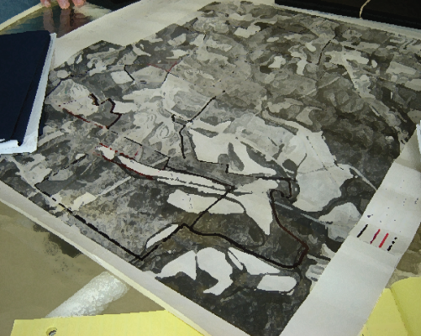
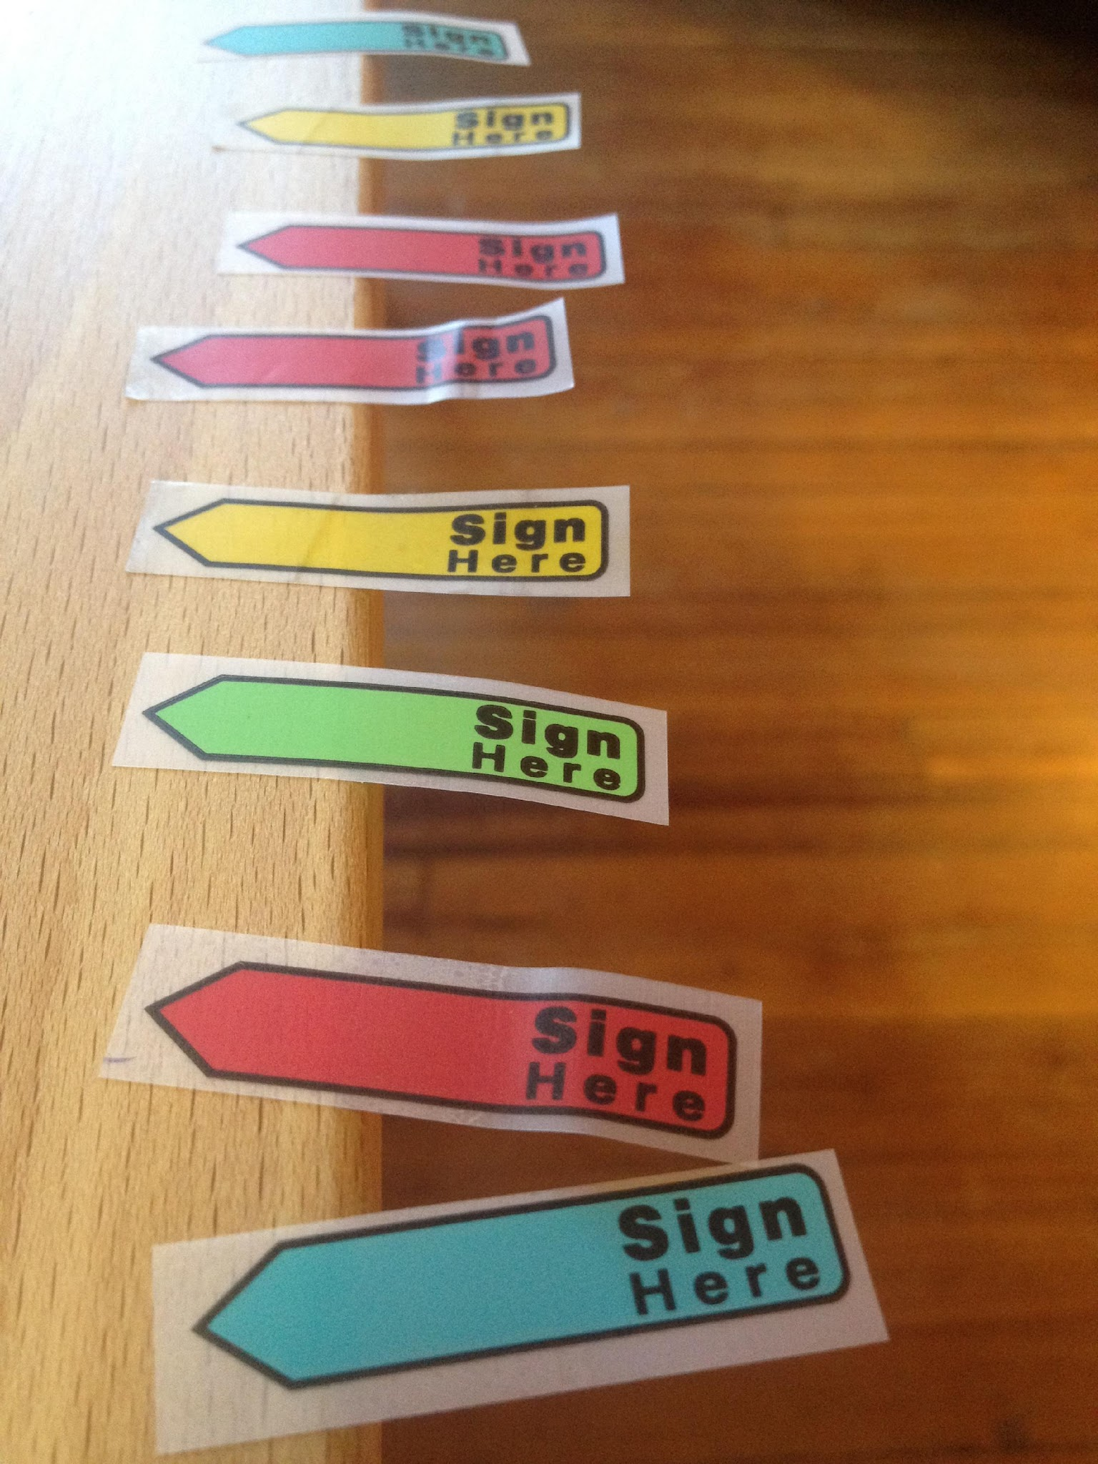

Farm Law for Producers and Landowners
Conservation Easements and Farm Succession
Part I: Rights in Real Property

Slide 2
This Series
Part I: Rights in Real Property (9/7)
Part II: The Disposition of Real Property (9/14)
Part III: The Impact of Conservation Easements on Real Property Transfer Decisions (9/21)
Part of NC Soil & Water Foundation effort to support and empower Conservation Districts in developing and monitoring conservation easements on working lands
Funding: NC Tobacco Trust Fund Commission and Southern SARE PDP program

Slide 3
This Lawyer’s Background
Member of the Virginia State Bar (1992) and North Carolina State Bar (2003)
Non-profit work in agriculture
  American Farmland Trust
  NC Farm Transition Network
Private (Farm) Law Practice (2010 - 2018)
NCSU Agricultural and Resource Economics (2018)
  50% Extension appointment
  50% Teaching (Environmental and Agriculture Law)

Slide 4
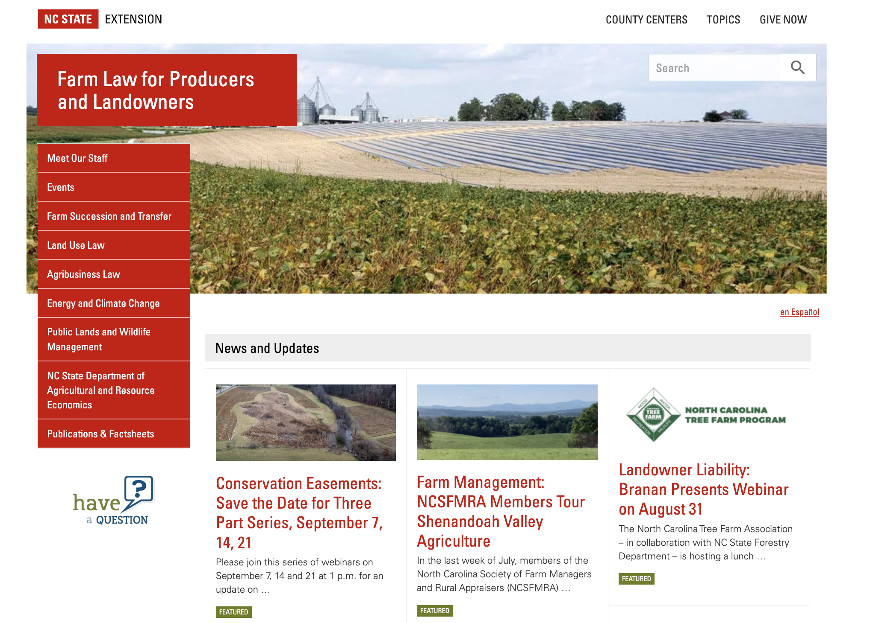
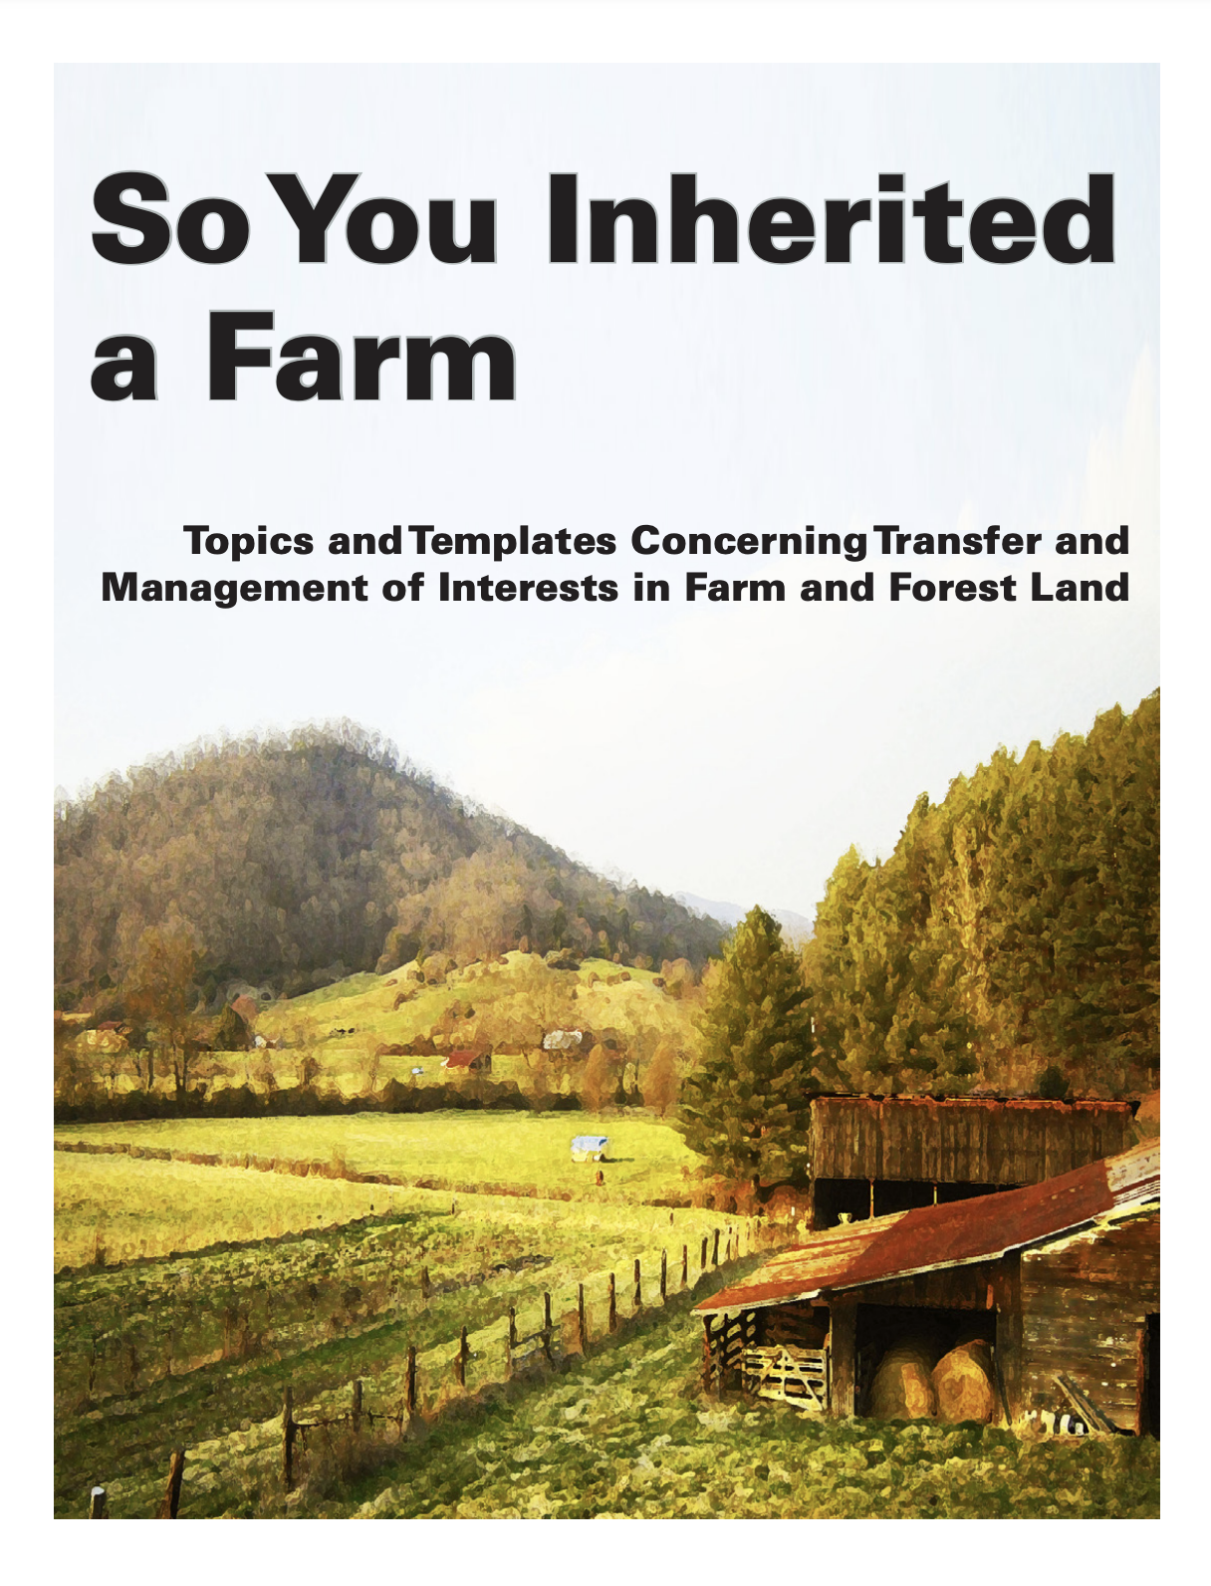
https://farmlaw.ces.ncsu.edu/
Landowner Liability Webinar (on demand)
(sponsored by NC Tree Farm Association)

Slide 5
This Lawyer’s Observations
Try not to give heirs undivided interests in land
Estate Tax exemptions still high
All land dispositions must be in writing
Careful of PUV when dividing land
Legacy planning is a series of disposition
decisions and executions
Be mindful of leaving obligations behind

Slide 6
A Thought for the Ages
“We think it enough that our title is derived by the grant of the former proprietor, by descent from our ancestors, or by the last will and testament of the dying owner; not caring to reflect that there is no foundation in nature or in natural law, why a set of words upon parchment should convey the dominion of land”
  Sir William Blackstone 1753

Slide 7
“Property”
Black’s Law Dictionary defines “Property” as “[t]hat which is peculiar or proper to any person, that which belongs to one… In the strict legal sense, [property is] an aggregate of rights which are guaranteed and protected by the government.”
  In other words, guaranteed to belong to a person by the law.
Personal Property: Things that are moveable
Real Property: Land
  And things affixed to land (structures and trees)

Slide 8
The Nature of Property
Property law concerns a humans right of use, control and disposition over things (“personal property”) and land (“real property”)
Land includes the surface, the subsurface and the sky above
  cujus est solum, ejus est usque ad coelum et ad inferos [whose is the soil, his is even to the skies and to the depths below]
An interest in land is known as an Estate (from Latin ”status” meaning state or condition)
Descriptive term for any type of Estates is called a Tenancy (from Latin “tenir” meaning “to hold”)
A holder of an estate in land is called a “Tenant”
Property rights are recognized in the US Constitution (5th Am) but the substantive law of real property is purely the realm of state sovereignty
  common law claims re trespass, nuisance, etc.
Notes:
Black’s Law Dictionary defines “Property” as “[t]hat which is peculiar or proper to any person, that which belongs to one… In the strict legal sense, [property is] an aggregate of rights which are guaranteed and protected by the government.” In other words, guaranteed to belong to a person by the law.
Property law concerns a humans right of use, control and disposition over things (known as “personal property”) and land (known as “real property”). For our course, we will focus mostly on the nature of real property and its various rights and restrictions on use, which is a key focus of environmental regulation.
Land includes the surface, the subsurface to the center of the earth – in an ever decreasing cone of course - and the sky above to space. Ownership of land – if you do indeed own it – is guaranteed by the Fifth Amendment to the US Constitution. Or rather, the Fifth Amendment guarantees that the government cannot take the value of your land from you. If the government needs your land for a public purpose, they must pay you for its value. (We’ll discuss this later in the semester). But generally the law protects your property from others simply taking it, occupying it, or otherwise infringing on your rights to your property.
Occupying your land or removing items therefrom is known as trespass. Interfering with your enjoyment of your property without entering upon it is called nuisance. These are the two common law claims we will discuss in this module.
Ownership or the right to use land is referred to as an “interest,” and an interest in land is known as an Estate (from Latin ”status” meaning state or condition). The descriptive term for any type of Estate is called a Tenancy (from Latin “tenir” meaning “to hold”). A holder of an estate in land is called a “Tenant.” Though we commonly think of that term as someone who rents land, it’s legal meaning includes one who owns it as well.
Property rights are recognized in the US Constitution (5th Am) but the substantive law of real property is purely the real of state sovereignty

Slide 9
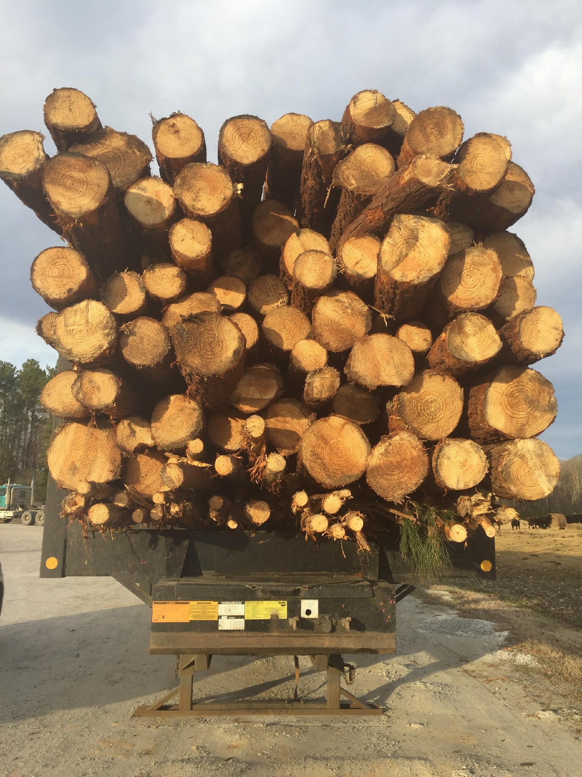
“The Bundle of Sticks”
(severable)
Water Rights: shared with neighbor
Right to Timber: Deed to timber buyer
Right to Subdivide: Deed to land trust in form of conservation easement
Right of Sole Possession: Leased to house tenant
Right of sole possession: Deed of Easement to neighbor
Right to Take Wildlife: Leased to hunt club
Right to Farm: Leased to farmer
Right to subsurface minerals: Deed to energy developer
Right of sole possession: Deed to DOT for Right of Way

Slide 10
The “Permanent” Conservation Easement
(the sticks removed)
Right to Subdivide: CE Deed restriction on parcel subdivision
Right to Build: CE Deed restricts increase % of impervious surfaces
Right to Timber: CE deed may restrict timber
Right of sole possession: CE deed must allow entry for monitoring
Right to subsurface minerals: CE Deed likely restricts mining

Slide 11
Written Transfer of Rights in Real Property
The Statute of Frauds – all dispositions of any right in land must be in writing to be enforceable (1677 England)
  You can allow verbal access, but in most cases it does not amount to a transfer of right
  Exception: Agricultural Tenancies of one year in North Carolina (protected by Statute)
  Other “time” or “necessity” exceptions:
    Easement by prescription: use easement long enough
    Easement by necessity: landlocked land has no other access
    Adverse possession (“squatter’s rights”,
      Seen often as an encroachment of building, fence or driveway across property line
  Title or right not defensible unless recorded prior to other claim
Personal Property: “Possession is nine-tenths of the law” –
  Can establish ownership with verbal testimony, other evidence
  Exception is titled vehicles
Notes:
All transfers of an interest in real property must be in writing. The Statute of Frauds, one of most enduring common law traditions, has its origins as “statute” – which we consider a written law passed duly by a representative body, or legislature – in the law by the same name passed in 1677 by the English Parliament. It’s obvious purpose was to eliminate the element of perjury in disputes concerning whether land had been transferred between two parties – as well as a number of other important contracts, such as marriage. Prior to this time, it was still possible for a party to claim a right in land and be awarded the same by simply convincing a jury or judge with a presentation of verbal testimony of the circumstances of the transfer followed presumably by “I swear it’s true.” The statute of frauds, as part of the English common law tradition now common to all state statutes concerning transfers of land, but also other contracts governed by the Uniform Commercial Code.
Now, as a landowner you can always verbally allow access to land, such as a verbal agreement to hunt on the land, draw water from the land, and farm the land. But such verbal assent by an owner does not amount to a property right on the part of the granted access to remain if told to leave, or to take something from the land if told not to. If challenged, the recipient of a verbal promise must quit their presence from the land and take nothing from it. There is one statutory exception, at least in North Carolina: if you verbally grant a farmer access to your land and he or she prepares it for planting, he or she is guaranteed the right to access the land to tend and harvest their crop within the period of one calendar year.
There are other, mostly time and occupancy-based exceptions which have been developed in the common law by courts, such as an easement by prescription – whereby a non-owner has been traversing another’s property for so long it amounts to an “earned” easement so to speak, or adverse possession – called sometimes “squatters rights” – whereby an unauthorized occupier of land can do so openly and for a long period of time (now defined by statute) sufficient to transfer actual title, or otherwise serve to prevent their ouster by the record title holder. Such issues are common when one landowner builds a building or driveway that sits across the property line of his or her neighbor for many years without the neighbor’s notice or objection. This is called an encroachment.
Regarding personal property, you sometimes hear that “Possession is nine-tenths of the law.” As it happens, this adage is generally true, in that if you possess something, whoever claims it generally has the burden of establishing before a court that it is theirs. They can of course weather such burden of proof – again, convince the trier of fact that their claim is true - with verbal testimony, photographs, and other evidence such as certificate of insurance, tax forms, etc. The obvious exception is personal property that requires title – such as over the road vehicles – or is traditionally titled or registered, such as livestock and domestic animals.

Slide 12
Exception: Statutory Ag Tenancy in NC
Vast majority of non-owner farm use is “verbal” (not written)
NCGS §42-15 through §42-25
  Termination 30 days (generally Jan 1 to Jan 1)
    Select counties Dec 1 to Dec 1 (notice by Oct 31)
    Wheat and cover crops (over-winter)
  Landlord crop lien (and crop insurance lien)
Evidence of term? (e.g. NRCS contract)
  Statute of frauds (3+ years)
    Must file Memorandum of Lease
A tenancy on transferred land (purchased, inherited) is not automatically renewable
Extension Fact Sheet: The Verbal (Statutory) Farm Tenancy

Slide 13
Exception: Adverse Possession
When one may claim title to land from another without specific conveyance… “squatter’s rights”
Requires proof of four elements:
  Actual Possession – exclusive to the claimant
  Possession must be “open and notorious” (essentially, discoverable to point where landowner could force the other to quit his or her property (called “ouster”)
  Possession must be “hostile” = claimed as one’s own
  Possession must be continuous for 20 years (in North Carolina)
    7 years under “color of title” (possessor has a defective deed)

Slide 14
Titled Estates in Land
(the ways land is owned)
Joint Tenancy with Right of Survivorship (RARE)
  Two or more simultaneous owners of undivided interest
  When an owner dies, his interest belongs to surviving owner(s) (Interest not inheritable)
  One joint tenant may not transfer interest
Tenancy by the Entireties: Joint Tenancy except for married couples (NCGS §41-55)
  property purchased during marriage presumed “marital property”
  property deeded to both spouses considered Tenancy by Entireties
Tenancy in Common
  Two or more simultaneous owners of undivided interests
  When an owner dies, interest passes to owners heirs by will or intestacy
  Each interest is freely alienable (can be sold or given to someone not currently a co-owner)
  Inherited property is not marital property [NCGS §50-20(b)(2)]
Farm Law Article: Land Title: Understanding Rights in Property
Notes:
An ownership interest in land is known as an estate, and the exploration of the development of estates and their current nature in modern law would take us into a whole different and future course of study. So let’s keep it simple for now.
If you own property in your name alone – you are the sole owner – you have what is called fee simple ownership: you own the whole show, and don’t share your ownership with anyone else. You own all of the rights, and can distribute those rights – what we’ll call the bundle of sticks in the next slide – to whomever you please. If you die owning the property, your heirs will receive your title.
Now, if you own your property concurrently with someone else, you have what is called a concurrent estate. When you own land concurrently with another owner, your ownership is expressed as a percentage but each of you have rights to the entire property. Your interest is called an undivided interest. The interest is not geographically defined within the boundaries of the property. For the moment, know that there are basically two types of ways people can own property concurrently.
First, there is joint tenancy with right of survivorship. This means that each owner owns a fractional share, but that share is tied to the life of each owner. When one owner dies, their interest automatically becomes the interest of their joint co-owner. Tenancy by the Entireties is essentially joint tenancy with right of survivorship between married persons. One cannot sell or alienate their interest in jointly-titled land unless all joint owners convey their interest or otherwise approve the transfer to a new joint owner.
Then, there is Tenancy in Common. A tenancy in common interest, like a joint tenancy interest is an undivided interest. However, each tenant in common can alienate their interest without the permission of another other owner. So one ownership interest can be freely swapped out so to speak. Because each interest is freely alienable, each interest is will pass to the interest holder’s heirs upon his or her death. Often after many years where co-tenants have died and their heirs inherit their interest, you can have dozens of concurrent owners. In North Carolina, one interest owner, regardless of how small the interest, has the right to petition the Clerk of Court to initiate a partition proceeding to divide up or auction the property and divide the proceeds. But like a more thorough discussion of estates in land, that is for another course in a future time.

Slide 15
Life Estates
Deed to Grantee(s) with a reservation of life estate in Grantor(s)
  Grantee’s remainder interests vests upon recording of deed, but possession delayed until death of Grantor
  Entire value of property may be reportable as gift (IRC § 2702)
  may be transferred as life estate per autre vie (another’s life)
Life Tenant responsible for taxes (NCGS §105-384)
Life Tenant may not commit “waste” (deplete resources) (NCGS § 1-533)
May not encumber property beyond term of life without agreement of remainderman
  Generally may not timber the land without agreement
  Life tenant or remainderman may partition standing timber (§ 46A-80(b))
Tip: reserve timber rights when granting life estate
NWOA Article: Use Life Estates with Caution

Slide 16
Example: Life Tenancy
Execute and record deed with the following language: “I (Andrew) or we (Andrew and Laura) convey the property described in Exhibit A to Caroline and Joe, subject to the reservation of a joint life estate in the Grantors herein”
Andrew and Laura are responsible for paying property taxes, maintaining the structures, etc.
When survivor of Andrew and Laura dies, Caroline and Joe own land as co-tenants
  Land does not pass by will or intestacy

Slide 17
Documents of Tenancy and Title
Purchase contract – a promise to convey title
Recording documents of transfer – County Register of Deeds “chain of title”
Deed – transfers complete or partial fee title
  Can transfer a specific right – e.g. Timber Deed (right to cut timber) – or all rights
  Description of Property: “metes and bounds” survey or plat
Deed of Trust (and Mortgage) – attaches lien to a piece of real property as security for a purchase loan
  Property with a lien is called collateral
Easement – allows non-owner a right of access, usually to cross the property (may be verbal or prescriptive)
  Right of Way (highway or utility)
Lease – allows a non-owner to use the property as a contractual property right
Notes:
So if transfer of rights in real property must be in writing, what is the form of this written documentation?
First, you have what is known as a purchase contract. A purchase contract does not transfer actual title to land, but is only a promise to convey title to land at a certain price and under certain conditions that must be satisfied prior to the transfer, such as an inspection, survey, title search, tax payoff, etc.
Most all other documents of title and right transfer, in addition to being in writing, must be recorded with the county Register of Deeds, so that they appear in that property’s chain of title, which is the final legal record of transfers of rights and title in all real property in the United States. As noted earlier, substantive real property law is purely the realm of state sovereign power to legislate.
The document that transfers fee title, that title to the whole of the rights in the property (the bundle of sticks in total that have not otherwise been severed), is called the deed. The person transferring the land is a Grantor, the recipient is a Grantee. There are numerous types of deeds, one being a Timber Deed that only transfers the right to cut timber from the property. A deed that transfers title must accurately describe the property, which will be what is called a metes and bounds description describing the lines drawn by a survey, or by reference to the survey itself if it has been recorded with the county register of deeds, whereby then it is called a plat.
A Deed of Trust and Mortgage are the same type of document that serves to secure the real property as collateral or security for a loan, meaning that if a borrower of money is unable to pay back the loan, the lender – via the rights granted to him by the Deed of Trust or Mortgage – has the legal authority to take possession of and sell the real property and apply the proceeds to satisfy (or pay-off) the loan. The lender’s loan is called a secured loan, and we say that the lender has “security.” Of course, following the sale the owner-borrower gets to keep the remaining money from the sale (minus costs of sale) if there is indeed any.
As noted earlier, it is possible to gain temporary access to land or to cross land without written permission but only in certain circumstances which must otherwise be proven in court. An easement of right that is readily evident will be in writing. Again, an easement is simply a permission to move across the land of another, normally along a prescribed route (which if the easement is long term or perpetual – meaning it has no termination date - can be paved. A common form of easement is a utility easement for electricity transmission lines or underground (or above-ground) pipeline. An easement also allows subsurface encroachment which is common in modern oil and gas extraction called fracking.
Rights of way of the descriptive term normally applied to public roads and utility easements. For example, the state of North Carolina does not own the land underneath two-lane secondary roads, but rather claims a right of way over other landowners land. When looking at a meets and bounds property description whereby a state road serves as a boundary, the line of the property will be the centerline of the road.
A lease is also a document granting certain uses or complete occupancy of another’s property. Common leases include the right to farm, the right to hunt, and the right to occupy and reside upon.
Easements and Leases and Timber Deeds are examples of Concurrent Estates, whereby two parties have overlapping or separate rights in the same piece of ground.
Sometimes easements need not be in writing if they have been on the land for a sufficient period, or if they are necessary to access a landlocked property.

Slide 18
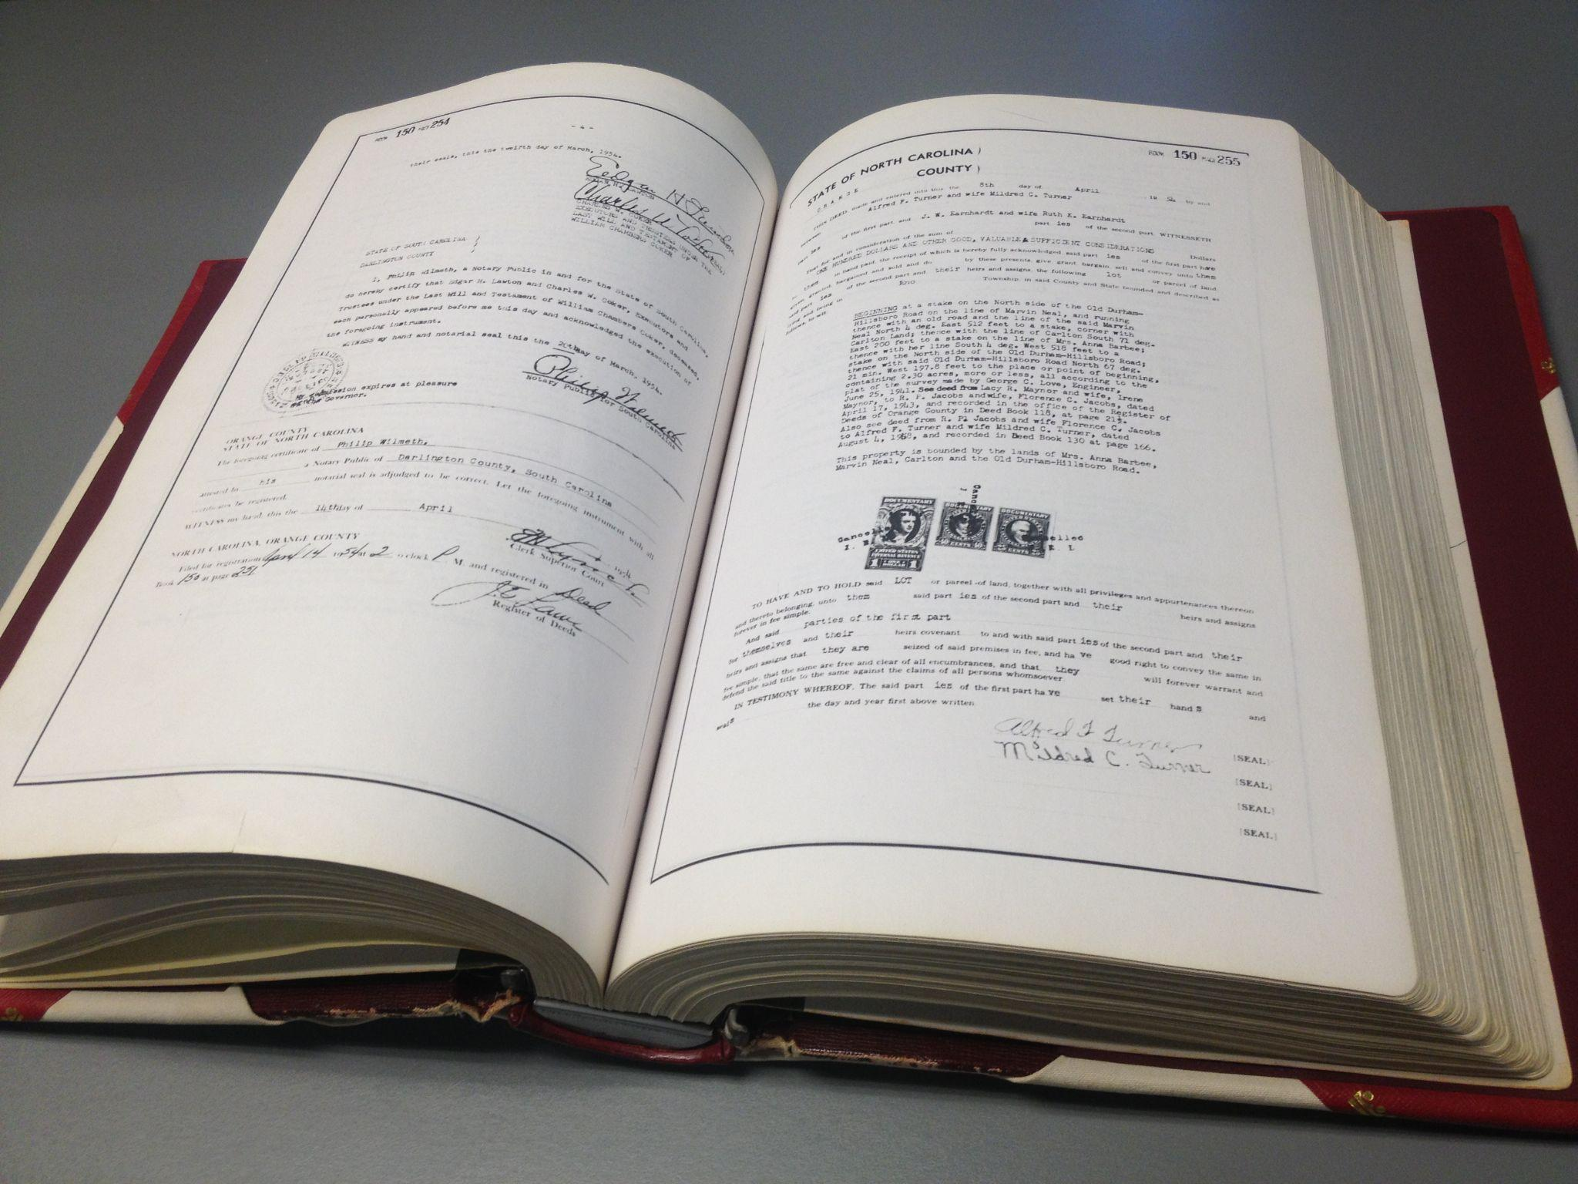
Types of Deeds
Warranty Deed – Grantor promises that he or she owns the rights being conveyed in the deed, has the right to convey those rights, and promises to “defend the title” against others claiming any of those rights
  Meaning: Grantor is financially responsible curing/defending title defects (claims of others to title)
  Deed language limitation:
“Subject to all liens, easements and other encumbrances of record”
  Title Insurance has effectively
replaced grantor’s guaranty
Quit Claim Deed – Grantor makes no promise that he or she owns or has the right to convey
  not “quick claim”

Slide 19
Other Deeds - Specific Conveyances
Timber Deed – conveyance of the right to harvest standing timber
  Includes right of access
  Timber cut becomes personal property
Deed of Easement – the granting of passage over the land of another
  Can be narrowly defined by language or map
  Recorded easement ”Runs with the land”
  Easements are generally transferrable (unless restricted in the deed)
  Conservation Easements – conveyance of right to subdivide and subject land to restrictive use
Deed of Trust – conveyance to another (i.e. lender of money) of the right to sell property in payment of a debt

Slide 20
Grantor and Grantee
Grantor – conveys his or her interest in the land
  Grantor can only convey that to which they have title
  For example: if Andrew conveyed his rights in his standing timber to Tom last year, Andrew can convey the balance of his rights to Scott
    Tom owns the right to cut standing timber
    Scott does not own the right to cut standing timber
Grantee – receives the conveyance
  Only receives the rights granted in the deed
  And only receives the rights owned by Grantor

Slide 21
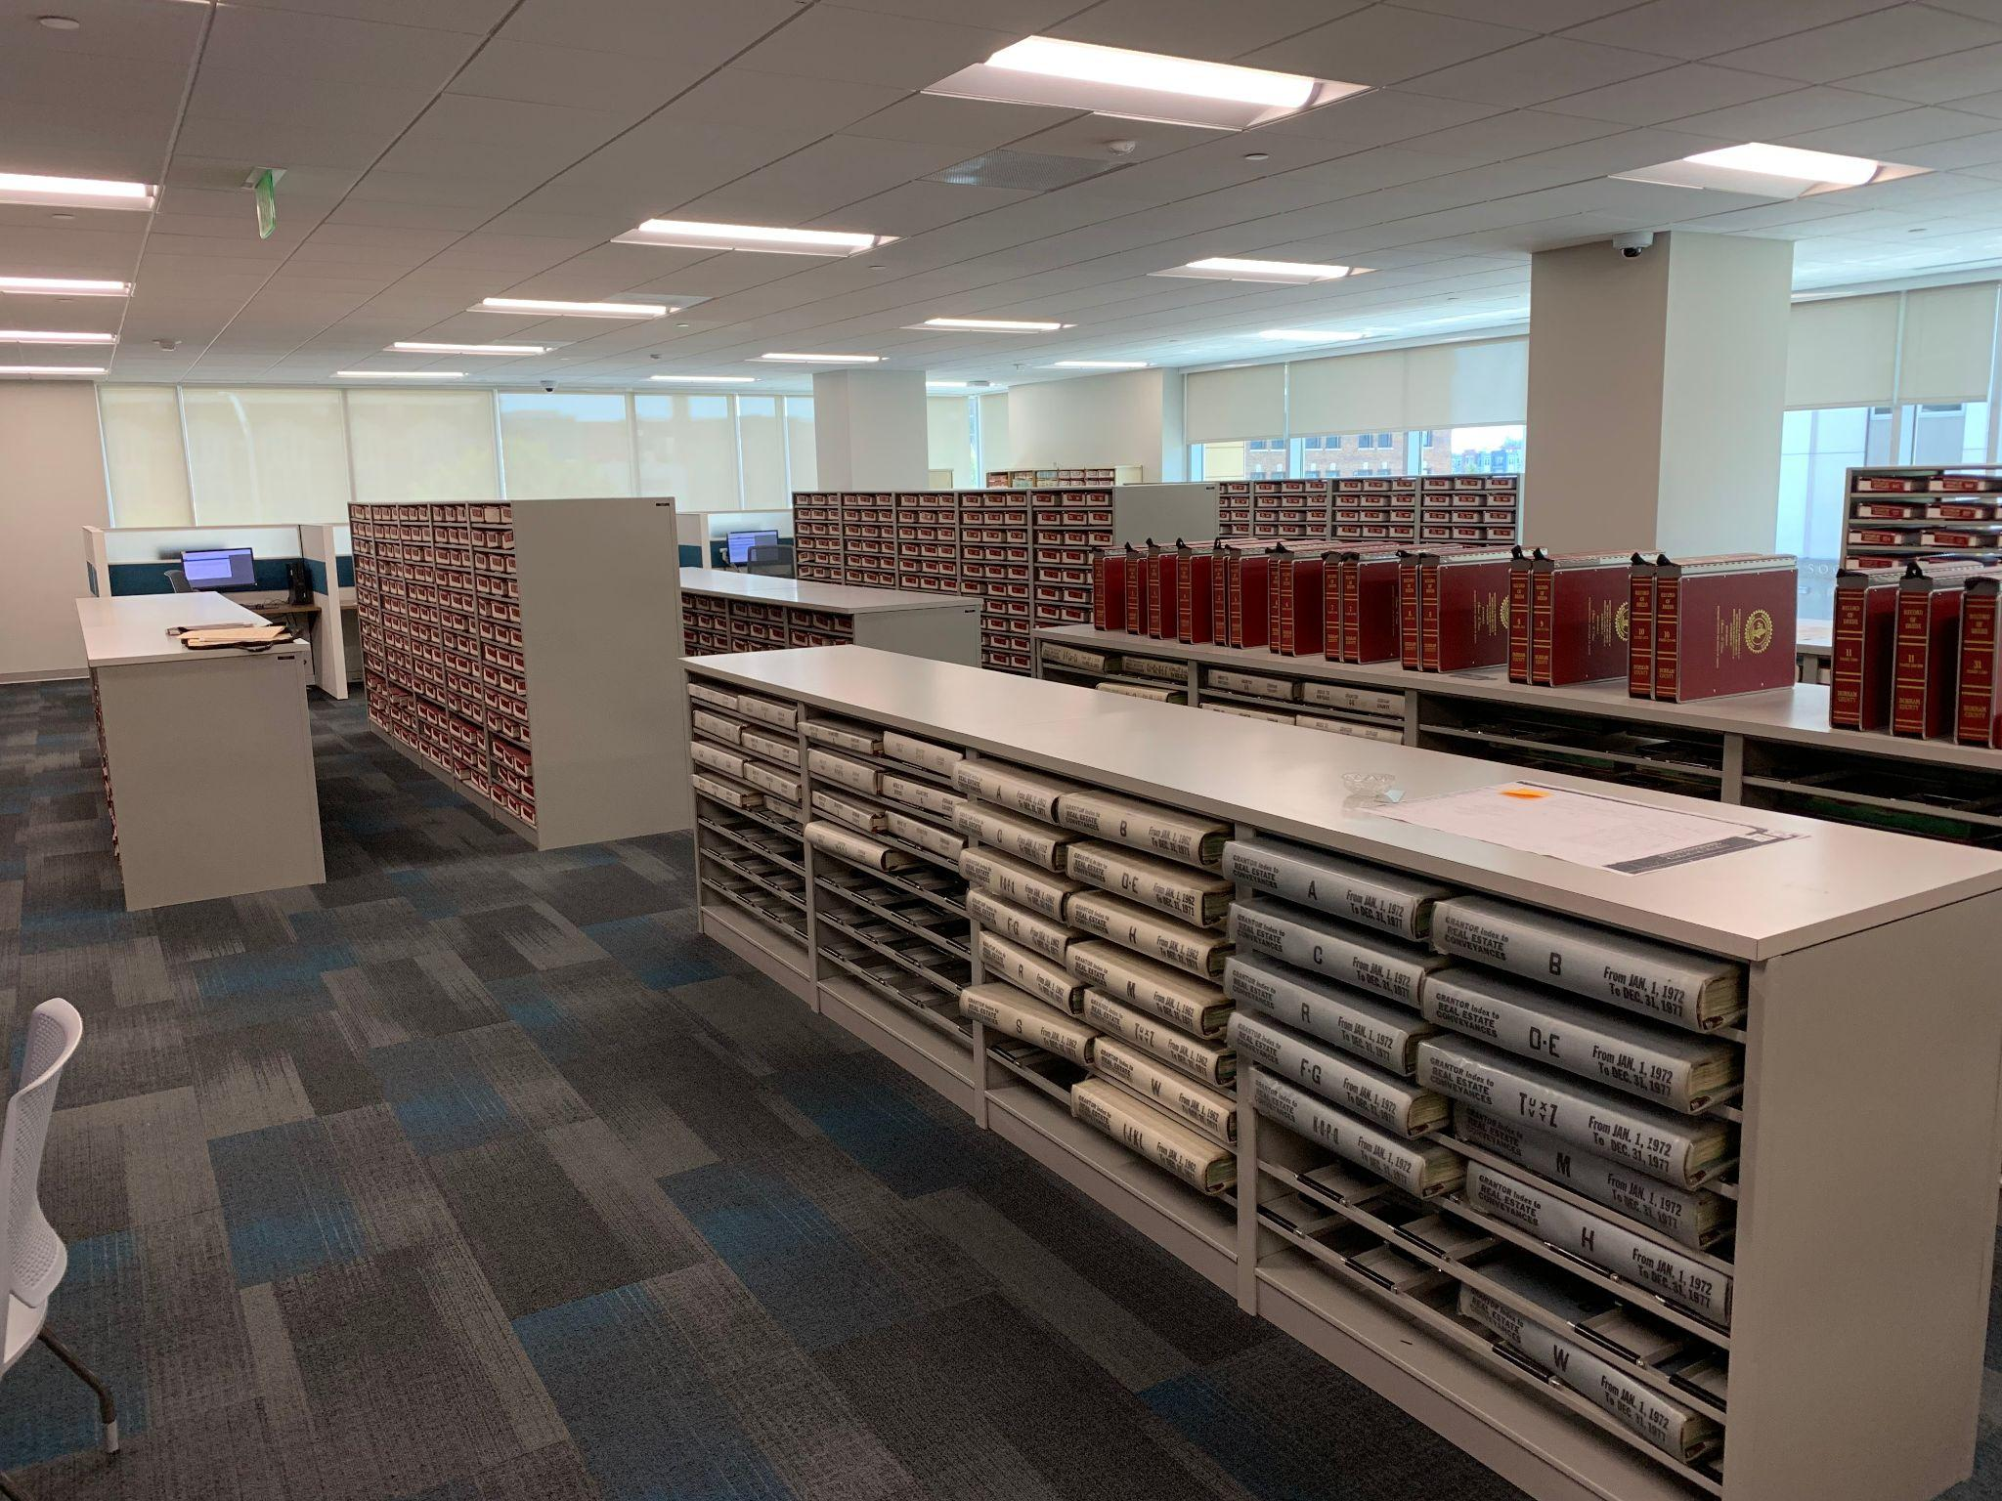
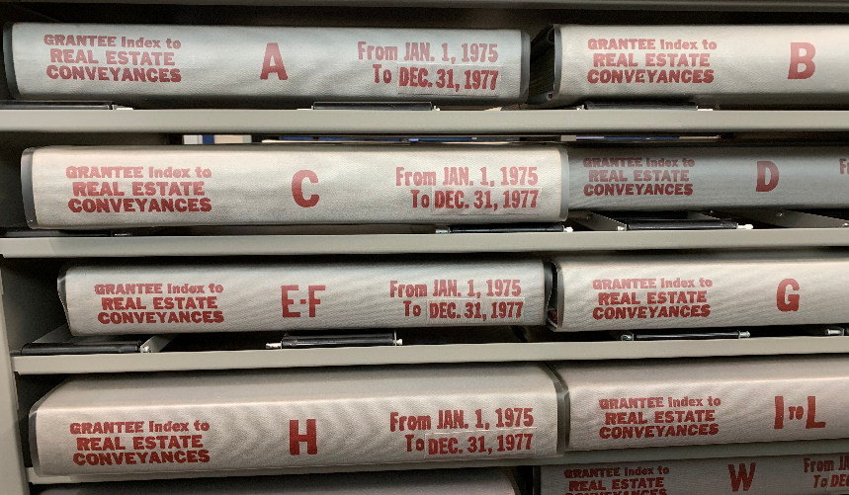
Title Search
Search Grantee Index back 30 years
  To determine previous Grantors
Search Grantor Index forward to present
  To identify any out conveyances
North Carolina Marketable Title Act (N.C.G.S. § 47B-1)
  Extinguishes claims during 30 years unbroken chain of title (provided no claims are made)
  Exceptions include
    Mineral rights
    Railroad rights of way
    Easements, etc.

Slide 22
Easements Terminology
Grantor of easement owns the “servient” estate over which easement crosses; Easement Grantee owns the “dominant” estate to which access is granted
  The right of ingress and egress dominates the landowner’s right to sole possession
  Easements “run with the land” and generally benefit parcels, not people (unless the grant of easement is term-limited to an individual’s ownership of the dominant estate)
Express Easement –
  Conveyed specifically by deed (appurtenant – runs with land)
  Reserved in a deed transferring subdivided property
  Easement shown on a plat
Easement by Prescription – adverse possession (20 years in North Carolina)
Easement by Necessity – when one parcel is subdivided, a landlocked parcel has an access easement implied by law
  see Cartway Proceeding (NCGS §136-69)
Implied Easement – two parcels under (at least one) common owner, dominant parcel continues easement from prior use
Gates on Easements: Farm Law case summary of Taylor v Hiatt

Slide 23
Partition of real property
Tenant in common has right of partition land
Co-tenant files partition petition with Clerk of Court
  Clerk appoints 3 “commissioners” to study partition claim and make recommendation
Actual Division (§46-1 et seq)
  Land surveyed into equal divisions
Sale in Lieu of Partition (NCGS §46-22)
  Commissioners cannot recommend or reach consensus on equal land division
  Too many heirs (“Heirs Property”): multiple tenants-in-common of differing generations
Conservation easement likely requires ‘sale in lieu’
  (current research; no NC cases)

Slide 24
Preventing Partition
LLC Operating Agreement restricts partition
Tenant in Common Agreement (template coming)
Beneficiary of Trust
  Limited to action against Trustee or Trust
Rights of First Refusal
  requirement to deal before partition
  Specific requirements (record Memorandum!)

Slide 25
Restrictive Covenants
Landowner may place restrictions on property prior to transfer
  often recorded as separate document
Common in subdivided rural properties (where original landowner still resided following parcel subdivision)
Covenants may be changed with approval of other landowners
  the covenants are considered a condition upon which they purchased their property
Can inhibit small farm development (usually limits on livestock, poultry, swine, commercial activity)
problem of enforcement as a civil matter...

Slide 26
Land Disputes
Processioning action (a boundary dispute) (NCGS 38-1 et seq)
  Establish correct location of dividing line
  Petition to Clerk of Court, who decides boundary
  Loser can appeal to Superior Court
    Dividing line is question for jury based on evidence
    Jury may set the line based on evidence (does not need to agree with either P or D)
  If title to land is an issue, then becomes Action to Quiet Title
Action to Quiet Title: NCGS 41-10. An action may be brought by any person against another who claims an estate or interest in real property adverse to him for the purpose of determining such adverse claims
Plaintiff (the filing landowner) must bring the proof

Slide 27
Government Taking of Private Property
U.S. Constitution 5th Amendment Takings Clause “… nor shall private property be taken for public use without just compensation”
  Requirement the government pays fair market value for ”taking” your property
  May only “take” property for public purpose (cannot hand it off to private entity)
  Just compensation is Fair Market Value
U.S. Constitution 5th Amendment Due Process Clause
  Requirement of process for taking: Eminent Domain

Slide 28
Eminent Domain
Authorized by state statute: NCGS §40A-1 et seq.
Available to public and private condemnors for various purposes
  Utilities (e.g. Duke Energy, Atlantic Coast Pipeline)
  NC Department of Transportation
No requirement of prior negotiation (though often made)
Reimbursement of property taxes
  Present use valuation “roll back”
Process initiated with County Clerk of Court
  Private Condemnors NCGS § § 40A-19 through 34
  Public Condemnors NCGS § § 40A-40 through 56
Just Compensation (NCGS §40A-62)
Cartway Proceeding (NCGS §136-68)
  private use of eminent domain process for easement to landlocked parcel for production purposes

Slide 29
Valuation of Real Property
Standard: “Highest and Best Use”
Factors in Valuations
  Scarcity
  Desirability
  Utility
  Effective Purchasing Power
Appraisal Methods
  Income approach (commercial property and farmland)
  Sales Comparison – residential, developed farmland)
  Cost approach – factors in cost of infrastructure

Slide 30
Present Use Value Disqualification
Tax deferment program, full taxes must be paid at some point in future
  benefit: only past 3 years must be paid
  called a “roll back”
Purchaser may agree to continued use and lien
Roll Back assessed by county upon disqualification
  voluntary removal (sell to non-farm purchaser)
  discovery upon transfer
  discovery upon audit (all PUV tracts reviewed once every 8 years)
    some counties have shorted 8 year review
    use of new satellite imagery to discover land changes
Care exercised in subdivision and transfer
  careful not to reduce tract size below min acreage
  careful to allocate ‘roll back’ or ‘continued use’ to purchaser (must be done in purchase contract [or non-farm commercial lease, e.g. solar)
Extension Fact Sheet: Present Use Value: Transferring Property Enrolled in Present Use Value Property Taxation

Slide 31
Zoning: The “Bona Fide Farm”
NC Counties are authorized to implement land use restrictions through zoning in their jurisdiction (outside of municipality)
A farm that qualifies for exemption from zoning under statute
  The term exists only in the context of zoning
    It has been appropriated to denote “legitimate farmer” (without statutory authority)
A bona fide farm parcel may not be annexed by a municipality without consent of the parcel owner [NCGS §160A-58.54(c)]
A bona fide farm parcel located in municipal extraterritorial jurisdiction (ETJ) is not subject to municipal zoning restrictions
  So long as parcel remains a bona fide farm

Slide 32
Bona Fide Farm (N.C.G.S. 160D-903)
The zoning exemption for farming and forestry
  formerly a general exemption “R/A”
  drawback of old exemption: county could interpret “agricultural use”
Objective qualifications (safe harbors), one of:
  Sales Tax Exemption Certificate (from NCDOR)
  Land qualifies for PUV
  Forestry plan
  Owner or tenant files a Schedule F (tax P&L farming)
Has a statutory definition of “agritourism”
Not an exemption from state building code

Slide 33
Only Three Ways to Dispose of Property
Sale
  Completely relinquish rights in property, receive fair market value in cash or equivalent (aka consideration)
  May reserve rights (timber, an easement, etc.)
  Tax consequence: capital gains on sale income (if held for more than one year)
Gift
  Completely relinquish rights in property, nothing in return
  File gift tax return for gifts over $15,000/donee/year
  Tax Consequence: Carry-over basis
Death
  Property interests pass to heirs at law, or devisees in will
  Tax Consequence
    Subject to federal estate tax
    Property exempted up to $11.4 million per person

Slide 34





THANKS FOR INVITING ME!
Robert Andrew Branan
Assistant Extension Professor
Department of
Agriculture and Resource Economics
North Carolina State University
rabrana2@ncsu.edu

Slide 35
Farm Law for Producers and Landowners
Conservation Easements and Farm Succession
Part II: The Disposition of Real Property

Slide 36
https://farmlaw.ces.ncsu.edu/
Landowner Liability Webinar (on demand)
(sponsored by NC Tree Farm Association)

Slide 37
Only Three Ways to Dispose of Property
Sale
  Completely relinquish rights in property, receive fair market value in cash or equivalent (aka consideration)
  May reserve rights (timber, an easement, etc.)
  Tax consequence: capital gains on sale income (if held for more than one year)
Gift
  Completely relinquish rights in the property, nothing in return
  File gift tax return for gifts over $16,000/donee/year
  Tax Consequence: Carry-over basis
Death
  Property interests pass to heirs at law, or devisees in will
  Tax Consequence
    Subject to federal estate tax
    Property exempted up to $12.06 million per person

Slide 38
Conservation Easements and Land Transfer
Landowner should try and avoid creating co-tenancy in inherited property
  land is often sold by ‘heirs’ or an agreed subdivision is reached
  ‘heirs’ struggle to agree on subdivision
A conservation easement may be subdivided, but there are permissions and restrictions (reviewed in Part III)
As best as possible, sync up title distribution plan with conservation deed language and baseline options for parcel subdivision

Slide 39
Estate Tax History
Vicesina Hereditatium (Egypt) tax on the 20th penny
“Dead to the Living”
Tax Stamp Act (US)
700 BCE —-- Medieval Taxes -------- 1797, 1862, 1916, 1924, 1932, 1948 —---------------------
2000
~$50,000
(= $1,278,500 in 2022)
~$60,000
$650,000
Tax Relief, Unemployment Insurance Reauthorization, and Job Creation Act of 2010
Tax Relief, Unemployment Insurance Reauthorization, and Job Creation Act of 2010
2001
2002-2003
2004-2005
2006-2008
2009
2010
2011
2012 - 2017
$675,000
$1,000,000
$1,500,000
$2,000,000
$3,500,000
$0
$1,000,000
$5.12M - 5.49M
$5,000,000
Tax Cuts and Jobs Act (TCJA)
TCJA sunset
2018
2019
2020
2021
2022
2023
2024
2025
2026
2027
$11.18M
$11.4M
$11.58M
$11.7M
$12.06M
[ continued increase ]
$5,000,000

Slide 40
Special Farm Valuations to
Reduce Estate Tax
Special valuation reduction available to farm estates under IRC §2032A, where qualified property taxable values may be reduced by up to $1,190,000.
Entity valuation discounts from property subject to restrictions on transfer or liquidation, called discounts for lack or marketability and lack of control… see 26 CFR § 25.2703-1
Conservation easement: can deduct up to 40% in value (max at $500,000)... see IRC §2031(c)

Slide 41
Estate Tax Exemption
Estate Exemption Amount for tax years beginning after December 31, 2017 and before January 1, 2026: $12,060,000 ($24,120,000, married couple)
(Sunsets to $5,000,000 in 2026, but portability remains)
Estate and Gift Tax are “unified”
Each gift dollar above $16,000 annual exclusion (per donee) is reported to IRS
Each dollar above $16,000 reduces lifetime exemption, the result is the available exemption at death (estate tax)
Top rate: 40% (depends on amount of wealth above the exemption)

Slide 42
Current Law: Gifts and Basis
Gift Tax Exclusion Amounts for tax years beginning after December 31, 2017 and before January 1, 2026:
Annual Exclusion $16,000
Lifetime Exemption (2022): $12,060,000 ($24,120,000, married couple)
Carry Over Basis (donee gets same basis as donor)
Step-up basis to Fair Market Value is retained for death time transfers
New basis at time of death, reduces capital gains if sold by ‘heirs’
(see IRC §1014)
Example Gift: Land purchased in 1985 at $1500/acre, current FMV $8000/ac
if gift and donee sells, capital gains/acre: ($8000 - $1500 = $6500) x 15% = $985
Example Death Transfer: Same basis, FMV $8500 at date of death
if death transfer and donee sells, capital gains (with modest appreciation)/acre: ($8700 - 8500 = $200) x 15% = $30/acre capital gain

Slide 43
Disposition at Death
Testate: person dies (decedent) with a valid will
  late 15c., from Latin testatus "public, manifest, published"
Intestate: person dies without a valid will, property is distributed according to Intestate Succession Act (N.C.G.S. Chapter 29)
  Distributions to spouse, lineal descendants, lateral descendants, or ancestors depending on facts at moment of death
    Spouse % varies with # of children or grandchildren
    Children and grandchildren (% varies by glass)
    Siblings and parents (depends on whether lineal descendants alive)

Slide 44
Creating a valid Will
Requirements codified N.C.G.S. § 31-1
Testator (age 18+) must have mental capacity
  Understand you are making a will
  Understand Nature of property you own
  Understand Who you are leaving it to
Testator must sign
  In the presence of two “disinterested” witnesses
    Have no inheritable interest under the will
  Self-Proving Will: Testator and witnesses sign in the presence of a notary public
    With no notary, Clerk must call in will witnesses to testify as to validity of signature
Holographic Wills: written and signed in handwriting of testator (N.C.G.S. § 31-3.4)
  If found among testators “valuable papers”, safe deposit box, etc.
Clerk must decide if will meets legal sufficiency for entry into probate
Extension Fact Sheet: The Last Will and Testament: A Primer

Slide 45
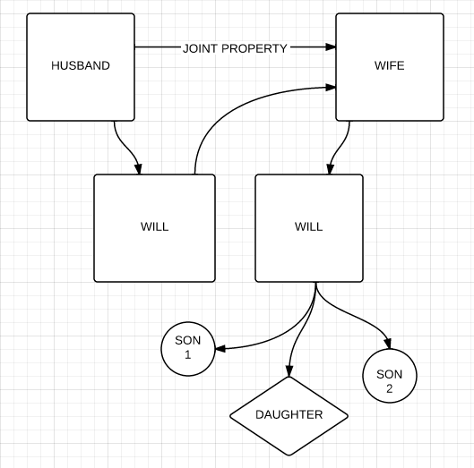
“All property to spouse”
“If predeceased by spouse, to children share and share alike, per stirpes”
“...share and share alike”

Slide 46
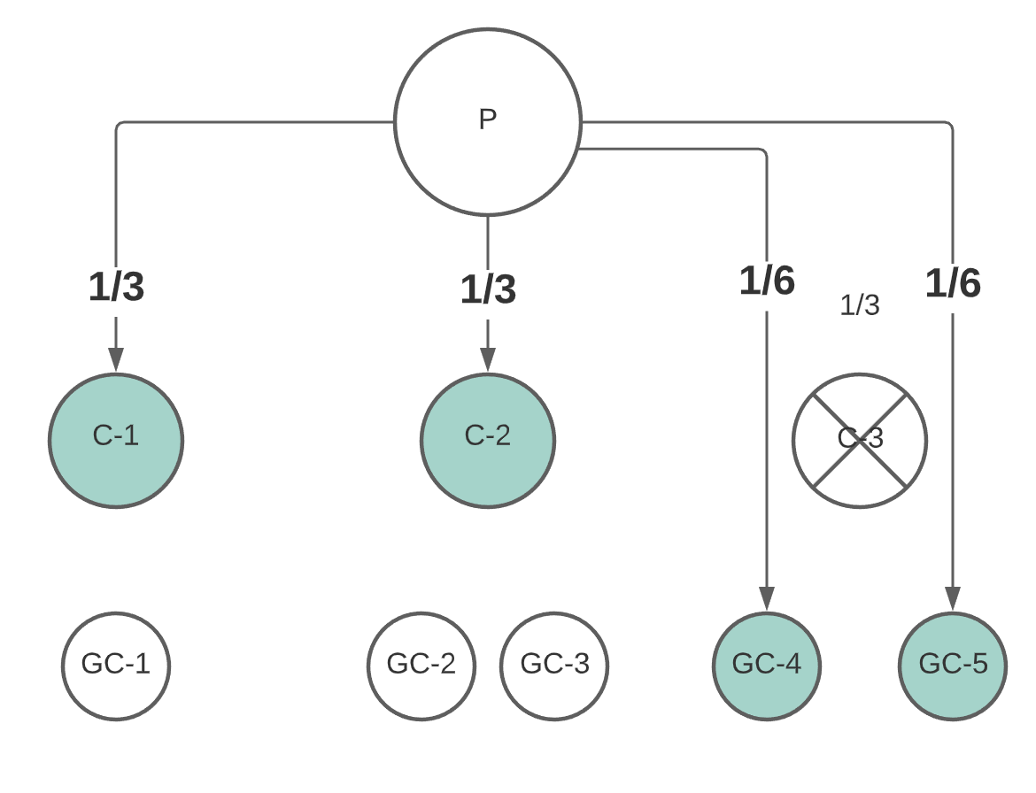
Multiple Generations of Co-Tenants

Slide 47
The Trust
A separate legal entity
Settlor (or Grantor): the person(s) who create(s) the trust and funds it (assigns property to the trust)
Trustee: the “legal owner” of the trust property, bound by a fiduciary duty (state law) and by terms of the trust
  Fiduciary powers of trustee NCGS
Beneficiary: The person(s) who receive the benefit of the trust
  income from assets
  distribution of assets
Language of the Trust controls distribution
Trusts are private, assets not part of probate estate (but part of taxable estate if trust is revocable)
Often used as “will substitutes”: trust determines distribution of property
Can empower Trustee to place conservation easement, place land in entity, etc.
Extension Fact Sheet: The Basics of Trusts in Farm Succession Planning

Slide 48
Types of Trusts
Testamentary Trust (established by executor pursuant to a will)
Revocable Trust
  Fund during lifetime (put in, take out)
  Fund through ‘pour over’ will
  Amend as needed
Irrevocable Trust
  Insurance Trust (ILIT)
  “Asset-Protection”
Special Needs Trust
Charitable Trusts
“Dynasty” Trusts
  Revocation of “rule against perpetuities”

Slide 49
Care in Using Devices
The Will
  title passes at moment of death
  unless specific property devises/bequests, property passes by class
    e.g. “To my children”: 3 children
    3 parcels of land, farm equipment/livestock, personal property
    each child takes ⅓ co-tenancy interest in land, ⅓ interest in all personal property
    Executor (and Clerk of Court) without authority to decide who gets specifically what
The Trust
  not ideal as long-term landowning device for farmland (rent may be insufficient to cover costs)
The LLC - the family members are ‘in business’ with one another

Slide 50
Three Ways to Dispose of Property
Sale
  Completely relinquish rights in property, receive fair market value in cash or equivalent (aka consideration)
  May reserve rights (timber, an easement, etc.)
Gift
  Completely relinquish dominion over property, nothing in return
  May reserve rights (timber, an easement, etc.)
Death
  Property interests pass to heirs testacy or intestacy
    By Will: Devisees
    By Statute: Heirs

Slide 51
Property Disposition Tax Implications
Sale of property: Capital Gains Tax
Gifting of property:
  Carry-Over Basis (potential higher capital gains tax)
  Gift Tax (for annual gifts above $16,000 [per donee])
  Lifetime gift tax exemption: $12,060,000
Property at Death:
  Estate Tax: percentage tax levied by law on all owned wealth transferred at death (aka “taxable estate”)
    Subject to ”Wealth Exemption”
    Federal Exemption = $12,060,000 per individual (federal only) (spouse gets other exemption for double)
    “Unified” with lifetime gift tax exemption (reduced dollar for dollar each annual aggregate gift above annual exclusion of $16,000/yr/donee)
    Estate tax abolished in North Carolina
  Probate costs: percentage levied by county on personal property wealth (aka “probate estate”)

Slide 52
Disposition at Death
Testate: person dies (decedent) with a valid will
  late 15c., from Latin testatus "public, manifest, published"
Intestate: person dies without a valid will, property is distributed according to Intestate Succession Act (N.C.G.S. Chapter 29)
  Distributions to spouse, lineal descendants, lateral descendants, or ancestors depending on facts at moment of death
    Spouse % varies with # of children or grandchildren
    Children and grandchildren (% varies by glass)
    Siblings and parents (depends on whether lineal descendants alive)

Slide 53
Vito
Carmela
Parents
Santino
Freddo
Michael
Connie
Sandra
Carlo
Children + Spouses
Kay
Predeceased Vito in 1946
Santino, Jr.
Francesca
Victor
Anthony
Frank
Michael
Kathryn
Mary
Grandchildren

Slide 54
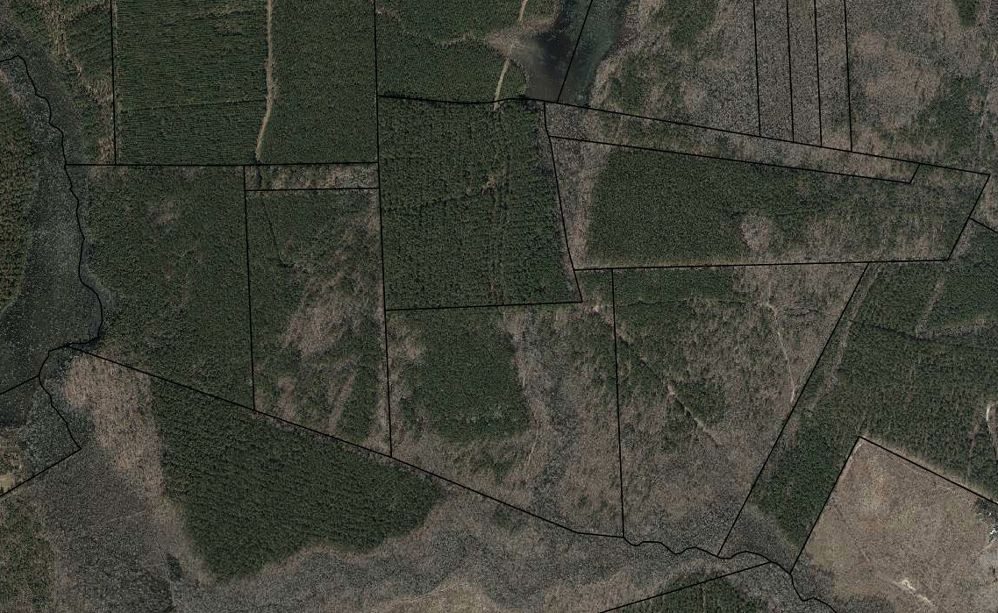
Corleone Family Forest Parcels
C
E
A
Purchased by Vito and Carmela
B
Inherited by Vito
Inherited by Vito
Inherited by Vito
F
D
Purchased by Vito and Carmela
Purchased by Vito and Carmela

Slide 55
Vito
Carmela
Vito and Carmela execute reciprocal wills
Parents
Santino
Freddo
Michael
Connie
Sandra
Carlo
Children + Spouses
Kay
Predeceases Vito in 1947
Santino, Jr.
Francesca
Victor
Anthony
Frank
Michael
Kathryn
Mary
Grandchildren

Slide 56
Basic Will Disposition
“I devise and bequeath my entire estate to my spouse.”
“If my spouse predeceases me, I devise and bequeath my personal and real property to my children, per stirpes.”
Dies in 1953
Result:
Vito’s 100% ownership of tracts A, B, and C pass to Carmela via Vito’s Will
Vito’s 50% share of tracts D, E, F vest in Carmela (owns D, E, F 100%)
Vito
Carmela
Parents
Santino
Freddo
Michael
Connie
Sandra
Carlo
Children + Spouses
Kay
Predeceased Vito in 1947
Santino, Jr.
Francesca
Victor
Anthony
Frank
Michael
Kathryn
Mary
Grandchildren

Slide 57
Basic Will Disposition
“I devise and bequeath my entire estate to my spouse.”
“If my spouse predeceases me, I devise and bequeath my personal and real property to my children, per stirpes.”
Predeceased Vito
Vito
Carmela
Parents
Santino
Freddo
Michael
Connie
Sandra
Carlo
Children + Spouses
1/4
1/4
Kay
Predeceased Vito
1/4
1/16
Santino, Jr.
Francesca
Victor
1/16
Anthony
1/16
Frank
Michael
Grandchildren
Mary
Kathryn
1/16

Slide 58
Vito’s Parcels Inherited by Heirs as Co-Tenants
C
E
¼ Connie
¼ Mike
¼ Freddo
1/16 Santino, Jr.
1/16 Frank
1/16 Kathryn
1/16 Francesca
¼ Connie
¼ Mike
¼ Freddo
1/16 Santino, Jr.
1/16 Frank
1/16 Kathryn
1/16 Francesca
A
¼ Connie
¼ Mike
¼ Freddo
1/16 Santino, Jr.
1/16 Frank
1/16 Kathryn
1/16 Francesca
B
¼ Connie
¼ Mike
¼ Freddo
1/16 Santino, Jr.
1/16 Frank
1/16 Kathryn
1/16 Francesca
F
D
¼ Connie
¼ Mike
¼ Freddo
1/16 Santino, Jr.
1/16 Frank
1/16 Kathryn
1/16 Francesca
¼ Connie
¼ Mike
¼ Freddo
1/16 Santino, Jr.
1/16 Frank
1/16 Kathryn
1/16 Francesca

Slide 59
Corleone Family Forest Parcels
C
E
A
Purchased by Vito and Carmela
B
Inherited by Vito
Inherited by Vito
Inherited by Vito
F
D
Purchased by Vito and Carmela
Purchased by Vito and Carmela

Slide 60
Vito dies intestate
Carmela opens estate with Clerk of Court, appointed Personal Representative
Vito’s estate distributed according to NC Intestate Succession Act
Vito
Carmela inherits ⅓ interest in tracts A, B, and C
Carmela gets $60,000 plus 1/3 remaining personal property
Vito’s 50% share of tracts D, E, F vest in Carmela (owns D, E, F 100%)
Carmela
Parents
1/12 …
Santino
Freddo
Michael
1/12 …
Connie
Sandra
Carlo
Children + Spouses
1/12 share of personal property; 1/12 interest in land
Kay
Predeceased Vito
1/48 …
1/48 …
Santino, Jr.
Francesca
Victor
Anthony
Vincent
Frank
Michael
Grandchildren
Kathryn
Mary
1/48 …
1/48 …

Slide 61
Managing Tenancy in Common
Tenancy in Common Agreement
  contract between co-tenants concerning
    management
    purchase of interests
    waiver of partition right
  must record memorandum in chain of title
Option to Purchase
  Right of First Refusal
    option holder allowed to match purchase offer by another party
  Right of First Offer
    requires other party to offer interest at market value ascertainable by appraisal (or otherwise by agreement)
Limited Liability Company
Extension Fact Sheet: Option Agreements for Purchase of Land

Slide 62
Use of Business Entities
Most prevalent: Limited Liability Company
Often used to hold “family” land
  Governing document (e.g. Operating Agreement) controls disposition of interests in entity
    The Buy-Sell Agreement (option, valuation (purchase price, payment)
    May limit ownership to “lineal descendants”
  Business Entity interest (shares, membership) = intangible personal property
    Gifts of interest to create equity in younger generation
  Land titled to business entity = personal property
May transfer interests in business entity to successors by gift, sale or at death
Farm Law Article: Business Entities: Partnerships, Corporations and LLCs

Slide 63
Limited Liability Company
Operating LLC (or S Corp)
  Partners contribute their ownership interest in cattle, bins, machinery, “sweat” etc.
  Use as transfer vehicle to farming heir (gifts/structured sale)
  Existing S Corp or Partnerships (merger, conversion, asset transfer, etc.)
Land LLC
  Deed Land interest to the LLC (never a corporation)
  Restrict membership
  Strip partition rights inherent to real property interest
  Structured exit of equity in land (title substitute)
  Conversion of existing Limited Partnership (w/o retitle property) (SOS filing)
Extension Fact Sheet: Limited Liability Companies: Steps in Formation

Slide 64
The Operating Agreement
A Contract between contributors of assets
Restricts who can be members
  Member vs. Assignee
Dictates voting requirements for decisions
  Manager
  Voting and Non-voting Units
Dictates triggers for buy-sell
  Option to Purchase
  Who may buy and when
  Appraisal procedure
  Price and payment terms (seller finance option)
For existing S Corps, use Stock Purchase Agreement
Extension Fact Sheet
  Limited Liability Companies: Operating Agreement Components and Sample Language

Slide 65
Buy-Sell Agreement
Restrictions on transfer
  New shareholder must get 75% approval
  Any other transfer (voluntary or otherwise) triggers buy-sell
Triggers
  Voluntary withdrawal
  Death, disability, personal bankruptcy, try sell to ”outsider”
Options
  First Company (to hold or reissue)
  Second other Shareholders
  Then mandatory Company redemption (if fails, then stock becomes non-voting)
Valuation of Company (V): V ÷ #S = value of share
Terms of Payment
  Basically forced seller finance
  Mandatory discount applied

Slide 66
Ownership of Land by LLC
C
E
A
Corleone Land Co, LLC
Corleone Land Co, LLC
Corleone Land Co, LLC
B
Corleone Land Co, LLC
F
D
Corleone Land Co, LLC
Corleone Land Co, LLC
Key Features:
Michael is Manager
Distributions of income to other members
Only lineal descendants of Vito and Carmela may become members
Buy sell provision established appraisal and payment terms

Slide 67
Transfer of LLC Interests
Gift of Interest (measured in “units”)
  Calculate value of company
  Divide value by number of units to determine price per unit
  Transfer total units < $16,000 annual gift tax exclusion
Sale
  Purchase from Other Members or Trust
    Purchase with insurance proceeds under Buy-Sell Agreement (Designate beneficiary and agreement between all participants + spouses)
  Spread capital gain over term note
  Discounting of interest value
  Some relief from Self Employment taxes

Slide 68
LLC Interest Transfer Example
LLC asset (land) worth $500,000 FMV
  tip: if farmland as collateral, get lenders most recent appraisal
  tax appraisal (highest, not PUV) may be sufficient
LLC consists of 5000 units (an arbitrary number written into operating agreement)
Each unit is worth $1000 (500,000/5000)
One member can transfer ≤ 16 units without exceeding the annual federal gift exclusion
  a member can use their spouse’s exclusion (even if non-member) to double the gift
tip: time gifts at end of the year to use same documented valuation for two gifts in different tax years
  16 (or 32) units transferred on Dec 31
  16 (or 32) units transferred on January 1
Documents: gift declaration, unit certificates (keep in LLC file, no notification to state)

Slide 69
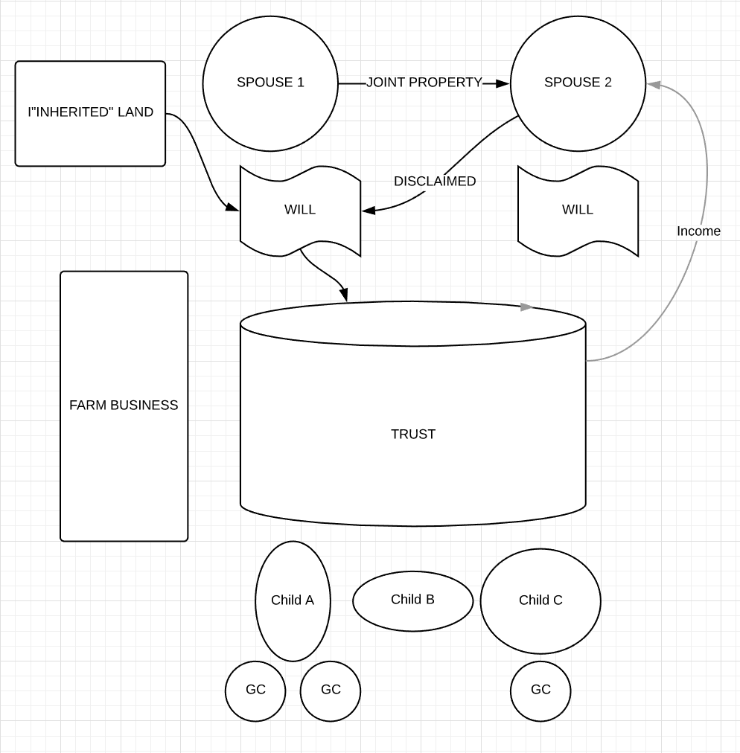
first to die
senior share of LLC
Farm tract
House
LLC
Forest tract
junior share
Farm tract
each tract has option agreement in favor of other heirs (?)
annual $16,000 gifts (?)

Slide 70

THANKS FOR INVITING ME!
Robert Andrew Branan
Assistant Extension Professor
Department of
Agriculture and Resource Economics
North Carolina State University
rabrana2@ncsu.edu

Slide 71
Farm Law for Producers and Landowners
Conservation Easements and Farm Succession
Part III: The Impact of Conservation Easements on Real Property Transfer Decisions

Slide 72
https://farmlaw.ces.ncsu.edu/
Landowner Liability Webinar (on demand)
(sponsored by NC Tree Farm Association)

Slide 73
Conservation Easements 101
Easement in gross (pr. grow)
Permanent restriction of landowners’ right to subdivide parcel
Landowner paid for giving up right to subdivide/develop
Landowner can donate the right to a third party
  Donation amount is tax deduction under US tax code
  Usually a combination of purchase and donation
Third Party – e.g. non-profit land trust, S&WCD – ensures the terms of the easement are not violated by landowner
  has right of access (and obligation) to monitor restrictions
Value of CE = Highest value – restricted value

Slide 74
Conservation Easement Concepts
“Highest and Best Use” – an appraisal-supported valuation of the maximum market value of a property
  Dependent on appraisal methods (certified appraiser)
  Dependent on infrastructure, zoning, etc. supporting development
    Residential: how many lots and houses can this parcel support with water, septic, etc.?
    Industrial: will water, infrastructure, zoning for industrial use
“Restricted Use Value” – the appraisal-supported value of the land without the right to subdivide or otherwise build on it
“Permanent” – restriction must be permanent, last forever, have no termination date
  No legal mechanism by which “stick” returns to bundle (but see
“Permeable Surface” – minimum allowable surface impermeable to water (asphalt roads, barn roofs, etc.)
“Building Envelope” – the location and size of additional structures allowed per the terms of the conservation easement deed

Slide 75
Funding for Purchase of
Development Rights
Federal: Agricultural Conservation Easement Program (ACEP) (formerly Farm and Ranchlands Protection Program)
  Funding amount authorized by Farm Bill (5 years)
  Apportioned to states by NRCS (e.g. NC has $X allocation of competitive funds)
State of North Carolina:
  Agricultural Development and Farmland Preservation Trust Fund (upland projects)
  Land and Water Fund (formerly CWMTF) (riparian projects)
Private donations of cash for purchase (wealthy donors cultivated by the Land Trust)
Landowner donation
  Cash for monitoring
  Donation of value of land (see example)
    Agree to take less than the value of the development right restricted by the easement

Slide 76
Conservation Easement Example
100 acre parcel
  Development Value: $1,000,000
  Value if could not develop: $650,000
Value of Easement: $1MM - $650K = $350K
Funding for purchase of Easement
  Federal ACEP: $200K
  State ADFPTF: $100K
  Other sources: $10K
  Donation of value: $40K
    Landowner may deduct $40K from federal income tax
    May carry unused portion forward for number of years (up to 10 if a “qualifying farmer”)

Slide 77
General “Estate Planning” Benefits of Conservation Easements
Reduction in value for federal estate tax purposes
IRC §2031(c) allows an executor to exclude up to 40% value of land subject to CE, with cap of $500,000
Federal Exemption = $11,400,000 per individual (federal only)
Possible reduction in income tax liability due to allowed deductions (frees cash for other operational purposes, ie. keep up farm infrastructure, expansion, etc.
Can provide cash money for:
purchase of whole life insurance policy (to provide an “estate share” for “non-successors”
can distribute cash money to “non-successors” as “estate share”
pay down debt that may burden farm in succession
purchase additional land to expand farm in succession
However, little or no research on how families have used CE funds, or how property has been distributed/disposed. Would be a great research project…

Slide 78
IRC §2031(c) Reduction in Land Value Subject to Conservation Easement
(c)Estate tax with respect to land subject to a qualified conservation easement
(1)In general
If the executor makes the election described in paragraph (6), then, except as otherwise provided in this subsection, there shall be excluded from the gross estate the lesser of—
(A)the applicable percentage of the value of land subject to a qualified conservation easement, reduced by the amount of any deduction under section 2055(f) with respect to such land, or
(B)$500,000.

Slide 79
Property Tax Benefits: PUV
Property must qualify for PUV to be eligible for ADFPTF funds
Though county tax appraisals are normally made on an octennial cycle (i.e. review of appraisals for one-eighth of county properties occurs in any given year), a parcel of real property whose development rights have been severed qualifies for an off-cycle re-appraisal to reflect a reduction in fair market value… N.C.G.S. §105-287(a)(2a)
For a CE to qualify property for permanent PUV enrollment (without regard to income requirement), the conservation easement must be in perpetuity and the landowner (grantor/donor) cannot have received more than 75% in compensation for the value of the conservation easement (development rights). N.C.G.S. §105-277.3(d1)

Slide 80
“Title” Effects of Conservation Easement
Subdivision Restriction
  can owner subdivide parcel in estate plan so that each heir ‘takes their own’?
  Subject to funder flexibility and deed language
  See NCGS §106-744(b)(1)
Defeats Partition Rights
  if land held in co-tenancy
  can a Clerk of Court force in-kind subdivision under NCGS § 46A-1?
Impervious Surface Restrictions
  limitation on new structures and paved surfaces in event of subdivision
Under what circumstances may a conservation easement be modified?
Article Draft: Conservation Agreements and Easements: Obligations, Modification and Termination

Slide 81
Principal Challenges
Adapt distribution scheme in estate plan (will and trust) to:
ensure equal distribution of wealth (a goal of many families)
avoid co-tenancy ownership in conservation easement tract (no guarantee of subdivision)
preserve cash (or its equivalent) from development rights sale for distribution to ‘heirs’ (it gets spent quickly)
Design conservation easement deed language to:
allow subdivision of parcel (to extent possible per zoning and funding restriction) as a matter of right
plan building envelopes and impervious surface growth
  financing for construction of allowed structure will encumber entire parcel unless subdivision allowed

Slide 82
Federal Tax Limitation on Modification
Relevant only if tax deduction taken for donated portion of development rights sale
“Private Benefit Doctrine”: Because the tax benefits to the individual are supplied by the public at large for their collective benefit - a modification of that benefit to advantage the taxpayer is not allowed
  normally a threat to taxpayer (clawed back deduction) and to 501(c)(3) status of a land trust
    Gentry, P. Applying the Private Benefit Doctrine to Farmland Conservation Easements (Duke Law J., 2013),

Slide 83
Modification Example from Regs
See § 1.170A-14 Qualified conservation contributions. No hard and fast rule found, but this example:
Example 3.
H owns Greenacre, a 900-acre parcel of woodland, rolling pasture, and orchards on the crest of a mountain. All of Greenacre is clearly visible from a nearby national park. Because of the strict enforcement of an applicable zoning plan, the highest and best use of Greenacre is as a subdivision of 40-acre tracts. H wishes to donate a scenic easement on Greenacre to a qualifying conservation organization, but H would like to reserve the right to subdivide Greenacre into 90-acre parcels with no more than one single-family home allowable on each parcel. Random building on the property, even as little as one home for each 90 acres, would destroy the scenic character of the view. Accordingly, no deduction would be allowable under this section.
RAB Comment: Note specificity of reason for denying subdivision. Similar situation with easement purpose focus on quality soils and water quality might have different result.
Subdivision decision would likely center on state law restrictions and impervious surface restrictions.

Slide 84
Restriction on Subdivision (ADFPTF)
From the ADFPTF Manual:
Land Division: Any parcel of land with an ADFP agricultural conservation easement will be limited to a minimum division of 20 acres in size. Any division of a land parcel must maintain agriculture, horticulture or forestry present use value status as designated by the State of North Carolina at the time of transfer. (Approved 12-09-08)
Subject to state statute limitation (see §106-744(b)(1) [next slide]
Note: Funding preference to applicants with “Farm or Forest Transition Plans”

Slide 85
NC Statutory Limitation on Subdivision
§ 106-744. Purchase of agricultural conservation easements; establishment of North Carolina Agricultural Development and Farmland Preservation Trust Fund and Advisory Committee.
(a) A county may, with the voluntary consent of landowners, acquire by purchase agricultural conservation easements over qualifying farmland as defined by G.S. 106-737.
(b) For purposes of this section, "agricultural conservation easement" means a negative easement in gross restricting residential, commercial, and industrial development of land for the purpose of maintaining its agricultural production capability. Such easement:
(1) May permit the creation of not more than three lots that meet applicable county zoning and subdivision regulations;
(1a) May permit agricultural uses as necessary to promote agricultural development associated with the family farm; and
(2) Shall be perpetual in duration, provided that, at least 20 years after the purchase of an easement, a county may agree to reconvey the easement to the owner of the land for consideration, if the landowner can demonstrate to the satisfaction of the county that commercial agriculture is no longer practicable on the land in question.
Is this restriction limited to county-held conservation easements?

Slide 86
Subdivision in NRCS Conservation Programs Manual (Part 528)
H. Subdivision
(1) The eligible entity must address the potential for future subdivision in each agricultural land easement deed by including provisions to prohibit subdivision of the easement area entirely or limit the subdivision of the easement area.
(2) In general, the agricultural land easement deed should prohibit future subdivision of the protected property. If the landowner intends to subdivide a parcel in the future, individual applications should be submitted for the individual intended subdivided parcels and ranking conducted on the individual applications. If the smaller parcels are individually eligible and rank high enough to be selected for funding, separate agricultural land easements may be purchased on the individual parcels.
(3) If the eligible entity includes provisions to prohibit subdivision of the easement area entirely, the provision may include an exception to address State or local regulations that explicitly require subdivision to construct residences for employees working on the agricultural land easement area.
(4) If the eligible entity instead of prohibiting future subdivision of the protected property wants to provide for the future subdivision of the protected property, then the agricultural land easement deed must identify the maximum number of future parcels, the terms required for the future conveyance of approved parcels, and identify the boundaries of the proposed subdivisions as follows—

Slide 87
Subdivision in NRCS Conservation Programs Manual (Part 528)... continued
(i) If Identified Prior to Closing.—Prior to closing, the eligible entity must provide NRCS a map of the proposed subdivision of the protected property. The individual parcels resulting from the proposed subdivision of the protected property must each meet the ACEP-ALE land eligibility requirements and program purposes, as determined by NRCS. Both the approved number and boundaries of the proposed subdivided parcels as approved by the State conservationist prior to closing must be identified in the agricultural land easement deed. No further NRCS review is required at the time of future conveyance of the parcels as identified in the deed.

Slide 88
Subdivision in NRCS Conservation Programs Manual (Part 528)... continued
(ii) If Identified After Closing.—The eligible entity must submit a request to the State conservationist for approval prior to authorizing a subdivision. The eligible entity must certify that the requested subdivision is required to keep all resulting farm or ranch parcels in production and viable for agricultural use. The State conservationist must determine that—
• Parcels resulting from the subdivision of the protected property will meet ACEP land eligibility requirements of 16 U.S.C. Section 3865 et seq. as enacted on the date the original parcel was enrolled in ACEP, including the allocation of the impervious surface limitation between the subdivided parcels.
• The resulting parcels will not be below the median size of farms in the county or parish as determined by USDA’s most recent National Agricultural Statistical Survey (NASS).

Slide 89
Subdivision Restrictions
(NRCS ALE Deed 2020)
(A) Subdivision – [Select Option 1, 2, or 3.] [Additionally, where required by State law the following may be inserted at the end of the selected option: Notwithstanding the foregoing, subdivision of the Protected Property is permissible when necessary to comply with State or local regulations that explicitly require subdivision to construct residences for employees working on the Protected Property. Grantor must provide written notice and evidence of such requirements to Grantee and the Chief of NRCS, or the Chief’s authorized designee (Chief of NRCS), prior to division of the Protected Property in accordance with such State or local regulations.]
[Option 1] Separate conveyance of a portion of the Protected Property or division or subdivision of the Protected Property is prohibited.
[Option 2] The Protected Property must not be divided or subdivided into, or separately conveyed as, more than _____ separate parcels (____ divisions allowed), the boundaries and the allocation of the impervious surface limitation of which have been identified in EXHIBIT _____, which is appended to and made a part of this ALE Deed. To protect the Purpose of the ALE, the boundaries of such divisions have been preapproved in writing by Grantee and the Chief of NRCS, or the Chief’s authorized designee (Chief of NRCS). Deviations from the identified boundaries will not be allowed. Grantor must give Grantee and the Chief of NRCS written notice prior to subdividing, dividing, or separately conveying a parcel of the Protected Property.

Slide 90
Subdivision Restrictions
(NRCS ALE Deed 2020)
[Option 3] The Protected Property must not be divided or subdivided into, or separately conveyed as, more than _____ separate parcels (____ divisions allowed). To protect the Purpose of the ALE, the boundaries of such divisions must be approved in writing by Grantee and the Chief of NRCS, or the Chief’s authorized designee (Chief of NRCS), before any such division, subdivision, or separate conveyance occurs. The Chief of NRCS may only approve the division, subdivision, or separate conveyance of the Protected Property into separately conveyable farm or ranch parcels when—
1. The Grantee requests the Chief of NRCS approval to subdivide the Protected Property into separate farm or ranch parcels, after receiving a request from the Grantor;
2. The Grantor certifies to the Chief of NRCS that the requested subdivision is required to keep all farm or ranch parcels in production and viable for agricultural use and that any new owners of the subdivided Protected Property farm or ranch parcels intend to use such parcels for agricultural operations; and
3. The Chief of NRCS determines that the—
a. Parcels resulting from the subdivision of the Protected Property will meet ACEP land eligibility requirements of 16 U.S.C. Section 3865 et seq. as enacted on the date the original parcel was enrolled in ACEP, including the allocation of the impervious surface limitation between the subdivided parcels, and
b. The resulting parcel will not be below the median size of farms in the county or parish as determined by the most recent United States Department of Agriculture’s National Agricultural Statistical Survey (NASS).

Slide 91
Impervious Surface Restrictions
(NRCS ALE Deed 2020)
1. Limitation on Impervious Surfaces. Impervious surfaces will not exceed ________ percent[Insert approved impervious surface percentage. Note: if greater than 2 percent, a written waiver from the Chief of NRCS or the Chief’s authorized designee is required.] of the Protected Property, excluding NRCS-approved conservation practices. Impervious surfaces are defined as material that does not allow water to percolate into the soil on the Protected Property, including, but not limited to, buildings with or without flooring, paved areas, and any other surfaces that are covered by asphalt, concrete, or roofs. This limitation does not include public roads or other roads owned and controlled by parties with rights superior to those rights conveyed to Grantee by this ALE Deed.
See 7 CFR § 1491.22: Director may waive to no more than 10%
[Include the following if limited subdivision is allowed below: In the event the Protected Property is subdivided as provided for in Section I, Paragraph (2)(A), the total cumulative impervious surface of the subdivided parcels must not exceed the impervious surface limitation referenced above. The Grantor, with Grantee approval, will allocate the impervious surface limit among the subdivided parcels and ensure said impervious surface limitation is clearly defined in each subdivided parcel’s recorded instrument.]

Slide 92
Conveyance Restrictions in Standard NRCS Deed
K. Subsequent Conveyances. The Landowner agrees to notify NRCS in writing of the names and addresses of any party to whom the property subject to this Easement Deed is to be transferred at or prior to the time the transfer is consummated. Landowner and its successors and assigns shall specifically refer to this Easement Deed in any subsequent lease, deed, or other instrument by which any interest in the property is conveyed.
Conservation Easement Deed should contain specific language allowing for transfer to entity or trust
Note: some entities have a “transfer fee”, consider language to except this fee for transfers to Trust or LLC or to lineal family members (defined)

Slide 93
Power of Trustee to Convey Development Rights (Conservation Easement)
§ 36C-8-816. Specific powers of trustee.
(8) With respect to an interest in real property, construct, or make ordinary or extraordinary repairs to, alterations to, or improvements in, buildings or other structures, demolish improvements, raze existing party walls or buildings or erect new party walls or buildings, subdivide or develop land, dedicate land to public use or grant public or private easements, and make or vacate plats and adjust boundaries, make contracts, licenses, leases, conveyances, or grants of every nature and kind with respect to crops, gravel, sand, oil, gas, timber and forest products, other usufructs or natural resources, and other benefits or incidents of the real property;

Slide 94
Sample Trust Language
In trust Article Titled “Disposition of Real Property”
§ Qualified Conservation Easements. Pursuant to trustees powers over real property in §§ - Trustee may create a qualified conservation easement, as defined in Section2031(c)(8)(A) of the Internal Revenue Code and NC General Statutes § 121-35 in any land held by the trust and may make the necessary election provided by Section 2031(c)(6).
May simply identify parcel: (e.g. “The Heron Farm”, PIN # 12345 comprised of 435 acres and described in Deed Book 1800 Page 100)
May place a time limit: “If within five (5) years of the death of surviving Grantor (of trust) Trustee is unable to create a qualified conservation on the property (identified in §§), Trustee shall subdivide property and distribute property to beneficiaries
much more detail here… lot sizes, specifically to whom, trustee consult with beneficiaries on subdivision, but has ultimate authority if no agreement of who gets what

Slide 95
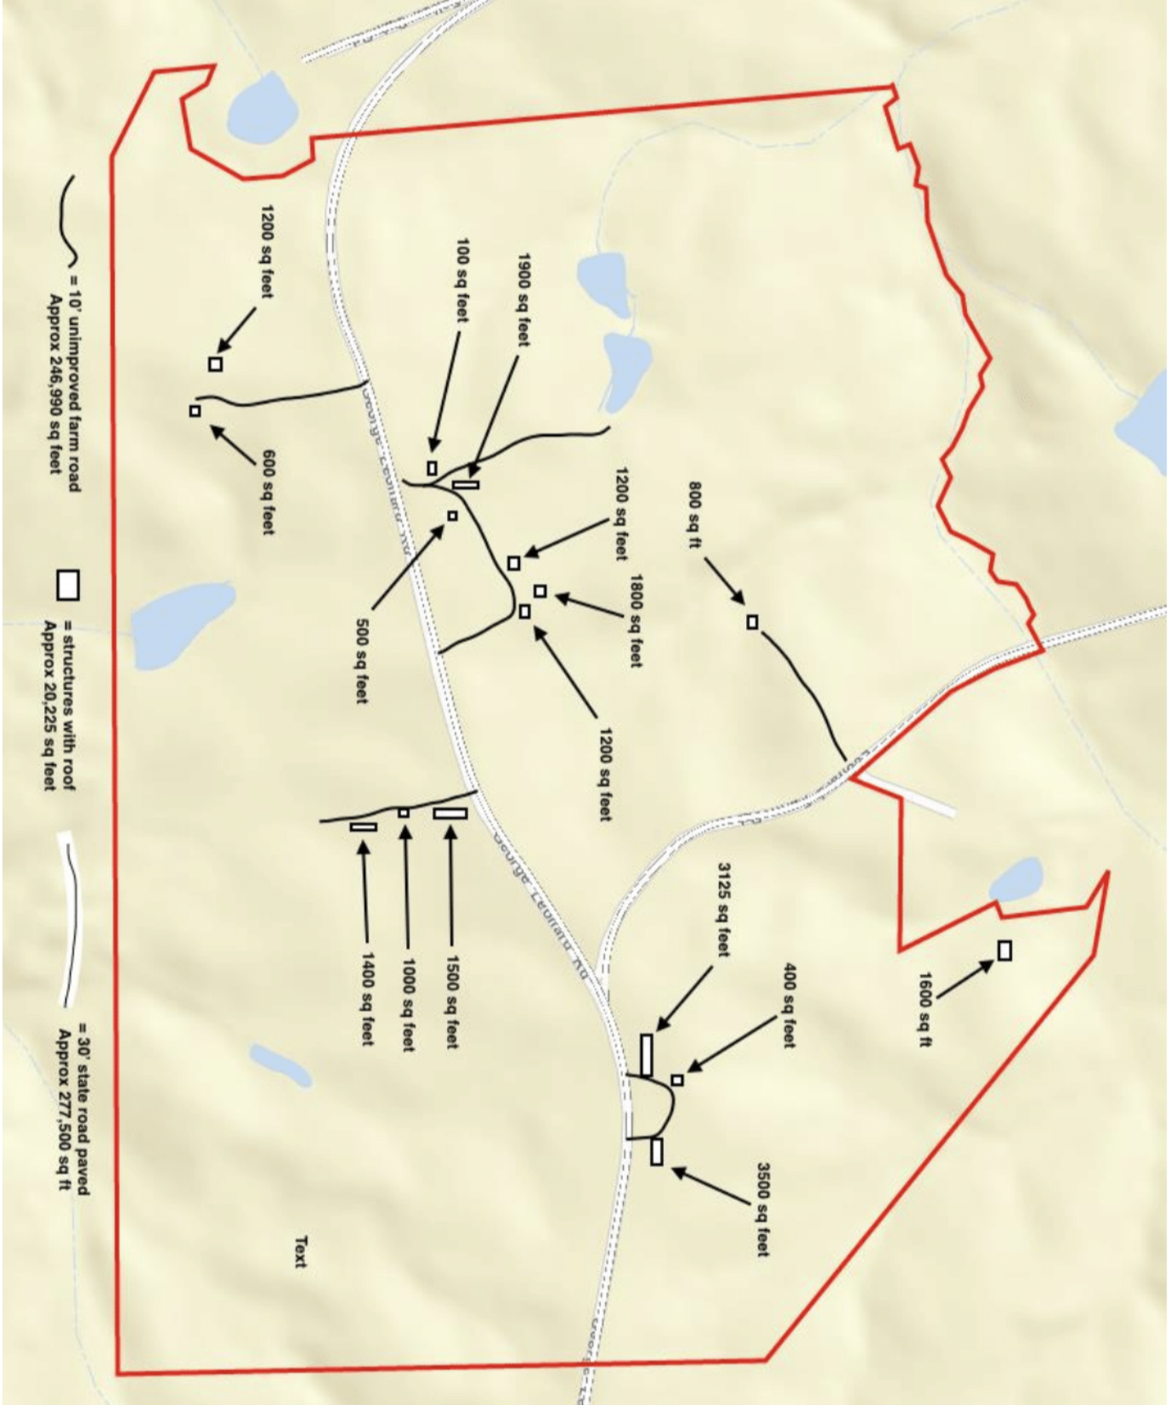

Slide 96
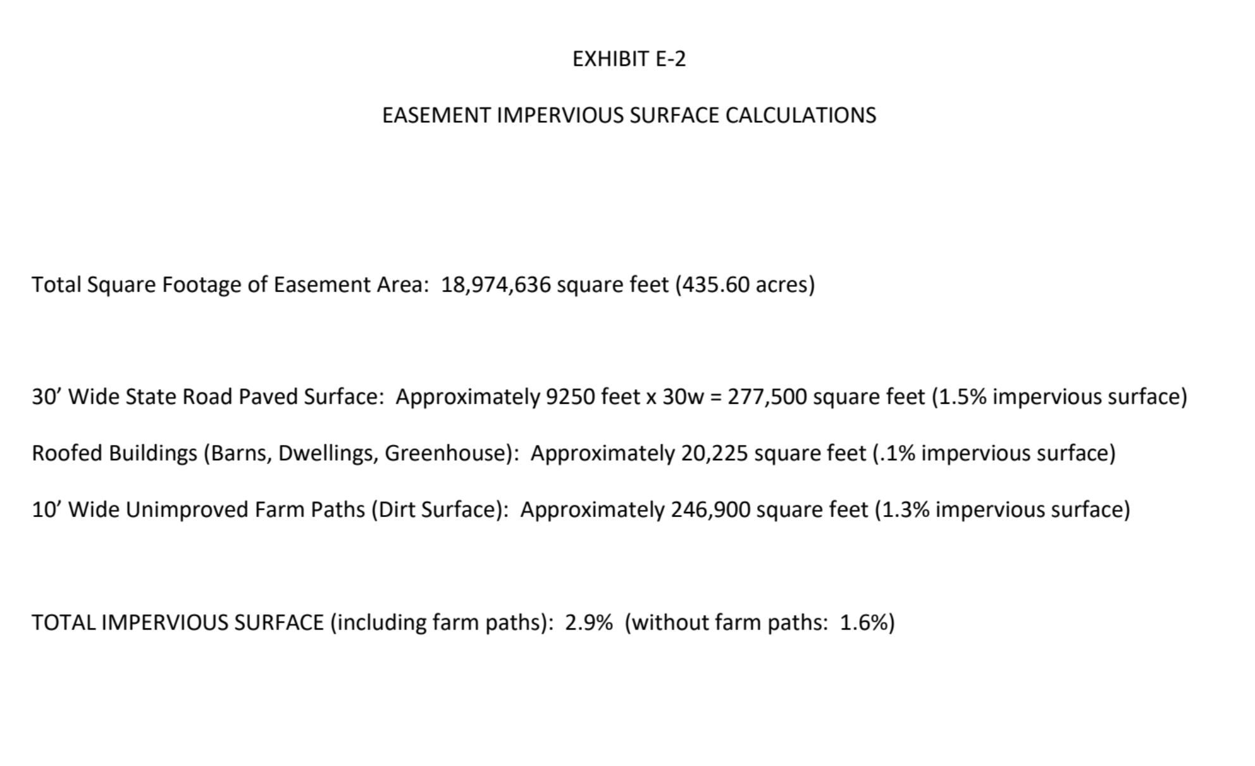

Slide 97
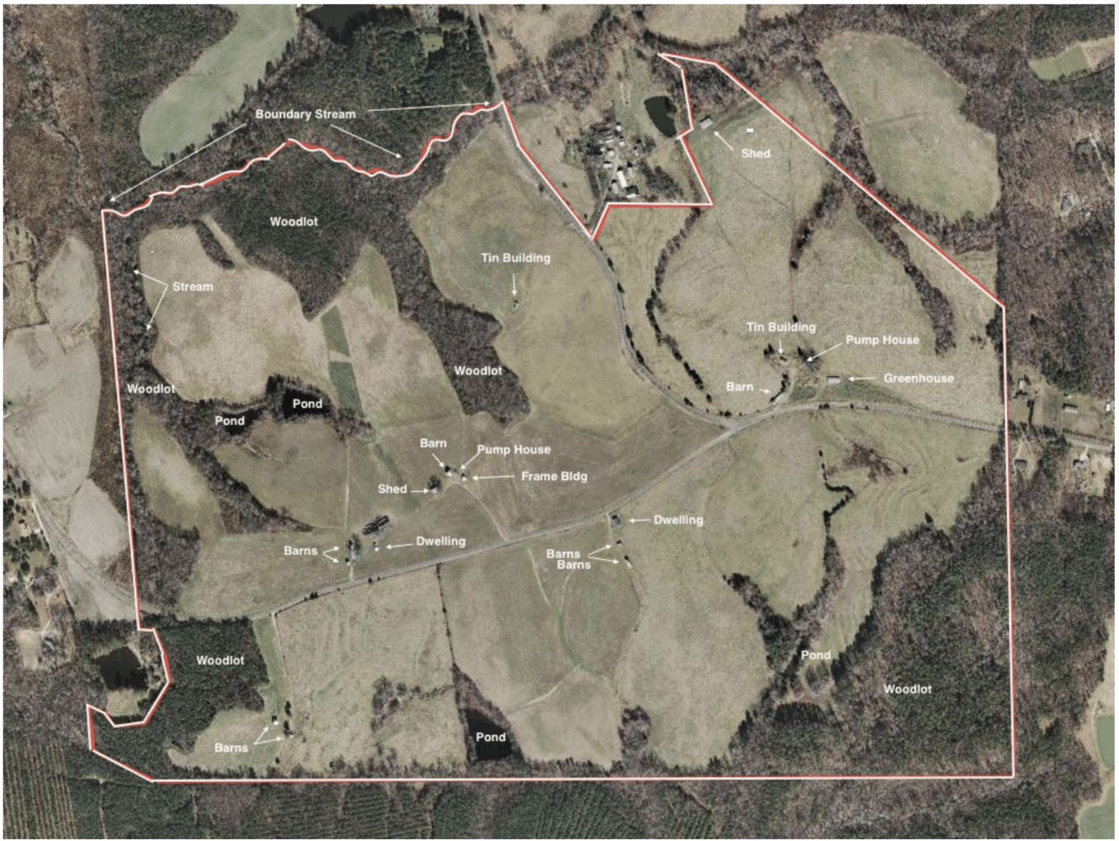

Slide 98
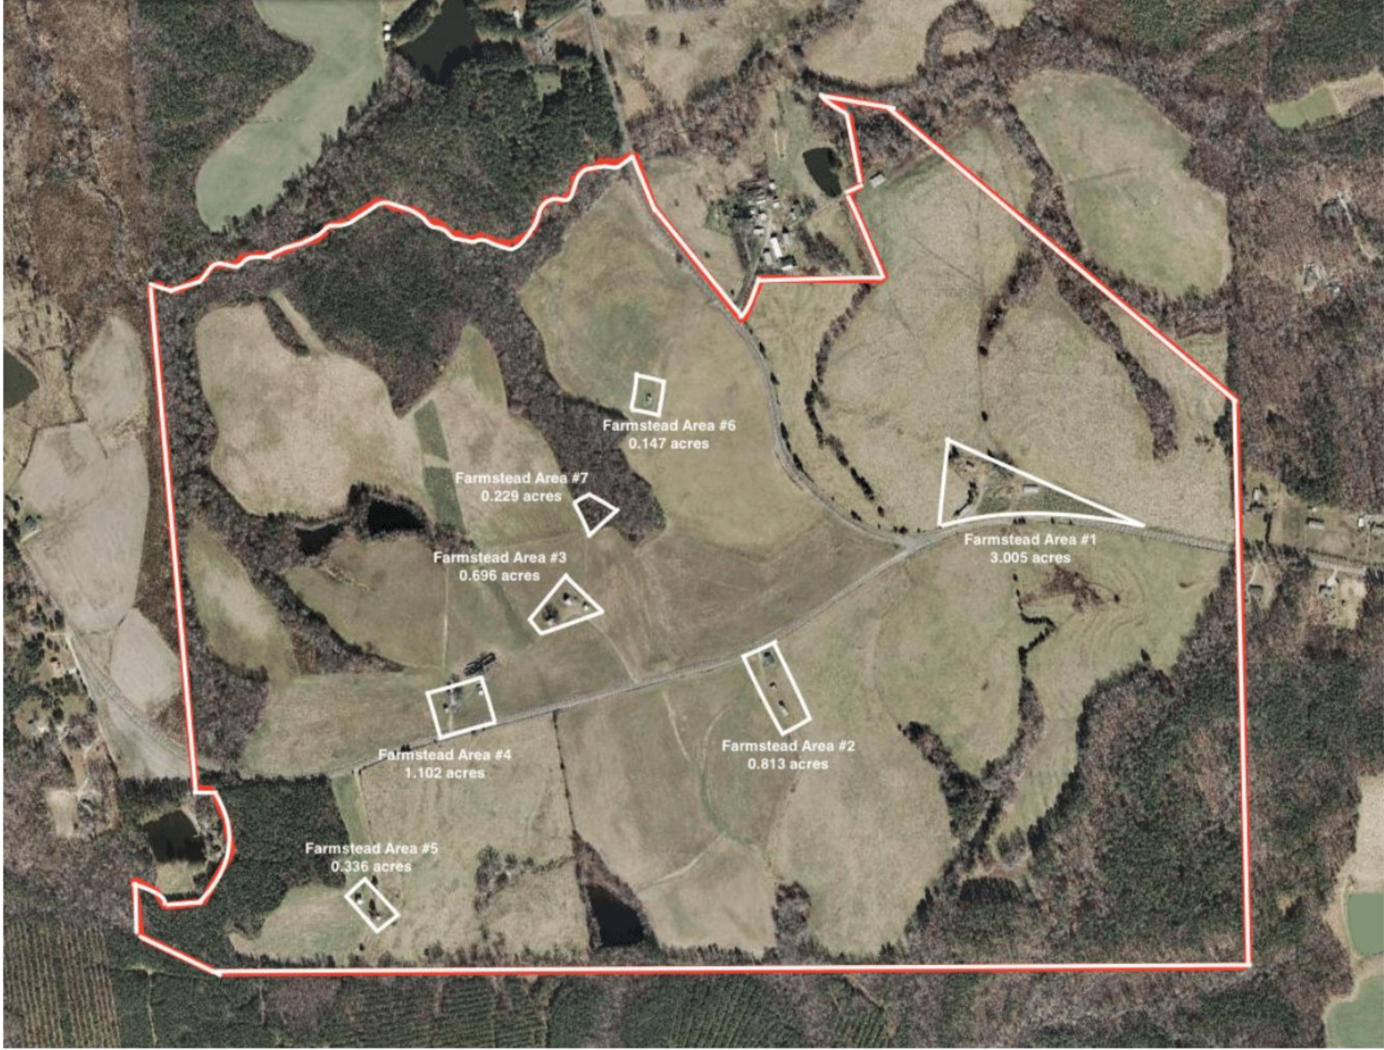

Slide 99
Possible Timeline with Will and Trust
Grantor Execute Will and Trust
Grantor Date of Death
Development Rights sold or donated to 3d party
Will simply devises all real property to Trust on Date of Death
(or) Will devises parcel A to Trust
Grantor deeds parcel A to Trust (?)
Parcel A
Parcel A
Parcel A
Parcel A
Parcel A
Trustee transacts project with 3d party
Grantor designs subdivision according to funding and statutory restrictions
Trustee directed and authorized to transact sale/donation of dev rights
Trustee restricted to negotiate proposed subdivisions with dev rights purchaser/donee?
Parcel A to beneficiaries by deed (whole or subdivided)
Trust terminates

Slide 100
Possible Timeline with Will only
Grantor Execute Will
Grantor Date of Death
Development Rights sold or donated to 3d party
Will simply devises all real property to devisees on Date of Death
Grantor and ALL devisees execute agreement for post-mortem sale/donation of development rights
Memorandum recorded with Register of Deeds
Parcel A
Parcel A
Parcel A
Devisees (representative under power of attorney?)
complete transaction
Interest in Parcel A passes to devisees immediately upon death
Subdivided by design?
Transferred to family LLC?

Slide 101
Possible Timeline with Option only
Grantor Execute Will
Grantor Date of Death
Development Rights sold or donated to 3d party
Will simply devises all real property to devisees on Date of Death
Parcel A
Parcel A
Parcel A
3 party executes option with Grantor
(option must specify subdivisions?)
Memorandum recorded with Register of Deeds
Runs with the land
Devisees under enforceable obligation to
complete transaction
Interest in Parcel A passes to devisees immediately upon death
Subdivided by design?
Transferred to family LLC?

Slide 102
THANKS FOR INVITING ME!
Robert Andrew Branan
Assistant Extension Professor
Department of
Agriculture and Resource Economics
North Carolina State University
rabrana2@ncsu.edu
This presentation and materials research, development and delivery are supported by the Sustainable Agriculture and Resource Education Professional Development Program Land Summit Professional Development grant (Award #531905)

