Slide 1
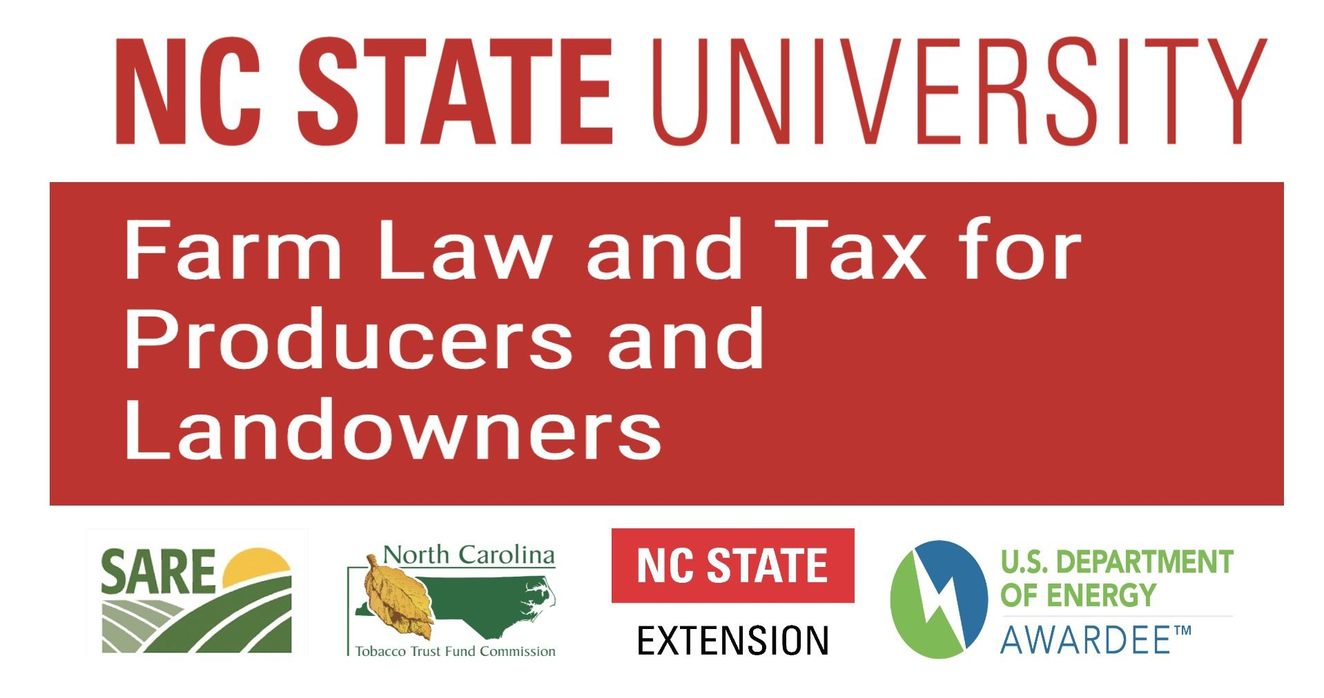
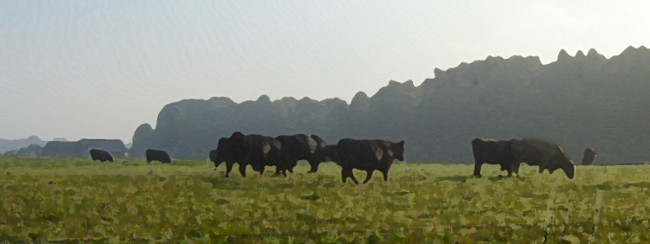
Farm Law and Tax for Operators and Landowners
2025 Land Use Law Update
Robert Andrew Branan, JD
Associate Extension Professor
Department of Agriculture and Resource Economics
North Carolina State University
rabrana2@ncsu.edu

Slide 2

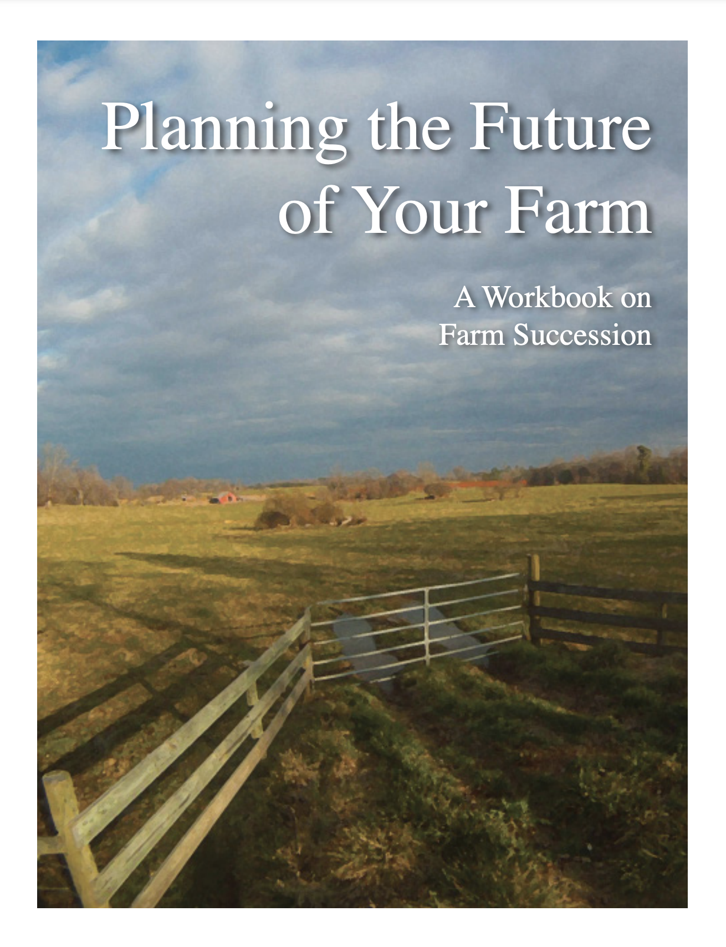
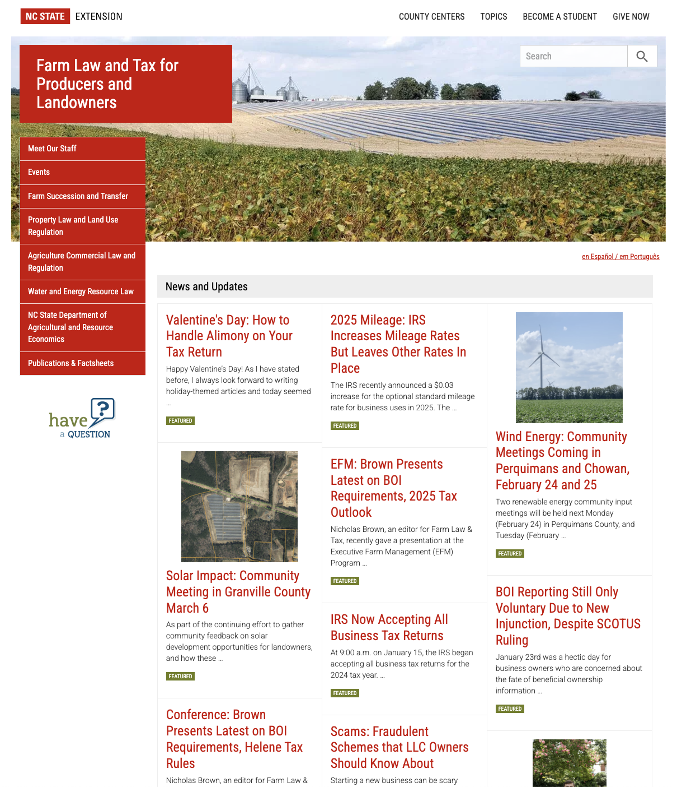
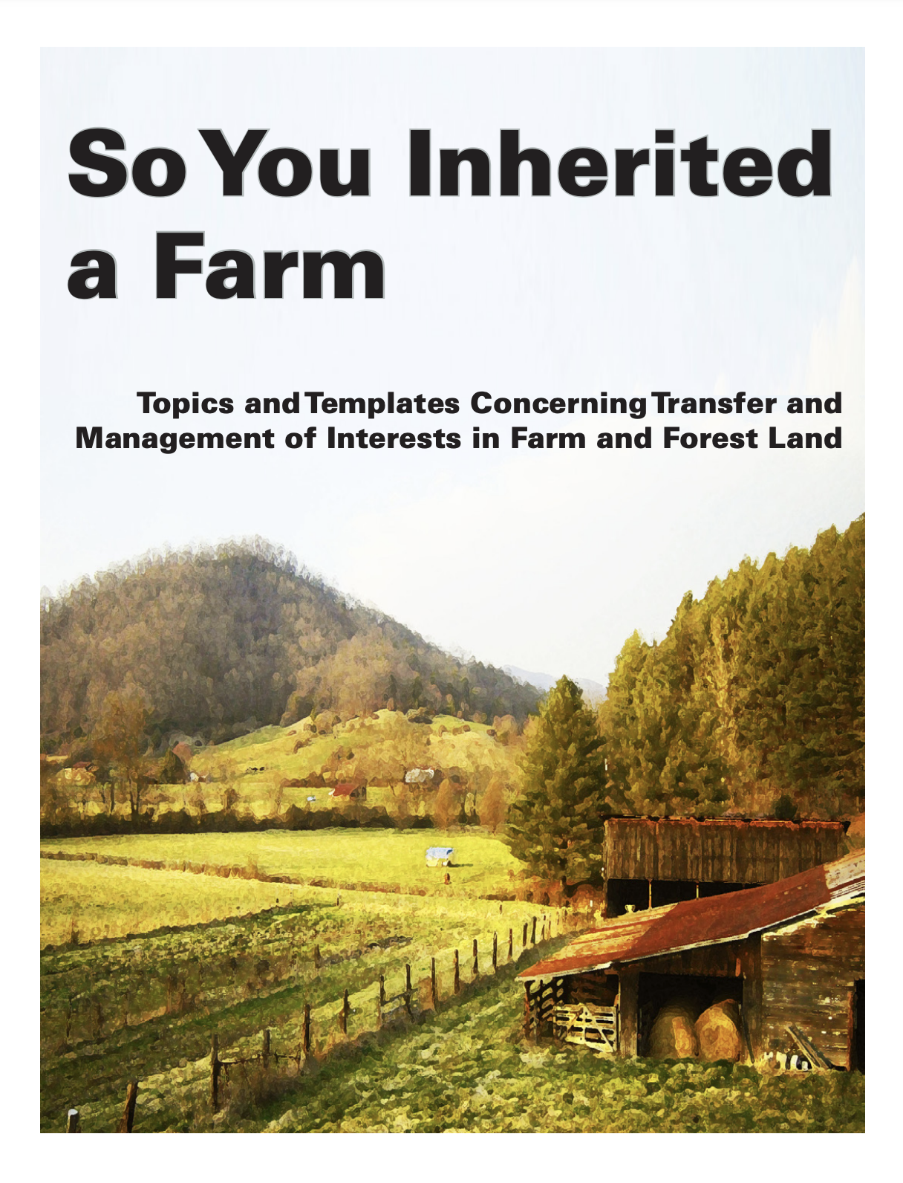
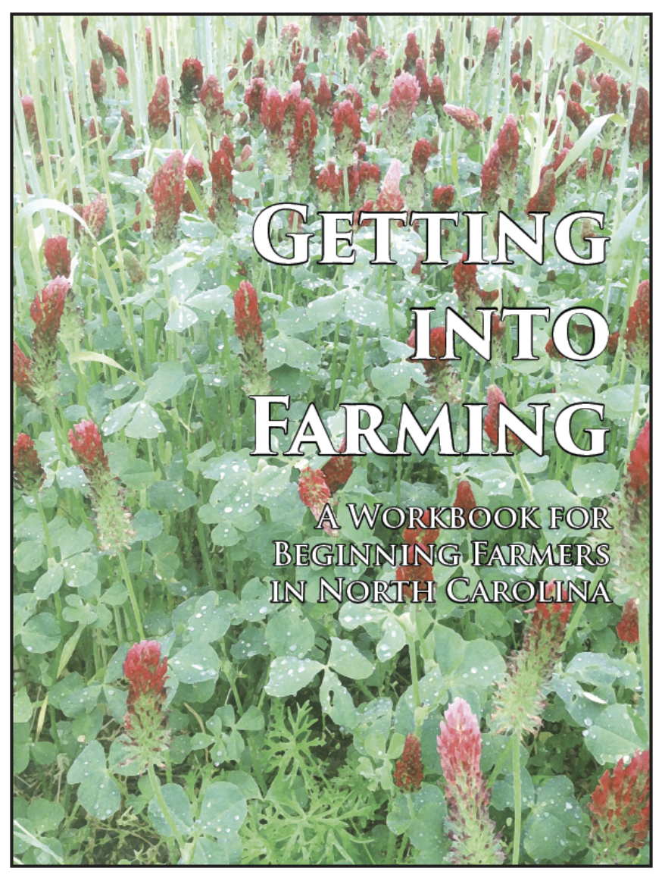

https://farmlaw.ces.ncsu.edu/
This web portal is supported by the Sustainable Agriculture and Resource Education Professional Development Program Land Summit Professional Development grant (Award #531905)

Slide 3
ARE Department Update
Approval of Masters of Agribusiness Management Program
  Provost approval for tenure-track professor to develop program
Teaching faculty under strain of student enrollment growth
Branan appointed ARE Coordinator for Agriculture Institute (NCSU 2-year associate’s degree)
  split now 50-50 Teaching/Extension
New Faculty
  Nicholas Brown, JD - non-tenure track Extension/Teaching
    redevelopment of tax program (replacement for Guido van der Hoeven)
  Dr. Seugnhyun Lee - tenure track Research/Extension
    production economist
  Dr. Zach Raff - tenure track Research/Teaching
    resource economist?

Slide 4
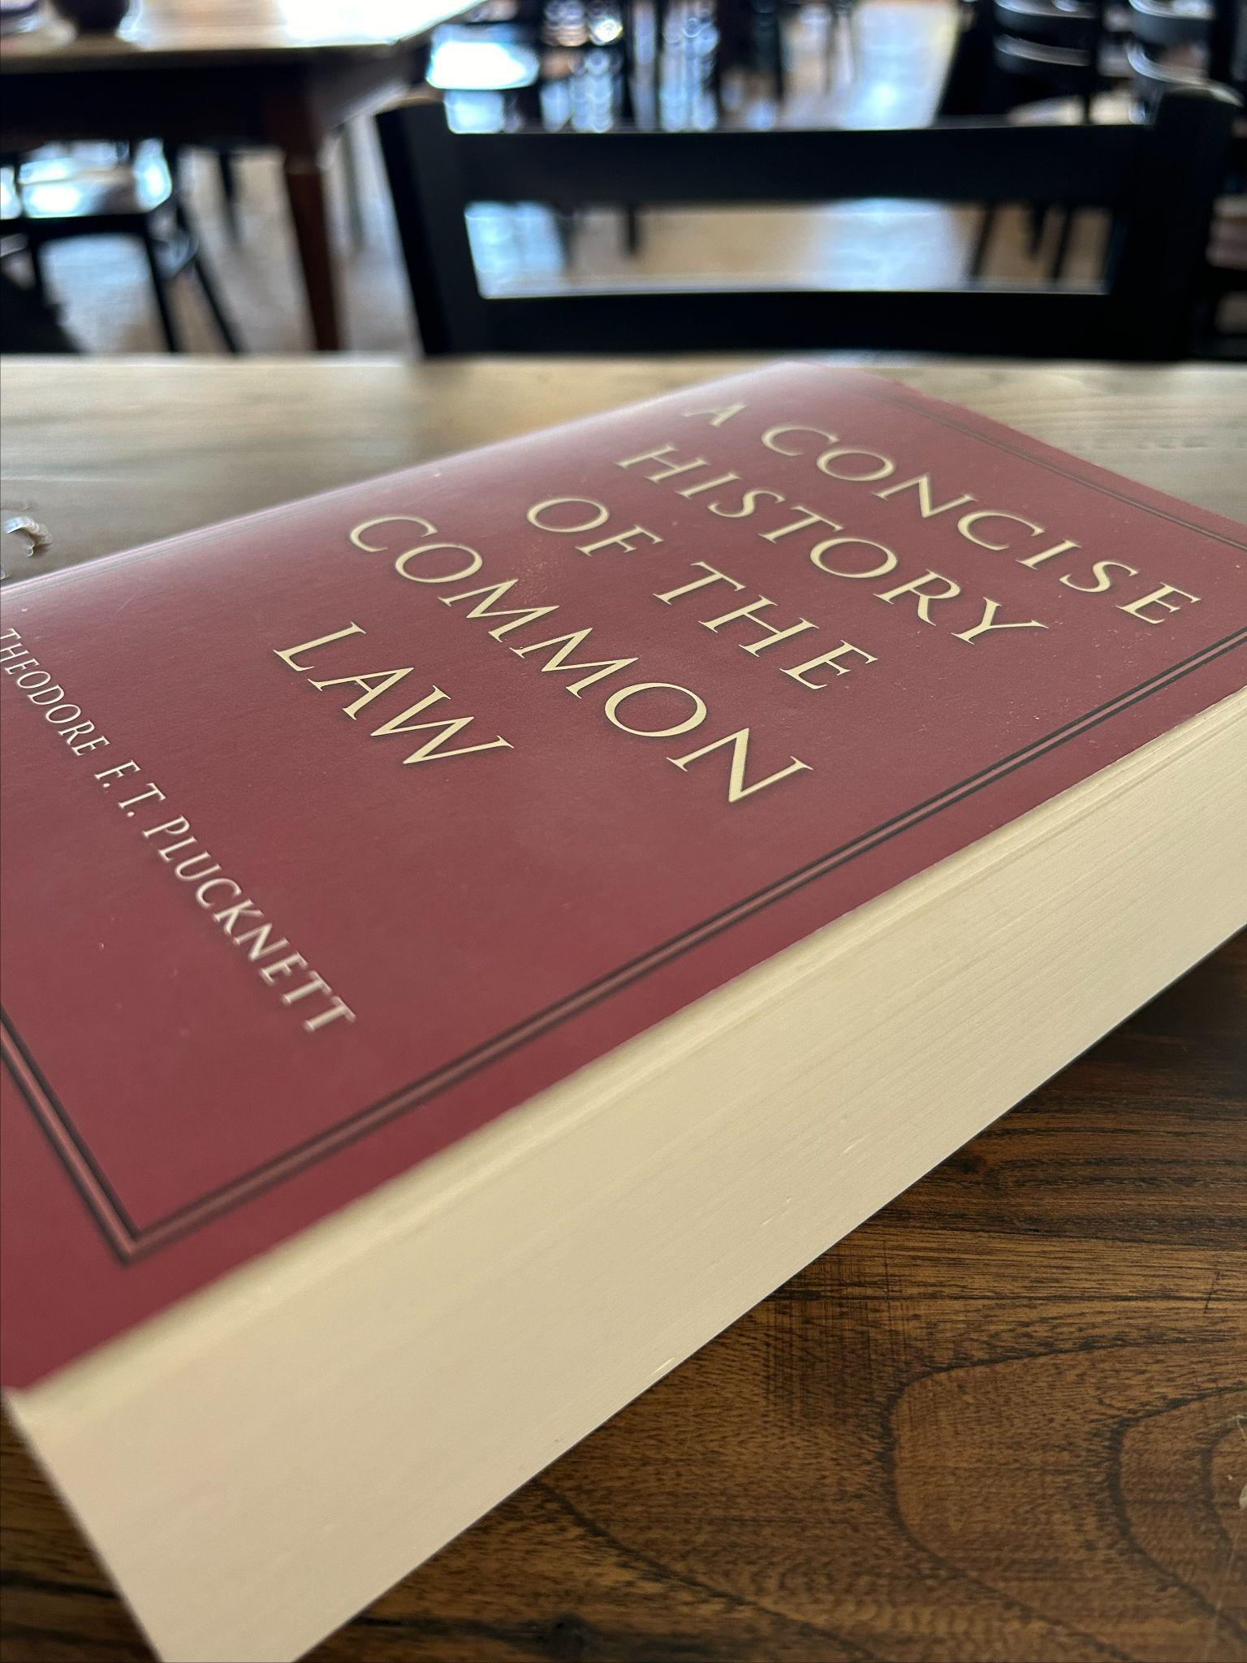
The Study of Law and Policy: Government Power and Dispute Resolution
The study and teaching of law traces the history of England and the United States (and North Carolina) in two tracks in the development of law:
Track One - The millennium of refining government power through its representative legitimacy
  Ours is the history of England, at least up to early 18th century
  experience of society fuels evolving concepts of civil liberty, equal protection and participation in government that check such power (what we call “human rights”)
Track Two - The millennium of forging rules and processes to resolve the peoples’ disputes peaceably (against the government and each other) where courts craft and follow rules to:
  determine ownership of property and obligations on contract
  assign responsibility for wrongs
  review whether government action upon the people is authorized by the people (modern)
    government has authority, only people have rights enshrined in federal and state constitutions
    all legal authorizations are “authorized privileges”
“The life of the law has not been logic; it has been experience.”
Justice Oliver Wendell Holmes, The Common Law

Slide 5
Federal, State Law and Local Authority
Federal government power is limited
  by the grant of authority in the words and phrases of the U.S. Constitution
  by the rights “we the people” have reserved to ourselves alone
All other power is reserved to the states via the 10th Amendment
  Land Use is a function generally reserved to the states
  Unless Congress chooses to intervene (e.g. environmental laws)
Local government (in NC) has no inherent power
  all zoning and taxing authority comes from state statute

Slide 6
Application of State Regulation and Exemptions
Statutes apply language in definitions left to interpretation
  e.g. exemption for “farm buildings”
  e.g. what is “horticulture” for PUV?
Exemptions - for most part - are based on actual growing and sale of products grown, and documentation of income
  e.g. property tax exemption (PUV) requires proof of income from sale of product
  e.g. sales tax exemption requires production on home farm

Slide 7
Challenge of Local Decisions and Authority
County will adopt a position adverse to a landowner or farmer’s interest
Farmer/Landowner comes to county Extension with the problem
Challenge is how to advocate for the local ‘client’
The County has adopted a position
  EXAMPLE:
    parcel owner A ‘loses’ acreage because neighbor B ‘surveyed’ away enough acreage to disqualify parcel A from 10 acres required for Present Use Value
    county applies roll back
    parcel A appeals (or fails to appeal)
    roll back is a lien on parcel A (owner has uphill battle)
    amount of lien <$1000, county assumes not enough money to hire counsel to fight
    will require a court to overturn county’s decision ($$$$$)
Can try to modify county’s position with an opinion

Slide 8
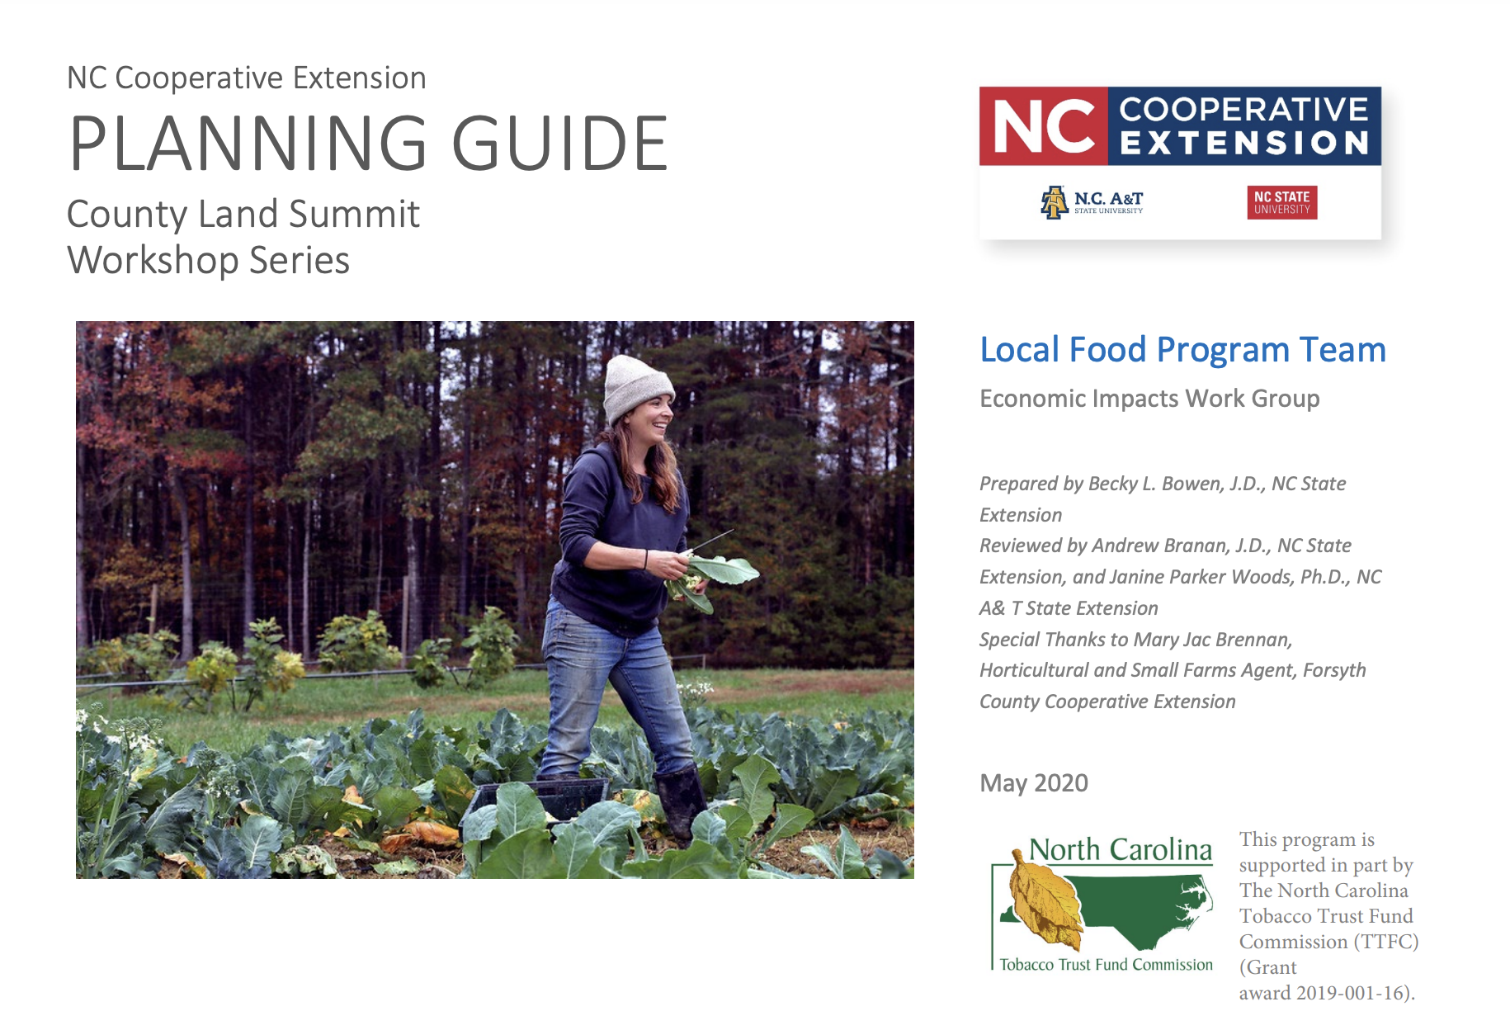

Projects: Land Summits
Landowner general land use law and tax and succession planning education
handy Planning Guide with proposed curriculum
  authored by Becky Bowen
Local presenters + Extension specialists
Topics:
  Conservation programs
  FSA programs
  Succession planning
  Extension resource programs (e.g. Farmlink)
  Property Taxes
  Timber management
  Easements and rights of way
  Etc.

Slide 9


Projects: Planning the
Future of Your Farm
Grant from NC Tobacco Trust Fund
Implement form of survey from FARMTRANSFERS project
Deliverables:
  survey/consult activity with commodity groups
  update of PFYF workbook
    WHY? because it is 7 years since last update and still in use
components as Extension fact sheets
The Ask: please respond to my email if you are connected with a group and can make
an introduction to Executive Director

Slide 10
Farm Succession Work continues…
Increasing focus on Professional Credit Education
Landscaper licensing
  western piedmont (January) and mountains (July)
  Appraisers
    NC Society Farm Managers and Rural Appraisers
    American Society of Farm Managers and Rural Appraisers
Planners - upcoming on solar and bona fide farm zoning
Lawyers - upcoming on solar permitting and conservation easements, etc.

Slide 11
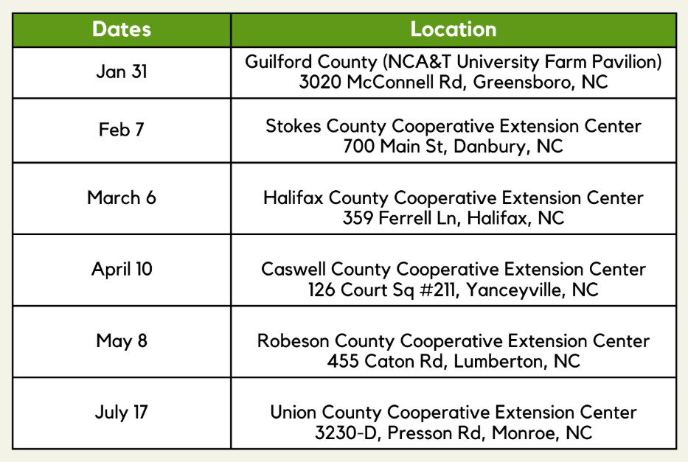
Heirs Property at the Community Level
Collaboration between A&T and NCSU (CALS and CNR)
Ending 9/30
Developed nexus with Urban Extension programming
Additionals
NC Coastal Conference - Nov 2024
Vance County - July 2025
Cullowee (WCU) - July 2025
Guilford - August 2025

Slide 12
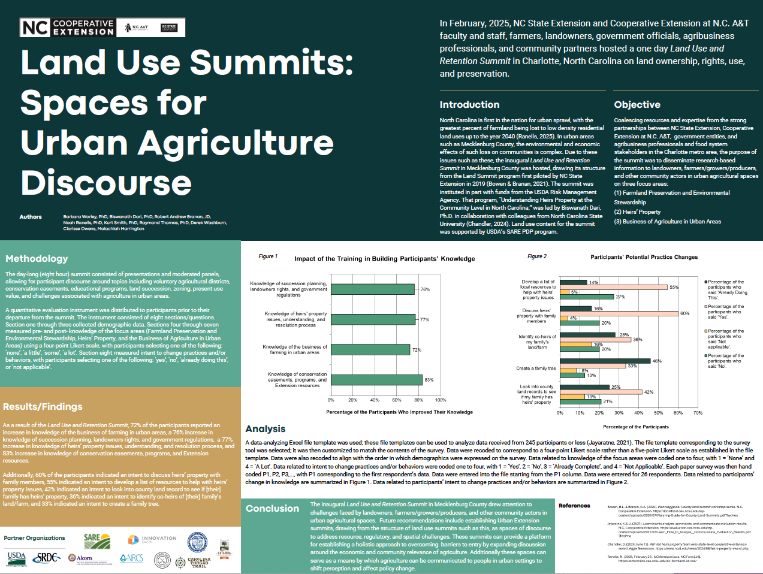

Slide 13
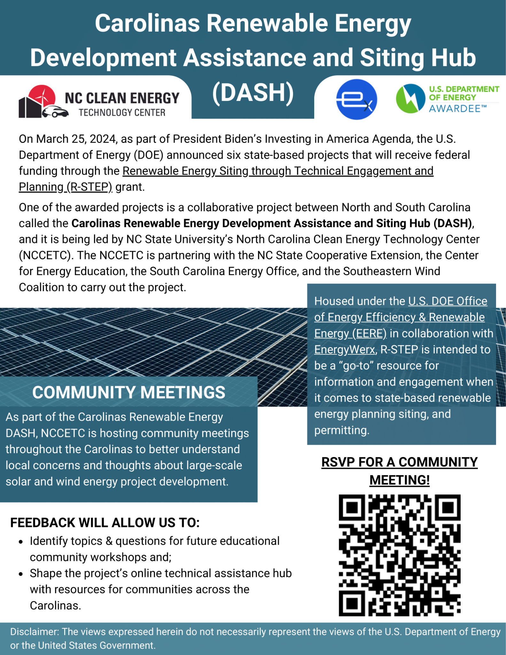
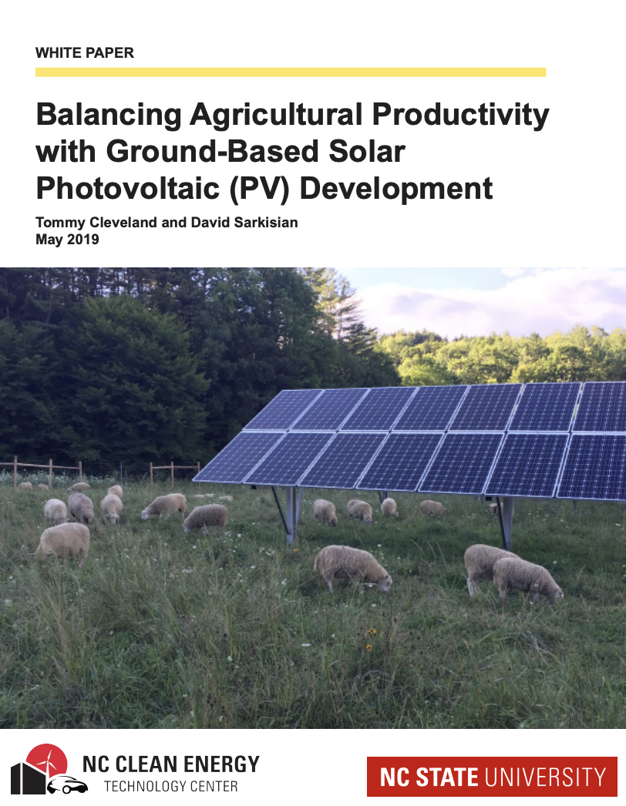
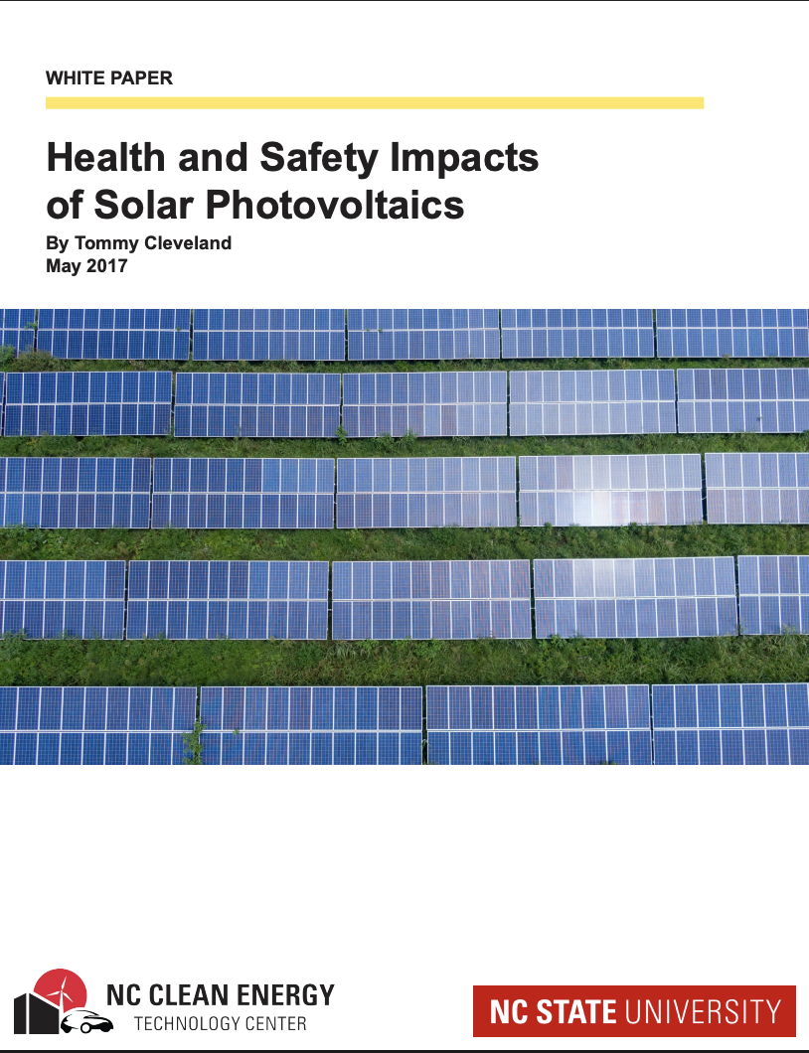
Renewable Energy Development (C-DASH Project)

Slide 14

NC Energy Policy
North Carolina Carbon Plan (HB 591: Energy Solutions for North Carolina
  requires Duke Energy to reduce carbon emissions by 70% from 2005 levels by 2030 (“net-zero” by 2050)
Duke Energy: “energy use is projected to grow by around 35,000 gigawatt-hours over the next 15 years Approved by the NCUC
The North Carolina Utilities Commission (NCUC) issued its most recent Carbon Plan Integrated Resource Plan (IRP) Order on November 1, 2024.
Additional clean energy resources: The NCUC accepted Duke Energy’s additional proposed clean energy buildout, including:
Solar: 3,460 megawatts (MW) of new solar generation, 6,700 MW total by 2031
Battery: 1,100 MW of battery energy storage, 2,700 MW total by 2031
Onshore Wind: 1,200 MW of onshore wind in operation by 2033, including at least 300 MW in operation by 2031
If 1MW = 5 acres, then 3460 x 5 = 17300 acres…

Slide 15
Renewable Energy Development in NC
Continuing development of larger utility scale facilities (in wake of 2017’s HB 589 procurement reform
Estimated 700 solar farms on nearly 35,000 acres (NCSCEA)
NC Utilities Commission has modified its Clean Energy Plan to extend targets
Duke Energy has requested extensions in timeline to transition coal energy to natural gas
  New Integrated Resource Plan submitted October 1 (to Revise November 2024 approved plan)
Counties are responding with revising ordinances and moratoria on solar development
State policy headwinds (e.g. repeal of personal property tax abatement, House Bill 729)

Slide 16
Branan’s Presentation of Renewable Energy Policy/Forecasts to NC Cooperative Extension (Jan 2025)
North Carolina Carbon Plan (HB 591: Energy Solutions for North Carolina
  requires Duke Energy to reduce carbon emissions by 70% from 2005 levels by 2030 (“net-zero” by 2050)
Duke Energy: energy use is projected to grow by around 35,000 gigawatt-hours over the next 15 years
The North Carolina Utilities Commission (NCUC) issued its most recent Carbon Plan Integrated Resource Plan (IRP) Order on November 1, 2024.
Additional clean energy resources: The NCUC accepted Duke Energy’s additional proposed clean energy buildout, including:
Solar: 3,460 megawatts (MW) of new solar generation, 6,700 MW total by 2031 If 1MW = 5 acres, then 3460 x 5 = 17300 acres +/-…
Battery: 1,100 MW of battery energy storage, 2,700 MW total by 2031
Onshore Wind: 1,200 MW of onshore wind in operation by 2033, including at least 300 MW in operation by 2031

Slide 17

Renewable Energy Development (C-DASH Project Survey Results)

Slide 18
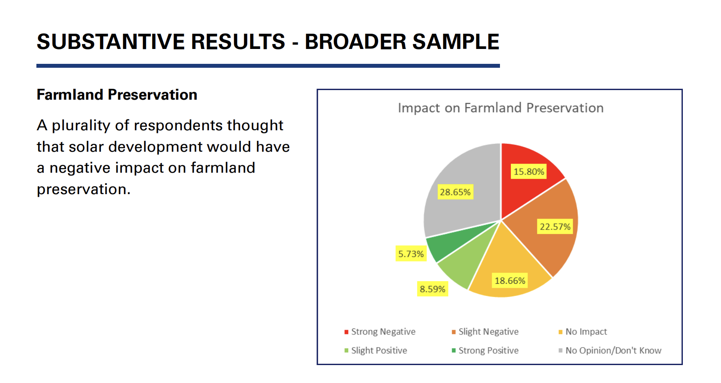
Renewable Energy Development (C-DASH Project Survey Results: Farmland Preservation)

Slide 19
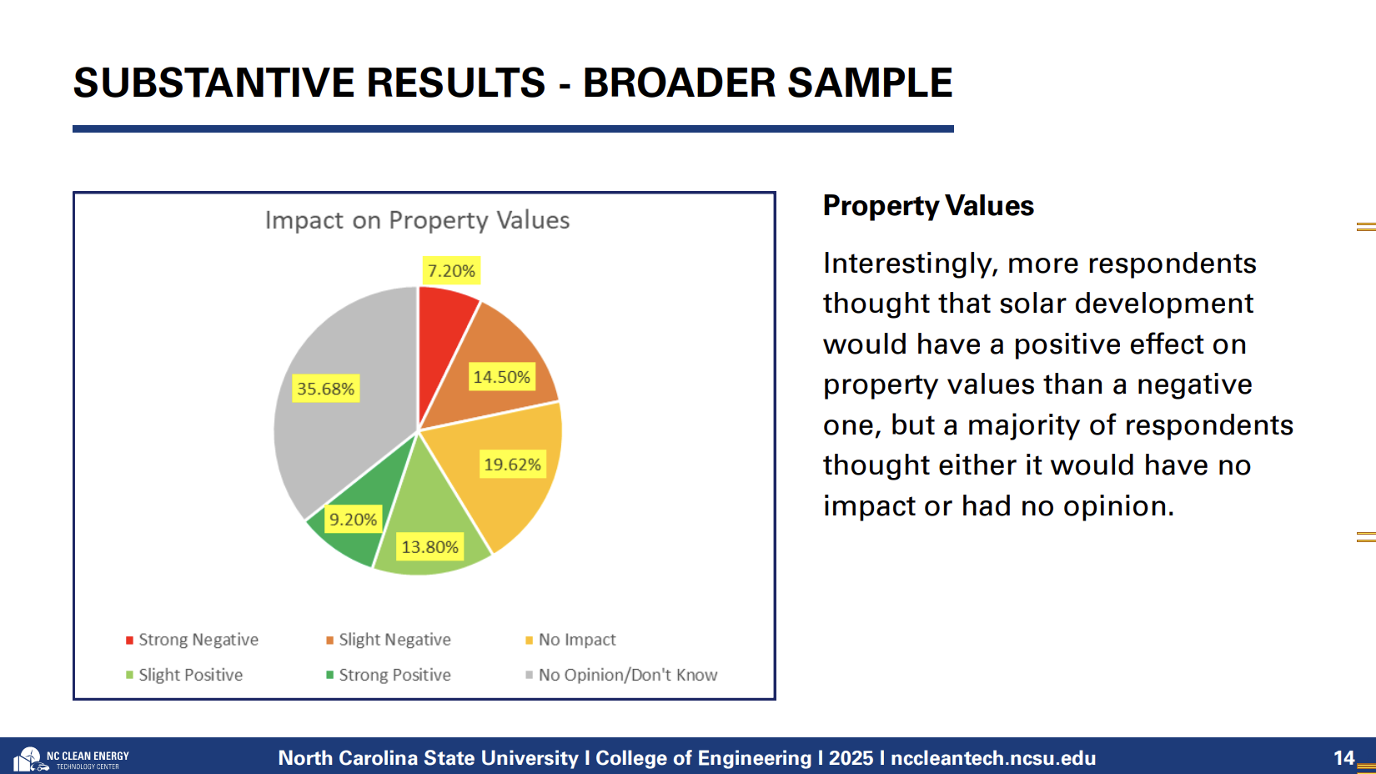
Renewable Energy Development (C-DASH Project Survey Results: Property Values)

Slide 20
Research on Farmland Values Near Solar Energy Sites
Source: Kirkland Appraisal Letter (for Stokes County proposed solar development, November 2024)
Solar’s Impact On Rural Property Values (Andy Eames, ASFMRA, Farm Journal, September 19, 2022)
Assessing property value impacts near utility-scale solar in the Midwestern United States (Simeng Hao, Gilbert Michaud, Solar Compass Volume 12, December 2024)
Shedding light on large-scale solar impacts: An analysis of property values and proximity to photovoltaics across six U.S. states (Salma Elmallah et al, Energy Policy Volume 175, April 2023, 113425)
Other Source:
Literature Review on the Impact of Utility-Scale Solar on Housing Prices (Greg Upton, Sarang Talpur, Louisiana State University, August 2024)

Slide 21
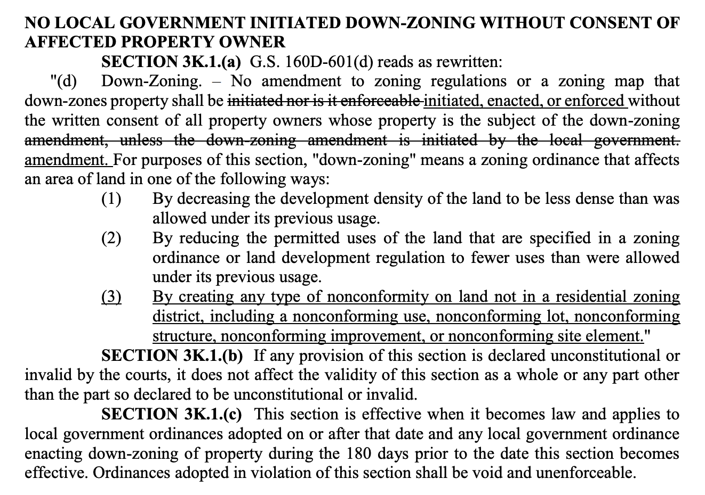
New Down-Zoning Legislation - SESSION LAW 2024-57 SENATE BILL 382 (inserted into Helene package)
.
The law expands the definition of down-zoning to include any change in zoning that decreases density, reduces permitted uses, or creates a nonconforming use, lot, or structure
“Down-zoning” means a zoning ordinance that affects an area of land in one of the following ways:
By decreasing the development density of the land to be less dense than was allowed under its previous usage.
By reducing the permitted uses of the land that are specified in a zoning ordinance or land development regulation to fewer uses than were allowed under its previous usage

Slide 22
New Zoning Legislation - Voluntary Agricultural Districts (SESSION LAW 2025-12 HOUSE BILL 126)
Increases public hearing requirements for condemnation and rezoning of land enrolled in a voluntary agricultural district
expands from condemnation to include rezoning
still applies only to public condemnors
Public hearing window increased from 30 days to 120 days
Questions:
must the public hearing follow form prescribed in zoning statute?

Slide 23
Voluntary Agricultural Districts
County ordinance authorized by NCGS 106-735 (91 counties)
  half administered by Cooperative Extension, half by Soil & Water
Voluntary agreement not to remove from farm or forest use for 10 years (freely revocable, no ramifications)
Requires a Conservation Agreement
  stand alone or part of application
Enhanced VAD agreements are irrevocable for 10 years
  auto 3 year renewal if do not terminate
  cannot revoke if attractive purchase offer emerges
Farm Act 2020: VAD Board may enroll land if delegated
Farm Law article: The VAD/EVAD Conservation Agreement Requirement

Slide 24
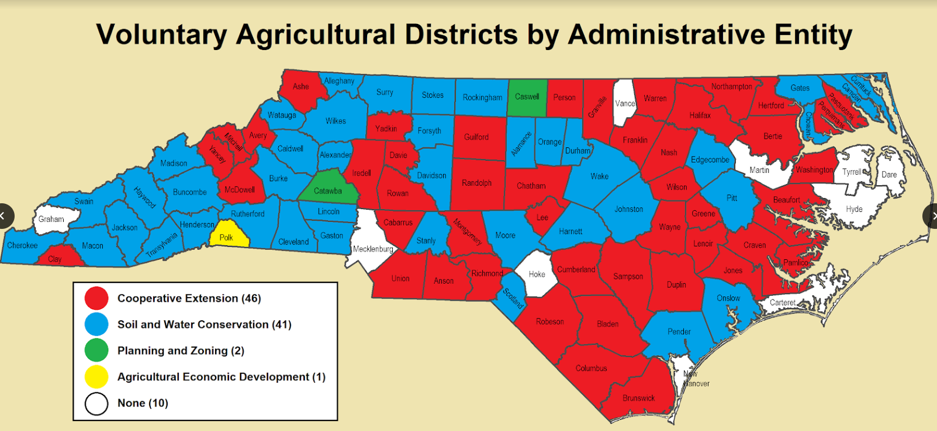

Slide 25
North Carolina Farm Act Highlights
2023: SESSION LAW 2023-63
aligns state wetlands protection with federal definition (no protection for ‘isolated’ wetlands)
  NOT a boon to producers, who are still subject to Farm Bill ‘swampbuster’ provision
adds income from sale of honey as qualifying income toward Present Use Value income requirement
adds compost as sales tax-exempt input under Qualifying Farmer Certificate
adds pine needles and biofuel production to definition of “agriculture”
allows ‘seasonal’ farm agritourism signs in DOT right of way
New Agritourism (99E) liability exemption signs:
"WARNING
Under North Carolina law, there is no liability for an injury to or death of a participant in an agritourism activity conducted at this agritourism location if such injury or death results from the inherent risks of the agritourism activity. Inherent risks of agritourism activities include, among others, risks of injury inherent to land, equipment, and animals, as well as the potential for you to act in a negligent manner that may contribute to your injury or death.
You are assuming the risk of participating in this agritourism activity."

Slide 26
2024: SL 2024-32
horse boarding, training, etc. is now included in definition of agriculture (any statutory reference to "§ 106-581.1” includes equine activity)
horse boarding, training, etc. is considered farming for purposes of right to farm law (nuisance)
horse boarding, training, etc. is specifically included as an agricultural activity as exempt from land disturbance under sedimentation control act (NCGS §113A)
a bit about shellfish leases
a bit about sweet potato promotion
swine general permits extended to June 2026 (assume in wake of Farm Bureau v. DEQ case)
composting facilities added to Right to Farm statute
limit regulation of bee hives by municipalities in their extra territorial jurisdictions
Return of the state Conservation Tax Credit
  equal to 25% of FMV of donated value ($500,000 cap)
  for individuals, C corporations and pass through entities (LLCs)

Slide 27

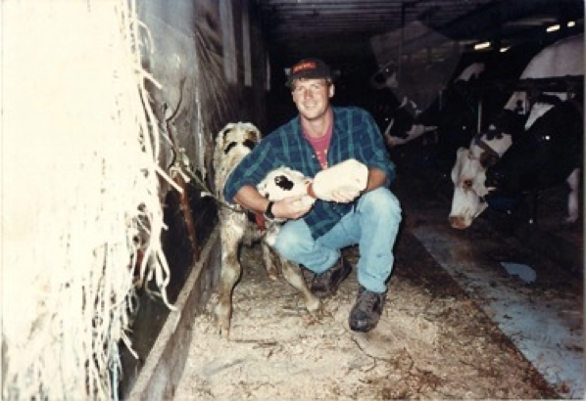
THANKS FOR INVITING ME!
Robert Andrew Branan
Associate Extension Professor
Department of
Agriculture and Resource Economics
North Carolina State University
rabrana2@ncsu.edu
This presentation and materials research, development and delivery are supported by the Sustainable Agriculture and Resource Education Professional Development Program Land Summit Professional Development grant (Award #531905)

