Slide 1
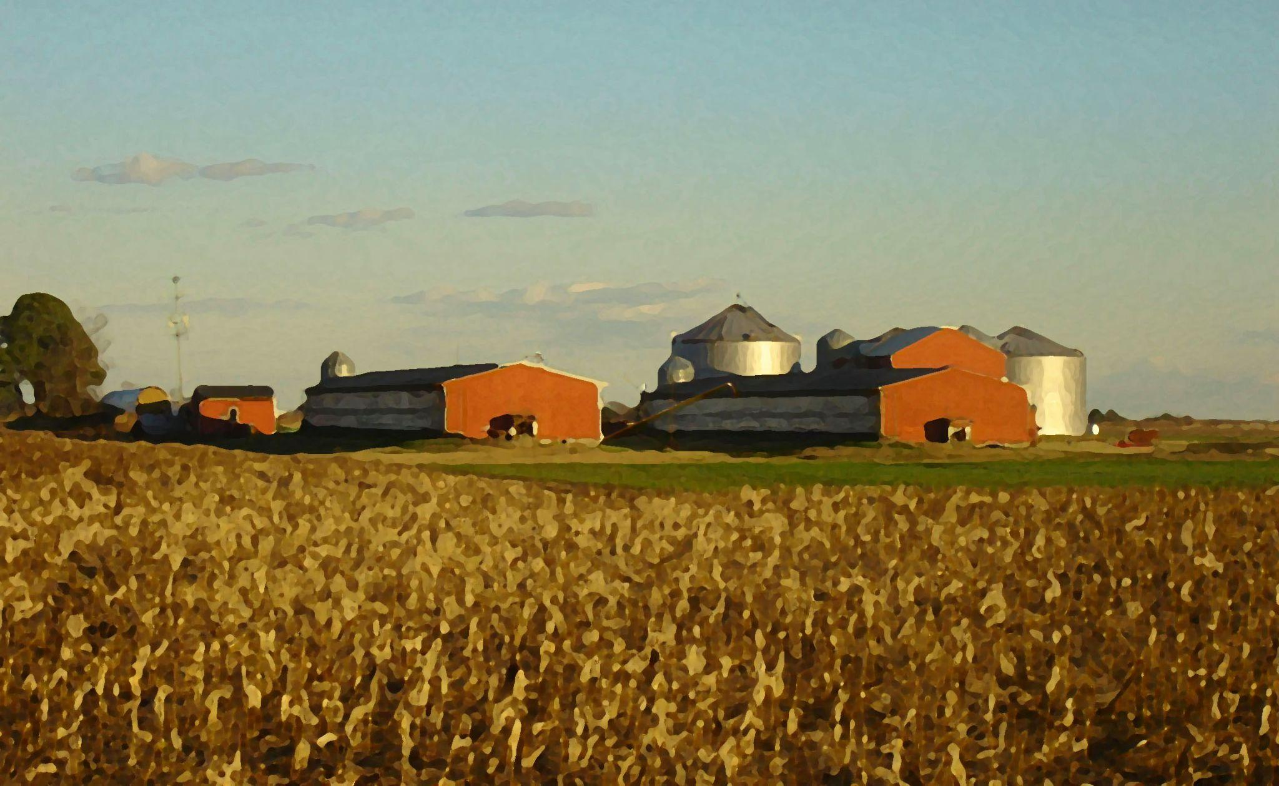
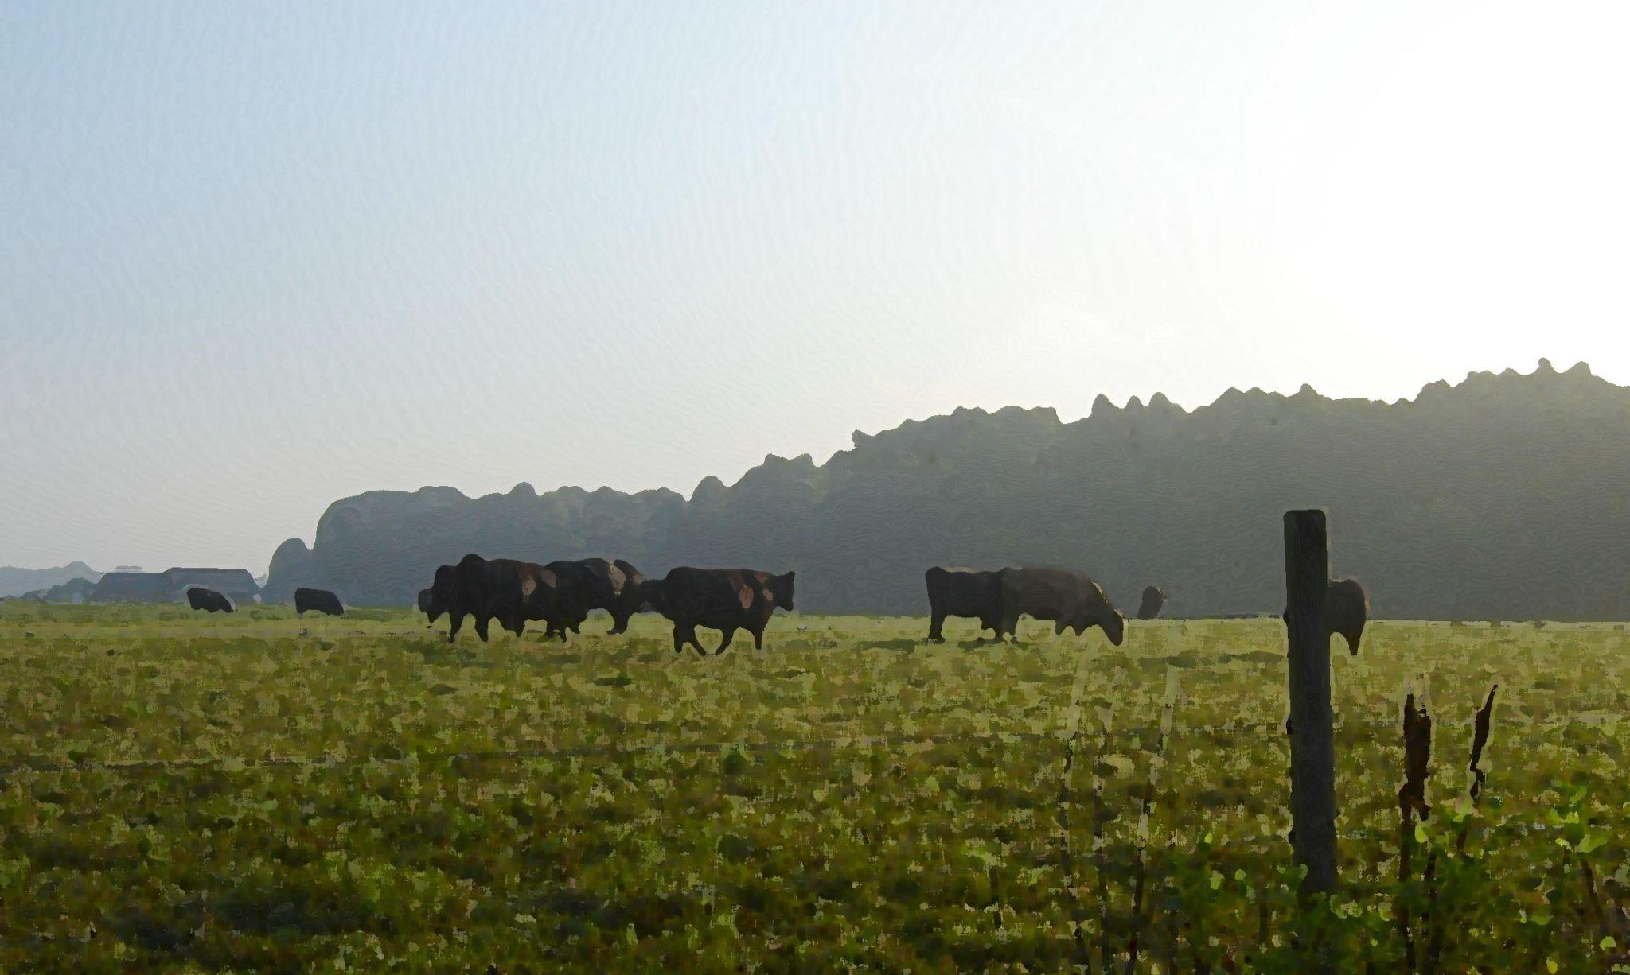
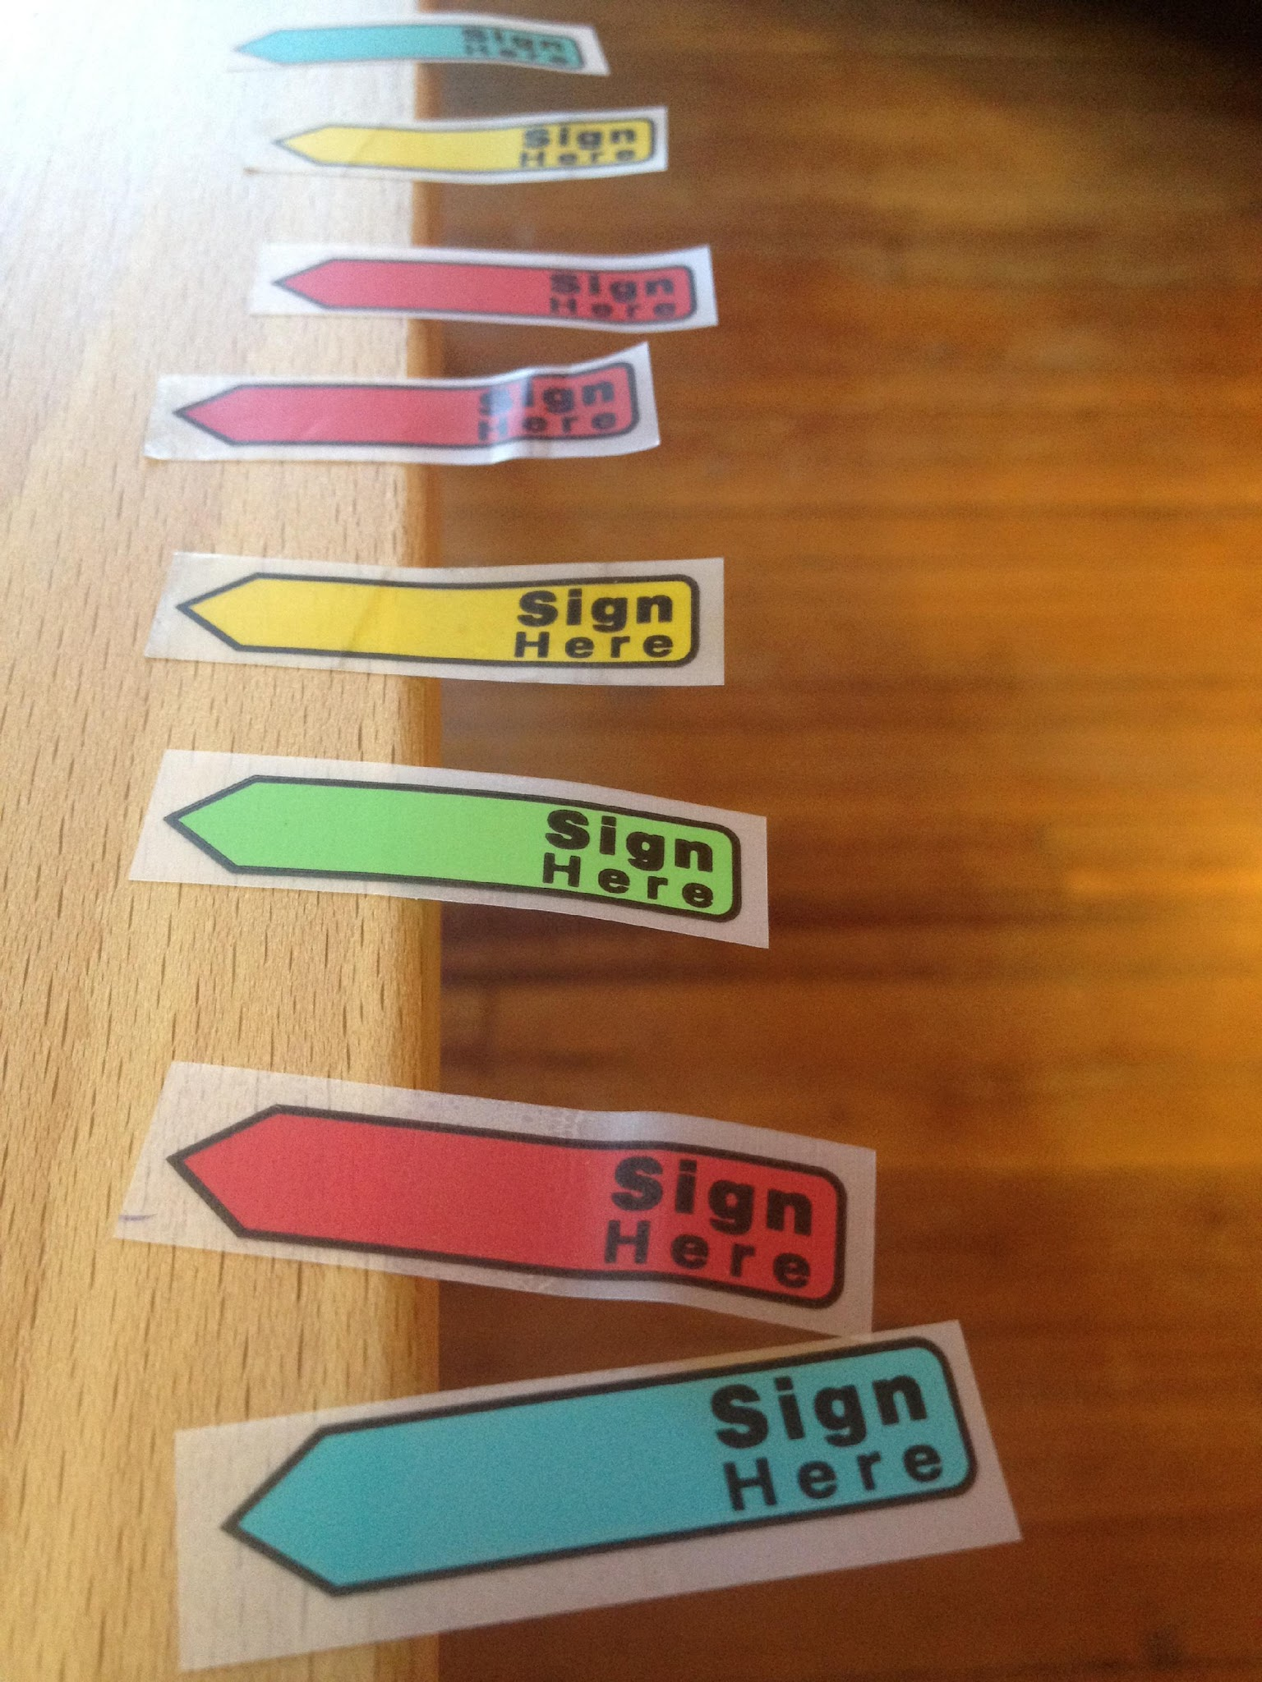
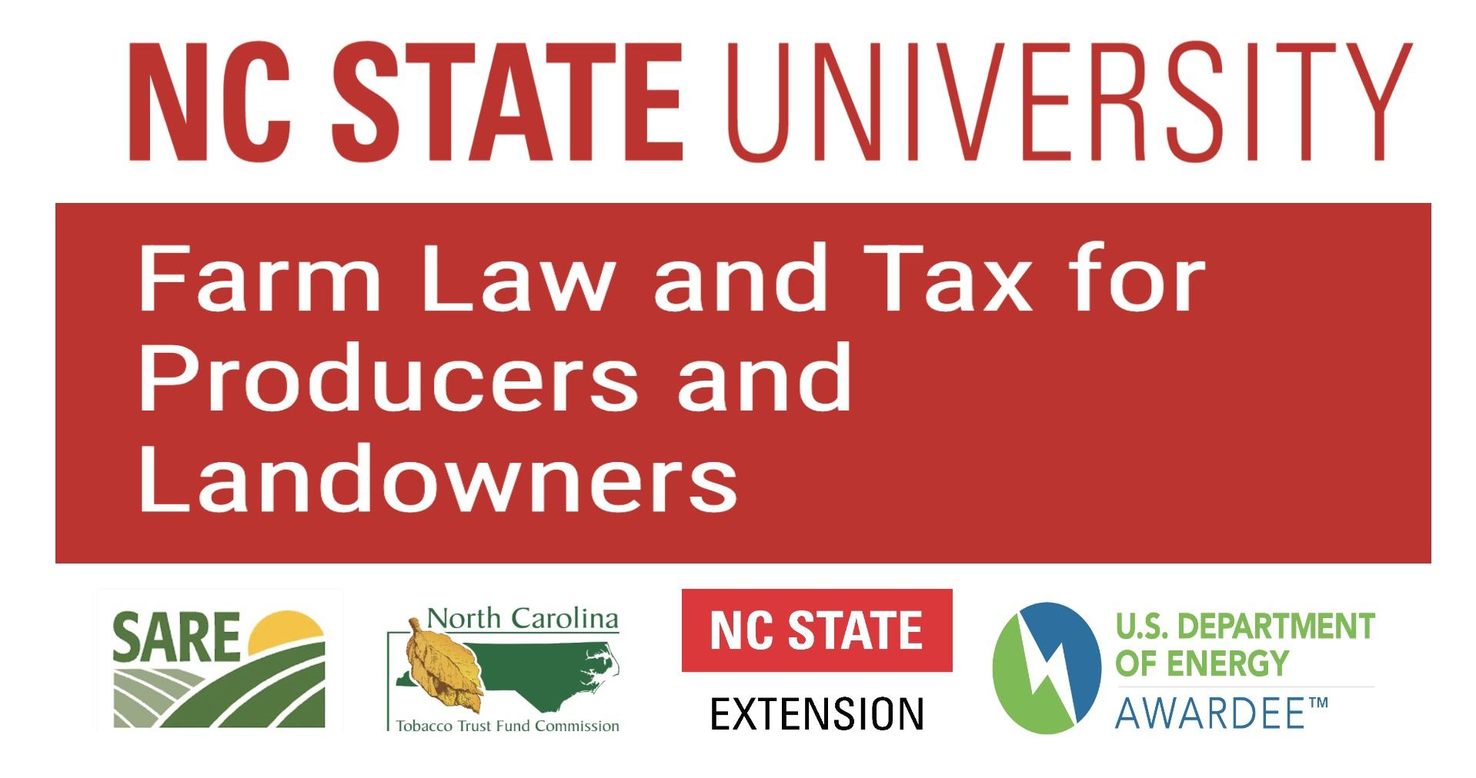
Farm Law and Tax for Producers and Landowners
The Flexible Architecture of Farm Succession:
Disposition, Management and Options
Robert Andrew Branan, JD • rabrana2@ncsu.edu

Slide 2
This Legal Educator’s Background
Member of the Virginia State Bar (1992) and North Carolina State Bar (2003)
Non-profit work in agriculture (2002 - 2009)
  American Farmland Trust
  NC Farm Transition Network
Private (Farm) Law Practice (2008 - 2018)
NCSU Agricultural and Resource Economics (2018 - )
  50% Extension appointment
  50% Teaching (Environmental and Agriculture Law)
      Agricultural Law (4 year NCSU undergraduate)
      Environmental Law and Economic Policy (4 year NCSU undergraduate)
      Agribusiness Law (2 year Agricultural Institute NCSU program)
        Curriculum Coordinator, April 1, 2025

Slide 3
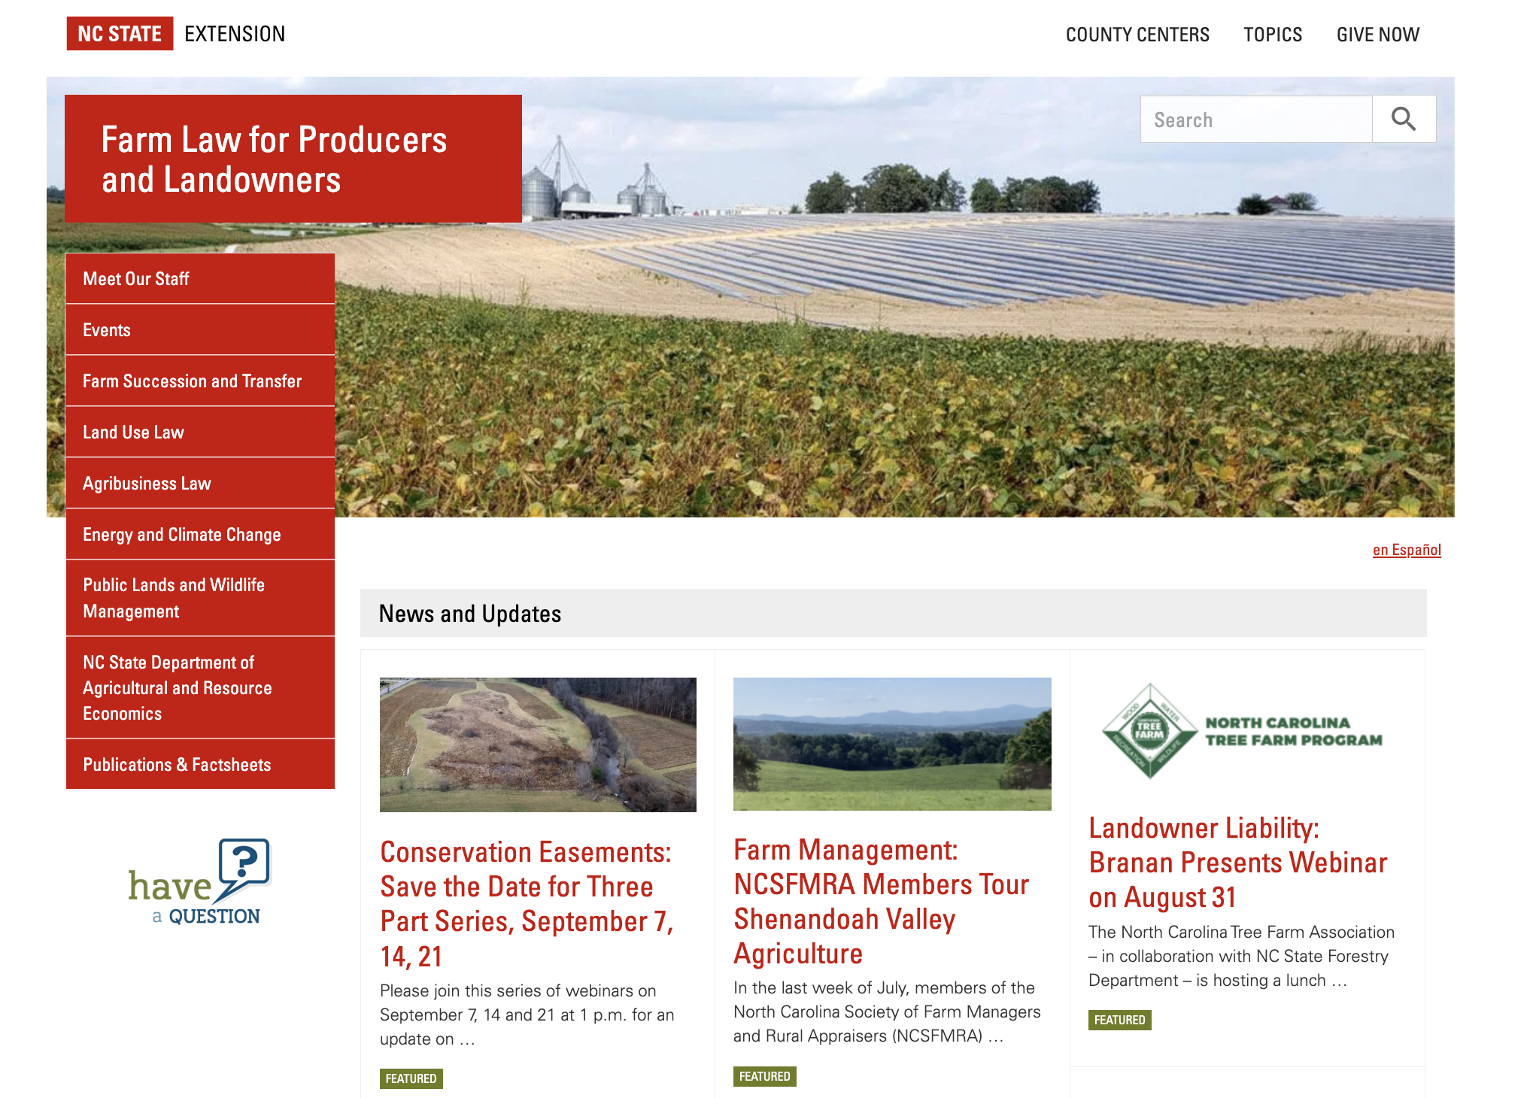
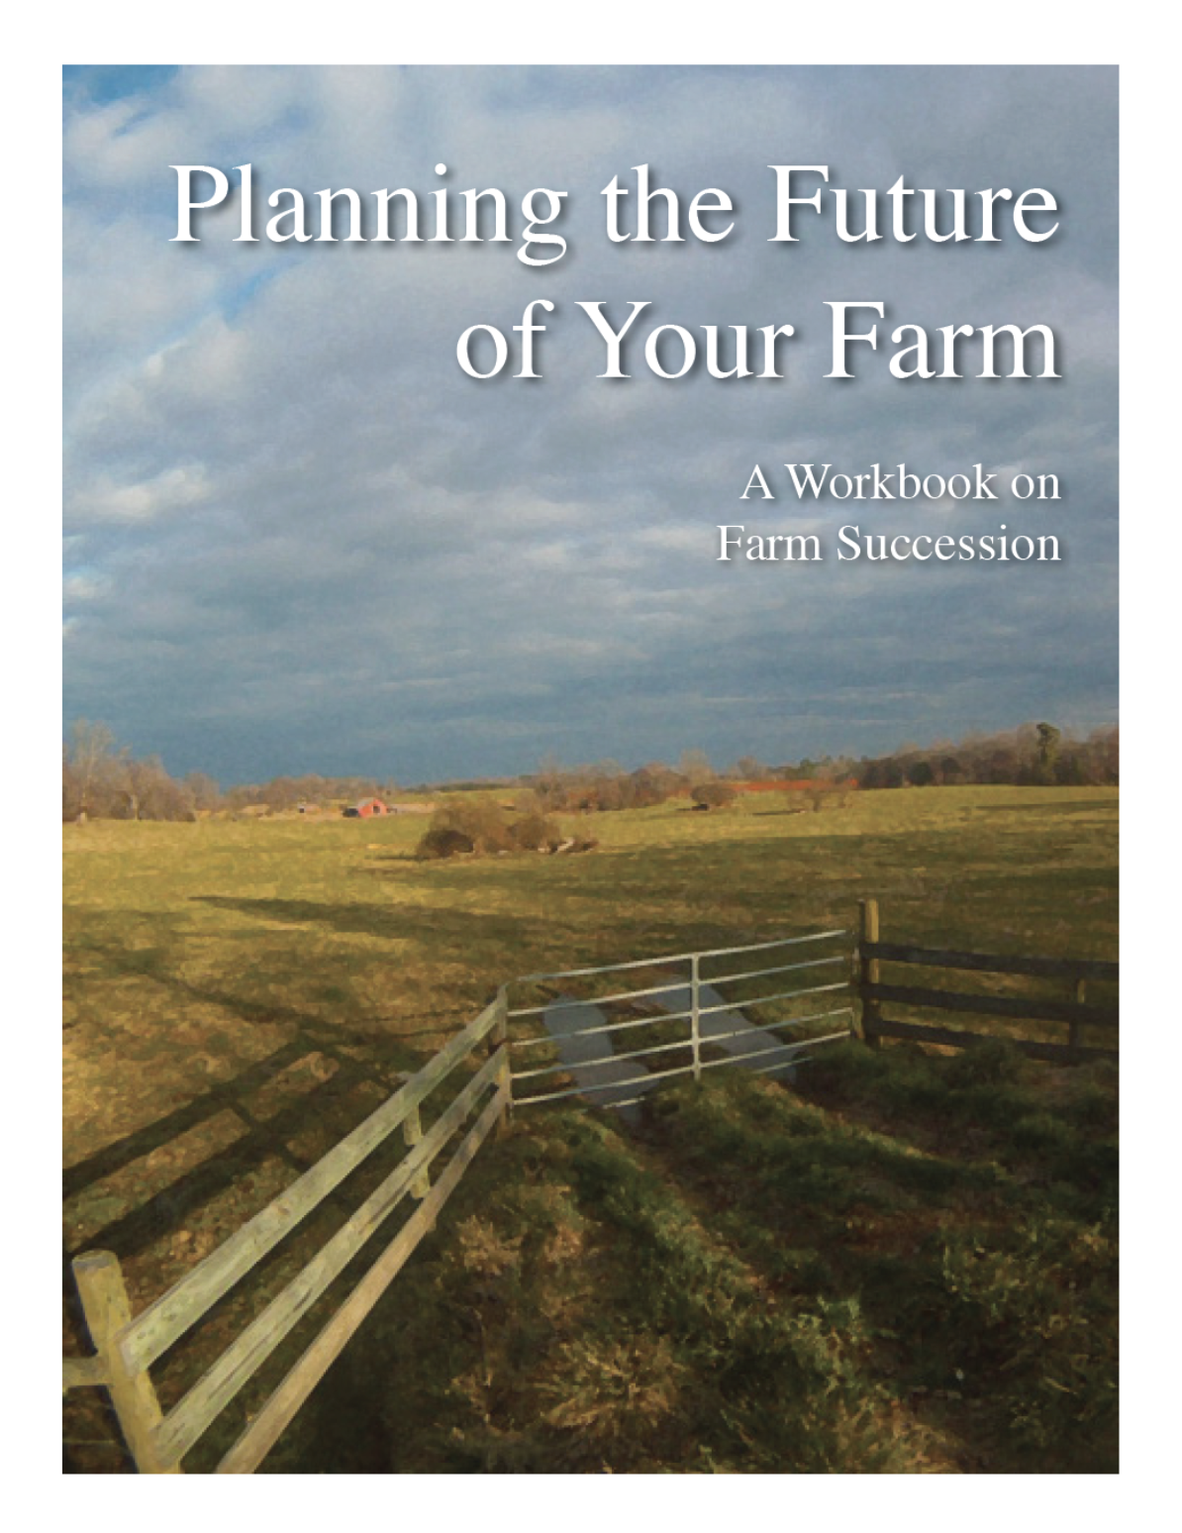
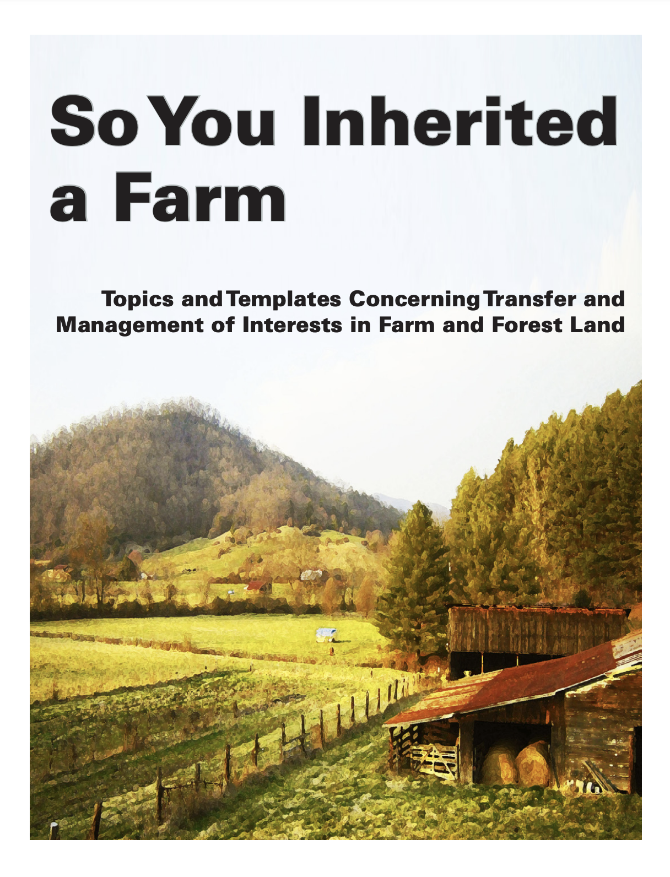
https://farmlaw.ces.ncsu.edu/

Slide 4
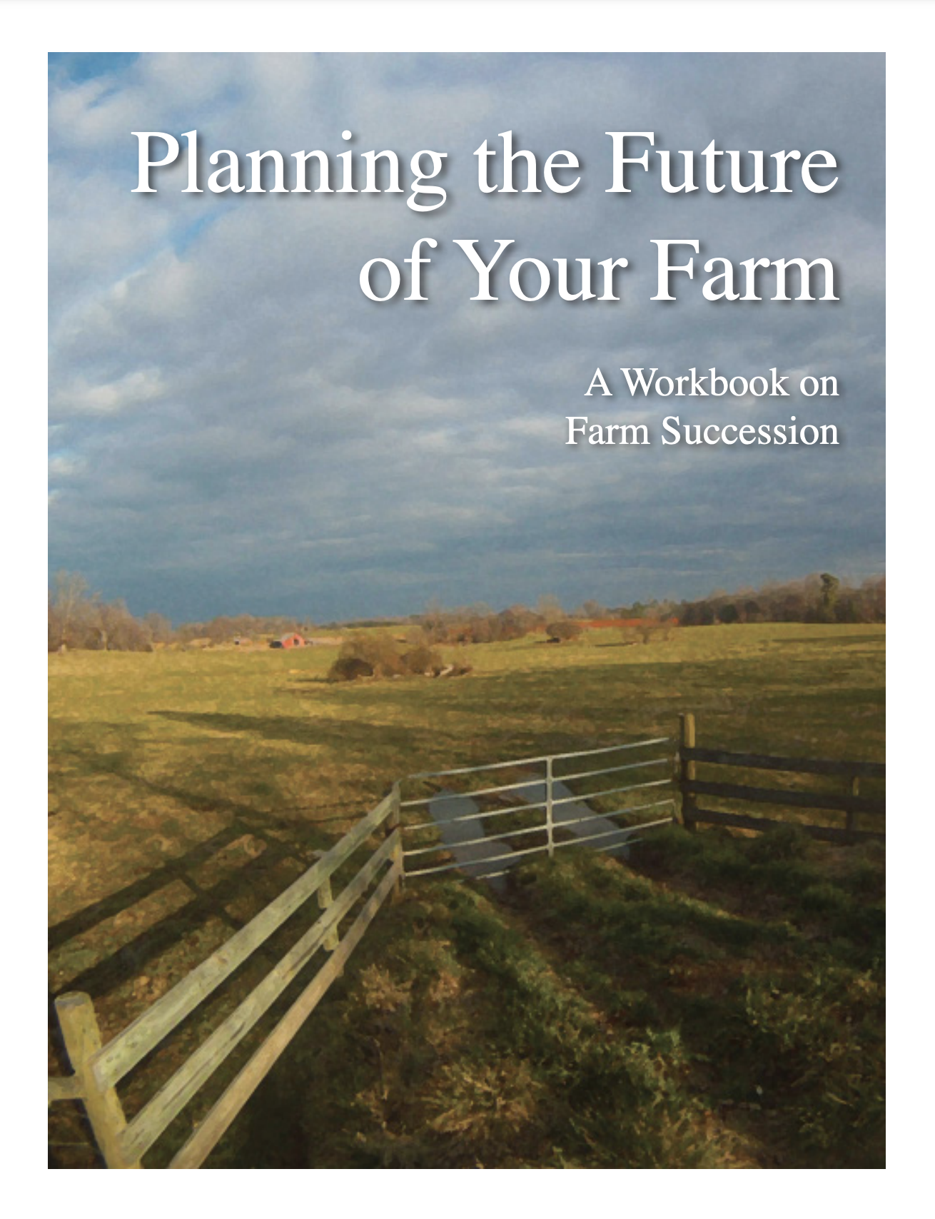


Projects: Planning the
Future of Your Farm Revisited
Grant from NC Tobacco Trust Fund
Implement form of survey from FARMTRANSFERS project
Deliverables:
  survey/consult activity with commodity groups
  update of PFYF workbook
    WHY? because it is 7 years since last update and still in use
components as Extension fact sheets
The Ask: please respond to my email if you are connected with a group and can make
an introduction to Executive Director

Slide 5
Recent Study on Farm Succession
Factors Impacting Succession Planning (Lippsmeyer, M. et al., Purdue University (quotes)
Our sample of 403 farmers across the United States indicates that implementation of succession plans for farms is largely unrelated to operator age
Examining specific management practices, 68% of farms with written succession plans use written lease agreements compared to just 52% of farms without succession plans
Farms with succession plans tend to use financial ratios and standard operating procedures, evaluate crop pricing performance, operate larger farms, are more resilient to strategic risk, and their operators are more highly educated.
… significant and positive correlations between succession planning and balance sheet strength; the establishment of goals, objectives, and core values; and farms looking for opportunities that new enterprises may provide.

Slide 6
This Legal Educator’s Observations
Try not to give heirs undivided interests in land
  property law is indifferent to your goals for the land
Estate Tax exemptions still high, but will sunset end of 2025
  election results likely ensure “permanency” at current exemption levels
  taxes should not be the focus of farm succession, but influence design
All land dispositions must be in writing… saying “all this will be yours” means nothing
Careful of PUV property tax when dividing land
“Legacy” planning is a series of disposition decisions and executions
Secure Option Agreements whenever possible (in leases, entities, etc.)
If real property (land) has a “change in use” appraised value, may have to subdivide and distribute

Slide 7
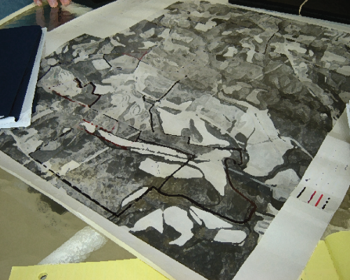

Multiple Goals of Succession…
“Keep land in the family” (preserve legacy)
“Preserve wealth, avoid taxes”
“Provide equal wealth for family members”
“Live in comfortable retirement”
“Keep a ‘going concern’ business in operation”
“Provide farming opportunity” (for family or community)
“Ensure land is never ‘sold for development’”

Slide 8
This Legal Educator’s Guiding Principles
“Planning is everything. The Plan is nothing.” - attributed to Gen. Dwight Eisenhower
“If you can’t make it perfect, make it flexible” - Pullet Grower, Chatham County
“You can’t paper over people” - Leon Geyer, Virginia Tech
“Be mindful of leaving legacy obligations behind” - R.A. Branan, NCSU

Slide 9
Property Disposition Tax Implications
Sale of property: Capital Gains Tax (FMV-Acquisition Value)x~15%
Gifting of property:
  Carry-Over Basis (potential higher capital gains tax)
  Gift Tax (for annual gifts above $18,000 [per donee])
  Lifetime gift tax exemption: $13,610,000
Property at Death:
  Estate Tax: percentage tax levied by law on all wealth transferred at death (aka “taxable estate”)
    Subject to ”Wealth Exemption”
    Federal Exemption = $13,610,000 per individual (federal only) (spouse gets other exemption for double)
    “Unified” with lifetime gift tax exemption (dollar for dollar, above annual exclusion of $18,000/yr/donee)
    Estate tax abolished in North Carolina
  Probate costs: percentage levied by county on personal property wealth (aka “probate estate”)

Slide 10
Current Law: Gifts and Basis
Gift Tax Exclusion Amounts for tax years beginning after December 31, 2017 and before January 1, 2026:
Annual Exclusion $18,000 (2024)
Lifetime Exemption (2024): $13,610,000 ($27,220,000, married couple)
Carry-Over Basis (donee gets same basis as donor)
Step-up basis to Fair Market Value is retained for death time transfers
New basis at time of death, reduces capital gains if sold by ‘heirs’ (see IRC §1014)
Example Gift: Land purchased in 1985 at $1500/acre, current FMV $8000/ac
if gift and donee sells, capital gains/acre: ($8000 - $1500 = $6500) x 15% = $985
Example Death Transfer: Same basis, FMV $8500 at date of death
if death transfer and donee sells, capital gains (with modest appreciation)/acre: ($8700 - 8500 = $200) x 15% = $30/acre capital gain
Can still defer capital gains with §1031 “like kind” exchange (e.g. land for land)
Still have LLC valuation discounts and §2032A valuation reduction for qualifying farms

Slide 11
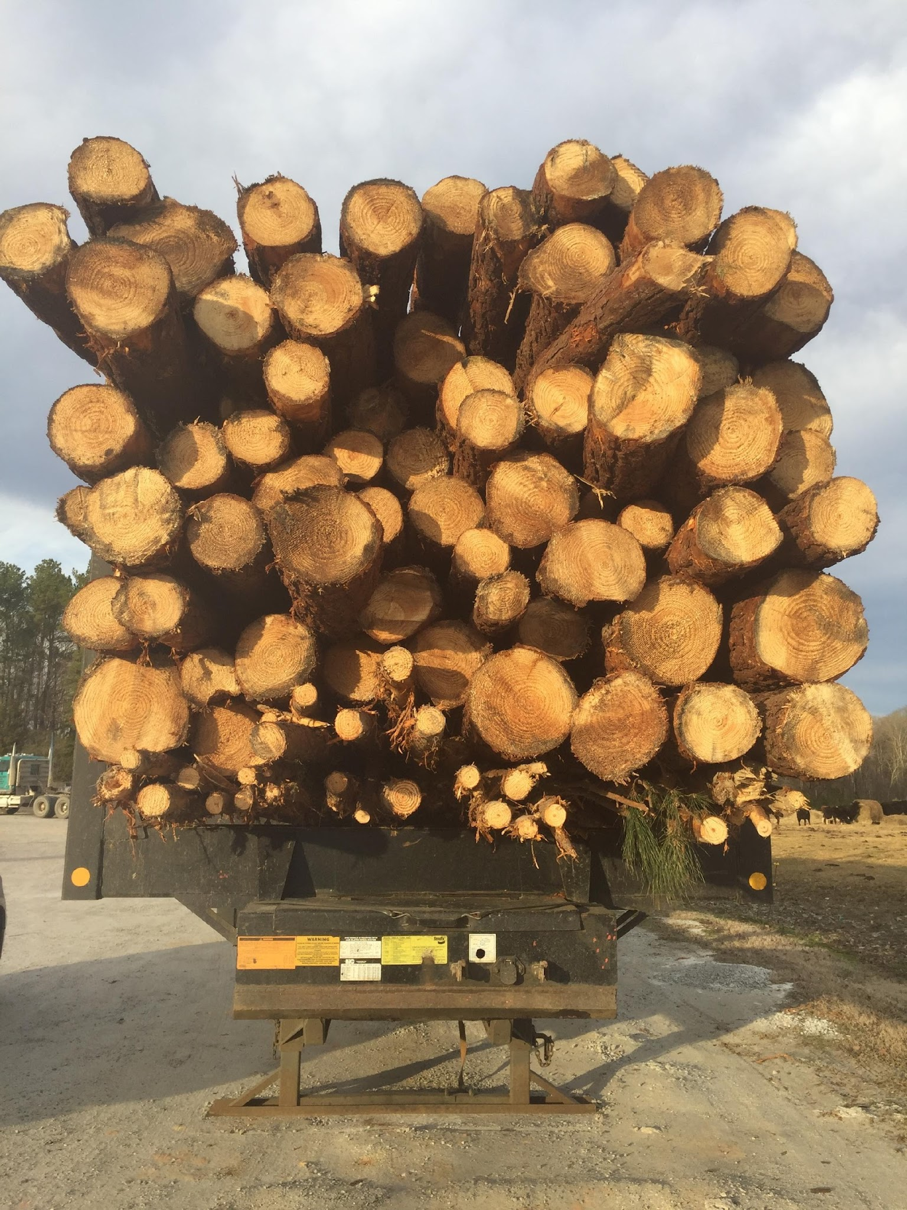
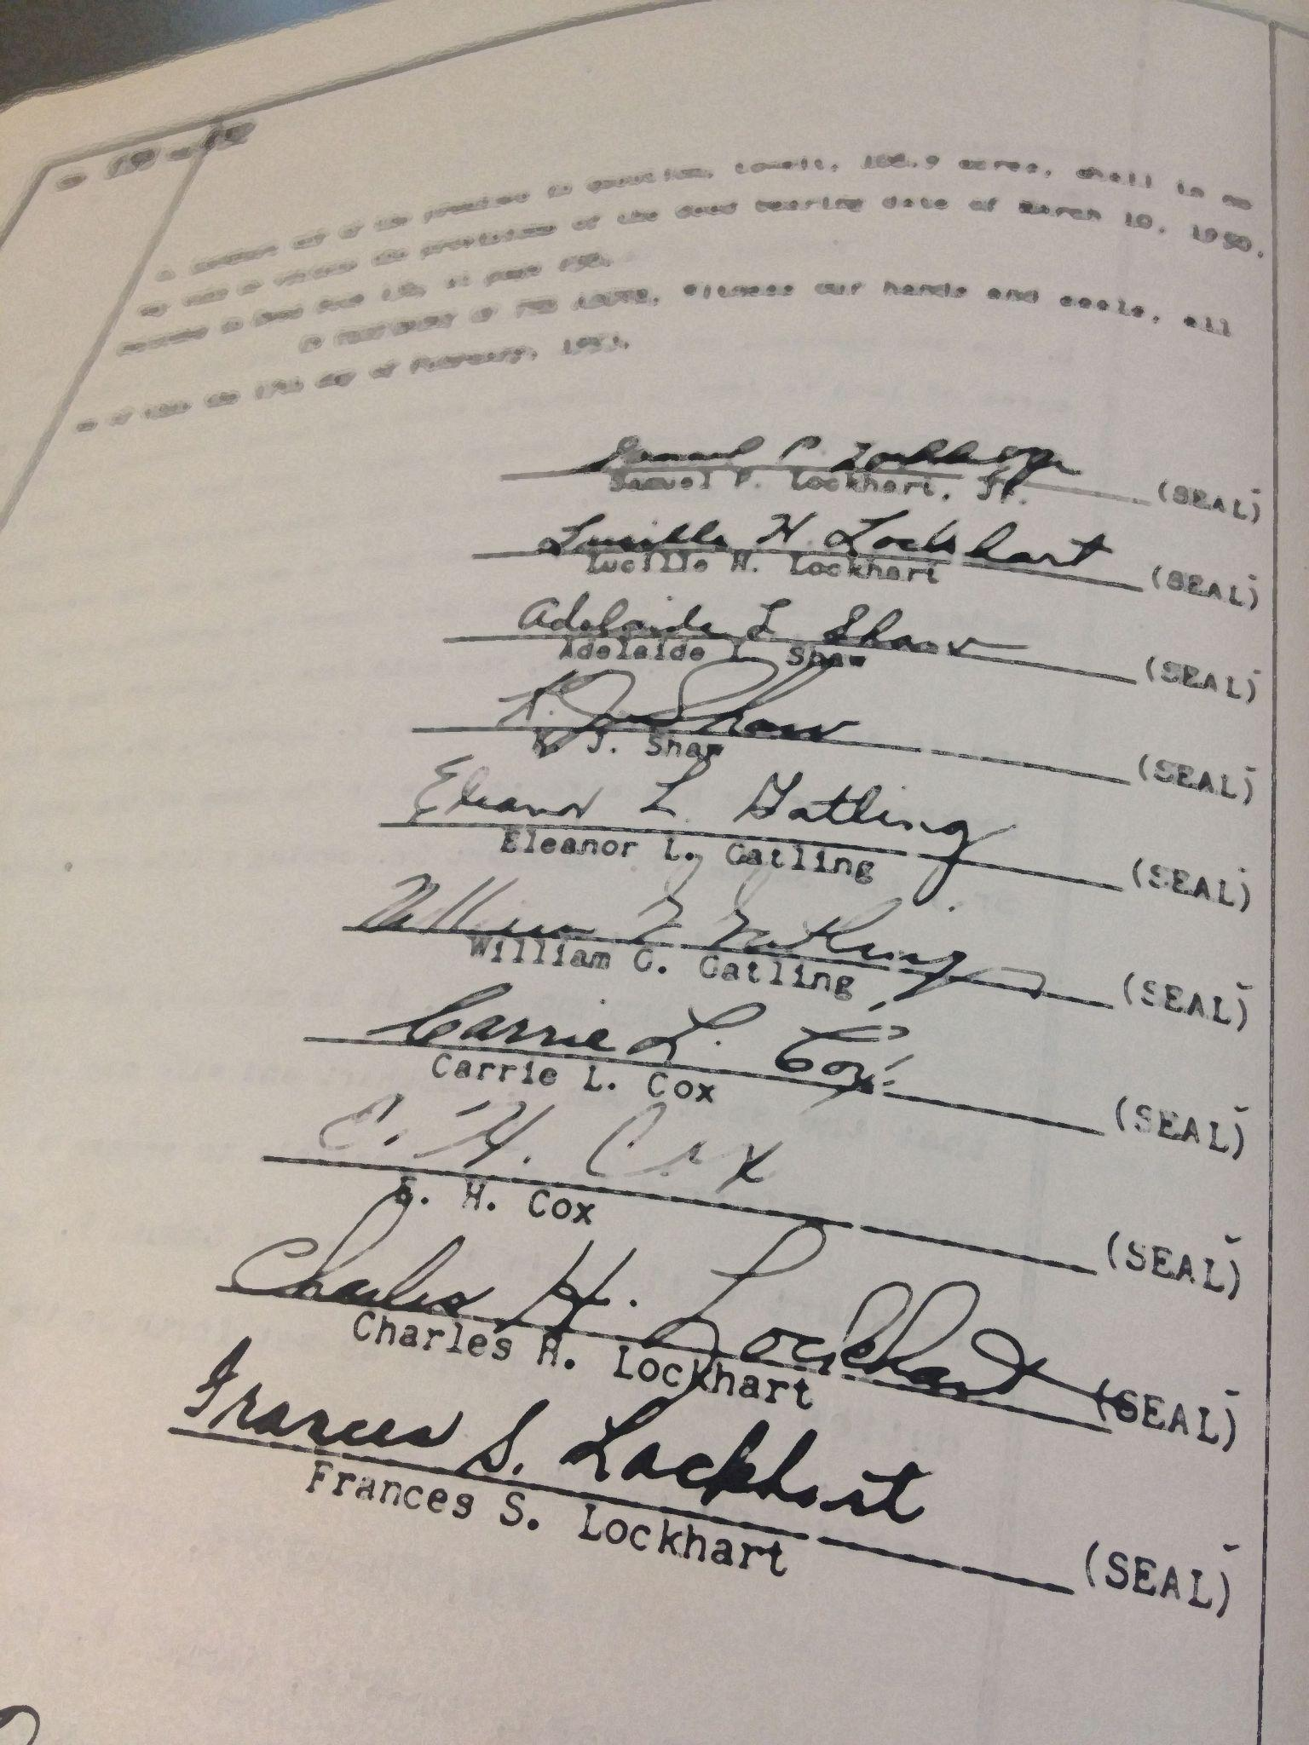
Capital Gain Income
Tax rate variable, 0%, 15%, 20% depending on income tax bracket
Rate applied to appreciation (difference between sale price and basis)
  e.g. 15% x ($100,000 - $85,000) = $2,250
Long term asset sales
  Real Property (land)
  long term assets
  Timber sales
  Stocks held ≥ 1 year
IRC §1231

Slide 12
Deferment of Capital Gain: §1031
Generally, for tax years beginning after December 31, 2017, like-kind exchanges are allowed for real property that is not held primarily for sale (inventory)
Must set up prior to closing, identify qualified intermediary to hold the sale funds
Must identify exchange property within 45 days of closing on relinquished property
  May identify up to 3 properties with listed values, OR
  any number of properties but combined not exceed 200% of property sold (26 CFR § 1.1031(k)-1)
  Must close on 95% of the properties identified
Must close on replacement property within 180 days of closing on relinquished property

Slide 13
Absorbing Shocks (a/k/a the 6 “D’s”)
Death
  how are assets disposed at death of interest owner? (will and trust)
Disability
  contingency for management in event of disability (LLC operating agreement, powers of attorney)
Divorce
  ensuring that a business or land interest stays ‘in the family’ (LLC operating agreement)
Disaster
  crop failure, unmanageable debt, bankruptcy (LLC operating agreement, crop insurance)
Disagreement
  framework for decision-making power and dispute resolution (trust, LLC operating agreement)
Disenchantment or Departure
  impact on ownership of business and assets (and property disposition decisions) (trust, LLC operating agreement, purchase options)

Slide 14
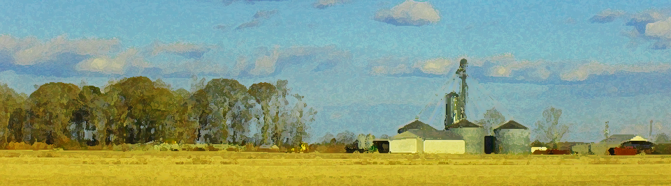
Scenario One
Dad has built farm operation up over years
Dad has inherited land
Dad has purchased land jointly with Mom
Dad operates as a sole proprietorship, married filing jointly
Son has come “back” after college to work on the farm
Son has two sisters who have moved away from the home farm
Assumption: there is enough available land to lease in the area to increase total acreage

Slide 15
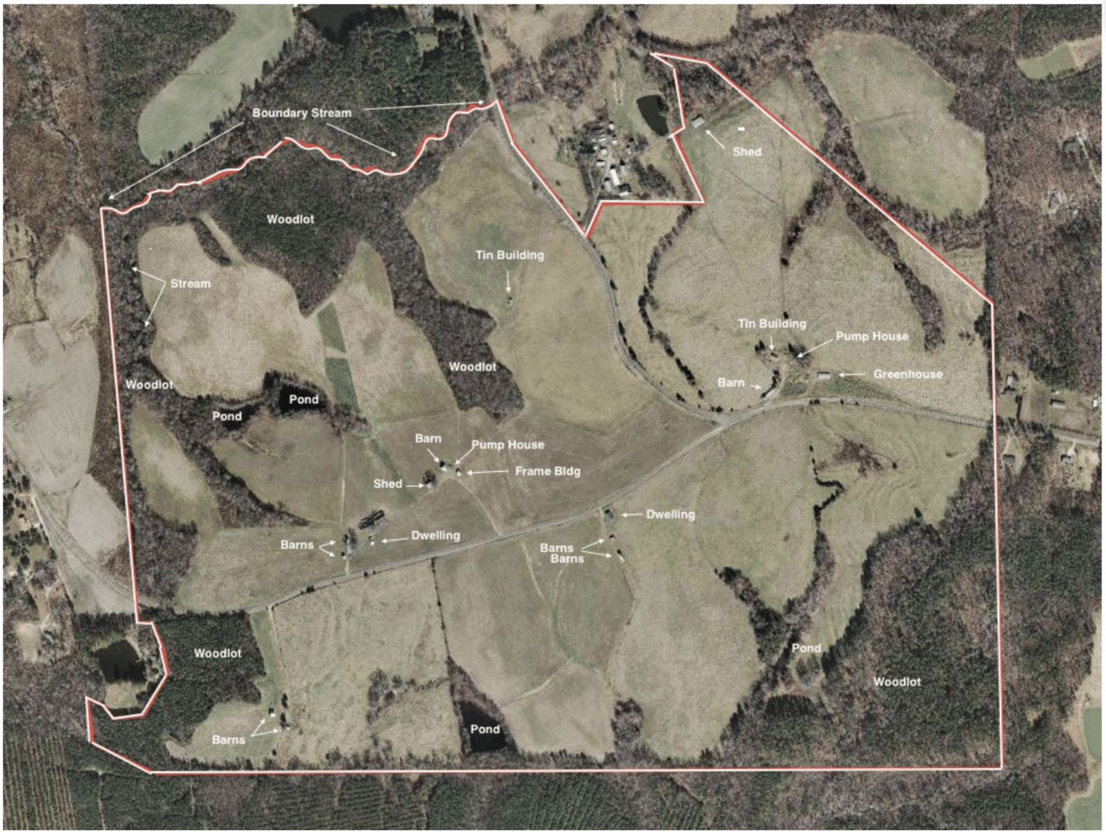

Slide 16
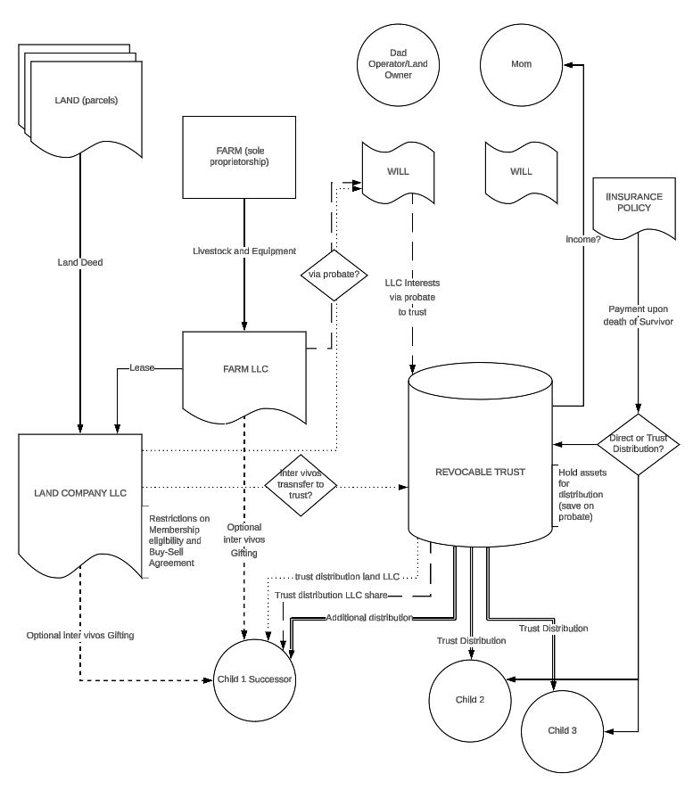

Slide 18
Agency: Powers of Attorney
A written document, signed and notarized
Where an adult person (the “principal”) assigns his or her rights and powers over property to another person, called an “attorney in fact”
  “Attorney in Fact” acts in the shoes of Principal
  Sell property, take loans, make financial dispositions, etc.
Durable Power of Attorney: powers of attorney in fact over property ’survive’ the incapacity of principal
  Requires recording with Register of Deeds
  Power ends at death of Principal
Health Care Power of Attorney: Principal empowers another to make medical decisions for him or her if cannot directly communicate with healthcare providers
  can contain a Do Not Resuscitate command
Living Will or Advance Medical Directive: speaks directly to healthcare providers regarding decision to end life support
  Takes decision away from anyone other than physician

Slide 19
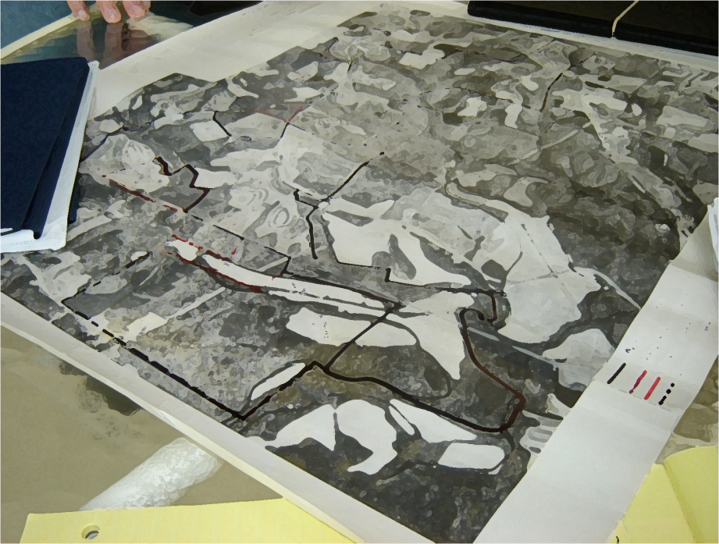
Real Property 101: Land Title
Fee Simple: owned by one person
Life Estate
  “Owner A for life, remainder to B”
Tenancy in Common
  Alienable and undivided interests
Joint Tenancy
  Joint Tenancy with Rights of
  Survivorship
    A modern rarity
  Tenancy by the Entireties
    may become joint property by deed (H to H + W)
    Spouse may have rights to inherited property at owner’s death or divorce (must claim, not automatic)
    Inherited land is not joint (or marital) property [NCGS 50-20(b)(2)]
      still subject to elective share [NCGS 30-3.1]
      still subject to life estate election [NCGS 29-30]
Land Title: Understanding Rights in Property
The Property Rights of Surviving Spouse
Present Use Value: Transferring Property Enrolled in Present Use Value Property Taxation
tk: prenuptial agreements

Slide 20

“The Bundle of Sticks”
(all severable)
Riparian (surface) Water Rights
(e.g. Deed to adjacent parcel right to draw surface water)
Right to Timber
(e.g. timber deed to timber buyer)
Right to Subdivide
(e.g. Deed to land trust in form of conservation easement)
Right to Groundwater
(e.g. shared with another entity or parcel)
Right to Take Wildlife
(e.g. leased to hunting club)
Right of sole possession (e.g. deed of access easement to adjacent parcel)
Right to Farm (e.g. Leased to farmer)
Right to subsurface minerals
(e.g. Deed to energy developer)
Right to transfer/control equity
(e.g. Deed of Trust to lender)
Right of sole possession (e.g. deeded right of way/easement to utility)

Slide 21
Only Three Ways to Dispose of Property
Sale
  Completely relinquish rights in property, receive fair market value in cash or equivalent (aka consideration)
  May reserve rights (timber, an easement, etc.)
  Tax consequence: capital gains on sale income
Gift
  Completely relinquish rights in property, nothing in return
  Tax Consequence: Carry-over basis
Death
  Property interests pass to heirs at law (intestate) or legatees (testate - personal property)/devisees (testate - real property)
  Tax Consequence
    Subject to federal estate tax
    Probate fee (not a tax) percentage of personal property value in probate estate (excludes survivorship property, property already in trust, etc.)

Slide 24
Disposition at Death
Testate: person dies (decedent) with a valid will
  late 15c., from Latin testatus "public, manifest, published"
Intestate: person dies without a valid will, property is distributed according to Intestate Succession Act (N.C.G.S. Chapter 29)
  Distributions to spouse, lineal descendants, lateral descendants, or ancestors depending on facts at moment of death
    Spouse % varies with # of children or grandchildren
    Children and grandchildren (% varies by glass)
    Siblings and parents (depends on whether lineal descendants alive)

Slide 25
Creating a valid Will
Requirements codified N.C.G.S. § 31-1
Testator (age 18+) must have mental capacity
  Understand you are making a will
  Understand Nature of property you own
  Understand Who you are leaving it to
Testator must sign
  In the presence of two “disinterested” witnesses
    Have no inheritable interest under the will
  Self-Proving Will: Testator and witnesses sign in the presence of a notary public
    With no notary, Clerk must call in will witnesses to testify as to validity of signature
Holographic Wills: written and signed in handwriting of testator (N.C.G.S. § 31-3.4)
Clerk must decide if will meets legal sufficiency for entry into probate
Intent of Testator Controls!
The Last Will and Testament: A Primer

Slide 26
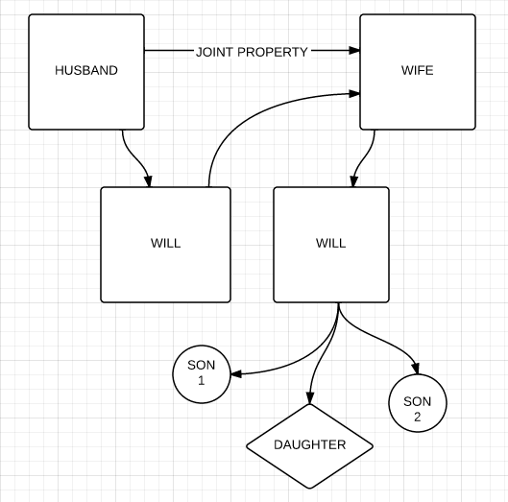
Typical Reciprocal Will scenario
When surviving spouse dies:
“All property to spouse”
Son 1: ⅓ all property undivided
“If predeceased by spouse, to children share and share alike, per stirpes”
Son 2: ⅓ all property undivided
Daughter: ⅓ all property undivided

Slide 28
The Trust
A separate legal entity
  NOT a potential intestate heir
Settlor (or Grantor): the person(s) who create(s) the trust and funds it (assigns property to the trust)
Trustee: the “legal owner” of the trust property, bound by a fiduciary duty (state law) and by terms of the trust
  Fiduciary powers of trustee NCGS § 36C‑8‑816
Beneficiary: The person(s) who receive the benefit of the trust
  income from assets
  distribution of assets
Language of the Trust controls distribution
Trusts are private, assets not part of probate estate (but part of taxable estate if trust was revocable)
  Often used as “will substitutes”: trust determines distribution of property
Can empower Trustee to place conservation easement, place land in entity, require leasing for farming, etc.
The Basics of Trusts in Farm Succession Planning

Slide 29
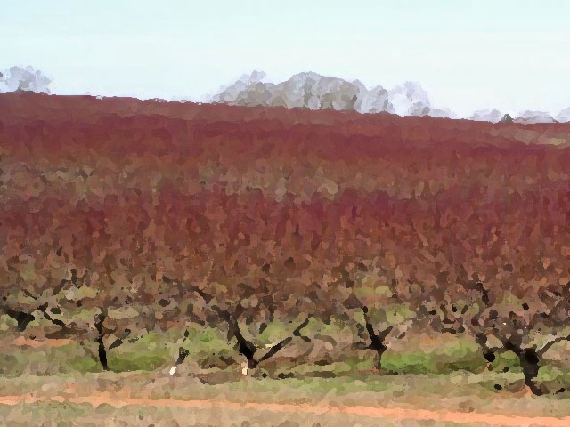
General Types of Trusts
Testamentary Trust (established by executor pursuant to a will)
Revocable Trust
  Fund during lifetime (put in, take out)
  Fund through ‘pour over’ will
  Amend as needed
  Table of Contents Example
Irrevocable Trust
  Insurance Trust (ILIT)
  “Asset-Protection”
Special Needs Trust
Charitable Trusts
“Dynasty” Trusts
  Revocation of “rule against perpetuities”

Slide 31
Use of Business Entities
Business Entity Interests
  Governing document (e.g. Operating Agreement) controls disposition of interests in entity
    The Buy-Sell Agreement (option, valuation (purchase price, payment)
  Business Entity interest (shares, membership) = intangible personal property
    Gifts of interest to create equity in younger generation
  Land titled to business entity = personal property
May transfer interests in business entity to successors by gift, sale or at death
Limited Liability Companies: Steps in Formation
Sample Asset Contribution List

Slide 32

Use of Business Entities
Liability protection (protect personal wealth, land)
Organization of business assets
  e.g. equipment, input inventory
Contract between owners
  determines rights in management and income
  ultimate disposition of assets
Possible vehicle for reducing parents’ estate value
  Valuation discounts under IRC regulations
  Organized gifting or sale program (annual transfer)
Can use multiple entities for large farm management
  USDA “payment limitation” structure

Slide 33
Limited Liability Company
Operating LLC (or S Corp)
  Partners contribute their ownership interest in cattle, bins, machinery, “sweat” etc.
  Use as transfer vehicle to farming heir (gifts/structured sale)
  Existing S Corp or Partnerships (merger, conversion, asset transfer, etc.)
Land LLC
  Deed Land interest to the LLC (never a corporation)
  Restrict membership
  Strip partition rights inherit to real property interest
  Structured exit of equity in land (title substitute)
  Conversion of existing Limited Partnership (w/o retitle property) (SOS filing)

Slide 34
The Operating Agreement
A Contract between contributors of assets
Restricts who can be members
  Member vs. Assignee
Dictates voting requirements for decisions
  Manager
  Voting and Non-voting Units
Dictates triggers for buy-sell
  Farming Heir Option to Purchase
  Who may buy and when
  Appraisal procedure
  Price and payment terms (seller finance option)
For existing S Corps, use Stock Purchase Agreement
Limited Liability Companies: Operating Agreement Components and Sample Language
Buy Sell Agreements - Options to Purchase

Slide 35
Intervivos Transfer of LLC Interests
Gift of Interest (measured in “units”)
  Calculate value of company
  Divide value by number of units to determine price per unit
  Transfer total units < $19,000 annual gift tax exclusion
Sale
  Purchase from Other Members or Trust
    Purchase with insurance proceeds under Buy-Sell Agreement (Designate beneficiary and agreement between all participants + spouses)
  Spread capital gain over term note
  Discounting of interest value
  Some relief from Self Employment taxes

Slide 36
Suite of Templates for LLC Unit Transfer Regimen (PFYF annotated docs)
Valuation of Units
Calculation of “tax-excluded” transfer
Ledger of ownership (noting certificates of ownership)
LLC Member Resolution to Add Member, Transfer Interest
Declaration of Gift
Unit Certificates and gift endorsements
Operating Agreement
PFYF working document for annotation

Slide 40
Testamentary/Trust Transfer of
LLC Interests
Transfer LLC interest to Trust whilst alive
  Trustee (also Grantor) executes suite of unit transfers to successor
Trust distribution of decedent’s trust units to successor
OR
Simply make the unit certificates themselves survivorship property

Slide 42
Lease Considerations
Basis for Agreement
  Landlord and tenant will meet with their own ideas
  And then meet in the middle
Legally enforceable vs. Practically enforceable
  Note what you want to leave with
Cash rent amount
  market difficult to discern (closely guarded secret)
  “$35/acre/year in Chatham County”
Crop Share
  not as common in North Carolina (?)
  “farming on fifths” (?)
Farm Management Agreement?
  Paying the tenant?
Consider options for purchase
Must record terms 3+ years (protect against sale)
Farm Law page: Leases and Farm Tenure
  The Verbal (Statutory) Farm Tenancy
  Leasing Considerations for Farmers and Landowners

Slide 43
Option Agreements
Contractual “foot in court house door”
Must be recorded in County Register of Deeds
  by memorandum (form in NCGS)
“Right of First Offer”: must negotiate prior to listing property
“Right of First Refusal”: less advantageous, optionee has leeway to entertain highest offer
May be embedded in lease
Set appraisal procedure, and process for reconciling competing valuations
Option Agreements for Purchase of Land

Slide 44
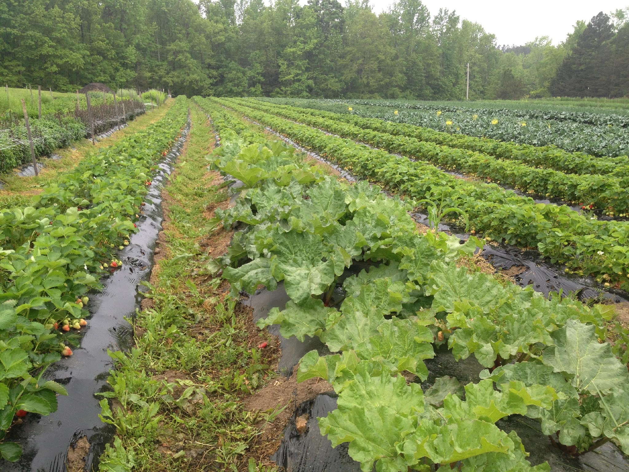
Going Concern Business Valuation Formula Terms
Going concern value: Price willing to pay ($Y) for a business if, based on that amount, purchaser will earn a future stream of income valued at ($X) annually?
  Y = historical gross income stream (discounting unusual events) x growth percentage (trend)
EBIDTA = Earnings Before Interest, Taxes, Depreciation and Amortization = cash flow
  Buyout price will reflect this figure (for a certain # years into future)
  Annual sales revenue x “industry multiplier”
Brand Value
  Trademark or brand name
  Visual assets such as a logo or brand colors
  Unique marketing strategy
  Digital assets or licenses
  Level of customer loyalty
    Key to valuing a local farm business

Slide 45
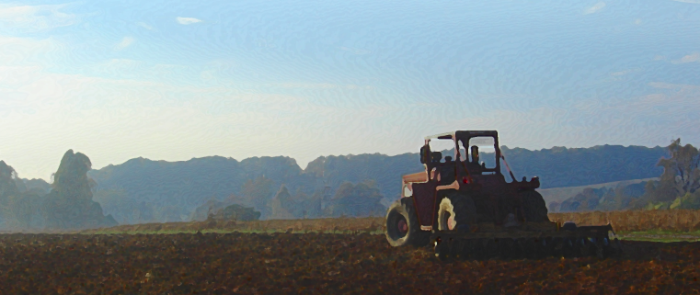
Valuation of Assets: Appraisal
Comparable Sales Method
  What have other properties sold for in the area (real property)
Cost Approach
  Replacement cost of asset (normally applied to personal property)
  Valuation of Machinery: take list (with year and make) to an equipment dealer
County tax appraisal for land
  good enough for planning

Slide 46
Care in Using Devices
The Will
  title passes at moment of death
  unless specific property devises/bequests, property passes by class
    e.g. “To my children”: 3 children
    3 parcels of land, farm equipment/livestock, personal property
    each child takes ⅓ co-tenancy interest in land, ⅓ interest in all personal property
    Executor (and Clerk of Court) without authority to decide who gets specifically what
The Trust
  must choose a trustee
  not ideal as long-term landowning device for farmland (rent may be insufficient to cover costs)
The LLC - the family members are ‘in business’ with one another
  cannot “paper over people”

Slide 47
Scenario Two: Brothers Partnership
Two brothers
inherited land from parents
each has purchased their own parcels
farm has large equipment portfolio
Younger brother divorced
Older brother married, thinking of retirement
Younger brother has son interested in joining in future
Significant acreage, need to maximize farm bill payments

Slide 48
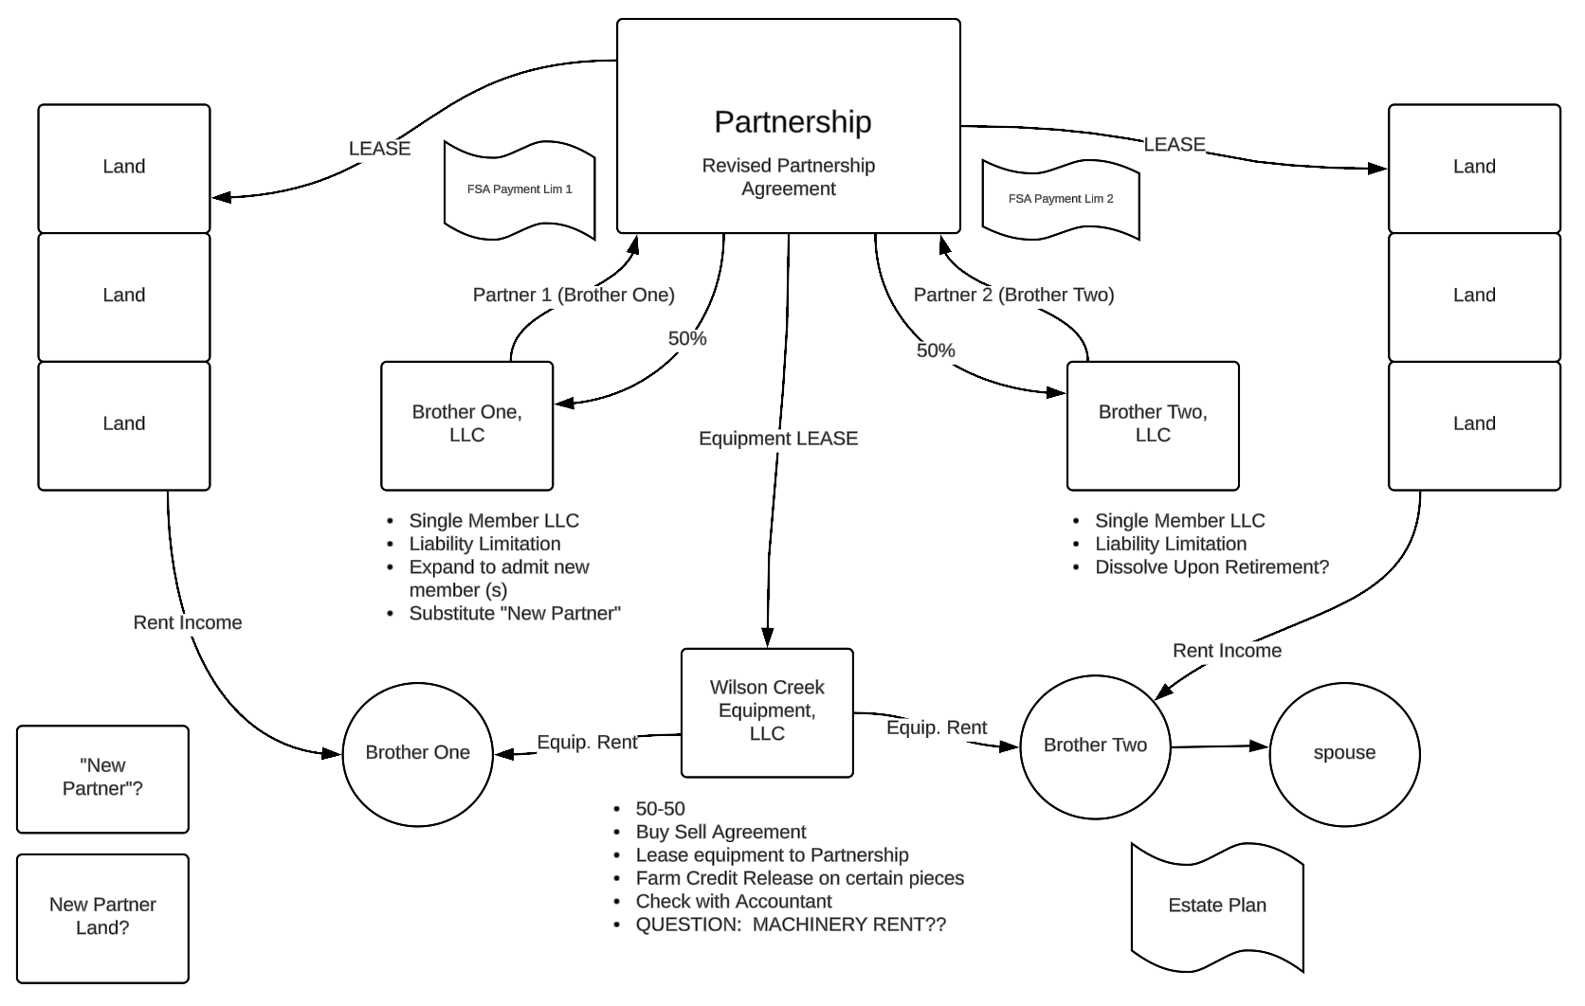

Slide 49
2018 Farm Bill Payment Limitations
Program | Limitation
Combined PLC and ARC payments | $125,000 per crop year
Noninsured Crop Disaster Assistance (NAP) | $125,000 per crop year
Market Facilitation Payment | $125,000 per person

Slide 50
“Actively Engaged in Farming”
“Family Farm” adults (18+ years) of common lineage deemed AEF (ascendants, descendants, siblings, spouses) (7 CFR 1400.208)
  2018 Farm Bill now includes first cousins, nieces, and nephews (reference)
  Landowner exception for share crop situations (reference)
Three AEF criteria (all)
  The person, independently and separately, makes a significant contribution* to the farming operation of (a) capital, equipment, or land; and (b) active personal labor, active personal management, or a combination of active personal labor and management.
  The person’s share of profits or losses is commensurate with his/her contribution to the farming operation.
  The person shares in the risk of loss from the farming operation.
  * defined In 7 CFR 1400.3

Slide 51
Entity Payment Limits
Corporations and LLC = one payment (before 2025)
  AFTER 2025, an LLC may receive multiple payments (one for each member)
All members must be AEF that is identifiable, documentable, separate, and distinct from the contributions made by any other partner
If a member is not AEF, then payment reduced by percentage of that owner’s share
Partnership comprised of multiple entities
  Each LLC is a partner, each gets a payment limit

Slide 52
Basic Model: Partnership Addition
Partnership
(farm operation)
LLC
Single Member
partner
LLC
Single Member
partner
LLC
Single Member
partner
Lease
Lease/Tenancy
Equipment LLC
Rented Land
Lease
Land LLC

Slide 53
Discussion Scenario
Philip and Elizabeth (60’s) have four children (30’s) (Charles, Andrew, Anne and Edward)
Parents own 900 acres of land (in 12 parcels)
50% farmland
50% timber and wetlands
Philip operates row crop operation, tobacco, etc. and livestock
farms 450 owned acres, 3000 rented acres
~ $1M in equipment
land used as collateral for operating loans
Charles is by farm most involved the operation

Slide 54
Suggestions
Organize farm operation into Partnership with individual LLCs
  preserves USDA payment limitations
  this serves as ownership and management transfer vehicle
  Philip can make gifts of ownership to Charles
  operating agreement provides framework of management, disagreement, etc.
  LLC becomes tenant to P & E’s land (and other owners)
  LLC gets long term lease (?)
Evaluate land resources (try even distribution in values)
  best farm land to Charles
  other farmland and timberland to other children, (perhaps Charles has option to purchase or right of first refusal)
Purchase life insurance to provide inheritance for uninvolved children
Place land in Trust (or pour to trust through Will)
  trustee distributes parcels upon death of survivor of P & E
  any LLC interest owned by P gots to C

Slide 55
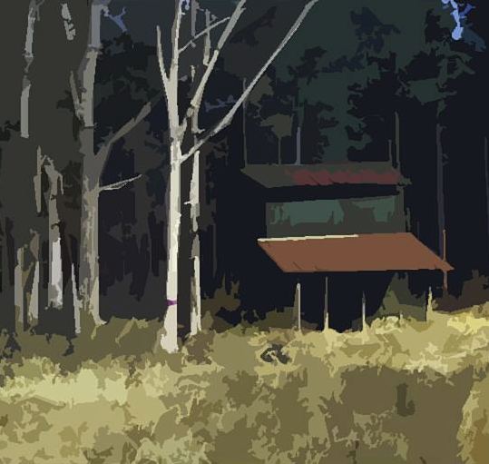
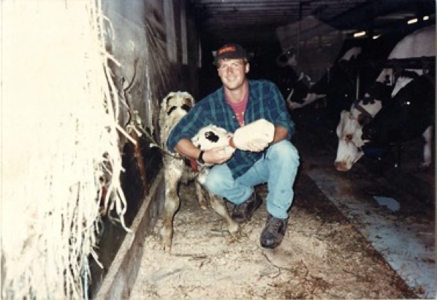

THANKS FOR INVITING ME!
Robert Andrew Branan, JD
Associate Extension Professor
Department of
Agriculture and Resource Economics
North Carolina State University
rabrana2@ncsu.edu
This presentation and materials research, development and delivery are supported by the Sustainable Agriculture and Resource Education Professional Development Program Land Summit Professional Development grant (Award #531905)

