Slide 1
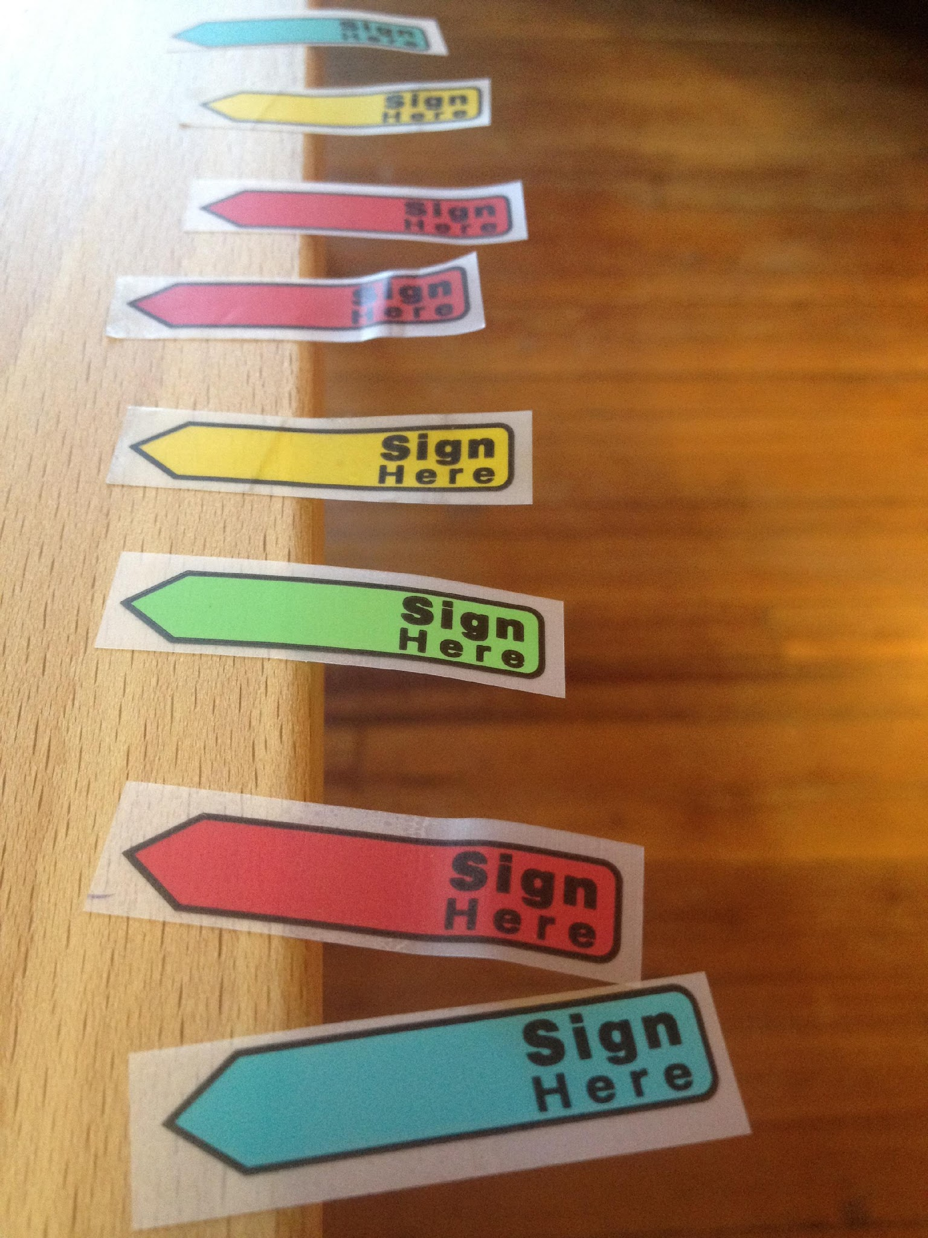

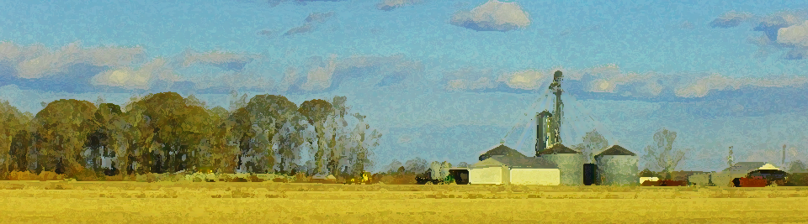
Farm Law for Producers and Landowners
Heirs Property Resolution
(a limited view from [former] private practice)
Robert Andrew Branan, JD
Associate Extension Professor
Agricultural and Resource Economics
NC State University
rabrana2@ncsu.edu

Slide 2
Branan’s Background/
Extension Concentrations
Member of the Virginia State Bar (1992) and North Carolina State Bar (2003)
Non-profit work in agriculture
  American Farmland Trust > NC Farm Transition Network (2002 - 2010)
Private (Farm) Law Practice (2010 - 2018)
NCSU Agricultural and Resource Economics (2018)
  50% Extension appointment/50% Teaching (courses in Environmental and Agriculture Law)
NCSU Extension focus
  general ag exemptions (zoning, sales and property taxes, employment), agritourism liability, fence law and liability, conservation easements, farm succession, solar development, heir property, drainage law and wetlands protection
  Collaborations:
    NC Farmlink (Extension) (succession planning and heir property)
    NC Renewable Energy Center (College of Engineering) (solar development on farmland, agrivoltaics)
    Biological and Agricultural Engineering Dept. (CALS) (drainage law and wetlands protection)

Slide 3
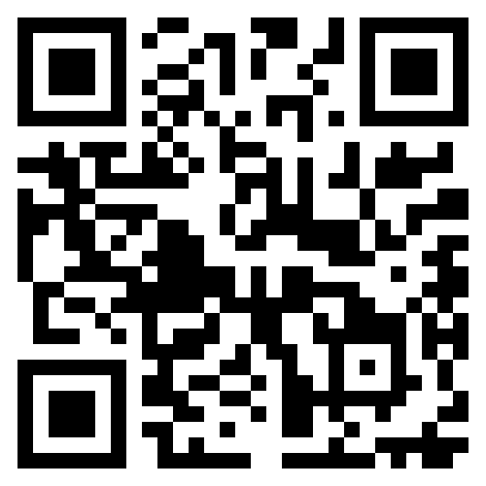
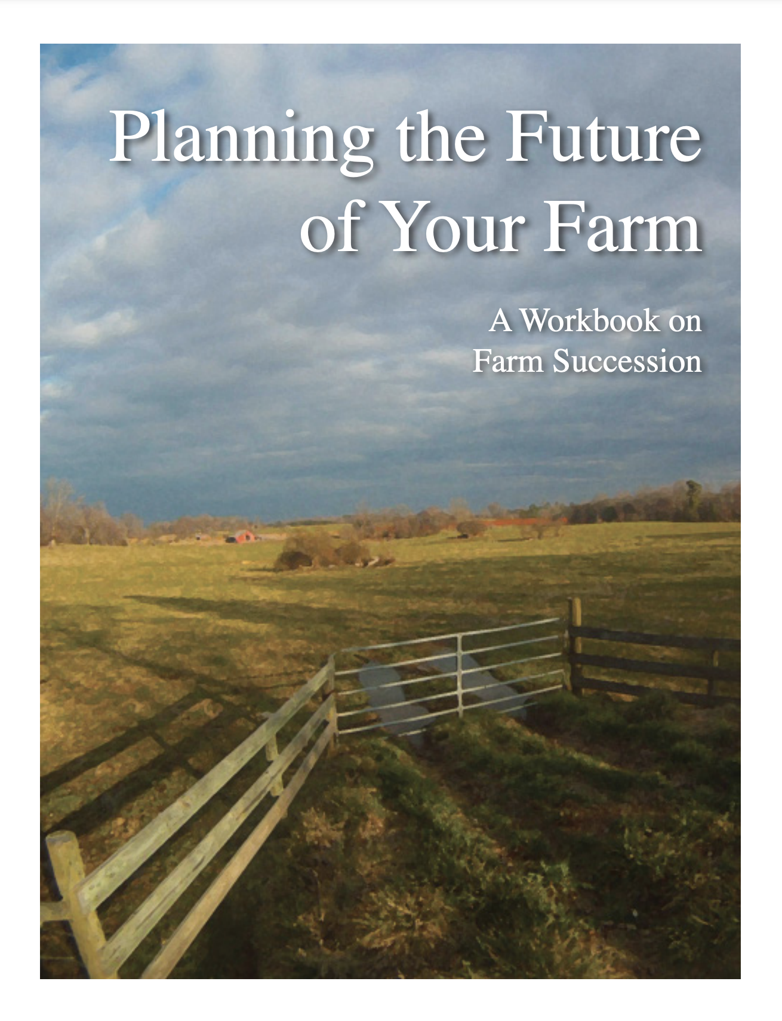
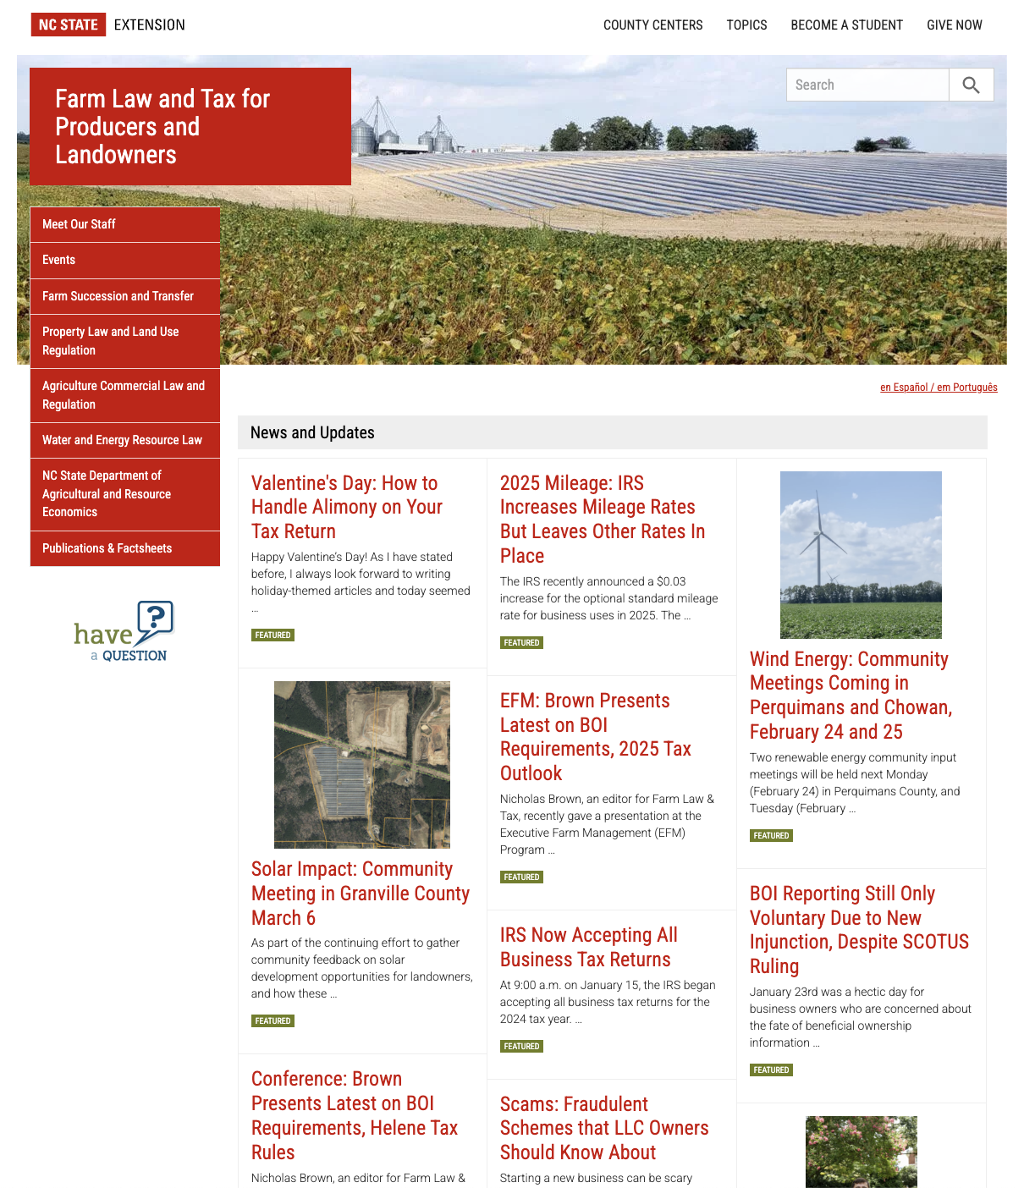
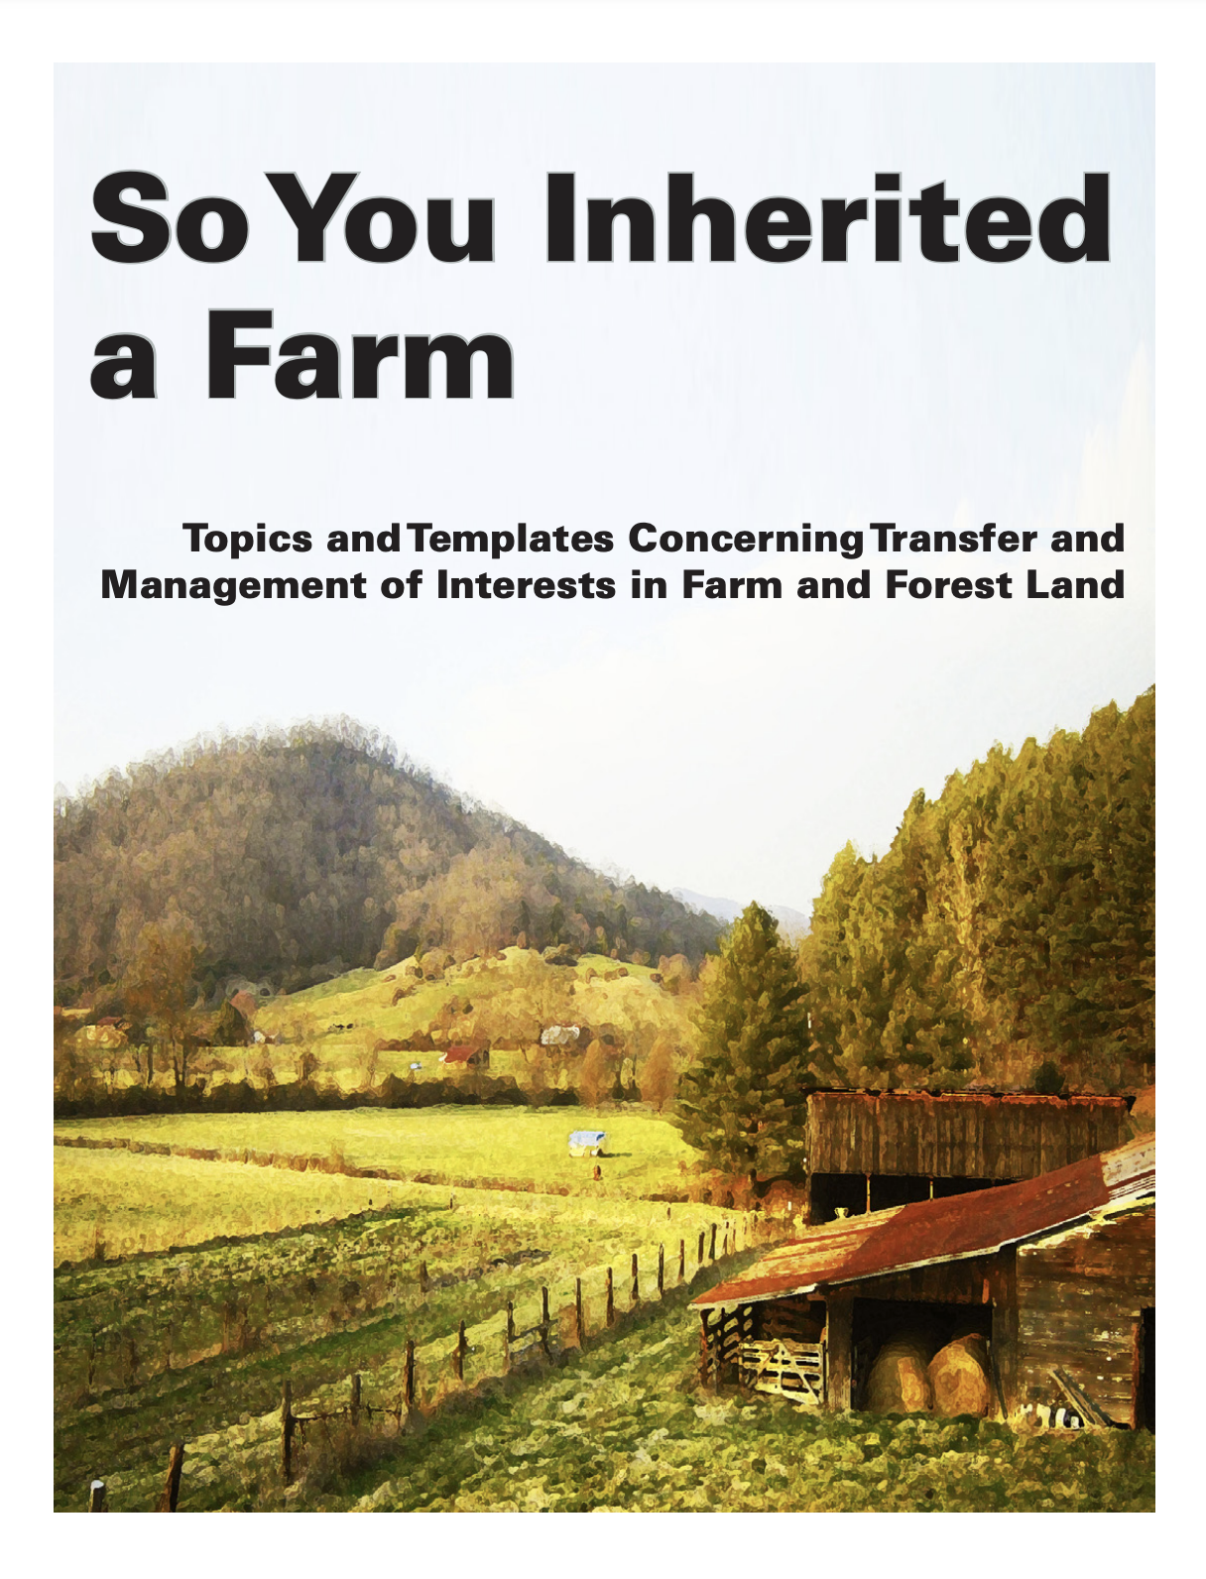
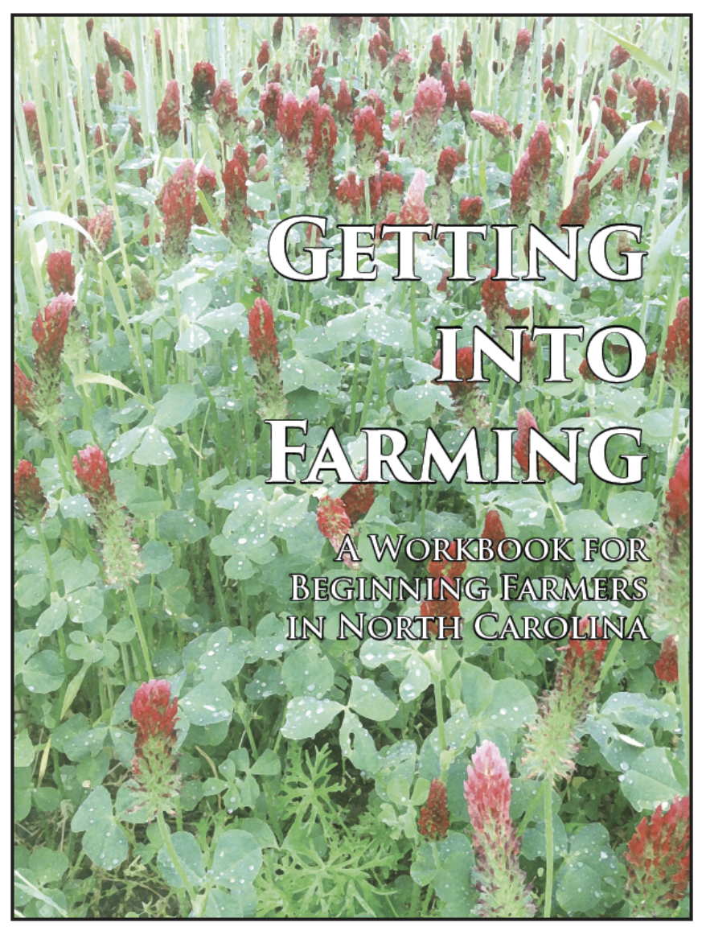

https://farmlaw.ces.ncsu.edu/

Slide 4
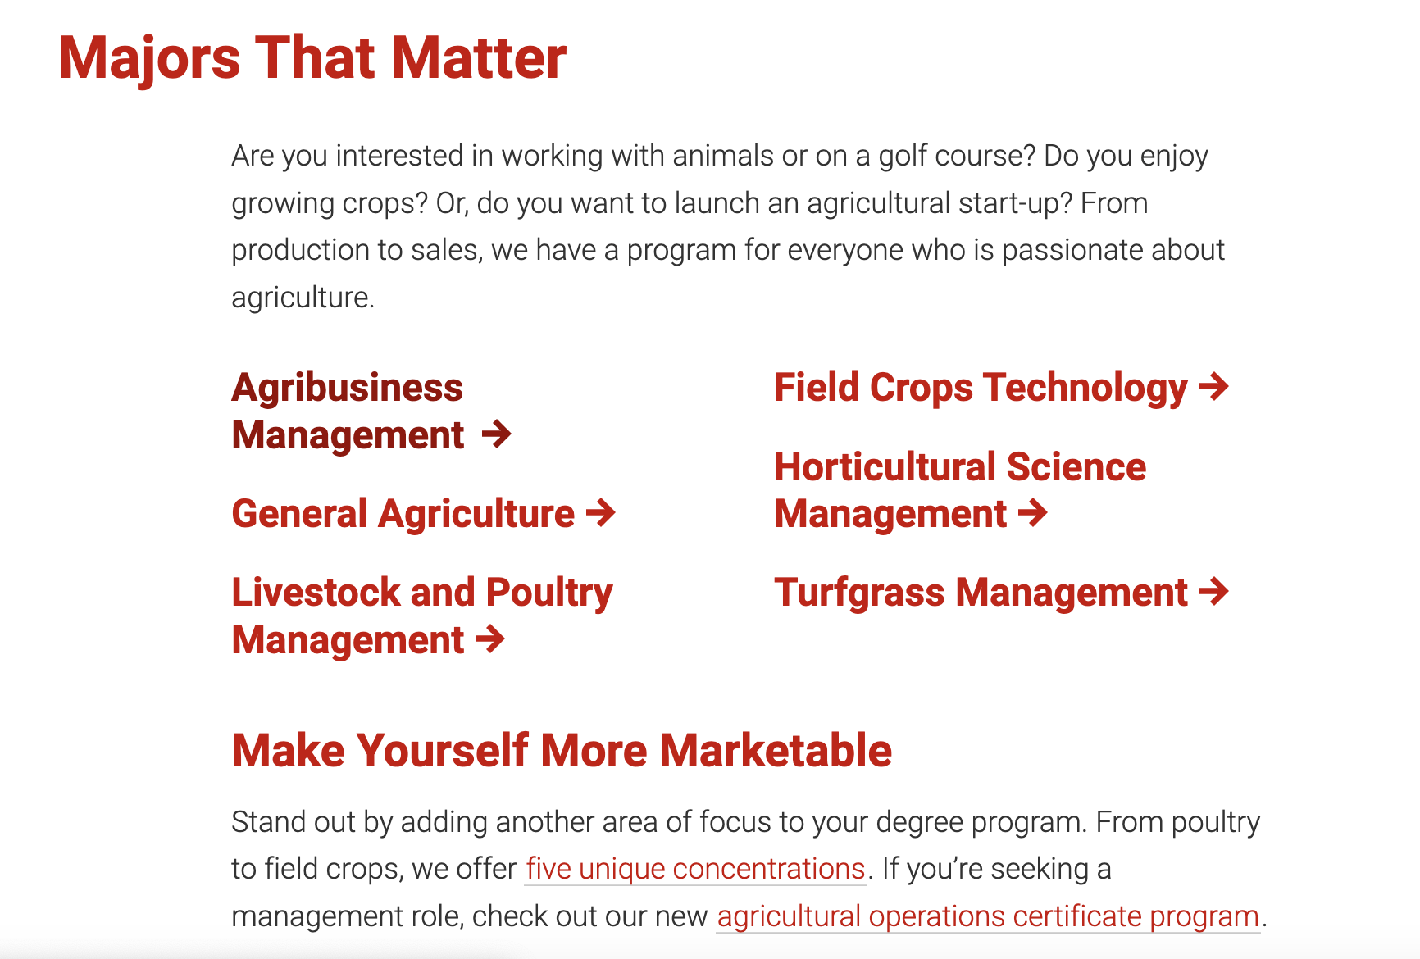
NC Agricultural Institute - NC State’s 2 year Associates Degree program

Slide 5
What is Heirs’ Property
Co-Tenancy (multiple fractional interests) in a Parcel of Real Property created by multiple intestate dispositions over several generations
Heirs’ property is not ‘created’ by testamentary distribution
  though wills may increase fractional interests
Considered “clouded” title, difficult to achieve 100% ownership consensus on sale and use

Slide 6
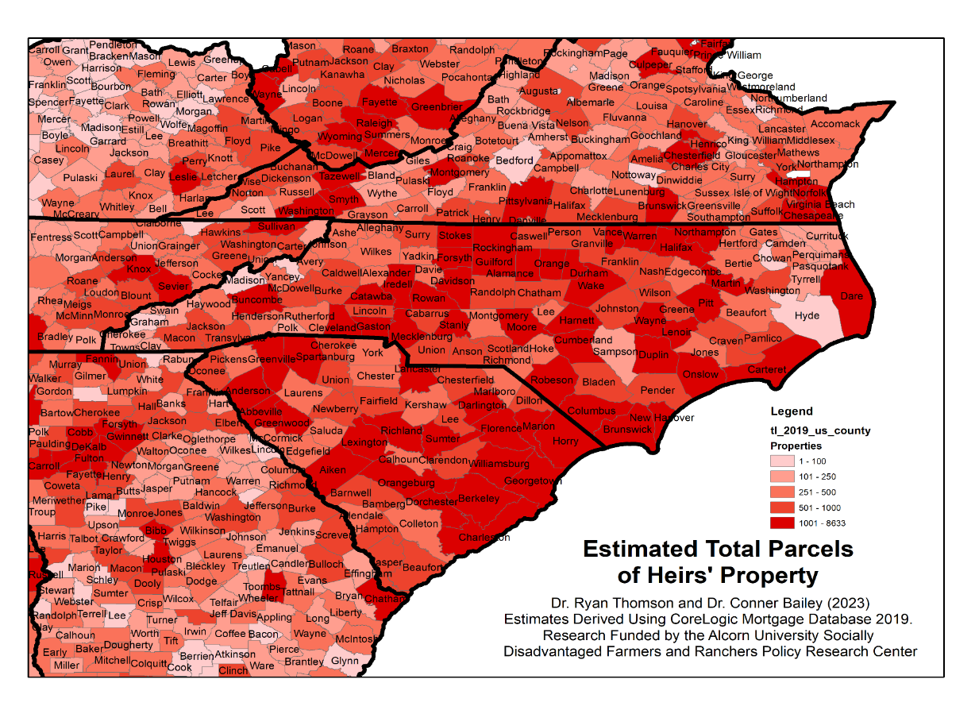
Estimated Total Parcels of Heirs Property in the Appalachian and Atlantic Southeast (Bailey and Thompson, 2023)
Bailey, C. and R. Thomson. 2023. Identifying Heirs’ Property: Extent and Value Across the South and Appalachia, Journal of Rural Social Sciences. 38(1): 29-38 https://tigerprints.clemson.edu/jrss/vol38/iss1/5/

Slide 7
Heirs Property Perceptions
Heirs Property land loss caused by partition actions under state law
  “no empirical evidence” (Mitchell, 2001)
Heir property caused by lack of access to legal service (for estate planning)
State partition statutes favor “partition in-kind,” (property divided into parcels for each fractional owner), though studies show more “partitions by sale” (auction sale of property, money divided among owners by fraction)
Land loss caused by developer opportunists who purchase a partial interest and partition
  led to new uniform partition law

Slide 8
Heirs Property Outreach and Research Questions
Questions:
What resources are required to “resolve title” on a parcel owned by multiple heirs?
What are efficiencies of partition actions to resolve title?
What are the downstream management experiences of families who resolve title?
How is the reformed partition law performing in other states?
Does NC timber partition law help resolve title?
Research requirements:
county by county records search
identify and survey practitioners
[“resolve title” = bring all fractional interests under common management and “interest exchange” structure (one or more people)]

Slide 9
A Thought for the Ages
“We think it enough that our title is derived by the grant of the former proprietor, by descent from our ancestors, or by the last will and testament of the dying owner; not caring to reflect that there is no foundation in nature or in natural law, why a set of words upon parchment should convey the dominion of land”
  Sir William Blackstone 1753

Slide 10
Real Property 101: Titled Estates in Land
(the ways land is owned)
Joint Tenancy with Right of Survivorship (RARE)
  Two or more simultaneous owners of undivided interest
  When an owner dies, his interest belongs to surviving owner(s) (Interest not inheritable)
  One joint tenant may not transfer interest
Tenancy by the Entireties: Joint Tenancy except for married couples (NCGS §41-55)
  property purchased during marriage presumed “marital property”
  property deeded to both spouses considered Tenancy by Entireties
Tenancy in Common
  Two or more simultaneous owners of undivided interests
  When a co-owner dies, interest passes to owners heirs by will or intestacy
  Each interest is freely alienable (can be sold or given to someone not currently a co-owner)
  Inherited property is not marital property [NCGS §50-20(b)(2)]
Farm Law Article: Land Title: Understanding Rights in Property
Notes:
An ownership interest in land is known as an estate, and the exploration of the development of estates and their current nature in modern law would take us into a whole different and future course of study. So let’s keep it simple for now.
If you own property in your name alone – you are the sole owner – you have what is called fee simple ownership: you own the whole show, and don’t share your ownership with anyone else. You own all of the rights, and can distribute those rights – what we’ll call the bundle of sticks in the next slide – to whomever you please. If you die owning the property, your heirs will receive your title.
Now, if you own your property concurrently with someone else, you have what is called a concurrent estate. When you own land concurrently with another owner, your ownership is expressed as a percentage but each of you have rights to the entire property. Your interest is called an undivided interest. The interest is not geographically defined within the boundaries of the property. For the moment, know that there are basically two types of ways people can own property concurrently.
First, there is joint tenancy with right of survivorship. This means that each owner owns a fractional share, but that share is tied to the life of each owner. When one owner dies, their interest automatically becomes the interest of their joint co-owner. Tenancy by the Entireties is essentially joint tenancy with right of survivorship between married persons. One cannot sell or alienate their interest in jointly-titled land unless all joint owners convey their interest or otherwise approve the transfer to a new joint owner.
Then, there is Tenancy in Common. A tenancy in common interest, like a joint tenancy interest is an undivided interest. However, each tenant in common can alienate their interest without the permission of another other owner. So one ownership interest can be freely swapped out so to speak. Because each interest is freely alienable, each interest is will pass to the interest holder’s heirs upon his or her death. Often after many years where co-tenants have died and their heirs inherit their interest, you can have dozens of concurrent owners. In North Carolina, one interest owner, regardless of how small the interest, has the right to petition the Clerk of Court to initiate a partition proceeding to divide up or auction the property and divide the proceeds. But like a more thorough discussion of estates in land, that is for another course in a future time.

Slide 11
Real Property 101: Titled Estates in Land
(the ways land is owned)
Joint Tenancy with Right of Survivorship (RARE)
  Two or more simultaneous owners of undivided interest
  When an owner dies, his interest belongs to surviving owner(s) (Interest not inheritable)
  One joint tenant may not transfer interest
Tenancy by the Entireties: Joint Tenancy except for married couples (NCGS §41-55)
  property purchased during marriage presumed “marital property”
  property deeded to both spouses considered Tenancy by Entireties
Tenancy in Common
  Two or more simultaneous owners of undivided interests
  When a co-owner dies, interest passes to owners heirs by will or intestacy
  Each interest is freely alienable (can be sold or given to someone not currently a co-owner)
  Inherited property is not marital property [NCGS §50-20(b)(2)]
Farm Law Article: Land Title: Understanding Rights in Property
Notes:
An ownership interest in land is known as an estate, and the exploration of the development of estates and their current nature in modern law would take us into a whole different and future course of study. So let’s keep it simple for now.
If you own property in your name alone – you are the sole owner – you have what is called fee simple ownership: you own the whole show, and don’t share your ownership with anyone else. You own all of the rights, and can distribute those rights – what we’ll call the bundle of sticks in the next slide – to whomever you please. If you die owning the property, your heirs will receive your title.
Now, if you own your property concurrently with someone else, you have what is called a concurrent estate. When you own land concurrently with another owner, your ownership is expressed as a percentage but each of you have rights to the entire property. Your interest is called an undivided interest. The interest is not geographically defined within the boundaries of the property. For the moment, know that there are basically two types of ways people can own property concurrently.
First, there is joint tenancy with right of survivorship. This means that each owner owns a fractional share, but that share is tied to the life of each owner. When one owner dies, their interest automatically becomes the interest of their joint co-owner. Tenancy by the Entireties is essentially joint tenancy with right of survivorship between married persons. One cannot sell or alienate their interest in jointly-titled land unless all joint owners convey their interest or otherwise approve the transfer to a new joint owner.
Then, there is Tenancy in Common. A tenancy in common interest, like a joint tenancy interest is an undivided interest. However, each tenant in common can alienate their interest without the permission of another other owner. So one ownership interest can be freely swapped out so to speak. Because each interest is freely alienable, each interest is will pass to the interest holder’s heirs upon his or her death. Often after many years where co-tenants have died and their heirs inherit their interest, you can have dozens of concurrent owners. In North Carolina, one interest owner, regardless of how small the interest, has the right to petition the Clerk of Court to initiate a partition proceeding to divide up or auction the property and divide the proceeds. But like a more thorough discussion of estates in land, that is for another course in a future time.

Slide 12
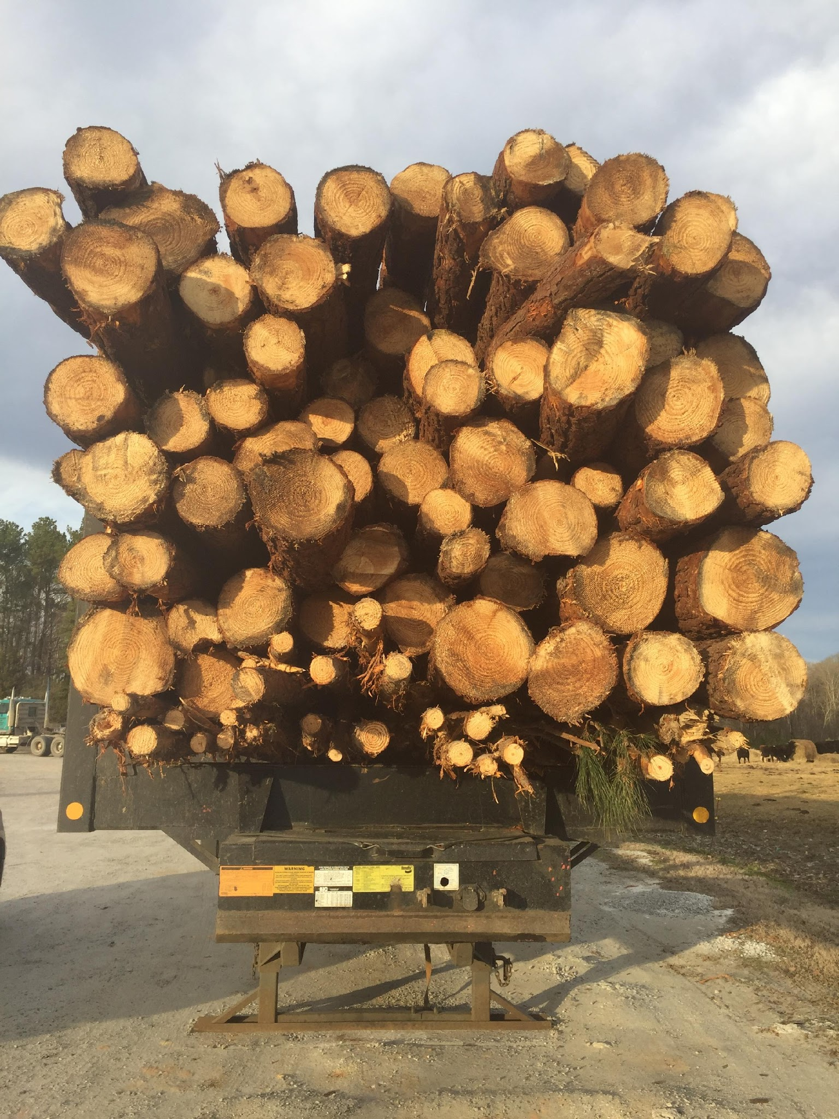
“The Bundle of Sticks”
(severable)
Water Rights: transferred to neighbor
Right to Timber: Sold to timber buyer
Right to Subdivide: transferred to land trust in form of conservation easement
Right of Sole Possession: Leased to house tenant
Right of sole possession: Grant of Easement to neighbor
Right to Take Wildlife: Leased to hunt club
Right to Farm: Leased to farmer
Right to subsurface minerals: Sold to energy developer
Right of sole possession: Transferred to DOT for Right of Way

Slide 13
Disposition at Death
Testate: person dies (decedent) with a valid will
  late 15c., from Latin testatus "public, manifest, published"
Intestate: person dies without a valid will, property is distributed according to Intestate Succession Act (N.C.G.S. Chapter 29)
  Distributions to spouse, lineal descendants, lateral descendants, or ancestors depending on facts at moment of death
    Spouse % varies with # of children or grandchildren
    Children and grandchildren (% varies by glass)
    Siblings and parents (depends on whether lineal descendants alive)

Slide 14
Intestate Succession
“Statute of Distributions” under old English law, adopted in United States by each state
Now, Intestate Succession Act (N.C.G.S. Chapter 29)
For disposition of property
  When no will properly executed
  When a will has been declared invalid by the court
Distributions
  First to spouse (legally married)
  Then to lineal descendants according to statute
  has effect of a testate per stirpes distribution (preserving a pre-deceased lineal descendant’s share for their descendants)

Slide 15
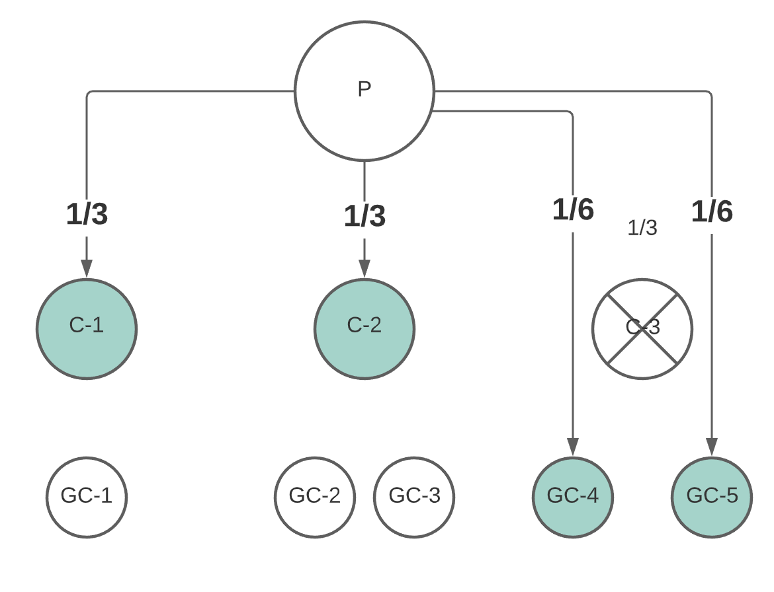
Effect of Intestate Distribution
(testate: per stirpes)

Slide 16
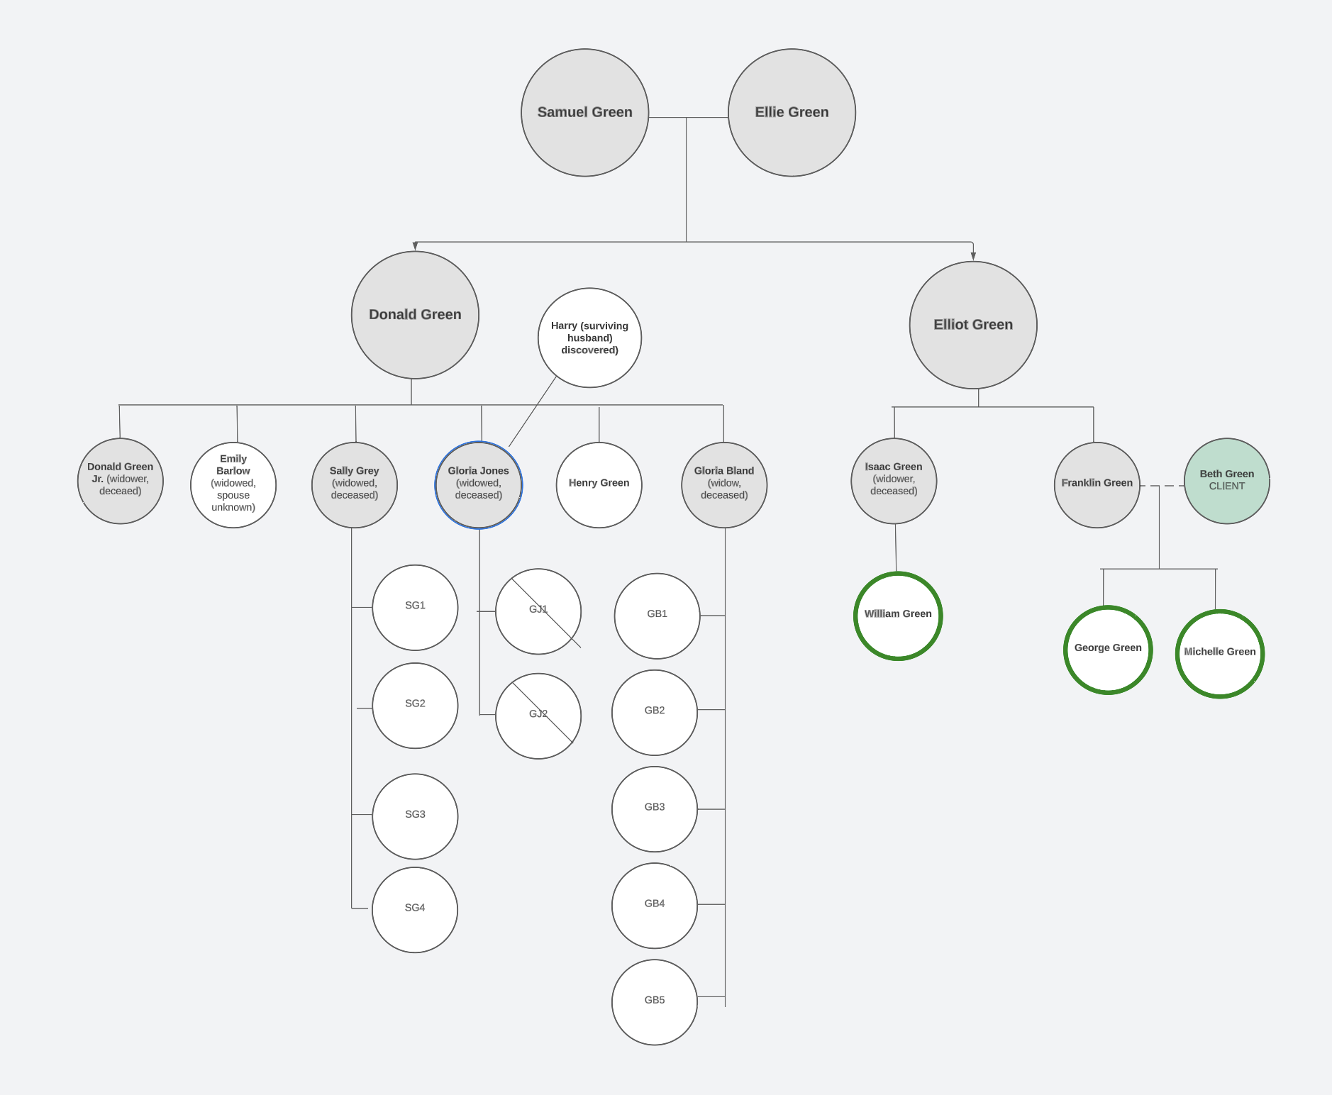

Slide 17
Heir Property Perceptions
Heir Property “land loss” caused by partition actions under state law
Heir property caused by lack of access to legal service (for estate planning)
  wills are important to establish a ‘certified’ record of descent of a particular interest
State partition statutes favor “partition in-kind,” (property divided into parcels for each fractional owner), though studies show more “partitions by sale” (auction sale of property, money divided among owners by fraction)
Land loss caused by opportunists who purchase a partial interest

Slide 18
“Certify Title”
Marketable title (and severed interests such as timber, etc.)
based on evidence of 100% ownership (aggregate of partial interests) sufficient to earn an opinion of certification from a licensed attorney
attorney certifies their opinion backed by a liability policy
title is certified to 3d party title insurer who will pay to defend title in the event it is challenged
title company may seek restitution from attorney’s policy

Slide 19
Claiming Title to Real Property
Action to Quiet Title: NCGS 41-10. An action may be brought by any person against another who claims an estate or interest in real property adverse to him for the purpose of determining such adverse claims
Adverse possession, marketable title act, connected chain of title from the state, proving superior title are all means of establishing a person’s interest or estate in real property.
In a connected chain of title, the claimant (plaintiff/defendant) must show that the description in each of the means of conveyance (deed, will, etc.) on which he bases his claim of title covers and includes the land he claims

Slide 20
What then…
still need to get 100% agreement on
how to manage the land
how to transfer interests
  to third parties
  to descendants
how to pay for management of the land
  property taxes
  insurance
  becomes more challenging if property is not producing sufficient income to pay costs

Slide 21
Partition of real property (NC)
Tenant in common has statutory right of partition land
Co-tenant files partition petition with Clerk of Court
  Clerk appoints a commissioner to study partition claim and make recommendation
    Actual Division (§46-1 et seq)
      Land surveyed into equal divisions
  Sale in Lieu of Partition (NCGS §46-22)
    Commissioner cannot recommend equal land division without damage to interests
    Too many heirs (“Heirs Property”): multiple tenants-in-common of differing generations
Timber Partition (§ 46A-80(b))

Slide 22
Revised Uniform Partition Act
Introduced in North Carolina [S363, H367] (did not pass to become law)
Creates “internal marketplace” among fractional heirs
  in a filed partition action, all heirs have a 30-day option to elect purchase of petitioner’s interest (60 days to secure financing)
Requires secondary valuation of fractional interest based on “fictitious” fair market value (valued as if no co-tenancy)
modifies “auction sale” pace to produce better price
Parcels under owner agreement not eligible
Study of its operation in other states (?)

Slide 23
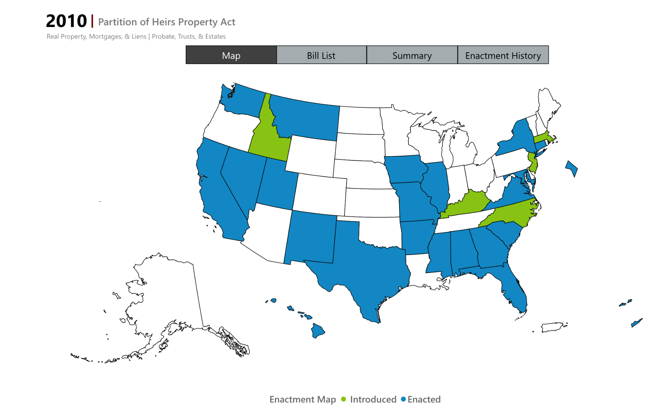

Slide 24
Private Practice Perspective on Heir Property Resolution
Can the practice absorb the cost (actual and opportunity) of sustaining a resolution project to completion
  Size of practice matters (?)
  How much pro bono or “low bono” service can the attorney take on?
  Fee arrangement (resolution on contingency?)
Who is the client?
  Difficult to represent all fractional interest owners
  Possible by agreement?

Slide 25
“Green” Resolution Project
Client: Former Spouse of Decedent (divorced)
Decedent: grandson of “original” owner (from 1937)
Client owned partial ownership interest
Pursuing project on behalf of her two children with decedent
Client had “maintained” property, payment of property taxes following illness of children’s aunt
Resource: 42 acres of land and mature timber (no residences)
Client’s goal: dispose of property for cash

Slide 27
“Sustaining” the Project
Client Agreement
  Client agrees to pay $200/month (with goal of securing reimbursement upon sale of property)
  Attorney agrees to accept excess billables upon sale of property
  Attorney does not request percentage of sale (customary in contingency cases)
    (customary in heir property cases?)
Goal to reimburse client for past payment of property taxes

Slide 28
The Approach
Challenge: how to secure agreement among co-tenants to liquidation of the property?
Timber partition: can sever the timber by partition petition prior to sale of land = generate shorter term cash for co-tenants
NC Timber Partition Statute: (§ 46A-80(b))
any co-tenant or life tenant (life estate) may petition clerk of court for partition and sale of timber interest

Slide 29
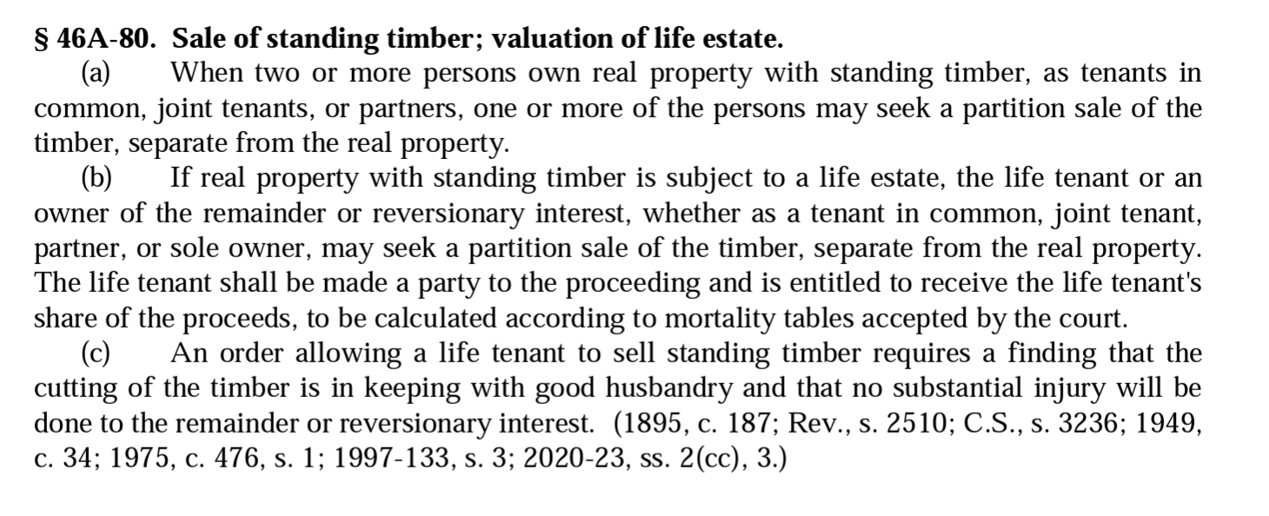
NC Timber Partition Statute

Slide 30
Survey to Known Heirs
QUESTIONNAIRE FOR HEIRS OF [FIRST OWNER NAME]
Please answer Yes or No to the following questions. Comments or questions may be provided below in the last section. Thank you.
Yes / No Are you a legal heir (son, daughter, grandchild, great-grand-child or surviving spouse
of the aforementioned) of [FIRST OWNER NAME]. If so please provide your connection to one
of his sons- [SON OF FIRST OWNER NAME] or [SON OF FIRST OWNER NAME]. ______________________________.
Yes / No Do you support the plan of a timber partition of the 20 acres that are deemed viable
at this time and are owned by the Heirs of [FIRST OWNER NAME].
Yes / No Do you support the plan of a property sale of the 32+/- acres that are currently owned
by the Heirs of [FIRST OWNER NAME]?
Yes / No Do you support reimbursement of past taxes to the heirs who have paid the taxes
over the last ten (10) years.
Yes / No Do you support the reimbursement of the reasonable and necessary costs (i.e. timber
appraisal/inventory costs, partition costs, attorney and court filing fees) from the timber partition.
Yes / No Do you support the reimbursement of the reasonable and necessary costs (i.e. timber
appraisal/inventory costs, partition costs, attorney and court filing fees) from the property sale.

Slide 31
Resolution
100% positive response rate to questionnaire
Benefits:
  confirm current addresses of heirs
  secure acceptance of service for partition petition (out of state)
  ensure no adverse challenges to timber and land sale, valuation, partition in kind, etc.
Hire consulting forester to proceed with timber cruz and valuation
Draft and file Petition for Statutory Partition and Sale of Standing Timber and Real Estate Sale
  Service by agreement with respondents by certified mail with return receipt

Slide 32
Unknown Potential Heirs
Original owner was married at time of death
Surviving spouse survived him by 20+ years
  Did surviving spouse remarry?
  Did surviving spouse have children by second marriage
Discussion with client about costs and time to locate vital records, estate file, etc.
Decision to appoint Guardian ad Litem to represent interests of surviving spouse heirs’ interest (if any)
  Local attorney familiar with names and vital records for that county (hours away from Branan law office)
  GAL determines that surviving spouse interest was in dower (a lifetime interest only)
    Dower abolished in NC in ________________

Slide 33
Resulting Reallocation of Interests
Samuel Green Heirs (ALL) | Original Petition | Amendment after GAL Response
Ellie Green Heirs | ⅓ (33.333%) | 0
William Green | ⅙ (16.670%) | ¼ (25.000%)
George Green | 1/12 (8.335%) | ⅛ (12.500%)
Michelle Green | 1/12 (8.335%) | ⅛ (12.500%)
Emily, Harry, Henry | 1/15 (6.666%) | 1/10 (10.000%)
SG1, SG2, SG3, SG4 | 1/60 (1.666%) | 1/40 (2.500%)
GB1, GB2, GB3, GB4, GB5 | 1/75 (1.333%) | 1/50 (2.000%)
 | 1/1 (100%) | 1/1 (100%)

Slide 34
Result and Costs
Sale of Timber (6-2-2016) $50,759
(closed bid by consulting forester)
Attorneys fees and costs ($23,374.71)
50 hours (June 2013 to Jan 2016) ($9151.85)
Costs (postage, forester fee, filing fees) ($2247.54)
Sale of Land (5-3-2019) $64,800
(listing by local RE agent) ($8986.13)
Attorney fees and costs
12 hours (June 2016 to June 2019) ($3244)
Costs (mostly distribution of funds) ($254)
Reimbursement of Taxes to Client $2827
Reimbursement of advanced attorney fees $
Attorney Fees Total
Commmissions

Slide 35
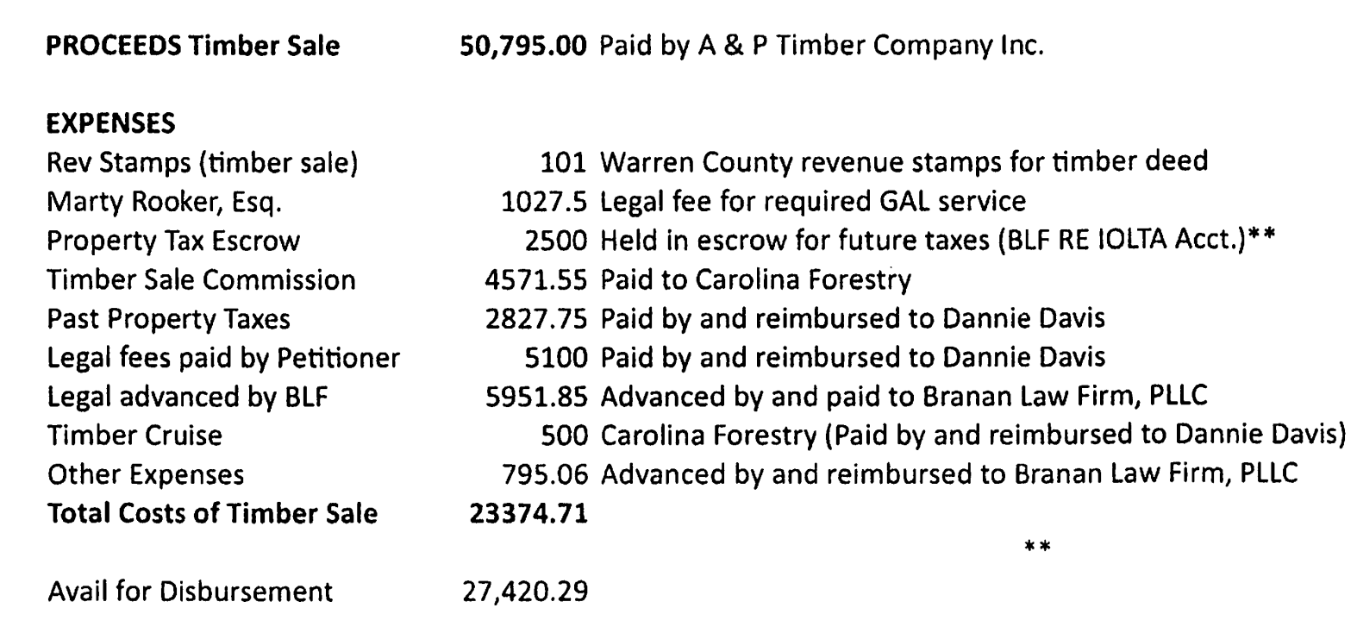
Report to Clerk (Timber Sale)

Slide 36
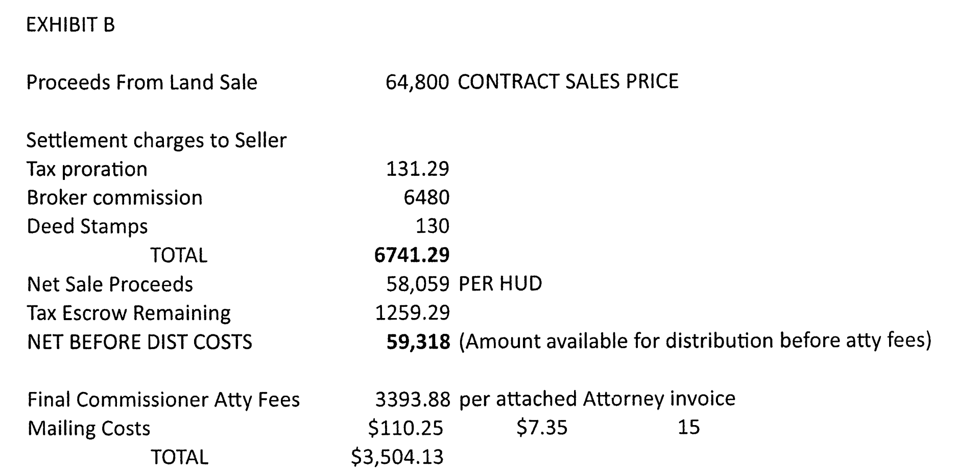
Costs of Land Sale
(from report to Clerk of Court)

Slide 38
Distribution of Timber Proceeds
Samuel Green Heirs (ALL) | Fractional Interests | Distribution from Timber Sale Only (after fees/costs and costs of sale) | Distribution of Land Sale Only (after fees/costs and costs of sale)
 |  | $27,420.29 | $55,813.87
Ellie Green Heirs | 0 | 0 | 0
William Green | ¼ (25.000%) | $6855.07 | $13,953
George Green | ⅛ (12.500%) | $3427.54 | $6976.73
Michelle Green | ⅛ (12.500%) | $3427.54 | $6976.73
Emily, Harry, Henry | 1/10 (10.000%) | $2742.03 | $5581.39 (each)
SG1, SG2, SG3, SG4 | 1/40 (2.500%) | $685.51 | $1395.35 (each)
GB1, GB2, GB3, GB4, GB5 | 1/50 (2.000%) | $548.41 | $1116.28 (each)
 | 1/1 (100%)

Slide 39
Managing Tenancy in Common
Tenancy in Common Agreement
  contract between co-tenants concerning
    management
    purchase of interests
    waiver of partition right
  must record memorandum in chain of title
Option to Purchase
  Right of First Refusal
    option holder allowed to match purchase offer by another party
  Right of First Offer
    requires other party to offer interest at market value ascertainable by appraisal (or otherwise by agreement)
Limited Liability Company

Slide 40
Limited Liability Company
Operating LLC (or S Corp)
  Partners contribute their ownership interest in cattle, bins, machinery, “sweat” etc.
  Use as transfer vehicle to farming heir (gifts/structured sale)
  Existing S Corp or Partnerships (merger, conversion, asset transfer, etc.)
Land LLC
  Deed Land interest to the LLC (never a corporation)
  Restrict membership
  Strip partition rights inherent to real property interest
  Structured exit of equity in land (title substitute)
  Conversion of existing Limited Partnership (w/o retitle property) (SOS filing)

Slide 41
The Operating Agreement
A Contract between contributors of assets
Restricts who can be members
  Member vs. Assignee
Dictates voting requirements for decisions
  Manager
  Voting and Non-voting Units
Dictates triggers for buy-sell
  Option to Purchase
  Who may buy and when
  Appraisal procedure
  Price and payment terms (seller finance option)
For existing S Corps, use Stock Purchase Agreement
Farm Law Articles
  Steps in LLC Formation
  Operating Agreements: Key Components and Sample Language

Slide 42
Transfer of LLC Interests
Gift of Interest (measured in “units”)
  Calculate value of company
  Divide value by number of units to determine price per unit
  Transfer total units < $17,000 annual gift tax exclusion
Sale
  Purchase from Other Members or Trust
    Purchase with insurance proceeds under Buy-Sell Agreement (Designate beneficiary and agreement between all participants + spouses)
  Spread capital gain over term note
  Discounting of interest value
  Some relief from Self Employment taxes

Slide 43
The Trust
A separate legal entity
Settlor (or Grantor): the person(s) who create(s) the trust and funds it (assigns property to the trust)
Trustee: the “legal owner” of the trust property, bound by a fiduciary duty (state law) and by terms of the trust
  Fiduciary powers of trustee NCGS § 36C-8-816
Beneficiary: The person(s) who receive the benefit of the trust
  distributions of income from assets (i.e. invested)
  distribution of principle (i.e. the assets themselves)
Language of the Trust controls
Trusts are private, assets not part of probate estate (but part of taxable estate if trust is revocable)

Slide 44
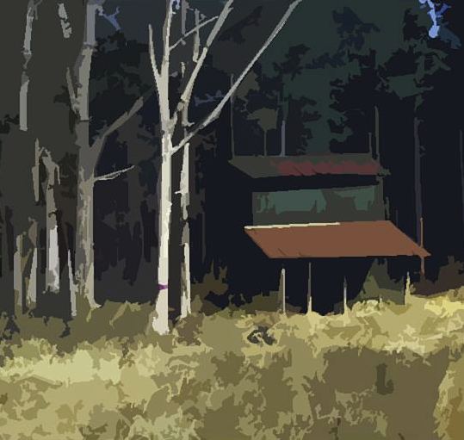
THANKS FOR INVITING ME!
Robert Andrew Branan
Associate Extension Professor
Department of
Agriculture and Resource Economics
North Carolina State University
rabrana2@ncsu.edu
This presentation and materials research, development and delivery are supported by the Sustainable Agriculture and Resource Education Professional Development Program Land Summit Professional Development grant (Award #531905)

