Slide 1
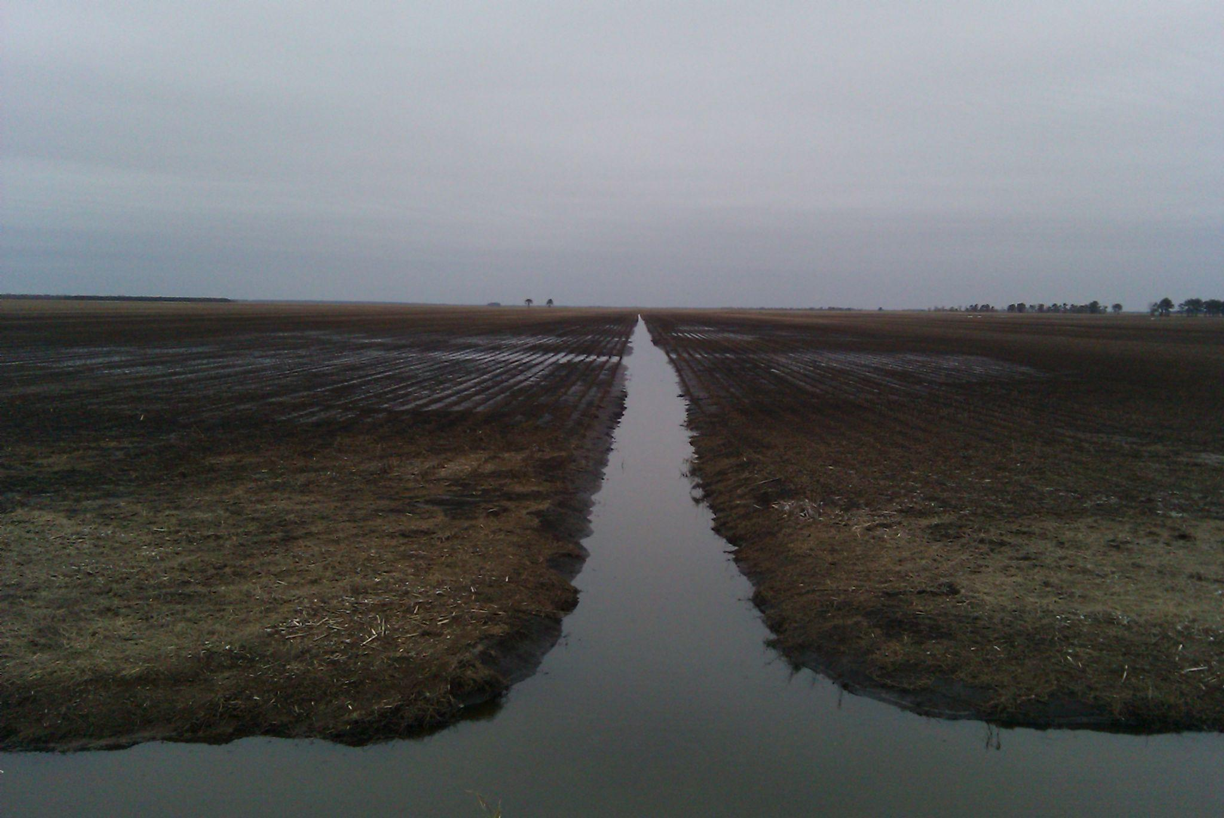
Farm Law and Tax for Producers and Landowners
Water Law:
Riparian Rights and Drainage
Robert Andrew Branan, JD
Associate Extension Professor
Department of Agriculture and Resource Economics
North Carolina State University
rabrana2@ncsu.edu
Notes:
Notes on future revision:
Add slide on ancient, Roman and common law history
Code of Hammurabi:
55. If any one open his ditches to water his crop, but is careless, and the water flood the field of his neighbor, then he shall pay his neighbor corn for his loss.
56. If a man let in the water, and the water overflow the plantation of his neighbor, he shall pay ten gur of corn for every ten gan of land.

Slide 2
How can those who depend on drainage system mandate its maintenance?
farmer against absentee or non-farm landowner?
landowner against government?
non-farm use landowner altering drainage system or natural flow?

Slide 3
The Takeaways
Landowner may not trespass upon neighboring property to clear drainage blockages or repair
  no right of entry
  2d degree trespass is Class 1 (§ 14-159.13)
  Civil trespass recoverable only if measurable damage
Landowner may not access another parcel without easement rights (or other permission)
Various easement rights may exist in the record depending on how drainage was originally developed
Maintenance funds (assessments or bonds) limited by statute (?)
County government (including Drainage Districts?) has eminent domain authority to create maintenance easements

Slide 4
Research Questions
Much study of micro-benefits of drainage tech… Not much study of the Eastern NC drainage system
How much of the current drainage in eastern NC was created by landowner petition under the 1909 Drainage Law? (includes easements)
How much created by agreement (that includes easements)
To what extent did governments under the 1909 Drainage Law (Ch 156) create access easements to clear drainage?
  information buried at the register of deeds?
What maintenance rights did P.L. 566 create?

Slide 5
Research Questions cont’d
Where may cleared ditch material (spoilage) be deposited?
What landowner assessment is necessary in a drainage district to cover costs of drainage maintenance?
  limited by statute?

Slide 6
Basic Easements Terminology
Easement: a right attached to one parcel allowing access across another parcel
  Easement Appurtenant: the right attaches to parcel, not its owner (‘runs with land’)
  Easement rights must be recorded (verbal permission is a one-time event)
Express Easement: an easement evident in the chain of title (either by deed or stand alone document)
  or possibly court records
Prescriptive Easement: easement by continued use
Dominant Estate: the parcel benefitted by the easement
Servient Estate: the parcel which the easement crosses

Slide 7
Dominant
Servient
Public Right of Way/Canal

Slide 8
A bit of water law history…
Charles II grants rights to use water running over or abutting land grants in newly-developing American colonies
  1663 Carolina Charters (Charles Town 1670)
  Landowner could use water, but the King owned it
“Reasonable Use” doctrine develops during industrial age, requiring rules for sharing of water between ”riparian owners” (those abutting water), industry and government
Western states (colonized under civil [Spanish] law) require rights established by putting water to beneficial use (“first in time, first in right”)
Notes:
Following the English Civil War (1642–1651) and the Restoration of the English monarchy in 1660, the King assumed the business of granting charters to private interests in lands of the eastern coast of the American continent. These grants applied English Common Law concepts of water rights, use of which is available to the landowner, but ownership is reserved to the monarch.
The reasonable use doctrine develops during the industrial revolution, as water use needs begin to vary greatly among those landowners with riparian rights, whereas a farm might require water for livestock or irrigation, a factory requires water diversion to run power sources (e.g. Water turbines).
In the Western states, colonized by the Spanish, adopted the civil law rule of first in time, first in right, whereby the first user of the water gets whatever they take (including all of it) irregardless of down-flow users needs.

Slide 9
Riparian water rights
”Reasonable Use” theory
  Not concerned with which use
    no preference for ag, recreation, industrial
  Correlative to all other downstream rights (a shared resource downstream from source)
Associated with ownership of abutting land, not ownership of water itself
  “Usufructurary”: the right to use
Applies to:
  Watercourses (with a bed and bank)
  Underground streams
  Percolating groundwater that has created a natural watercourse
Notes:
There are two theories of riparian water rights; the natural flow theory and the reasonable use theory. The reasonable use theory does not distinguish the purpose to which the water is being put. It asks only whether the use of the water is reasonable under all of the circumstances. In riparian rights states, the right to use water is a correlative use. That means that is a shared resource. It is a property right; however, unlike the ownership of land that confers both a right of use and a right of possession, a riparian right confers only a right of use.
In natural flow theory jurisdictions, of which there are few or none since the natural flow theory is the older, pre-industrial English common law, one was permitted to use as much water as one wished for domestic uses but was severely limited in the uses that could be made for artificial or commercial purposes. Obviously this rule was incompatible with the needs of the Industrial Revolution that was initially powered by water.
The system of riparian rights applies to natural watercourses, underground streams, and some springs. The system of riparian rights applies to springs that are the source of natural watercourses. For springs the determinative factor is not the source of the spring but whether or not the spring gives rise to a natural watercourse.
A natural watercourse has a well-defined channel with a bed and banks that are capable of retaining water. A natural watercourse has a flow. For seasonal streams the flow does not have to be continuous. Natural lakes are governed by the system of riparian rights. For a riparian right to attach, the landowner’s land must touch the water. A leaseholder steps into the shoes of the landowner and has the same riparian rights as the landowner for the duration of the lease. Riparian rights do not attach to diffuse surface waters that are usually created by precipitation. Riparian rights do not attach to floodwaters, water in artificial channels and ponds, or percolating groundwater.

Slide 10
Water rights (like all real property rights) are severable and transferrable
Tract with Riparian Right may share with non-riparian right owner subject to reasonable use doctrine
Riparian right (reasonable use)
impound
Riparian right (reasonable use)
No riparian right
transfer of water rights

Slide 11
Reasonable Use Not Applicable to…
Diffuse surface water (precipitation)
  Water captured by landowner is owned by landowner (does not have to share)
    But may have to allow natural drainage flow
Floodwater – overflow of natural banks
  periodic flooding does not create a riparian right
Water in artificial channels & sheet flow ponds
  does a drainage ditch grant a riparian right?
Percolating groundwater if not source of natural water course
Notes:
Whereas riparian rights are user rights, a landowner an actually own water as well. Ownership of water applies to diffuse flow, or sheet flow, where water flows across the land, not in a channel, from precipitation. A landowner is free to capture this water and may deny it to down-drainage landowners.
Likewise, floodwater that overflows natural banks also generally belongs to the landowner who suffers it, and some states allow capture of floodwater. A landowner can own the water in an artificial channel, so long as it does not support riparian rights downstream.
A landowner may also capture ownership of percolating groundwater, so long as it is not the feed source for a natural watercourse

Slide 12
Sheet flow
sheet flow capture = absolute ownership
no correlative down-drainage use
berm
Parcel A
Parcel B

Slide 13
Surface Drainage Law Theories
  “civil law rule” – landowner has liability to down-drainage owners if he alters sheet flow to their detriment
    aqua currit et debet currere, ut currere solebat (water flows and as it flows so it ought to flow)
  “common enemy rule” – landowner has right to alter land to change natural sheet flow, since water is a common enemy to all
    cujus est solum, ejus est usque ad coelum et ad inferos (whose is the soil, his is even to the skies and to the depths below)

Slide 14
North Carolina “Reasonable Use”
North Carolina adopted a compromise between “civil law” and “common enemy” in Pendergrast v. Aiken, 293 N.C. 201, 212, 236 S.E.2d 787 (1977)
  "The upper owner can not divert and throw water on his neighbor, nor the latter back water on the other with impunity. Sic utere tuo, ut alienum non laedas. [Use your own property in such a manner as not to injure that of another].
  Liability for intentional, unreasonable, negligent or reckless actions that cause “downhill” flooding
Balances value to landowner, whether suitable to locality, burden on landowner to minimize damage (“nuisance theory” elements)

Slide 15
Sheet flow
Diversion of flow
Is A’s diversion of water onto B reasonable?
Jury must decide
Parcel A
Parcel B

Slide 16
NC Court Decisions on
Up-drainage Diversion
"It is now well settled that neither a corporation nor an individual can divert water from its natural course so as to damage another. They may increase and accelerate, but not divert." Hocutt v. Wilmington & W. R. Co., 124 N.C. 214
Applied to NC DOT (gov’t): “[W]hile municipal authorities may pave and grade their streets and are not ordinarily liable for an increase of surface water naturally falling on the lands of a private owner, …they are not allowed… to concentrate and gather such waters into artificial drains and throw them on the lands of an individual owner in such manner and volume as to cause substantial injury to the same and without making adequate provision for its proper outflow, unless compensation is made, and for breach of duty in this respect an action will lie..” Braswell v. State Highway & Public Works Com., 250 N.C. 508, 510, 108 S.E.2d 912 (1959

Slide 17
Case Law on Drainage and Gov’t Takings
U.S. Constitution 5th Amendment: “… nor shall private property be taken for public use without just compensation.”
  Applied to NC government through Article I of NC Constitution “law of the land” clause
NC Supreme Court: “If the right to have water flow in the direction provided by nature is a property right, it follows that the owner of property is protected by the constitutional guarantee and must be compensated when he has been damaged by the destruction of that right. Repeated decisions of this Court have clearly indicated… that the benefits accruing to property by adhering to nature and permitting water to drain according to the terrain and natural flow is a property right.” Eller v. Board of Education, supra; Johnson v. Winston-Salem, 239 N.C. 697, 81 S.E. 2d 153; Phillips v. Chesson, 231 N.C. 566, 58 S.E. 2d 343; McKinney v. Deneen, supra; Mizzell v. McGowan, 120 N. C. 134.
U.S. Supreme Court: “A servitude was created by reason of intermittent overflows which impaired the use of the lands for agricultural purposes. …There was thus a partial taking of the lands for which the Government was bound to make just compensation under the Fifth Amendment. Jacobs v. U. S., 290 U.S. 13, 78 L. Ed. 142 (1933)

Slide 18
NC Case Law Down-drainage
That a lower owner can not obstruct a natural waterway so as to flood the lands above him has long been settled. Pugh v. Wheeler, 19 N.C. 50; Overton v. Sawyer, 46 N.C. 308; Cagle v. Parker, 97 N.C. 271, 2 S.E. 76; Ridley v. R. R., 118 N.C. 996, 24 S.E. 730; R. R. v. Wicker, 74 N.C. 220; Porter v. Durham, 74 N.C. 767.
what components of drainage system are considered “natural”?
does lack of maintenance (passive obstruction) equal “obstruct”?
The lower proprietor is not required to avoid damages to his land in such case by digging ditches to carry off surface water wrongfully diverted from its natural flow by the upper proprietor to his damage. Roberts v. Baldwin, 155 N.C. 276; Waters v. Kear, ante, 246.
Barcliff v. Norfolk S. R. Co., 168 N.C. 268, 270, 84 S.E. 290, 292 (1915)
relevant to suing an upstream owner

Slide 19
Duty of “down drainage” parcel owner to upper owners re obstruction
“aqua currit et debet currere ut currere solebat”
(“Water runs, and ought to run, as it has used to run”)
Davis v. Cahoon, 5 N.C. App. 46 (1969)
North Carolina has not recognized and does not apply the common enemy doctrine but follows the civil law rule. The civil law rule places less emphasis on the existence of well-defined watercourses than does the common enemy doctrine. The rule embraces surface waters flowing and draining naturally from a higher to a lower level, and is stated thus: The law confers on the owner of each upper estate an easement or servitude in the lower estates for the drainage of surface water flowing in its natural course and manner without obstruction or interruption by the owners of the lower estates to the detriment or injury of the upper estates. Each of the lower parcels along the drainway is servient to those on higher levels in the sense that each is required to receive and allow passage of the natural flow of surface water from higher land.
Applies the ‘old’ Civil Law rule, but above maxim informs what a jury may find as “reasonable” in any contested obstruction

Slide 20
Gov’t Entity Adopting Existing Drainage
No Gov’t duty to maintain private drainage
Use does not equal “adoption”
  where a private party has constructed drainage and it is now part of drainage system used elsewhere by government entity (municipality or county), government is not required to maintain drainage flow
    see Asheville Sports Props., LLC v. City of Asheville, 199 N.C. App. 341 (2009)
      citing Mitchell v. City of High Point, 31 N.C. App. 71, 71-72, 228 S.E.2d 634, 634-35 (1976)
However, a City may be liable for flood damage by increasing flow to a private drainage system where it controls drainage above and below private drainage system Hooper v. City of Wilmington, 42 N.C. App. 548, 257 S.E.2d 142, disc. review denied, 298 N.C. 568, 261 S.E.2d 122 (1979)

Slide 21
Provisions of NC 1909 Drainage Statute (Ch 156)
Petition mechanism for drainage through another’s land (NCGS §156-2)
any person owning “lowlands” subject to inundation which cannot conveniently drained
petition to Superior Court
appointment of 3 commissioners (like in partition) to examine location of drainage
Creation of an easement, with width for maintenance (§156-5)
Right to drain into canal (§156-10)
Right of petition (per §156-2)
… parties are those before “furthest artificial outlet”
Provision for notice of entry and repair (§156-12)

Slide 22
Dominant
Dominant
Servient
Servient
Servient
Canal

Slide 23
NC Drainage Statute (Cont’d)
§ 156-14. Subsequent owners bound. All persons to whom may descend, or who may otherwise own or occupy lands drained by any canal or ditch, for the privilege of cutting which any labor for repairing is assessed, shall contribute the same, and shall be bound therefor to all intents and purposes, and in the same manner and by the same judgment as the original party himself would be if he occupied the land. (R.C., c. 40, s. 13; Code, s. 1309; Rev., s. 3994; C.S., s. 5273.)

Slide 24
Drainage Statute
§ 156-20. Right of dominant owner to repair. In the absence of any agreement for maintaining the efficiency of such ditch or canal, or should the servient owner neglect or refuse to clean out or aid in cleaning out the same through his lands, it shall be lawful for the dominant or higher owner, after giving three days' notice to the servient owner, to enter along such canal and not more than 12 feet therefrom and clean out or remove obstructions or accumulated debris therefrom at his own personal expense or without cost to the servient owner. (1899, c. 255, s. 2; Rev., s. 4025; C.S., s. 5279.)

Slide 25
The Big Questions:
Does a drainage create an implied easement, and if so does that implied easement confer a duty on the ‘lower’ estate(s) to maintain free flow of water?
Is the existence of the drainage or canal sufficient evidence to put a purchaser on notice that there is an implied drainage easement through their property?
In other words, is allowing a ditch to deteriorate or become obstructed to the point of blocking drainage, a violation of the duty “not to block” drainage?
can the rule of “petition-created” express drainage easements be applied to implied easements

Slide 26
Drainage Districts Overview
Formation authorized by 1909 statute to drain areas for agriculture and public health.
Drainage Districts are legal political subdivisions of the state.
Under oversight of the Clerk of Superior Court in their home county.
  Appoint Commissioners and fill vacancies.
  Commissioners serve three year staggered terms.
  Receive the annual reports.
  Hire an auditor(s) to audit each district annually

Slide 27
Drainage Districts Overview
Each District is responsible for maintenance of laterals and drainage infrastructure within their district
  Are assessments enough to cover costs?
Maintains a checking account into which the county deposits assessments
Sets the amount of the annual levy
Is supposed to have 3 commissioners appointed by the clerk of courts
Must file an annual report showing all receipts and disbursements
Has the authority to issue bonds

Slide 28
Ditch Clean Up Responsibility
Where ditch serves as border between tracks
  Outside of Drainage District, no particular responsibility (?)
  Inside Drainage District, responsibility of District
    Land assessed to pool funds for maintenance
    District may make special assessment against lands in District
Ditch runs through another’s property
  Inside drainage district, responsibility of District
  If subject to drainage easement, may enter to clear
  Filling in a ditch outside drainage district?

Slide 29
Devonwood-Loch Lomond Lake Association, Inc. v. City of Fayetteville (Decided Dec. 2025)
Hurricane Matthew breaches four private "amenity" dams.
Court rules the City did not cause the initial dam failure; Takings claims dismissed.
N.C. Court of Appeals clears the way for trial, ruling stormwater management is a proprietary function not protected by governmental immunity.
Trial ends in a Directed Verdict for the City; Judge rules Plaintiffs failed to prove the City had a legal duty to restore private infrastructure.

Slide 30
Ditch Discharge Permit Exemptions (when jurisdictional WOTUS)
33 CFR § 323.4 - Discharges not requiring permits
  Upland ditching and tiling, connecting to jurisdictional WOTUS
    new proposed rule: will connection become a point source?
  Removal of obstructions caused during floods (within one year)
    will S&W $36billion create any permit problems (i.e. removal of sediment)

Slide 31

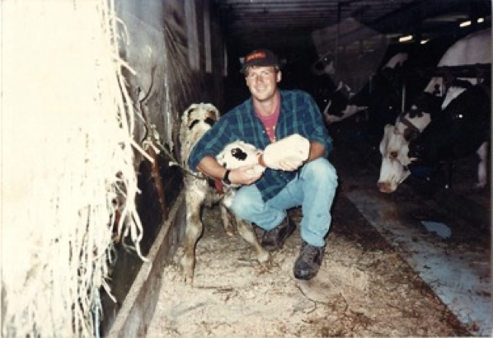

THANKS FOR INVITING ME!
Robert Andrew Branan
Associate Extension Professor
Department of
Agriculture and Resource Economics
North Carolina State University
rabrana2@ncsu.edu
This presentation and materials research, development and delivery are supported by the Sustainable Agriculture and Resource Education Professional Development Program Land Summit Professional Development grant (Award #531905)

