Slide 1
Sustainable Sidedress Nitrogen Applications for Early Corn and Cotton Using Unmanned Aerial Systems Imaging
Nolan Parker
Under the direction of
Amelia A.A. Fox, Ph.D.
March 11, 2022
1

Slide 2
Introduction
~405 oceanic “Dead Zones” (hypoxic) in oceans worldwide (Diaz, 2018; AP, 2021; Bruckner, 2019).
Inefficient N use contributes to pollution of waterways (Kanter, 2019).
sUAS missions may support estimating canopy N status in corn and cotton (Xu et al., 2019).
Failure to address farm N use may exacerbate already excessive N runoff (Erisman et al., 2013).
2

Slide 3
Study Purpose
Compare aerial imaging techniques to aid in estimating early crop N status in corn and cotton
H_{a1}: Fixed-wing may provide imaging data returns with higher efficacy due to factors such as speed and power consumption.
H_{a2}: sUAS will accurately estimate early corn and cotton crop leaf N percentage and help improve NUE
3

Slide 4
Study Objectives
Compare unmanned, fixed-wing flight technology to quad-copter to establish which system estimates early crop canopy N status most effectively
Evaluate five different VIs for estimating early corn and cotton canopy N status
Demonstrate a sensor-based VRN technology in a producer’s field using VI calibrated imagery captured on unmanned flight systems
4
Notes:
Compare fixed-wing flight technology to quad-copter to establish most effective platform

Slide 5
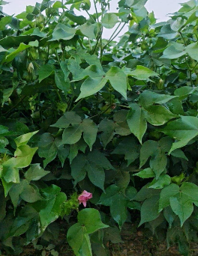
Background
Corn and cotton distinctive canopy architecture aids in estimating N requirements through remote sensing (Baret et al., 2007; Cammarano et al., 2011)
Remote sensing and aerial imagery predate to the mid-19th century (Byrum, 2017)
sUAS market evaluated at $1.19 billion in 2018, predicted to be $6.52 billion by 2026 (Watson, 2019)
(Parker, 2021)
5

Slide 6
Background
Normalized difference vegetation index (NDVI) (Rouse, 1974) most common VI in agriculture (Glenn et al., 2011)
Normalized Difference Red Edge Index (NDRE) (Barnes et al., 2000) found efficient for assessing N status (Paiao, 2018)
Simplified Canopy Chlorophyll Content Index (SCCCI) (Barnes et al. 2000) highest coefficient of determination for detecting N status (Ballester et al., 2017; Fox, 2015; Varco et al., 2013)
6

Slide 7
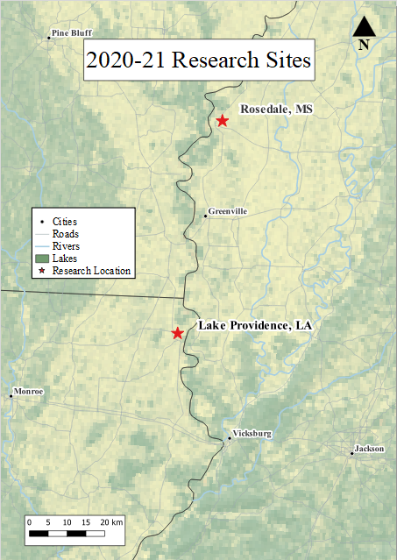
Materials & Methods
Rosedale, MS
Lake Providence, LA
Corn in MS 2020
Cotton in LA 2020
Corn and Cotton in LA 2021
7
Notes:
No cotton data for year one yet.

Slide 8
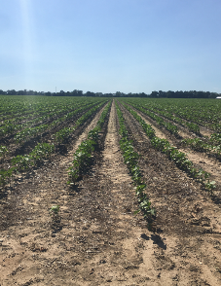
Materials & Methods
Randomized complete block design
Full fixed-rate N application as control
VRN treatments established on 24-row plots
Four reps of two treatments established on one 9 ha (20 ac) corn plot and two 9 ha (20 ac) cotton plots
Employed Vari-Rite® algorithm for VRN app.
(Parker, 2020)
8

Slide 9
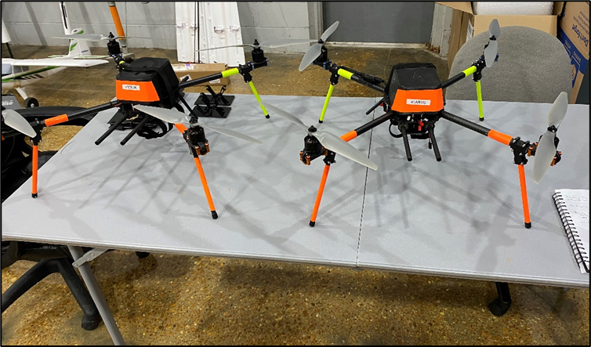
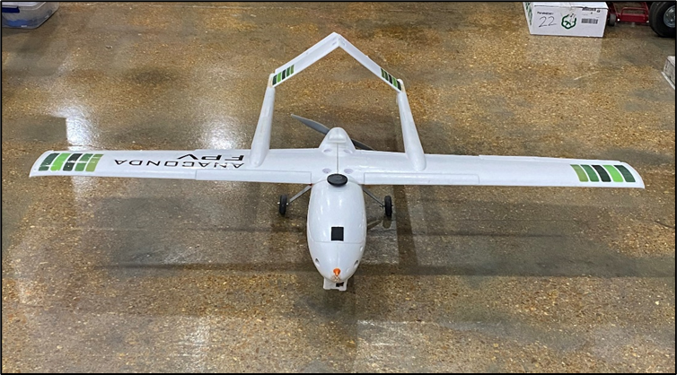
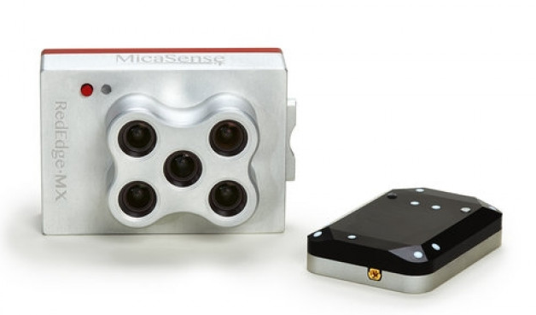
Flight Platforms & Payload
(Parker, 2021)
9
(DroneNerds, 2022)

Slide 10
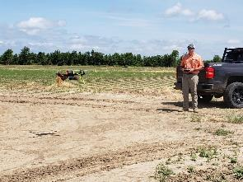
Sensing Missions
Year 1: Quad-copter missions flown at four different speeds for comparing VI sensitivity at 16/24/32/40 km h⁻¹ (10/15/20/25 mi h⁻¹)
Year 2: Quad-copter mission flown at 32 km h⁻¹ (20 mi h⁻¹) and fixed-wing mission flown at 64 km h⁻¹ (40 mi h⁻¹)
32 kmh (20 mph) flight used for VRN calculation
(Lott, 2020)
10

Slide 11
VRN Nitrogen Applications
Date | Crop | VRN Rate Low | VRN Rate High | Fixed-Rate
June 8, 2020 | Corn | 114.33 kg ha⁻¹ | 170.37 kg ha⁻¹ | 170.37 kg ha⁻¹
July 15, 2020 | Cotton | 0 kg ha⁻¹ | 33.63 kg ha⁻¹ | 33.63 kg ha⁻¹
May 8, 2021 | Corn | 78.46 kg ha⁻¹ | 134.50 kg ha⁻¹ | 134.50 kg ha⁻¹
June 20, 2021 | Cotton | 56.04 kg ha⁻¹ | 89.67 kg ha⁻¹ | 89.67 kg ha⁻¹
11
(Parker, 2020)

Slide 12
Data Analysis
SAS® 9.4 PROC GLM & PROC GPLOT for outlier identification
SAS® 9.4 PROC REG for SEq calculations and relate leaf N to VIs
Means separation: Tukey’s studentized range test (LSD)
Difference significant at α=0.05
12

Slide 13
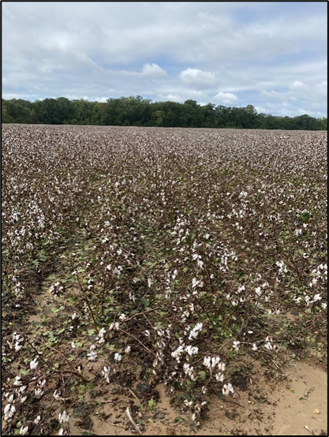
Study Limitations
Study restricted to LA and MS
Applications less than $10,000 and utile by farmers and farm service providers
2020 Corn and 2020 Cotton South yield affected by Hurricane Laura
(Parker, 2020)
13

Slide 14
2020 Corn 16 km h⁻¹ |  |  |  | 2020 Corn 24 km h⁻¹
SLOPE | SPAD | Leaf N% |  | SLOPE | SPAD | Leaf N%
NDVI | 0.0028 | 0.0341 |  | NDVI | 0.0021 | 0.0498
GNDVI | 0.0031 | 0.0323 |  | GNDVI | 0.0027 | 0.0531
NDRE | 0.0025 | 0.0309 |  | NDRE | 0.0024 | 0.0462
SCCCI | 0.0023 | 0.0267 |  | SCCCI | 0.0030 | 0.0422
FENDVI | 0.0021 | 0.0256 |  | FENDVI | 0.0024 | 0.0367
BENDVI | 0.0024 | 0.0232 |  | BENDVI | -0.0026 | -0.0414
RMSE |  |  |  | RMSE
NDVI | 0.0439 | 0.0442 |  | NDVI | 0.0435 | 0.0424
GNDVI | 0.0289 | 0.0299 |  | GNDVI | 0.0309 | 0.0295
NDRE | 0.0252 | 0.0257 |  | NDRE | 0.0255 | 0.0243
SCCCI | 0.0076 | 0.0090 |  | SCCCI | 0.0091 | 0.0092
FENDVI | 0.0087 | 0.0094 |  | FENDVI | 0.0117 | 0.0112
BENDVI | 0.0283 | 0.0289 |  | BENDVI | 0.0201 | 0.0195
SEq |  |  |  | SEq
NDVI | 0.0649 | 0.7722 |  | NDVI | 0.0482 | 1.1751
GNDVI | 0.1096 | 1.0813 |  | GNDVI | 0.0882 | 1.7955
NDRE | 0.1024 | 1.2031 |  | NDRE | 0.0946 | 1.8950
SCCCI | 0.3085 | 2.9743 |  | SCCCI | 0.3340 | 4.5474
FENDVI | 0.2408 | 2.7274 |  | FENDVI | 0.2112 | 3.2577
BENDVI | 0.0858 | 0.8028 |  | BENDVI | -0.1274 | -2.1205
2020 Corn 32 km h­⁻¹ |  |  |  | 2020 Corn 40 km h⁻¹
SLOPE | SPAD | Leaf N% |  | SLOPE | SPAD | Leaf N%
NDVI | 0.0017 | 0.0458 |  | NDVI | 0.0009 | 0.0475
GNDVI | 0.0028 | 0.0469 |  | GNDVI | 9.2222 | 0.0204
NDRE | 0.0023 | 0.0389 |  | NDRE | 0.0015 | 0.0405
SCCCI | 0.0034 | 0.0347 |  | SCCCI | 0.0031 | 0.0484
FENDVI | 0.0028 | 0.0249 |  | FENDVI | 0.0030 | -0.0542
BENDVI | -0.0004 | -0.0111 |  | BENDVI | -0.0020 | -0.0199
RMSE |  |  |  | RMSE
NDVI | 0.0516 | 0.0508 |  | NDVI | 0.0502 | 0.0490
GNDVI | 0.0317 | 0.0310 |  | GNDVI | 0.0248 | 0.0243
NDRE | 0.0281 | 0.0276 |  | NDRE | 0.0277 | 0.0264
SCCCI | 0.0066 | 0.0104 |  | SCCCI | 0.0112 | 0.0101
FENDVI | 0.0084 | 0.0110 |  | FENDVI | 0.0150 | 0.0125
BENDVI | 0.0233 | 0.0232 |  | BENDVI | 0.0116 | 0.0126
SEq |  |  |  | SEq
NDVI | 0.0330 | 0.9016 |  | NDVI | 0.0191 | 0.9694
GNDVI | 0.0892 | 1.5117 |  | GNDVI | 0.0037 | 0.8396
NDRE | 0.0820 | 1.4090 |  | NDRE | 0.0550 | 1.5288
SCCCI | 0.5287 | 3.3234 |  | SCCCI | 0.2810 | 4.7828
FENDVI | 0.3321 | 2.2511 |  | FENDVI | 0.1988 | 4.3338
BENDVI | -0.0174 | -0.4749 |  | BENDVI | -0.1759 | -1.5748
14

Slide 15
2020 Cotton North 16 km h­⁻¹ |  |  |  | 2020 Cotton North 24 km h⁻¹
SLOPE | SPAD | Leaf N% |  | SLOPE | SPAD | Leaf N%
NDVI | 0.0115 | -0.0003 |  | NDVI | 0.0019 | -0.0007
GNDVI | 0.0036 | 0.0186 |  | GNDVI | -0.0013 | 0.0035
NDRE | 0.0143 | -0.0001 |  | NDRE | -0.0015 | 0.0159
SCCCI | -0.0290 | -0.0005 |  | SCCCI | 0.0230 | -0.0732
FENDVI | 0.0093 | 0.0007 |  | FENDVI | -0.0046 | 0.0197
BENDVI | 0.0753 | 0.2007 |  | BENDVI | -0.0078 | 0.0148
RMSE |  |  |  | RMSE
NDVI | 0.1015 | 0.1032 |  | NDVI | 0.1160 | 0.1161
GNDVI | 0.0853 | 0.0852 |  | GNDVI | 0.0835 | 0.0835
NDRE | 0.0693 | 0.0731 |  | NDRE | 0.0859 | 0.0857
SCCCI | 0.0551 | 0.0726 |  | SCCCI | 0.1439 | 0.1457
FENDVI | 0.0165 | 0.0224 |  | FENDVI | 0.0354 | 0.0353
BENDVI | 0.4619 | 0.4710 |  | BENDVI | 0.1307 | 0.1312
SEq |  |  |  | SEq
NDVI | 0.1136 | -0.0037 |  | NDVI | 0.0163 | -0.0005
GNDVI | 0.0424 | 0.2186 |  | GNDVI | -0.0164 | 0.0419
NDRE | 0.2062 | -0.0025 |  | NDRE | -0.0181 | 0.1855
SCCCI | -0.5263 | -0.0070 |  | SCCCI | 0.1599 | -0.5029
FENDVI | 0.5615 | 0.0331 |  | FENDVI | -0.1313 | 0.5599
BENDVI | 0.1631 | 0.4262 |  | BENDVI | -0.0598 | 0.1130
2020 Cotton North 32 km h­⁻¹ |  |  |  | 2020 Cotton North 40 km h⁻¹
SLOPE | SPAD | Leaf N% |  | SLOPE | SPAD | Leaf N%
NDVI | -0.0001 | -0.0401 |  | NDVI | 0.0042 | 0.0841
GNDVI | -0.0021 | -0.0224 |  | GNDVI | -0.0004 | 0.0639
NDRE | -0.0024 | -0.0165 |  | NDRE | -0.0030 | 0.0638
SCCCI | 0.0217 | -0.0047 |  | SCCCI | 0.0318 | -0.0884
FENDVI | -0.0040 | 0.0022 |  | FENDVI | -0.0076 | 0.0234
BENDVI | -0.0027 | -0.0258 |  | BENDVI | -0.0148 | 0.1288
RMSE |  |  |  | RMSE
NDVI | 0.1142 | 0.1130 |  | NDVI | 0.1062 | 0.1008
GNDVI | 0.0834 | 0.0830 |  | GNDVI | 0.0797 | 0.0754
NDRE | 0.0846 | 0.0844 |  | NDRE | 0.0790 | 0.0748
SCCCI | 0.1595 | 0.1634 |  | SCCCI | 0.1194 | 0.1252
FENDVI | 0.0375 | 0.0381 |  | FENDVI | 0.0300 | 0.0311
BENDVI | 0.1165 | 0.1161 |  | BENDVI | 0.1204 | 0.1111
SEq |  |  |  | SEq
NDVI | -0.0011 | -0.3548 |  | NDVI | 0.0403 | 0.8341
GNDVI | -0.0257 | -0.2706 |  | GNDVI | -0.0051 | 0.8475
NDRE | -0.0286 | -0.1960 |  | NDRE | -0.0379 | 0.8526
SCCCI | 0.1360 | -0.0292 |  | SCCCI | 0.2668 | -0.7062
FENDVI | -0.1070 | 0.0598 |  | FENDVI | -0.2543 | 0.7540
BENDVI | -0.0235 | -0.2227 |  | BENDVI | -0.1229 | 1.1585
15

Slide 16
2020 Cotton South 16 km h­⁻¹ |  |  |  | 2020 Cotton South 24 km h⁻¹
SLOPE | SPAD | Leaf N% |  | SLOPE | SPAD | Leaf N%
NDVI | 0.0013 | 0.0050 |  | NDVI | -0.0010 | 0.0002
GNDVI | 0.0022 | 0.0064 |  | GNDVI | -0.0005 | -0.0063
NDRE | 0.0035 | 0.0050 |  | NDRE | -0.0026 | -0.0095
SCCCI | 0.0053 | 0.0033 |  | SCCCI | -0.0020 | -0.0100
FENDVI | 0.0026 | 0.0016 |  | FENDVI | -0.0039 | -0.0199
BENDVI | 0.0279 | 0.1298 |  | BENDVI | 0.0552 | -0.0325
RMSE |  |  |  | RMSE
NDVI | 0.0033 | 0.0046 |  | NDVI | 0.0071 | 0.0075
GNDVI | 0.0054 | 0.0076 |  | GNDVI | 0.0057 | 0.0055
NDRE | 0.0095 | 0.0128 |  | NDRE | 0.032 | 0.0333
SCCCI | 0.0153 | 0.0201 |  | SCCCI | 0.0300 | 0.0303
FENDVI | 0.0077 | 0.0101 |  | FENDVI | 0.0608 | 0.0614
BENDVI | 0.0732 | 0.0957 |  | BENDVI | 0.6736 | 0.6870
SEq |  |  |  | SEq
NDVI | 0.4186 | 1.0909 |  | NDVI | -0.1412 | 0.0326
GNDVI | 0.4139 | 0.8503 |  | GNDVI | -0.0996 | -1.1482
NDRE | 0.3695 | 0.3914 |  | NDRE | -0.0795 | -0.2852
SCCCI | 0.3478 | 0.1650 |  | SCCCI | -0.0669 | -0.3313
FENDVI | 0.3427 | 0.1615 |  | FENDVI | -0.0652 | -0.3246
BENDVI | 0.3808 | 1.3559 |  | BENDVI | 0.0819 | -0.0473
2020 Cotton South 32 km h­⁻¹ |  |  |  | 2020 Cotton South 40 km h⁻¹
SLOPE | SPAD | Leaf N% |  | SLOPE | SPAD | Leaf N%
NDVI | 0.0044 | 0.0262 |  | NDVI | 0.0024 | 0.017
GNDVI | 0.0049 | 0.0231 |  | GNDVI | 0.0038 | 0.0183
NDRE | 0.0078 | 0.0339 |  | NDRE | 0.0052 | 0.0305
SCCCI | 0.0060 | 0.0712 |  | SCCCI | 0.0041 | 0.0214
FENDVI | 0.0059 | 0.0216 |  | FENDVI | 0.0040 | 0.0210
BENDVI | 0.0142 | 0.2255 |  | BENDVI | 0.0134 | 0.0661
RMSE |  |  |  | RMSE
NDVI | 0.0083 | 0.0123 |  | NDVI | 0.0054 | 0.0071
GNDVI | 0.0104 | 0.0150 |  | GNDVI | 0.0074 | 0.0111
NDRE | 0.0149 | 0.0231 |  | NDRE | 0.0100 | 0.0148
SCCCI | 0.0124 | 0.0608 |  | SCCCI | 0.0076 | 0.0117
FENDVI | 0.0121 | 0.0183 |  | FENDVI | 0.0075 | 0.0115
BENDVI | 0.1055 | 0.0991 |  | BENDVI | 0.0312 | 0.0429
SEq |  |  |  | SEq
NDVI | 0.5317 | 2.1171 |  | NDVI | 0.4480 | 2.4894
GNDVI | 0.4736 | 1.5371 |  | GNDVI | 0.5114 | 1.6478
NDRE | 0.5260 | 1.4673 |  | NDRE | 0.5223 | 2.0573
SCCCI | 0.4858 | 1.1507 |  | SCCCI | 0.5377 | 1.8246
FENDVI | 0.4897 | 1.1751 |  | FENDVI | 0.5383 | 1.8259
BENDVI | 0.1354 | 2.2754 |  | BENDVI | 0.4314 | 1.5415
16

Slide 17
2021 Corn 32 km h­⁻¹ |  |  |  | 2021 Corn 64 km h⁻¹
SLOPE | SPAD | Leaf N% |  | SLOPE | SPAD | Leaf N%
NDVI | -0.0059 | 0.0348 |  | NDVI | -0.0056 | 0.0430
GNDVI | -0.0008 | 0.0302 |  | GNDVI | -0.0005 | 0.0359
NDRE | 0.0018 | 0.0386 |  | NDRE | 0.0020 | 0.0457
SCCCI | 0.0088 | 0.0375 |  | SCCCI | 0.0087 | 0.0479
FENDVI | 0.0396 | 0.1905 |  | FENDVI | 0.0514 | 0.3073
BENDVI | -0.0036 | 0.0266 |  | BENDVI | -0.0034 | 0.0298
RMSE |  |  |  | RMSE
NDVI | 0.0548 | 0.0546 |  | NDVI | 0.0582 | 0.0572
GNDVI | 0.0311 | 0.0293 |  | GNDVI | 0.0359 | 0.0336
NDRE | 0.0297 | 0.0266 |  | NDRE | 0.0327 | 0.0287
SCCCI | 0.0236 | 0.0256 |  | SCCCI | 0.0297 | 0.0293
FENDVI | 0.1130 | 0.1172 |  | FENDVI | 0.1911 | 0.1843
BENDVI | 0.0340 | 0.0334 |  | BENDVI | 0.0331 | 0.0320
SEq |  |  |  | SEq
NDVI | -0.1090 | 0.6373 |  | NDVI | -0.0960 | 0.7517
GNDVI | -0.0264 | 1.0317 |  | GNDVI | -0.0147 | 1.0677
NDRE | 0.0605 | 1.4476 |  | NDRE | 0.0610 | 1.5912
SCCCI | 0.3754 | 1.4637 |  | SCCCI | 0.2941 | 1.6322
FENDVI | 0.3509 | 1.6254 |  | FENDVI | 0.2688 | 1.6670
BENDVI | -0.1083 | 0.7970 |  | BENDVI | -0.1038 | 0.9326
17

Slide 18
2021 Cotton 32 km h­⁻¹
SLOPE | SPAD | Leaf N%
NDVI | 0.0018 | 0.0438
GNDVI | 0.0007 | 0.0069
NDRE | 0.0006 | 0.0135
SCCCI | 0.0000 | 0.0227
FENDVI | 0.0007 | 0.0736
BENDVI | 0.0008 | 0.0061
RMSE
NDVI | 0.0306 | 0.0283
GNDVI | 0.0137 | 0.0138
NDRE | 0.0096 | 0.0090
SCCCI | 0.0126 | 0.0105
FENDVI | 0.0905 | 0.0879
BENDVI | 0.0180 | 0.0181
SEq
NDVI | 0.0598 | 1.5470
GNDVI | 0.0574 | 0.5007
NDRE | 0.0717 | 1.5033
SCCCI | 0.0022 | 2.1537
FENDVI | 0.0077 | 0.8373
BENDVI | 0.0474 | 0.3393
2021 Cotton 32 km h­⁻¹ |  |  |  | 2021 Cotton 64 km h⁻¹
SLOPE | SPAD | Leaf N% |  | SLOPE | SPAD | Leaf N%
NDVI | -0.0008 | 0.0475 |  | NDVI | 0.0011 | 0.0566
GNDVI | -0.0003 | 0.0324 |  | GNDVI | 0.0012 | 0.0402
NDRE | 0.0001 | 0.0383 |  | NDRE | 0.0017 | 0.0464
SCCCI | 0.0007 | 0.0151 |  | SCCCI | 0.0012 | 0.0153
FENDVI | 0.0023 | 0.0526 |  | FENDVI | 0.0039 | 0.0492
BENDVI | -0.0007 | 0.0327 |  | BENDVI | 0.0009 | 0.0426
RMSE |  |  |  | RMSE
NDVI | 0.0434 | 0.0411 |  | NDVI | 0.0349 | 0.0305
GNDVI | 0.0281 | 0.0265 |  | GNDVI | 0.0215 | 0.0181
NDRE | 0.0305 | 0.0284 |  | NDRE | 0.0214 | 0.0169
SCCCI | 0.0108 | 0.0101 |  | SCCCI | 0.0087 | 0.0083
FENDVI | 0.0397 | 0.0373 |  | FENDVI | 0.0280 | 0.0267
BENDVI | 0.0316 | 0.0302 |  | BENDVI | 0.0266 | 0.0234
SEq |  |  |  | SEq
NDVI | -0.0200 | 1.1536 |  | NDVI | 0.0317 | 1.8556
GNDVI | -0.0109 | 1.2240 |  | GNDVI | 0.0565 | 2.2224
NDRE | 0.0058 | 1.3462 |  | NDRE | 0.0834 | 2.7379
SCCCI | 0.0671 | 1.4911 |  | SCCCI | 0.1397 | 1.8469
FENDVI | 0.0588 | 1.4075 |  | FENDVI | 0.1392 | 1.8445
BENDVI | -0.0234 | 1.0830 |  | BENDVI | 0.0360 | 1.8198
18

Slide 19
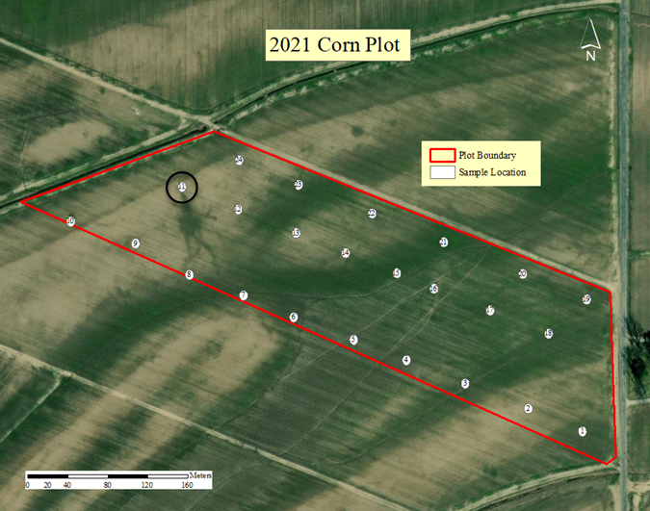
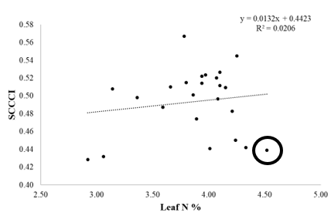
Obs | DFBETAS
 | Intercept | LN
1 | -0.0385 | 0.0473
2 | -0.2297 | 0.2592
3 | -0.0004 | 0.0005
4 | 0.1525 | -0.1065
5 | -0.0221 | 0.0388
6 | 0.3680 | -0.4067
7 | 0.0058 | -0.0015
8 | -1.0099 | 0.9732
9 | -0.7676 | 0.7345
10 | -0.0067 | -0.0044
11 | -0.6345 | 0.6812
12 | 0.0747 | -0.1076
13 | 0.0627 | -0.0719
14 | -0.0109 | 0.0096
15 | 0.0937 | -0.0872
16 | 0.0352 | -0.0227
17 | 0.3023 | -0.2878
18 | 0.0690 | -0.0582
19 | -0.0517 | 0.0658
20 | -0.0096 | 0.0255
21 | -0.0779 | 0.0957
22 | -0.0068 | 0.0181
23 | -0.0399 | 0.0472
24 | 0.2316 | -0.2623
Outlier Identification by way of geographic and linear model analysis
19
Notes:
Used ln bc more accurate than spad

Slide 20
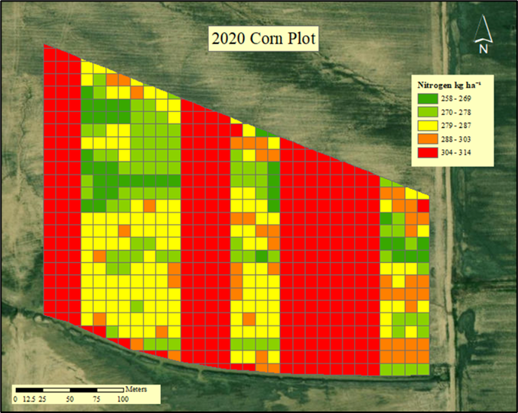
Corn Rx at V10 June 8, 2020
20
Notes:
Discuss corn prescription map

Slide 21
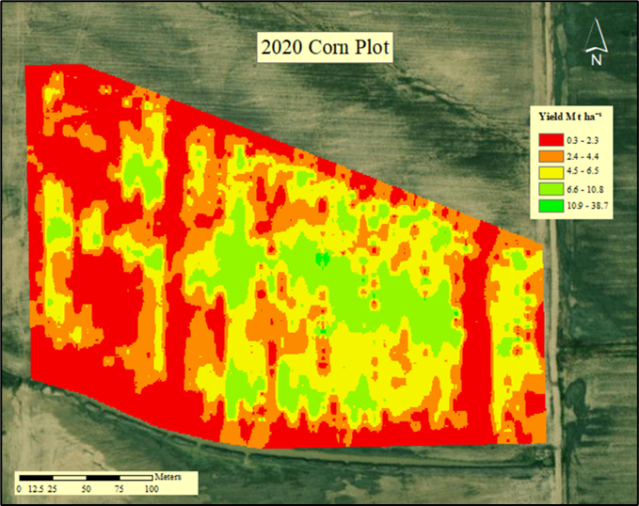
Corn Yield September 9, 2020
21
Notes:
Camera angle differing SCCCI values

Slide 22
N Rate Class | N Rate by Class (kg ha⁻¹) | Yield by N Rate (Mt ha⁻¹) | N Rate NUE | Total Available NUE
VRN Low | 114-129 | 3.01 | 0.40 | 0.15
VRN Mod Low | 130-142 | 3.45 | 0.42 | 0.16
VRN Mod High | 143-157 | 3.76 | 0.42 | 0.17
VRN High | 158-170 | 1.88 | 0.19 | 0.08
Fixed Rate | 170 | 4.13 | 0.40 | 0.17
2020 Corn NUE & Means Separation
 | Yield LSMEAN | Treatment Class
A | 4.1443 | 5
A | 3.7606 | 3
A | 3.5511 | 2
A | 3.0432 | 1
B | 1.8807 | 4
22

Slide 23
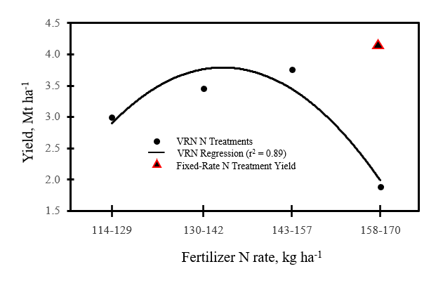
2020 Corn Yield Related to VRN Rates
23

Slide 24
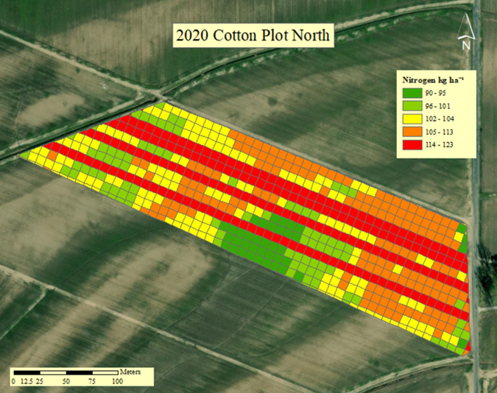
Cotton North Rx July 15, 2020
24

Slide 25
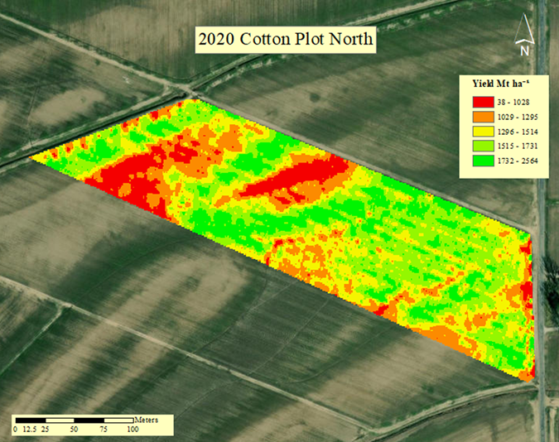
Cotton North Yield October 17, 2020
25

Slide 26
N Rate Class | N Rate by Class (kg ha⁻¹) | Yield by N Rate (kg ha⁻¹) | N Rate NUE | Total Available NUE
VRN Low | 0-9 | 1,419.70 | 3.03 | 6.51
VRN Mod Low | 10-17 | 1,444.73 | 4.64 | 6.57
VRN Mod High | 18-26 | 1,422.63 | 4.68 | 7.03
VRN High | 27-34 | 1,377.65 | 4.76 | 6.35
Fixed Rate | 34 | 1,439.36 | 4.28 | 6.74
2020 Cotton North NUE & Means Separation
 | Yield LSMEAN | Treatment Class
A | 1443.9 | 2
A
A | 1439.4 | 5
A
A | 1422.8 | 1
A
A | 1422.6 | 3
A
A | 1377.7 | 4
 | Yield LSMEAN | Treatment Class
A | 1443.9 | 2
A | 1439.4 | 5
A | 1422.8 | 1
A | 1422.6 | 3
A | 1377.7 | 4
26

Slide 27
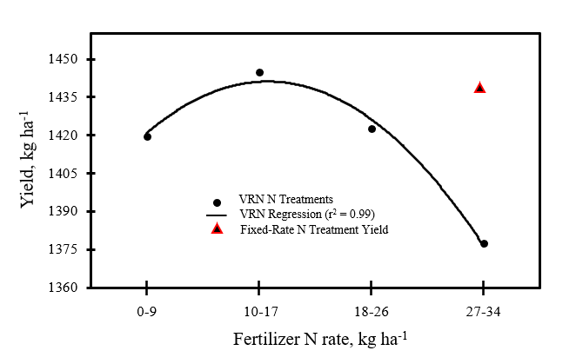
2020 Cotton North Yield Related to VRN Rates
27

Slide 28
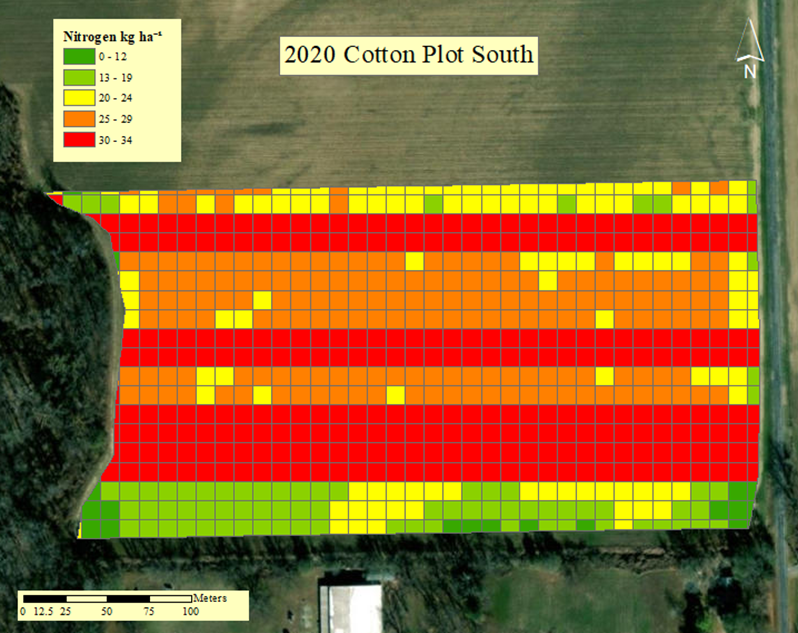
Cotton South Rx July 15, 2020
28

Slide 29
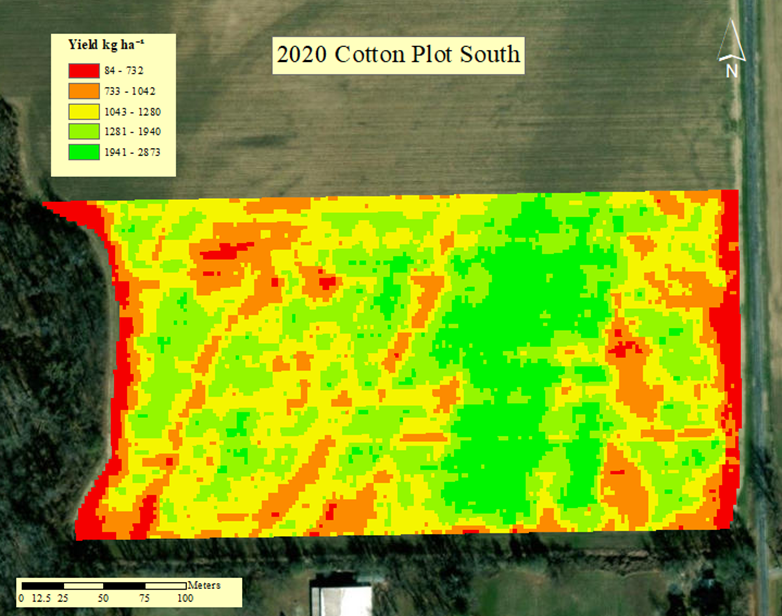
Cotton North Yield October 17, 2020
29

Slide 30
N Rate Class | N Rate by Class (kg ha⁻¹) | Yield by N Rate (kg ha⁻¹) | N Rate NUE | Total Available NUE
VRN Low | 0-9 | 1,350.86 | 2.15 | 5.97
VRN Mod Low | 9-16 | 1,343.71 | 4.90 | 6.67
VRN Mod High | 17-24 | 1,203.72 | 5.68 | 6.01
VRN High | 25-34 | 1,149.32 | 4.46 | 5.64
Fixed Rate | 34 | 1,185.86 | 3.53 | 5.59
2020 Cotton South NUE & Means Separation
 | Yield LSMEAN | Treatment Class
A | 1350.9 | 1
A | 1334.5 | 2
A | 1223.9 | 3
A | 1215.8 | 5
A | 1184.3 | 4
30

Slide 31
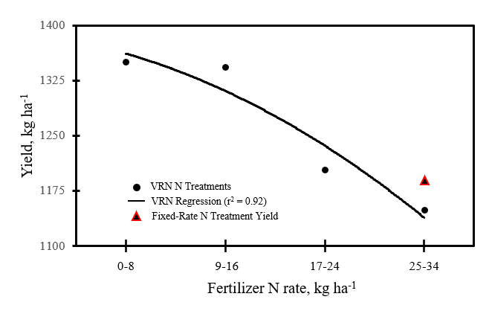
2020 Cotton South Yield Related to VRN Rates
31

Slide 32
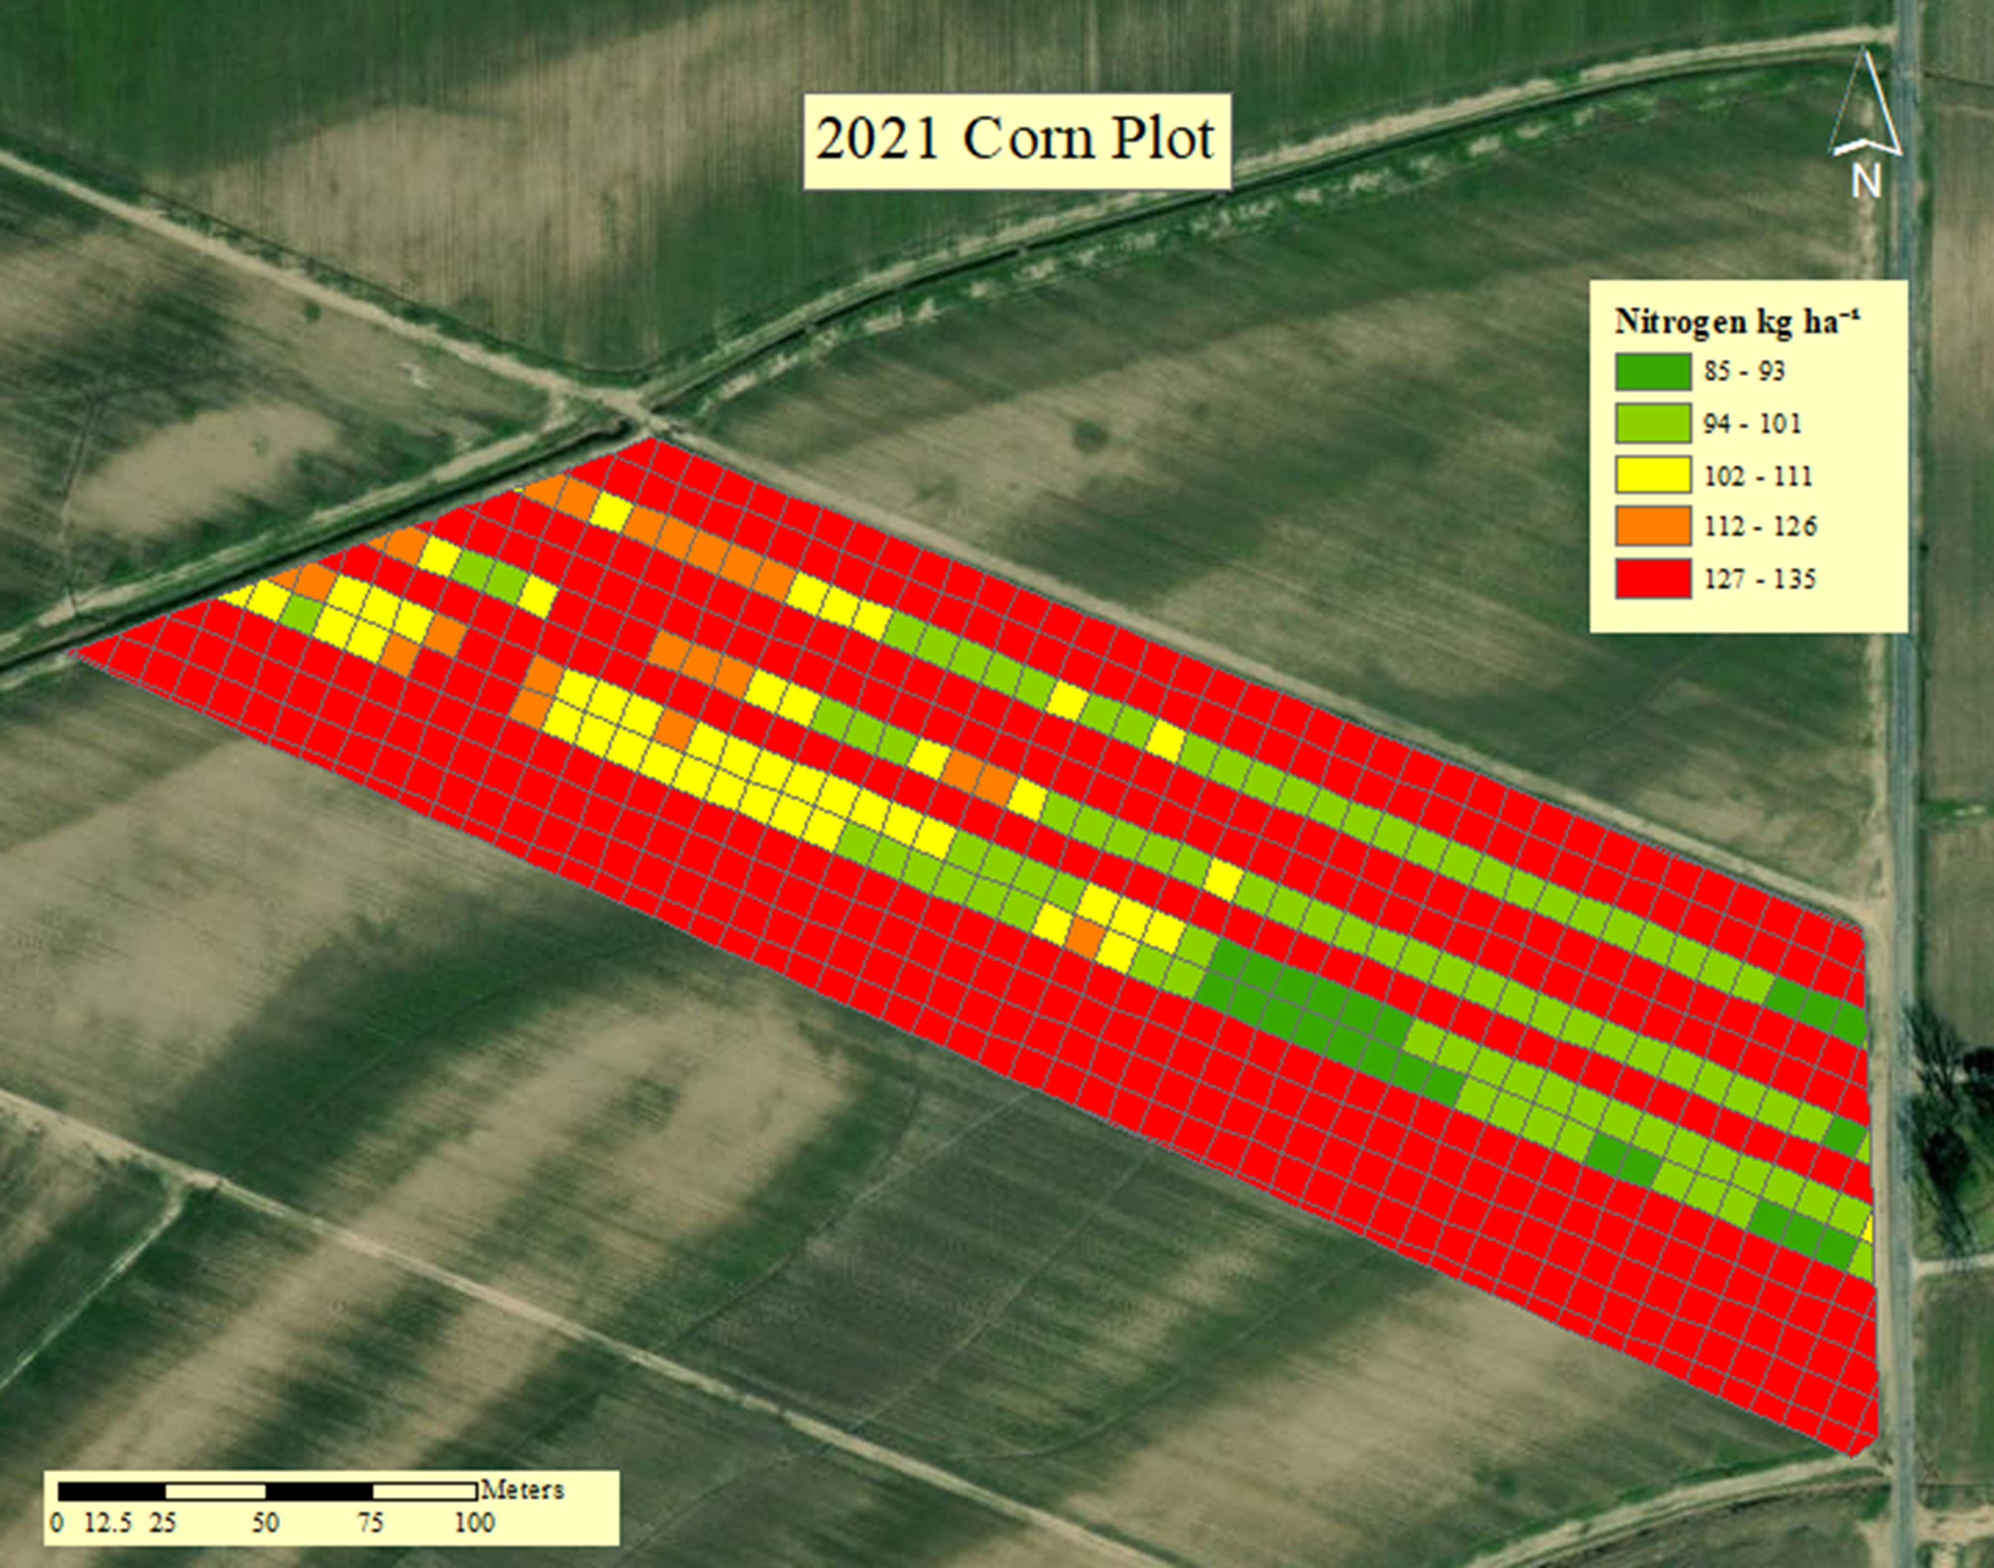
Corn Rx May 8, 2020
32

Slide 33
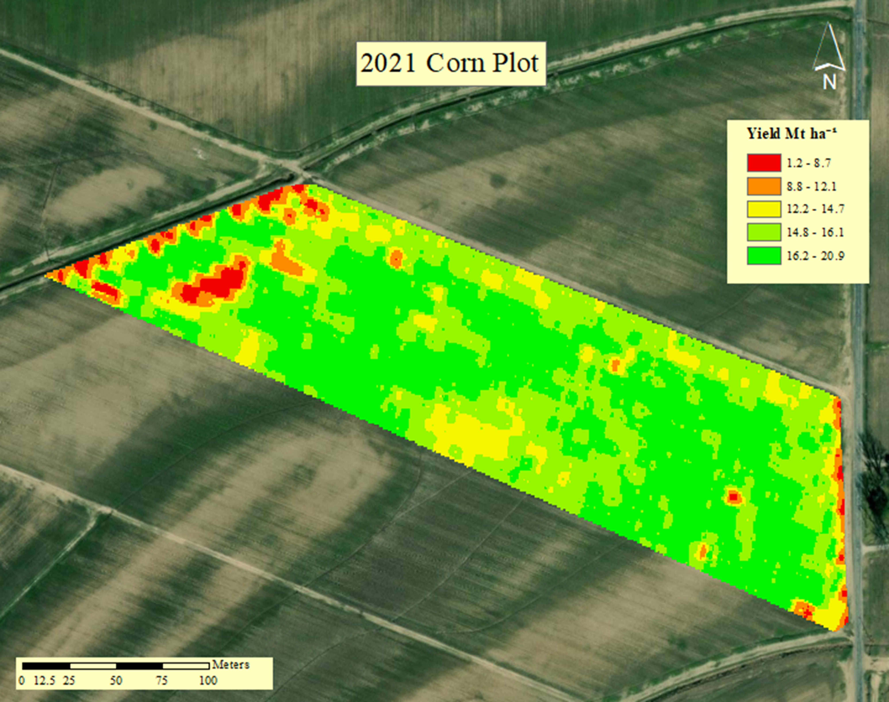
Corn Yield August 28, 2020
33

Slide 34
N Rate Class | N Rate by Class (kg ha⁻¹) | Yield by N Rate (Mt ha⁻¹) | N Rate NUE | Total Available NUE
VRN Low | 85-98 | 14.90 | 2.63 | 0.71
VRN Mod Low | 99-110 | 14.98 | 2.42 | 0.71
VRN Mod High | 111-122 | 15.23 | 2.22 | 0.7
VRN High | 123-134 | 15.16 | 1.96 | 0.68
Fixed Rate | 34 | 15.11 | 1.81 | 0.63
2021 Corn NUE & Means Separation
 | Yield LSMEAN | Treatment Class
A | 15.23 | 3
A | 15.16 | 4
A | 15.10 | 5
A | 14.98 | 2
A | 14.90 | 1
34

Slide 35
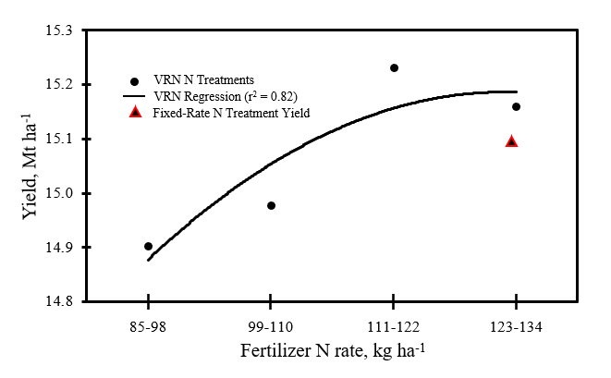
2021 Corn Yield Modeled Related to VRN Rates
35

Slide 36
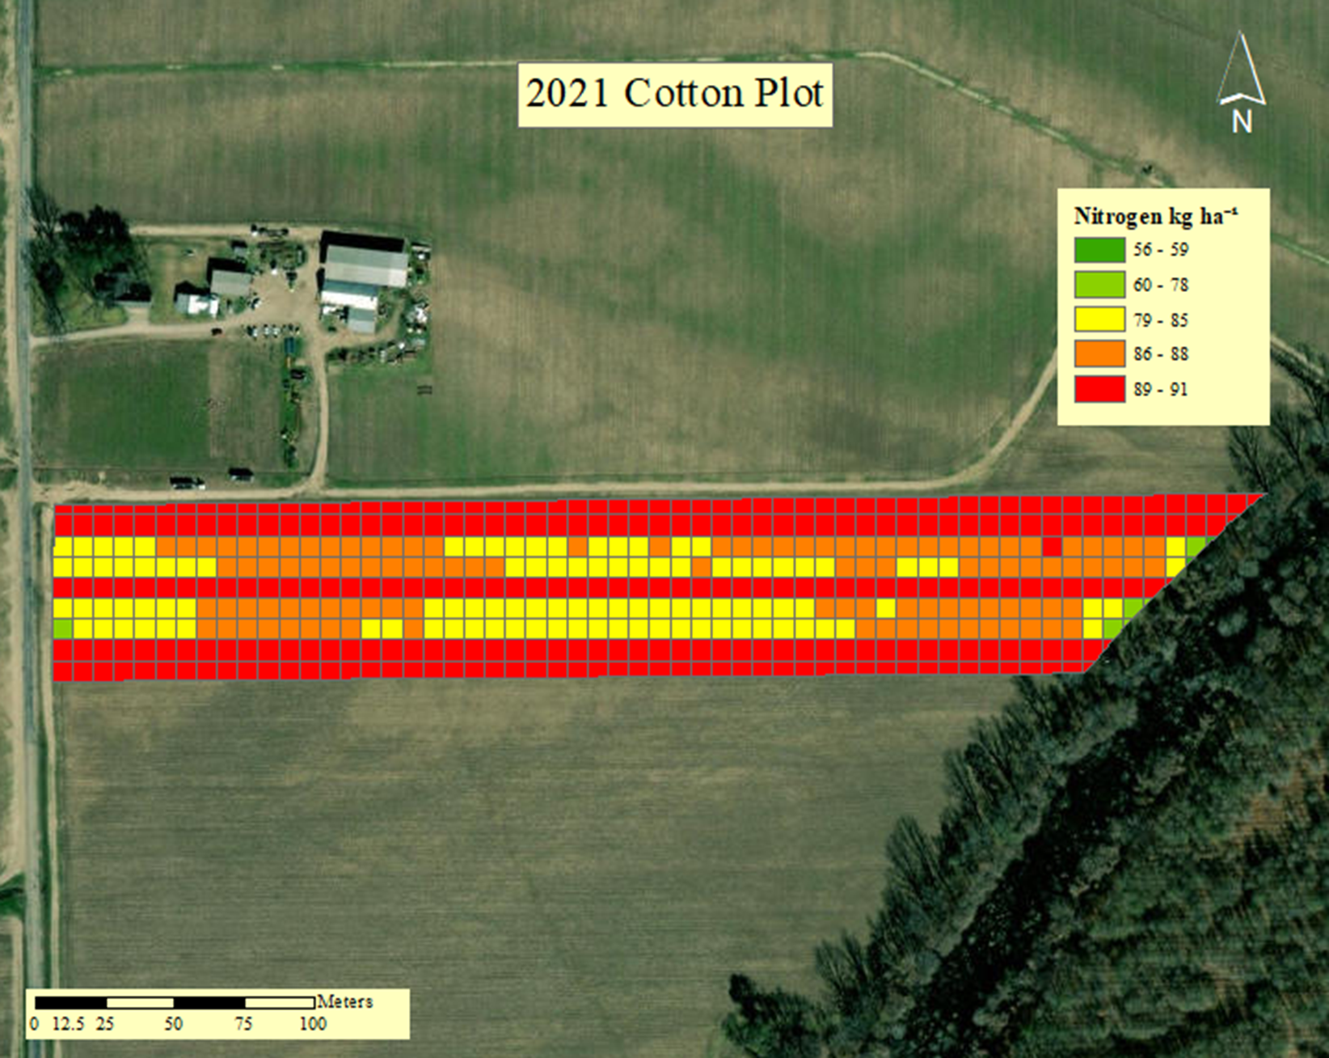
Cotton Rx June 20, 2021
36

Slide 37
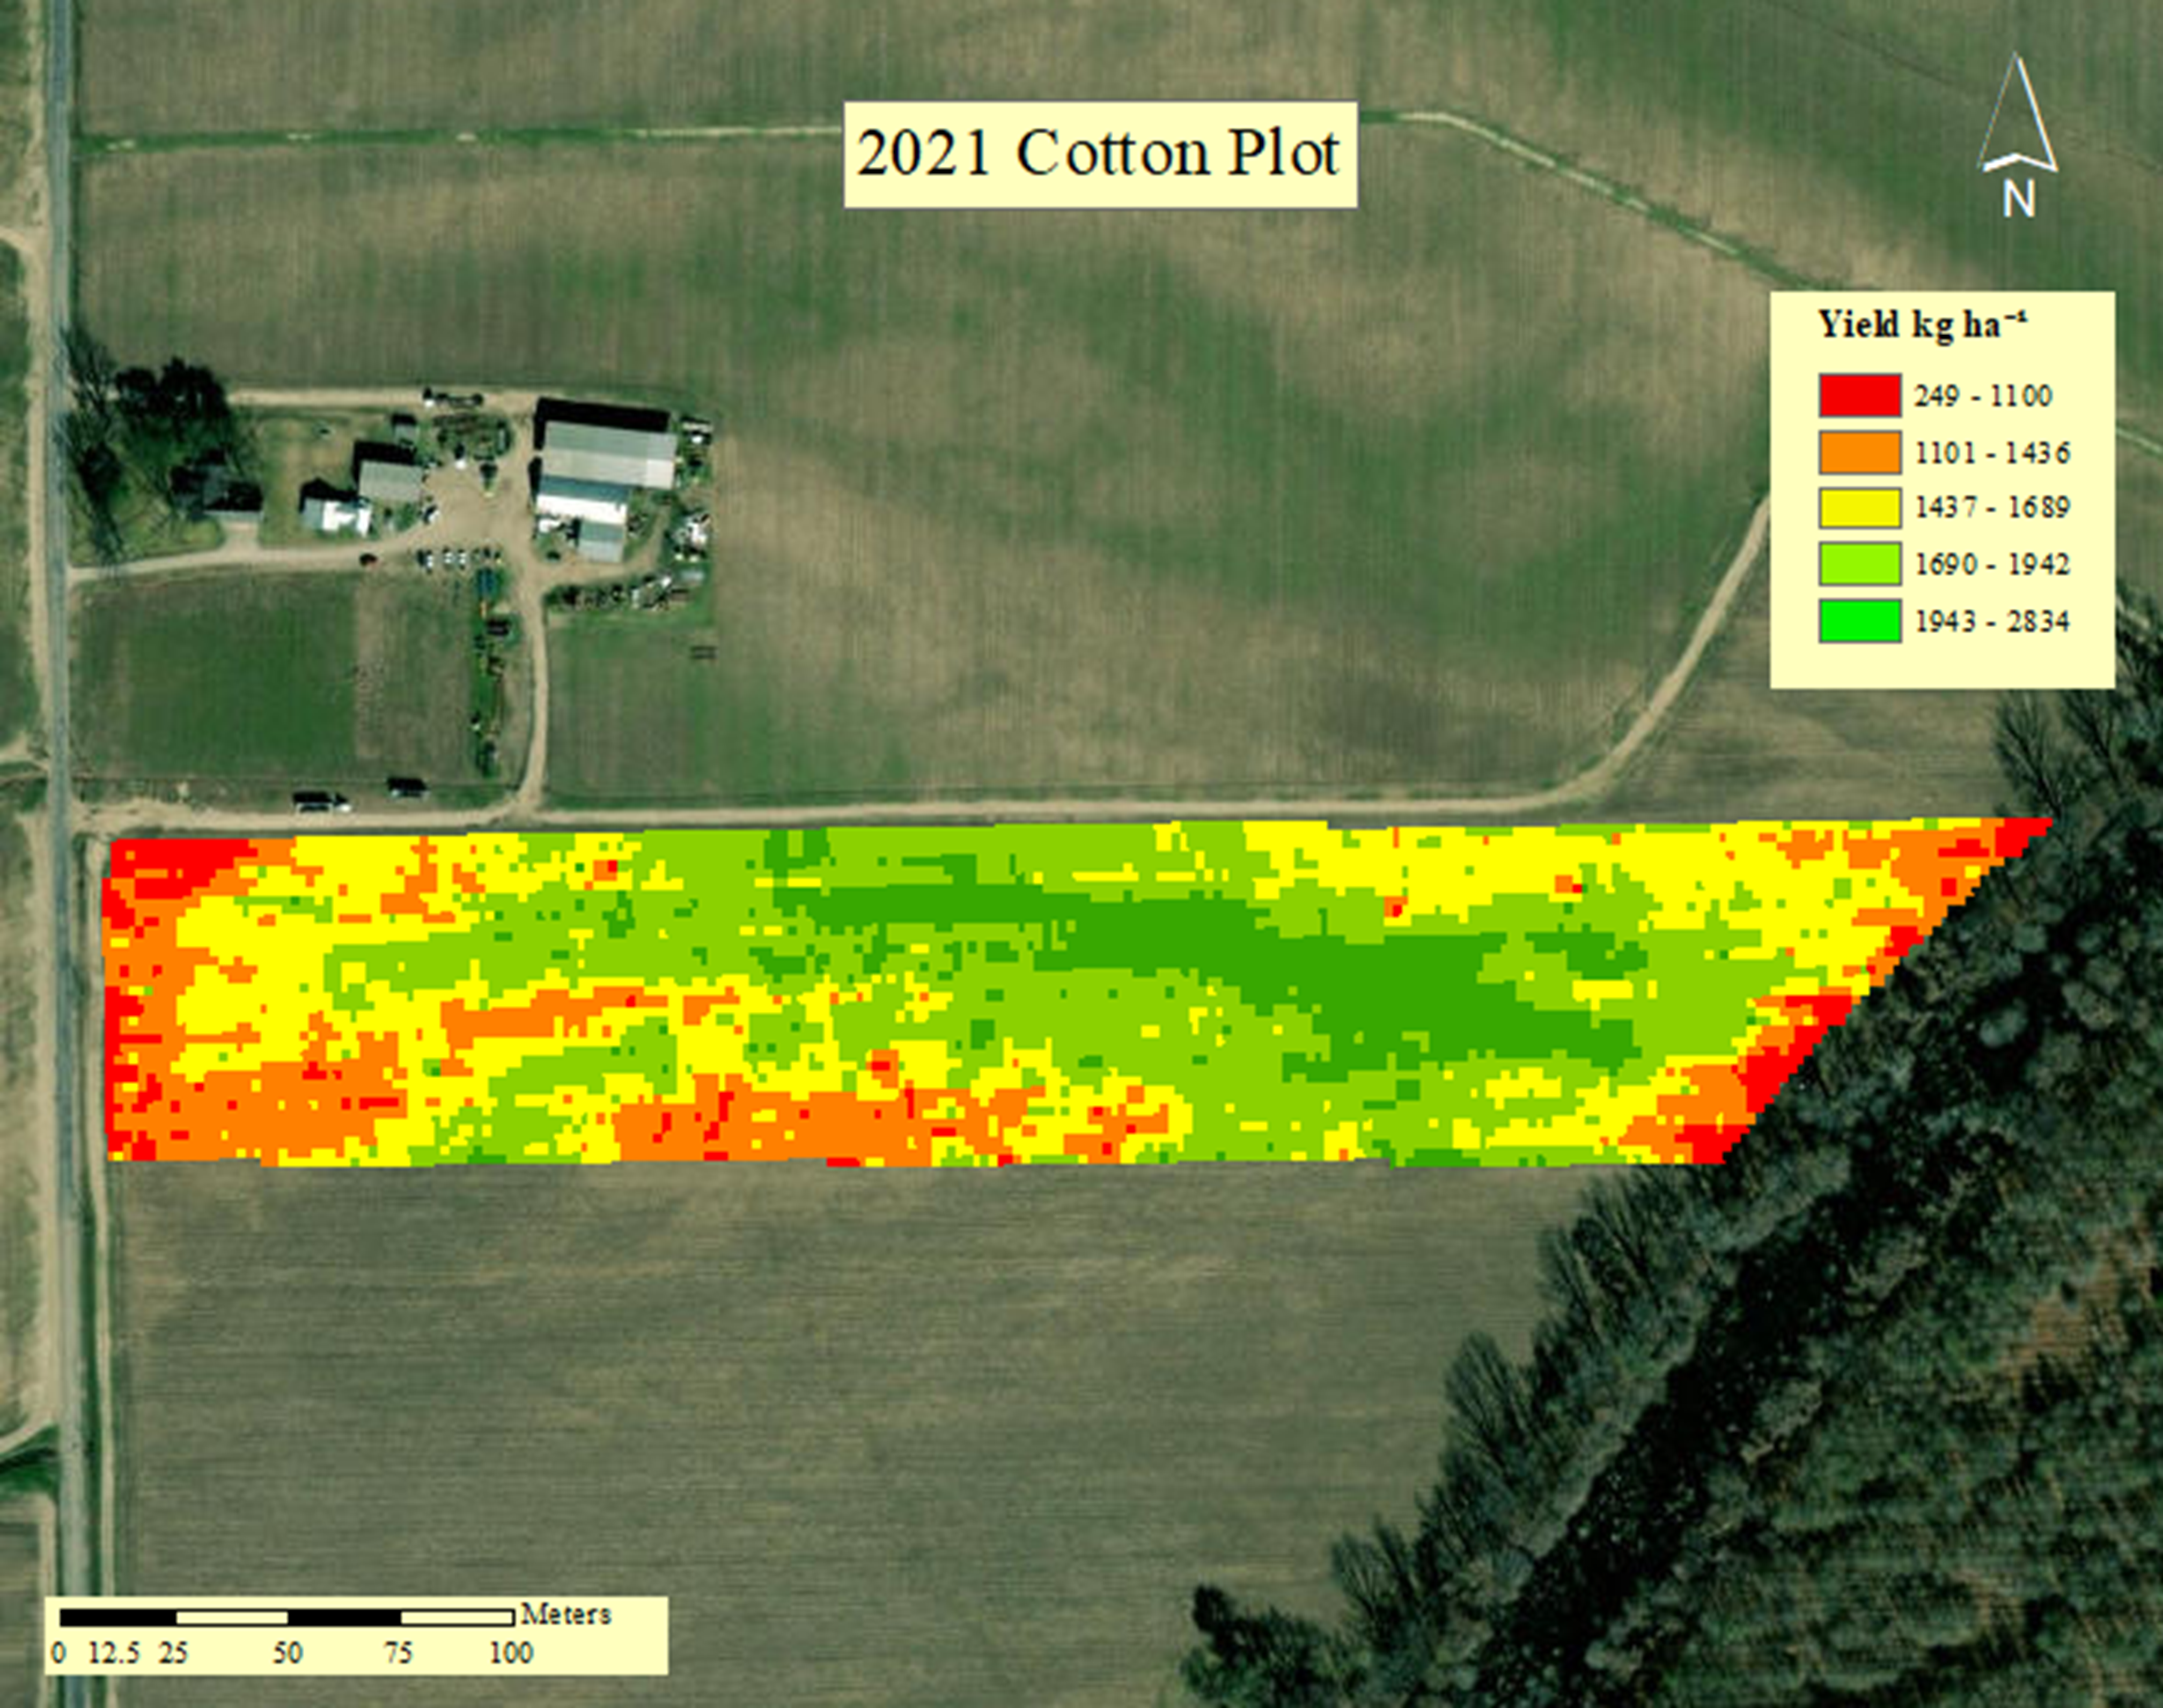
Cotton Yield October 23, 2020
37

Slide 38
N Rate Class | N Rate by Class (kg ha⁻¹) | Yield by N Rate (kg ha⁻¹) | N Rate NUE | Total Available NUE
VRN Low | 73-76 | 1,586.50 | 21.41 | 8.31
VRN Mod Low | 77-81 | 1,645.63 | 20.61 | 8.62
VRN Mod High | 82-84 | 1,663.44 | 19.98 | 8.08
VRN High | 85-89 | 1,559.24 | 18.09 | 8.31
Fixed Rate | 89 | 1,542.29 | 17.21 | 7.28
2021 Cotton NUE & Means Separation
 | Yield LSMEAN | Treatment Class
A | 1662.65 | 3
A | 1644.55 | 2
A | 1641.24 | 5
A | 1586.50 | 1
A | 1565.04 | 4
38

Slide 39
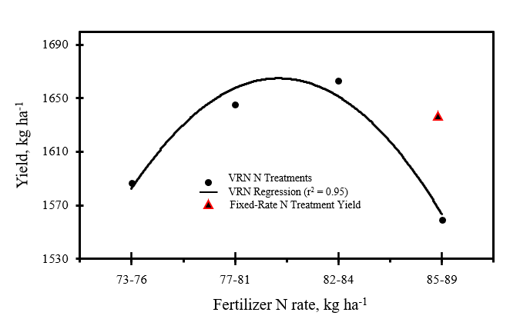
2021 Cotton Yield Modeled Related to VRN Rates
39

Slide 40
Results
H_{o1}: Fixed-wing may provide imaging data returns with lower efficacy than quad-copter
Reject H_{o1}: Fixed-wing provided imaging data with higher efficacy than quad-copter
H_{o2}: sUAS will not accurately estimate early corn and cotton crop leaf N percentage and help improve NUE
Reject H_{o2}: sUAS successfully estimated early crop leaf N percentage and improved NUE
40

Slide 41
Results
sUAS sensing mission data provided sufficient evidence suggesting that fixed-wing flight platforms may be successfully deployed to estimate crop canopy N status
The SCCCI and FENDVI VIs most often were highly related by SEq to early corn and cotton canopy N status
The VariRite™ technology was successfully implemented in a producer’s field using VI calibrated imagery captured on an sUAS

Slide 42
Conclusions & Recommendations
Increase number of sample locations
Quad-copter tilt
Large plot research for fixed-wing
Rededge “rubberbanding” effect

Slide 43
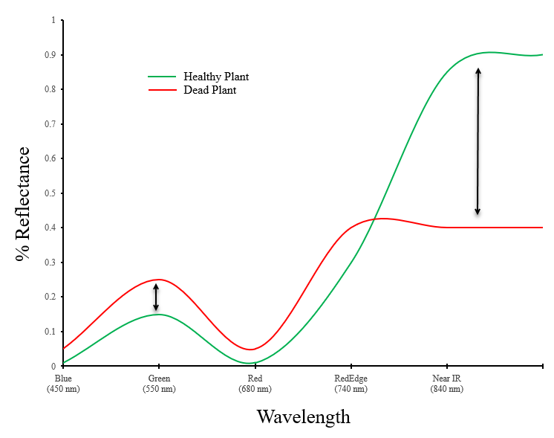
RedEdge “Rubberbanding” Effect

Slide 44
Acknowledgments
Dr. Amelia Fox and committee members: Dr. Jac Varco, Dr. Rocky Lemus, Dr. Jagman Dhillon, and Dr. Brian Pieralisi
Louisiana Farm Producer: Tap Parker
Mississippi Farm Producer: Jonathan Brown
Fellow Graduate Students
Mississippi Corn Promotion Board
Southern SARE

Slide 45
References
Associated Press, T. 2021. NOAA: Average-sized “dead zone” likely off Louisiana | AP News. https://apnews.com/article/louisiana-science-environment-and-nature-d1ed9eee3c81e10012cf293295639924 (accessed 20 December 2021)
Ballester, C., J. Hornbuckle, J. Brinkhoff, J. Smith, and W. Quayle. 2017. Assessment of In-Season Cotton Nitrogen Status and Lint Yield Prediction from Unmanned Aerial System Imagery. Remote Sens. 9(11): 1149. doi: 10.3390/rs9111149.
Baret, F., V. Houlès, and M. Guérif. 2007. Quantification of plant stress using remote sensing observations and crop models: the case of nitrogen management. J. Exp. Bot. 58(4): 869–80. doi: 10.1093//erl231.
Barnes, E., T. Clarke, S. Richards, P. Colaizzi, J. Haberland, et al. 2000. Coincident detection of crop water stress, nitrogen status and canopy density using ground-based multispectral data.
Bruckner, M. 2019. NOAA forecasts very large ‘dead zone’ for Gulf of Mexico | National Oceanic and Atmospheric Administration. https://www.noaa.gov/media-release/noaa-forecasts-very-large-dead-zone-for-gulf-of-mexico (accessed 5 March 2020).
Byrum, J. 2017. How Remote Sensing Powers Precision Agriculture. AgFUNDER NEWS. https://agfundernews.com/remote-sensing-powers-precision-agriculture.html (accessed 15 February 2020).
Cammarano, D., G. Fitzgerald, B. Basso, G. O’Leary, D. Chen, et al. 2011. Use of the canopy chlorophyl content index (ccci) for remote estimation of wheat nitrogen content in rainfed environments. Agron. J. 103(6): 1597–1603. doi: 10.2134/agronj2011.0124.
Diaz, B. 2018. Dead zones | virginia institute of marine science. https://www.vims.edu/research/topics/dead_zones/index.php (accessed 5 March 2020).
Erisman, J.W., J.N. Galloway, S. Seitzinger, A. Bleeker, N.B. Dise, et al. 2013. Consequences of human modification of the global nitrogen cycle. Philos. Trans. R. Soc. B Biol. Sci. 368(1621). doi: 10.1098/rstb.2013.0116.
Foley, J. 2013. It’s Time to Rethink America’s Corn System - Scientific American. https://www.scientificamerican.com/article/time-to-rethink-corn/ (accessed 3 March 2020).
Fox, A.A. 2015. An integrated approach for predicting nitrogen status in early cotton and corn. Mississippi State University Dissertation. https://search.proquest.com/openview/354c314ed6efe1b418f1ccba0768670a/1?pq-origsite=gscholar&cbl=18750&diss=y. (Accessed 3/4/2020)
Glenn, E.P., C.M.U. Neale, D.J. Hunsaker, and P.L. Nagler. 2011. Vegetation index-based crop coefficients to estimate evapotranspiration by remote sensing in agricultural and natural ecosystems. Hydrol. Process. 25(26): 4050–4062. doi: 10.1002/hyp.8392.
Kanter, D. 2019. A new way to curb nitrogen pollution: Regulate fertilizer producers, not just farmers. Retrieved from http://theconversation.com/a-new-way-to-curb-nitrogen-pollution-regulate-fertilizer-producers-not-just-farmers-106291.
Katz, B. 2018. Rethinking the Corny History of Maize | Smart News | Smithsonian Magazine. https://www.smithsonianmag.com/smart-news/rethinking-corny-history-maize-180971038/ (accessed 24 February 2020).
Meyer, L. 2019. Cotton Sector at a Glance. USDA. https://www.ers.usda.gov/topics/crops/cotton-wool/cotton-sector-at-a-glance/ (accessed 24 February 2020).
Nag, O. 2017. World Leaders In Corn (Maize) Production, By Country - WorldAtlas.com. https://www.worldatlas.com/articles/world-leaders-in-corn-maize-production-by-country.html (accessed 24 February 2020).
Rouse, J. 1974. Monitoring the vernal advancement and retrogradation (green wave effect) of...: Discovery Service for Mississippi State University. https://eds.b.ebscohost.com/eds/detail/detail?vid=6&sid=c6e4a716-4e83-40b0-9b9b-143eaec33943%40pdc-v-sessmgr05&bdata=JmxvZ2luLmFzcCUzZmN1c3RpZCUzZG1hZ24xMzA3JnNpdGU9ZWRzLWxpdmUmc2NvcGU9c2l0ZQ%3D%3D#AN=edsnas.19740022555&db=edsnas (accessed 24 February 2020).
Shahbandeh, M. 2018. Cotton - Statistics & Facts | Statista. https://www.statista.com/topics/1542/cotton/ (accessed 23 February 2020).
Varco, J.J., A.A. Fox, T.B. Raper, and K.J. Hubbard. 2013. Development of sensor based detection of crop nitrogen status for utilization in variable rate nitrogen fertilization. : 145–150. doi: 10.3920/978-90-8686-778-3 16.
Watson, J. 2019. Agriculture drones market to reach usd 6.52 billion by 2026 | Reports And Data. https://www.globenewswire.com/news-release/2019/07/10/1881014/0/en/Agriculture-Drones-Market-To-Reach-USD-6-52-Billion-By-2026-Reports-And-Data.html (accessed 18 February 2020).
Wendel, J.F., C.L. Brubaker, and T. Seelanan. 2010. The Origin and Evolution of Gossypium. Physiology of Cotton. Springer Netherlands. p. 1–18
Xu, M., R. Liu, J.M. Chen, Y. Liu, R. Shang, et al. 2019. Retrieving leaf chlorophyll content using a matrix-based vegetation index combination approach. Remote Sens. Environ. 224: 60–73. doi: 10.1016/j.rse.2019.01.039.

Slide 46
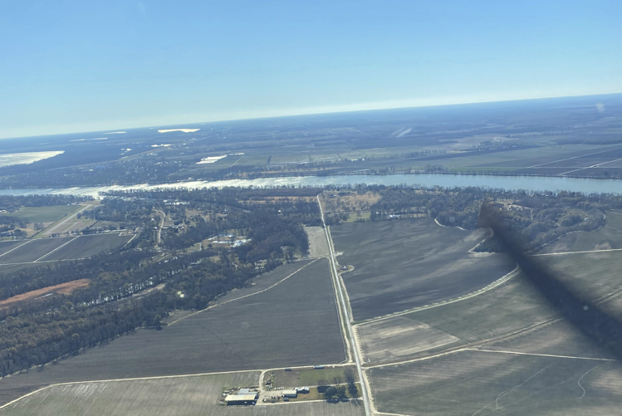
Questions?

