Slide 1
Leadership for Local Foods
Participant Sharing
ND Local Foods Leadership Training
NC SARE Grant
Abby Gold, Megan Myrdal & Glenn Muske
NDSU Extension

Slide 2
Promote Local Foods through Harvest Festival Vaughn Hammond

Slide 3
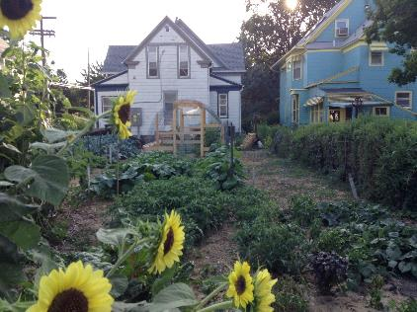
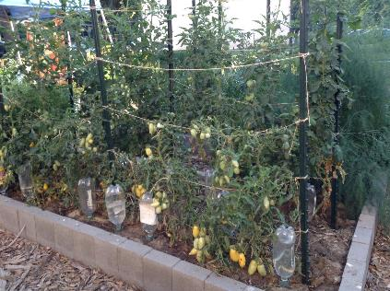
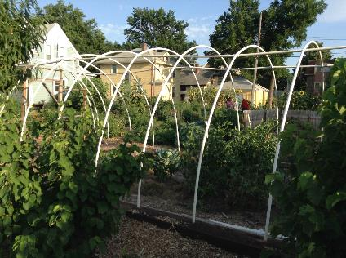
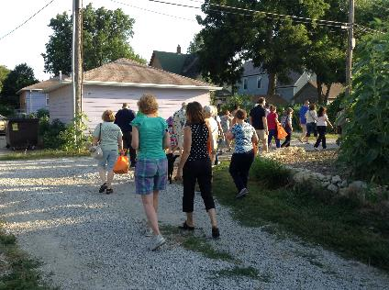

Slide 4
Local Foods Program for Native Americans in the Fargo Area Jaclynn Davis Wallette

Slide 5
Farmers Showcase at Local Foods Economic Development Summit Sue Balcom
We need to support farmers meeting economic developers and encourage scaling up through economic development
Summit: April 14 and 15 – the applications will be released soon, postcards went out Nov. 25
Outcomes: To showcase CSAs, farmers markets, food hubs, aggregation, cooperative models and support the ND local food system as a tool for economic development in small communities — and large.
We hope putting a face on the farmer will encourage more JDA and Economic Development offices to support projects such as light processing and food hubs to assist with the distribution of locally grown and value added agriculture products.

Slide 6
Sustainable Gluten Free Crops in Central ND Glen Philbrick
Rational: To promote locally grown gluten free foods in central ND and prove that ND can sustainably grow gluten free foods.
How Did it Go? I handed out all recipe cards printed, plus extra printed at BisMarket. The tour had 20 participants. I had several discussions with people about gluten free foods such as quinoa and amaranth.
Main Outcomes: Most people I have met were not aware quinoa and amaranth could be grown in ND. Customers were excited they will have a local option for gluten free grains.
Future Plans: Upon the cleaning of the quinoa and amaranth, I will begin marketing them. I plan on hosting at least one class this winter concerning how to cook gluten free.

Slide 7
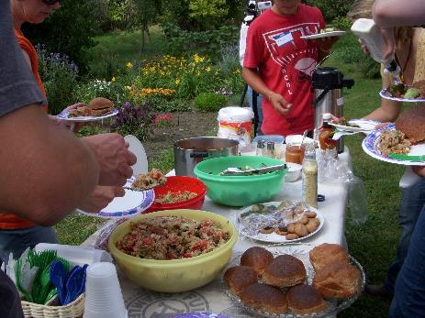
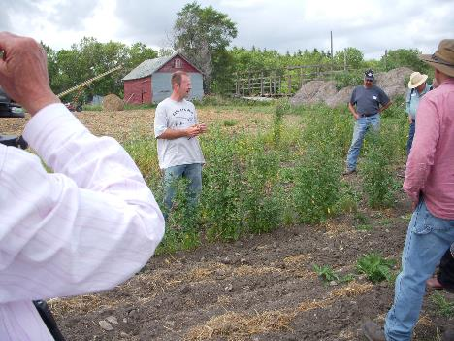

Slide 8
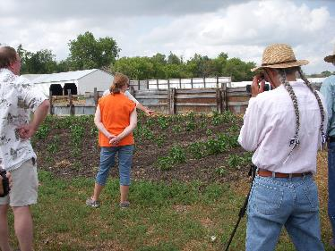
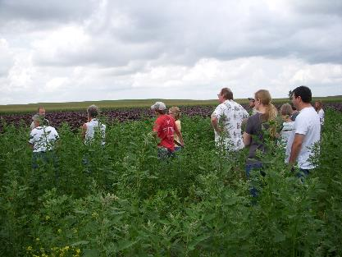
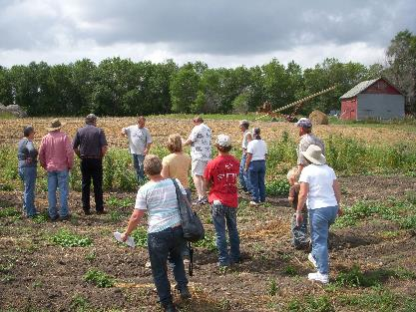

Slide 9
Cross-Pollination Tour to Farm to Table Coop in Glendive, MT Stephanie Blumhagen

Slide 10
Keep it Local, Keep it Fresh: A Local Foods Initiative for Eddy County and Beyond Rachel Brazil & Jill Louters
Rational: To help build a visible and accessible network of local food producers and consumers in our community.
How Did it Go? Still in the works. We have found significant consumer interest in local food. Identifying potential producer sources, has been more difficult. We're working toward providing some beginning resources to "start the conversation."
Main Outcomes: Facilitated meeting determining the interest of community members regarding local foods, a Facebook group page in which we can share and request information, a local food and agriculture resource collections at the public and school libraries.
Future Plans: Organize field trips for potential local food producers to see season extension and pasture grazing practices in action, host a farm to school training for food producers interested in selling to the New Rockford- Sheyenne School District.

Slide 11
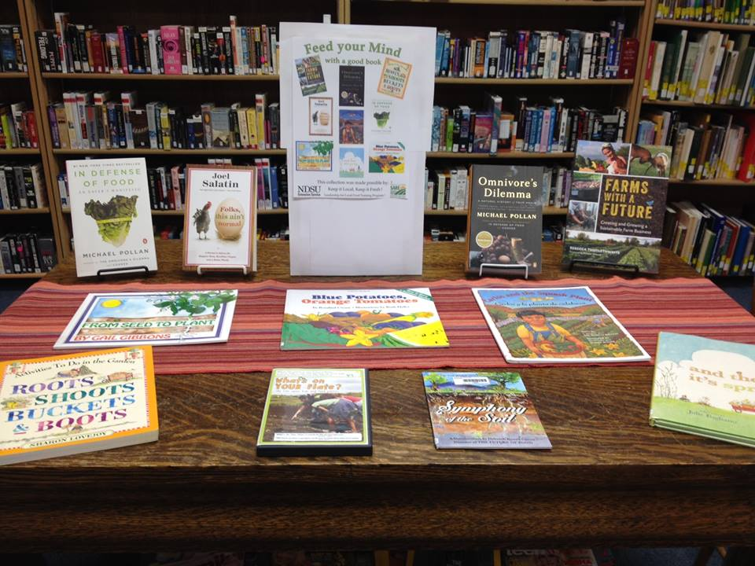

Slide 12
Farm to School Awareness and Marketing Campaign. Jonathon Moser
Progress: To be implemented Spring of 2015.
Main Objective: To increase awareness about Forager Farm and Jamestown Public School District's involvement in ND Farm to School. We will be designing and distributing informational marketing materials to schools. We will also be hosting on the farm tours for students from Jamestown Schools.

Slide 13
Heart of Dakota Local Foods Educational Wagon Irene Graves
Project Name: Heart of Dakota Local Foods Educational Wagon
Rational: To Educate the public about Local Foods
How Did it Go? GREAT
182 surveys
379 direct contacts
Handed out over 1,500 publications and information sheets
Ponies brought in diverse crowd
Main Outcomes:
There is a great need for education
Gardeners do not see there foods as commercial item will give it away but not sell.
Local Foods – interpreted as a brand name not a locally grown food.
Future Plans:
Will repeat the process
More invitations than available weekends – do as many as possible

Slide 14
Heart of Dakota Local Foods Educational Wagon

Slide 15
Extend & Enhance Farmers Markets During Off-Season Hampton & Cynthia Spencer

Slide 16
Morning Joy Farm Kitchen Annie Carlson
Rational: To value-add our farm products and provide consumers with healthy, whole food ready to eat options
How Did it Go? Slowly, painfully slowly. But as we come to the end of the building phase, the marketing phase is taking over.
Main Outcomes: Be patient. Building anything takes 3 times longer and cost twice as much as you thought it would. Our customers are excited for us. But all of them cook so our new kitchen offerings have meant we need to increase our marketing contacts to new groups.
Future Plans: Now we focus on marketing and product development.
I'm so thankful to have attended the Stockman Grass Farmer Marketing School. Now I am armed with lots of great marketing tools and advice.

Slide 17
United Tribes Technical College Winter Market Jana Millner
Notes:
United Tribes Multipurpose Room - Late season vegetables and homemade goods. – Dozen vendors and attendance was about 100 people.
There will be 5 more to this winter.

Slide 18
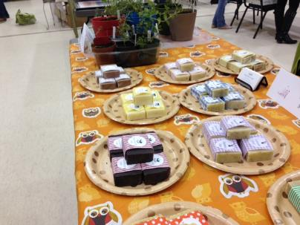
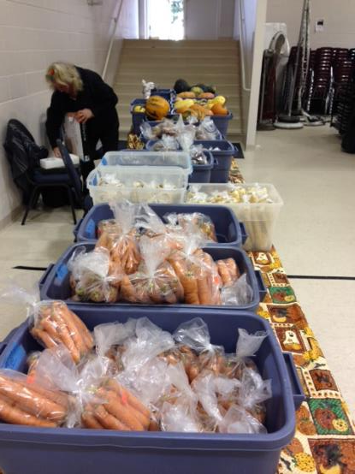
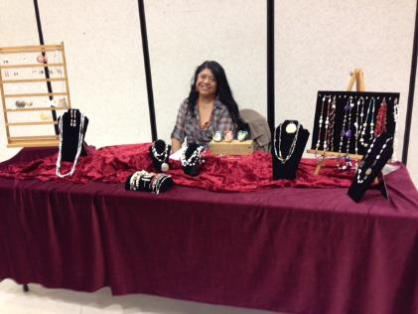

Slide 19
