Slide 1
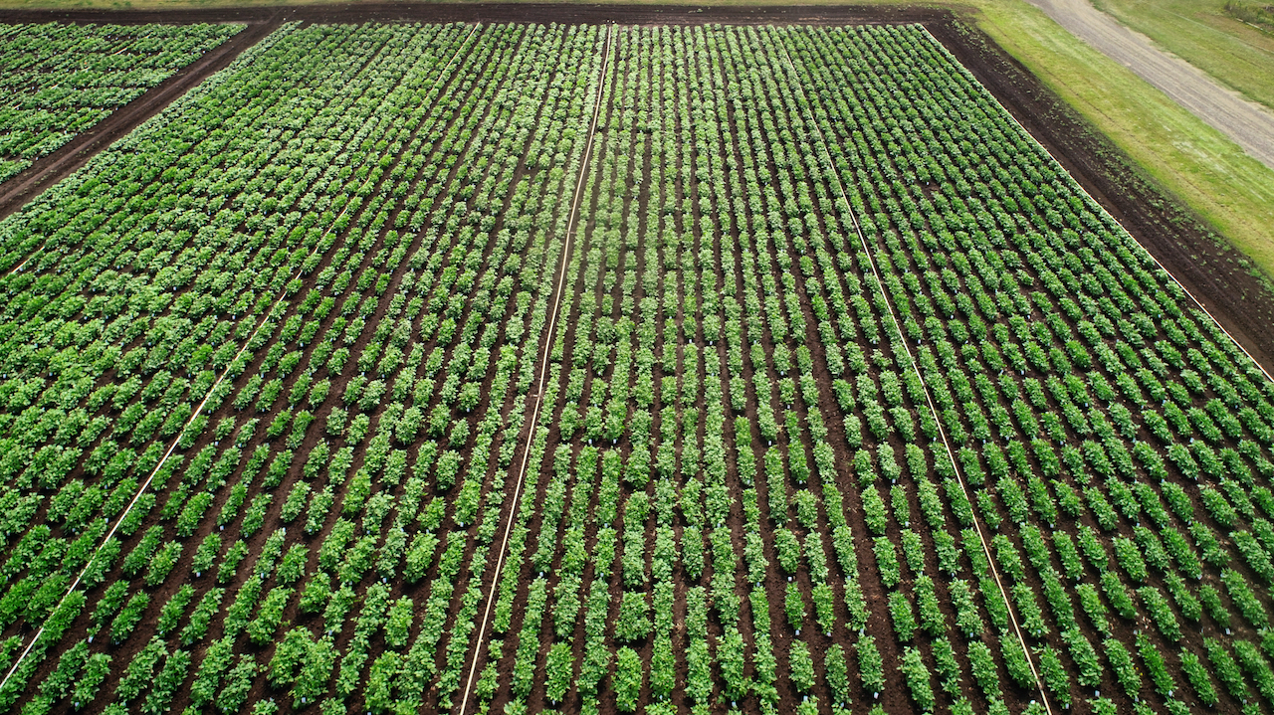
Participatory Breeding with Territorial Seed Company

Slide 2
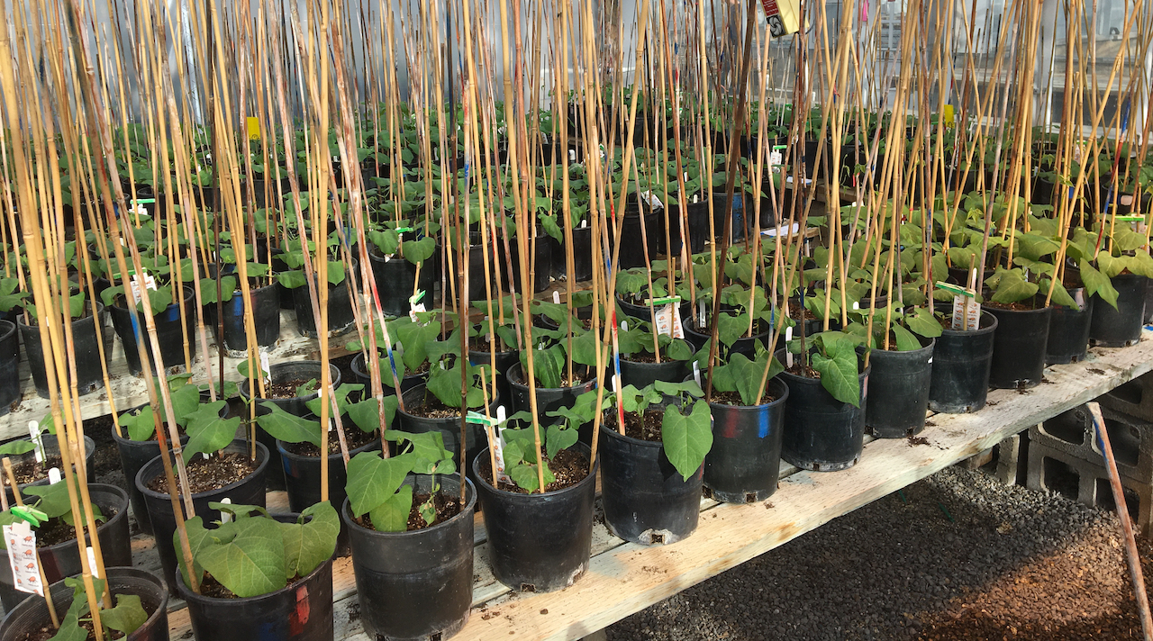
Subset of Populations – Greenhouse 2020
10 random families/population
40 accessions
Also used for microbiome studies
Date Collected:
Pod curl
Cross section
PC
Pod Color
Strings
Informed later selection of 20 lines to include in the summer 2020 taste test

Slide 3
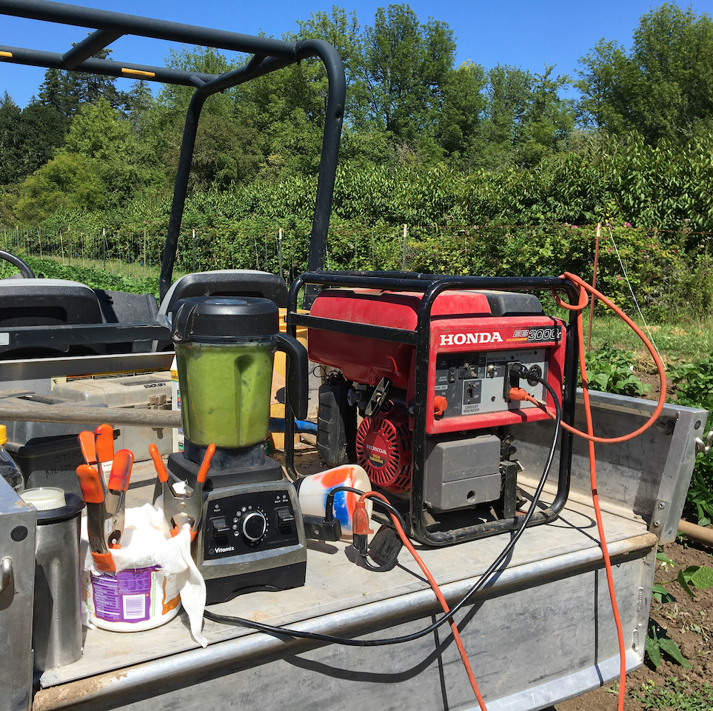
Summer 2020
Lewis Brown and Vegetable Research Farms
Early-season performance
Days to germination (2 locations), germination percentage (1 location), vigor (1 location)
Phenological traits
Days to flowering
Morphological traits
General growth habit, pod shape, pod curl, strings, pod pubescence, pod smoothness, sieve size, harvest length
Harvest Data
Days to first harvest, yield/plant (lbs)
BCMV → occurred in field, did not spread to any of the breeding germplasm

Slide 4
Remote Taste Test
Lattice design
Flavor notes:
“s-shaped, very light green, softer/sweeter flavor, buttery texture, would eat every day”
“over cooked, skin falls apart, tastes like broccoli stems”
“color too regular, nutty flavor, it squeeked in mouth”
Bean Number | Please assign a 1-9 rating (1=least desirable and 9=most desirable)
 | Pod Shape | Pod Color | Flavor | Texture (Crispness) | Other Flavor Notes*
1
2
3
4
5

Slide 5
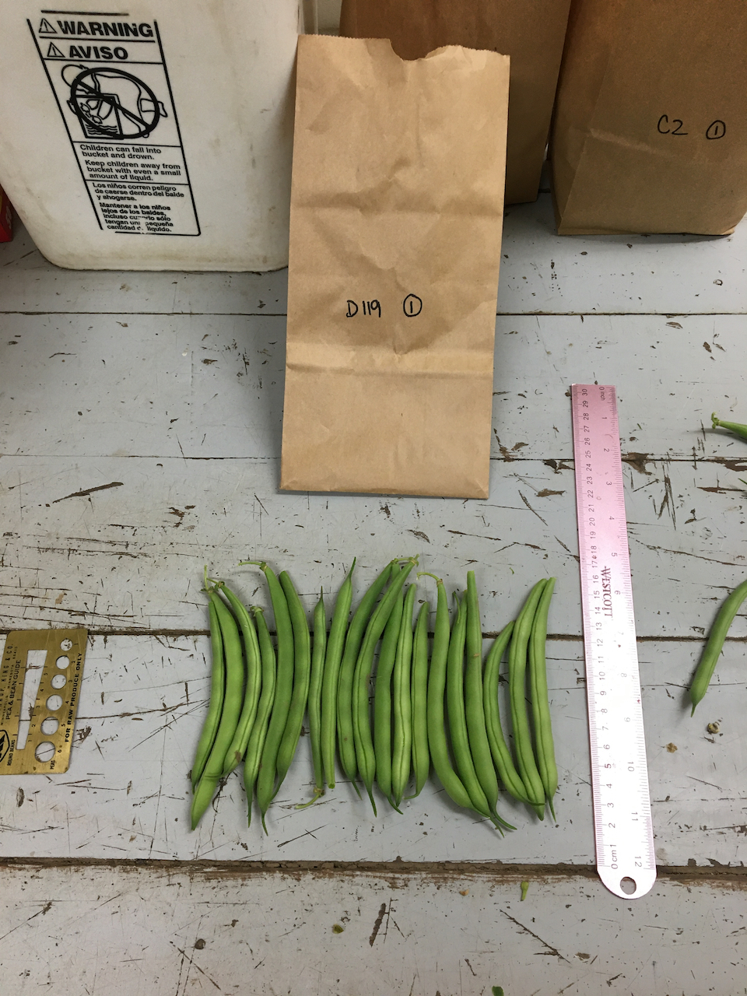
Remote Taste Test

Slide 6
Remote Taste Test - Averages
Flavor Summary | Data | Pod Shape | Pod Color | Flavor | Texture |  | Three or more high marks
A131 | Average | 6.375 | 5.5 | 4.75 | 6
A78 | Average | 4.75 | 7.5 | 5.75 | 4.75
B200 | Average | 7 | 7.5 | 5.25 | 4.75 |  | X
C103 | Average | 6.125 | 6.5 | 7 | 7.25 |  | X
C106 | Average | 7.5 | 8 | 5.75 | 6 |  | X
C121 | Average | 6.5 | 4.5 | 4.75 | 5.25
C134 | Average | 6.5 | 6.25 | 5.125 | 7.5 |  | X
C2 | Average | 7.25 | 5.5 | 7.5 | 7.5 |  | X
C45 | Average | 6.875 | 6.75 | 7 | 7.25 |  | X
C76 | Average | 7.25 | 8 | 5.75 | 6 |  | X
C87 | Average | 7 | 7.5 | 7.25 | 7.25 |  | X
C91 | Average | 6 | 5.75 | 5.75 | 7.5 |  | X
C92 | Average | 6.25 | 6.125 | 4.875 | 5.625
D119 | Average | 7.75 | 7 | 4.75 | 5.5
D125 | Average | 5.75 | 4.75 | 5 | 5.25
D149 | Average | 7.25 | 4.5 | 6.125 | 6 |  | X
D17 | Average | 7.25 | 6.5 | 6.25 | 6 |  | X
D178 | Average | 6.5 | 5.75 | 4.5 | 6.25
D34 | Average | 6.5 | 5.25 | 4.875 | 6
D89 | Average | 6.5 | 5.75 | 4.75 | 4.25

Slide 7
Top Performers
Accession ID | Days to Germ | Days to Harvest (from sowing) | Growing Habit | Seed Color | Pod Shape | Harvest Length (cm) | Taste Test Notes*
B200 | 8 days | 62 days | Upright, loose | White | Oval | 16 | Shape: Excellent Color: Excellent Flavor: Good Texture: Adequate
C103 | 8 days | 60 days | Upright | Purple/White | Heart | 15 | Shape: Adequate Color: Good Flavor: Excellent Texture: Excellent
C106 | 10 days | 61 days | Compact, uniform | Purple | Round | 14 | Shape: Excellent Color: Excellent Flavor: Good Texture: Excellent
C134 | 9 days | 62 days | Upright | Black | Round | 14 | Shape: Good Color: Good Flavor: Good Texture: Excellent

Slide 8
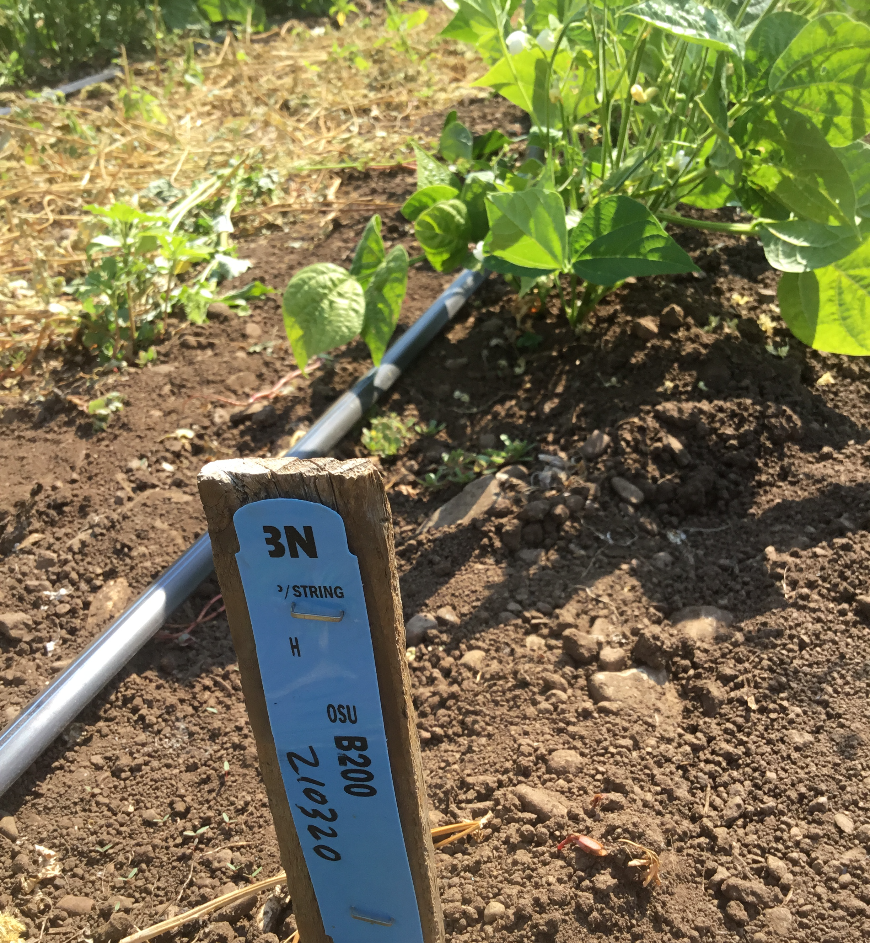
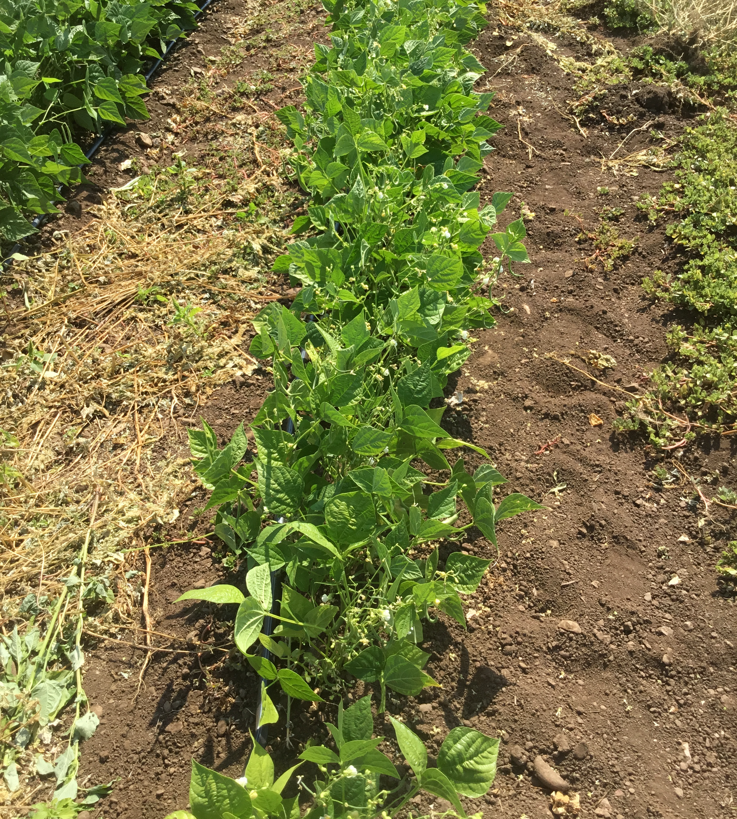
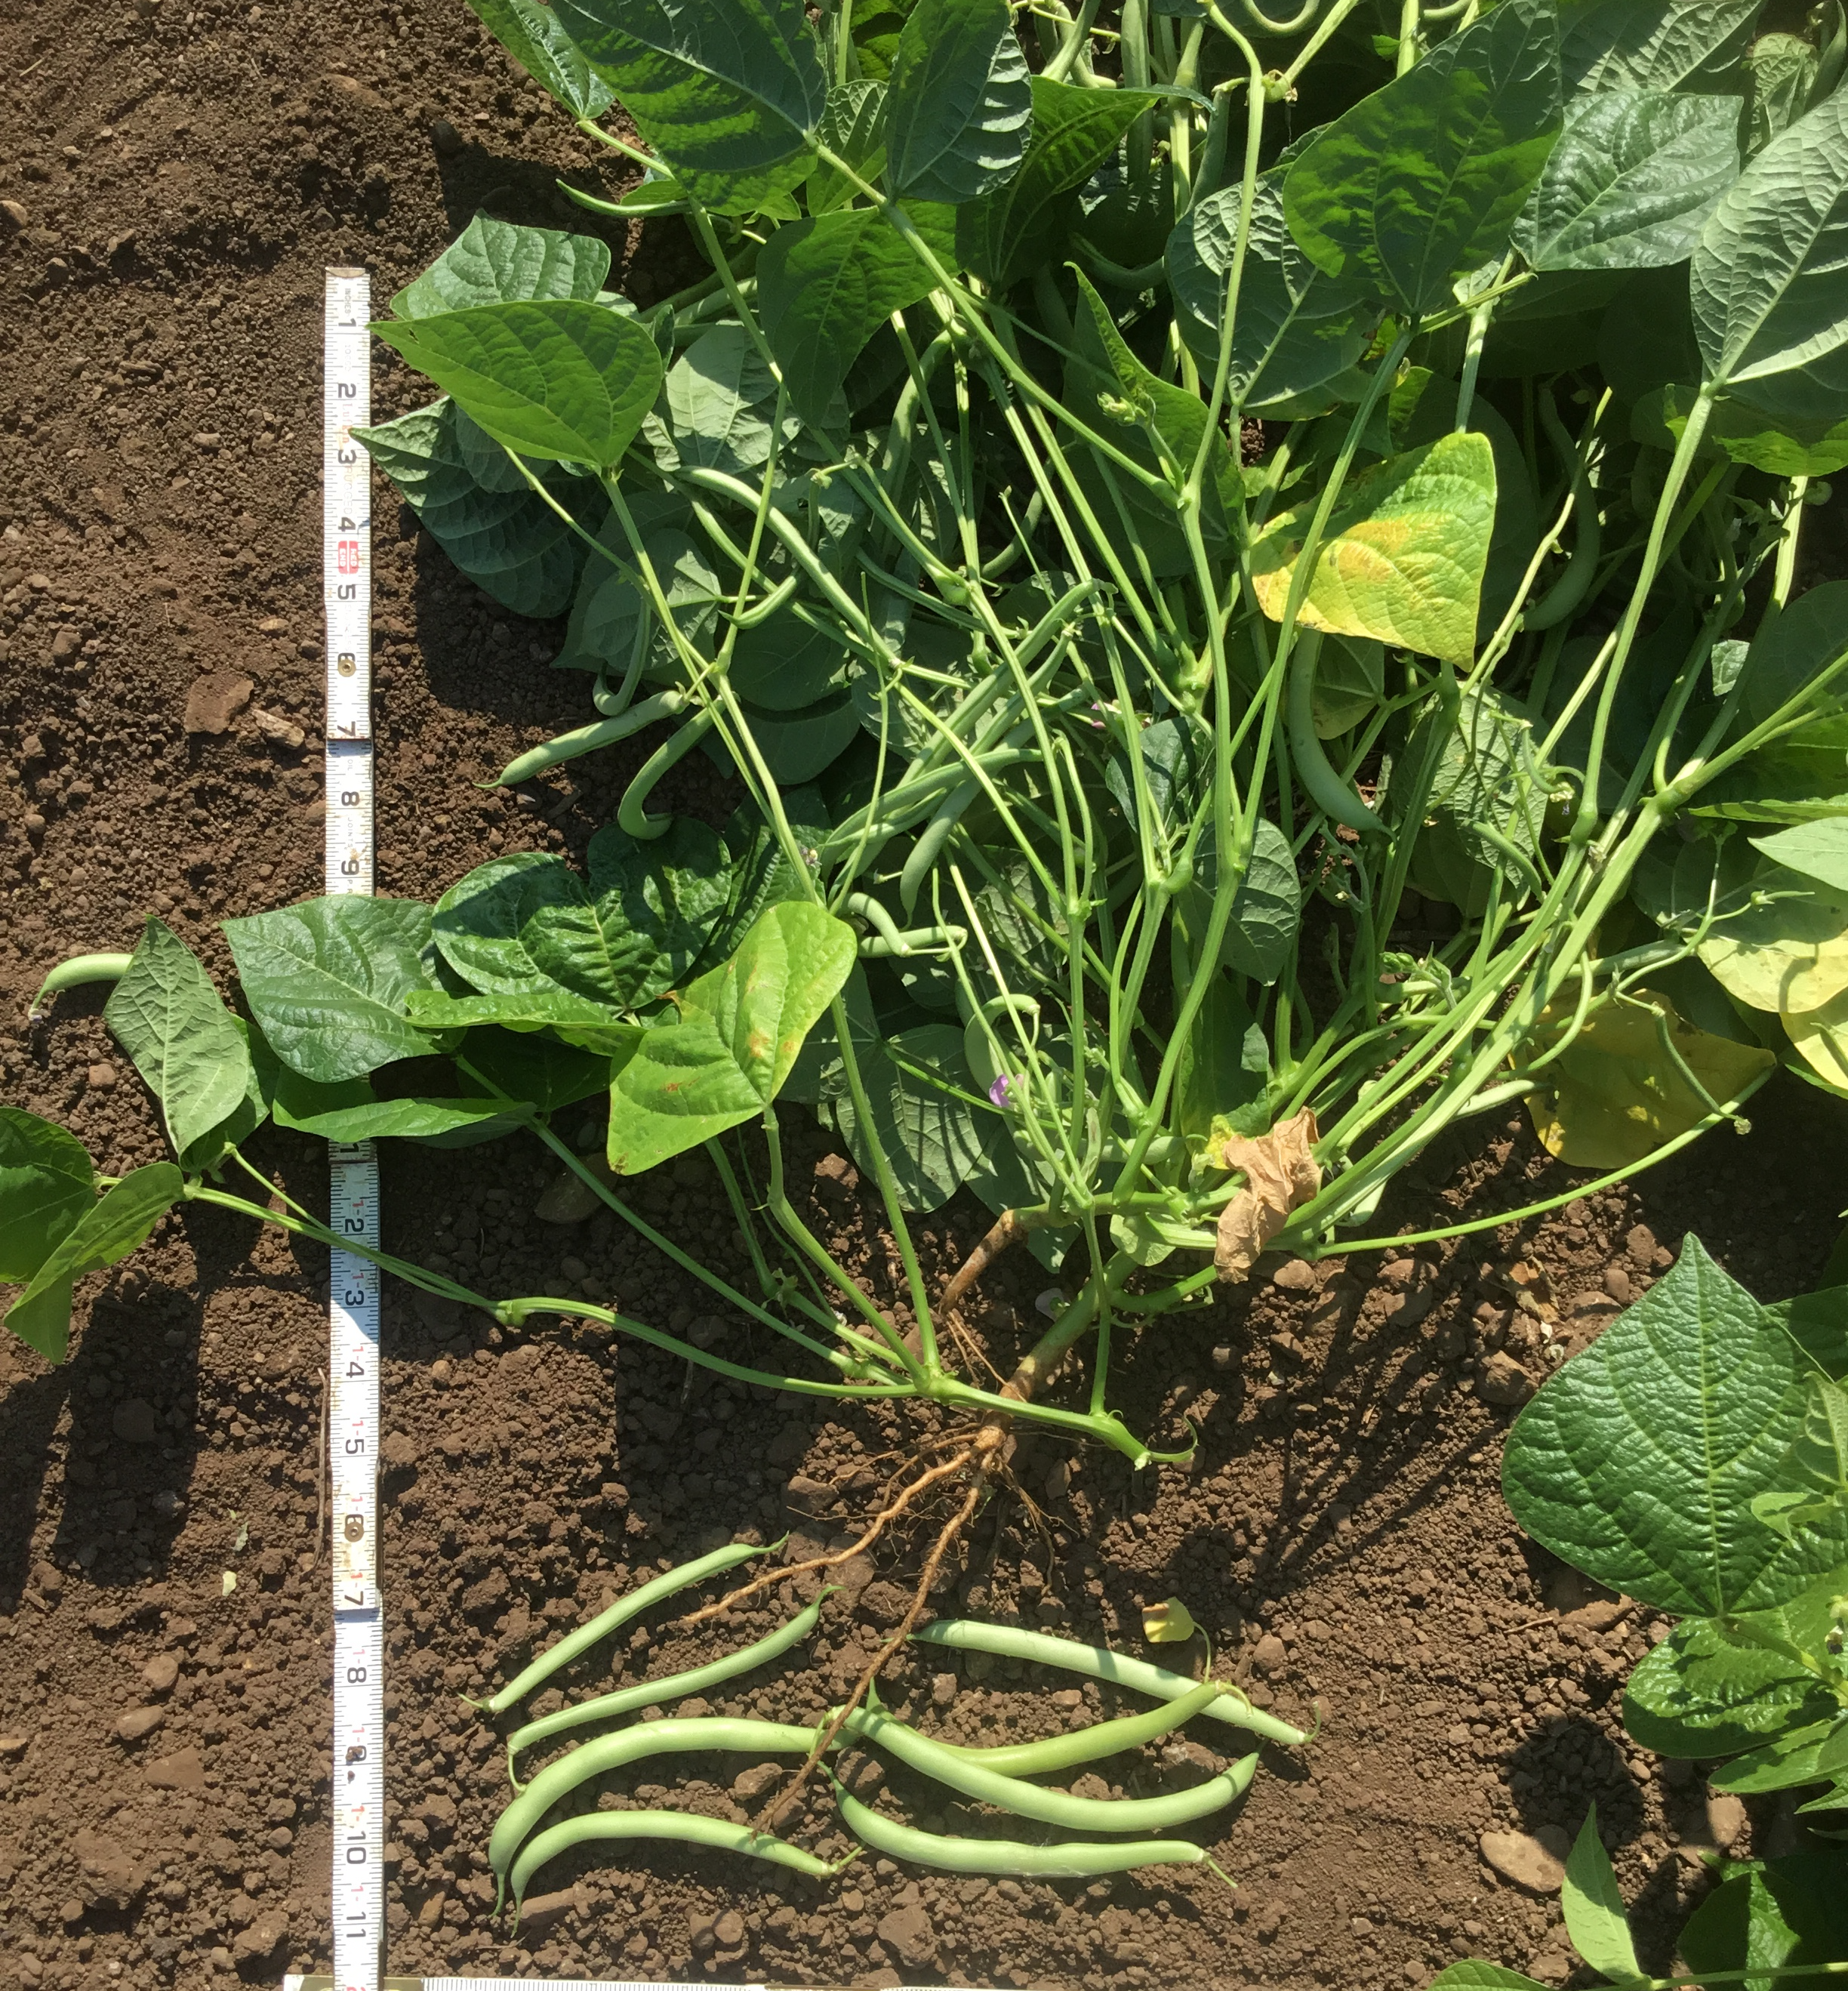
Trials at Territorial Seed Co. - 2021
11 “top performers” identified in 2020
4 parents
Included in main snap bean trial alongside other commercial releases

Slide 9
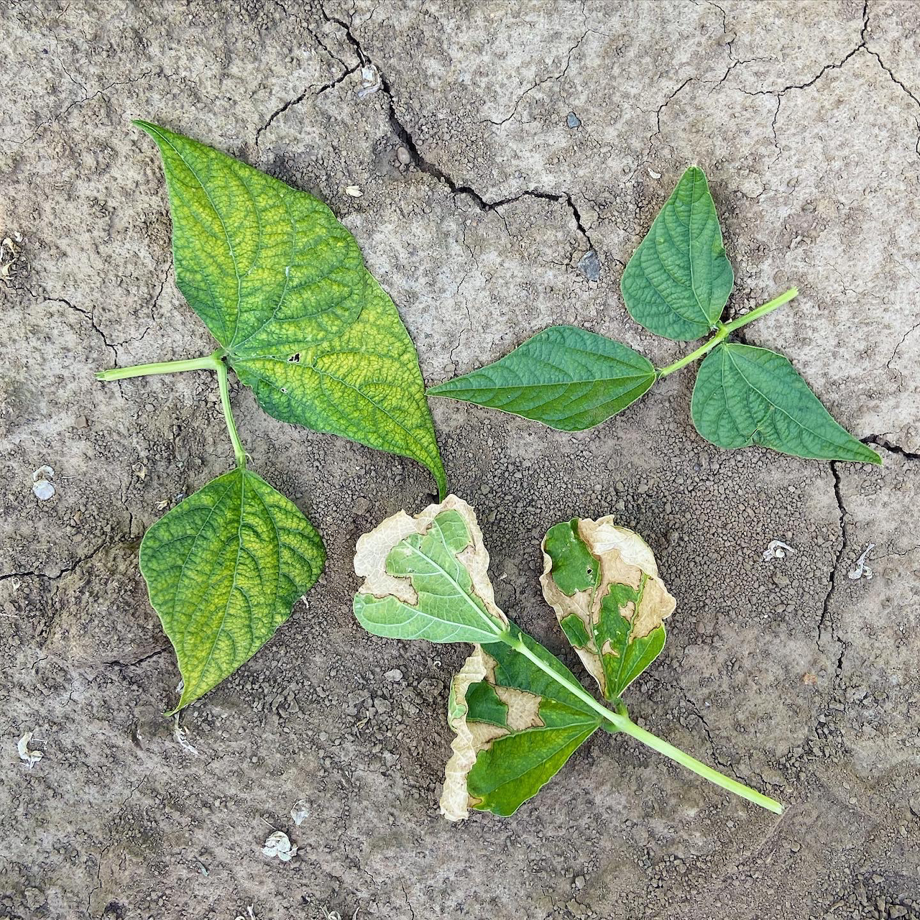
Summer 2021 – Vegetable Research Farm
Early season performance
Days to germination, germination percentage, vigor
Heat tolerance
Leaf susceptibility
Leaf bronzing
Morphological traits
Pod length, sieve size, pod straightness, pod color, cross-section, pod smoothness, pod distribution throughout plant
Visual yield estimate

Slide 10
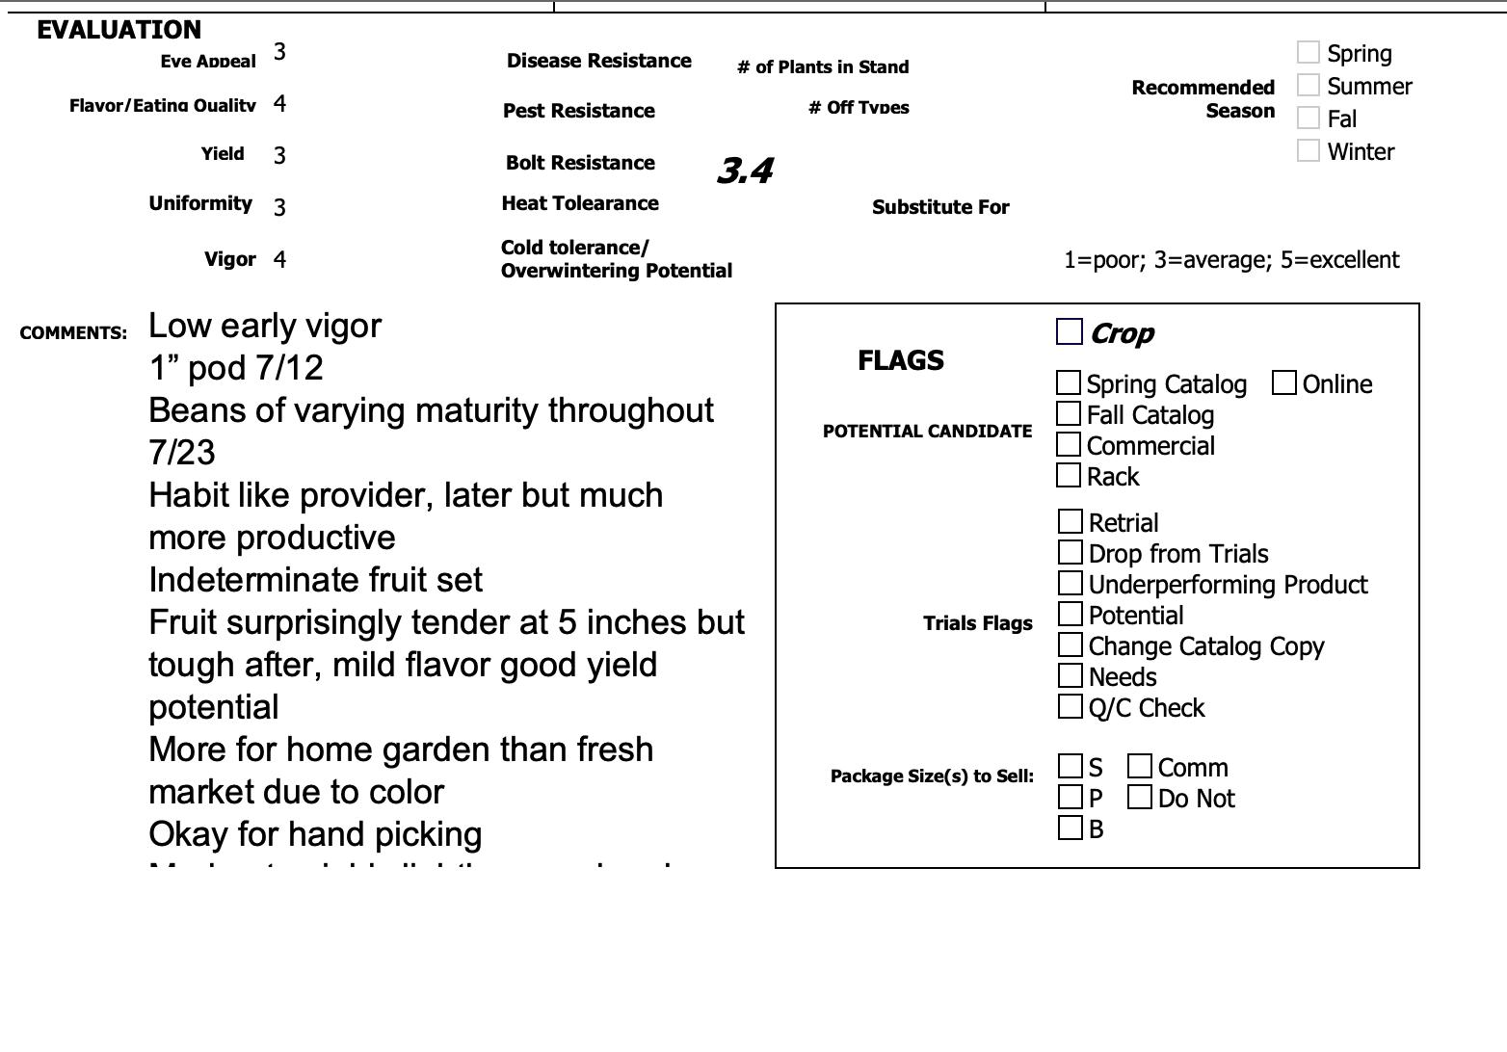
Summer 2021 - Territorial

Slide 11
Candidate Lines
Accession ID | Days to Germ | Days to Harvest (from sowing) | Growing Habit | Seed Color | Pod Shape | Harvest Length (cm) | Taste Test Notes
C103 | 8 days | 60 days | Upright | Purple/White | Heart | 15 | Shape: Adequate Color: Good Flavor: Excellent Texture: Excellent
C134 | 9 days | 62 days | Upright | Black | Round | 14 | Shape: Good Color: Good Flavor: Good Texture: Excellent
C45 | 8 days | 61 days | Upright | Brown | Round | 15 | Shape: Good Color: Good Flavor: Excellent Texture: Excellent
C76 | 9 days | 61 days | Upright, loose | Purple | Round | 15.25 | Shape: Excellent Color: Excellent Flavor: Good Texture: Good
C87 | 9 days | 61 days | Compact, uniform | Black/brown | Round | 13.75 | Shape: Excellent Color: Excellent Flavor: Excellent Texture: Excellent

Slide 12
Next Steps
OSU/Vegetable Research Farm
Territorial Seed Co.
Summer 2022
Yield data in commercial nursery
Summer 2023
Yield data in commercial nursery
Seed increase
Begin commercialization process with tech transfer (?)
Summer 2022
Commercial seed grow out
Summer 2023
Seed yield test
Seed yield test (could be in 2023 depending on our seed quantities)

Slide 13
Funding Acknowledgements
This material is based upon work that is supported by the National Institute of Food and Agriculture, U.S. Department of Agriculture, through the Western Sustainable Agriculture Research and Education program under project number GW21-229. USDA is an equal opportunity employer and service provider. Any opinions, findings, conclusions, or recommendations expressed in this publication are those of the author(s) and do not necessarily reflect the view of the U.S. Department of Agriculture.

