Slide 1
Organic Soils, Nutrients & Composting
Intro &
Physical Properties
This material is based upon work that is supported by the National Institute of Food and Agriculture, U.S. Department of Agriculture, under award number 2019-38640-29879 through the North Central Region SARE program under project number ENC19-175. USDA is an equal opportunity employer and service provider. Any opinions, findings, conclusions, or recommendations expressed in this publication are those of the author(s) and do not necessarily reflect the view of the U.S. Department of Agriculture

Slide 2
Healthy soils = healthy plants = healthy animals = healthy products = healthy people
You’ve likely seen some version of this statement:
This is a guiding principle of organic farming – soils are the foundation of health
This material is based upon work that is supported by the National Institute of Food and Agriculture, U.S. Department of Agriculture, under award number 2019-38640-29879 through the North Central Region SARE program under project number ENC19-175. USDA is an equal opportunity employer and service provider. Any opinions, findings, conclusions, or recommendations expressed in this publication are those of the author(s) and do not necessarily reflect the view of the U.S. Department of Agriculture

Slide 3
What do we mean by “organic” soil? How do we build healthy soil? Where are the gaps in conventional soil science?
We’ll explore this all throughout this course

Slide 4
Masters Degree in Agronomy (field crops). Worked at UW Soil Testing Lab for 4 years.
A bit of my background
Ate soil brownies at Aunt Beth & Uncle Merrill’s farm when I was a kid.
This material is based upon work that is supported by the National Institute of Food and Agriculture, U.S. Department of Agriculture, under award number 2019-38640-29879 through the North Central Region SARE program under project number ENC19-175. USDA is an equal opportunity employer and service provider. Any opinions, findings, conclusions, or recommendations expressed in this publication are those of the author(s) and do not necessarily reflect the view of the U.S. Department of Agriculture

Slide 5
By the end of this course I want you to:
Be able to take a soil sample.
Submit the sample for nutrient testing.
Interpret the test results.
Decide which (if any) fertilizers or amendments to apply.
Build healthy soil:
….with compost
…..by supporting microscopic life in the soil
…..by using cover crops and green manures
6. Keep soil on the land & conserve soil.
This material is based upon work that is supported by the National Institute of Food and Agriculture, U.S. Department of Agriculture, under award number 2019-38640-29879 through the North Central Region SARE program under project number ENC19-175. USDA is an equal opportunity employer and service provider. Any opinions, findings, conclusions, or recommendations expressed in this publication are those of the author(s) and do not necessarily reflect the view of the U.S. Department of Agriculture

Slide 6
The 8 week, 3 credit course is organized approximately like this:
Part ONE: SOIL foundations
1. physical properties
2. sampling & testing
3. chemistry
nutrients
Fertilizers
Review
This material is based upon work that is supported by the National Institute of Food and Agriculture, U.S. Department of Agriculture, under award number 2019-38640-29879 through the North Central Region SARE program under project number ENC19-175. USDA is an equal opportunity employer and service provider. Any opinions, findings, conclusions, or recommendations expressed in this publication are those of the author(s) and do not necessarily reflect the view of the U.S. Department of Agriculture

Slide 7
This course is organized approximately like this:
Part TWO: Soil is alive
Amendments, Organics
Composting
Soil biology
Life in the soil
Building soil; green manures & cover crops
This material is based upon work that is supported by the National Institute of Food and Agriculture, U.S. Department of Agriculture, under award number 2019-38640-29879 through the North Central Region SARE program under project number ENC19-175. USDA is an equal opportunity employer and service provider. Any opinions, findings, conclusions, or recommendations expressed in this publication are those of the author(s) and do not necessarily reflect the view of the U.S. Department of Agriculture

Slide 8
This course is organized approximately like this:
Part THREE: Caring for soil
12. Soil conservation
13. Soil as a pollutant
Organic certification
Regenerating soil
This material is based upon work that is supported by the National Institute of Food and Agriculture, U.S. Department of Agriculture, under award number 2019-38640-29879 through the North Central Region SARE program under project number ENC19-175. USDA is an equal opportunity employer and service provider. Any opinions, findings, conclusions, or recommendations expressed in this publication are those of the author(s) and do not necessarily reflect the view of the U.S. Department of Agriculture

Slide 9
There are many definitions of soil
(my favorite definition)
Soil is the interface between living &dead
(Foth – fundamentals of Soil Science)
This material is based upon work that is supported by the National Institute of Food and Agriculture, U.S. Department of Agriculture, under award number 2019-38640-29879 through the North Central Region SARE program under project number ENC19-175. USDA is an equal opportunity employer and service provider. Any opinions, findings, conclusions, or recommendations expressed in this publication are those of the author(s) and do not necessarily reflect the view of the U.S. Department of Agriculture

Slide 10
the interface between living &dead
Think about that statement.
In soil, lifeless minerals are taken up by soil organisms or by plants and become part of a living system. Conversely, organisms that formerly were alive, become recycled to release their nutrients back into the environment for use again
This material is based upon work that is supported by the National Institute of Food and Agriculture, U.S. Department of Agriculture, under award number 2019-38640-29879 through the North Central Region SARE program under project number ENC19-175. USDA is an equal opportunity employer and service provider. Any opinions, findings, conclusions, or recommendations expressed in this publication are those of the author(s) and do not necessarily reflect the view of the U.S. Department of Agriculture

Slide 11
Let’s look at physical properties of soil, starting with it’s structure.
This material is based upon work that is supported by the National Institute of Food and Agriculture, U.S. Department of Agriculture, under award number 2019-38640-29879 through the North Central Region SARE program under project number ENC19-175. USDA is an equal opportunity employer and service provider. Any opinions, findings, conclusions, or recommendations expressed in this publication are those of the author(s) and do not necessarily reflect the view of the U.S. Department of Agriculture

Slide 12
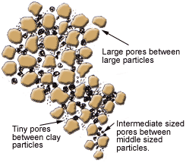
Soil Structure, it’s made up of: 1. solids 2. pores
This material is based upon work that is supported by the National Institute of Food and Agriculture, U.S. Department of Agriculture, under award number 2019-38640-29879 through the North Central Region SARE program under project number ENC19-175. USDA is an equal opportunity employer and service provider. Any opinions, findings, conclusions, or recommendations expressed in this publication are those of the author(s) and do not necessarily reflect the view of the U.S. Department of Agriculture

Slide 13
Soil Pores Liquids – mostly rainwater form a film around the solid particles. Fills the smaller pores – 25% of total Gases – oxygen & CO2 fill the larger pores – 25% of total
This material is based upon work that is supported by the National Institute of Food and Agriculture, U.S. Department of Agriculture, under award number 2019-38640-29879 through the North Central Region SARE program under project number ENC19-175. USDA is an equal opportunity employer and service provider. Any opinions, findings, conclusions, or recommendations expressed in this publication are those of the author(s) and do not necessarily reflect the view of the U.S. Department of Agriculture

Slide 14
Soil solids Mineral particles (45%) form a skeletal framework on which Humus – organic particles (5%) are adsorbed
This material is based upon work that is supported by the National Institute of Food and Agriculture, U.S. Department of Agriculture, under award number 2019-38640-29879 through the North Central Region SARE program under project number ENC19-175. USDA is an equal opportunity employer and service provider. Any opinions, findings, conclusions, or recommendations expressed in this publication are those of the author(s) and do not necessarily reflect the view of the U.S. Department of Agriculture

Slide 15
An ideal soil 45% mineral particles 5% organic particles 25% water in pore spaces 25% gases in pore spaces
This material is based upon work that is supported by the National Institute of Food and Agriculture, U.S. Department of Agriculture, under award number 2019-38640-29879 through the North Central Region SARE program under project number ENC19-175. USDA is an equal opportunity employer and service provider. Any opinions, findings, conclusions, or recommendations expressed in this publication are those of the author(s) and do not necessarily reflect the view of the U.S. Department of Agriculture

Slide 16
Most soil physical qualities are derived from parent rock material. The soil physical properties change as one digs deeper into soil layers or horizons.
This material is based upon work that is supported by the National Institute of Food and Agriculture, U.S. Department of Agriculture, under award number 2019-38640-29879 through the North Central Region SARE program under project number ENC19-175. USDA is an equal opportunity employer and service provider. Any opinions, findings, conclusions, or recommendations expressed in this publication are those of the author(s) and do not necessarily reflect the view of the U.S. Department of Agriculture

Slide 17
Understanding the soil structure helps us visualize how organic soil management can give high yields compared to conventional soil management
This material is based upon work that is supported by the National Institute of Food and Agriculture, U.S. Department of Agriculture, under award number 2019-38640-29879 through the North Central Region SARE program under project number ENC19-175. USDA is an equal opportunity employer and service provider. Any opinions, findings, conclusions, or recommendations expressed in this publication are those of the author(s) and do not necessarily reflect the view of the U.S. Department of Agriculture

Slide 18
Soil Structure describes how well soil “hangs together”. Loose, crumbly is ideal absorbs water, yet drains well roots penetrate it easily and stay anchored
This material is based upon work that is supported by the National Institute of Food and Agriculture, U.S. Department of Agriculture, under award number 2019-38640-29879 through the North Central Region SARE program under project number ENC19-175. USDA is an equal opportunity employer and service provider. Any opinions, findings, conclusions, or recommendations expressed in this publication are those of the author(s) and do not necessarily reflect the view of the U.S. Department of Agriculture

Slide 19
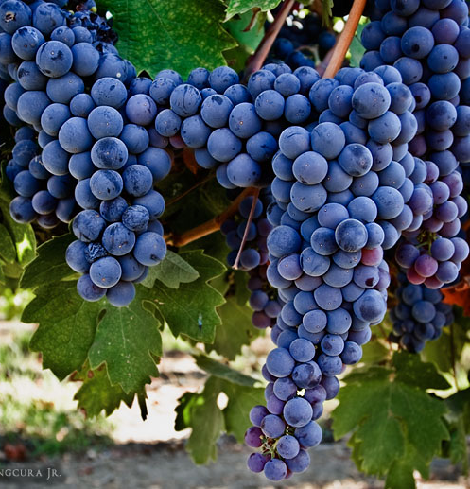
Soil structure is like
Clusters of grapes. Soil particles are the individual grapes. Structure or aggregation is a term describing how the grapes cluster or bunch together. The more aggregation the better. This creates pore spaces between clusters,
This material is based upon work that is supported by the National Institute of Food and Agriculture, U.S. Department of Agriculture, under award number 2019-38640-29879 through the North Central Region SARE program under project number ENC19-175. USDA is an equal opportunity employer and service provider. Any opinions, findings, conclusions, or recommendations expressed in this publication are those of the author(s) and do not necessarily reflect the view of the U.S. Department of Agriculture

Slide 20
Soil physical properties
We just reviewed soil STRUCTURE
Another physical property is soil TEXTURE
(NOTE: There are generally considered five more physical properties of soil:
Consistence, porosity, density, color & temperature
We will not cover these in this course.)
This material is based upon work that is supported by the National Institute of Food and Agriculture, U.S. Department of Agriculture, under award number 2019-38640-29879 through the North Central Region SARE program under project number ENC19-175. USDA is an equal opportunity employer and service provider. Any opinions, findings, conclusions, or recommendations expressed in this publication are those of the author(s) and do not necessarily reflect the view of the U.S. Department of Agriculture

Slide 21
Soil texture: refers to the size of the different soil particles and how much, proportionally, is clay, silt or sand
This material is based upon work that is supported by the National Institute of Food and Agriculture, U.S. Department of Agriculture, under award number 2019-38640-29879 through the North Central Region SARE program under project number ENC19-175. USDA is an equal opportunity employer and service provider. Any opinions, findings, conclusions, or recommendations expressed in this publication are those of the author(s) and do not necessarily reflect the view of the U.S. Department of Agriculture

Slide 22
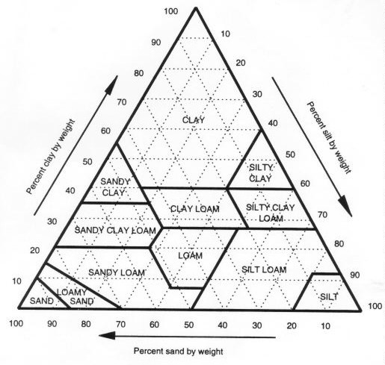
Soil texture refers to particle size (….sand) (…silt) (……clay)
……………………………………………………
clay
Loam
.………….….……
…………………………………….
……………….
Silt
Sand
This material is based upon work that is supported by the National Institute of Food and Agriculture, U.S. Department of Agriculture, under award number 2019-38640-29879 through the North Central Region SARE program under project number ENC19-175. USDA is an equal opportunity employer and service provider. Any opinions, findings, conclusions, or recommendations expressed in this publication are those of the author(s) and do not necessarily reflect the view of the U.S. Department of Agriculture

Slide 23
Loamy
This is a desirable soil texture that is equal parts sand, clay and silt.
This material is based upon work that is supported by the National Institute of Food and Agriculture, U.S. Department of Agriculture, under award number 2019-38640-29879 through the North Central Region SARE program under project number ENC19-175. USDA is an equal opportunity employer and service provider. Any opinions, findings, conclusions, or recommendations expressed in this publication are those of the author(s) and do not necessarily reflect the view of the U.S. Department of Agriculture

Slide 24
Soil Function: What is soil for? What does soil do? Why do we need soil? It has four main agricultural functions
This material is based upon work that is supported by the National Institute of Food and Agriculture, U.S. Department of Agriculture, under award number 2019-38640-29879 through the North Central Region SARE program under project number ENC19-175. USDA is an equal opportunity employer and service provider. Any opinions, findings, conclusions, or recommendations expressed in this publication are those of the author(s) and do not necessarily reflect the view of the U.S. Department of Agriculture

Slide 25
Function #1 - It supports the plant. (soil structure) Roots find “hand holds” or anchors Even sterile soils can perform this function Hydroponics – grow plants with external support no soil needed
This material is based upon work that is supported by the National Institute of Food and Agriculture, U.S. Department of Agriculture, under award number 2019-38640-29879 through the North Central Region SARE program under project number ENC19-175. USDA is an equal opportunity employer and service provider. Any opinions, findings, conclusions, or recommendations expressed in this publication are those of the author(s) and do not necessarily reflect the view of the U.S. Department of Agriculture

Slide 26
Soil Function #2 (soil structure) It allows gases to be exchanged in the root zone. Root respiration and organic matter decomposition need oxygen to enter need CO2 to leave
This material is based upon work that is supported by the National Institute of Food and Agriculture, U.S. Department of Agriculture, under award number 2019-38640-29879 through the North Central Region SARE program under project number ENC19-175. USDA is an equal opportunity employer and service provider. Any opinions, findings, conclusions, or recommendations expressed in this publication are those of the author(s) and do not necessarily reflect the view of the U.S. Department of Agriculture

Slide 27
Soil Function #3: (soil structure) It allows water to meet the plant root
This material is based upon work that is supported by the National Institute of Food and Agriculture, U.S. Department of Agriculture, under award number 2019-38640-29879 through the North Central Region SARE program under project number ENC19-175. USDA is an equal opportunity employer and service provider. Any opinions, findings, conclusions, or recommendations expressed in this publication are those of the author(s) and do not necessarily reflect the view of the U.S. Department of Agriculture

Slide 28
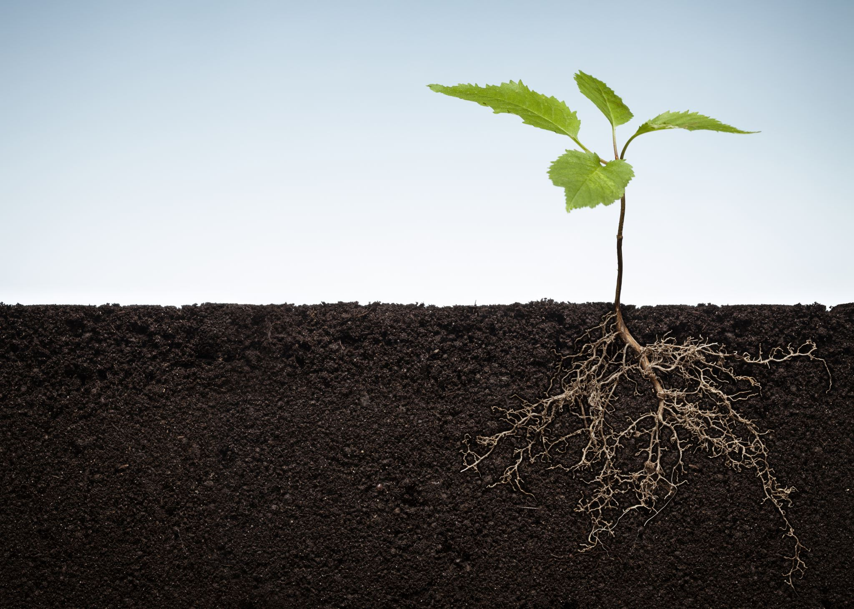
Function #4: (soil nutrients) Soil helps feed the plant Soil is the interface, the place where nutrients are absorbed by plant cells, root hairs. Soil itself supplies only a tiny bit of material to the plant’s whole body.
This material is based upon work that is supported by the National Institute of Food and Agriculture, U.S. Department of Agriculture, under award number 2019-38640-29879 through the North Central Region SARE program under project number ENC19-175. USDA is an equal opportunity employer and service provider. Any opinions, findings, conclusions, or recommendations expressed in this publication are those of the author(s) and do not necessarily reflect the view of the U.S. Department of Agriculture

Slide 29
Key point
A major difference between organic and conventional farmers is that organic farmers pay closer attention to the soil’s physical properties because they know that good function is dependent on good structure.
This material is based upon work that is supported by the National Institute of Food and Agriculture, U.S. Department of Agriculture, under award number 2019-38640-29879 through the North Central Region SARE program under project number ENC19-175. USDA is an equal opportunity employer and service provider. Any opinions, findings, conclusions, or recommendations expressed in this publication are those of the author(s) and do not necessarily reflect the view of the U.S. Department of Agriculture

Slide 30
How do organic farmers “help” improve or preserve soil structure
Don’t drive on wet soil
1
Keep compaction to a minimum
2
Invest in compost as a soil “fluffer”
3
Keep soil microbiology “happy”
4
Don’t use synthetics (pesticides, herbicides, fertilizers)
5
Rotate crops
6
Use soil building crops & green manures
7
Build organic matter by using managed grazing & animal manures
8
This material is based upon work that is supported by the National Institute of Food and Agriculture, U.S. Department of Agriculture, under award number 2019-38640-29879 through the North Central Region SARE program under project number ENC19-175. USDA is an equal opportunity employer and service provider. Any opinions, findings, conclusions, or recommendations expressed in this publication are those of the author(s) and do not necessarily reflect the view of the U.S. Department of Agriculture

