Slide 1
Soil solarization for sustainable management of weeds, pests, and pathogens in Kentucky and Tennessee high tunnels
Rachel Rudolph, Annette Wszelaki, Luize Lessmann, Brooke Emery, April Lamb, Nicole Gauthier, Erin Haramoto, Jonathan Larson,

Slide 2
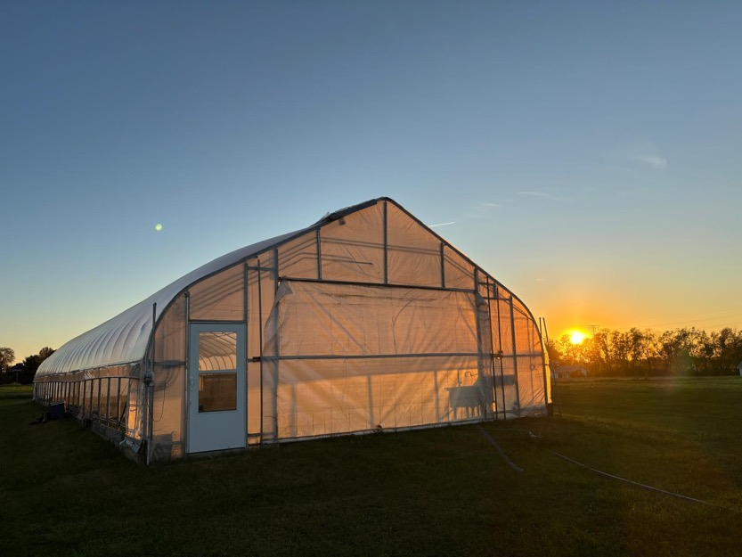
High tunnels (HTs) in Kentucky and Tennessee
Kentucky has ~1,700 HTs
Tennessee has over 700 HTs
Soilborne diseases, pests, and weeds can become problematic in HTs
Causing yield loss
Issues with crop and soil quality
High Tunnel at UK Horticulture Research Farm
Photo credit: Luize Lessmann
Notes:
Issues: rarely moved due to labor and expenses many people do not rotate the crop pesticides and herbicides restricted, either by legality of expense to buy them

Slide 3
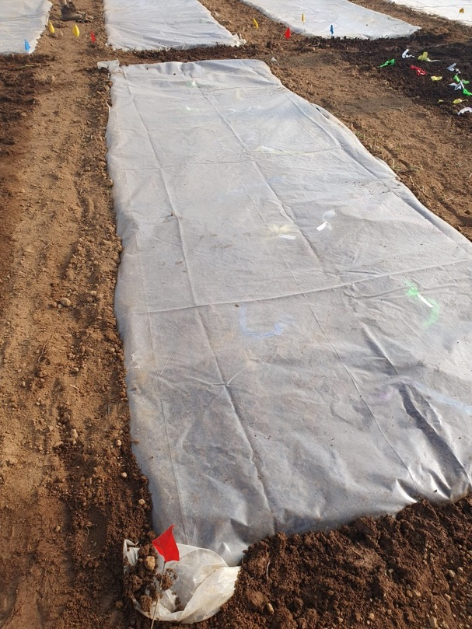
Soil solarization
Uses passive solar heating of wet soil under transparent plastic tarping
Achieves high soil temperatures
Temperatures reached can be detrimental to soilborne pathogens, pests, and weeds
Target is 104°F or higher
Soil Solarization at UK Horticulture Research Farm
Photo credit: Luize Lessmann

Slide 4
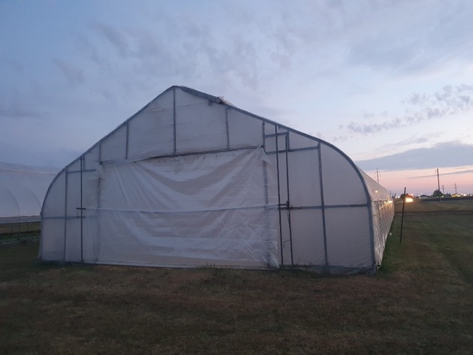
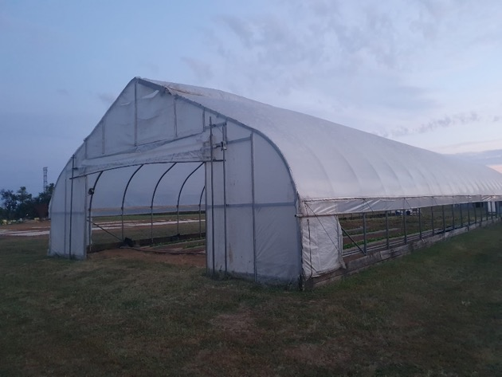
Objectives
A
Locations:
Lexington, KY (38.0389° N)
Knoxville, TN (35.9606° N)
Solarization in open and closed tunnels
Seasons and duration
April, July, September
2 and 4 weeks of solarization
Soil temperature at different soil depths
2, 4, and 6 inches
Effect of soil solarization on weeds and pests
Pathogens at different soil depths (closed tunnel at UK only)
Lettuce yield and quality
B
A: Sealed High Tunnel B: Open high tunnel
Photo credit: Luize Lessmann

Slide 5
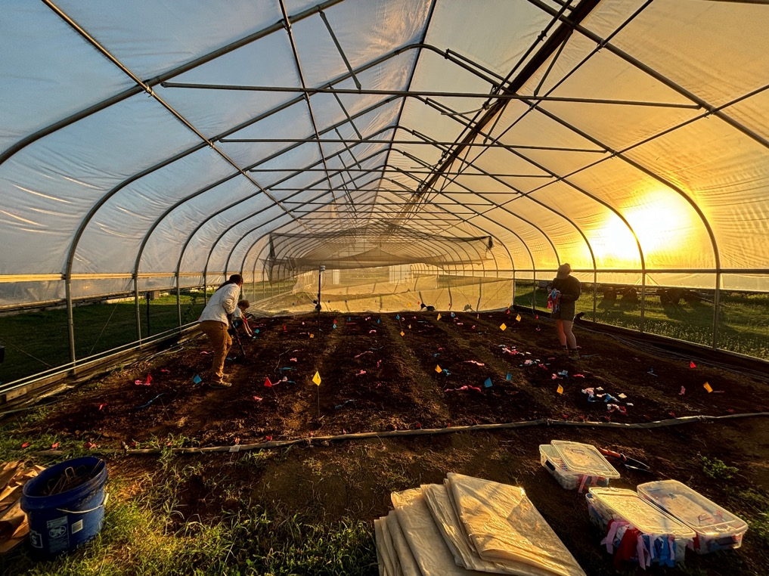
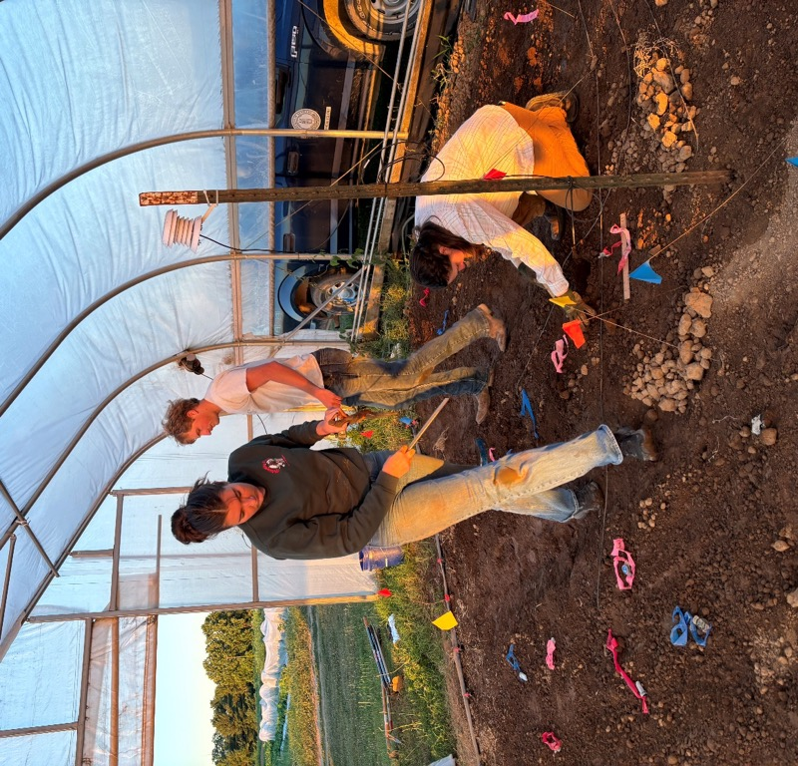
Day of solarization
Soil at 70% water capacity - distributing pathogens, burying pathogens and data loggers, trenching
Photo credit: Luize Lessmann
Burying pathogens
Photo credit: Luize Lessmann

Slide 6
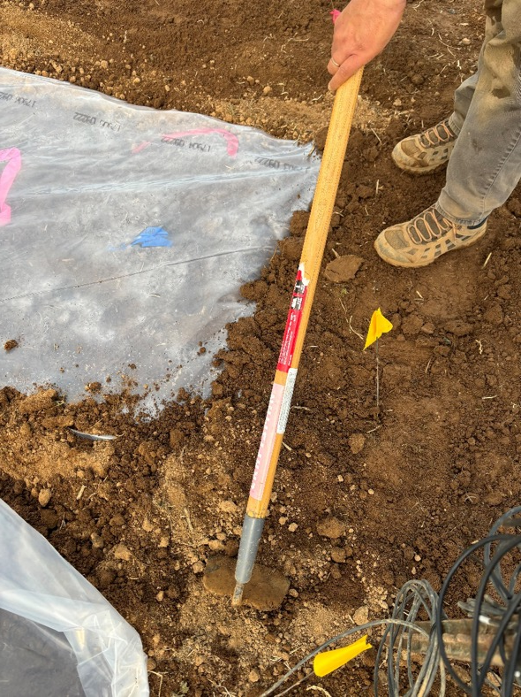
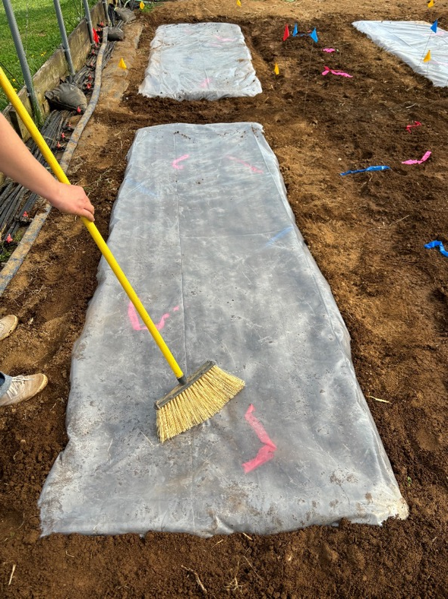
Day of solarization
Seal the edges with soil
Photo credit: Luize Lessmann
Sweep soil from plastic tarp
Photo credit: Luize Lessmann

Slide 7
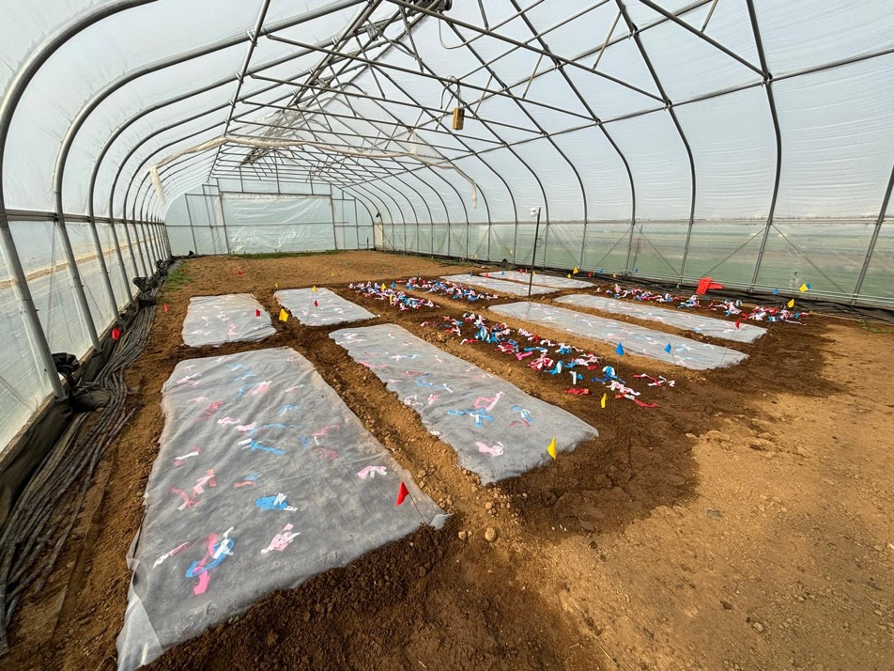
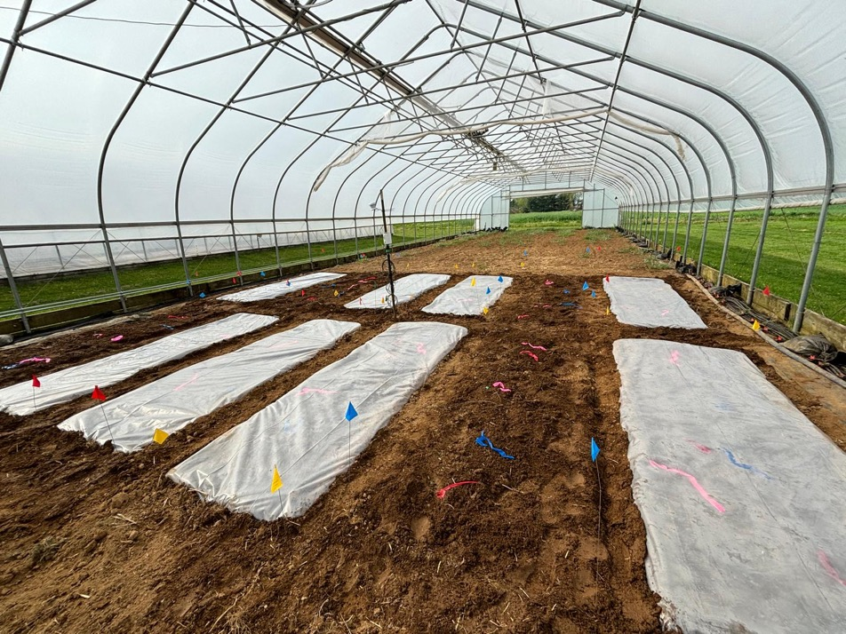
Soil solarization
Soil solarization in the closed tunnel
Photo credit: Luize Lessmann
Soil solarization in the open tunnel
Photo credit: Luize Lessmann

Slide 8
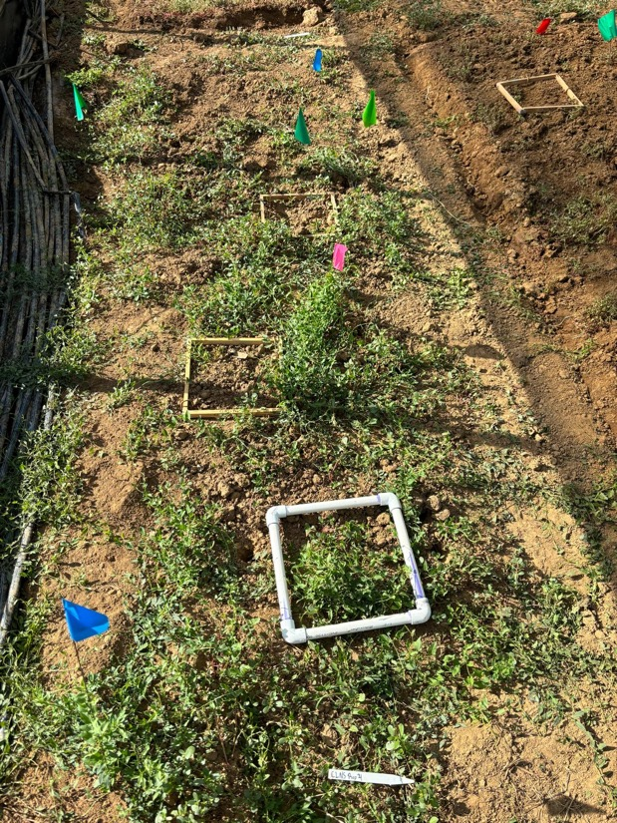
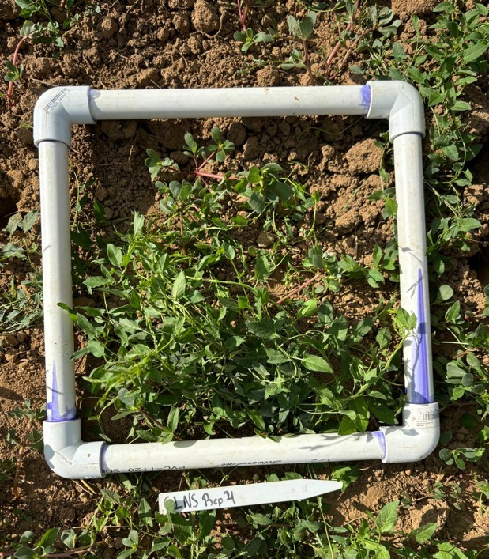
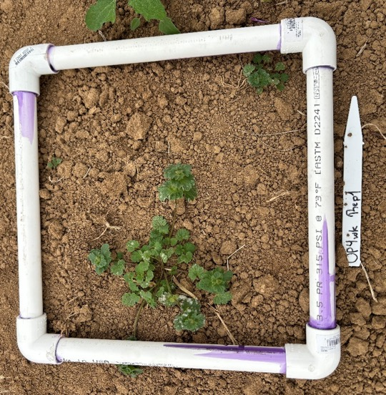
Weed sampling
1 quadrat per plot
Identified and dried biomass
Quadrat with weeds
Photo credit: Luize Lessmann
Quadrat randomly placed within the plot
Photo credit: Luize Lessmann
Quadrat with weeds
Photo credit: Luize Lessmann

Slide 9
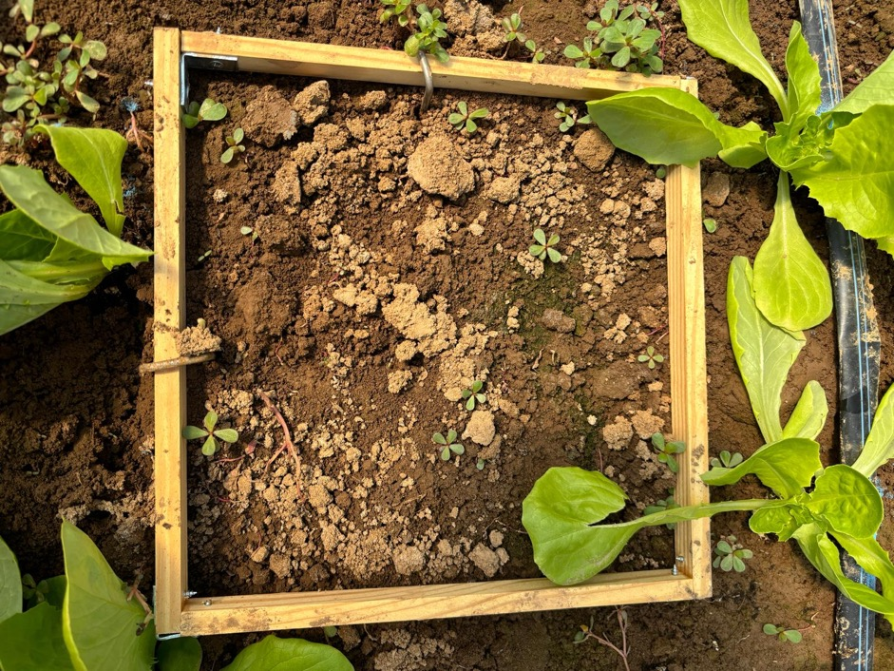
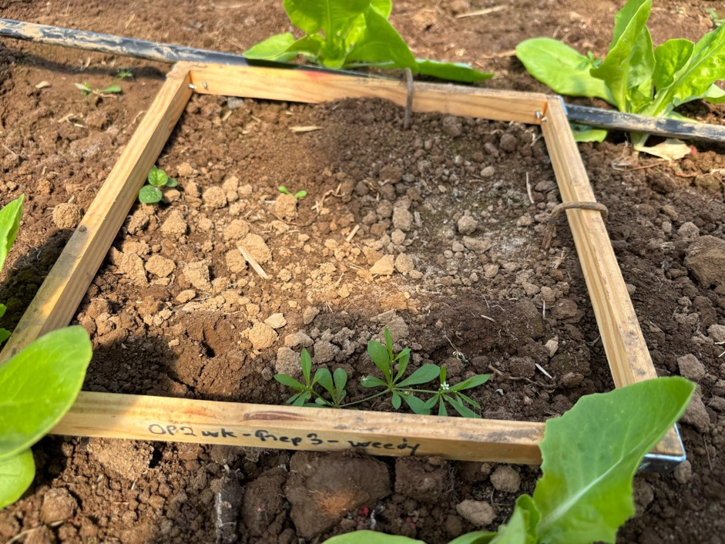
Weed emergence
Weed emergence closed tunnel
Photo credit: Luize Lessmann
Weed emergence open tunnel
Photo credit: Luize Lessmann

Slide 10
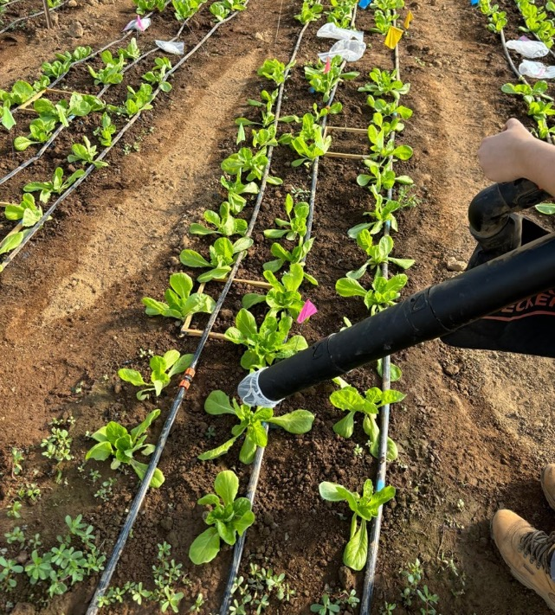
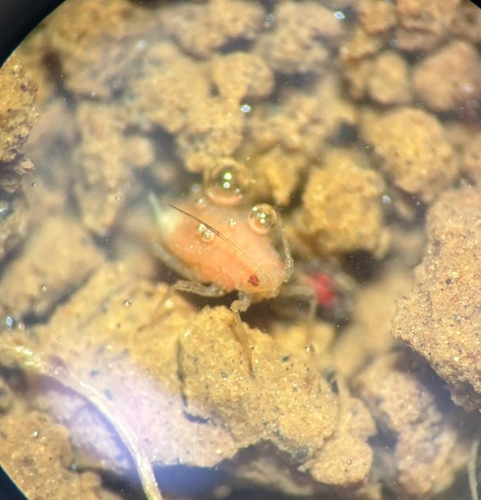
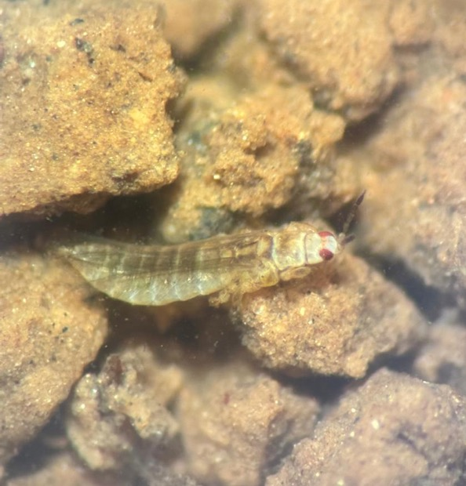
Pest collection
Vacuumed over top vegetation to collect and identify pests
Aphid
Photo credit: Luize Lessmann
Thrips
Photo credit: Luize Lessmann
Vacuuming the insects
Photo credit: Luize Lessmann

Slide 11
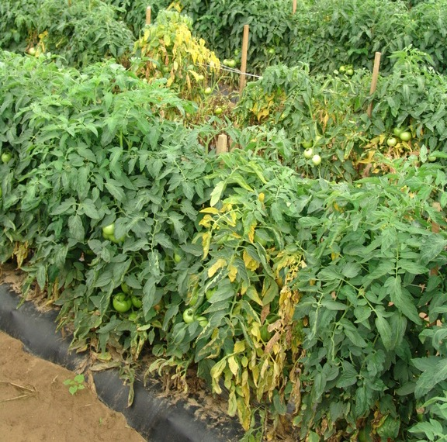
Soilborne diseases
Typically, fungi or water molds
Complete lives within the soil
Affect below ground or soil-surface plant parts
May move to crowns or lower canopy
Spread via soil particles and water, sometimes seed
Build up over time

Slide 12
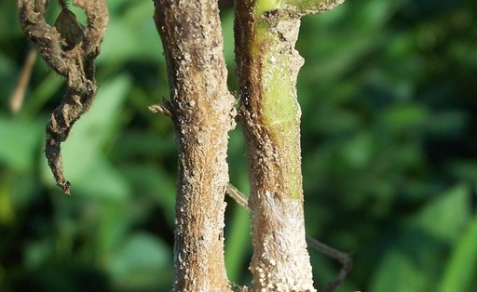
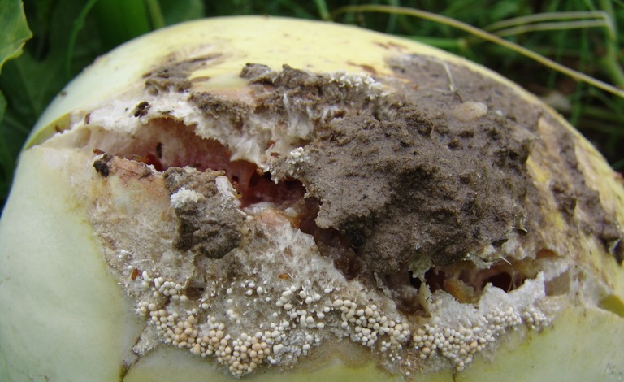
Southern Blight (Agroathelia rolfsii)
Pathogen targeted
Infects stem and crown of plants
Rot
Wilting
Stunting
Plant death
Optimal conditions 80-95°F
Wide host range (> 500 species)
Survives 2 to 3 years

Slide 13
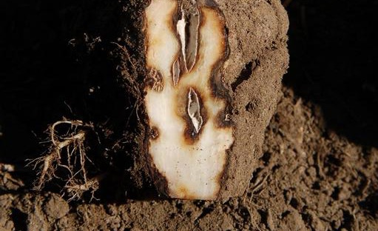
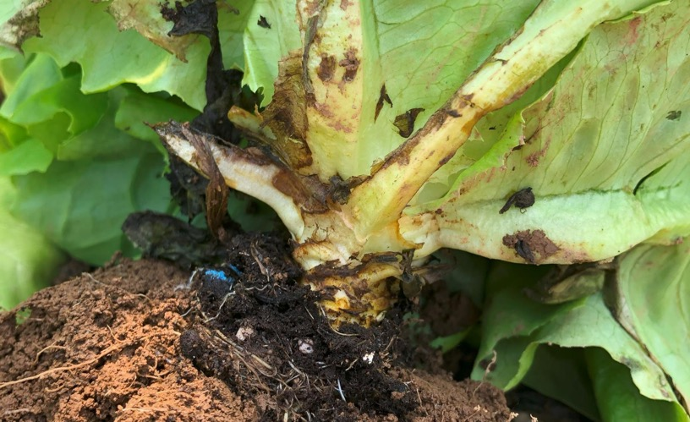
Rhizoctonia Rot (Rhizoctonia solani)
Pathogen targeted
Infects roots and crown
Crown rot
Stunting
Wilting
Plant death
Optimal conditions 60-80°F
Wide host range (> 200 species)
Survives 2 to 3 years

Slide 14
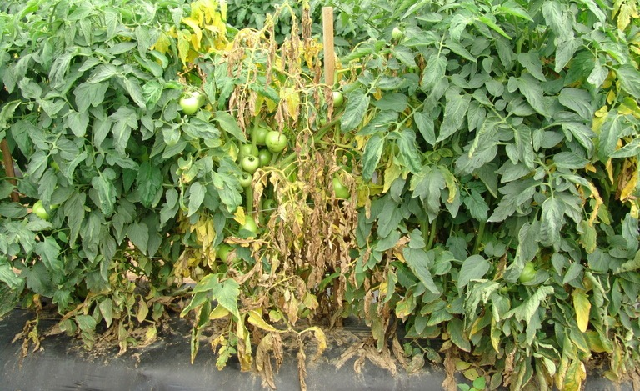
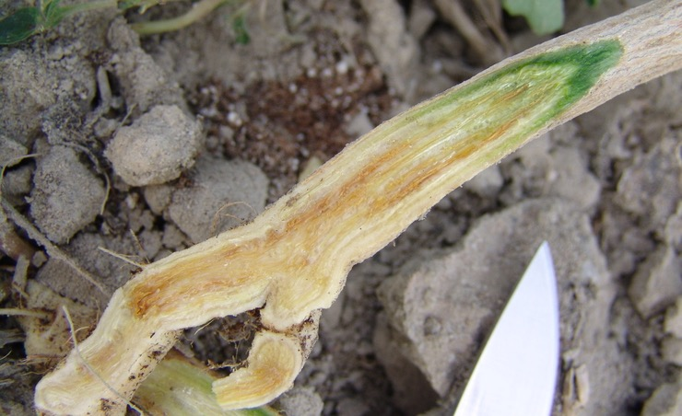
Fusarium Wilt (Fusarium oxysporum)
Pathogen targeted
Enters vasculature of plants
Xylem necrosis
Wilting
Yellowing
Plant death
Optimal soil conditions 75-80°F
Wide host range (>120 species)
Survives 3 to 5 years (up to 10 yrs)

Slide 15
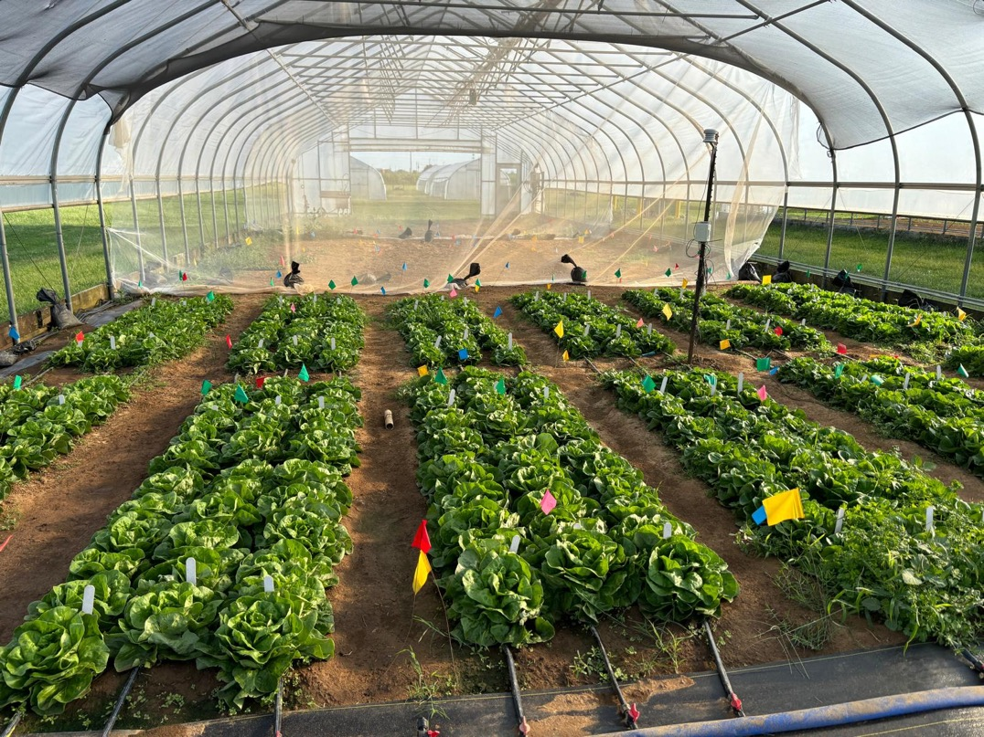
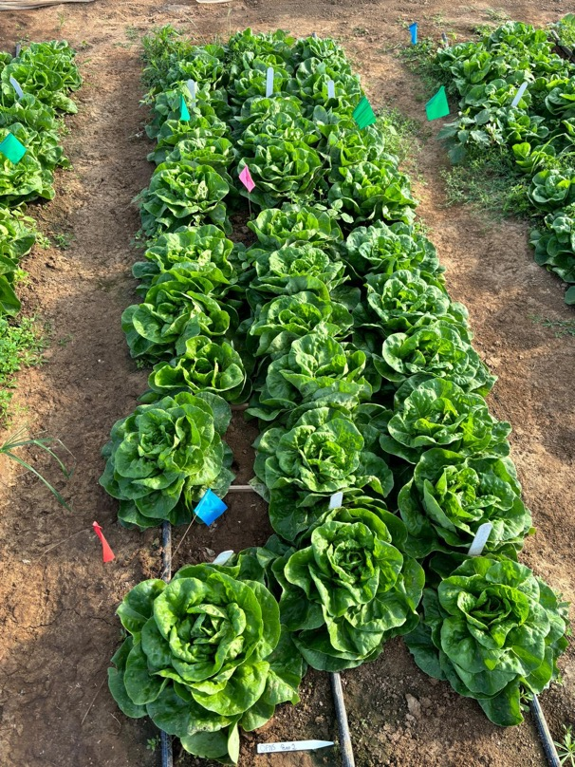
Lettuce production
Plots with lettuce at UK Horticulture Research Farm
Photo credit: Luize Lessmann
Plot with lettuce at UK Horticulture Research Farm
Photo credit: Luize Lessmann

Slide 16
Average soil daily maximum temperature (°F)
Treatment | Soil Depth (in) | Open Tunnel |  |  |  |  |  | Closed Tunnel
 |  | April |  | July |  | Sept |  | April |  | July |  | Sept
 |  | TN | KY | TN | KY | TN | KY | TN | KY | TN | KY | TN | KY
2 week | 2 | 98 | 90 | 122 | 109 | 107 | 97 | 105 | 103 | 136 | 116 | 119 | 104
 | 4 | 94 | 84 | 115 | 99 | 104 | 91 | 101 | 95 | 128 | 108 | 116 | 100
 | 6 | 88 | 81 | 112 | 96 | 100 | 90 | 93 | 90 | 121 | 104 | 108 | 95
4 week | 2 | 100 | 92 | 117 | 104 | 104 | 92 | 108 | 103 | 126 | 113 | 116 | 98
 | 4 | 94 | 84 | 111 | 97 | 101 | 88 | 101 | 97 | 119 | 107 | 106 | 94
 | 6 | 91 | 81 | 101 | 94 | 97 | 86 | 95 | 93 | 114 | 103 | 103 | 91
Nonsolarized (2 week) | 2 | 84 | 75 | 102 | 93 | 92 | 82 | 99 | 88 | 126 | 100 | 94 | 91
 | 4 | 79 | 72 | 96 | 87 | 91 | 79 | 89 | 84 | 111 | 96 | 106 | 87
 | 6 | 77 | 69 | 94 | 85 | 86 | 78 | 85 | 81 | 107 | 93 | 100 | 85
Nonsolarized (4 week) | 2 | 88 | 80 | 96 | 94 | 91 | 82 | 101 | 91 | 121 | 100 | 91 | 89
 | 4 | 82 | 76 | 92 | 87 | 91 | 79 | 91 | 87 | 107 | 96 | 103 | 85
 | 6 | 80 | 73 | 90 | 86 | 89 | 78 | 87 | 84 | 104 | 93 | 98 | 84
*Dark grey boxes indicate reaching ≥ 104°F

Slide 17
Average soil daily maximum temperature (°F)
Treatment | Soil Depth (in) | Open Tunnel |  |  |  |  |  | Closed Tunnel
 |  | April |  | July |  | Sept |  | April |  | July |  | Sept
 |  | TN | KY | TN | KY | TN | KY | TN | KY | TN | KY | TN | KY
2 week | 2 | 98 | 90 | 122 | 109 | 107 | 97 | 105 | 103 | 136 | 116 | 119 | 104
 | 4 | 94 | 84 | 115 | 99 | 104 | 91 | 101 | 95 | 128 | 108 | 116 | 100
 | 6 | 88 | 81 | 112 | 96 | 100 | 90 | 93 | 90 | 121 | 104 | 108 | 95
4 week | 2 | 100 | 92 | 117 | 104 | 104 | 92 | 108 | 103 | 126 | 113 | 116 | 98
 | 4 | 94 | 84 | 111 | 97 | 101 | 88 | 101 | 97 | 119 | 107 | 106 | 94
 | 6 | 91 | 81 | 101 | 94 | 97 | 86 | 95 | 93 | 114 | 103 | 103 | 91
Nonsolarized (2 week) | 2 | 84 | 75 | 102 | 93 | 92 | 82 | 99 | 88 | 126 | 100 | 94 | 91
 | 4 | 79 | 72 | 96 | 87 | 91 | 79 | 89 | 84 | 111 | 96 | 106 | 87
 | 6 | 77 | 69 | 94 | 85 | 86 | 78 | 85 | 81 | 107 | 93 | 100 | 85
Nonsolarized (4 week) | 2 | 88 | 80 | 96 | 94 | 91 | 82 | 101 | 91 | 121 | 100 | 91 | 89
 | 4 | 82 | 76 | 92 | 87 | 91 | 79 | 91 | 87 | 107 | 96 | 103 | 85
 | 6 | 80 | 73 | 90 | 86 | 89 | 78 | 87 | 84 | 104 | 93 | 98 | 84
*Dark grey boxes indicate reaching ≥ 104°F

Slide 18
Accumulated hours ≥ 104 °F in soil
Treatment | Soil Depth (in) | Open Tunnel |  |  |  |  |  | Closed Tunnel
 |  | April |  | July |  | Sept |  | April |  | July |  | Sept
 |  | TN | KY | TN | KY | TN | KY | TN | KY | TN | KY | TN | KY
2 week | 2 | 20 | 0 | 137 | 81 | 63 | 5 | 50 | 36 | 187 | 130 | 100 | 54
 | 4 | 12 | 0 | 123 | 16 | 44 | 0 | 40 | 0 | 192 | 84 | 99 | 14
 | 6 | 0 | 0 | 114 | 0 | 22 | 0 | 1 | 0 | 189 | 62 | 74 | 0
4 week | 2 | 47 | 4 | 197 | 92 | 106 | 2 | 111 | 65 | 288 | 231 | 164 | 71
 | 4 | 19 | 0 | 170 | 7 | 74 | 0 | 57 | 16 | 262 | 176 | 126 | 14
 | 6 | 0 | 0 | 70 | 0 | 33 | 0 | 10 | 5 | 261 | 101 | 102 | 0
Nonsolarized (2 week) | 2 | 0 | 0 | 17 | 0 | 0 | 0 | 21 | 0 | 125 | 22 | 57 | 0
 | 4 | 0 | 0 | 0 | 0 | 0 | 0 | 0 | 0 | 93 | 0 | 39 | 0
 | 6 | 0 | 0 | 0 | 0 | 0 | 0 | 0 | 0 | 69 | 0 | 6 | 0
Nonsolarized (4 week) | 2 | 0 | 0 | 19 | 0 | 0 | 0 | 47 | 2 | 210 | 44 | 104 | 0
 | 4 | 0 | 0 | 0 | 0 | 5 | 0 | 4 | 0 | 134 | 1 | 83 | 0
 | 6 | 0 | 0 | 0 | 0 | 0 | 0 | 0 | 0 | 93 | 0 | 32 | 0

Slide 19
Accumulated Hours ≥ 104 °F in soil
Treatment | Soil Depth (in) | Open Tunnel |  |  |  |  |  | Closed Tunnel
 |  | April |  | July |  | Sept |  | April |  | July |  | Sept
 |  | TN | KY | TN | KY | TN | KY | TN | KY | TN | KY | TN | KY
2 week | 2 | 20 | 0 | 137 | 81 | 63 | 5 | 50 | 36 | 187 | 130 | 100 | 54
 | 4 | 12 | 0 | 123 | 16 | 44 | 0 | 40 | 0 | 192 | 84 | 99 | 14
 | 6 | 0 | 0 | 114 | 0 | 22 | 0 | 1 | 0 | 189 | 62 | 74 | 0
4 week | 2 | 47 | 4 | 197 | 92 | 106 | 2 | 111 | 65 | 288 | 231 | 164 | 71
 | 4 | 19 | 0 | 170 | 7 | 74 | 0 | 57 | 16 | 262 | 176 | 126 | 14
 | 6 | 0 | 0 | 70 | 0 | 33 | 0 | 10 | 5 | 261 | 101 | 102 | 0
Nonsolarized (2 week) | 2 | 0 | 0 | 17 | 0 | 0 | 0 | 21 | 0 | 125 | 22 | 57 | 0
 | 4 | 0 | 0 | 0 | 0 | 0 | 0 | 0 | 0 | 93 | 0 | 39 | 0
 | 6 | 0 | 0 | 0 | 0 | 0 | 0 | 0 | 0 | 69 | 0 | 6 | 0
Nonsolarized (4 week) | 2 | 0 | 0 | 19 | 0 | 0 | 0 | 47 | 2 | 210 | 44 | 104 | 0
 | 4 | 0 | 0 | 0 | 0 | 5 | 0 | 4 | 0 | 134 | 1 | 83 | 0
 | 6 | 0 | 0 | 0 | 0 | 0 | 0 | 0 | 0 | 93 | 0 | 32 | 0

Slide 20
Outside air temperature April through November

Slide 21
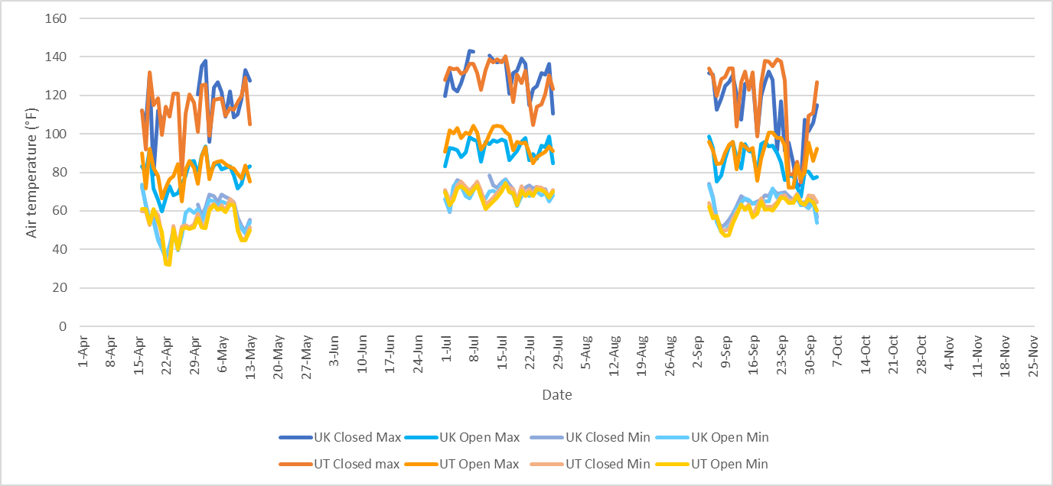
High tunnel temperature April through November

Slide 22
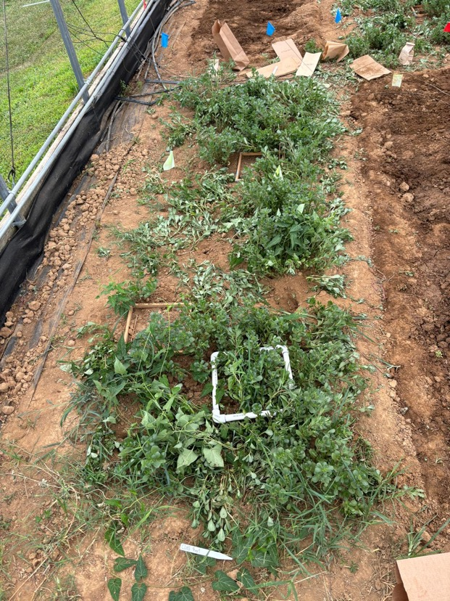
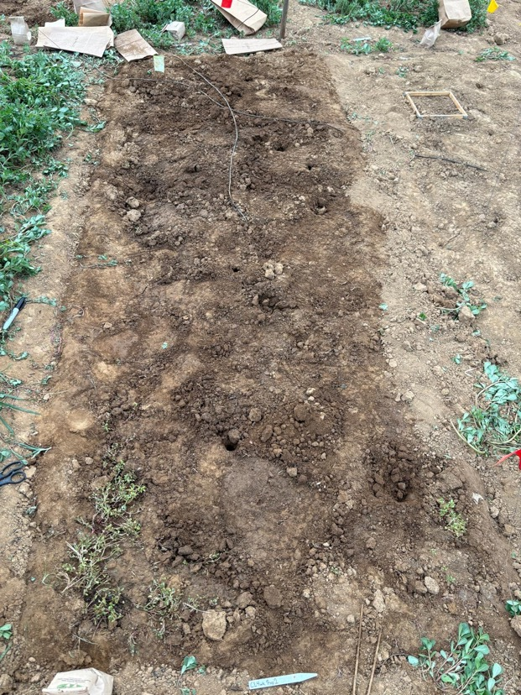
KY weeds in the closed tunnel after July tarp removal
Nonsolarized control
4 week solarization
Photo credit: Luize Lessmann
Photo credit: Luize Lessmann

Slide 23
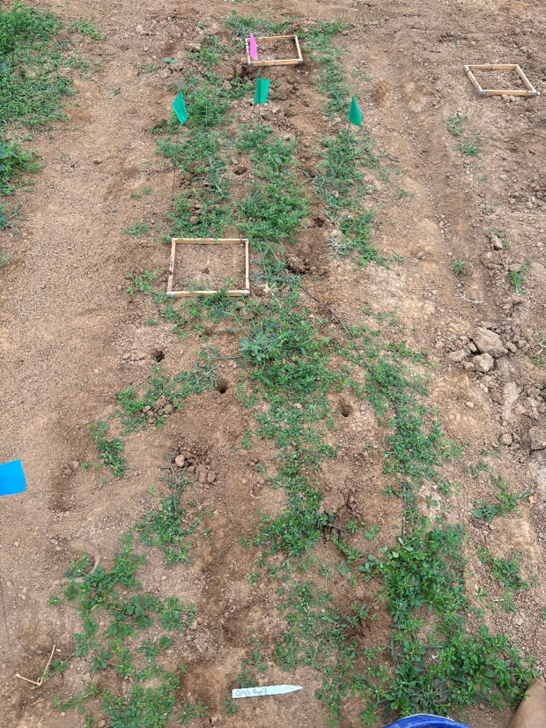
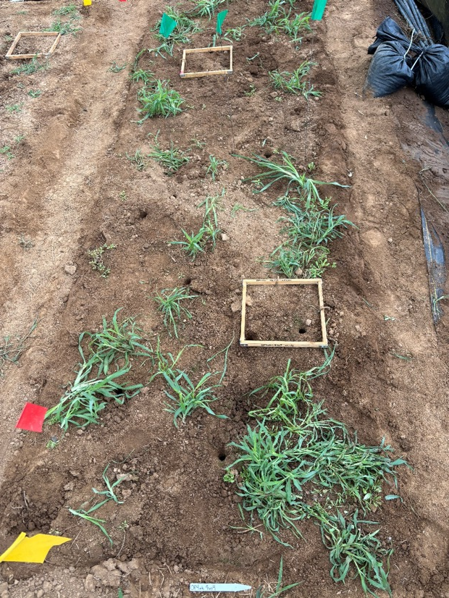
KY weeds in the open tunnel after July tarp removal
Nonsolarized control
4 week solarization
Photo credit: Luize Lessmann
Photo credit: Luize Lessmann

Slide 24
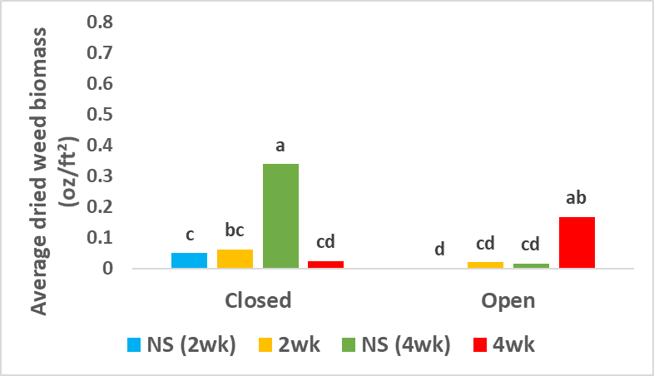
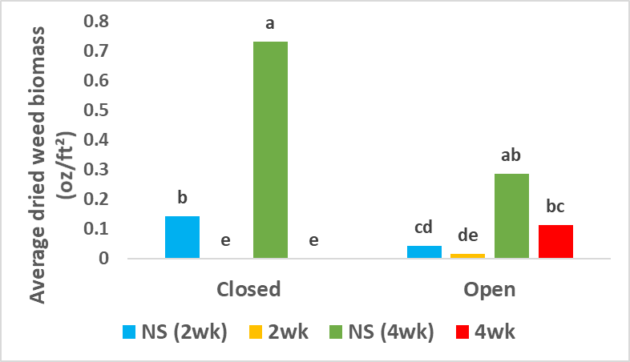
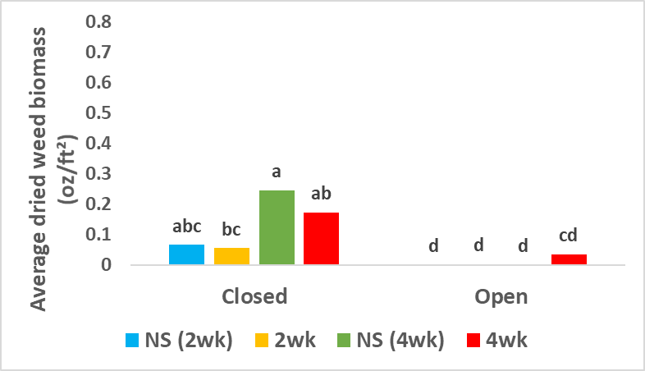
KY dried weed biomass after tarp removal
April
July
September

Slide 25
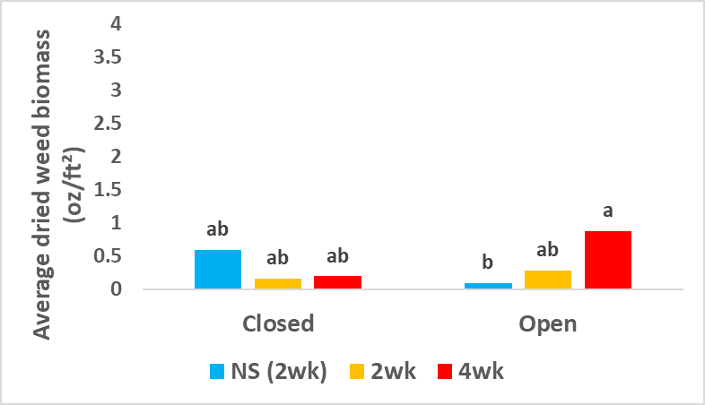
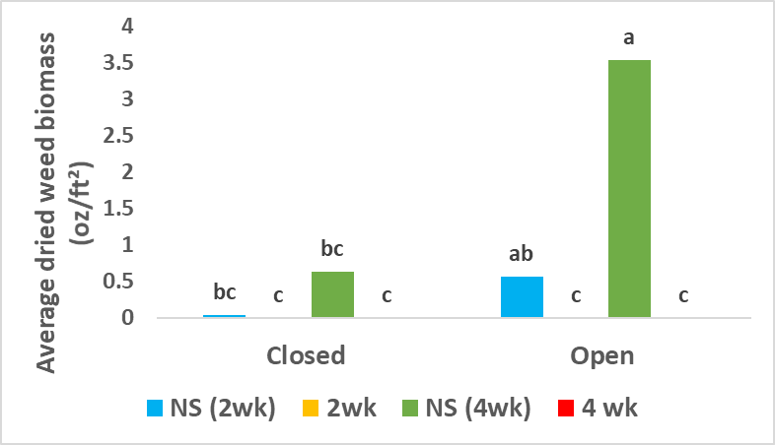
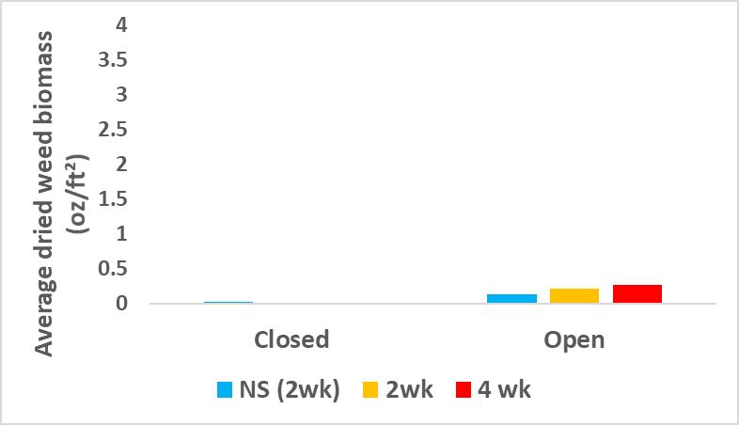
TN dried weed biomass after tarp removal
April
July
September

Slide 26
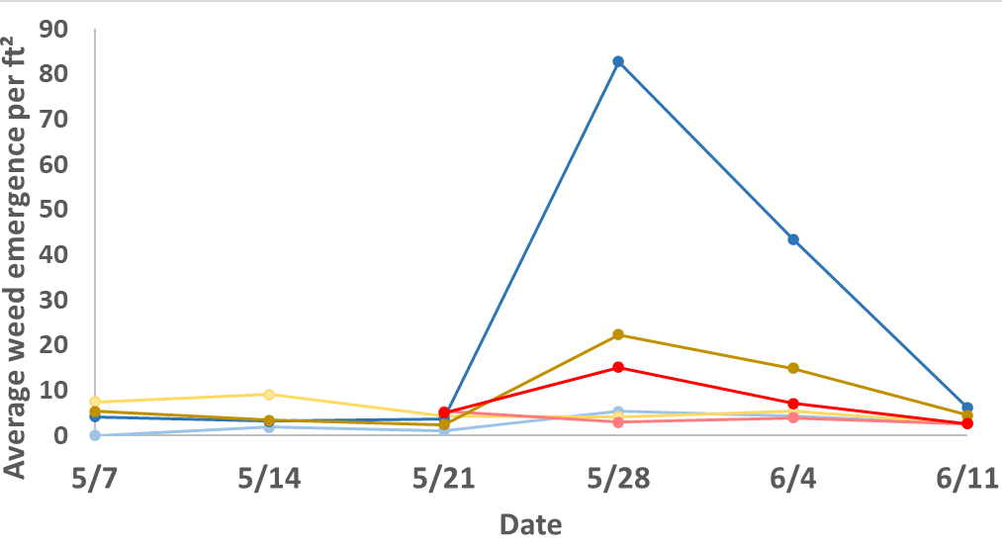
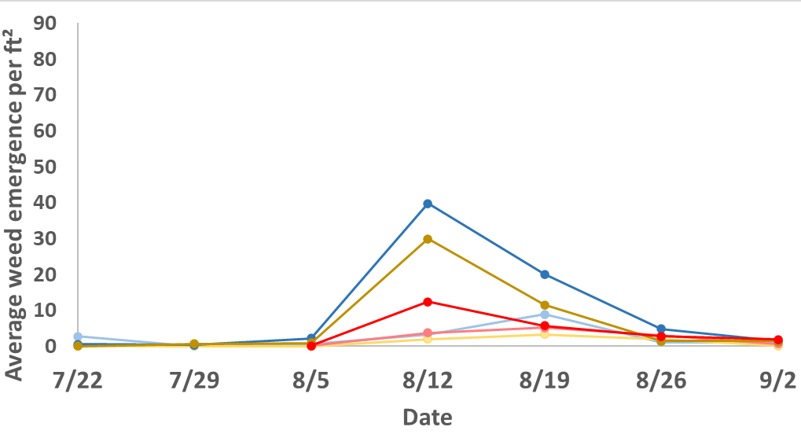
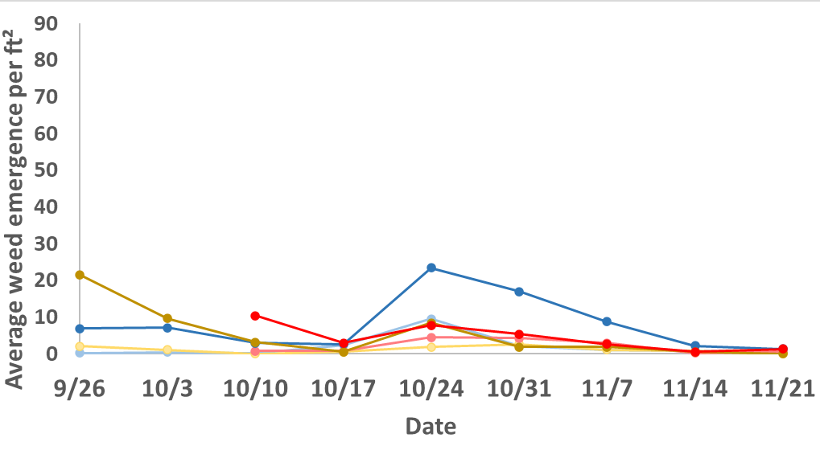
KY weed emergence weekly
April
July
September

Slide 27
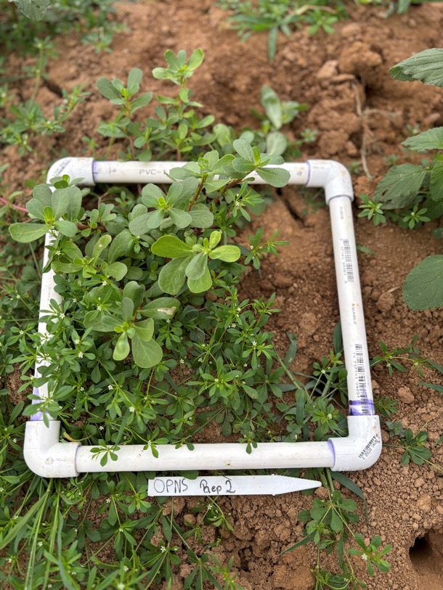
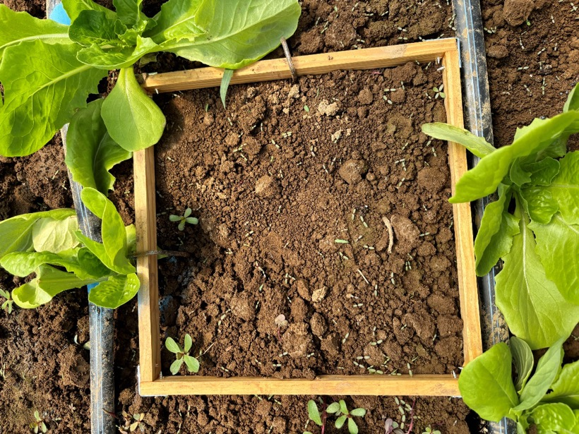
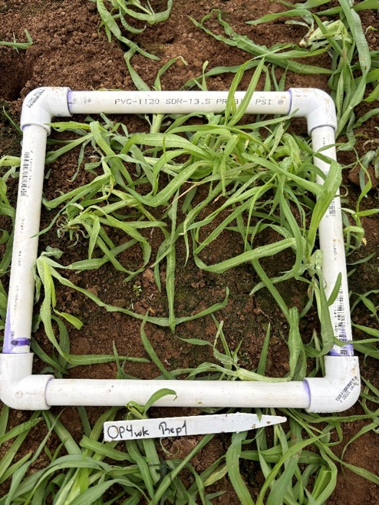
KY weed emergence
Main weeds emerging:
Common purslane, crabgrass, goosegrass, carpetweed
Photos credit: Luize Lessmann

Slide 28
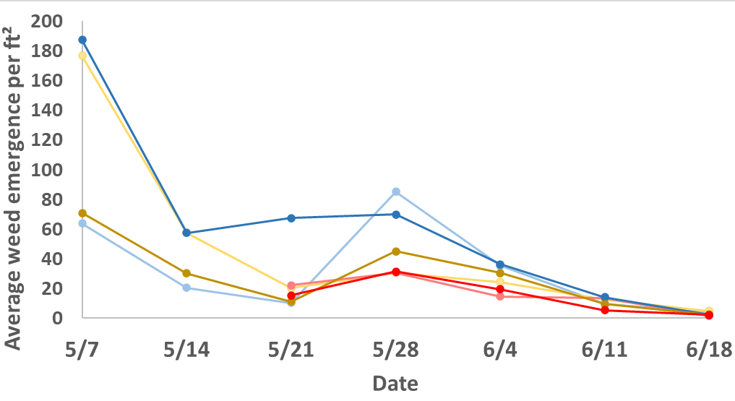
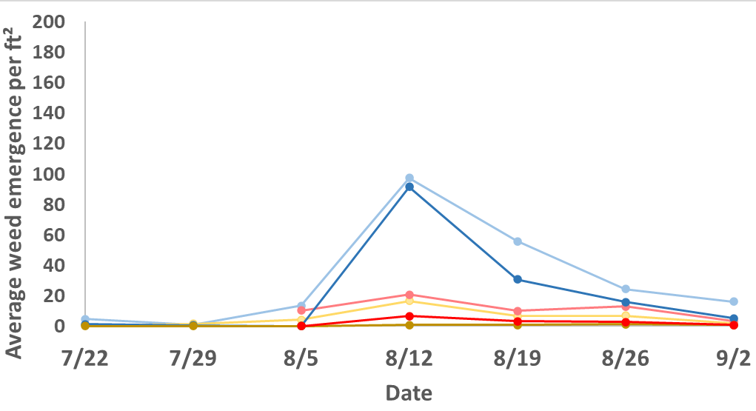
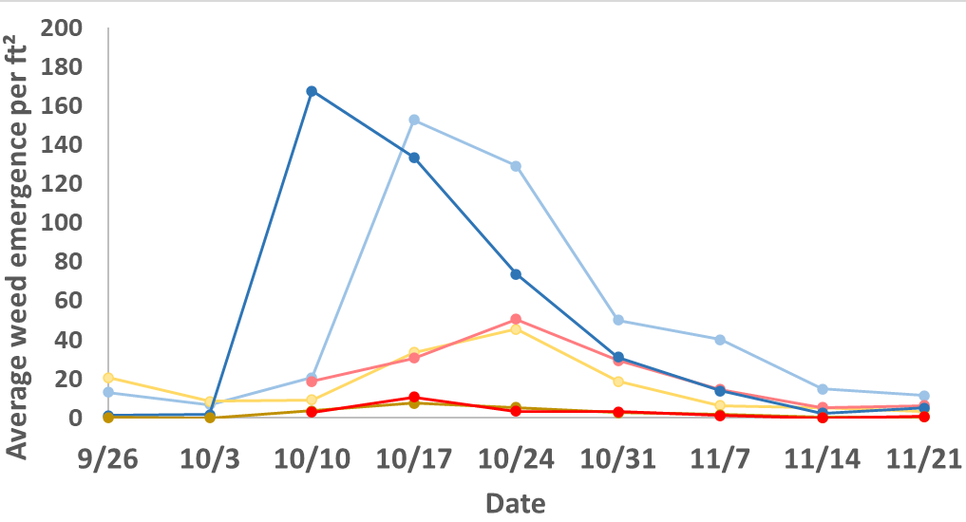
TN weed emergence weekly
April
July
September

Slide 29
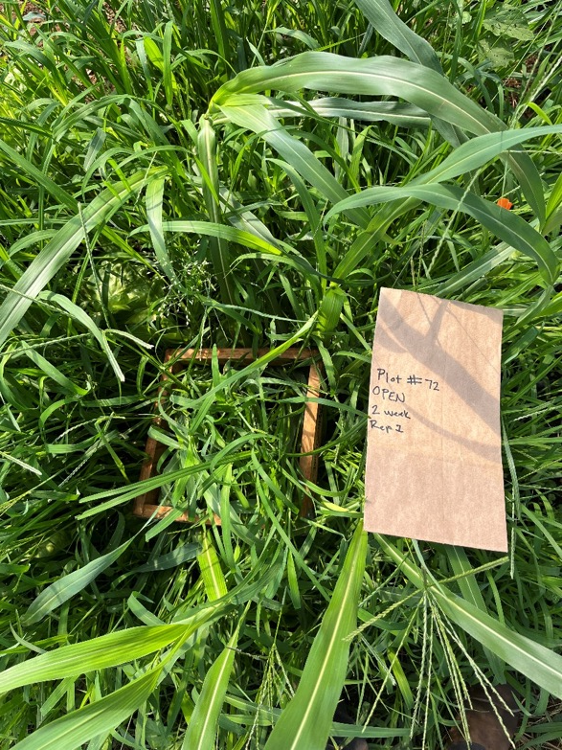
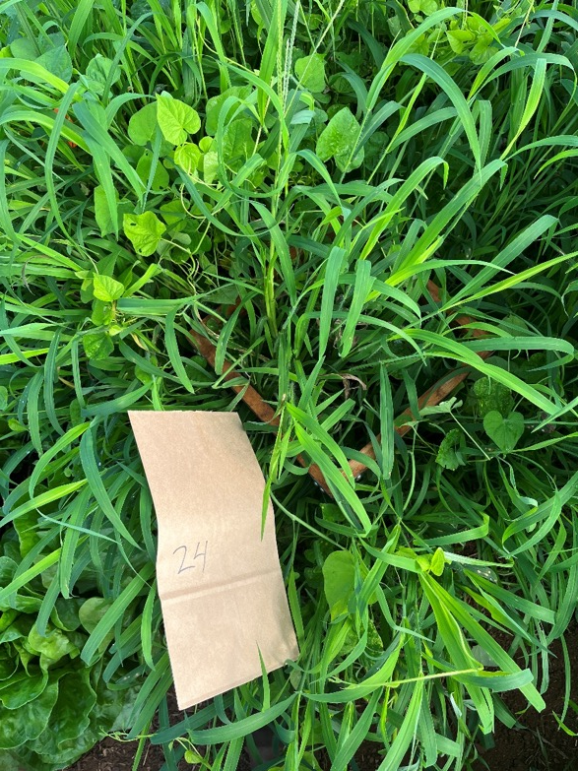
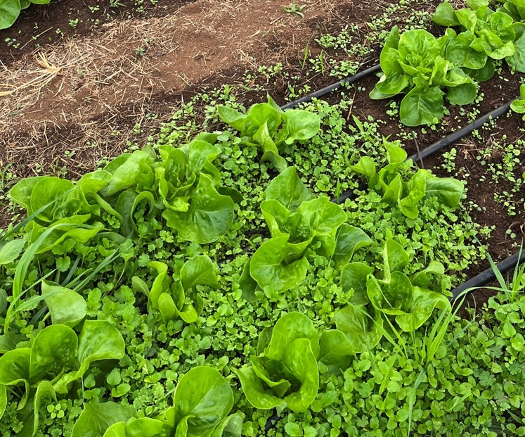
TN weed emergence
Main weeds emerging:
Morning glory, crabgrass, Johnson grass, henbit
Photos credit: Brooke Emery

Slide 30
KY weekly pest count
April
July

Slide 31
Most common pests in KY
Whitefly
Aphid
Leafhopper
Thrips
Photos credit: Luize Lessmann

Slide 32
TN weekly pest count
April
July

Slide 33
Most common pests in TN
Aphid
Leaf hopper
https://extension.usu.edu/planthealth/ipm/ornamental-pest-guide/arthopods/aphids-adelgids/other-aphids
https://wiki.bugwood.org/HPIPM:Leafhoppers_DB
Tarnished plant bug
Looper & Armyworm
https://extension.umaine.edu/home-and-garden-ipm/fact-sheets/common-name-listing/tarnished-plant-bug/
https://hgic.clemson.edu/factsheet/integrated-pest-management-i-p-m-for-cabbage-looper/

Slide 34
Southern Blight

Slide 35
Rhizoctonia Rot

Slide 36
Fusarium Wilt

Slide 37
KY lettuce yield
April
July
September

Slide 38
TN lettuce yield
April
July
September

Slide 39
Conclusions
KY: Max soil temps 10-16 °F higher in solarized plots compared to nonsolarized control
TN: Max soil temps up to 25 °F higher in solarized plots compared to nonsolarized plots Soil temperature was higher in TN compared to KY (due differences in plastic layers & age)
April:
Too cold to successfully solarize in an open HT
July:
Solarization was successful in both open and closed HTs
Better weed control in closed HT
Lettuce yield higher in 4wk solarization regardless of tunnel
September:
Variable temperatures
More successful in closed tunnel than open
Differences between locations
Will repeat experiment in 2025

Slide 40
Thank you! Questions? Email: rachel.rudolph@uky.edu or annettew@utk.edu
Acknowledgements
Rudolph and Gauthier Labs: Wszelaki Lab:
Kathryn Pettigrew Amanda Carroll
Martín Polo Reagan Masengil
Ed Dixon
Kim Leonberger OCU Farm Crew
Henry Smith

