Slide 1
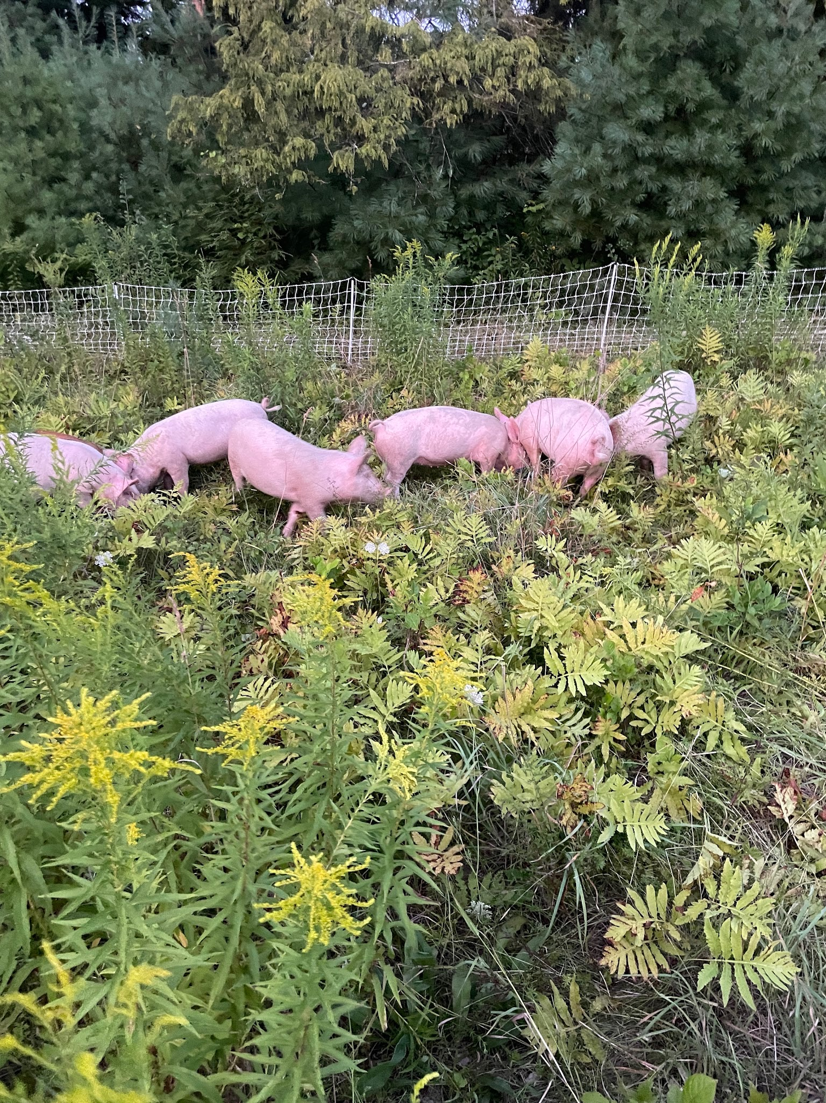

Pigs As Partners:
Exploring Livestock-Driven Pasture Restoration and Silvopasture Transition at Three Square Farm

Slide 2
This material is based upon work supported by the National Institute of Food and Agriculture, U.S. Department of Agriculture, through the Northeast Sustainable Agriculture Research and Education program under subaward number FNE25-123
Technical Advisor: Kristen Jovanelly
Farmers: Melissa & Toby Malandrinos

Slide 3
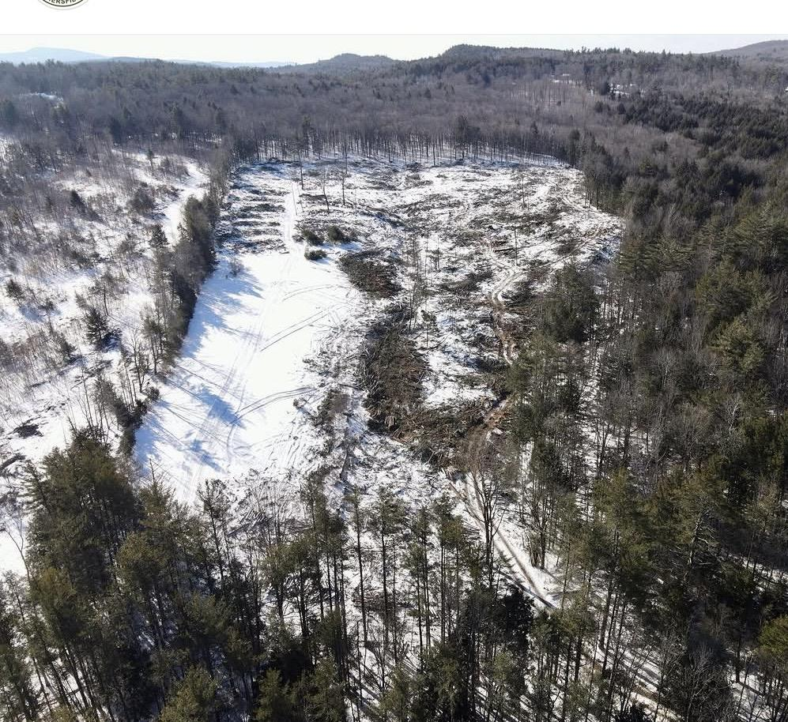
This project evaluated whether rotational pigs could serve as a practical tool for renovating an underutilized, woody-encroached pasture at Three Square Farm while maintaining the ecological resources needed for continued pasture development.
We monitored vegetation and soil conditions before and after grazing to assess how a carefully managed pig rotation influenced plant abundance, species richness, community composition, and soil properties.

Slide 4
Why the project…? We need more pasture!
About the farm
Why the logging?
So what next?
-After using the timber harvest to fund an excavator rental for stumping, the area was still not fully usable for livestock.
-Ruled out: Bale grazing the cattle to deposit organic matter due to safety concerns because of the remaining sticks, rocks and holes.
-Ruled out: Renting a bulldozer and scraping everything due to cost and general ecological unfriendliness.
-Ruled out: Browsing goats on the emerging early successional species due to the parasite concerns of managing both goats & sheep on the same landscape.
-Three Square Farm is a small, diversified livestock farm based on 64 predominantly wooded acres in Weathersfield, Vermont
-Started in 2021, our focus has been producing quality pasture-based meats.
-With only 7 acres of useful pasture at our home site, the majority of our grazing and haying activities have taken place on leased land since starting the farm.
-In 2021, our Current Use forestry plan was up for renewal. Knowing that we would need more pasture, we explored ways to do this.
-Unfortunately, the state did not at that time recognize silvopasture activities!
-We were encouraged to cut the 13 acres of mature white pine/hemlock identified as the best area for future pasture completely to ‘convert’ it to agricultural use

Slide 5
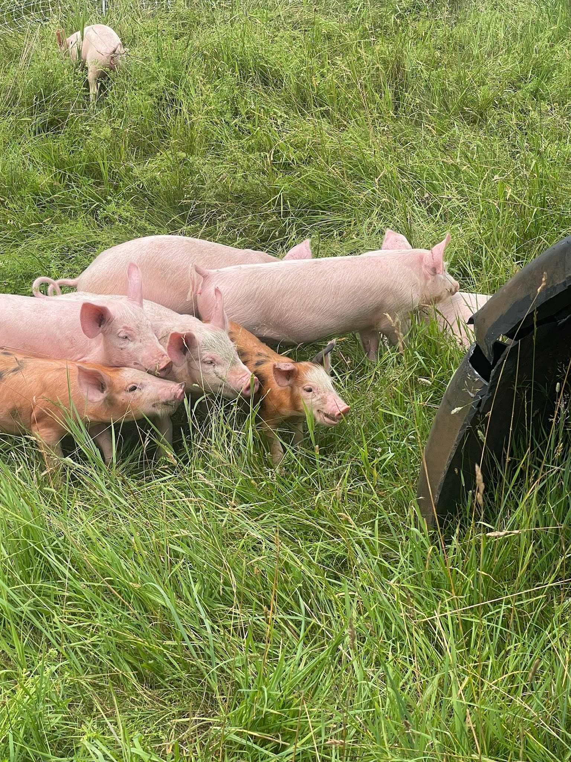
Were pigs the answer to this problem?
Pigs are renowned for their ability to disrupt plant communities through foraging behavior, which, when managed thoughtfully, can facilitate the conversion of degraded pastures into more diverse ecosystems (Tisdell, 2013).

Slide 6
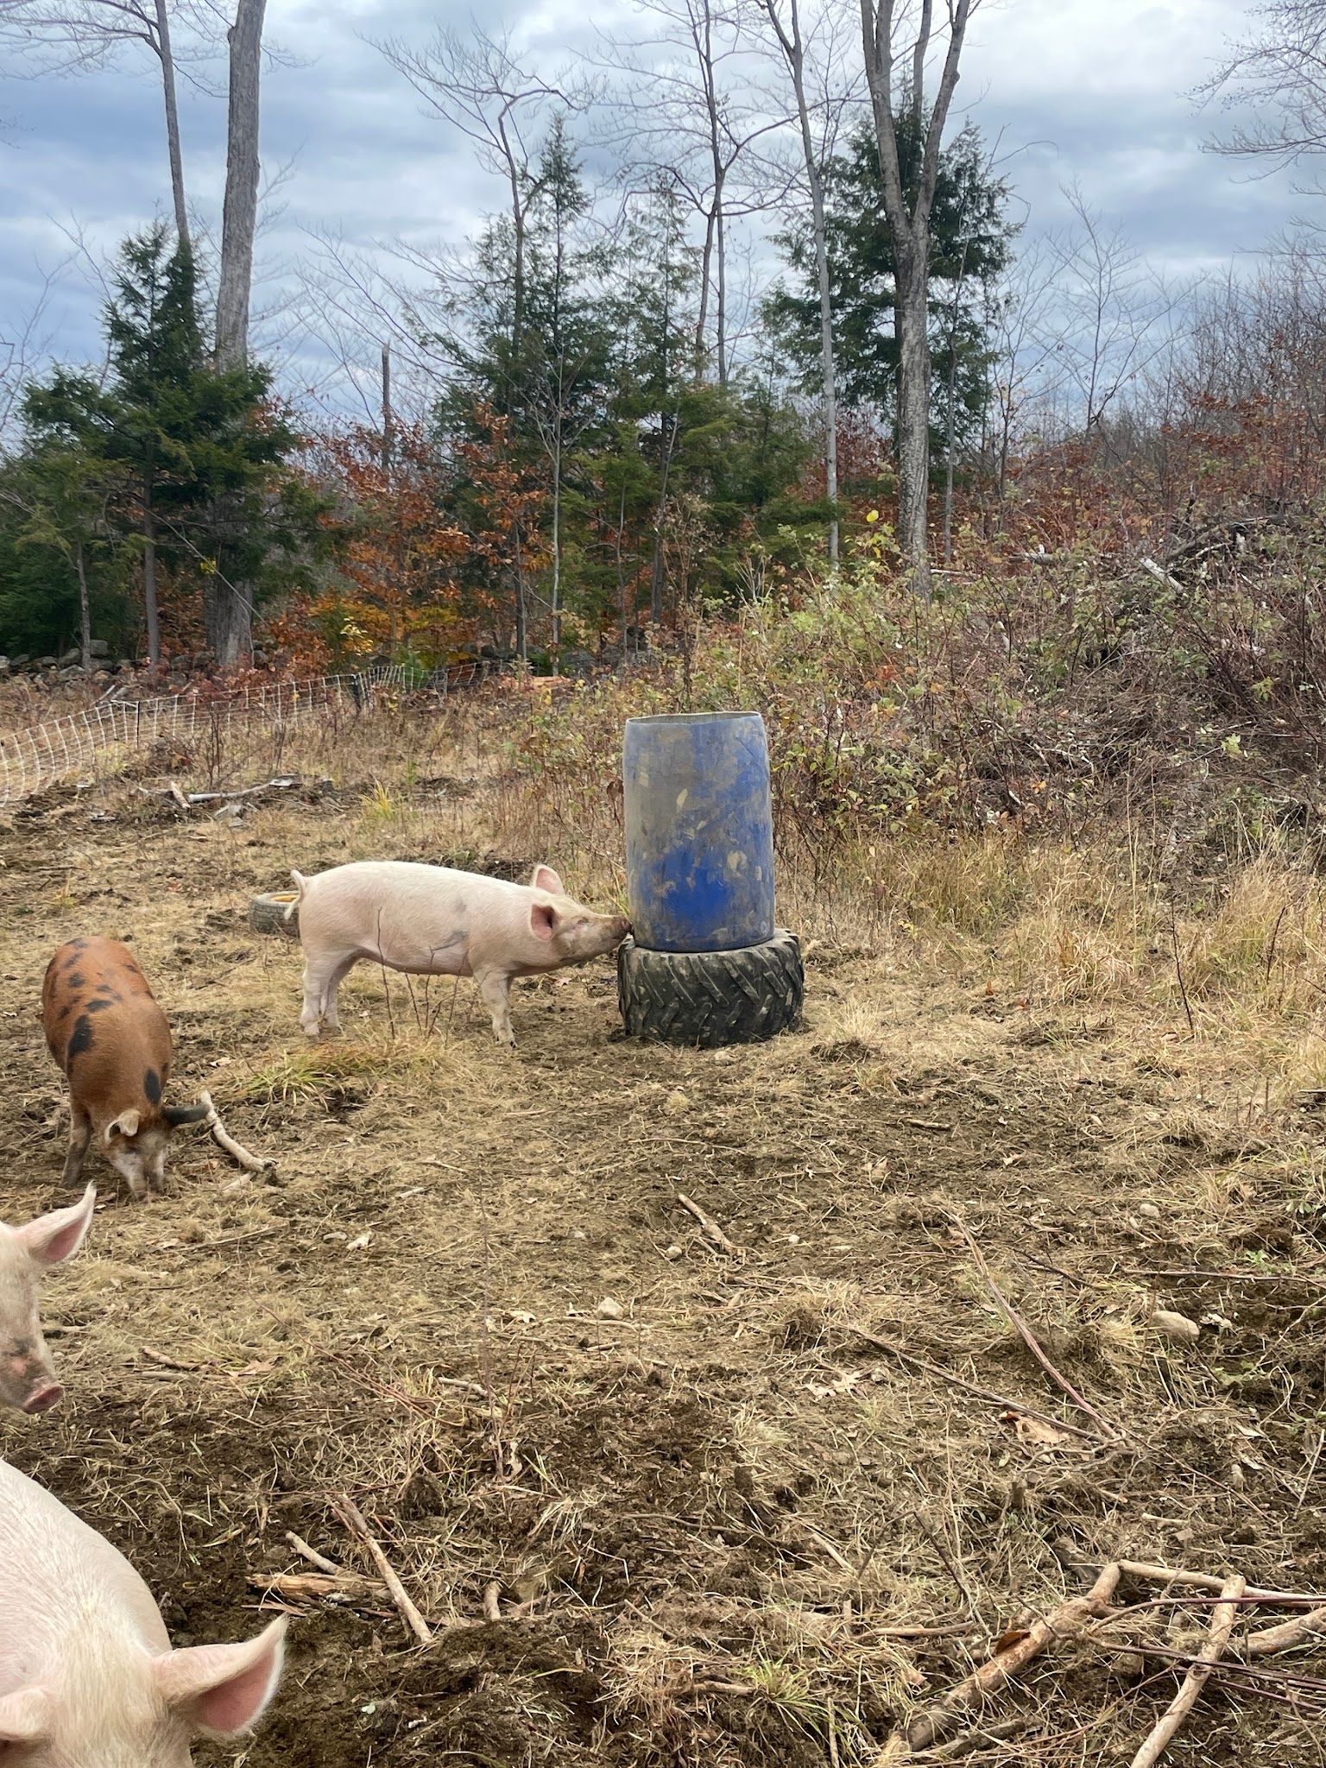
Project Objectives
Evaluate Vegetation and Soil Changes Due to Pig Grazing
To measure the impact of pig grazing on vegetation structure, species composition, and soil health in previously underutilized pastures. Specifically, we will:
  Quantify changes in vegetation cover, species diversity, and bare ground within paddocks over a 3.5 month grazing period
  Assess soil compaction, organic matter, and macronutrient levels before and after grazing in each paddock using standardized soil tests.

Slide 7
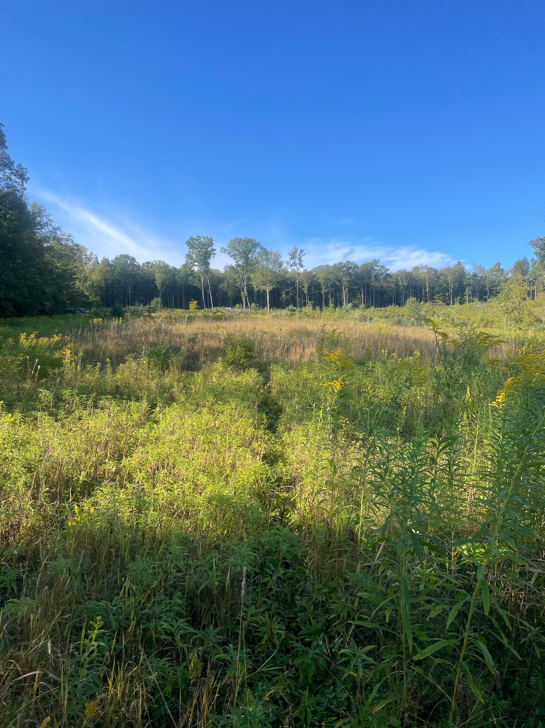
Project Objectives
2. Compare Vegetative Recovery Rates at Varying Grazing Intensities
To compare the rates of vegetation regrowth and ecosystem recovery under different grazing intensities. We will:
  Use two paddocks with similar initial vegetation: one grazed to a 25% impact level and the other to 50%.
  Document differences in vegetation recovery visually (via images) and quantitatively (via species composition and coverage data) to inform best practices for pasture restoration.

Slide 8
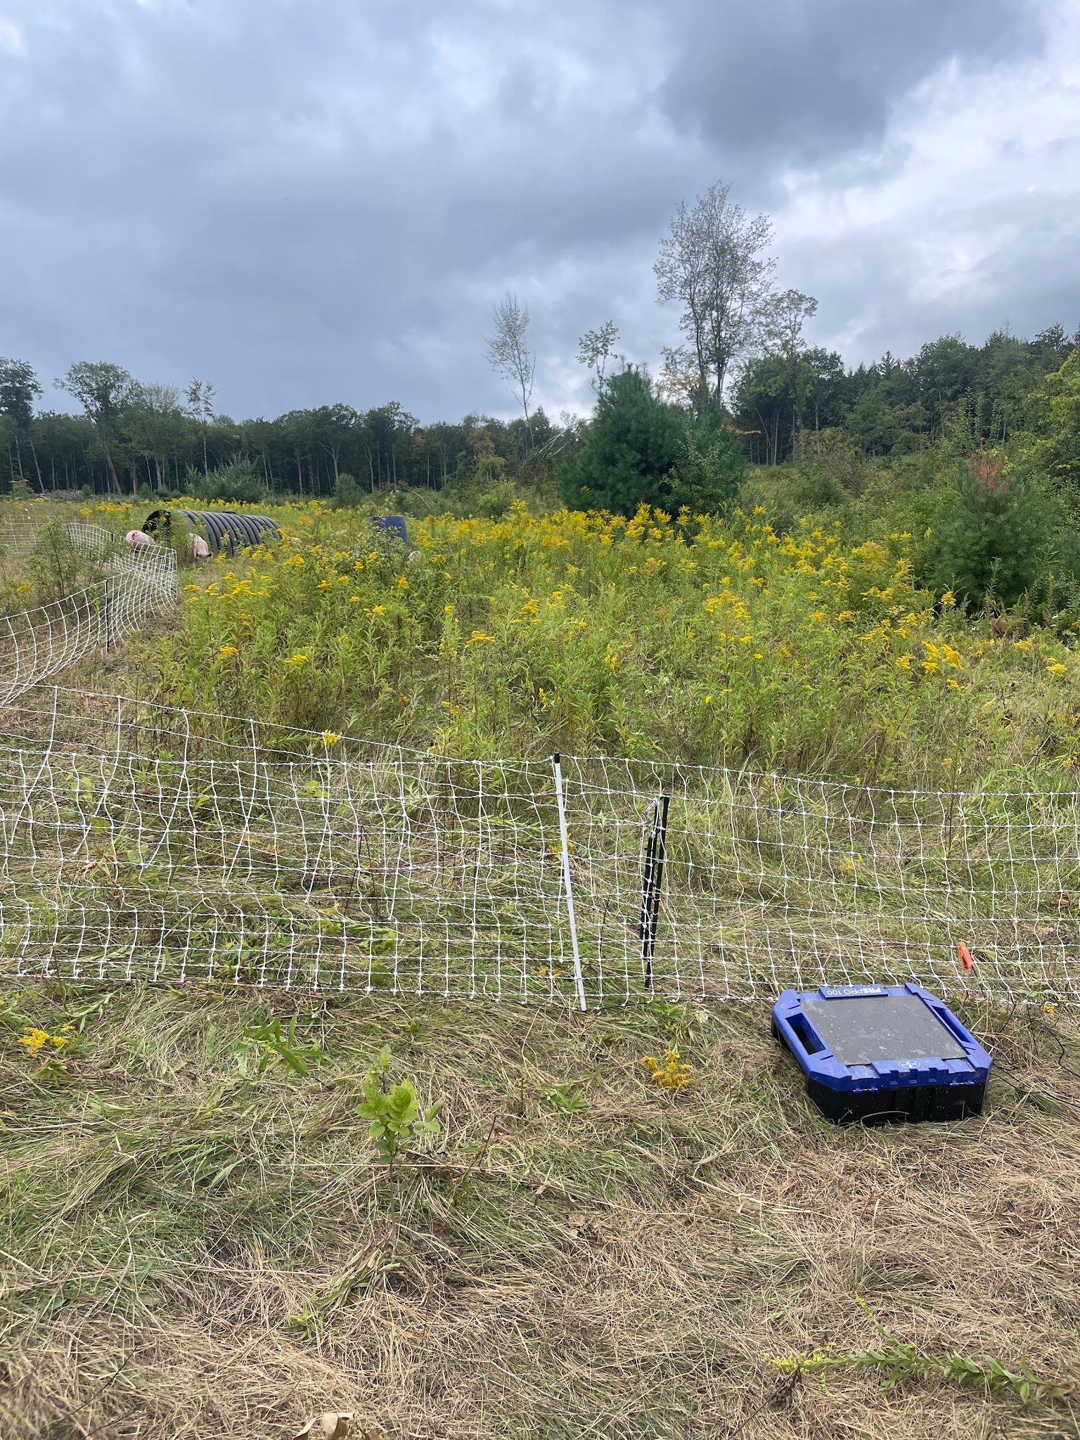
Project Objectives:
3. Analyze the Effects of Rotational Grazing on Soil Quality and Biodiversity
To evaluate whether rotational pig grazing can enhance soil quality and biodiversity over time. Specifically, we will:
  Use ANOVA to analyze changes in soil organic matter, bulk density, and nutrient levels across low and high-traffic zones within paddocks.
  Conduct ANOSIM tests to assess differences in plant community composition between areas with different grazing intensities.

Slide 9
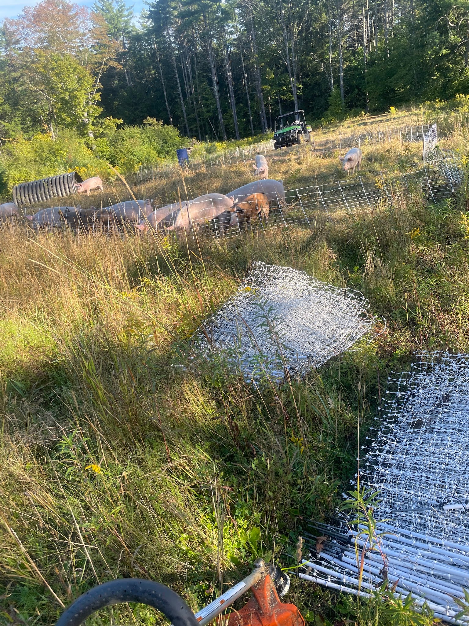
Project Objectives:
4. Identify Best Management Practices for New Farmers in Pasture Restoration Using Pigs
To develop actionable guidelines for integrating pigs into pasture renovation, balancing productivity and conservation. We aim to:
  Share preliminary results through a field day, where attendees can observe paddock rotations, sacrifice area management, and soil monitoring methods.
  Create accessible resources, including handouts, online updates, and an article summarizing results, so other farmers can consider similar strategies.

Slide 10
Methods/Materials:
Initial soil samples and vegetation surveys of the planned grazing area were obtained in June 2025.
Beginning in August 2025, pigs were grazed in 300-600' perimeter paddocks through the land that was cleared in 2022. Paddock size was dependent on topography and vegetation. Soil samples and vegetation surveys were conducted by Kristen Jovanelly, and the farmers did not have any indication of where the areas were, so no intentional decisions on paddock placement were based on those coordinates.
Premier1 hog fencing in 100' lengths with solar energizer was used, with varying levels of success at containment. It was necessary to use a brush saw or weedwhacker to clear an area for each fence line prior to setting it up, to avoid grounding out this fencing. Since this pasture area was 1/4 mile through the woods from our water source, access to the field with a UTV was necessary to haul water out and move the housing. For shelter, we used a plastic drainage culvert cut in half, and were able to flip it over and drag it with the UTV between each pasture move. Water was provided by a 50 gallon food grade barrel with hog nipple installed.

Slide 11
Methods/Materials:
Paddocks were moved every 3-6 days based on observable disturbance to soil. Effort was made to not impact any given paddock by over 50% reduction to vegetation or soil disturbance, with 25% preferred. Pigs were grazed in target area of study from August to mid November 2025. Pictures & videos of impact were obtained in most paddock areas and observations made. Final soil testing and vegetation surveys were conducted July 2026.
Changes to original methods included a later start on the project due to unavailability of piglets from our preferred source. The grazing timeframe in the target areas was shortened to 3.5 months. Drought affected the vegetation and how long each paddock was able to be grazed. Our original methods also detailed a "hub and spoke" type approach with a centralized area for housing and water, however we realized that this would disproportionately impact each quadrant and it was better to include their housing & water source with each paddock move.

Slide 12
Results Summary
Pig-mediated pasture renovation was associated with substantial changes in vegetation between 2025 and 2026.
Changes in vegetation abundance were accompanied by a pronounced shift in the kinds of plants making up the community. Across the site, grasses increased from approximately 11% to 32% of recorded abundance and legumes from approximately 2% to 9%, while woody/vine vegetation declined from approximately 15% to 8% and sedges/rushes from approximately 15% to 3%.
In contrast to these pronounced aboveground responses, measured soil properties remained comparatively stable between 2025 and 2026.
The results suggest that careful rotation and attention to the degree of ground disturbance may be critical to obtaining useful vegetation change while protecting the soil resource.

Slide 13
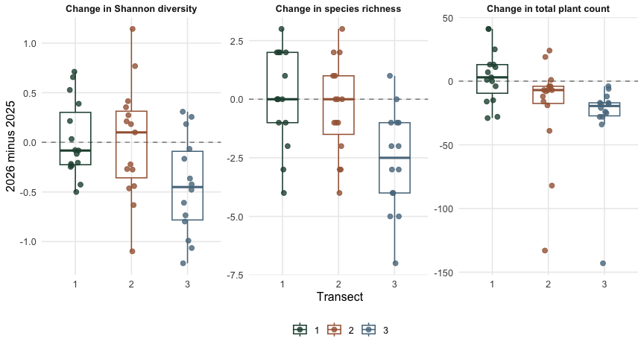
Figure 1. Spatial variation in vegetation change from 2025 to 2026. Points show the difference between paired 2025 and 2026 quadrats for Shannon diversity, species richness, and total plant abundance within each of three transects; values below zero indicate declines from 2025 to 2026. Boxplots summarize the distribution of paired changes, and dashed lines indicate no change. The magnitude of change differed significantly among transects for Shannon diversity (Kruskal–Wallis p = 0.045), species richness (p = 0.006), and total plant abundance (p = 0.002).

Slide 14
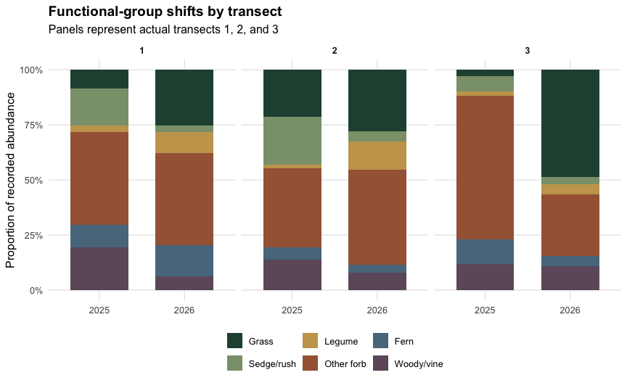
Changes in vegetation functional-group composition from 2025 to 2026 across three pasture transects. Bars show the proportional abundance of grasses, legumes, sedges/rushes, forbs, ferns, and woody/vine vegetation in each year. Responses varied spatially, but the overall pattern included greater representation of grasses and legumes and reduced representation of woody/vine and sedge/rush vegetation in 2026.

Slide 15
Soil metric | Median 2025 | Median 2026 | Median_change 2026-2025 | Paired Wilcoxon Statistic | p_value
pH | 6.210 | 6.480 | 0.130 | 71.0 | 0.551
Organic matter (%) | 7.787 | 8.606 | 0.000 | 56.0 | 0.851
Available P | 1.550 | 1.850 | 0.300 | 71.0 | 0.551
K | 91.000 | 81.000 | -10.000 | 44.0 | 0.379
Ca | 1375.000 | 1869.000 | 405.000 | 79.0 | 0.293
Mg | 256.000 | 338.000 | 26.000 | 65.0 | 0.451
S | 10.000 | 6.500 | -1.000 | 53.5 | 0.733
CEC | 10.977 | 13.990 | 1.081 | 87.0 | 0.132
Soil properties measured at paired sampling locations in 2025 and 2026. Values show median soil conditions in each year and the median paired change (2026 − 2025). Differences were evaluated using paired Wilcoxon signed-rank tests. None of the measured soil indicators differed significantly between years (p > 0.05).

Slide 16
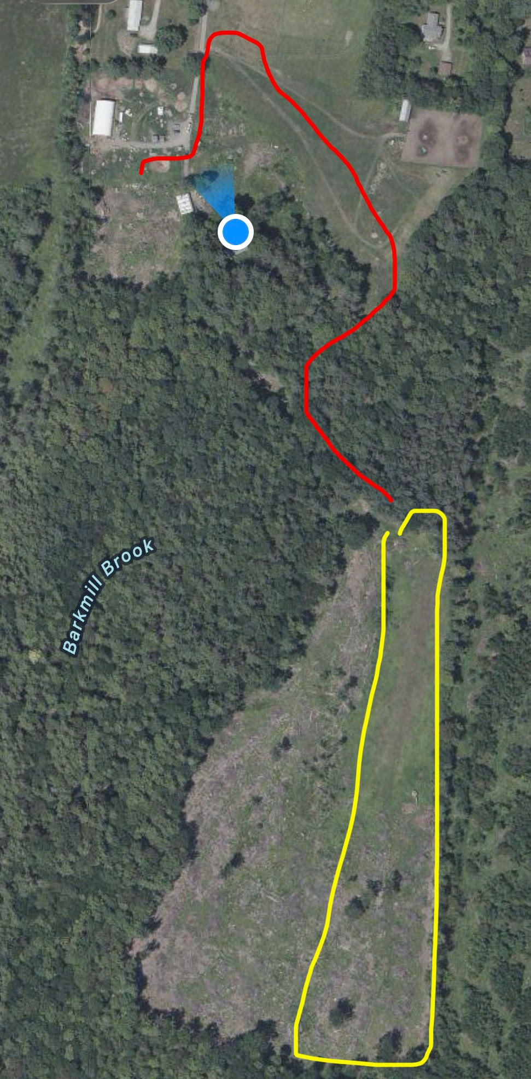
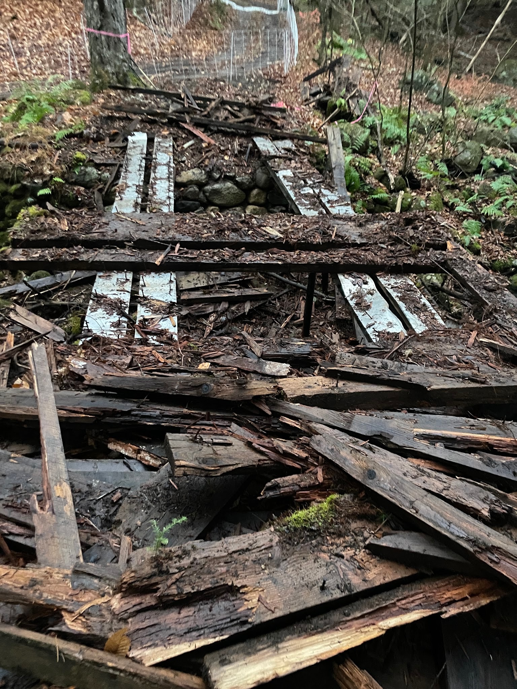
So.
Many.
Challenges!
One of the difficulties we faced in executing this project was unique to our particular property.
Red=route to the study area
Yellow=study area
This is normally a very easy drive in our UTV, but approx 6 weeks into the project, the bridge across Barkmill Brook gave out. We knew it was on its last legs and had avoided taking tractors across it, but the extent of the rot revealed itself and we were pretty lucky no one had gotten hurt driving across it while it was in use.
This meant that twice a day, we had to ford the brook in the Gator to check and feed the pigs and haul water. Since the project extended until mid November, sometimes this was in the dark…for extra excitement.

Slide 17
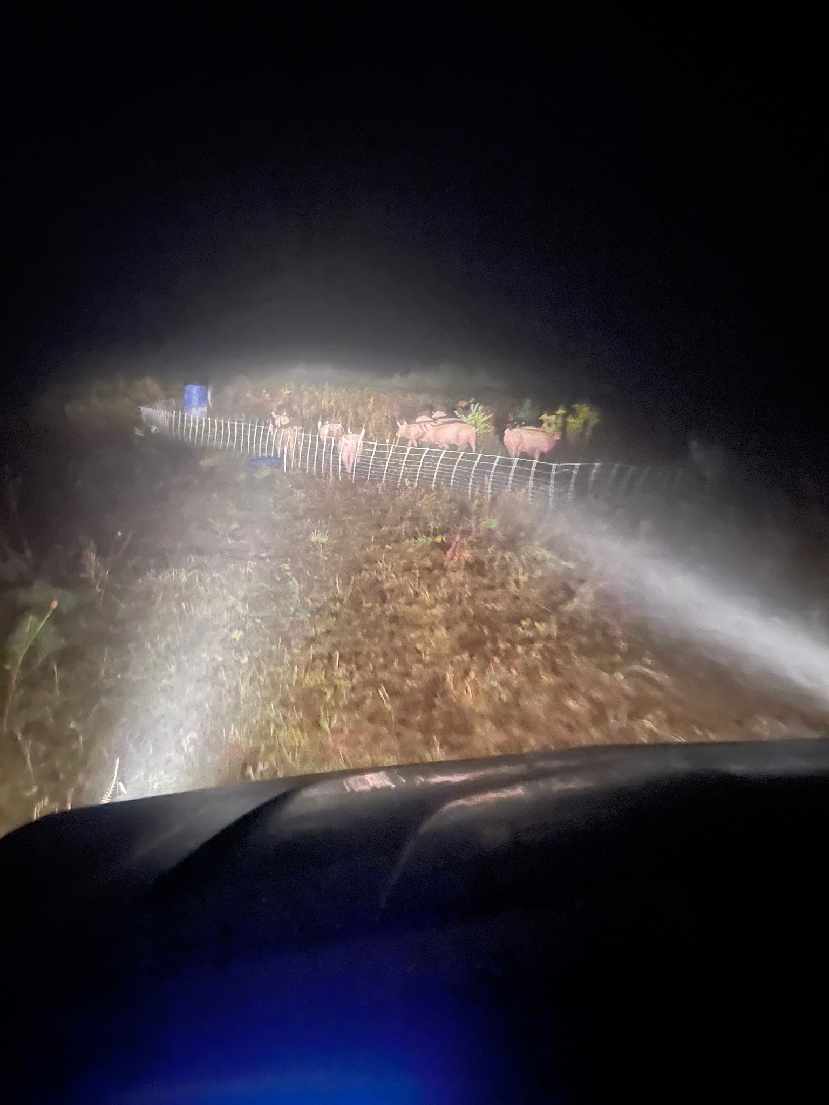
How to level up your spooky season:
Go to feed your squealing pigs alone, after dark, in the mist, way back in the woods where no one can hear if you scream for help.

Slide 18
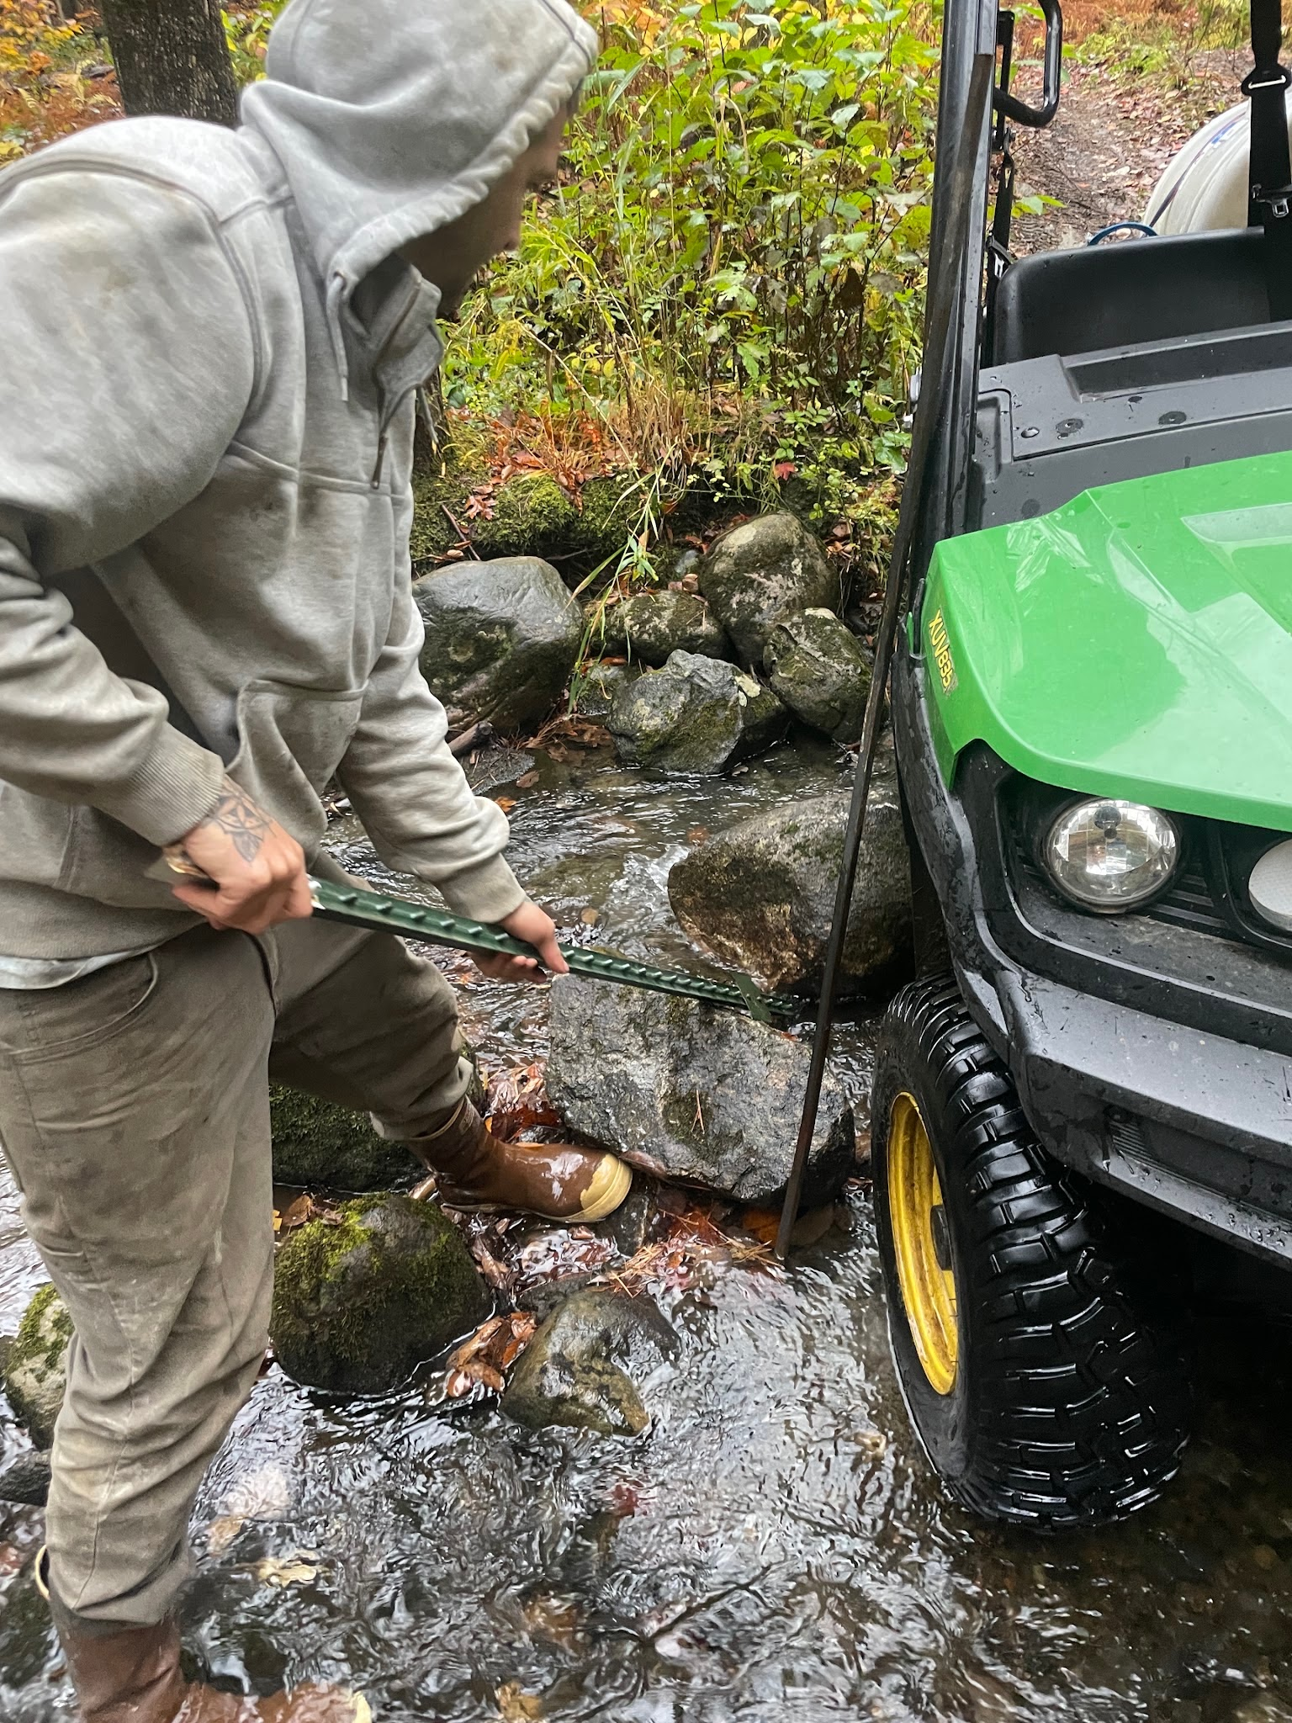
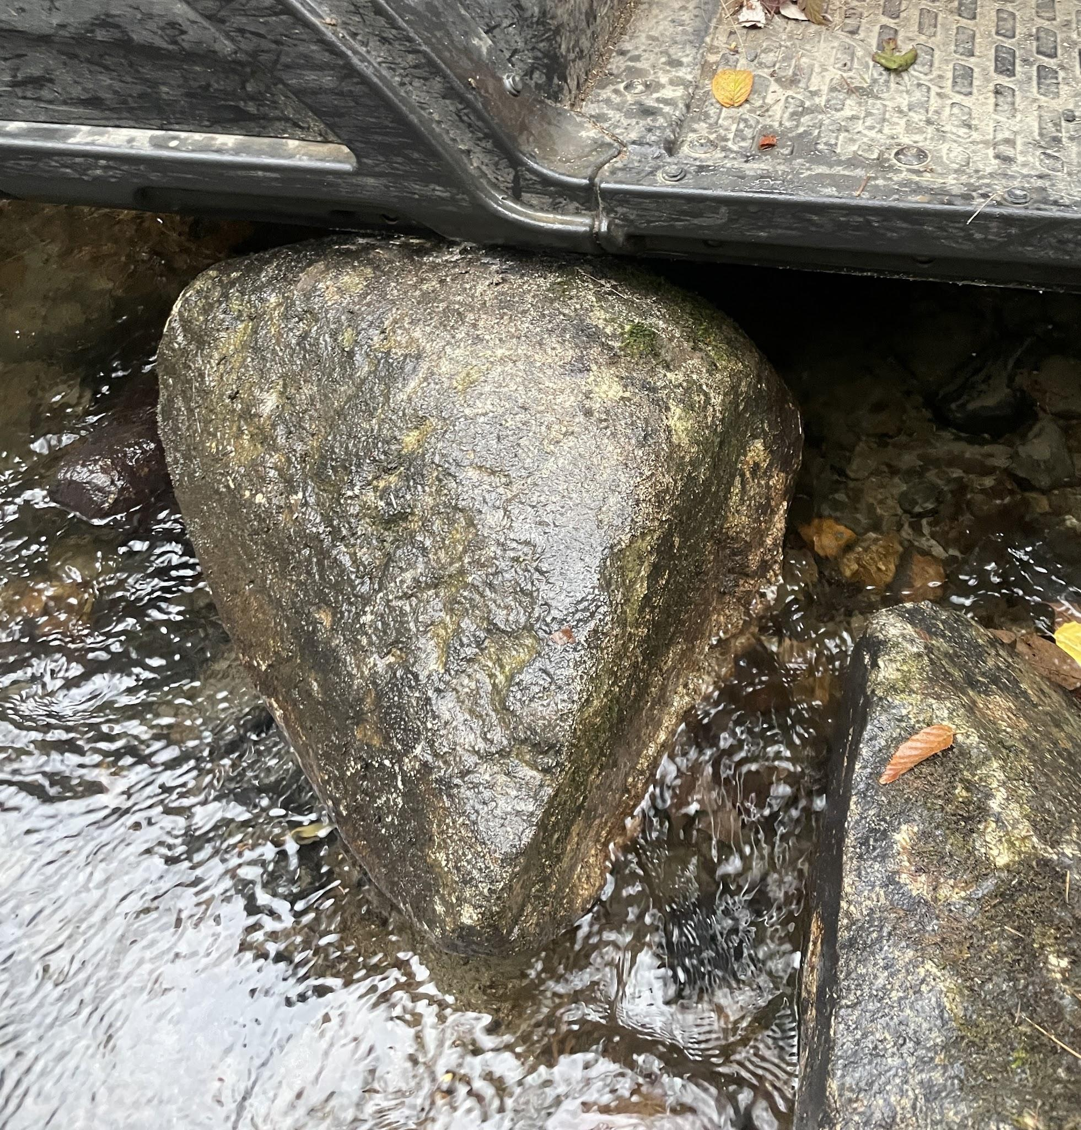
Special mention to this rescue mission in particular
Nothing says “dedication to science” like having to call your resident project cooperator (technical SARE lingo) / spouse to unwedge the Gator off a rock in the brook when things got slippery in the rain.
The skid plates on that thing worked very hard last fall.

Slide 19
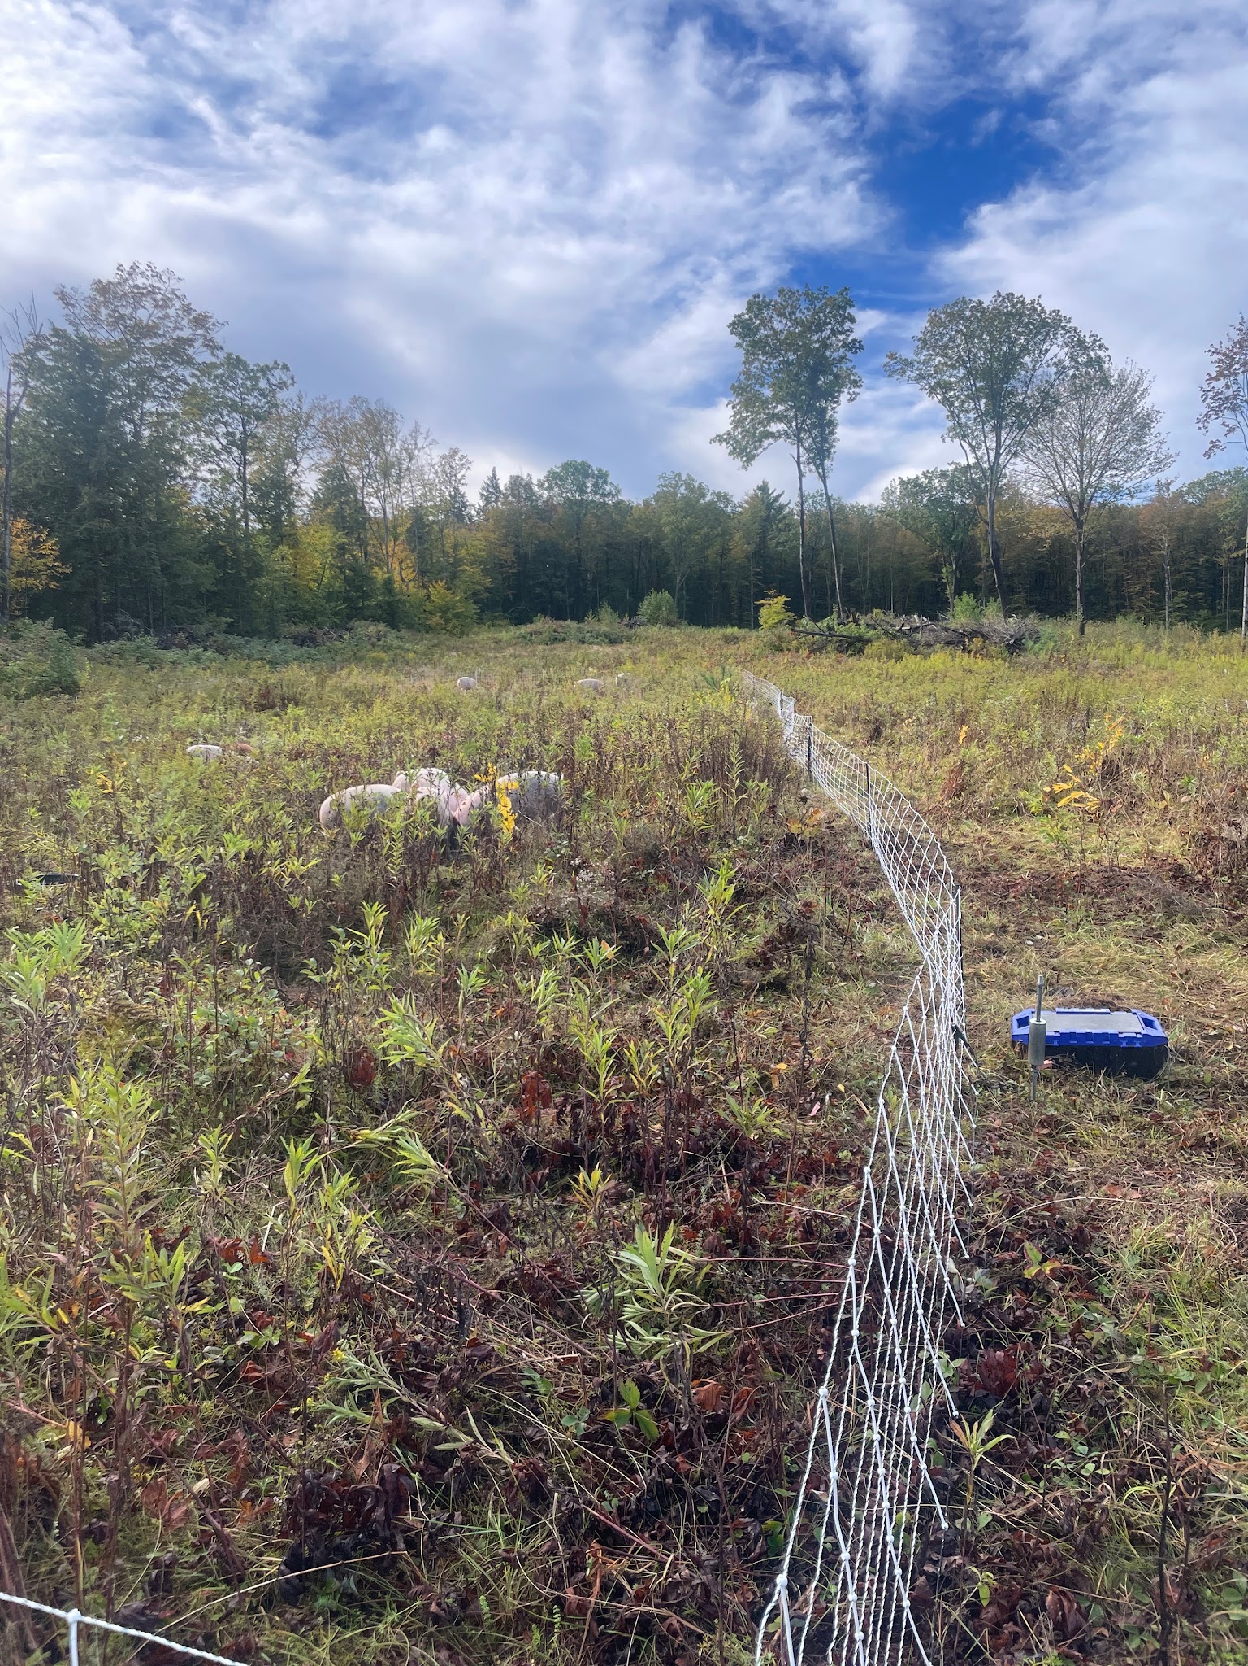
Fencing complications
We chose to use Premier1 mesh fencing for its ease of setup. Three types were used: piglet, and 2 sizes of their hog net. There were pros and cons to each.
Ultimately, the 10/24/12 Hognet was our favorite **once we understood how to connect it properly**
The 10/24/12 Hognet can be set up as pos/neg or pos/pos so we initially had some escapes and frustration due to accidentally grounding out the fence ourselves, because it was unclear on how we should connect it to different types of fencing.

Slide 20
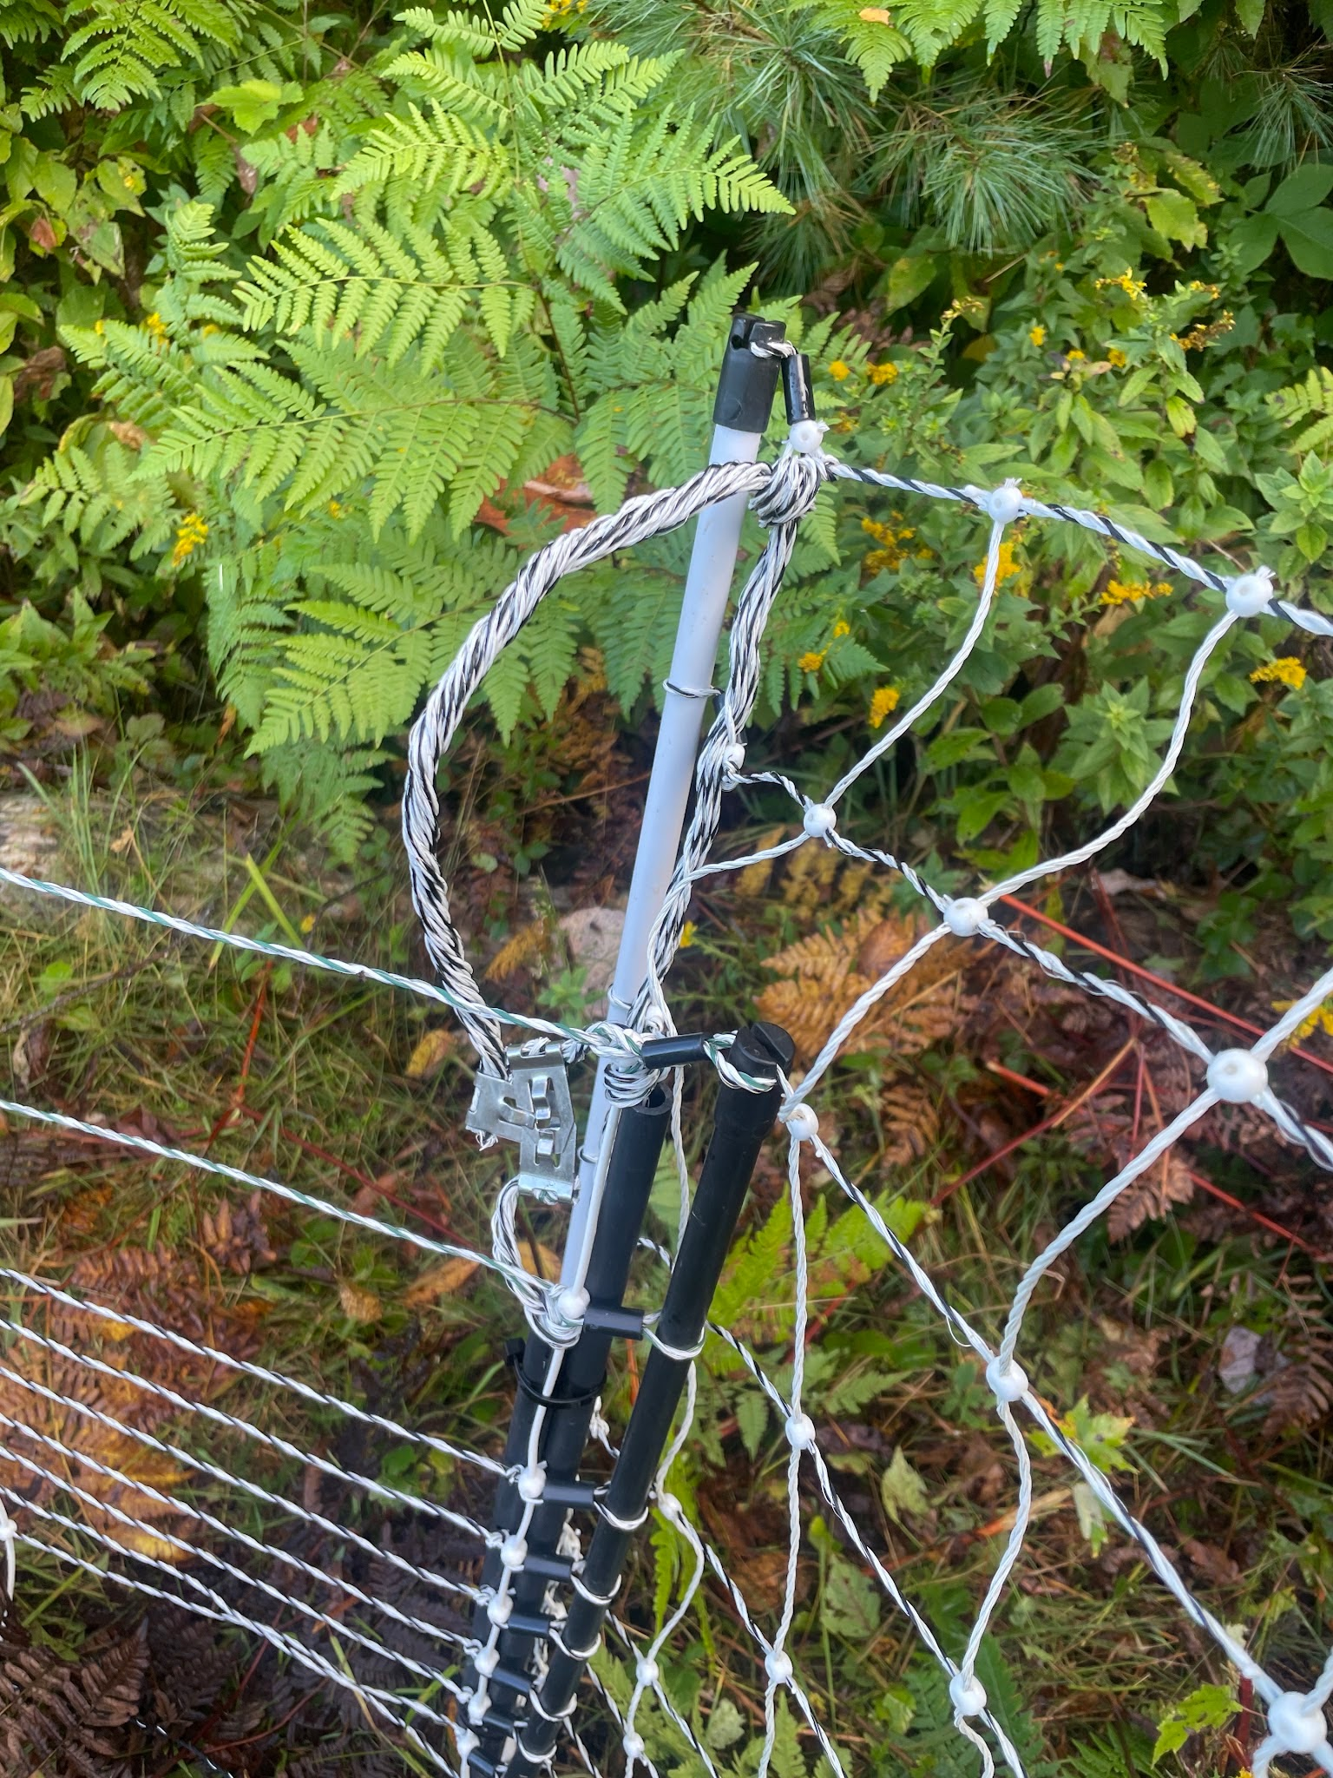
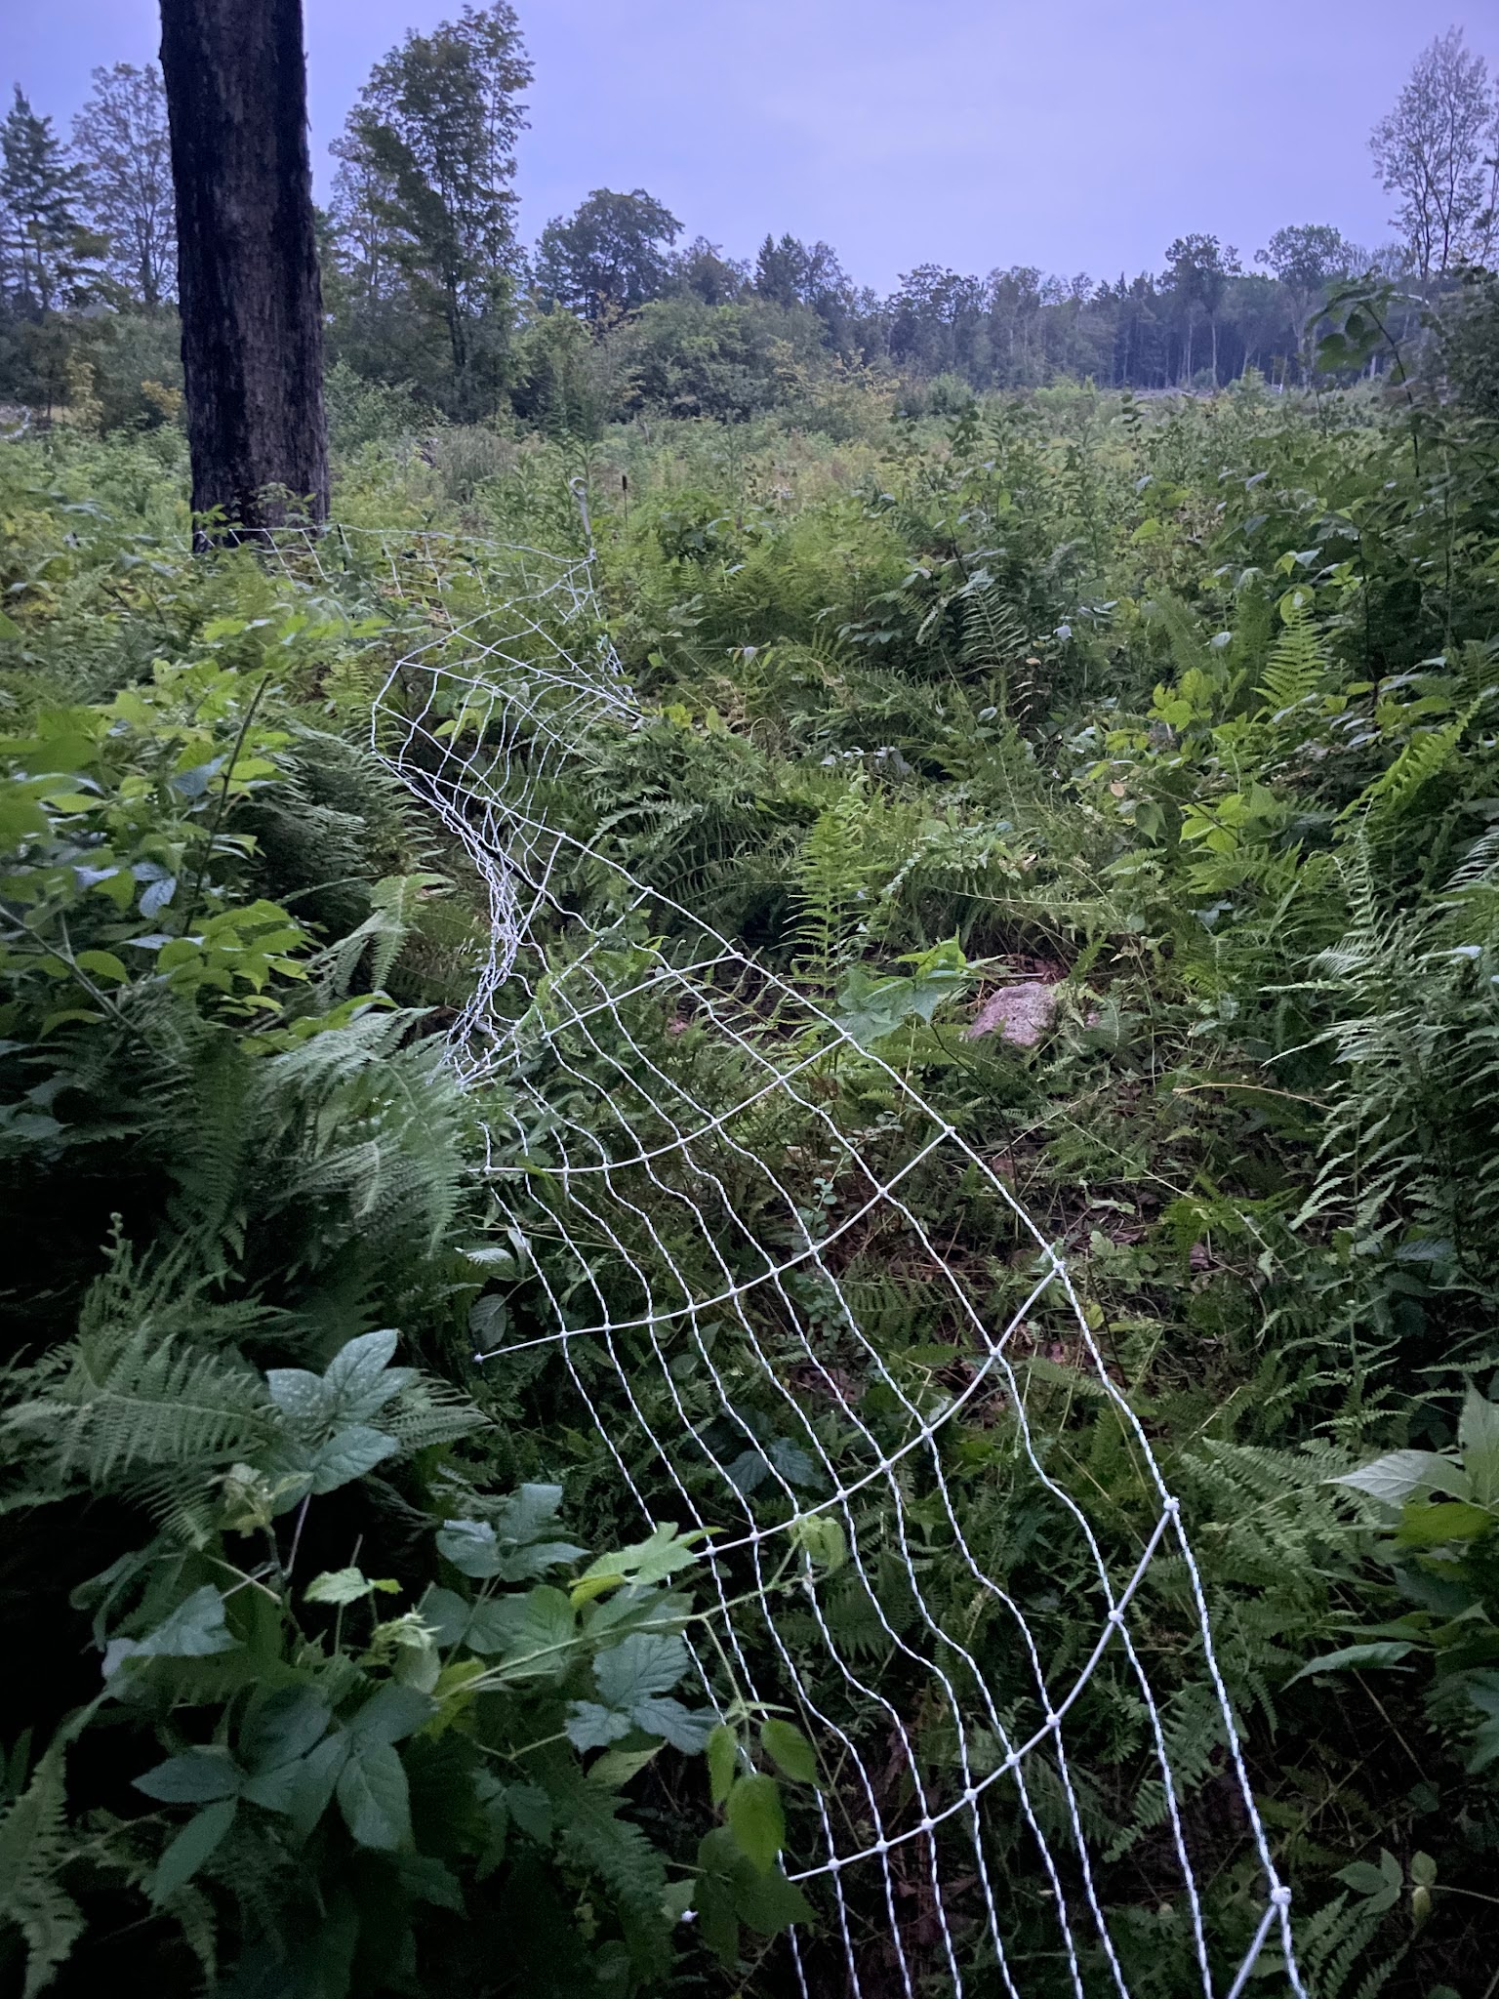
Fencing complications
Here’s a connection of 30” piglet fencing to the 10/24/12 Hognet.
The pos/neg ends of the Hognet are clipped together, with the Piglet fencing connected to it after.
Also shown: the chaos that can result from not knowing how to hook up your fence correctly.

Slide 21
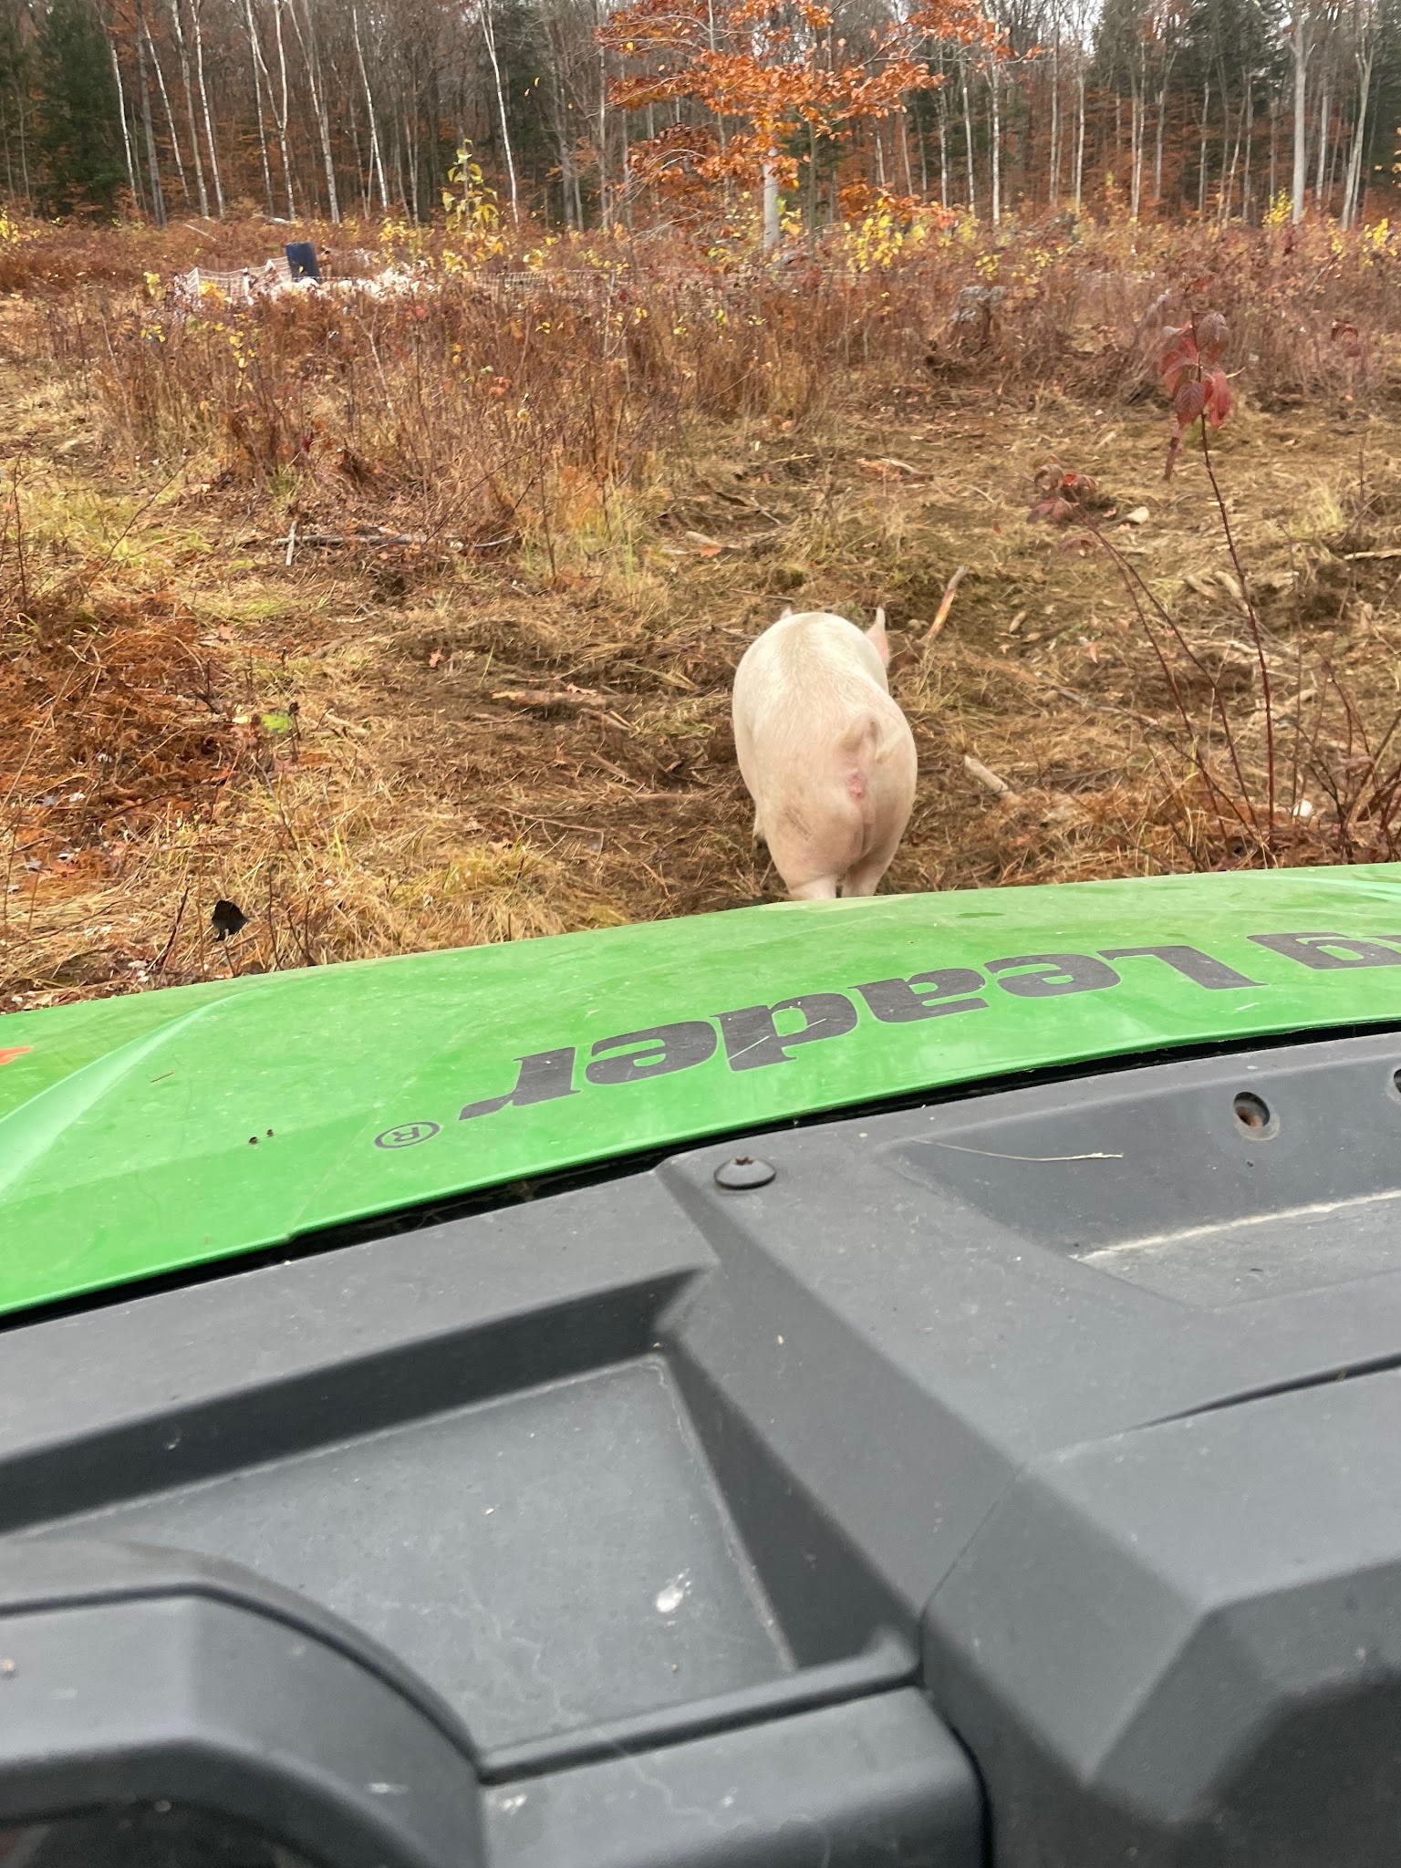
Fencing complications
Other downsides to net fencing: It is really easy for the pigs to root and throw sticks and mud onto the net, dragging it down and grounding it out. This became a popular activity for them in the fall!
Another easy escape from net fencing activity: Tossing the smaller pigs into the fence to take the shock, then running over them.
Overall, the decision to use net fencing was a hassle, but the ease of moving it when pigs were rotated every 3-6 days was hard to beat. With 2 people, we could have a new area (with brush sawing fencelines!) set up in 1-1.5 hours.
If anyone has a simple and portable method to do single or double strand polywire that is pig proof and can tolerate that many moves and be set up as quickly…we would love to hear about it.

Slide 22
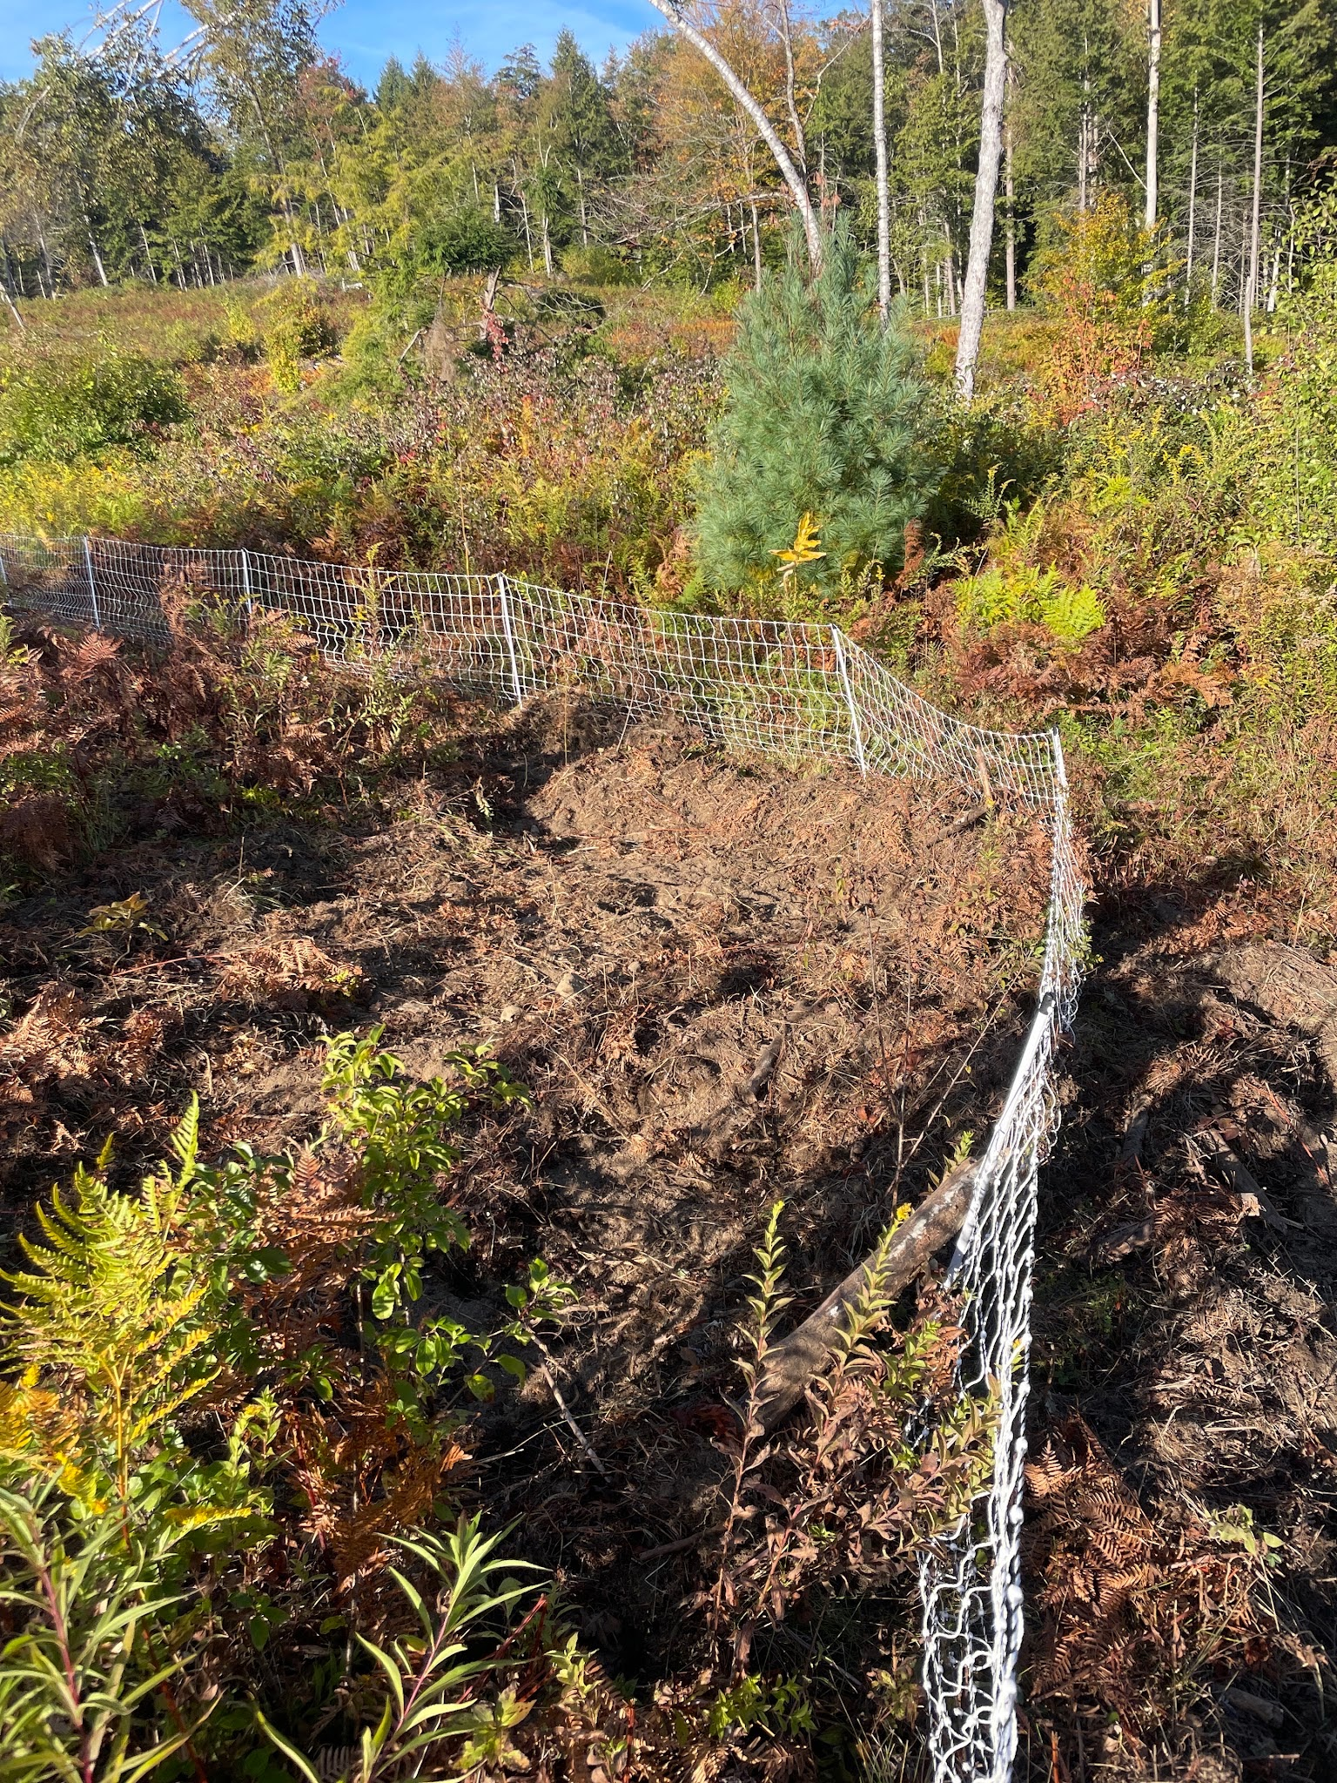
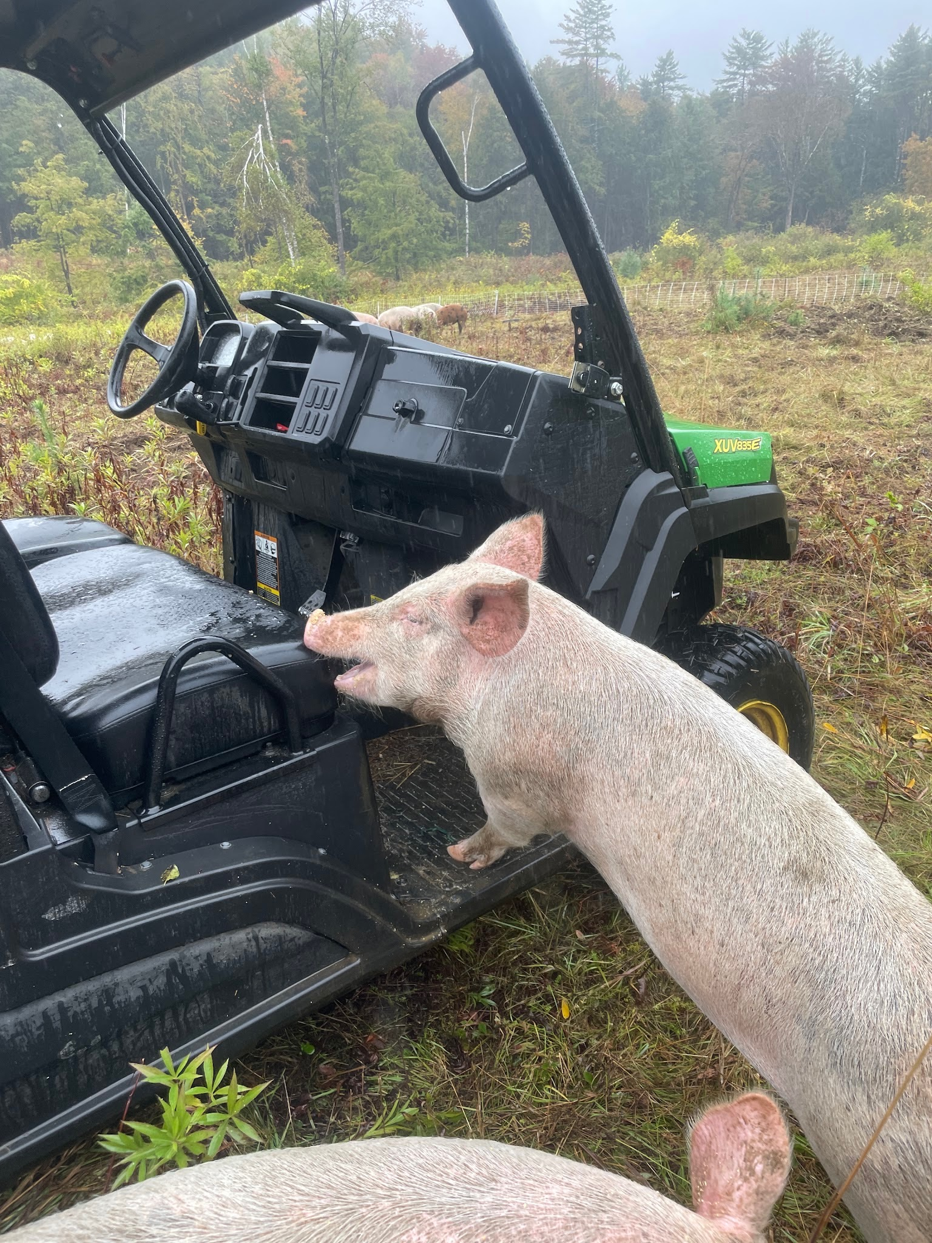
Excellent example of rooting in the corners and grounding out the fence
But what else can you expect from these absolute MENACES

Slide 23
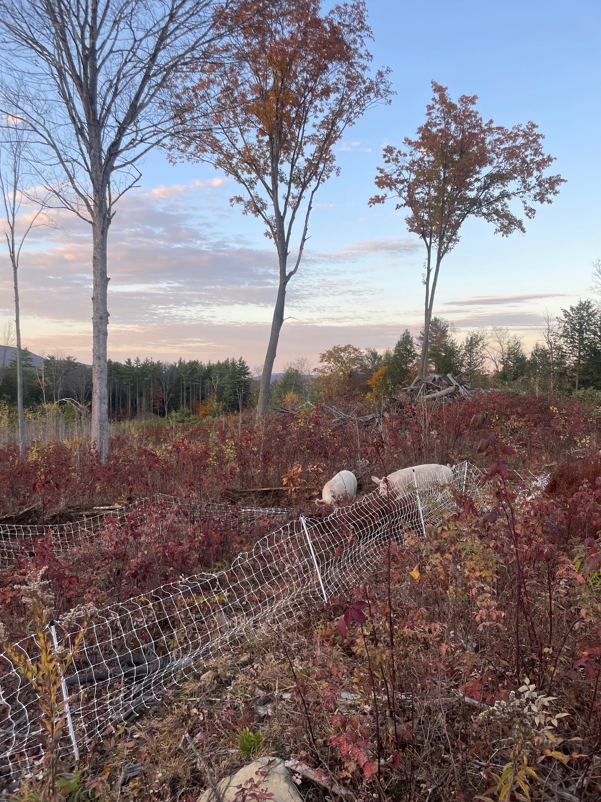
With all that said, here’s why we’ll do it again….
Fall 2025

Slide 24
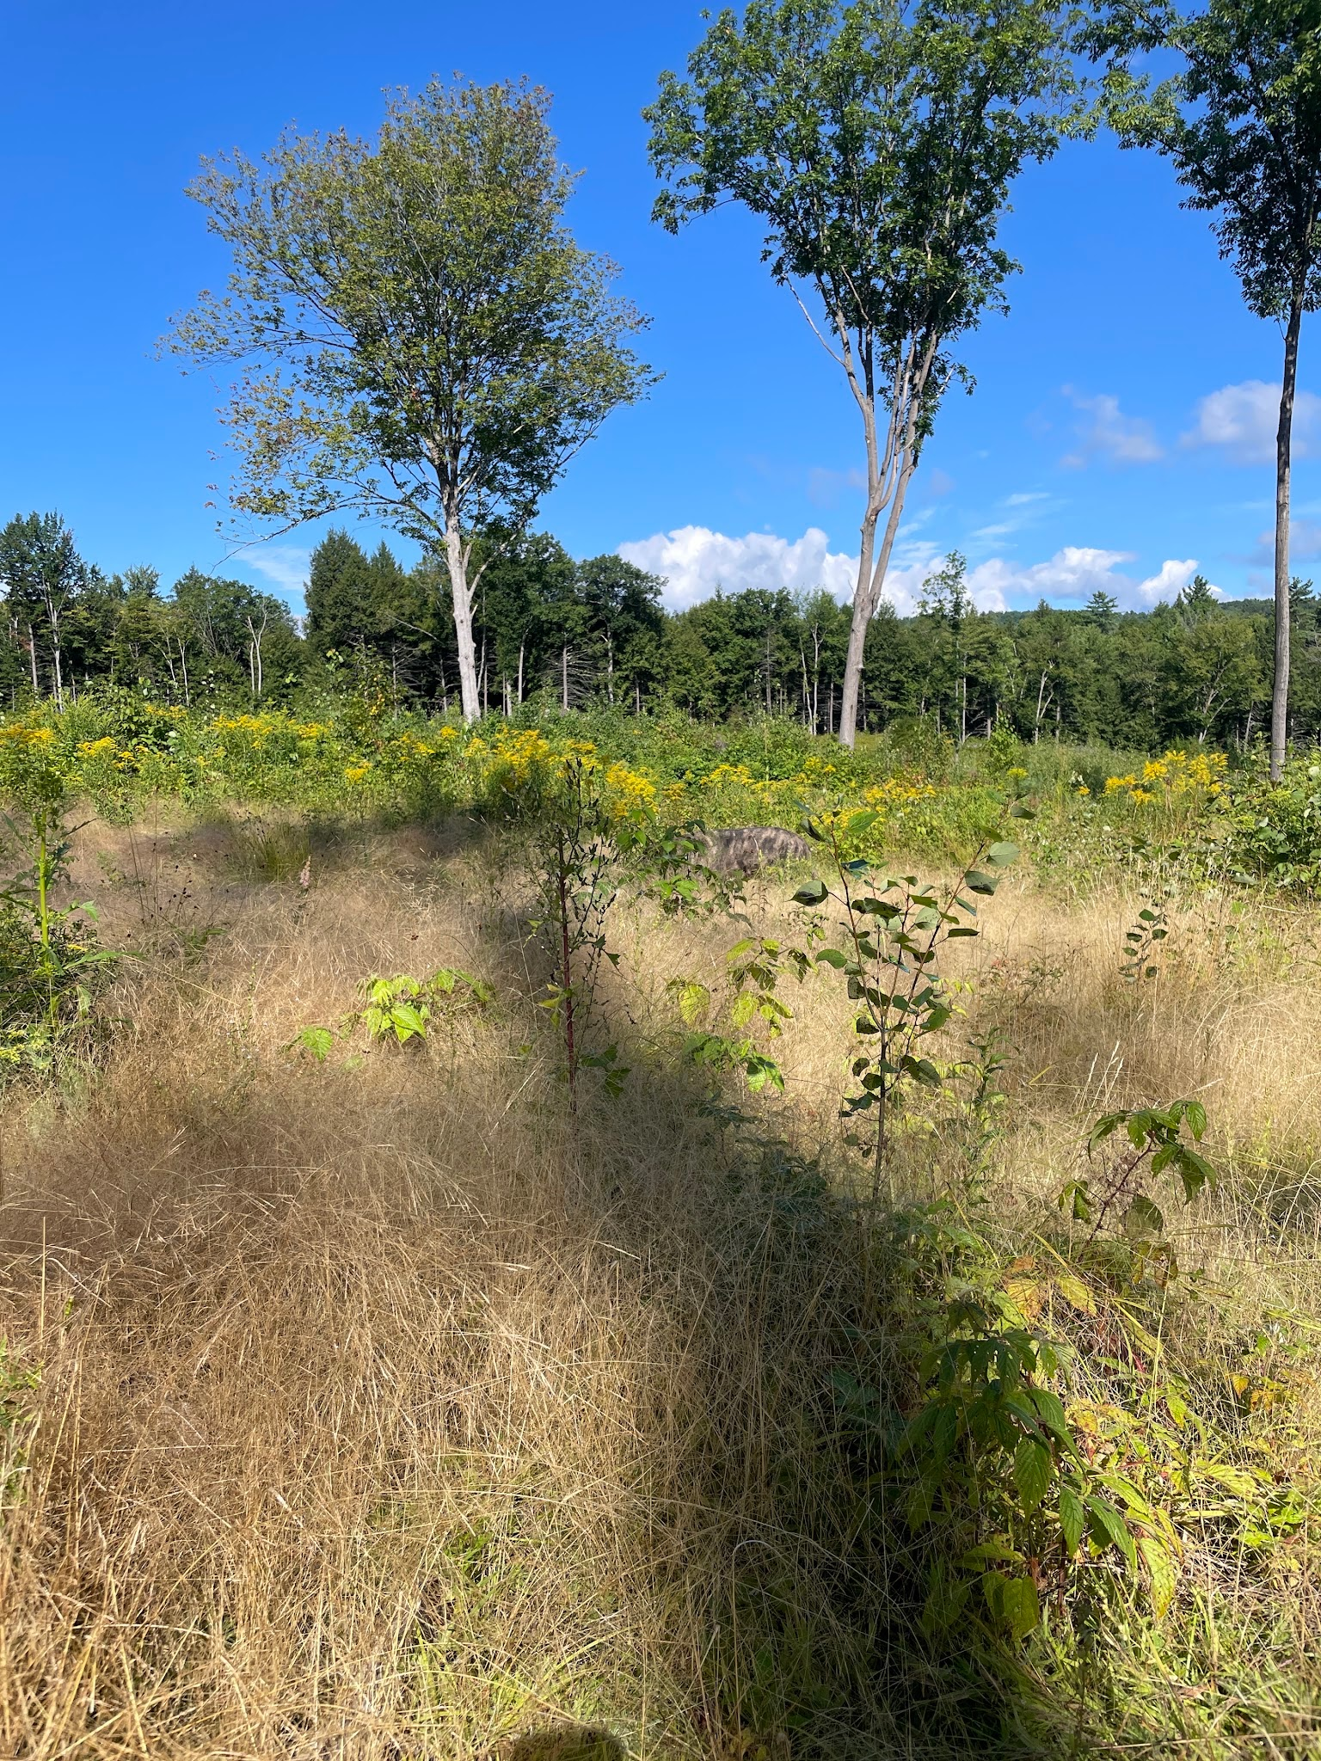
Summer 2026!
After 3.5 months of pig impact, the vegetation change is very noticeable

Slide 25
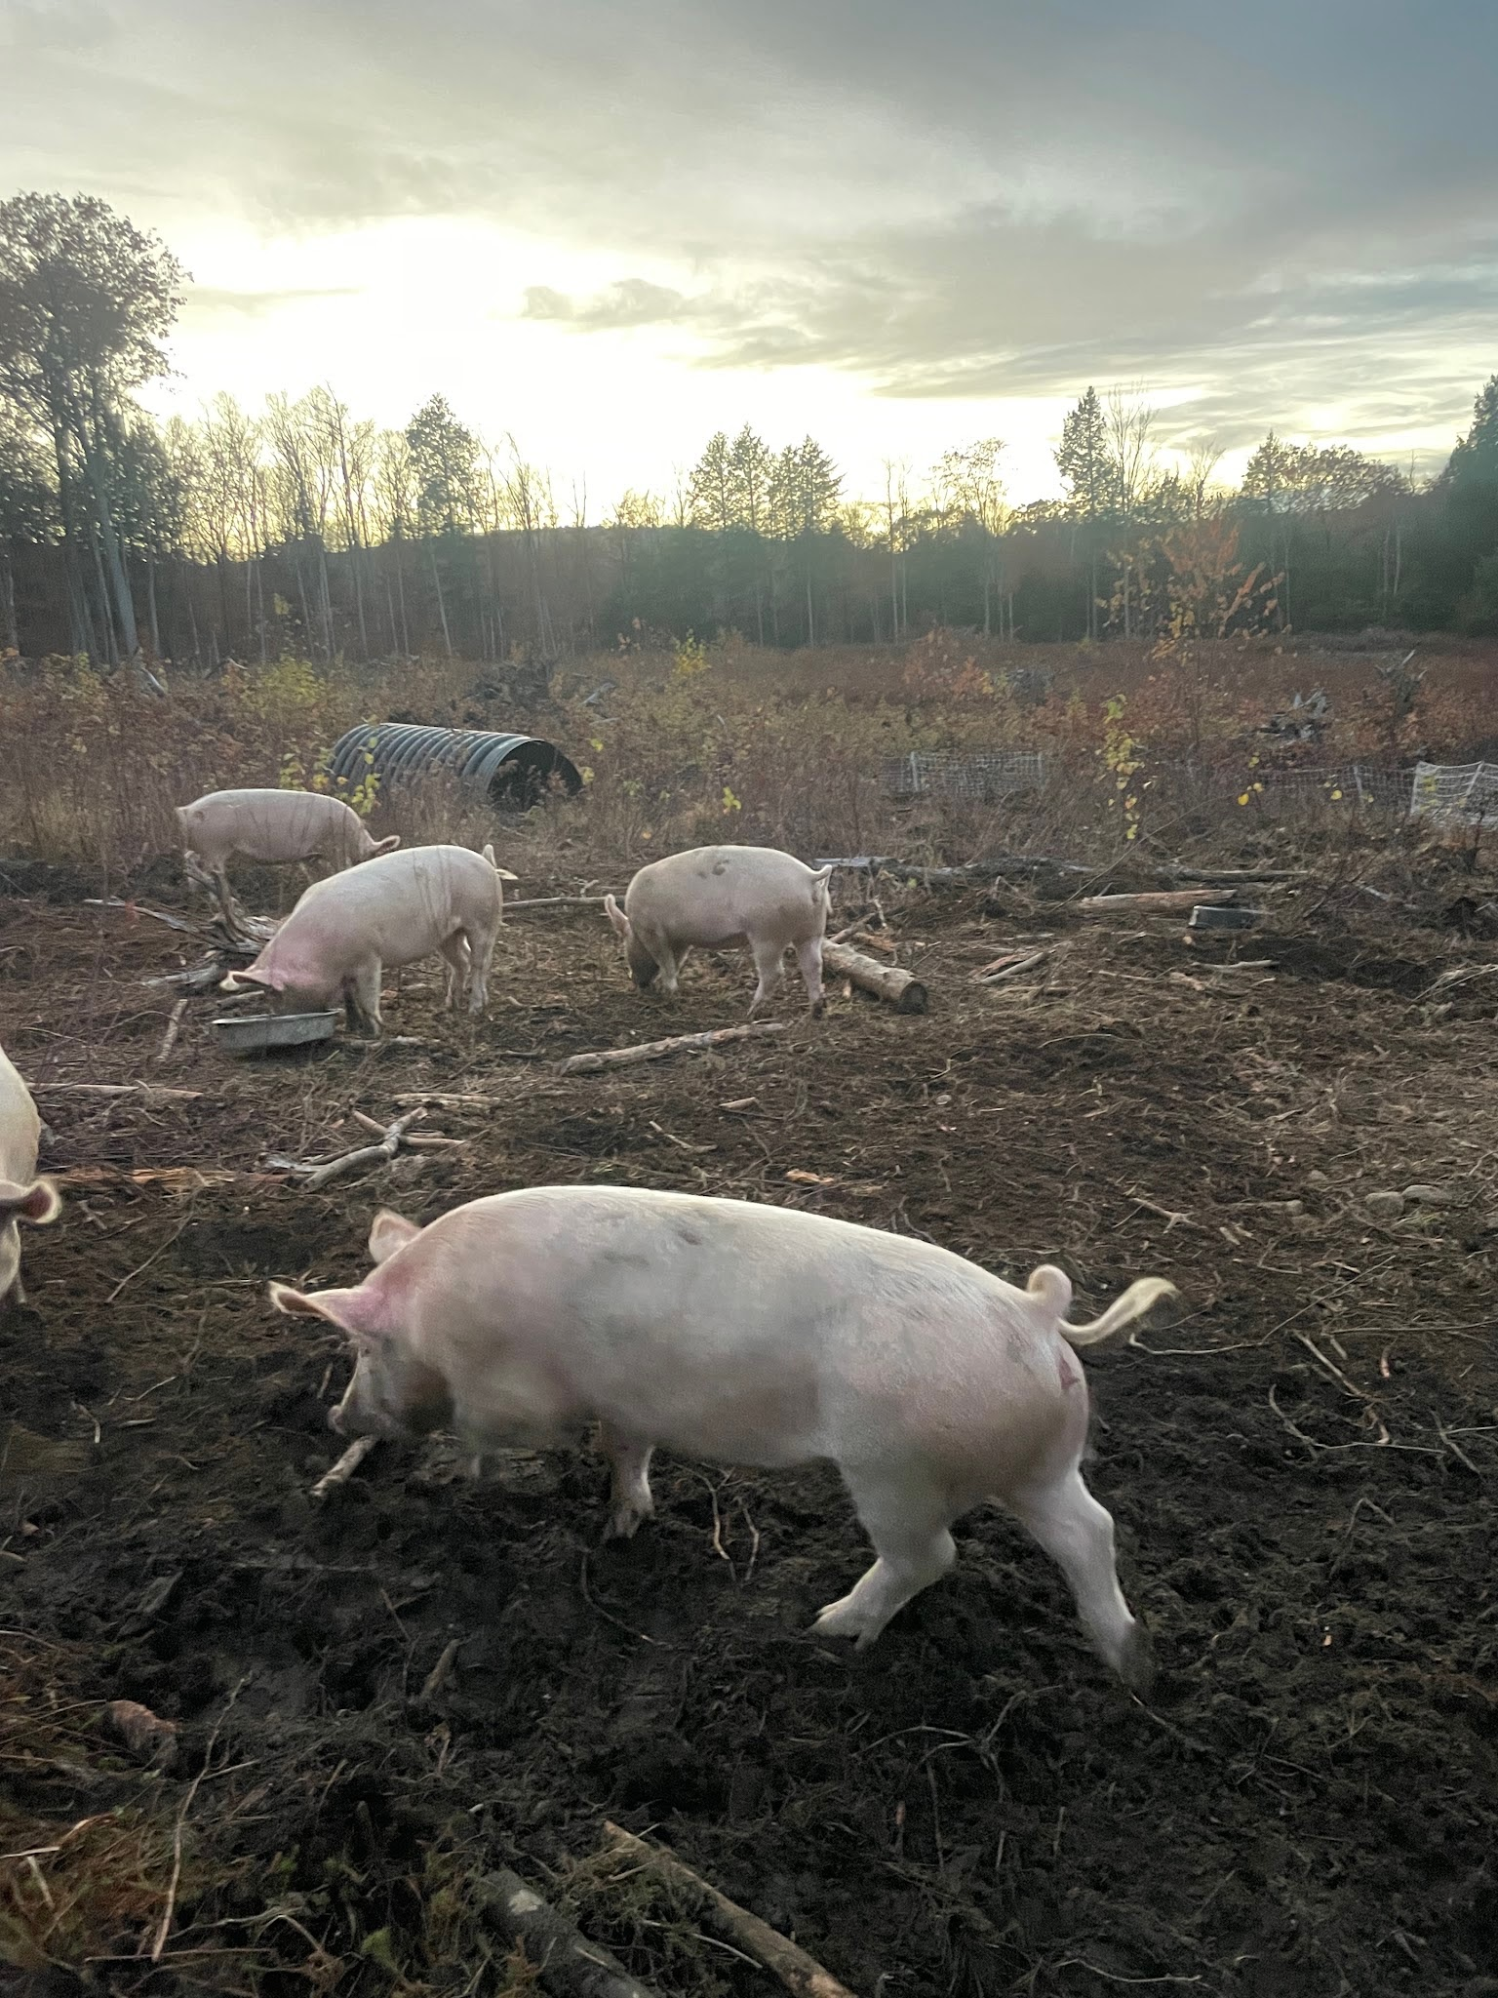
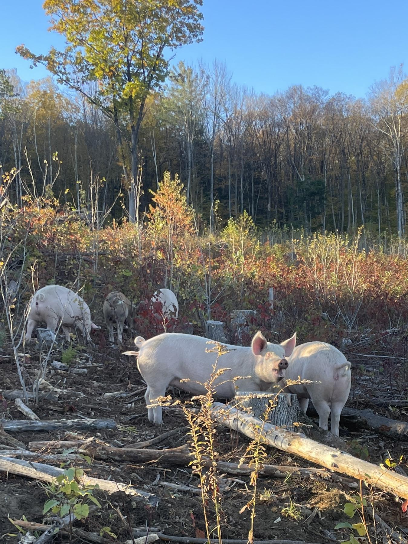

Slide 26
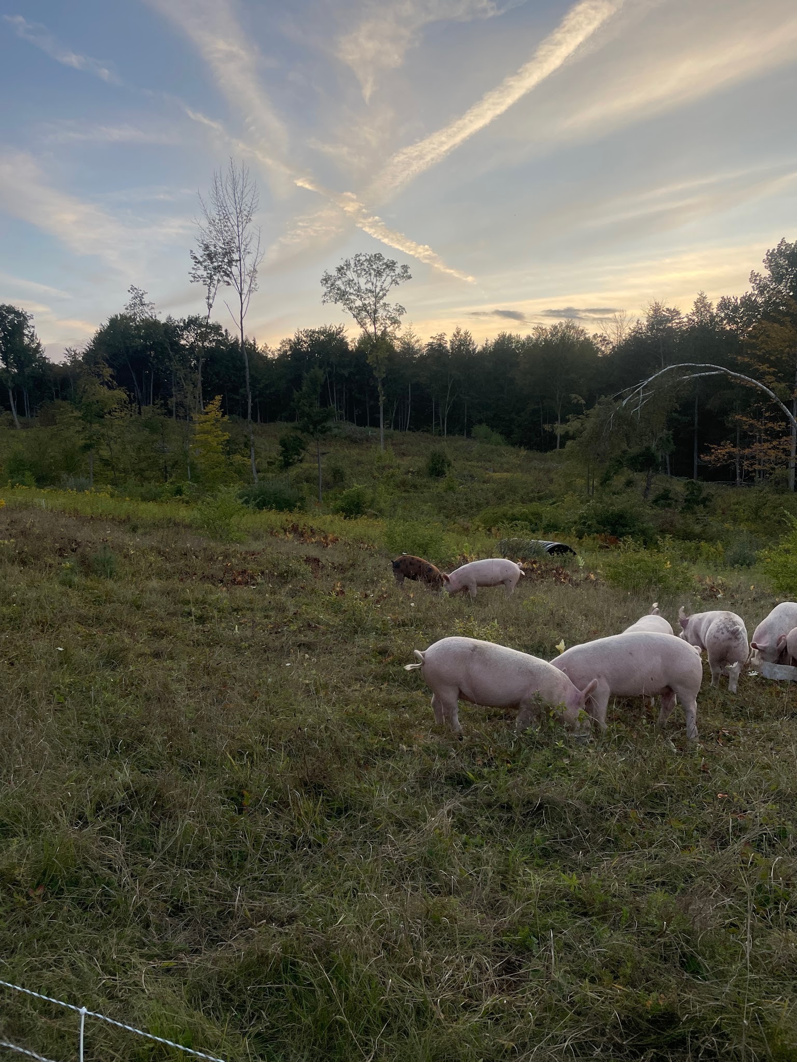

Slide 27
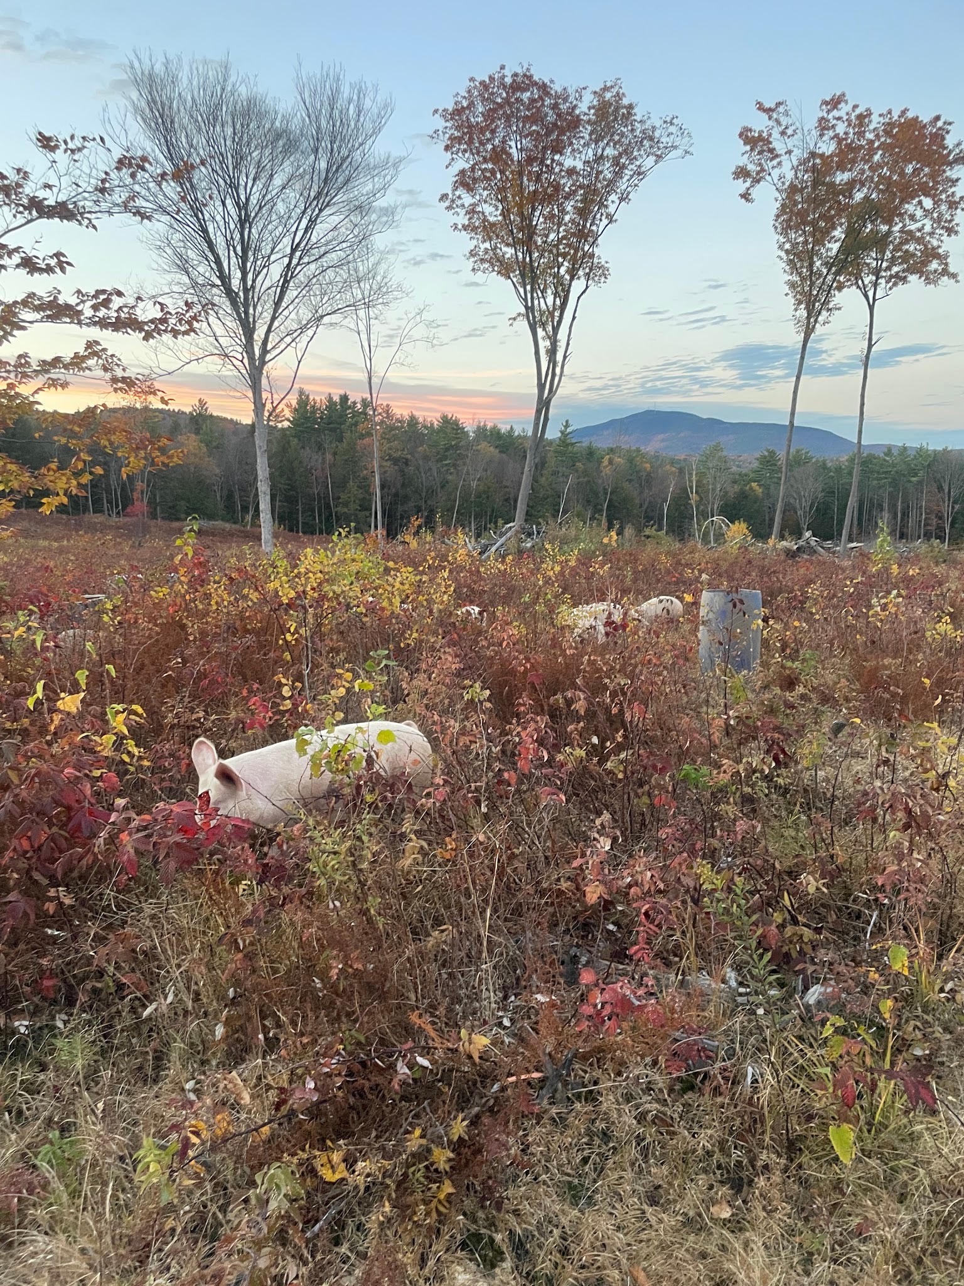
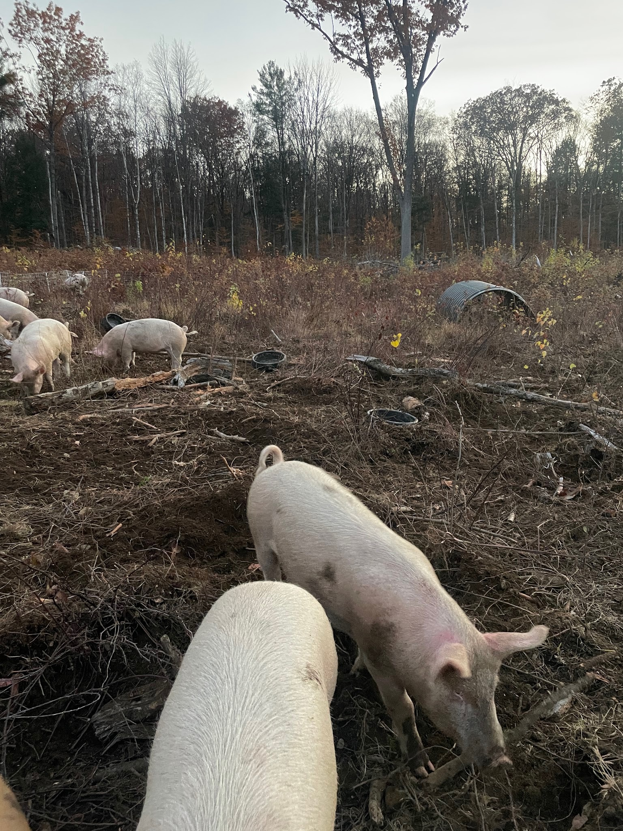

Slide 28
Next Steps
-Bale grazing cattle on previous study area: this is now possible with our NEW BRIDGE! Tractor access to haul round bales and a safe way to bring cattle across the brook is now back in play.
-Kristen is writing a paper based on these interesting results!
-Melissa would like to do this again in the unrenovated parts of the clearing, but Toby now has a strong aversion to the stress of having pigs unsupervised way out back. If we can reach a compromise with improved methodology, there may be a phase 2 to the project. Stay tuned.

Slide 29
Special thanks to:
Kristen Jovanelly, for being a most excellent and very patient technical advisor. Not only did she handle all the soil testing and vegetation surveys and technical writing for this, but she had to help two deadline-allergic farmers navigate the grant application process. Thank you for all your time and encouragement!
Julia & Molly Maki, for pig chore assistance and most importantly, their service on Big Move day when we brought the pigs up front prior to harvest days. They jumped in on a rainy day in mid November to help move 12 pigs over a quarter mile through the woods, including fording the brook.
Anyone at UVM/Northeast SARE who has had to nag Melissa about deadlines and return incorrectly filled out forms to sender.

