Slide 1
Plant Propagation by Cuttings
Prepared by: Mark Acosta, L. Robert Barber, Alicia Borja, Frank Cruz, Joe Tuquero, David Camacho, Ilene Quitugua, Roland Quitugua, Rynette DeCastro, Duane Dominguez, Ian Iriarte, Ashley Yamanaka, Remylynn Yamanaka

Slide 2
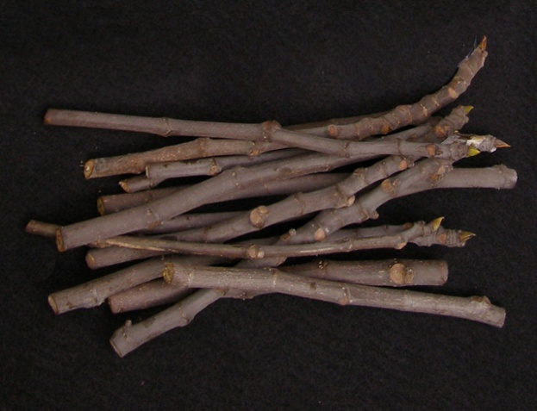
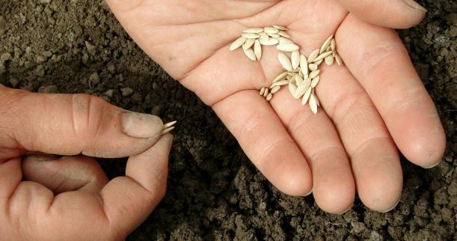
Propagation & Cuttings?
Propagation
    Making more plants
    Two Methods
      Vegetative
      Seed
Cuttings
  A method of vegetative/asexual
  propagation that uses sections of
  plant stems.

Slide 3
What is Asexual Propagation?
Growing new plants without the use of seeds
Creating a new plant from an existing parent plant know as “cloning” (exact same genes)
Asexual techniques include: air layering (marcott), cutting, grafting, division, and tissue culture.
Note to participants: take pictures of each as you see them during the workshops

Slide 4
Nursery for Cuttings
Requirements
Good water source
Wind protection/high humidity for cuttings
Good growing media
Containers or production beds
Good plant material
Rooting hormone helps
Can be done in a backyard or small farm

Slide 5

Good Growing Media
Disease free
Weed seed free
  Composting
  Soil sterilization
  Commercial mixes
      Not all created equal
Examples of media:
  Compost, washed sand, perlite, coconut husk

Slide 6
Different Kinds of Cuttings
Cuttings
  Root cutting and root shoot
  Stem cutting
  Leaf cutting

Slide 7
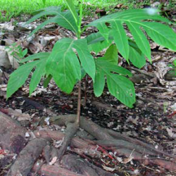
Root/Shoot Cutting – Breadfruit

Slide 8
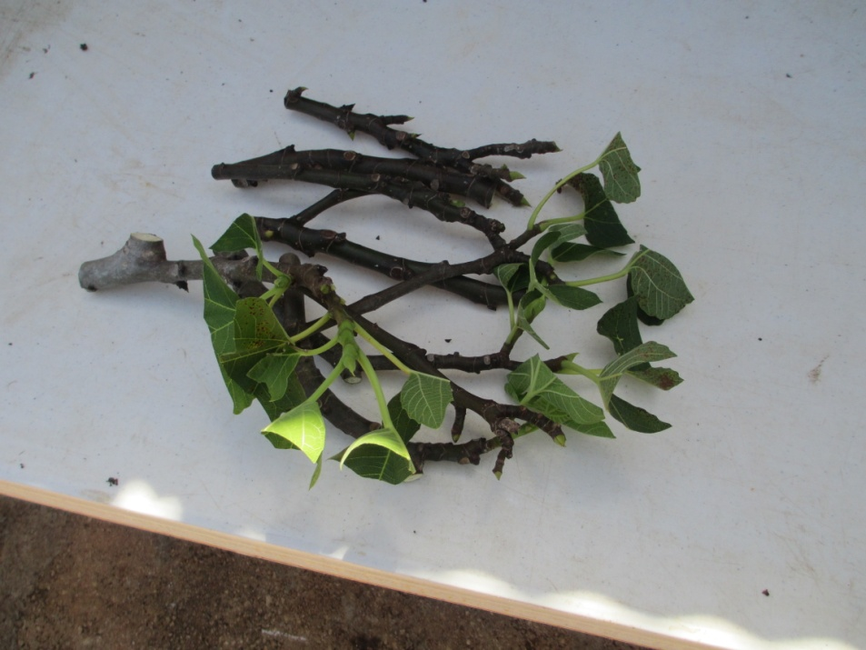
Stem Cutting– Fig

Slide 9
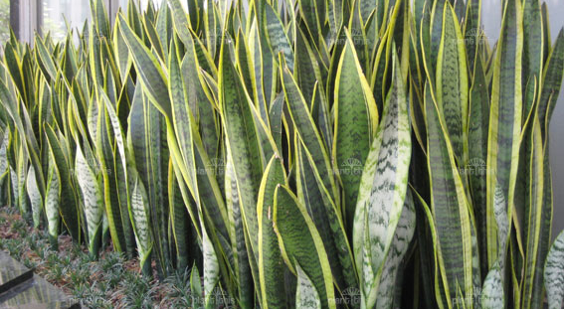
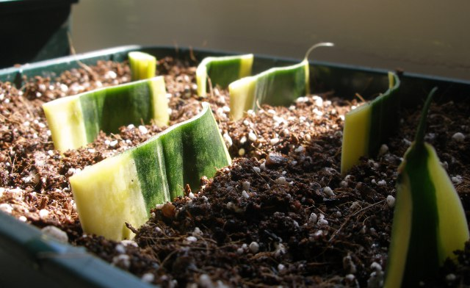
Leaf Cutting– mother-in-law’s tongue

Slide 10
Different Kinds of Cuttings
Cuttings
  Leaf– mother-in-law-tongue,
  kalanchoe
  Root cutting and sucker–
  breadfruit, guava, citrus,
  pomegranate
  Stem cutting – softwood, semi-hardwood, hardwood -
  sweet potato, mulberry, fig

Slide 11
Types of Stem Cuttings
Types | Local Examples
Herbaceous: non-woody, herbaceous plant | Basil, Dill, Mint, Sweet Potato, Kang-Kong
Soft-Wood: soft, succulent, new growth of woody plant | Hibiscus, Mulberry, Plumeria
Semi-hardwood: partially mature wood | Hibiscus, Citrus, Guava, Coffee, Mulberry
Hardwood: dormant, mature stems | Fig, Mulberry, Pomegranate, Spanish Plum

Slide 12
Advantages and Disadvantages of Cuttings
Advantages
  Plant will be true-to-type, it is an identical clone of the parent plant
  Matures faster and produces flowers and fruits sooner
Disadvantages
  No tap root
  No Genetic Diversity – Cuttings are genetically the same plant, so pests and diseases infestations can spread fast. It is possible to loose the entire crop.

Slide 13
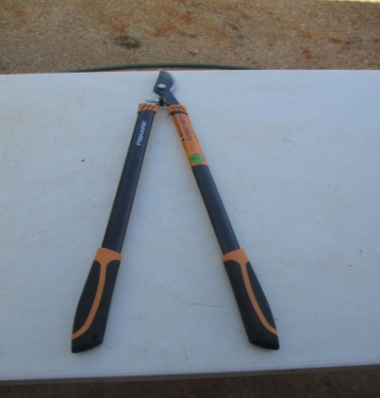
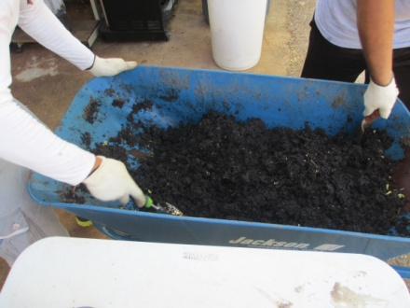
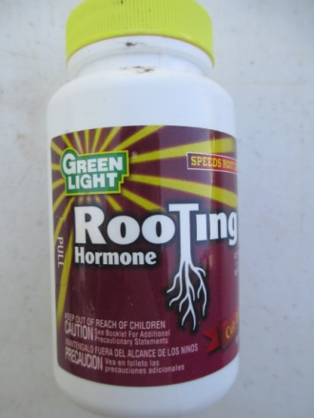
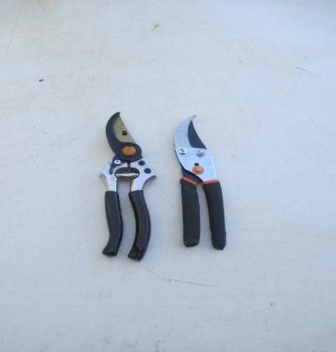
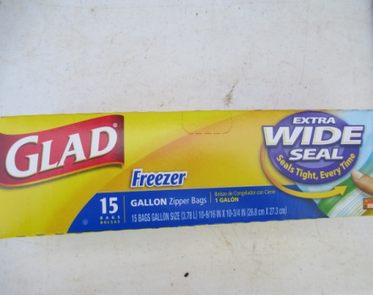
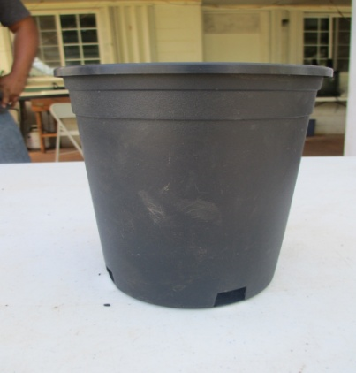
Materials
Tools – pruners/loppers/shovel
Wheelbarrow
Gloves
Pots
Soil Medium
Root Hormone
Plastic Bags
Tape/rubber band
Labeling materials
Plant Cuttings

Slide 14
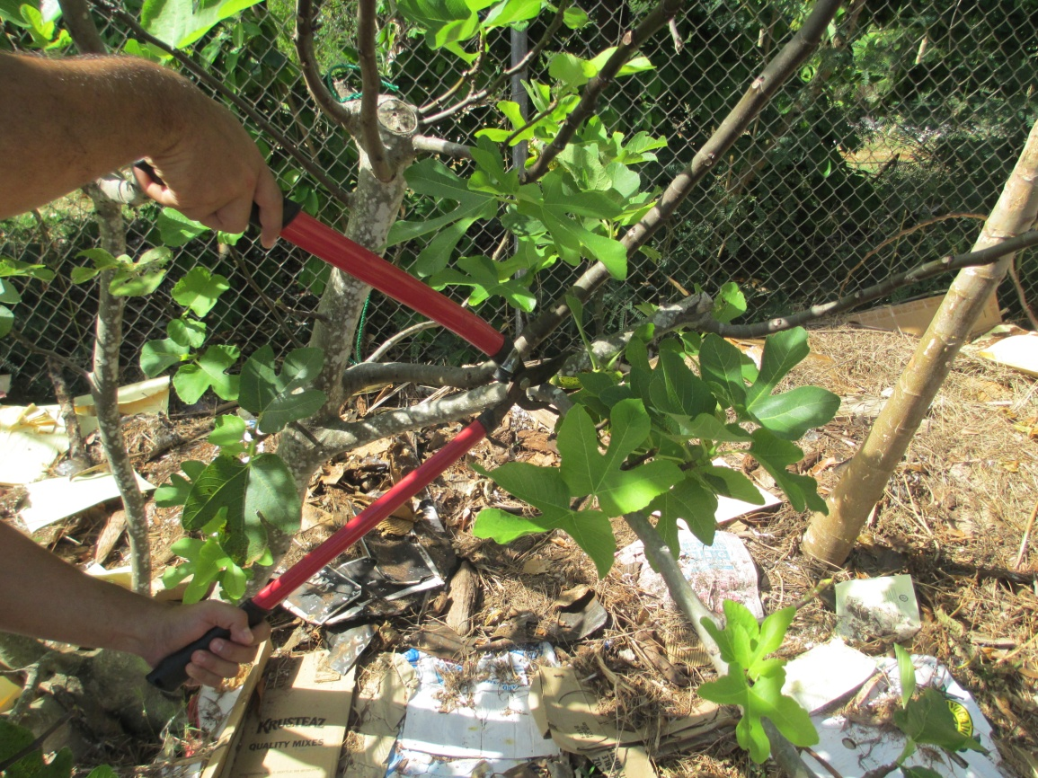
Propagation Step 1
Obtain stem cuttings from healthy plants

Slide 15
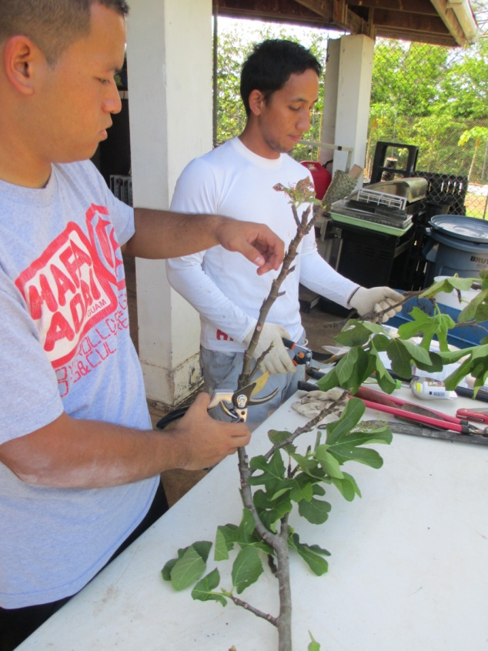
Step 2
Cut stems into at least 8 inch pieces. Remove any flowers or flower buds and remove 1/3 to 1/2 of the leaves from each cutting.

Slide 16
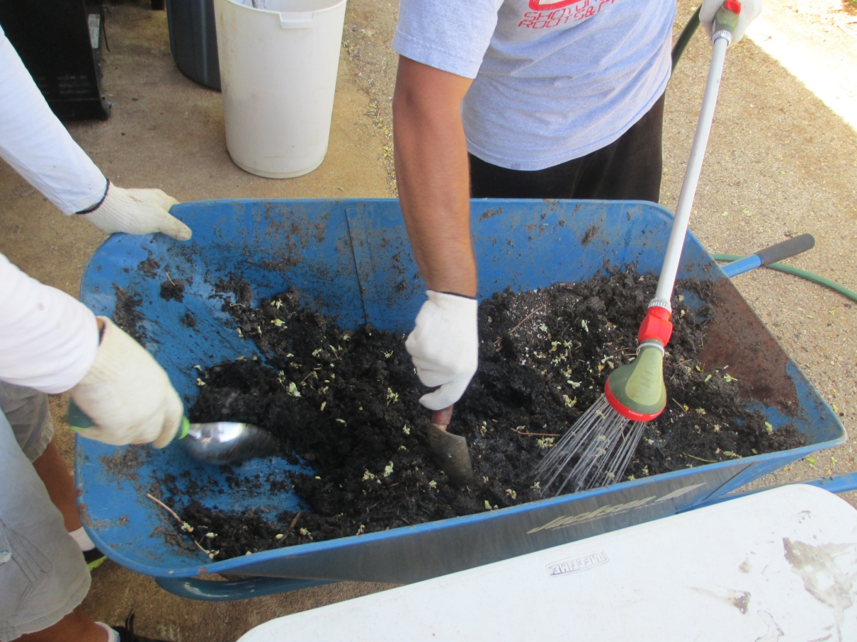
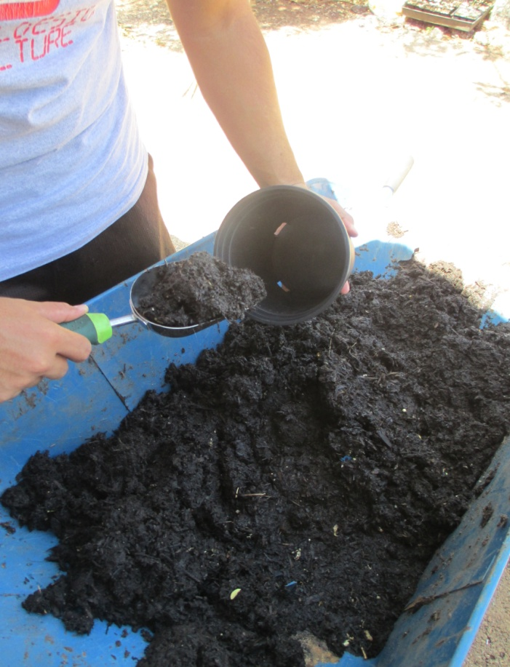
Step 3
Moisten media and transfer into pot.

Slide 17
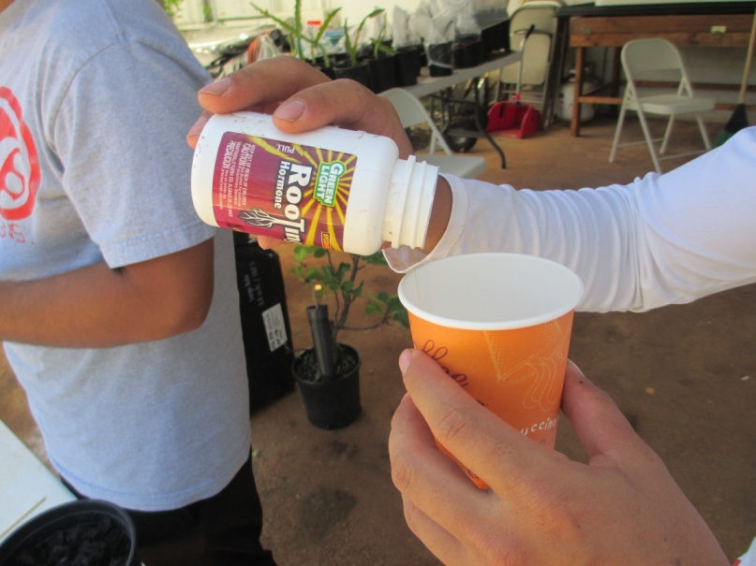
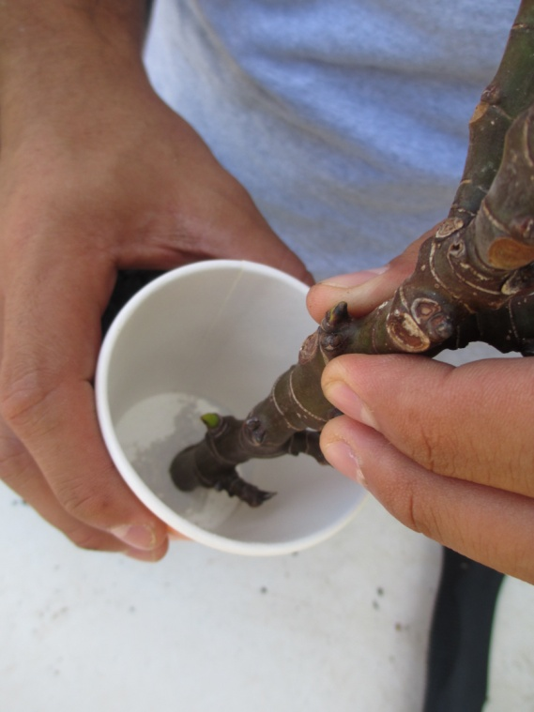
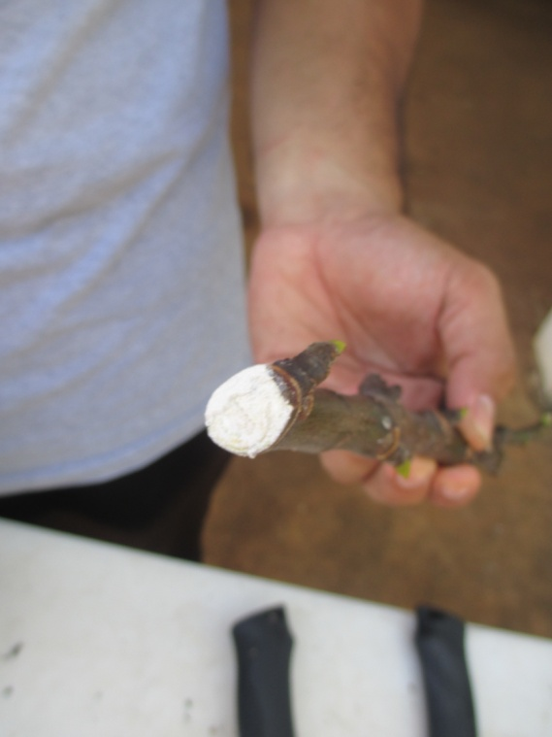
Step 4
Before using root hormone, place the amount needed in a separate container. Dip bottom part of cutting into rooting hormone.

Slide 18
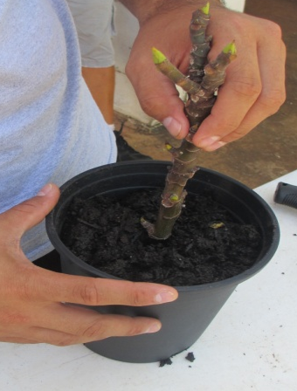
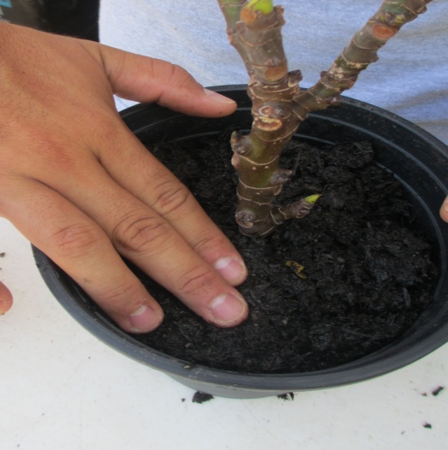
Step 5
Make a hole into the prepared soil in pot
Insert cutting (at least 4 inches)
Press soil around cutting to hold in place.
Water again to settle the soil down

Slide 19
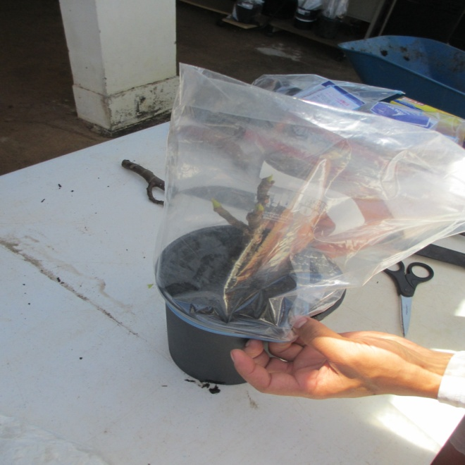
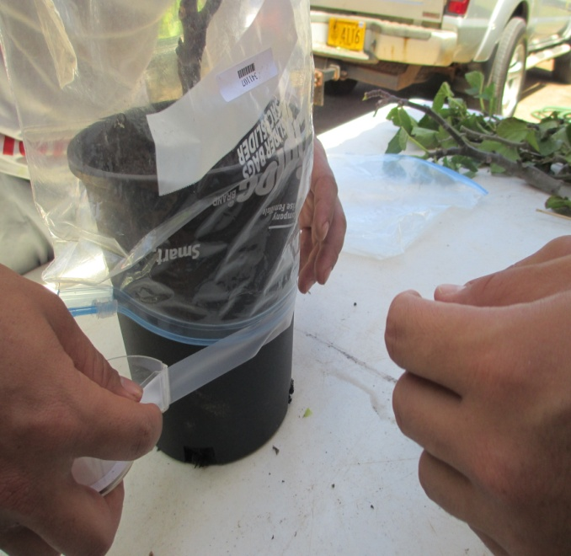
Step 6
Wet the inside of the plastic bag then cover over the plant to maintain humidity
Tape/rubber band around the plastic bag.
Label your newly planted cutting.

Slide 20
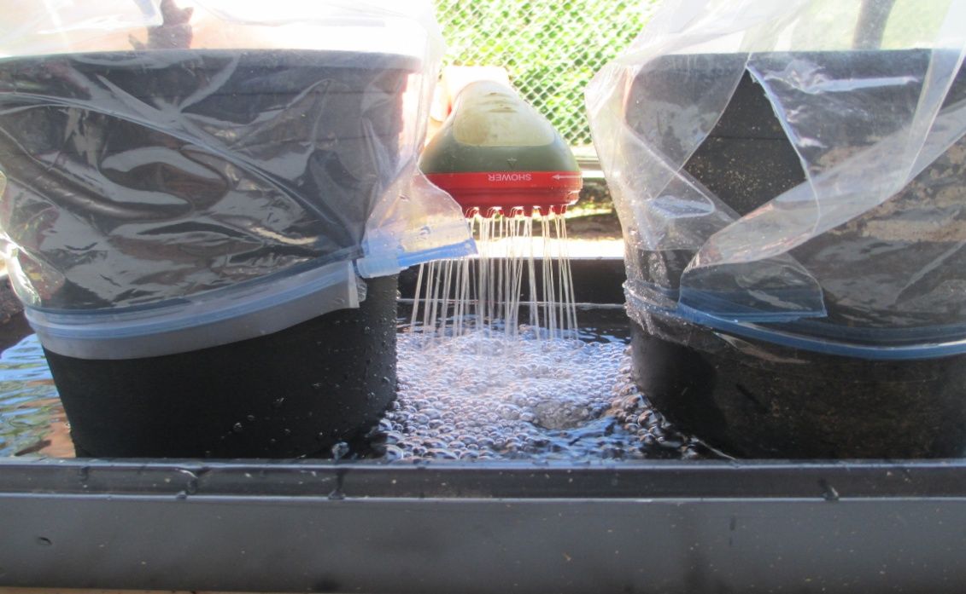
Step 7
To keep plants from drying out, place pots in a tray filled with water.
Be sure to keep your plants in a warm area out of direct sunlight.

Slide 21
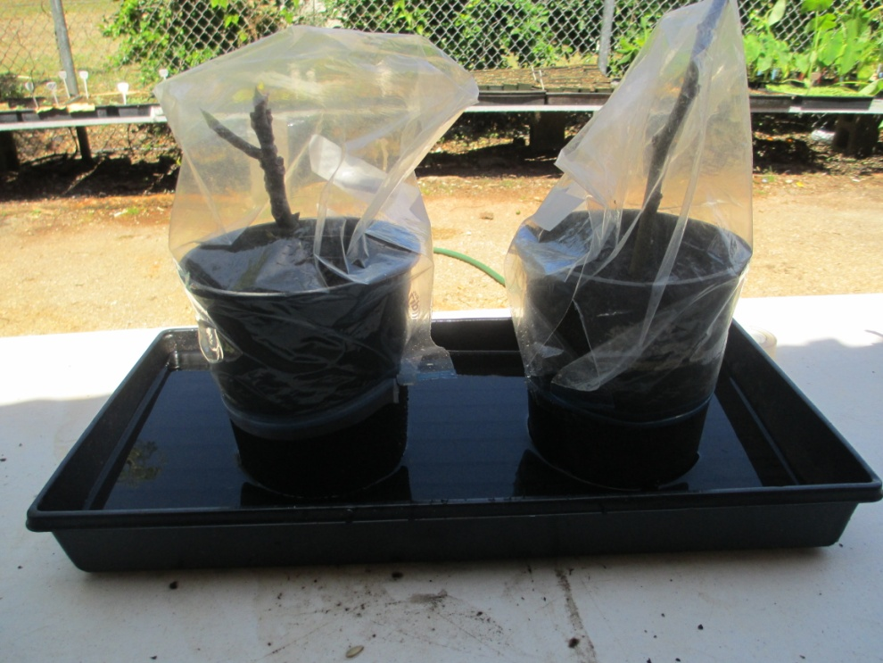
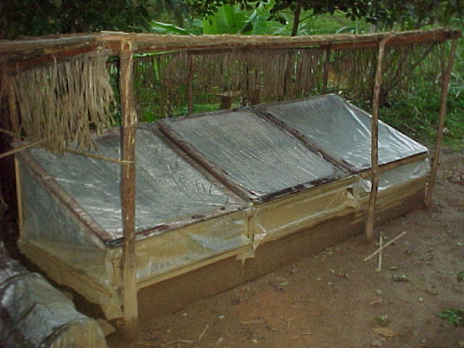
Non-Mist Cutting Structure

Slide 22
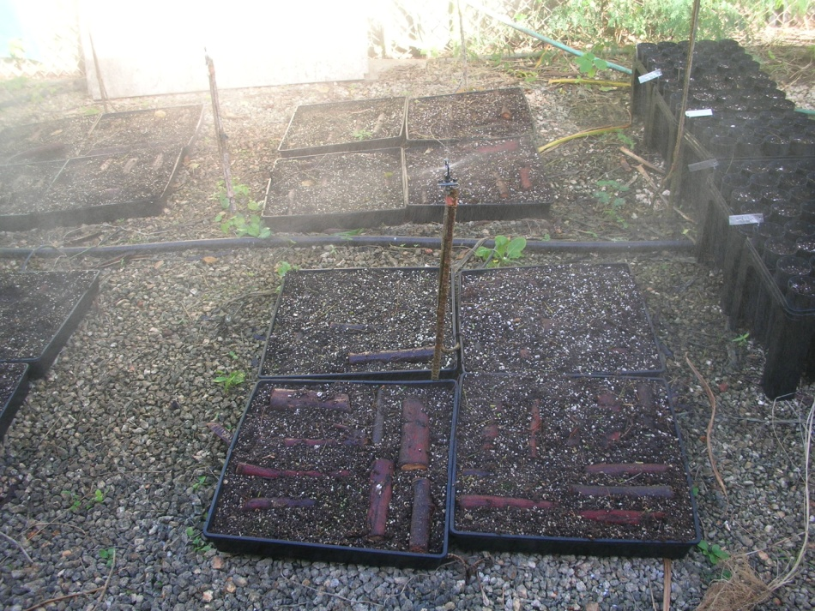
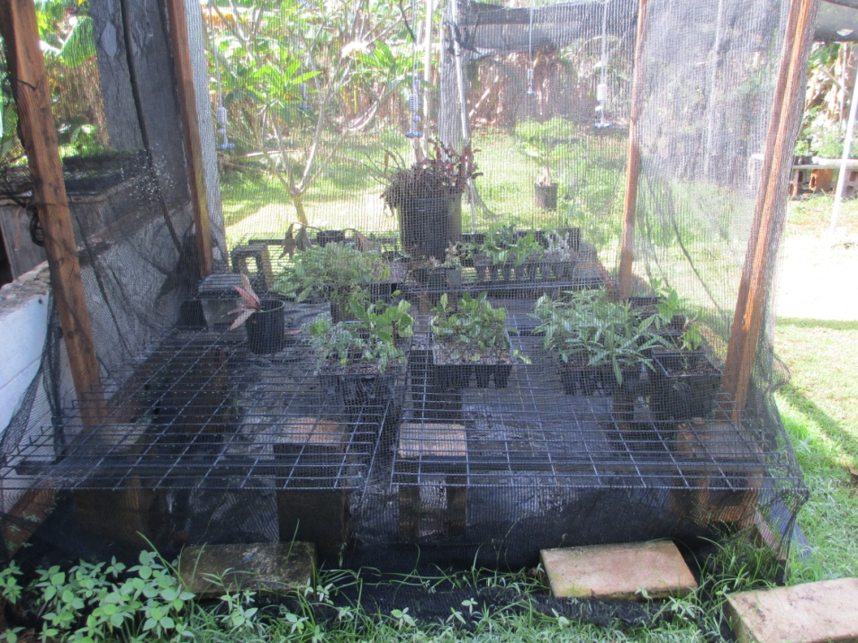
Mist System for Cuttings

Slide 23
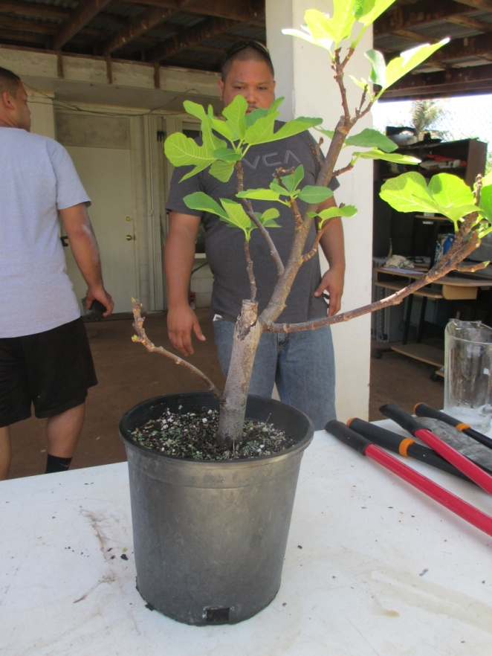
Removal of Plastic Covering
Remove plastic covering when signs of growth are seen.

Slide 24
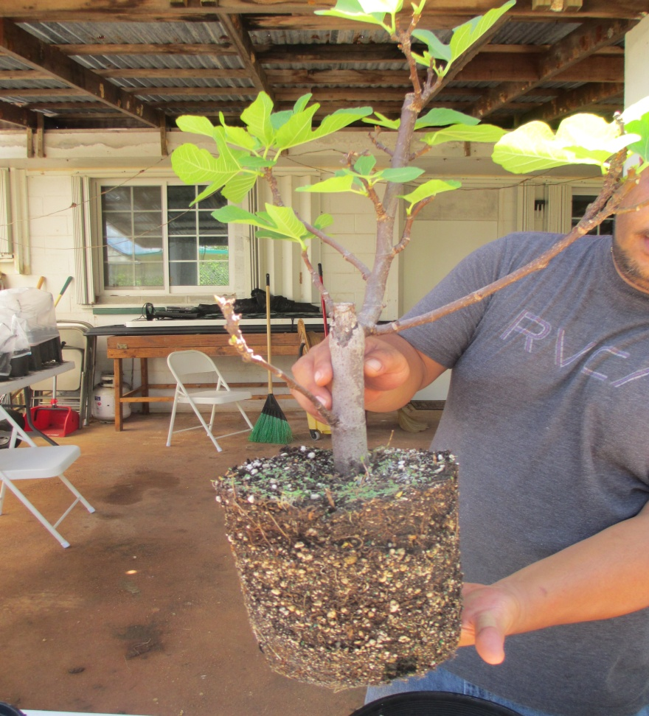
Transplanting Your Cutting
When your plant is growing well, transition from shade to sunlight and days later transplant into its permanent location. This is know as hardening the plant.

Slide 25
Conclusion
Asexual propagation
  is growing new plants without the use of seeds
Advantages
  Plant will be true-to-type, identical clone of the parent plant
  Matures faster and produces flowers and fruits sooner
Different Kinds of Cuttings
  (leaf, root, and stem)

