Slide 1
Poisonous Plants for Livestock in Alabama
Kim Mullenix, Ph.D., Extension Beef Specialist

Slide 2
The Situation
Cattle and horses are grazing animals
It is likely that animals will encounter a poisonous plant in or near the pasture
Most of these plants are bitter in taste and undesirable to the animal – do not consume in quantities large enough to cause a toxicity

Slide 3
However…
Livestock may consume poisonous plants when:
Drought/weather conditions limit forage growth
Withering plants have a “sweet” smell and taste that encourages consumption
Grazing other plants in the stand and they encounter young, tender weeds

Slide 4
Classic Signs of Toxicity in Livestock
Poisonous plants will always cause a reduction in dry matter intake in grazing livestock
Reduced grazing activity
Reduced consumption of provided feeds
Animals appear to go “off” feed

Slide 5
Poisonous plants in alabama

Slide 6
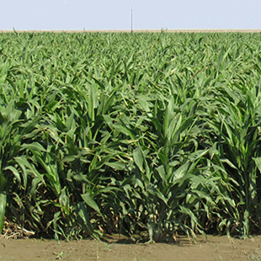
Cyanide Accumulators – Prussic Acid Poisoning
Occurs following an environmental stressor
Drought
Frost
Sorghum family
Johnsongrass, sorghum, sorghum x sudangrass, sudangrass

Slide 7
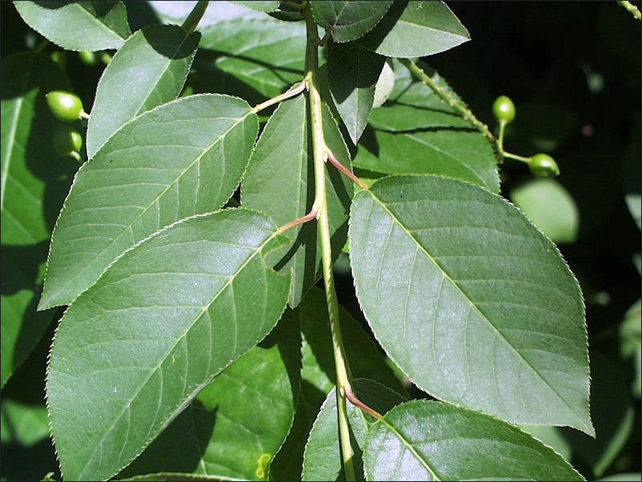
Cyanide Accumulators – Prussic Acid Poisnoning
Wild black cherry trees
Prevalent in overgrown fencelines, around creeks and ponds
As leaves wither – cyanide is released
Occurs during fall of year and when trees fall
Photo Source: Iowa State University Extension and Outreach

Slide 8
Nitrate Toxicity
Under conditions of high fertility (greater than 80 lb N/acre), some forages can accumulate nitrates
Only occurs under environmental stress – drought, etc.
Summer annuals, Johnsongrass, sometimes bermudagrass
Unlike prussic acid – nitrate concentrations can be maintained in forages for a long period of time
Stored as hay – conduct a forage analysis
Notes:
Want to stress that fertility is important and that appropriate amount of fertilizer should be applied to meet production goals. Nitrate toxicity is only a risk in this situation when drought or some other environmental stressor occurs that causes the accumulation.

Slide 9
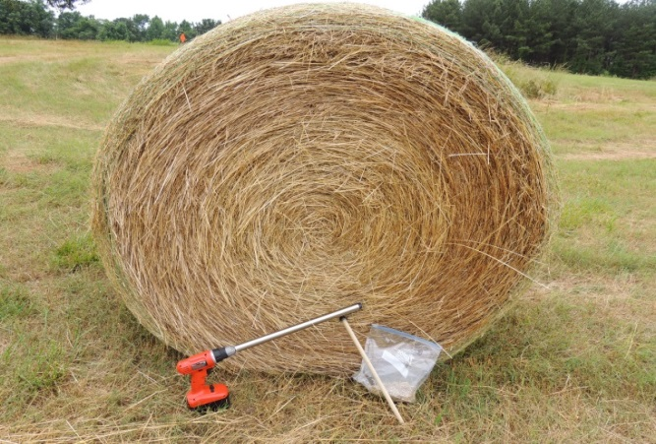
Forage Analysis – Nitrate Results
Table 1. Nitrate nitrogen levels (ppm) and risk levels for feeding livestock.
Nitrate Nitrogen (NO₃-N), ppm | Level of Risk
0 to 1,500 | Generally safe
1,500 to 5,000 | Limit to ½ of DMI
5,000 + | Toxic – Use no more than 15% of total ration
More on forage sampling at:
www.aces.edu/go/523

Slide 10
What about weeds?
“Livestock will graze around the weeds”
This is not always the case – in situations where forage availability is limited, animals will graze some weeds
When weeds are young and tender, sometimes animals will graze them as well

Slide 11
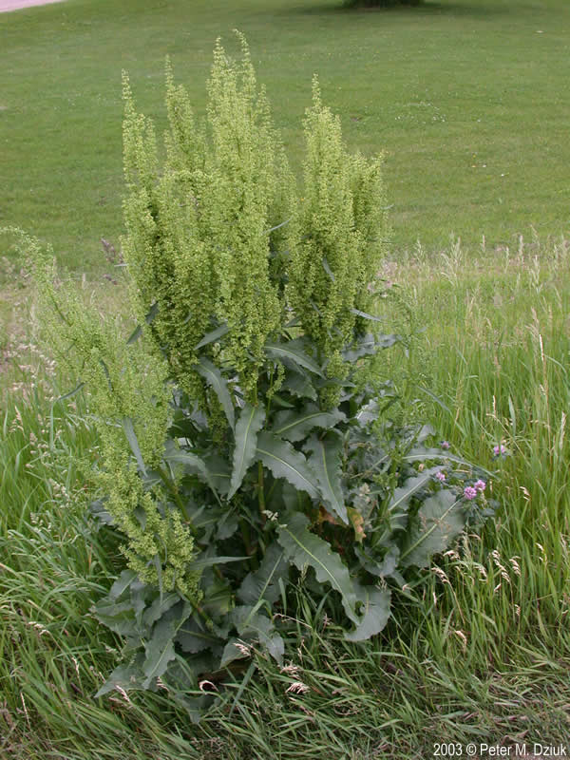
Curly dock
Perennial herb
“Curly” leaves – crisped, rolled up edges of leaves
Flowers are small, green and three-winges
Found along roadsides, pastures, and cultivated fields
Toxicity: Oxalate and nitrate accumulator; Seeds, leaves, and stems can accumulate these compounds
Causes erratic behavior in cattle/horses – gastrointestinal disturbances are common; death only occurs after consuming large quantities
Photo Source: Minnesota Wildflowers

Slide 12
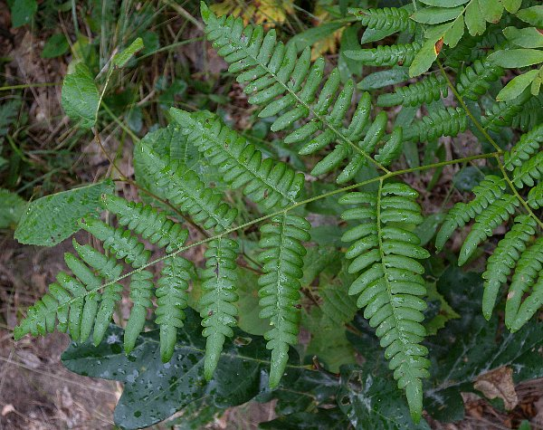
Bracken fern
Coarse, perennial fern
Leathery texture to fronds
Strong root system – rhizomes
Common in old fields, open woods, roadsides
Adapted to dry sites
Toxicity: Thiaminase – enzyme that effects the use of thiamine by the animal
Plant poisoning requires accumulation over time – signs observed in spring or late summer/fall – especially during drought periods
Photo Source: Illinois Wildflowers

Slide 13
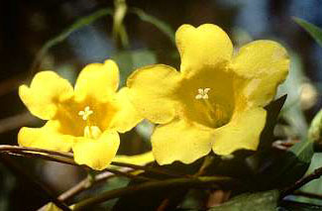
Yellow jessamine
Climbing/trailing perennial vine
Yellow flowers, fragrant
Abundant in fence rows and open woods
Toxicity: Alkaloids; Animals stagger and appear uncoordinated upon consumption – death can occur quickly
Livestock consuming plant parts during winter/spring months due to fragrant/honey smell
Photo Source: Alabama Extension

Slide 14
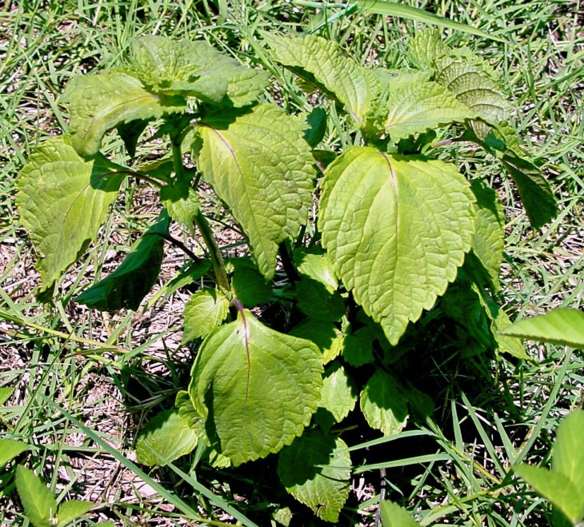
Perilla mint
Annual herb
Stems four sided, square like
Flowers are white to purple
Strong smell of leaves/stems when crushed
Purple undertone to leaves
Toxicity: Contains perilla ketone – a compound that causes pulmonary edema
Occurs late summer/fall after grazing of the plant in cattle and horses
Especially prevalent in drought years
Photo Source: UF/IFAS Northwest Extension District

Slide 15
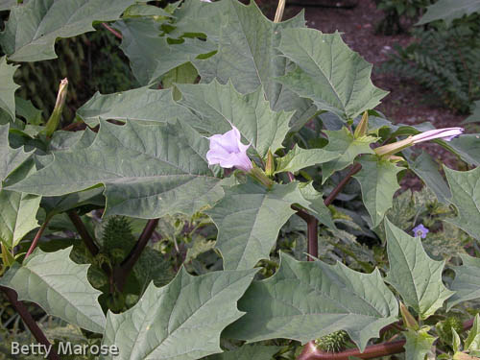
Jimsonweed
Coarse, foul-smelling annual
Leaves have a “toothed” appearance
Found in fertile fields, gardens, and barn lots (heavy use areas)
Toxicity: Alkaloids – may cause weak, rapid heartbeat, slowed breathing, convulsions or coma
Livestock typically only consume this in the absence of other forage
Photo Source: University of Maryland Extension

Slide 16
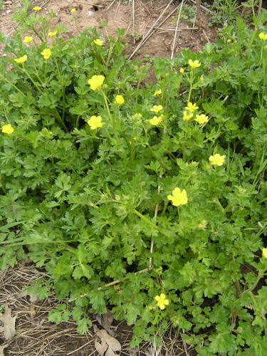
Buttercup
Annual herb
Basal rosette of leaves
Five petaled flowers – yellow
Multiple flowers per plant
Common in low, moist areas, pastures in spring
Toxicity: Irritant oil – protoanemonin; Found in stems and leaves
Plant is very distasteful to livestock, and toxicity rarely occurs
Photo Source: Mississippi State University Extension Service

Slide 17
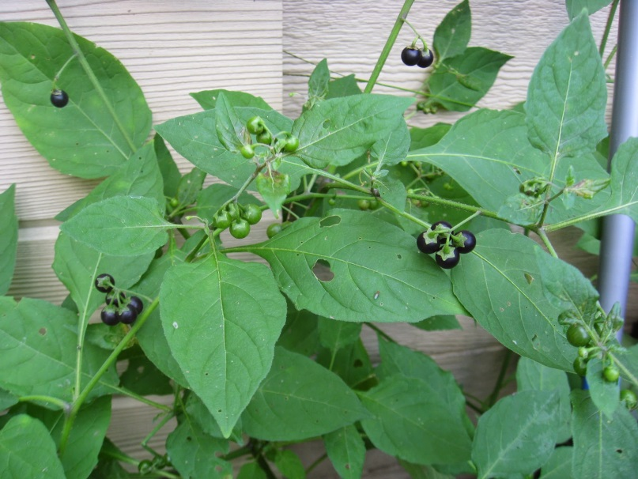
Black nightshade
Annual, thornless herb
White flowers
Shiny, black fruit when ripe
Often found in disturbed ground
Toxicity: Alkaloid (solanine); Berries are the most toxic – especially when they are green and immature
More acute problems – irritation of the mouth and gastrointestinal lesions
Photo Source: Capital Naturalist

Slide 18
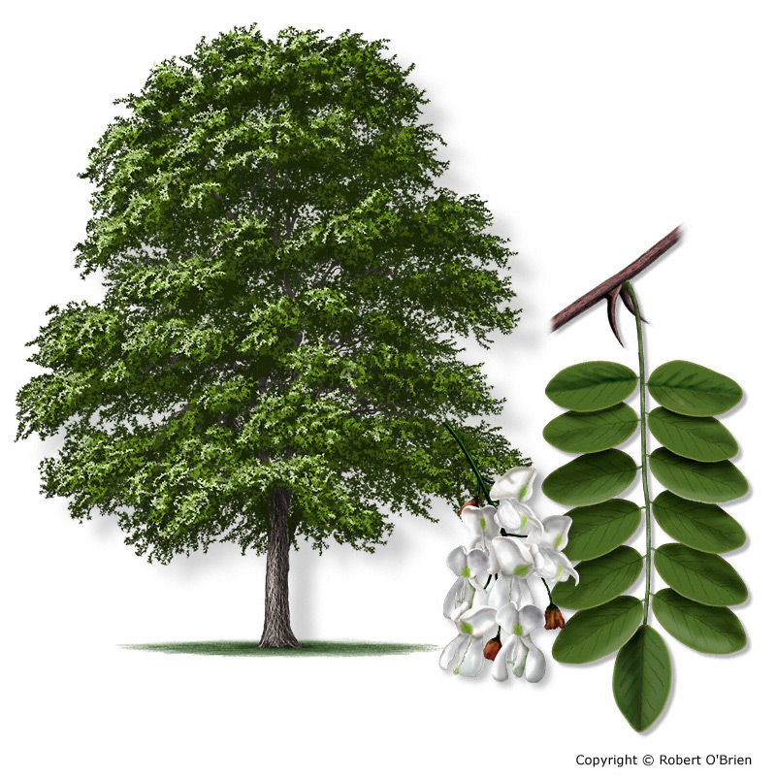
Black locust
Shrub/tree with thick bark and paired thorns
Alternate leaves
Often found in open woods, roadsides, old fields and pinelands
More common on clay soils than sands
Toxicity: Glycosidic compound – robitin; phytotoxin – robinin; Weakness, loss of appetite, difficulty breathing in cattle and horses
Photo Source: Texas A&M Forest Service

Slide 19
More information on poisonous plants
Poisonous Plants of the Southeastern United States
ANR-0975

Slide 20
Questions?
Visit www.aces.edu/beefsystems

