Slide 1
2023-24 BIPOC Farming Network Policy Fellowship for Regenerative Farmers
A Progress Report

Slide 2
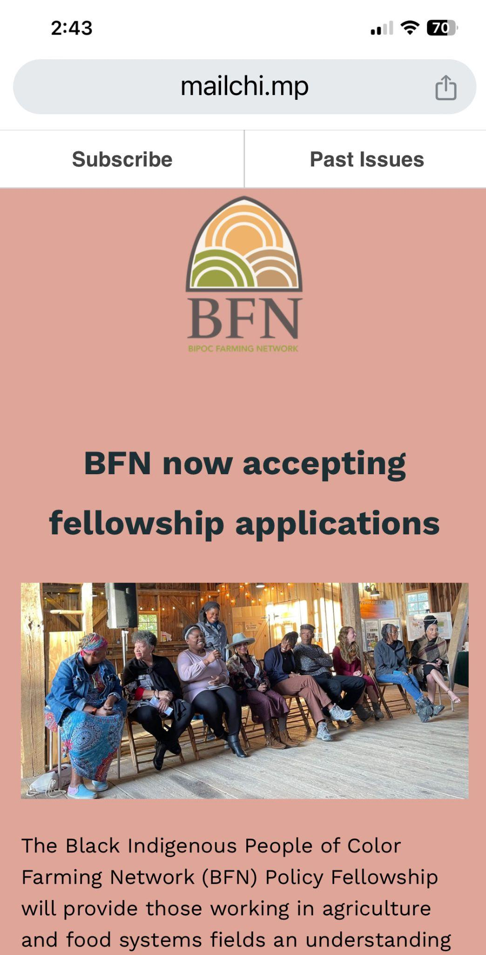
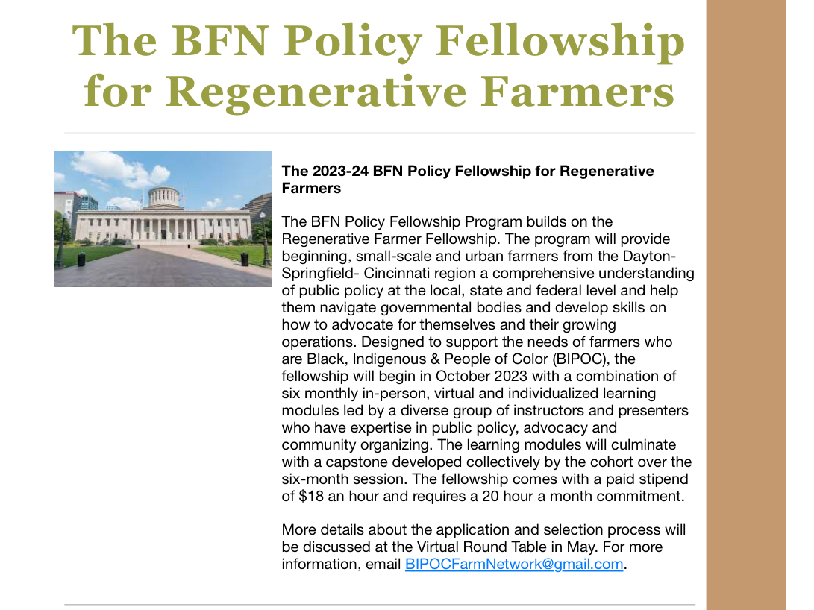
Fellowship Launch: Newsletter Announcements
The first announcement for the BFN Policy Fellowship for Regenerative Farmers was in the BFN Newsletter on April 26, 2023 and the announcement opening the application process was on July 18, 2023. The application deadline was August 11, 2023.

Slide 3
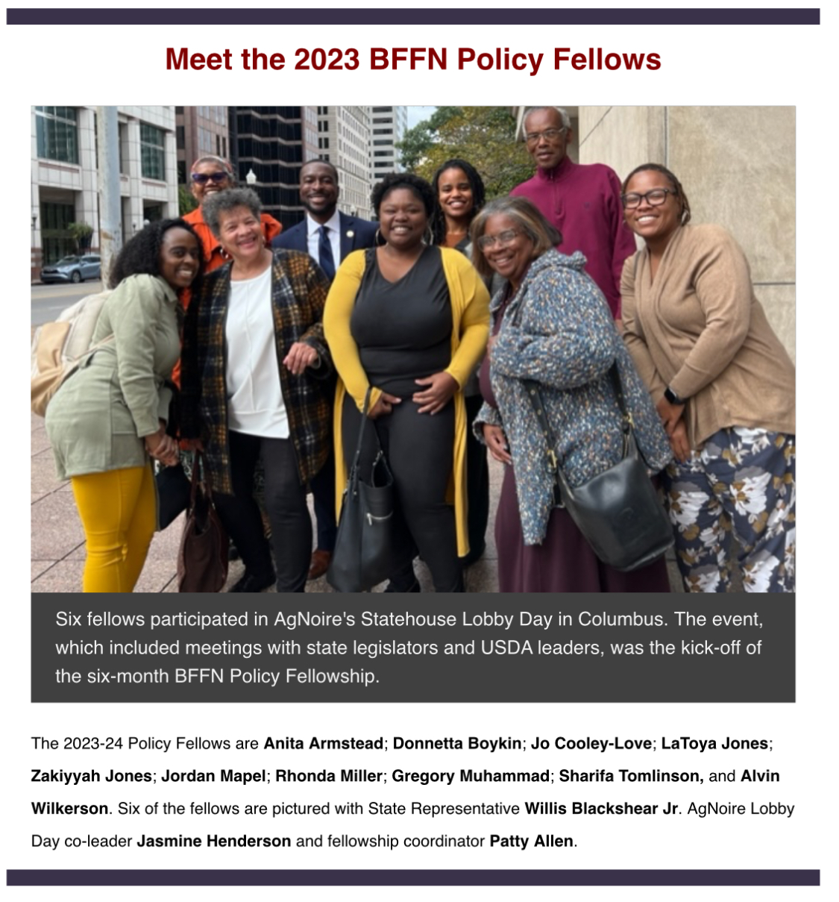
Fellowship Launch: Application & Selection Process
We received 25 applications for 5 open spots; 5 spots were reserved for the 2022 Cohort of the Regenerative Farming Fellowship. Applications were screened and reviewed by a selection committee. The selection committee was: A.J. Boyce, the Nature Conservancy; Tia Stuart, Coordinator for the Regenerative Farming Fellowship; Tracy Freeman, consultant, BFN Policy Fellowship and Patty Allen, fellowship coordinator.

Slide 4
Fellow Biographies
Anita Armstead I am a community leader, beginning farmer, and founder and visionary of Eden’s Harvest, a 3.5 acre regenerative urban farm start-up in Northwest Dayton. The vision is to create urban growing spaces that enable community members to heal while reclaiming their connection to the earth and gain agency over the quality, production, and distribution of the food they consume. I have completed a Regenerative Agriculture Fellowship through the Agraria Center for Regenerative Practice where I then became the Regenerative Farming Fellowship (RFF) Coordinator at Agraria where I provided administrative support and helped deliver informational sessions for beginning farmers. I am also a healer and herbalist.I am a member of Dayton United for Human Rights Movement (DUHR) whose goal is to help declare Dayton a human rights city. Donnetta Boykin My farm is Endigo's Herbals & Organics, located in Trotwood. I grow tomatoes, okra, peppers, greens, squash and zucchini. I am also the founder of Seven Seed Sowers Co-op. We are a sales and marketing co-op with a twist. We offer educational opportunities and resources to the community and beginning farmers. My other activities in sustainable agriculture included serving as host with the Ohio Ecological Food and Farm Association, a BIPOC Farm Bill think-tank, and I traveled to Washington DC with Central State University to lobby for funding. Jo Cooley-LoveI have been farming for the past five years, starting in Omaha, NE, continuing when I moved to Los Angeles, CA, and doubling down on the practice after returning to Dayton. That has included volunteering at multiple community gardens, teaching children how to farm at Westwood Elementary School, and participating in the CSU Extension Incubator program at the Edgemont Solar Garden, and that is only my Dayton adventures. I have farmed in urban environments, as small as a backyard and as large as a fully functioning farm operation, both in Omaha. Partnerships have ranged from multiple members to a two-person outfit to being alone in a farm space. I am the agriculture and farming teacher at E.J. Brown Middle School in Dayton.

Slide 5
Fellow Biographies
Latoya Jones. I am a native Daytonian. For the last 3 years, I have been farming at Central State incubator farm in Trotwood. I also have a nonprofit, Raising Our Own to Survive (ROOTS) , focused on the education of youth about agriculture. In my free time, I enjoy being active in praise dance ministry and preparing farm-to-table meals. I'm currently a member on 2 non-profit boards that focus on youth and families in our communities. The one policy/community issue that I would like to work on is funding for urban gardeners.
Zakiyyah Jones I am from Xenia, Ohio. I work with food as a home gardener. I also am an environmental engineering student conducting research on aquaculture at Central State University. I’m also interested in mycology and biochemistry.
Jordan Mapel I’m a small farm owner of Biddie Bobby Far in Springfield, Ohio. I focus on Indigenous farming methods to work with the plants as we mitigate climate change. I am not a solo farmer – I work with a cohort of other BIPOC farmers who live near me and do chore shares with some fellow smaller farm neighbors.
Rhonda Miller works for and serves on the board for Edgemont Solar Gardens, an urban farm community in Dayton. We have training for incubator farmers, we provide space for groups and individuals to come and grow. We grow our own crops to sale. We represent the community of Edgemont and try to meet the needs of our neighbors as we all live in a food desert.

Slide 6
Fellow Biographies
Gregory Muhammad bought a piece of land in a low-income West Dayton neighborhood for $1 in 2014. He’s named it the Oasis Agricultural Learning Center. He farms on the four acre lot, growing vegetables and herbs. He completed a Regenerative Agriculture Fellowship through the Agraria Center for Regenerative Practice. Prior to returning to farming, Muhammad worked as a tutor in the Dayton Public Schools and continues to work in construction. In addition to running his own farm, he works part-time as the farm manager for St. Vincent de Paul’s men’s shelter community garden. He also is a farm mentor for Central State University extension and serves on the board of Edgemont Solar Gardens. Sharifa L. Tomlinson is a passionate, regenerative farmer, and founder of ARROWROCK FARM an urban sanctuary. A BIPOC cooperative twelve-acre urban market and demonstration farm found in Riverside, Ohio. As an Afroatlantic Two Spirit Elder, I honor my Black Loyalist, Mi’kmaq, and Cuban ancestors in all that I do, even when living outside of my ancestral homelands. In addition to earth tending, I am a poultry producer, land defender, woods womyn, registered nurse, doula, community educator, and the most important, a space holder in this scared place where communal care, shared joy, and restorative healing can grow on healthy, fertile soil.
Currently, I am involved in a second year BIPOC regenerative farmers' fellowship. Serve on the planning committee for The BIPOC Farming Network annual BFN Conference. Food Animals Concerns Trust (FACT) mentee for heritage breed Gloucestershire Old Spot (GOS) pigs and goats. Participant in the Central State University USDA 2501 project, and a Fair Share Ohio Advisory Committee member. Working with the Ohio CAN program I am a proud poultry producer for food banks in my community. Building community is particularly important to me and mentoring allows me to learn and teach aspiring beginning BIPOC urban growers and poultry farmers.

Slide 7
Fellow Biographies
Alvin Wilkerson I currently farm with NuSol Farms, a 5 person farming collective based in West Dayton. I was also a participant in the first Cohort of the Central State University/Edgemont Solar Gardens new farmers incubator program. I am an engineer during the day and also one of the co-founders of the Westside Makerspace. A cooperative developing a Makerspace in West Dayton that will provide members access to tools, classes, space and resources to further their hobby or business.
.

Slide 8
Black Farming Conference & Fellowship Orientation
On Friday, Sept. 29, the BIPOC Food and Farming Network held its Black Farming Conference. The first event was the keynote dinner held at the Afro-American Museum and Cultural Center in Wilberforce Ohio. All of the fellows participated in an informal gathering and related conference activities.

Slide 9
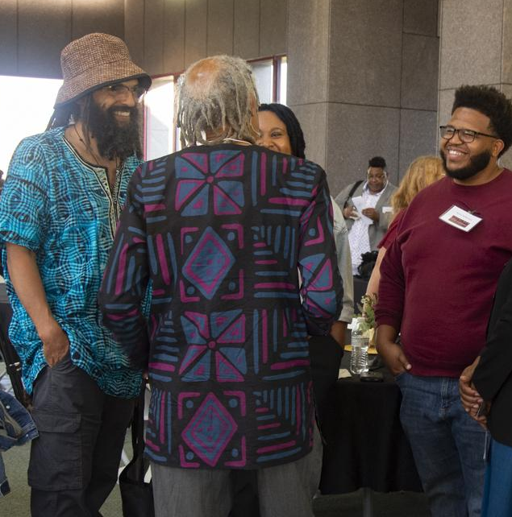
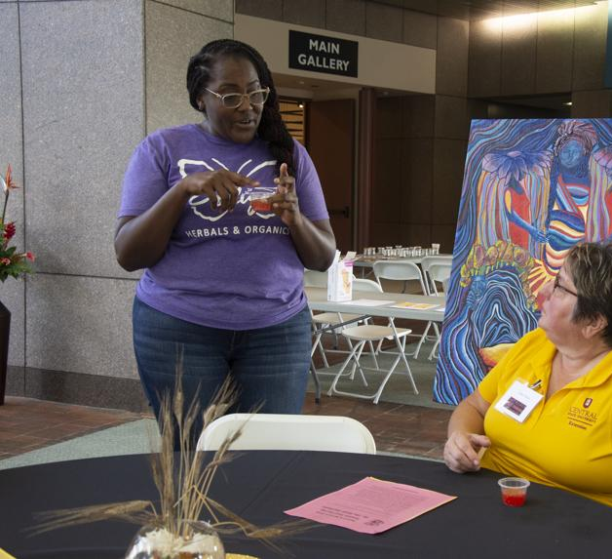
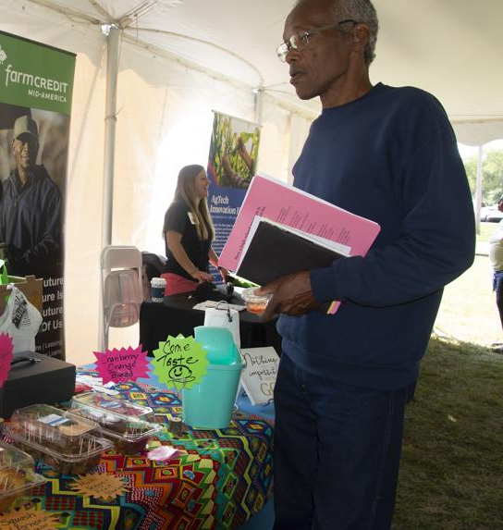
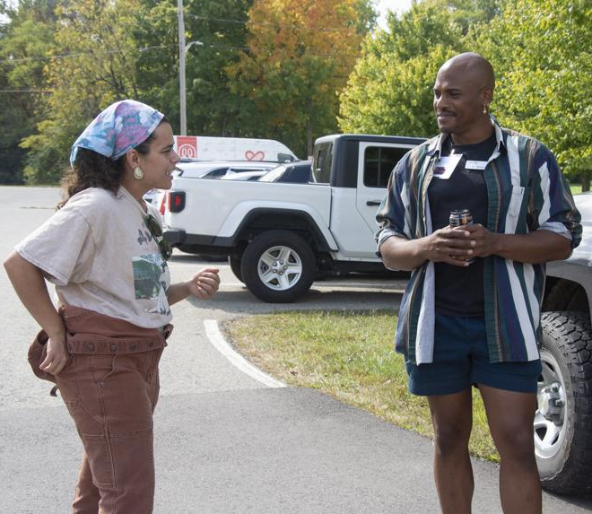
The Policy Fellows participated in the Black Farming Conference, as participants and skillshare leaders. In the photos are: Top row: Alvin Wilkerson (in red shirt); Donnetta Boykin (leading a seed saving skillshare); Anita Armstead (leading an infused oil skillshare); Zakiyyah Jones; bottom row:Jordan Mapel and Gregory Muhammad. Other fellows in attendance were LaToya Jones, Sharifa Tomlinson and Jo Cooley-Love.

Slide 10
Orientation Oct. 1, 2023:Introduction to program, W-2 forms; distribution of syllabus; selection of a Cohort Capstone project theme. Why is understanding public policy important as a BIPOC, urban, small-scale regenerative farmer? Led by Tracy Freeman, Gov Relations Professional Inspiring Outcomes LLC; and Patricia Allen, Program Manager BIPOC Farming Network.
Orientation was held at the University of Dayton, Fitz Center for Leadership in Community

Slide 11
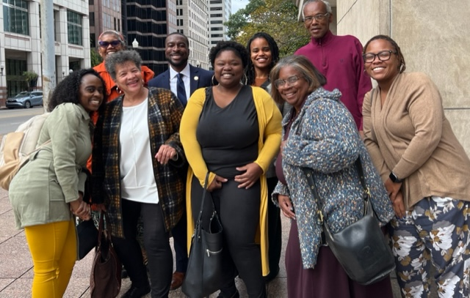
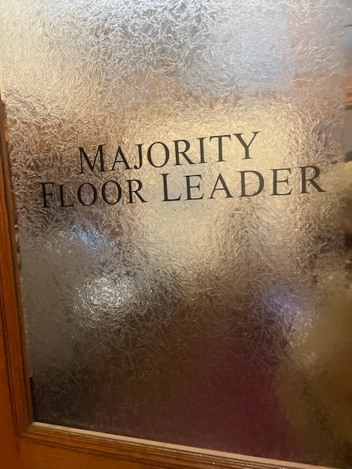
Ohio Statehouse Lobby Day
October Module: State Government Field Trip: On October 17, Fellows traveled from Dayton to Columbus to participate in the Statehouse Lobby Day. The event were organized by module presenters AgNoire Urban Farming Association founder Celeste Treece (pictured in the bottom row photo) and Jasmine Henderson.
The session began with Celeste and Jasmine providing an overview on the Ohio General Assembly, key legislators on the agriculture committees and discussion on the lobby process. Fellows, along with other BIPOC and urban farmers who participated, developed their issues platform to take to their meetings with legislators. Fellows met in small groups with five legislators and staffers.
Also during the session, presentations were given by staff from the Ohio Department of Agriculture and the state policy director for the Ohio Ecological Food and Farming Association.
Because the activity took place during weekday business hours, only 6 of the 10 fellows were able to participate.

Slide 12
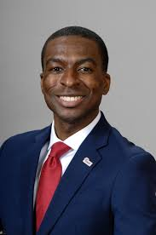
November Modules: Local legislators & Capstone discussions
November Module:
Strategies for accessing policymakers and impacting policy: Ohio General Assembly House Rep. Willis Blackshear Jr.(Dayton District 38) met with the fellows to discuss his work in the Ohio General, status on Senate Bill 111, the Hicks-Hudson on Urban Agriculture Bill. Rep. Blackshear (pictured left) also discussed how policy is drafted and enacted and how to work with his office. Leonard Hubert, of L. Hubert & Associates, Columbus, and the former State Executive Director, Ohio for the USDA Farm Service Agency discussed developing strategies for influencing public policies on food, environment and agriculture. Fred Strahorn, former Ohio House Minority Leader, provided an “insider’s view” of the Ohio Statehouse and strategies for engaging with state senators and representatives.
Capstone Discussion: Held a one-hour zoom, led by Patty Allen and Tracy Freeman, to discuss fellows’ capstone projects. Fellows provided

Slide 13
Fellows Proposed Capstone Projects Fellowship coordinators Patty Allen and Tracy Freeman met with fellows in January for an one-on-one progress report. Fellows receive regular coaching and feedback from external advisors as well as the coordinators.
LaToya Jones: Examining food growing and food equity programs in area churches.
Gregory Muhammad: Working with the city on quarterly storm drain fees being charged to his farm.
Anita Armstead: Developing a module for how BIPOC Ag Co-ops can get state and federal funding.
Donnetta Boykin: Establishing a seed library at the Trotwood public library and developing a template with recommendations/suggestions for other libraries.
Alvin Wilkerson: Starting a blog for NuSol Farm and doing research on the Farm Bill.
Sharifa Tomlinson: Develop a template for municipalities to develop a Health & Safety Committee that includes recommendations to promote Urban and Small-scale Agriculture.
Jo Cooley-Love: Developing a proposal for farm-to-school and culinary education in the Dayton public school system. Side project: urban growing collectivism, creating local directory of growers with the intention of tool and work sharing, leading to the eventual creation of a local food processing facility.
Zakiyyah Jones: Black-owned fast. A public awareness project that supports black growers and food producers.
Jordan Mapel: Creating and producing the AGrow podcast on farming basics and will include a segment on the Farm Bill.
Rhonda Miller: Developing and executing a healthy soil, native plants and pollinators (sunflowers) plan at Edgemont.

Slide 14
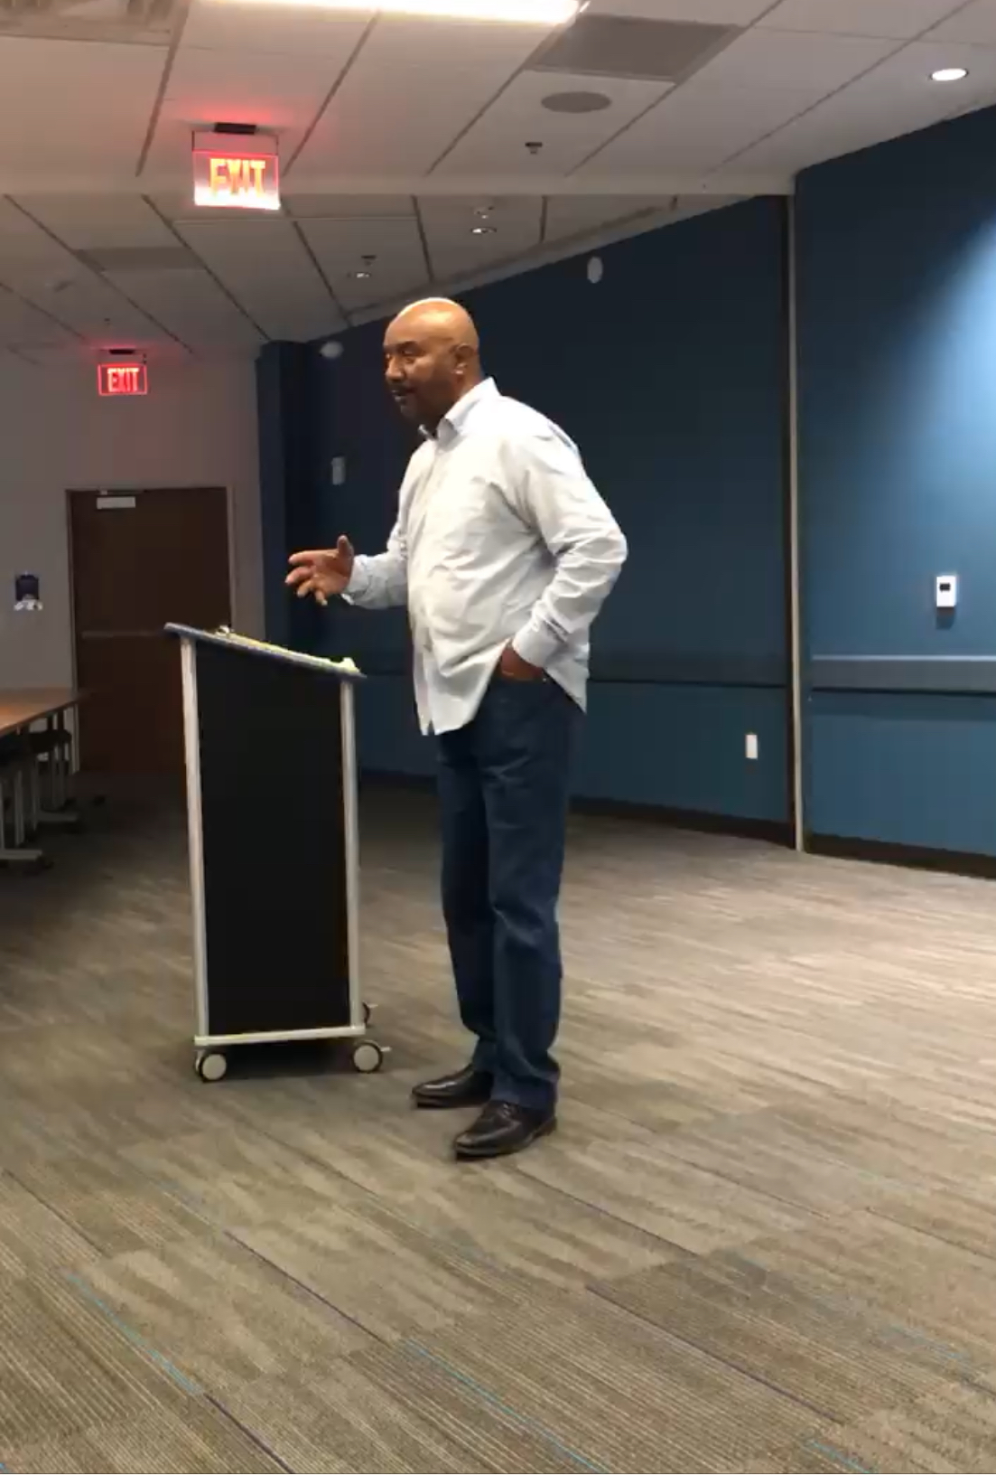
December Module: Local Government
Inside the City of Dayton: Real Talk with former Dayton Mayor Rhine McLin, an insider’s candid view of the inner workings of Dayton city government and tips for how to work with local government officials; a farmer’s perspective, a 20+ year farming veteran, Donovan Larkin (pictured left at the session), Shekinah Ranch Fresh Food Farms LLC, discusses his experience of dealing with food and agriculture policymakers and regulators within Montgomery County, state and federal level.
Online session: Zoom with USDA-NRCS soil conservationist Brooke White who works with the Montgomery County Soil & Water Conservation District.

Slide 15
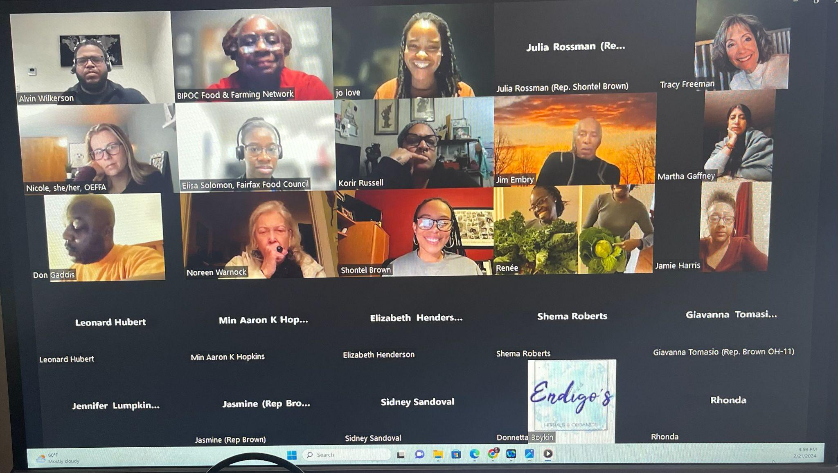
Congresswoman Shontel Brown OH-11 (pictured above) was the featured speaker on January 22, 2024 kicking-off our focus on the federal government and programs. We ended up opening the event to the BIPOC Food & Farming Network along with the Policy Fellows. The conversation was a question-and-answer format moderated by policy fellows Jo Cooley-Love and Alvin Wilkerson.
Informal online dialogue session: Patty Allen and Tracy Freeman shared their experiences working with U.S. senators, House members as well as the President of the United States.

Slide 16
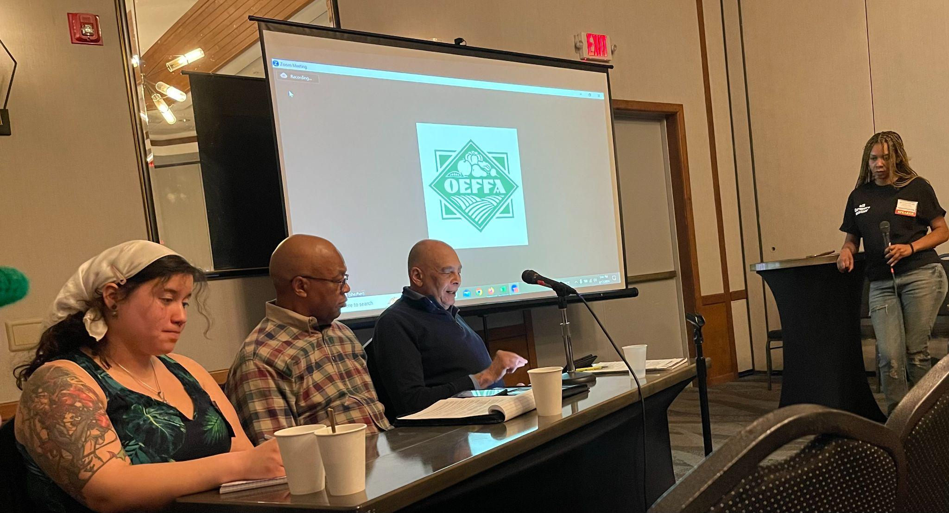
OEFFA Annual Conference
February Module: Module at the OEFFA Conference: Non-Governmental Organizations and Public Policy Advocacy Organizations - Feb. 15-17. Fellows explored the importance of involvement in professional network organizations and non-governmental organizations. Learn how to leverage non-governmental organizations for advocacy such as OEFFA. At this year’s OEFFA conference, “A Seat at OEFFA's Table: Policy Agenda for Urban and BIPOC Communities” will feature panelist Amanda Hernandez, Leonard Hubert, L Hubert and Associates, Bill Miller, Ohio Farmers Union, Celeste Treece, AgNoire Urban Farming Association (all pictured to left). Panelists discussed how predominantly white organizations in an industry that has historically discriminated against farmers of color can genuinely support and advocate for their issues and how organizations like OEFFA improve their engagement with farmers of color. Panelist debated the benefits to urban farmers and food producers of color and the best strategies for utilizing organizations like OEFFA. This was an open and frank discussion on coalition building, racial equity and inclusion in public policy advocacy.
Ohio agriculture Zoom session was held on Wednesday, February 28 with Ohio Department of Agriculture Program Manager Ainsley Lightcap and the USDA Urban Agriculture Specialist Tristam Musik. They discussed their agencies and how to engage with them and the resources and services that are available.

Slide 17
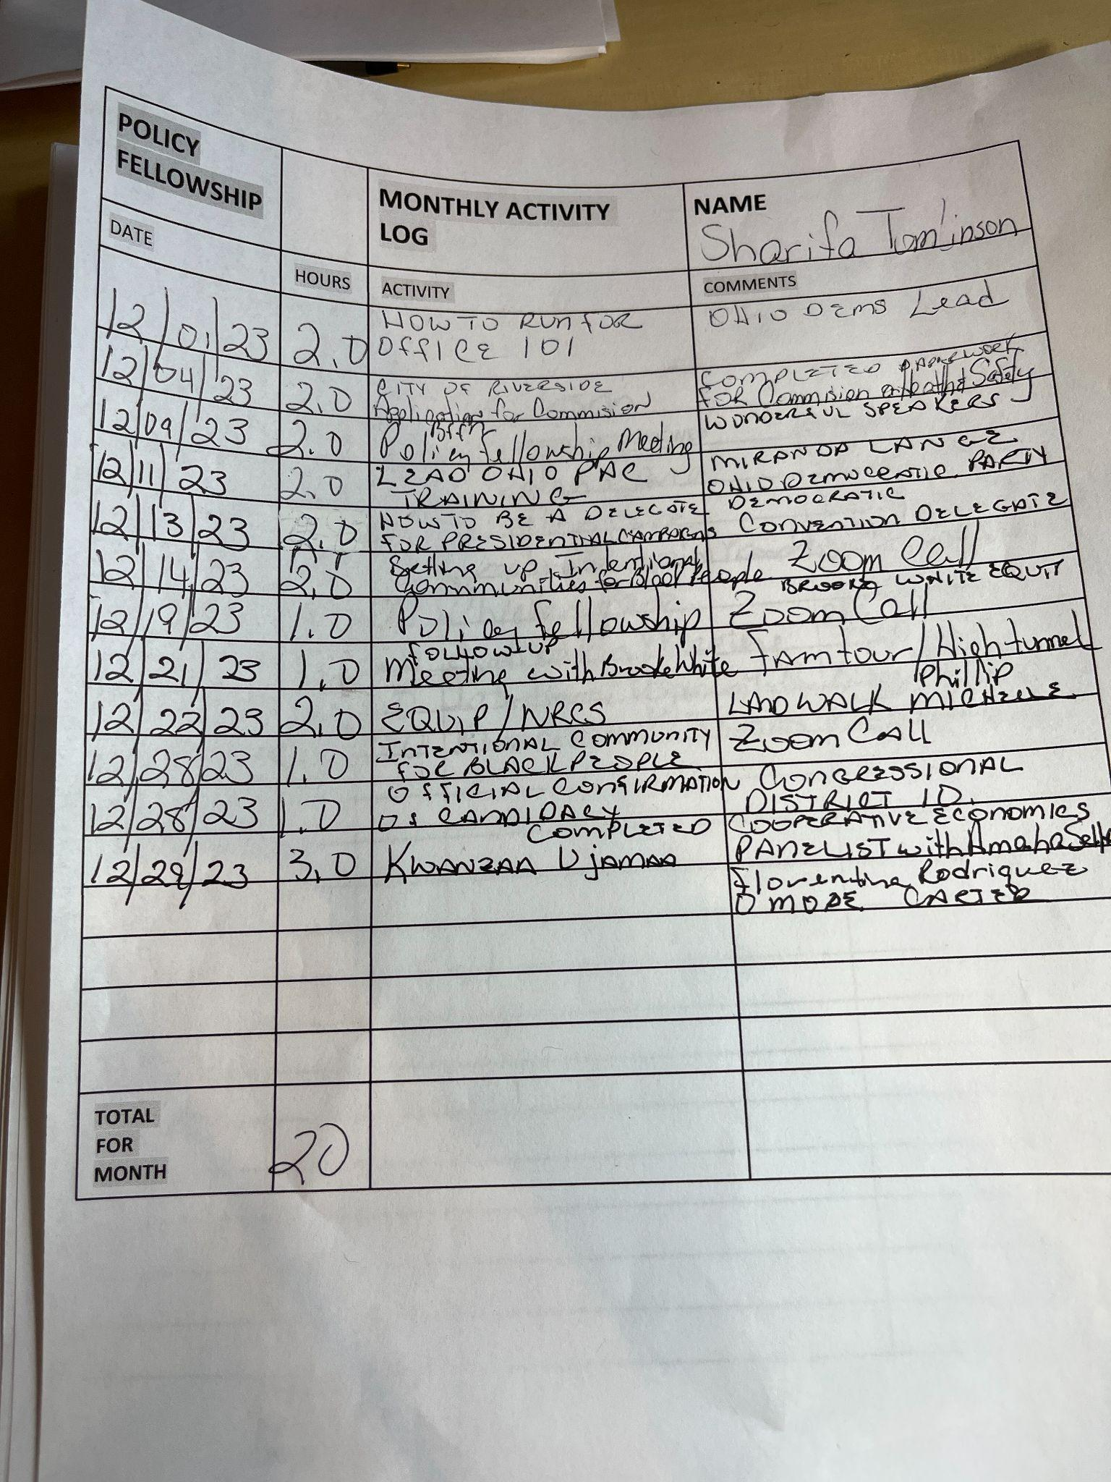
Monthly Reports from Fellows
Fellows turn in a monthly activity log that also serves as their timesheets detailing their Capstone work, seminar participation and related policy fellowship requirements, such as attending local government meetings and readings.

