Slide 1
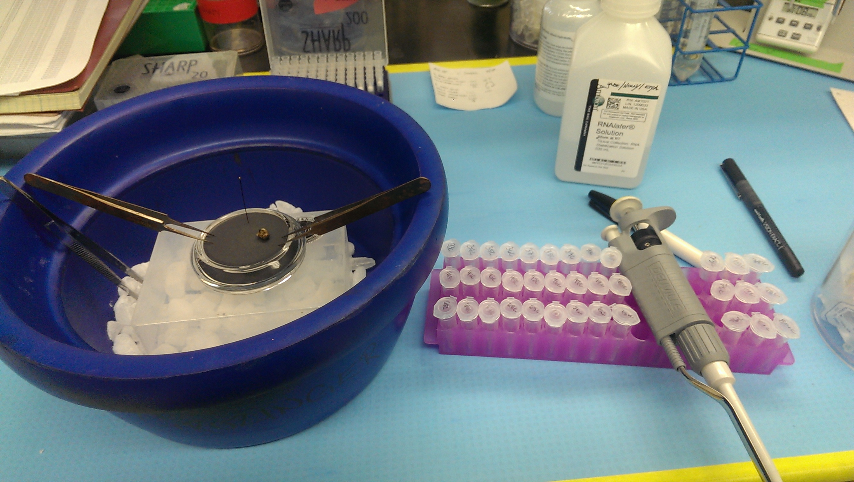
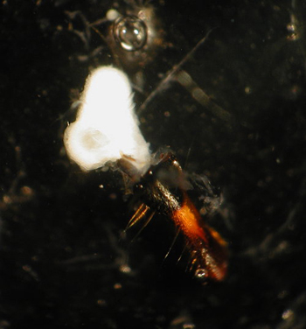
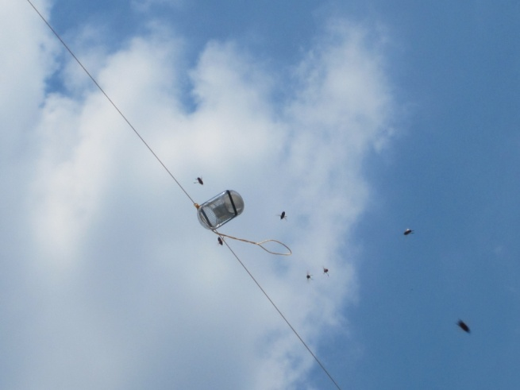
Behavioral and Chemical Characterization of Drone-produced Mandibular Gland Compounds in the Honey Bee
Gabriel Villar¹, Abraham Hefetz², Christina Grozinger¹
¹The Pennsylvania State University, Department of Entomology, The Center for Pollinator Research, The Huck Institutes of the Life Sciences. University Park, PA
² Tel Aviv University, Department of Zoology, George S. Wise Faculty of Life Sciences, Ramat Aviv, Israel
Abstract
Pheromones play a critical role in shaping the social structure of societies of social insects, including honey bees (Apis mellifera). While diverse functions have been ascribed to queen- and worker-produced compounds, few studies have explored the identity and function of male (drone) produced compounds. However, several lines of evidence suggest that drones engage in complex social interactions within and outside of the colony. Here we test the hypothesis that compounds produced in the drone mandibular gland mediate drone social interactions, and detail for the first time the chemical composition of these glands. Investigating the identity of drone-produced compounds is a first step in understanding whether drone-drone and drone-worker interactions are chemically mediated.
Background
Drone chemical signaling may mediate interactions, specifically aggregations, among drones. Sexually mature drones fly out of the colony and aggregate at specific drone congregation areas (DCAs) with other drones. Here they wait for virgin queens to arrive at which point they scramble to mate with her¹. Because the location of a DCA is stable over time, it has been hypothesized that drones locate them primarily by following specific features in the landscape²; however, it has also been demonstrated that the extracts from drone mandibular glands (DMG) can elicit long range attraction of other drones³, suggesting an alternate chemically mediated mechanism for the formation and/or maintenance of DCAs.
Chemical communication may also play a role in additional drone-associated interactions inside the colony. A small subset of workers in the colony perform a “shaking” signal on drones, where workers approach and grab the abdomen of drones and briefly vibrate⁴. This behavior is biased towards younger drones and appears to increase their solicitation of food from nurses. This selective targeting suggests that workers may be identifying drones of different ages from odorants they produce.
In order to ultimately understand whether drone-associated interactions are mediated by drone-produced odorants, we must first identify the compounds that are being produced by drones so that we can ascertain their biological activity.
Results
A
B
p= 0.0132
C
D
Figure 1. We were able to identify 19 of the compounds produced in the drone mandibular gland, constituting 65% of the total contents of the gland. Unidentified compounds account for the outstanding 35% (data not shown). Gland components consist primarily of saturated and unsaturated fatty acids. The six compounds that were found in greatest proportion and at a ratio of 105:94:36:19:13:10 were used to create the synthetic blend we used in field trials.
Figure 2. Drone long-range (A,C) and short-range (B,D) responses to lures impregnated with a solvent control and natural drone mandibular gland extracts (A,B; N=15) or a synthetic blend (C,D; N=10) of the six major components of the drone mandibular gland. Both the natural extracts and the synthetic blend tested recruited drones to the lures to a significantly greater extent than the solvent control. Short range responses to the natural extracts did not differ from the control. However, short range responses to the synthetic blend were significantly greater than those to the control.
Methods
Chemical characterization of the drone mandibular gland: Briefly, 80 glands were dissected and extracted in methanol overnight, derivatized, and processed on a GC-MS. Chromatograms were scored and compounds were identified according to their retention times and mass spectra using the National Institute of Standards and Technology’s mass spectral library. Compound identities were confirmed using analytical standards.
Field tests of natural drone mandibular extracts and synthetic blend. Natural extracts were created from 40 dissected drone glands which were extracted overnight in 100 μl of diethyl ether. Synthetic blends contained the six most prominent compounds in the drone gland in the ratio we identified them to be represented in the DMG relative to each other (105:94:36:19:13:10). 300 μg of the blend was used in each synthetic blend trial as the treatment. Natural extracts or synthetic blends in a total volume of 100 μl of solvent were used to impregnate Whatman paper discs which were suspended ~10 meters high adjacent to our research apiary. A solvent control was also hung at the same location, 20 meters from the gland extracts. Lures were simultaneously video recorded and the videos were used to identify the number of drones recruited to the area in which the lure was hung (“long range attraction”) and which altered their flight path or behavior in close proximity to the lures (“short-range attraction”). Videos were scored every five minutes for twenty minutes. Natural extract data represents three replicates and synthetic extract data represents two replicates.
Discussion
We have identified, for the first time, a majority (by % composition) of the compounds produced in the drone mandibular gland. This is an instrumental first step in identifying whether drone-produced compounds are mediating or facilitating social or antagonistic interactions in and outside of the colony. A previous study showed that extracts from drone mandibular glands was able to attract drones within an apiary³. We have confirmed this finding and elaborated on it by demonstrating that we can elicit attraction using natural extracts away from an apiary.
As a result of our chemical analysis, we identified the primary compounds produced in the drone mandibular gland to be hexadecanoic, octadecenoic, octadecanoic, tetradecanoic, hexadecenoic and pentadecanoic acids at a ratio of 105:94:36:19:13:10 relative to each other. These compounds are commonly found in the glands of worker and queen honey bees. Though aliphatic, some of these compounds are volatile and odorous and may be detected over range.
Interestingly, our test of a blend of these six compounds in the proportions found in the gland yielded significantly greater short and long range responses from drones than the solvent controls, indicating that there might be some biological activity to at least one of these six compounds. We used what we believe to be a very high concentration of this blend, representing more than the 20 drone equivalents that were tested in the natural blend studies. This is consistent with the bolstered increase in long-range recruitment of the synthetic blend. Note that short-range responses did not scale up accordingly between the natural and synthetic blend trials. This may indicate a lack of short-range function outside of the colony for drone mandibular gland compounds. Rather, drones may be using these compounds more generally, to identify the presence of other drones at congregation areas, possibly gauging competition at these sites.
Here, we identified a majority of the compounds produced in the drone mandibular gland, have confirmed previous studies which have shown some attractive qualities of the compounds in the glands and have identified the primary components which may contain much of the biological activity of the gland. However, future studies are needed to determine if production of these compounds is associated with sexual maturation and mating flight behavior in drones, and if these compound influence drone-drone and drone-worker interactions in the hive.
References
Ruttner, H. & Ruttner, F. 1972 Investigations on the flight activity and mating behaviour of drones: Drone congregation areas and mating distance. Apdologie 3, 203–232.
Galindo-Cardona, A., Monmany, A. C., Moreno-Jackson, R., Rivera-Rivera, C., Huertas-Dones, C., Caicedo-Quiroga, L. & Giray, T. 2012 Landscape analysis of drone congregation areas of the honey bee, Apis mellifera. J. Insect Sci. 12, 122
Lensky, Y., et al. "Pheromonal activity and fine structure of the mandibular glands of honeybee drones (Apis mellifera.)(Insecta, Hymenoptera, Apidae)." Journal of insect physiology 31.4 (1985): 265-276.
Boucher, Marina, and Stanley S. Schneider. "Communication signals used in worker–drone interactions in the honeybee, Apis mellifea." Animal Behaviour 78.2 (2009): 247-254.
Acknowledgements
I would like to thank Bernardo Niño and Mario Padilla for their technical support in the field and to members of the Grozinger Lab for their professional support. Special thanks to my mentor, Christina Grozinger, and to my esteemed collaborator Abraham Hefetz whose expertise has been instrumental in the progression of these studies. This research is supported by a USDA-NIFA Predoctoral Fellowship Award to GV, a NE-SARE student research grant awarded to GV, and a Predoctoral Fellowship from the Alfred P. Sloan Foundation awarded to GV.
Left to right: Sample collections; Honey bee mandibular gland still attached to mandible; Drone responses to pheromone impregnated lure

