Slide 1

Powdery Mildew
Conventional vs Natural Farming
Donnetta Boykin

Slide 2
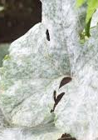
Agenda
Here’s The Skinny
Plan of Attack
Korean Natural Farming
Efficiency vs Effectiveness
Cons & Complications
Closing remarks

Slide 3
Here’s the Skinny
Powdery Mildew is a fungal disease that attacks the leaves, stems reducing production, decreased qualify of fruit and even cause death.
Cause by various fungal pathogens such as: Erysiphe, Microsphaera, Phyllactinia, Podosphaera, Sphaerotheca, and Uncinula
It is spread by wind and/or can splash onto the plant during irrigation if present on the soil
Plants to watch: Sunflowers, Wheat, Grapes, Squash, Melons, Cucumbers, Legumes, Greens, Tomatoes, Strawberries, Apples, Onions, Pears, Barley, Lilacs, Hydrangea, Roses, Zinnias, Peony etc.
Loves cool humid nights and dry warm days

Slide 4





Plan of attack
Stargus
Cerva
Milk
KNF
Non-treated
biofungicide
Copper Fungicide
Organics Milk– Unpasteurized is best
JMS (microorganism solution)
JS (sulfur solution)
JWA (wetting agent

Slide 5
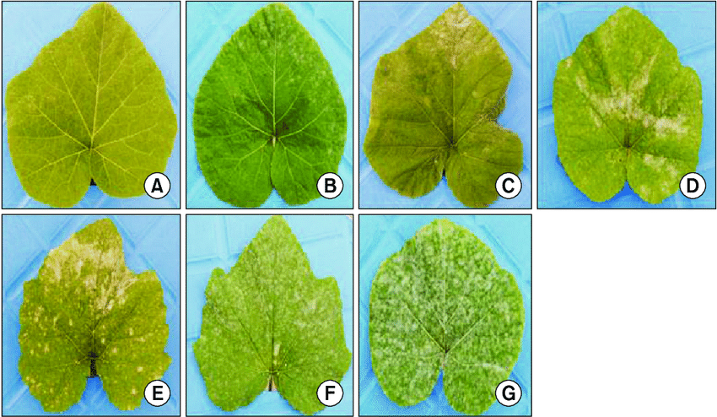
The Scale

Slide 6
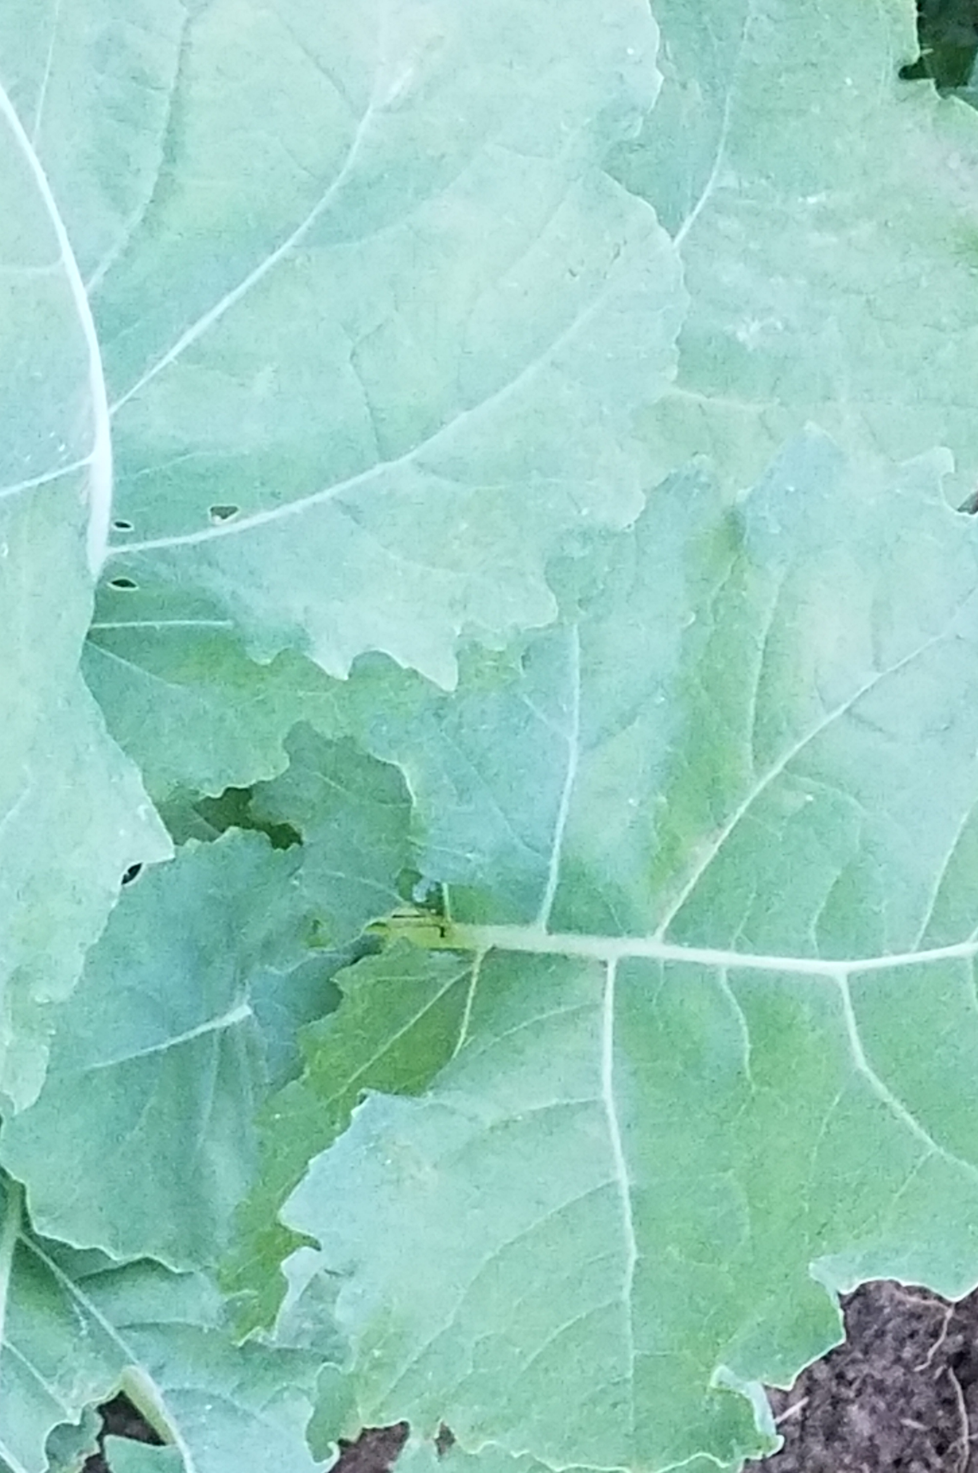
Korean Natural Farming
Master Cho vs JADAM Organics

Slide 7
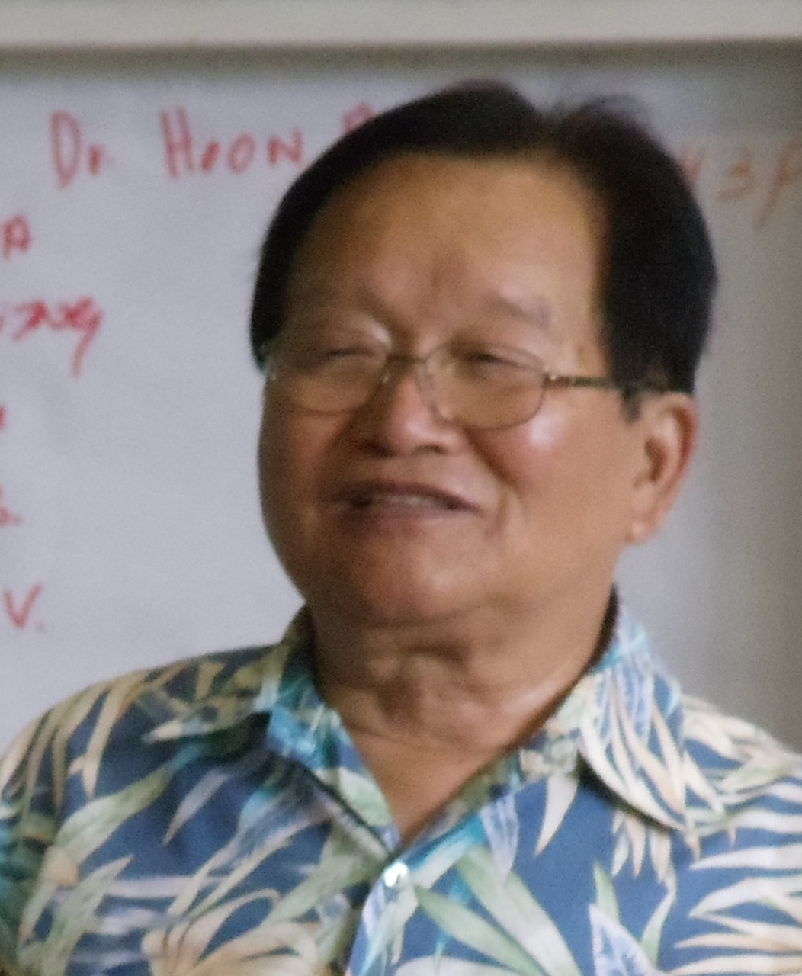
Drake & Master Cho
Developed by Hankyu Cho of the Janong Farming Institute
Indigenous Microorganisms (IMO) and Nutritive Cycles to create healthy soil instead of harsh chemicals
Eric Drake Weinert
https://naturalfarminghawaii.net/

Slide 9
JADAM Organic
This is considered the “quick and dirty” version of KNF
Developed by the Master Cho’s son Youngsang Cho
It uses chemicals that are considered safe and are listed on the USDA Organics list
Misuse or over use can have a negative impact
The solutions take up to 4 days to create but have a “forever” storage life
The solutions can be mixed to create the prefect tonic for the pest or disease you are addressing

Slide 10
Solutions of JADAM
JADAM MS
  Water
  Leaf Mold
  Potatoes
  Sea Salt or Sea Water
JADAM Fertilizer
  Water
  Leaf Mold
  Plant material
JADAM Wetting Agent
  Soft Water
  Canola Oil
  Potassium Hydroxide
JADAM Herbal Solution*
  Mint
  Rosemary
  Pokeweed
  Artichoke
    Any plant that has insecticide properties
JADAM Sulfur
  sulfur
  Sodium hydroxide
  water
  phyllite powder*
  red clay powder*
  sea salt
    *Can be made without

Slide 11
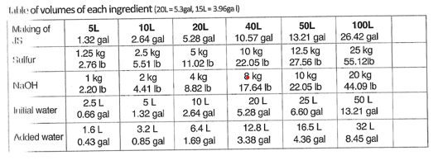
WHAT DID YOU DOOOOOO

Slide 12
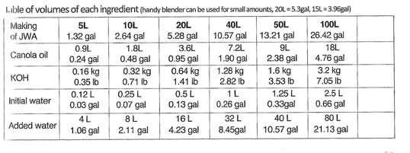
WHAT DID YOU DOOOOOO pt2

Slide 13
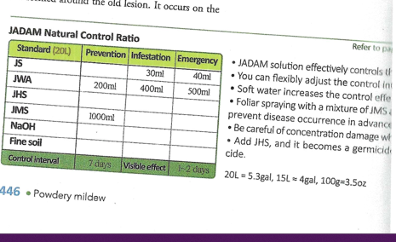
Powdery Mildew JADAM WAY
JWA and JMA are used for prevention
JS and JWA are used to attack

Slide 14
The beginning is the most important part of the work
“
”
- Plato

Slide 15
How Did It Workout? Efficiency vs Effectiveness
 | Time | Cost | Fruit Production | Efficiency
Stargus | 15 mins | $175.00 | 82.6 lbs | 4
Cerva | 15 mins | $139.75 | 108.9 lbs | 4
Milk | 15 mins;trips to market | $60.20 | 114.6 lbs | 4
KNF | 1-4 days; no expiration | $124.50 | 111.2lbs | 4

Slide 16
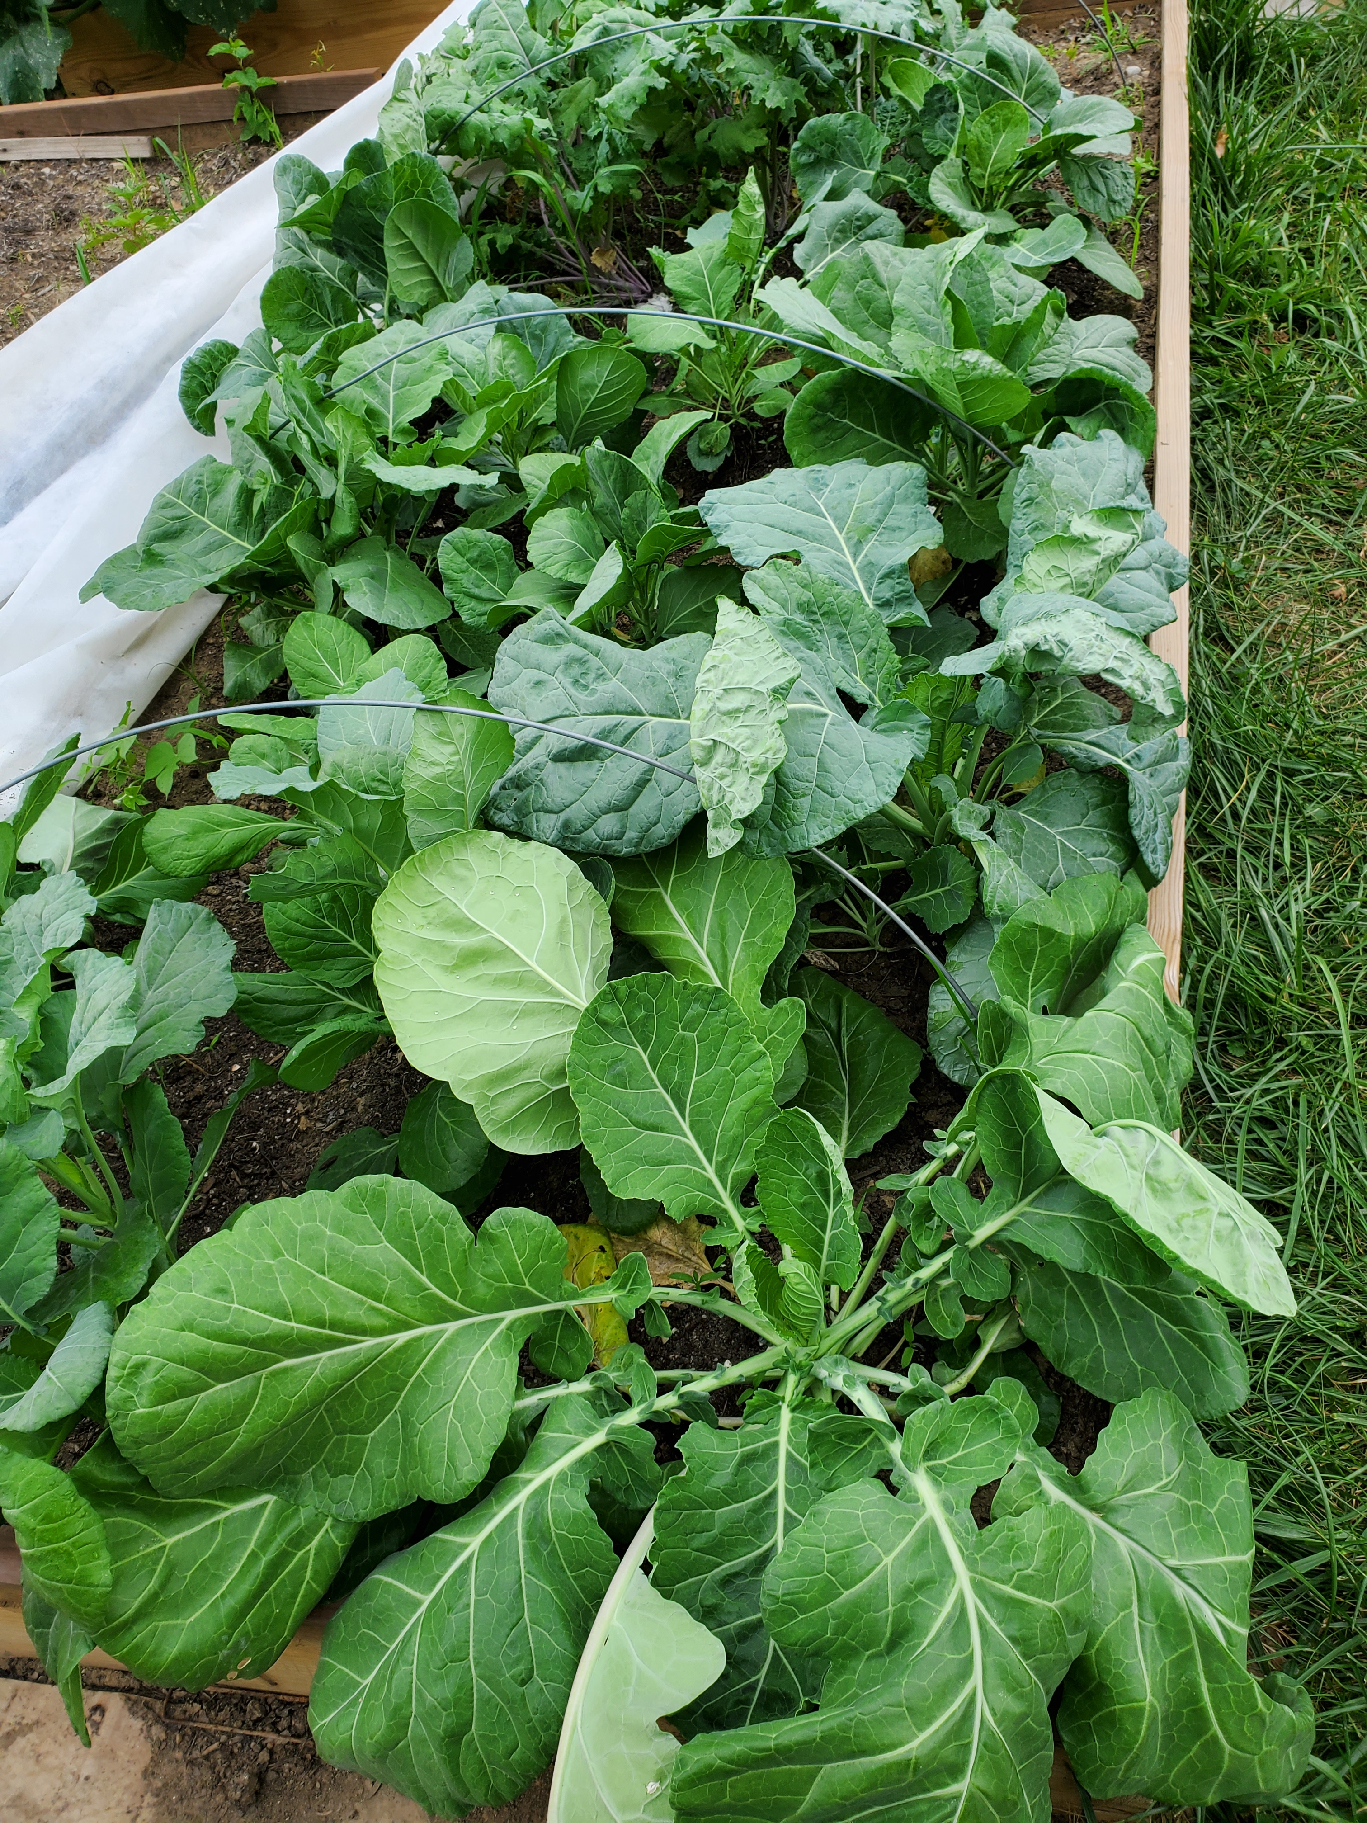
Cons & Observations
The nontreated beds were close by and them staying infected cause reinfections of powder mildew.
Milk - requires multiple trips to the store unless you own a cow. Must be applies early morning to allow time to dry before night fall
Didn’t like using PPE (KNF & Conventional)
Math is Math’ing – KNF
Conventional Methods
  Noticed plants died during the season (could have been due to a combination of mildew and squash beatless from new by plot) and struggled to continue producing new leaves once mildew reached 30%. It also produce less fruit than the milk and KNF methods.

Slide 17
Cons & Observations
Milk & conventional methods are the easiest to make
Milk - The plant remained the healthiest and continued to produce new leaves and healthy fruit until temp drop
KNF - Could have possibly been more effective if using all of KNF mixes and if grown in a separate area.
KNF- This method does require more precautions and time but the solutions don’t have an expiration date if stored properly.
Conventional methods are expensive and the best results were achieved when alternating the two

Slide 18
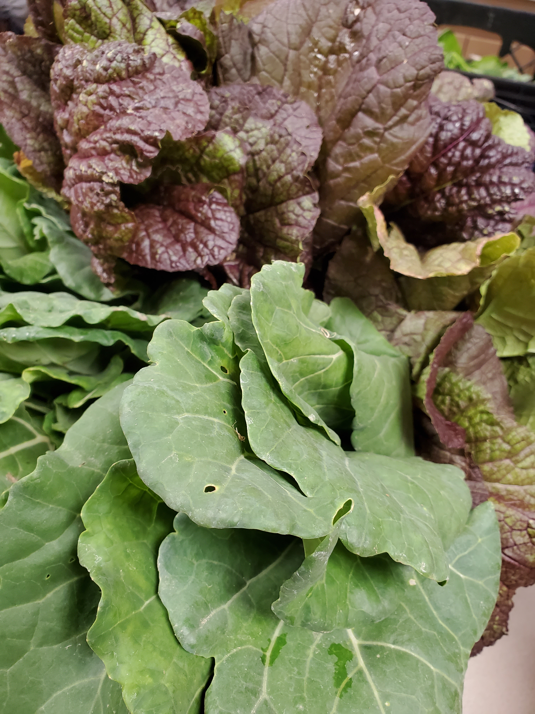
Closing remarks
You live and if you are blessed you learn!
This year I am finishing my last year of the grant.
The current goal it to attempt both techniques:
Chris Trump: https://www.biomei.solutions/

Slide 19
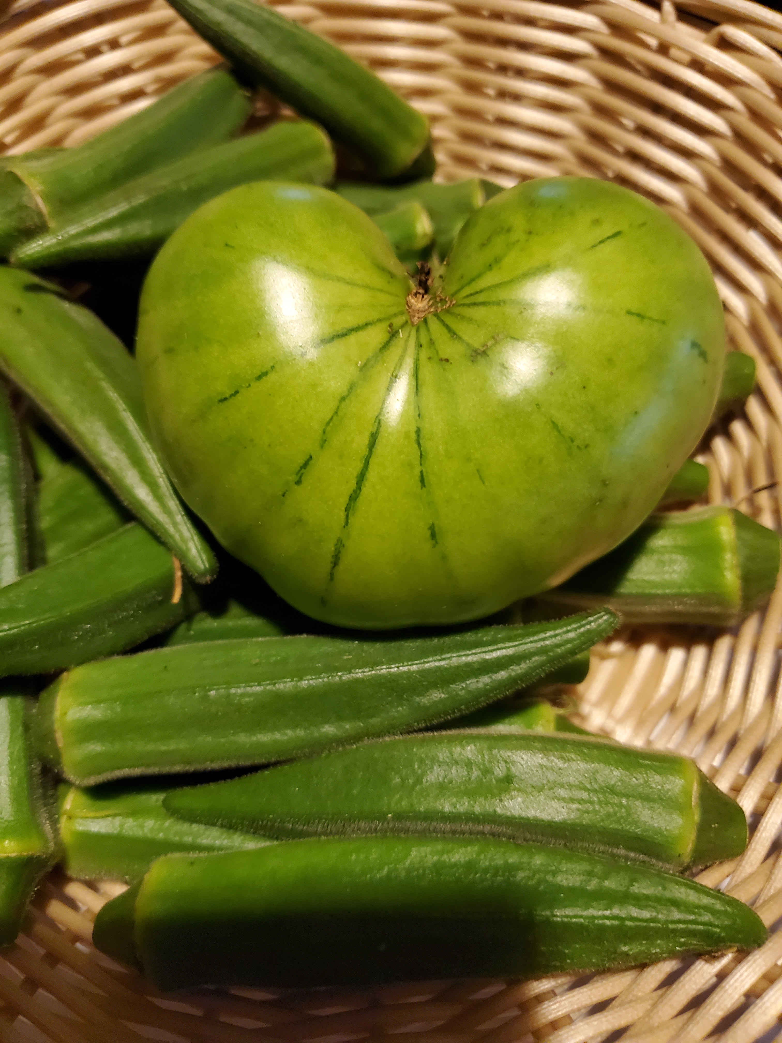
Thank you
Donnetta Boykin
  Support@NaturallyEndigo.com
  7seedsowers@gmail.com
  NaturallyEndigo.com
  SevenSeedSowers.org

