Slide 1
Microbial Communities on Aerial Surfaces: Disease Impact and Resource Dynamics
Max Aleman
Hockett Lab – Plant Pathology and Environmental Microbiology

Slide 2
Defining Aerial Surfaces
Notes:
Outer most layer of the host epidermis, typically consists of a layer of host epitherlial cells and a protective layer. There aerial surfaces act as the interface between the host interior and the external environment

Slide 3
Defining Aerial Surfaces
Skin
Upper respiratory tract
‘Mushroom’ (sporocarp)
Stems
Leaves
Flowers
Notes:
We can find aerial surfaces across many organisms Many different forms of these aerial surfaces exist

Slide 4
Defining Aerial Surfaces
Outer layer of Skin
Upper respiratory tract
‘Mushroom’ (sporocarp)
Leaves
Notes:
In thinking about aerial surfaces Now that it’s narrowed down a little bit, we can also draw a couple generalizable functions that host aerial surfaces aid.

Slide 5
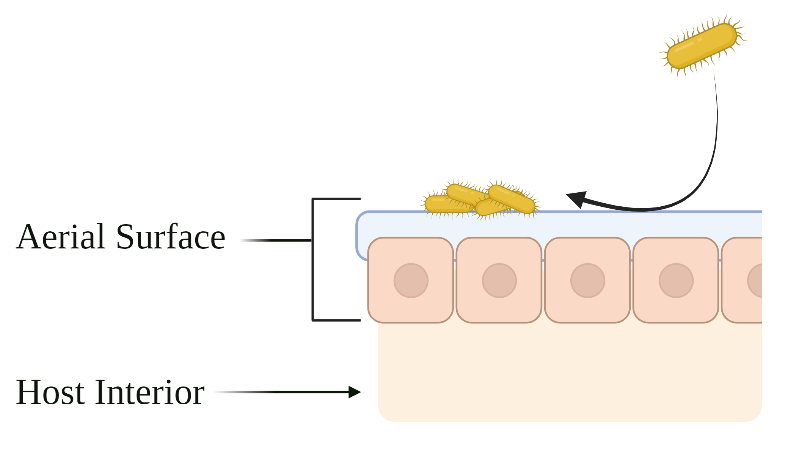
Function of Aerial Surfaces
Protects host tissue from invasion by microbes
1
Notes:
Leads to the accumulation of bacteria in consistent association with the aerial surface
This is particularly interesting as we often consider plant and fungal aerial surfaces to be resource poor- an outcome aided by the aerial surface
This is particularly tough as we often consider aerial surface to be nutrient poor due to the second function

Slide 6
Function of Aerial Surfaces
Limits the flow of material from host interior to the aerial surface
Protects host tissue from invasion by microbes
1
2
Notes:
Which is that the aerial surfaces limit the diffusion of the material rich host interior to the exterior.
And I say limit

Slide 7
Function of Aerial Surfaces
Most resources utilizable by microbes on aerial surfaces diffuse from the host interior
Comprised of nutrients (sugars, amino acids, etc.), primary and secondary metabolites
Composition of resources significantly impacts aerial surface colonizers
Limits the flow of material from host interior to the aerial surface
2
Notes:
Leads to the accumulation of bacteria in consistent association with the aerial surface
This is particularly interesting as we often consider plant and fungal aerial surfaces to be resource poor- an outcome aided by the aerial surface
This is particularly tough as we often consider aerial surface to be nutrient poor due to the second function

Slide 8
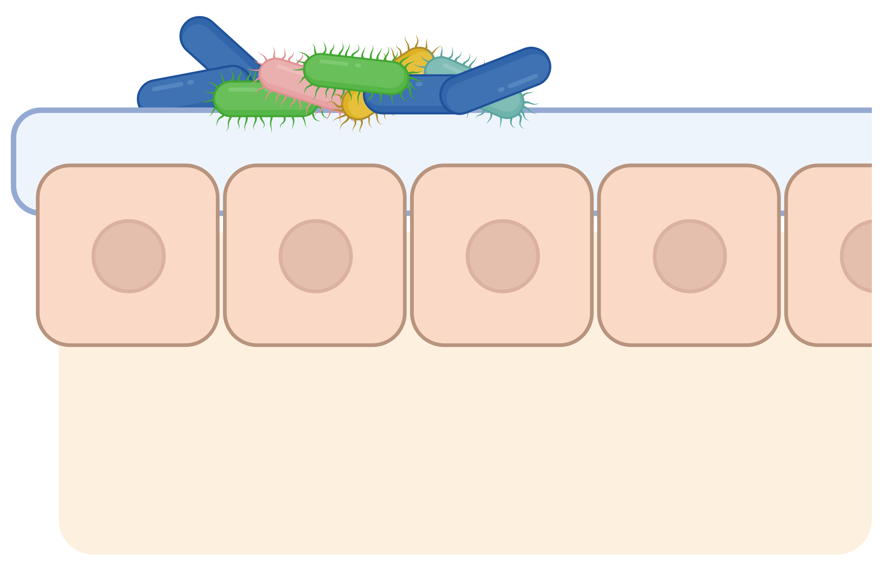
Altered Host Metabolism
Asymptomatic Phenotype: Unaltered host metabolic output; no significant stressor present.
Notes:
MICROBIOMES ARE IMPORANT FOR THE HEALTH OF THE HOST AND WE KNOW THAT
Things not a fan: you’re showing that they’re endophytic
Symptomatic phenotype and then showing a change on the microbial community on the surface

Slide 9
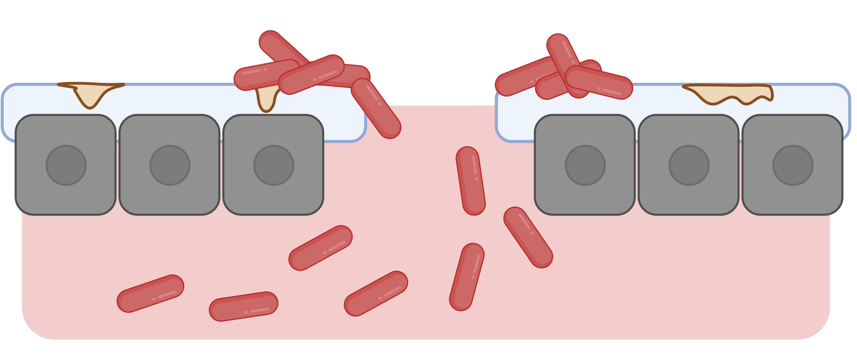
Altered Host Metabolism
Asymptomatic Phenotype: Unaltered host metabolic output; no significant stressor present.
Symptomatic Phenotype: Altered host metabolic output due to infection by pathogen; disease symptoms are present.
Notes:
MICROBIOMES ARE IMPORANT FOR THE HEALTH OF THE HOST AND WE KNOW THAT
Things not a fan: you’re showing that they’re endophytic
Symptomatic phenotype and then showing a change on the microbial community on the surface

Slide 10
Tie in host surfaces to disease
Notes:
Goal of the work I’ve done is to define trends in aerial surfaces during altered metabolic states. Specifically, I’ve wanted to know the extent of change that occurs solely at this surface as it is the first step in invasion into the host
Change the background of the left in number 1 -> take out the pathogenic cells | On the right, presence of pathogen will alter the microbiome but can also affect the microbiome
Even don’t need to get into the weeds to get into the GAM model and DESeq

Slide 11
Notes:
Are there any generalizable patterns in the change of microbiomes or resources available at this host interface during disease? Due to the importance of the microbiome, and the function of the protective layer, I’m curious if disease alters the chemical composition of this

Slide 12
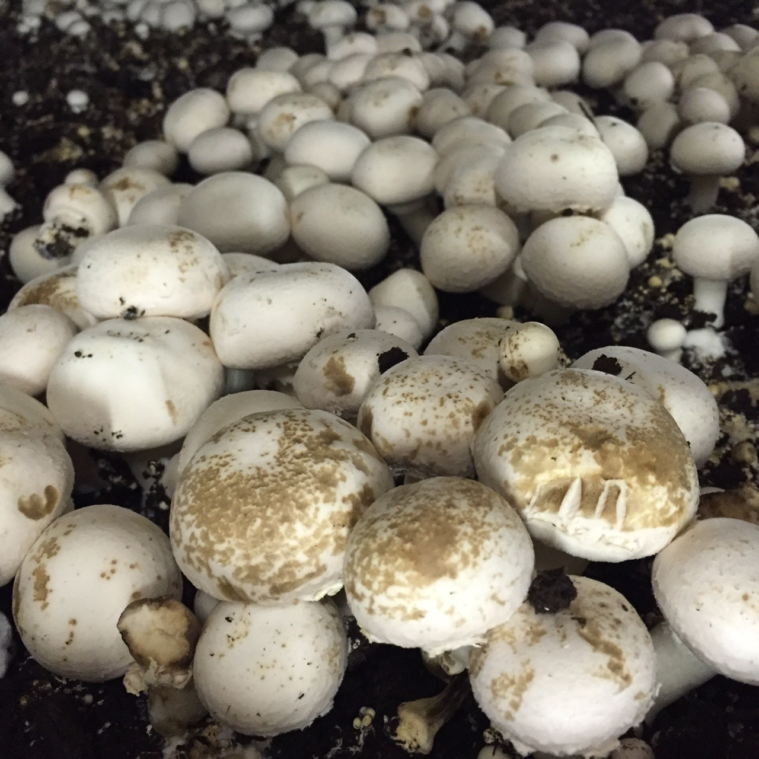
Bacterial Blotch on White Button Mushroom Microbiomes
Bacterial Blotch was first reportedly caused by P. tolaasii; now many species are known to cause blotch-like symptoms
Caps with visible lesions (symptomatic; S) and no visible lesions (asymptomatic; A)
Carolee Bull, 2018
Carolee Bull, 2018
Notes:
Agaricus bisporus, or as we know it white button mushroom, account for 85% of all mushrooms sold as ‘fresh’ in America, which is about a 1.2 billion dollar industry. One of the more commercially impactful diseases in this system is bacterial blotch. This is due to the brown lesions that form on the cap surface that stops sellers from marketing them to customers.
Fresh market mushrooms are a 1.2 billion dollar industry, and ~ 85% of those mushroom sold as ‘fresh’ are agaricus bisporus. One commericially impact disease to affect bisporus is bacterial blotch.
Causes a brown lesion that is typically slimey to the touch. Diseased mushrooms can not be sold as consumers don’t want to by mushrooms like this, it as well reduces how long they can be stored before using.
Bacterial Blotch was first reportedly caused by P. tolaasii; now many species are known to cause blotch-like symptoms
Caps with visible lesions (symptomatic; S) and no visible lesions (asymptomatic; A) were collected as pairs throughout the mushroom growing facility.

Slide 13
Bacterial Blotch on White Button Mushroom Microbiomes
Pseudomonads within the growing substrate are critical for proper mushroom formation and development
Mushroom Pathogens
Pseudomonas tolaasii
Pseudomonas salomonii
Pseudomonas agarici
Mushroom Growth Promoters
Pseudomonas putida
Pseudomonas fluorescens
Pseudomonas chlororaphis
Carolee Bull, 2018
Carolee Bull, 2018
Notes:
Controlling bacterial blotch is actually challenging, as we there are many positive growth promoters in the growing substrate. To make it more challenging organisms that play a very positive and negative role are within the Pseudomonas genus. These organisms are found ubiquitously within the growing house and substrate as they persist through pasteurization. And typically it’s through environmental conditions like water persisting on mushroom caps that causes the initiation of symptoms.
Bacterial Blotch was first reportedly caused by P. tolaasii; now many species are known to cause blotch-like symptoms
Caps with visible lesions (symptomatic; S) and no visible lesions (asymptomatic; A) were collected as pairs throughout the mushroom growing facility.

Slide 14
Bacterial Blotch on White Button Mushroom Microbiomes
Initial publication by Samuel Martins investigated the impact of Bacterial Blotch Disease on mushroom microbiomes to the genus level.
Carolee Bull, 2018
Carolee Bull, 2018
Notes:
Curious if we could find trends in the communities associated with either phenotype; this gives us insight into future directions for
Bacterial Blotch was first reportedly caused by P. tolaasii; now many species are known to cause blotch-like symptoms
Caps with visible lesions (symptomatic; S) and no visible lesions (asymptomatic; A) were collected as pairs throughout the mushroom growing facility.

Slide 15
Resolution Relevant for Disease Diagnosis in Bacterial Blotch
Community One
Community Two
16s rRNA resolution (genus level)
16s rRNA resolution (genus level)
Notes:
The first problem with utilizing genus level resolutions is that it underestimates community diversity which can lead to
Make it clearer and compare 16s on the left and metagenomics on the right

Slide 16
Resolution Relevant for Disease Diagnosis in Bacterial Blotch
Community One
Community Two
Metagenomic resolution (Species / Subspecies level)
Metagenomic resolution (Species / Subspecies level)
Notes:
And the second problem is that a genus level resolution is not always relevant for disesase management, as is the case for mushroom systems since both pathogens and critical mushroom growth promoters are pseudomonads

Slide 17
Resolution Relevant for Disease Diagnosis in Bacterial Blotch
Community Two
Mushroom Pathogens
Pseudomonas tolaasii
Pseudomonas salomonii
Pseudomonas agarici
Mushroom Growth Promoters
Pseudomonas putida
Pseudomonas fluorescens
Pseudomonas chlororaphis
Metagenomic resolution (Species / Subspecies level)
Notes:
And the second problem is that a genus level resolution is not always relevant for disesase management, as is the case for mushroom systems

Slide 18
Goal: Identify taxonomic differences in Agaricus bisporus pileipellis (mushroom aerial surface) microbiomes associated with Asymptomatic and Bacterial Blotch Symptomatic phenotypes.
Notes:
quick methods on how I did the data stuff
I will alaso have that to say (kraken 2)
What questions can I get at that Martins

Slide 19
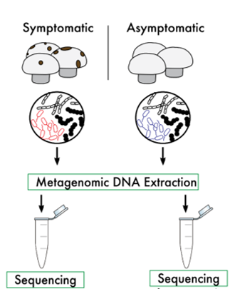
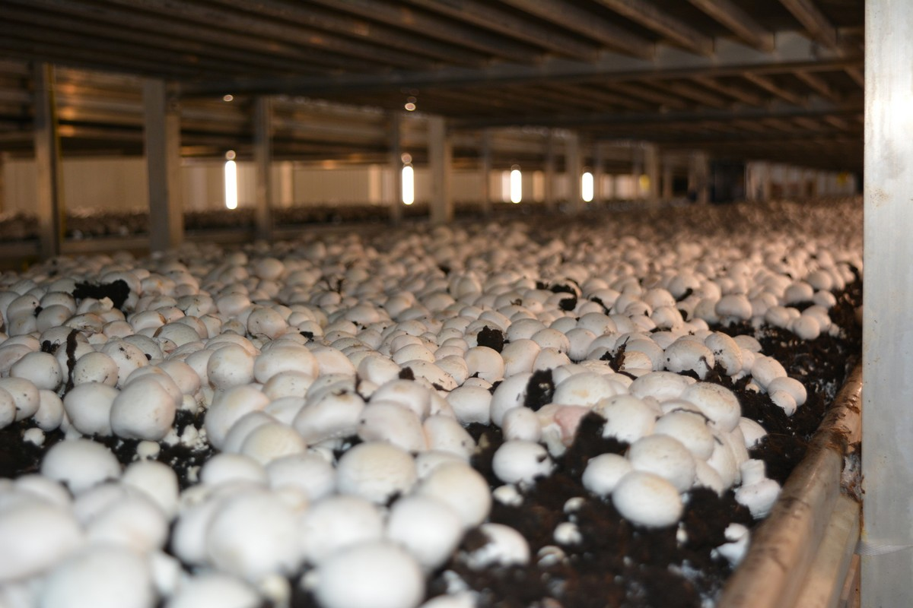
Sampling Methodology

Slide 20
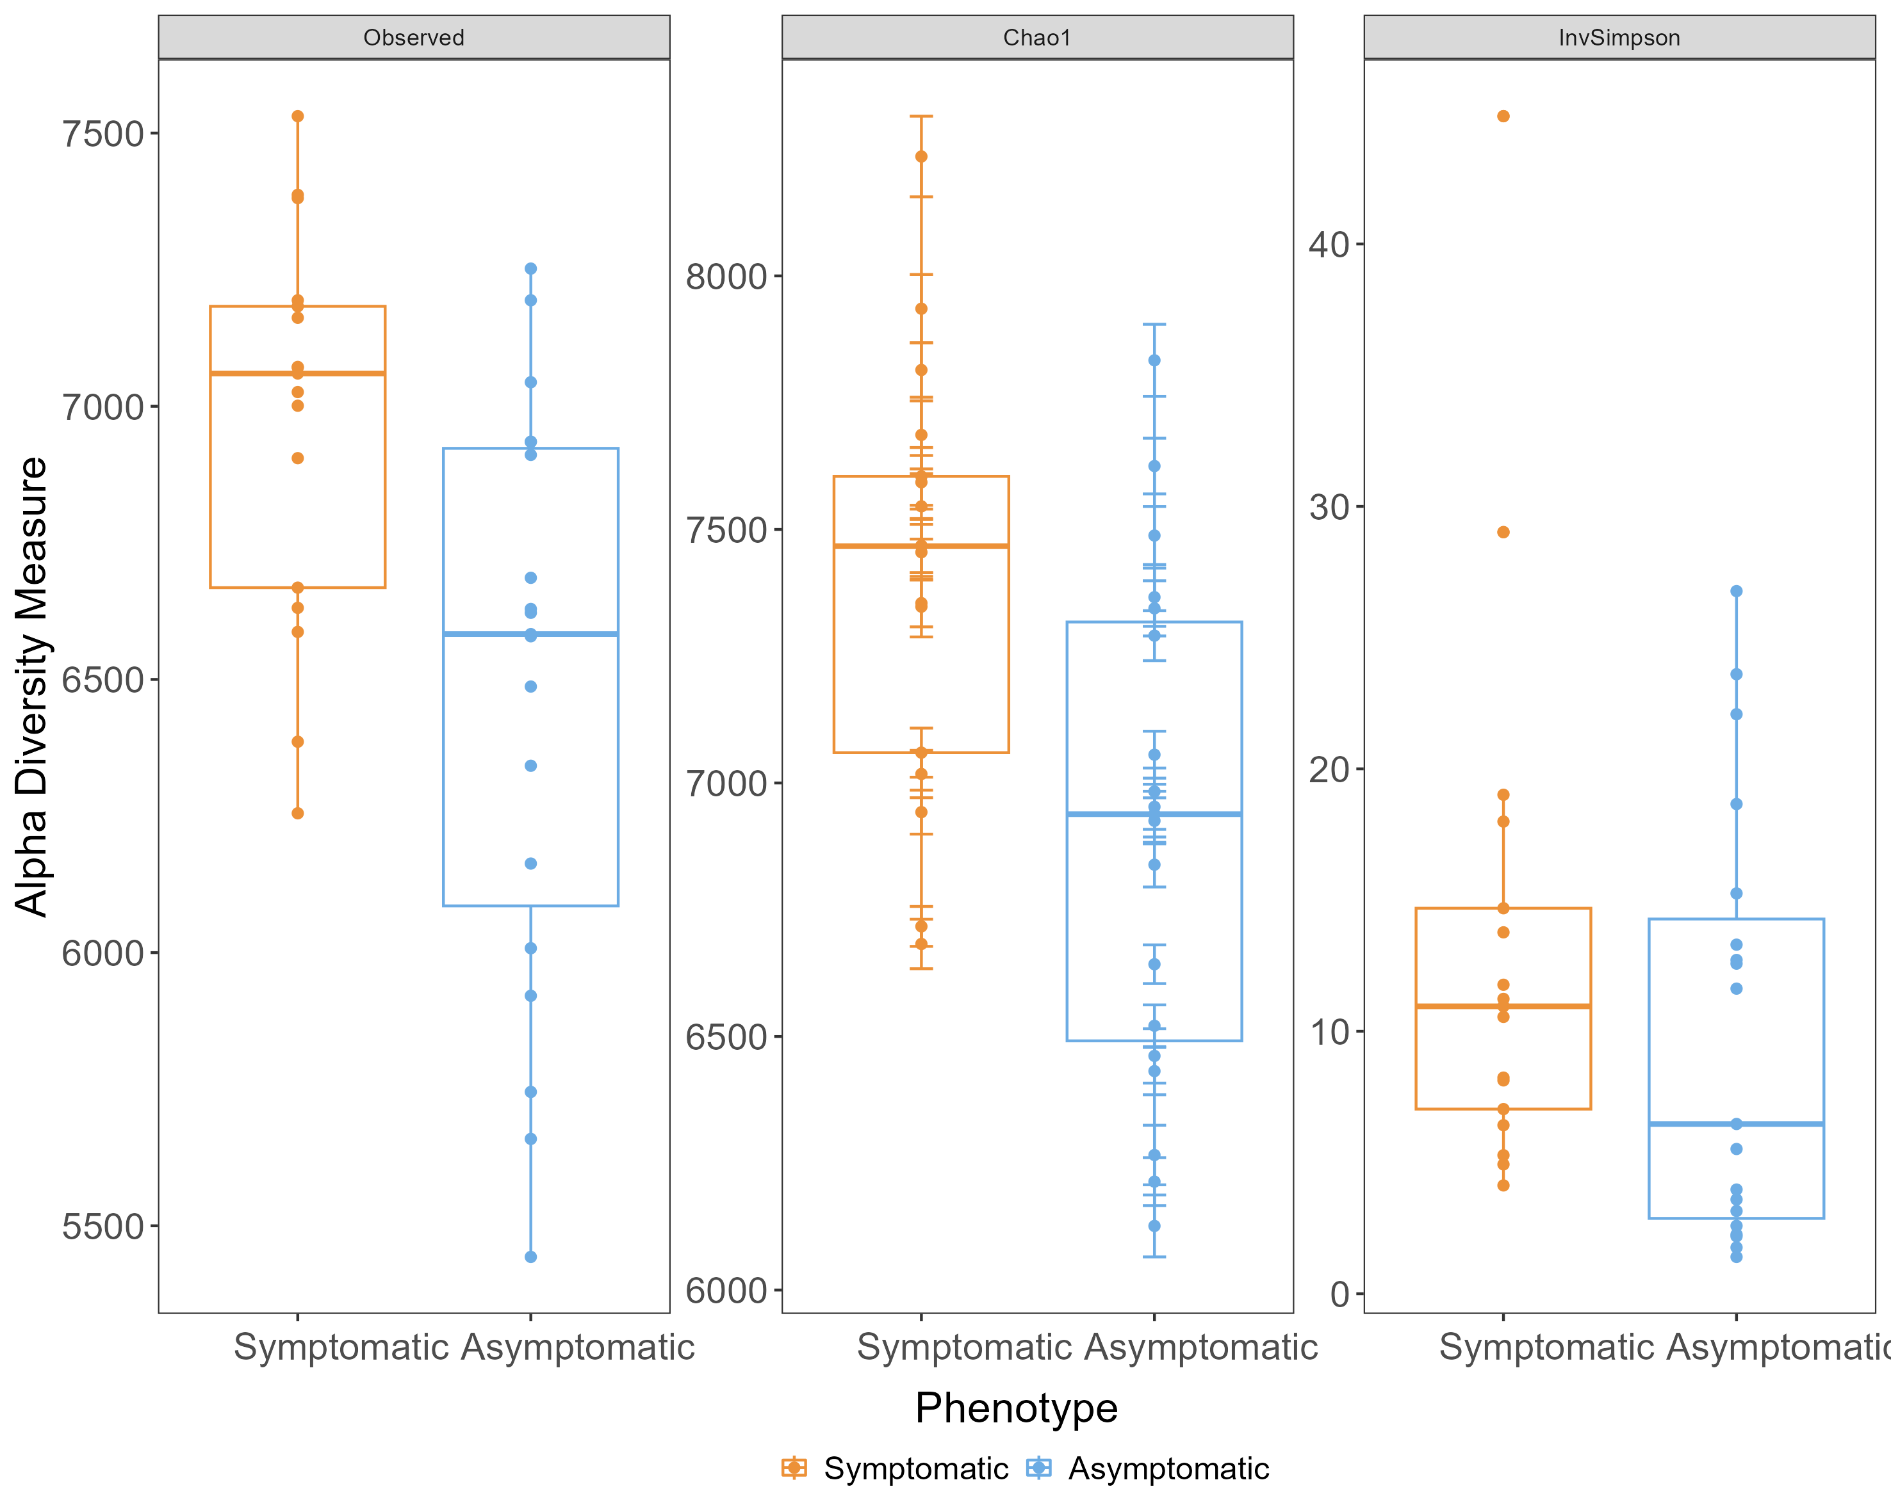
Observed
P = .005
P = .23
P = .005
Alpha diversity: species evenness and richness within a sample.
Notes:
number of species observed in a single sample or community. It's a basic measure of species richness, but it doesn't consider the relative abundance of each species
Increased their relative abundance in the S vs A
Could go at my presentation from two angles: start with my BETA diversity and say ‘okay the communities are kinda different but they aren’t overwhelming, and then going towards the communities are overall different.
Get rid of shannon and Invsimpson, and then go one by one of chao1 and invsimpson
Make the transition nicer, now that we are going to ‘zoom out’
Putida HAS to be present for spawning and fruiting
Chao1 under emphasives eveness and relies more on richness
Inv emphasizes evenness while taking into account richness
Increasing # of rare taxa we see within our communities; bringing them above the threshold of recognition
Invssimpson is a measure of the evenness of a community.
Chao1 is a measure of the richness of a community. It is an estimator of the number of species in a community, and it takes into account the fact that some species may be rare and therefore not sampled very often. Chao1 is therefore higher when there are more species in a community, regardless of their relative abundance.
Fisher alpha diversity is a measure of both the richness and evenness of a community. It is calculated as the product of Chao1 and the Shannon index, which is another measure of the diversity of a community. Fisher alpha diversity is therefore high when there are many species in a community and those species are all relatively abundant.

Slide 21
CHAO1
P = .23
P = .005
Alpha diversity: species evenness and richness within a sample.
Notes:
Chao1 is a measure of the richness of a community | Chao1 under emphasives eveness and relies more on richness | takes into account the fact that some species may be rare and therefore not sampled very often
Increasing # of rare taxa we see within our communities; bringing them above the threshold of recognition
Invssimpson is a measure of the evenness of a community.
Chao1 is a measure of the richness of a community. It is an estimator of the number of species in a community, and it takes into account the fact that some species may be rare and therefore not sampled very often. Chao1 is therefore higher when there are more species in a community, regardless of their relative abundance.
species diversity within a specific sample | many different species are present in that sample and how evenly abundant they are.
Alpha diversity, denoted by the Greek letter α (alpha), refers to the species diversity within a specific habitat or sample. It essentially tells you how many different species are present in that particular location and how evenly abundant they are.
Increase their relative abundance in the S vs A
Could go at my presentation from two angles: start with my BETA diversity and say ‘okay the communities are kinda different but they aren’t overwhelming, and then going towards the communities are overall different.
Get rid of shannon and Invsimpson, and then go one by one of chao1 and invsimpson
Make the transition nicer, now that we are going to ‘zoom out’
Putida HAS to be present for spawning and fruiting
Increasing # of rare taxa we see within our communities; bringing them above the threshold of recognition
Invssimpson is a measure of the evenness of a community.
Chao1 is a measure of the richness of a community. It is an estimator of the number of species in a community, and it takes into account the fact that some species may be rare and therefore not sampled very often. Chao1 is therefore higher when there are more species in a community, regardless of their relative abundance.
Fisher alpha diversity is a measure of both the richness and evenness of a community. It is calculated as the product of Chao1 and the Shannon index, which is another measure of the diversity of a community. Fisher alpha diversity is therefore high when there are many species in a community and those species are all relatively abundant.

Slide 22
Invsimpson
P = .21
Alpha diversity: species evenness and richness within a sample.
Notes:
Inv emphasizes evenness while taking into account richness
Could go at my presentation from two angles: start with my BETA diversity and say ‘okay the communities are kinda different but they aren’t overwhelming, and then going towards the communities are overall different.
Get rid of shannon and Invsimpson, and then go one by one of chao1 and invsimpson
Make the transition nicer, now that we are going to ‘zoom out’
Putida HAS to be present for spawning and fruiting
Chao1 under emphasives eveness and relies more on richness
Inv emphasizes evenness while taking into account richness
Increasing # of rare taxa we see within our communities; bringing them above the threshold of recognition
Invssimpson is a measure of the evenness of a community.
Chao1 is a measure of the richness of a community. It is an estimator of the number of species in a community, and it takes into account the fact that some species may be rare and therefore not sampled very often. Chao1 is therefore higher when there are more species in a community, regardless of their relative abundance.
Fisher alpha diversity is a measure of both the richness and evenness of a community. It is calculated as the product of Chao1 and the Shannon index, which is another measure of the diversity of a community. Fisher alpha diversity is therefore high when there are many species in a community and those species are all relatively abundant.

Slide 23
Take Away: Enrichment of rarer species in symptomatic communities drives a large portion of the differences observed between phenotypes.
Observed
CHA01
Invsimpson
Alpha diversity: species evenness and richness within a sample.
Notes:
Increasing # of rare taxa we see within our communities; bringing them above the threshold of recognition
Increase their relative abundance in the S vs A
Could go at my presentation from two angles: start with my BETA diversity and say ‘okay the communities are kinda different but they aren’t overwhelming, and then going towards the communities are overall different.
Get rid of shannon and Invsimpson, and then go one by one of chao1 and invsimpson
Make the transition nicer, now that we are going to ‘zoom out’
Putida HAS to be present for spawning and fruiting
Chao1 under emphasives eveness and relies more on richness
Inv emphasizes evenness while taking into account richness
Increasing # of rare taxa we see within our communities; bringing them above the threshold of recognition
Invssimpson is a measure of the evenness of a community.
Chao1 is a measure of the richness of a community. It is an estimator of the number of species in a community, and it takes into account the fact that some species may be rare and therefore not sampled very often. Chao1 is therefore higher when there are more species in a community, regardless of their relative abundance.
Fisher alpha diversity is a measure of both the richness and evenness of a community. It is calculated as the product of Chao1 and the Shannon index, which is another measure of the diversity of a community. Fisher alpha diversity is therefore high when there are many species in a community and those species are all relatively abundant.

Slide 24
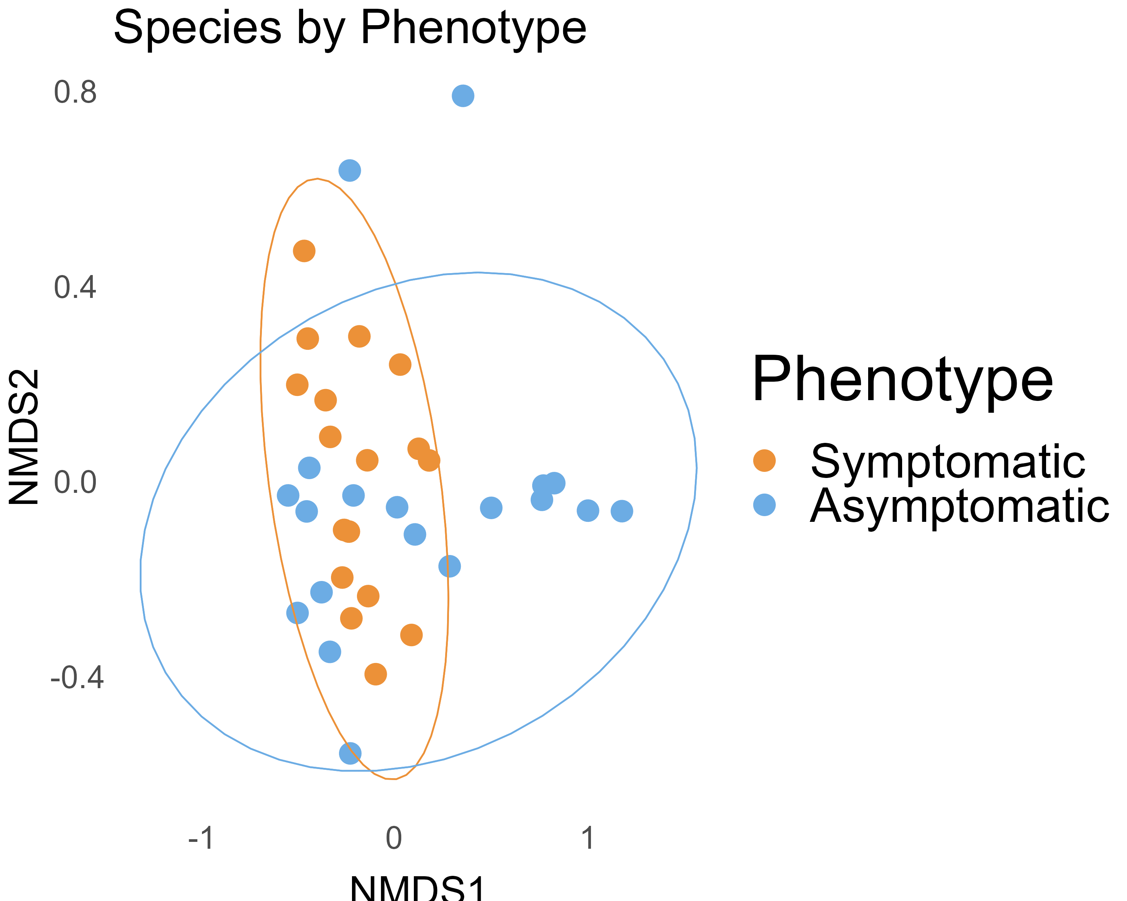
Take Away: No separation between asymptomatic and symptomatic communities.
Solid line: represents a 95% confidence interval
Beta diversity: ratio between regional and local species diversity; measures the distance or dissimilarity between each sample
Notes:
The numbers here need to be explained (the axis) about and I need to make sure I orient people FIRST to the slide and not go crazy

Slide 25
What is driving the difference between the asymptomatic communities?
1
Notes:
The numbers here need to be explained (the axis) about and I need to make sure I orient people FIRST to the slide and not go crazy

Slide 26
Are there differences between the asymptomatic communities?
1
Notes:
The numbers here need to be explained (the axis) about and I need to make sure I orient people FIRST to the slide and not go crazy

Slide 27
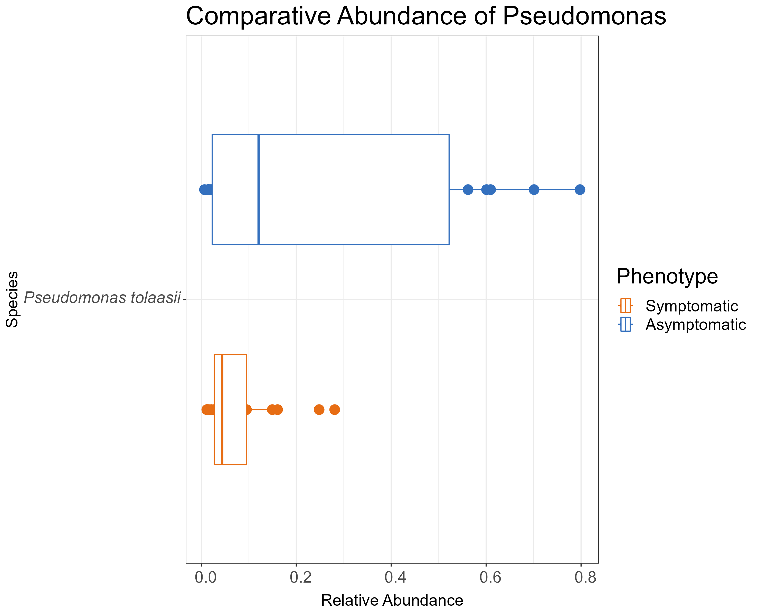
Take Away: P. tolaasii makes up between 55 - 80% of the total reads attributed to samples in the non-overlapping asymptomatic 95% confidence interval.
Relative Abundance of P. tolaasii
Notes:
The numbers here need to be explained (the axis) about and I need to make sure I orient people FIRST to the slide and not go crazy

Slide 28
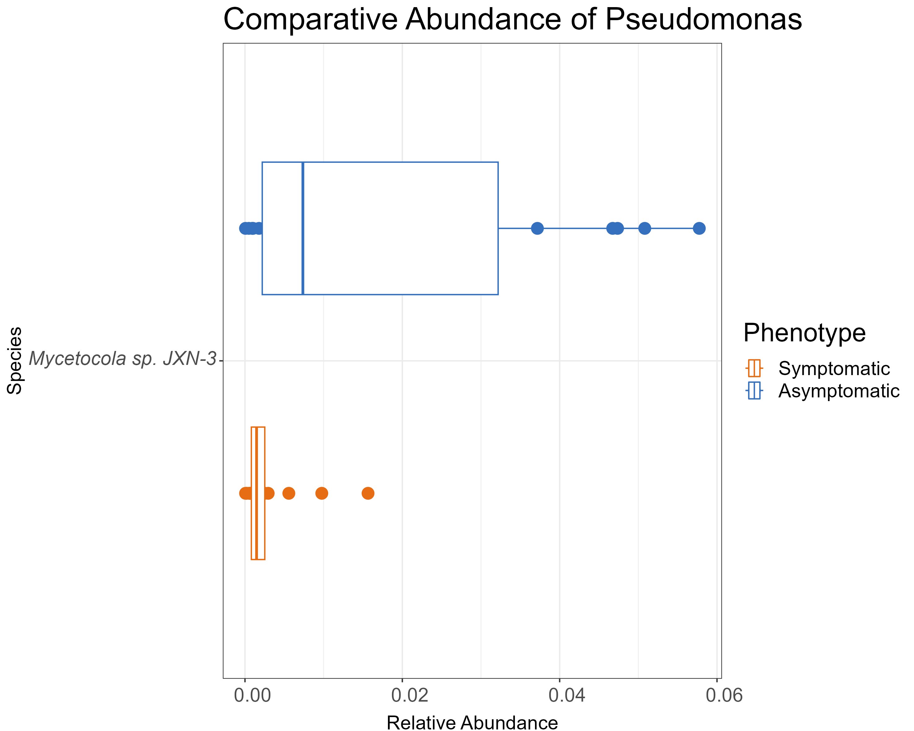
Take Away: Mycetocola sp. JXN-3 is significantly enriched in the same samples as P. tolaasii across both phenotypes.
Relative Abundance of Mycetocola sp. JXN-3
Notes:
Has been identified as a fungal pathogen of mushroom- typically considered the stipe

Slide 29
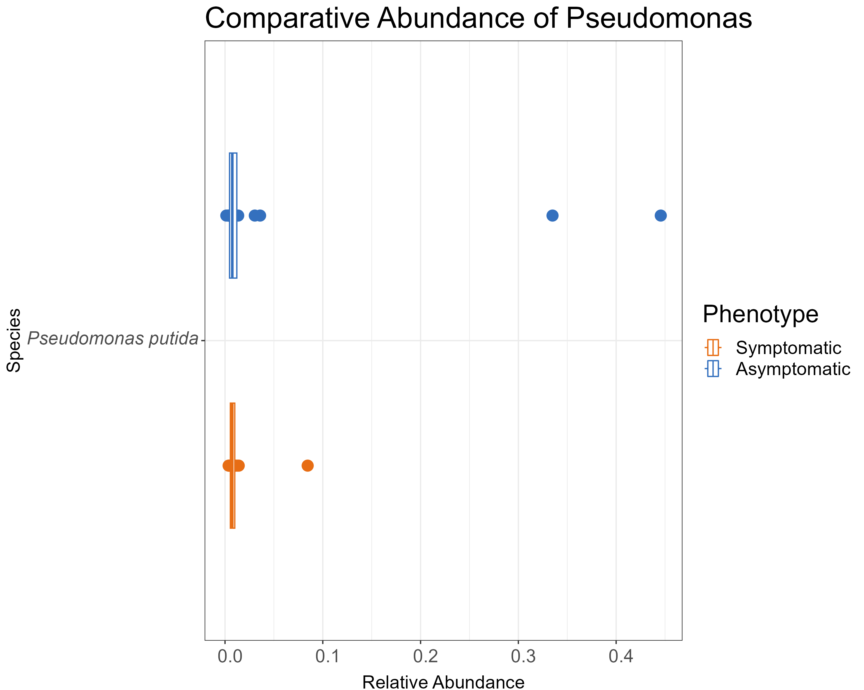
Take Away: P. putida makes up 33% and 45% of the total reads attributed to samples not overlapped by either 95% confidence interval.
Relative Abundance of P. putida
Notes:
The numbers here need to be explained (the axis) about and I need to make sure I orient people FIRST to the slide and not go crazy

Slide 30
What is driving the difference between the asymptomatic communities?
1
Are there differences between phenotypes?
2
Notes:
The numbers here need to be explained (the axis) about and I need to make sure I orient people FIRST to the slide and not go crazy

Slide 31
Are there differences between phenotypes?
2
Notes:
The numbers here need to be explained (the axis) about and I need to make sure I orient people FIRST to the slide and not go crazy

Slide 32
Are there differences between phenotypes?
2
Species | Pr(>|t|)
Mycetocola sp. JXN-3 | 2.43E-03
Pedobacter sp. HDW13 | 2.54E-03
Pseudomonas azotoformans | 3.21E-04
Pseudomonas fluorescens | 6.28E-19
Pseudomonas putida | 1.10E-16
Pseudomonas reinekei | 1.38E-02
Pseudomonas simiae | 7.39E-03
Pseudomonas sp. NS1(2017) | 3.51E-43
Pseudomonas tolaasii | 4.25E-06
Pseudomonas trivialis | 2.52E-02
Staphylococcus aureus | 1.11E-04
Notes:
The numbers here need to be explained (the axis) about and I need to make sure I orient people FIRST to the slide and not go crazy

Slide 33
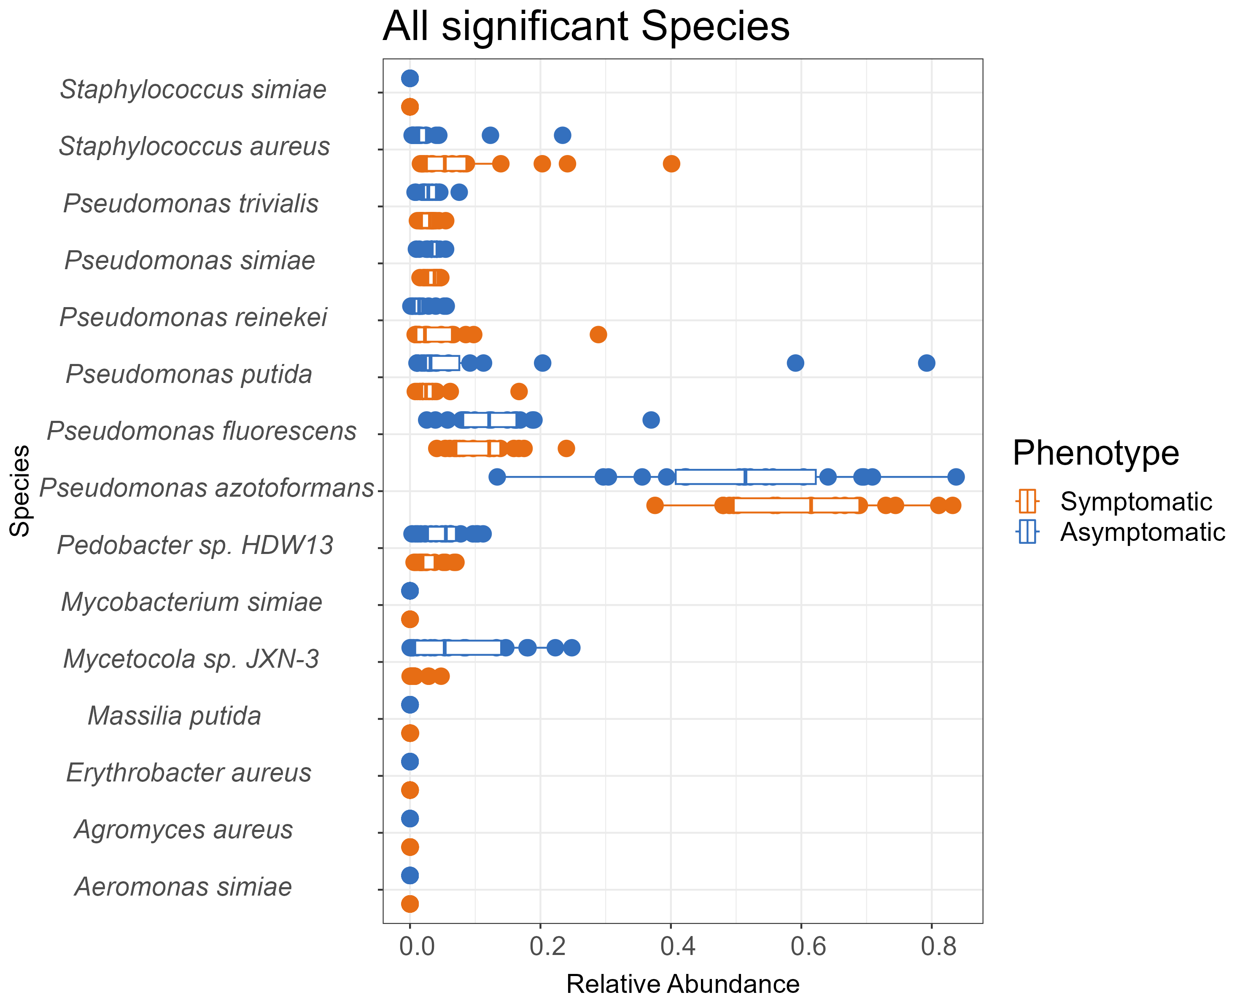
Are there differences between phenotypes?
2
Notes:
The numbers here need to be explained (the axis) about and I need to make sure I orient people FIRST to the slide and not go crazy

Slide 34
Concluding Remarks
Goal: Identify taxonomic differences in pileipellis (mushroom surface) microbiomes associated with Asymptomatic and Bacterial Blotch Symptomatic phenotypes.
1
Increased species richness in caps symptomatic for bacterial blotch; no difference in species diversity across phenotypes
2
Pseudomonas species were significantly enriched in asymptomatic communities.
Notes:
Here needs to include the 'host aerial surfaces'
reput part of his intro slide 'this is how we answered part. and this is how we answered this part’
2 reasons why tolaasii and disease may be enriched but not seeing a clear separation
-> If we’d waited one more day we might have disease

Slide 35
Concluding Remarks
Goal: Identify taxonomic differences in pileipellis (mushroom surface) microbiomes associated with Asymptomatic and Bacterial Blotch Symptomatic phenotypes.
1
2
1
Increased species richness in caps symptomatic for bacterial blotch; no difference in species diversity across phenotypes
Pseudomonas species were significantly enriched in asymptomatic communities.
Functional Annotation Imminent
Notes:
Here needs to include the 'host aerial surfaces'
reput part of his intro slide 'this is how we answered part. and this is how we answered this part’
2 reasons why tolaasii and disease may be enriched but not seeing a clear separation
-> If we’d waited one more day we might have disease

Slide 36
Tie in host surfaces to disease
Notes:
Goal of the work I’ve done is to define trends in aerial surfaces during altered metabolic states. Specifically, I’ve wanted to know the extent of change that occurs solely at this surface as it is the first step in invasion into the host
Change the background of the left in number 1 -> take out the pathogenic cells | On the right, presence of pathogen will alter the microbiome but can also affect the microbiome
Even don’t need to get into the weeds to get into the GAM model and DESeq

Slide 38
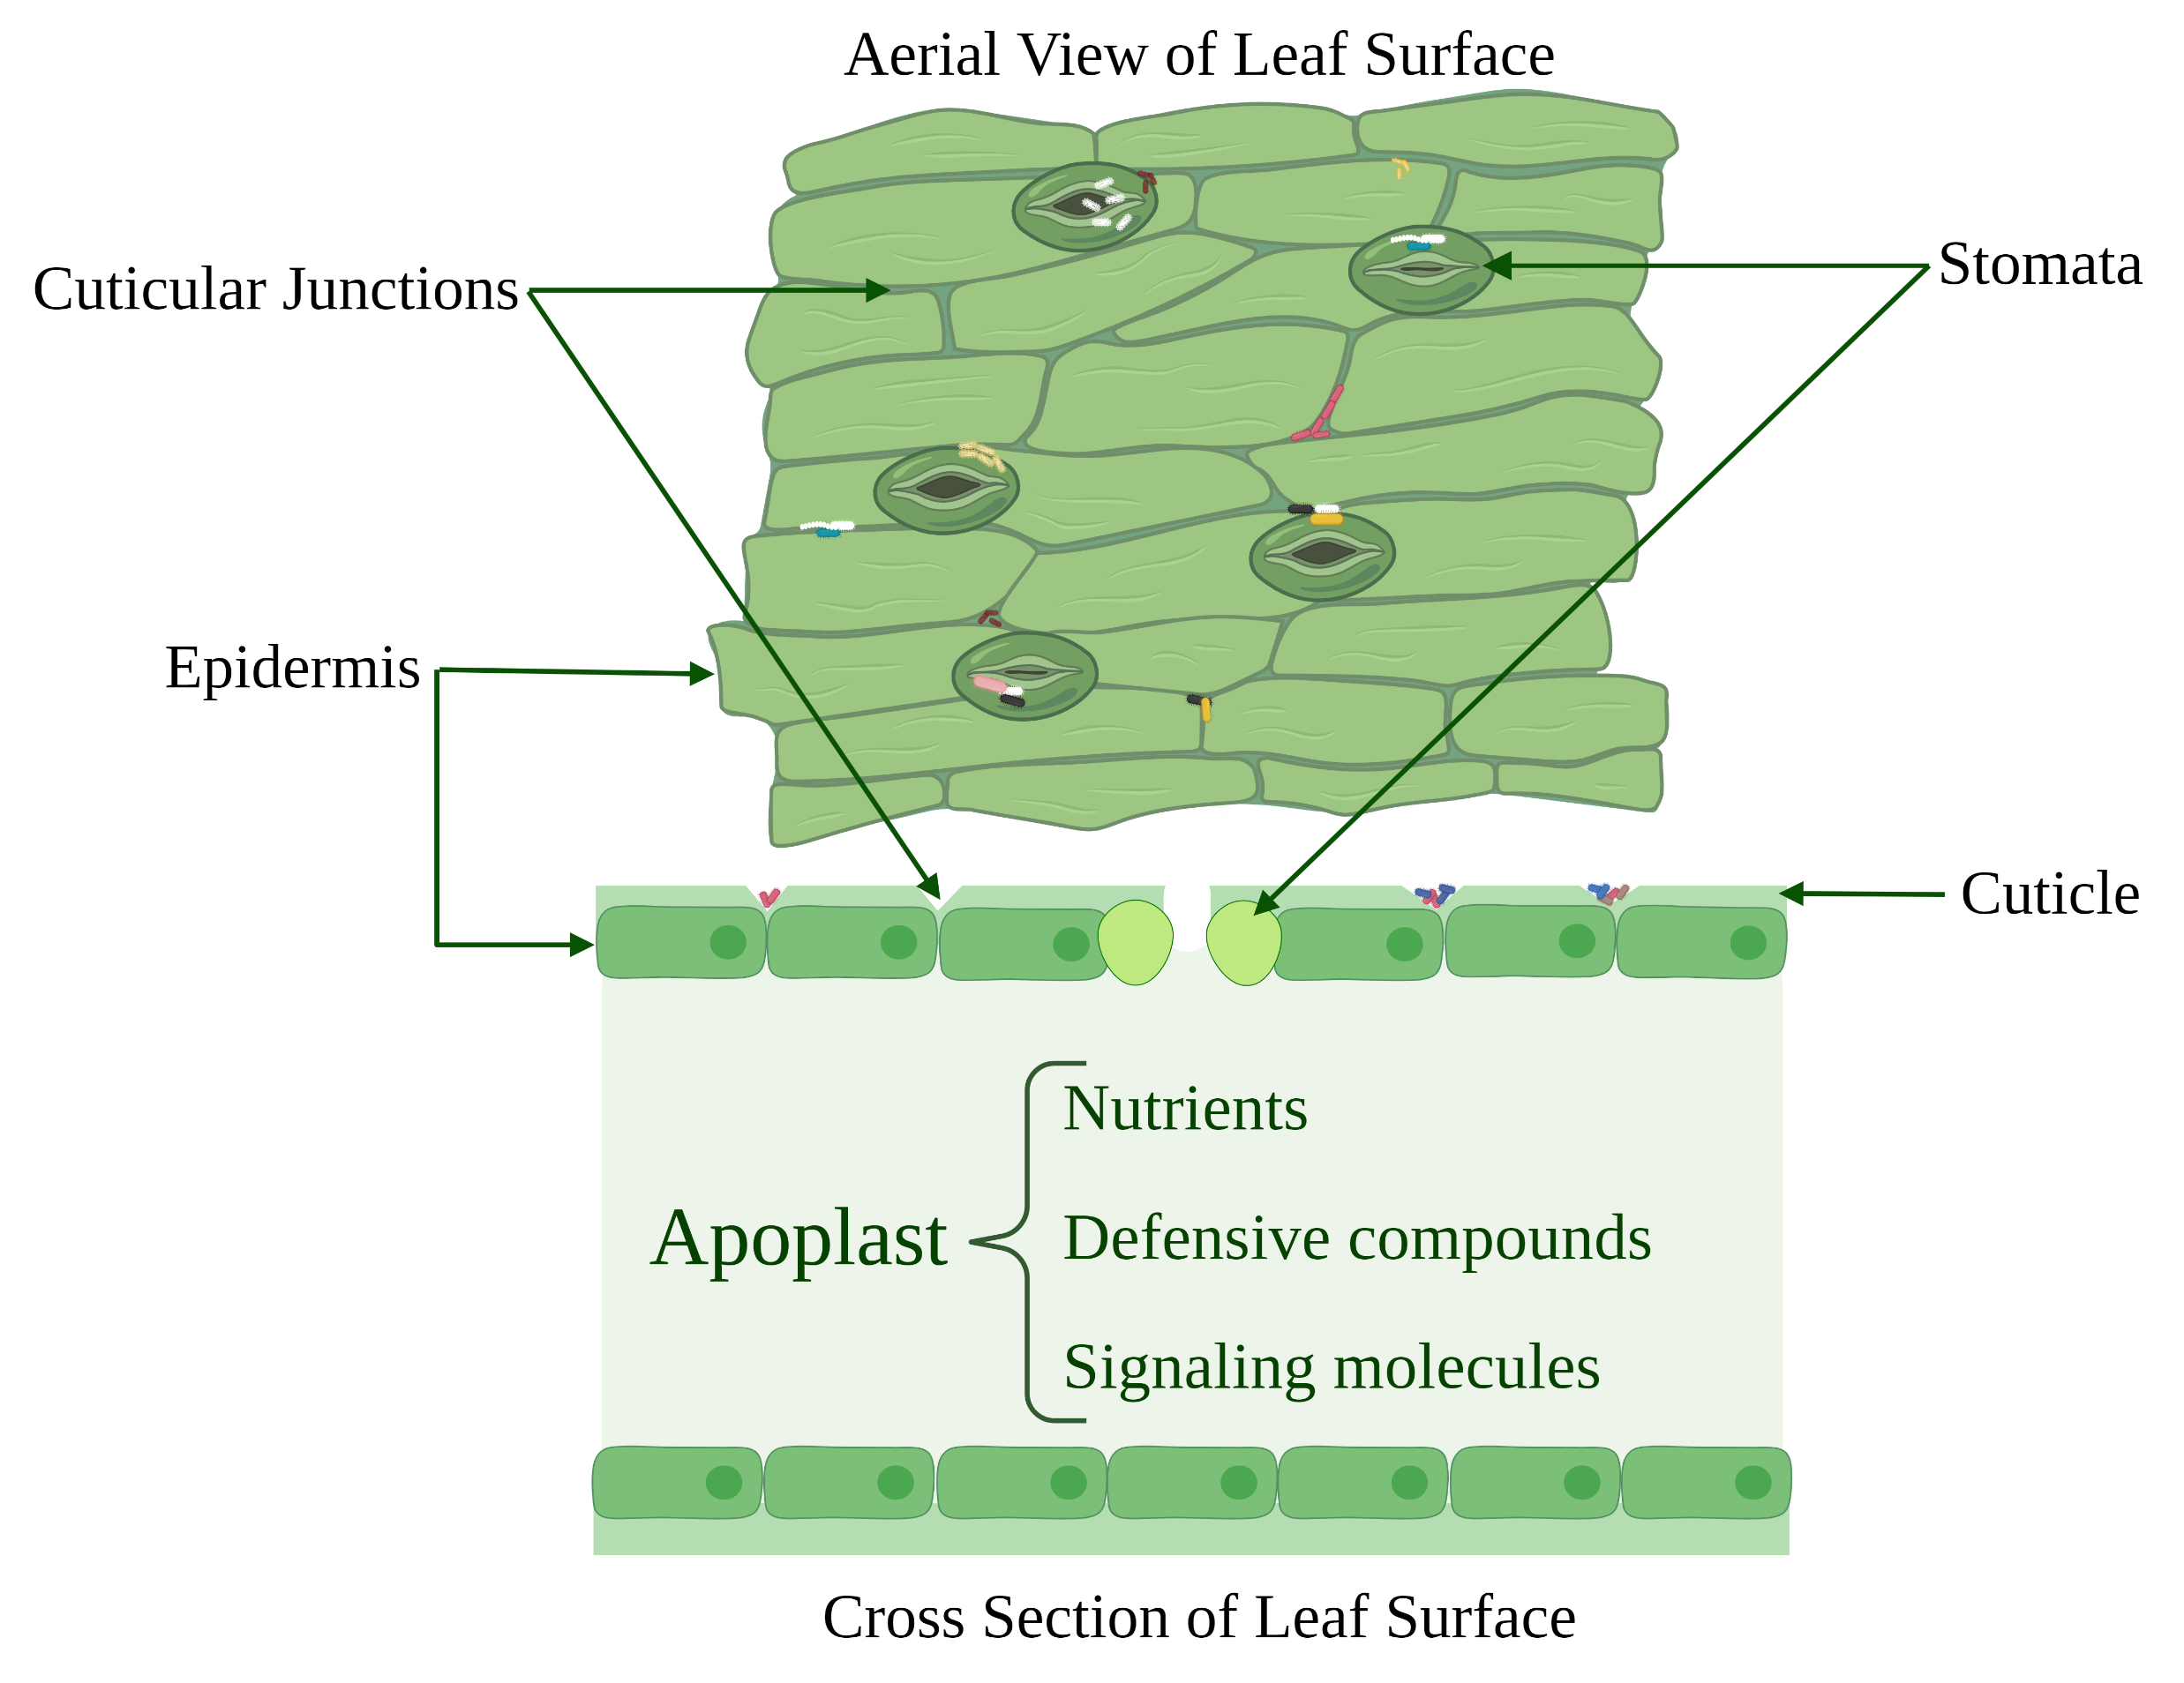
Tomato leaf surface

Slide 39
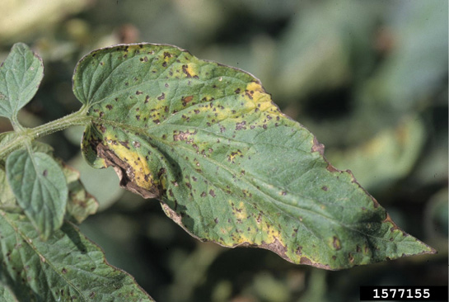
Bacterial Speck of tomato
Bacterial speck caused by Pseudomonas syringae pv. tomato (DC3K)
Missouri State University extension

Slide 40
Goal 1: Determine if inoculating leaves with a pathogen causes changes to leaf surface metabolites at the site of infection as well as the leaf closest to it.
Goal 2: Determine if changes in leaf surface metabolite profiles affect microbes.

Slide 41
Experimental Treatments:
1. Control (MgCl2 + Silwet) (Con) 2. Pseudomonas syringae pv. tomato DC3000 (DC3K)
Notes:
NMR
Trim this down
Data in appendix in your disertation: Methodology for the optimization of the metabolomic extraction ; In the papers you write the new method but in the appendix you may show the three experiments and decide why you chose what you chose
* This is also where you can give credit to my undergraduate
*appendix like in chapter one's long read work
* showcase the gen s I used
Utilizing complimentary mutants
(plasmid or constituative gene that indicates the effect if it are readded)
* mutants generated in another lab and are well characterized | we know the loss of coronatine is an affect by that gene and not necessarily another mutation within the mutant line | partly showing | consider adding /think about if we need compliments ; look to the labs that have already sent this to us
* Send kevin the data about the gene that we utilized / what's the gene that was targeted for the complementation
* would have to have three more samples -
Two step approach

Slide 42
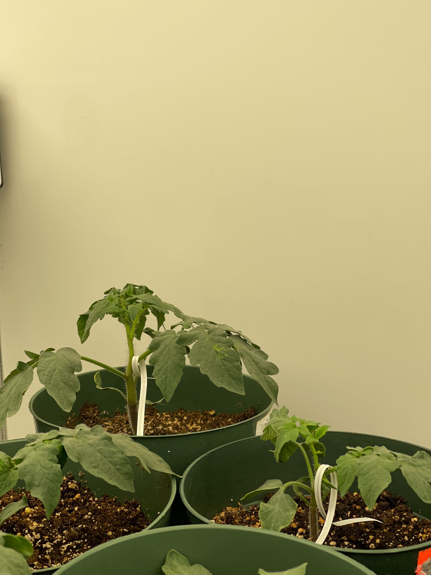
Distal Leaf
Treated Leaf

Slide 43
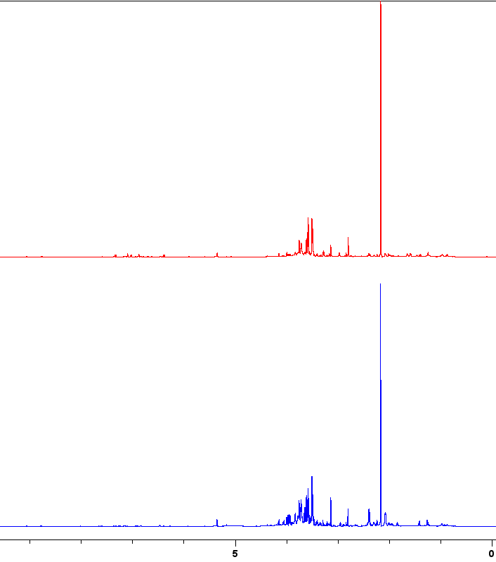
Control treated
Normalization: 100 mg of dried metabolites into 1.5 mL of deuterated H2O
Notes:
Murti, R. H., Afifah, E. N., & Nuringtyas, T. R. (2021). Metabolomic Response of Tomatoes (Solanum lycopersicum L.) against Bacterial Wilt (Ralstonia solanacearum) Using 1H-NMR Spectroscopy. Plants, 10(6), 1143.
Mazzei, P., Vinale, F., Woo, S. L., Pascale, A., Lorito, M., & Piccolo, A. (2016). Metabolomics by proton high-resolution magic-angle-spinning nuclear magnetic resonance of tomato plants treated with two secondary metabolites isolated from Trichoderma. Journal of agricultural and food chemistry, 64(18), 3538-3545.

Slide 44
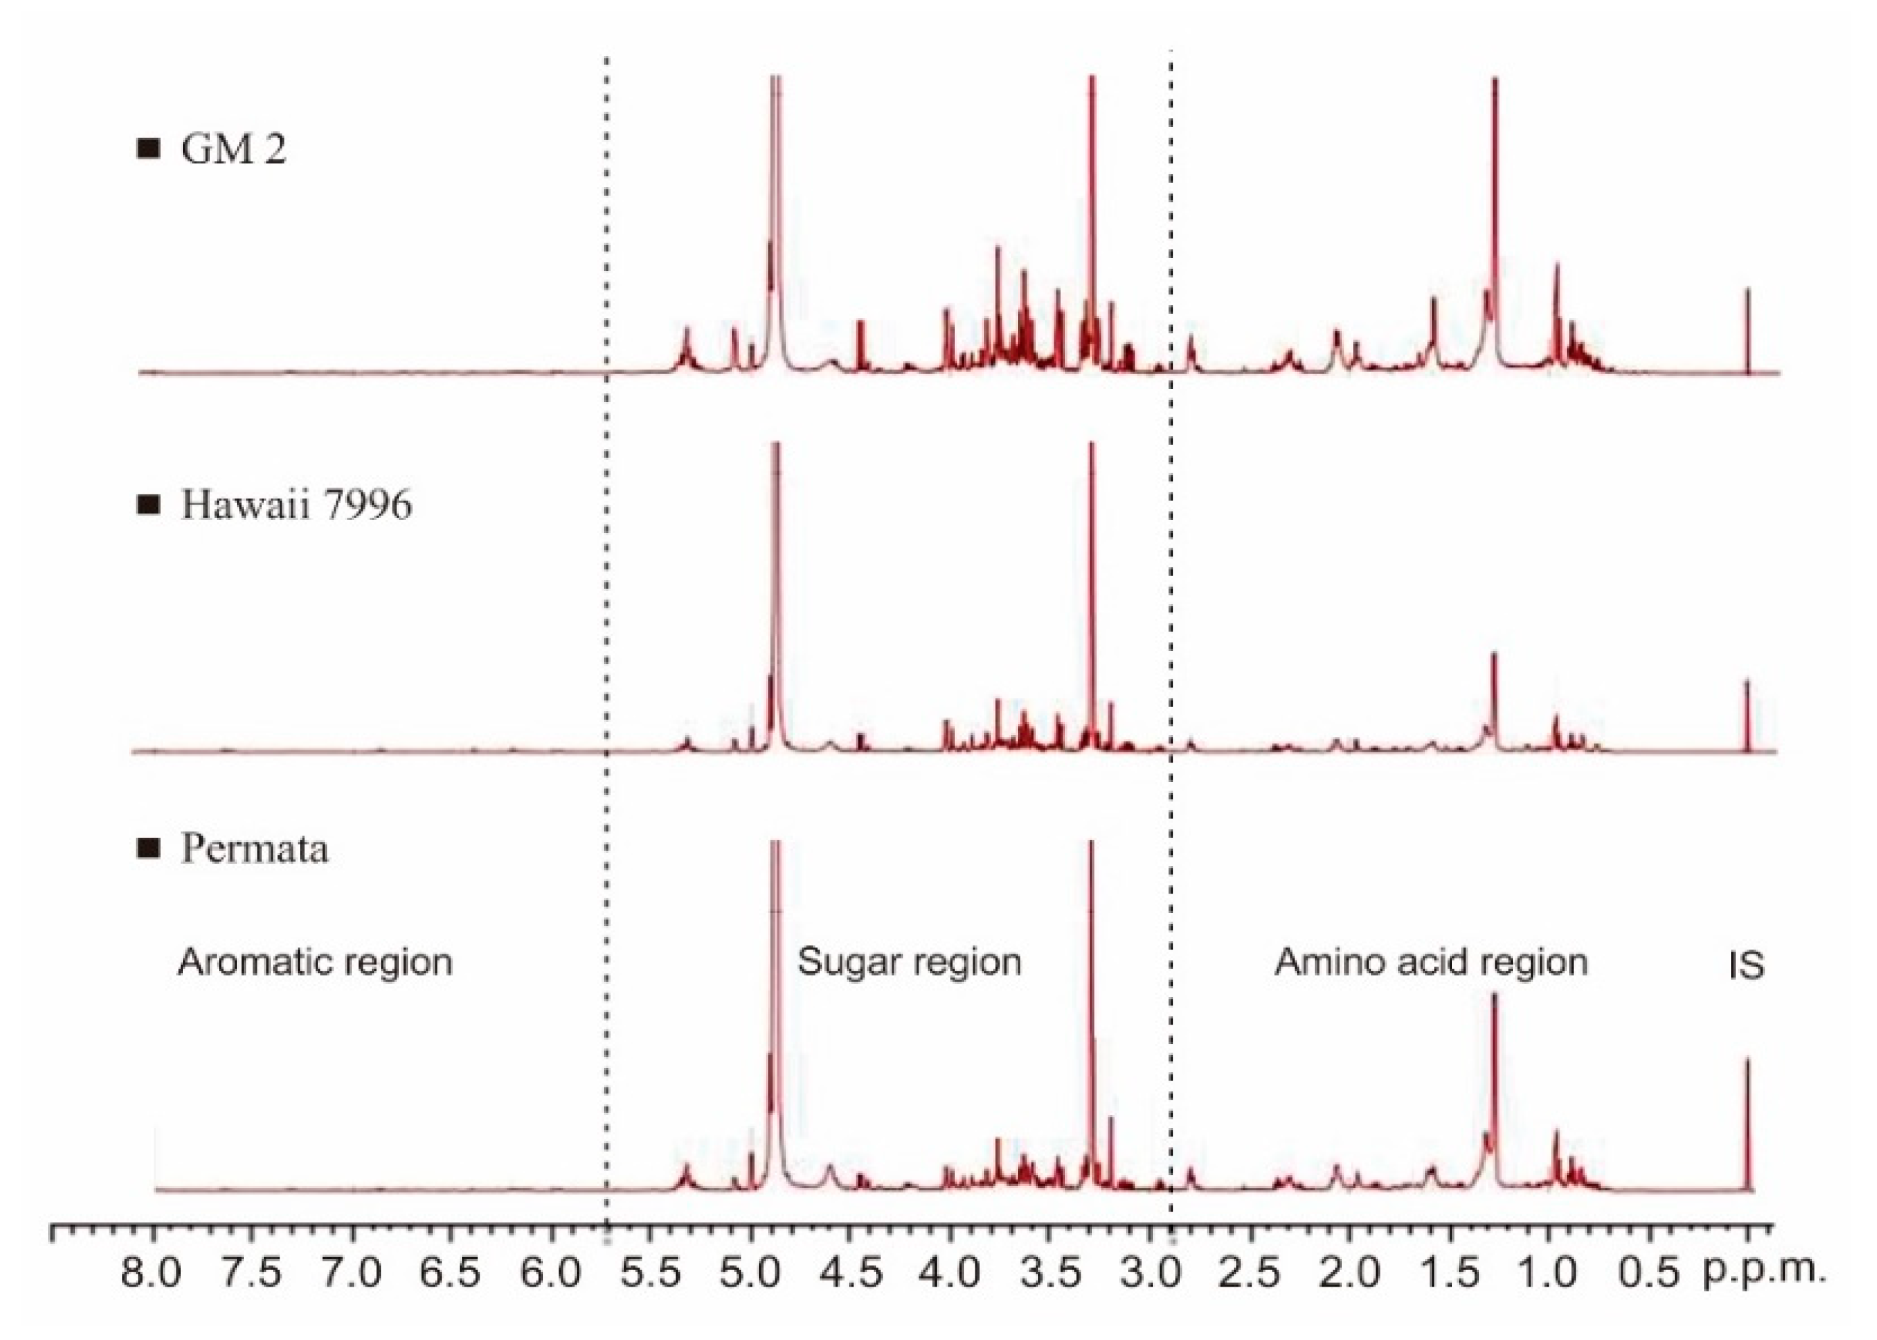
9 – 5.8 ppm
5.7 – 3.0 ppm
2.9 – 0 ppm
Aromatic Region
Sugar Region
Amino Acid Region
DC3K-T
Con-T
Murti, et. al., 2021; Mazzei, et. al., 2016
Normalization: 100 mg of dried metabolites into 1.5 mL of deuterated H2O
Notes:
Murti, R. H., Afifah, E. N., & Nuringtyas, T. R. (2021). Metabolomic Response of Tomatoes (Solanum lycopersicum L.) against Bacterial Wilt (Ralstonia solanacearum) Using 1H-NMR Spectroscopy. Plants, 10(6), 1143.
Mazzei, P., Vinale, F., Woo, S. L., Pascale, A., Lorito, M., & Piccolo, A. (2016). Metabolomics by proton high-resolution magic-angle-spinning nuclear magnetic resonance of tomato plants treated with two secondary metabolites isolated from Trichoderma. Journal of agricultural and food chemistry, 64(18), 3538-3545.

Slide 45
Take away: Unique sugar profiles were present on inoculated leaves and treated leaves, with highest ‘sugar’ content in DC3K treated
Control
Treated
P. syringae pv. tomato (DC3K )
Treated; These leaves were treated with the pathogen
Control
Distal
P. syringae pv. tomato (DC3K )
Distal; These leaves were NOT directly treated with the defense response elicitor
Notes:
I need to practice this a ton

Slide 46
Take away: Unique sugar profiles were present on inoculated leaves and treated leaves, with highest ‘sugar’ content in DC3K treated
Control
Treated
P. syringae pv. tomato (DC3K )
Treated; These leaves were treated with the defense response elicitor
Control
Distal
P. syringae pv. tomato (DC3K )
Distal; These leaves were NOT directly treated with the pathogen
Notes:
I need to practice this a ton

Slide 47
Take away: Unique phenolic profile was present on DC3K treated and distal leaves but not distal leaves
Control
Treated
P. syringae pv. tomato (DC3K )
Control
Distal
P. syringae pv. tomato (DC3K )
Notes:
Practice this a ton

Slide 48
Take away: Unique phenolic profile was present on DC3K treated and distal leaves but not distal leaves
Control
Treated
P. syringae pv. tomato (DC3K )
Control
Distal
P. syringae pv. tomato (DC3K )
Notes:
Practice this a ton

Slide 49
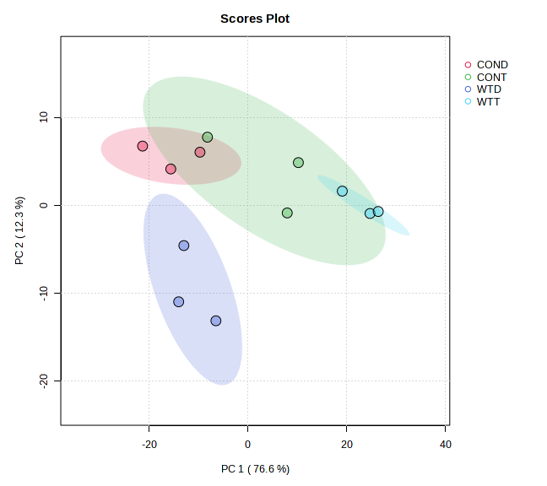
Take away: Unique leaf surface metabolite profiles were identified utilizing peak position and peak intensity
Control Distal
Control Treated
DC3K Distal
DC3K Treated

Slide 50
Goal 1: Determine if inoculating leaves with a pathogen causes changes to leaf surface metabolites at the site of infection as well as the leaf closest to it.
Goal 2: Determine if changes in leaf surface metabolite profiles affect microbes
Outcome: There is a significant pathogen effect on the changes in the leaf surface metabolite profile, but at the current resolution (NMR) we are unable to fully differentiate down to the compound level what is changing.

Slide 51
Goal 1: Determine if inoculating leaves with an elicitor causes changes to leaf surface metabolites at the site of infection as well as the leaf closest to it.
Goal 2: Determine if changes in leaf surface metabolite profiles affect microbes.
Notes:
WE SAW AN INCREASE in sugar, but does this improve everyone’s colonization or just the oathogen’s?
Nutrients A506 is stimulating, is it only utilizable by DC3K or can other organisms, especiallya closely related non pathogenic orgaisms capable of utilizing those resource

Slide 52
Goal 2: Determine if changes in leaf surface metabolite profiles affect microbes.
Tomato Pathogen
Pseudomonas syringae pv. tomato DC3000 (DC3K)
Tomato Growth Promoter
Pseudomonas fluorescens A506
Notes:
WE SAW AN INCREASE in sugar, but does this improve everyone’s colonization or just the oathogen’s?
Nutrients A506 is stimulating, is it only utilizable by DC3K or can other organisms, especiallya closely related non pathogenic orgaisms capable of utilizing those resource

Slide 53
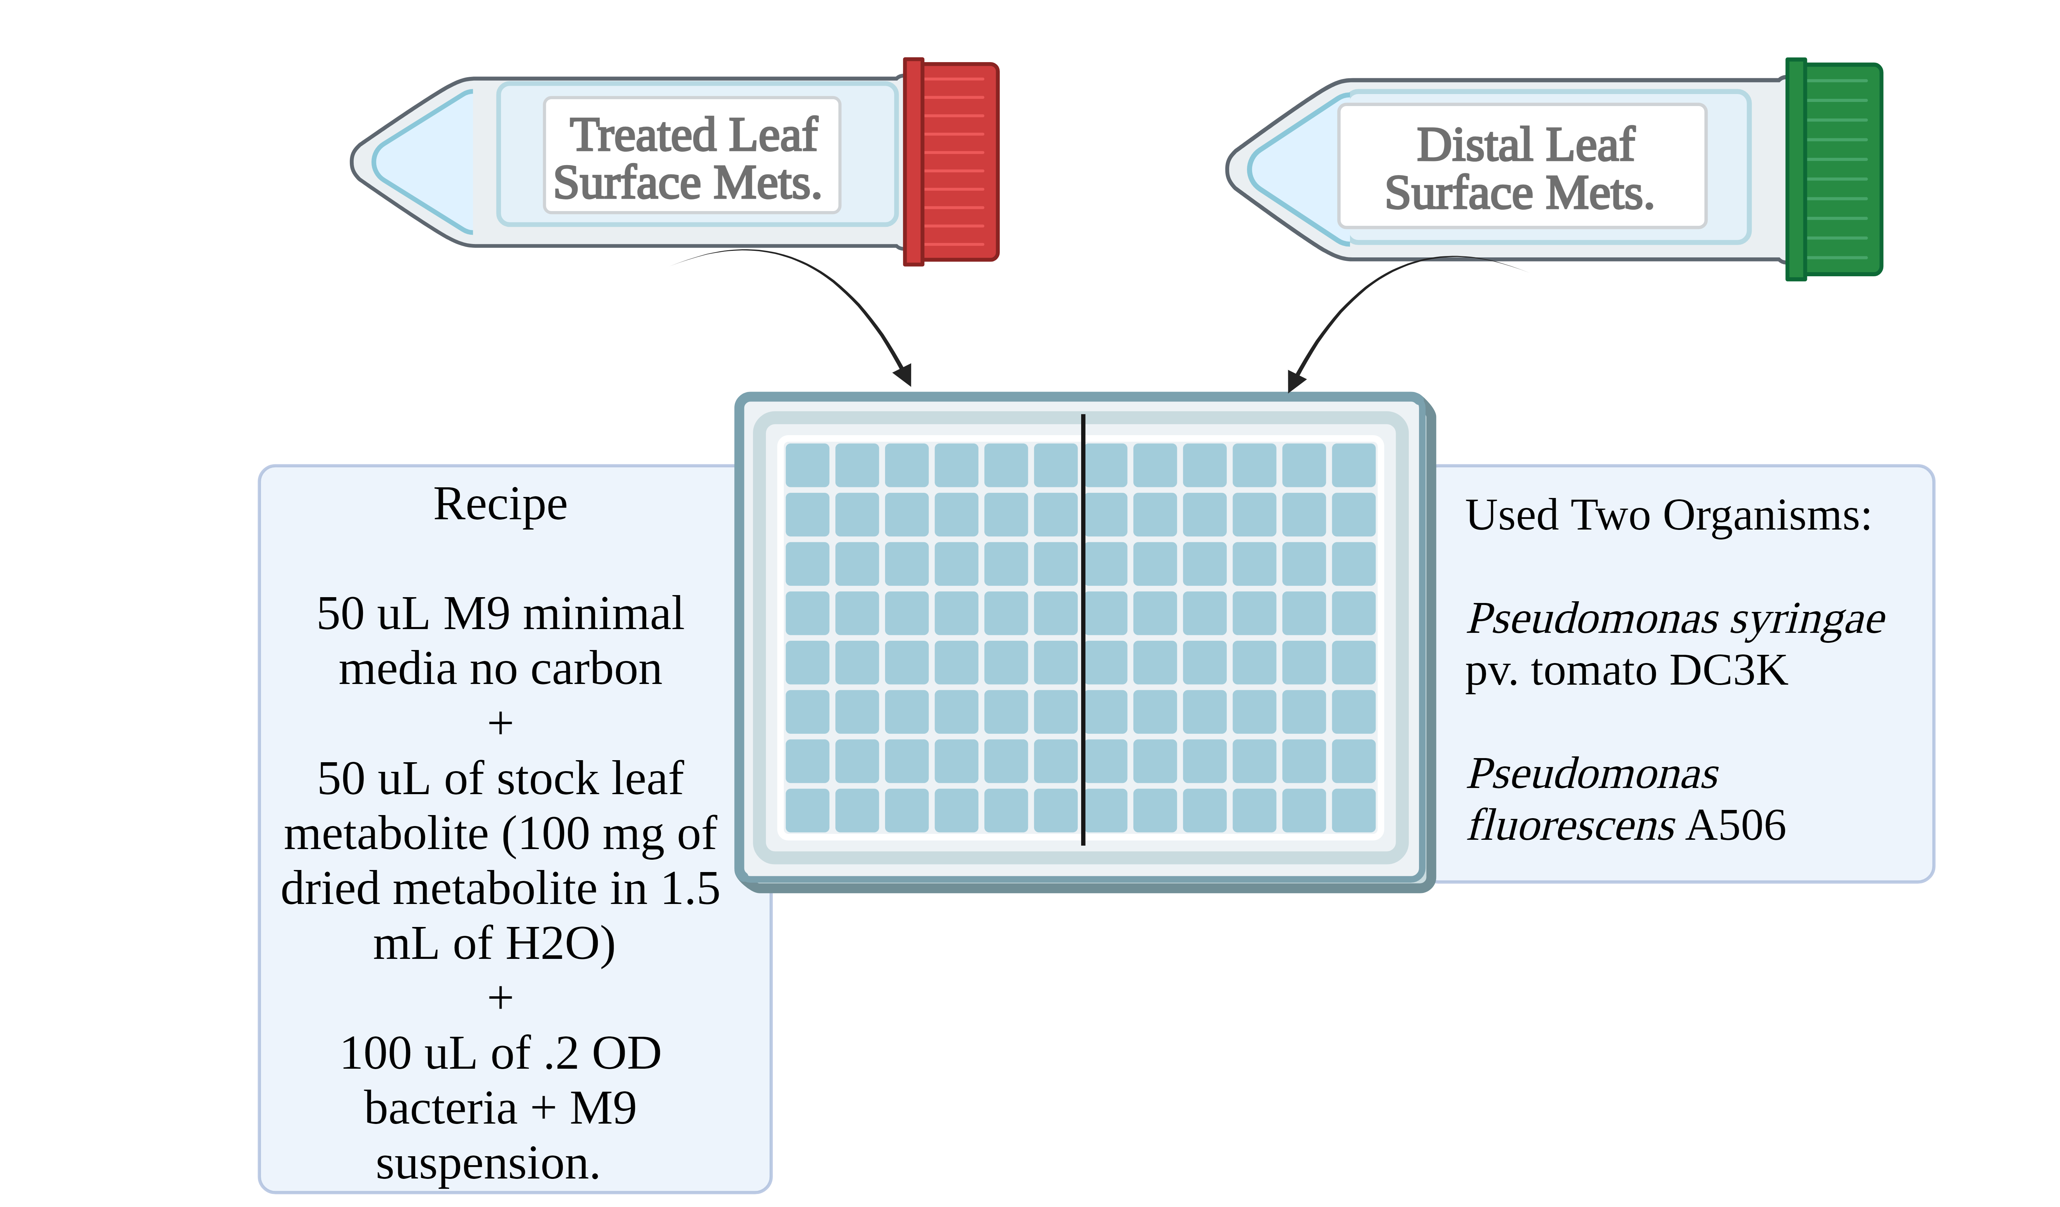
Notes:
This needs to be bigger, more prvelant, and it needs to be COLORS
REDDISH FOR DC3K and a teal-ish color for A506 (non pathogen; plant associated)

Slide 54
Take Away:
Leaf surface metabolites extracted from leaves distal to the inoculation with DC3K had metabolite profiles that significantly improved DC3K population size and growth.
Notes:
DC3K and 0d-D change these to the elicitor profile earlier

Slide 55
Take Away:
Pseudomonas fluorescens A506 seems to preferentially grow in leaf surface metabolite profiles extracted from distal leaves of DC3K treated plants.
A506 reach similar OD highs as DC3K when grown in DC3K treated leaf surface metabolite profiles, and this was the only time
Notes:
Plant is it
Control Distal
Control Treated
DC3K Treated
DC3K Treated
Here’s another species associated with plants; non pathogenic’ can’t cause a disease On the right side I can just add what those each mean and how this works out

Slide 56
Goal 1: Determine if inoculating leaves with an elicitor causes changes to leaf surface metabolites at the site of infection as well as the leaf closest to it.
Goal 2: Determine if changes in leaf surface metabolite profiles affect microbes
Outcome: The changes observed in Goal 1 seem to have an affect on both DC3K and A506 in vitro that can be directly attributed to the leaf surface metabolite profile
Notes:
WE SAW AN INCREASE in sugar, but does this improve everyone’s colonization or just the oathogen’s?

Slide 57
Tie in host surfaces to disease
Notes:
Goal of the work I’ve done is to define trends in aerial surfaces during altered metabolic states. Specifically, I’ve wanted to know the extent of change that occurs solely at this surface as it is the first step in invasion into the host
Change the background of the left in number 1 -> take out the pathogenic cells | On the right, presence of pathogen will alter the microbiome but can also affect the microbiome
Even don’t need to get into the weeds to get into the GAM model and DESeq

Slide 58
Goal: Determine if initial infection of a pathogen on a plant improves subsequent pathogen establishment into other, non infected, leaves.

Slide 59
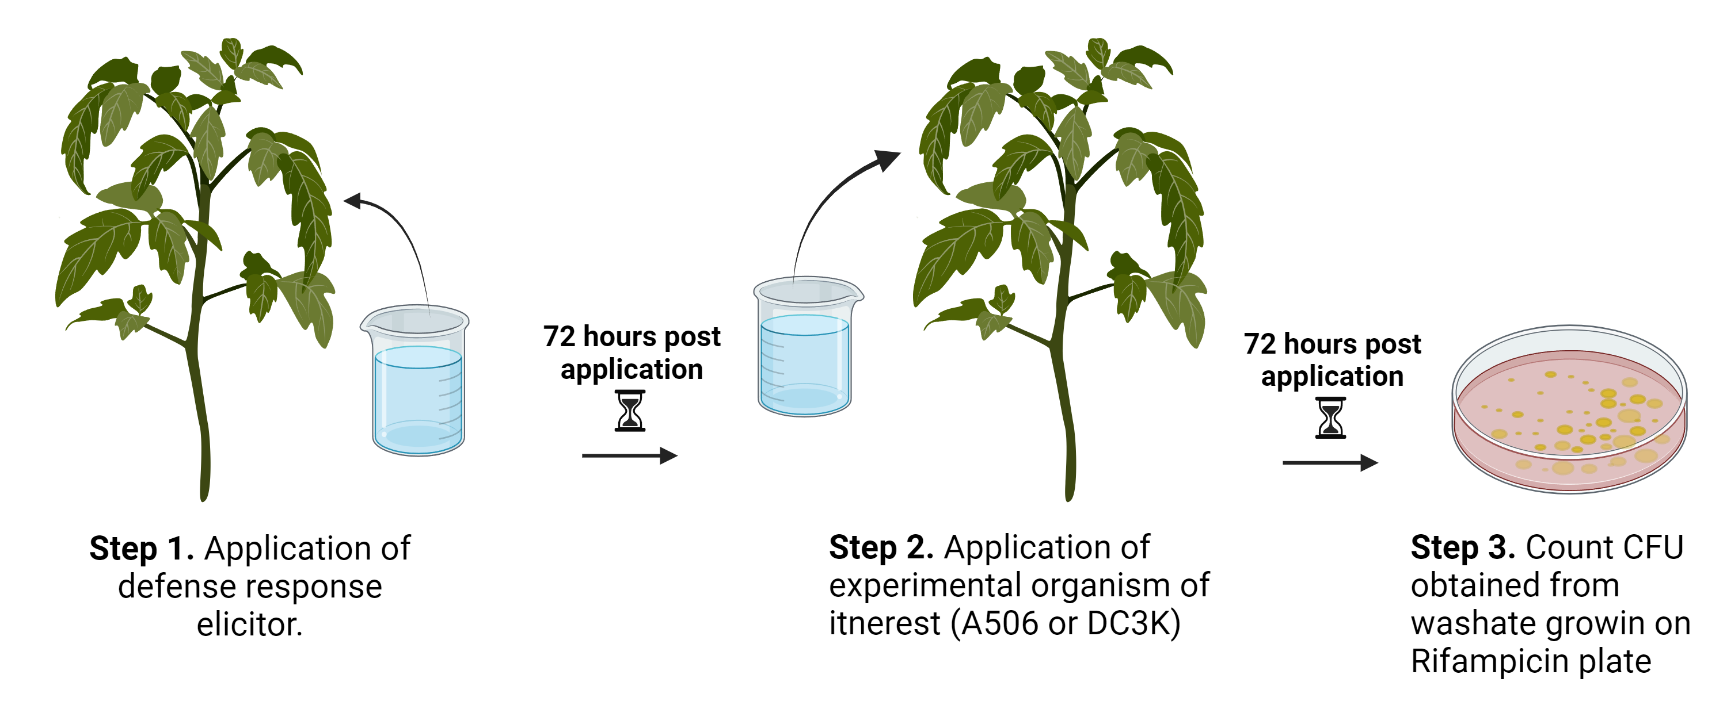
∅/A506
DC3K/A506
Elicitors
(phase 1 / phase 2)
∅/DC3K
A506/DC3K
DC3K/DC3K

Slide 60
Take Away:
Changes in leaf surface metabolites during pathogen infection elicited little change in A506 population size
Notes:
Change the scales to match to better observe differences in CFU growth
Indicate no significant difference here

Slide 61
Take Away:
Changes in leaf surface metabolites during DC3K infection elicited significant changes in DC3K population size in comparison to the control.
Changes in leaf surface metabolites during A506 colonization elicited significant changes in DC3K population size in comparison to the control.
Notes:
Change the scales to match to better observe differences in CFU growth

Slide 62
Yes they do. Species are differentially enriched when compared between mushrooms symptomatic for bacterial blotch and asymptomatic caps.
Yes they do. Resources at the leaf surface alter in a manner dependent on the presence of disease. Furthermore, changes in these surface materials can reach to uninfected tissue. Lastly, these changes seem to preferentially affect the pathogen. This alteration of the aerial surface materials has implications in
1. Host surface associated microbiomes
2. Host tolerance to subsequent pathogen infections
Yes it does. Observed pathogen populations were typically 3 fold greater on distal leaves of DC3K inoculated plants than in DC3K grown on uninfected hosts. DC3K growth was statistically improved by the presence of A506, but this relationship was not reciprocal.

Slide 63
Yes they do. Species are differentially enriched when compared between mushrooms symptomatic for bacterial blotch and asymptomatic caps.
Yes they do. Resources at the leaf surface alter in a manner dependent on the presence of disease. Furthermore, changes in these surface materials can reach to uninfected tissue. Lastly, these changes seem to preferentially affect the pathogen. This alteration of the aerial surface materials has implications in
1. Host surface associated microbiomes
2. Host tolerance to subsequent pathogen infections
Yes it does. Observed pathogen populations were typically 3 fold greater on distal leaves of DC3K inoculated plants than in DC3K grown on uninfected hosts. DC3K growth was statistically improved by the presence of A506, but this relationship was not reciprocal.

Slide 64
Yes they do. Species are differentially enriched when compared between mushrooms symptomatic for bacterial blotch and asymptomatic caps.
Yes they do. Resources at the leaf surface alter in a manner dependent on the presence of disease. Furthermore, changes in these surface materials can reach to uninfected tissue. Lastly, these changes seem to preferentially affect the pathogen. This alteration of the aerial surface materials has implications in
1. Host surface associated microbiomes
2. Host tolerance to subsequent pathogen infections
Yes it does. Observed pathogen populations were typically 3 fold greater on distal leaves of DC3K inoculated plants than in DC3K grown on uninfected hosts. DC3K growth was statistically improved by the presence of A506, but this relationship was not reciprocal.

Slide 65
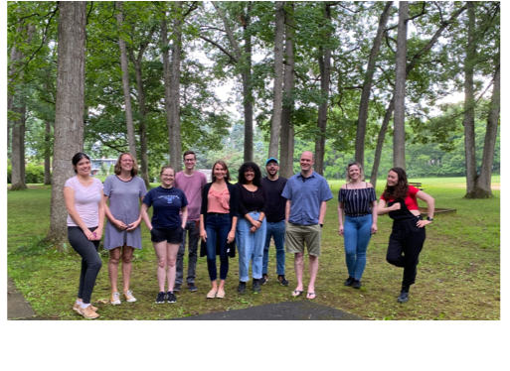
@ Phyllomax
(me :)
Hockett Lab
Bull Lab
Samuel Martins
Laura Ramos-Sepulveda

