Slide 1

Classifying Aflatoxin B1-Contaminated Peanut Seeds Using Hyperspectral Imaging with Machine Learning
Md Tauhidul Alam¹, Jake Fountain¹, Harald Scherm¹, Md Sultan Mahmud¹, Christopher Kucha²
¹Department of Plant Pathology, University of Georgia
²Department of Food Science & Technology, University of Georgia

Slide 2
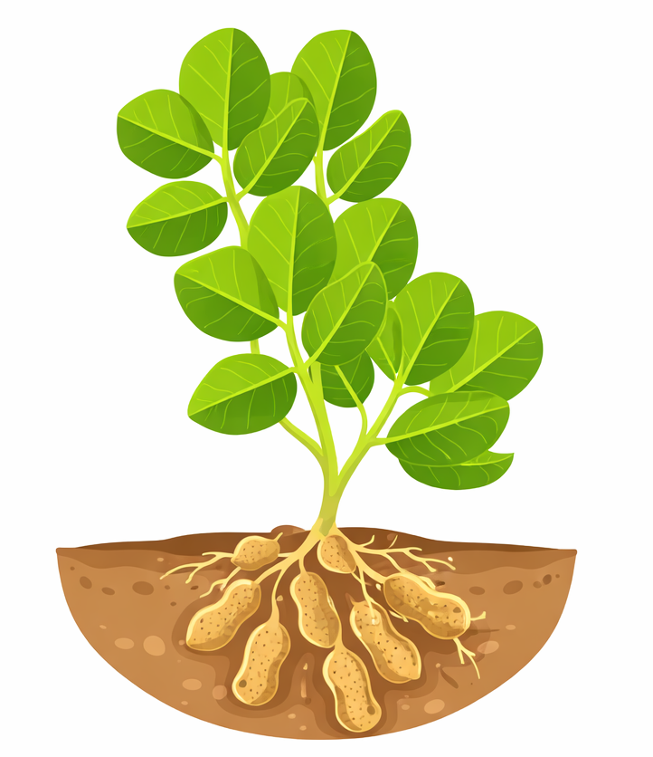
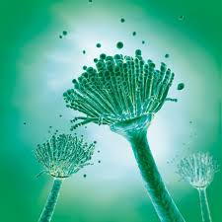
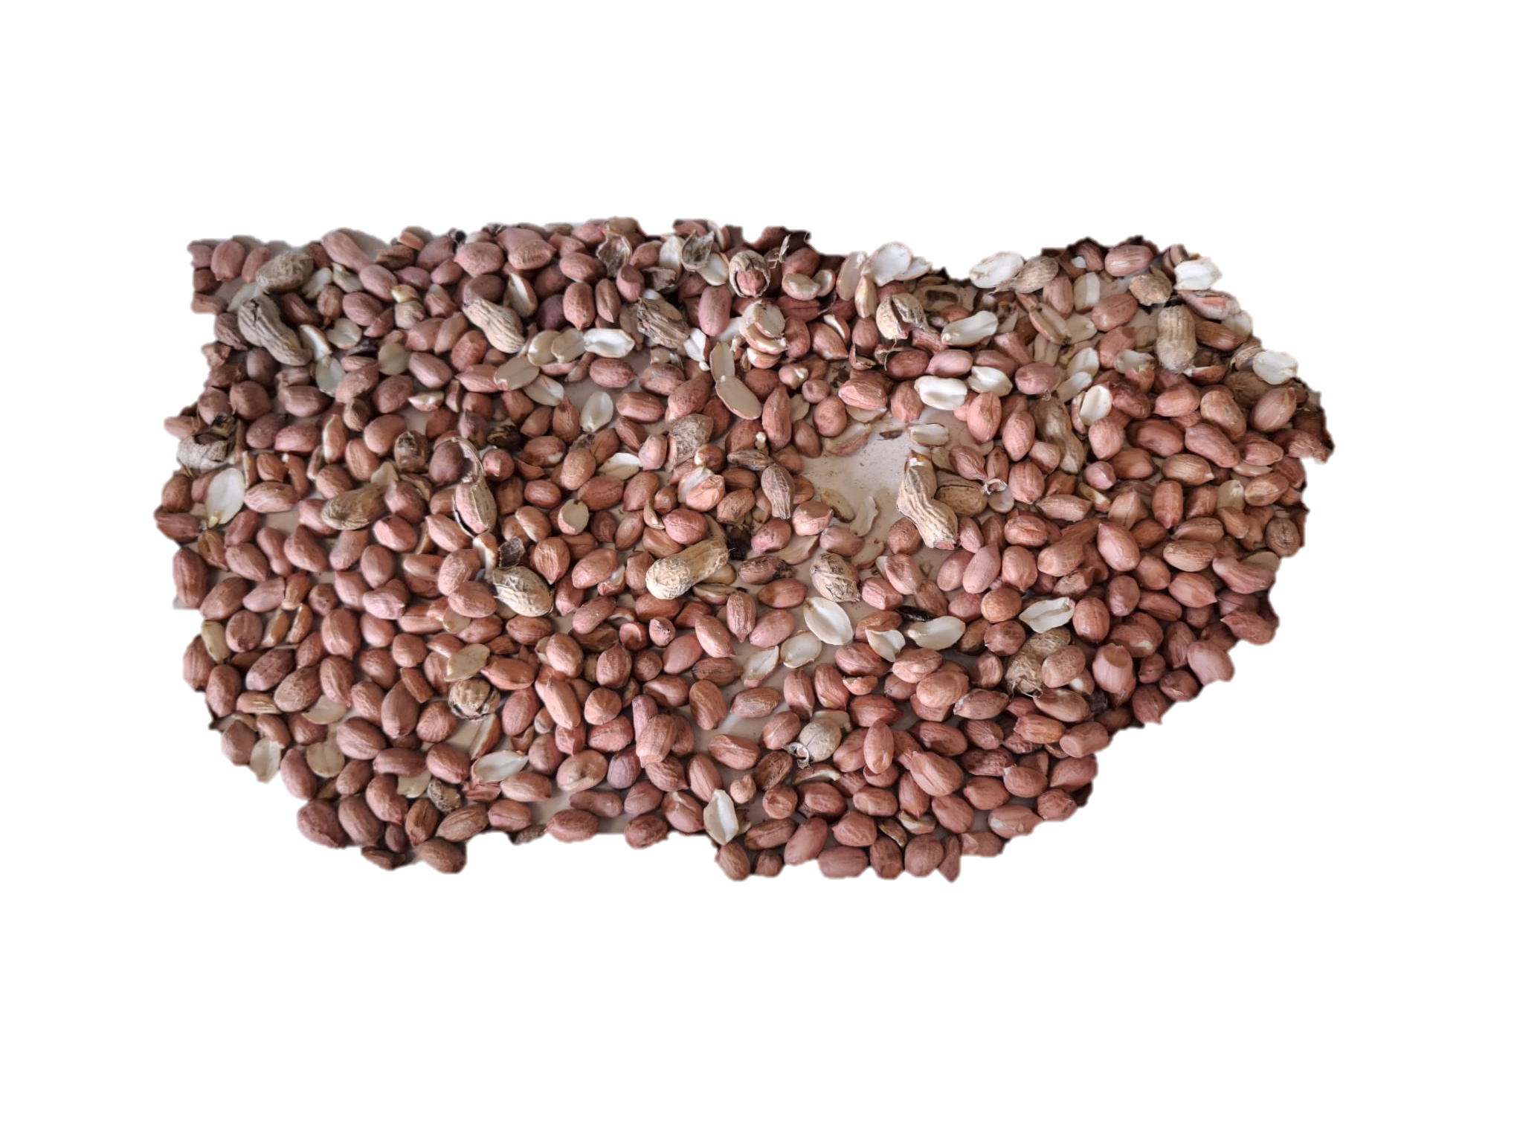

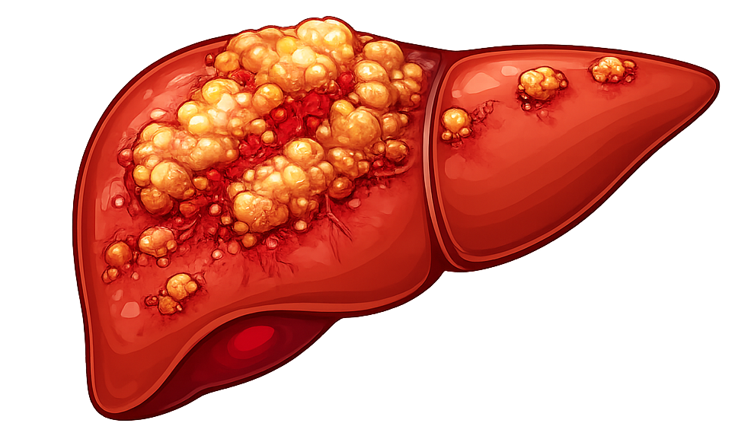
Introduction: Peanut Industry and Aflatoxin Issue
Georgia produces more than 50% of peanut grown in the USA^{[1]}
A $2.2 billion peanut industry in Georgia^{[1]}
Aflatoxin produced by Aspergillus flavus and Aspergillus parasiticus
Affect vital organs
In 2019, 126 million losses due to the rejection of 30% shelled runner peanuts in the southeastern U.S.^{[2]}
Aspergillus spp.
AFB1
Infected Peanuts
Liver Cancer
Aflatoxicosis
Immune Suppression
Stunt Growth
Fig. Health impacts of Aflatoxin
¹ Georgia Peanut Commission. Georgia Peanut Commission. Available from: https://gapeanuts.com/about/.
² Butts, C., et al., US peanut quality: Industry priorities to mitigate aflatoxin risk from farm to consumer. Peanut Science, 2023. 50(1): p. 29–40.
2

Slide 3
Introduction: Contaminated Peanut Identification and Limitations
Seg. I Peanuts (0 ppb)
Seg. III Peanuts - Perception (Uniform Contamination)
Seg. III Peanuts - Reality (Heterogenous Contamination)
Shelled Peanut Lot
20 MT 20 MT
10000 ppb
20 ppb
Aggregate Sample 70-75 kg
20 ppb
20 ppb
5000 ppb
0ppb
10000 ppb
Sample 1
22kg
Sample 2
22kg
Sample 3
22kg
0ppb
1100 g
1100 g
1100 g
Aflatoxin contamination in peanuts is extremely uneven
A few bad peanuts can be scattered among thousands of good ones
Sampling system can easily miss contaminated kernels or wrongly classify a good lot as bad (due to small sample size)
1A
1B
2A
2B
3A
3B
3
Notes:
Shelled peanut lot sizes in US commerce are typically 20 metric tons (MT) form which 70-75 kg sample is collected and divided into three independent 22 kg samples for sequential aflatoxin testing (Davis et al., 2018). From each 22 kg sample, 1100 grams is collected and divided into two subsamples (A and B) for duplicate chemical analysis

Slide 4
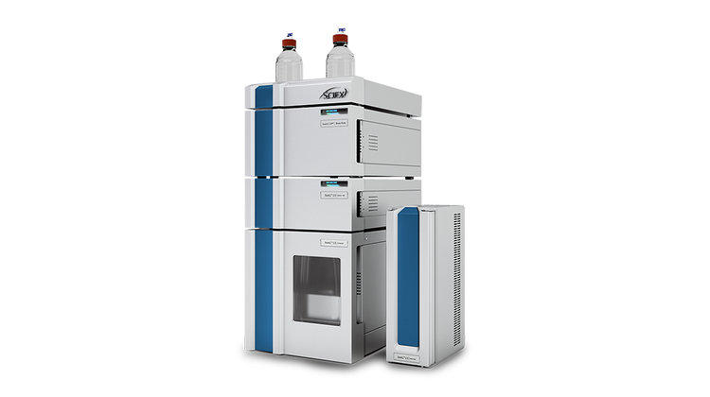
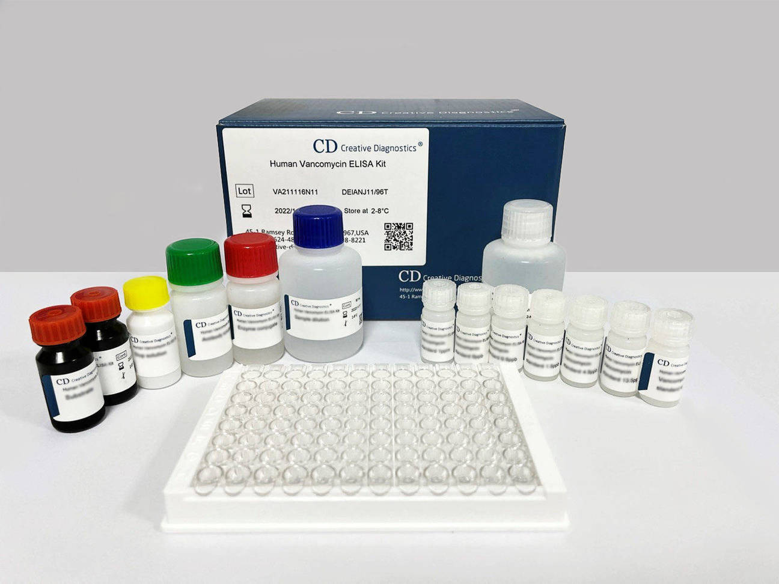
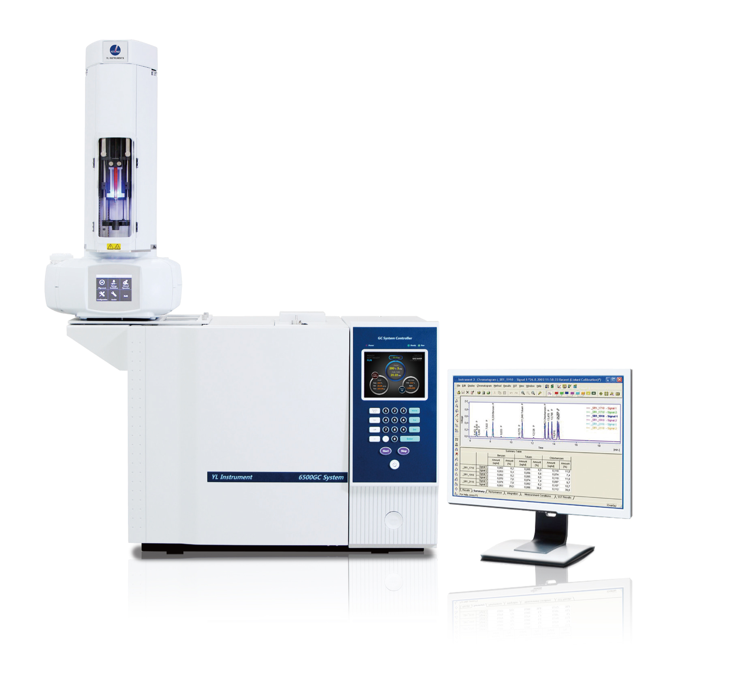
Introduction: Methods of Aflatoxin Detection and Limitations
Slow, destructive, and expensive, requiring milling, chemical extraction, and lab analysis
Because only a tiny fraction of kernels are actually tested, even a well‑designed sampling program cannot guarantee that every contaminated peanut is caught
Industry demand fast, automated, non‑destructive methods to scan each kernel directly and rapidly
HPLC
AFB1
ELISA
Gas Chromatography
4

Slide 5

Introduction: Hyperspectral Imaging and It’s Potential
Visible light
RGB is suitable for detecting moldy, discolored and damaged peanuts
RGB not suitable for detecting asymptomatic aflatoxin-contaminated peanuts
Hyperspectral imaging (HSI) has potential to identify both symptomatic and asymptomatic contaminated peanuts
RGB cameras
400 nm
700 nm
HSI cameras
Visible light
Near Infrared
400 nm
700 nm
1700 nm
5

Slide 6
Goal and Objectives
Goal: Develop an autonomous screening system capable of distinguishing and separating each aflatoxin-contaminated peanut from non-contaminated ones reliably and rapidly
Specific Objectives:
Artificially contaminate peanuts with aflatoxin B1 to obtain controlled contamination levels for experimental samples
Identify important hyperspectral imaging wavelengths sensitive to aflatoxin contamination to reduce data processing time and improve detection performance
Use machine learning models with identified important wavelengths to distinguish contaminated peanuts with 10,000 ppb aflatoxin B1 from non-contaminated peanuts treated with 70% methanol
6

Slide 7
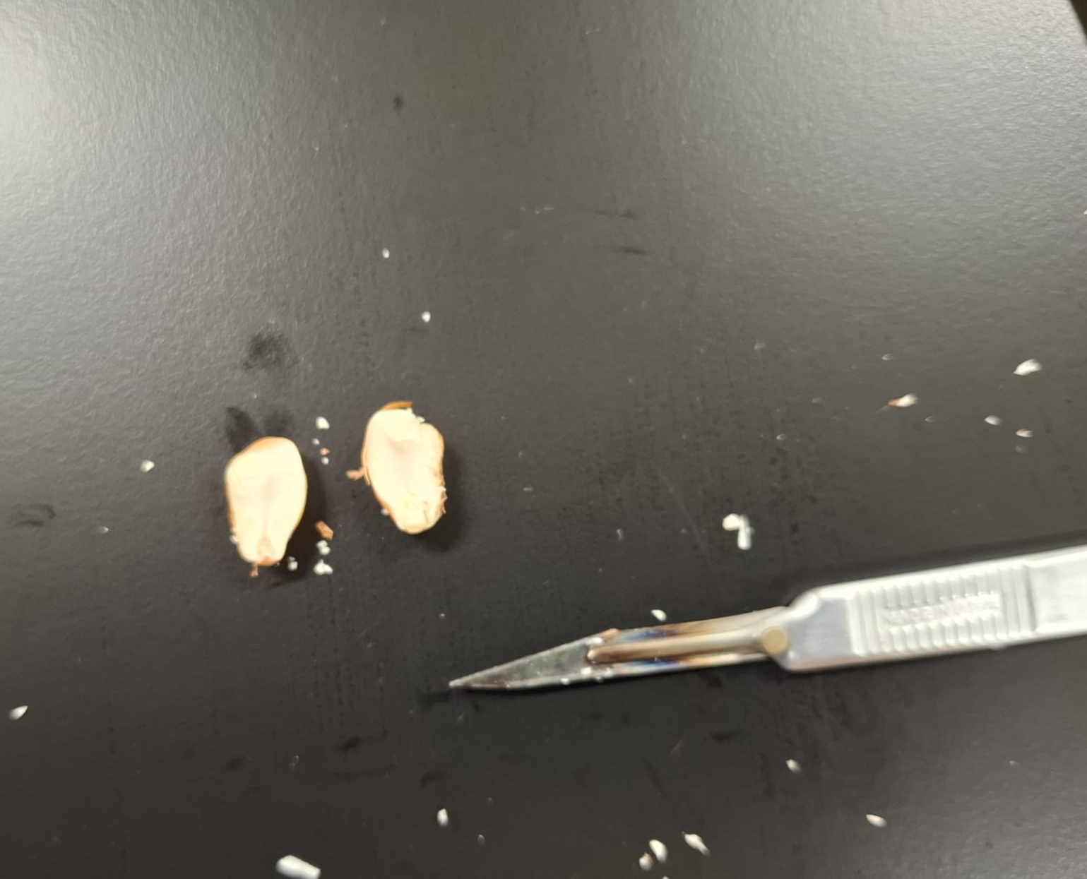
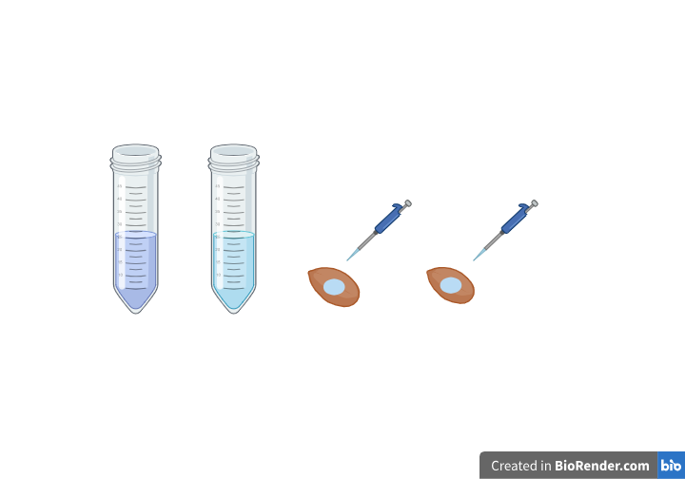
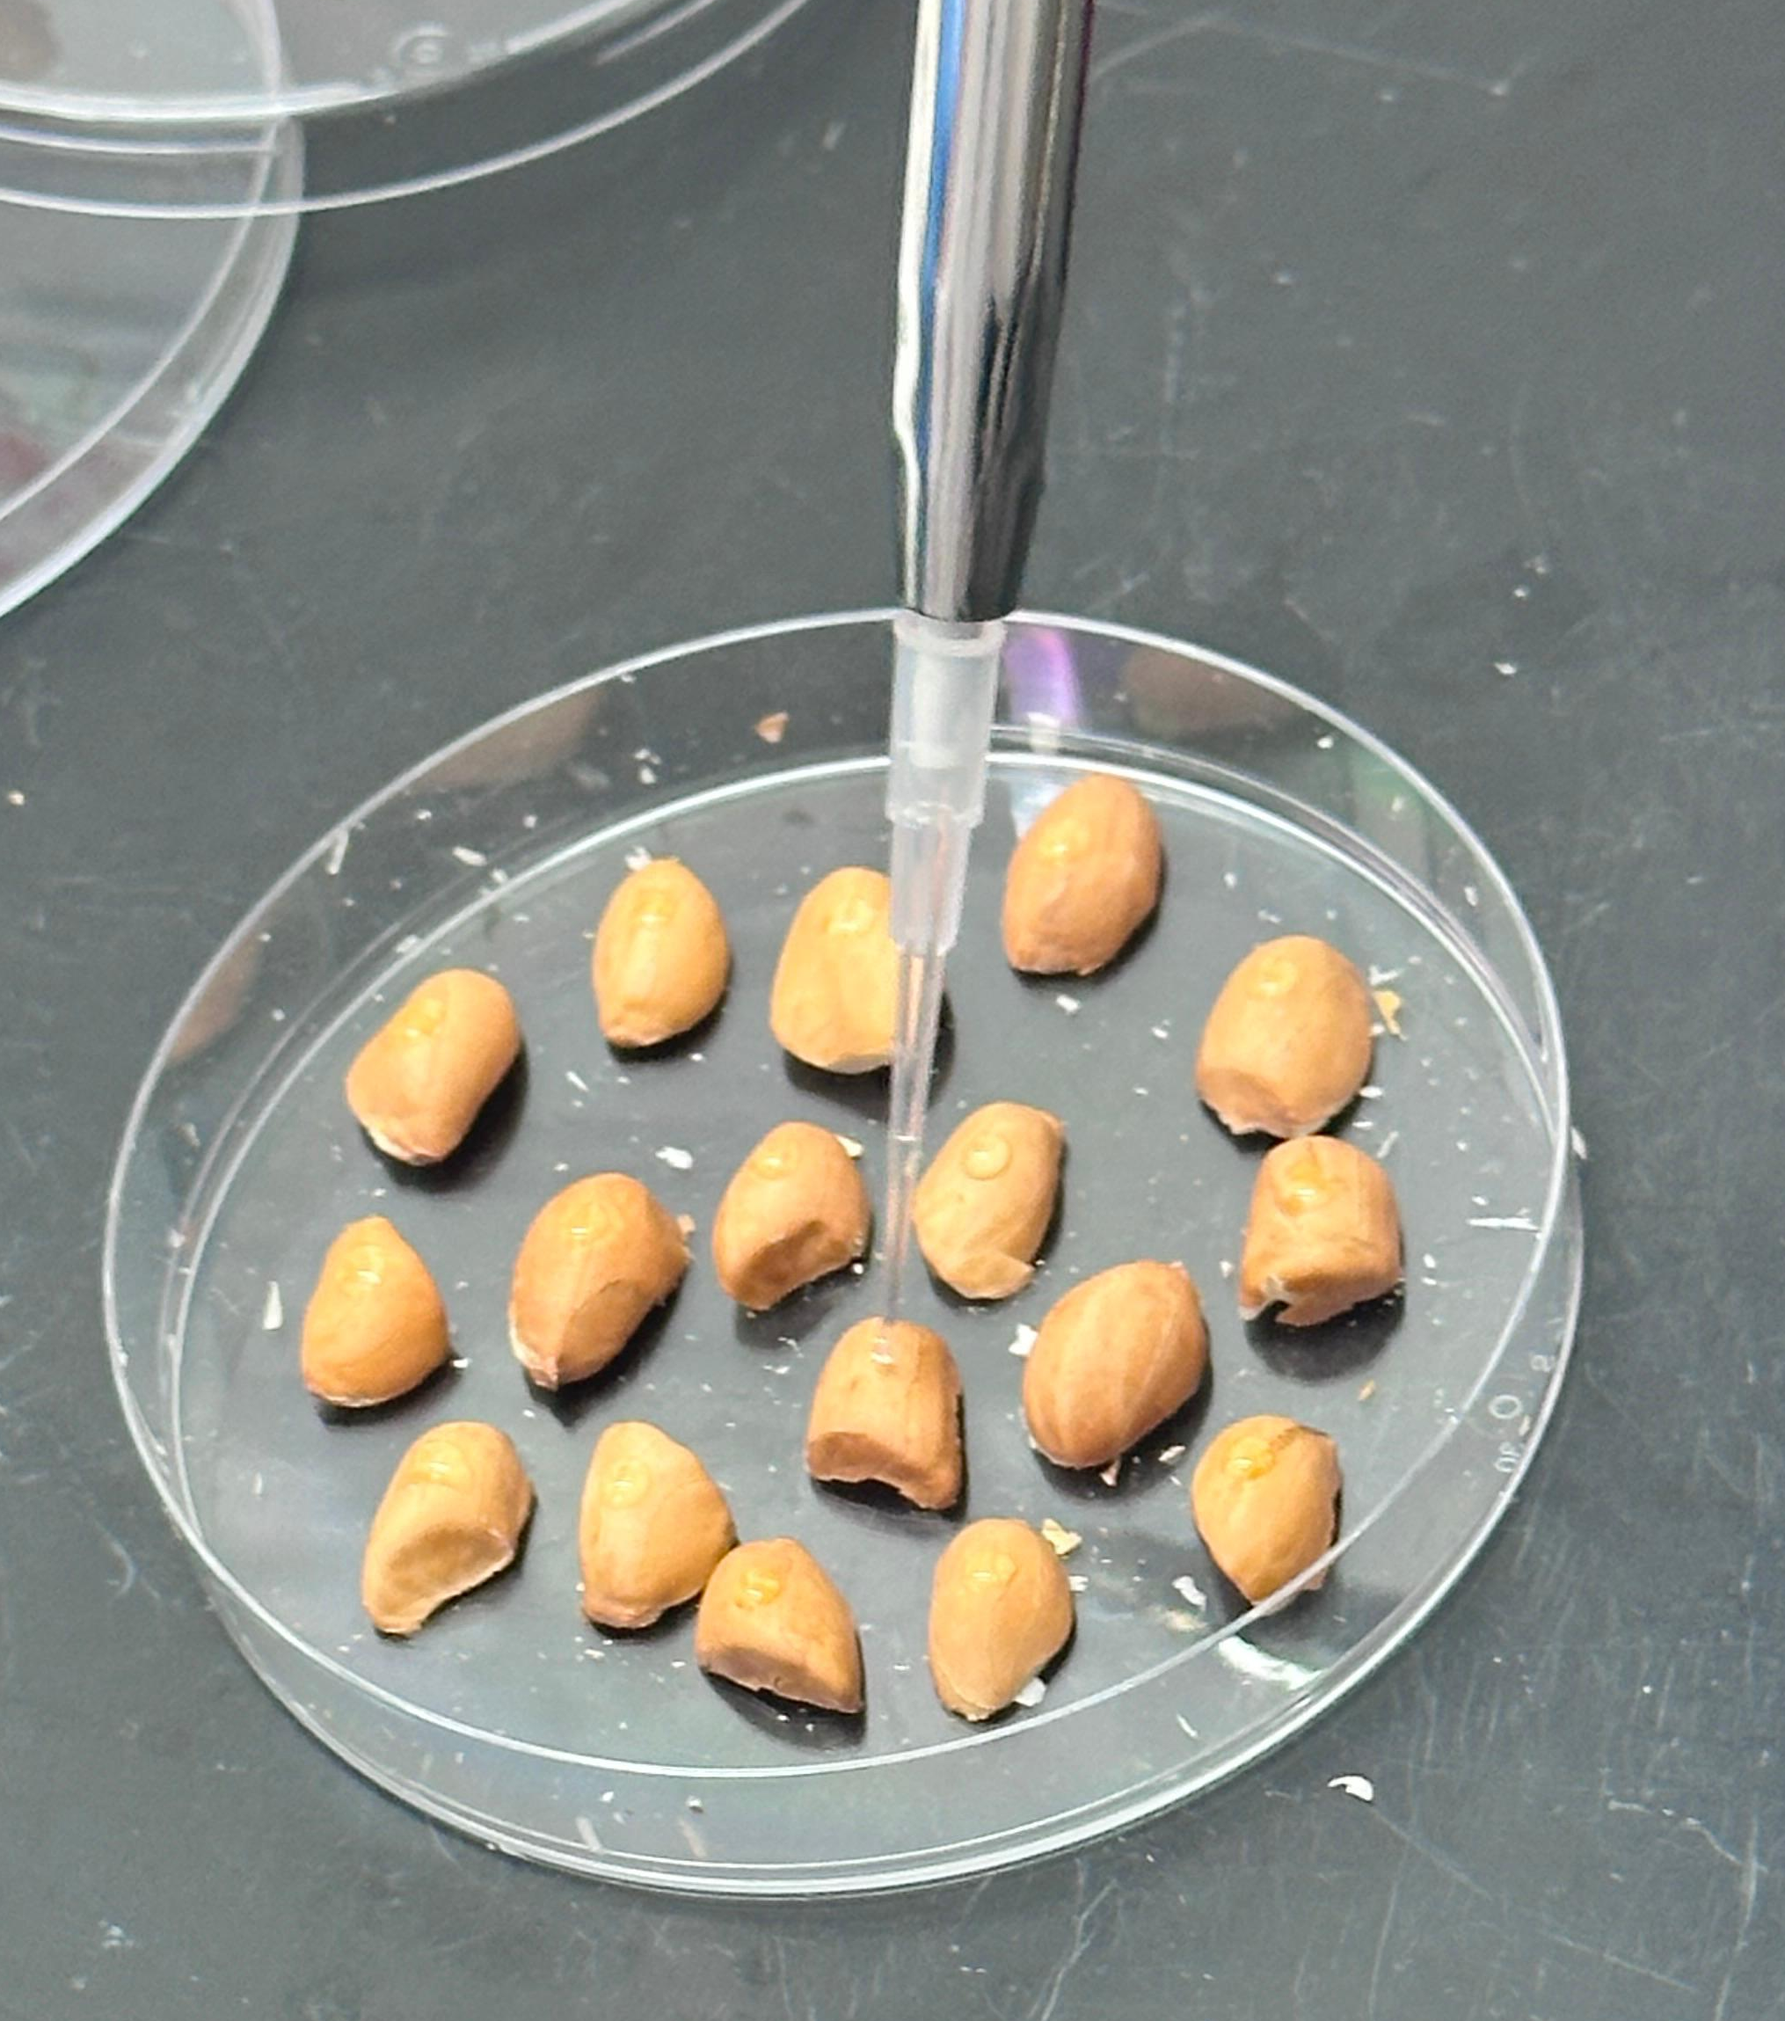
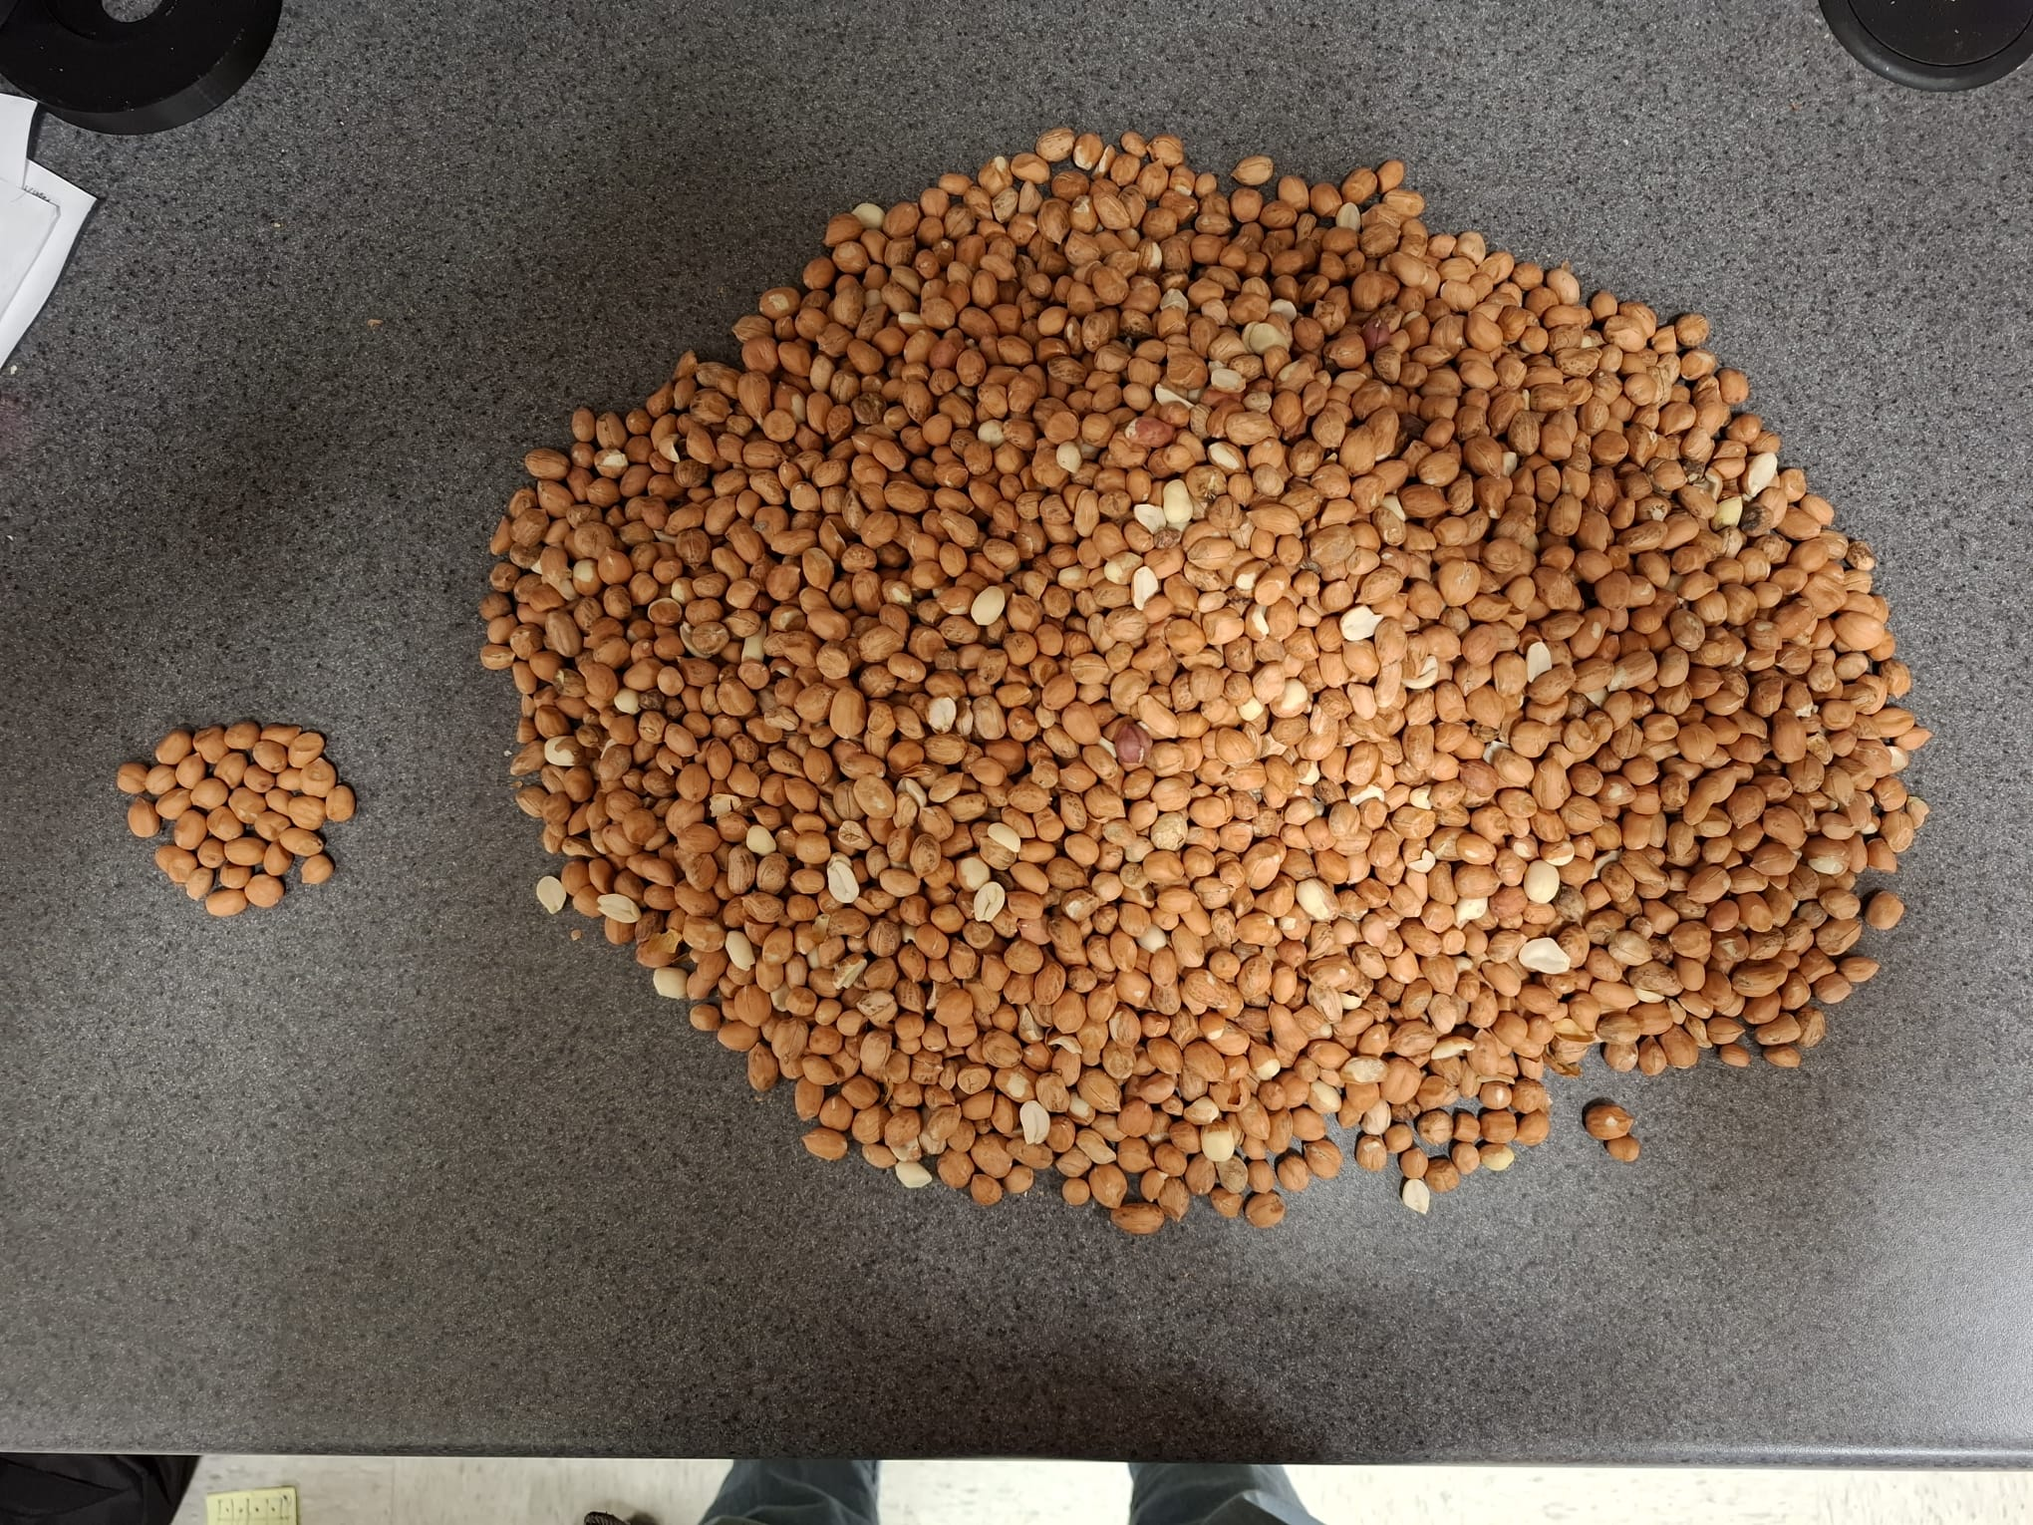
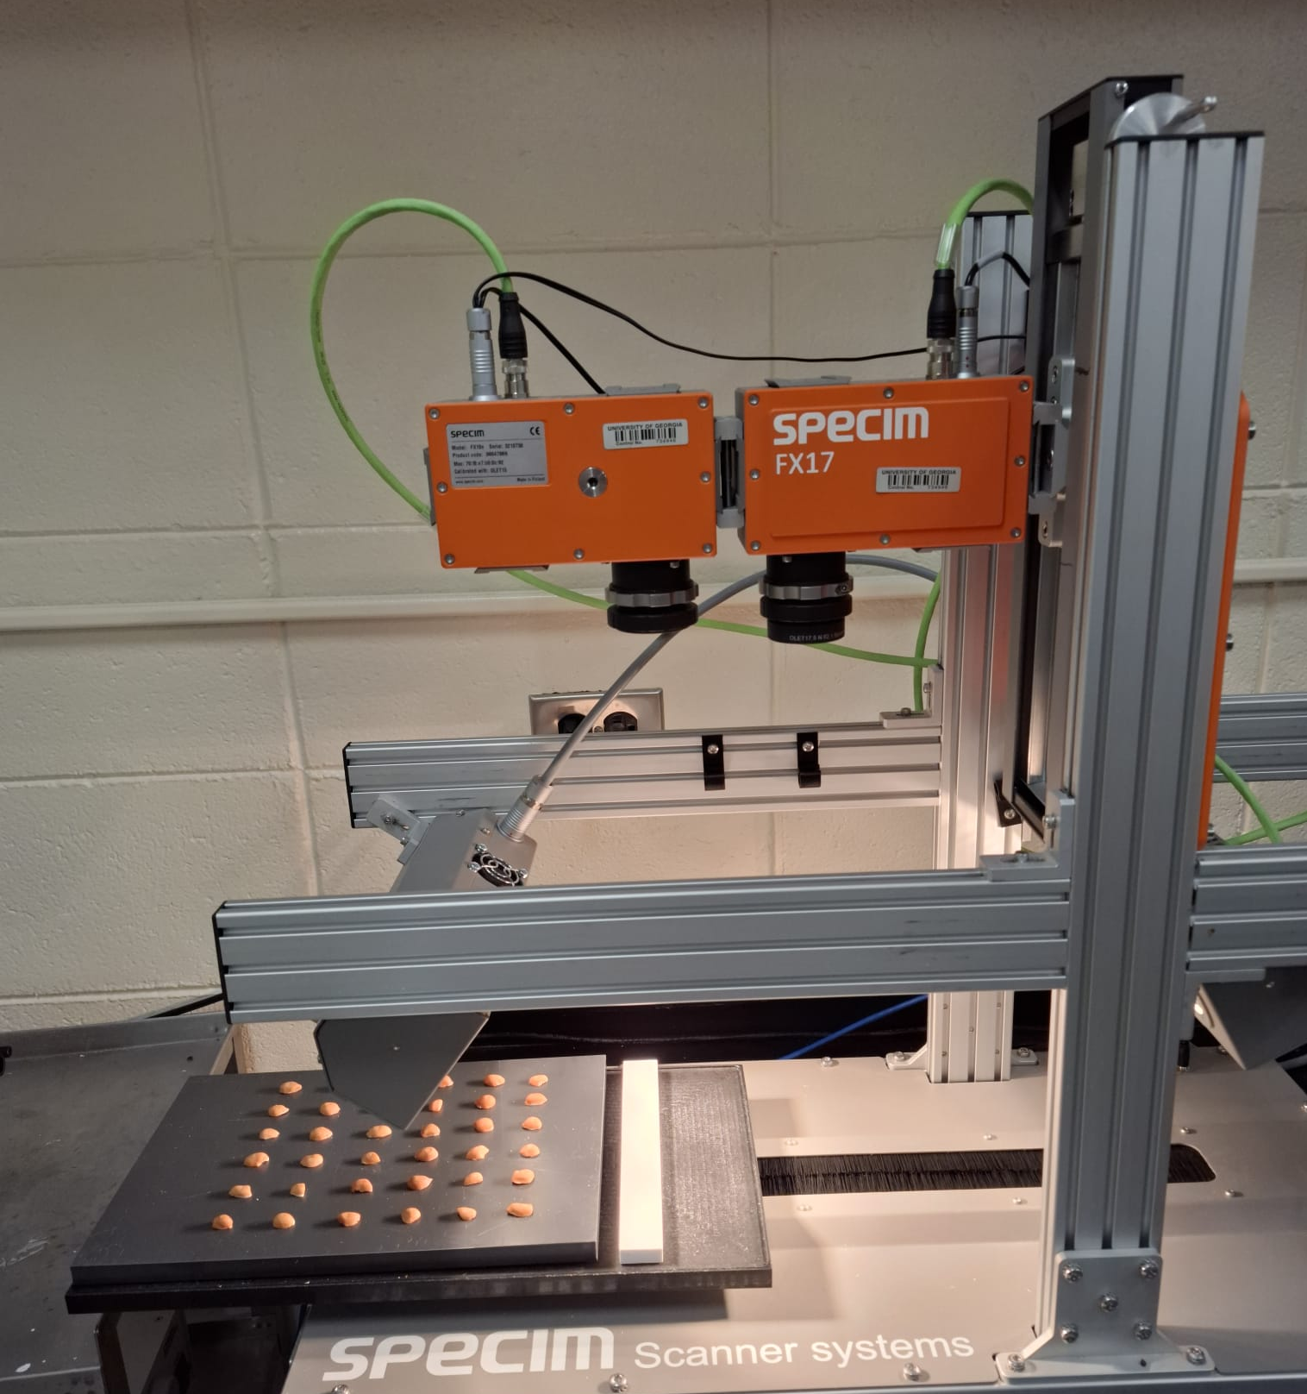
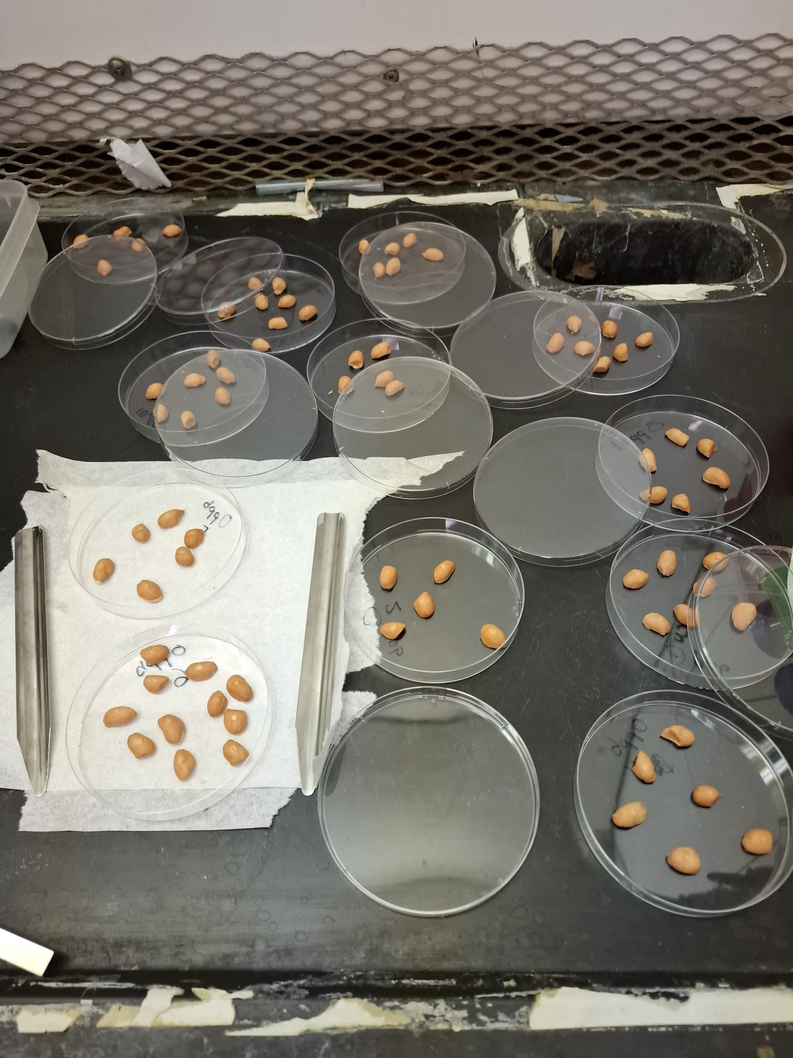
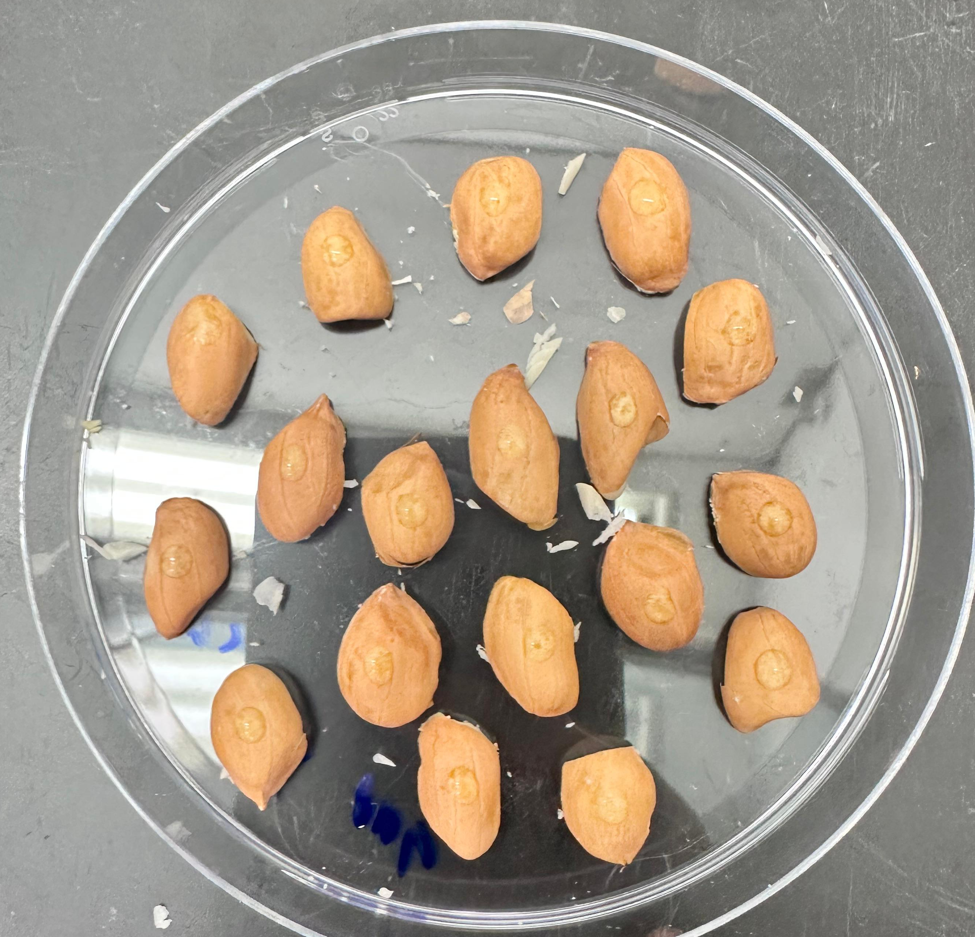
Georgia-06 peanuts with uniform size and no visible damage
Peanut kernels were cut in half using a scalpel
10,000 ppb AFB1 (Cat. No. A6636, Sigma-Aldrich, USA)
70% methanol (control)
5 µL of 10,000 ppb AFB1 applied to each peanut using a micropipette
Camera: 400-1000 nm
Camera: 900-1700 nm
Halogen light (50 watt):400-2000
Conveyor plate
Seeds were dried in for 2.5 hours
5 µL of 70% methanol applied to each peanut using a micropipette
Image acquisition with hyperspectral imaging system

Slide 8
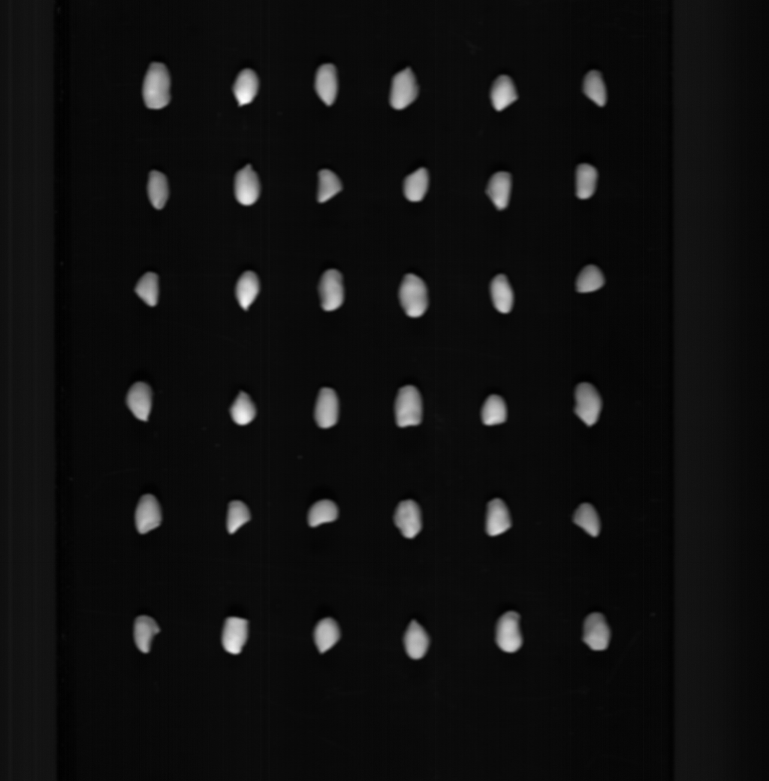
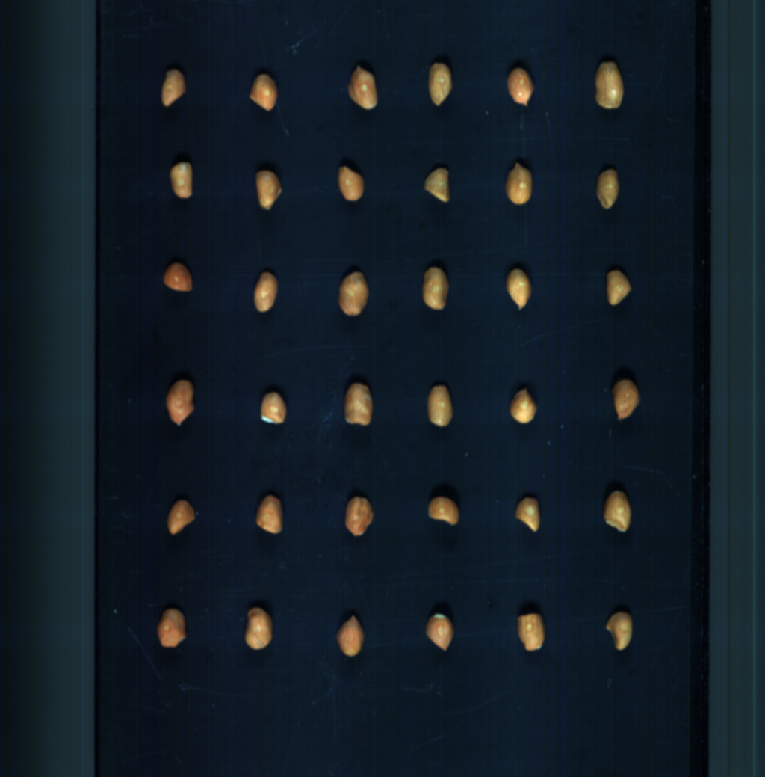
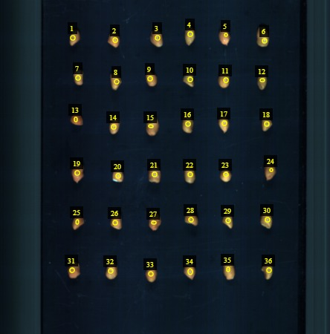
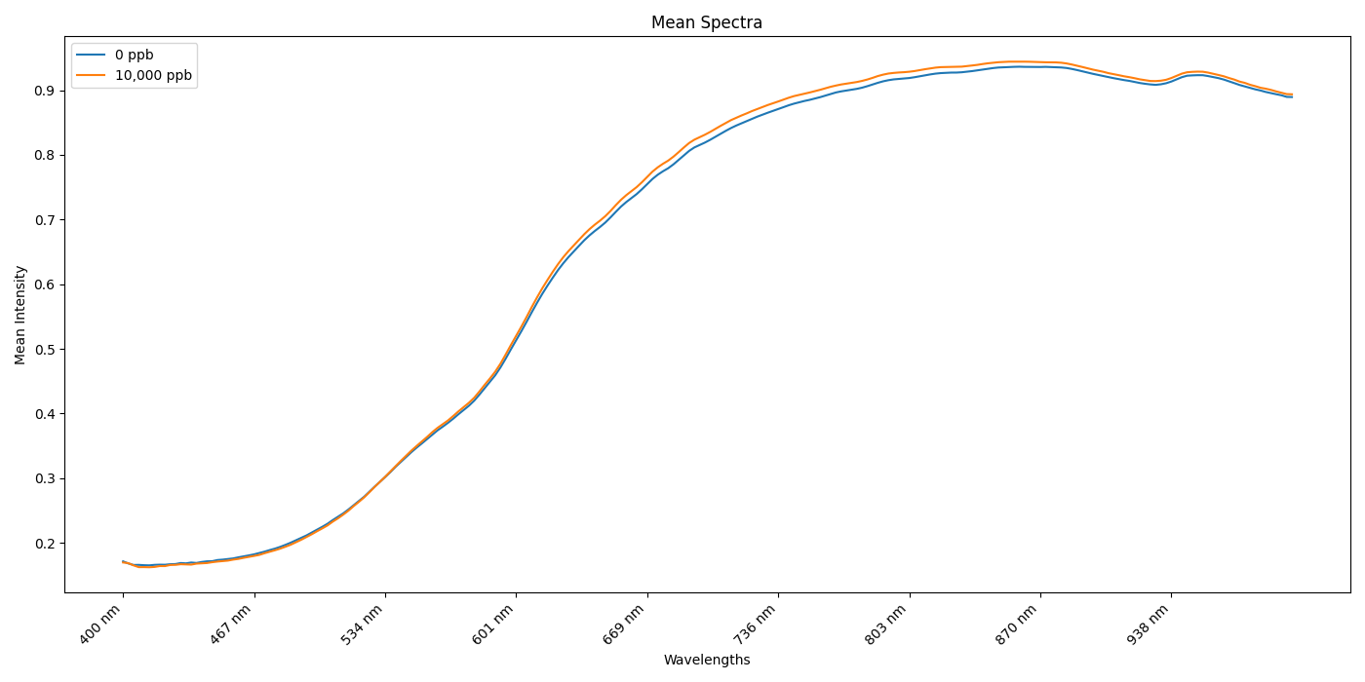
Methodology: Data Processing and Classification Workflow
Raw Image
RGB Image
Image Annotation
Mean Spectra
Machine Learning Models
Identifying important Wavelengths
PLS-DA
Comminated
LDA
Non contaminated
CARS
Logistic Regression
Support Vector Regression
8

Slide 9
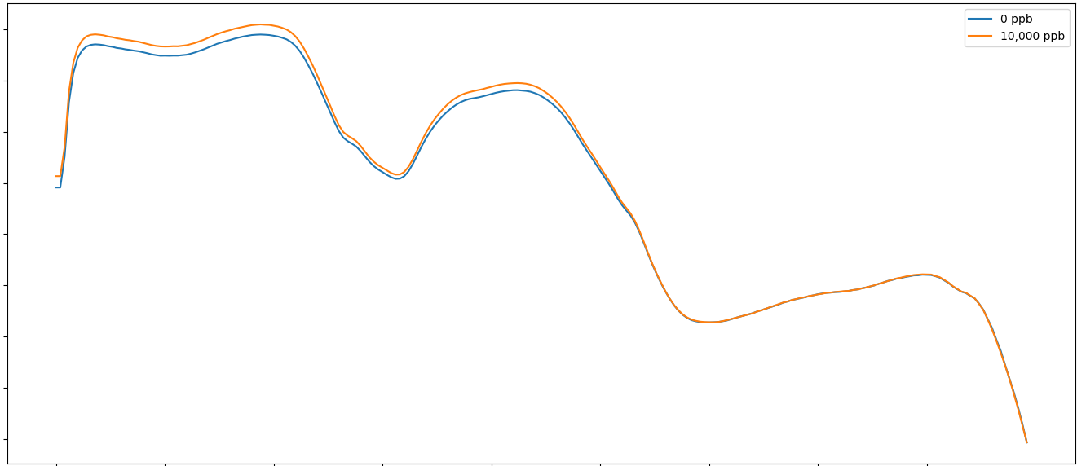
Results: Mean Spectra
0.95
0 ppb
0.90
10,000 ppb
Near-Infrared (NIR) Reflectance (900 – 1800 nm)
0.85
Mean Intensity
0.80
0.75
0.70
0.65
0.60
0.55
Showing differences between 0 ppb and 10,000 ppb in HSI spectra
900
989
1079
1169
1258
1348
1438
1527
1617
1700
Wavelengths (nm)
0.9
0 ppb
0.8
10,000 ppb
Visible Near-Infrared (VNIR) Reflectance (400 nm – 1000 nm)
0.7
Mean Intensity
0.6
0.5
0.4
0.3
0.2
400
467
534
601
669
736
803
870
938
1000
Wavelengths (nm)
Notes:
Write how you will explain

Slide 10
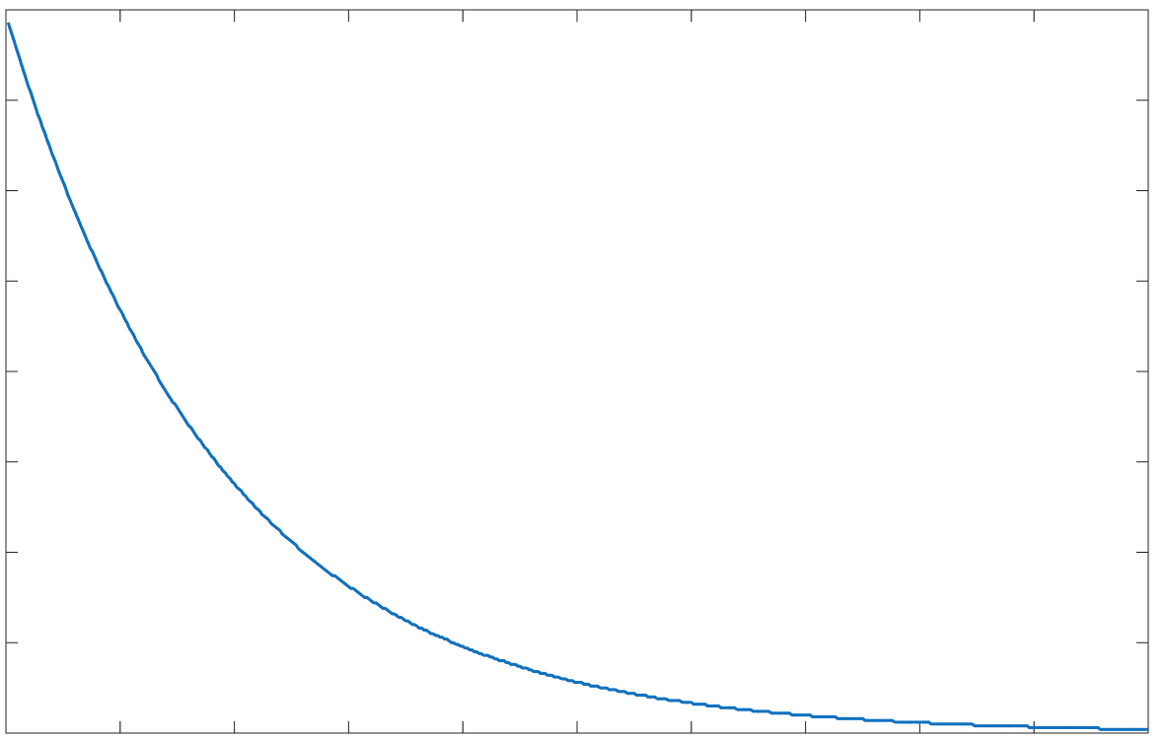
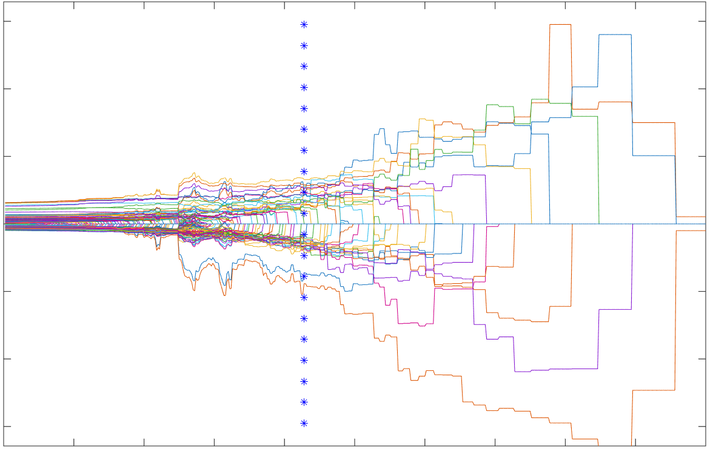
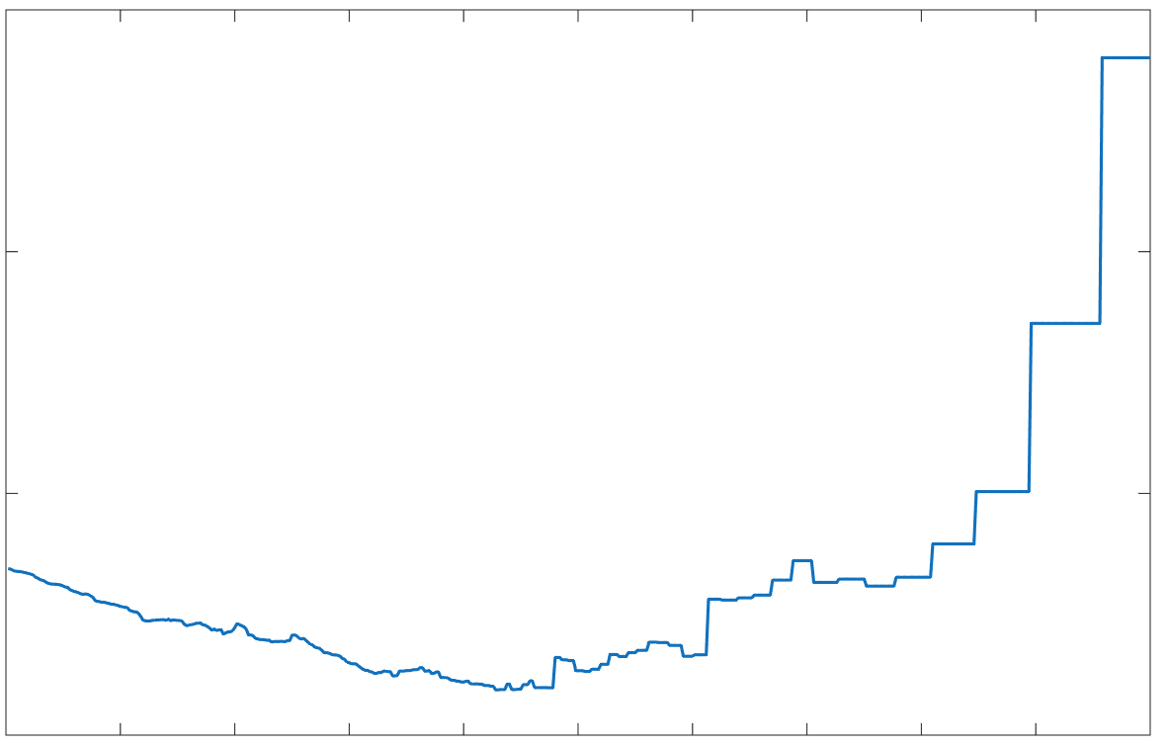
Results: Feature Selection Using CARS
(a)
(c)
350
VNIR Data Annotation
Data Source | Selected Wavelengths (CARS)
VNIR | 22 bands
NIR | 23 bands
Fused Spectral Data (VNIR and NIR) | 41 bands
Number of sampled variables
400
Regression coefficients path
0
50
100
150
200
250
300
-150
-100
-50
0
50
100
150
0
50
100
150
200
250
300
350
400
450
500
0
50
100
150
200
250
300
350
400
450
500
Number of sampling runs
Number of sampling runs
0.5
(b)
Fig. (a) shows the progression of feature elimination using Monte Carlo sampling. The number of wavelengths decreases and stabilizes around 210 runs, indicating the optimal feature set.
Fig (b) shows that RMSECV reaches its minimum between 214 to 225 runs, confirming the best model performance at this point.
Fig. (c) illustrates that regression coefficients stabilize near 214 runs, revealing the key wavelengths selected by CARS.
RMSECV
0.45
0.4
0.35
50
100
150
200
250
300
350
400
450
500
0
Number of sampling runs
10
Notes:
Write how you will explain

Slide 11
Results: Classification Results
Four algorithms were used for classification: Partial Least Squares Discriminant Analysis (PLS-DA), Linear Discriminant Analysis (LDA), Support Vector Regressor (SVR), and Logistic Regression
Machine learning models learn patterns from peanut spectral data to distinguish contaminated and non-contaminated kernels
NIR Data
Fused Spectral Data
11
Notes:
How ML works

Slide 12
Summary and Future Directions
VNIR Data Annotation
CARS outperformed Principal Component Analysis (PCA) because it directly selects the most informative wavelengths related to aflatoxin contamination.
Forty-one key wavelengths from combined dataset showed strong potential for differentiating highly contaminated peanuts from non-contaminated kernels
Support Vector Regression (SVR) achieved the highest classification accuracy (87.88%) for distinguishing 0 and 10,000 ppb aflatoxin B1 contamination levels
Validate selected key wavelengths and models using naturally contaminated peanut samples
12

Slide 13



Acknowledgements
Grant No. GS25-332
Dr. Jake Fountain
Dr. Harald Scherm
Dr. Md Sultan Mahmud
Dr. Christopher Kucha
Dr. Marin Brewer
Dr. Shavannor Smith
Ms. Lorna Nissen
Lab Members from Drs. Smith, Fountain and Mahmud Lab
13

Slide 14
Thank You
Contact: MdTauhidul.Alam@uga.edu (T. Alam)

