Slide 1

Production Systems
Nazirahk Amen
@doctorfarmerbrother

Slide 2
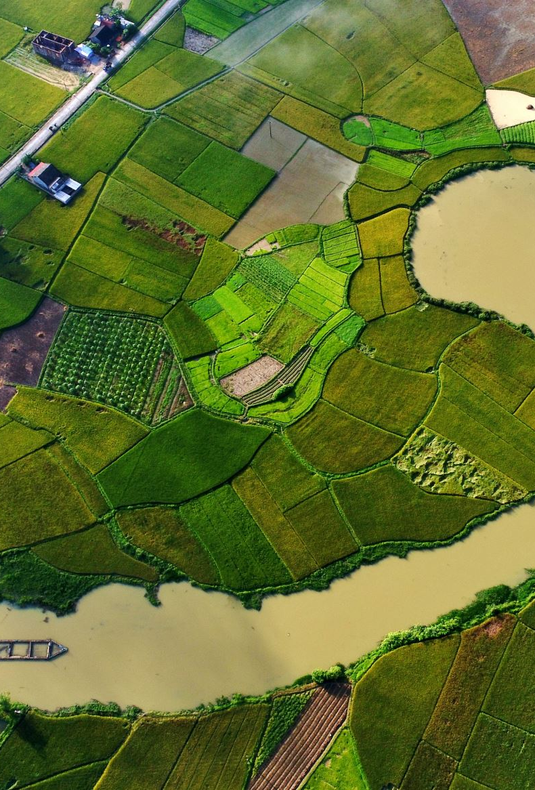
Value of Diversity in Production
Diversity in agricultural production is crucial for enhancing resilience, optimizing resources, improving soil health, and increasing profitability. By diversifying crops, livestock, and farming practices, farmers can mitigate risks, improve biodiversity, and create multiple revenue streams.

Slide 3
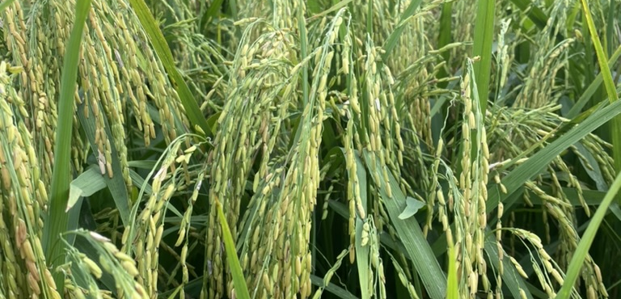
Dryland/upland rice

Slide 4
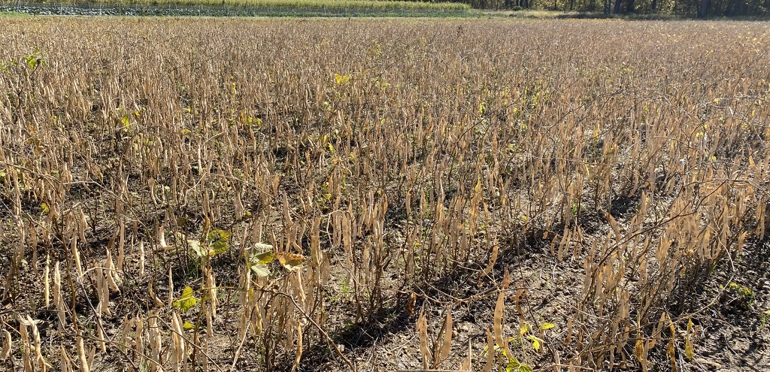
Dry Beans

Slide 5
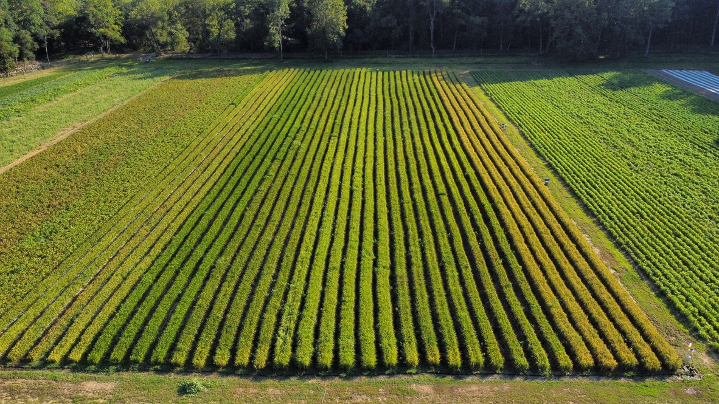

Slide 6
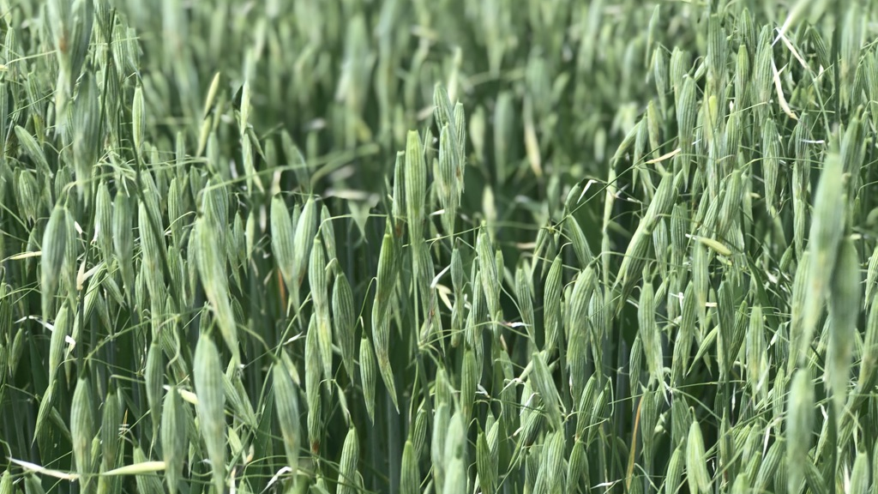
Oats

Slide 7
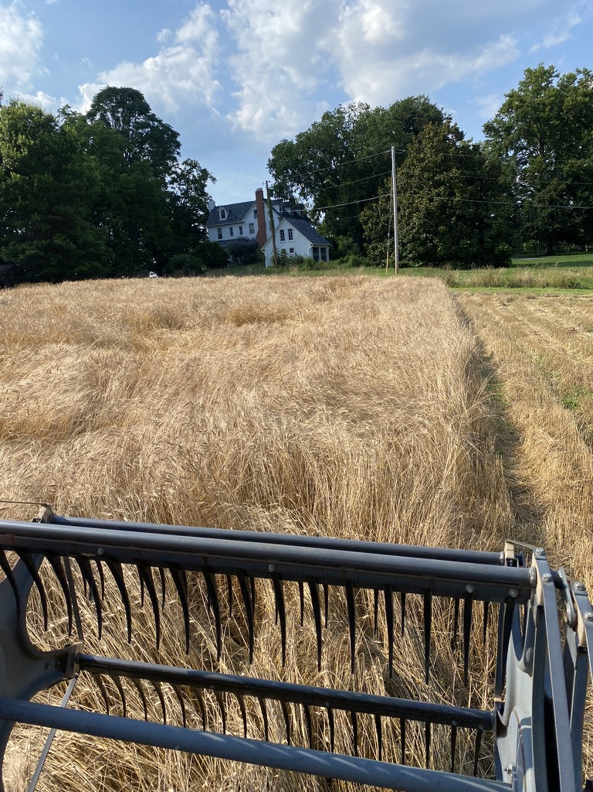
Einkorn Einkorn and Winter WHeatnd Wheat

Slide 8
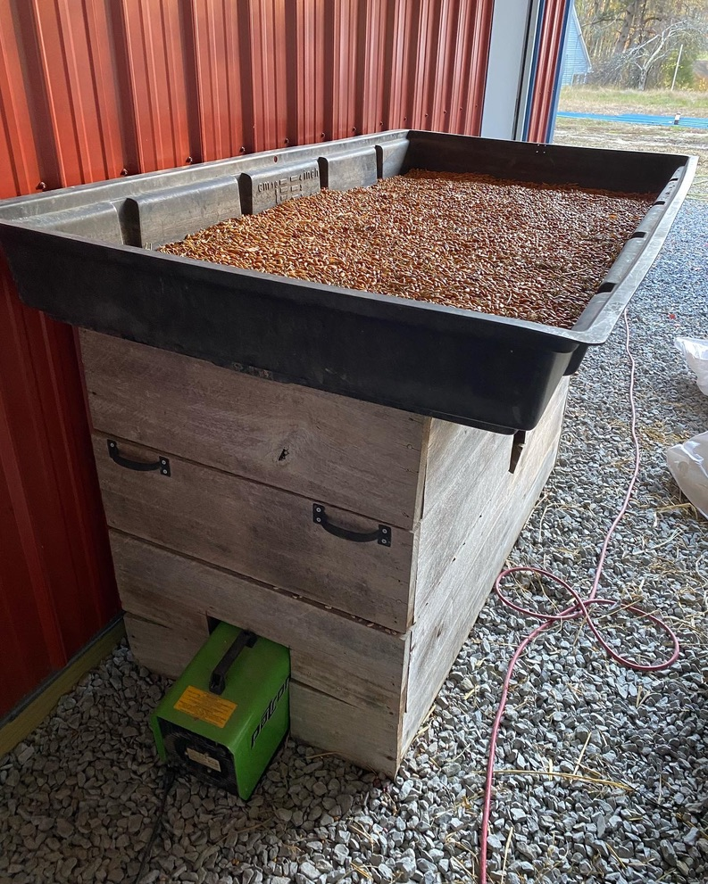
Creative
Bean/Grain
Small Scale Drying Solutions

Slide 9
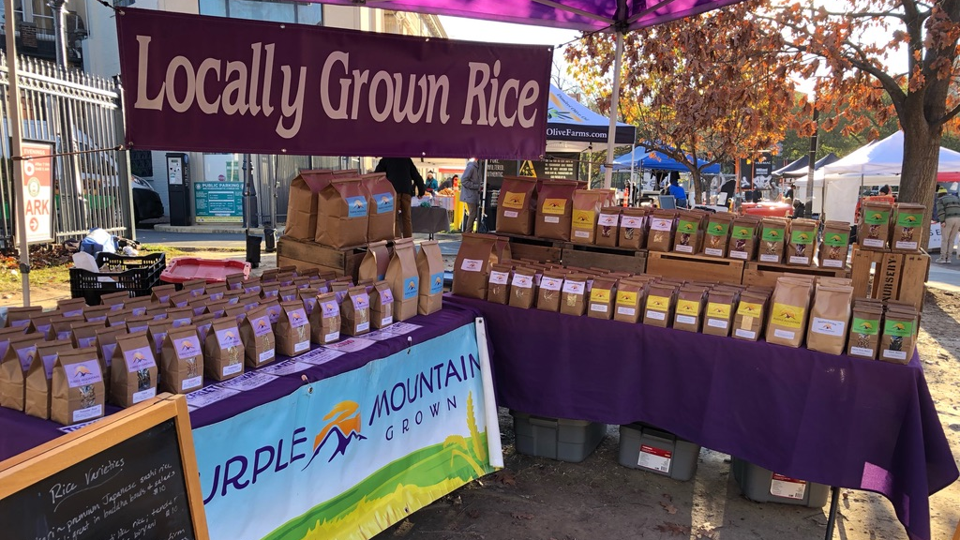

Slide 10
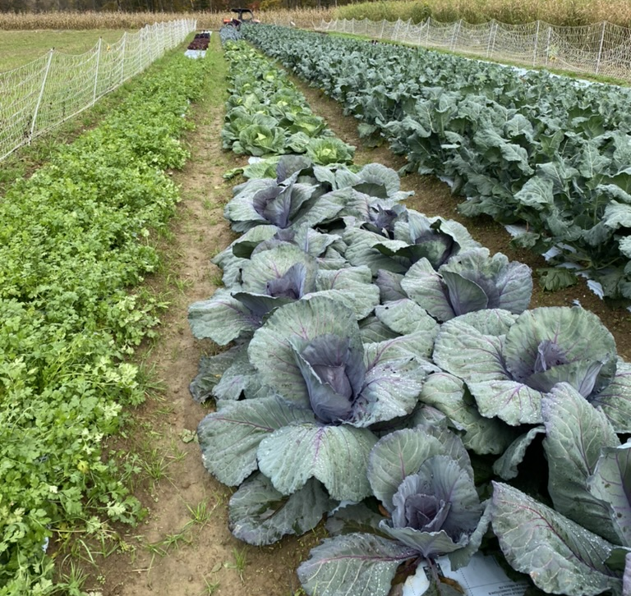
Diversified
Vegetable Farming

Slide 11
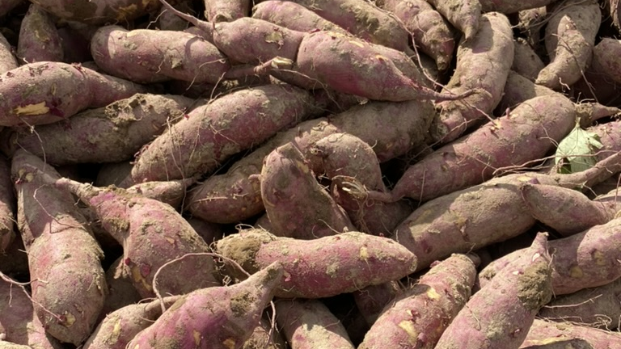
Sweet potatoes

Slide 12
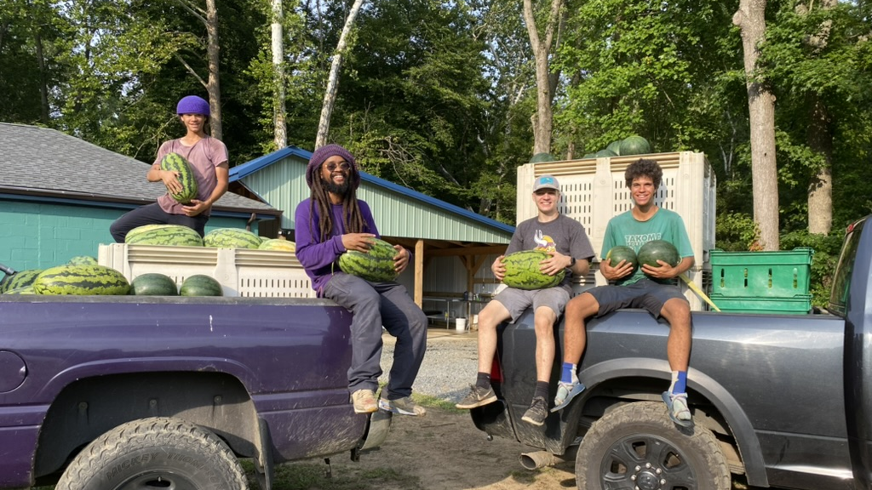
Watermelons!!!

Slide 13
Soil Health
Soil health refers to the ability of soil to sustain plant growth, support environmental functions, and maintain productivity over time. Healthy soil supports robust plant growth, enhances resilience against pests and diseases, and helps manage water and nutrient availability.

Slide 14

Key Aspects of Soil Health
Soil Structure The arrangement of soil particles into aggregates or clumps.
Importance Good soil structure improves aeration, water infiltration, and root penetration.
Improvement Use practices like adding organic matter (compost, cover crops) and avoiding excessive tillage.
Soil Texture The proportion of sand, silt, and clay particles in the soil.
Importance Affects water retention, drainage, and nutrient availability.
Assessment Conduct a soil texture test to determine your soil’s composition.
Organic Matter Decomposed plant and animal material in the soil.
Importance Enhances soil structure, water holding capacity, and nutrient availability.
Increase Add compost, manure, and cover crops to boost organic matter content.

Slide 15

Soil Biology and Water
Soil Biological Activity The presence and activity of microorganisms, fungi, earthworms, and other soil organisms.
Importance Supports nutrient cycling, soil structure formation, and plant health.
Enhancement Avoid overuse of synthetic chemicals and provide habitat for beneficial organisms.
Soil Moisture:The amount of water available in the soil.
Importance: Adequate moisture is crucial for plant growth and nutrient uptake.
Management Use mulches, fabric cover crops, and efficient irrigation practices to manage soil moisture.

Slide 16
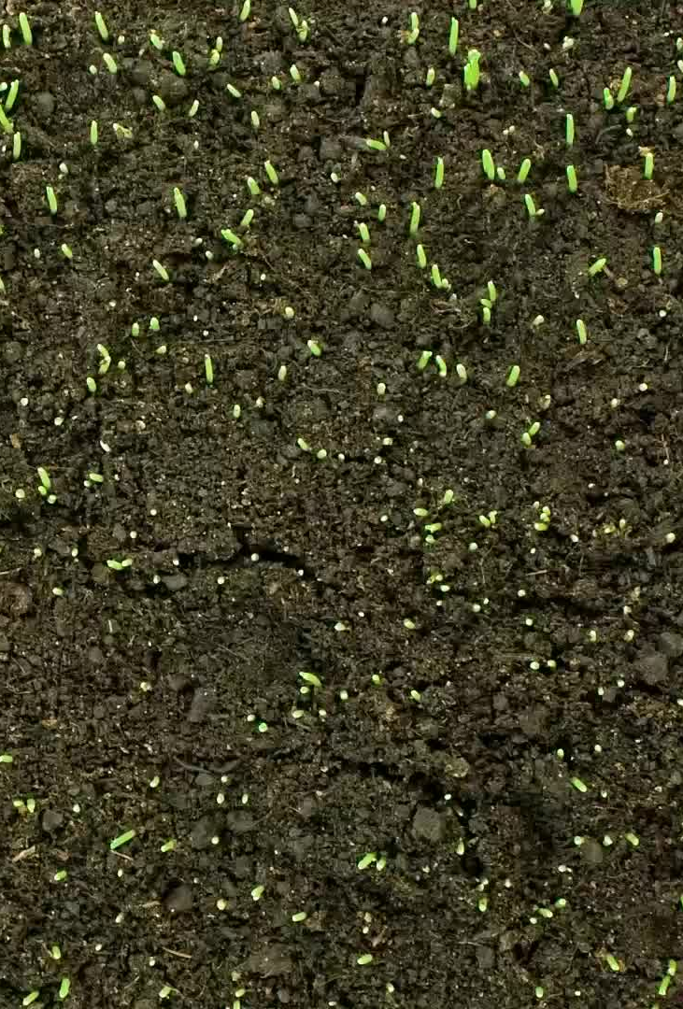
Soil Fertility
Soil fertility refers to the soil’s capacity to supply essential nutrients to plants in adequate amounts and proper proportions. Fertile soil supports healthy plant growth and high yields

Slide 17
Essential Nutrients:
Primary Nutrients: Nitrogen (N), phosphorus (P), potassium (K).
Nitrogen: Promotes leaf and stem growth.
Phosphorus: Supports root development and flowering.
Potassium: Enhances overall plant health and disease resistance.
Secondary Nutrients: Calcium (Ca), magnesium (Mg), sulfur (S).
Calcium: Strengthens cell walls and improves soil structure.
Magnesium: Central component of chlorophyll and aids in photosynthesis.
Sulfur: Important for protein synthesis and enzyme function.
Micronutrients: Iron (Fe), manganese (Mn), zinc (Zn), copper (Cu), molybdenum (Mo), boron (B).
Function: Support various biochemical processes in plants.

Slide 18
Essential Nutrients and pH Conditions
Essential Nutrients Nitrogen (N), phosphorus (P), potassium (K), calcium (Ca), magnesium (Mg), sulfur (S), and trace elements.pH
Conditions Optimal soil pH is typically between 6.0 and 7.0 for most crops. Proper pH ensures nutrient availability and healthy plant growth.

Slide 19
Soil Assessments
Soil pH: A measure of soil acidity or alkalinity.
Importance: Affects nutrient availability and microbial activity.
Optimal Range: Most crops grow best in soil pH between 6.0 and 7.0.
Adjustment: Use lime to raise pH (reduce acidity) or sulfur to lower pH (increase acidity).
Soil Testing: Analyzing soil samples to determine nutrient levels, pH, and other characteristics.
Importance: Provides information on soil fertility and helps guide fertilization and soil management practices.
Procedure: Collect soil samples from different areas of your farm, send them to a laboratory, and interpret the results.

Slide 20
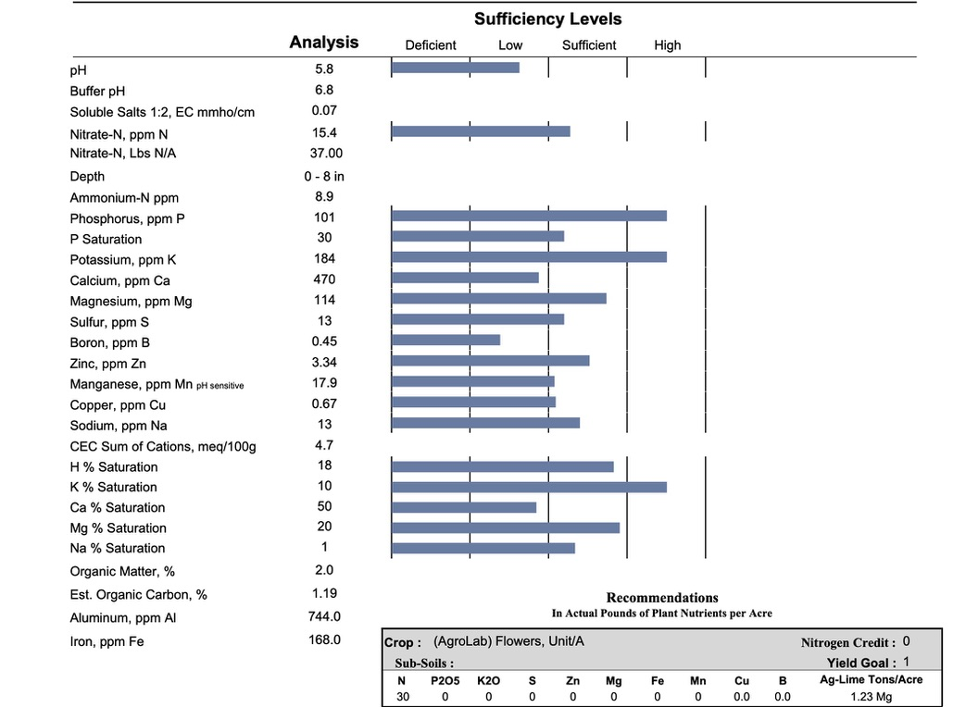

Slide 21
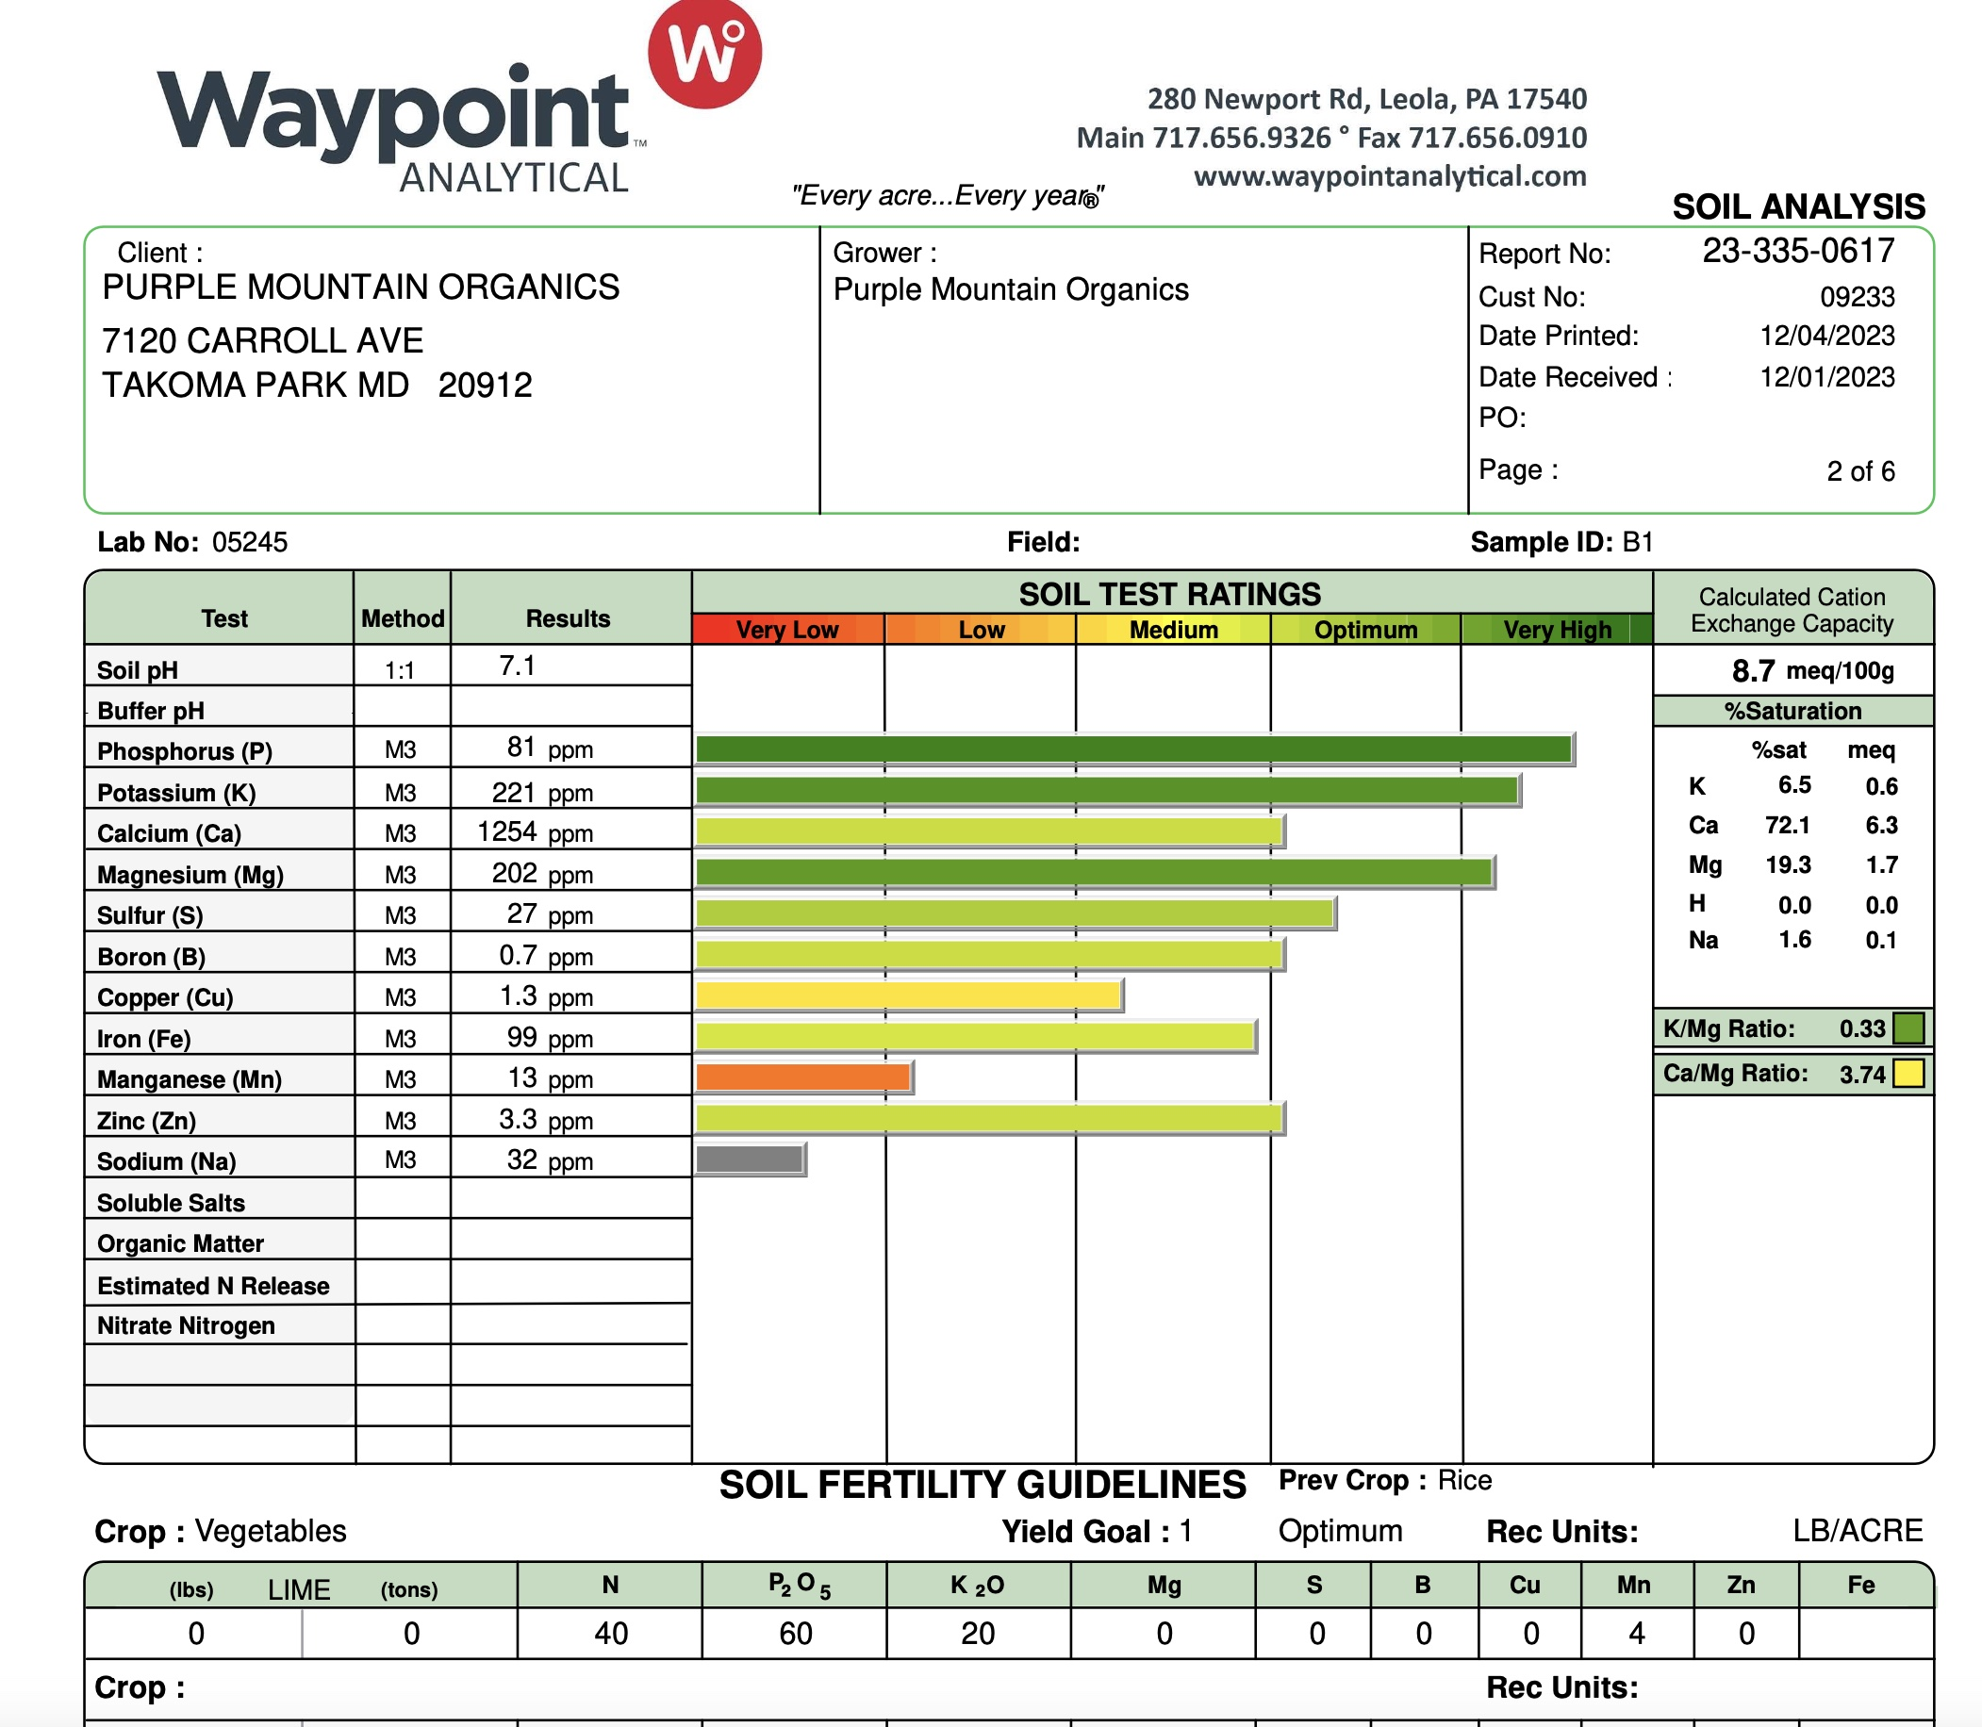

Slide 22
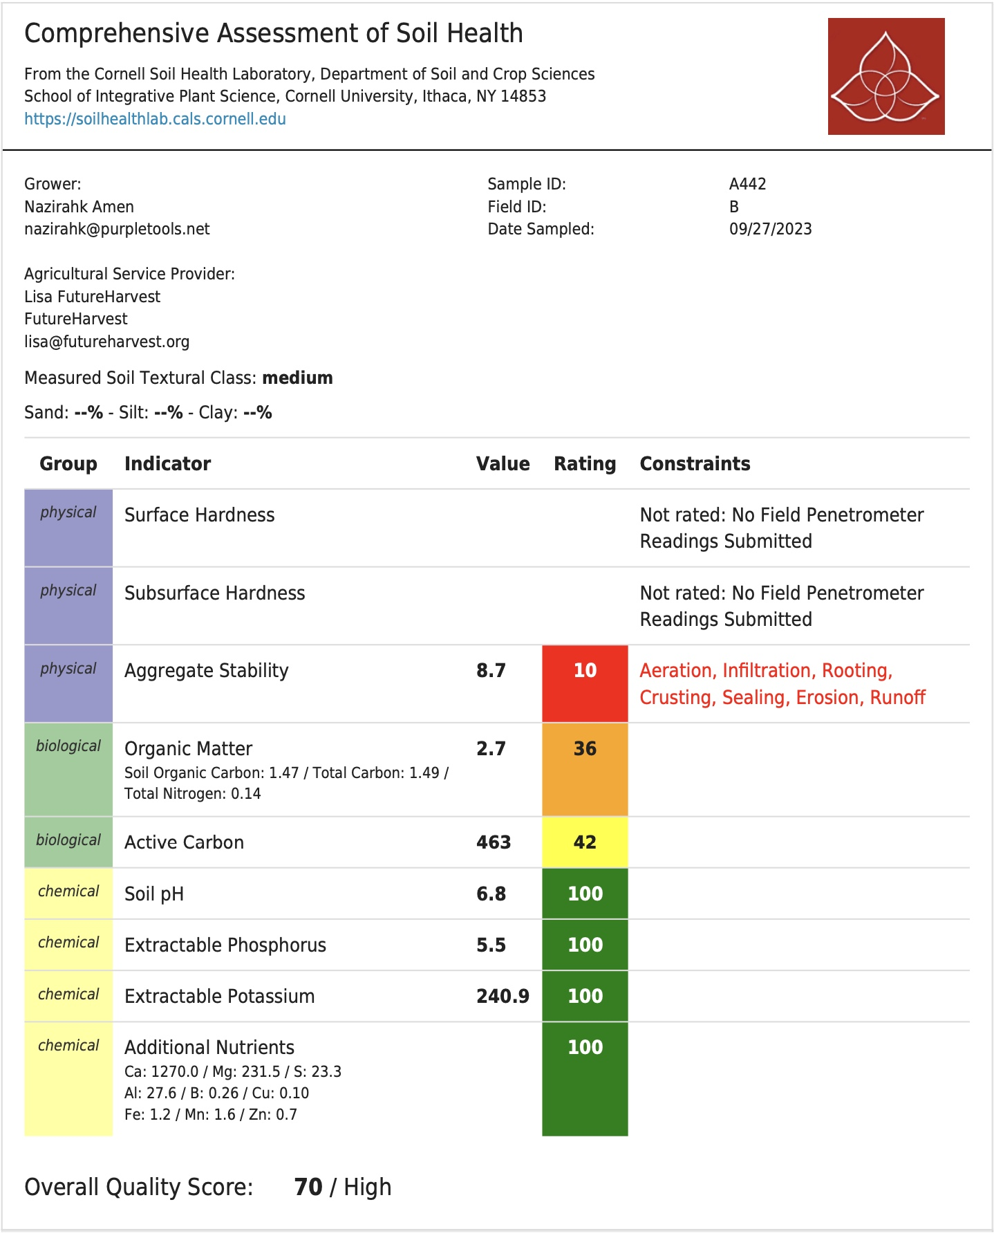

Slide 23
Implementing Soil Health and Fertility Practices
Add Organic Matter Decomposed organic material that improves soil structure, fertility, and moisture retention.
Manure: Animal waste that adds nutrients and organic matter.
Green Manures/Cover Crops Plants grown to improve soil health and fertility when tilled under.
Practice Crop Rotation Growing different crops in succession on the same land.
Benefits Reduces nutrient depletion, breaks pest and disease cycles, and enhances soil fertility.

Slide 24
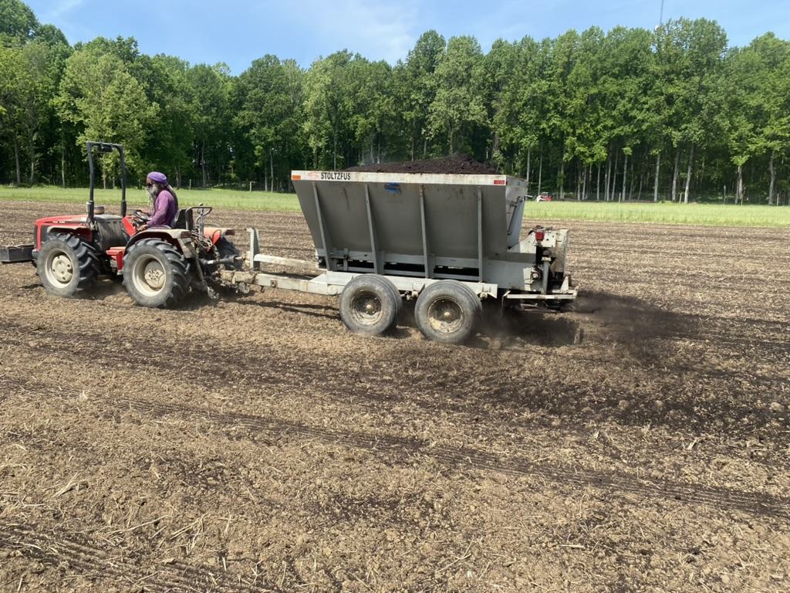

Slide 25
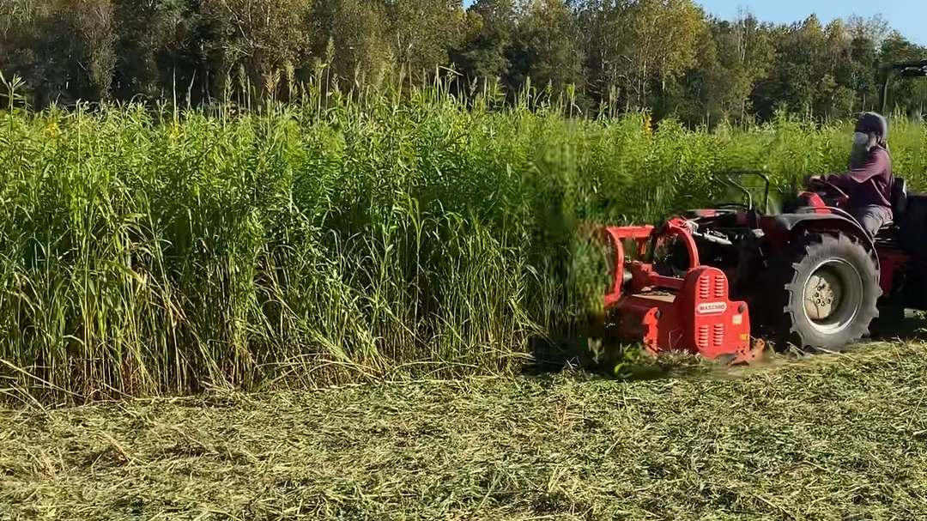
Cover Crop Soil Building/
Flail Mower

Slide 26
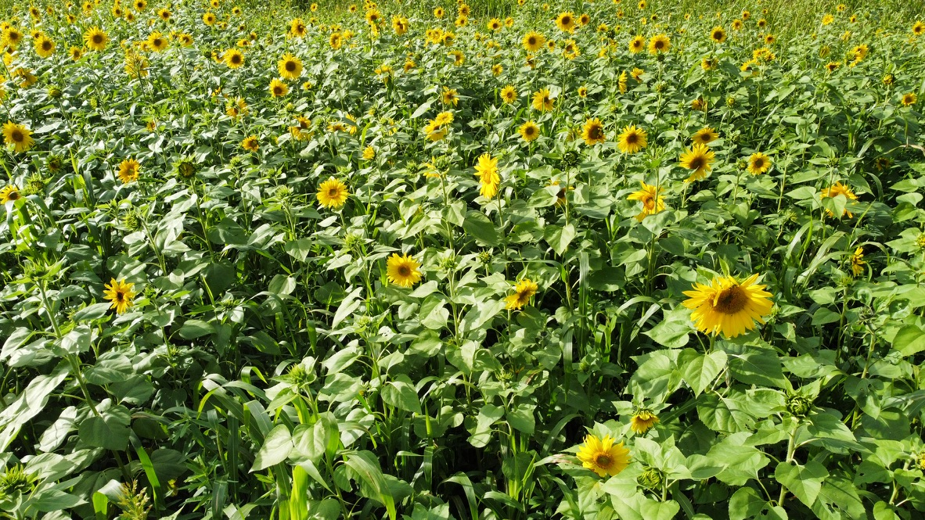
Multi Species Cover Cropping

Slide 27
Bio-Intensive Production
Definition A method of growing as much organic produce as possible in a limited space by maximizing soil health and planting density.
Benefits Improves soil fertility, reduces water usage, and increases yield per square foot.
Practices Double-digging, composting, close plant spacing, companion planting, and intensive planting.

Slide 28
High-Efficiency Market Garden
Definition A farming approach focusing on producing high yields on small plots of land using intensive cultivation methods.
Benefits High productivity, efficient use of space, and sustainable practices.
Practices Succession planting, crop rotation, use of cover crops, and organic inputs.

Slide 29
Landscape Fabric
Definition: A synthetic material used to suppress weeds, retain soil moisture, and control soil erosion.
Benefits: Reduces weed competition, conserves water, and helps maintain soil structure.
Practices: Prevent weed growth and concentrates soil energy on plan.

Slide 30
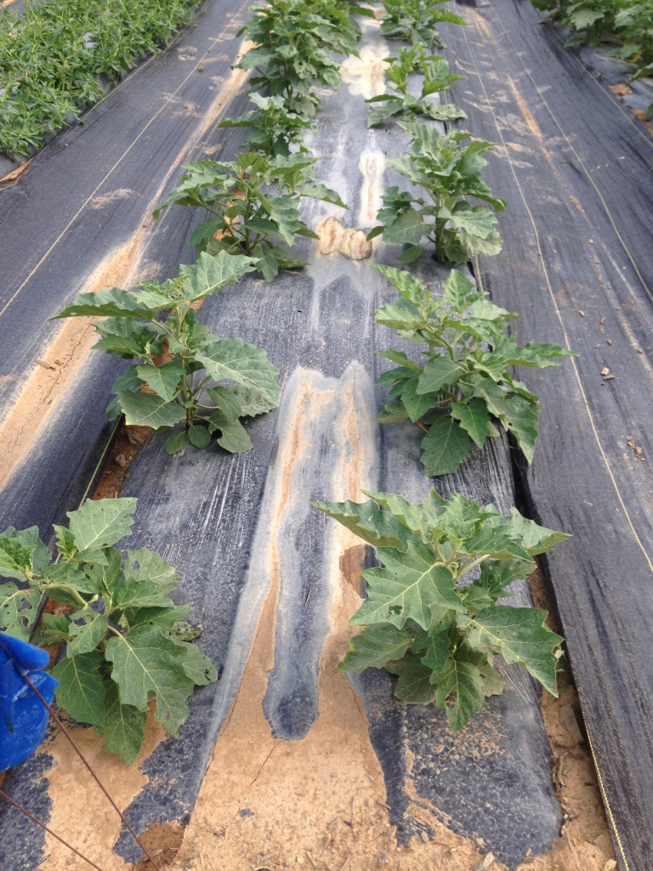

Slide 31
Raised Bed
Definition Elevated soil beds often enclosed by wood, stone, or other materials.
Benefits Improved soil drainage, warmer soil, better soil structure, and easier access for planting and maintenance.
Practices Filling with high-quality soil mix, amending with compost, and mulching.

Slide 32
Long Row Production
Definition: Planting crops in long, continuous rows.
Benefits: Easier mechanical cultivation, efficient use of space, and better air circulation around plants.
Practices: Suitable for higher volume scale vegetable production and row crops.

Slide 33
Implementing Soil Health and Fertility Practices
Cont’d
Use Cover Crops Plants grown to cover the soil, improve soil health, and manage nutrients.
Benefits Adds organic matter, fixes nitrogen, prevents erosion, and suppresses weeds.
Monitor and Adjust Soil pH Testing Regularly test soil pH and adjust as needed to maintain optimal levels for crop growth.
Efficient Irrigation: Select appropriate irrigation methods (drip, overhead, hand watering) to manage soil moisture and prevent erosion.
Prevent Soil Erosion: Use mulches, plant ground cover, and employ conservation tillage to protect soil from erosion.

Slide 34

Compost Types:
Mushroom Compost A byproduct of mushroom farming, rich in organic matter and nutrients.
Compost Tea A liquid extract made by steeping compost in water, used as a foliar spray or soil drench.
Compost Extract A concentrated solution made from compost, used to inoculate soil with beneficial microbes.

Slide 35
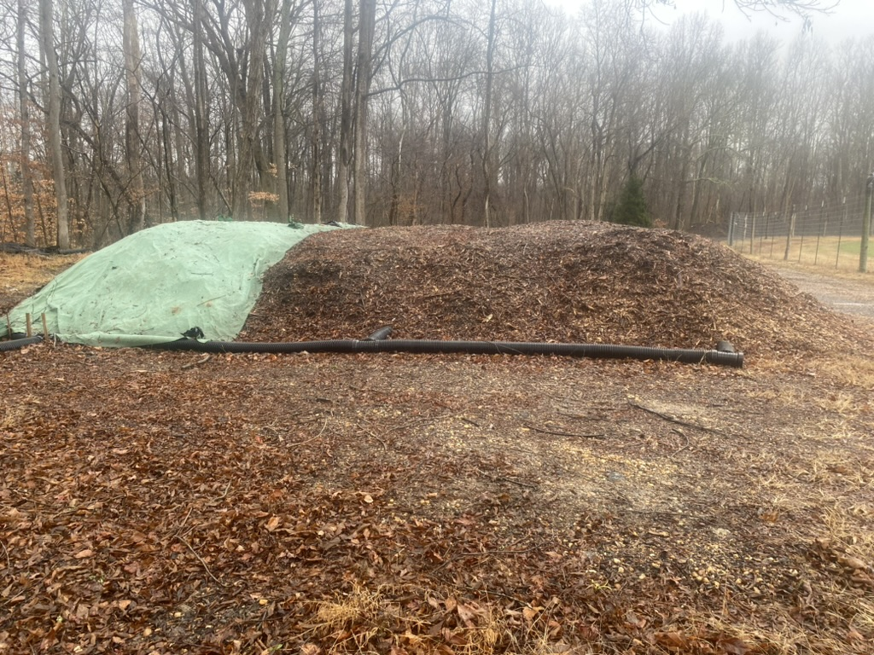

Slide 36
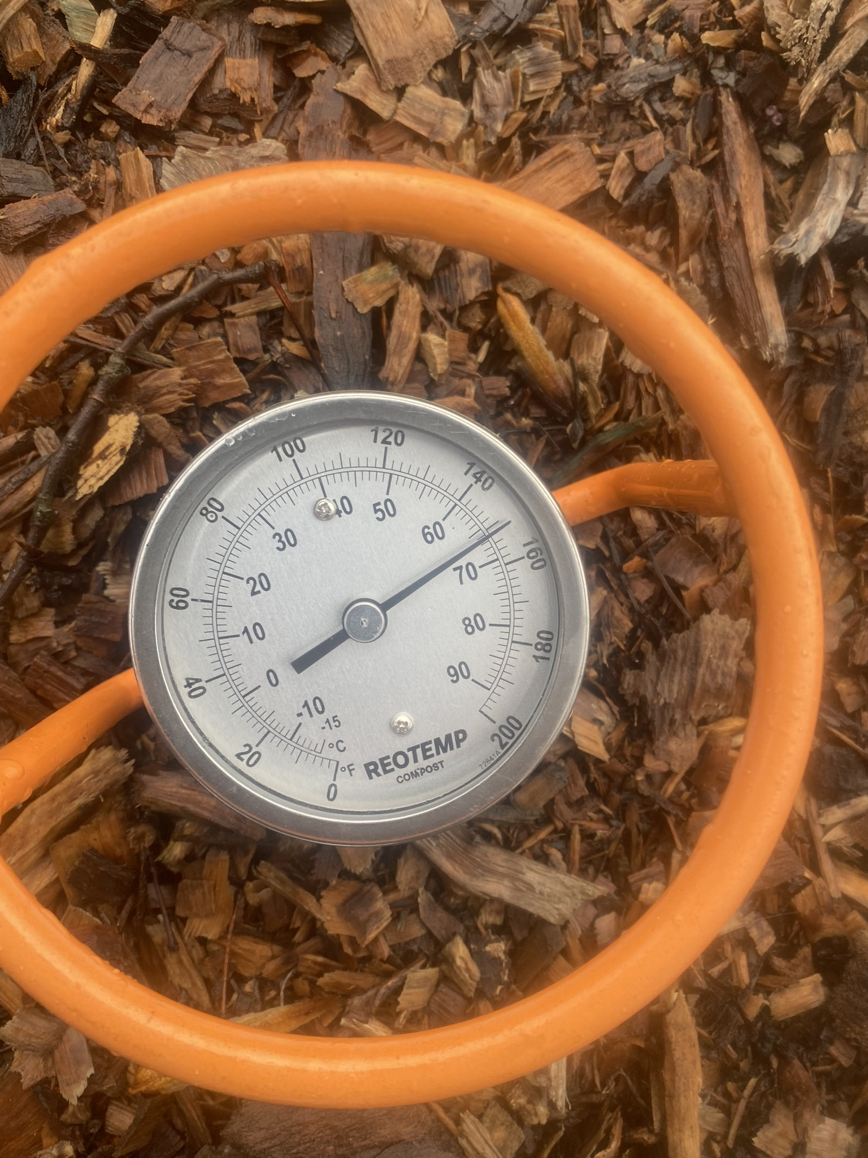

Slide 37
Benefits of Cover Cropping
Improves Soil Health:
Enhances Soil Structure: Cover crops help to create a better soil structure by adding organic matter. This improves soil aeration and reduces compaction.
Increases Organic Matter: As cover crops decompose, they add organic matter to the soil, which increases the soil’s fertility and water-holding capacity.
Reduces Erosion:
Prevents Soil Erosion: The root systems of cover crops help to hold soil in place, reducing erosion caused by wind and water.
Suppresses Weeds:
Weed Control: Cover crops can outcompete weeds for light, nutrients, and space, reducing the need for herbicides.

Slide 38
Benefits of Cover Cropping
Nitrogen Fixation: Leguminous cover crops, such as clover or vetch, can fix atmospheric nitrogen into the soil, reducing the need for synthetic fertilizers.
Improves Soil Moisture:
Moisture Retention: Cover crops help to retain soil moisture by reducing evaporation and improving water infiltration.
Provides Habitat:
Beneficial Insects: Cover crops can provide habitat for beneficial insects and pollinators, which can help control pests and improve crop yields.

Slide 39
Types of Cover Crops
Legumes Clover, vetch, peas, beans.
Benefits: Fix nitrogen in the soil, enhance soil fertility.
Grasses: Rye, barley, oats.
Benefits: Improve soil structure, prevent erosion, and add organic matter.
Brassicas: Radishes, turnips, mustard.
Benefits: Help to break up compacted soil, add organic matter, and can suppress weeds.
Broadleaf Plants: Buckwheat, phacelia.
Benefits: Provide ground cover, attract pollinators, and improve soil structure.

Slide 40
How to Implement a Cover Cropping System
Choose the Right Cover Crop-Climate, soil type, crop rotation plans, and specific goals (e.g., nitrogen fixation, erosion control).
Selection Choose cover crops that suit your local conditions and objectives.
Planting Timing-Before Main Crops Plant cover crops in the fall after harvesting your main crop.
Between Crops Plant cover crops between main crop harvests to maintain soil cover.
Planting Methods-Direct Seeding Sow cover crop seeds directly into the soil.
Broadcasting Spread seeds over the soil surface and incorporate them with light tillage.

Slide 41
Cover Crop Management
Termination Decide when and how to terminate the cover crop (e.g., mowing, tilling, or herbicides). The timing should align with your main crop planting schedule.
Incorporation Incorporate the decomposed cover crop residues into the soil to enhance their benefits.
Evaluate Results Monitor soil health and productivity to assess the effectiveness of your cover cropping system.
Adjust Practices Modify your cover cropping practices based on results and changing farm conditions.

Slide 42
Sizing Plants for Urban Agriculture Production Sites
Considerations Available space, light conditions, and intended use.
Examples Compact vegetable varieties, small fruits (smaller tomotoes or eggplants (faster growth cycle) and vertical trelissing systems for maximizing limited space.

Slide 43
Equipment
BCS Tractors
Definition Versatile, two-wheeled tractors suitable for small farms.
Benefits Can be equipped with various implements for tilling, mowing, and other tasks.
Uses Soil preparation, planting, cultivation, and harvesting.
Hand Tools:
Types Stirup Hoes, shovels, rakes, and hand trowels.
Benefits Essential for precise, small-scale tasks and maintaining control in intensive gardening systems.
Uses Weeding, planting, soil amendment, and harvesting.

Slide 44
Aspects of Production: Crop Plan/Land Prep
Crop Planning
  https://nesfp.nutrition.tufts.edu/resources/crop-planning-sheet
  https://urbanagriculture.horticulture.wisc.edu/crop-planning/#crop
  https://www.sare.org/publications/crop-rotation-on-organic-farms/a-crop-rotation-planning-procedure/
  https://agroecology.ucsc.edu/documents/Teaching%20Direct%20Marketing/4.5_CSA_crop_plan.pdf
  https://www.almanac.com/gardening/planting-calendar
Land Prep/production
  https://www.fao.org/4/y4360e/y4360e0a.htm
  https://www.victoriafarmeq.com/blog/how-to-clear-land-for-farming
  https://www.pubs.ext.vt.edu/SPES/spes-616/spes-616.html
  https://www.farmbrite.com/post/how-to-prepare-a-field-for-planting
  https://content.ces.ncsu.edu/extension-gardener-handbook/6-weeds#section_heading_7498

Slide 45
Aspects of Production: Irrigation/IPM
Irrigation
  https://www.nrcs.usda.gov/sites/default/files/2022-11/2022-small-scale-solutions-factsheet-LOW-COST-IRRIGATION-SYSTEM.pdf
  https://futurepump.com/smallholder-irrigation-options/
  https://agrilinks.org/post/irrigation-methods-addressing-water-scarcity
IPM
  https://agroecology.ucsc.edu/resources/publications/grower-guides/pdf-downloads/pestchart.pdf
  https://anrcatalog.ucanr.edu/pdf/7251.pdf
  https://content.ces.ncsu.edu/pdf/insect-management-on-organic-far/2015-03-13/insectmgmtfinaljan09.pdf

