Slide 1
Progress on capture techniques of post-larval rabbitfishes in Pohnpei. Lessons learned.

Slide 2
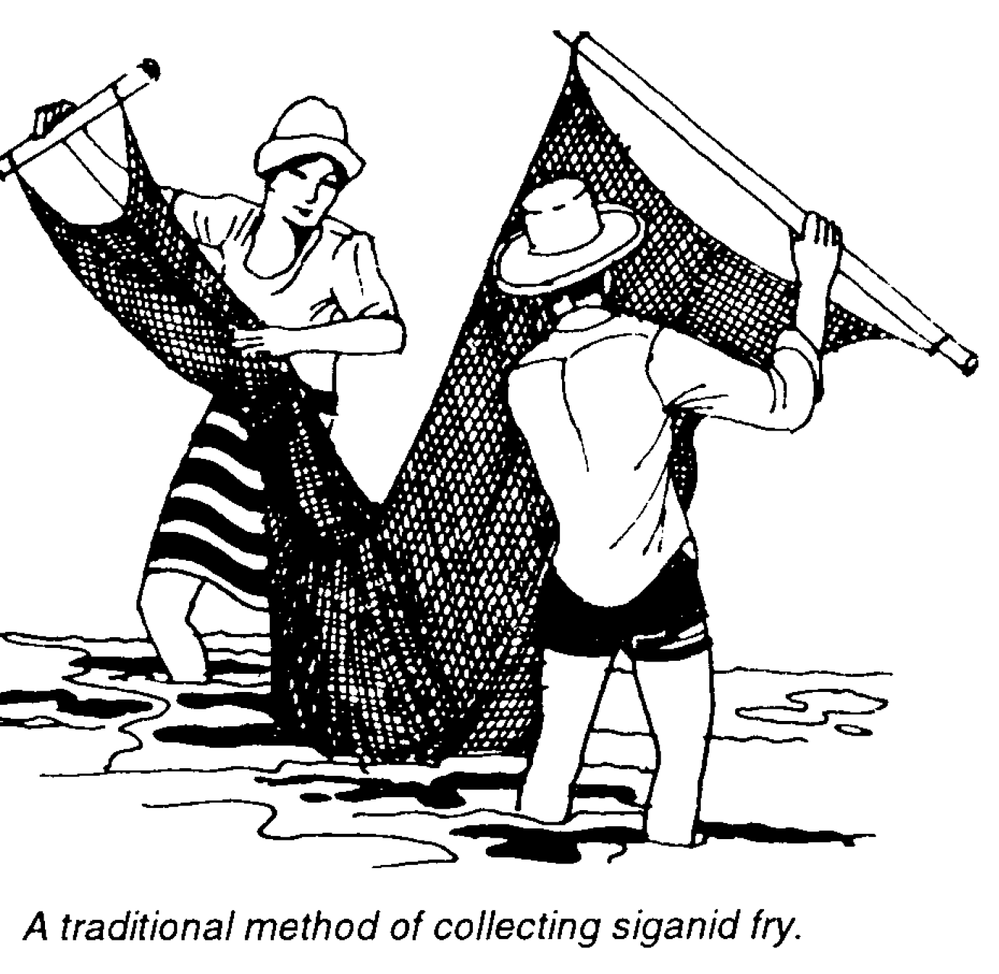
Capture
Not much reference in the literature
Use of scoop nets
Also bag seines 3 mm
Luring fish to algae bundles
and scooping

Slide 3
MERIP tests
2017 – 1/2” gill net for capture of marine ornamentals was used. Fish were too large and the smaller ones escaped.
2018. ¼” gill net designed for capture of smelt in Great Lakes was ordered and has proven successful at capturing settlement stage Siganids in the sea grass beds. Needs a heavy lead line and good floats. Duluth Nets (Dululthnets.com)
2018. S. randalli successfully scoop netted from the mangrove fringes around MERIP.
2017. Small quantities of S. randalli self recruited into cages.

Slide 4
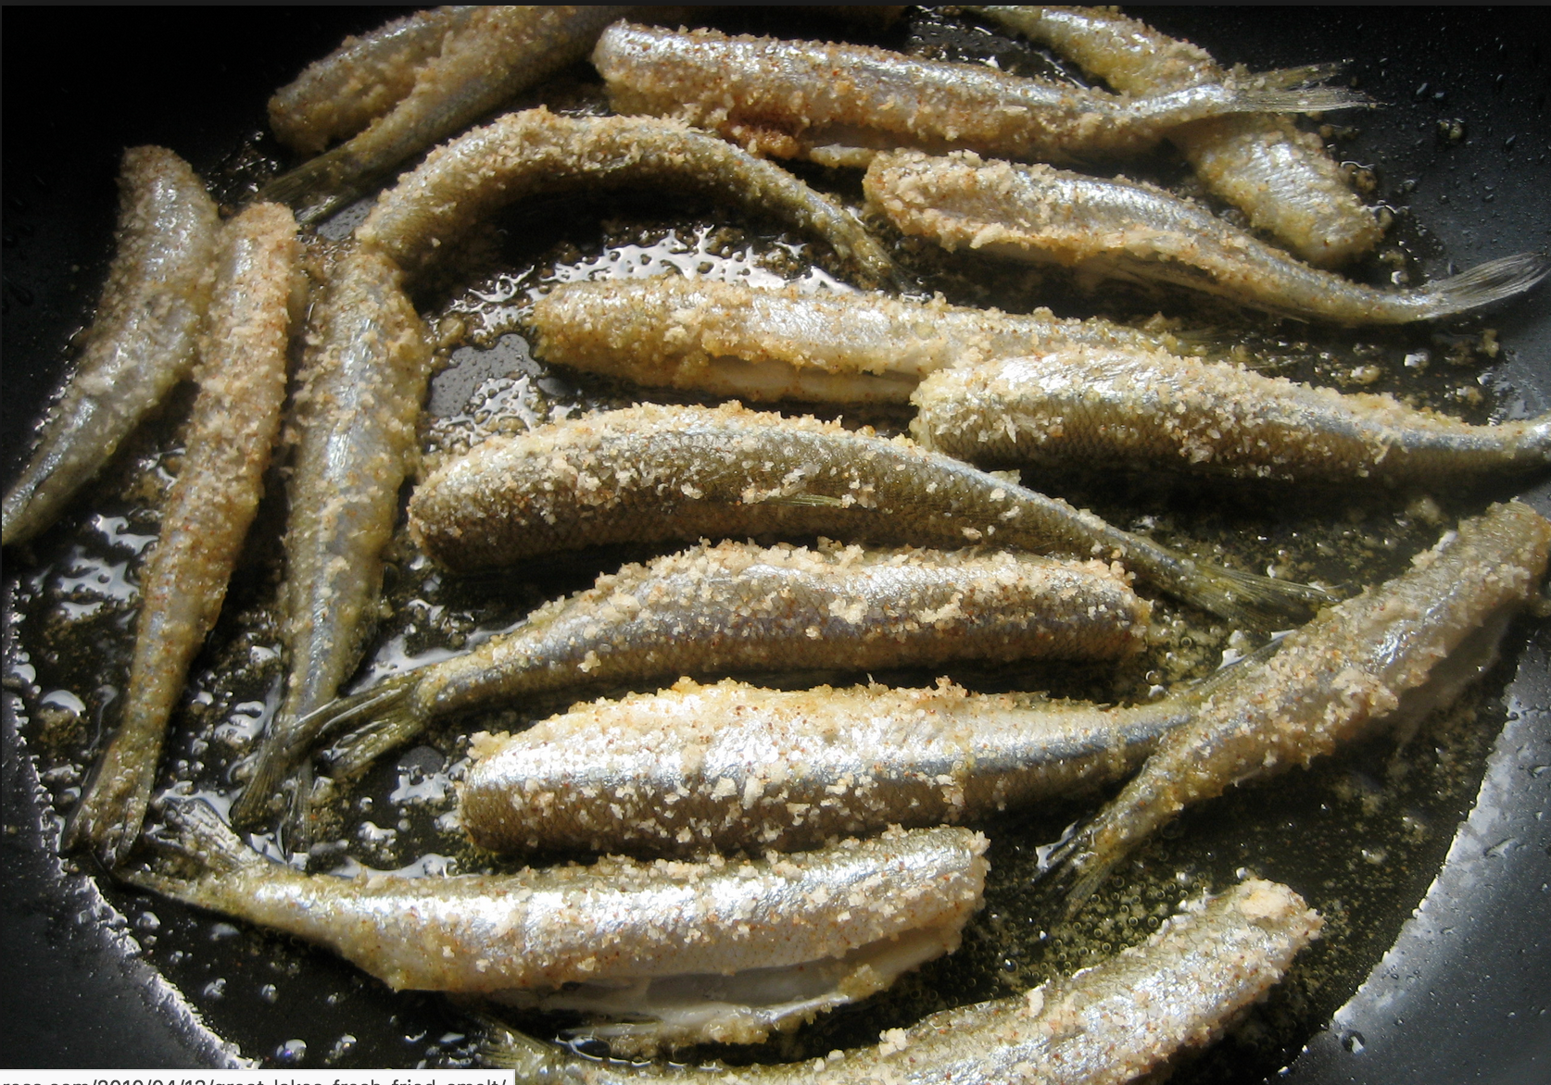
Smelt

Slide 5
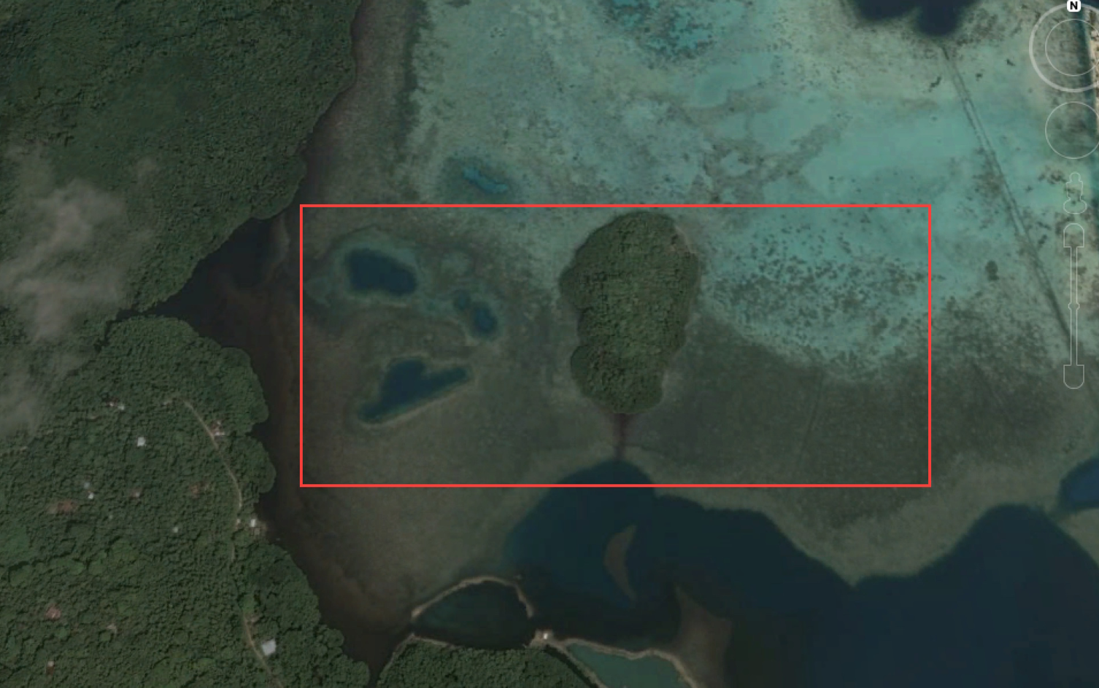
Main Project Work Site

Slide 6
Early Efforts – crest net

Slide 7
Prototype gill net 2017

Slide 10
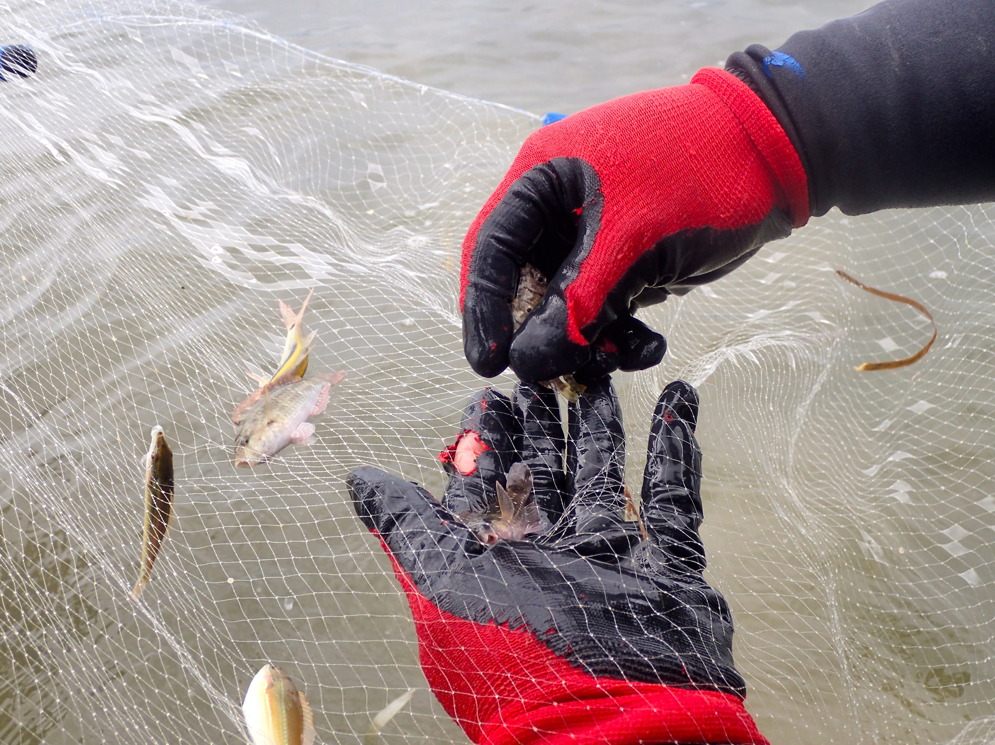

Slide 11
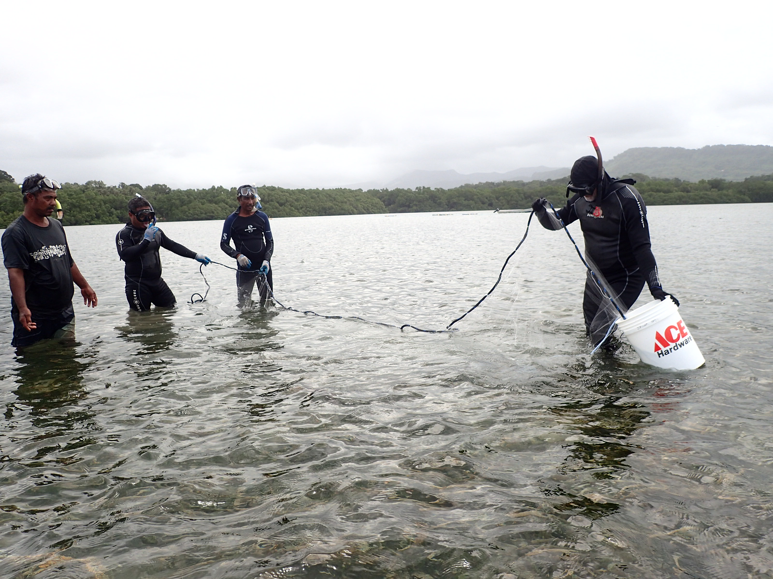
2018 Improvements
Purchased 50 ft ¼” gill net
Heavier lead line
Significantly more fish
Settlement stage fish

Slide 13
Forktail April 24

Slide 14
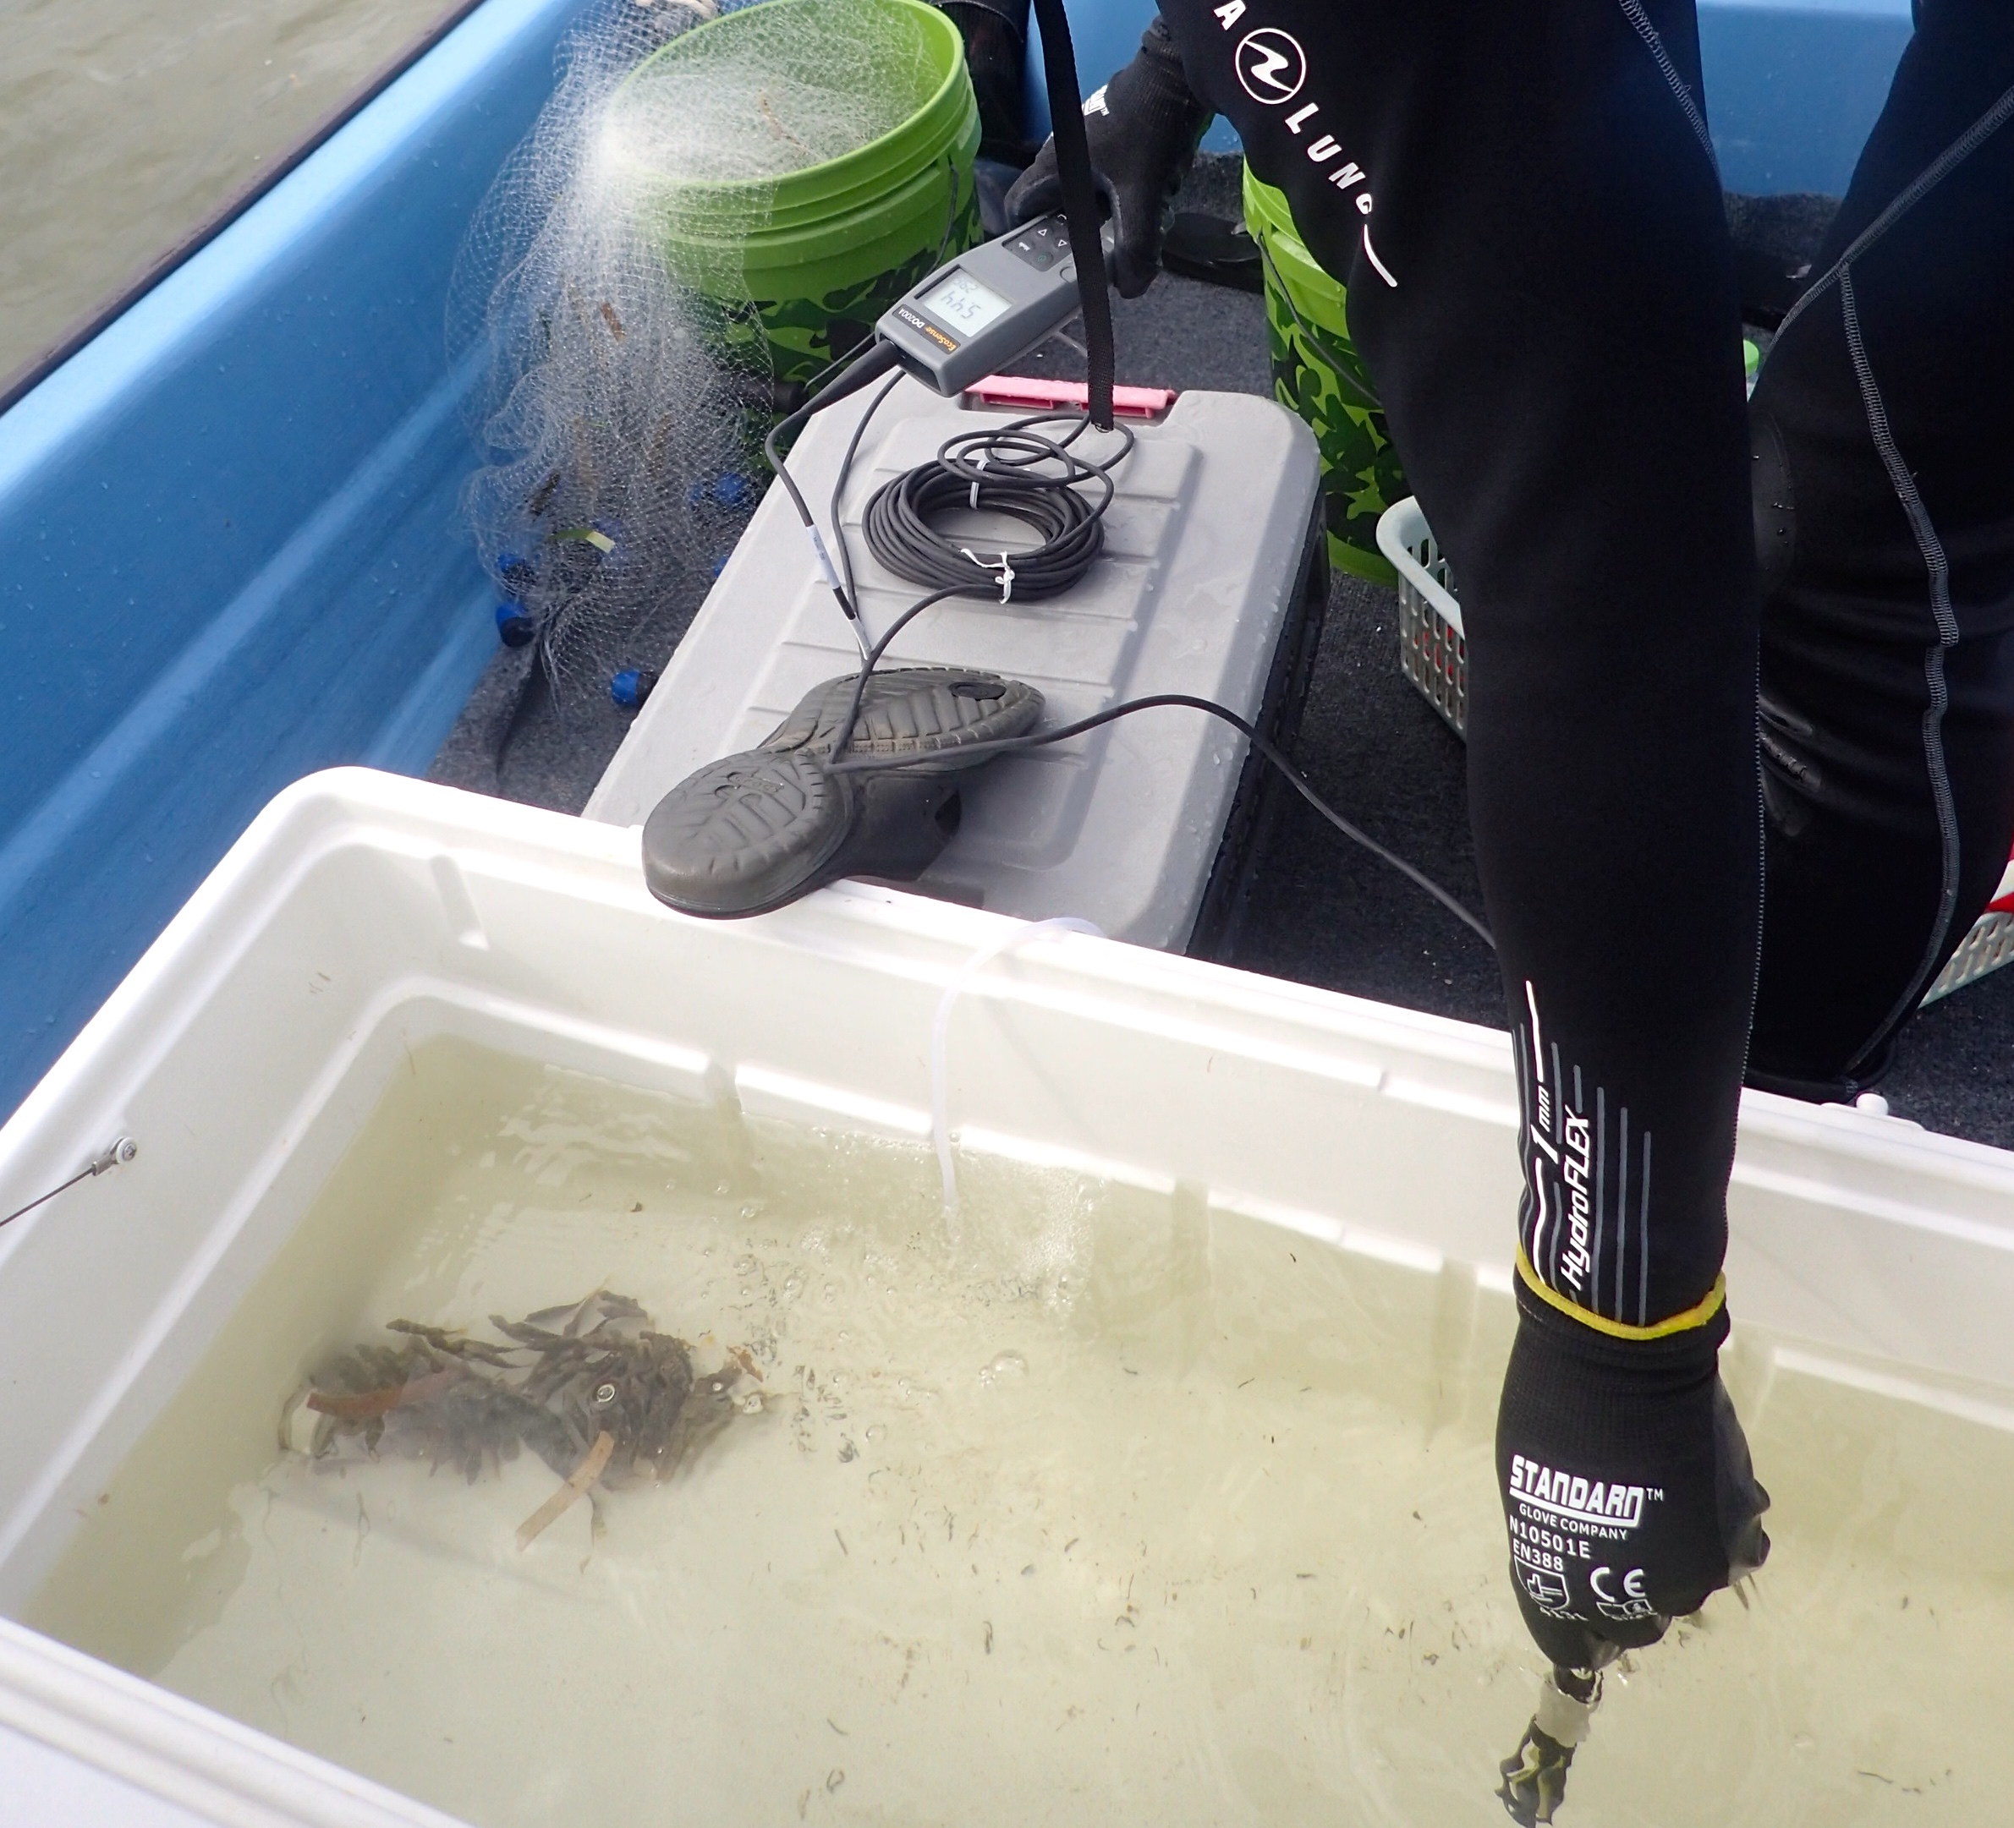
Transport after capture
Fish kept in ice chest in seawater for temperature stability
Portable aeration used
Dissolved oxygen monitored
Measures taken not to overcrowd the fish and get them to the cages promptly

Slide 16
Chronology of Settlement
Literature suggests seasonality for many species
Tendency to settle around new moon
2016 and 2017 predictions for settlement were based on predicted spawning times provided by Dr. Kevin Rhodes and Pohnpei State R&D/OFA scientists.
2018 -2019. Monthly transect surveys to be conducted in sea grass areas to monitor rabbitfish settlement times. Started in February 2018.

Slide 17
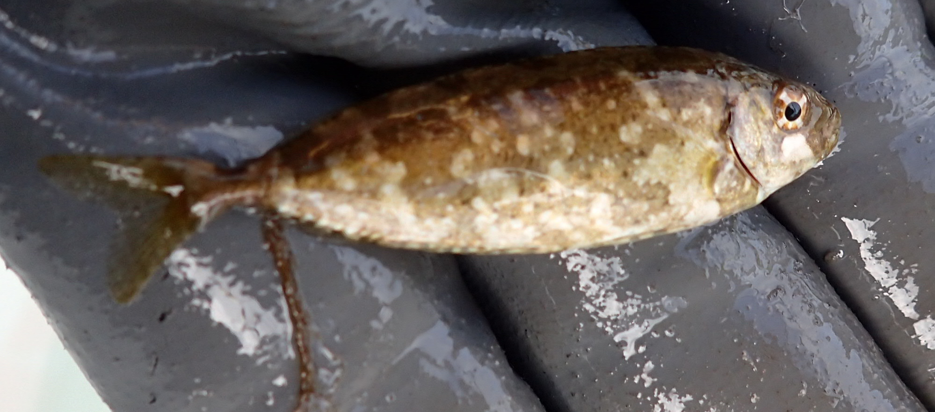
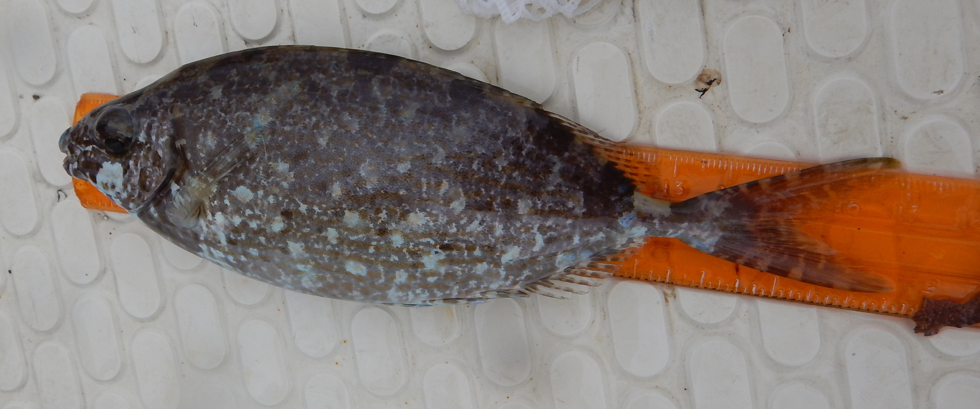
Forktail rabbitfish – S. argenteus
High potential for culture
Settlement 4-5 days before new moon April (2016, 2017 and 2018) and smaller pulse in May (2018)
Abundance – moderate to high

Slide 18
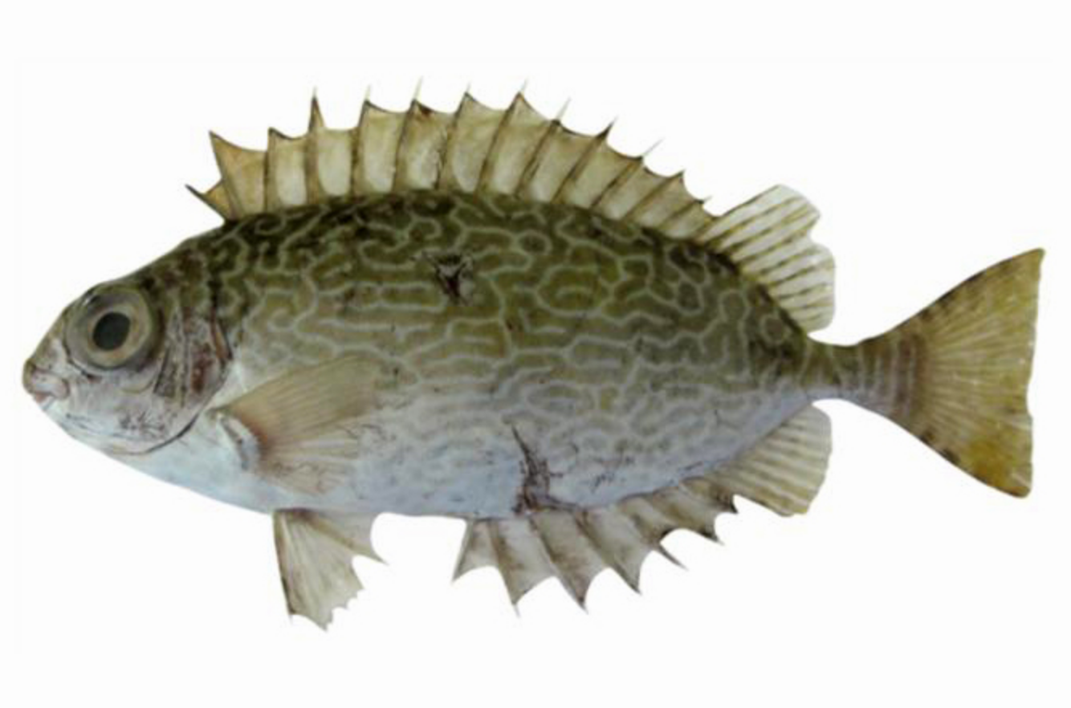
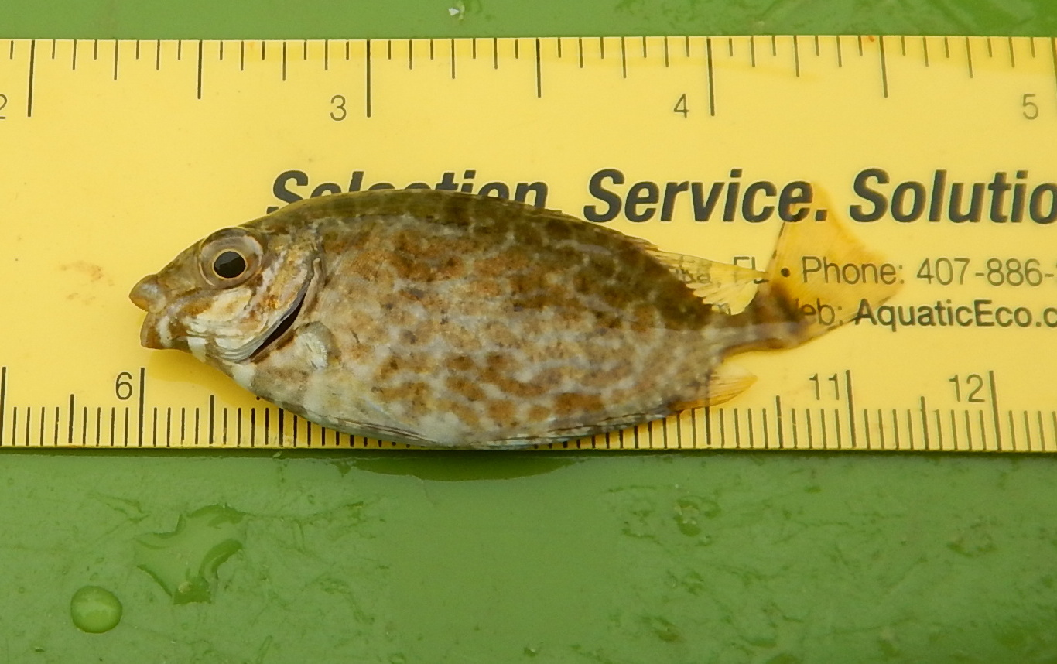
Scribbled rabbitfish – S. spinus
Poor results so far in culture. Grows to 9 inches (24 cm)
Settlement 4-5 days before new moon April (2016, 2017 and 2018) and smaller pulse in May (2018)
Highly abundant

Slide 19
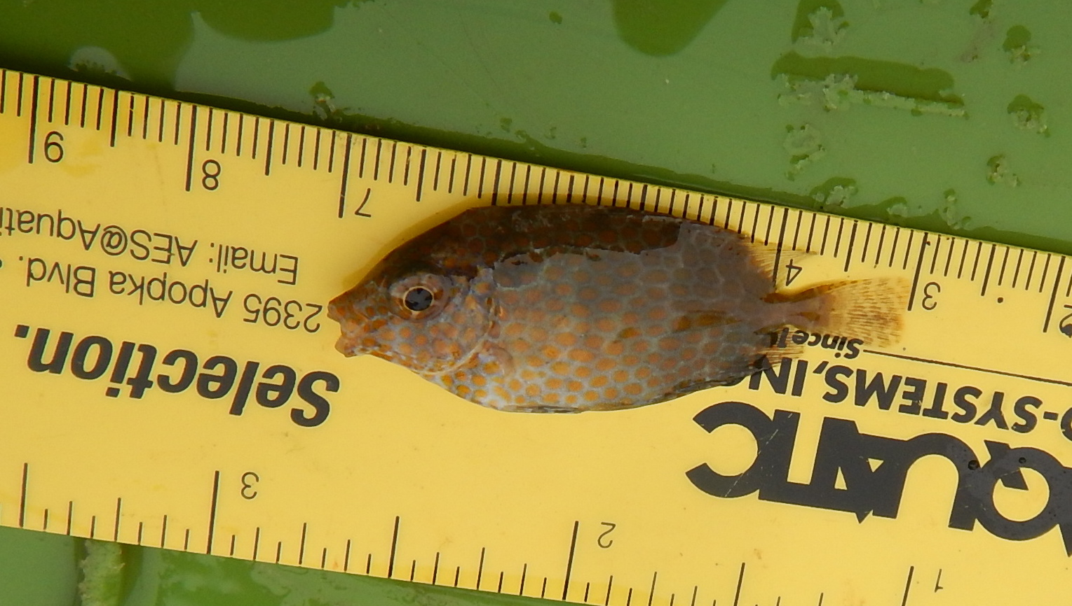
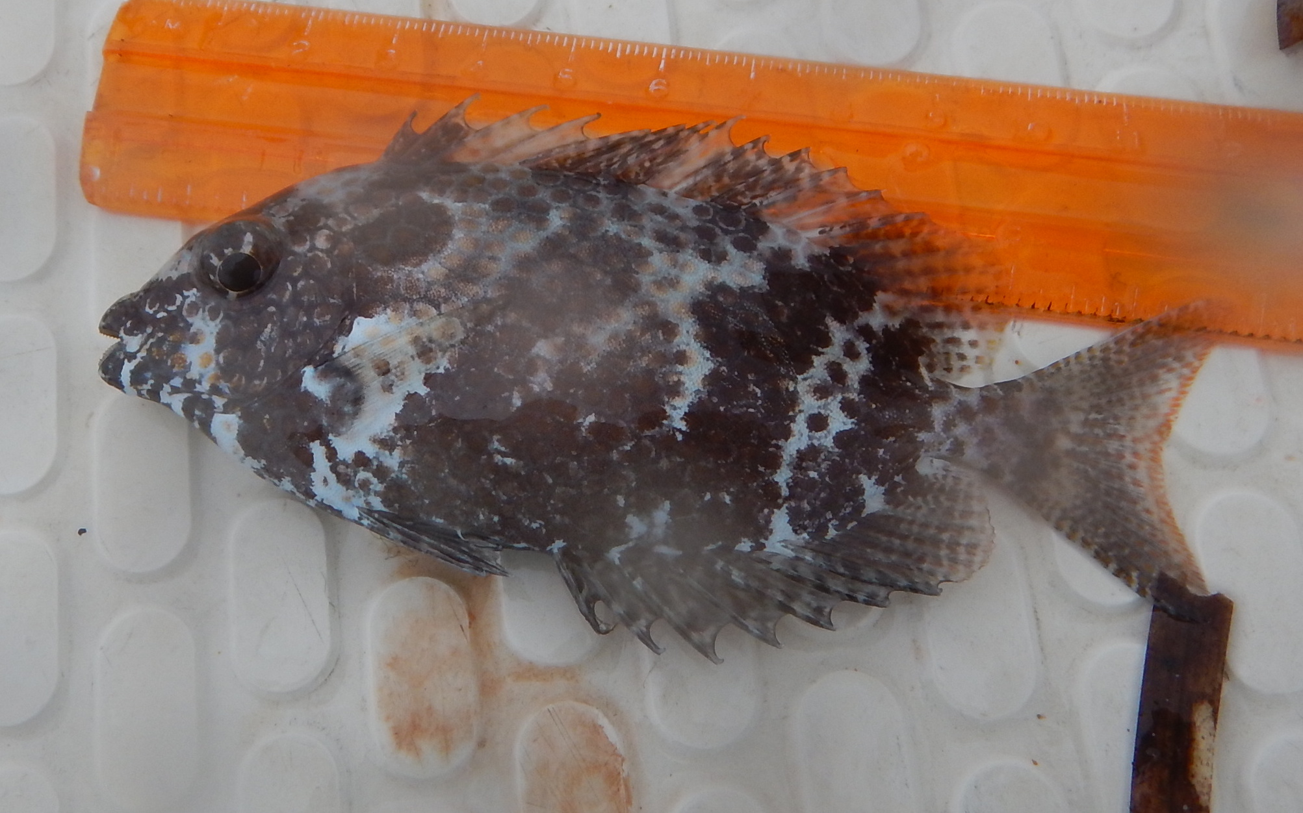
Gold-spotted rabbitfish – S. punctatus
Moderate performance in cages. Likes to stay on the bottom. Ornamental potential. Can grow to 16 inches (43 cm)
Settlement around new moon or slightly later
Not abundant – two small pulses in April and May

Slide 20
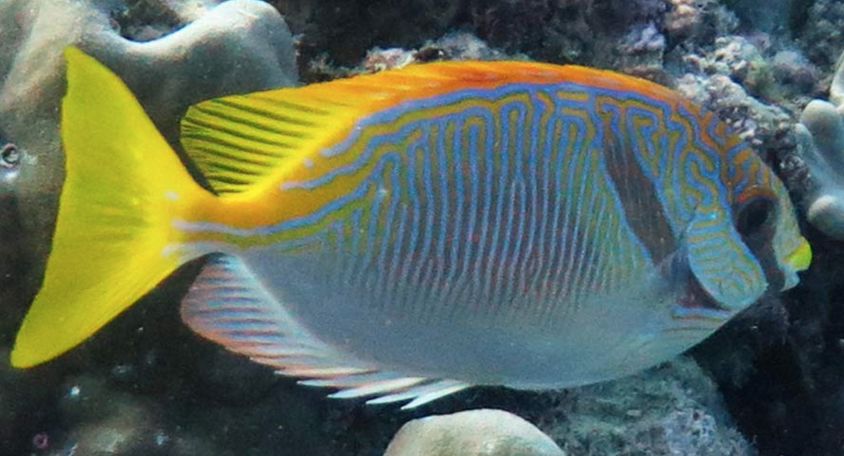
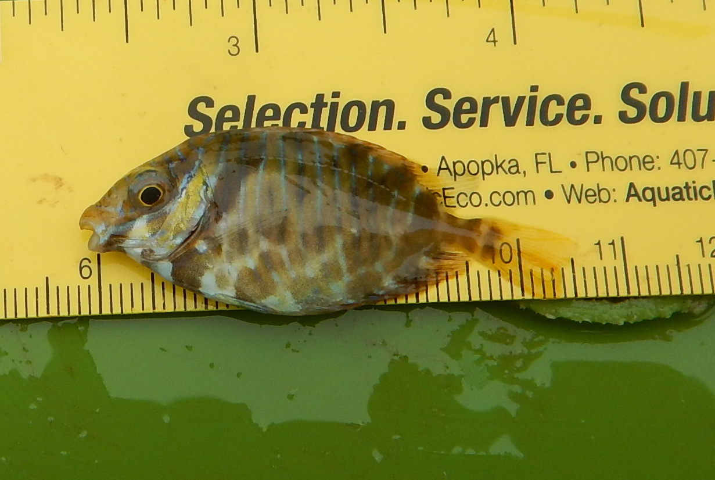
Pencil-streaked rabbitfish – S. doliatus
Poor performance in cages. Does not feed well. Ornamental potential
Seems to settle later than new moon. 10 inches (25 cm)
Small pulse in April but very abundant in May

Slide 21
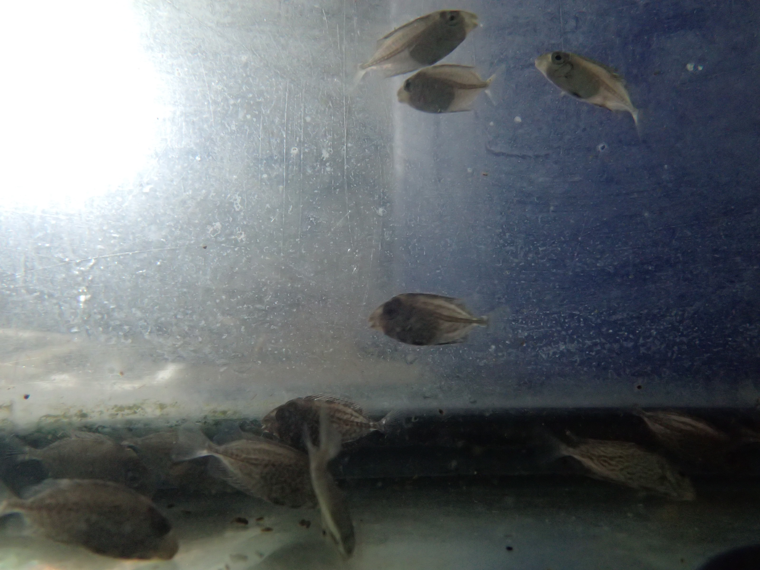
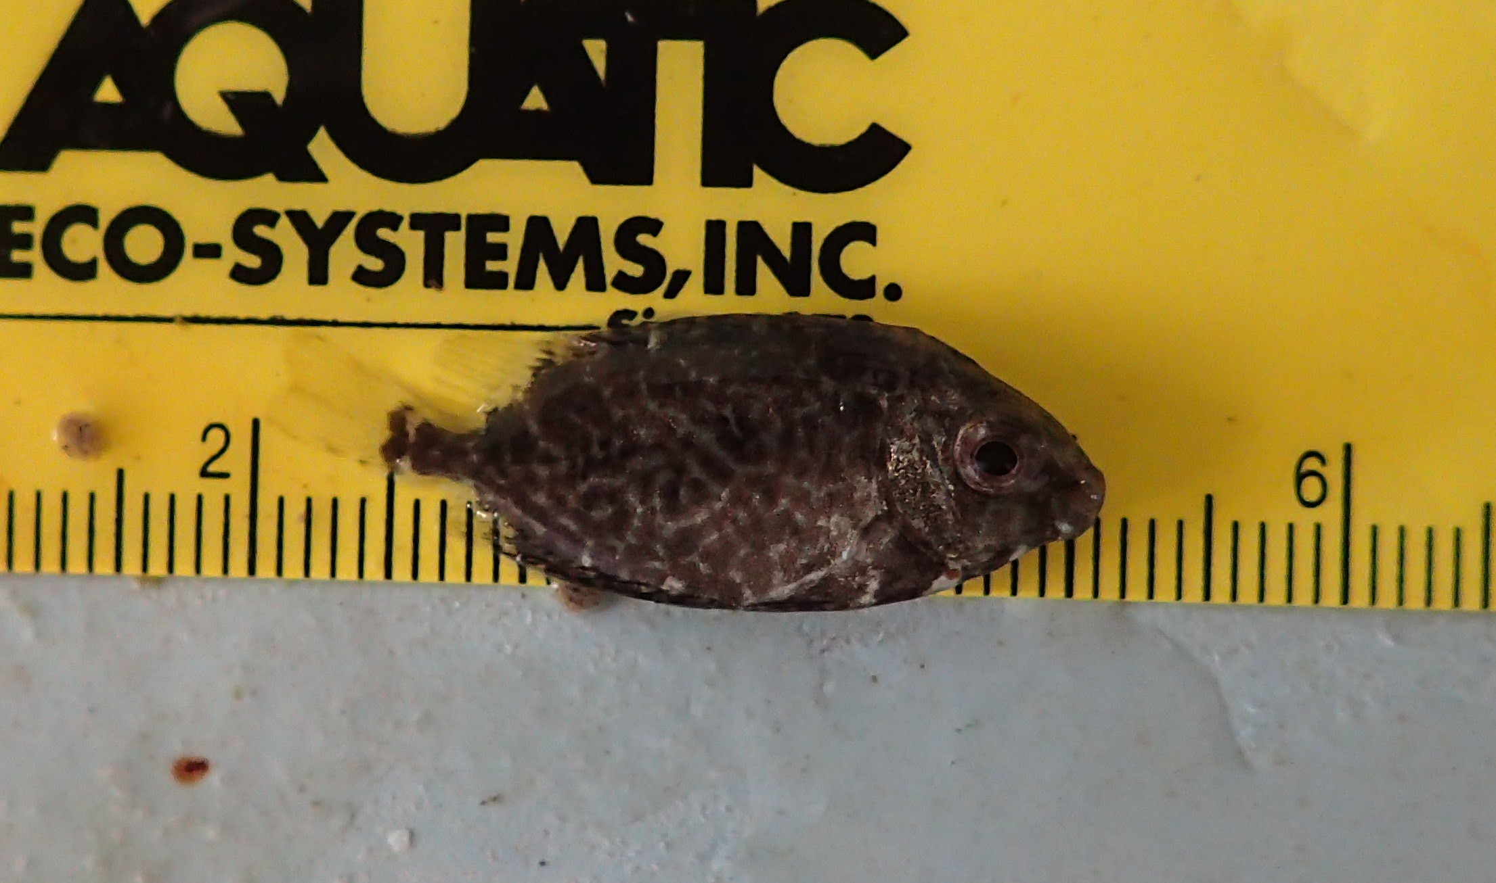
Randalls rabbitfish – S. randalli
Good performance in cages. Feeds and adapts well. To 12 in (30 cm)
First seen one week after new moon in April.
Abundance – moderate to high

Slide 23
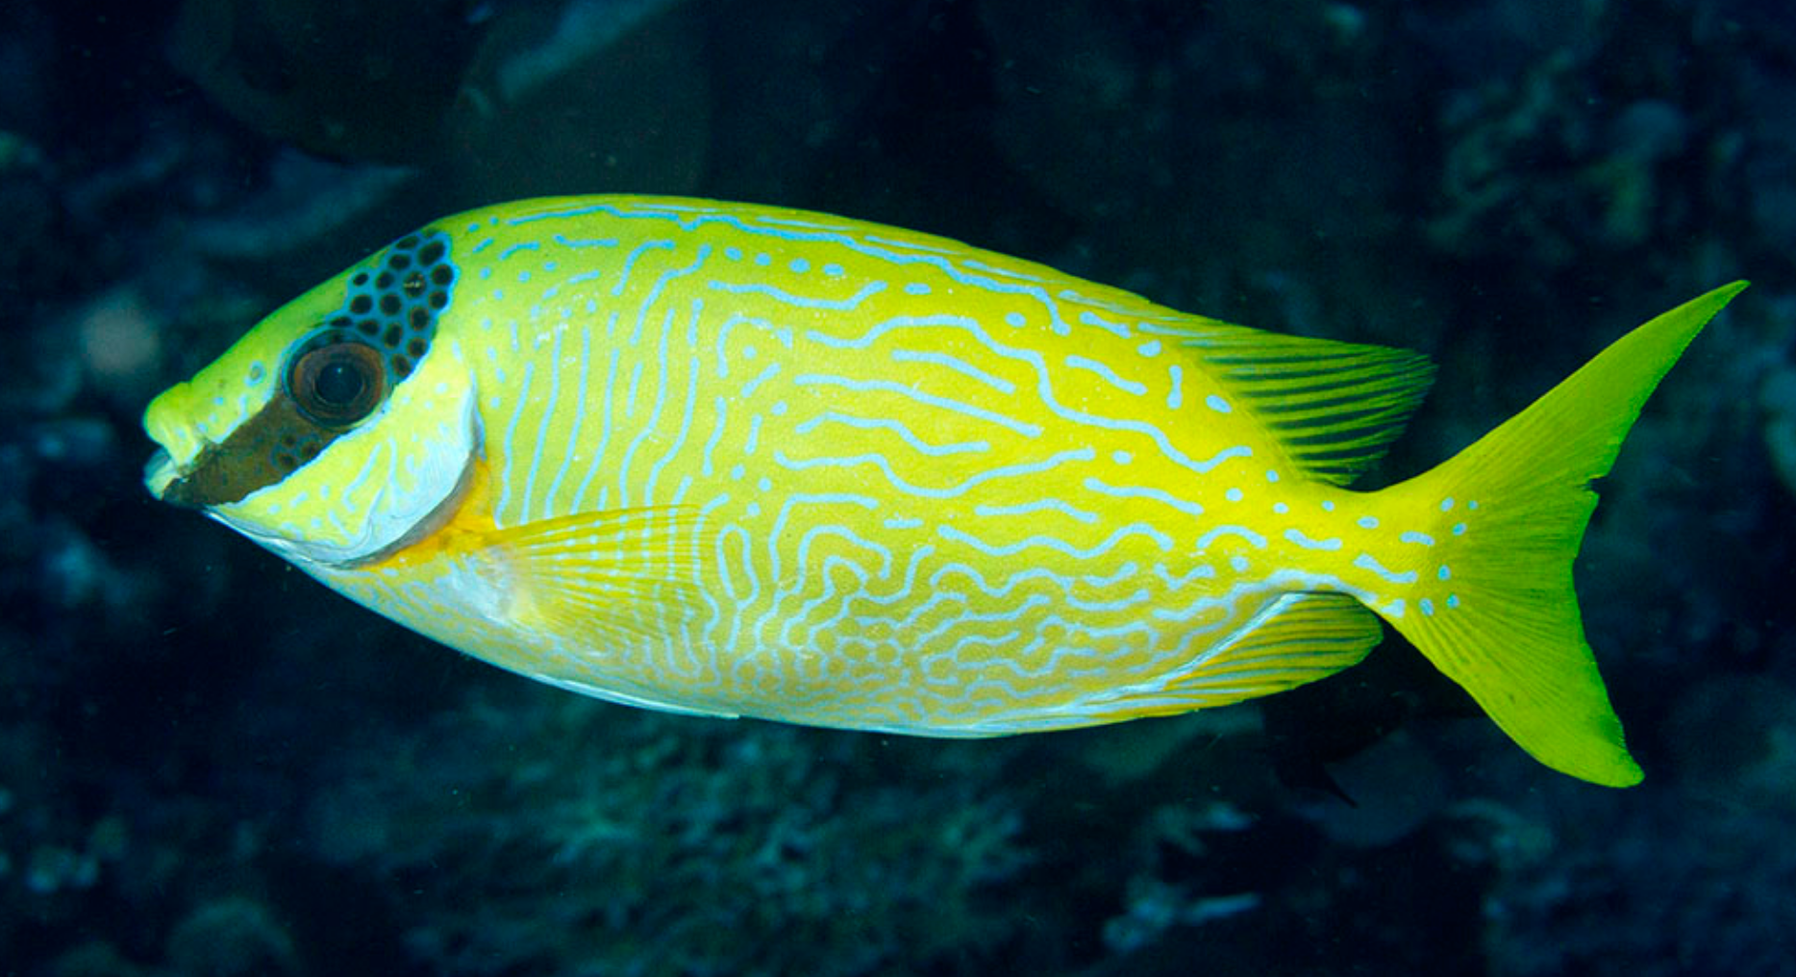
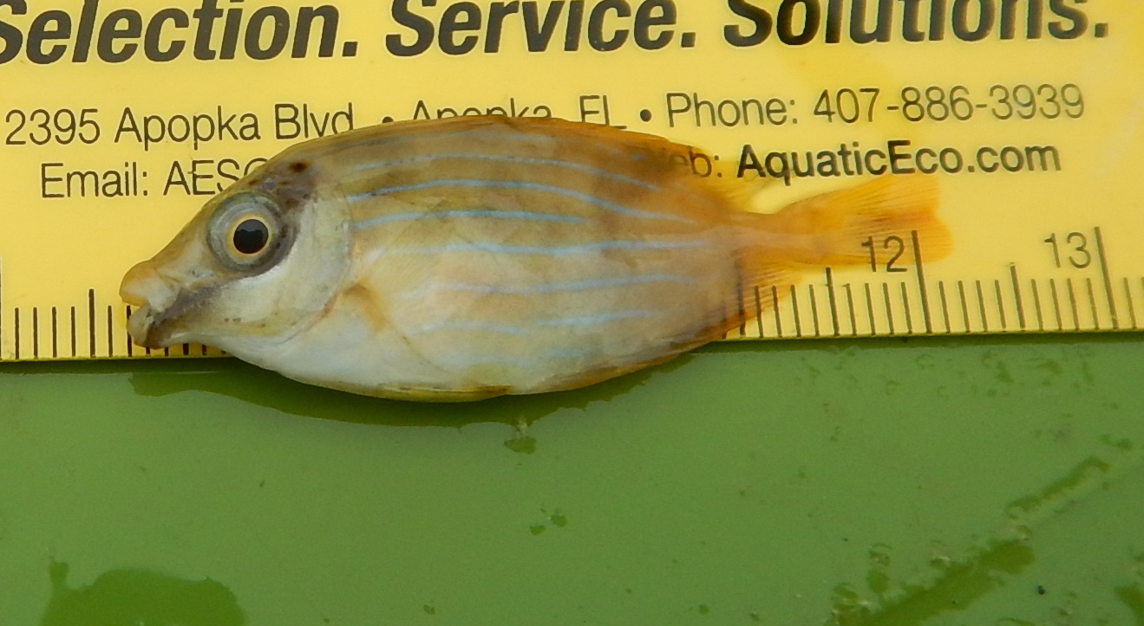
Masked rabbitfish – S. puellus
New capture in 2018. Ornamental potential. Reaches 15 in (38 cm)
Settle before new moon in May
Pulse in May seemed small but may have missed the larger set

Slide 24
Summary
While spawning is seasonal there will most likely be pulses of recruitment many months of the year around new moon.
Start catching 4 days before new moon for most species
Still a lot to be learned about settlement chronology
Potential for food and ornamental markets

