Slide 1

Coding techniques & information for using Nvivo
11.18.2022

Slide 2

General coding background
Coding in qualitative research allows for the identification of themes, patterns and categories within the data
Good coding recognizes biases and assumptions coders are bringing to the table and aims to control for this—coding is not about seeing what we want to see in the data but rather articulating what is legitimately contained within the data
Multiple coders increases coding validity
Coding is an iterative process—multiple rounds of coding the same transcript is necessary to achieve acceptable reliability and establish rigor

Slide 3
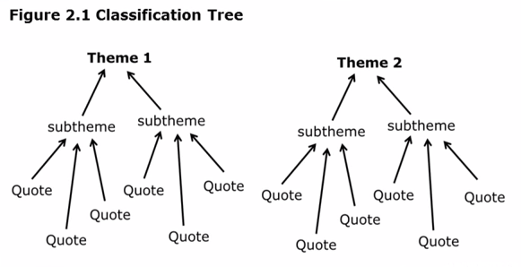
Identification of Themes

Slide 4
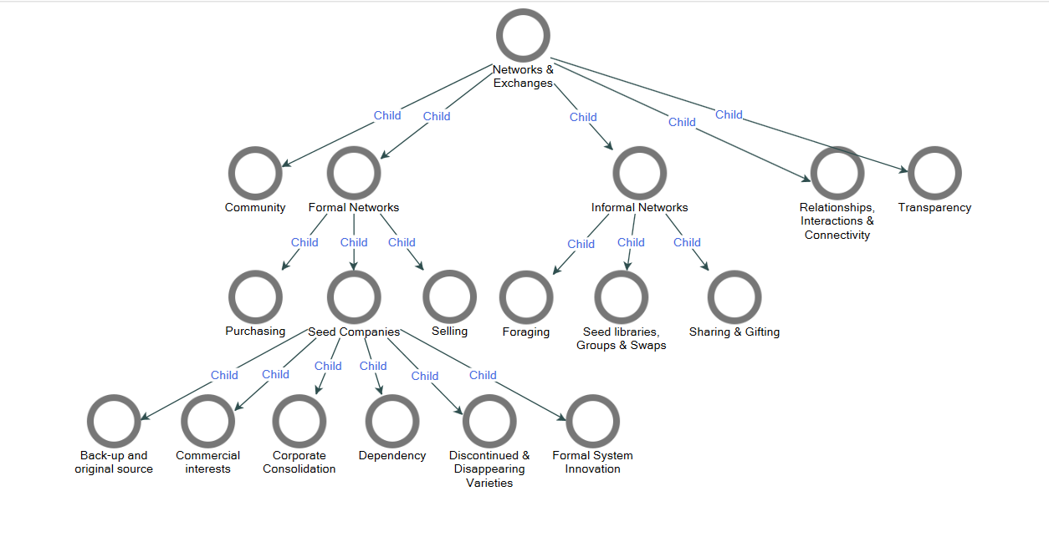
Identification of Themes

Slide 5
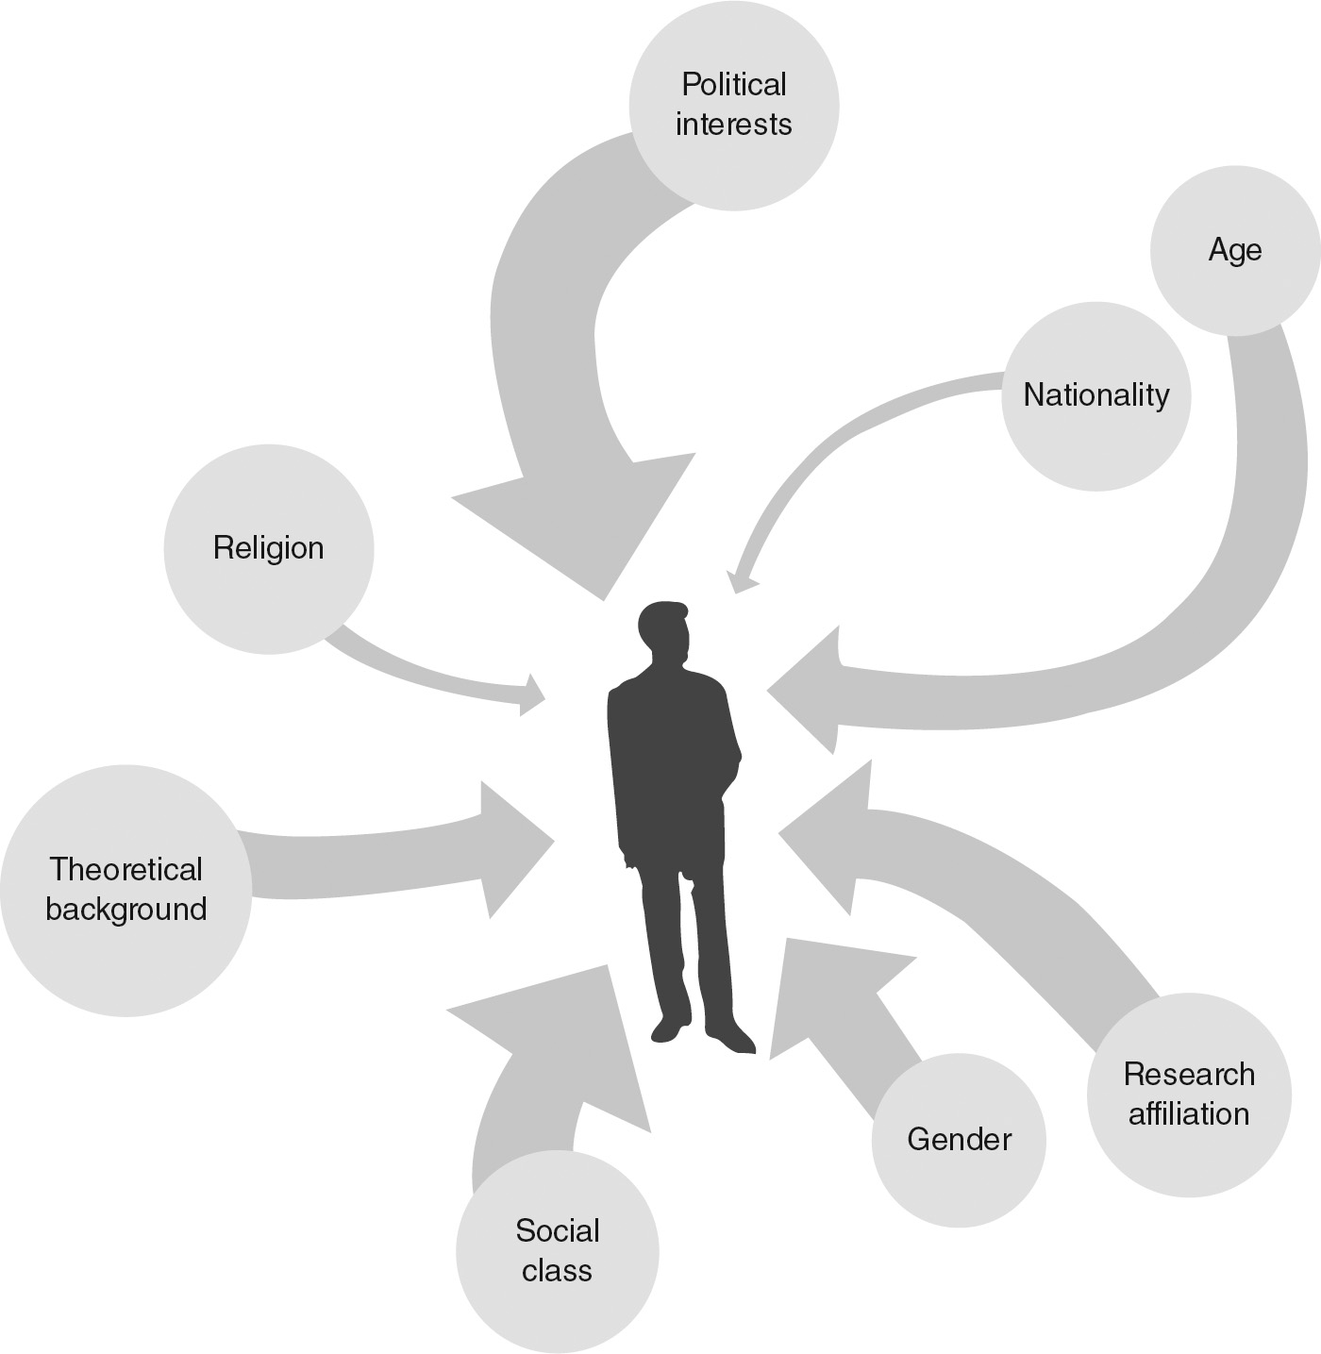
Biases and Reflexivity
def. …the examination of one’s own beliefs, judgments and practices … and how these may have influenced the research
TIP: Constantly reflect on whether your coding is based on the data or what you want to see

Slide 6
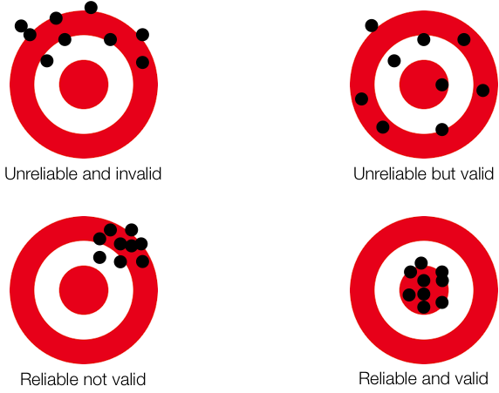
Validity and Reliability
Multiple coders increases coding validity
Coding is an iterative process—multiple rounds of coding the same transcript is necessary to achieve acceptable reliability and establish rigor

Slide 7
Our Data
6 focus groups transcripts: seed companies, Ujamaa growers, BIPOC chefs/restaurants, farmers/gardeners, produce wholesalers/distributors, ethnic/specialty grocers
All transcripts have been deidentified to protect the confidentiality of participants

Slide 8
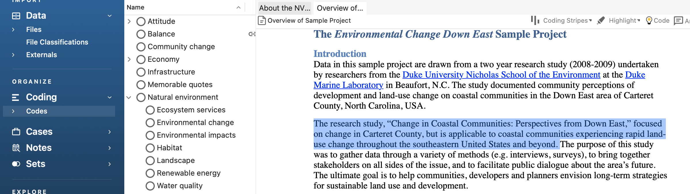
Navigating NVivo
NVivo is a qualitative data analysis computer software package where all our coding will take place
On the left-hand side of NVivo’s home screen is where you will find the launch pad
  This launch pad is how you access your data files and the project codes
  Files are where each transcription should be houses
  Codes are themes and patterns related to the transcripts
Notes:
This slide is a bit messy to look at- I’m (Sally) not the best at formatting but please add any other information that would be helpful here. It could also be made into two slides: one for how to navigate the interface and the other for how to actually code

Slide 9
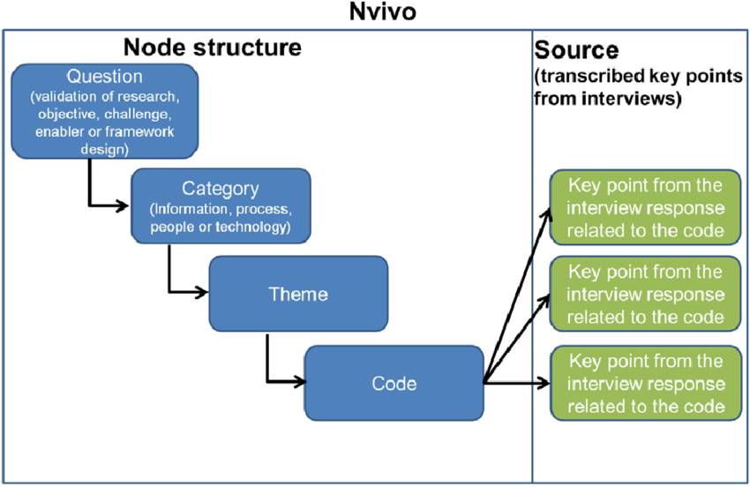

Navigating nvivo
Each of our codes will have sub-codes that can be accessed by clicking on the parent code
To code a transcript segment, simply highlight the segment of text, drag it over to the relevant code, and drop it in
You can highlight codes to keep track of what you’ve already coded, as well as see what/how many files are associated with each code.

Slide 10
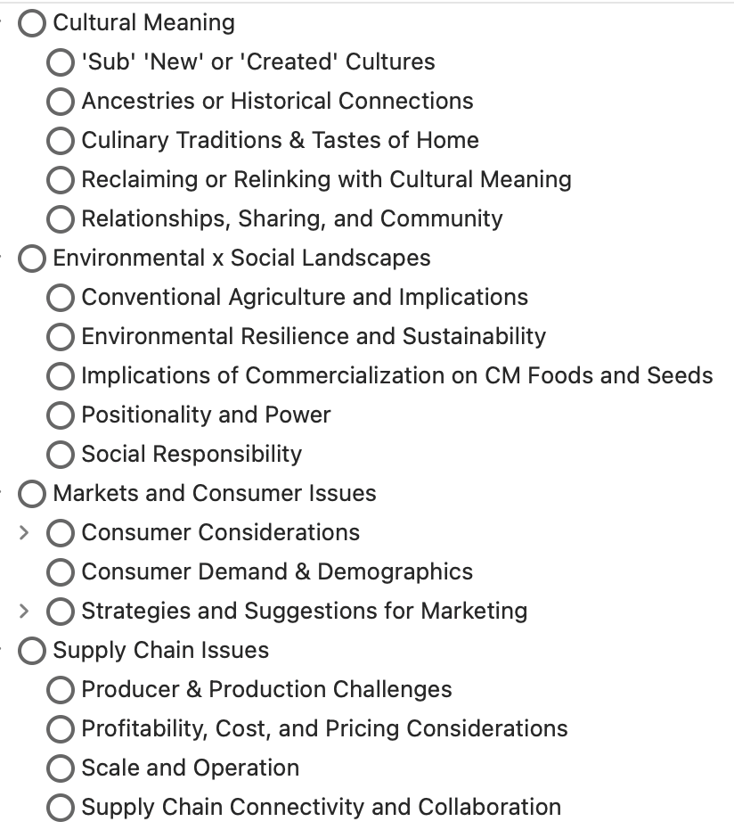
Our codes and what they mean
This is meant to be a general guide
Each code is emergent (themes that came up during interviews regardless of questions asked)
Codes are open to revision (but not until the first run-through)
We will first be conducting within-case coding, before eventually moving into across-case doing

Slide 11
NOTES
Do not make edits to the text body of the transcripts, if all the transcripts are not exactly the same, NVivo will not be able to merge them, and we won’t be able to assess inter-rater reliability!
All data must remain on our devices only and not shared with any outside parties for privacy and IRB purposes

Slide 12
How coding fits into this project/what’s next
The themes that emerge from coding these focus groups will inform the questions developed for the surveys that will be deployed
The focus groups themselves also provide valuable insights into these different actors along the seed value chain

Slide 13

Workflow and timeline
Stage One: Collectively code the first three focus groups and meet to discuss by December 9th
  Re-code as necessary until agreeance is established
Stage Two: Collectively code the next three focus groups and meet again to discuss by the end of December
  Re-code as necessary until agreeance is established
Stage Three: Collectively code all six focus groups (across case) by mid-January
  Re-code as necessary until agreeance is established
End of January: Finish coding and begin survey development

