Slide 1
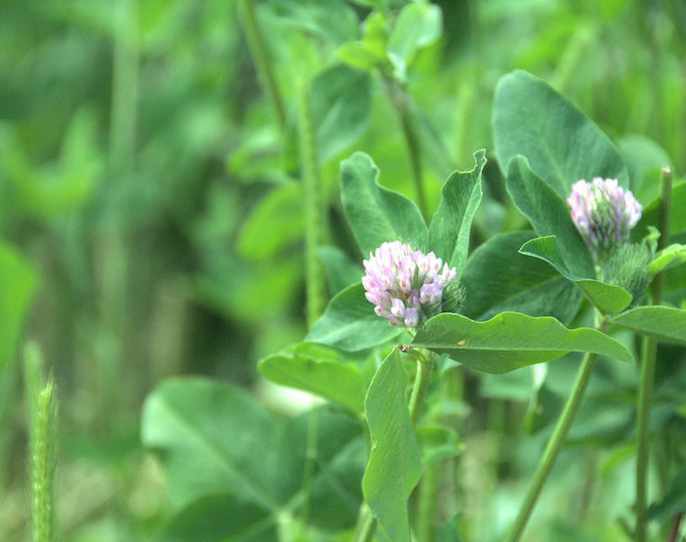


Third Crop: Small Grain + Cover Crop Identifying a Nitrogen Credit Frost Seeded Red Clover Diverse Summer Covers
Funding by SARE and DATCP-NOPP
Nicole Tautges
Will Fulwider

Slide 2

This material is based upon work that was supported by the National Institute of Food and Agriculture, U.S. Department of Agriculture, under agreement number 2022-38640-37486, through the North Central region SARE program under number ONC23-132.

Slide 3
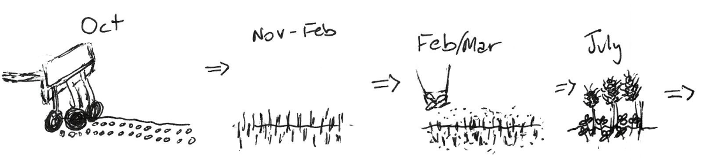
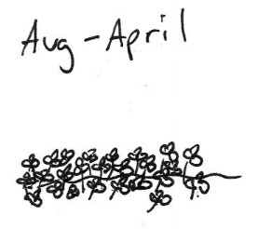
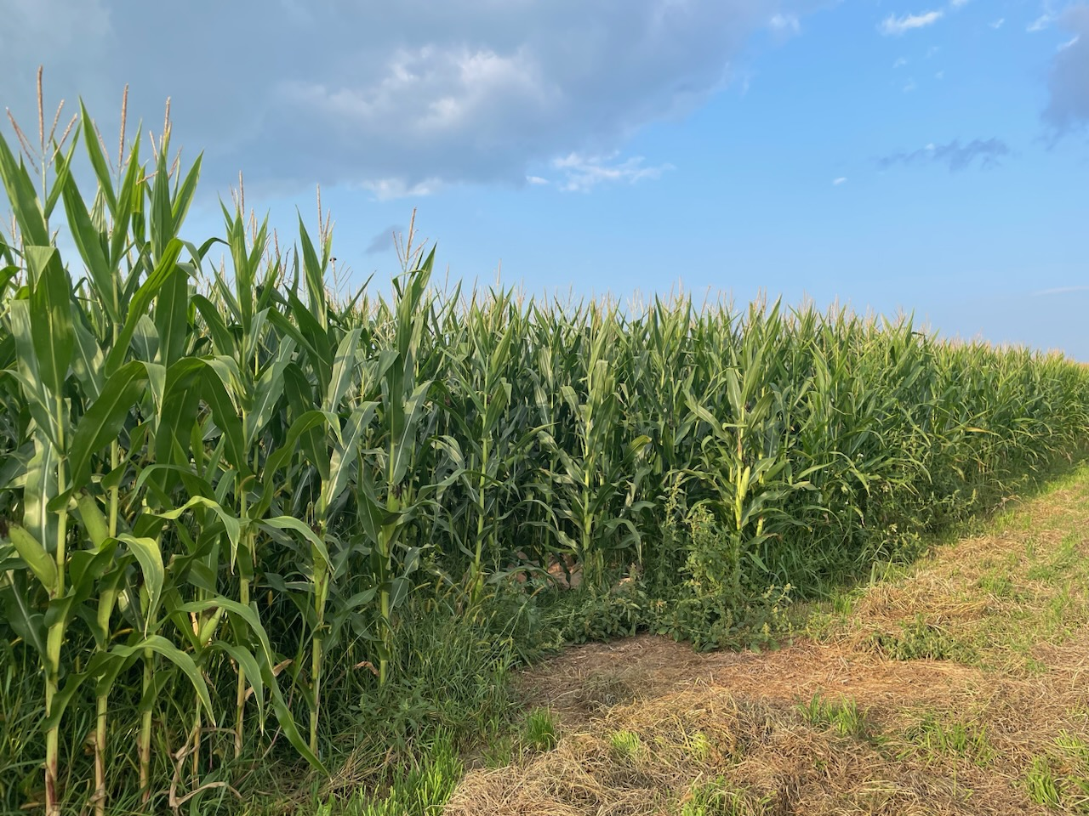
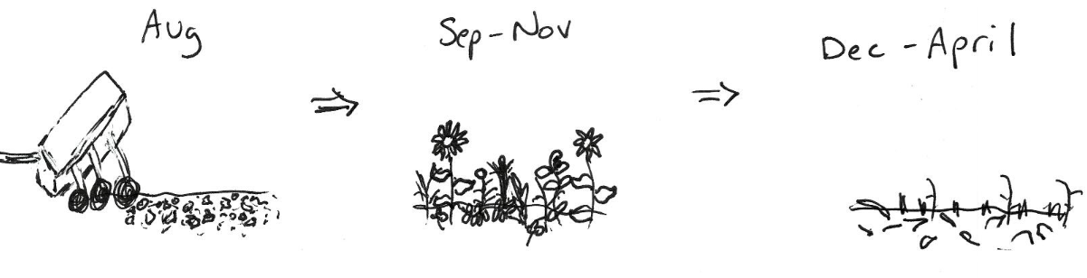
Frost-Seeded Red Clover System
Diverse Summer Cover Mix
Photo: W. Fulwider

Slide 4
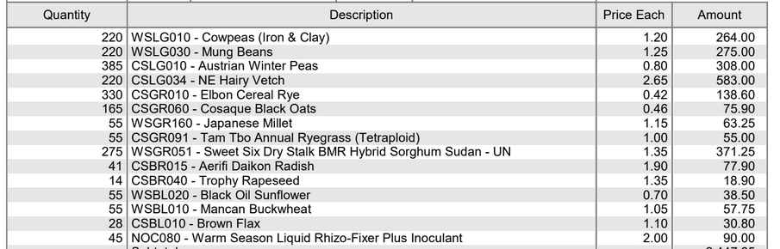
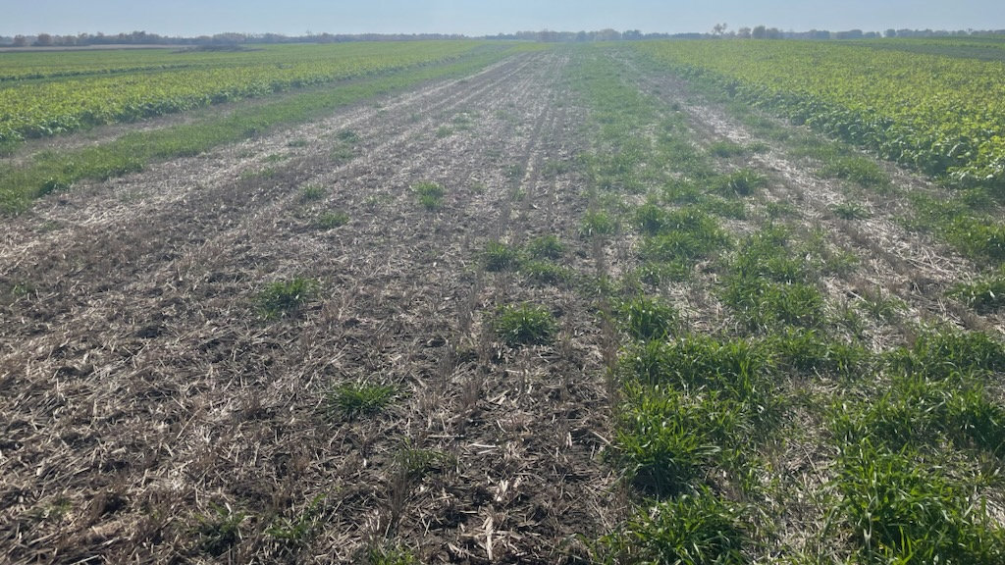
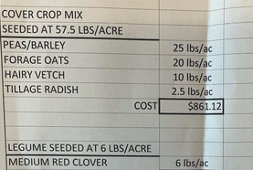
Methods
7 on-farm locations
Dane, Dodge, Waukesha Counties
Randomized complete block design
Whole plot: CC vs. None
Split plot: N rate (0, 40, 80, 120, 160 lb N/ac)
Measured:
Soil routine & health analysis
CC Fall Biomass
CC Spring Biomass
PPNT
PSNT
Corn leaves at V6
Corn yield
Photo: W. Fulwider

Slide 5
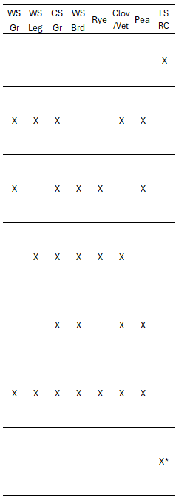
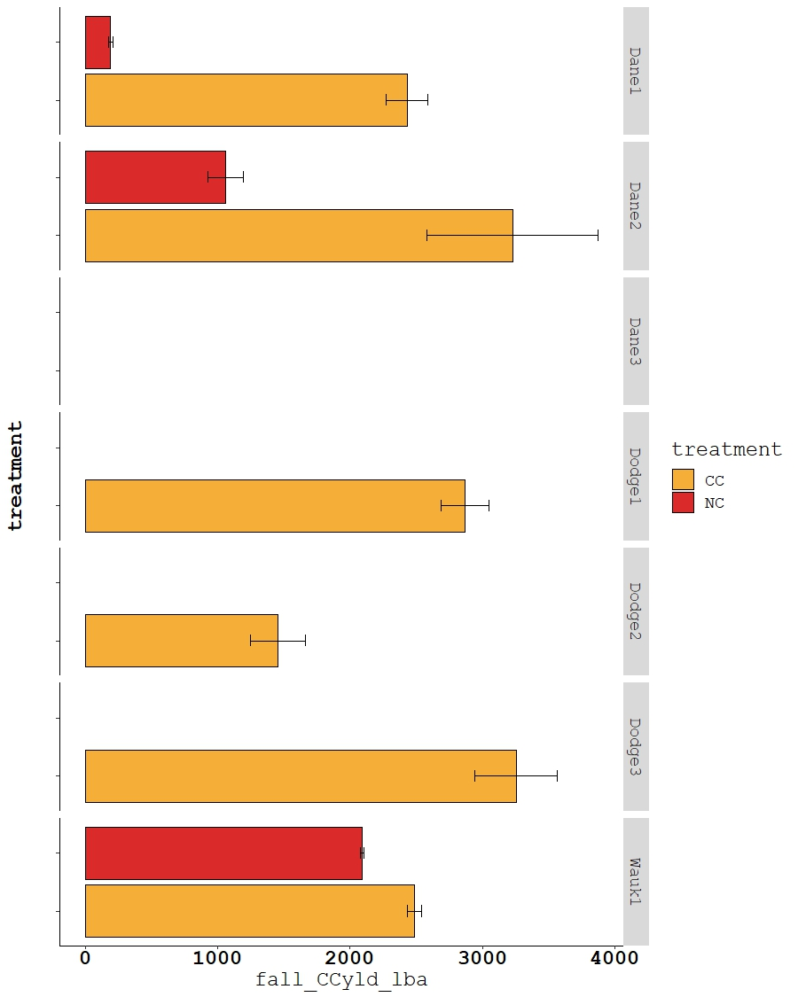
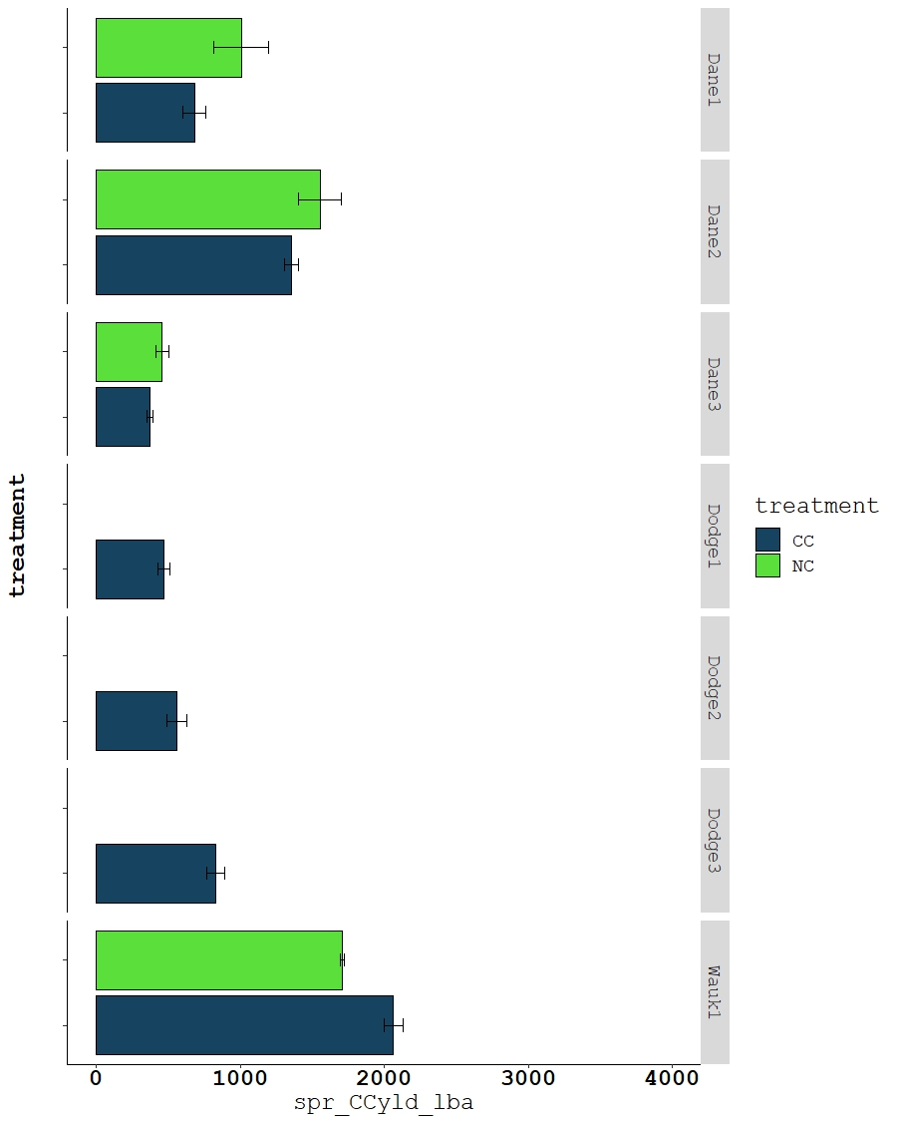
Fall CC Biomass
Spring CC Biomass

Slide 6
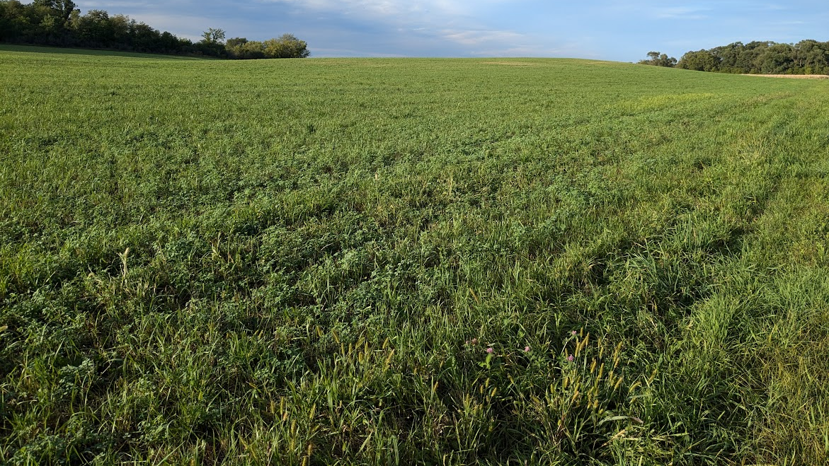
Year-on-Year Use of Red Clover CC

Slide 7
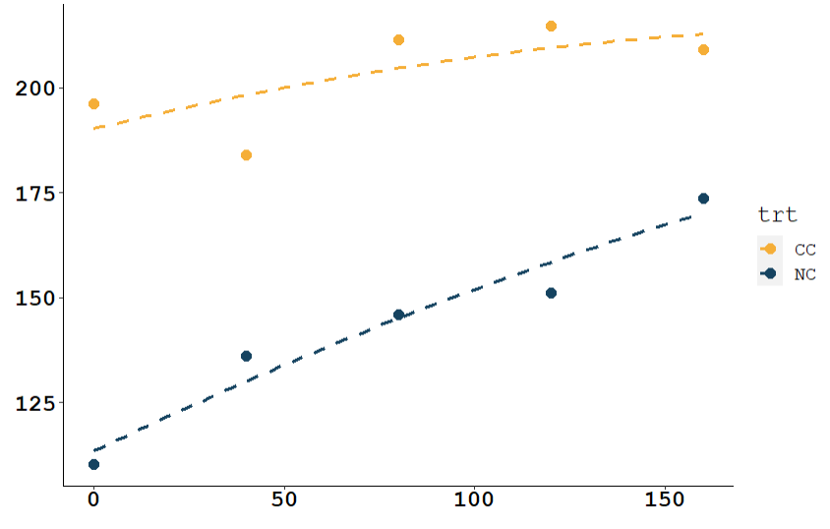
Wauk1 Site 2024
Max of this curve occurs at x = 436
Corn Yield (bu/a)
N fertilizer rate (lb N/acre)
$50+/ac urea savings
$200-250/ac more from yld gain

Slide 8
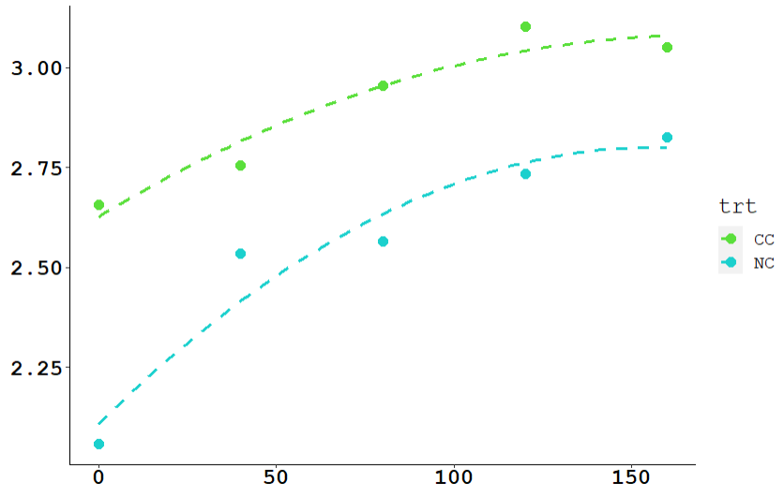
Wauk1 Site 2024
Leaf Nitrogen (%)
N fertilizer rate (lb N/acre)

Slide 9
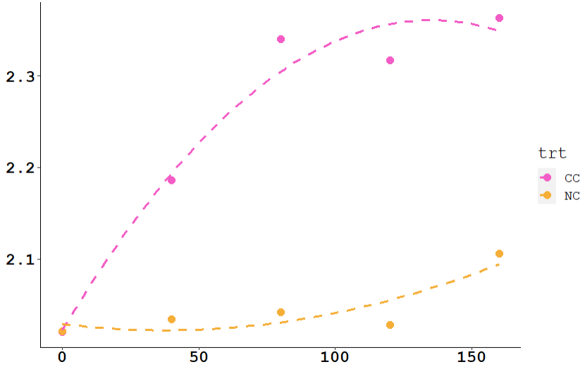
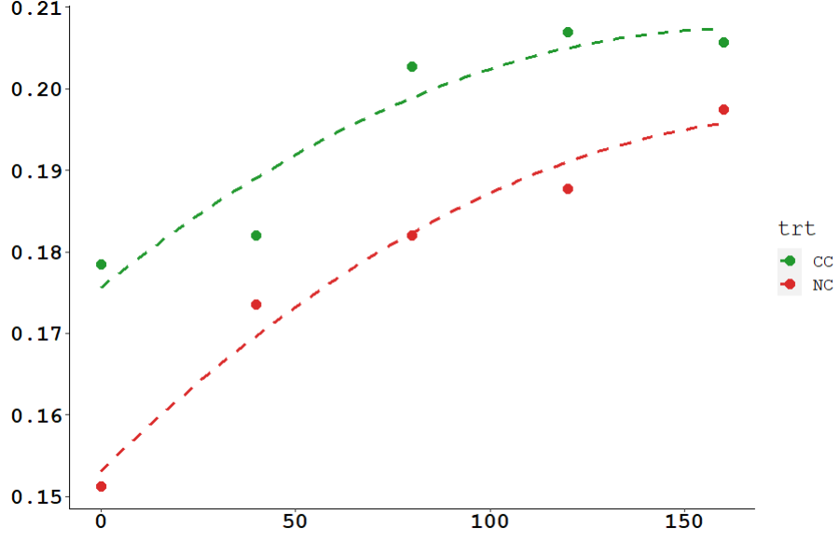
Wauk1 Site 2024
Leaf Sulfur (%)
Leaf Potassium (%)
N fertilizer rate (lb N/acre)
N fertilizer rate (lb N/acre)
Facilitation of uptake and access to other nutrients?

Slide 10
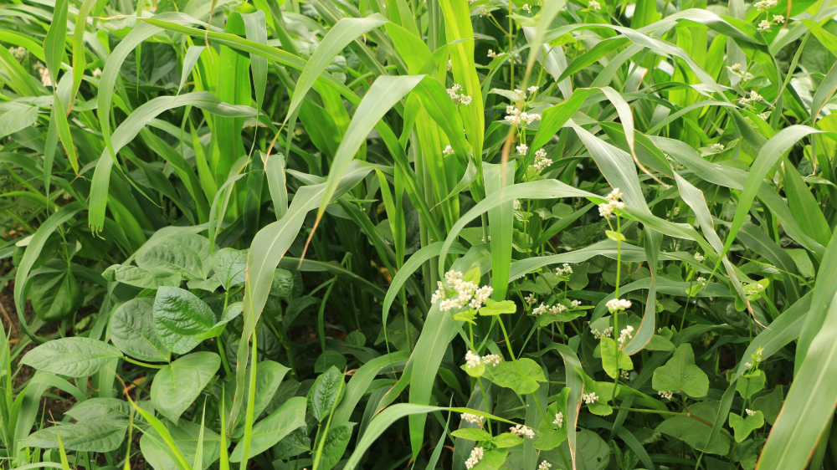
Diverse Summer Cover Mixes

Slide 11
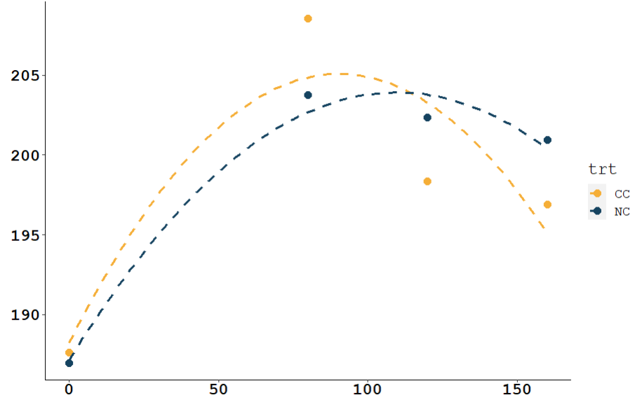
Dane1 Site 2024
Corn Yield (bu/a)
N fertilizer rate (lb N/acre)

Slide 12
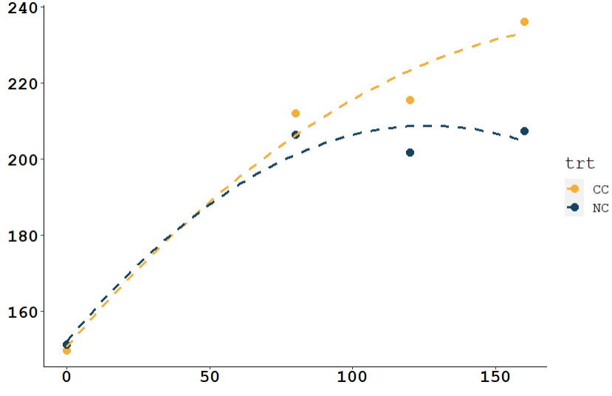
Dane2 Site 2024
Corn Yield (bu/a)
N fertilizer rate (lb N/acre)

Slide 13
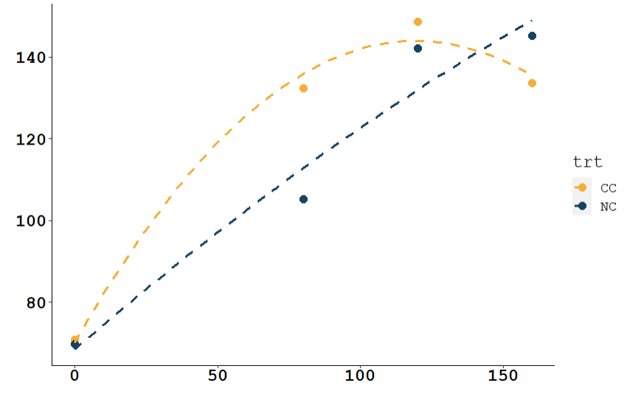
Dane3 Site 2024
Corn Yield (bu/a)
N fertilizer rate (lb N/acre)

Slide 14
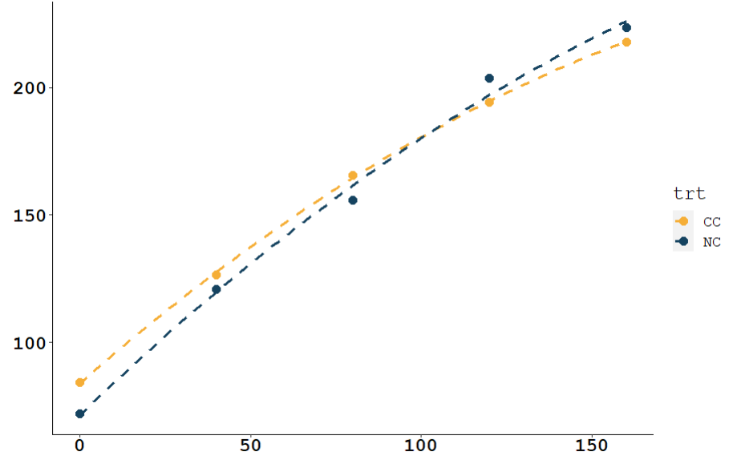
Dodge1 Site 2024
Corn Yield (bu/a)
N fertilizer rate (lb N/acre)

Slide 15
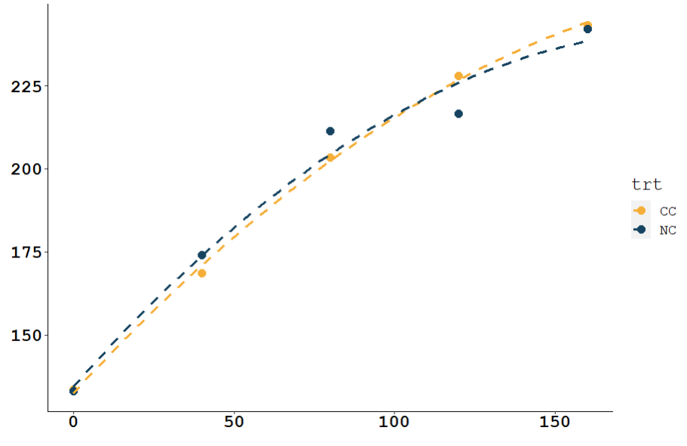
Dodge2 Site 2024
Corn Yield (bu/a)
N fertilizer rate (lb N/acre)

Slide 16
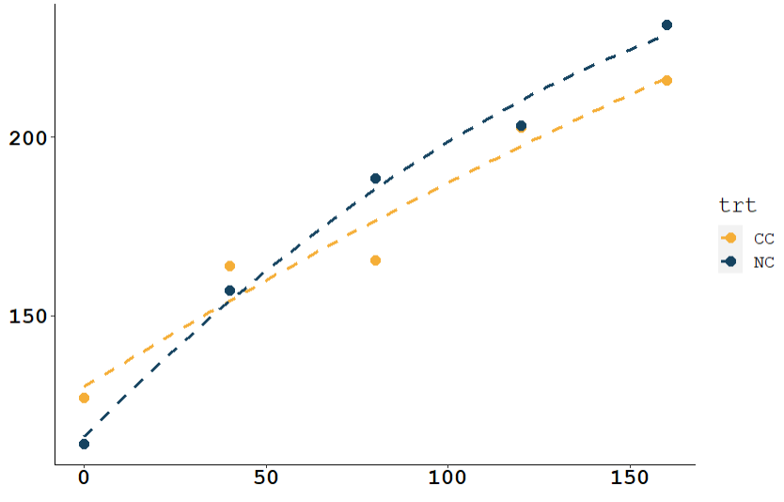
Dodge3 Site 2024
Corn Yield (bu/a)
N fertilizer rate (lb N/acre)

Slide 17
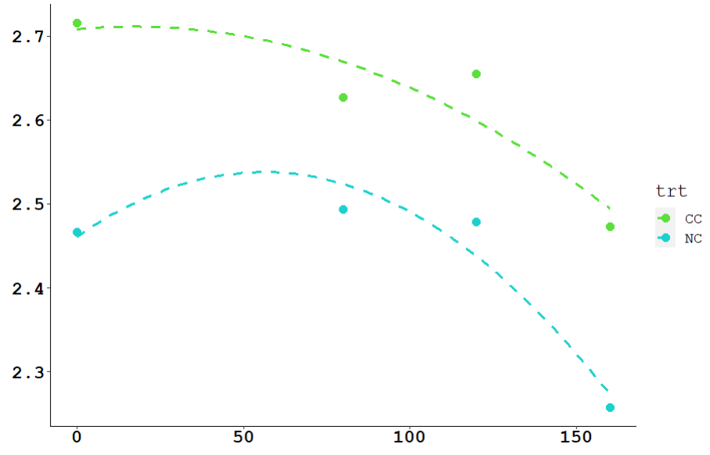
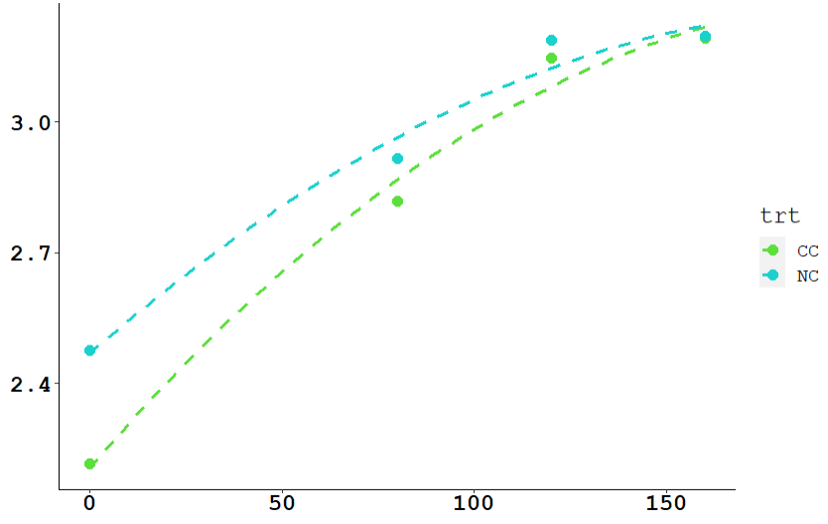
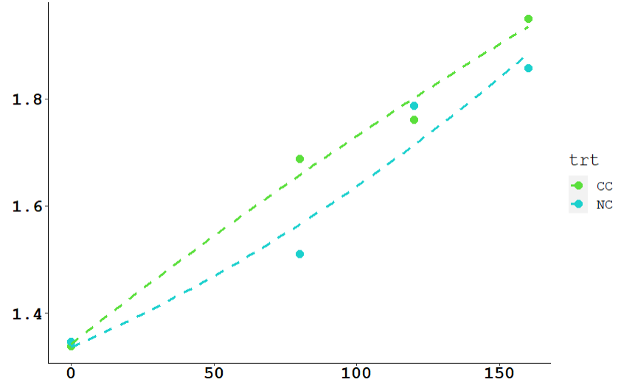
Dane1 Site 2024
Leaf Nitrogen
Dane2 Site 2024
Leaf Nitrogen(%)
Leaf Nitrogen(%)
N fertilizer rate (lb N/acre)
N fertilizer rate (lb N/acre)
Dane3 Site 2024
Leaf Nitrogen(%)
N fertilizer rate (lb N/acre)

Slide 18
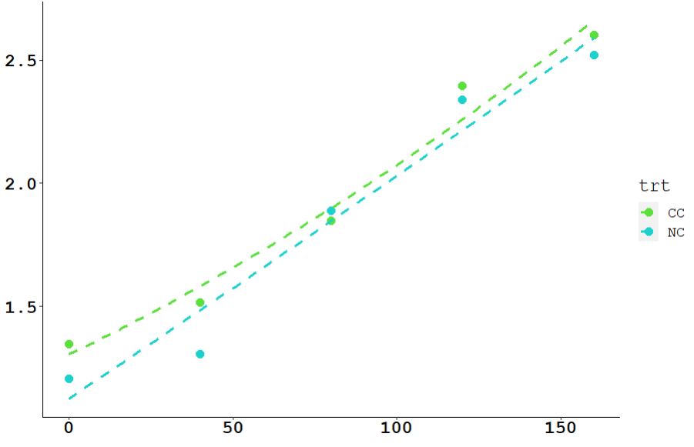
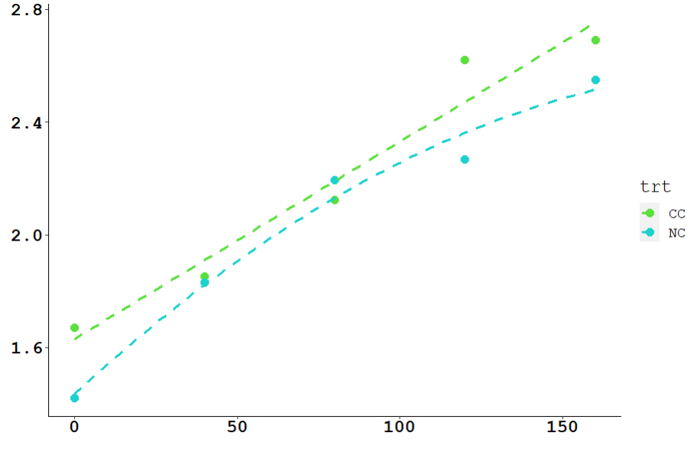
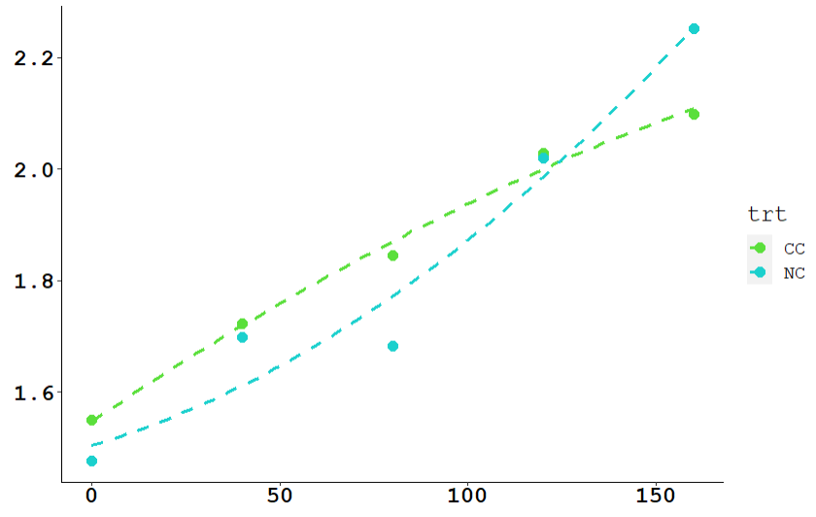
Dodge1 Site 2024
Leaf Nitrogen
Dodge2 Site 2024
Leaf Nitrogen(%)
Leaf Nitrogen(%)
N fertilizer rate (lb N/acre)
N fertilizer rate (lb N/acre)
Dodge3 Site 2024
Leaf Nitrogen(%)
N fertilizer rate (lb N/acre)

Slide 19
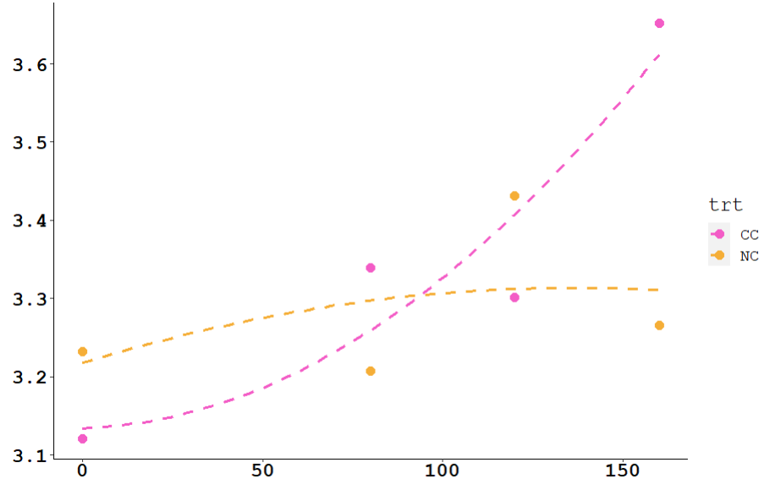
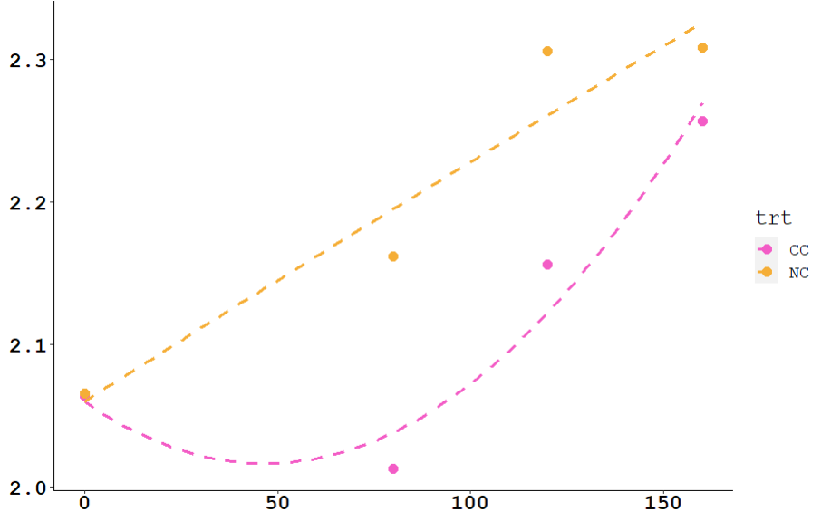
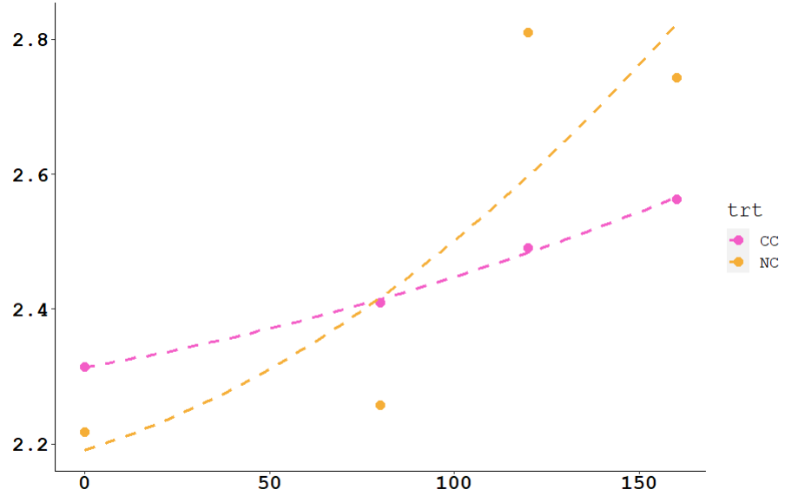
Dane1 Site 2024
Leaf Potassium
Dane2 Site 2024
Leaf Potassium(%)
Leaf Potassium(%)
N fertilizer rate (lb N/acre)
N fertilizer rate (lb N/acre)
Dane3 Site 2024
Leaf Potassium(%)
N fertilizer rate (lb N/acre)

Slide 20
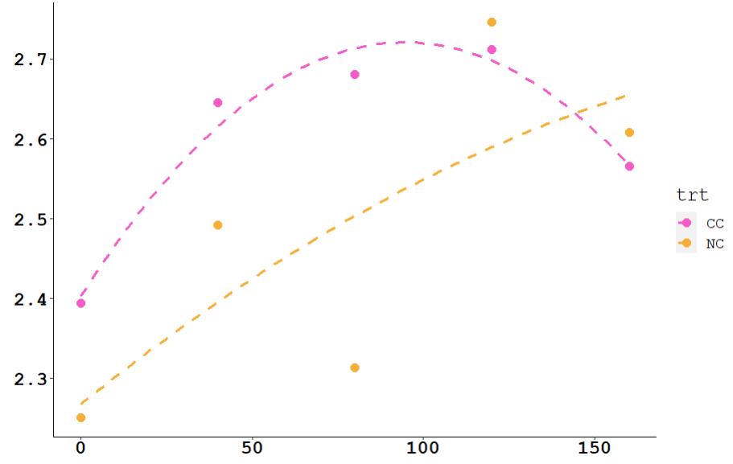
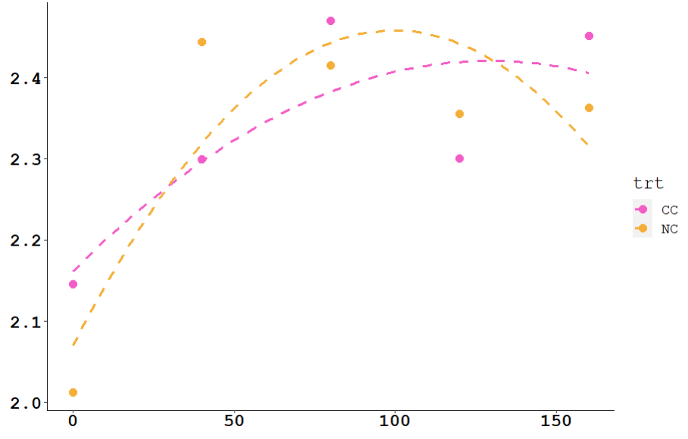
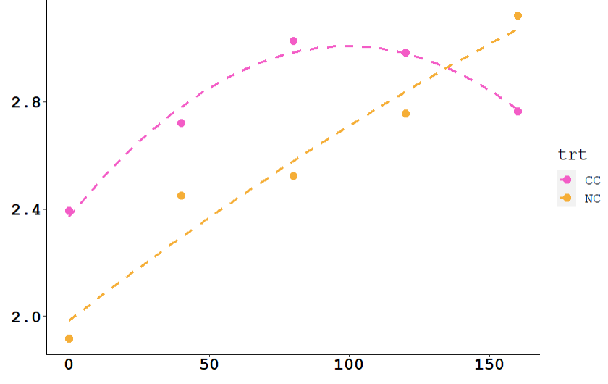
Dodge1 Site 2024
Leaf Potassium
Dodge2 Site 2024
Leaf Potassium(%)
Leaf Potassium(%)
N fertilizer rate (lb N/acre)
N fertilizer rate (lb N/acre)
Dodge3 Site 2024
Leaf Potassium(%)
N fertilizer rate (lb N/acre)

Slide 21
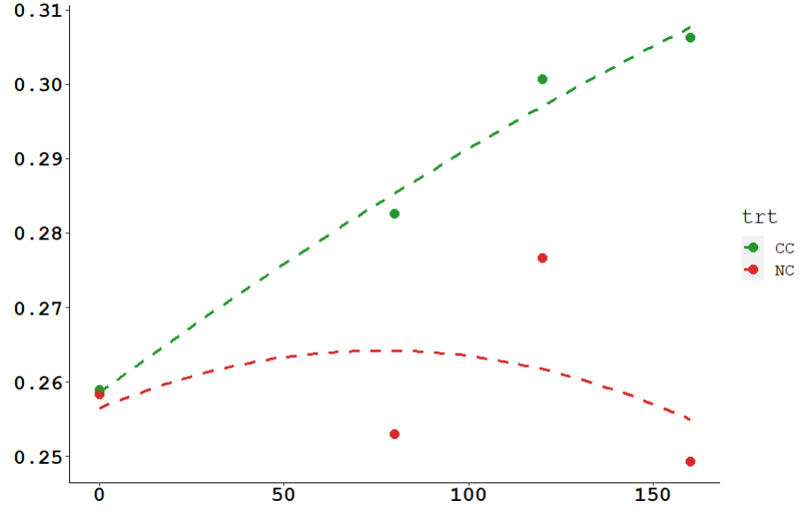
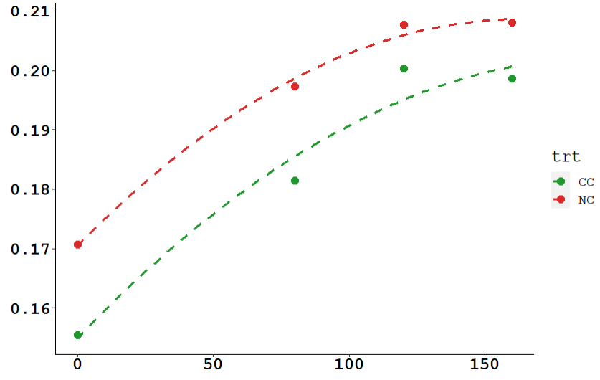
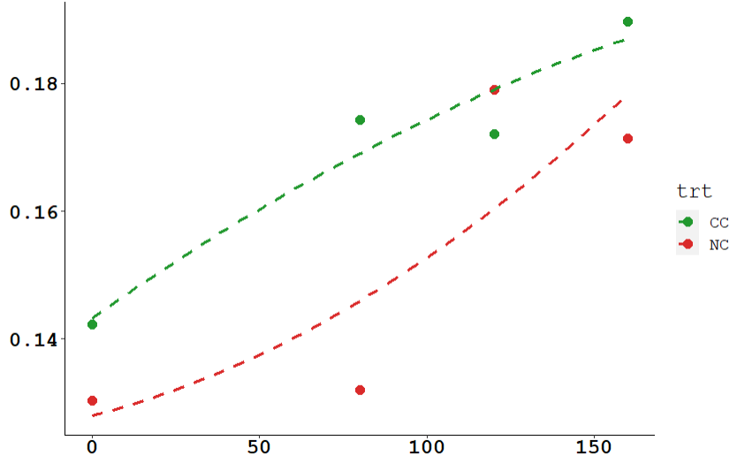
Dane1 Site 2024
Leaf Sulfur
Dane2 Site 2024
Leaf Sulfur(%)
Leaf Sulfur(%)
N fertilizer rate (lb N/acre)
N fertilizer rate (lb N/acre)
Dane3 Site 2024
Leaf Sulfur(%)
N fertilizer rate (lb N/acre)

Slide 22
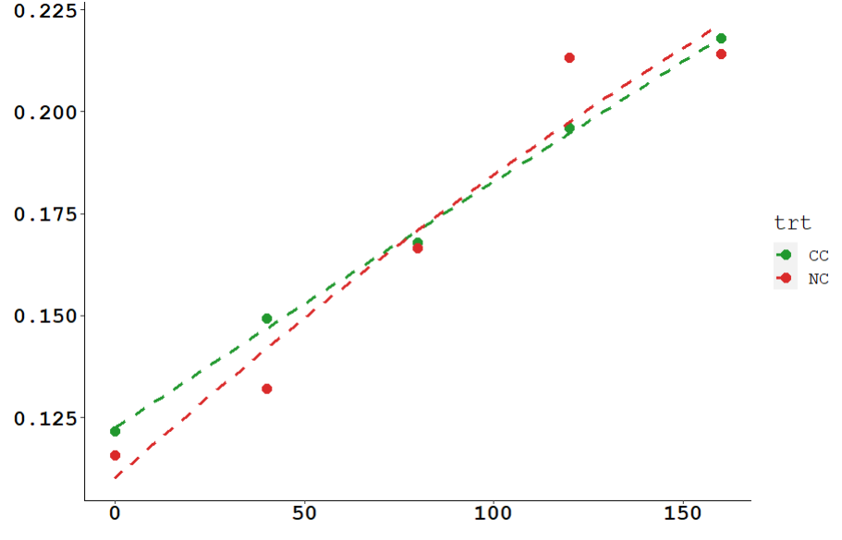
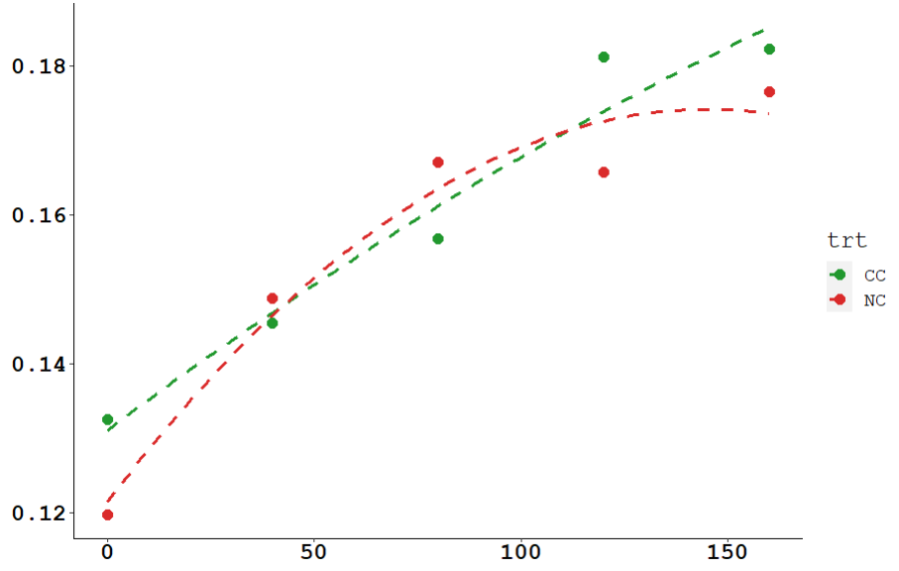
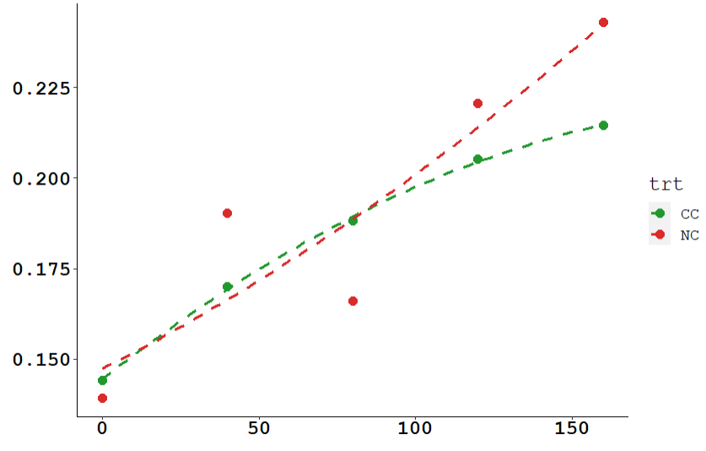
Dodge1 Site 2024
Leaf Sulfur
Dodge2 Site 2024
Leaf Sulfur(%)
Leaf Sulfur(%)
N fertilizer rate (lb N/acre)
N fertilizer rate (lb N/acre)
Dodge3 Site 2024
Leaf Sulfur(%)
N fertilizer rate (lb N/acre)

Slide 23
Cover Crop Effects on Soil Preplant Nitrate
Soil ammonium poor indicator of system function
Soil Preplant Nitrate Correlated with Cover Crop Fall/Spring Biomass but NOT the amount of Nitrogen Incorporated (non-N effect?)
Effects of Cover Crop seem more evident in the second foot of soil
Don’t let your small grain volunteer in spring!

Slide 24
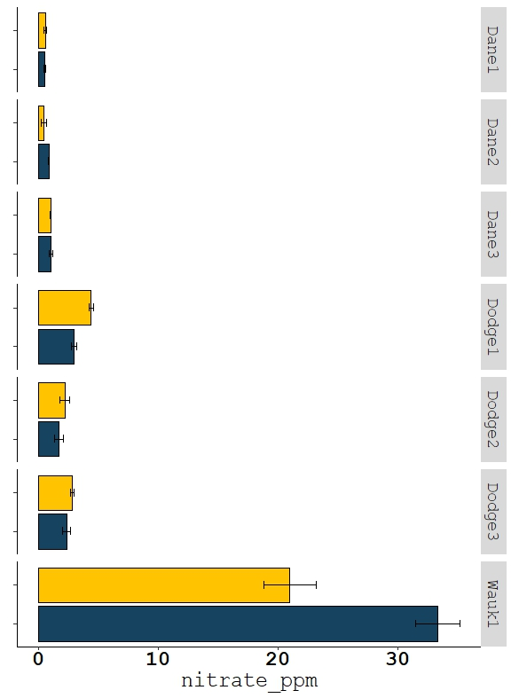
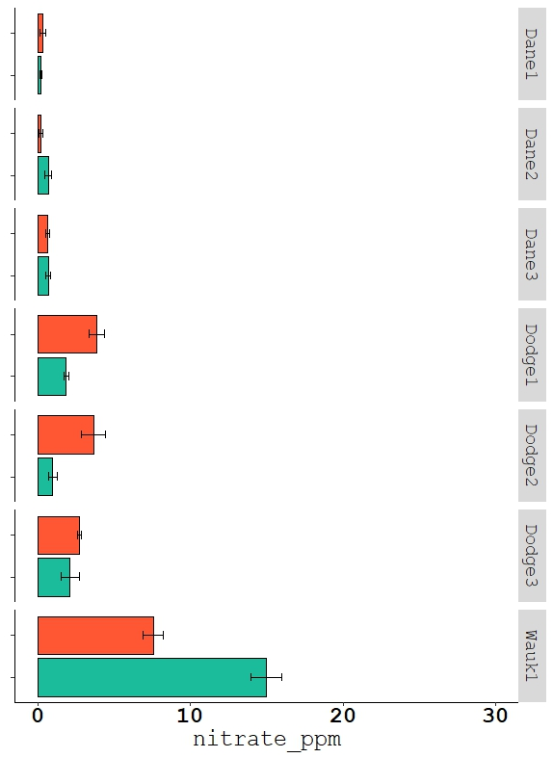


PPNT 0-1 ft
PPNT 1-2 ft
*
*
*
*
*
*
*
*
*

Slide 25
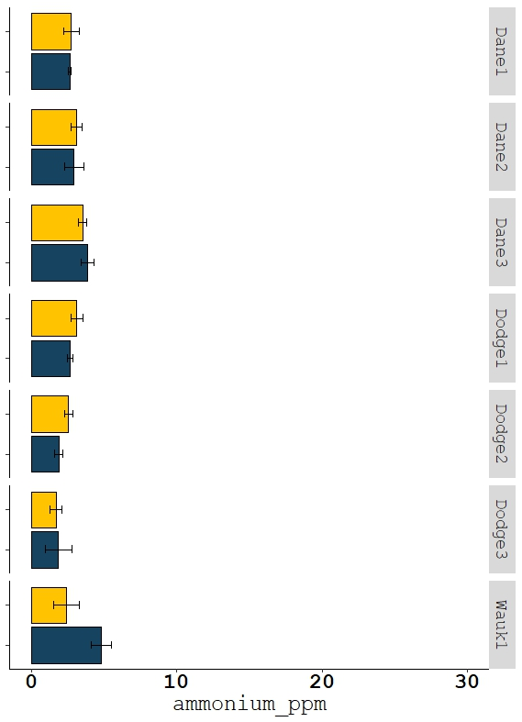
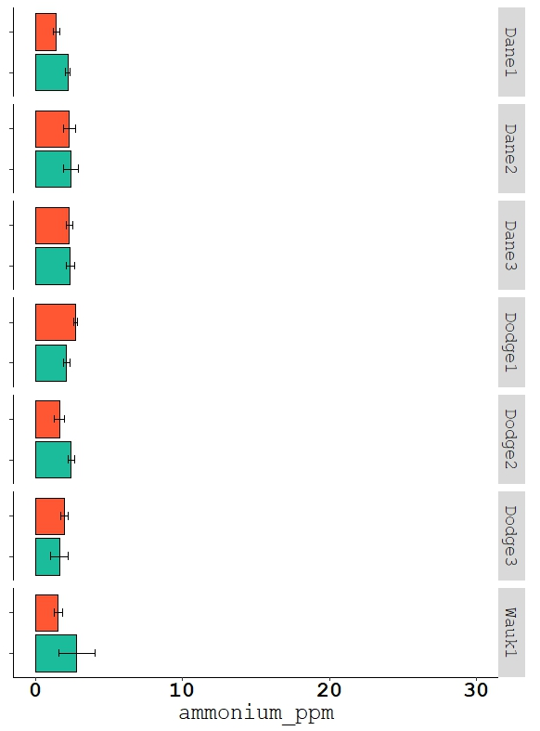
PPNT 0-1 ft
PPNT 1-2 ft
*
*
*
*
*

Slide 26
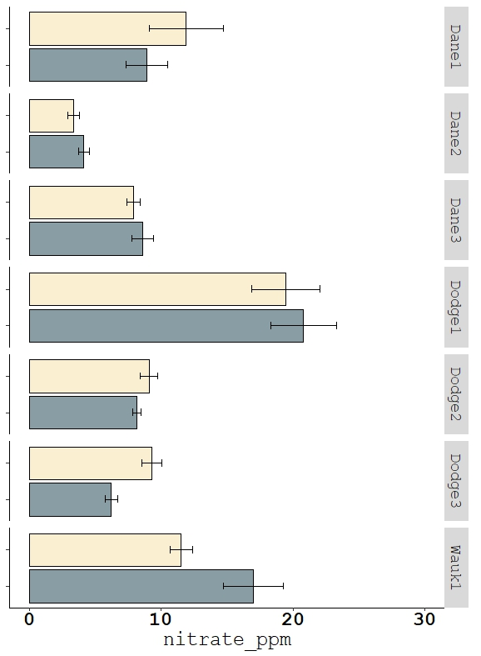
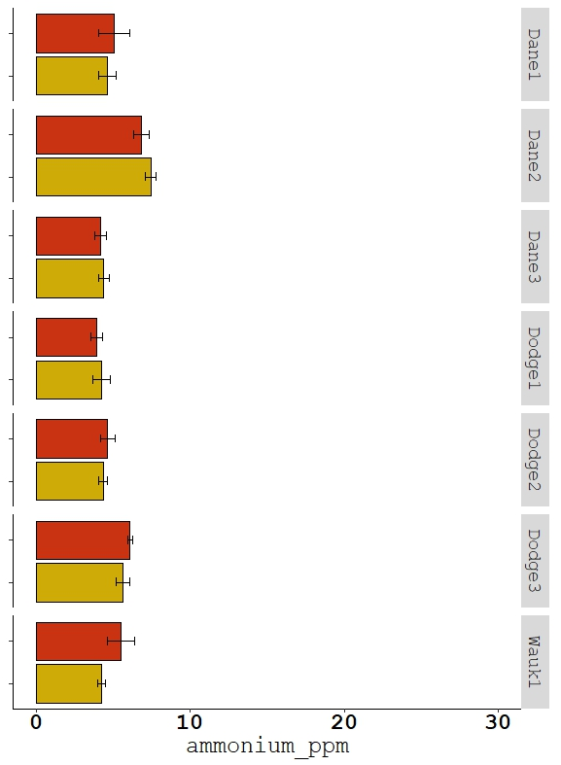


PSNT 0-1 ft
PSNT 0-1 ft
*
*
*
*

Slide 27
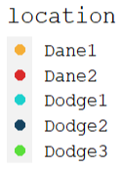
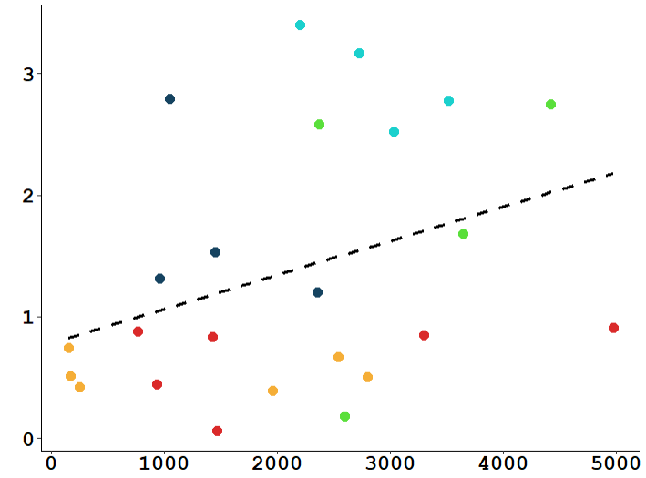
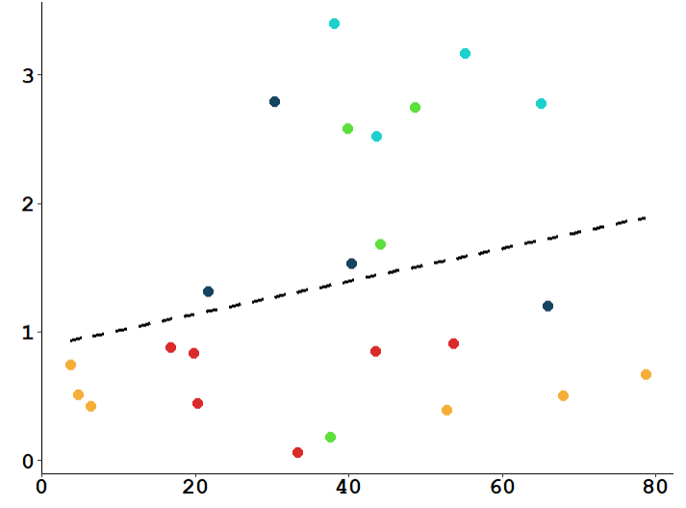
Soil PrePlant Nitrate 0-1 ft
p=0.094
p=0.240
Soil PPNT(ppm)
Fall Cover Crop Yield from Aboveground Biomass(lb DM/a)
Fall Cover Crop Nitrogen from Aboveground Biomass(lb N/a)
Not a statistically significant relationship

Slide 28


Soil PrePlant Nitrate 1-2 ft
p=0.0041
p=0.230
Soil PPNT(ppm)
Fall Cover Crop Yield from Aboveground Biomass(lb/a)
Fall Cover Crop Nitrogen from Aboveground Biomass(lb/a)
Not a statistically significant relationship

Slide 29

Soil PrePlant Nitrate 0-1 ft
Soil PPNT(ppm)
Volunteer Wheat
Spring Cover Crop Yield from Aboveground Biomass(lb/a)

Slide 30


Soil PrePlant Nitrate 0-1 ft
Soil PrePlant Nitrate 1-2 ft
p=0.230
p=0.109
p=0.543
Soil PPNT(ppm)
Spring Cover Crop Yield from Aboveground Biomass(lb/a)
Spring Cover Crop Yield from Aboveground Biomass(lb/a)

Slide 31
Which CC Species Affect Soil PPN ? Top foot
Inclusion of
Warm Season Grass no effect on PPNT
Warm Season Legume positive effect on PPNT (p=0.005)
Cool Season Grass no effect on PPNT
Warm Season Broadleaf AND/OR Rye positive effect on PPNT (p=0.043)
Summer-sown Clover or Vetch no effect on PPNT
Summer-sown Pea negative effect on PPNT (p=0.028)
Additive linear regression resulted in the model:
PPNT_0-1~WSLeg+Rye+Pea (AIC=83)

Slide 32
Which CC Species Affect Soil PPN ? Second foot
Inclusion of
Warm Season Grass no effect on PPNT
Warm Season Legume no effect on PPNT
Cool Season Grass no effect on PPNT
Warm Season Broadleaf AND/OR Rye positive effect on PPNT (p<0.0001)
Summer-sown Clover or Vetch no effect on PPNT
Summer-sown Pea no effect on PPNT
Additive linear regression resulted in the model:
PPNT_1-2~fallCCyld+Rye OR WSBrd (AIC=67)

