Slide 1




Pesticide Resistance Management

Slide 2
What is Pesticide Resistance?
An inheritable characteristic of a pest that makes it less sensitive to a pesticide
Renders the pest able to survive exposure to that pesticide that would normally kill those without the genes
Occurs in all pests - weeds, insects, fungi, etc.
Reflected by failure of a product to achieve expected level of control

Slide 3
What is Pesticide Resistance?
    A mutation makes a pest less sensitive to a pesticide, can naturally occur in pest population before pesticide use
    Pesticide use kills susceptible individuals (those without the mutation/gene), and “selects” those with the mutation to survive
    Pests with the mutation live, reproduce, and pass on the genes, which made them less sensitive to the pesticide, to their offspring
    The pest population has increasing numbers of resistant individuals

Slide 4
What is tolerance?
Tolerance - natural ability of a species or individual member of a species to survive and reproduce after a pesticide treatment.
This implies no selection or genetic manipulation to make the organism this way.
Tolerance is a natural tendency and is not a result of selection pressure.
Example: Mature caterpillars are more tolerant to many insecticides than younger ones of the same species due to differences in body size, exoskeleton thickness, and the ability to metabolize a poison. These differences are identified as tolerance or natural resistance rather than true insecticide resistance.
Notes:
In contrast to resistance, insecticide tolerance is a natural tendency and is not a result of selection pressure. Mature caterpillars are more tolerant to many insecticides than younger ones of the same species due to differences in body size, exoskeleton thickness, and the ability to metabolize a poison. These differences are identified as tolerance or natural resistance rather than true insecticide resistance.

Slide 5

Why do pests become resistant?
Pre-adaptation
High fertility
Short generation time
Selection pressure
Intrinsic properties of pest species. Can’t be controlled.
Under human control!

Slide 6
Natural pest population
Some individuals have genes that make them less sensitive to a pesticide

Slide 7
Pesticide application
Individuals that are susceptible die
X
X
X
X
X
X
X
X
X
X
X
X
X
X
X
X
X
X
X
X
X
X
X
X
X
X
X
X
X
X
X
X
X
X
X
X
X
X
X
X
X
X
X
X
X
X
X
X
X
X
X
X
X
X
X
X
X
X
X
X
X
X
X
X
X
X
X
X
X
X
X
X
X
X
X
X
X
X
X
X
X
X
X
X
X
X
X
X

Slide 8
Pesticide application
Individuals with naturally occurring genes that make them less sensitive to a pesticide survive…

Slide 9
After pesticide application
Humans have applied selection pressure.
Individuals with genes that make them less sensitive to a pesticide reproduce.
The offspring have the genes that make them less sensitive to the pesticide.
The new population is more resistant than a natural population

Slide 10
Eventually, the population is mostly made up of resistant individuals.
Under permanent selection pressure, resistant insects outnumber susceptible ones and the insecticide is no longer effective.

Slide 11
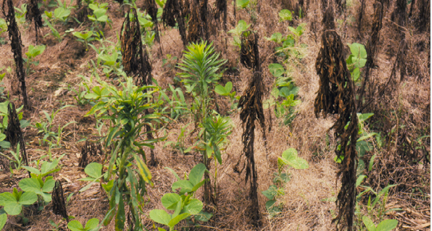
After glyphosate application in a soybean field
Glyphosate-resistant horseweed
Glyphosate-susceptible horseweed
Notes:
Weed pest resistance occurs in a similar fashion as with insect pest resistance. This slide shows what happens as resistance is developed – the resistant individuals will eventually make up the entire population.

Slide 12
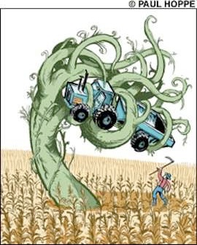
Why is Managing Resistance Important?
Pesticide resistance is increasing
Currently:
    520 insect and mite species
      At least 17 insect species are resistant to all major classes of insecticides
273 weed species
150 plant diseases
10 rodent species

Slide 13
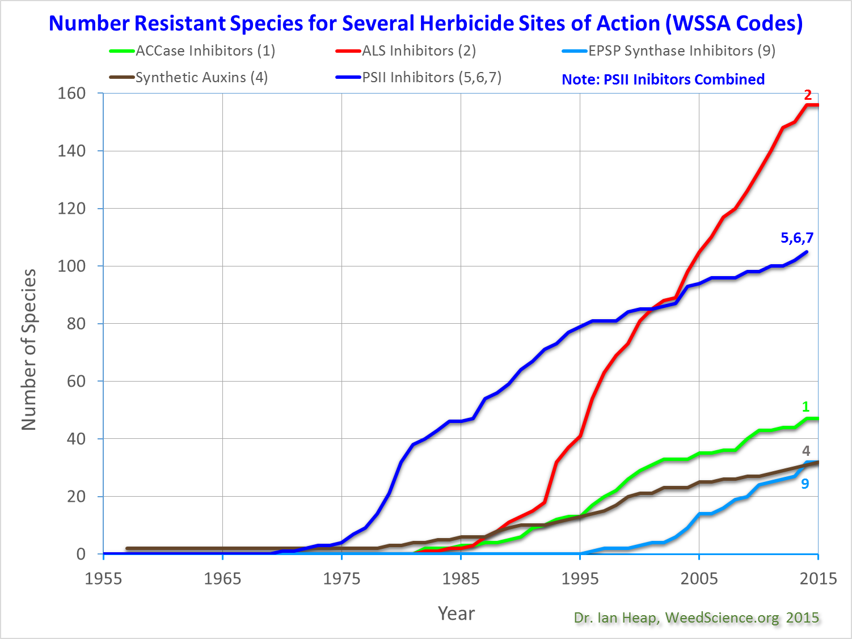
Notes:
This graph presents the chronological increase in resistance to 5 herbicide sites of action. The letters refer to the Weed Science Society of America code (WSSA) to identify herbicide sites of action. Different herbicide sites of action have different propensities to select resistance. PSII inhibitor (Group 5, 6, 7) herbicides, primarily atrazine resistant weeds in corn, dominated in the USA and Europe in the 1970’s and 80’s. ALS inhibitor (Group 2) herbicides are the most prone to resistance. Note that the Y axis is the number of species (because a species is only plotted once per site of action).

Slide 14
Why is Managing Resistance Important?
We want pesticides to provide effective control of pests
It’s hard to develop new products for pest control
  If we exhaust current technology, it might be a long time until something is developed to replace it!
Environmental stewardship
  Pest are mobile, resistance that develops in one crop can spread
  Minimize ineffective use?? of pesticides

Slide 15
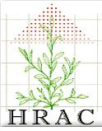
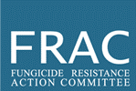

All types of pesticides are at risk for resistance!
Herbicides
Herbicide Resistance Action Committee (HRAC) http://www.hracglobal.com
Fungicides
Fungicide Resistance Action Committee (FRAC) http://www.frac.info
Insecticides
Insecticide Resistance Action Committee (IRAC) http://www.irac-online.org
International groups founded by the agrochemical industry for a cooperative approach to resistance management. Sources for info and education materials.

Slide 16
What Products are Resistant Prone?
All pesticides have some risk, BUT not to the same extent
Those with single-site mode of action, targeted and narrow-spectrum more at risk

Slide 17
High Risk
Repeated applications of the same insecticide
Regular calendar-based spraying
Continuous crop
Treating whole field
Alternating applications of different insecticides
Spraying based on an economic threshold
Spot and perimeter treatment
Annual crop rotation
Low Risk

Slide 18
Mode of action (MoA)
The chemical structure of a pesticide generally defines its target site and its mode of action at that target site.
Target site - the physical location within an organism where the pesticide acts
Mode of action - the action of a pesticide at its target site. The way in which it causes physiological disruption at the target site.
Each pesticide has a Group Number to help growers make resistance management decisions
Group number is clearly marked on all labels

Slide 19
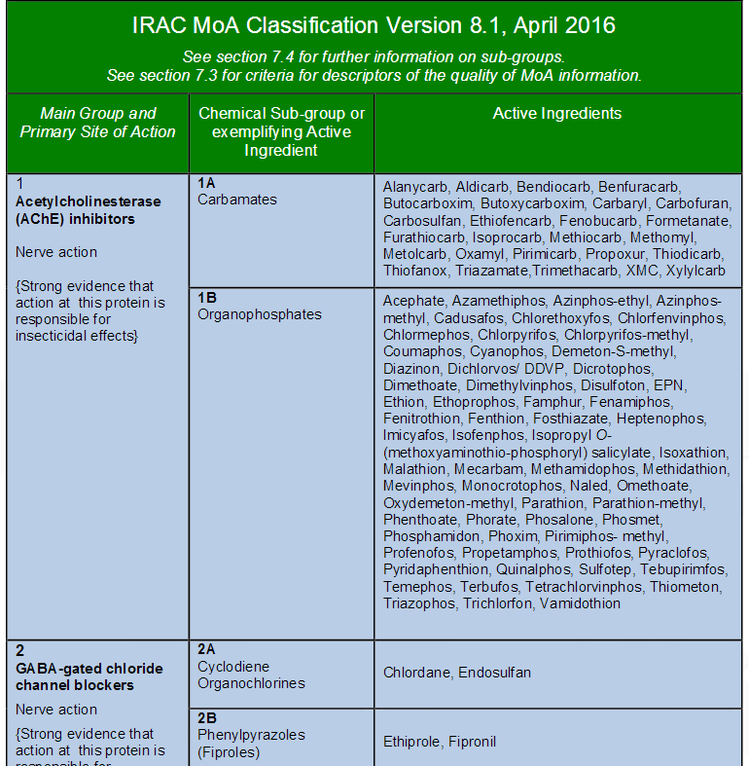
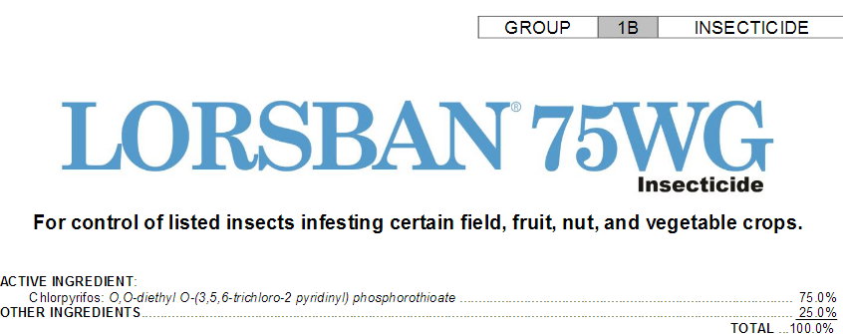
Insecticides - IRAC codes
Based on site of action
Notes:
Educators are encouraged to show farmers how to find IRAC group codes in the pesticide guideline that they use routinely.

Slide 20
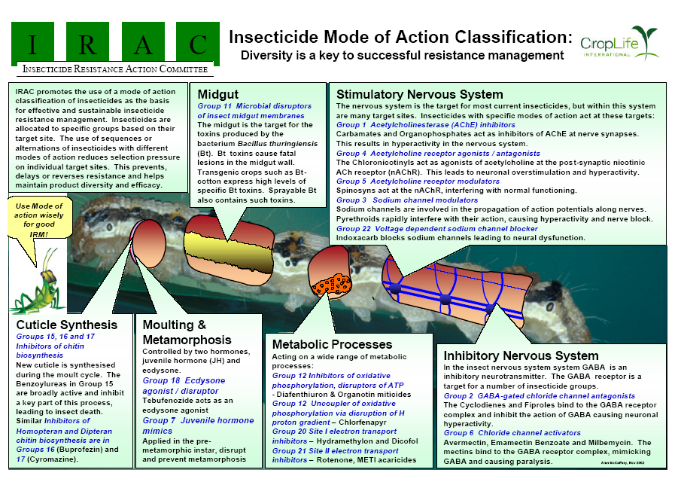

Slide 22
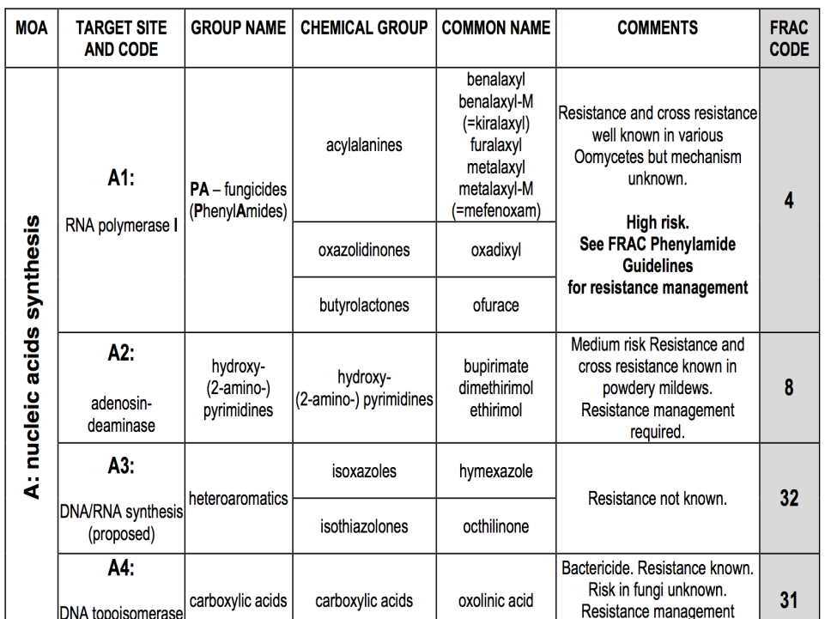

Fungicides - FRAC codes
Based on cross resistance behavior

Slide 23
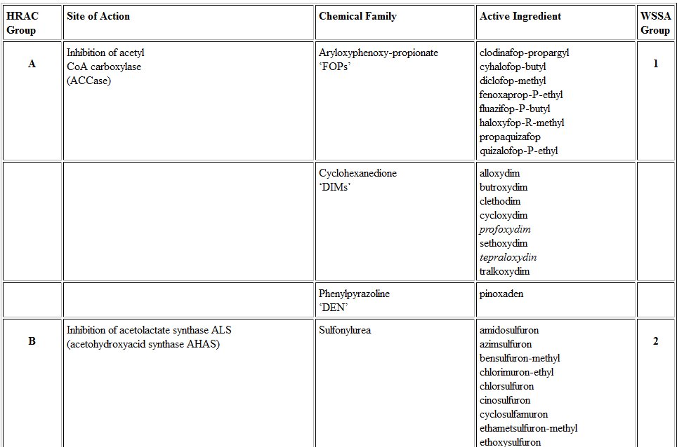
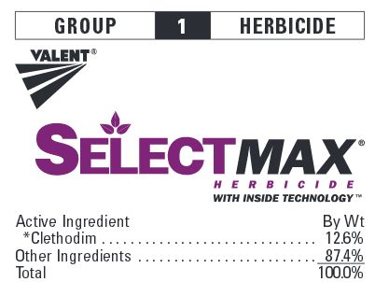
Herbicides - HRAC and WSSA groups
HRAC and WSSA (Weed Science Society of America) codes, differ slightly but very similar
Systems based on site of action
Notes:
Just as a note to educators: WSSA is currently in discussion with EPA to see if these 2 systems can be unified somehow.

Slide 24
Other terminology
Cross-resistance - resistance to two or more pesticides resulting from a single resistance mechanism. Can occur even where the pest has not been exposed to all products it is resistant to.
e.g. An insect resistant to parathion (an organophosphate) also has reduced susceptibility to other organophosphates.
X
X
X
X
X
X
X
X
X

Slide 25
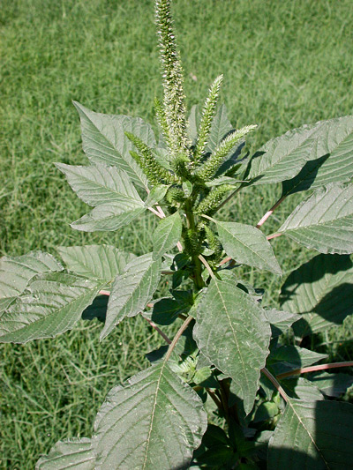
Other terminology
Multiple resistance - resistance to several pesticides from two or more distinct resistance mechanisms in the same organism.
e.g. Palmer amaranth is resistant to atrazine (a triazine herbicide), and also mesotrione (an HPPD inhibitor herbicide).

Slide 26
Other terminology
Quantitative Resistance
Either the pesticide works…. or it does not.
Complete loss of control.
Qualitative Resistance
Pest exhibits range in sensitivity.
Gradual loss of control.
Can be regained with higher rate or more active pesticide.

Slide 27
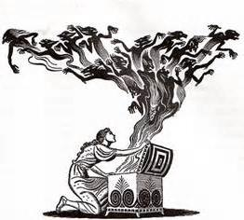
Key Points About Managing Resistance
Goal is delaying development of resistance, not managing resistant pest biotypes once detected
Use Integrated Pest Management (IPM) program
Minimize use of at-risk products

Slide 28
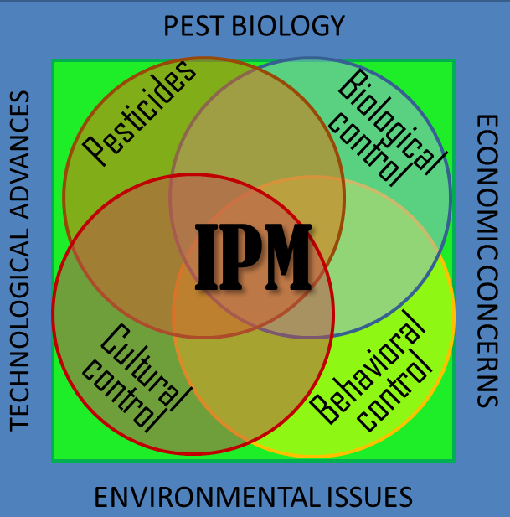
Do not rely on pesticides alone
Integrate different controls!
synthetic pesticides
biological pesticides
beneficial insects (predators/parasites)
cultural practices
transgenic plants (where allowed)
crop rotation
pest-resistant crop varieties
chemical attractants or deterrents

Slide 29
Alternate, rotate, or sequence different pesticide MoA classes
Use FRAC, IRAC, and HRAC when choosing chemicals!
  Do not rely on product names
  Do not rely on active ingredients
    Many different products and active ingredients can be in the same group!
Alternaria leaf spot – Cantaloupe
Fungicide FRAC Code
Cabrio (pyraclostrobin) 11
Pristine (pyraclostrobin + boscalid) 7 + 11
Quadris (azoxystrobin) 11
Quadris Top (azoxystrobin + difenoconazol 3 + 11
Reason (fenamidone) 11
Notes:
The individual educators should change slide to represent a spray program that they would routinely use for their crop. Then the educator could pick and choose the ones that they focused on during the presentation.

Slide 30
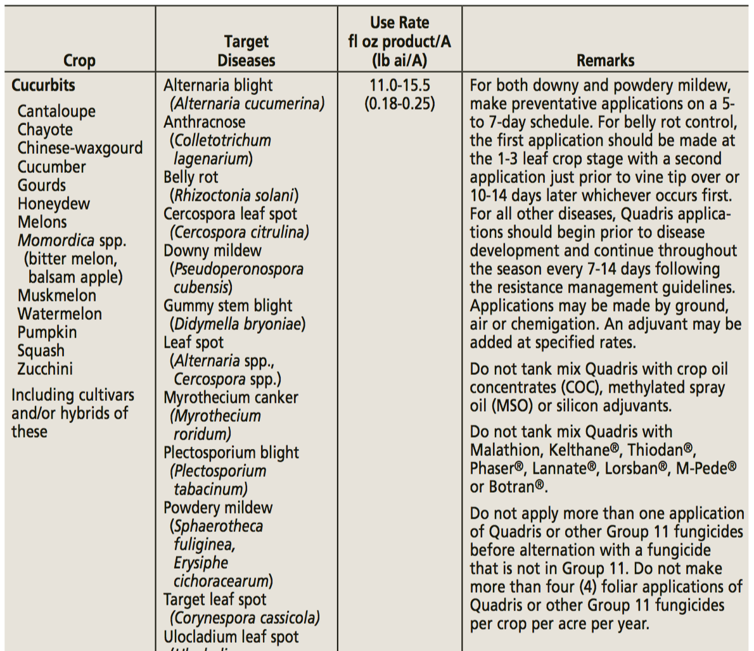
Resistance
management
guidelines on label MUST
be followed.

Slide 31
Applications must be timed correctly
Target the most vulnerable life stage of the pest
Use spray rates and application intervals recommended by the manufacturer and in compliance with local agricultural extension regulations.
  A high rate can take out pests that might be somewhat resistant, but using too low a rate may allow them to survive

Slide 32
Challenges to Managing Resistance
Do not have adequate tools
  Not enough registered products to permit rotation
The program may not be as effective
The program may be more expensive
Products with resistance risk for one pest are also used for others

Slide 33
Preserve susceptible genes
Preserve susceptible individuals within the target population by providing a refuge or haven for susceptible insects
Unsprayed areas within treated fields
Adjacent refuge fields
These susceptible individuals may out-compete and interbreed with resistant individuals, diluting the impact of any resistance that may have developed in the population.

Slide 34
Do genetically engineered crops (GMOs) contribute to resistance development?
Not directly!
Growers may manage those crops differently, encourage resistance development inadvertently
Example: “RoundUp” ready crops, over reliance on single herbicide

Slide 35

Supporting funds were provided by NE-SARE Professional Development Program Grant, ENE15-140-29994
Presentation developed by K. Ghantous, H. Sandler, and L. McDermott.
With special thanks to:
Dr. Margaret McGrath, Cornell University
Dr. Andrei Alyokhin, University of Maine
Dr. Richard Bonanno, University of Massachusetts
for their expertise and contribution of materials for presentation

