Slide 1
Rabbitfish Biology and Suitability for Aquaculture
Simon Ellis

Slide 2
Rabbitfish Taxonomy
Two genera in the family Siganidae: Lo and Siganus
Siganus – 22 species
Lo – 5 species

Slide 3
Family Characteristics
Deep compressed body with a snout resembling a rabbit
13 dorsal spines and 7 anal fin and 2 pelvic fin spines
Generally split into two characteristically separate groups: 15 species are gregarious schoolers and the rest form pairs and tend to inhabit coral reef areas.
The paired species are found on coral reefs and are of limited commercial or aquaculture value
The gregarious schoolers can handle large changes in salinity and temperature and are non-aggressive. They are the most commercially valuable species and have the best aquaculture potential.

Slide 5
Coral dwelling rabbitfish – e.g. S. corallinus
Colorful
Not abundant
Have potential for aquarium industry

Slide 6
Gregarious schoolers – e.g. S. argenteus
More drab in color
Congregate in schools
Able to tolerate large changes in temperature and salinity
More suitable for food aquaculture

Slide 7
Distribution
Naturally occurring in the Indo-Pacific region
One species passed through the Suez canal and is now common in the Mediterranean area – S. rivulatus
In Micronesia there are 13 species present
8 species gregarious schoolers
5 species coral pairers

Slide 8
Habitats
Different species occupy different habitats ranging from reef edges to reef flats and sea grass beds and mangrove areas.
While they can tolerate large changes in salinity only S. lineatus is truly estuarine.
They are often found in very shallow areas feeding on algae
Most Siganids are herbivores – another reason they are called rabbitfishes

Slide 9
Life Cycle
Rabbitfishes generally mature within 1-2 years
Spawning tends to occur in the period between the new moon and full moon. Most aggregating species have seasons. Pairs tend to spawn more frequently
Large adults can produce up to 1 million eggs which are quite small 0.5 to 0.75 mm.
Eggs are demersal (sinking) and adhesive (sticky). Unlike many marine fish.

Slide 10
Oceanic Phase

Slide 11
Larval Development S. guttatus

Slide 13
Settlement and Recruitment
Larvae settle between 25 and 60 days after hatching
They usually come in during new moon periods
Often in large numbers
They tend to settle in sea grass and mangrove areas
Juveniles can often be seen in large numbers in these areas
After a period of weeks to months they will migrate to their adult habitat

Slide 14
Rabbitfish Suitability for Aquaculture
Only some species have shown to be suitable for aquaculture
Desirable traits are:
fast growth
schooling behavior
non aggressive behavior
tolerance of changing temperatures and salinity
Tolerance of poor water quality
Good feed conversion – mainly herbivorous

Slide 15
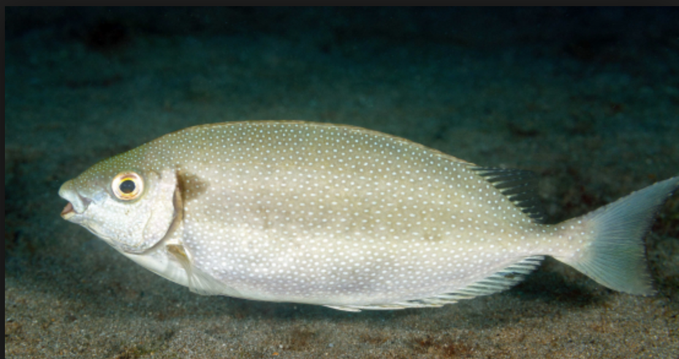
Species Presently Aquacultured
S. canaliculatus (white-spotted spinefoot) – grows to 20 cm in 6 months. Does not occur Micronesia

Slide 16
S. Guttatus – Golden rabbitfish
Can be bred in hatcheries
Occurs in Micronesia
Yet to see it settle in sampling conducted at MERIP

Slide 17
S. fuscescens – dusky rabbitfish
Cultured in Palau with some success
Has not been captured yet during sampling at MERIP

Slide 18
S. argenteus – forktail rabbitfish
Best success to date at MERIP
Very little information in the literature for culture of this species
Successfully captured and farmed at MERIP for 3 years
Settle from plankton in April and May

Slide 19
S. randalli – Randall’s rabbitfish
Popular fish in Pohnpei - Kioak
Has been captured in the mangroves and is being farmed
Growth rates so far are ok
Hatchery technology is understood
Studied in Guam

Slide 20
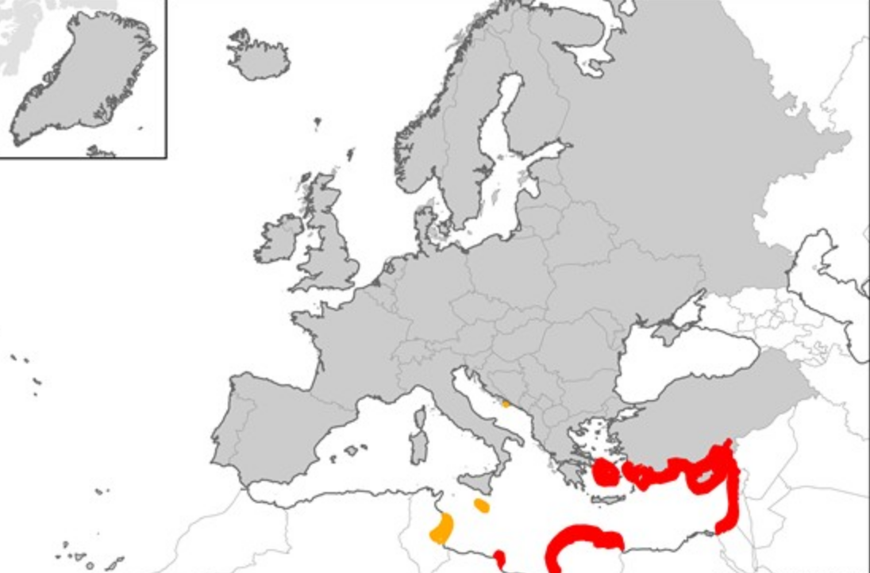
S. rivulatus – Marbled spinefoot
Introduced to Mediterranean
Now makes up 5-15% of many inshore fisheries
Grows well in culture
Does not occur in Micronesia

Slide 21
Hatchery Rearing Success
S. randalli - Guam
S. canaliculatus
S. lineatus – New Caledonia
S. fuscescens – Palau
S. rivulatus

Slide 22
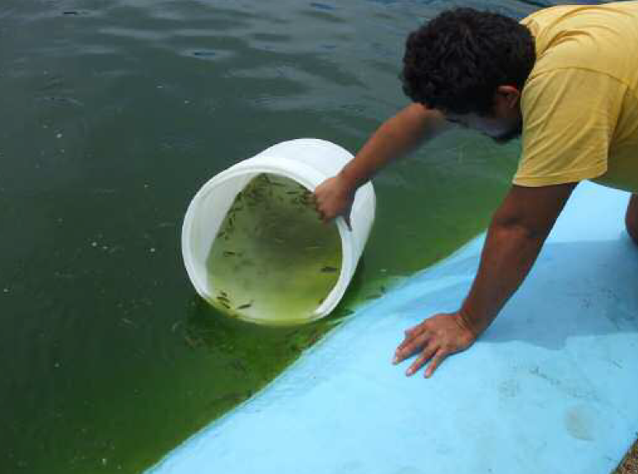
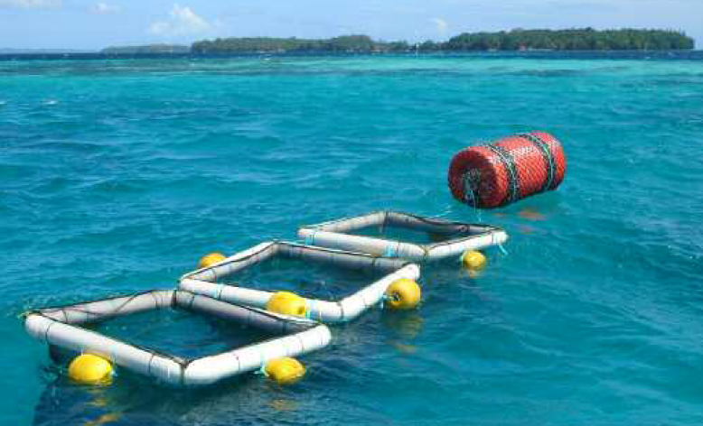
Pacific Based Grow-out Trials
S. argenteus – Solomon islands in cages and Cook Islands in ponds
S. lineatus - New Caledonia in cages
S. fuscescens - cages in Palau
S. randalli – cages in Guam

