Slide 1

Rain Garden Project Logistics

Slide 2
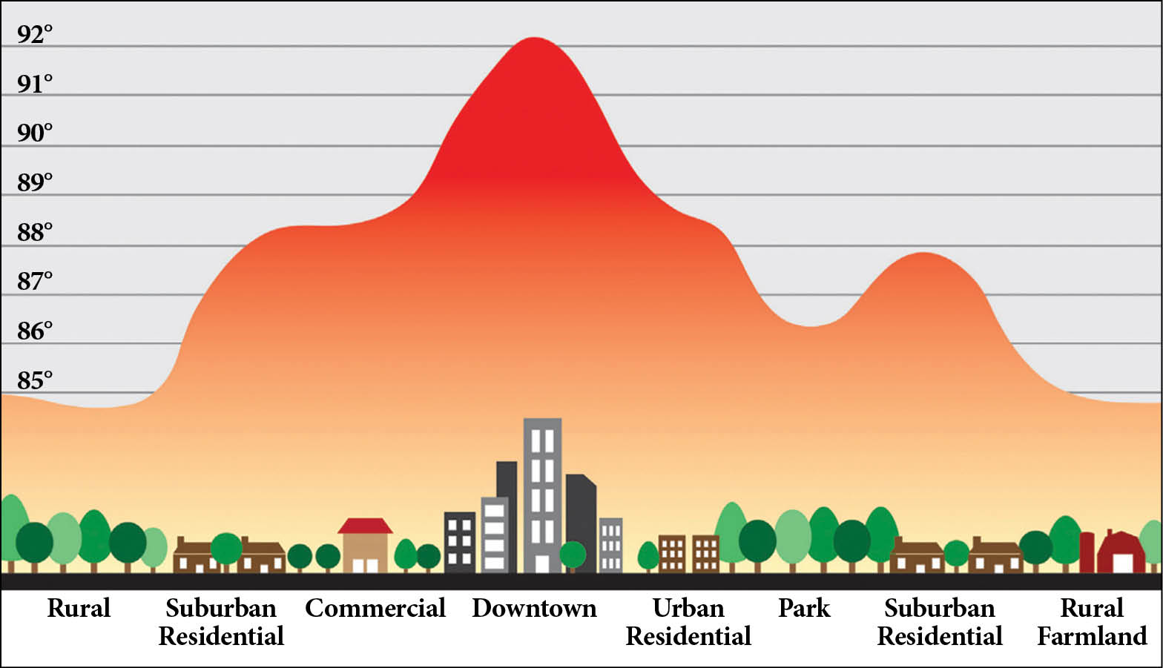
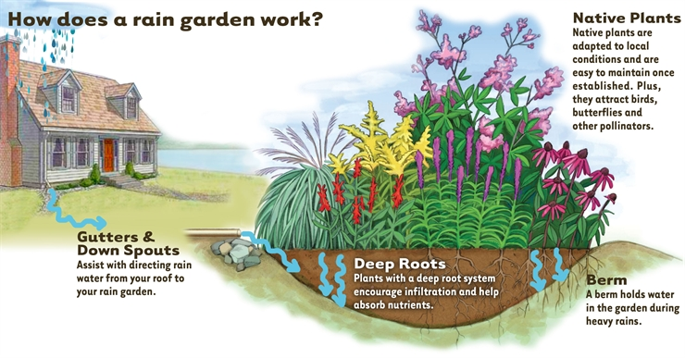
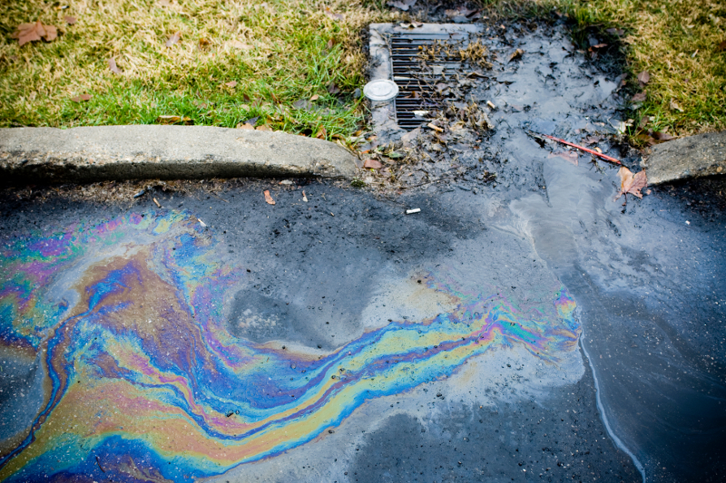
Why Rain Gardens?
Notes:
Pollution control: stormwater runoff is the leading cause of water pollution
Replenish groundwater
Habitat creation
Cool the air (prevent urban heat)
Save money

Slide 3

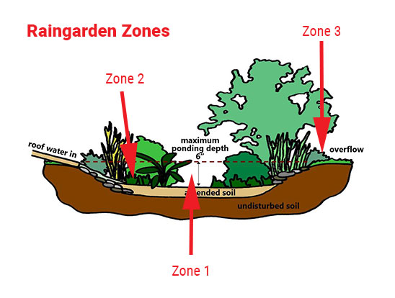



A Brief Review of Rain Gardens
A GARDEN WITH A SHALLOW DEPRESSION TO FILTER OUT AND ABSORB POLLUTANTS IN STORMWATER
MUST ABSORB WATER WITHIN 24 HOURS
INCLUDES NATIVE PLANTS

Slide 4
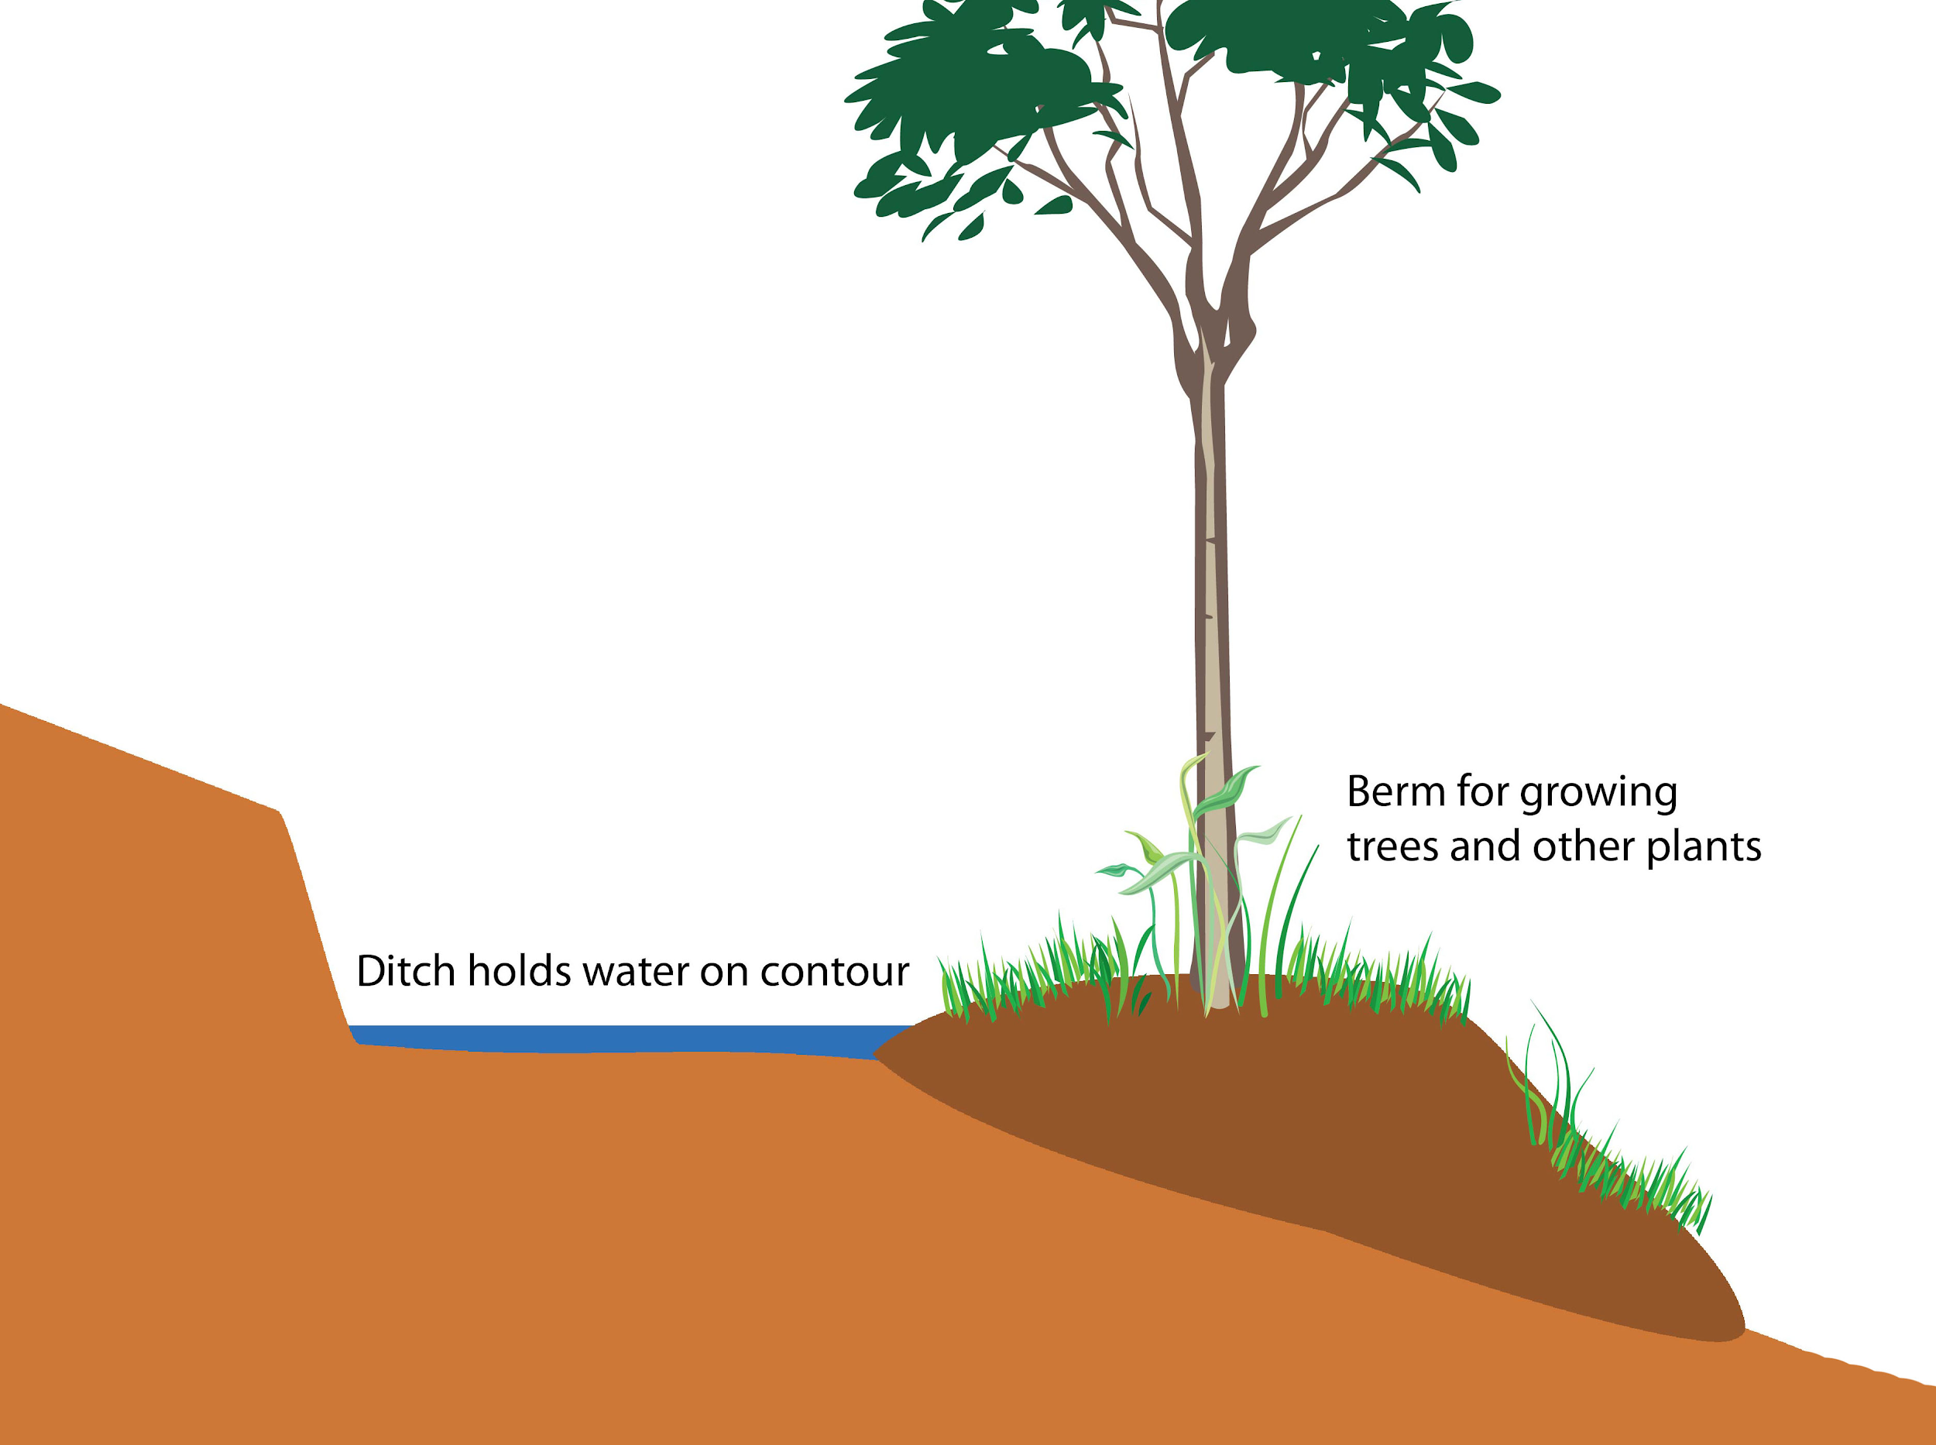
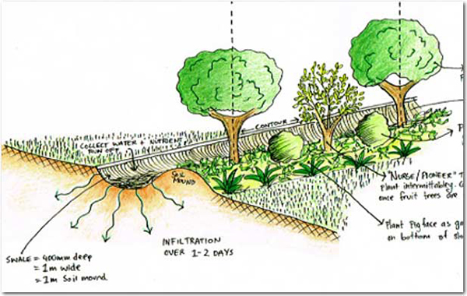
Swale: a shallow ditch that slows down water
Berm: a bit of raised earth, an artificial ridge

Slide 5
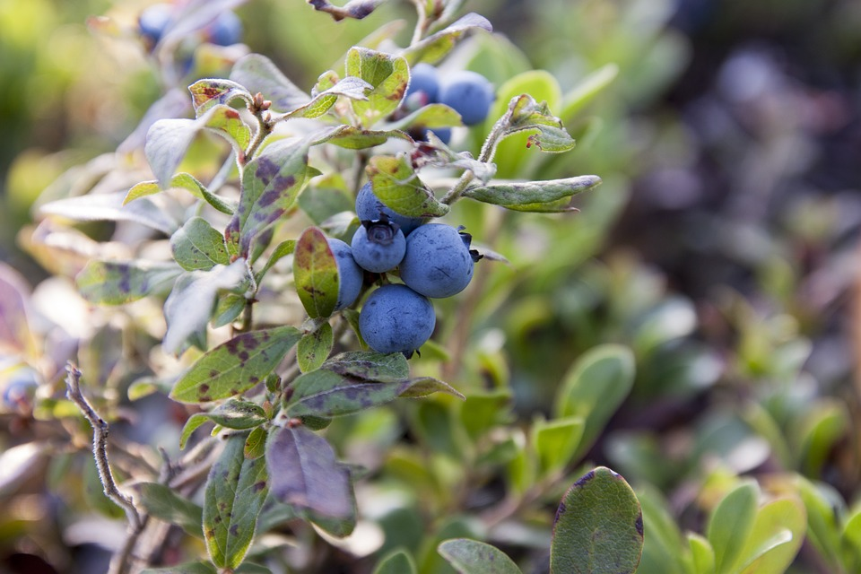
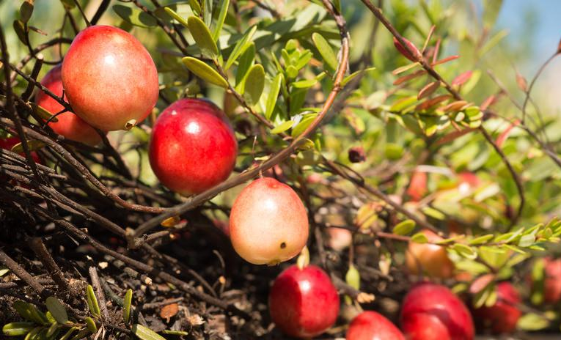
Blueberries and cranberries need more acidic soil. We can add sphagnum peat to make the soil more acidic.

Slide 6
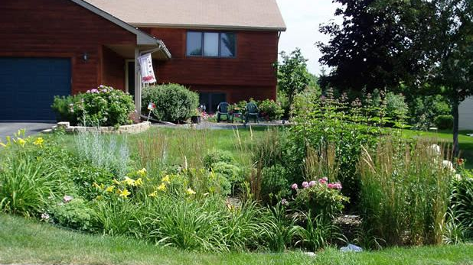

Slide 7
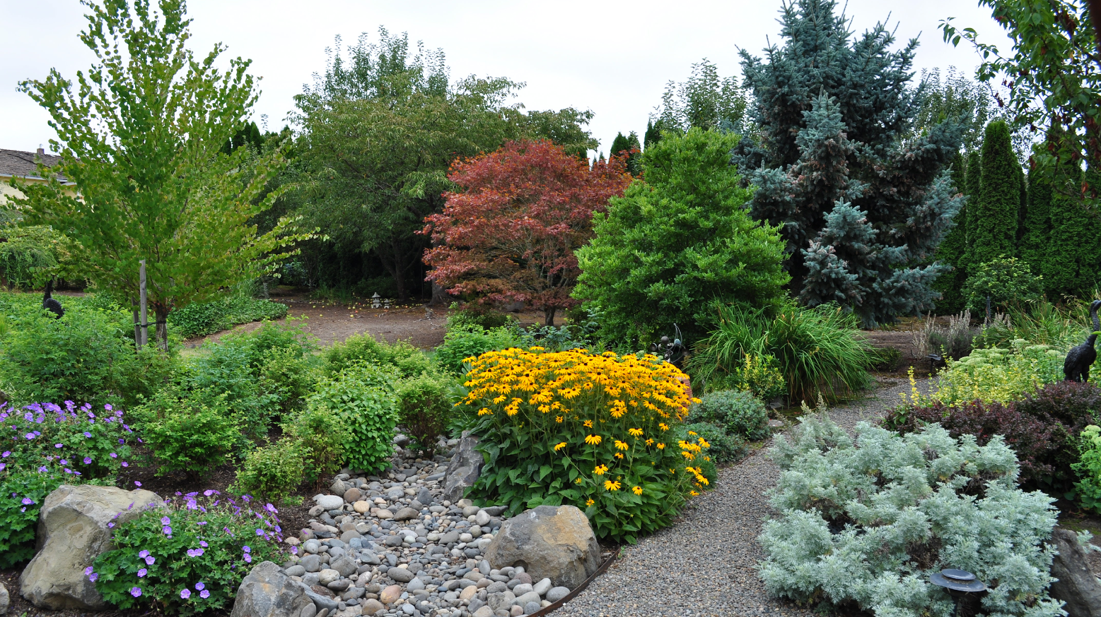

Slide 8
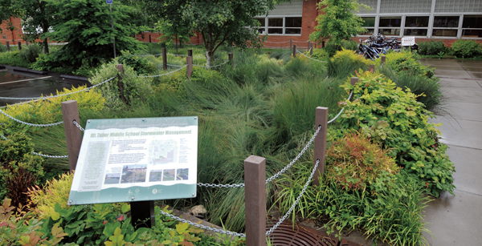

Slide 9
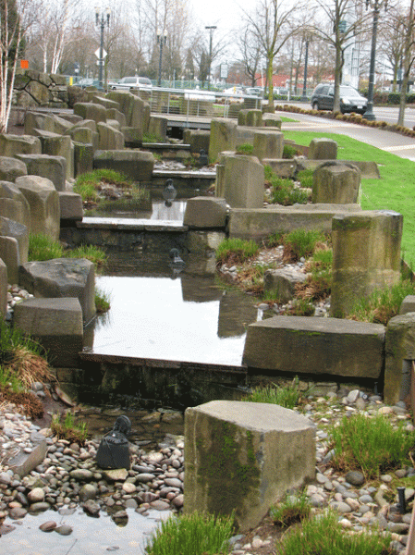

Slide 10
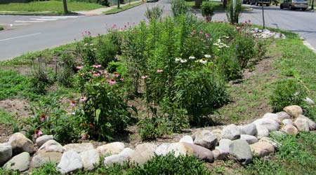

Slide 11
Rain Garden Project Essentials
Your group’s rain garden project will have two separate tasks that need to be completed:
Task 1: Rain Garden Pitch/Proposal
The rain garden pitch will be a brief presentation (roughly 5 min in length) in which you will describe your rain garden design and why it should be the rain garden that will be created this summer.
Task 2: Rain Garden Design
- The design itself must be drawn and complete with dimensions for the rain garden itself, as well as the surrounding garden or design item you wish to incorporate

Slide 12
Rain Garden Proposal Must Include:
A brief description of your rain garden design and what the creative twist is that you plan to incorporate
A powerpoint presentation of which native plants you would like to include in your rain garden
  Where these plants will be placed in the garden (remember what types of plants grow in what water filtration levels)
  Why these native plants are unique and cool
  What the signage would look like for each native plant
Why you believe your design should be the one used as Roosevelt’s rain garden

Slide 13
Rain Garden Design Must Include:
A design plan with proper dimensions of the rain garden itself and the surrounding garden
Pathways to walk on while walking through the garden
Proper labels of what plants you have chosen to incorporate in your garden and where they will be placed
A cool, creative, and functional twist

Slide 14
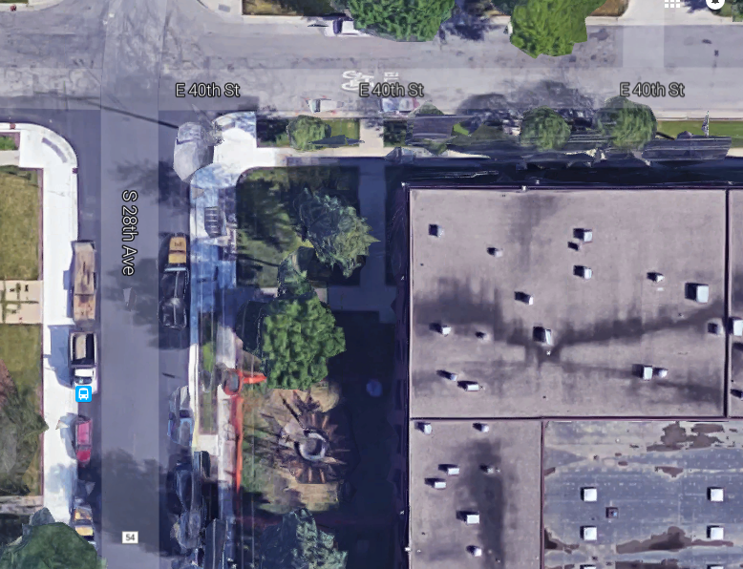
How to properly calculate volume of storm water runoff
First you must calculate the volume of the building the rain garden will be capturing the rain from
  Volume= Length x Width x Height
  W=143.82ft, L=196.86ft, H=20ft
Formula to calculate storm water run off:
  V = C x 0.083 feet; C=Catchment area
Ex. Volume=100 feet, so 100 ft = C x 0.083 feet
  100 ft x 0.083 ft = C
  C= 8.3 ft

Slide 15
Calculate Rain Garden Size
(with 6-inch ponding depth)
O = optimal rain garden size in square feet
V = Volume of stormwater captured by rain garden in design storm in cubic feet
______V_______ = O
0.5 feet
Example: For a catchment area that will collect a total volume of 200 cubic feet of runoff , divide 200 cubic feet by 0.5 feet (the ponding depth should be 6 inches and 6 inches = 0.5 feet):
200 cubic feet/0.5 square feet = 400 square feet

