Slide 1
Plot Rainfall Simulator
Data & Imagery
Desktop Demonstration and Research Tool
11 Dec 2021

Slide 2
Google Earth Image from 2009
25 June 2021
Sample Locations
2021 Plot
CVI #111011
Near Janesville, IA
(North of Waterloo)
Very Dry Early Season

Slide 3
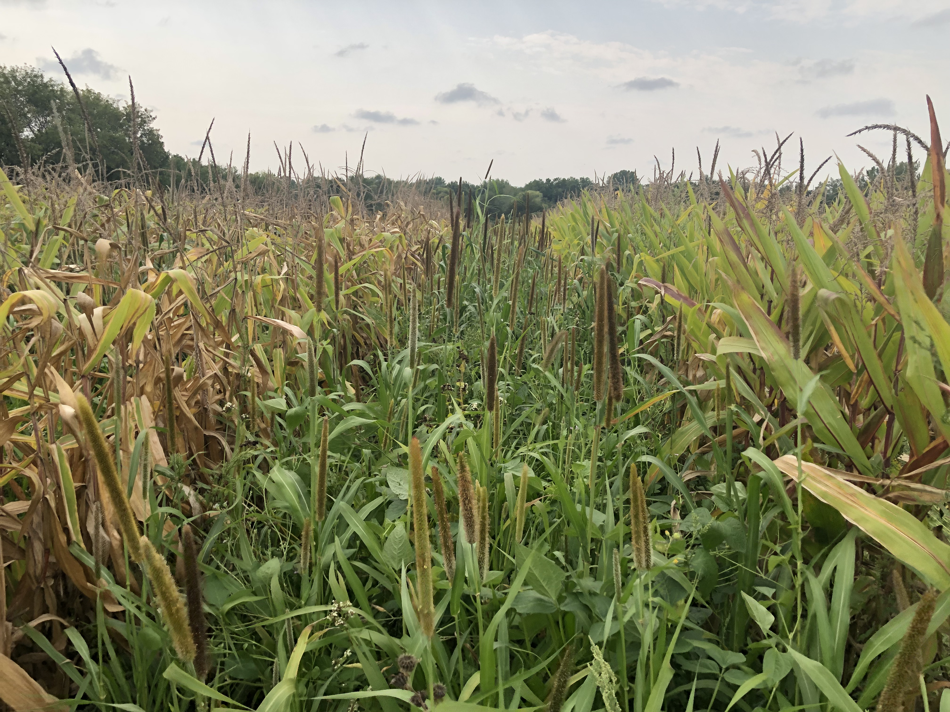
Max Soil Building Cover Crop in 90” Twin Rows
Extraordinary Response by the Complex Cover Crop Mix in a failing corn crop

Slide 4
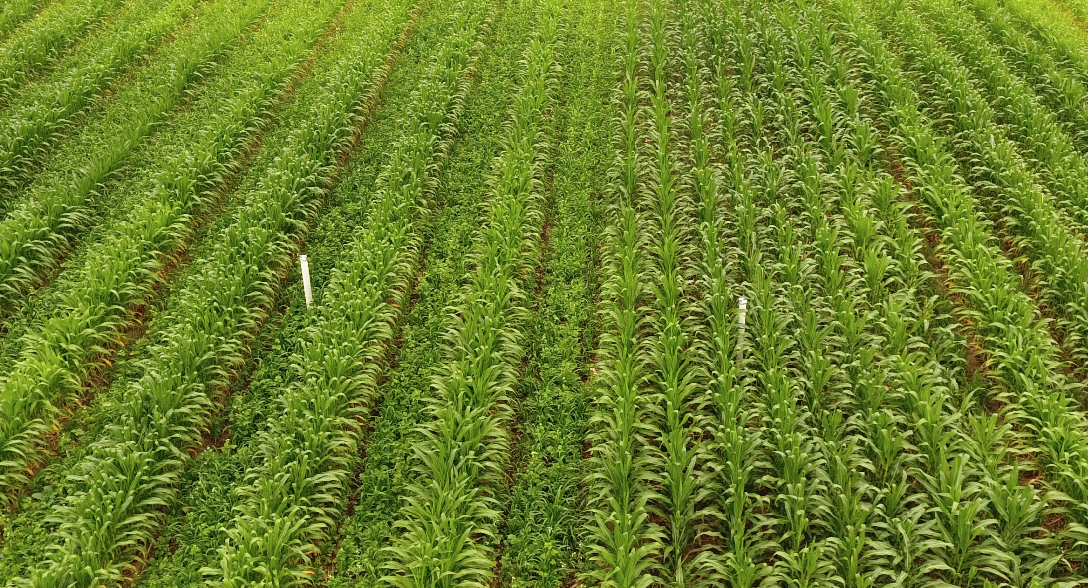
Sample Locations

Slide 5
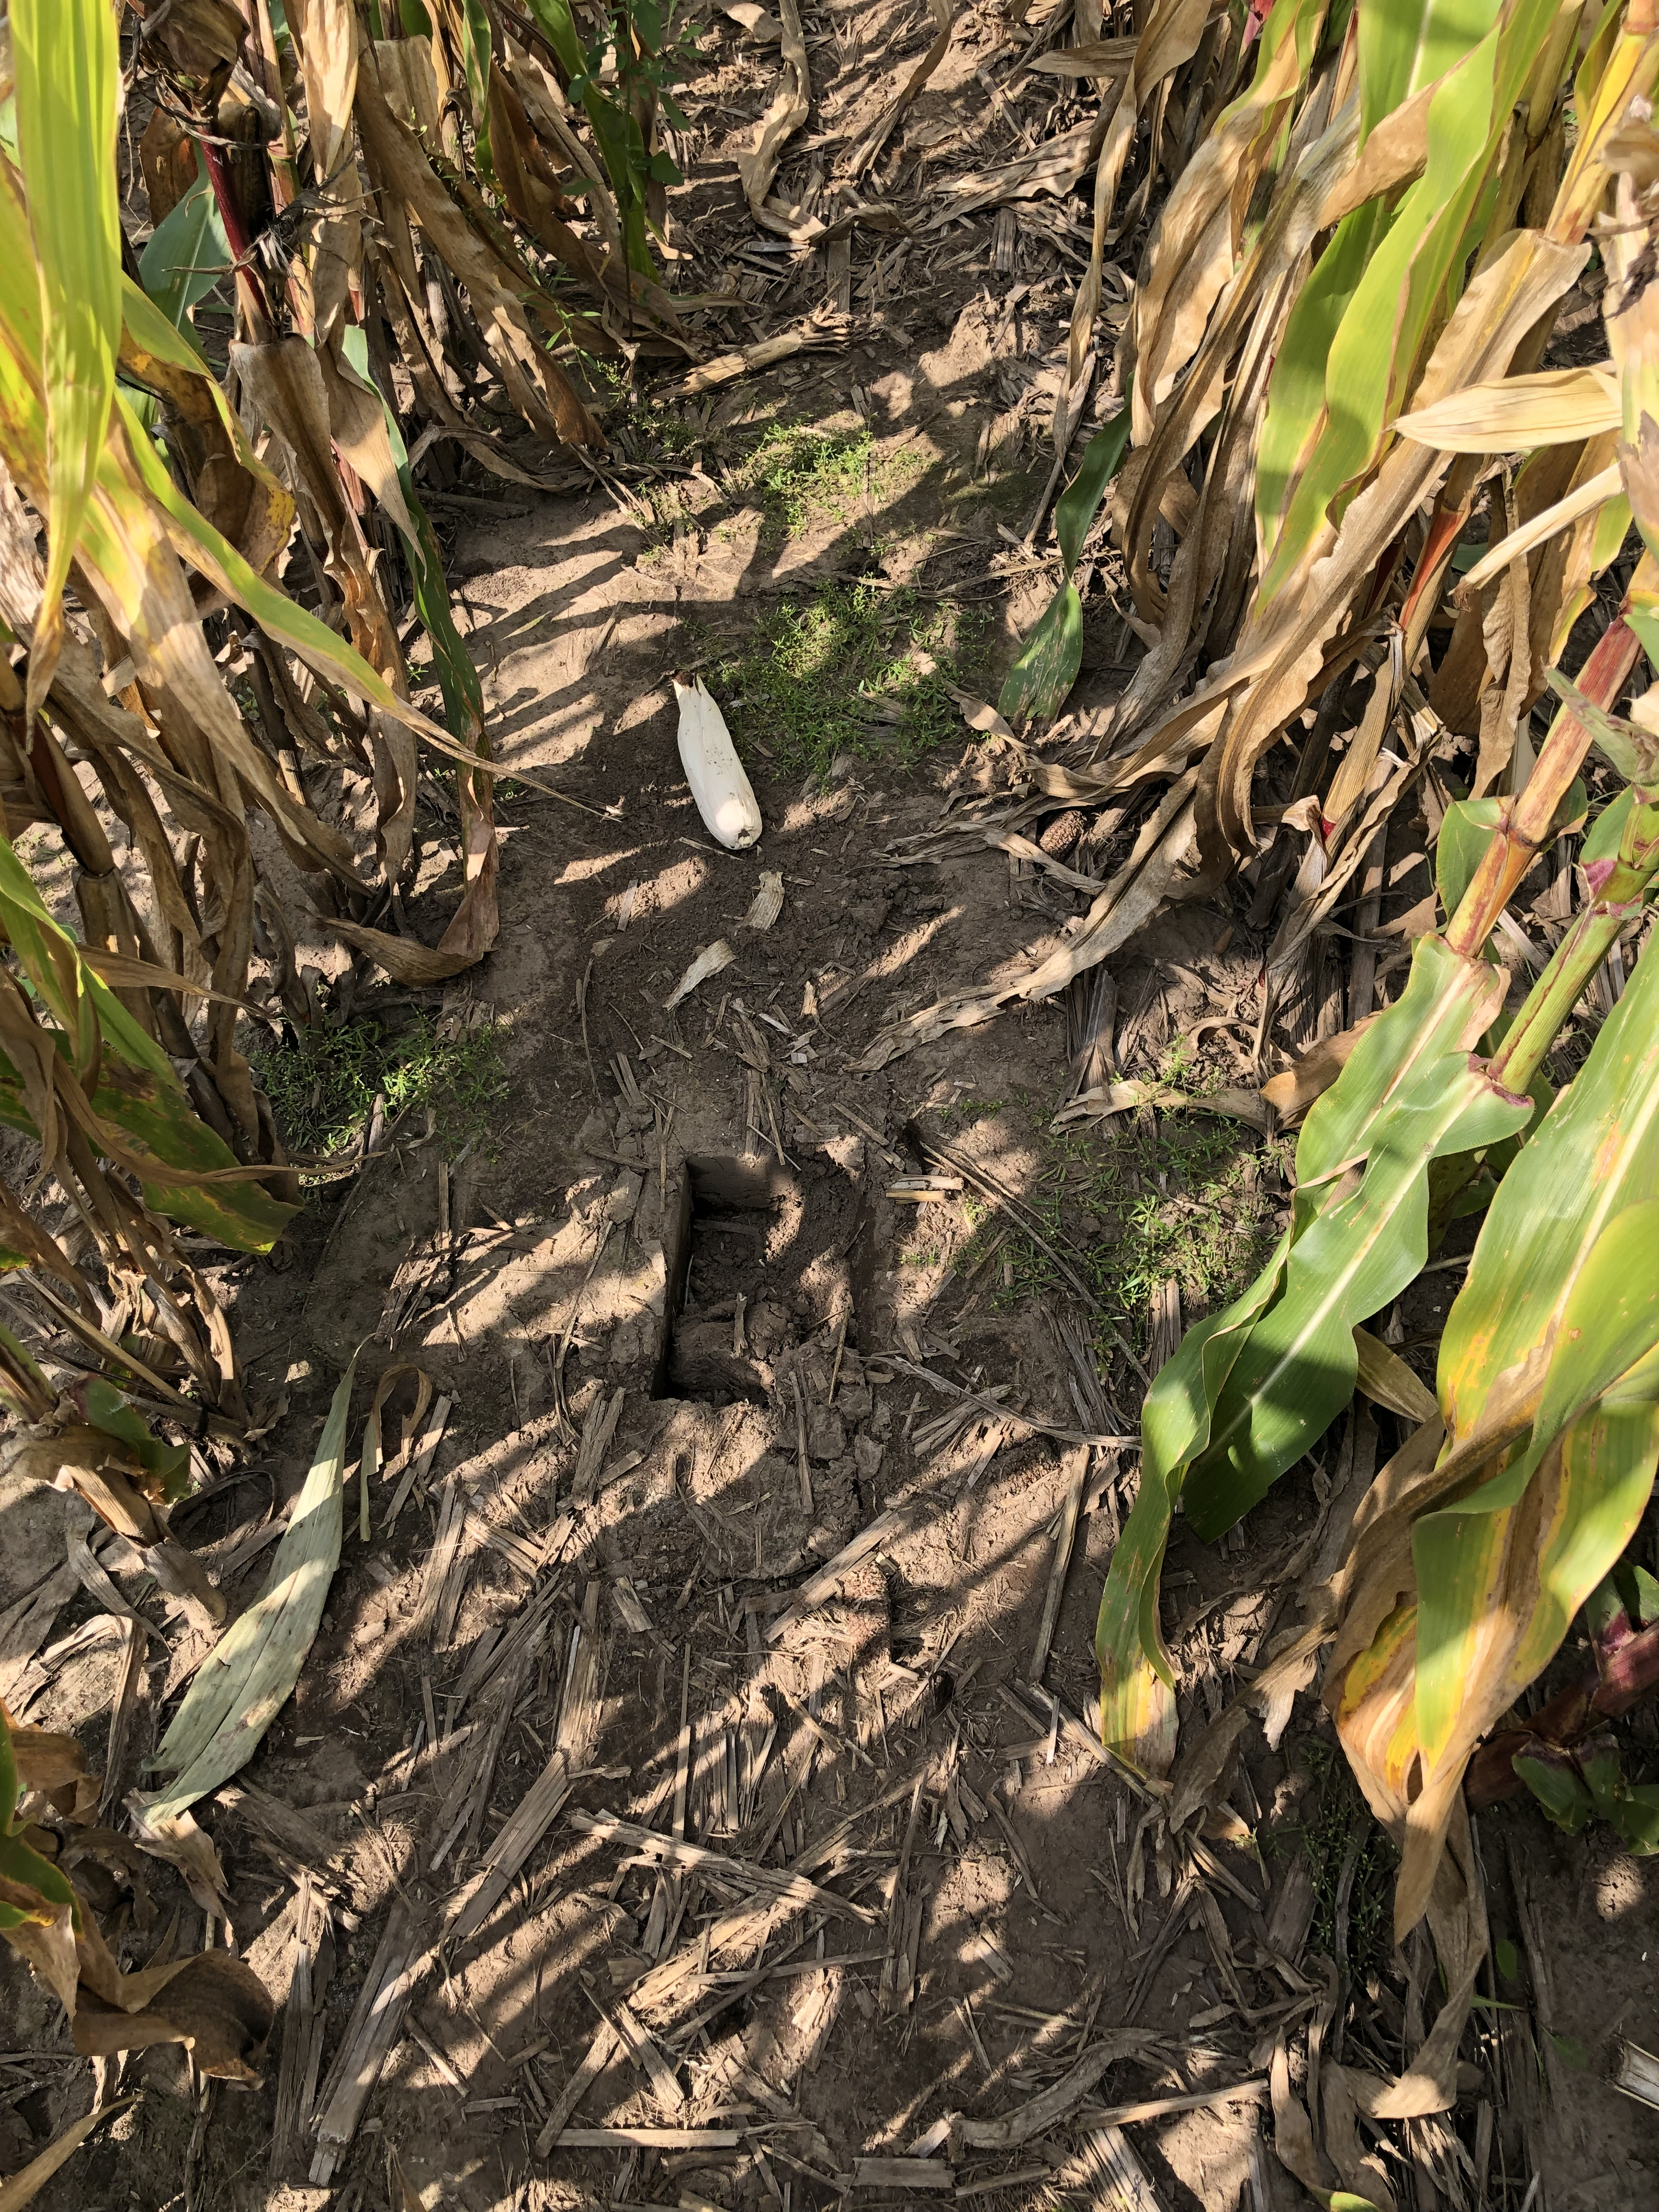
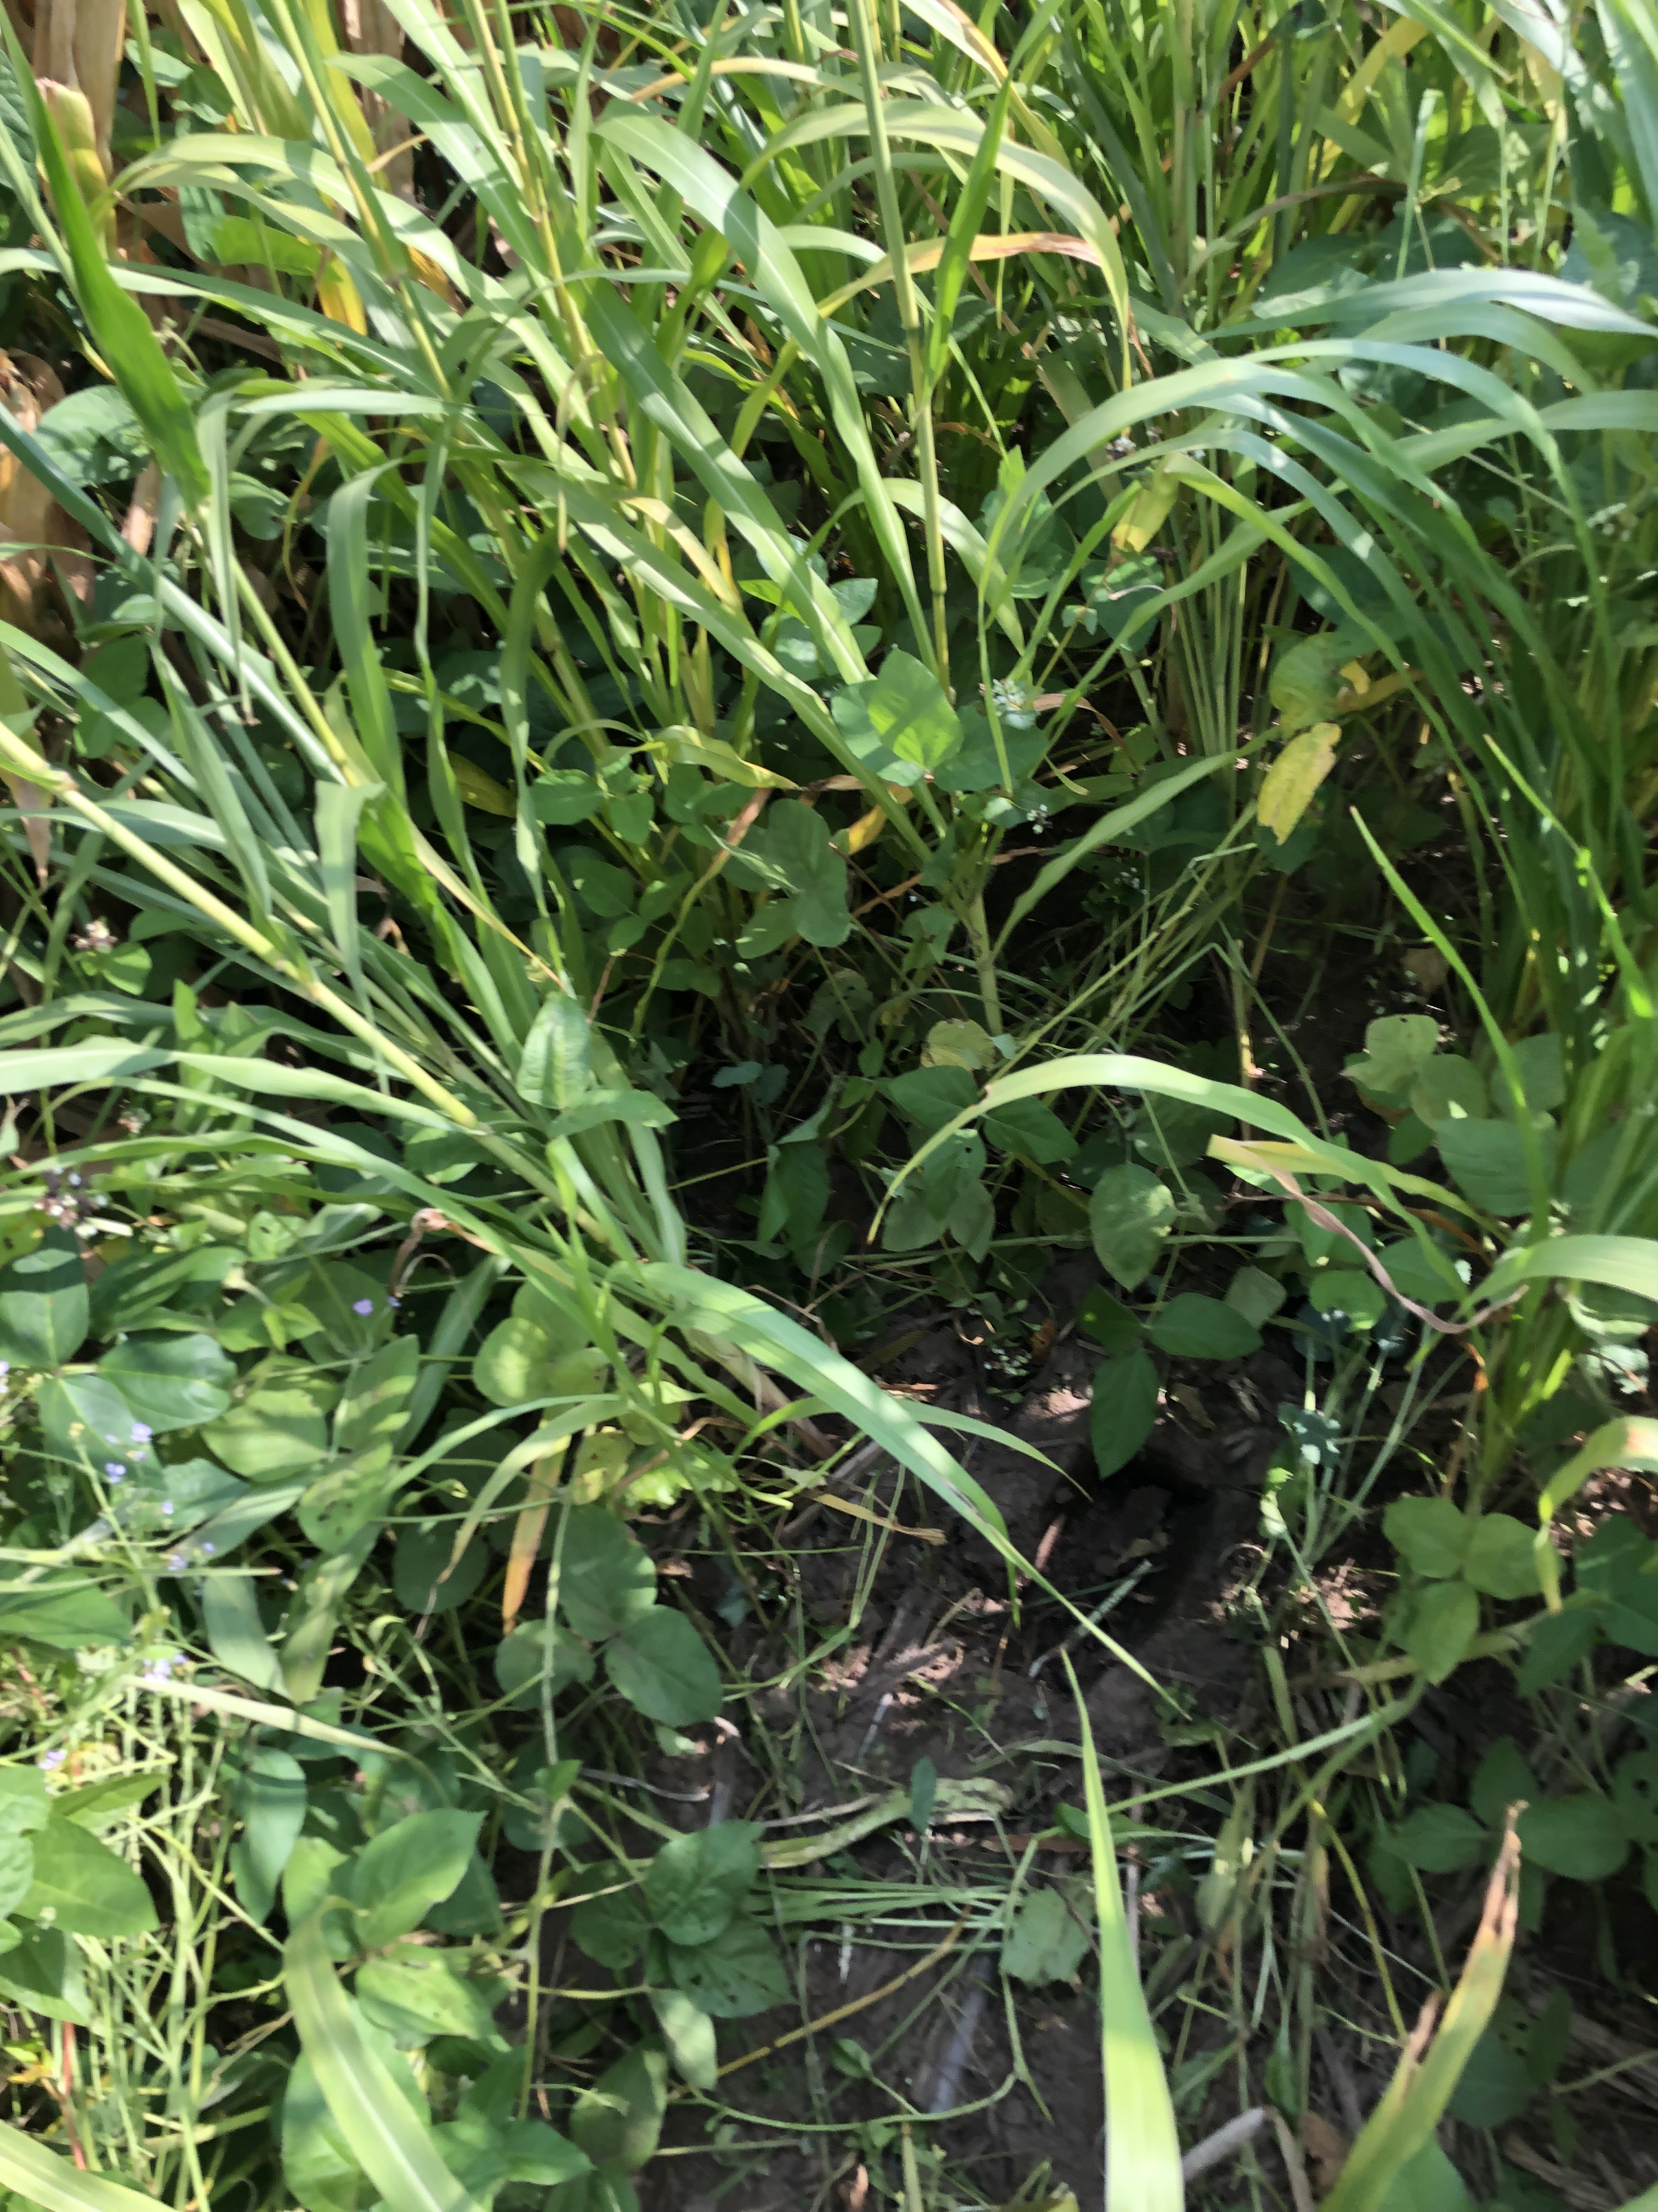
90” Twin Row with Max Soil Builder Cover Crop
30” No Cover Crop

Slide 6
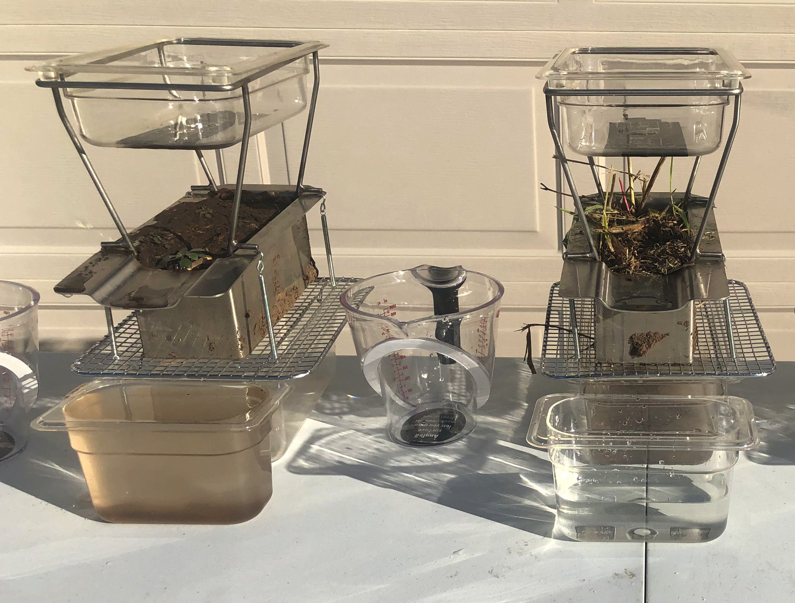
Plot 111011
Runoff with Soil
56% Less* Runoff Cleaner Runoff
30” No Cover Crop
90” Twin Row
with Cover Crop
* Average of 5 Replications

Slide 7
Example of Sample ”Drydown” after Rainfall Event

Slide 8

Thank You for your support!

