Slide 1
Organic and Conventional Agriculture: Learning from Each Other to Promote Soil Health and Economic Viability in West Texas (LS19-313)
Project Investigators: Katie Lewis, Paul DeLaune, Wayne Keeling, Terry Gentry, Emi Kimura, and Will Keeling
Graduate Students: Leah Ellman-Stortz and Nicholas Boogades

Slide 2
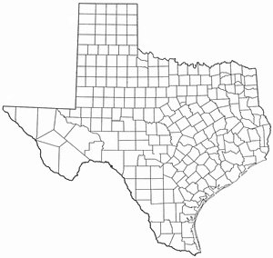
Locations
Lubbock and Vernon AgriLife Research Centers (2020)
High Plains and Rolling Plains ecoregions
Lubbock: Olton clay loam
Vernon: Miles loamy fine sand
Lubbock
Vernon
Notes:
Rainfall: 15-20in and 20-28in, respectively
Need soil series for both locations
Acknowledge Dr. De Laune as Vern. collaborator
Olton clay loam (Lubbock)?
Explain why 2 sites?

Slide 3
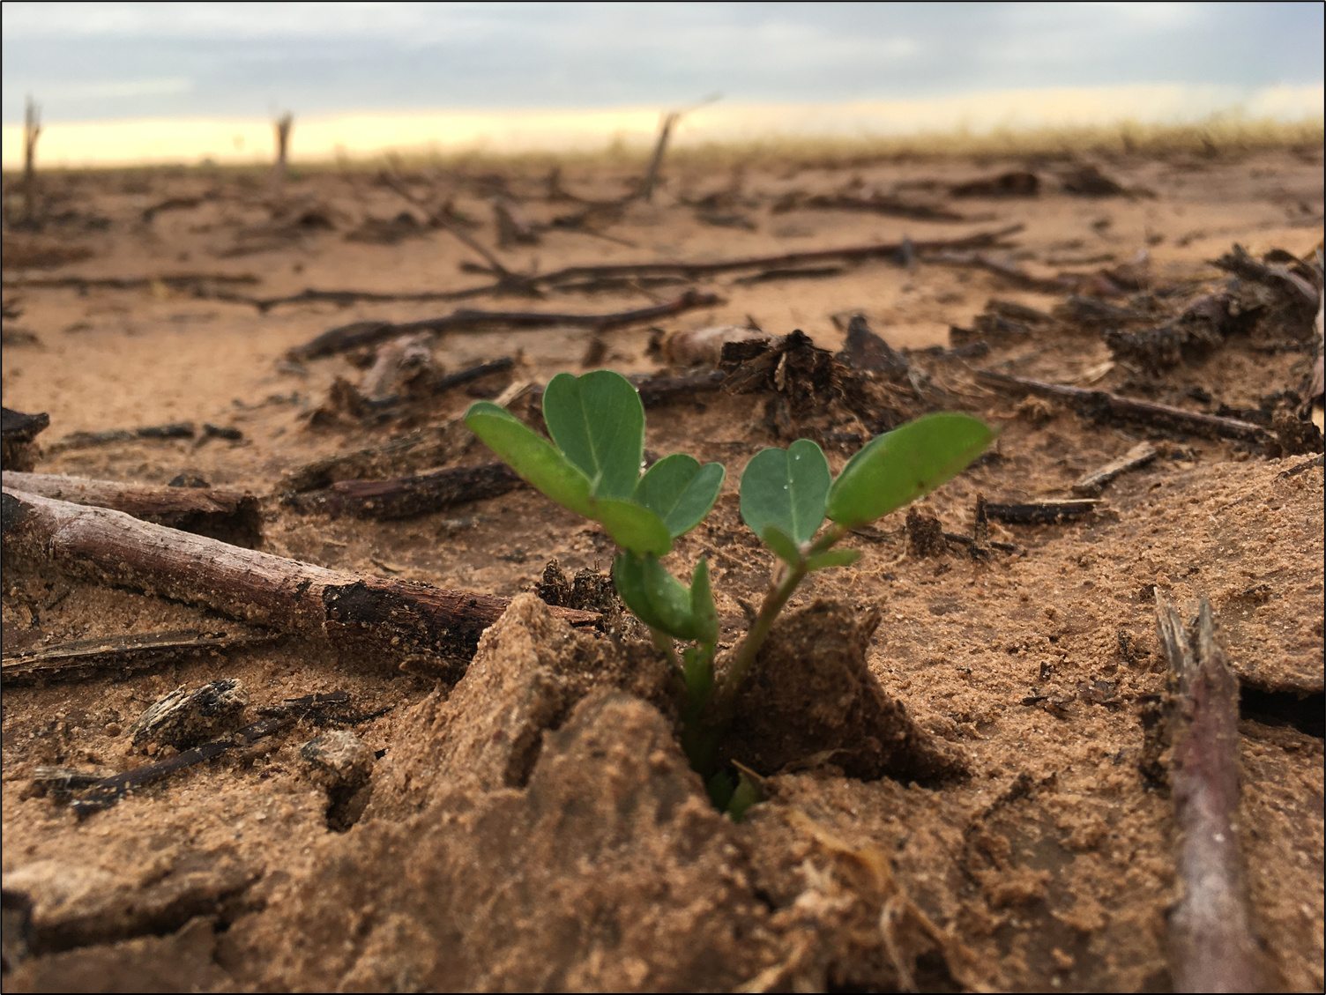
Results

Slide 4
Cover Crop Biomass – Figure 1
Management
Lubbock
Vernon
Notes:
Biomass kg/ha (management vs trt above graphs)
Re-color code slides (org = blue, con = red)
Can probably remove trt graph

Slide 5
Vernon: PLFAs – Figure 2
Notes:
Not sure if I will keep
Still need to calculate significance
Need to check on units
Data is most interesting in terms of correlations with other parameters

Slide 6
Cumulative CO₂-C Flux – Figure 3
Greater CO₂-C flux levels under conventional management. Significant for Lubbock only (p < 0.05).
Notes:
Color-code lines (ex: yellow tones for con. Blue tones for org.)
Tell audience what each slide means right away (why do we care???)
Need more intervals with grid
Solid vs dashed for con. Vs org. (and more contrasting colors)
Make last date 12/20/2020
Use megagrams instead of kg
Box around graph itself (instead of around outside)

Slide 7
Cumulative CO₂-C Flux – Figure 4
Greater CO₂-C flux levels under conventional management. Vernon not significant.
Notes:
Color-code lines (ex: yellow tones for con. Blue tones for org.)
Tell audience what each slide means right away (why do we care???)
Get rid of “2020” for dates (x axis)/adjust date angle
Include irrigation/fertilizer “bars”
From gasmet reading
Increase tick labels

Slide 8
Mineralizable Carbon: Lubbock Figure 5
mg CO₂-C kg⁻¹
Mineralizable carbon generally greater under conventional management throughout the season

Slide 9
Mineralizable Carbon: Vernon Figure 6
mg CO₂-C kg⁻¹
Significant differences observed during July collection at both depths
Greater levels of mineralizable carbon found under organic management up until August
Notes:
Fertilizer: cotton (manure to org/inorganic fert to con; uan 100 lb N/ac (con); 2 tons compost/ac (org)
Economic Qs → not my portion of the research project; mechanical weed control = cost to farmers; diff. seed used b/w org and con cc (organic seed/conventional seed)

Slide 10
Mid-Season Enzyme Activity – Figure 7
Lubbock
Vernon
Significant differences between management treatments at mid-season.
Organic management experienced greater enzyme activity at both locations.
Significant correlations to mineralizable carbon throughout growing season.

Slide 11
Peanut Yield – Figure 8
No significant difference in yield according to management or cover crop selection.

Slide 12
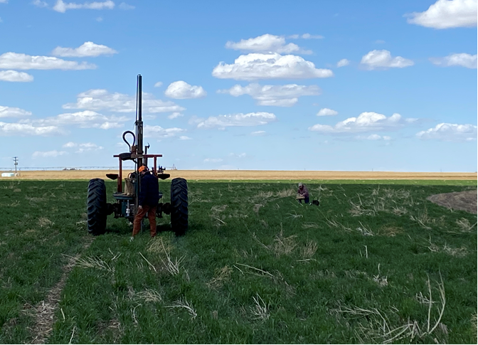
On-Farm Results

Slide 13
Total PLFAs – Figure 9
0-8” Soil Depth
Notes:
Look up what cover crops were planted on which fields… Could effect microbe populations.

Slide 14
Warren Gram Negative Bacteria – Figure 10
Notes:
Warrens conventional field had the mixed species cover crop which has legume species in it, which may be contributing to the higher numbers of gram negative bacteria. G- bacteria form mutually beneficial relationships with legumes and Fix atmospheric Nitrogen to produce ammonium, an inorganic form of N that is available for plant uptake.
G- bacteria are common in the bulk soil and concentrated in the rhizosphere.

Slide 15
Carbon Mineralization – Figure 11

Slide 16
Soil organic C – Figure 12

Slide 17
Permanganate oxidizable C – Figure 13

Slide 18
Brown Farm Enzyme Activity – Figure 14

Slide 19
2021 Lubbock Cover Crop Biomass – Figure 15

Slide 20
2021 Lubbock Cotton Yield – Figure 16

Slide 21
2021 Vernon Cotton Yield – Figure 17

Slide 22
2022 Lubbock Cover Crop Biomass – Figure 18

Slide 23
2022 Vernon Cover Crop Biomass – Figure 19

Slide 24
Weed Counts in Lubbock on June 27, 2022 – Figure 20

Slide 25
Weed Counts in Lubbock on July 29, 2022 – Figure 21

Slide 26
June Mineralizable C – Figure 22

Slide 27
Mineralizable C at the 0-10 cm depth at Vernon – Figure 23

Slide 28
Net Gain Per Acre – Figure 24

Slide 29
Total Production Cost Per Acre – Figure 25

