Slide 1
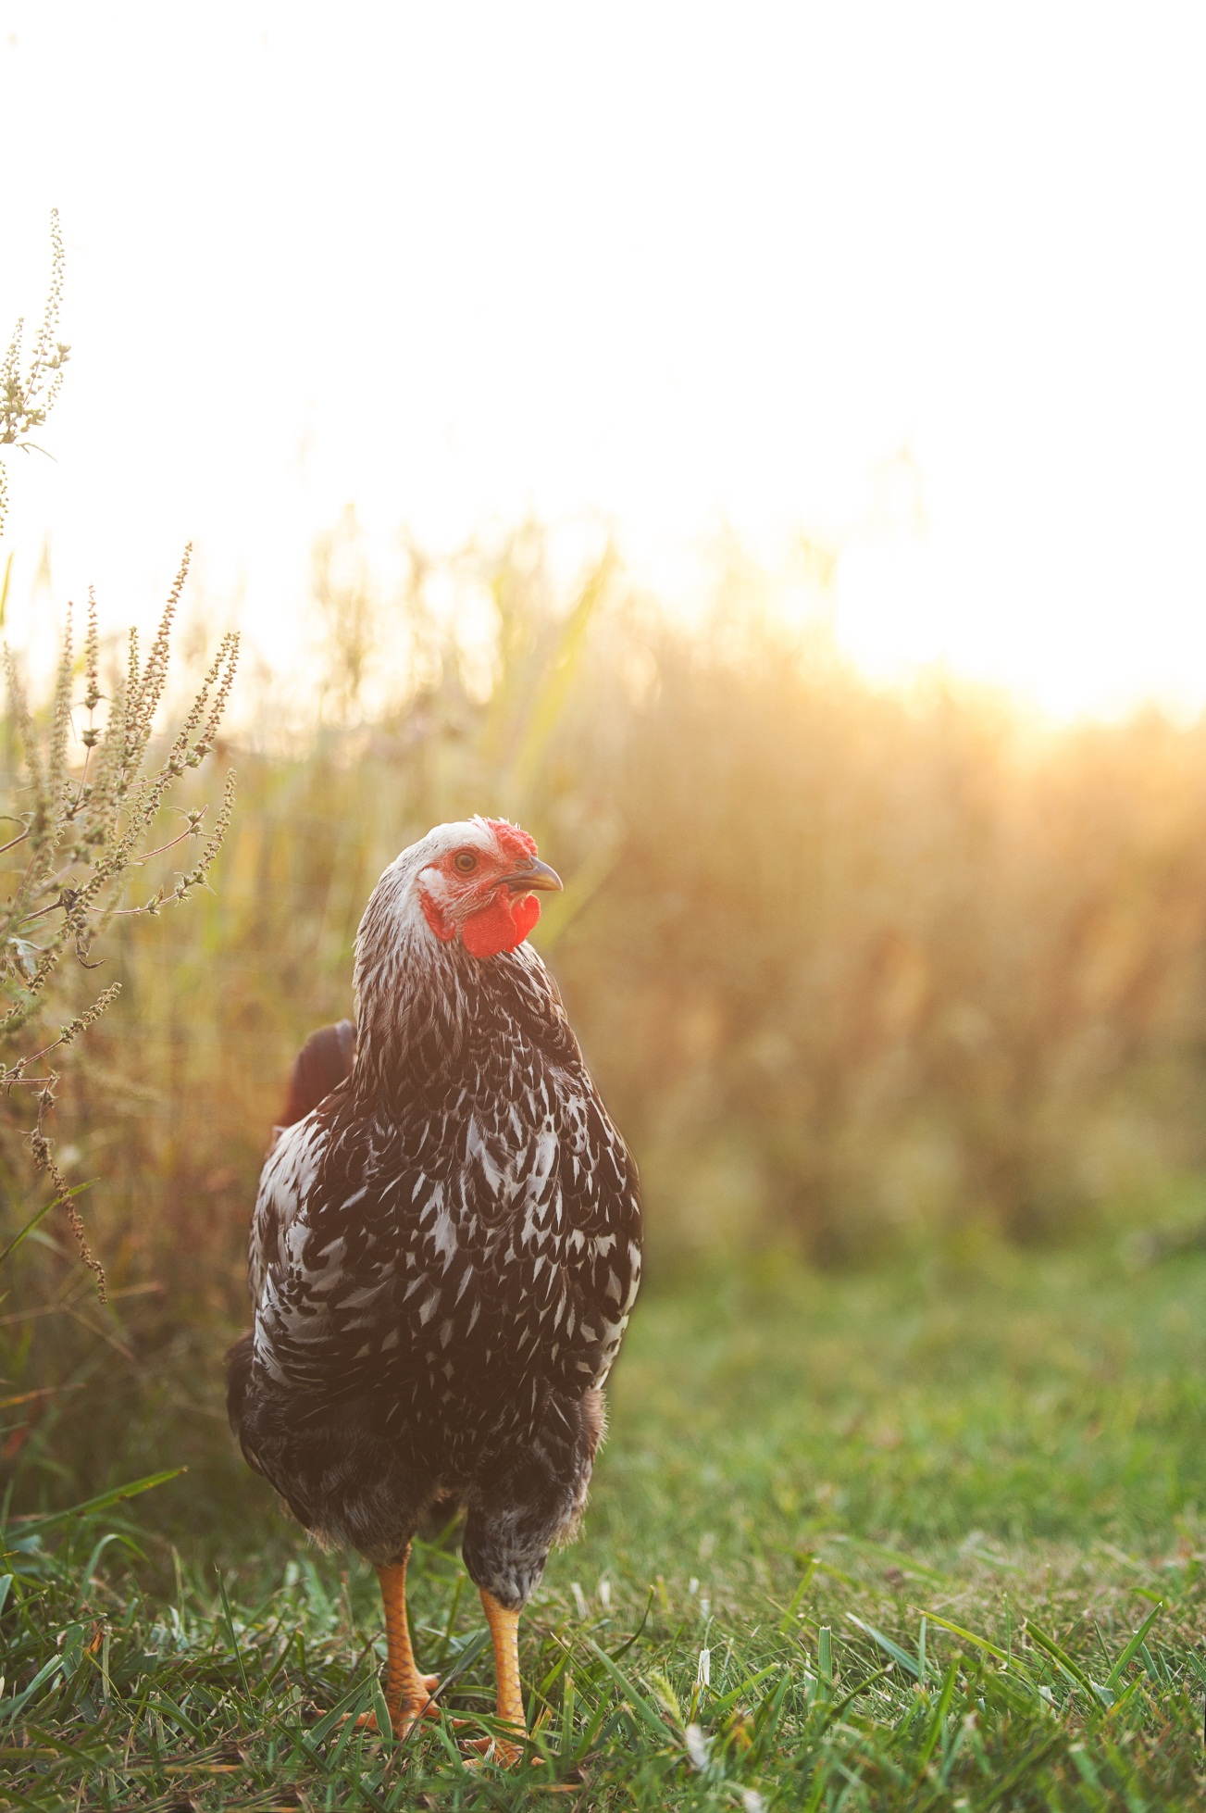
Robariah Farms Local Kosher Pasture-Raised
5 Capt. Lathrop Dr.
Deerfield, MA 01373
info@robariah.com
robariahfarms.com
Notes:
How many of you eat meat?
How many of you have been a vegetarian?
How many of you who eat meat are choosy about the meat you eat?
How many of you keep kosher?

Slide 2
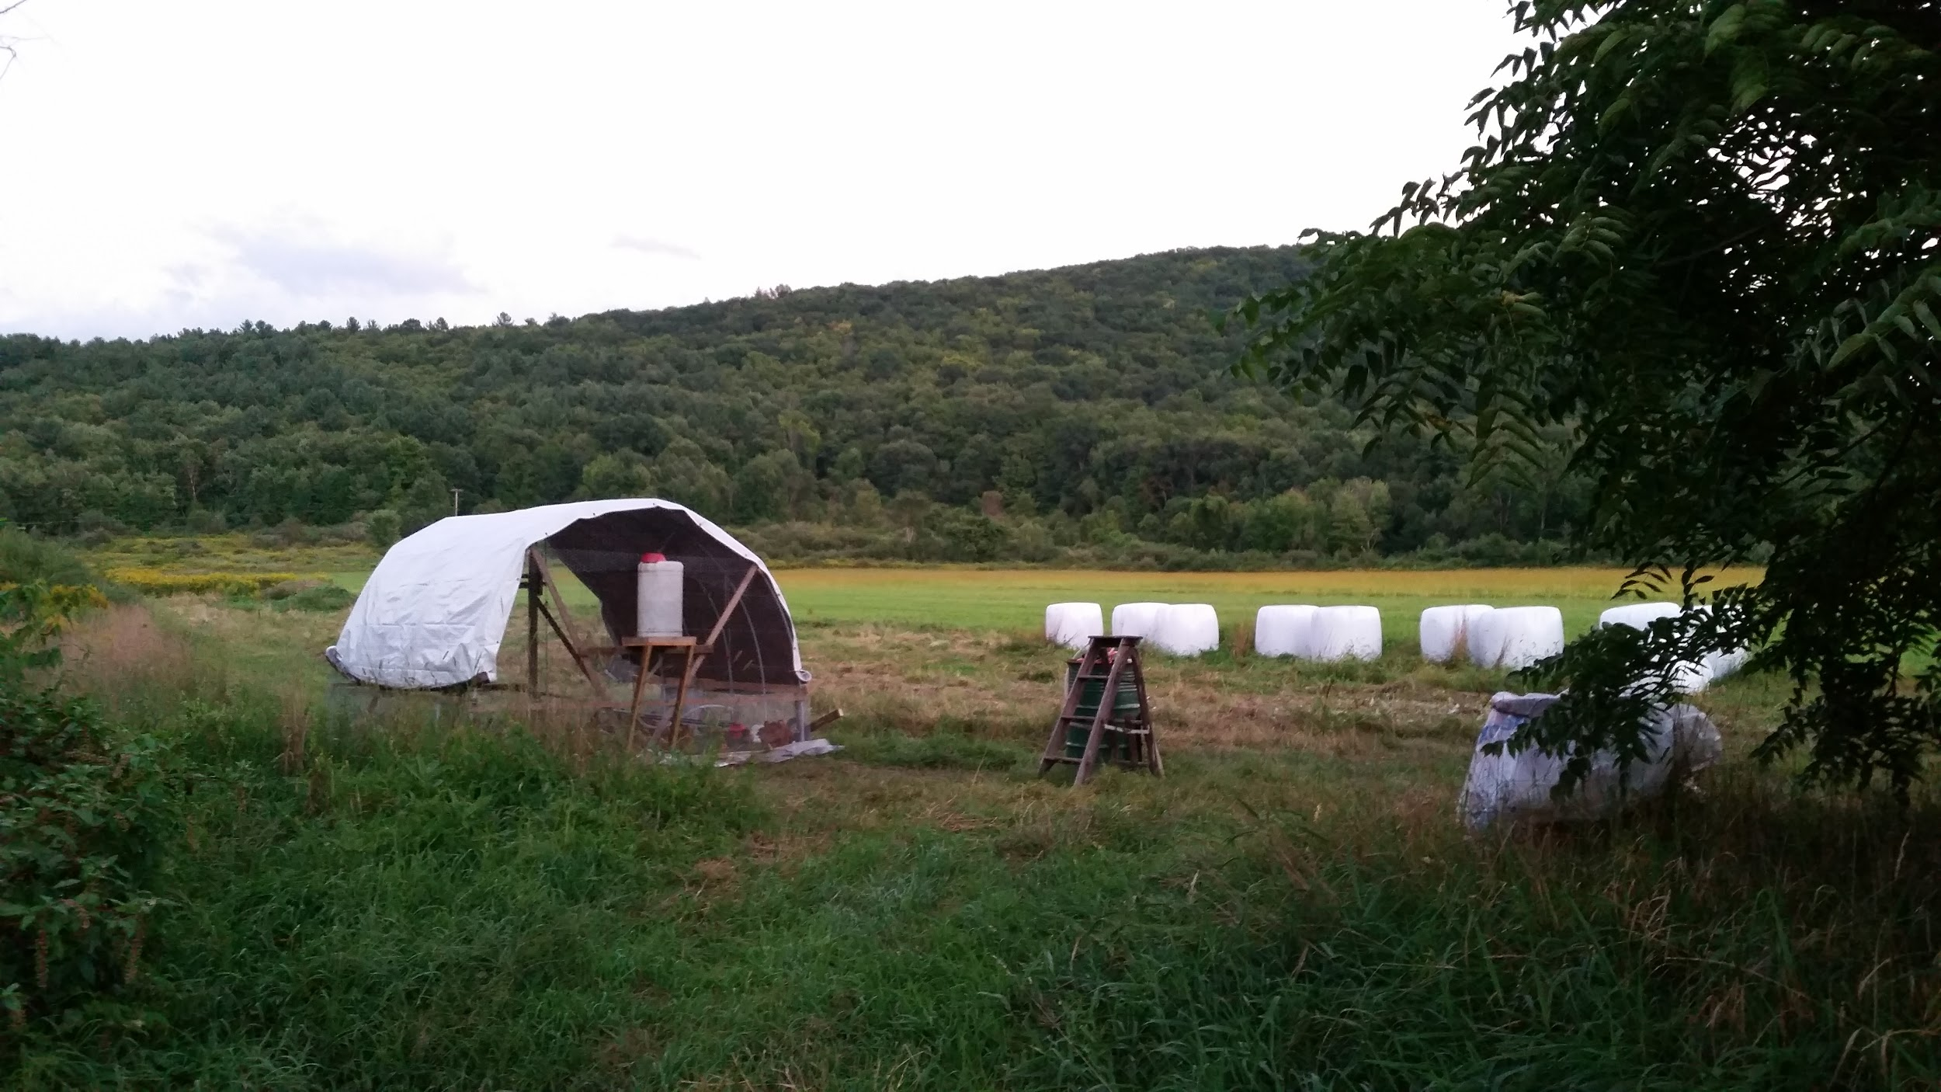
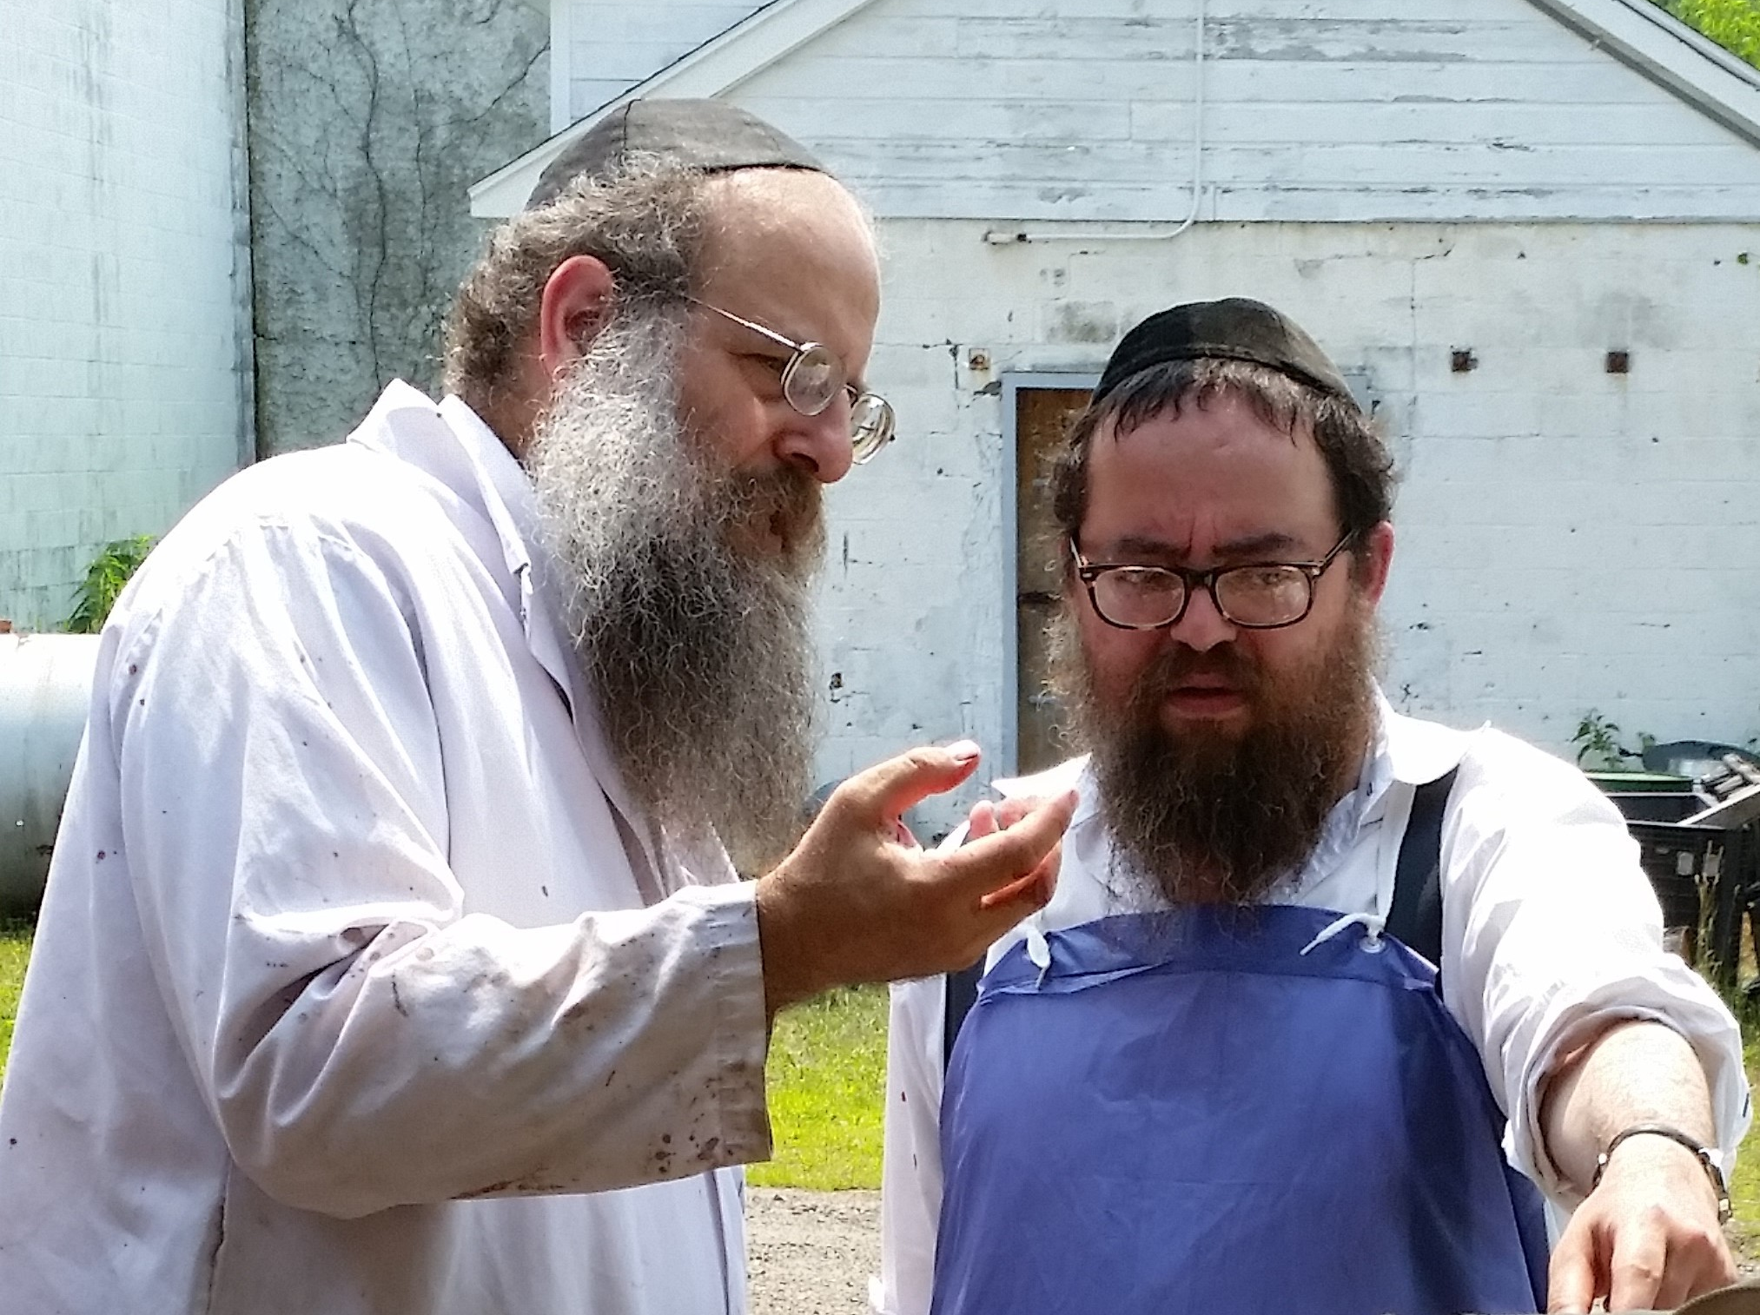
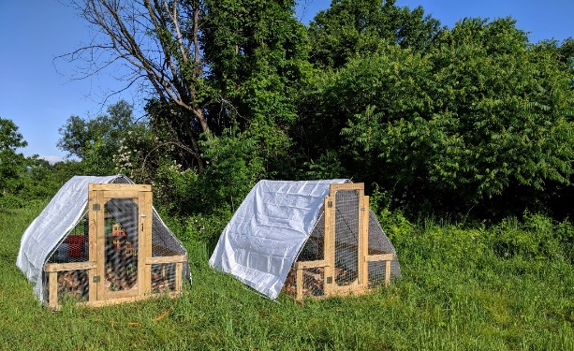
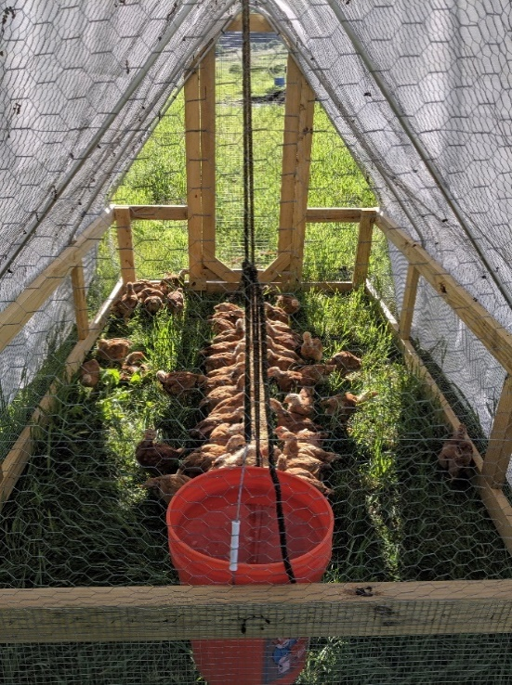
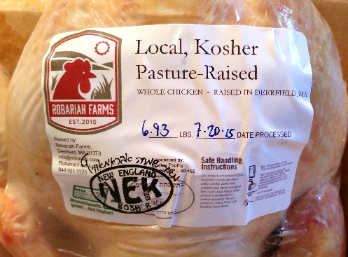
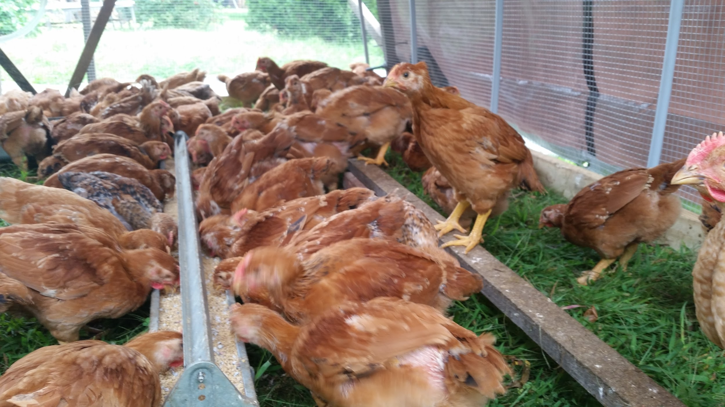
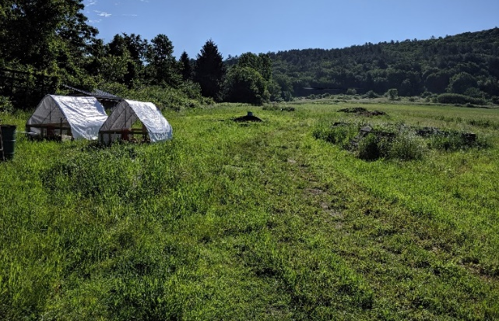
Mission
The mission of Robariah Farms is to provide the New England community with locally grown, pasture-raised, kosher meat.

Slide 3
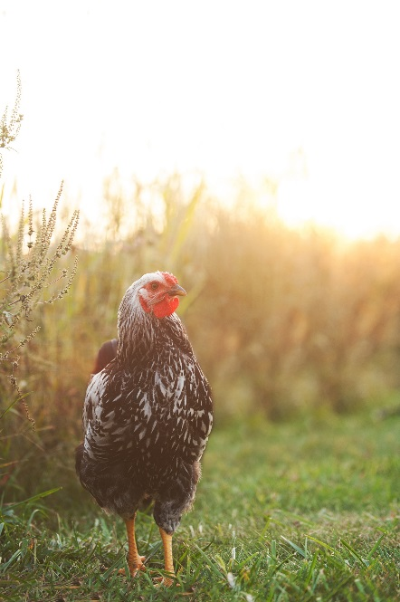
Farm Description
Locally established in Deerfield, MA, in 2010
Family operated on 10 acres of leased pasture
Raises slower growing breeds that thrive on pasture and produce more nutritious, succulent meat
Rotates mobile coops daily for high animal welfare (air, space, pasture, nutrition) and soil management
Conducts kosher processing for humane, ethical standards

Slide 4
Goals
Develop a successful 5-year business plan
Conduct farm research to explore viability of local kosher processing.
Develop core group of local customer families to serve as farm ambassadors.
Purchase and install kosher processing equipment in local partner facility.
Diversify product line to include duck, lamb, and beef.
Increase overall production and efficiencies with strategic capital improvement purchases

Slide 5
Our Industry
The absence of local kosher poultry processors is a significant problem with market demand rising for sustainably raised, locally produced kosher meat.
“…significant demand for slaughter and processing services, and potential supply of inputs for slaughter/processing services. 59% of the farmers who responded said they would more than double their herds with additional processing capacity…” “Demand and Options for Local Meat Processing [in the CT River Valley]” June 2008
44% of the kosher market is Jewish consumers (2009 Mintel market research report)
In New England, 4–5% of the population is Jewish—almost double the national percentage.
15% of those who purchase kosher products do so for religious reasons
62% of those who seek out kosher products buy the items for food quality
19% of the kosher market is Muslim (for Halal)

Slide 6
Our Competition
Local, non-kosher meat (i.e., locally raised meat that is pasture-raised or confined indoors, and is conventionally processed and not kosher).
Non-local, conventionally raised, kosher meat (i.e., meat raised elsewhere in the US or other countries that is mass-produced in confined indoor environments and processed kosher).
Non-local, pasture-raised, kosher meat (i.e., sustainably raised meat produced elsewhere in the US or other countries that is processed kosher and shipped frozen).

Slide 7
Our Customers
Direct to Consumer
CSA pick-up
Food co-ops
Local and regional farm and food co-op stores focused on local products
Restaurants
High-end restaurants focus on local products
Institutional dining facilities
Retreat/conference centers, summer camps, and educational institutions focused on local products
New England
Boston Area
Western Mass

Slide 8
Marketing
Positive word-of-mouth
E-mail campaigns
Educational programs
Marketing collateral at CSA pick-up locations
Paid advertising in targeted publications and online media

Slide 9
Testimonials
"It's the best I've ever had!" - Batshua bat Yehonatan
“Our customers say they are delicious! Including one customer that bought 15, and she may well buy some more from the ones remaining. I had a couple myself and they are exceptional.” - Alex Khitrik, Owner of Inna’s Kitchen
"It's so rare that we truly know where our meat comes from and how it was raised. But with the chickens we got from Robariah Farms there was nothing we didn't know. And they tasted great! It's really been a terrific experience that we plan on repeating next year." - Sam K. Weber
“Your chickens are the best I've had! I mean, it's hard to eat other chicken after I've had yours. I certainly don't like to buy any other chickens, just the ones from your farm.”
- Rachel Barbanel-Fried, Psy.D.

Slide 10
Local Kosher Pasture-Raised
Deerfield, MA
info@robariah.com
robariahfarms.com
Notes:
How many of you eat meat?
How many of you have been a vegetarian?
How many of you who eat meat are choosy about the meat you eat?
How many of you keep kosher?

