Slide 1
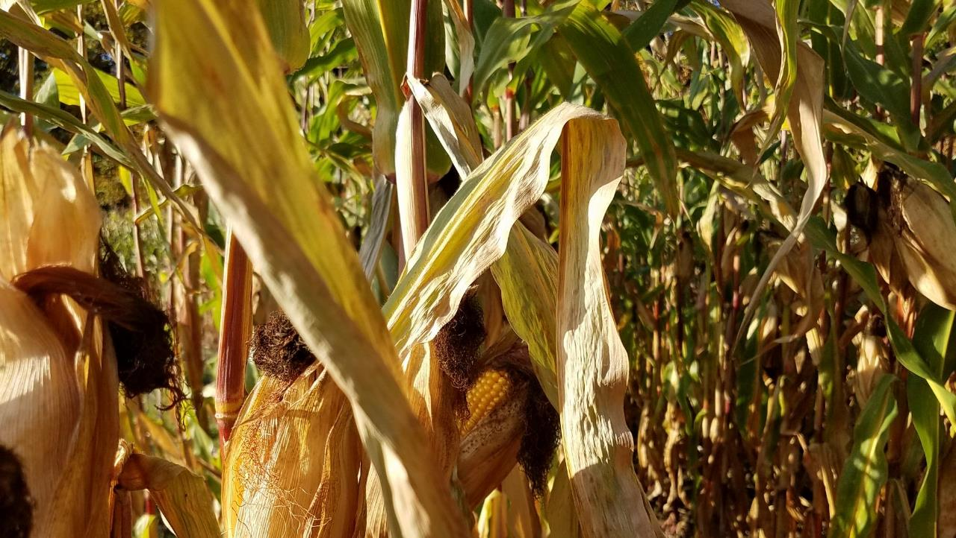





Phosphorus spatial variability in silage corn fields receiving dairy manure
Wayne Roper
Postdoctoral researcher
Department of Plant Science and Landscape Architecture

Slide 2
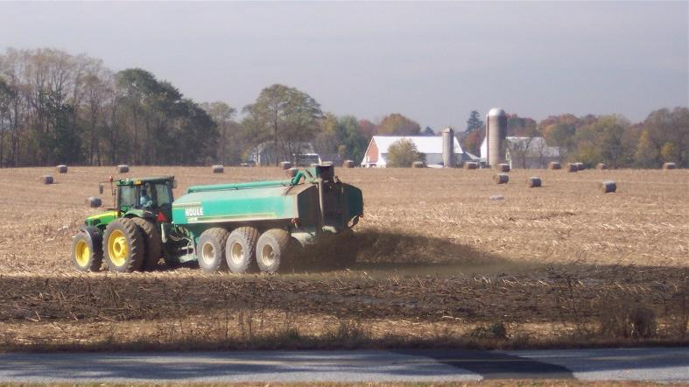
Background Information
Dairy farms in New England
Dairy farms dedicate much crop land to growing corn silage to feed cows
Manure from cows is used to fertilize corn silage land
Challenges with field management can result in uneven distribution of manure
Consistency of manure
Equipment
Applicator technique
Access to land
Topography
Weather
Soil characteristics
Photo: https://www.dailyencouragement.net/images/natural_fertilizer.jpg

Slide 3
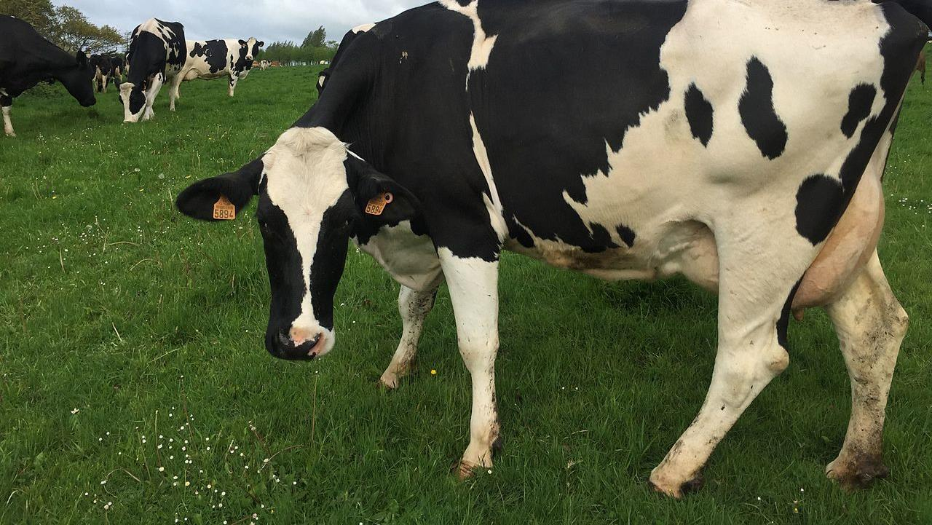
Background Information
Problems may be caused by uneven manure P distribution
Inefficient use of farm resources
Environmental pollution
Compliance with nutrient management plans

Slide 4

Research objectives
Calculate the number of soil samples needed to accurately represent P concentrations for silage corn fields receiving dairy manure
Assess P concentrations in different field areas to determine if different P management zones exist
Find the minimum separation distance needed to collect independent soil samples for P analysis

Slide 5
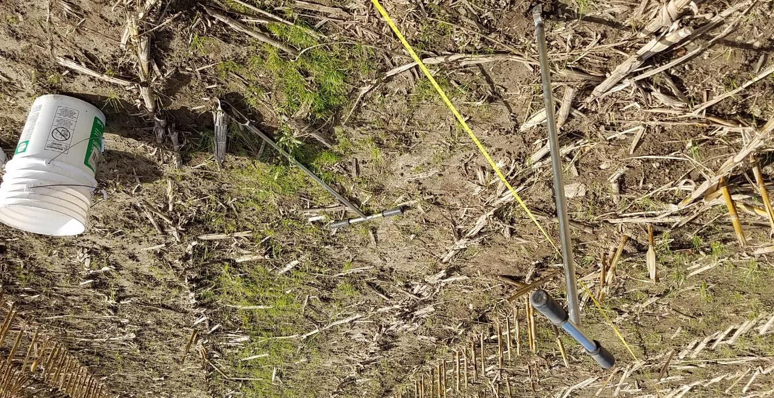
Methods

Slide 6
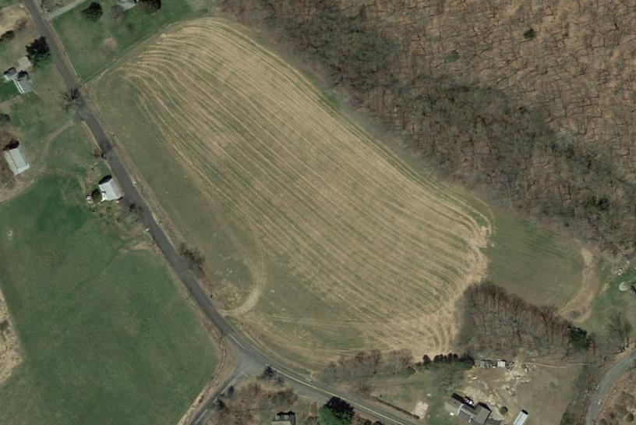
Methods
Field selection criteria
Long-term silage corn
History of dairy manure
No banded P
Field size ~ 10 acres
Modified morgan extractable P:
30 – 100 lb ac⁻¹
Soil collected in fall after corn harvest (2018-2019)
Photo: Google maps

Slide 7
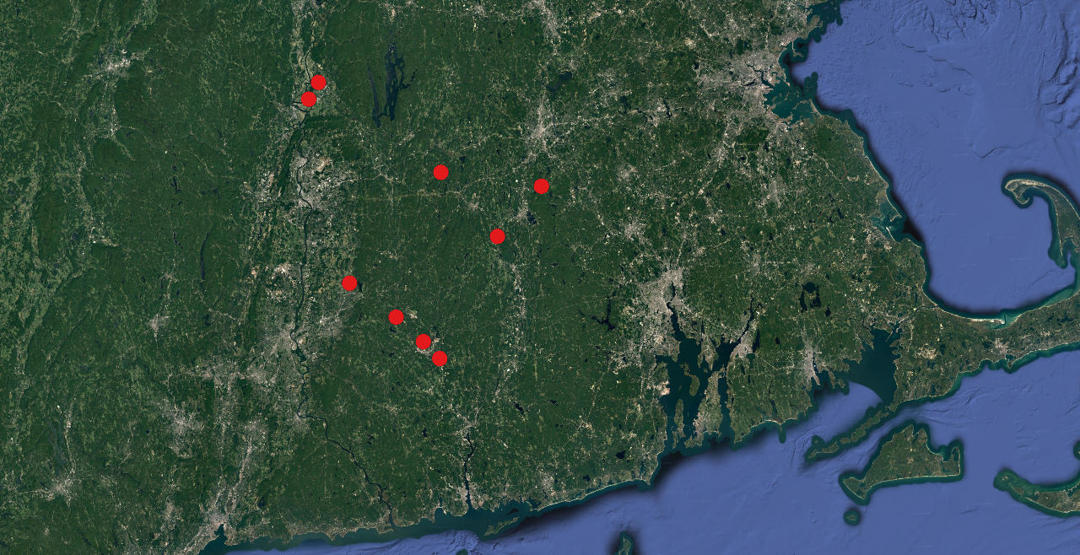
Field locations
Massachusetts
Connecticut

Slide 8
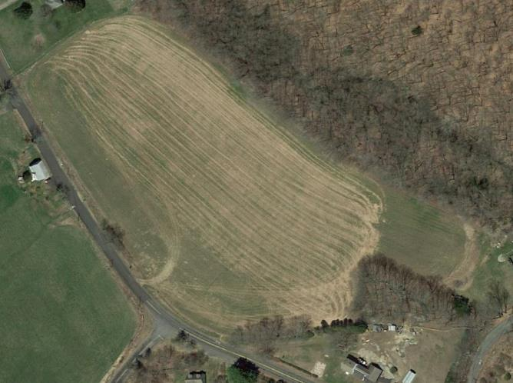
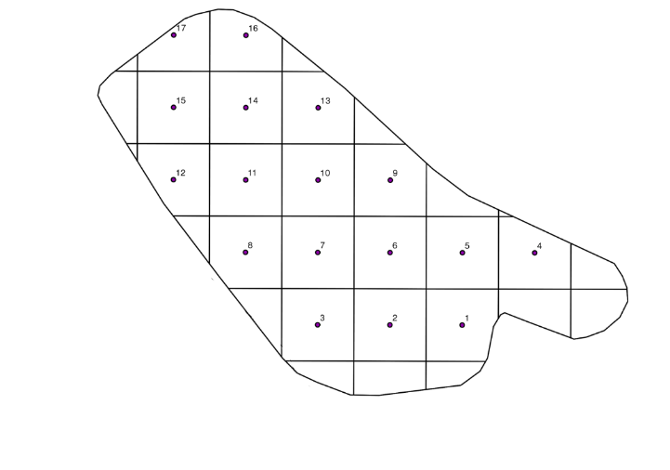
Methods
Sampling design: centroids
Use GPS to superimpose a 150 x 150 ft (50 x 50 m) grid over field
Place points at center of each grid cell for sampling (centroids)
Locate and mark centroids in field

Slide 9
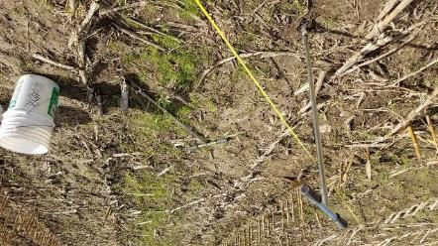
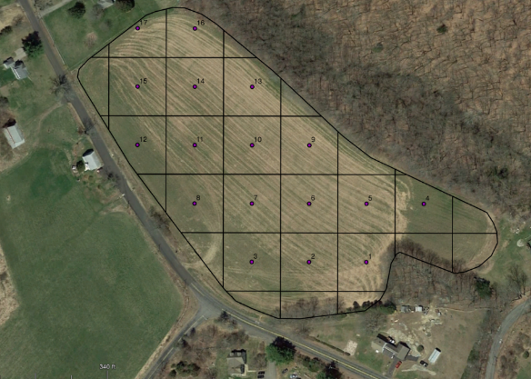
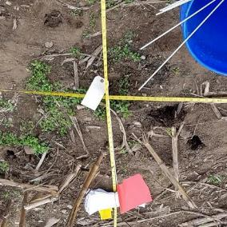
Methods
Soil sampling
2-inch diameter auger to 6 in (15 cm)
Whole field: Standard “z” random sample, 12 cores
Centroids: 4 random cores within 3 ft (1 m) radius of centroid

Slide 10
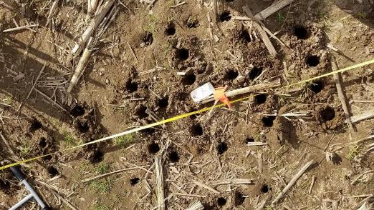
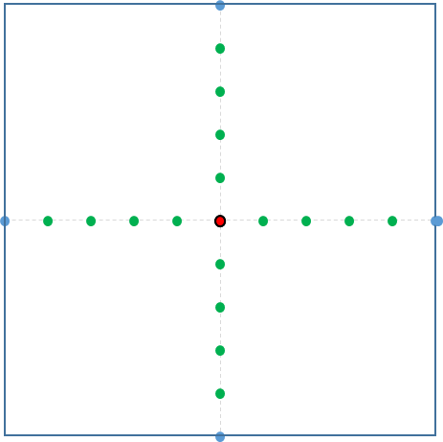
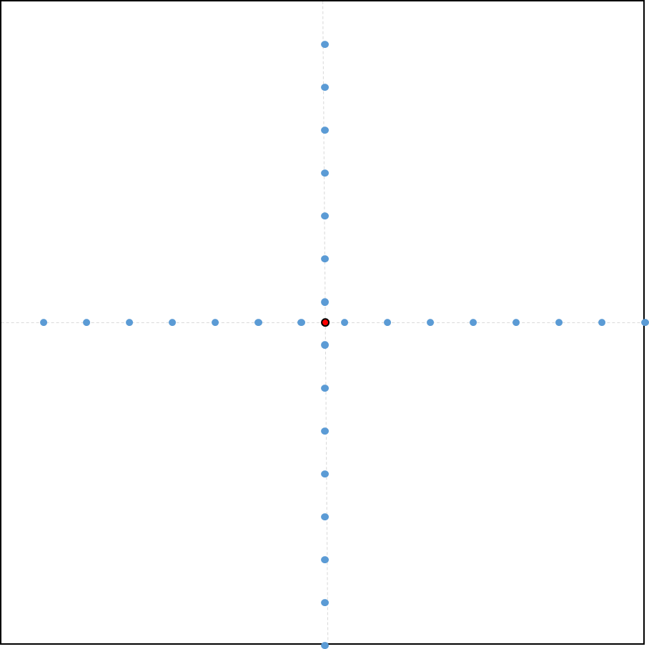
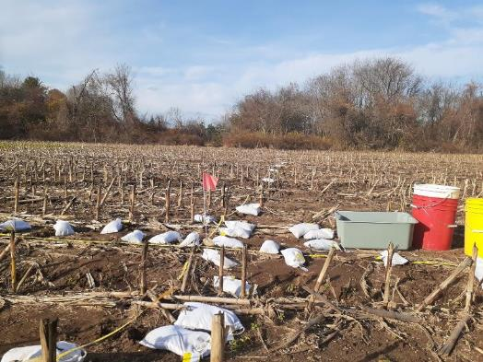
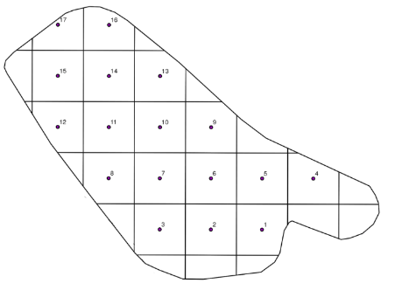
Methods
Sampling design: transects
Short transect
1 ft sections, 10 ft
Long transect
10 ft sections, 150 ft

Slide 11
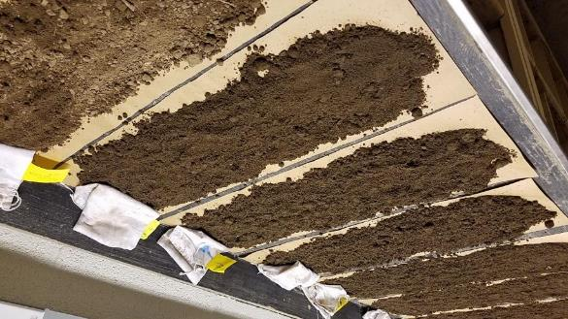
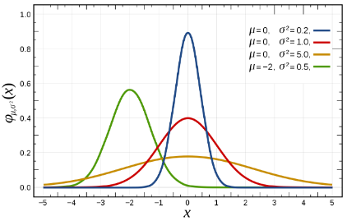
Methods
Soil and data analysis
Air dried
Sieved < 2 mm
Modified Morgan extraction
Mehlich 3 extraction
General descriptive statistics: R, Microsoft excel
Variogram modeling: R with “geoR”

Slide 12
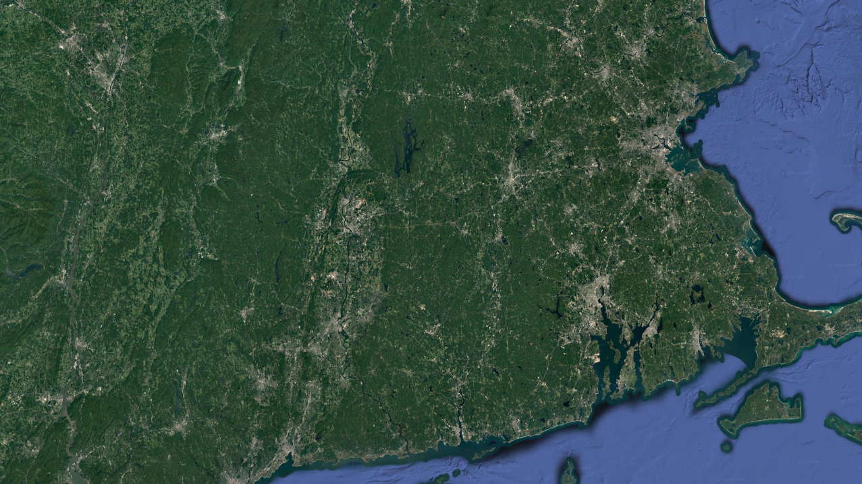
Results: Obj 1 - Representative sample size
Calculate the number of soil samples needed to accurately represent P concentrations for silage corn fields receiving dairy manure

Slide 13
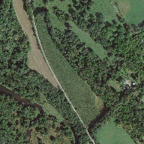
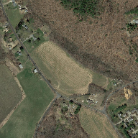
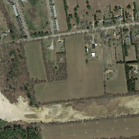
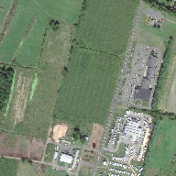
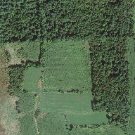
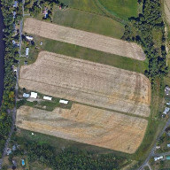
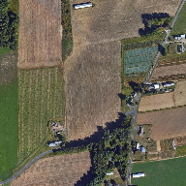
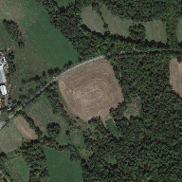
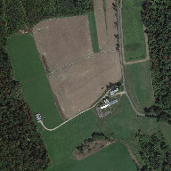
Results: Obj 1 - Representative sample size
Fields included in research
C1
C2
C3
C4
C5
M1
M2
M3
M4

Slide 14
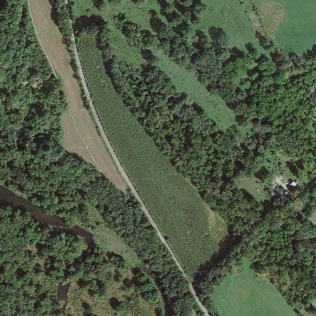

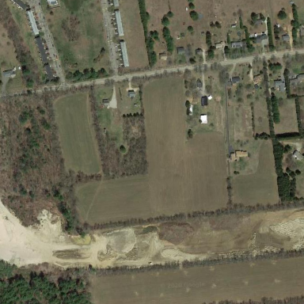
Results: Obj 1 - Representative sample size
P spatial variability patterns in fields (modified morgan)
C1
C2
C3

Slide 15
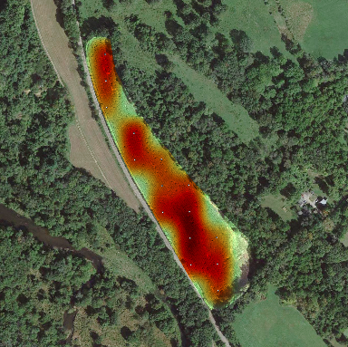
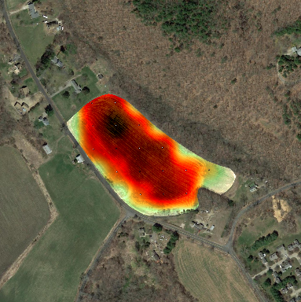
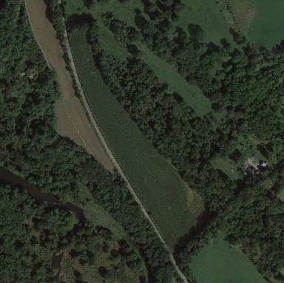
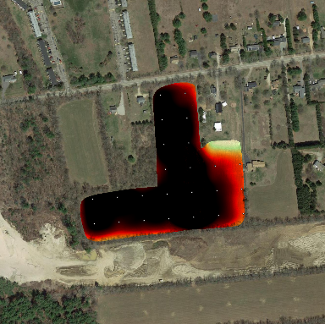

Results: Obj 1 - Representative sample size
P spatial variability patterns in fields (modified morgan)
C1
C2
C3
Modified Morgan
Some fields have visible hotspots
Some fields have a concerning amount of P
80 lb P ac⁻¹ is the suggested environmental critical concentration of P in New York

Slide 16
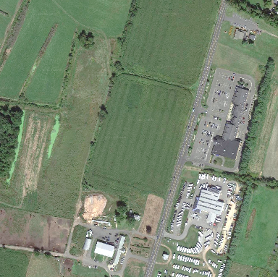
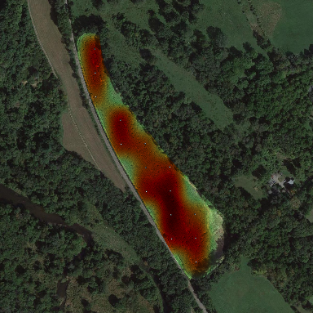


Results: Obj 1 - Representative sample size
P spatial variability patterns in fields (modified morgan)
C4
C5
M1

Slide 17
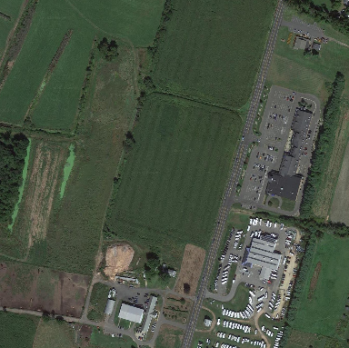
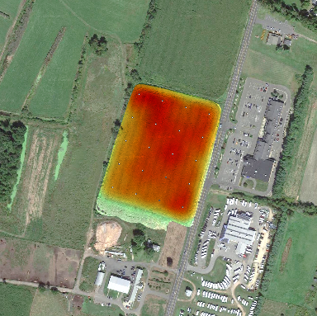
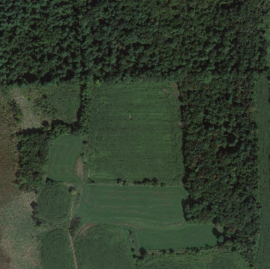
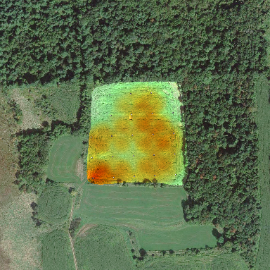
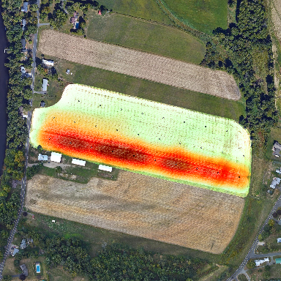
Results: Obj 1 - Representative sample size
P spatial variability patterns in fields (modified morgan)
C4
C5
M1
Modified Morgan

Slide 18


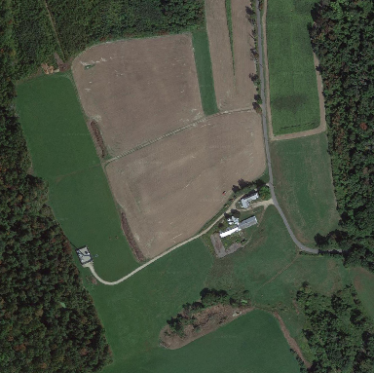
Results: Obj 1 - Representative sample size
P spatial variability patterns in fields (modified morgan)
M2
M3
M4

Slide 19
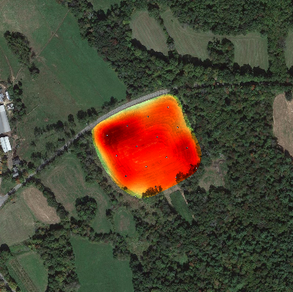
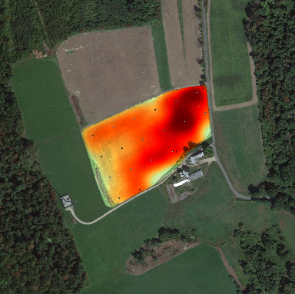
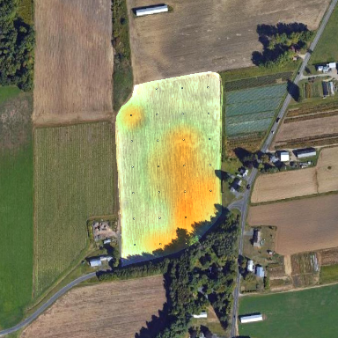
Results: Obj 1 - Representative sample size
P spatial variability patterns in fields (modified morgan)
M2
M3
M4
Modified Morgan

Slide 20
Results: Obj 1 - Representative sample size
Comparing P concentration between random and structured samples
Modified morgan extractable P (lb ac⁻¹) |  | P (lb ac⁻¹)
Field Name | # Centroids | Random | Structured | Difference (absolute) | Difference (%)
C1 | 15 | 79 | 69 | -10 | -13
C2 | 17 | 102 | 86 | -16 | -15
C3 | 24 | 234 | 141 | -93 | -40
C4 | 20 | 62 | 59 | -3 | -5
C5 | 23 | 22 | 33 | 11 | 52
M1 | 28 | 27 | 41 | 14 | 50
M2 | 26 | 21 | 22 | 1 | 5
M3 | 16 | 63 | 66 | 3 | 5
M4 | 19 | 67 | 59 | -8 | -12
7/9 fields are below 80 lb P ac⁻¹ environmental critical concentration
5/9 fields had less extractable P with structured sampling

Slide 21
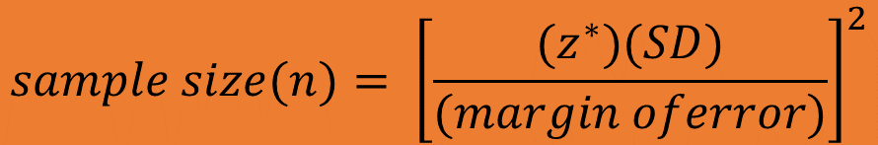
Results: Obj 1 - Representative sample size
Calculating representative sample size
$$sample size(n)= {\left[\frac{(z^{∗})(SD)}{(margin oferror)}\right]}^{2}$$
Sample size calculation (10% error) of 5/9 fields are within the recommended 12 subsample minimum for random sampling
Modified Morgan extractable P (lb ac⁻¹)
Field Name | # Centroids | Random | Structured | # samples 10% error
C1 | 15 | 79 | 69 | 7
C2 | 17 | 102 | 86 | 24
C3 | 24 | 234 | 141 | 87
C4 | 20 | 62 | 59 | 2
C5 | 23 | 22 | 33 | 6
M1 | 28 | 27 | 41 | 40
M2 | 26 | 21 | 22 | 4
M3 | 16 | 63 | 66 | 11
M4 | 19 | 67 | 59 | 17

Slide 22
Results: Obj 1 - Representative sample size
Comparing P concentration between random and structured samples
Mehlich 3 extractable P (lb ac⁻¹) |  | P (lb ac⁻¹)
Field Name | # Centroids | Random | Structured | Difference (absolute) | Difference (%)
C1 | 15 | 1104 | 1064 | -40 | -4
C2 | 17 | 1100 | 1076 | -24 | -2
C3 | 24 | 1370 | 2028 | 658 | 48
C4 | 20 | 1464 | 1434 | -30 | -2
C5 | 23 | 728 | 732 | 4 | 1
M1 | 28 | 710 | 754 | 44 | 6
M2 | 26 | 604 | 664 | 60 | 10
M3 | 16 | 1376 | 1424 | 48 | 3
M4 | 19 | 934 | 882 | -52 | -6
Much more P is extracted by Mehlich 3
All fields above the 400 lb ac⁻¹ Mehlich 3 screening concentration
4/9 fields had less extractable P with structured sampling
% difference between random and structured samples is decreased in most cases

Slide 23
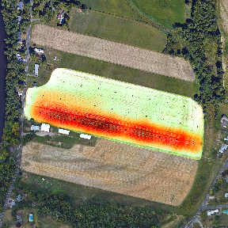
Results: Obj 1 - Representative sample size
Calculating representative sample size
$$sample size(n)= {\left[\frac{(z^{∗})(SD)}{(margin oferror)}\right]}^{2}$$
Sample size calculation (10% error) of 4/9 fields are within the recommended 12 subsample minimum for random sampling
Mehlich 3 extractable P (lb ac⁻¹) |  | P (lb ac⁻¹)
Field Name | # Centroids | Random | Structured | # samples 10% error
C1 | 15 | 1104 | 1064 | 4
C2 | 17 | 1100 | 1076 | 5
C3 | 24 | 1370 | 2028 | 9
C4 | 20 | 1464 | 1434 | 3
C5 | 23 | 728 | 732 | 38
M1 | 28 | 710 | 754 | 91
M2 | 26 | 604 | 664 | 61
M3 | 16 | 1376 | 1424 | 19
M4 | 19 | 934 | 882 | 15
Lots of variability discovered by structured sampling

Slide 24
Conclusion: Obj 1 - Representative sample size
Calculate the number of soil samples needed to accurately represent P concentrations for silage corn fields receiving dairy manure
Mehlich 3 extractable P is less variable when comparing random samples to structured samples.
Measuring extractable soil P from 10-20 random samples is likely to be within 10% of the field average of structured sampling
The recommended number of subsamples has a wide range because of uneven distribution of manure P.

Slide 25
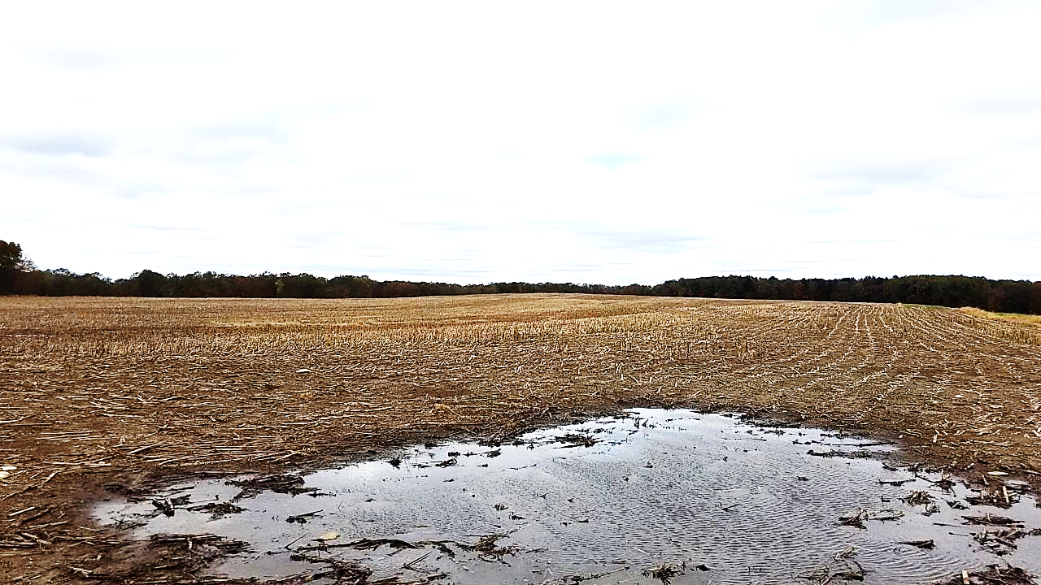
Results: Obj 2 – Management zones
Assess P concentrations in different field areas to determine if different P management zones exist

Slide 26
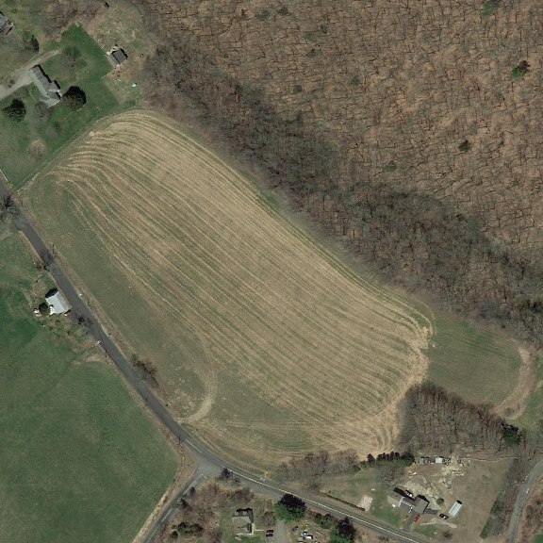
Results: Obj 2 – Management zones
Differentiating sampling areas with transect data
Farmers often manage areas of the field differently depending on topography, ease of access, and various other factors.

Slide 27
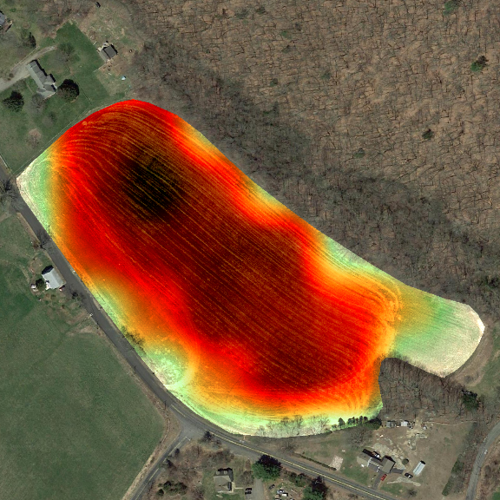
Results: Obj 2 – Management zones
Differentiating sampling areas with transect data
Farmers often manage areas of the field differently depending on topography, ease of access, and various other factors
We wanted to find out if areas of the centroid grid would have different P concentrations based on liner transects through centroids.
Modified Morgan

Slide 28

Results: Obj 2 – Management zones
Differentiating sampling areas with transect data
Farmers often manage areas of the field differently depending on topography, ease of access, and various other factors
We wanted to find out if areas of the grid would have different P concentrations based on liner transects through centroids
P is visibly different across this field based on the extractable P heatmap. Numbers represent modified morgan extractable P (lb ac⁻¹) at that location.
Modified Morgan

Slide 29

Results: Obj 2 – Management zones
Differentiating sampling areas with transect data
Farmers often manage areas of the field differently depending on topography, ease of access, and various other factors
We wanted to find out if areas of the grid would have different P concentrations based on liner transects through centroids
The amount of P is visibly different across this field based on the heatmap. The numbers are the amount of P (lb ac⁻¹) measured at each centroid point
The additional dots are the points included when measuring extractable soil P based on transects. Transects include 3 m (10 ft) spacing across 50 m (150 ft) and 0.3 m (1 ft) spacing closer to the centroid
0.3 m (1 ft)
3 m (10 ft)
50 m (150 ft)
Modified Morgan
Area 1
Area 2

Slide 30
Results: Obj 2 – Management zones
Comparing field areas based on extractable P concentration
Areas were selected based on topography or recommendation from farmer
Modified morgan extractable P (lb ac⁻¹)
Field | Area 1 mean | Area 2 mean | Different
C1 | 76 | 75
C2 | 81 | 98 | *
C3 | 139 | 182 | *
C4 | 75 | 65 | *
C5 | 32 | 42
M1 | 19 | 26 | *
M2 | 13 | 38 | *
M3 | 74 | 77
M4 | 59 | 86 | *
Most compared areas identified as uniquely different from each other within the same field
The use of management zones in fields is justified

Slide 31
Conclusion: Obj 2 – Management zones
Assess P concentrations in different field areas to determine if different P management zones exist
We identified differences in extractable P concentrations in 6/9 fields and believe that management zones should be considered when sampling for P.

Slide 32

Results: Obj 3 – Minimum separation distance
Find the minimum separation distance needed to collect independent soil samples for P analysis

Slide 33



Results: Obj 3 – Minimum separation distance
Variogram explanation
Variograms are used to calculate and depict variance in spatial continuity of a measured parameter
Calculating an experimental variogram
In other words:
An experimental variogram is calculated from half of the squared difference in a parameter between all measured points at a set distance
Incremental distances can be plotted and used to create a function of variance of the parameter as it relates to distance between measured points
The ideal variogram model reaches steady variance at distance
Oliver and Webster (2014)

Slide 34

Results: Obj 3 – Minimum separation distance
Variogram example
0.3 m (1 ft)
3 m (10 ft)
Semivariance
50 m (150 ft)
Peak semivariance
Other models
Modified Morgan
Distance where semivariance peaks
Distance (m)

Slide 35






Results: Obj 3 – Minimum separation distance
Variogram plots
Modified Morgan
C1
C2
C3
Semivariance
Minimum
Distance (m):
Distance (m)
60
60
110

Slide 36





Results: Obj 3 – Minimum separation distance
Variogram plots
Modified Morgan
C4
C5
M1
Semivariance
Minimum
Distance (m):
Distance (m)
95
110
160

Slide 37







Results: Obj 3 – Minimum separation distance
Variogram plots
Modified Morgan
M2
M3
M4
Semivariance
Minimum
Distance (m):
Distance (m)
200
90
60

Slide 38
Results: Obj 3 – Minimum separation distance
Variogram minimum separation distance and sample size
Field | Sample distance (m) | Sample distance (ft)
C1 | 60 | 197
C2 | 60 | 197
C3 | 110 | 361
C4 | 95 | 312
C5 | 110 | 361
M1 | 160 | 525
M2 | 200 | 656
M3 | 90 | 295
M4 | 60 | 197
Field | Sample size traditional | Sample size variogram
C1 | 4 | 12
C2 | 5 | 6
C3 | 9 | 11
C4 | 3 | 7
C5 | 38 | 29
M1 | 91 | 290
M2 | 61 | 98
M3 | 19 | 27
M4 | 15 | 28
Sample distance between 60-200 m based on P variability
Variogram sample size estimate is generally larger than traditional

Slide 39
Conclusion: Obj 3 – Minimum sampling distance
Find the minimum separation distance needed to collect independent soil samples for P analysis
Minimum separation distance was not similar across fields
Walking 60 – 200 m (180 – 600 ft) between samples should provide independent data when compositing for extractable soil P

Slide 40

Overall conclusions
Objective 1
Calculate the number of soil samples needed to accurately represent P concentrations for silage corn fields receiving dairy manure
Collecting 10-20 random subsamples for composites is likely to be within 10% of the “real” average extractable P concentration for the whole field.
Objective 2
Assess P concentrations in different field areas to determine if different P management zones exist
Management zones should be considered when sampling for P.
Objective 3
Find the minimum separation distance needed to collect independent soil samples for P analysis
Walking 60 – 200 m (180 – 600 ft) between samples should provide independent data when compositing for extractable soil P.

Slide 41
Ongoing
Implications
Future work
Composite soil samples for nutrient management should be collected with great consideration of management history to avoid inaccurate representation of P concentrations.
Spatial models vary because many fields have their own “identity”, which complicates creation of a simple model for sample size and sample distance that can be used for many fields.
Compare different variogram models
Spatial correlation of P with other nutrients

Slide 42


Acknowledgements
Data collection
Soil analysis
Statistical consulting
Tom Morris
Rich Meinert
Cameron Richards
UConn soil nutrient analysis laboratory
Patrick Lawrence
UConn Statistics department
University collaborators
Masoud Hashemi
John Jemison
Funding
NRCS – Connecticut

Slide 43

Thank you

Slide 44












Results: Objective 1
Visual patterns of extractable P in silage corn fields

Slide 45
Outline
Background: Soil P for dairy farms
Research objectives for assessing soil P
Methods
  Soil sampling design
  Soil and data analysis
Results
  Representative sample size
  Management zones
  Minimum sampling distance
Implications and future work

