Slide 1
Effects of Harvest Date on Falling Number and Baking Quality in Cereal Rye
Fall 2020

Slide 2
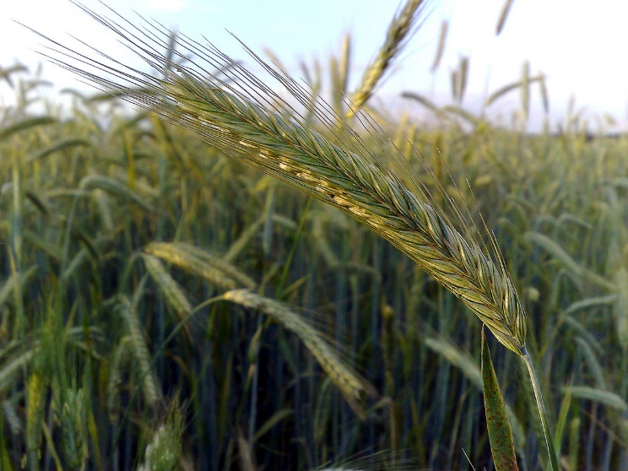
Cereal Rye in the Northeast
Gaining in popularity as part of the local grains movement
Primary uses for baking bread and distilling
Fall seeded/winter grain
Tolerates cold temperatures and poor soils

Slide 3
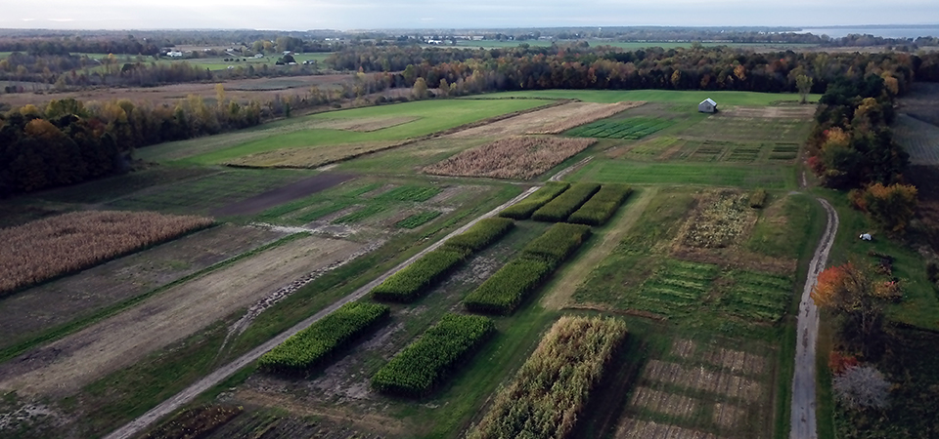
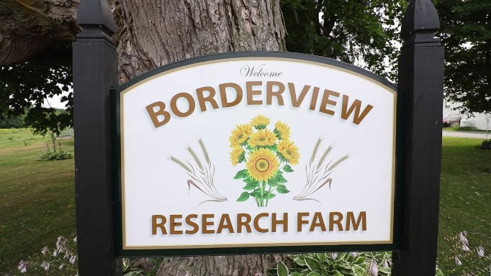
Cereal Rye Trials at Borderview Research Farm
Northeast SARE Partnership Grant
Variety trial
15 varieties
Nitrogen fertility trial
3 treatments
Harvest Date trial
2 varieties
4 harvest dates each

Slide 4
Rye Harvest Date Trial
Hazlet and Danko varieties fall seeded
Samples of each variety harvested on four different dates, a week apart
Four samples per variety, eight samples total
Falling number test performed on each
Blind bake test conducted on both varieties

Slide 5
Falling Number
Falling Number measures viscosity which is an indicator of alpha-amylase activity
Typically used to indicate premature harvest or pre-harvest sprouting
As the grain begins to germinate enzymes convert complex starches into simple sugars, impacts dough fermentation in the bakery
High FN means low enzymatic activity
Low FN means high enzymatic activity
Higher falling number is preferred in wheat and barley
We are studying acceptable falling number values for rye

Slide 6
Falling Number in Rye
Hypothesis and rationale:
Samples with lower falling numbers would create better quality bread
Rye bread ferments more quickly than wheat
Relies on starch for structure rather than gluten
Faster fermentation means less risk of starch degradation
Starch degradation creates poor loaf volume and gummy texture
Lower falling number increases fermentation rate and lowers risk of starch degradation

Slide 7
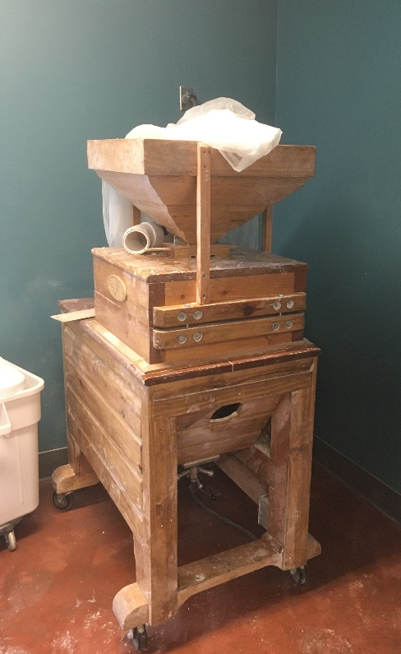
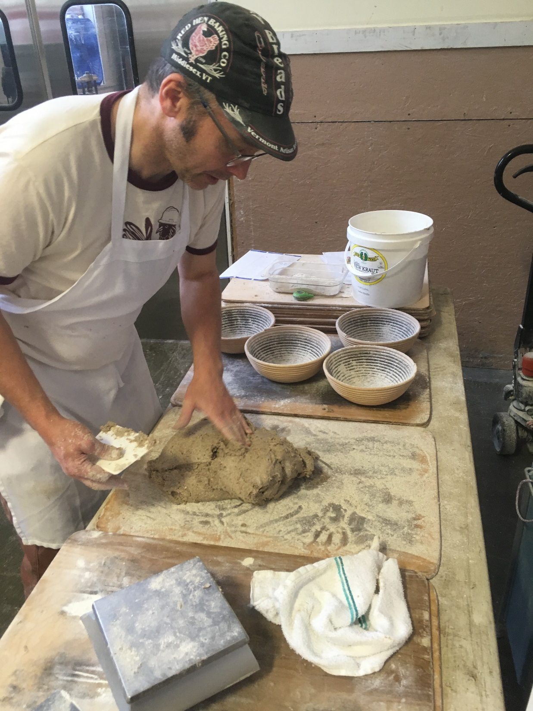
Bake Test
Randy George and Jeffrey Hamelman conducted blind test bakes
Randy received Danko, Jeffrey received Hazlet
Stone milled into flour and baked using a standardized recipe
Scored on a 200 point scale
Dough quality
Fermentation
Loaf volume
Crust and crumb
Flavor

Slide 8
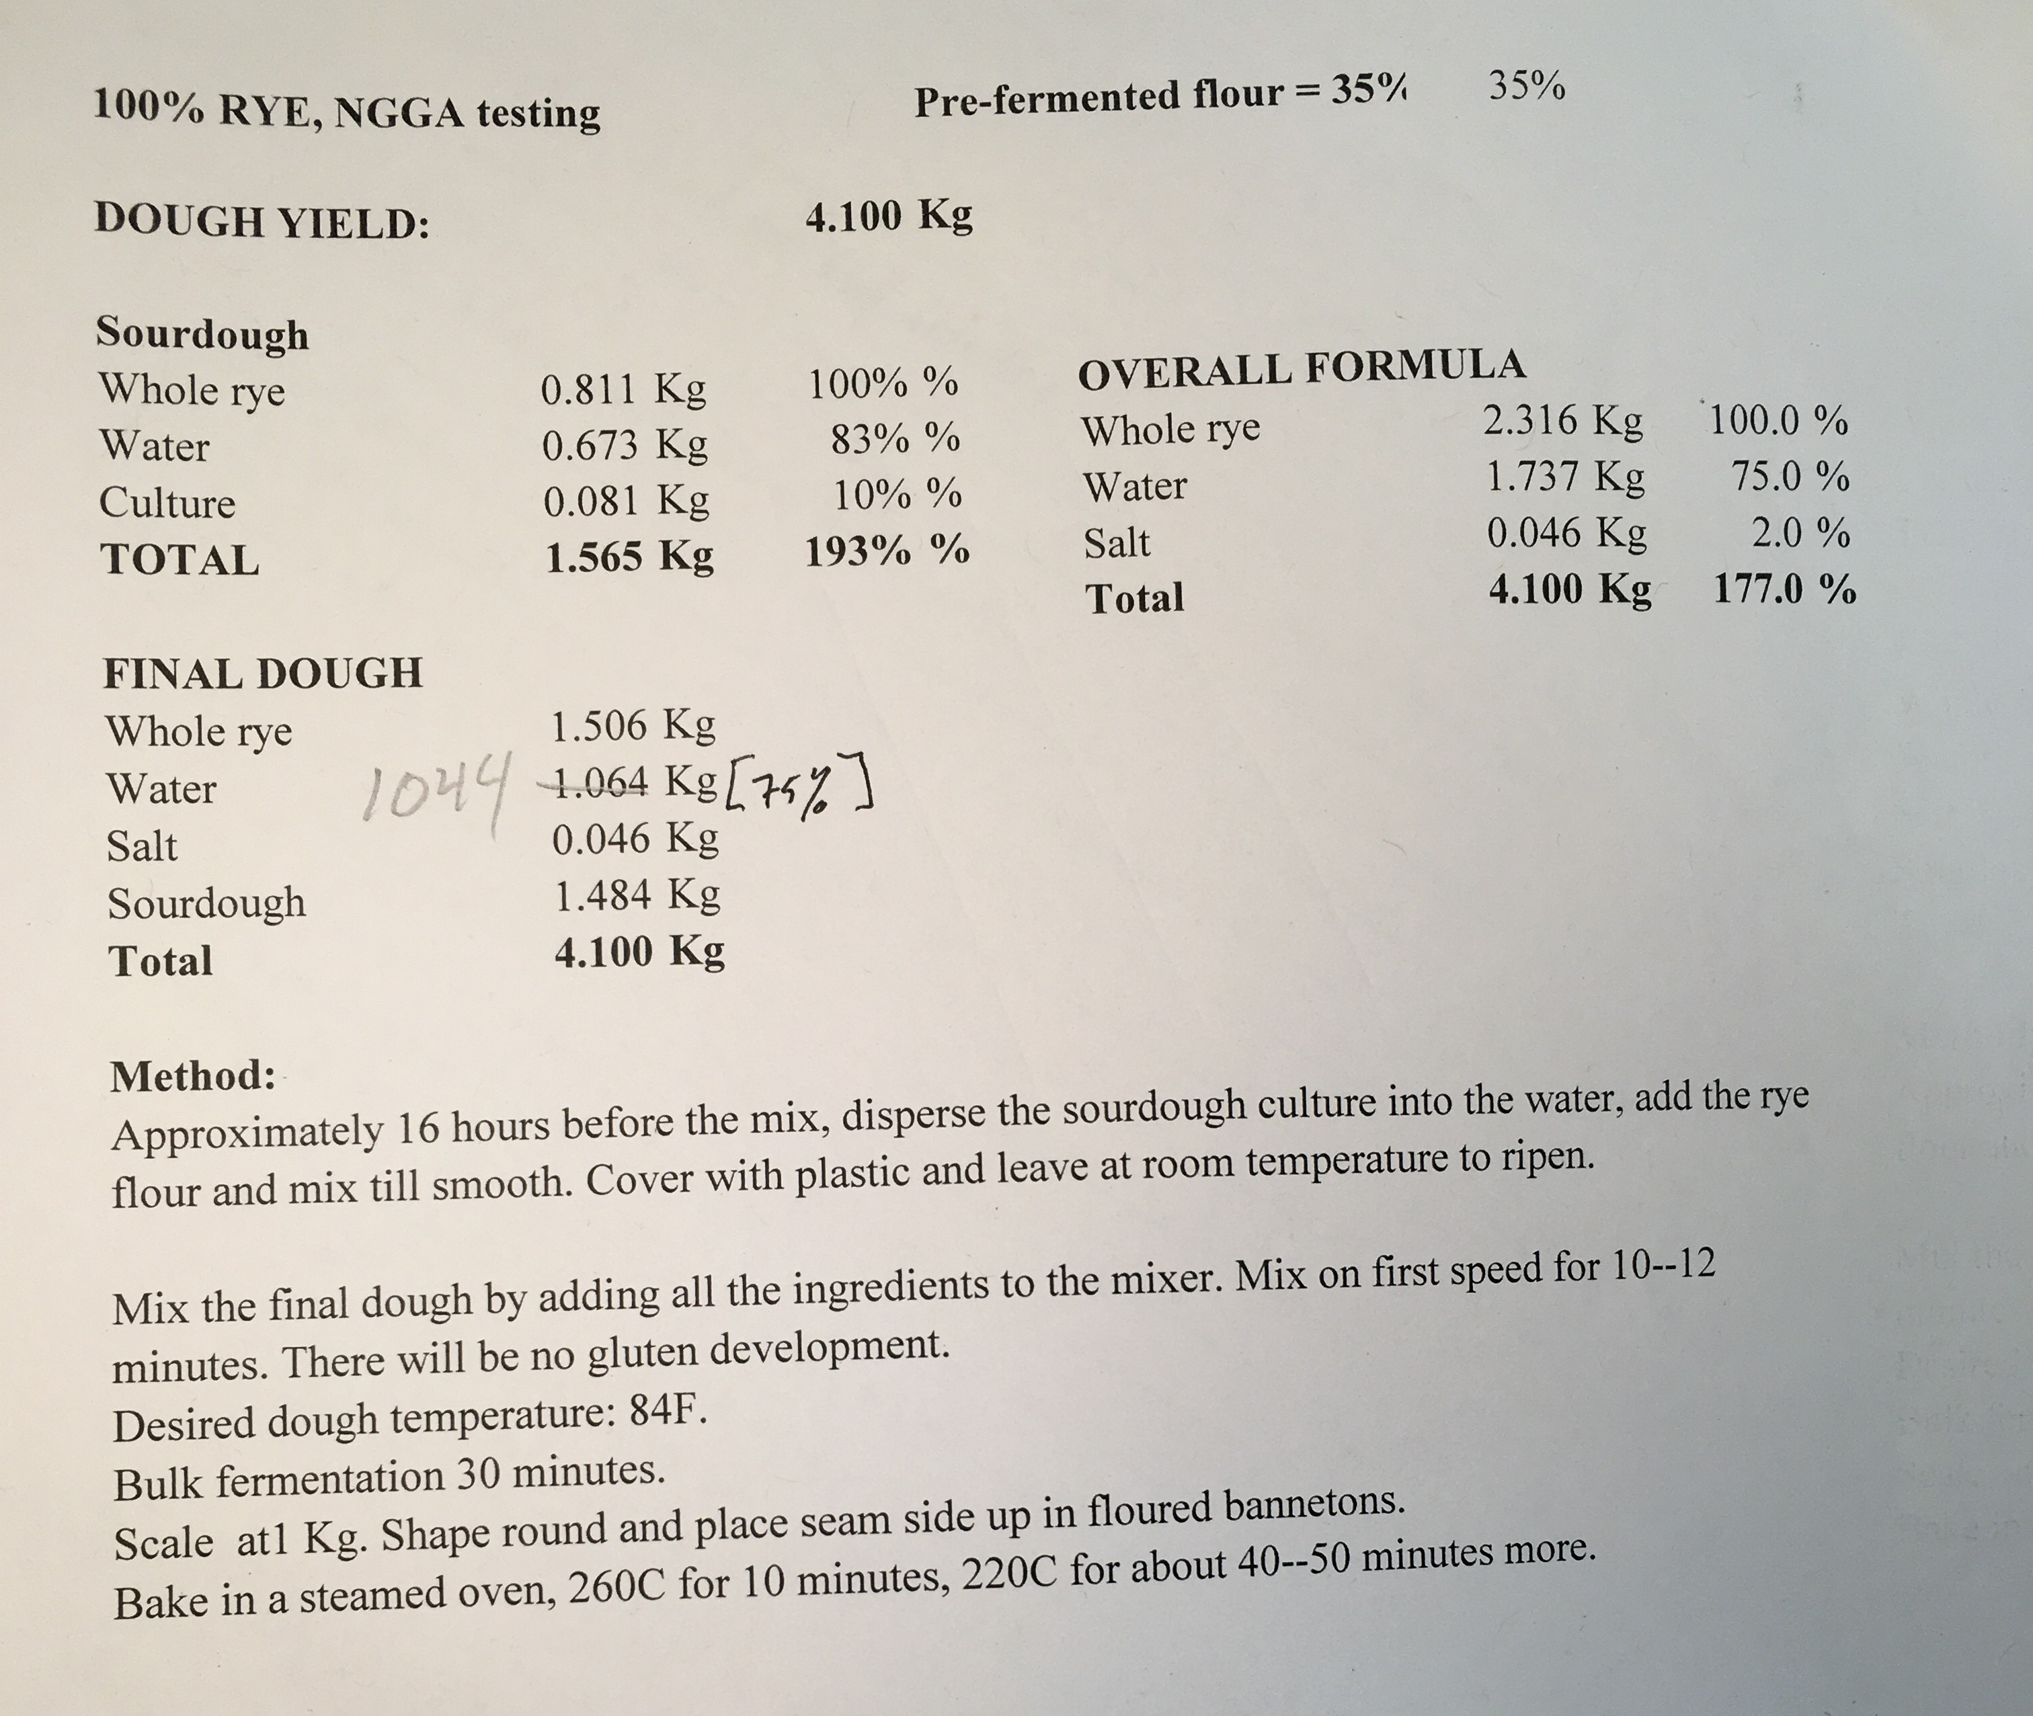
Formula

Slide 9
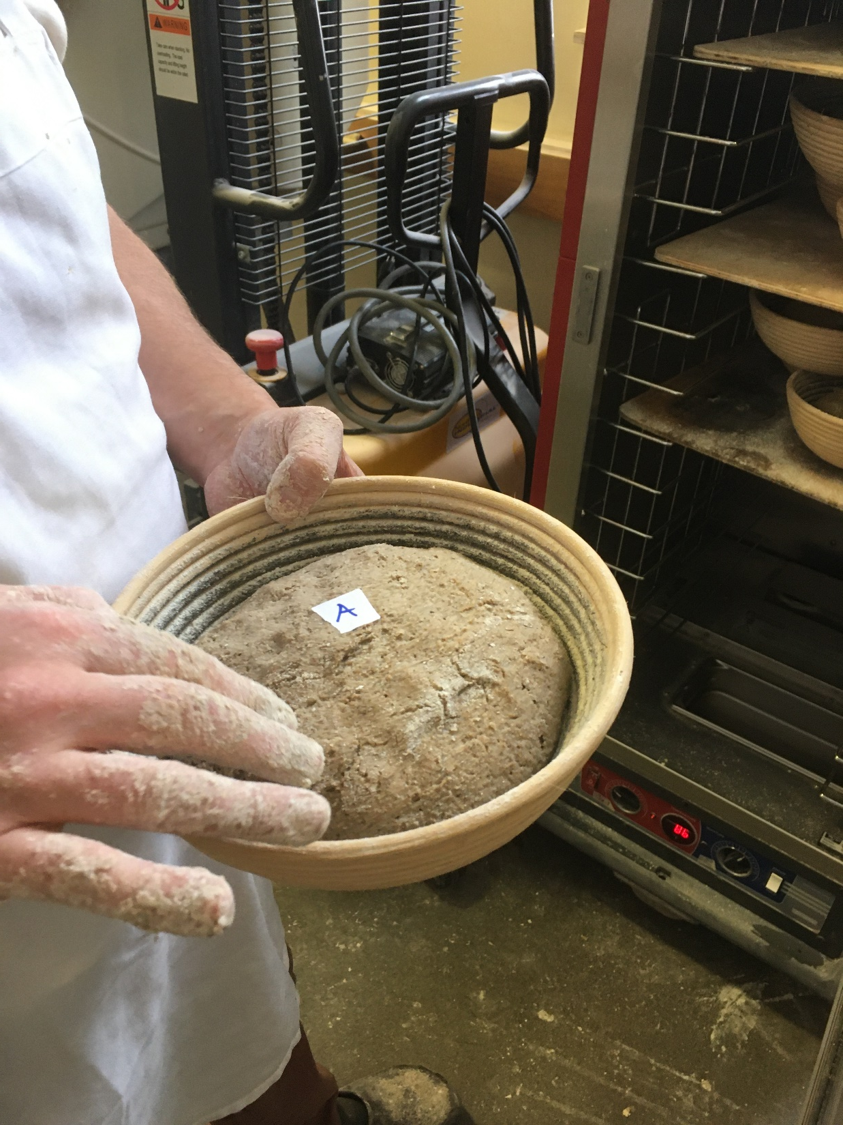
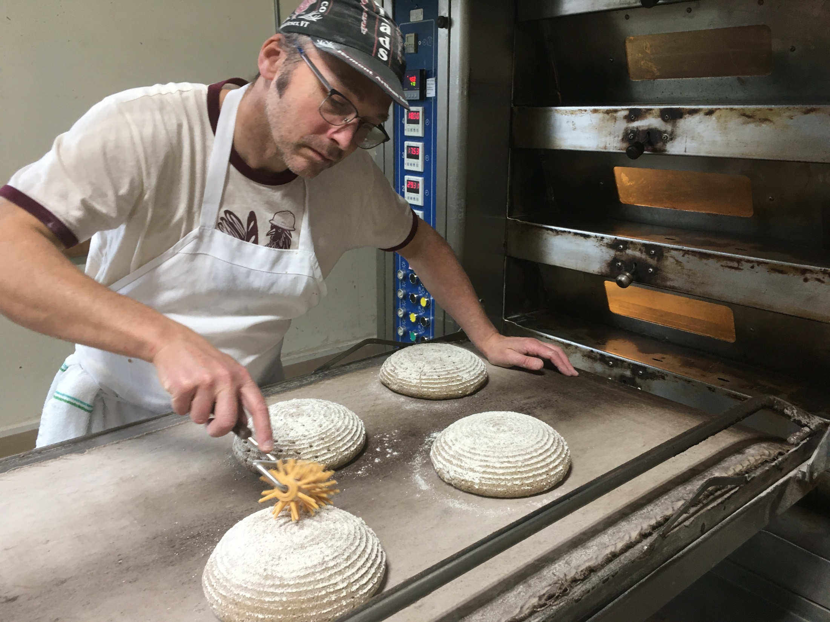
Bake Test cont’d
Loaves A and D had the most consistent dough-feel and fermentation times
C was tighter, drier and slower to ferment
B was more slack and fermented more quickly

Slide 10
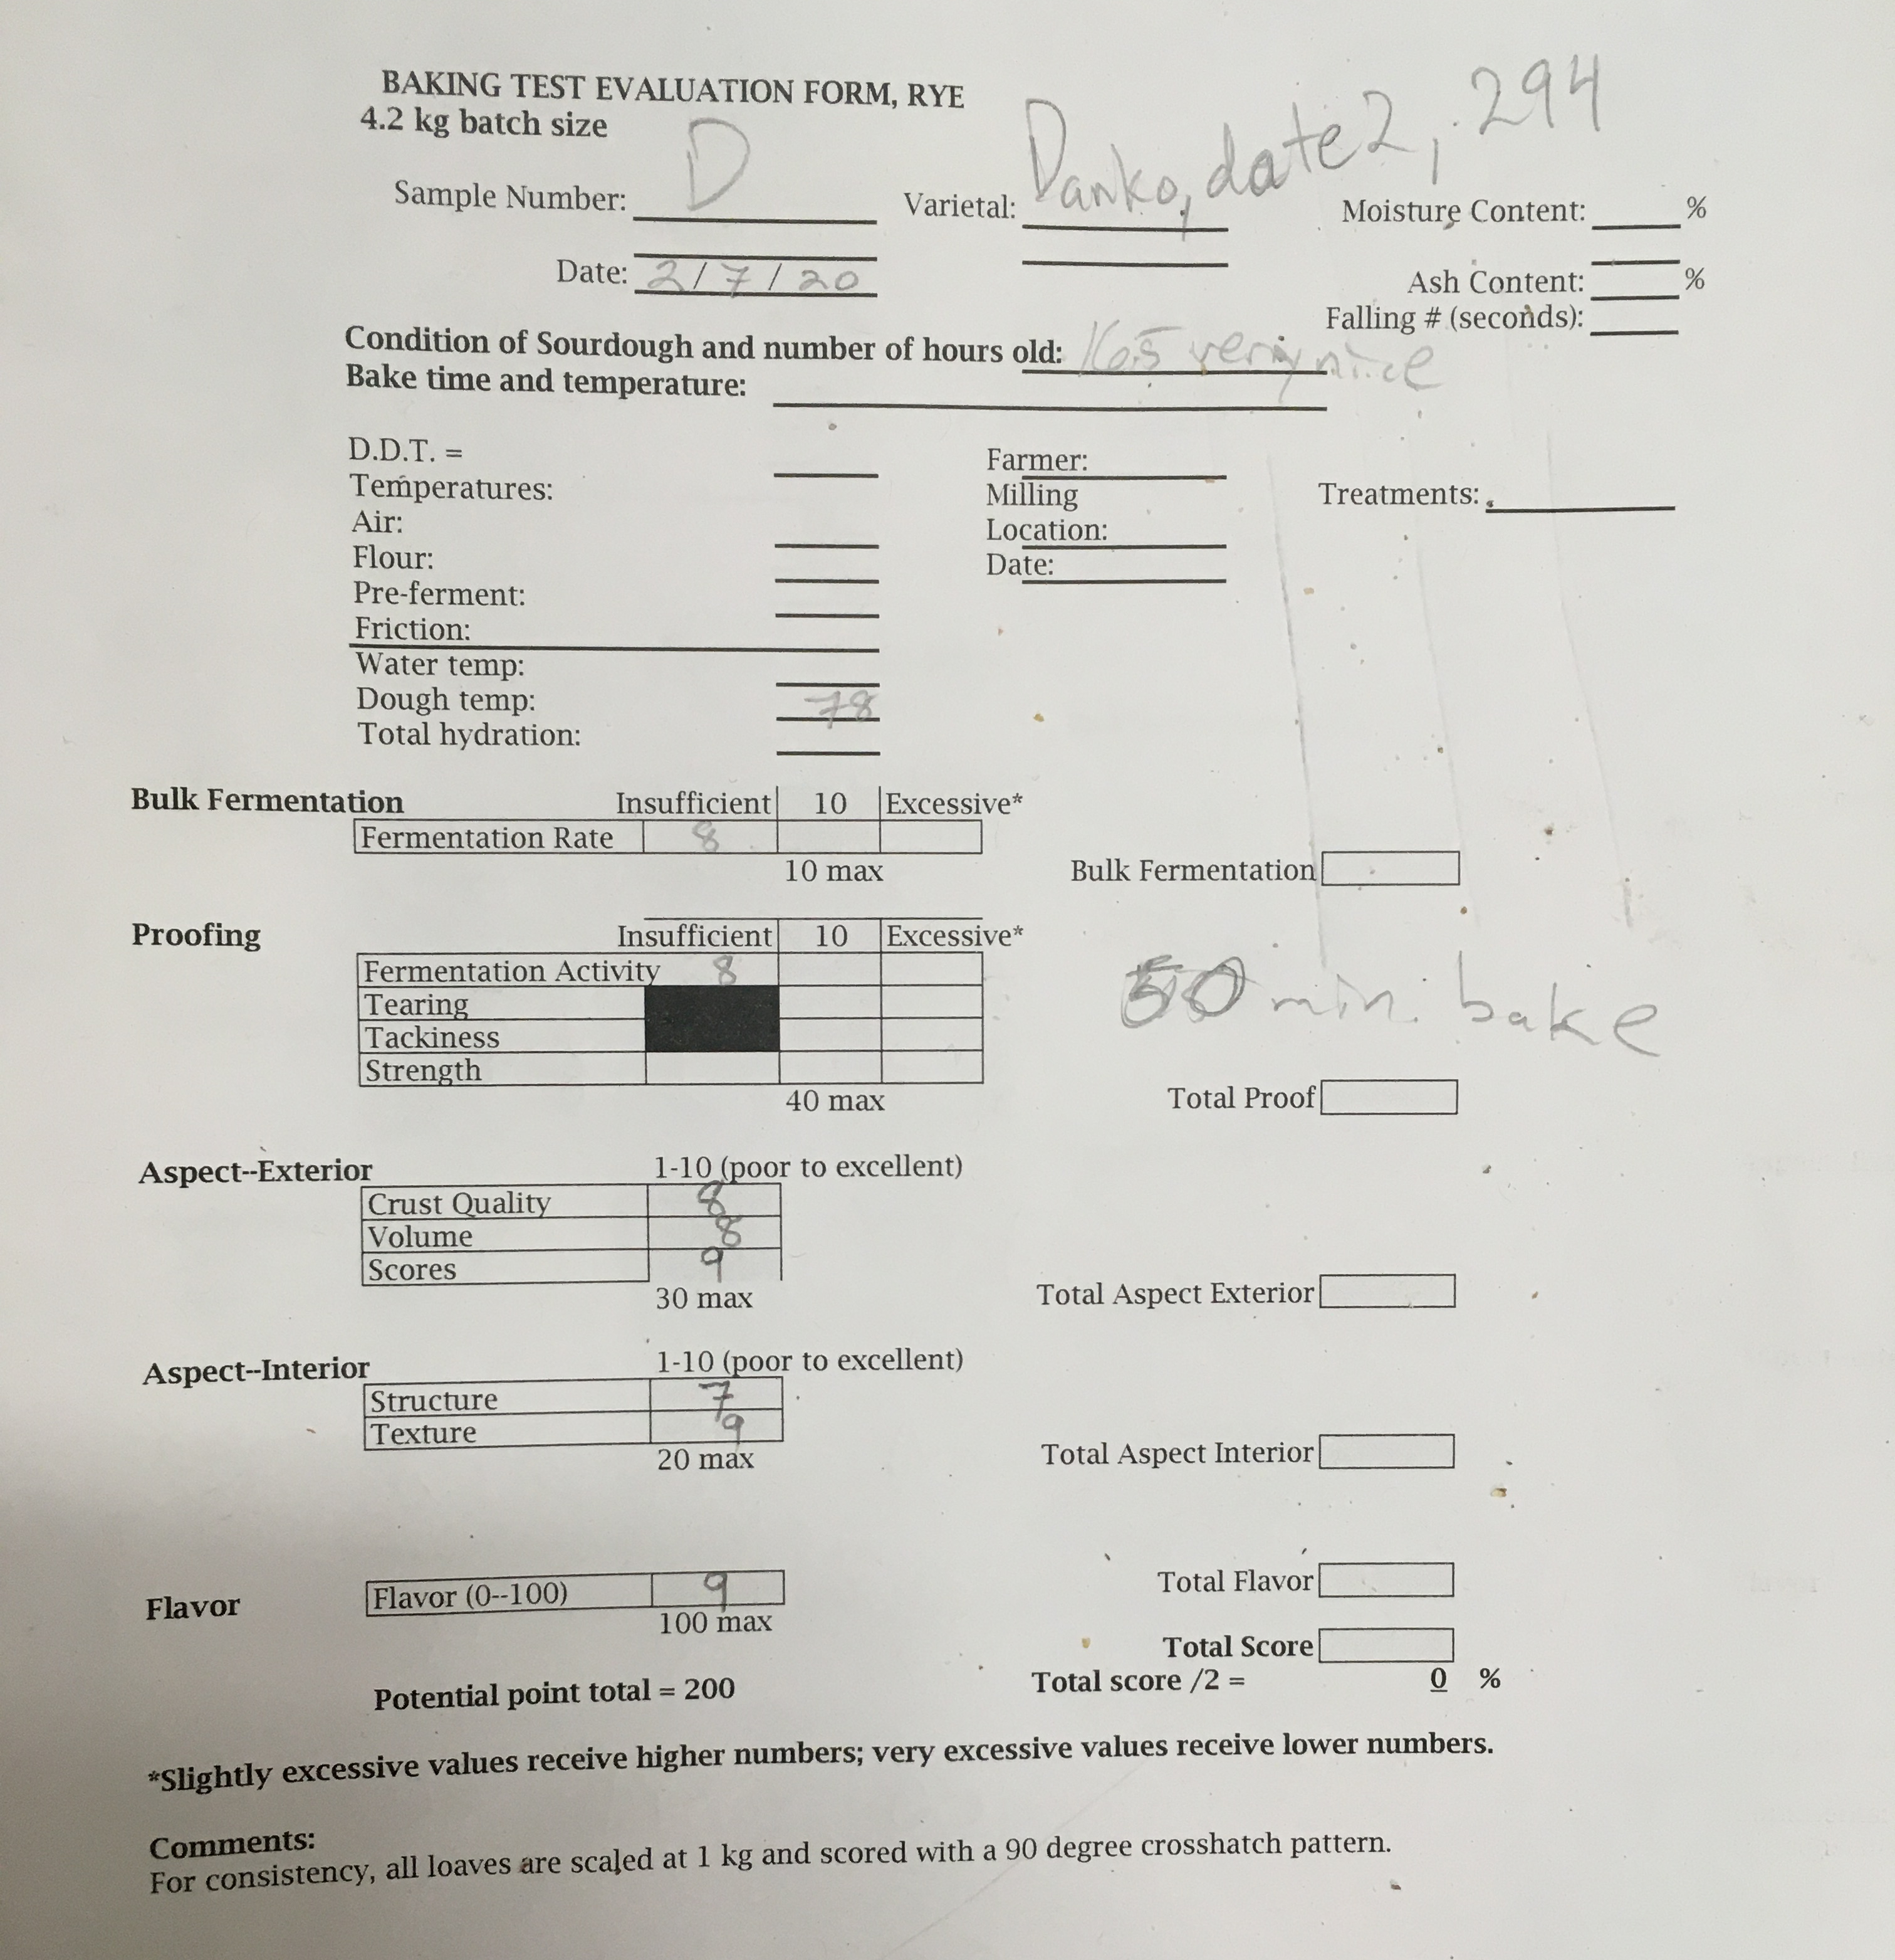
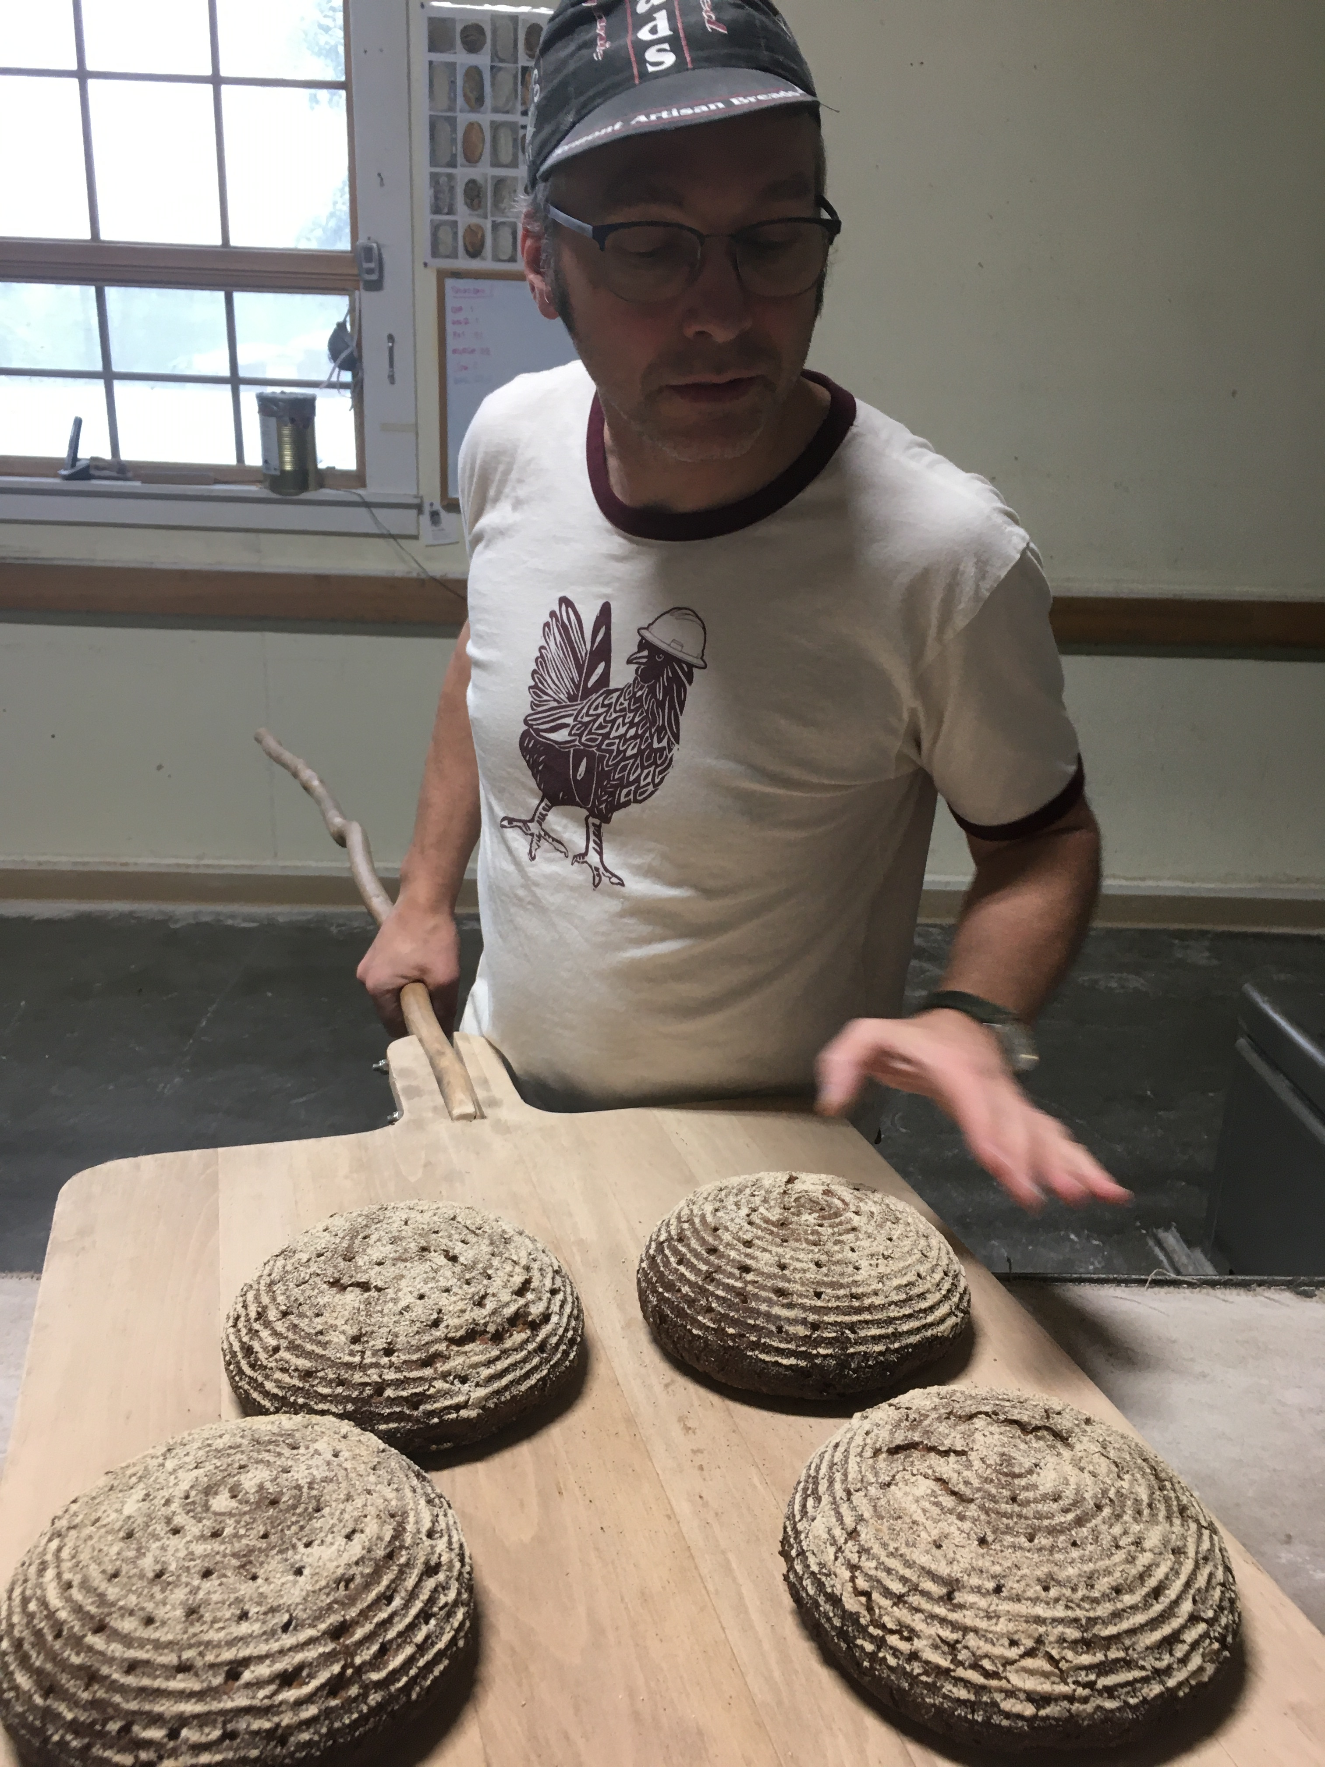
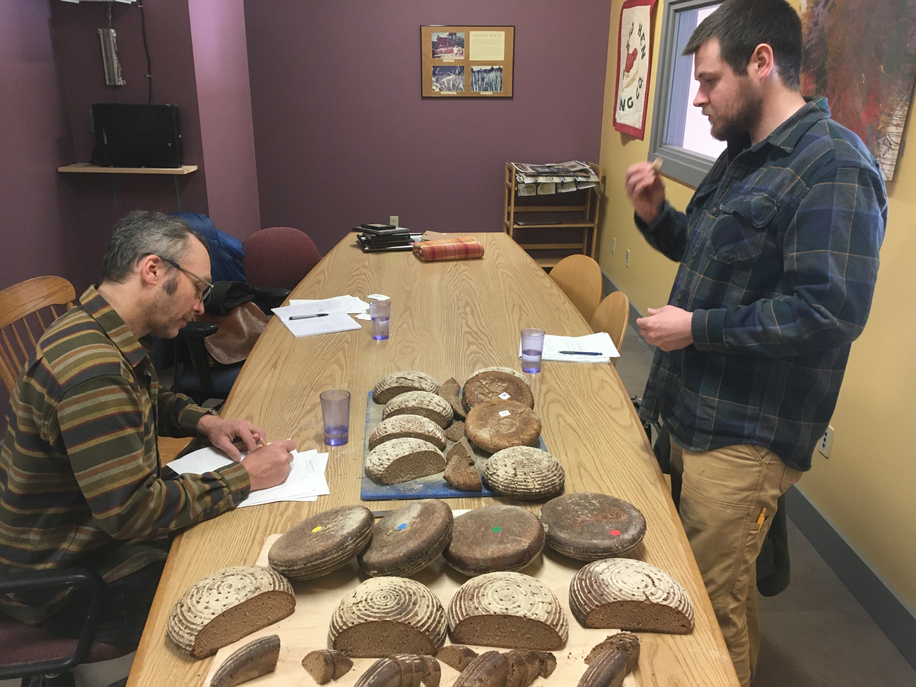
Scorecard

Slide 11
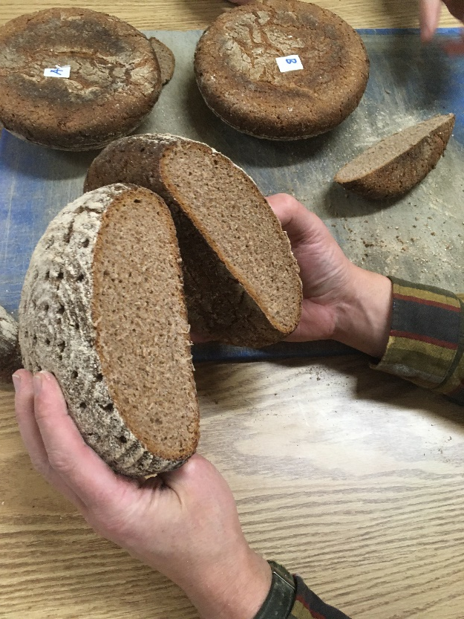
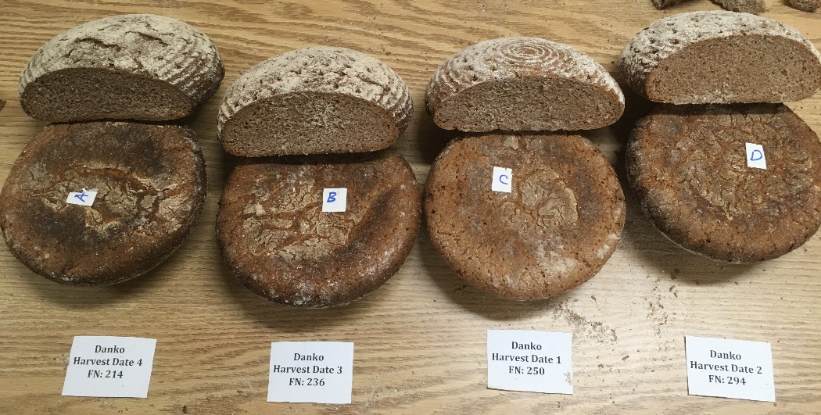
Bake Test Results
We incorrectly guessed that B was the lowest FN, C was the highest and A and D were mid-range
B resulted in the best quality bread
Caramelized and chewy crust
Complex, well-balanced flavor
Consistent size and distribution of air pockets
Crumby, moist and chewy
Not gummy or sticky
Variety | Harvest Date | Falling Number | Loaf Code
Danko | 1 | 250 | C
Danko | 2 | 294 | D
Danko | 3 | 236 | B
Danko | 4 | 214 | A
Hazlet | 1 | 250
Hazlet | 2 | 270
Hazlet | 3 | 153
Hazlet | 4 | 112

Slide 12
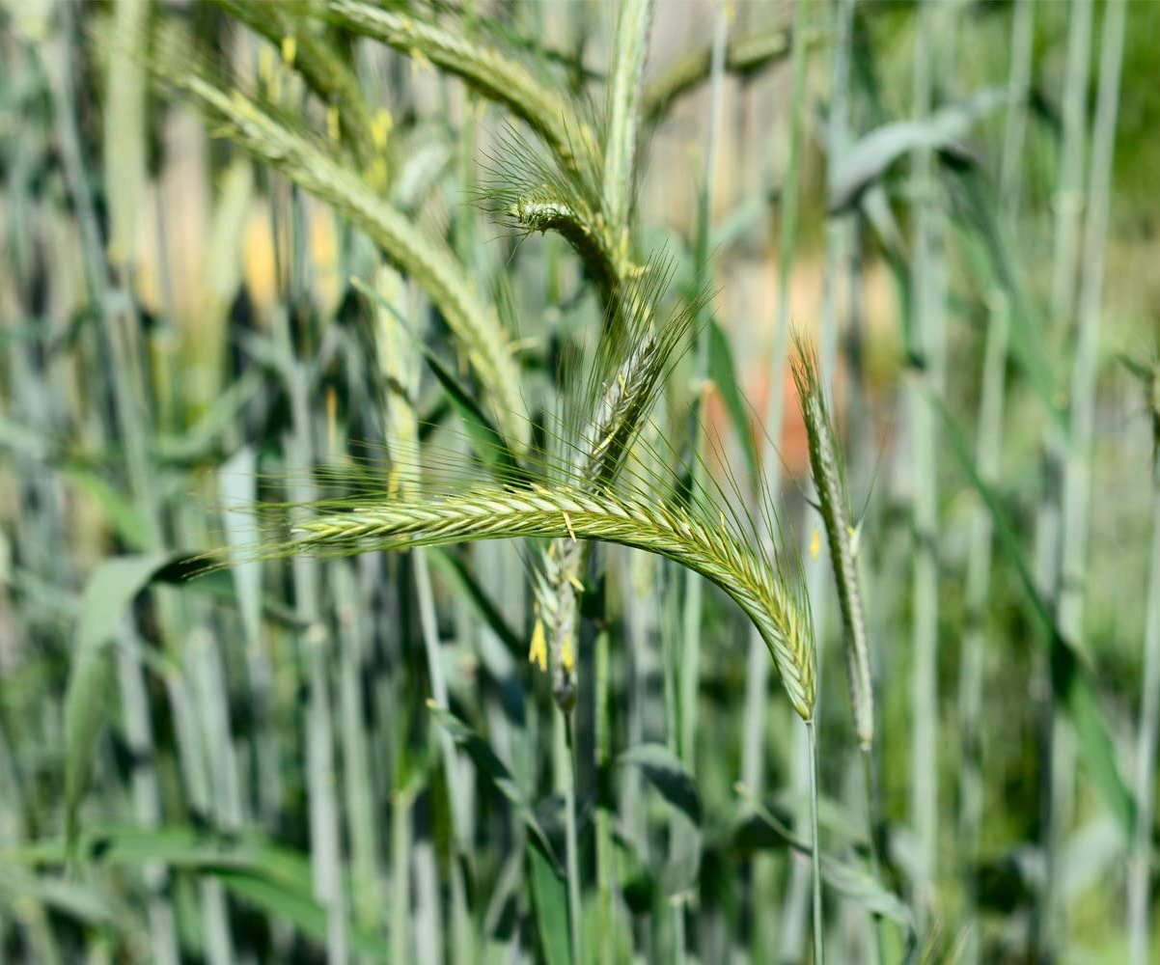
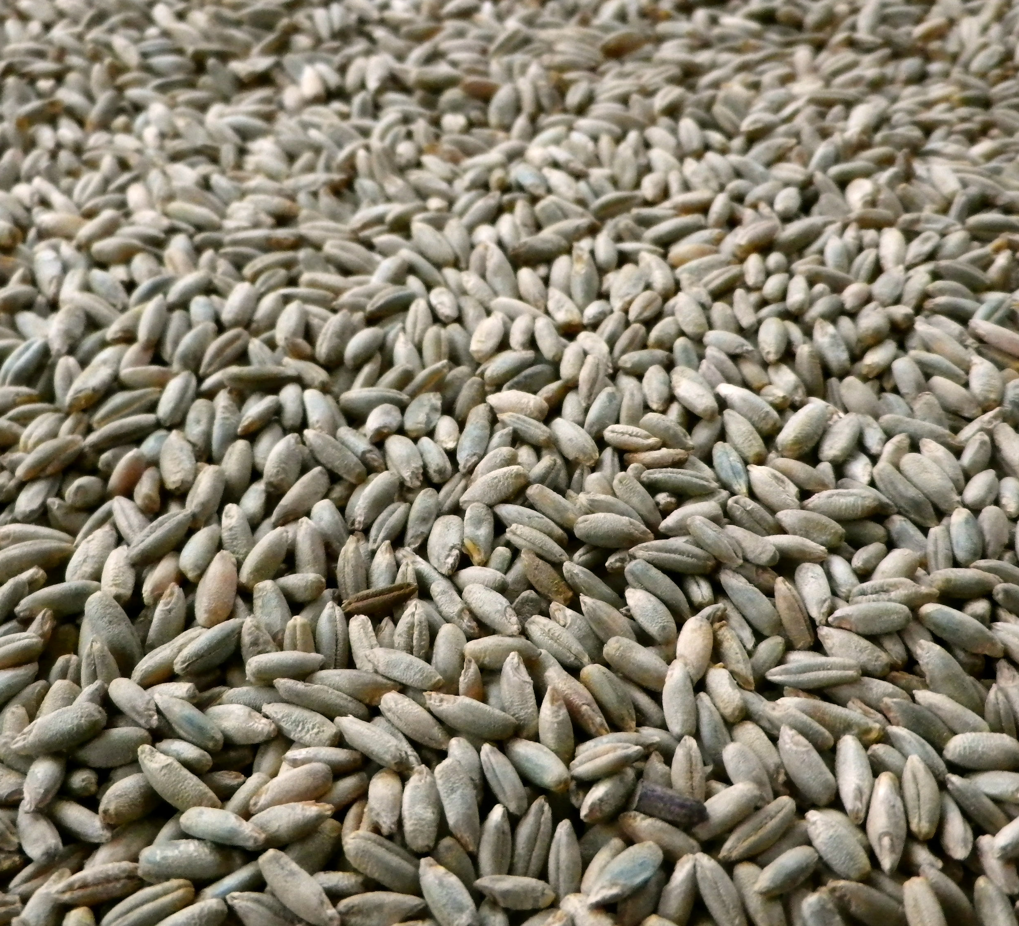
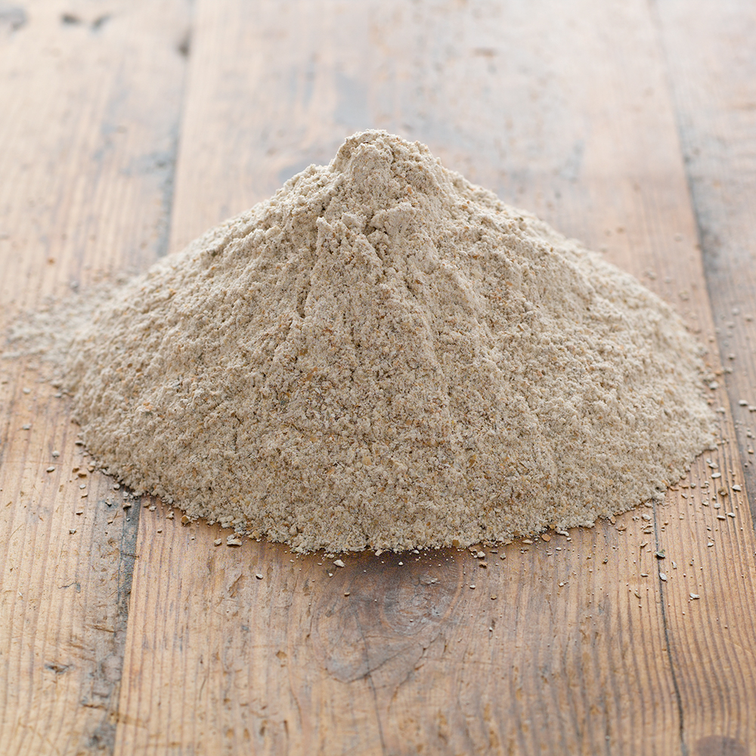
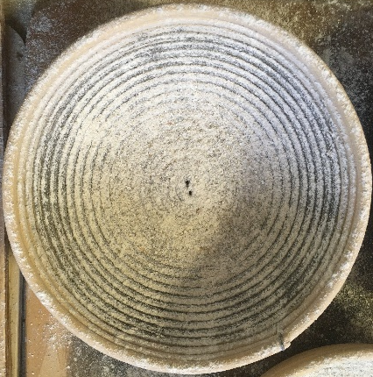
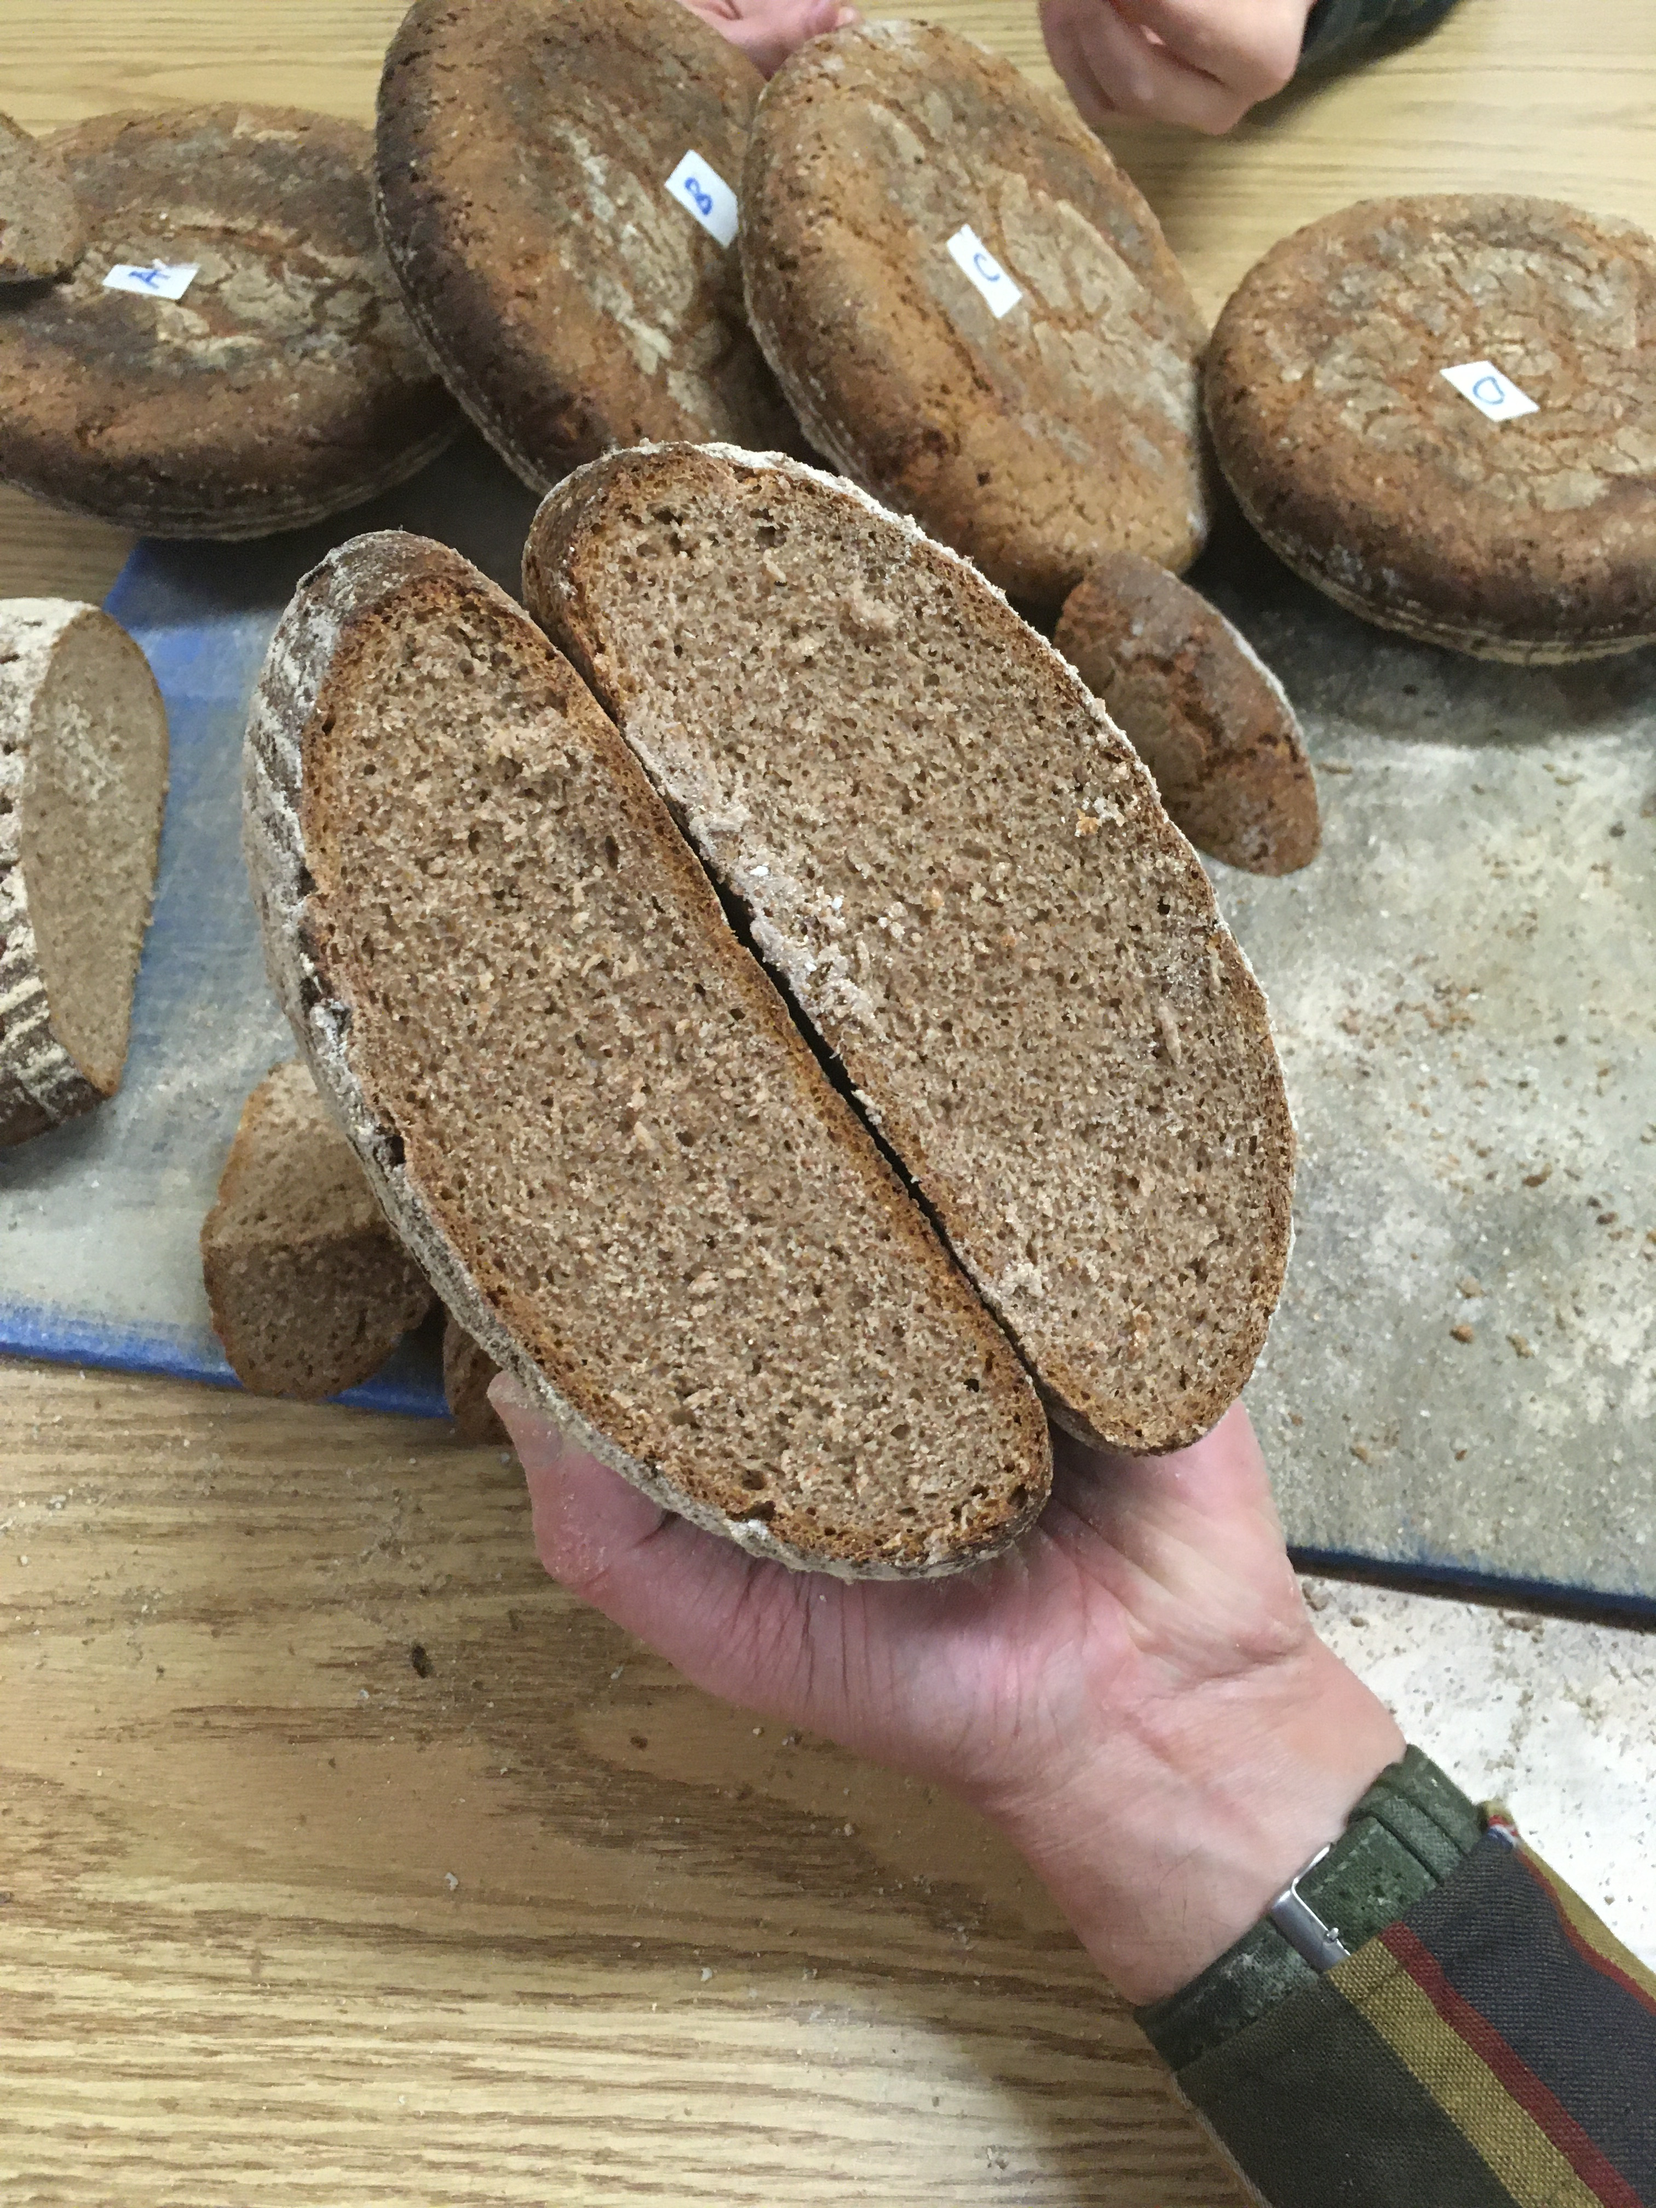
Results
Inconclusive results, not clear on what they mean.
Preliminary results imply there may be a wide range of acceptable FN in rye for bread baking
Danko was more stable over the 4-week harvest period than Hazlet
Would like to conduct additional testing to better understand the differences found between harvest dates
Interested in additional analyses for distilling quality including spirit yield, plumpness, and correlating falling number to Rapid Visco Analysis (RVA)

Slide 13
Acknowledgements
Bakers:
Randy George, Red Hen Bakery
Jeffrey Hamelman
UVM Extension:
Heather Darby, Henry Blair, John Bruce
Funding:
- Northeast SARE, project number ONE18-312

