Slide 1
Organic Asian Vegetables
&
Community
Supported
Agriculture
Choy Division & Gentle Time Farm

Slide 2
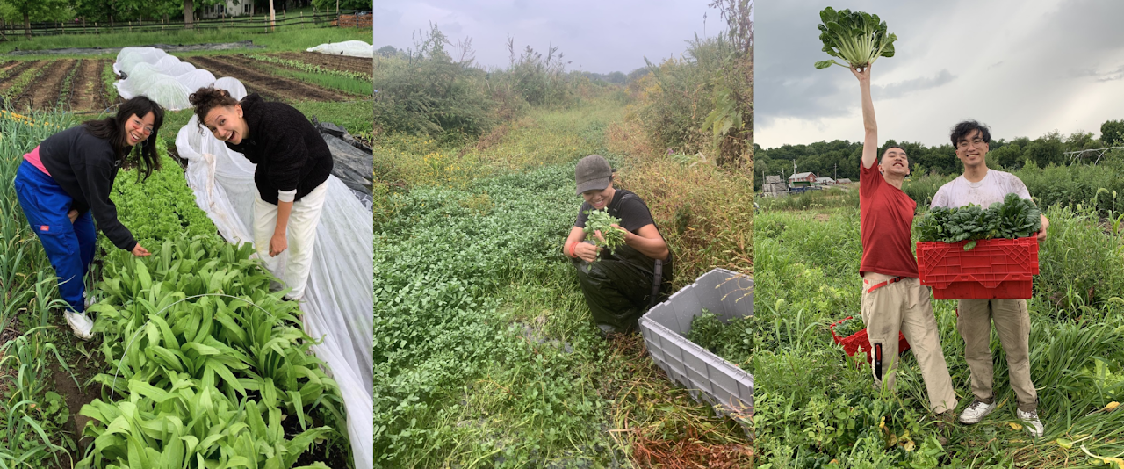
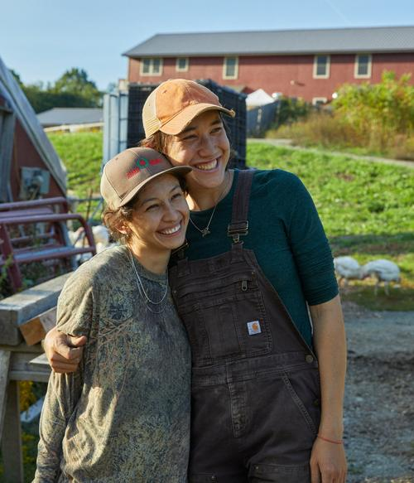
We are Gentle Time Farm!

Slide 3
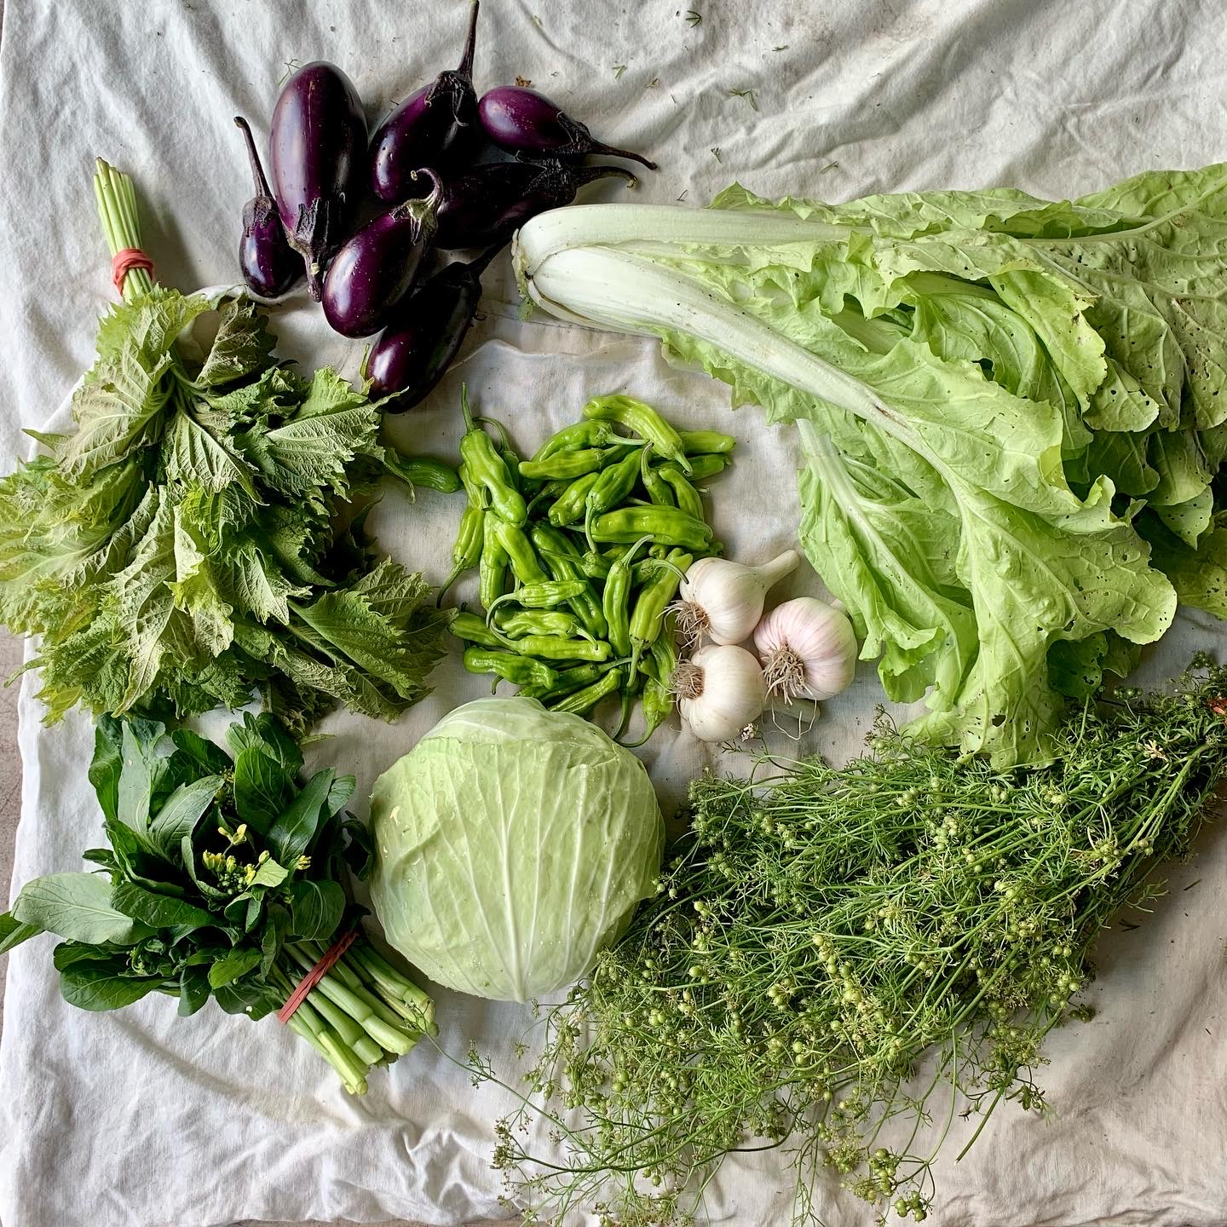
What is a CSA?
Community members (that’s you!) purchase vegetables from a local farm in advance.
This helps farmers to offset the costs of seed, equipment, and labor.
In return, CSA members get a weekly selection of the best quality organic vegetables from the farm.
Notes:
Also mention different types of CSAs, most CSA are western vegetables but some are specialized

Slide 4
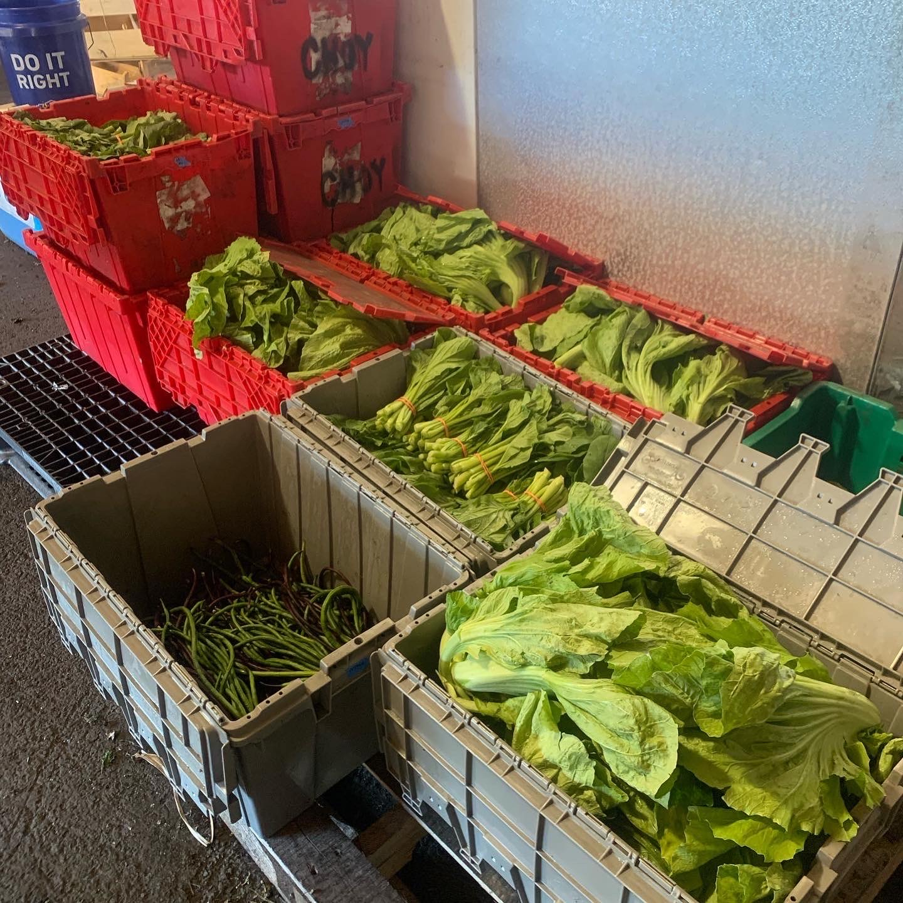
How it works
Become a member at the start of the season. You can pay in full or in installments.
When the season begins, pick up your weekly share on your designated day!

Slide 5
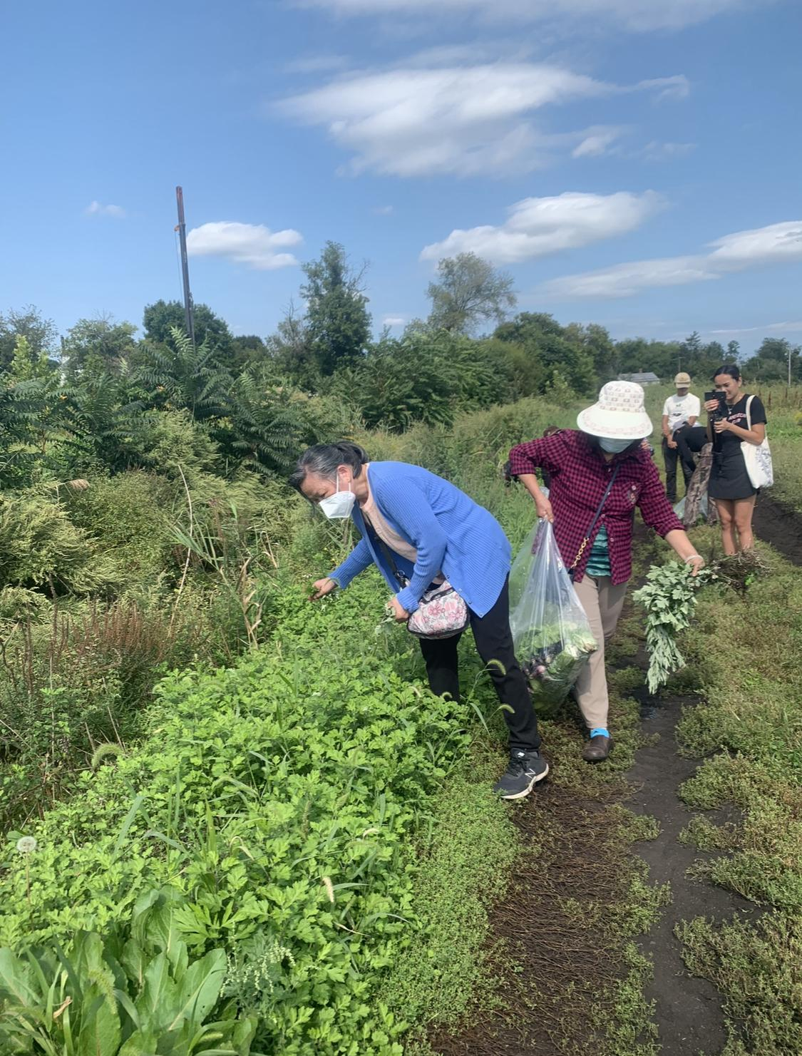
Benefits
Fresher and tastier than the supermarket!
No pesticides or chemicals
Eat seasonally
Support local small businesses and Asian farmers
Farm tour and activities

Slide 6
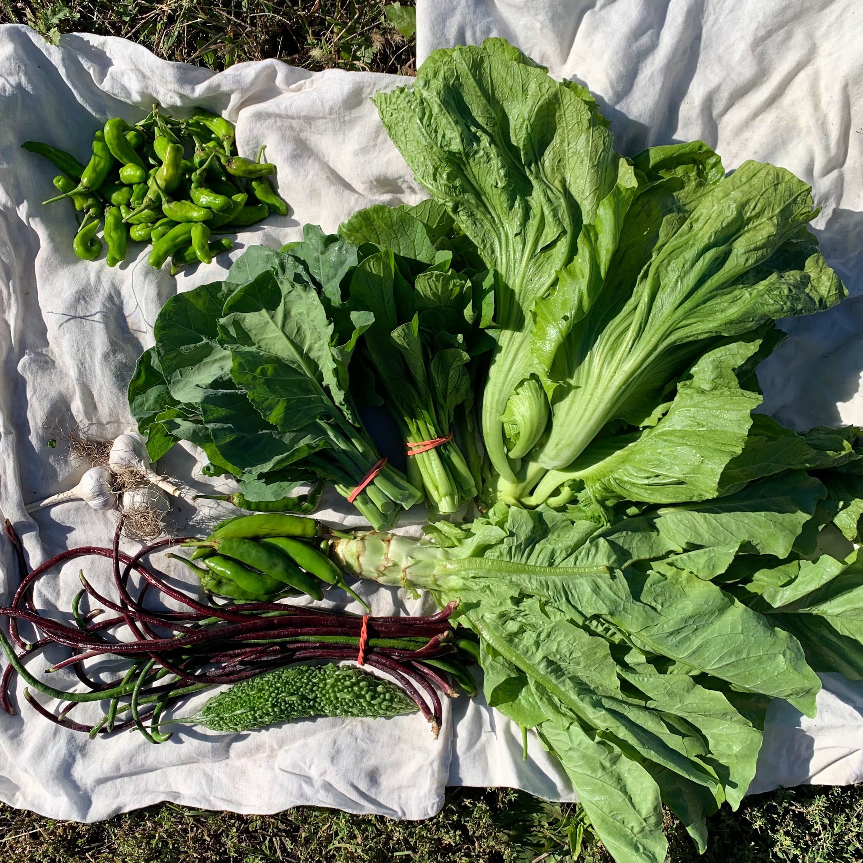
Example boxes
Sample fall vegetable box:
Shishito peppers
Long beans
Gai lan
Choy sum
Chili peppers
Celtuce
Dai Gai Choy
Bitter Melon

