Slide 1
SARE GNE15-113 Natural and eco-friendly approaches to control aflatoxins in poultry feed
University of Connecticut
Graduate student: Hsinbai Yin
Major Advisor: Dr. Kumar Venkitanarayanan
Notes:
Good morning everyone. Welcome to my defense My Ph.D. dissertation entitled

Slide 2
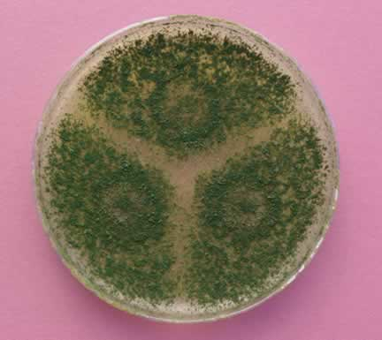
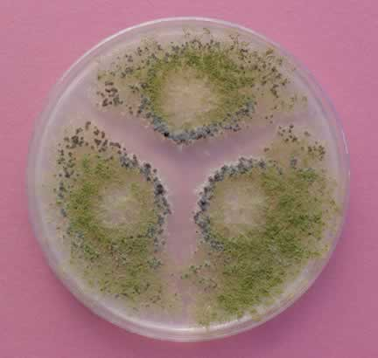
Aflatoxins (AF)
Aspergillus spp. - A. flavus, A. parasiticus
First outbreak in England: Turkey X-disease in 1960s
Aflatoxin was named from Aspergillus flavus
A. parasiticus A. flavus
Sargeant et al., 1961
Notes:
Aflatoxin are mycotoxins, produced by fungus Aspergillus flavus and Aspergillus parasiticus .
The first outbreak of AF was occurred in England in 1960 after which caused the death of 100,000 turkeys after consumed AF contaminated feed, which was characterized as Turkey X-disease.
One year later, researchers iidentified a toxigenic fungus strain which namely Aspergillus flavus is able to produce a toxin which was responsible for the Turkey X-disease, theyrefore, the name of Aflatotxins as the toxins produced by Aspergillus flavus

Slide 3
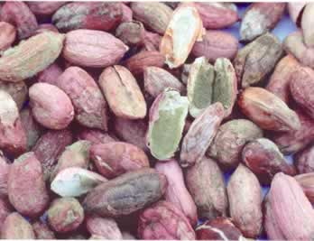
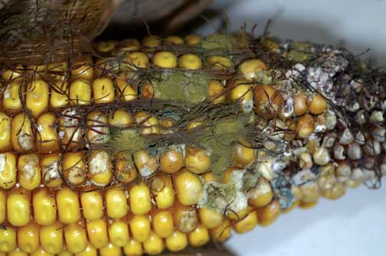
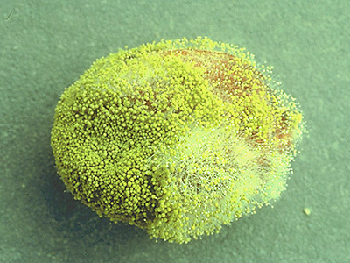
Aflatoxins in foods
Fungal toxins in animal feeds.
Routes of the contamination of grains:
Pre-harvest, post-harvest, and transportation
Processing of grains
Formulated feed after processing
Manafi et al., 2012
Notes:
Aflatoxin can containate feed ingredients such corns, peanuts and cottonseed. These fungus could grow and contaminate grains before or after they are harvested or during the transportation time.
More importantly, these fungus can also contaminate the grains even they are after processing or the formulated feedstuff

Slide 4
Maximum tolerable limits of AF
Feed ingredients | Level
Corn and peanut for poultry | 100 ppb
All other feedstuff for poultry | 20 ppb
Food for human consumption | 20 ppb
USDA Aflatoxin Handbook, 2002; FDA Guidance for Industry, 2000
Notes:
Aflatoxin is the only FDA regulated mycotoxin since it can enter the human food chain system and cause liver cancer. Limitation of aflaotxin in the USA for poultry are:
For the mature poultry, 100 ppb limits for corn and peanut and 20 ppb for all other feedstuff. For the immature poultry and food for human consumption purpose, 20 ppb is the limit for all food and grains.
In light of hazards of aflatoxin in chicken, there are number of methods for reducing contamination of alfatoxin in chicken feed.

Slide 5
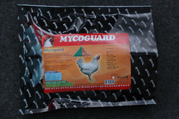
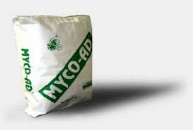
Current methods of AF control in feed
Toxin binders :
Hydrated sodium calcium aluminosilicates (HSCAS)
Zeolites: alkaline cations
Bentonites
Dietary clay
Bind with essential nutrients in feed
Oguz, 2012
Notes:
Other chemical toxin binders could also strongly bind with AF in chciken feed to prevent toxic interactions with the consuming chickensanimal and to prevent totxin absorption acrosschicken digestive tract.
However, some of these toxin binders such as zeolites, bentonite, and clay could bind to the essential nutrient materials in the feed and decrease the bio-available nutrients in the chicken digestic tract. And there is a high risk of clay binders binding with heavy metals.
Our approached in this research was using totally different directions, we don’t even allow fungus produce AF. We used plant derived molecules CR and TC to inhibit A. flavus and A. parasiticus growh and AF production.
-------------------------------------------------------------------------------------------------------
The addition of binding agents can reduce the bioavailability of these compounds in ani‐ mals, and limit the presence of toxin residues in animal products. In case of aflatoxin B1 (AFB1), hydrated sodium calcium aluminosilicates (HSCAS) and phyllosilicates derived from natural zeolites have a high affinity, both in vitro and in vivo. Zeolites, which are hy‐ drated aluminosilicates of alkaline cations are able to adsorb AFB1. Bentonites have been shown to be effective for the adsorption of AFB1. Other clays, such as kaolin, sepiolite and montmorillonite, bind AFB1 but less effectively than HSCAS and bentonite. Activated char‐ coal has mixed results against AFB1.
Although clays are effective against aflatoxins, caution should be exercised to make sure that their inclusion level is not too high and they are free from impurities such as dioxin. When the level of inclusion is very high, which is actually required for them to be effective, there are chances that these compounds can bind minerals and antibiotics like monensin. Some of the binders are not biodegradable and could pose environmental problem.

Slide 6
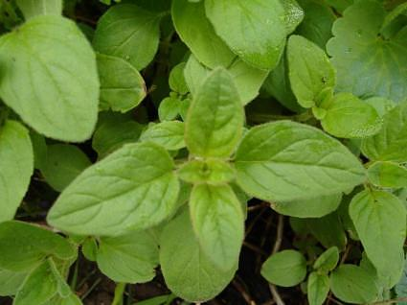
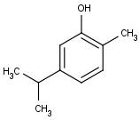
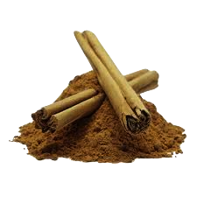
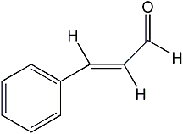
Plant-derived antimicrobials
Carvacrol (CR) :
Phenol-derivative from oregano oil
Generally recognized as safe (GRAS) by FDA
Trans-cinnamaldehyde (TC) :
Aromatic aldehyde-derivative from cinnamon
GRAS
Notes:
In this regard, Plant-derived molecules are a group of natural antimicrobials that have traditionally been used to preserve foods and enhance food flavor.
Carvacrol (CAR) is major ingredients in oregano oil. The oil has been found effective against bacterial and fungal infections of the gastrointestinal tract.
Trans-cinnamaldehyde (TC) is an aromatic aldehyde present as a major component in cinnamon. The molecule has been reported to possess antimicrobial activity toward a wide range of foodborne pathogens.
Both of these plant derived molecules are Gras-status by FDA means generally recognized as safe

Slide 7
Hypothesis
Plant-derived antimicrobials, CR and TC, reduce A. flavus and A. parasiticus growth and AF production.
In-feed supplementation of CR and TC reduces aflatoxicosis in chickens.

Slide 8
Objectives
To investigate the efficacy of carvacrol (CR) and trans-cinnamaldehyde (TC) in reducing Aspergillus flavus and A. parasiticus growth and aflatoxin (AF) production in chicken feed during long-term storage.
To determine the efficacy of in-feed supplementation of CR and TC in reducing aflatoxicosis in chickens.
To study the heat stability of CR and TC treated with commercial manufacturing temperatures in chicken feed.
Notes:
Coming to my first objective, my first objective was to

Slide 9
Specific objective # 1
To investigate the efficacy of carvacrol (CR) and trans-cinnamaldehyde (TC) in reducing Aspergillus flavus and A. parasiticus growth and aflatoxin (AF) production in chicken feed during long-term storage.
Notes:
Potato dextrose broth is a nutrient broth specific for fungus growth

Slide 10
Rationale
CR or TC supplemented in the feed
Inhibit mold growth and AF production
Decrease aflatoxicosis in chickens

Slide 11
Summary of results
CR and TC significantly decreased A. flavus and A. parasiticus growth and AF production in chicken feed (p< 0.05)
Notes:
To summarize,
Although the mold counts were not as significantly decreased by the lower concentration of plant molecules, CR and TC were very effective in reducing the aflatoxin produced without killing the fungus. We hepothesized that these plant molecules could down-regulated the aflatoxin production genes. Therefore, our last objective was…..

Slide 12
Specific objective # 2
To determine the efficacy of in-feed supplementation of CR and TC in reducing aflatoxicosis in chickens.

Slide 13
Aflatoxicosis in chickens
Pre- or Post-harvest feed contamination
Poor storage condition
Aflatoxin accumulation in feed
Aflatoxin consumption by chicken
Acute or Chronic Aflatoxicosis
Notes:
Generally, chicken feed would be contaminated by AF through post contamination or poor storage condition to allow fungus contaminate and produce aflatoxin. Postharvest contamination can occur if crop drying is delayed or the processing temperature is not enough, and when the conditions during storage of the crop are poor such as with high moisture environment or insect and rodent could easily contact with feed.After chicken consumed with AF contained feed would cause chronic or acute aflatoxicosis. The chronic or acute aflatoxicoses as well as its carcinogenicity depends on the concentration of AF exposed and duration of exposure

Slide 14
Rationale
Pre-existing aflatoxins in the feed
Feed contaminated by molds
In-feed supplementation of CR or TC
Reduce aflatoxicosis in chickens

Slide 15
Summary of results
Chickens fed 2.5 ppm AF diet significantly decreased body weight in week 4 and week 5 (p < 0.05)
CR and TC decreased aflatoxicosis and AF-induced toxic effect to liver in chickens (p < 0.05)
Notes:
Crtical aflatoxin production pathway genes

Slide 16
Specific objective # 3
To study the heat stability of CR and TC treated with commercial manufacturing temperatures in chicken feed.
Notes:
Now we observed the significanly decresed in aflatoxin production, our next objective was to delineate the mechanism by CR and TC reduce aflaotxin production, out third objective was looking into the effect of

Slide 17
Summary of results
The recovery rate (%) of CR and TC treated at 150ºF and 180ºF in the feed was not affected as compared to the untreated controls on day 0 (P > 0.05).
At the end of the 2 month storage, at least 87% of CR and 77% of TC treated at 180ºF were still recovered as compared to the control
Notes:
A similar results was found in A. flavus showed 0.08% inhibited the A. flavus growth.

Slide 18
Conclusion
Carvacrol and trans-cinnamaldehyde:
Inhibited A. flavus and A. parasiticus growth and AF production in chicken feed (p<0.05)
Decreased aflatoxicosis and AF-induced liver damage in broiler chickens (p<0.05).
Maintained high heat-stability in chicken feed treated at the manufacturing temperatures.

Slide 19
Impact of research
CR and TC could be potentially used as feed additives to control aflatoxicosis in chickens

Slide 20
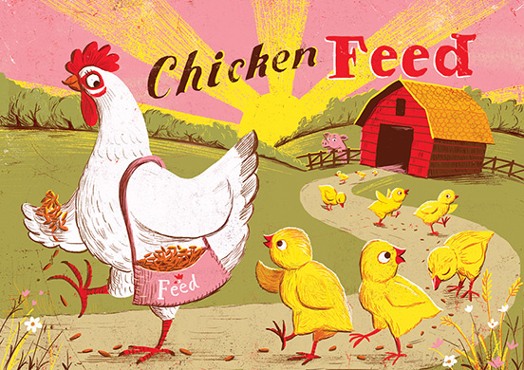
Thank You

