Slide 1
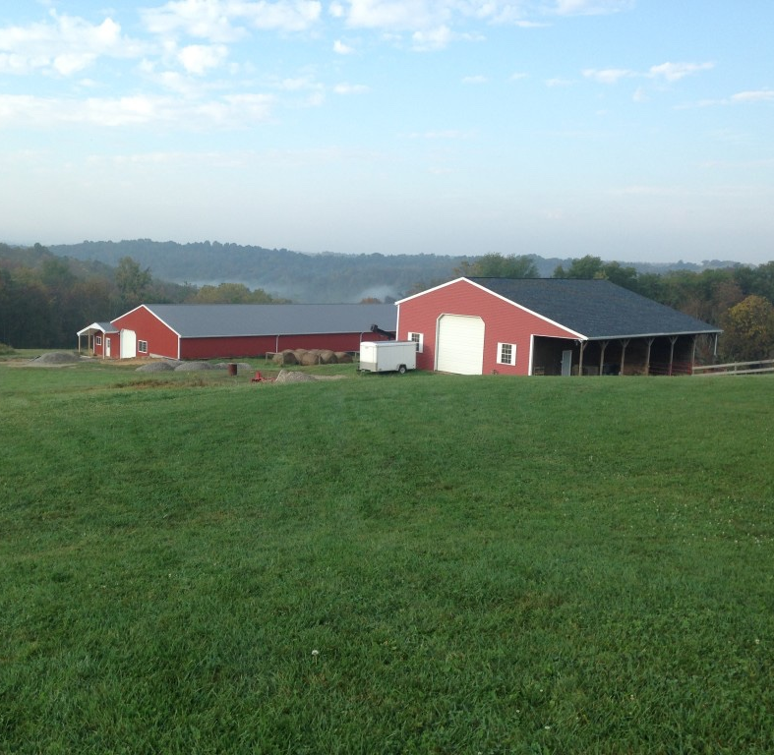
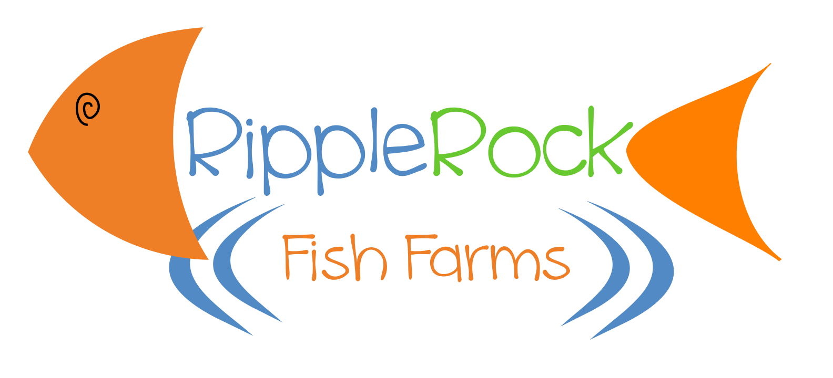
RIPPLE ROCK FISH FARMS LLC
NCR-SARE GRANT
March 2020 – March 2022
Improving oxygen transfer in a RAS system, to increase production and promote the sustainability of raising tilapia indoors.

Slide 2
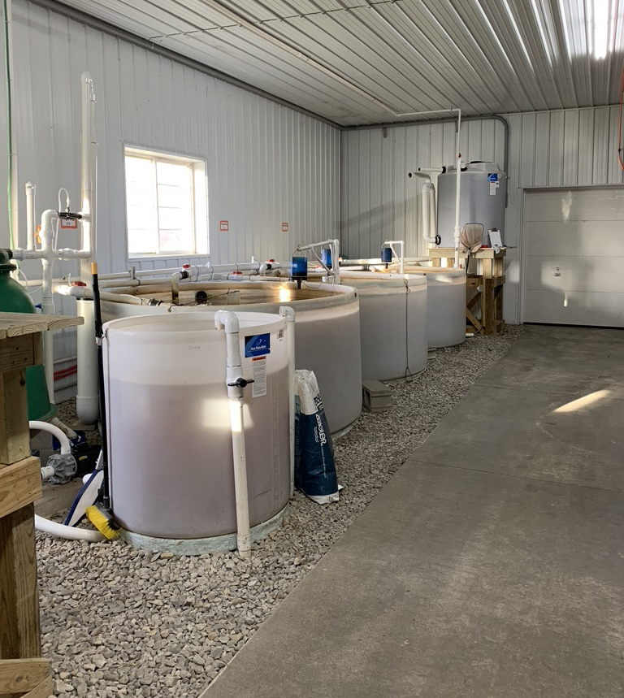
The problem: It’s never enough
Oxygen readings are low… stop feeding
Oxygen goes back up … turn on the feeders
Growth rates are compromised
Profitability suffers

Slide 3
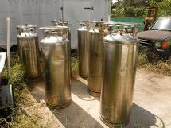
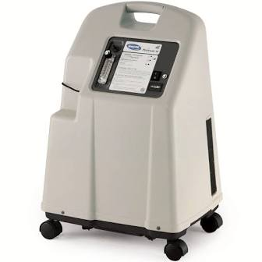
The journey with oxygen:
Blower
Liquid bottles (cost, transport)
Home health concentrators
Oxygen Transfer Options:
Airstones
Ceramic Diffusers

Slide 4
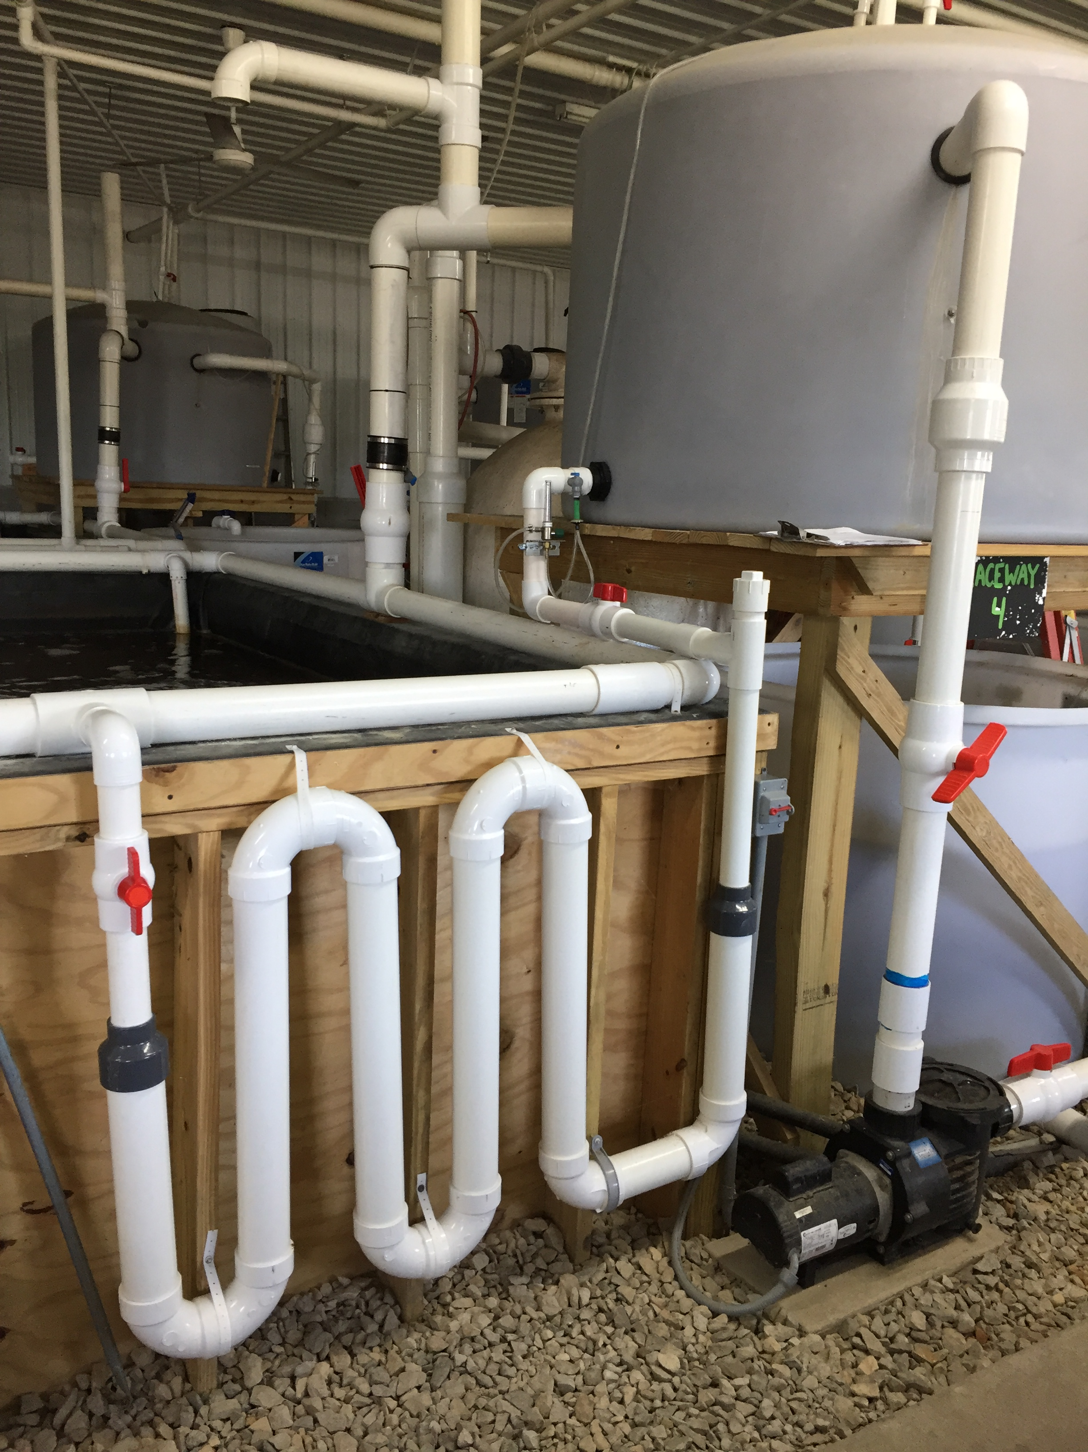
FAIL:

Slide 5
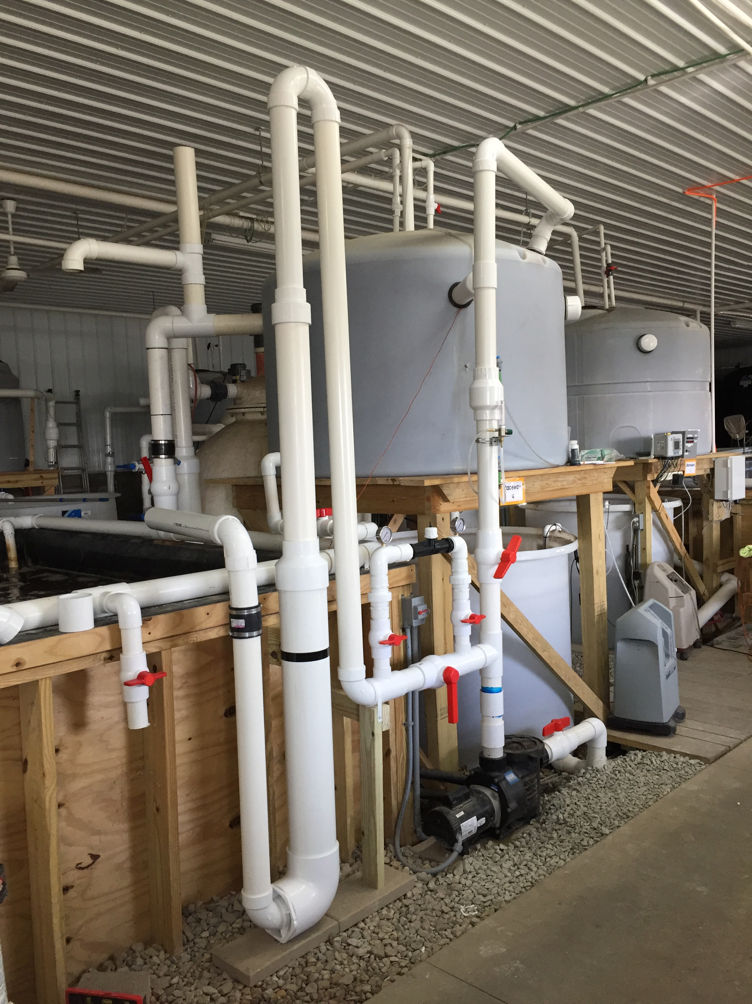
Oxygen Transfer Re-Engineered:
Parts:
Home Health Oxygen Concentrator
Venturi Injector
Oxygen Saturator

Slide 6
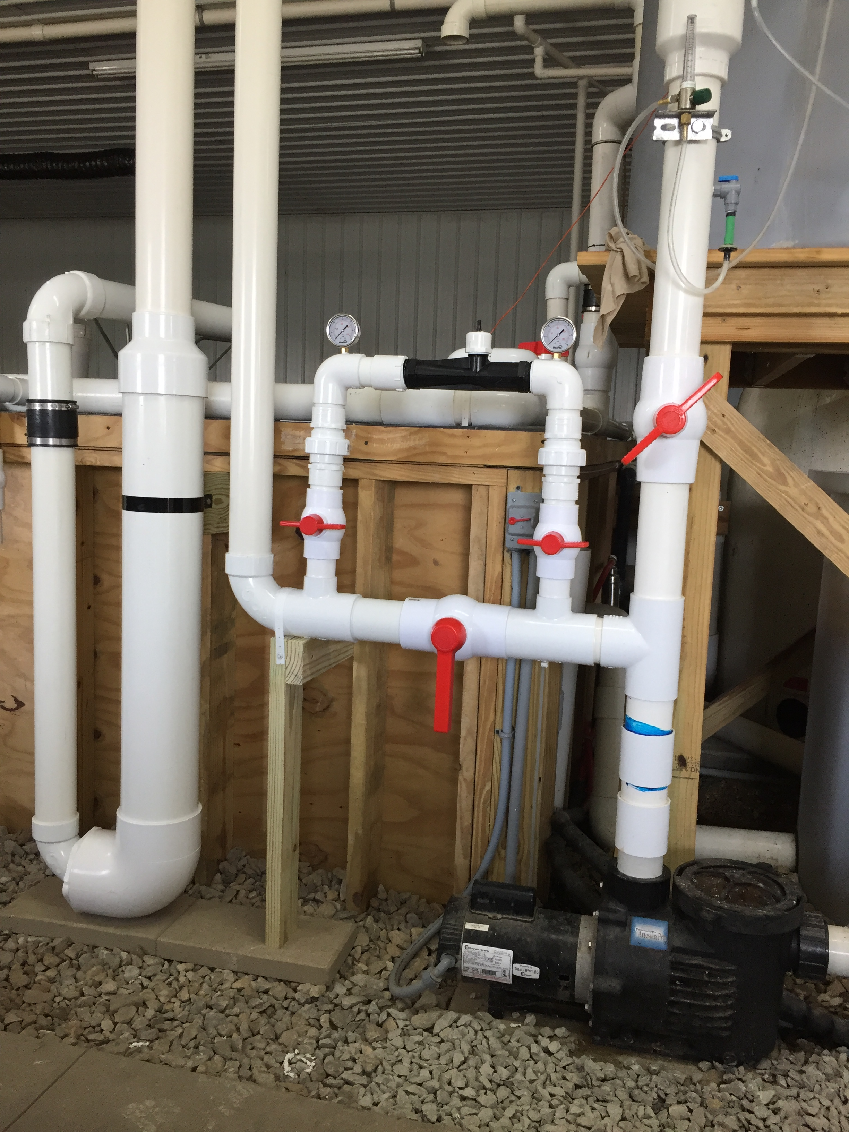
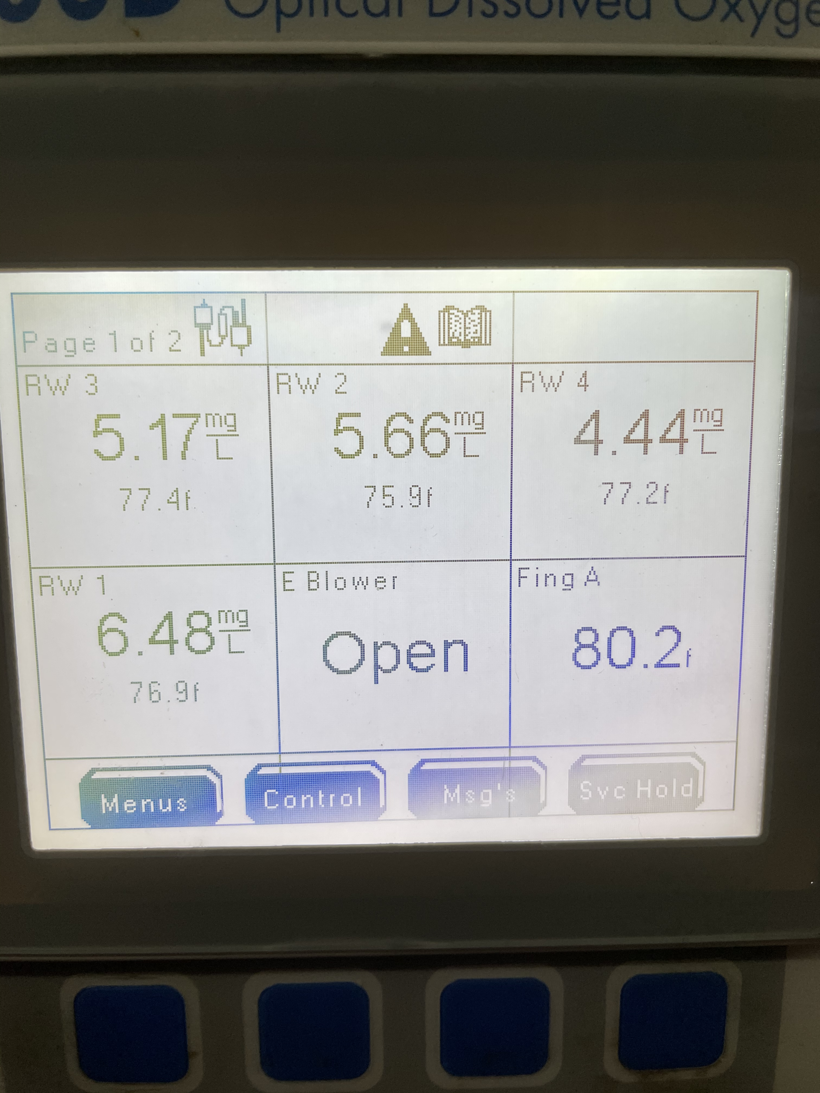
O2 Readings
(Prior readings often dropped between 2.0 mg/L and 3.0mg/L)

Slide 7
Production levels were static in 2018 and 2019. By addressing oxygen saturation in 2020, production levels grew more than 25%.

Slide 8
Topline sales increased 23% in 2020 and is projected to increase 50% in 2021.

Slide 9
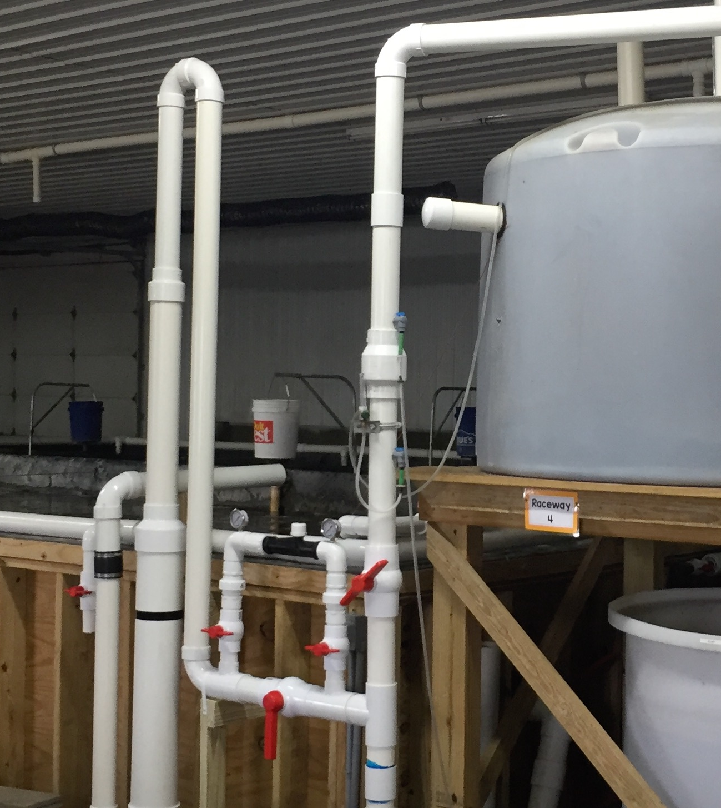
Benefits:
Cost-effective to install
Increase in production
Increase in profitability

Slide 10
Success!

Slide 11
Ripple Rock Fish Farms LLC (Craig & Traci Bell)
Stagecoach Fish Farms (CJ Johnson)
- Freedom Fish Farms (Curtis Gram)

