Slide 1
SARE Grant for Pepper Berries Urban Farm
!. Steps To Take….
A. Read the grant carefully.
B. Look at other grants that are similar to your idea. Can you expand upon them or do you have a completely different and new idea.
C. Think through how your grant will work and who it will benefit.
D. Hit as many of the critical points that your grant is trying to target.
E. Discuss with others your proposal, write several drafts and let them read your final draft.
F. Work with other initiates to help get your project accomplished. (University, Master Gardeners, Community Centers, etc.)
Growing Produce Vertically instead of Horizontally to get a High Production on a Small Urban Farm

Slide 2
The Vision for Pepper Berries Urban Farm
Teaching Gardening Classes on……..
Growing up instead of Out…..With towers, fencing, milk crates
Gardening where ever you are…… With pallets, barrels, gutters, hay bale, containers, etc.
Teaching Cooking Classes on……..
How to cook with fresh produce.
How to can your produce to store for future use.
How to dehydrate your produce
How to freeze your produce

Slide 3
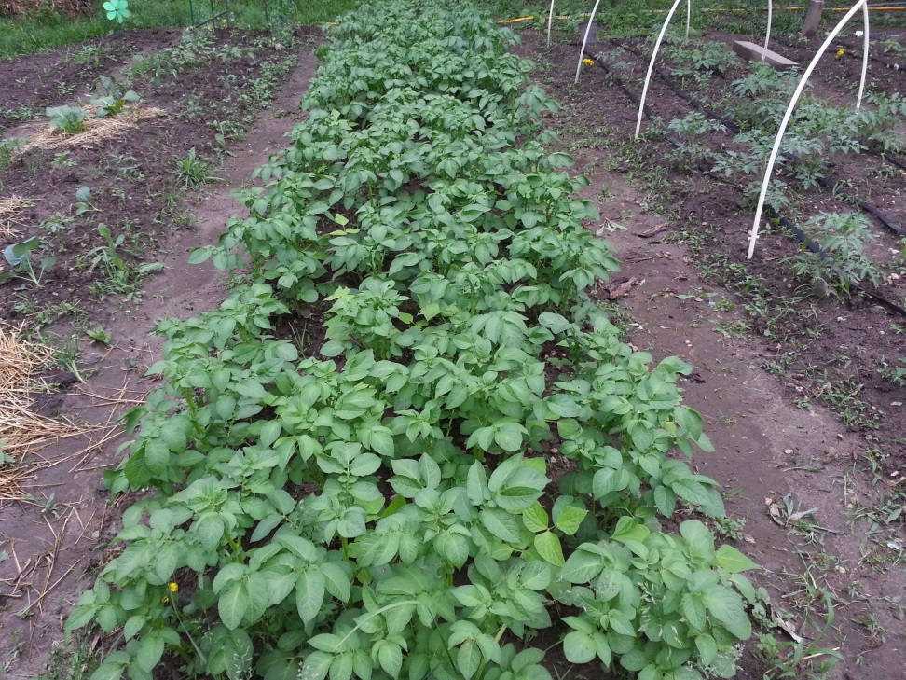
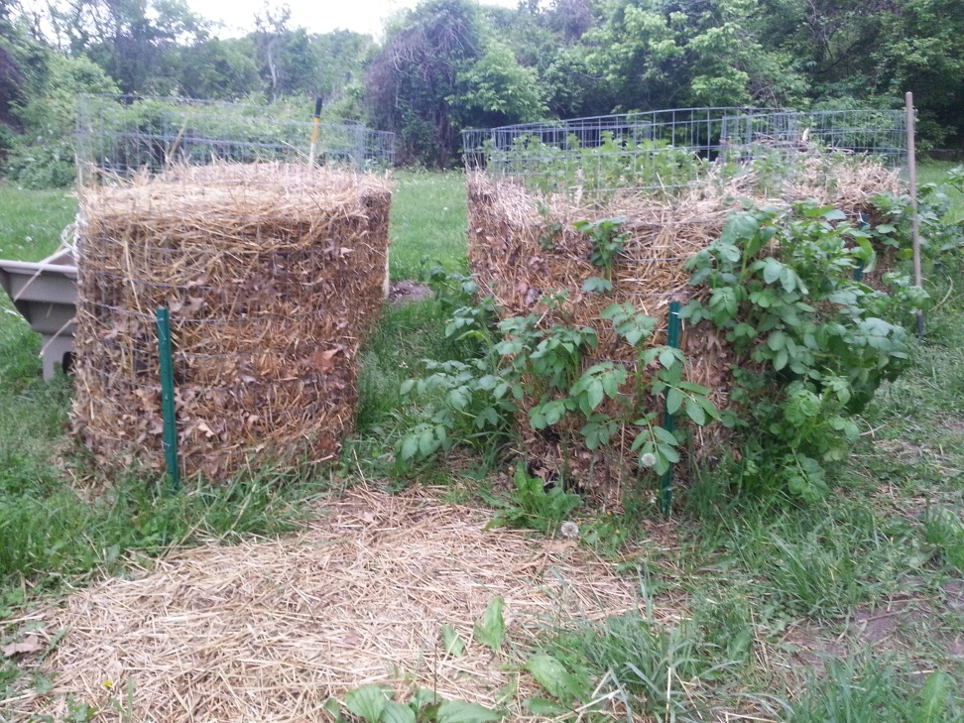
Growing Potatoes in 2015

Slide 4
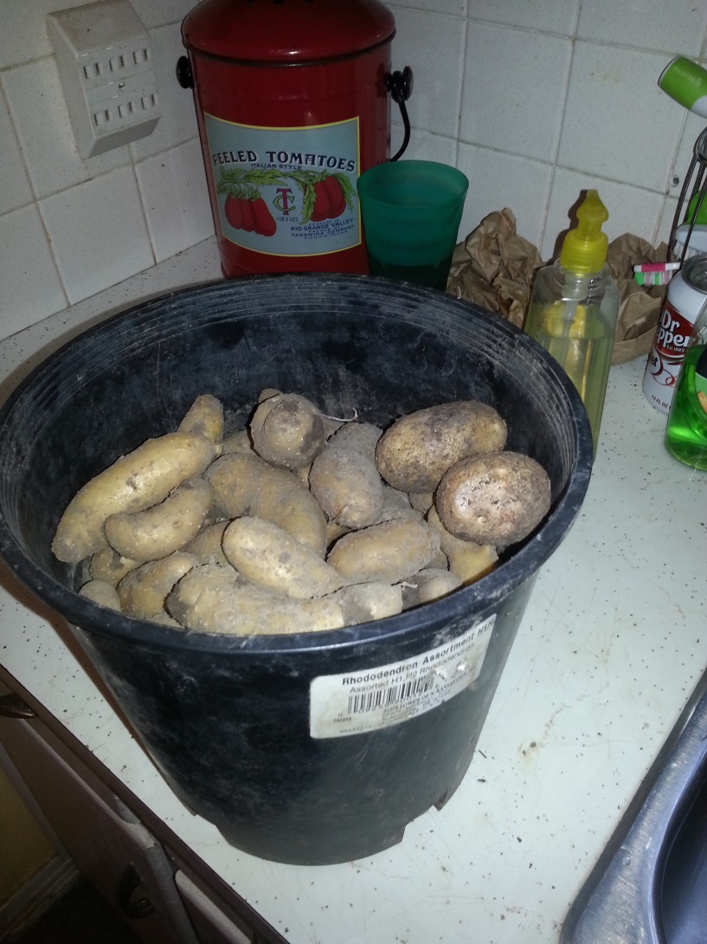
Growing Potatoes in 2016
We grew potatoes 5 different ways this year….
Smaller towers
In the ground
In potato bags
In containers
In raised beds

Slide 5
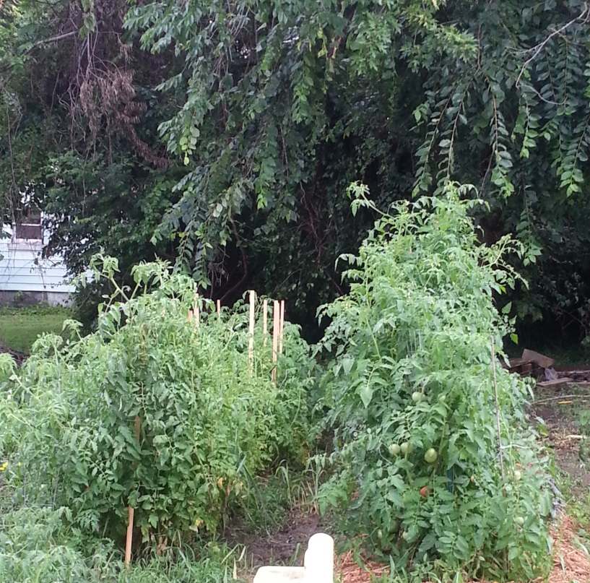
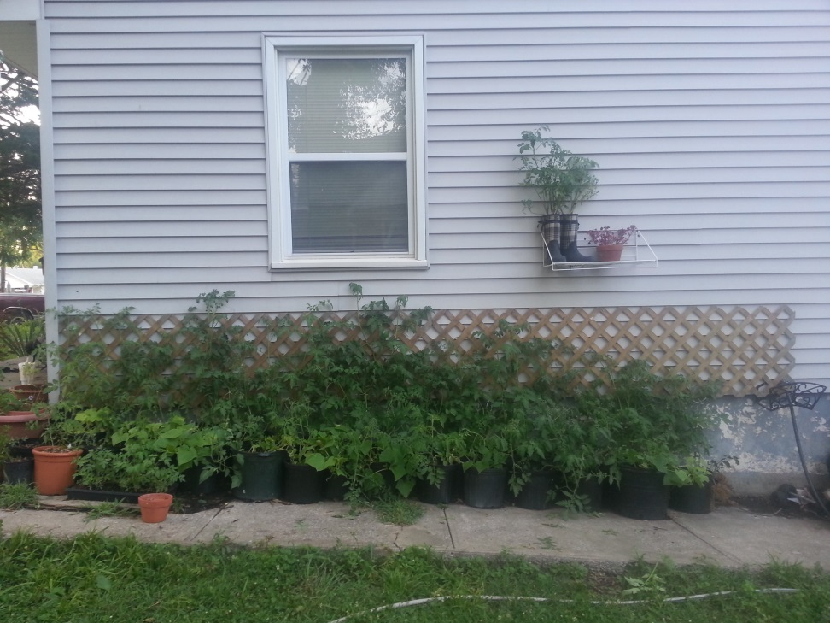
We grew tomatoes….

Slide 6
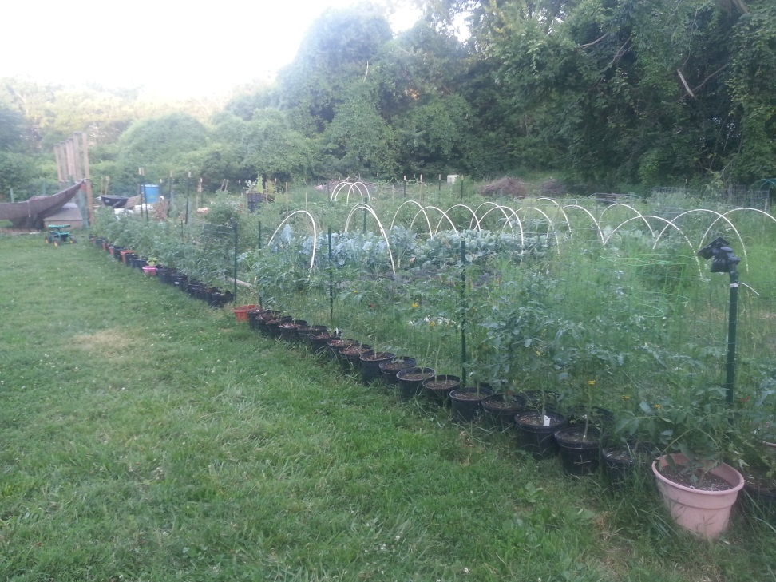
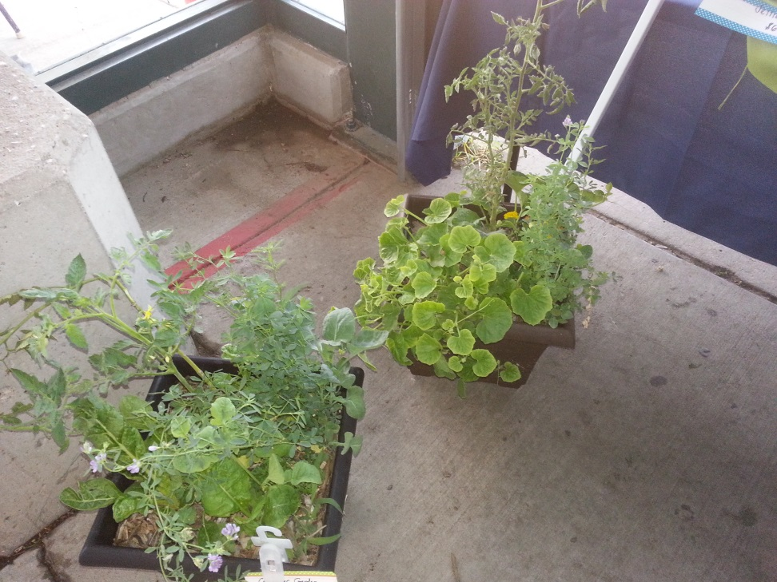
And more tomatoes

Slide 7
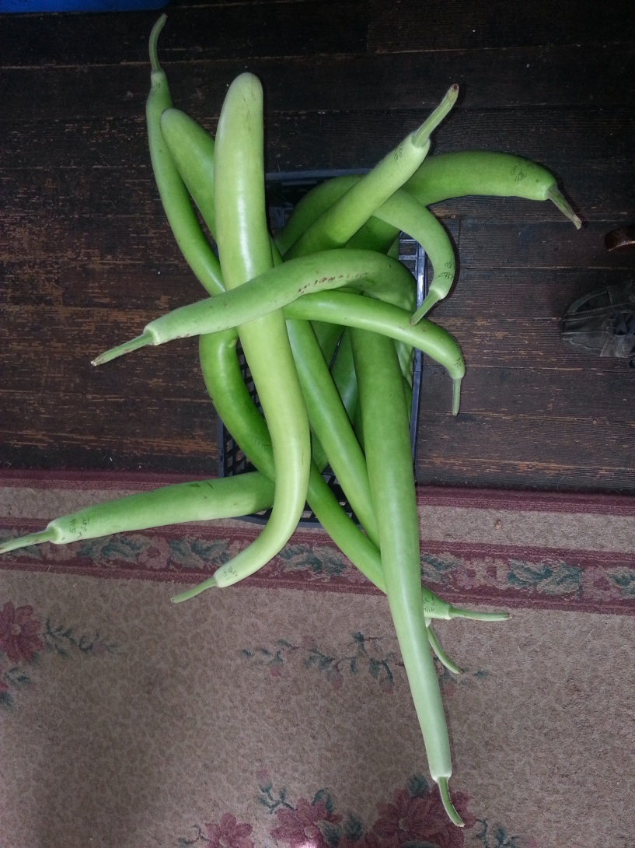
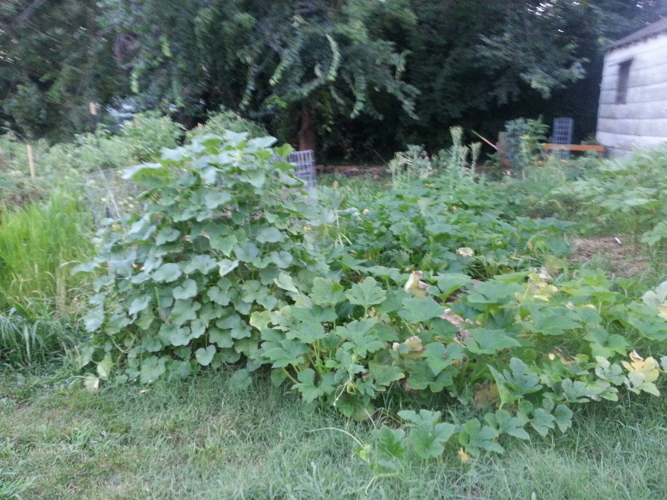
Cucuzza Squash

Slide 8
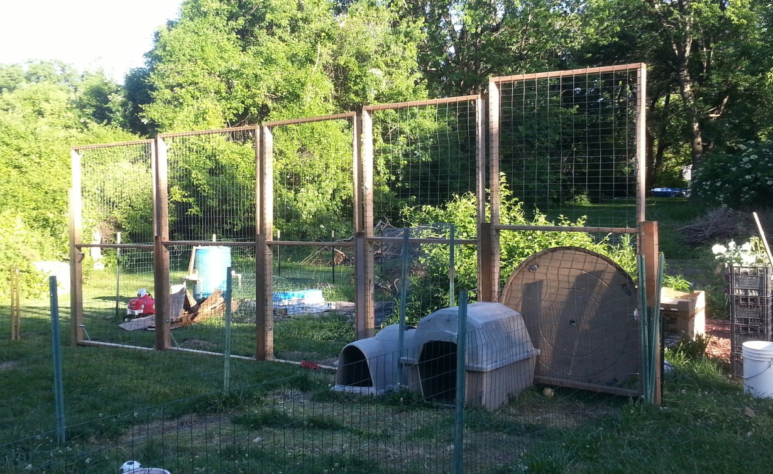
Cucuzza Squash
This is the wall we built for the cucuzza this year, it is 25 ft. wide x 8 ft. high
This could be build for a side of a garage, shed or even your house.
Cucuzza can feed an army!! We harvested over 50 Lbs every week.

Slide 9
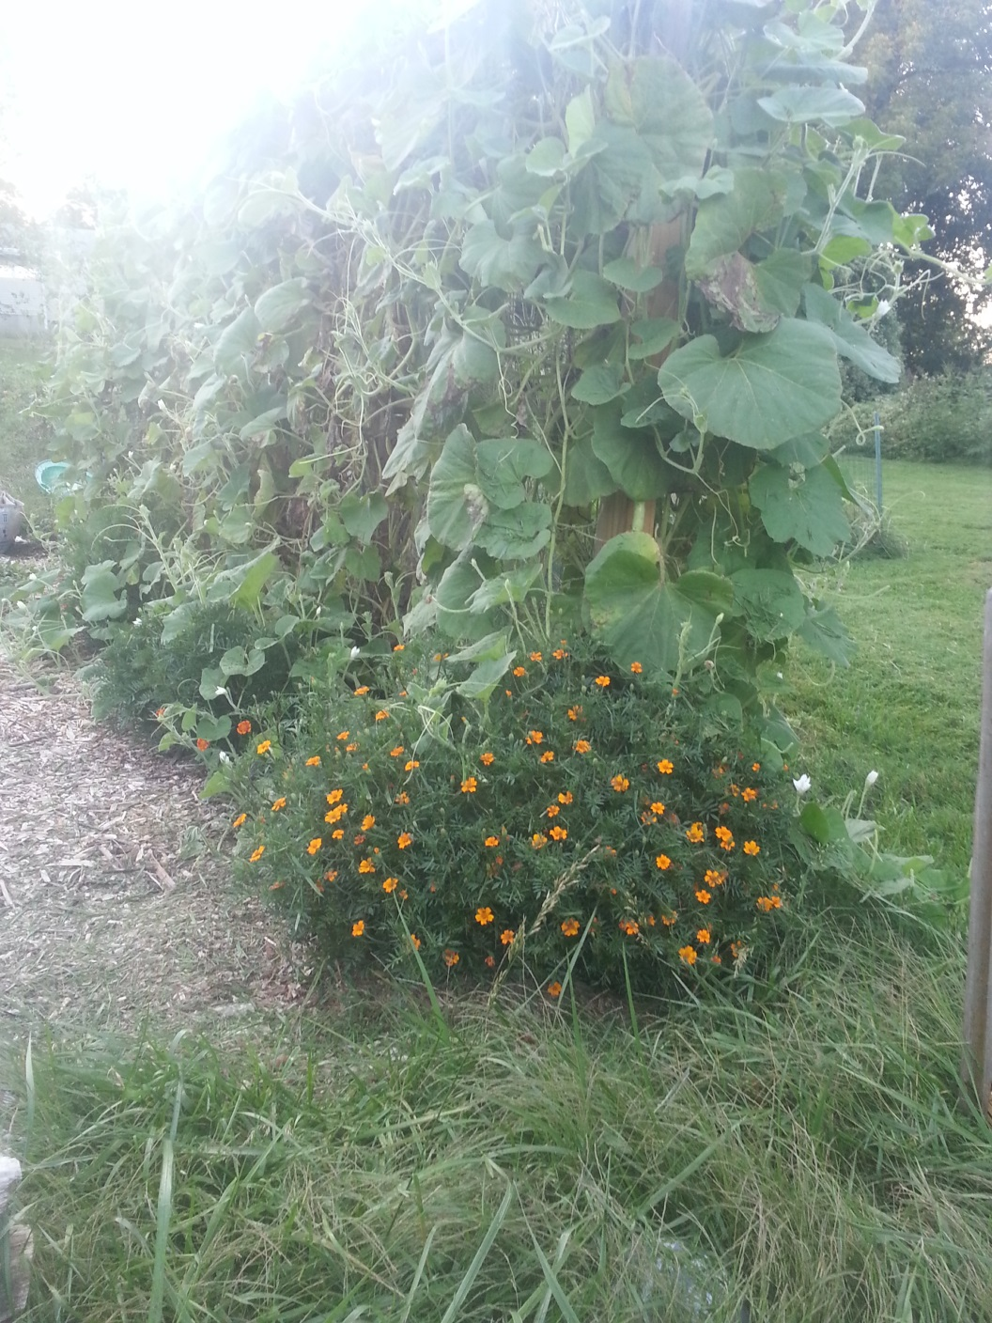
Cushaw Squash
We built a metal form out of 2 cattle guard s and metal garden T stakes
8 ft. tall and 8 ft. wide
It worked great for the cushaw squash to grow on. We harvested them at 10 lbs. We harvested over 100 lbs. Next year we will let them go up to 20 lbs.
This will be an easy growing structure for any urban grower next to their house, garage or shed.

Slide 10
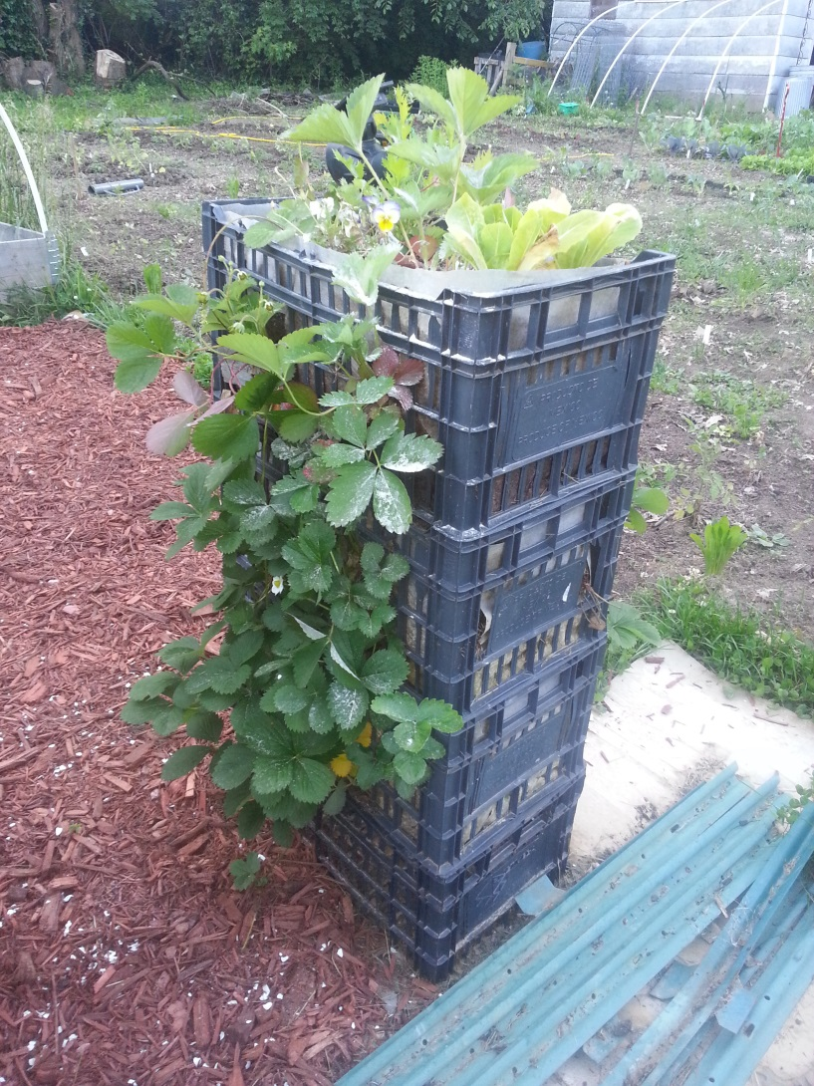
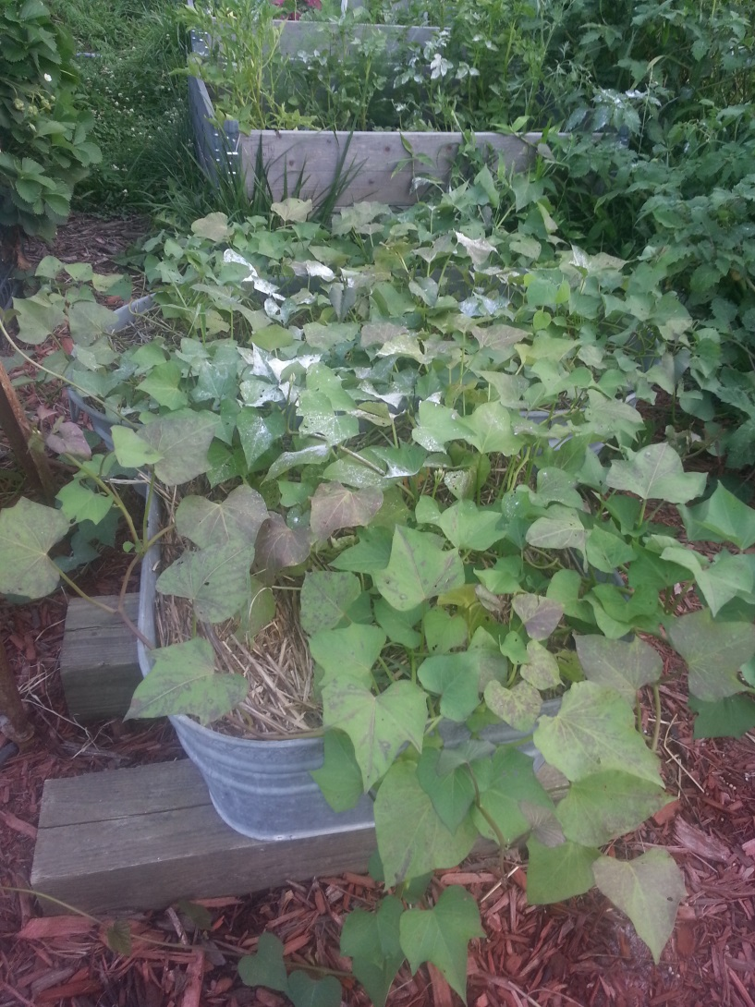
Building the sample garden

Slide 11
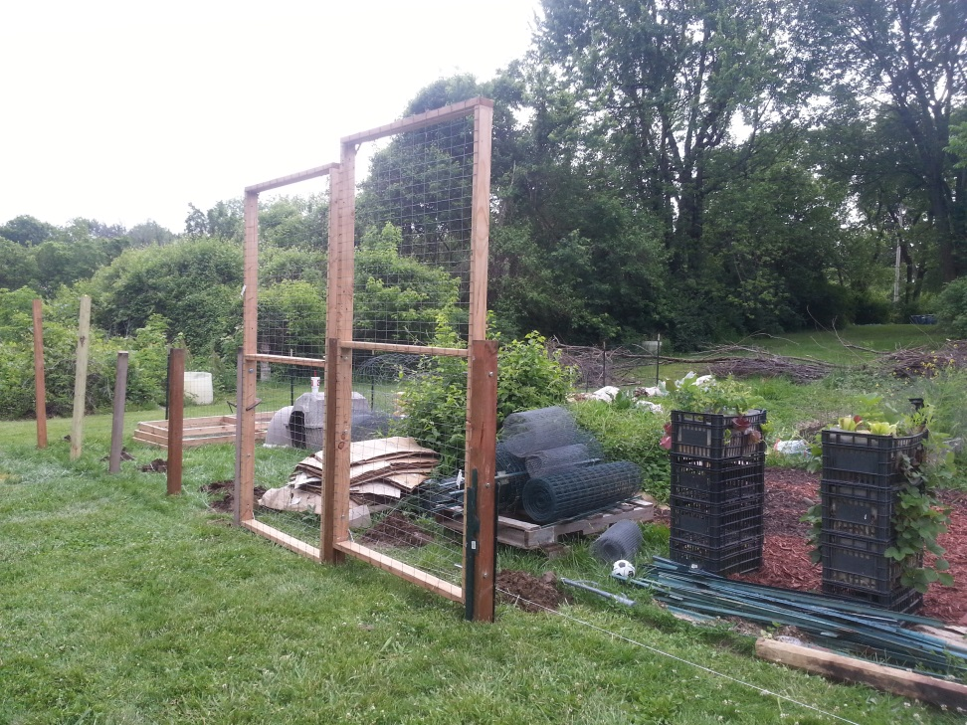
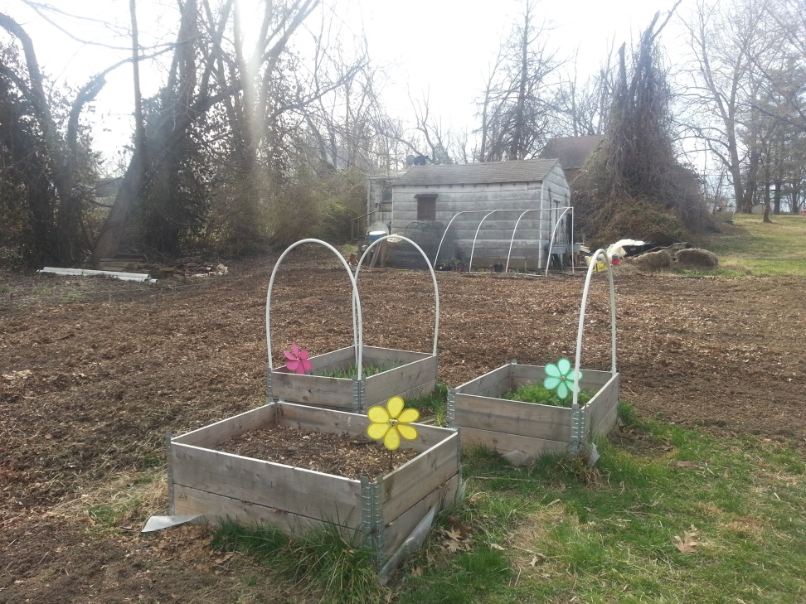
Sample garden

Slide 12
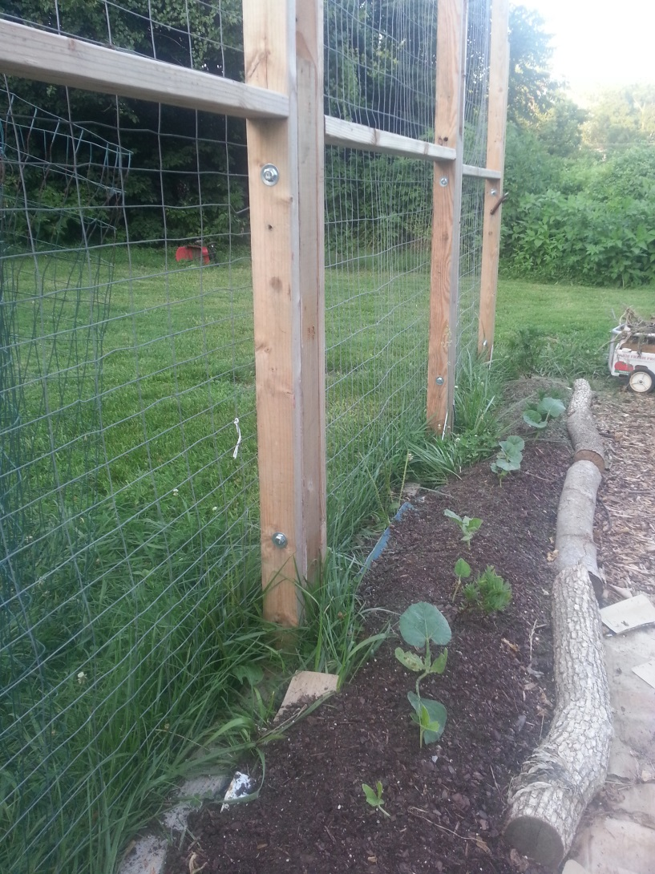
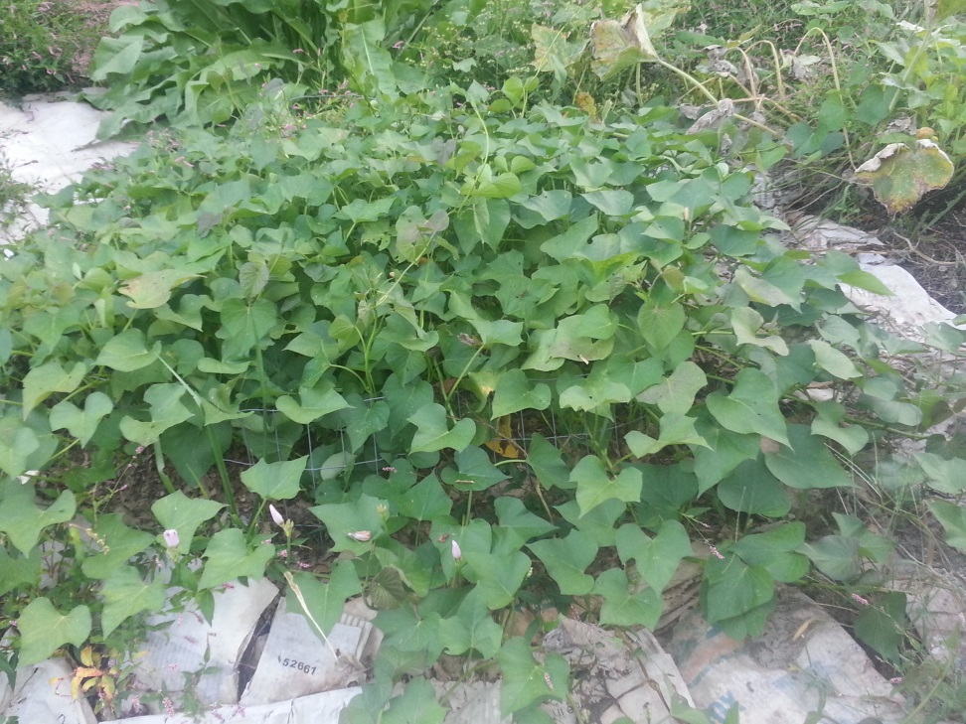
Sample garden

Slide 13
What we accomplished in 2016
Built the beginnings of the sample garden
Milk Crate Gardens
Raised Beds gardens
Tomatoes in Containers
Sweet Potatoes in Containers
Strawberries Containers
Cucumbers Containers
Container Gardens w /4
Worked with 4 people for grant
Potatoes in 5 different growing techniques
Cucuzza & Cushaw walls
Sweet Potatoes & Potatoes under leaves
Smaller Potato Towers
Peanut Towers
Put in blueberry, raspberry & black berries
Taught 5 garden classes
Taught 9 induvials hands on in the garden how to plant, maintain and harvest produce

Slide 14
What to accomplish in 2017
Finish building the sample garden……
50 gallon barrel garden
Pallet gardens
Gutter garden
Hydroponic garden
Self watering raised bed
Hay Bale garden
Teach more garden class
Give away more types of garden supplies
Plant container and ground mulberry and grapes

