Slide 1
Welcome!
CO-OP + Community Building
Poughkeepsie, New York
March 23, 2024

Slide 2
Purpose
To increase financial and social sustainability, and improve mental health, well-being, and community connections for Black Farmers Statewide.
To network Black farmers statewide to support and grow our individual and collective power.
USDA SARE Northeast Grant:
Building and Strengthening Social and Economic Sustainability Among NY State Black Farmers
Notes:
Mel

Slide 3
Sustainable Agriculture Research and Education (SARE)
Partners
Notes:
Provide background on SARE grant (collaboration from 2021-2024). These partners on the slide to support Black farmers in NYS to increase their financial and social sustainability through educational skillshares.

Slide 4
SARE skillshare topic areas
All skillshares organized through this grant are on topics selected by Black farmers that were surveyed at the beginning of the grant period. These topics include:
Business and entrepreneurship
Rural homesteading & self-sufficiency skills
Land acquisition/ownership

Slide 5
CO-OP Skillshare Survey + Attendance
Scan here

Slide 6
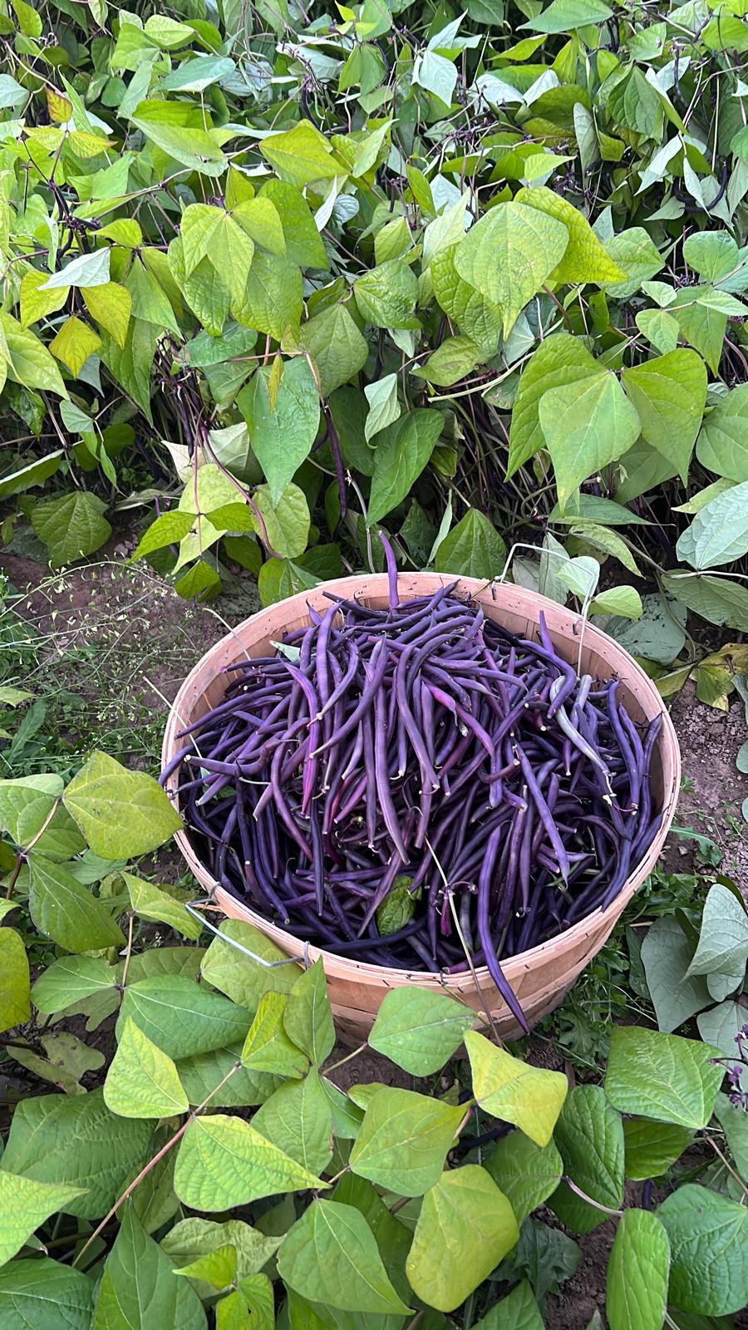
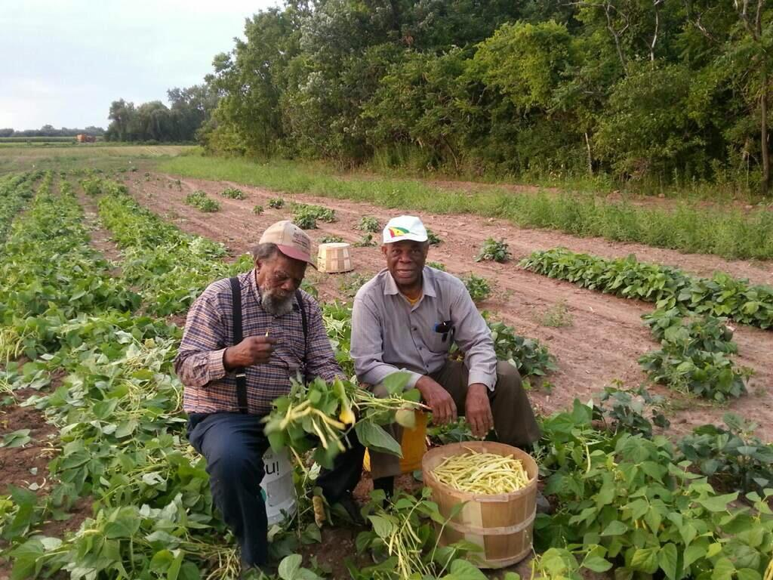
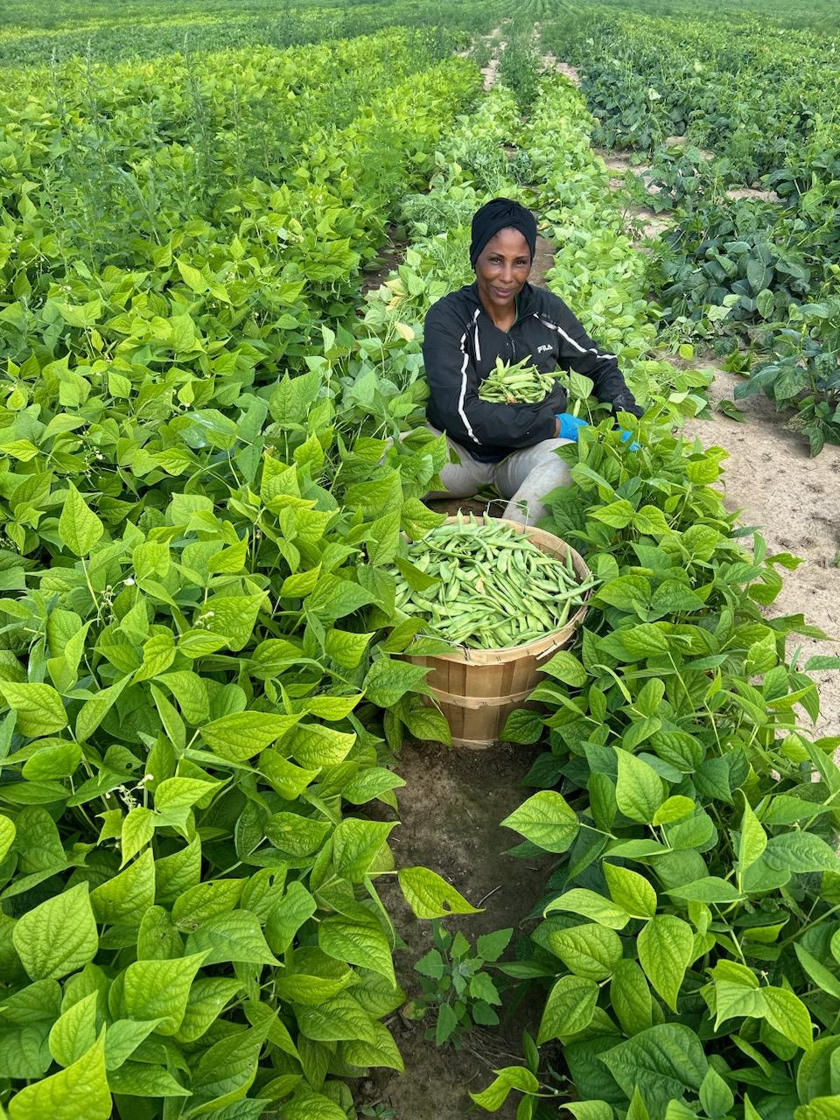
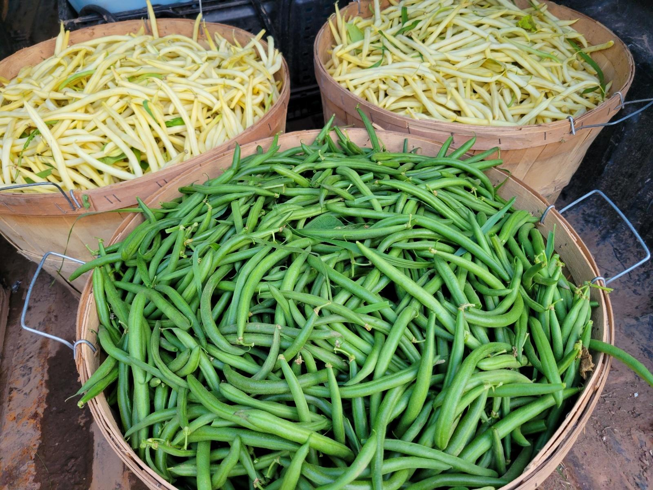
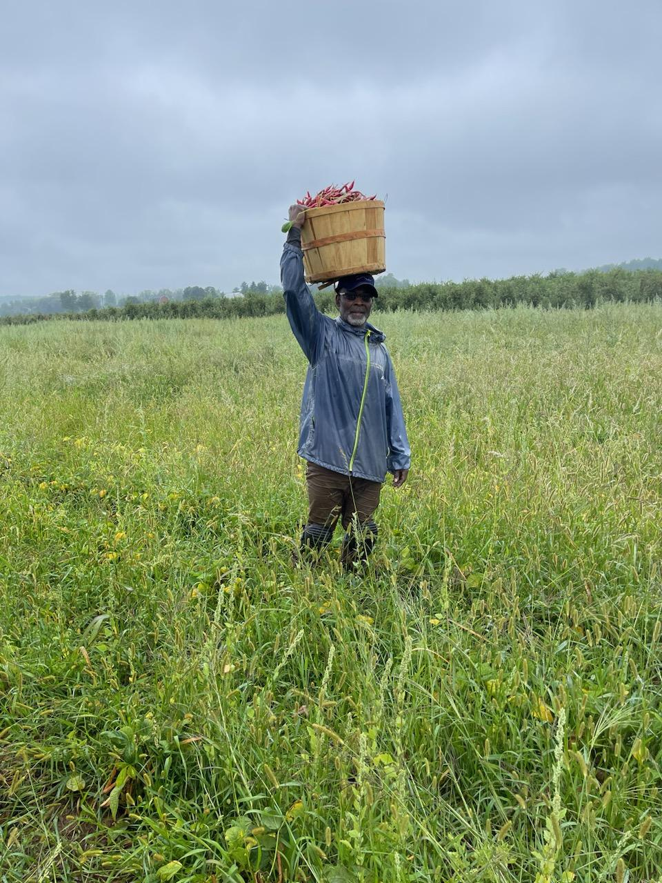
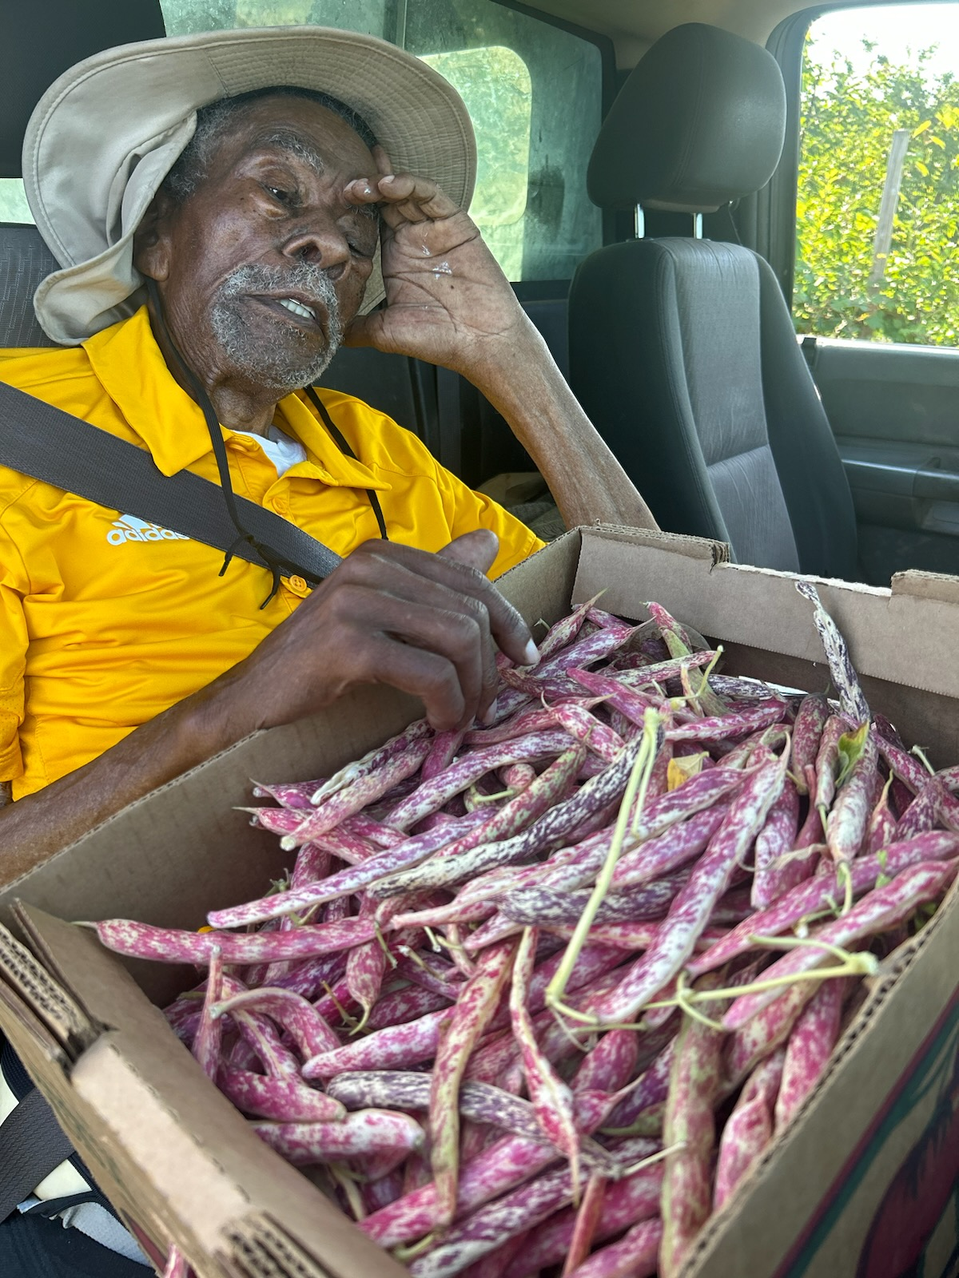
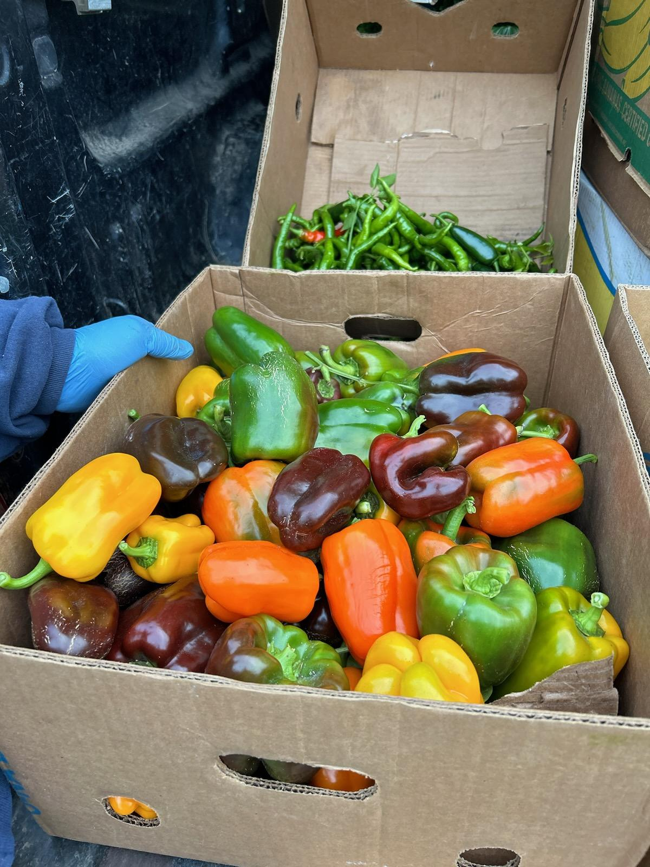
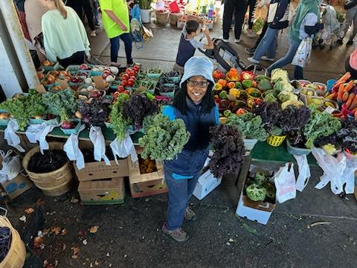
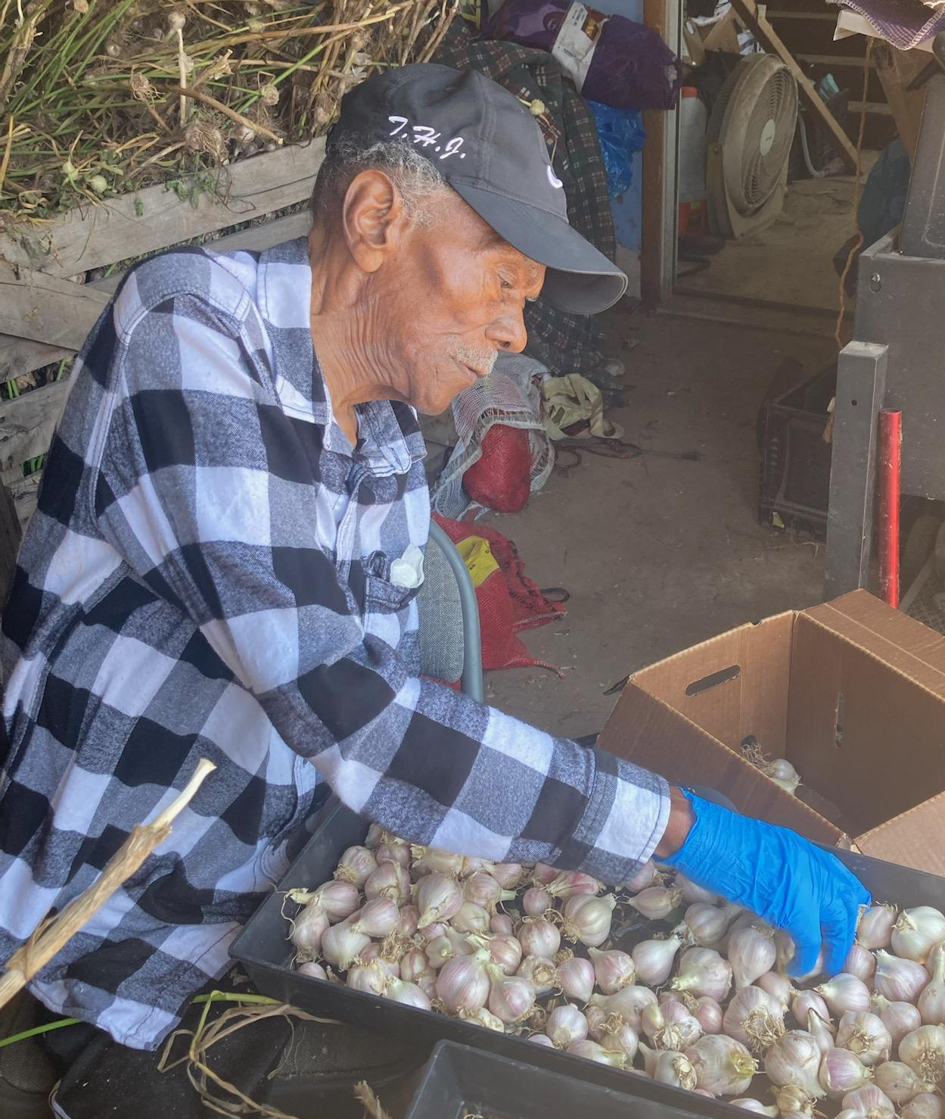
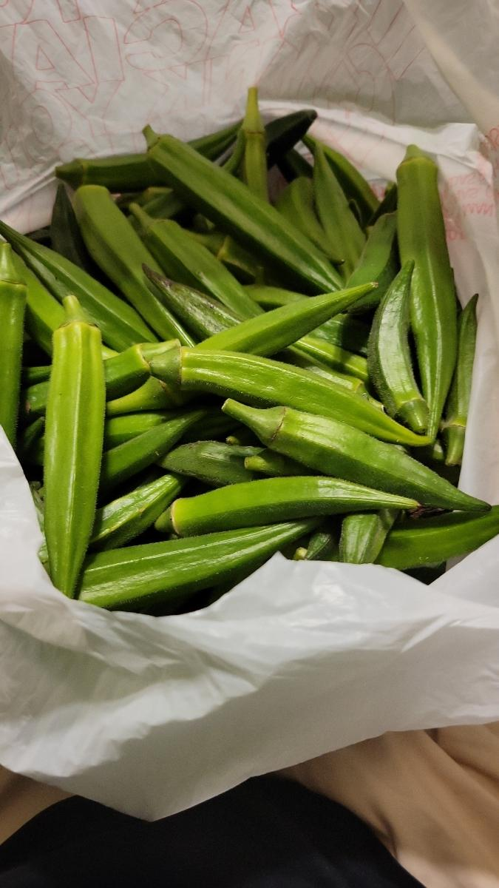
Moss Fresh Fruits & Vegetables, Albion, NY
Moss Family Farm

Slide 7
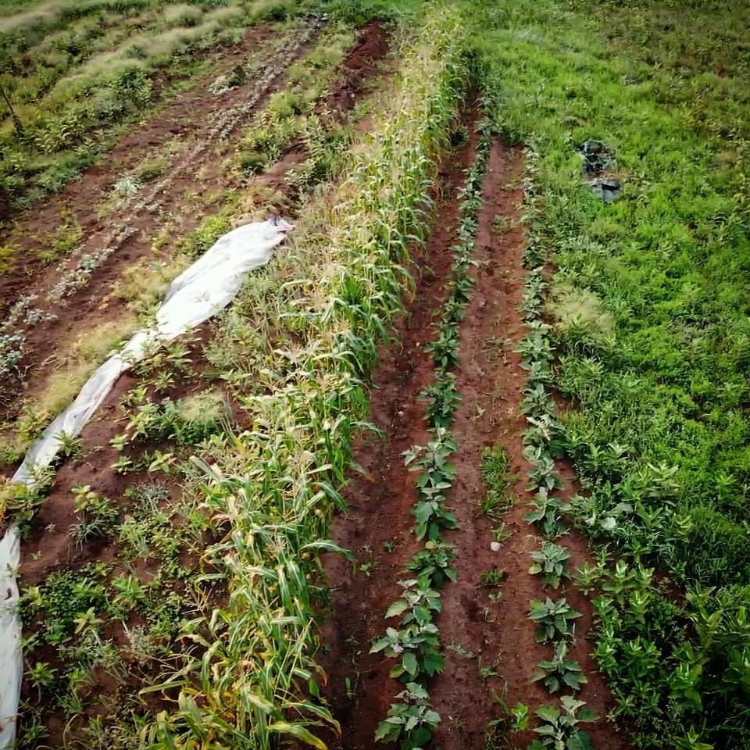
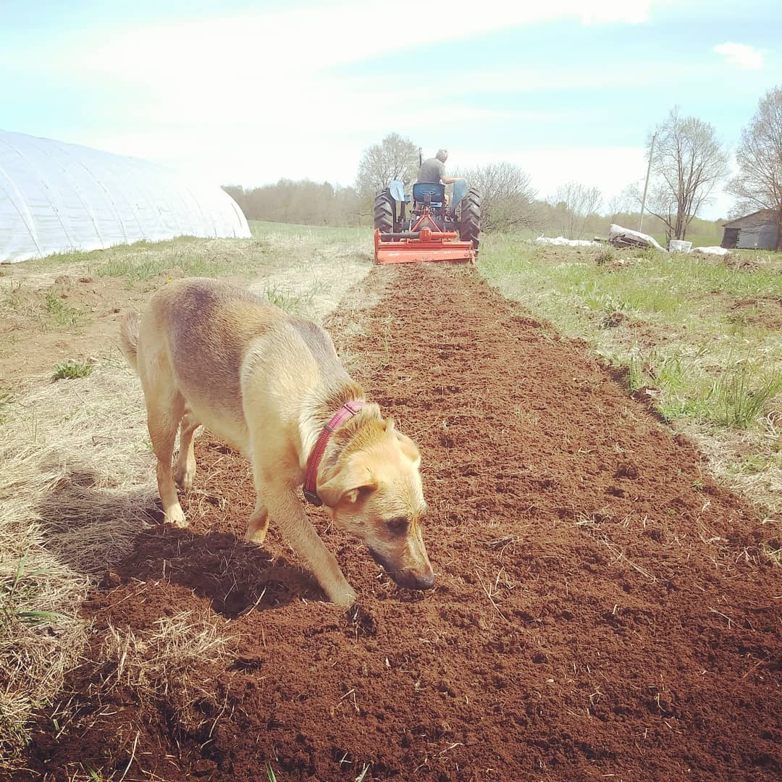
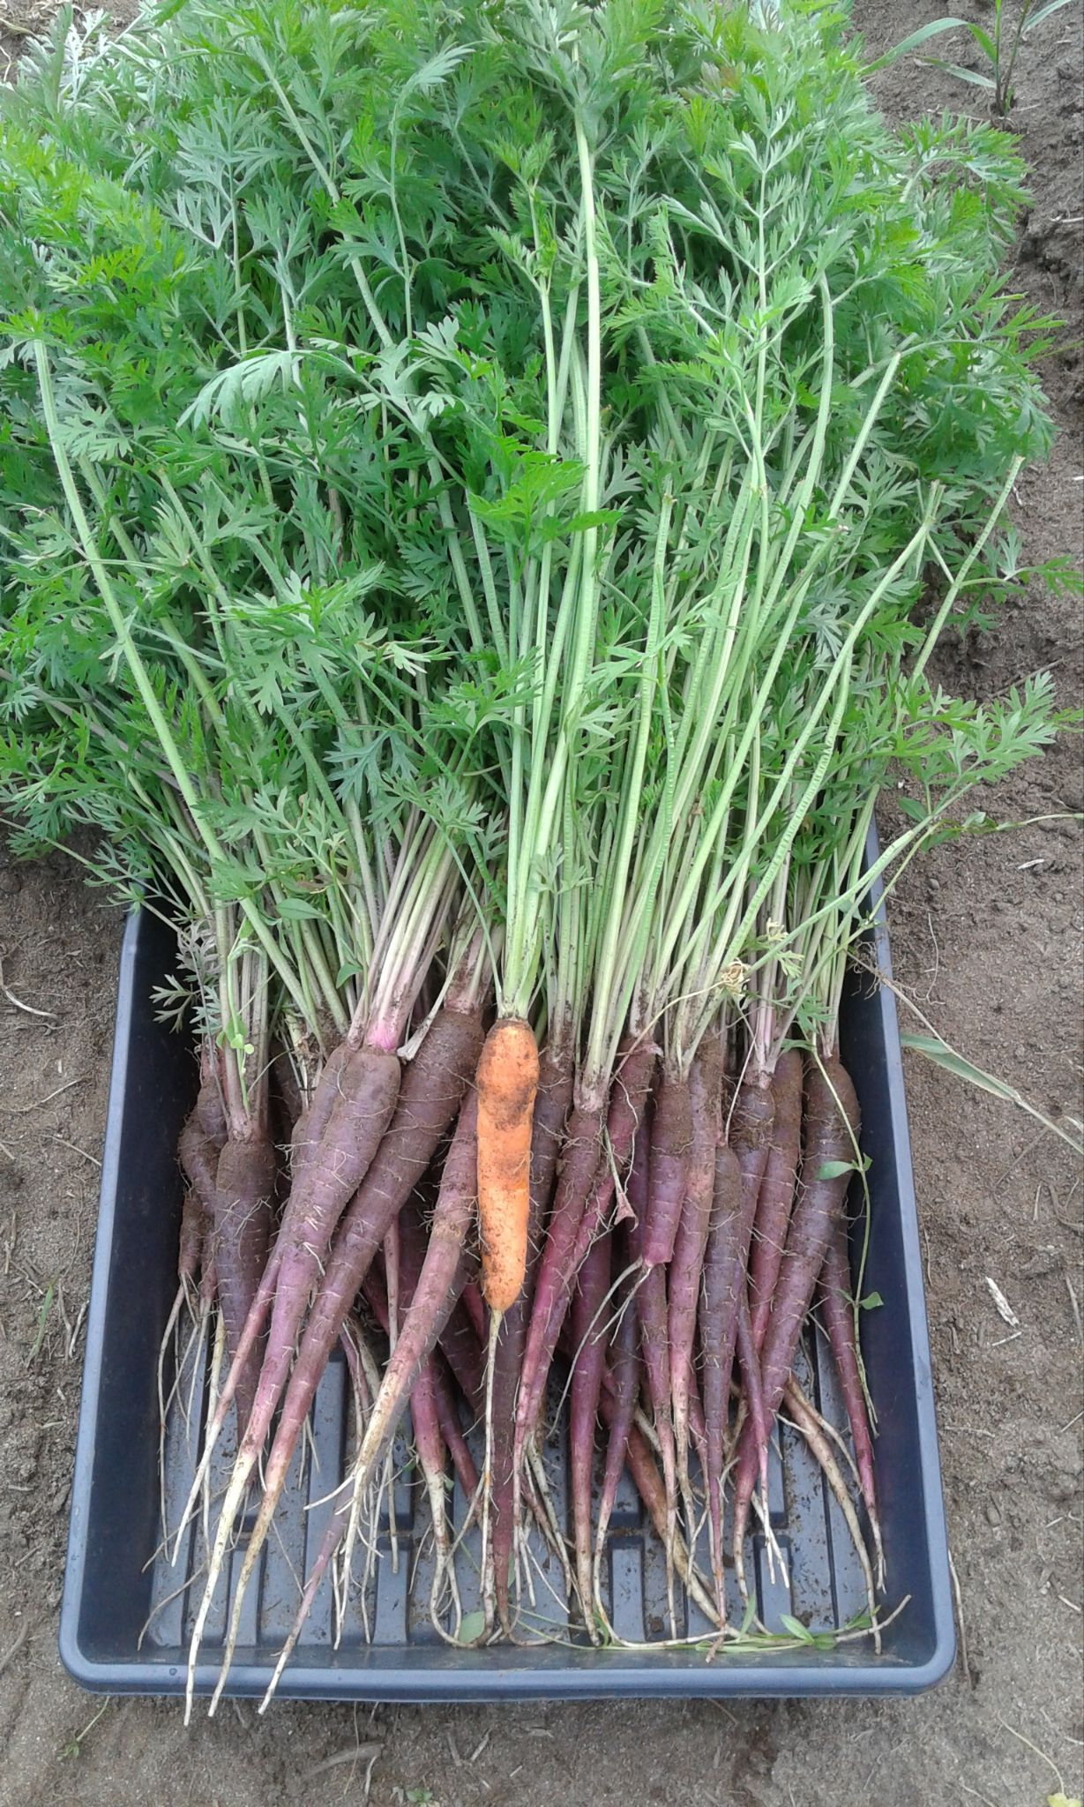
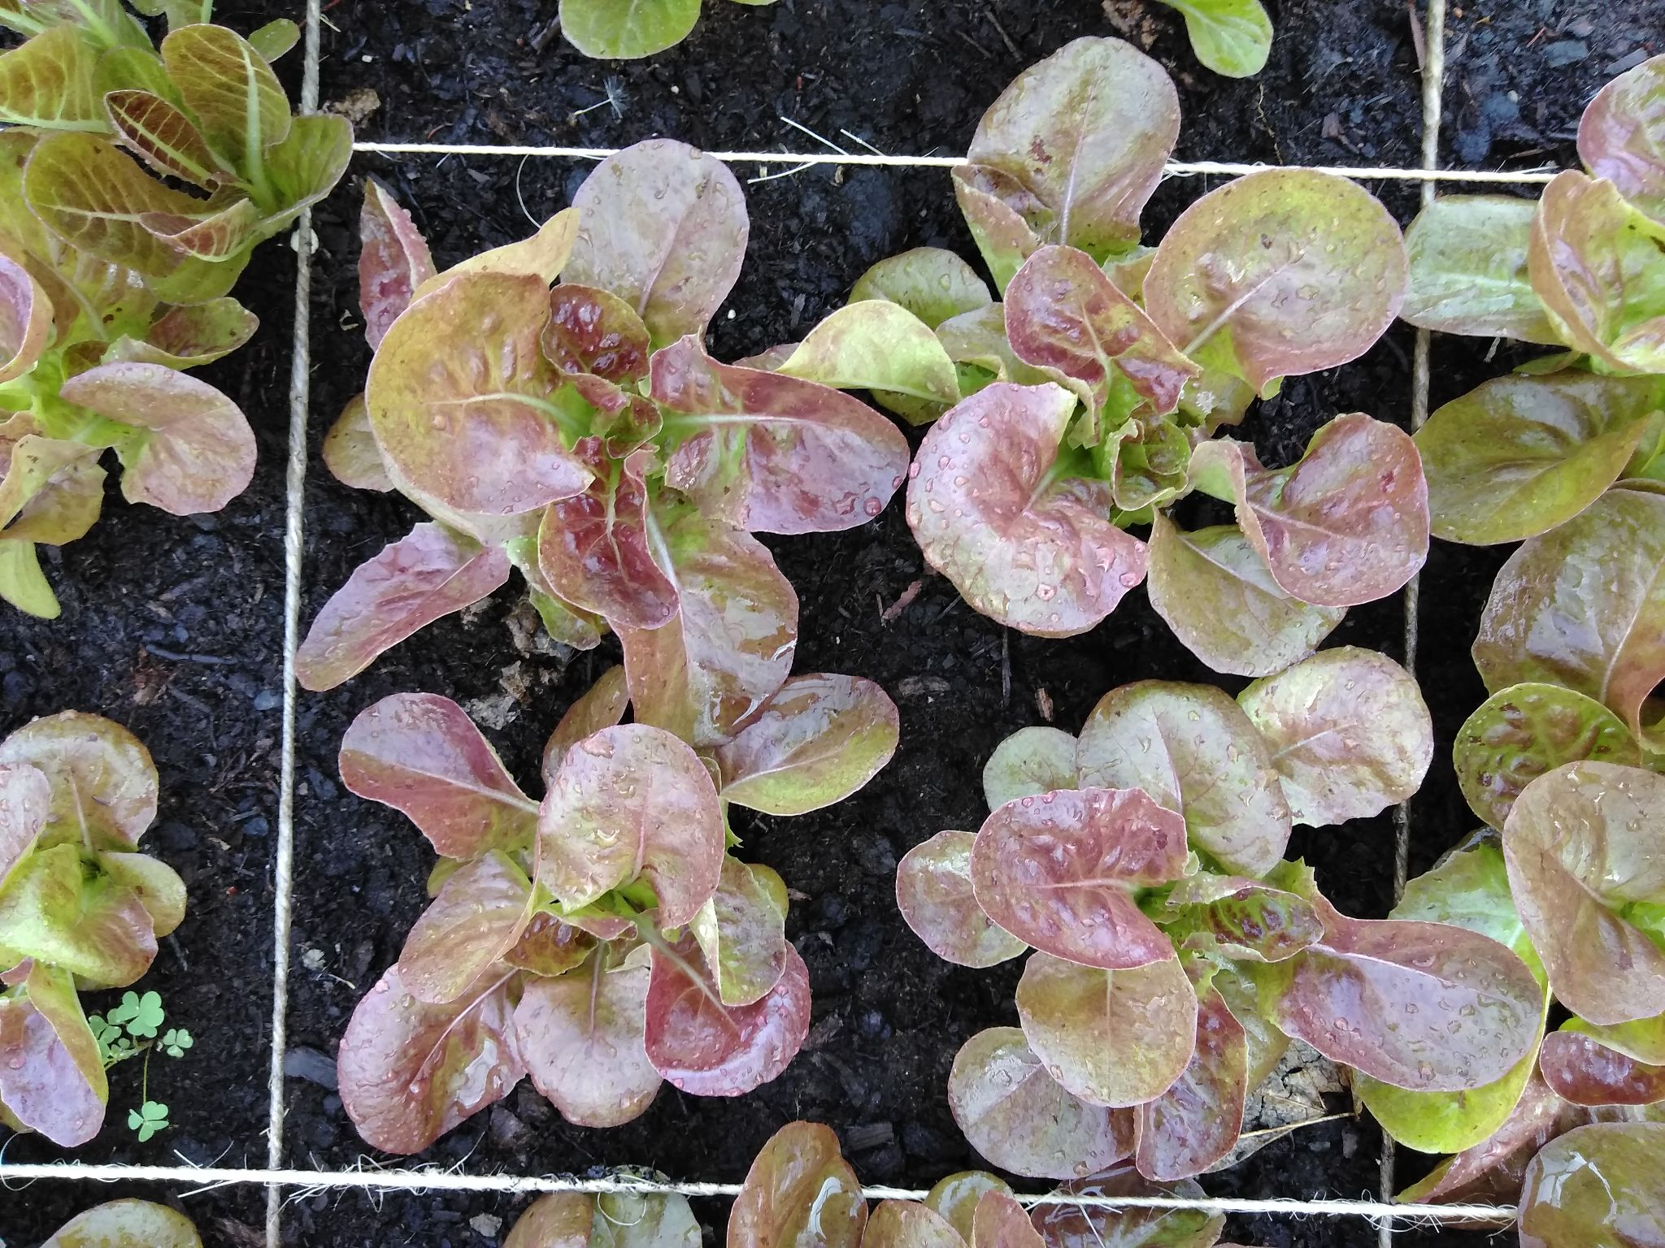
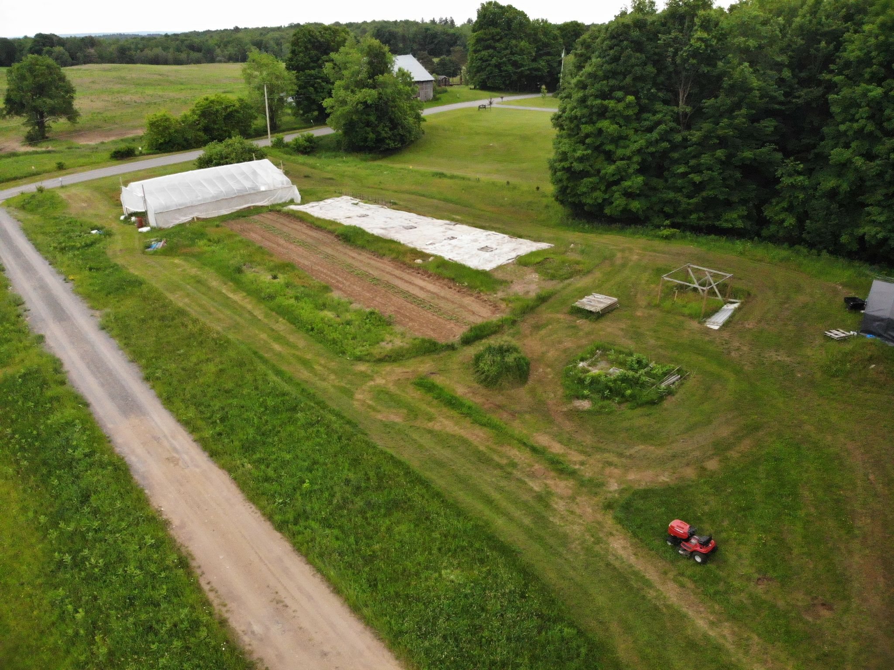
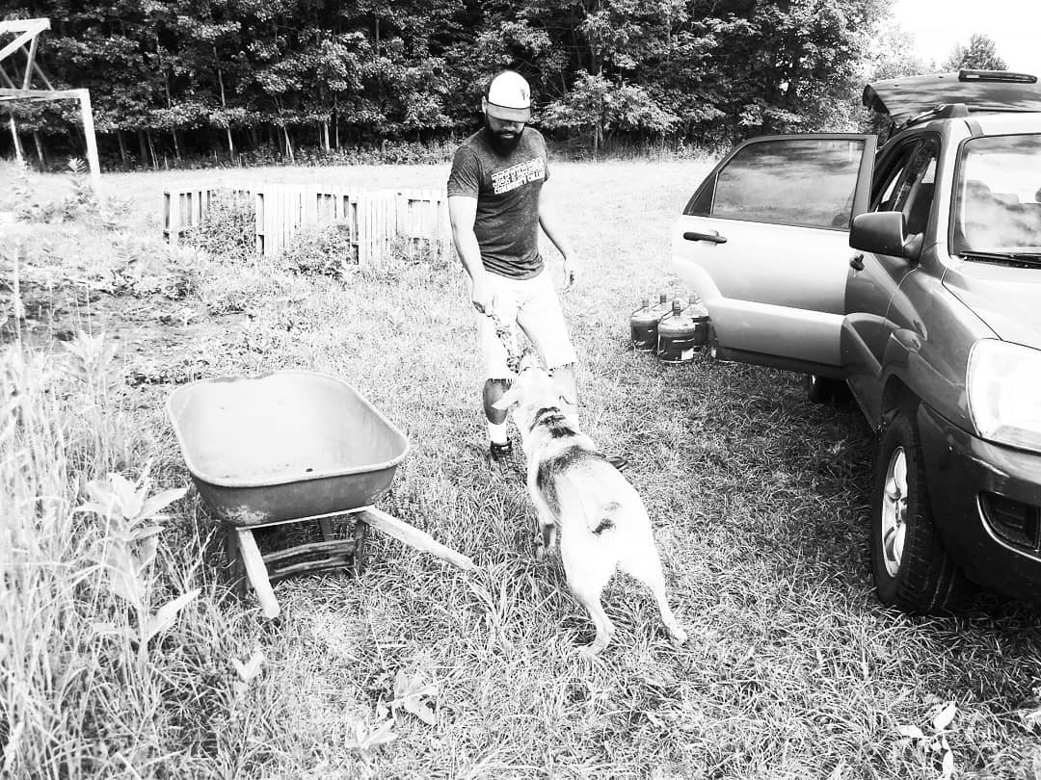
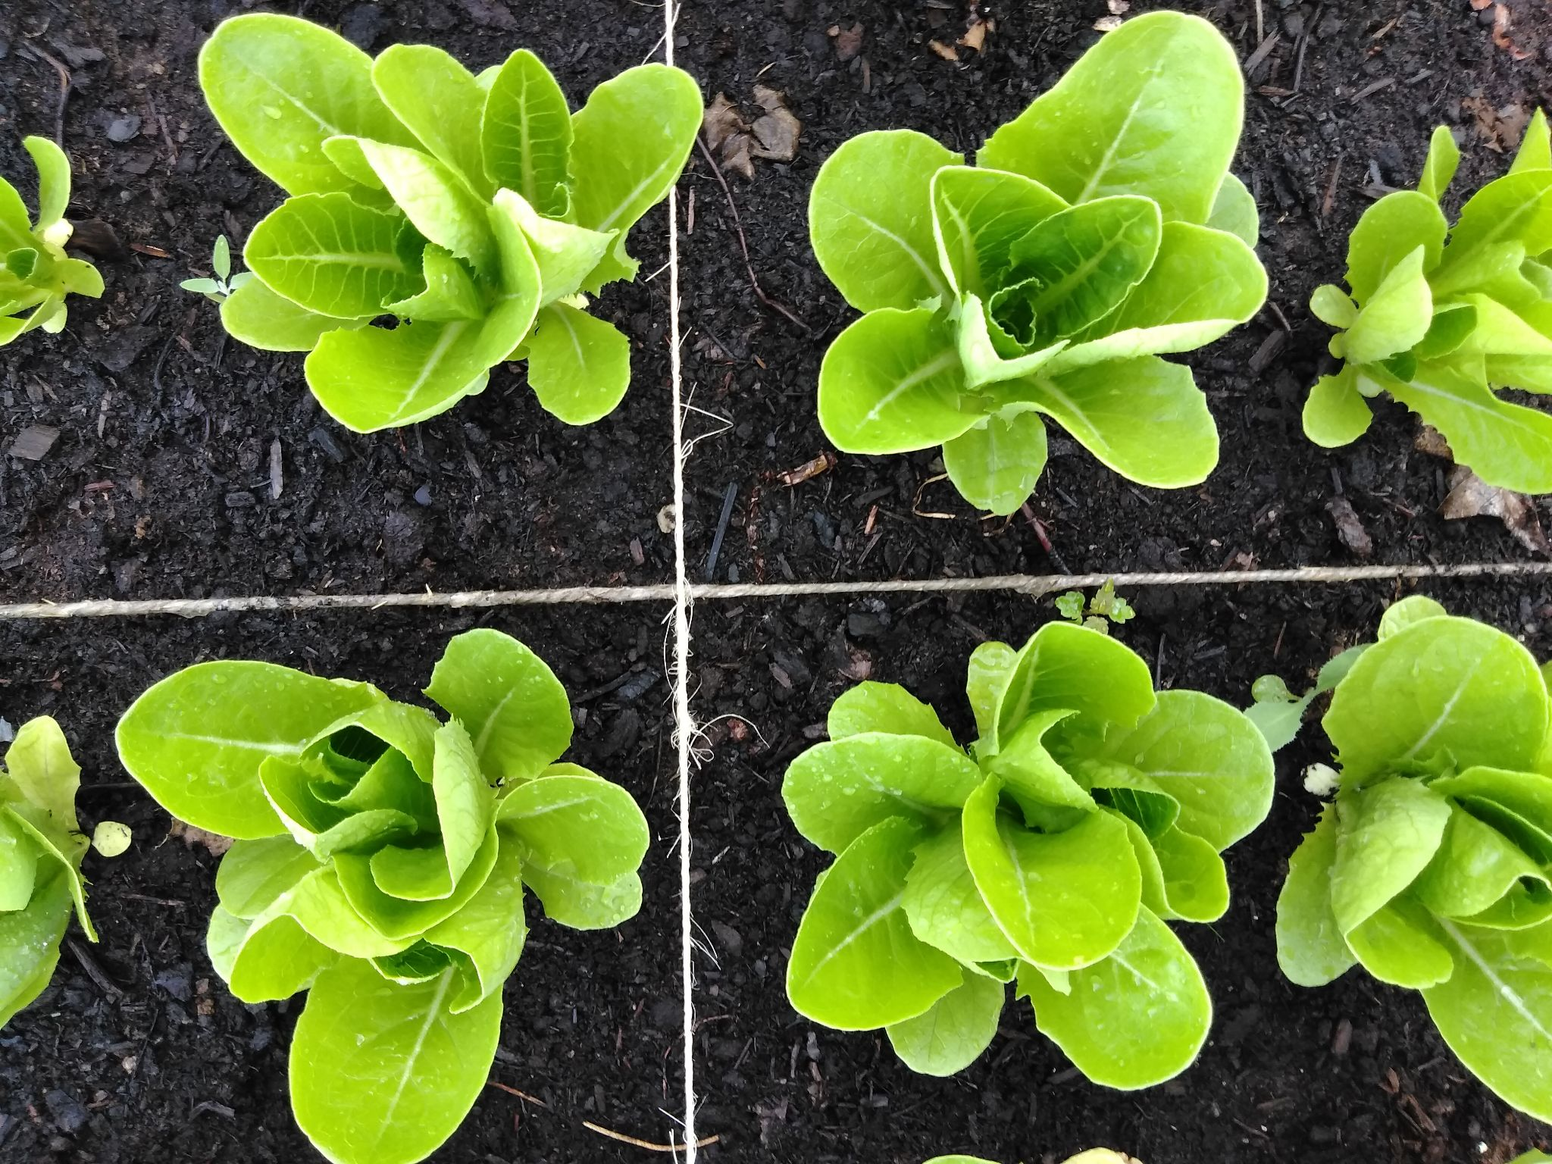
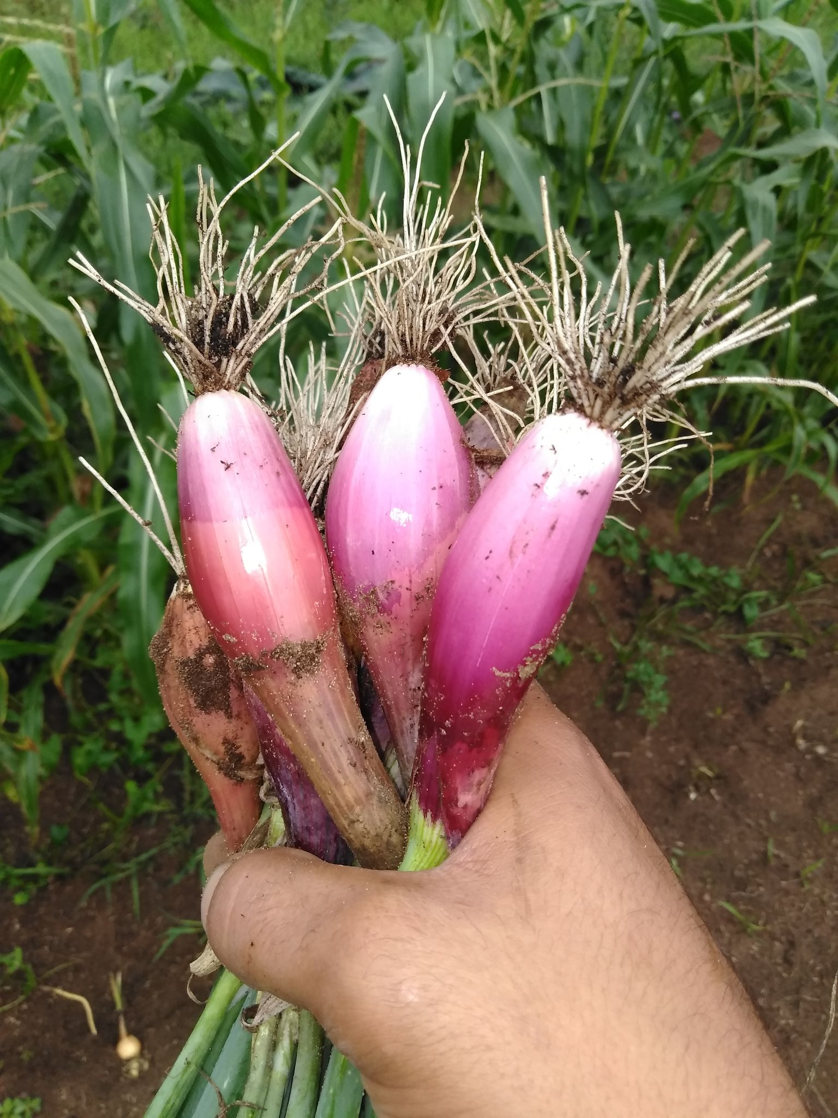
Julian Mangano- Restore Forward

Slide 8
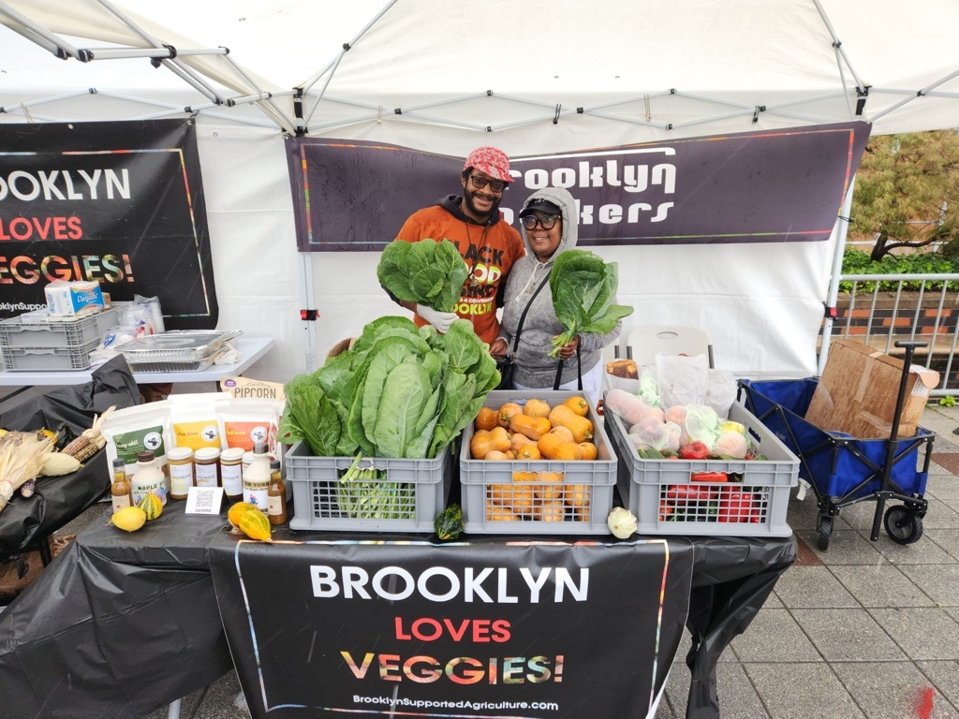
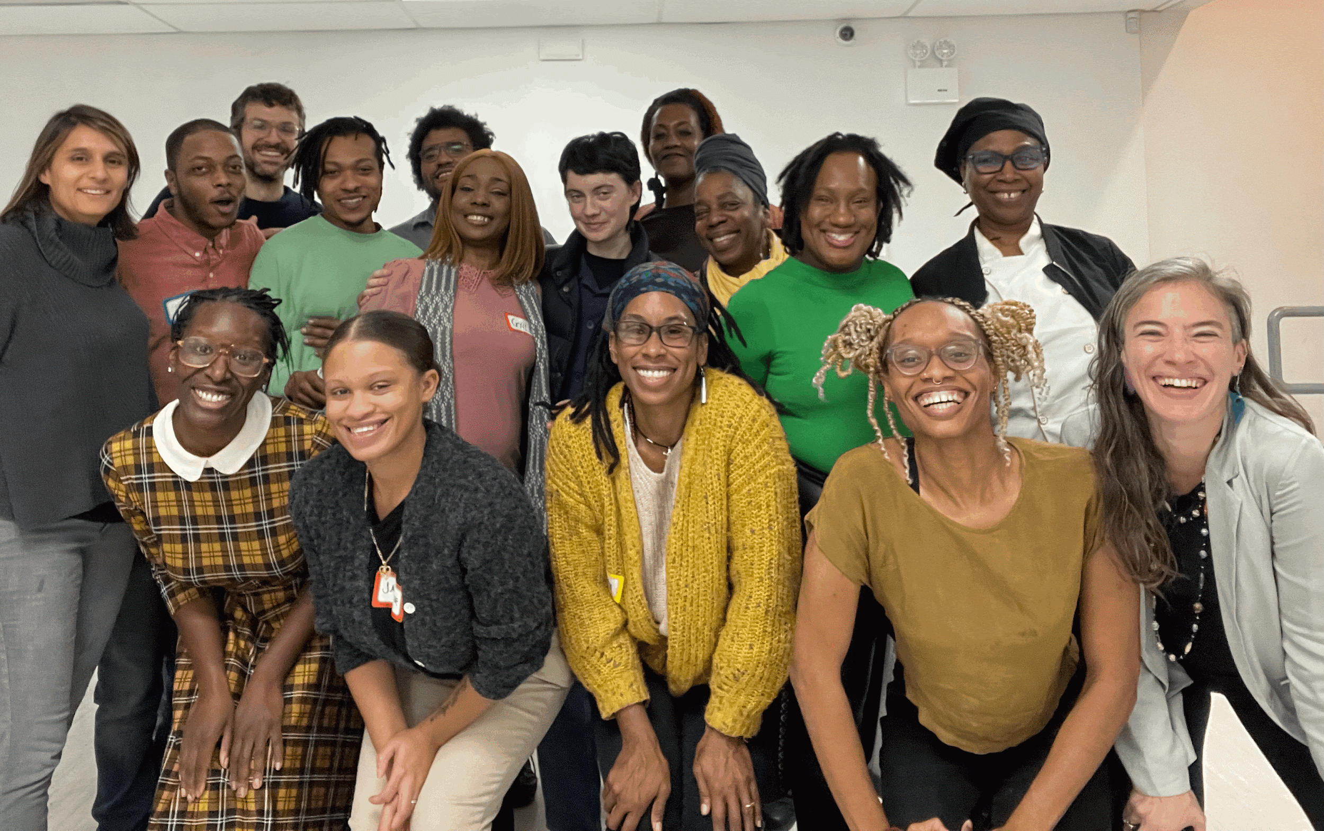
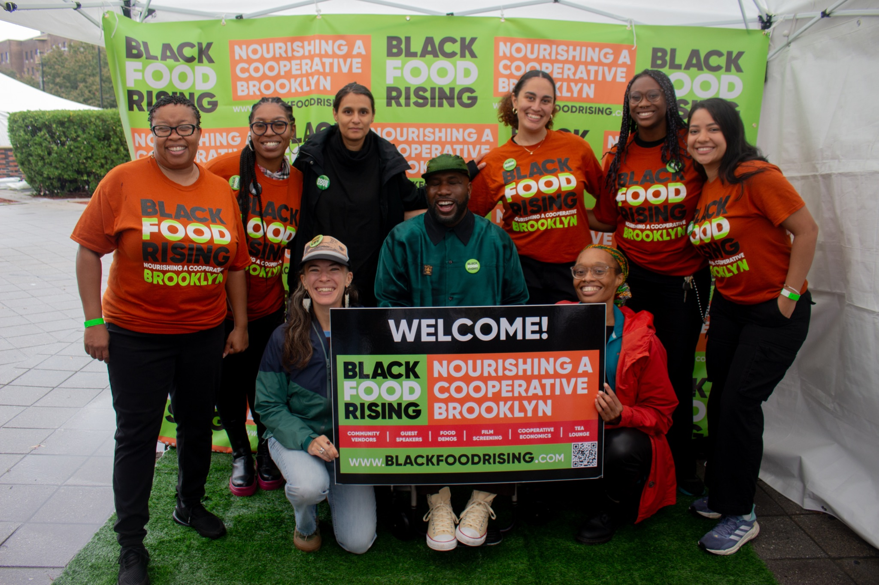
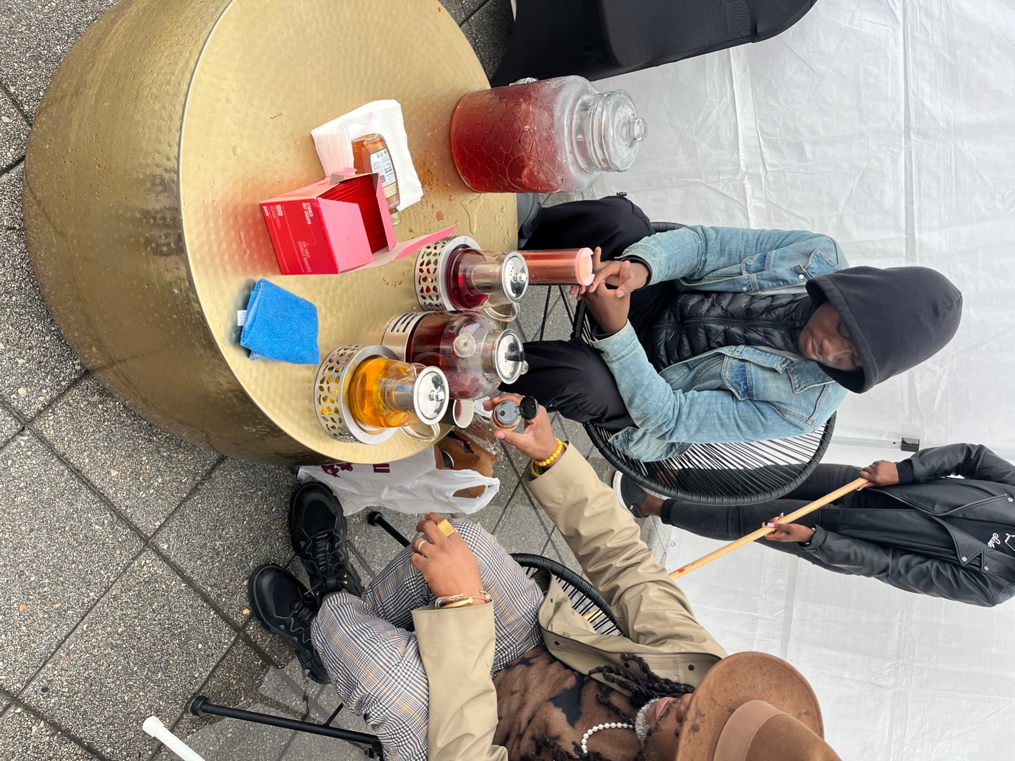
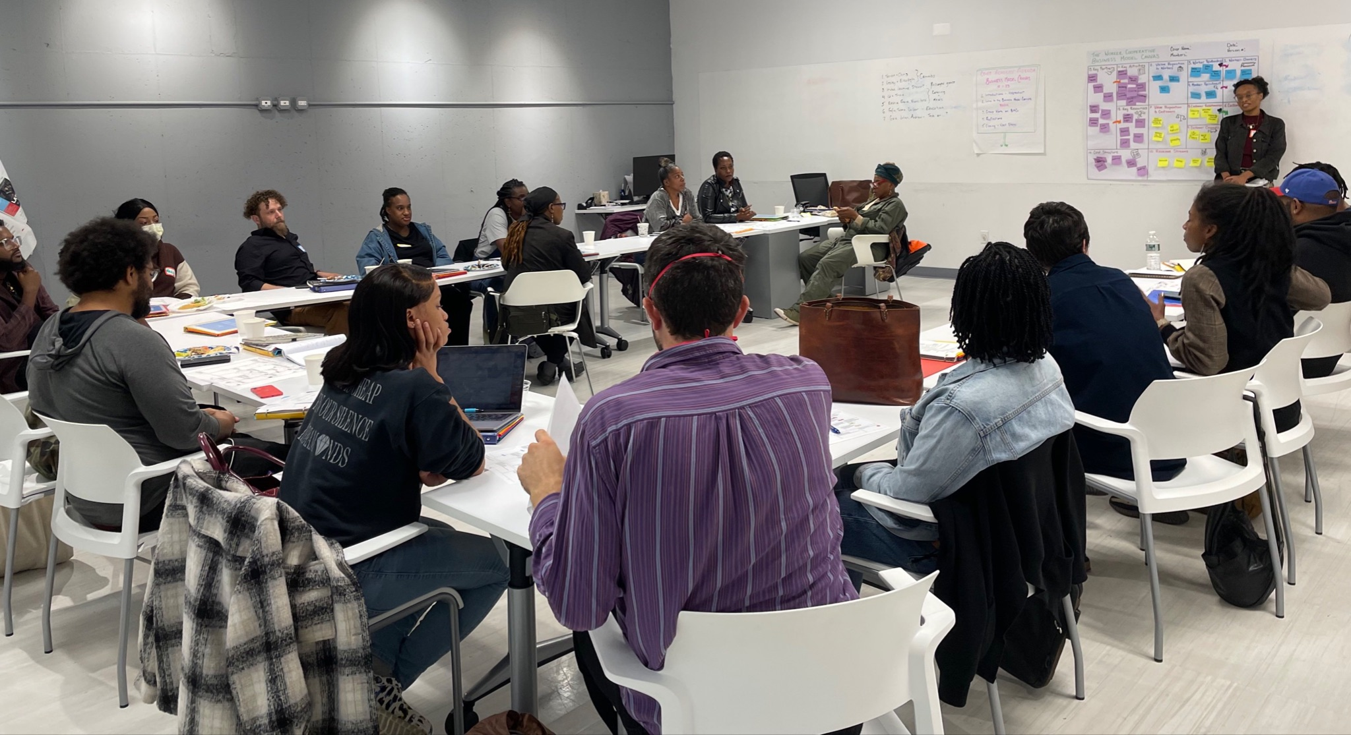
Ashleigh Eubanks

Slide 9
Co-op Crash Course
Ashleigh Eubanks
RiseBoro | Central Brooklyn Food Democracy Project

Slide 10
Economy:
A system that creates and distributes resources

Slide 11
Capitalist Supply Chains

Slide 12
Capitalism is an economic system in which private individuals and corporations largely control the production and distribution of resources, and where the maximization of profit & enclosure of wealth is prioritized above all else.
Notes:
People say that capitalism is too hard to define. So then, on the left, it just becomes a catchall for everything we don’t like.
It’s a simple definition and of course there’s much more that we could explore: racial capitalism, patriarchy, class struggle, property relations, and much more. the assumptions about human nature, how capitalism is built on conquest, colonialism, imperialism, extraction, exploitation, blind growth.

Slide 13
Capitalism Wheel aka “Supply Chain”
CAPITALISM WHEEL aka “Supply Chain”
Creation
Extraction (mining, polluting, deforestation…)
Imperialism & militarism
Land grabs
Production
Commodity production (natural resources + toxic chemicals = toxic products)
Private ownership;
Wage labor
Exploitation of labor
Monopolies
Surplus Allocation
Enclosure of wealth & power
Banks, Wall Street, Hedge Funds
Retirement accounts
Ownership
Capitalist Economy
Consumption/Use
Consumerism
Disposability
Data
Exchange/Transfer
Maximization of profit
Market exchange/sale
Notes:
The capitalists benefit from stealing the surplus that people and workers - predominantly underpaid or unpaid Black and brown labor - have created through this process. The Just Transition Framework tells us that the purpose of capitalism is the enclosure of wealth and power, upheld by the myth of white supremacy and heteropatriarchy. And it is an endless cycle, supported by each aspect here.
The wealth is held and multiplied via banks, Wall Street, Hedge Funds that place bets on the extraction of labor and land in order to sustain & protect that surplus.
Even philanthropy encloses wealth through tax deductions for the wealthy and philanthropic endowments that are privately managed by mostly white trustees, and minimally provided to communities most impacted by racial capitalism. Scholar Ruth Wilson Gilmore calls this “twice stolen wealth”
At every step, here, wealth is consolidated, isolated, extracted - serving racial capitalism and harming everyone else.
If you’re lucky enough to have an employer contribute to your retirement, the amount is based on how much you make.
In this system, if you don’t own or buy things, you don’t have value
You can see, in this wheel, how very looooooong these chains have become - directly tied to climate devastation. Ali will show how the SE alternative is very much about shortening supply chains.

Slide 14
Solidarity Economy Alternatives
Notes:
explore each sector - capitalist exploitation → solidarity economy alternatives

Slide 15
“Solidarity Economy value chains happen when each link in a supply chain is a solidarity economy coop, group or other entity.”
Notes:
There are a variety of ways that communities can organize their resources. And historically, resource production and distribution was at a small and local scale. But colonization and the entrance of capitalism has redefined what we even think of as “THE” economy.

Slide 16
Solidarity Economy Wheel aka “Value Chains”
CAPITALISM WHEEL aka “Supply Chain”
Creation
Community Land Trusts /
Cooperative Energy / Collective Farms
Production
Community Gardens /
Worker Cooperatives / Mutual Aid
Surplus Allocation
Community Development Credit Unions /
Cooperative Loan Funds / Public Banking
Solidarity Economy
Consumption/Use
Consumer Cooperatives /
Housing Cooperatives /
Food Coops
Exchange/Transfer
Sliding Scale Pricing /
Joint Purchasing Agreements /
Time Banks
Notes:
solidarity economy value chains are when each link in that chain is a solidarity economy coop, group or other entity.
Now, why does this matter?
Right now in New York all cooperatives and groups exist - for the most part - in the dominant economy’s supply chain. This means they have to compete with corporations and economics models that are much, much larger than them, that receive huge government support (think back to the proposed Amazon deal here) and crucially operate with very different values.
This matters then because:
Often when coops/groups work with other coops they treat each other better, which can mean lower costs, collective buying power and care and more.
More than that though, strengthening local cooperative economics can lead to community wealth building - and as we know our groups in neighborhoods that have been locked out of wealth for decades.
Finally, if we want to challenge and present a real alternative to how economics happens in our city, we need to bring this holistic vision - where we’ve covered each link with a solidarity economy approach that can grow independently as an autonomous force. That’s how real economic power that can become transformative

Slide 17
The Cooperative Model
Notes:
explore each sector - capitalist exploitation → solidarity economy alternatives

Slide 18
Cooperative
an autonomous association of people united voluntarily to meet their common economic, social and cultural needs and aspirations through a jointly owned and democratically controlled business.
Notes:
Cooperatives are defined differently by different people. Here’s one basic definition of a cooperative. In your experience - in particular those of you that are part of cooperatives - how do you define what a cooperative is?
Are there particular principles or values that are most important to you?

Slide 19
Types of Cooperatives
Hybrid
Commonalities:
Democratically owned (1 member, 1 vote)
Profits shared and controlled by members
Motivated by services to their members, not profit
Committed to a non-exploitative economy
Committed to community & collaborations between cooperatives
Worker
Producer
Coops
Consumer
Purchasing
Notes:
There are different types of cooperatives but they all have things in common, they are all democratically owned, profits are shared and controlled by their members (which means they are autonomous), and they are motivated by services to their members, which falls within the solidarity economy and resource sharing.
All cooperatives are creating an alternative to our capitalist society because they are driven by a plight for equality, better wages and dignified work. While they are still functioning within the capitalist system, there are places in the world like Mondragon, Spain or Emilia Romagna, Italy – a region of 4.2 million people and more than 7500 coops, where 10% of all employment is through cooperatives – it’s a system where you go eat a restaurant and it’s worker owned, you go to withdraw money from the bank and it’s a credit union.
Another thing they all have in common is that they are driven by 7 cooperative principles, which we will be discussing later.

Slide 20
7 International Cooperative Principles

Slide 21
7 International Cooperative Principles
Open and Voluntary Membership
Democratic Member Control
Member Economic Participation
Autonomy & Independence
Education, Training & Information
Cooperation Among Cooperatives
Concern for the Community
Notes:
What’s missing?
Mention REJC of USFWC → new explicit principles
Next Generation Principles
Next Economy Enterprises

Slide 22
Black Farmers + Cooperatives
Fannie Lou Hamer & Freedom Farm Cooperative

Slide 23
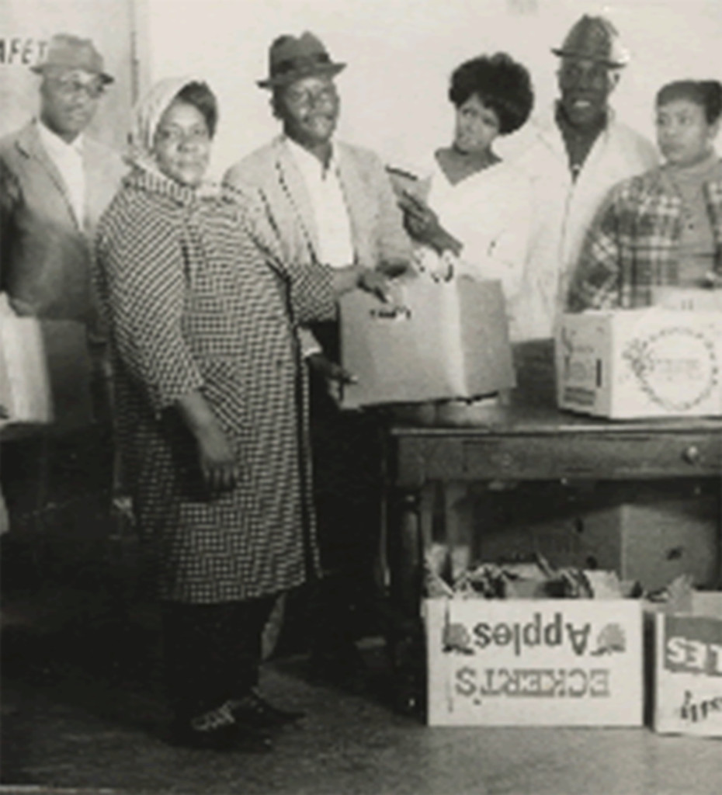
Freedom Farm Cooperative
1500 families were members
Cultivated over 680 acres in rural Mississippi
Pig Bank
Space for activism and mobilization
People were asked to pay $1 month but many didn’t
Only requirement was that you had to be poor.

Slide 24
Freedom Farm Cooperative Challenges
Fannie Lou Hamer carried much of the work and leadership .
Folks were often targeted by the state and white folks b/c of their work
Still up against the same oppressive forces.
Required an immense amount of labor and effort to sustain itself

Slide 25
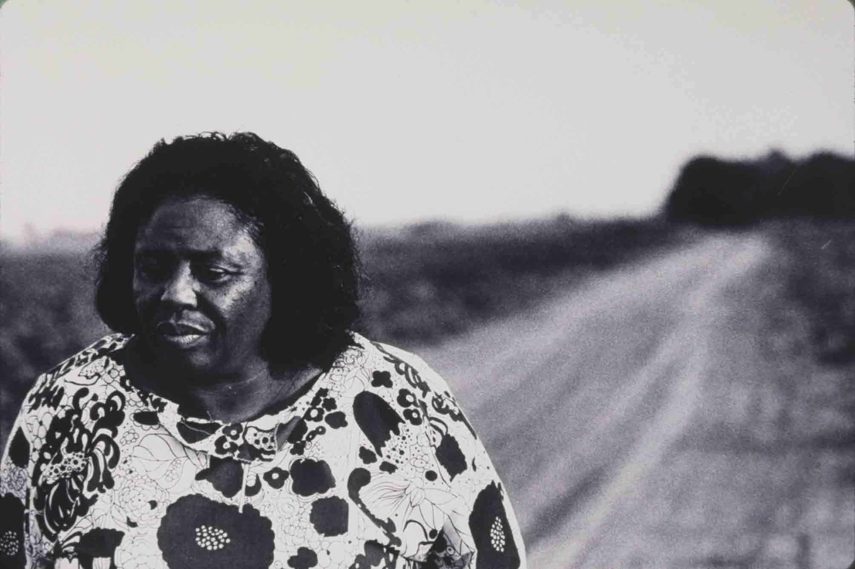
Fannie Lou Hamer
“Never to forget where we came from and always praise the bridges that carried us over”

Slide 26
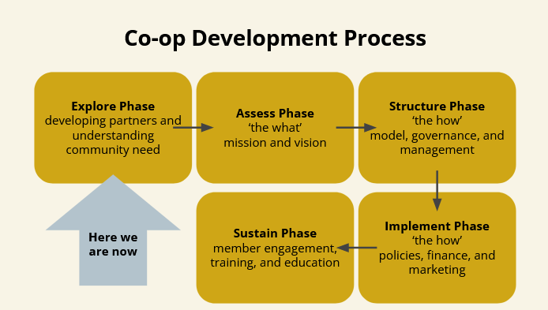
Notes:
History, how you both met, decided on which coop model, talk about developing partners, existing and welcoming potential partners,

Slide 27
The Mission:
NYS Black Farmer Co-op:
We are an inclusive ecosystem of New York State Black farmers moving products throughout the state to strengthen Black and underserved communities, growing and accessing new market shares on a multi-regional scale. We work collaboratively to advance community health and well-being by educating, cultivating, and producing food and farmers centering sustainability and food sovereignty.

Slide 28
Key Activities:
Connect with Black farmers throughout NYS who grow food
Pickup produce from the farmers and distribute it to markets that serve underserved populations
Take phone calls, emails, and logistics out of the farmers hands and into centralized automated systems
Take phone calls (and other types of) requests for bulk quantities of produce
Prioritize aggregating produce, but also shared butchering, aggregation and packaging for meat, and value-added products
Share buying of equipment and produce (inputs for the farm season)
Inter-member buying and selling of produce and shared member pricing, farm-to-farm
Shared equipment - borrow equipment for a week on a shared schedule

Slide 29
Customer Segment I:
Black farmers and other farmers of color in New York State!
Farmers seeking access to distribution systems and a plan for distribution
Farmers seeking business sustainability
Farmers seeking support to transition to non-gmo and environmentally sustainable growing practices
Beginning farmers needing training and support to establish their farm business

Slide 30
Customer Segment II:
Markets who want to buy specifically from Black farmers
People in need of nutrient dense foods
Farmers markets
Food co-ops
Black-owned food business and restaurants
Schools, hospitals, institutions and other housing, senior housing

Slide 31
Value Proposition:
What problems are we solving for the farmers?
What will we offer them?
What qualifies them to be members?
Issues of scale and numbers of Black Farmers
Access to markets
Individual brand visibility
Established farmers

Slide 32
A Vision for a Producer Owned Co-op:
Key Partners
Employ an “Org-to-Org” partnership approach - the co-op works with partner organizations
It is important that farmers are cultivated, supported, and introduced to the co-op
The co-op will partner with orgs training up-and-coming farmers
Potential partners could include:
Technical Assistance (TA) providers
Funders
Training & Farmer Support Organizations
Potential Partners
Municipalities, schools, and cooperative extensions (i.e., RIT and SUNY UB)
Steph Wiley (Hylo and Brooklyn Packers)
Black Farmer Fund
Black Farmers United
Buffalo Go Green
Corbin Hill Food Project
Farm School NYC
Federation of Southern Cooperatives
Food for the Spirit
Headwater Co-op
Northeast Farmers of Color (NEFOC)
NYS 1115 Waiver project
Soul Fire Farm

Slide 33
Next Steps:
Recruit potential ecosystem members
+ Additional incorporators
Develop membership and governance structure
Develop financial and fundraising plans and begin fundraising
Release a survey for farmers interested in membership
Map the geographic location of the farmers, as well as their products and existing resources
ID underserved communities and markets serving those communities

