Slide 1
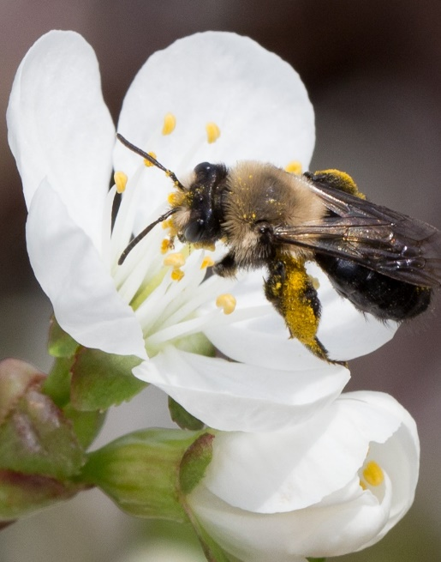
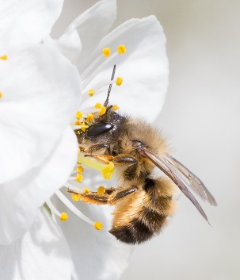
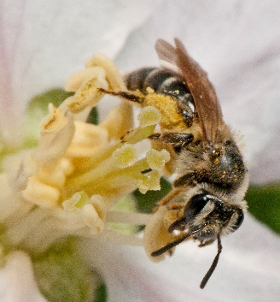
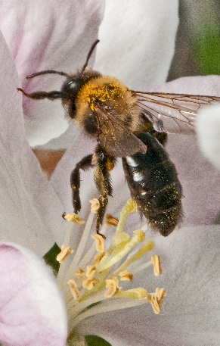
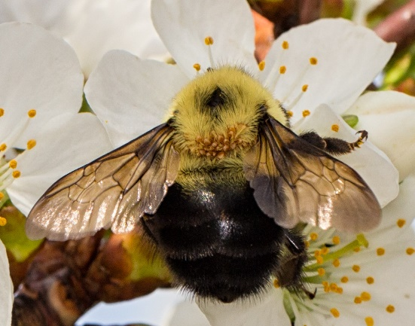
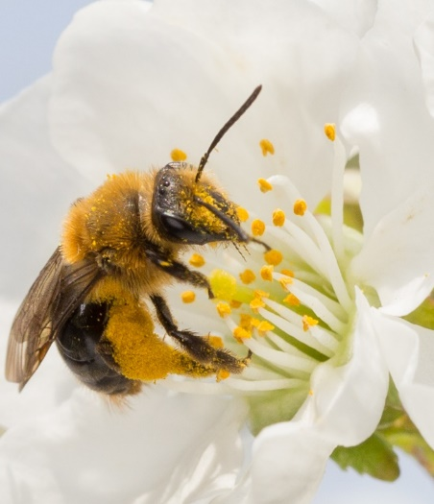
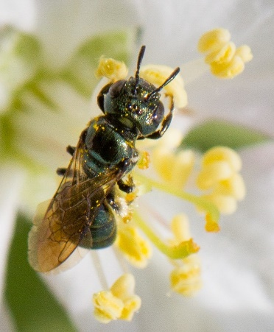
Introduction
Northeast Pollinator Partnership
A project to educate agricultural service providers about the biology, importance and conservation of wild bees
For more information on the project: https://projects.sare.org/sare_project/ene22-175/
Notes:
With funding support from SARE the Northeast Pollinator Partnership is able to facilitate and educational program focused on educating ag service providers about the biology, importance, and conservation of wild native bees so that they can help teach growers how to conserve these important species on their land.

Slide 2
Introduction
Project overview (modules):
Diversity and ecology of bees in the northeast
Habitat management for wild bees
Quantifying the economic value of wild bees
Balancing effective pest-management while simultaneously protecting wild bees
Using the NEPP smartphone app to monitor bee abundance
Notes:
The program consists of 5 modules:
Diversity and ecology of bees in the northeast
Habitat management for wild bees
Quantifying the economic value of wild bees
Balancing effective pest-management while simultaneously protecting wild bees
Using the NEPP smartphone app to monitor bee abundance

Slide 3
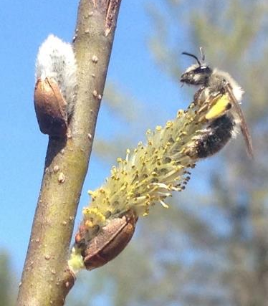
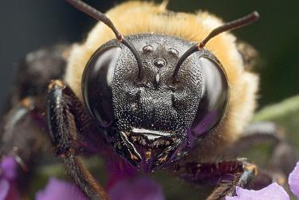
Module 1 Outline:
Outline
1. Bee Diversity
a. Diversity on a global scale b. Diversity in the Northeast c. Diversity in apple orchards 2. Wild Bee Life History & Ecology
Notes:
In this Module we wanted to educate on the diversity of bees and give you a peak at how they live their lives.
What bees do when they are not flying or foraging on a flower is often a mystery so we think it will help you if you can catch a glimpse into their mysterious lives. We believe this baseline biological information will help you be able to integrate the ‘why’ and ‘how’ when approaching wild bee conservation and management.

Slide 4
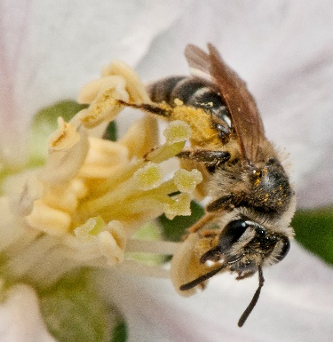
Diversity and ecology of bees in the northeast Part I: Diversity
Native Bee Diversity
Maria Van Dyke
Department of Entomology
Cornell University
Notes:
I want to share that everything you will be learning in this module and the following modules is based on research from the research in our bee labs at Cornell as well as colleagues in the NE and as well as the state dept of env conservation, including support from Cornell Cooperative Extension and various non-profit education organizations including Xerces and IPM Inst of NA most notably.

Slide 5
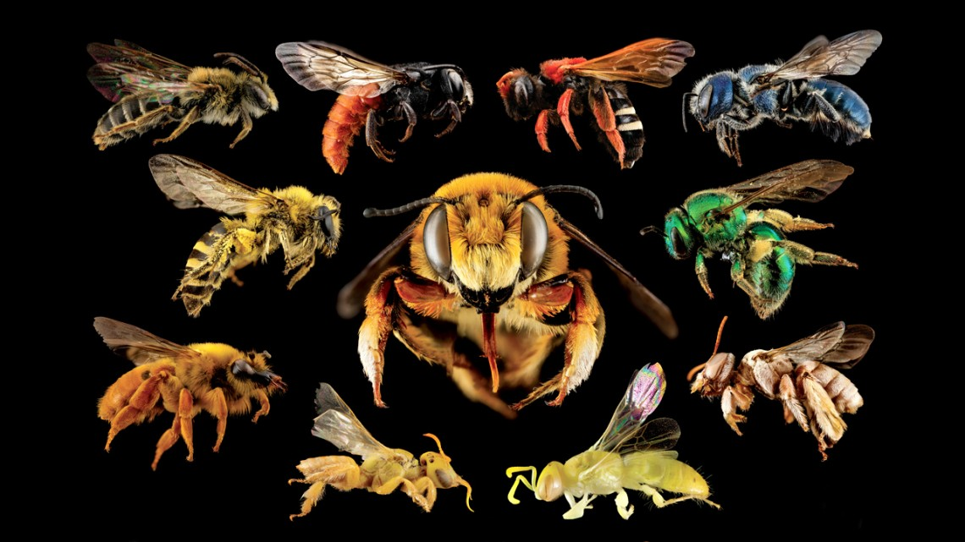
Native Bee Diversity
© Sam Droege
Notes:
To do this we will now review how north American native bee species live, their differing social habits, their development stages of their lifecycle, what their seasonal and daily activity looks like, How far they can efficiently forage, what they eat and where they live. A good way to think about life history of bees is by thinking of their .
I organized this portion of the talk considering a Pyramid of Hierarchical Parameters that control the crest of the triangle THE reproductive output. I will share the information in this order, ending with what could be considered the baseline resource for our bee community since safe homes are key to population continuity. Butwe will start at the top looking at sociality to understand how sociality controls activities of bees.
And finally let's focus on bee diversity in agriculture and because apple is the biggest pollinator dependent crop in the northeast lets look specifically at Apple, So far, researchers have found 120 species of native bees visiting apple blossoms during New York’ Apple Bloom Season. While our research was limited to New York, it is likely that similar native bee communities are found in Apple Orchards from Pennsylvania north to Maine and East to Delaware. Based on this research the Danforth lab has identified some key characteristics of bee communities in the northeast based on these three regions of New York.
The majority of species are solitary and communal nesters
Social bees that visit are Bumble bee species and the Honey bee.
The majority of the bee species (~95%) that forage on apple are ground nesting
(Pause) I will have slides prepared for other crops that extension can use based on their audience. (Ill show example at end of talk)
BUT now I just want introduce you to the most common bee families in agriculture, our spring bees.
Other Crops
Native bees come in a wide array of sizes, and colors, and “hairstyles’.. They are also varied in their life styles, the places they frequent, the nests they build, the flowers they visit, and their season of activity. They remain ignored or unknown by most of us. This diversity makes them distinct and interesting. Notice there is not a honey bee in this picture, honey bees are not native to North America.

Slide 6
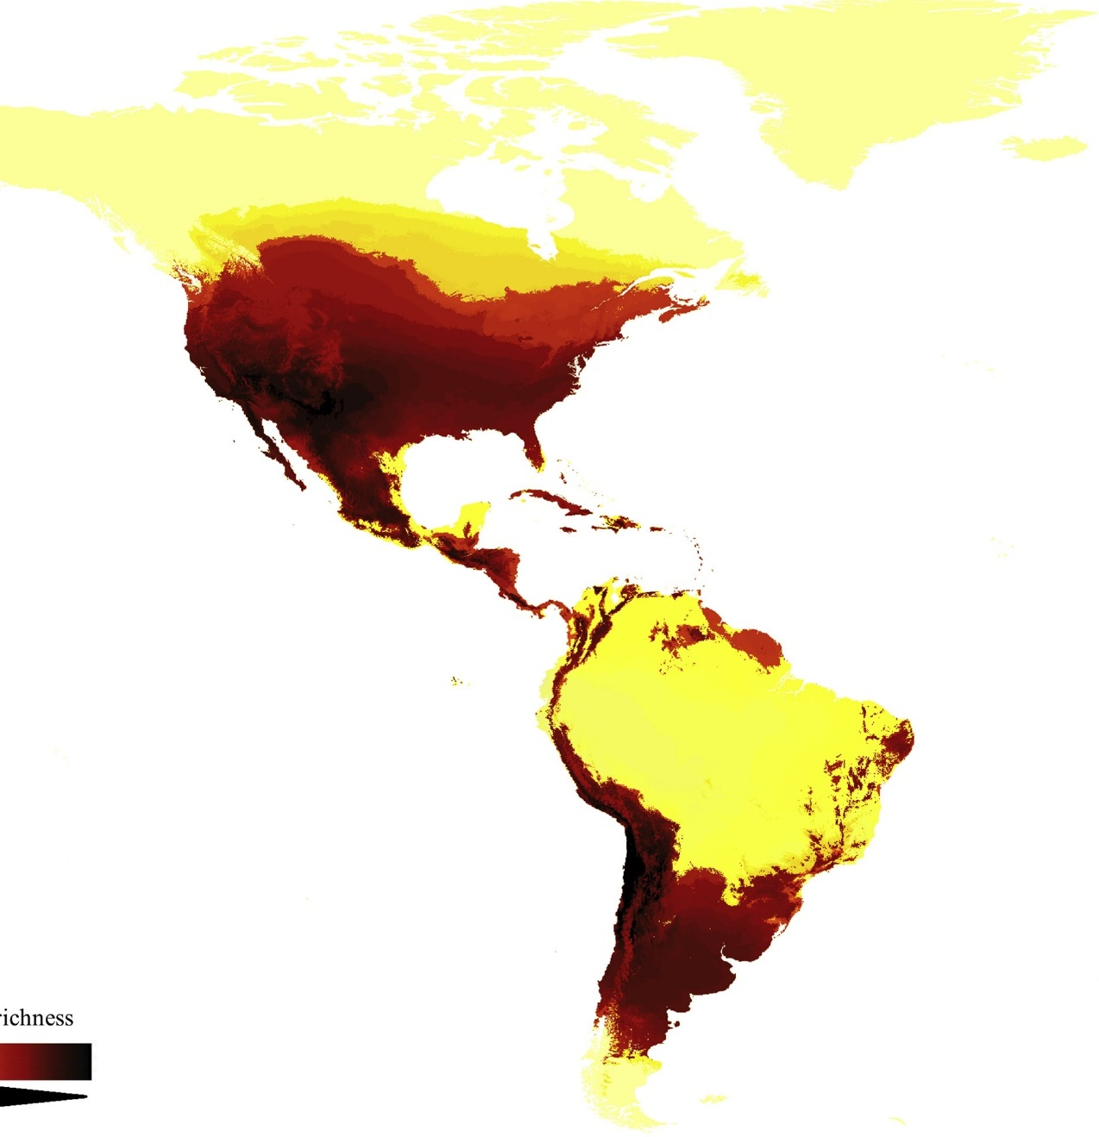
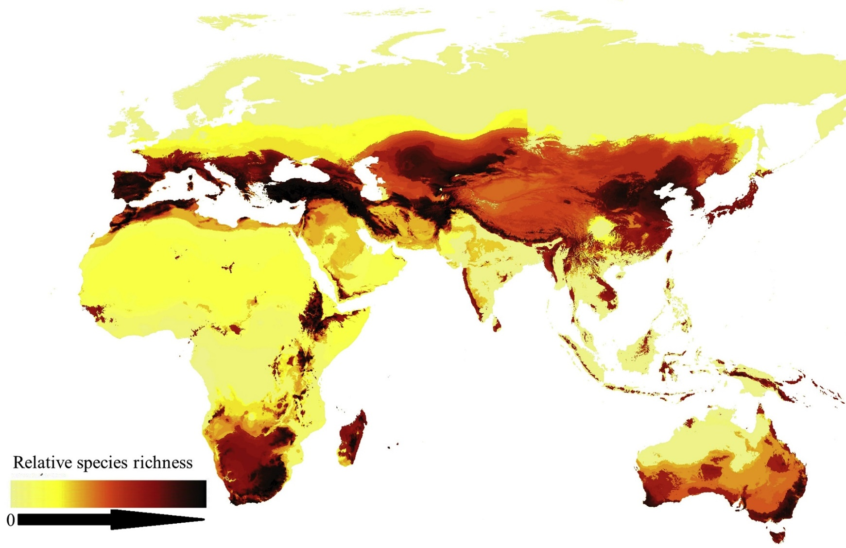
Native Bee Diversity - World
Michael C. Orr et. al. 2021
Notes:
Social
Reproductive output is highly dependent on the amount of resources you can gather and competition for resources. Sociality has a huge part to play in this process. Everyone is familiar with our social bees like the honey bee and the bumble bee species that occur on the extreme end of social structure/hierarchy. Of the bee species that are native to North America, Bumble bee species are our only native colonial bee species. Meaning that there is a queen and a complex hierarchical caste system. These eusocial species build a large hive population that can exploit floral resources en masse and fly great distances making them resilient to resource fluctuation and ensuring high reproductive output (HB moms lay 20-50K eggs, BB’s less at 100-500 eggs)
Cooperative
Across the world we have close to 20,000- bee species spanning seven families.
Looking at this world map of bee diversity hot spots we can see bee diversity is highest in dry arid regions. As you can see on this world map. Tropical areas lack diversity in comparison.
Today, 80% of flowering plants around the world rely on animal pollinators – and bees are by far the most important
Keep in mind that this map is somewhat a product of where research is most and least intense, but it still illustrates the trend. “We still have high levels of undiscovered diversity (~10%).

Slide 7
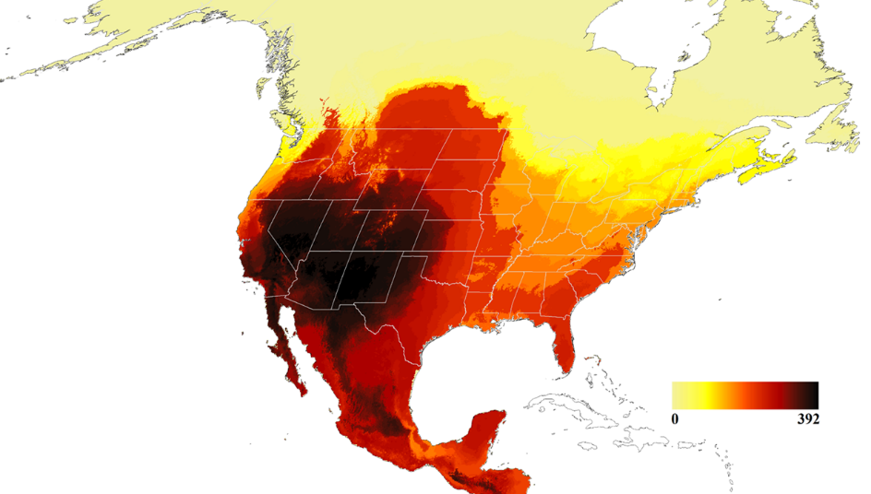
Native Bee Diversity – United States
Michael C. Orr et. al. 2021
Notes:
So now that you have some basic understanding of wild bee social structure and responsibilities, let’s look at reproduction and what goes on in the nests of the solitary bees with some lifecycle diagrams and photos. Then I’ll show the eusocial bumble bee lifecycle.
In this visual you can see the egg hatches into a larva, the hatched larva feeds on pollen and continues to grow until it has eaten all the pollen, and then pupates.
Depending on the species, the larva will pupate into its final adult stage before Winter or right before it emerges in early Spring the beginning of its foraging window. Similar to bear hibernation, solitary bees slow down their metabolism to overwinter in a state that is called diapause (an an insect term for hibernation)
Think about it,… while we think of bees as being flying creatures, the solitary bee species actually live most of their lives inside sitting and waiting in their nest cell. Their foraging season is only 3-6 weeks long and then they die off leaving their young to finish development into adulthood on their own. During those 11 months in their nests, they are extremely vulnerable to disturbances to vegetation or soil depending on where they nest.
Here in North America you can see that the Center of Bee Diversity is in the Southwest US and Northern mexico.. Research has found that the desert southwest of the US was the center of bee speciation back in the mid-cretaceous period following an explosion of flowering plant diversity when the first bees began to broaden their pollen diet.
Of the 20,000 or so bee species, about 4,000 of them are native to the United States.
While honeybees are key to the pollination of large industrial ag operations, native bees were here in NA long before European honeybees were brought here on European ships to Jamestown, VA in 1622. Back then their utility was distinctly tied to the wax they produced for candle making and the honey for sweetener.

Slide 8
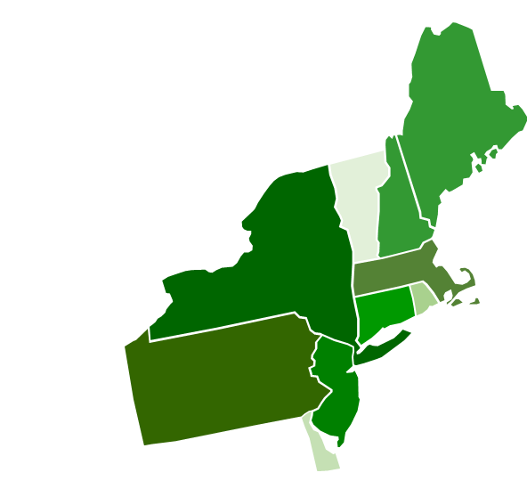
Native Bee Diversity – Northeast U.S.
ME
278
VT
194
NH
257
NY 448
MA 371
CT 333
RI
200
PA 437
NJ
400
ME: Dibble et al. 2017, "Bees of Maine…" Northeastern Naturalist 24, no. m15 (2017): 1-48.
NH:
PA:
NY:
DE, NJ, RI, CT, MA, VT: Summery calculation based on Discoverlife by Mark Buckner from Ascher, J. S. & Pickering, J.
DE
222
Notes:
Again
You can see that proximity of resources if very important to the reproductive tasks and output. The closer the foraging resources are to nest sites the higher the reproductive capacity. A Lack of Nest Sites near forage Can Limit Native Bee Populations.
Here in the Northeast we have more than 600 species of bees, that are supporting resilient landscapes in natural areas as well as a broad diversity of crops.
While this talk is directed at the northeast as a whole, we will be using NY as an example. Keep in mind that bee diversity diminishes in the northern latitudes with shorter summers and harsh winters.
Dibble, Alison C., Francis A. Drummond, Constance Stubbs, Michael Veit, and John S. Ascher. "Bees of Maine, with a state species checklist." Northeastern Naturalist 24, no. m15 (2017): 1-48.

Slide 9
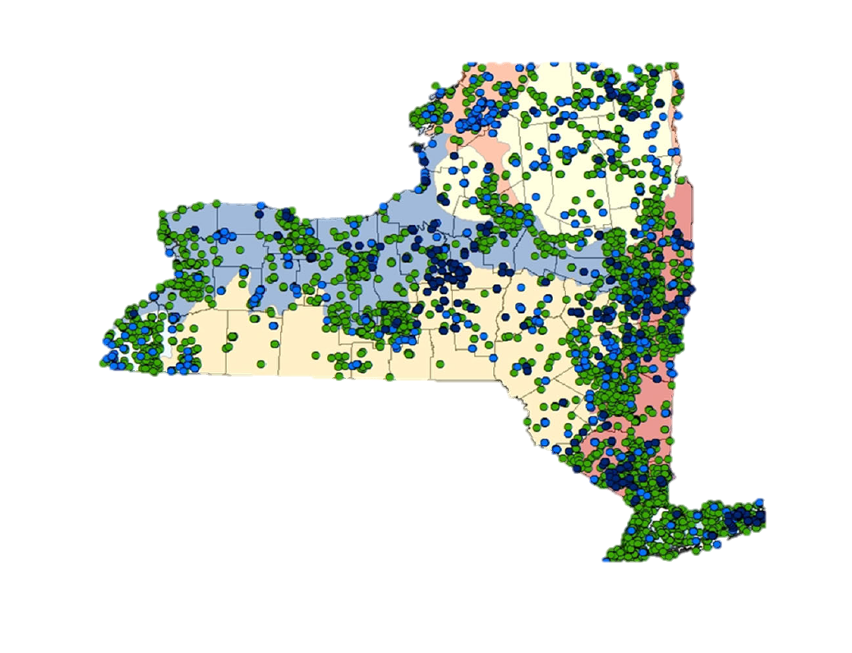
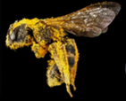
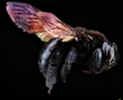
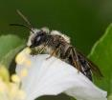
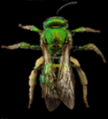
Status of Pollinators
Native Bee Diversity – New York
Empire State Native Pollinator Survey
Habitats sampled
Grassland/Meadow
Forests
Wetland
Roadsides
448 Species
Goals
Establish a comprehensive list of bee species in NYS
Assess the conservation status of NY bee species
Notes:
So let us now home in on New York. Recently, the Empire State Native Pollinator Survey was recently completed. This effort was led by the DEC NY Natural Heritage Program along with collaboration from several state institutions. The intention of the survey was to target a focal selection of bee species that tend to be relatively sensitive in order to assess the conservation status. In the process we also established a comprehensive list of bee species in NYS. The research included net and bowl sampling of 4 habitat types (grassland, forest, wetland, field edge) across the state from late May – October. This was the first statewide survey to ever be conducted.

Slide 10
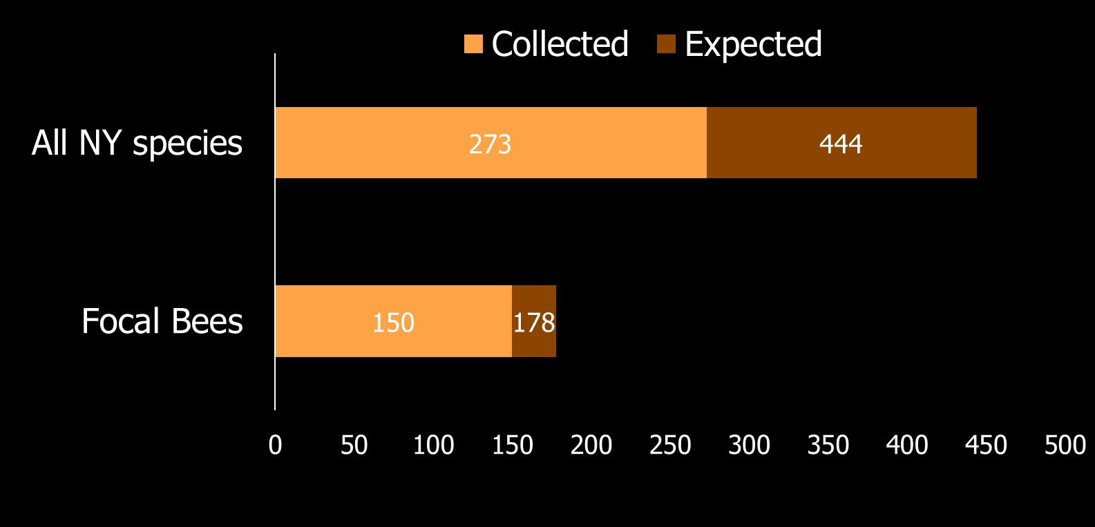
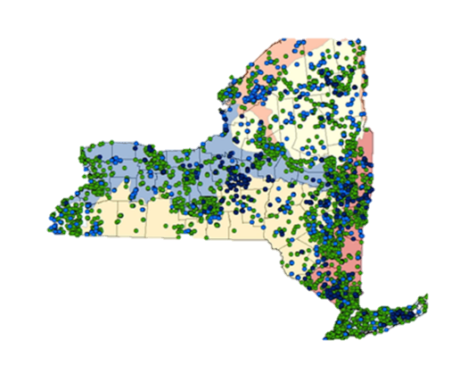
Managing for Native Bees
Empire State Native Pollinator Survey Results
61%
84%
23 %
of the ranked focal bee species are
AT RISK
Or last seen before 2000
Notes:
The survey confirmed a state total of 430 bee species. The survey found 263 of those species (63%). Please note that there are still non-focal specimens awaiting determination. This is a good proportion of the total community for such a short study. Realistically it would take 10 years or more to do an exhaustive sampling of the state.

Slide 11
Native Bee Diversity – New York
Diverse Nesting Strategies
Notes:
Due to the huge amount of species diversity it is not surprising that they are also diverse in their nesting strategies….. you can see the majority of the NY species as well as the northeast species are ground nesting bees with the next largest group being the parasitic bees and the stem and cavity nesters. I would like to point out the lesser-known strategies which include nesting in rotten wood, in fuzzy leaf hairs scraped from fuzzy leaves, and we even have a snail shell nester.

Slide 12
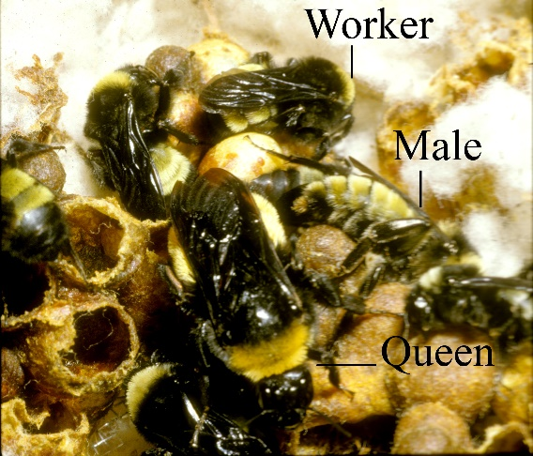
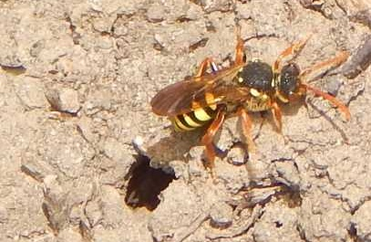
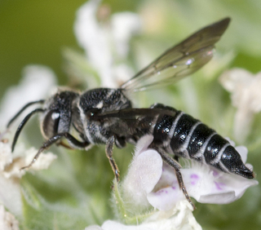
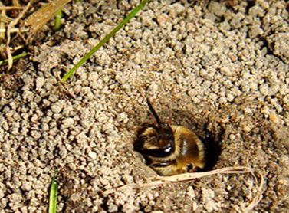
Native Bee Diversity – New York
Diversity of sociality
Photo by S.A. Cameron
Notes:
Here you can see that the majority of our bees are solitary THE Opposite social strategy as honey bees.

Slide 13
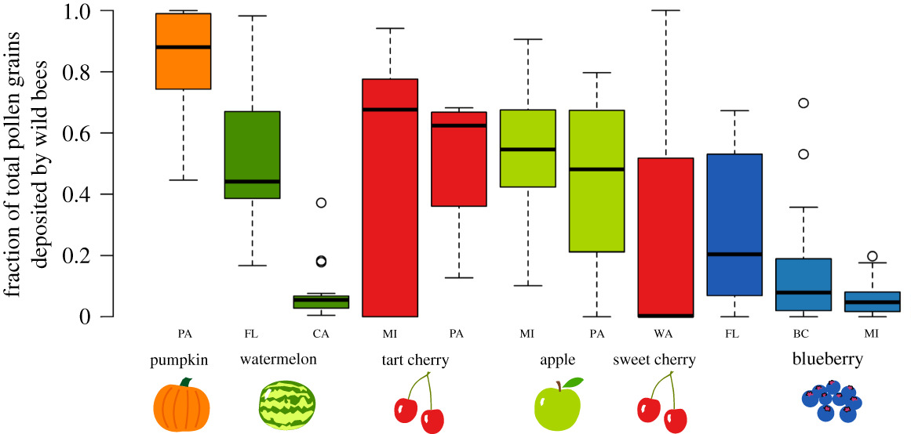
Native Bee Diversity – NY apple orchards
Reilly et al, 2020
Notes:
SQUASH
To illustrate this coevultionary resltionship of specialist bees I want to share with you the story of the squash Genus, ‘Cucurbita pepo’ and its specialist bee Eucera pruinosa.
Squash did not occur in North America before Native Americans carried the seeds with them along the migrations trails northward from Mexico, cultivating & trading the seeds along the way. Squash bees (Eucera pruinosa) followed behind along the trail of squash cultivation.
The reason they followed this path so faithfully is because they are 100% dependent on the pollen of this Cucurbita species to feed their young and the squash bees (Eucera pruinosa) typically find the best soil to build their nests in under the shade of the big Cucurbita leaves where the protected soil is softer, however their nest aggregations can be found in other locations as well.
APPLE FACT* Apple orchards help support at least six species of bees that specialize on the pollen specifically from the family Rosaceae of which apple is a member. So you can imagine that these species migrated toward apple orchards as growers becan growing them in masse.
Specialist Map
Looking at this heat map of the number of specialist bees across US states created by Mark Buckner and adapted from Jarrod Fowler and Sam Droege, we can see that about 20% of our species here in the northeast are specialists,
Let’s now transition to native bees and apple pollination. Apples, like many of the most high-value crops in New York (and the northeast) are highly dependent on pollinators. This figure shows the contribution of wild bees to the pollination of various crops that are also grown in the NE. This shows that wild bees deposit a significant amount of pollen onto pumpkin, watermelon, apple, cherry and blueberries. Note that this graph is not the NE but demonstrates the variability of wild bee contribution depending on farmscape.–these crops need healthy pollinator populations.

Slide 14
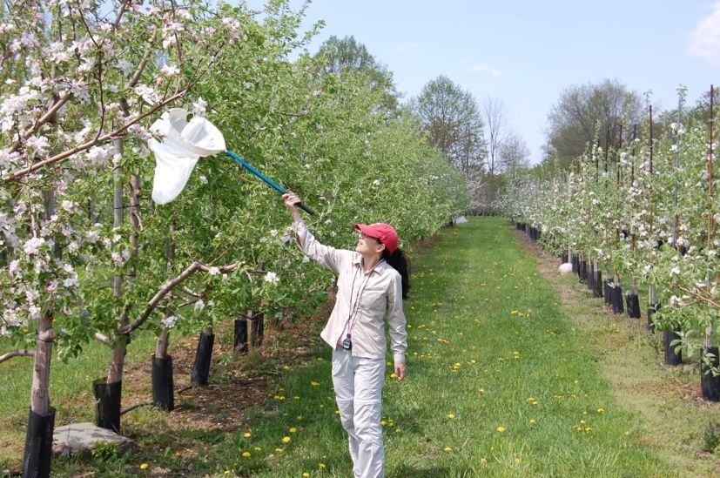
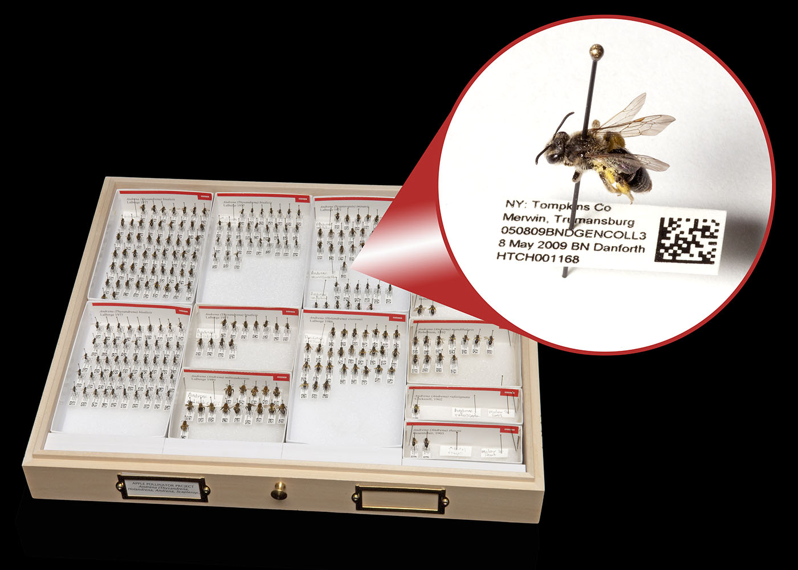
Native Bee Diversity – NY apple orchards
Research on Apple Orchards since 2009
Mia Park, EJ Blitzer, Jason Gibbs
Notes:
The post docs and grad students in the Danforth lab have conducted a huge amount of research on wild bees in apple orchards since 2009 and there has been concerted effort to learn the dynamics of bee species populations in these orchards and how landscape and management impact them. The specimen collections from these studies are are stored in the Cornell University Insect Collection and are a valuable research tool for future work. Through this work we were able to characterize the bee community that supports apple blossom pollination.

Slide 15
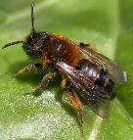
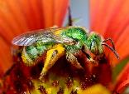
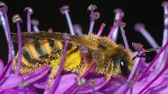
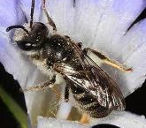
Native Bee Diversity – NY apple orchards – Species Diversity
L. Shyamal,
CC BY-SA 3.0
Judy Gallagher, CC BY 2.0
Terry Lucas, Cc-by-3.0
Alvesgaspar, CC BY-SA 3.0
Marc Newman, CC BY 3.0 AU
Notes:
First we found that there is a diverse community of wild native bee species in apple orchards in some 13 genera. If we sum all the species we caught across 28 orchards we found 120 wild bee species with around 15-60 species depending on orchards and weather. The genera with the most species are Lasioglossum and Andrena

Slide 16
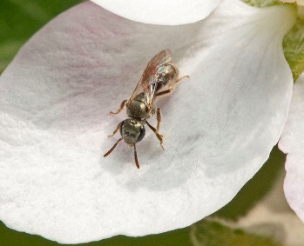
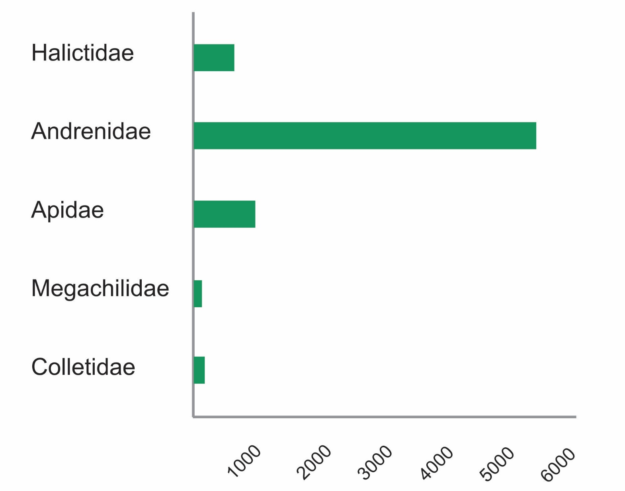
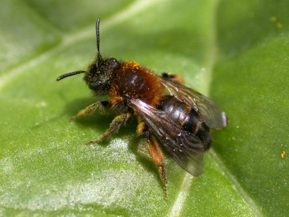
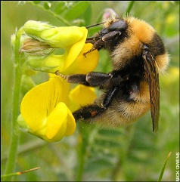
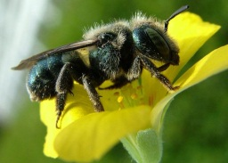
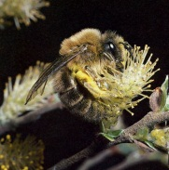
Native Bee Diversity – NY apple orchards – Bee abundance
Bee Family
Number specimens
Notes:
And while we find quite a diversity of Lasioglossum orchards you can see in this graph that shows the number of individuals per bee family visiting apple, that the most abundant species were the Andrena which are as effective or more effective pollinators than honey bees. We will go into the specifics of their pollination efficiency in Module 3 (The economic value of pollination) but just know that their presence in our apple bee fauna is incredibly important

Slide 17
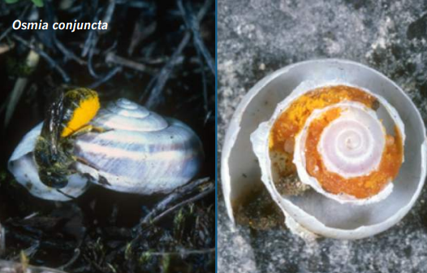
Native Bee Diversity – NY apple orchards – Nest Diversity of bees in Apple
Nesting Diversity of Apple Bees
Notes:
This pie chart illustrates the proportion of different nesting strategies the wild bee community of apple has. You will see that the majority of the apple bee community (~95%) are ground nesting\
You will also see that apple supports some of our creative nesters like those that nest in rotten wood or even better, snail shells.

Slide 18
Native Bee Diversity – NY apple orchards – Social Diversity of bee species in Apple
Photo by S.A. Cameron
Social Diversity of Apple Bees
Notes:
As I mentioned in the beginning, bee species are diverse in many ways. Each species also has a preferred social strategy.
The majority of our bee species in the apple bee community are solitary bees. These are female bees that do all the work to feed and raise their babies all by themselves without the help of other bees.
Social bees that visit are the well know honey bee plus several bumble bee species and some small halictid species.
The majority of species are solitary and communal nesters

Slide 19
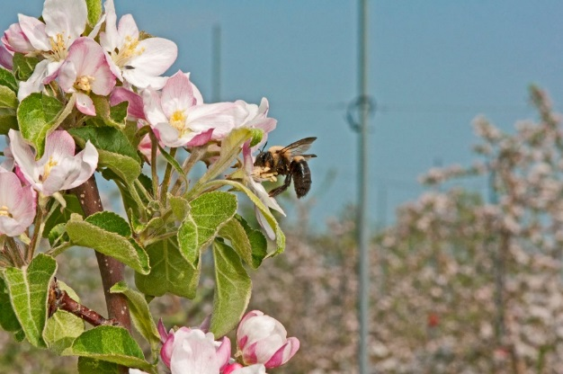
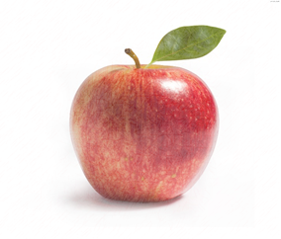
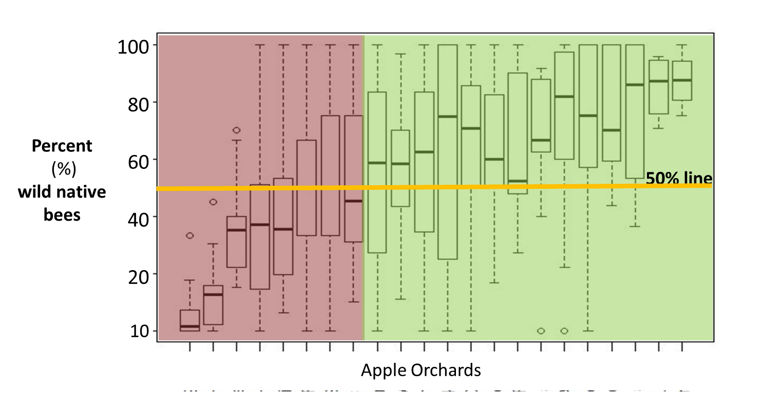
Native Bee Diversity – NY apple orchards – Social Diversity of bee species in Apple
Wild Bees are abundant in Apple orchards
Increasing Native Wild Bee Abundance
(Russo et al. 2015)
Notes:
120 species out of 400 in NY. This is an

Slide 20
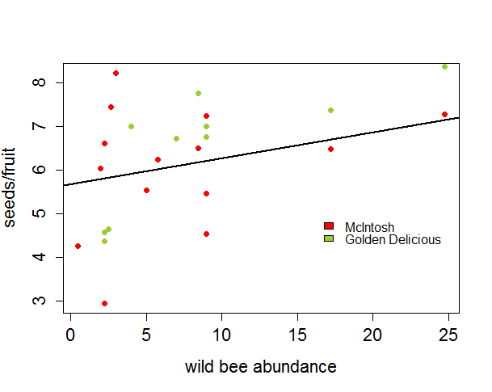
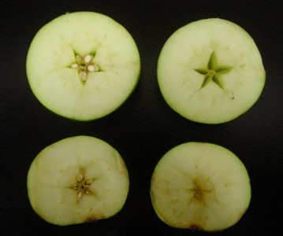
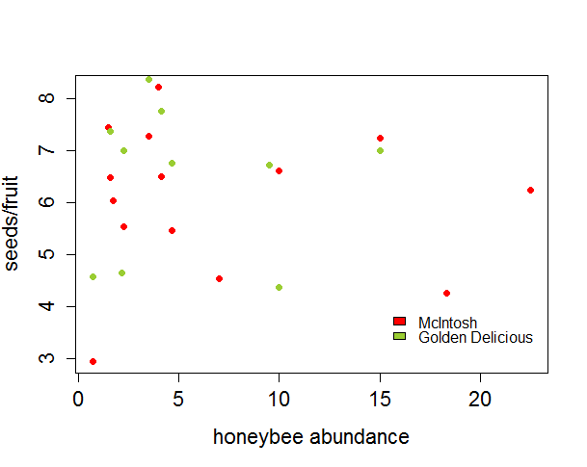
Native Bee Diversity – NY apple orchards – Social Diversity of bee species in Apple
Wild bee abundance NOT honey bee abundance
correlates with seed set in apple (better fruit)
p=0.018
Increased
seed set
Wild Bee Abundance
p=0.271
Honey Bee Abundance
No effect on
seed set
Blitzer et al. 2016
Notes:
AGAIN
However, does the abundance and diversity of native bees impact seed set and therefore fruit production? In 2013 we conducted an experiment to understand if the local bee fauna at an orchard had an impact on seed set and fruit production. This was a complex experiment run by EJ Blitzer, a post-doc in my lab last year. [EXPLAIN AXES, MAKE THIS GRAPH CLEAR]

Slide 21
Native Bee Diversity – NY apple orchards
NYS growers are relying heavily on wild pollinators for their pollination services
!
120 species of bees have been documented visiting apple flowers in surveys of New York orchards (15-50 species per orchard)
The majority of species are solitary and ground-nesting
Many native bee species are more effective pollinators (on a per-bee basis) than honeybees
Notes:
Numerically, the most abundant bee group is the genus Andrena (Andrenidae)

Slide 22
Native Bee Diversity – summary
Take aways…
Bees are the primary pollinators of flowering plants around the world
Wild bees are abundant and valuable pollinators of specialty crops in the Northeast
Maintaining a diverse bee fauna is crucial to sustainable apple production
Notes:
And more broadly….

Slide 23
7 Extra Slides if you want to give talk to these other crop grower audiences
Other Crops
Blueberry
Cranberry
Squash & Pumpkin
Caneberries (Raspberry and Blackberry)
Legumes

Slide 24
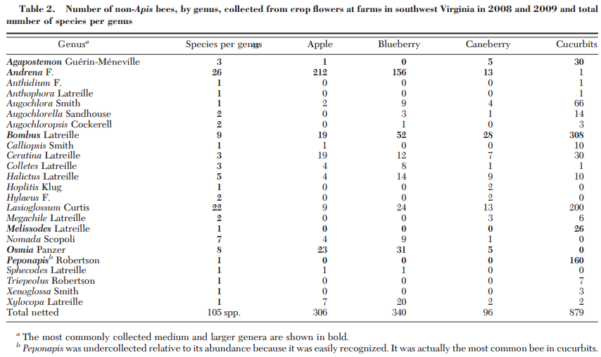
Status of Pollinators
Native Bee Diversity – other crops; Example from mid-Atlantic that can be applied in the northeast
Genera per crop
Apple
13
Blueberry
13
Caneberry
15
Cucurbit
19
With 37-59 sp per crop and 12-19 species per farm
Notes:
The most abundant non-Apis medium and larger bees on crops were Andrena, Bombus, Osmia, and Peponapis. Prior research has shown that bees in these genera are at least as effective as honey bees in pollinating the crops studied here. A few hundred Bombus and Osmia (both with species commercially managed for pollination) can provide the equivalent pollination service of thousands of honey bees in some fruit crops including apple, blueberry, and caneberry (Richards 1993, Ladurner et al. 2004, Cane 2005, Velthuis and van Doorn 2006). Andrena was found to be fourfold as effective as honey bees in blueberry pollination (Javorek et al. 2002). Bombus and the pollen specialists Peponapis and Xenoglossa have been found to be substantially more effective than honey bees at pollinating squash and pumpkins (Tepedino 1981, Fuchs and Muller 2004). Although Javorek et al. (2002) measured the effectiveness of Andrena in blueberry pollination, less research has focused on the pollination effectiveness of other ground-nesting bees that cannot easily be managed (versus relatively well-studied managed bees, such asBombus andOsmia).Andrena can clearly play an important role in crop pollination, especially spring-ßowering fruit crops (McGregor 1976, Havenith 2000, Tepedino et al. 2007, Tuell et al. 2009). Batra (1999) conducted a detailed study ofAndrena fenningeri Viereck, promoting its use as an orchard pollinator and proposing techniques for introducing and helping to maintain populations on site. Researchers have documented the diversity and abundance of wild bees in cropsand thepositive correlationsbetweenbeediversity and improved pollination (Chagnon et al. 1993, Winfree and Kremen 2009).
The most abundant non-Apis medium to larger bees visiting apple, blueberry, and caneberry ßowers were
Andrena, Bombus, and Osmia (Table 2).
Abundant genera in cucurbits were Agapostemon, Bombus, Melissodes, and Eucera pruinosa, a cucurbit specialist.
Ten species were netted from all crops: Apis mellifera, Augochlora pura, Bombus bimaculatus, B. griseocollis, B. impatiens, B. perplexus, Ceratina calcarata, Halictus confusus, H. ligatus, and Xylocopa virginica

Slide 25
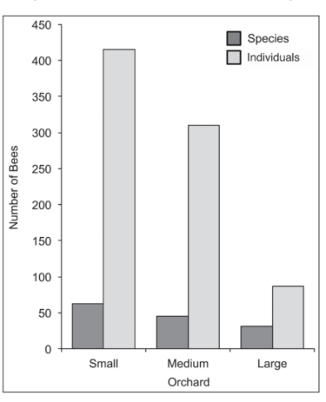
Native Bee Diversity
Status of Pollinators
Bee Diversity in Blueberry
(RI, VT, NH, ME, NY)
NH – 31 - 62 species (Nooten et al 2020)
NY – 68-82 species in commercial blueberry
44-51 species in natural blueberry patches (Mackenzie and Eickwort, 1996)
RI – 40 species (Scott, Z et al 2016)
ME – 124 species on lowbush blueberry (Bushman and Drummond, 2015)
NJ – 44 species (Benjamin and Winfree (2014)
VT – 84 species (Nicholson et. al., 2017)
Canada – As low as 10 species in urban environments
(Mackenzie & Winston, 1984)
New Hampshire, Nooten et al 2020
Notes:
NH – Blue berry 31 to 62 species per blueberry orchard large to small Nooten et al 2020
Rhode Island Blueberry 40 sp by Scott, Z et al 2016 –
Benjamin and Winfree (2014) studied honey and native bee pollination in commercial highbush blueberry in New Jersey. They found that the European honey bee, Apis mellifera L., deposited a median of 18.5 tetrads of pollen during a nectar-collecting visit, 24 tetrads during a pollen-collecting visit, and 0.5 tetrads during a secondary nectar-robbing visit. They also found that pollen tetrads deposited by Bombus spp., large Andrena spp., medium Andrena spp., and Xylocopa virginica were 23.5, 9.0, 11.5, and 2.5 tetrads, respectively. All of their study sites were stocked with domesticated honey bees at densities of 2.5–7.5 hives ha−¹. Honey bees provided 86% and native bees 14% of the pollination.
Conversely, Winfree et al. (2007) found that native bees were the most important pollinators and alone were sufficient to pollinate commercially grown watermelons in New Jersey and Pennsylvania. Previous studies have shown that native bees contribute to crop pollination at farms near natural habitat, but not in more intensively used agricultural areas (Kremen et al. 2004, Klein et al. 2007). Our study sites were relatively small (0.08–0.8 ha) and native bees are probably adequate for pollination. Only four farms had honey bee hives.
Rhode Island growers should be able to increase their pollination by stocking domesticated honey bees and increasing habitat and forage for native bees beyond blueberry bloom. The largest number of important native bee blueberry pollinators were found in northern Rhode Island.

Slide 26
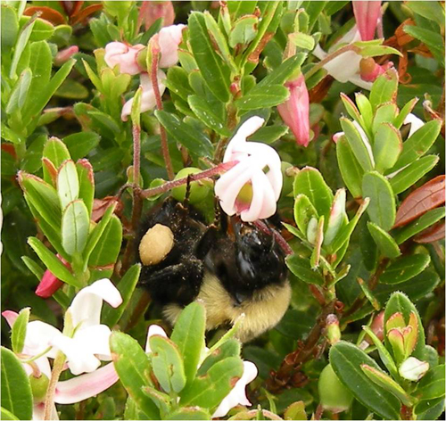
Status of Pollinators
Native Bee Diversity – other crops; Example from mid-Atlantic that can be applied in the northeast
Bee Diversity in Cranberry
Maine to Massachusetts
Bombus (most efficient/abundant)
Megachile (most efficient/abundant)
Melitta americana (a specialist)
Andrena
Osmia
Melissodes
Xylocopa
Ceratina
Agapostemon
Augochlora
Augochloropsis
Dialictus
Dufourea
Lasioglossum
Halictus
Sphecodes
Hoplitis
Coelioxys
Apis mellifera
by A. Averill
80 bee species in the northeast
However, urban environments cannot support the pollinator community Loose, 2000; Mackenzie & Averill, 1995; Mackenzie and Winston, 1984
Notes:
Decline in Carnberry brought about by habitat destruction and pesticide use. Native bees do not currently exist in high enough numbers to play a significant role in cranberry pollination in many of the intensively managed cranberry bogs (Cane et al. 1996; Loose 2000; MacKenzie and Averill 1995). Therefore, efforts should be made to enhance their populations.
Current state of native bees in Carnberry……….
tive bees for farm pollination services is an attainable goal. The cranberry agroecosytem is diverse in habitats, having deciduous and coniferous forest, open meadow, wetland and riparian corridors. This diversity of habitats provides nesting sites and wild flowering plants necessary for the conservation and augmentation of native bee communities (Westrich 1996). In addition to increasing native bee densities, and thus decreasing the need for honey bees, there are other advantages to managing the cranberry landscape for bees. Increasing habitat complexity, by providing wild flowering plants and nesting sites may also benefit predatory and parasitic wasps (Altieri 1994; Altieri and Whitcomb 1979; Andow 1991; Barbosa 1998; Collins and Qualset 1998; Kim 1993) that attack cranberry insect pests. Providing adjacent habitat creates “stepping stones” that enable these predators and bees to disperse between fields (Kruess and Tscharntke 1994; Saure 1996). The findings of Loose (2000) suggest that cranberry bee communities are localized, even between beds less a kilometer apart, and are responding to the amount of wild flowering plants growing immediately around the periphery of cranberry beds.
Notes for Managmen Talk from Drummond better known as Looe et al, 2005 “Conservtion & Management of Native Bees in Cranberry
A common soil-nesting bee in cranberry in southeastern Massachusetts is M. addenda. This species was the most abundant bee in southeastern Massachusetts (Loose 2000) and New Jersey (Cane et al. 1996) cranberry beds during bloom. It is common, univoltine, nests in and around cranberry beds, and can withstand the flooding associated with cranberry cultivation. Emergence of the bee in the spring coincides with cranberry bloom, which extends from late June through early July. It is also an efficient pollinator. Cane et al. (1996) found that single nest cell of a female bee of this species contained pollen from at least 1,076 virgin cranberry flowers. Marucci (1967) showed that floral fidelity by this bee to cranberry during bloom appears absolute. Megachile addenda has also been collected on Compositae (Asteraceae) and Fabaceae (Cane et al. 1996), and may use these flowers as forage after cranberry bloom.
Soil nests. Bees often nest on southerly exposed banks that are well drained and warm. Batra (2001) proposes the term “bee zone” to describe an area that can be maintained by a grower for native bee nesting. The zones should be permanent strips of land along the northern to northwestern edges of the cranberry bed to maximize exposure of nest sites to solar radiation. In most cases the zone should also be protected from cold northwesterly winds that accompany storm fronts in the northeastern USA. Planting a double row of evergreens as a windbreak several meters to the north of the bee zone could also accomplish this. Hummocks and hills are also a part of the landscape that may provide protection to bee nest sites from wind. Bees often select sandy loam banks for nesting, which are common in the cranberry agroecosystem. Clearing banks of vegetation each spring (as vegetation insulates the soil in winter) and keeping them free of insecticide drift will encourage bees. Although, some species of bees can survive submergence under water while in the nest (e.g., M. addenda) many are sensitive to waterlogged soils and thus depend upon undisturbed upland soils for nesting. If it is necessary to construct soil nesting banks, they should be 1 to 2 m MAFES Technical Bulletin 191 17 high, 2 to 3 m wide, and 3 m or more long (Batra 2001). Many species of native bees have short foraging distances
SUMMARY
Native bee species are a natural resource. The cranberry agroecosystem is a natural landscape that is now intensively managed commercially. Although many species of bees potentially can inhabit this landscape, there are many threats to their existence. Conservation of native bee species is a worthwhile investment for growers because honey bees, the major pollinators of cranberry, are in decline worldwide due to parasites, diseases, and global trade pressures that reduce the profitability of cranberry production, resulting in fewer growers being able to afford honey bee rentals. Bumble bees (Bombus spp.) and the leaf-cutter bee M. addenda are both common and effective pollinators of cranberry in Massachusetts. Their densities are tied to the abundance of wild flowering plants around the periphery of cranberry beds throughout the season, the availability of nesting sites, and refuge from insecticides. Including considerations for native bees in management plans of the land around cranberry beds may boost their abundance and diversity and increase their contribution to cranberry pollination. Therefore, a management perspective that MAFES Technical Bulletin 191 21 focuses only on cranberry beds needs to be replaced with a perspective that includes more of the surrounding landscape.

Slide 27
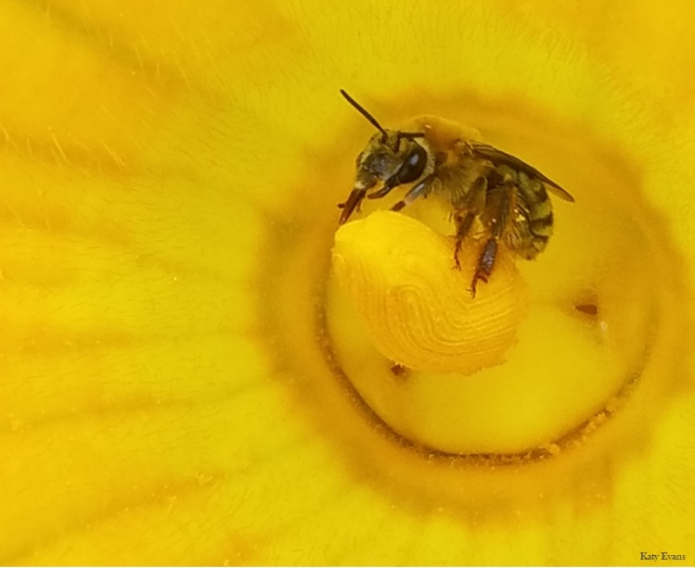
Native Bee Diversity
Status of Pollinators
Bee Diversity in
Squash & Pumpkin
But also:
Melissodes bimaculata
Xenoglossa strenua &
Xylocopa virginica
Plus, several other smaller species
Bombus impatiens & B pensylvanicus
Bumble Bee
Bumble bees and the Squash bee are the most abundant and efficient pollinators of squash and cucurbits in general.
Eucera pruinosa
Squash Bee
Apis mellifera
Honey Bee
Notes:
Literature
Adamson et al, 2012,

Slide 28
Native Bee Diversity
Status of Pollinators
Bee Diversity in Raspberry
Raspberries produce more and larger fruit when a variety of bee species visit the flowers
Total Species found on Raspberry in Vermont
52 species (mostly Bombus, Andrena, Ceratina. & Apis)
Total species found in Raspberry on Urban Farms
12 species + Apis mellifera
Bombus sp (4)
Lasioglossum sp (5)
Andrena (3)
“Destruction of nest sites from development and competition from honey bee hives”
Andrikopoulos & Cane, 2018ab; Goodwin, 2012; Hayes, 2017 (VT); Mackenzie and Winston, 1984
Notes:
The most abundant non-Apis medium and larger bees on crops were Andrena, Bombus, Osmia, and Peponapis. Prior research has shown that bees in these genera are at least as effective as honey bees in pollinating the crops studied here. A few hundred Bombus and Osmia (both with species commercially managed for pollination) can provide the equivalent pollination service of thousands of honey bees in some fruit crops including apple, blueberry, and caneberry (Richards 1993, Ladurner et al. 2004, Cane 2005, Velthuis and van Doorn 2006). Andrena was found to be fourfold as effective as honey bees in blueberry pollination (Javorek et al. 2002). Bombus and the pollen specialists Peponapis and Xenoglossa have been found to be substantially more effective than honey bees at pollinating squash and pumpkins (Tepedino 1981, Fuchs and Muller 2004). Although Javorek et al. (2002) measured the effectiveness of Andrena in blueberry pollination, less research has focused on the pollination effectiveness of other ground-nesting bees that cannot easily be managed (versus relatively well-studied managed bees, such asBombus andOsmia).Andrena can clearly play an important role in crop pollination, especially spring-ßowering fruit crops (McGregor 1976, Havenith 2000, Tepedino et al. 2007, Tuell et al. 2009). Batra (1999) conducted a detailed study ofAndrena fenningeri Viereck, promoting its use as an orchard pollinator and proposing techniques for introducing and helping to maintain populations on site. Researchers have documented the diversity and abundance of wild bees in cropsand thepositive correlationsbetweenbeediversity and improved pollination (Chagnon et al. 1993, Winfree and Kremen 2009).
The most abundant non-Apis medium to larger bees visiting apple, blueberry, and caneberry ßowers were
Andrena, Bombus, and Osmia (Table 2).
Abundant genera in cucurbits were Agapostemon, Bombus, Melissodes, and Eucera pruinosa, a cucurbit specialist.
Ten species were netted from all crops: Apis mellifera, Augochlora pura, Bombus bimaculatus, B. griseocollis, B. impatiens, B. perplexus, Ceratina calcarata, Halictus confusus, H. ligatus, and Xylocopa virginica

Slide 29
Native Bee Diversity
Status of Pollinators
Bee Diversity in Legumes
No studies in northeast however, the bee genera and known species netted on legume flowers in Tennessee are abundant here in the northeast.
Listed most to least abundant
Lasioglossum sp
Megachile sp
Bombus sp
Melissodes sp
Agapostemon sp
Augochlorella sp
Halictus sp
Xylocopa virginica
Calliopsis sp
Augochlora pura Lawson, 2020 (Thesis)
by MaLisa Spring

Slide 30
Native Bee Diversity
Status of Pollinators
Bee Diversity in Strawberry
65 species in New York Strawberry
Andrena
Apis mellifera
Bombus
Ceratina
Nomada
Xylocopa
Hylaeus
Augochlorella
Augochlora
Halictus
Lasioglossum
Connelly, Poveda, Loeb, 2015

Slide 31
NEXT TALK
ECOLOGY and LIFE HISTORY

Slide 32
Diversity and ecology of bees in the northeast Part II: Ecology and Life History
Maria Van Dyke
Department of Entomology
Cornell University
Notes:
H I look forward to sharing what I know about the ……..title……. I think it will help you be able to integrate the ‘why’ into approaching wild bee conservation and management.
This Modules is the first of a 5 part series education program.

Slide 33
To HELP wild native bee species we need to understand their diverse lifestyles.
Life History
photo: Sam Droege
Notes:
So we can see that bees are diverse here in the northeast and even in agriculture with 15-25% of the state diversity visiting pollinator dependent crops. This gives us reason to consider supporting our bee communities.
BUT If we want to help bees, we need to understand their natural history. This means we need to fully realize how they fit into an ecosystem in time and space.

Slide 34
Important Life History Traits
Life History
Social behavior
Nesting resources
Lifecycle
Seasonal Activity
5. Foraging Range
6. Floral resources
Notes:
To do this we will now review how north American native bee species live in the order presented here: their social needs, Foraging range, lifecycle, Where they live, what they eat, and what their seasonal activity looks like.
Levels of Sociality
Nesting (Where they live and the materials they need)
Lifecycle (development stages - lifetime)
Foraging Range (How far are bees able to travel and still be successful)
Seasonal Activity (Species distribution across summer)
Floral Resources (Who eats what & what do they eat?)

Slide 35
Life History – Sociality
Eusocial
continuum
Photo: Steve Buchmann
Honey bee moms lay 20-50K eggs,
Bumble bee moms lay 100-500 eggs
Notes:
Reproductive output is highly dependent on the amount of resources you can gather and competition for resources. Sociality has a huge part to play in this process. Everyone is familiar with our social bees like the homey bee and the bumble bee species that occur on the extreme end of social structure/hierarchy. Of the bee species that are native to North America, Bumble bee species are our only native colonial bee species. Meaning that there is a queen and a complex hierarchical caste system. These eusocial species build a large hive population that can exploit floral resources en masse and fly great distances making them resilient to resource fluctuation and ensuring high reproductive output (HB moms lay 20-50K eggs, BB’s less at 100-500 eggs)

Slide 36
Life History – Sociality
Social
Cooperative
Eusocial
continuum
Lawson et al, 2020
Photo: Steve Buchmann
Cooperative moms lay
10-30 eggs (carpenter bees)
Notes:
These eusocial species with a division of labor and extended brood care are just one type of social species. We also have Cooperative nesting species or cooperative breeders.
These cooperative breeders, such as our small and large carpenters bees, Ceratina and Xylocopa species respectively as well as many of our sweat bee species also live in a community where the mother rears her young all the way to adulthood. Mothers and offspring live in the same nest whether that be stems, decomposing wood, or in the ground and the duties of the offspring is foraging and guarding the nest entrance while the mother forages and delivers pollen and nectar to her young. When mothers get old they die off leaving the nest to their most alpha offspring who can continue on. Some individuals act solitarily but studies show the solitary drifters produce males more so than females
You would imagine these species garner a pretty high reproductive output due to these social behaviors however there is much competition between mother bee and foraging bees with lots of egg replacement behaviors which ultimately keep # of eggs layed per female as low as the solitary bees I will discussing shortly.

Slide 37
Life History – Sociality
Solitary
Social
Solitary
Communal
Cooperative
Eusocial
continuum
Most solitary and communal bees lay around 10-15 eggs
Notes:
Solitary
And now we come to the star of our NA native bee community, the solitary bees. I want to take a moment to emphasize the differences between social and solitary species which are important to keep in mind because most of our native and wild species live solitarily lifestyles that are not as well known to the public as the social lifestyle of honey bees which has been made popular Hollywood.
At the solitary end of the spectrum of sociality responsibilities are very different for the Mother. There are two means of being solitary. Distinctly Solitary females build each of her nests in her own preferred elusive location; Communal solitary species have a tendency to nest near each other in the same location or they share a nest entrance but maintain a solitary lifestyle otherwise.
Both Solitary and Communal nesting solitary females work alone, building nests, constructing brood cells, gathering provisions and delivering them to brood cells, and laying her eggs. Think single mother….
A benefit of communal nesting is that they can passively protect the nest entrance/entrances from brood parasites since there is always someone coming or going from their nesting area.
The majority of bee species here in North America are solitary and communal solitary nesters (about 75% of our species), therefore we should keep it in the forefront of our mind that proximity of resources is more important for these species than social bees since they are doing all the work themselves which slows down their reproductive output.

Slide 38
Life History – Sociality
Solitary
Social
Solitary
Communal
Cooperative
Eusocial
continuum
Brood parasites
Social parasites
Michael Veit
Tom Murray
Notes:
Sharing the scene with solitary and social bees are their nest parasites, the parasitic bees including the brood parasites that parasitize the solitary bee groups and the social parasites that attack the social bee groups.. These bees only forage for nectar on flowers and instead of collecting pollen they sneak into the nests of their hosts and either destroy the hosts eggs and lay their eggs in their place or they lay their egg in the cells with the host egg and then their offspring quickly develop and destroy the host offspring and feed on the pollen provision thereby obfuscating with all of the hardwork of the solitary mama.
Division of labor
Generational overlap
Conceptualize sociality by pictures of the nests (WikiMEdia Commons – google images only include creative commons)
Take out Nomada and add Dialictus

Slide 39
Natural History
Life History – Nesting resources
Two broad categories of nesting:
Below Ground:
Soil excavators
& Ground Burrow Renters
70% of the species
Above Ground:
Wood & Stem Excavators & Wood, Stem, or Cavity Renters (dead trees, stems)
30% of the species
Notes:
NESTING
In order to protect the homes that our crop pollinating bees live and raise their young in you need to know where they live. With such broad species diversity, the places these native bee species nest are endless.
Broadly there are two main types of nesting (Above ground and Below Ground). Ground nesting bees either nest below ground in the soil where they excavate tunnels and chambers, or they rent abandoned rodent or insect buroughs,
Cavity nesting bees nest above ground excavating or renting space in various materials including stems, branches, tree trunks, old beetle burrows, and decomposing wood, to name a few.
This slide shows four different species and how and where they nest and what their nest provisions look like (clockwise, Osmia, Megachile, Eucera, Colletes). The Megachile cavity nesters often use leaves stuffed into crevices as are shown here on the right to line their nests and provide physical and chemical protection from pests and fungal pathogens. There is a huge amount of diversity in the way bee species line their nest to protect them from the elements (some using internally made secretions that they paint the nest cell walls with). Even the way bees mix their provisions varies between species, some species make soupy wet nesting provisions for their young to gobble up and others leave the pollen loose and messy.

Slide 40
Natural History
Life History – Nesting resources
Where do native NYS bee species live?
Notes:
GRAPH
Here is a breakdown on where the native bees of new York nest. We presume that these distributions are similar across the northeast due to the similar climate and vegetation.
Illustrated in this way you can easily see that ground nesting solitary bees make up the majority of non-nest thieving bee species in our region.
Seventy percent of northeastern bees are ground nesting and if we look specifically at tree fruit pollination {apples, cherries, plums, peaches), 95% of the pollination is coming from ground nesting species. Therefore, assessing and managing the landscape to provide attractive nesting localities is an important management activity. (Management for bees will be covered in Module 2). Knowing these ecological traits we can more easily predict where wild bees might be nesting in the landscape and help to protect those areas.

Slide 41
Natural History
Life History – Nesting resources
Where do wild native NYS bee species live?
Notes:
GRAPH
Here is a breakdown on where the native bees of new York nest. We presume that these distributions are similar across the northeast due to the similar climate and vegetation.
Illustrated in this way you can easily see that ground nesting solitary bees make up the majority of non-nest thieving bee species in our region.
Seventy percent of northeastern bees are ground nesting and if we look specifically at tree fruit pollination {apples, cherries, plums, peaches), 95% of the pollination is coming from ground nesting species. Therefore, assessing and managing the landscape to provide attractive nesting localities is an important management activity. (Management for bees will be covered in Module 2). Knowing these ecological traits we can more easily predict where wild bees might be nesting in the landscape and help to protect those areas.

Slide 42
Life History – Nesting resources
Notes:
NEST MATERIALS
Our bee species also use materials from the environment to line their nest cells or in some cases construct their nests. It is important that these materials are in proximity to nesting sites and floral resource areas.
For example, the Osmia sp up here on the left lines its nest with mud. Here you can see the physical adaptations this Osmia species has (two horn-like projections) above the mandibles which aid in transporting the mud to its nest.
The genus Anthidum scrapes the leaves of plants like Mullein and Lamb’s Ear to make a large ball of fuzzy trichomes within which it creates various nest cell spaces, preparing a pollen provision in each one and laying its eggs.
And again here is the leafcutter bee, Megachile who cuts perfect circles out of leaves with their mandibles for lining their nest cells.

Slide 43
Biology
Life History – lifecycle
Squash Bees (Eucera pruinosa)
The majority of our solitary bees’ lives are spent
in their nest before they emerge (Diapause)
Notes:
So now that you have some basic understanding of wild bee social structure and responsibilities, let’s look at reproduction and what goes on in the nests of the solitary bees with some lifecycle diagrams and photos. Then I’ll show the eusocial bumble bee lifecycle.
In this visual you can see the egg hatches into a larva, the hatched larva feeds on pollen and continues to grow until it has eaten all the pollen, and then pupates.
Depending on the species, the larva will pupate into its final adult stage before Winter or right before it emerges in early Spring the beginning of its foraging window. Similar to bear hibernation, solitary bees slow down their metabolism to overwinter in a state that is called diapause (an an insect term for hibernation)
Think about it,… while we think of bees as being flying creatures, the solitary bee species actually live most of their lives inside sitting and waiting in their nest cell. Their foraging season is only 3-6 weeks long and then they die off leaving their young to finish development into adulthood on their own. During those 11 months in their nests, they are extremely vulnerable to disturbances to vegetation or soil depending on where they nest.

Slide 44
Biology
Life History – lifecycle
Solitary Lifecycle
Cooperative breeder Lifecycle
Ceratina - Small Carpenter Bee
Nguyen & Rehan, 2022
Colletes sp. Danforth et al, 2019
Notes:
Here are a few other examples of bee lifecycles. On the left we have a the solitary species of Colletes, and On the right we have all the stages of the cooperative nester Ceratina. Ceratina is typically solitary in the early spring and becomes semi-social later in the season as the mothers care for there young from egg to adulthood and offspring become many foragers plus a guard bee.
USE THIS

Slide 45
Biology
Life History – lifecycle
Bumblebees
Jeremy Hemberger
Notes:
And here we get to peak into the elusive life of the bumble bee. Early in the spring the mated Queen from the previous season emerges from her small ground borough (think abandoned rodent borough) under an insulating pile of leaves. Upon emerging she searches for a good meal of nectar and pollen, then searches for a bigger nesting cavity to build her colony. Once she has found the nesting cavity, she continues to forage for resources to build her nest cells and honey pots, lay her eggs and feed her larva daily. At this first phase she alone cares for her first generation from egg to adulthood which takes about 4-5 weeks. Once she has enough workers to take over foraging responsibilities for her she then transitions to full time egg laying and brood care while her daughters/workers take over 100% of the foraging duties and helping with brood care. In the late summer the (unfertilized) workers begin to lay eggs which produce the males. At this time new queen eggs begin to be reared as well. Once these new queens mature in the Fall, they will leave the nest and mate before they start the cycle over by once again finding a small protected abandoned rodent cavity under leaves and in burrows in it to rest for the Winter.
In a way these BB queens have it easy like Queen Honey bees… they have helpers that take over their foraging work so they can remain in the nest and focus on laying eggs. Albeit a more modern day woman than the honey bee queen since she starts the season off on her own.

Slide 46
Life History – Seasonal activity
Honey Bees
Bumble Bees
Digger Bees (Andrenidae)
Mason Bees (Osmia sp)
Leaf-cutting Bees (Megachile)
Cellophane Bees (Colletes)
Squash Bees
September
November
February
December
January
March
August
October
April
May
June
July
Notes:
(I have Changed this order, change outline as well)
Think about Colletes
Remove back ground and possibly use the bee types in the illustration.
Redo this graphic in adobe so they all have similar graphics.
Wild bees are active in species specific seasons and times of the day. Meaning that each species emerges from Winter at its genetically predetermined timeframe which typically tracks the flowering of the plant groups it collects pollen from. Here you can see that at any given time in the summer we will see a different community of bee species. This is obviously a broad representation of bee groups, if we showed each species, there would be continuous overriding bell curves. Notice how the social bees populations build and are most abundant come mid-summer, long-term until the weather forces their numbers back down.
Most solitary bees are active for just a few weeks to a month;
Species not only differ in their season of activity but also in the time of day they forage. Take for instance the bees that are specialists on squash. If you want to see these busy characters at work, you need to be in the pumpkin patch at dawn. If you stroll in at 11am on a hot day its likely they have all turned in for the day….however you might find their male counter parts sleeping in a flower.
Even temperature and sunshine will determine who is flying. On a cool, cloudy day here in the northeast bumble bees and carpenter bees are often the only visitors until some rays of sunshine burst through. These later or warmer parts of the day are when most of the other species get active. By later afternoon most solitary bees have settled into their nest maintenance duties for the evening. We only find the Bumble bees, carpenter bees and honey bees into the later hours of the after noon and early evening.

Slide 47
Life History – Foraging range
Natural History
Flight distance largely depends on bee size
Small foraging range (25 meters)
Large foraging range (5+ miles)
continuum
Small Bees (2-4 mm)
Large Bees (25 mm)
Proximity of resources is extremely important for small species
Notes:
when we think of foraging range we are really considering how far the bee can fly to forage for resources and maintain a viable reproductive output to ensure the longevity of its population. A bees foraging range is constrained by its size. Its size will determine the limitations of the proximity of resources. The smaller the bee, the shorter distances bees fly to look for pollen and nectar for their young. While bees as big as carpenter bees or bumble bee Queens can fly upwards of 5 miles our smaller bees, like this Perdita species mounted on the head of the largest bee known in the world, a Megachile pluto, can be limited to les than 25 meters.

Slide 48
Life History – Floral resources
Natural History
(Polylecty) Generalist foragers
continuum
Notes:
Polylecty
In order to protect and provide rich foraging habitat for our native bees it is important to understand the diversity of their diet choice.
AND the plants are not just important for forage as we just learned they are also important for nest building (i.e. oils, leaves, trichomes, etc). While adult bees are responsible for collecting all the pollen and nectar, it is really their young larvae that are eating the majority of the pollen and nectar they collect. Adults predominantly survive on nectar and one belly full of pollen a day.
Our native bees coevolved with the plant's native to north America due to various biotic and abiotic influences. Bees are strongly tied to plant species distribution as well as the physical, chemical and nutritional composition of their preferred pollen, These bee plant relationships can also be understood along a spectrum.
The broadest relationships are those where a bee species can develop on the pollen of many different plants species….This behavior is called ‘Polylecty’ also know as generalist foraging.

Slide 49
Life History – Floral resources
Natural History
(Monolecty) Specialist foragers
(Polylecty) Generalist foragers
continuum
Notes:
Monolecty
On the opposite end of this spectrum/continuum from the generalist foraging behaviror of ‘Polylecty’ we find other bee species that have a very narrow diet, utilizing only one plant species to feed their young larvae, This behavior is called ‘Monolecty’. ‘Monolecty’ is used to describe the most specialized bee species. Species that are narrow specialists have evolved independently to digest a specific plant species’ pollen (For example: the ability to digest its exine or its chemical and amino acid composition).

Slide 50
Life History – Floral resources
Natural History
(Monolecty) Specialist foragers
(Oligolecty)
Broad specialist foragers
(Polylecty) Generalist foragers
continuum
Proximity to floral resources can limit bee reproductive output
Notes:
Oligolecty
OF course we cannot merely put bee species into just two categories. There is a lot of variation happening between these two extremes. Some bee species will be adapted to a few plant genera in a family, or to a handful of species from one or two families. This is called ‘Oligolecty’ -- or broad specialization. Understanding this continuum can help us see why bees are important for maintaining plant diversity and ecosystem resiliency.
Also its important to note and remember that these more specialized bees are further confined by the ‘proximity of resources’.

Slide 51
The migration of squash and its specialist pollinator
Life History – Floral resources
Kristen Brochu
Squash bees consume only squash pollen.
Squash bees nest in the ground, laying each egg on a soupy mix of pollen and nectar at the end of a series of tunnels.
Squash bees were able to travel across North America by tracking Native American Cucurbita cultivation. As a result, squash bees are not only found in Mexico, where they originated, but are also found as far north as Vermont.
Laura Russo
Squash bees nest underneath squash vines.
Lopez-Uribe et al, 2016
Notes:
To illustrate this coevolutionary relationship of specialist bees I want to share with you the story of the squash Genus, ‘Cucurbita pepo’ and its specialist bee Eucera pruinosa.
Squash did not occur in North America before Native Americans carried the seeds with them along the migrations trails northward from Mexico, cultivating & trading the seeds along the way. Squash bees (Eucera pruinosa) followed behind along the trail of squash cultivation.
The reason they followed this path so faithfully is because they are 100% dependent on the pollen of this Cucurbita species to feed their young and the squash bees (Eucera pruinosa) typically find the best soil to build their nests in under the shade of the big Cucurbita leaves where the protected soil is softer, however their nest aggregations can be found in other locations as well.
APPLE FACT* Apple orchards help support at least six species of bees that specialize on the pollen specifically from the family Rosaceae of which apple is a member. So you can imagine that these species migrated toward apple orchards as growers began growing them in masse.

Slide 52
Managing for Native Bees
Putting the Pieces Together
Proximity of Resources
Reproductive output depends on proximity of resources
Pollen & nectar
Access to clean water
or moist soils
Especially for social bees & mason bees
Nests
Notes:
PROXIMITY OF RESOURCES
I hope this talk has demonstrated the biological needs in a clear way so that you can see that supporting these important bee plant relationships is highly dependent on the proximity of healthy, abundant and diverse resources that need to be available at the right time of the season depending on the bees you are trying to support the most.
Apple growers will want to focus on the providing resources for bees of the early Spring to mid to late May. While Strawberry growers will be most interested in making sure resources are available fo the bees that visit their flowers from early May to Early June as well as Berry growers. Remember bees are present in your landscape a week or two before your crop blooms so your goal is to make them stay there until your crop blooms. Module 2 will take you through how to manage your landscape for supporting native bee species with special attention to crop bloom times using Apple as our main example.

Slide 53
Putting the Pieces Together
Native bees are inextricably tied to the landscape
Cécile Antoine & Philippe Tremblay.
Alanso Abogattas
Jaime Pawelek
Heather Holm
HONEY BEES CAN BE MOVED TO SAFE PLACES
Kelly Gill
gardenerspath.com
Jaime Pawelek
gardenerspath.com
Notes:
As you can see our native bees are industrious creatures and are totally dependent on the landscape and are vulnerable to anything we do to the soil or vegetation. What more they are not domesticated and cared for the way honey bees are. Nobody can come whisk their nests away on a whim if land excavation ensues or pesticides are sprayed. IF the bees survive big nest disturbances, they must rebuild new nests somewhere else and their previous eggs may or may not survive the management activity, the forest clearing or the construction that caused the disturbance. When pesticides are sprayed they typically continue to forage and are thereby exposed to the lethal and sublethal effects of the chemicals.
NOTE- Do not need to ‘say’ now but will be in Management Module #2: To help nesting bees, consider leaving patches of open soil close to crops while restricting or eliminating pesticide use. Decaying wood, dead hollowed out stems, and dead trees with beetle burrows can also be used as nesting habitat for the smaller community of tree crop pollinating bees that nest in cavities. These sites will also be used by many Megachilidae that are active just after tree fruit flowering but are important for many native species as well as legume crops. (This will be covered more thoroughly in Module 2/3??)

Slide 54
Questions?
Notes:
Thank you to our funders (Bryan - Should I also put all past funders….I definitely intend to on the data modules but there was not data here)

Slide 55
Native Bee Diversity – NY apple orchards
Family
120
wild bee species visiting apple blossoms
Total number bee species: 120
Number species
Notes:
After approximately 10 years of surveys we can say that we have pretty well fully characterized the bee fauna of NYS apple orchards. We detected species from 5 of the 7 extant bee families. Our bee community was particular diversity in Halictidae and Andrenidae, but also included Apidae, Megachilidae, and Colletidae. In the end we found a total of 120 bee species… let that sink in for a minute. There are ~440 bee species in NYS – we were able to collect nearly ¼ of all of the bee species of NY just in NYS apple orchards. This is an incredibly diverse and interesting fauna.

