Slide 1
SARE PROJECT
Precision Planting of Cover Crops
GOAL
Maximize benefits of cover crops
  And Minimize Challenges of high residue systems

Slide 2
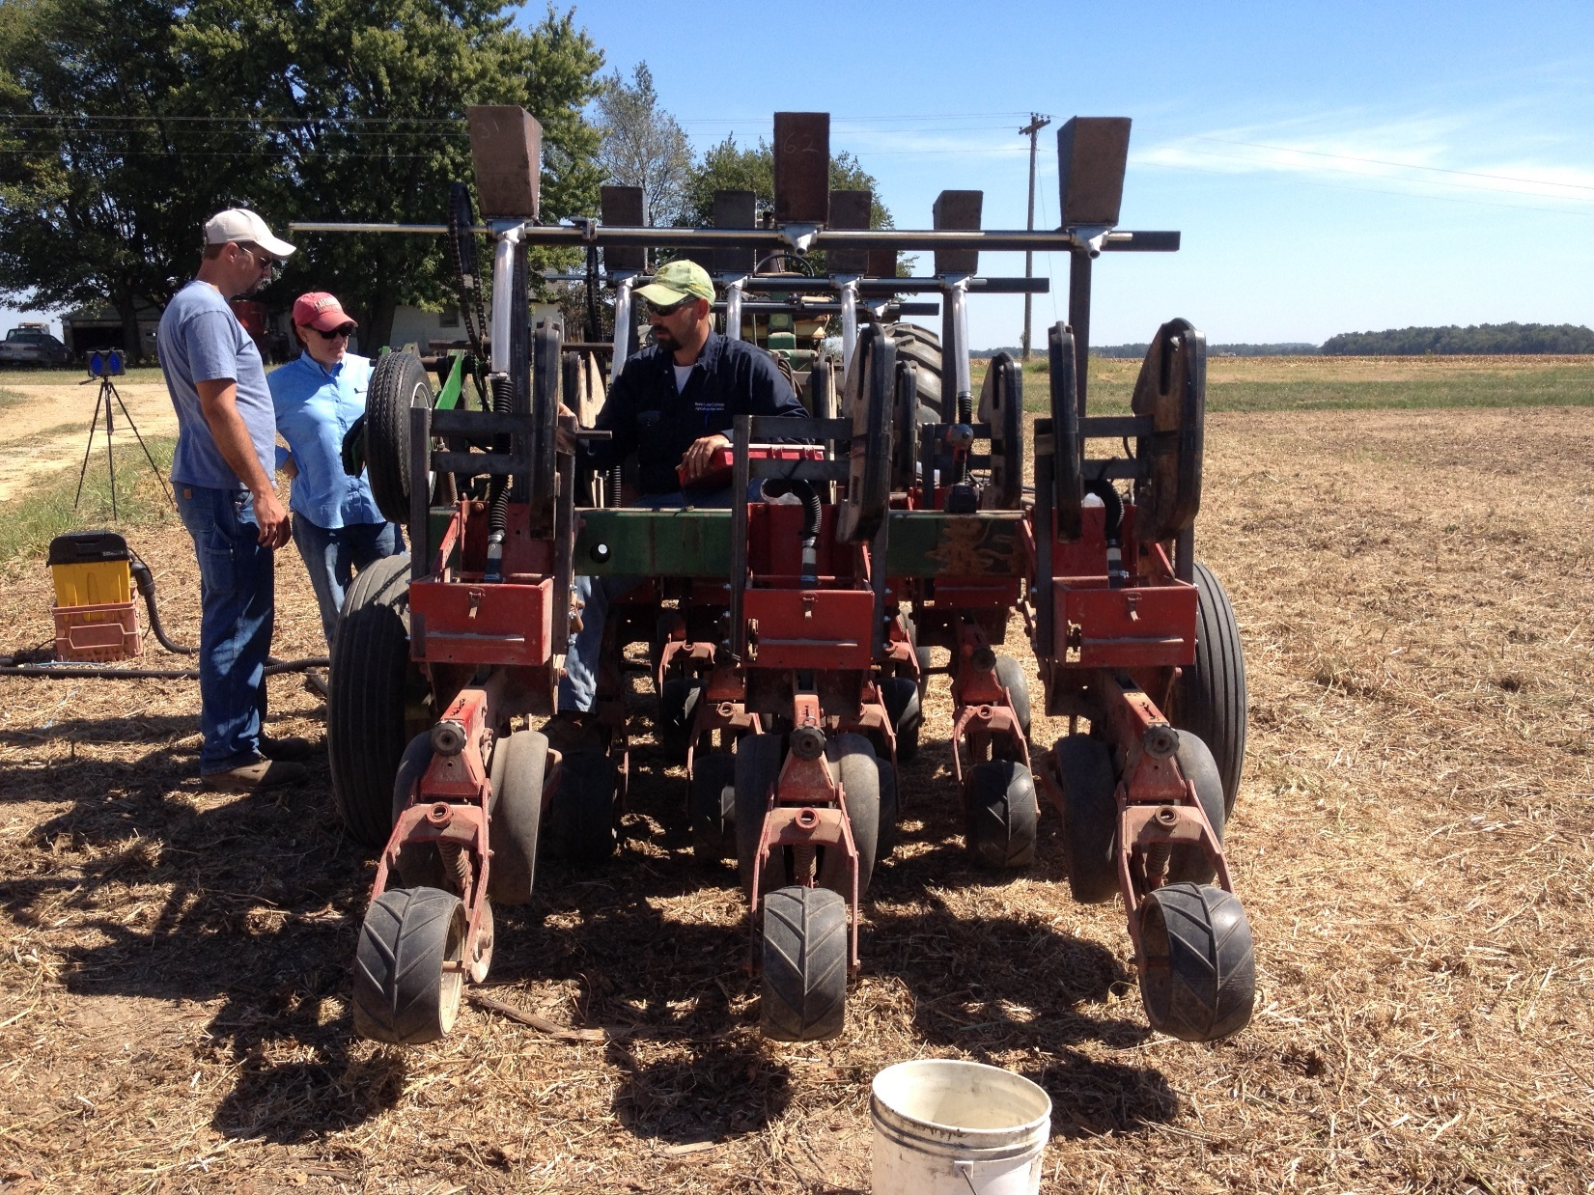
Calibrating the planter

Slide 4
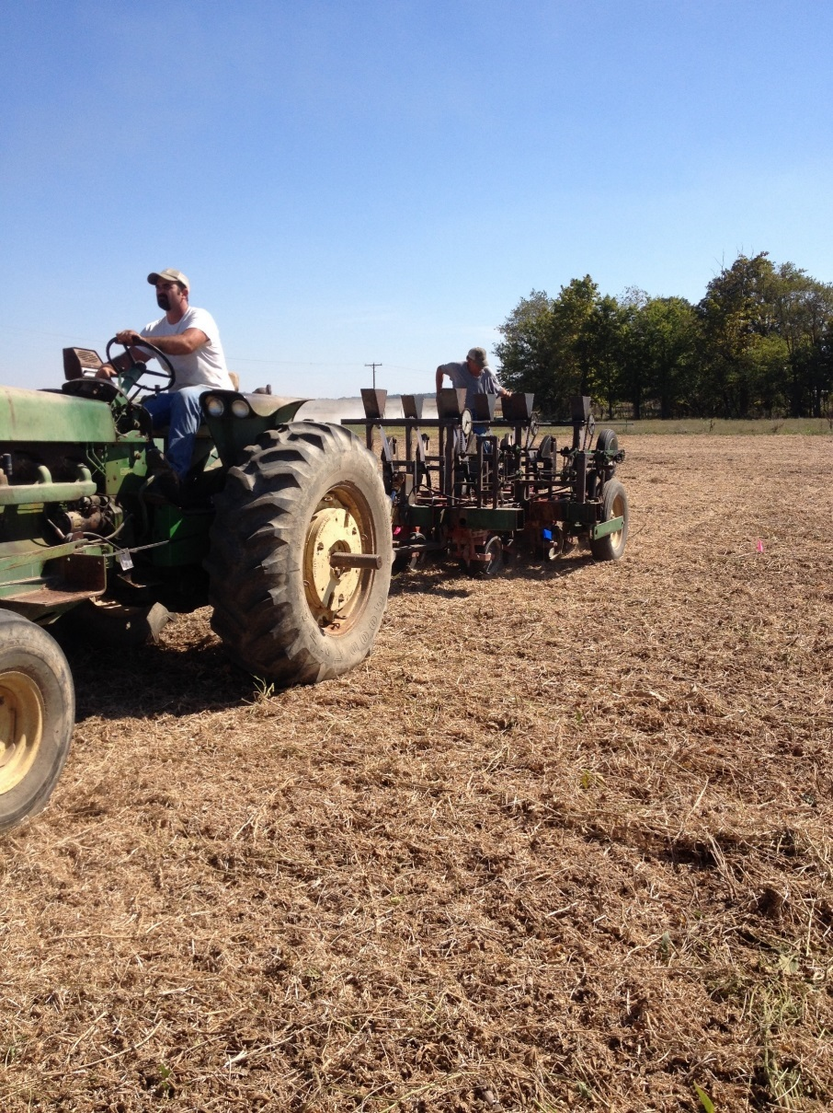
Plot Planting

Slide 5
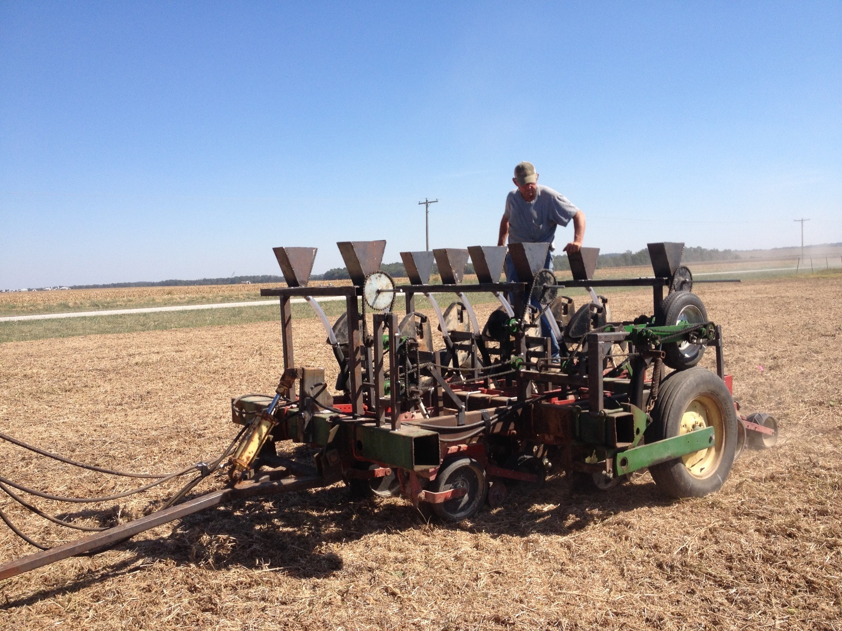
Ralph Upton, Jr. Monitors Seeding Operations

Slide 6
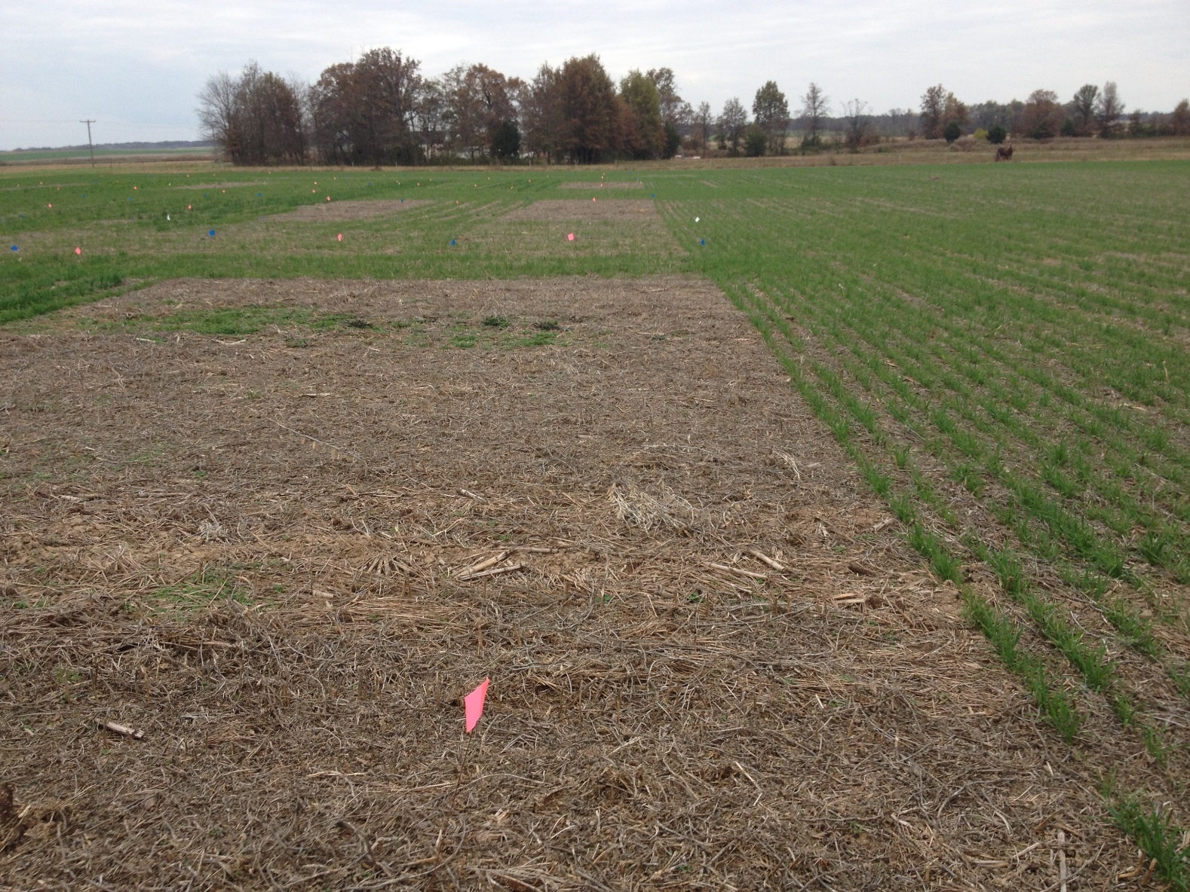
No Cover Check/Control In Replicated Plot

Slide 7
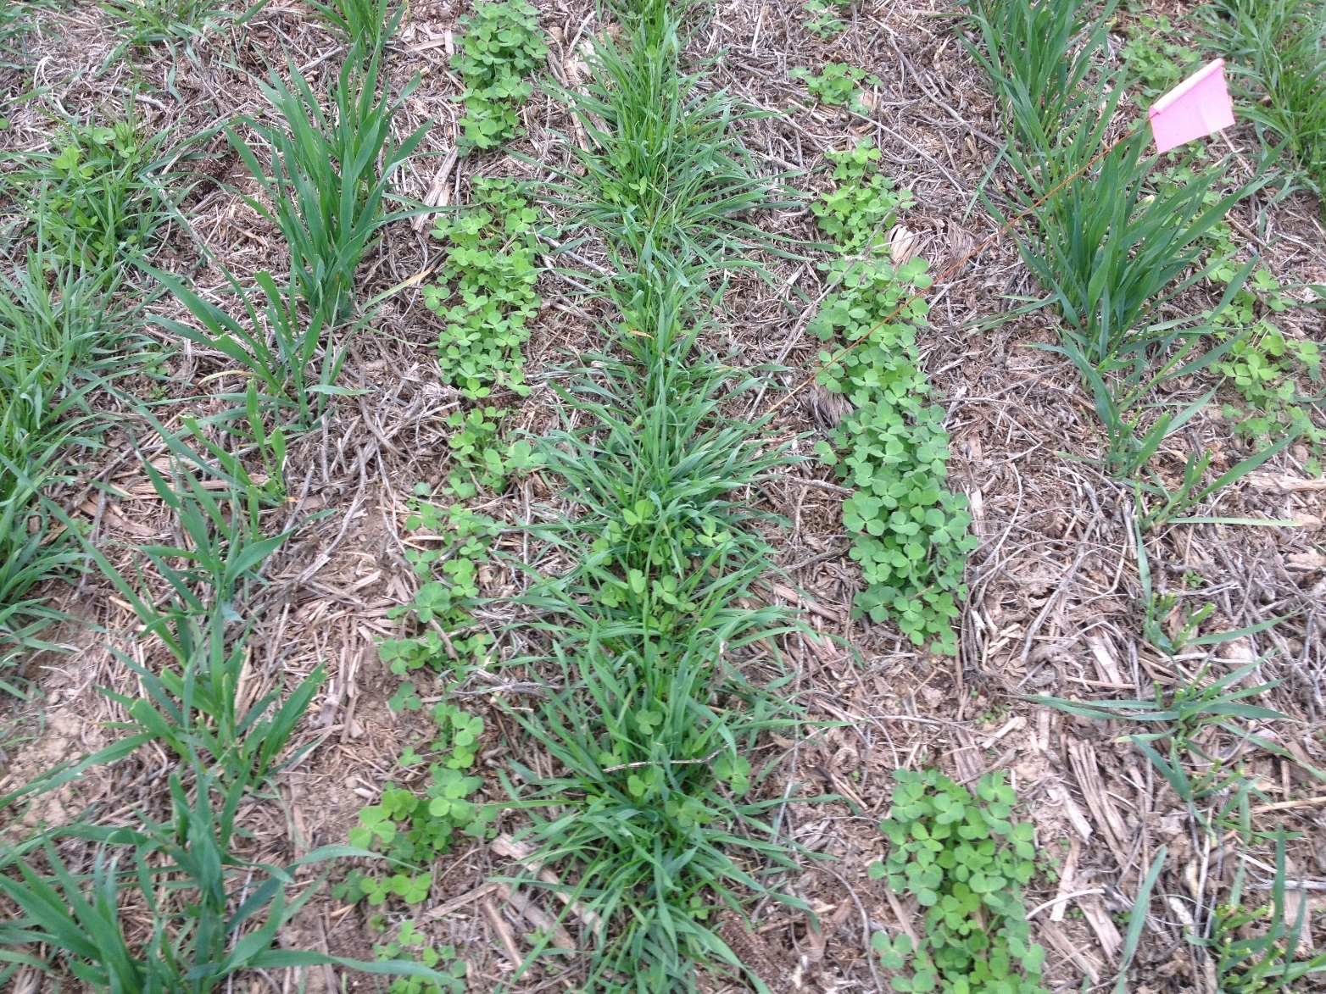
Precision Planting of Cover Crops

Slide 8
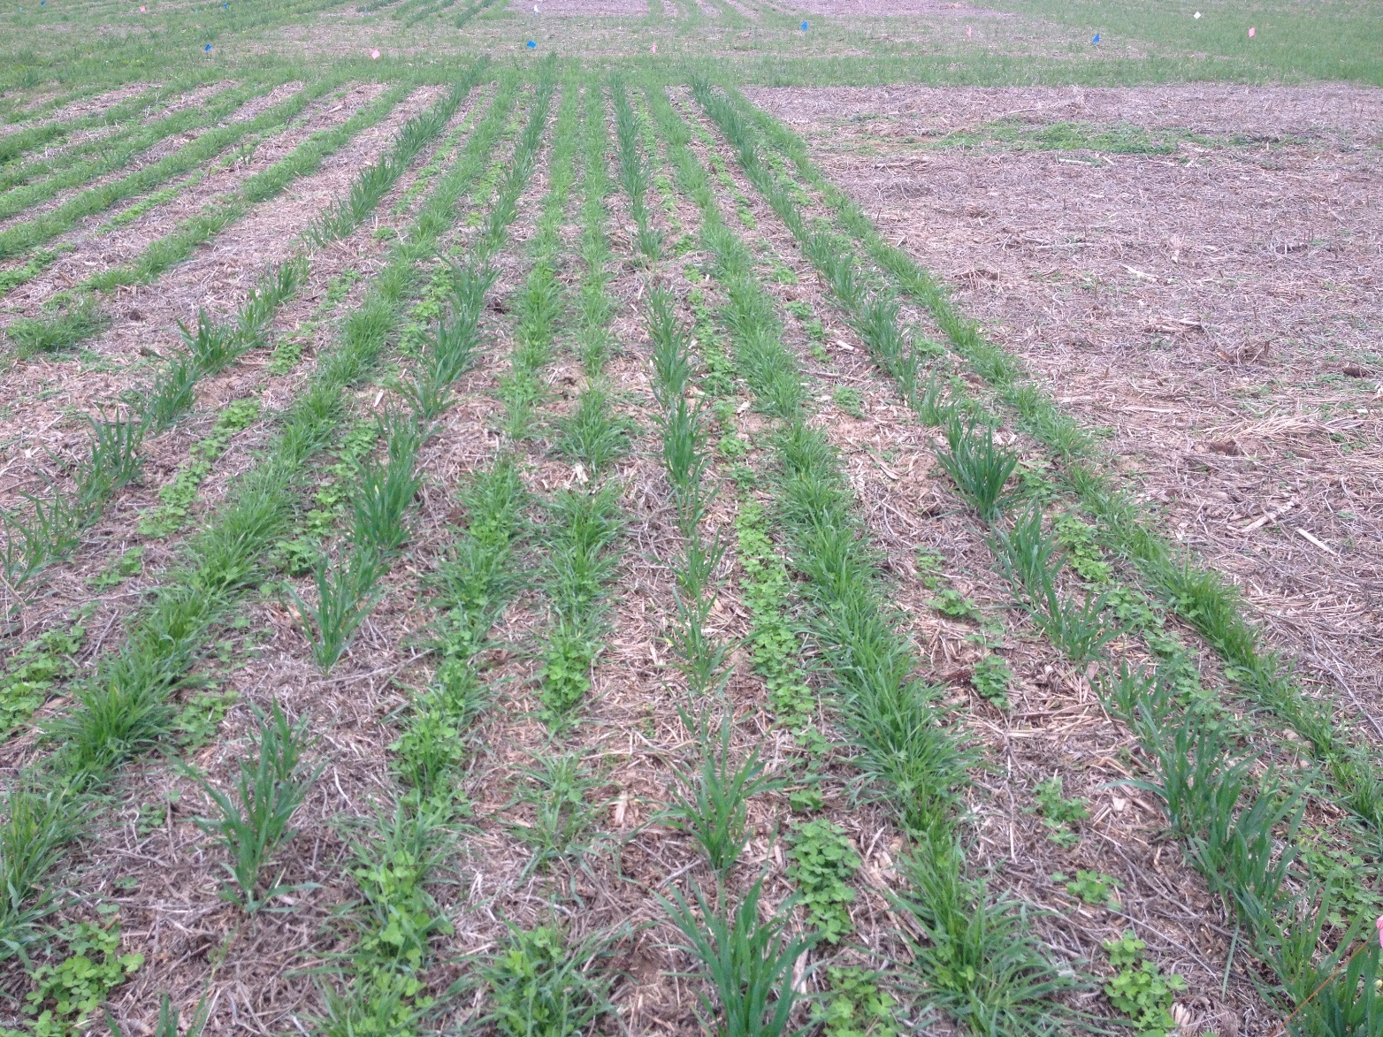

Slide 9
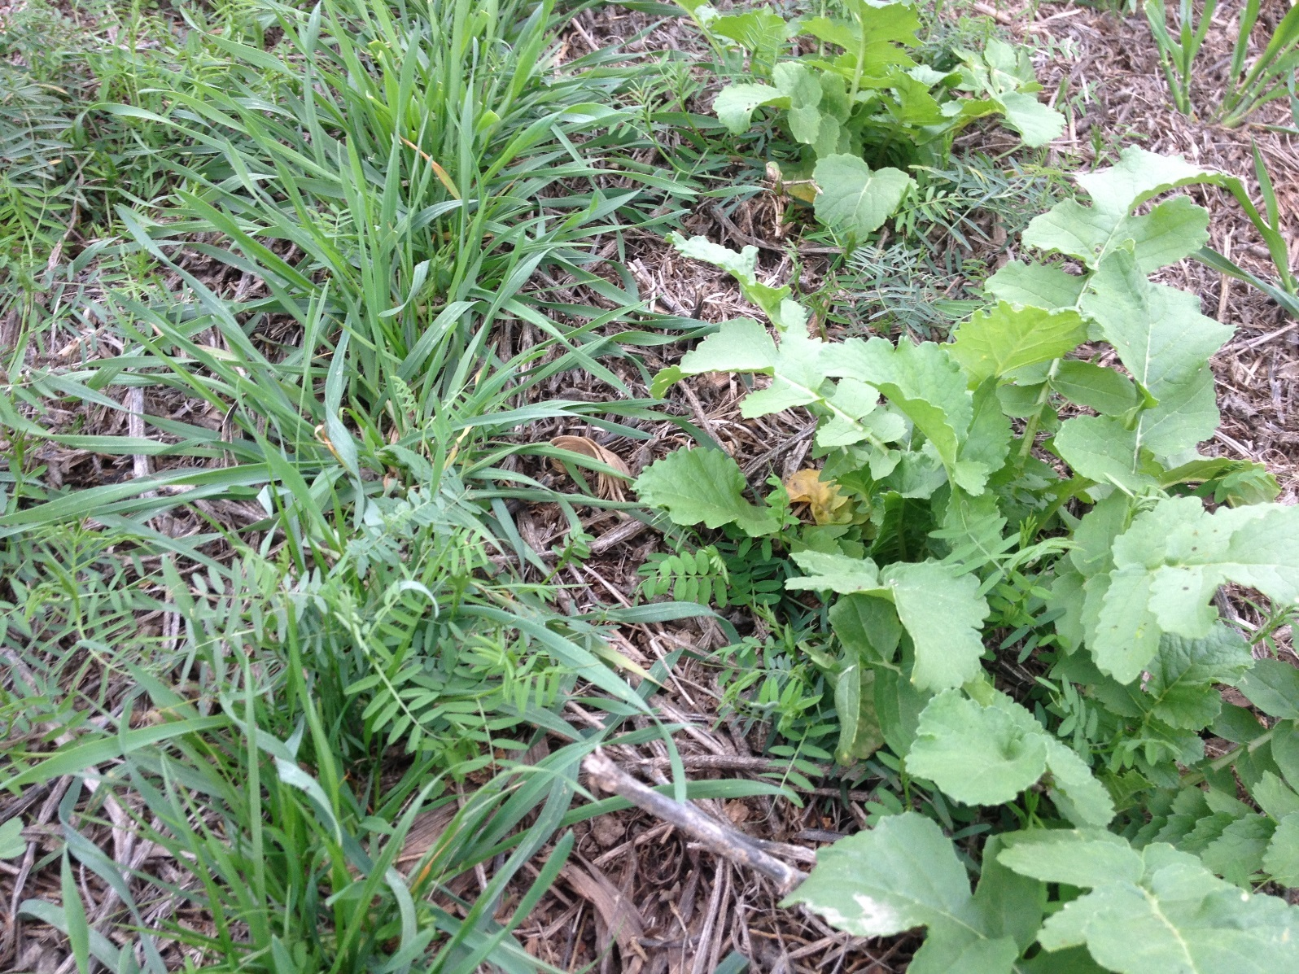
Radish row on right will winter kill to leave a low residue strip for the corn row

Slide 10
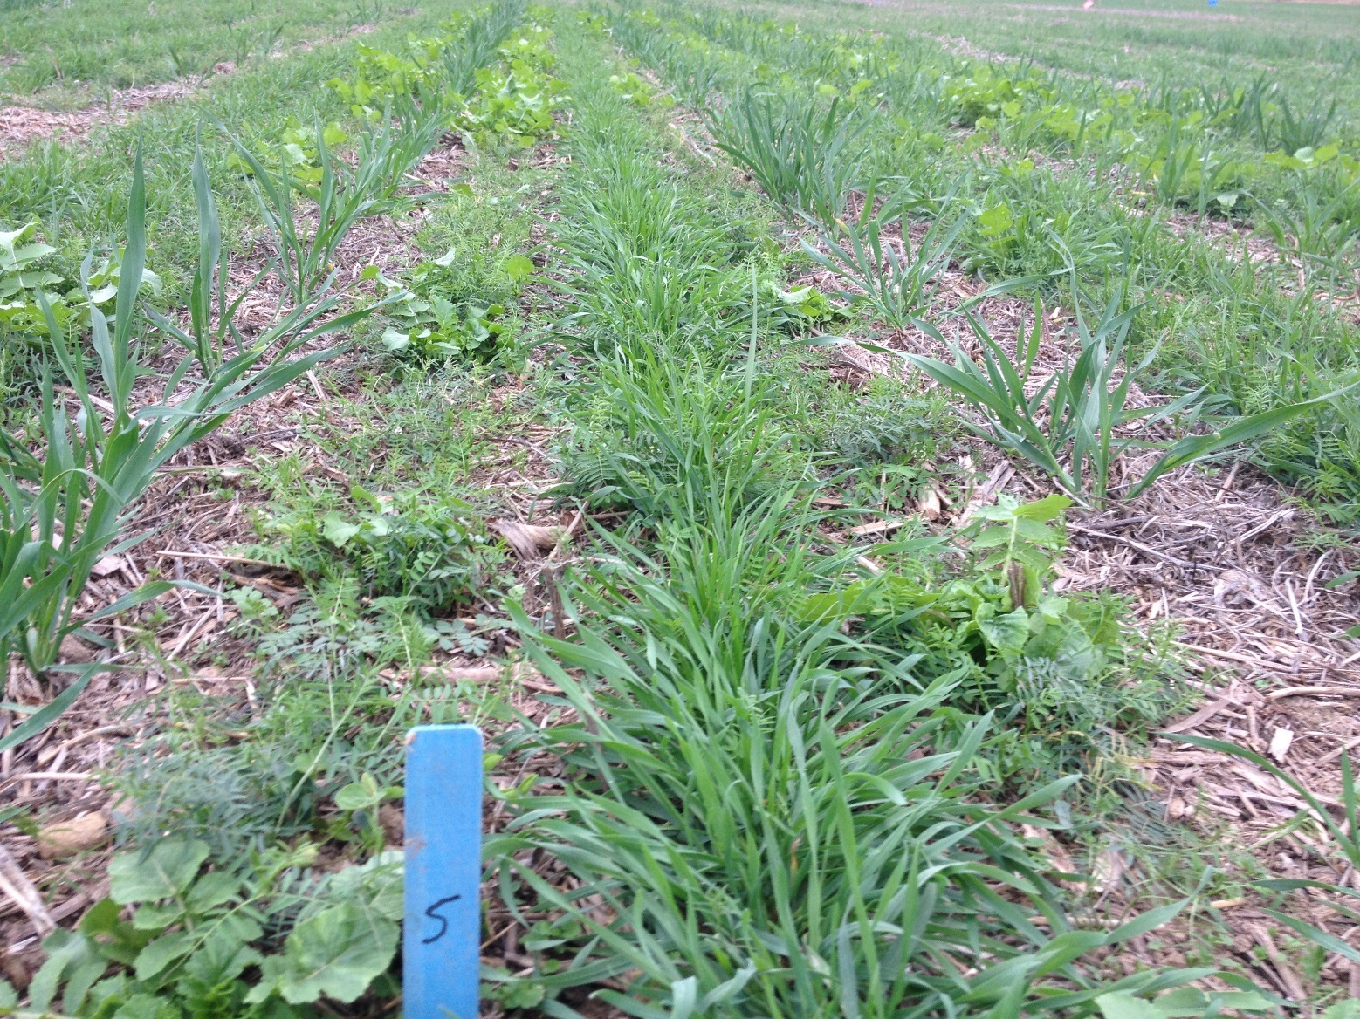
A= Oats/Buckwheat (Where corn row will be planted)
B= Hairy Vetch and Radish
C= Annual Ryegrass/Cereal Rye/Vetch mix (center of corn row)
A
C
B

Slide 11
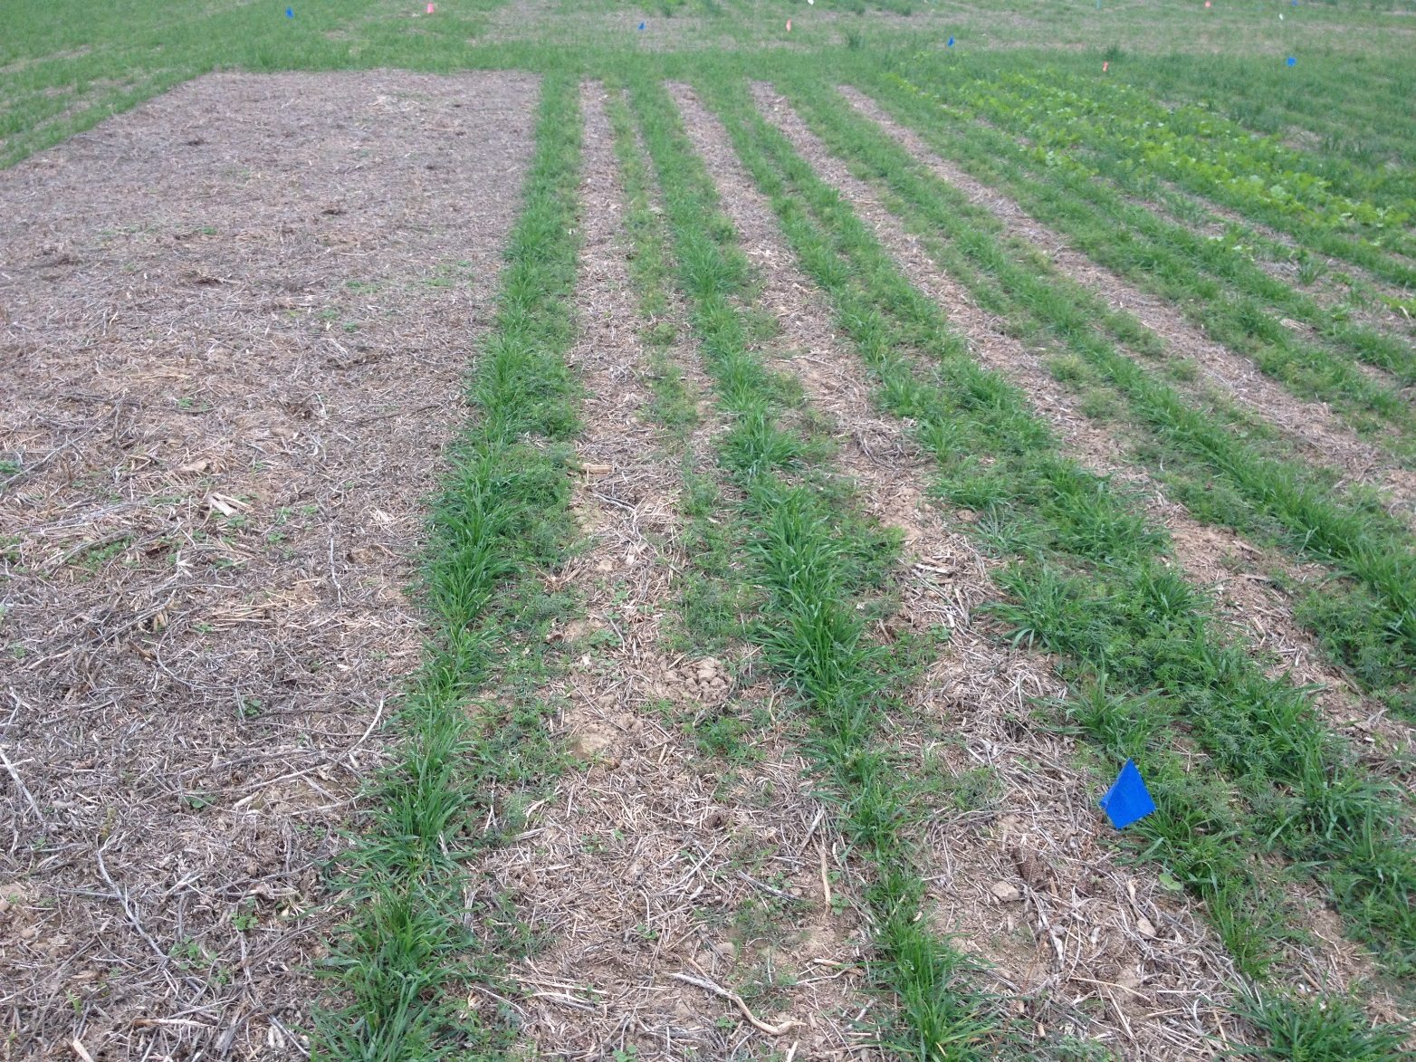

Slide 12
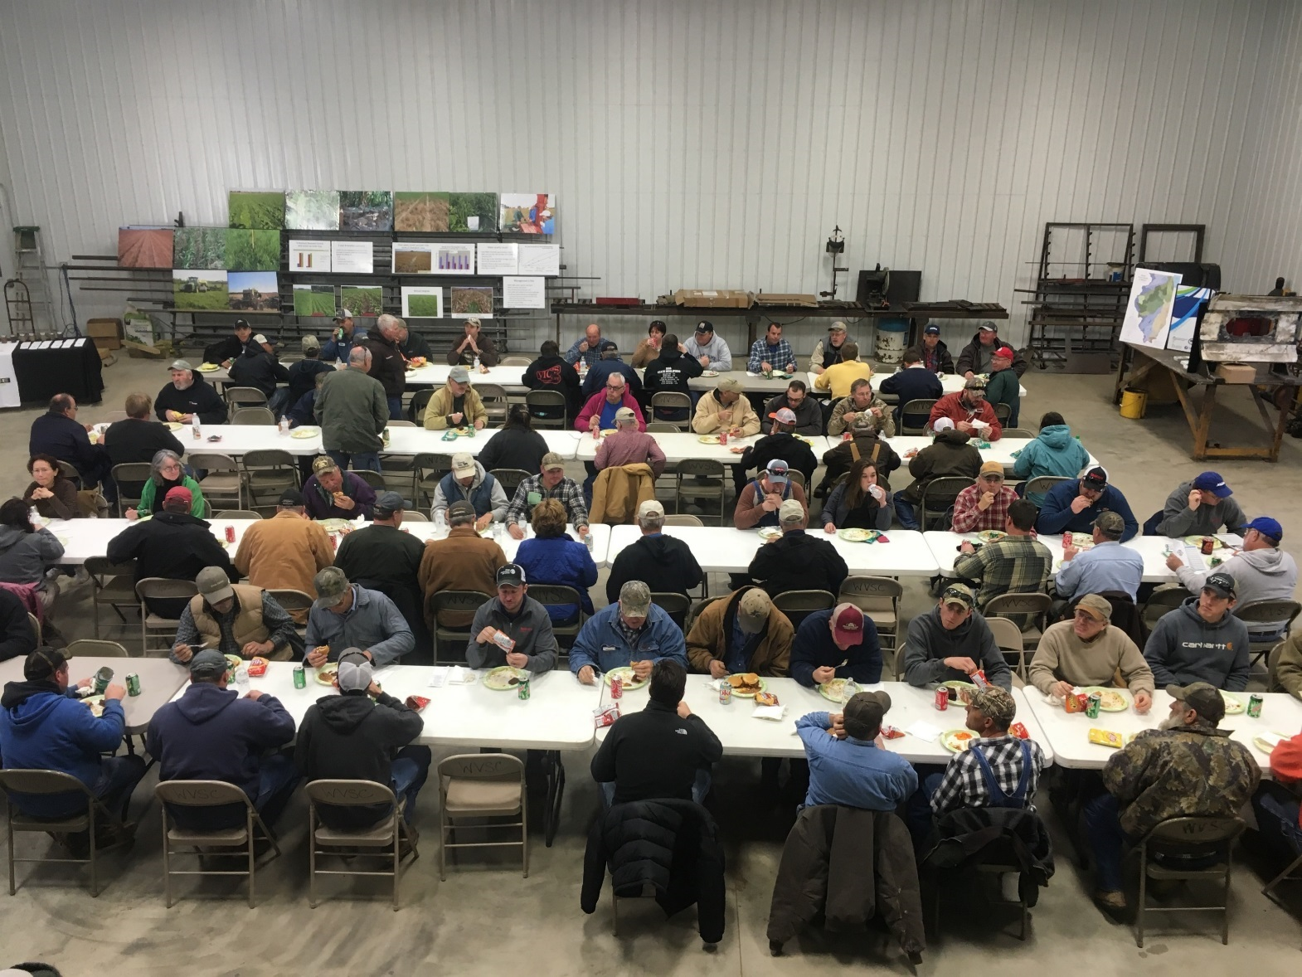
Field Day Lunch

Slide 13
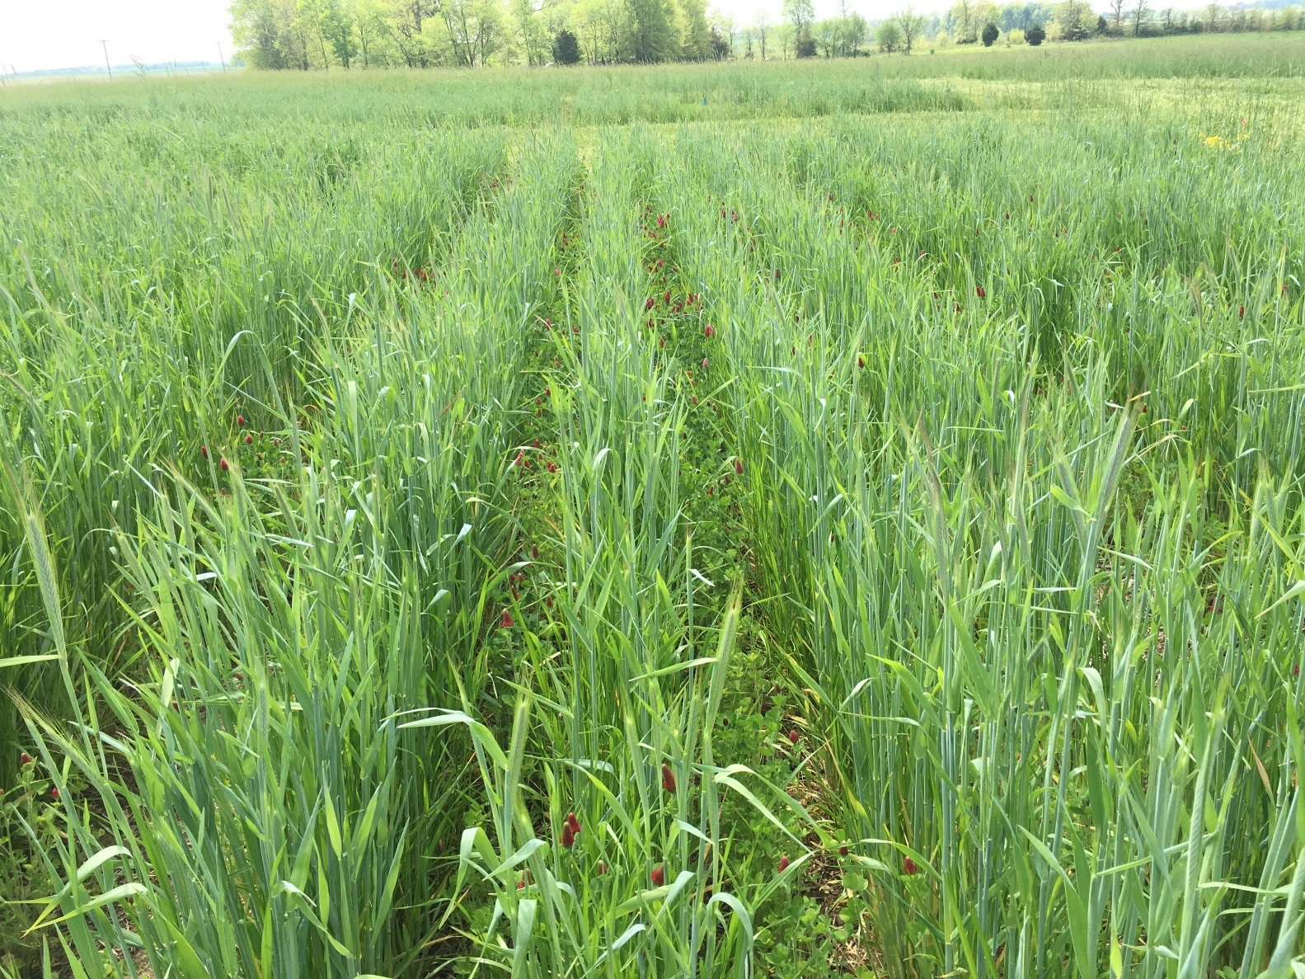
Mid-Spring (This is the stage when corn planting would normally be done)

Slide 14
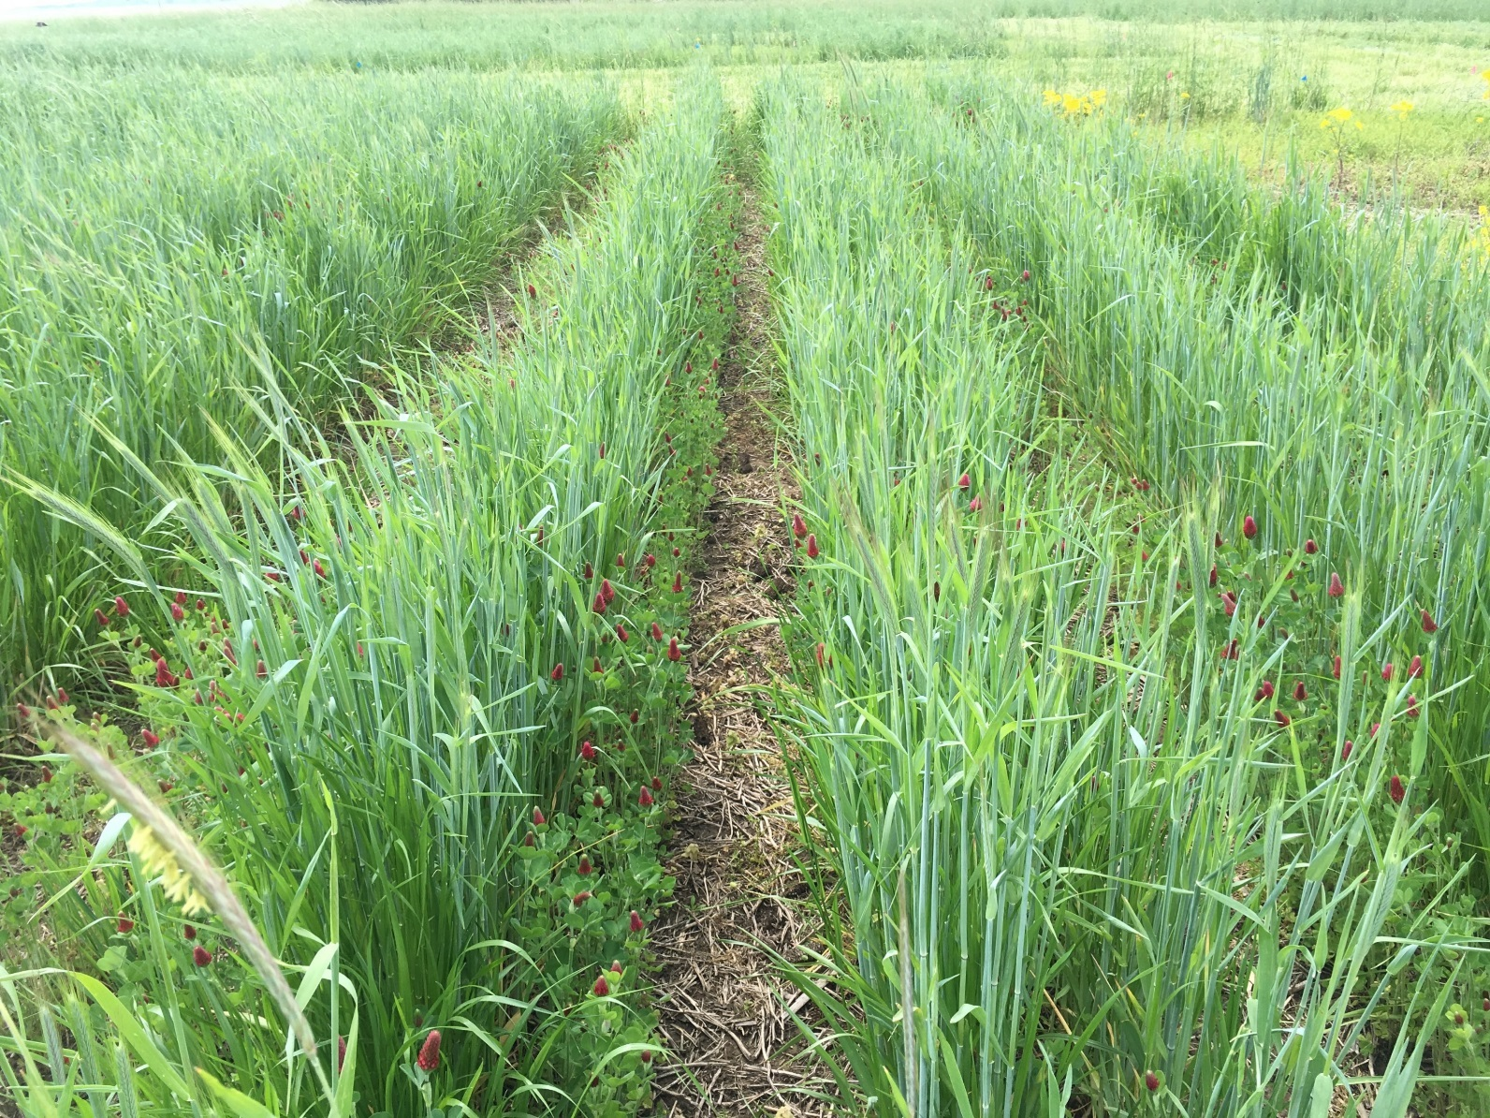
“Blank” strip for corn row with good planting conditions

Slide 15
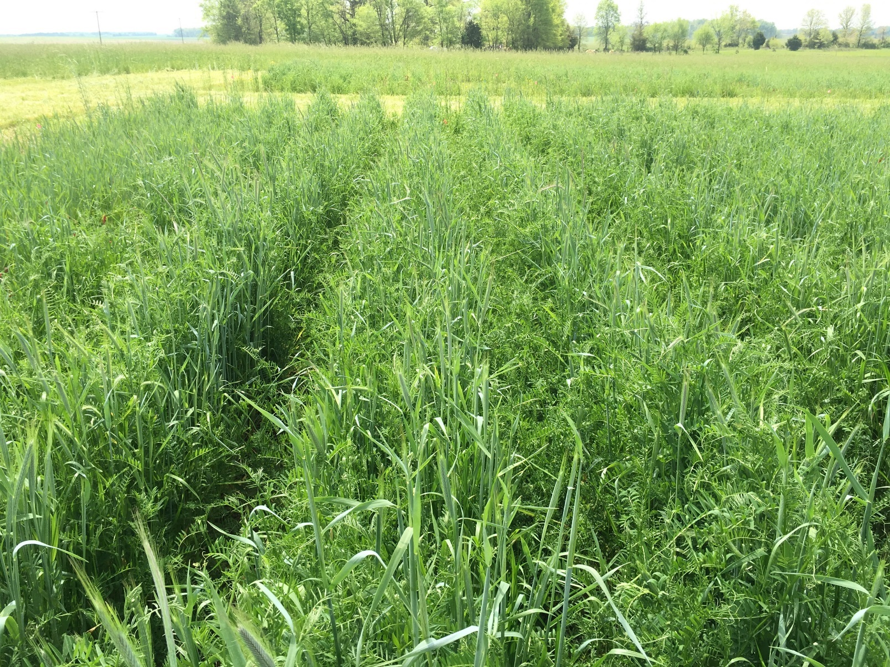
Corn Row will go here

Slide 16
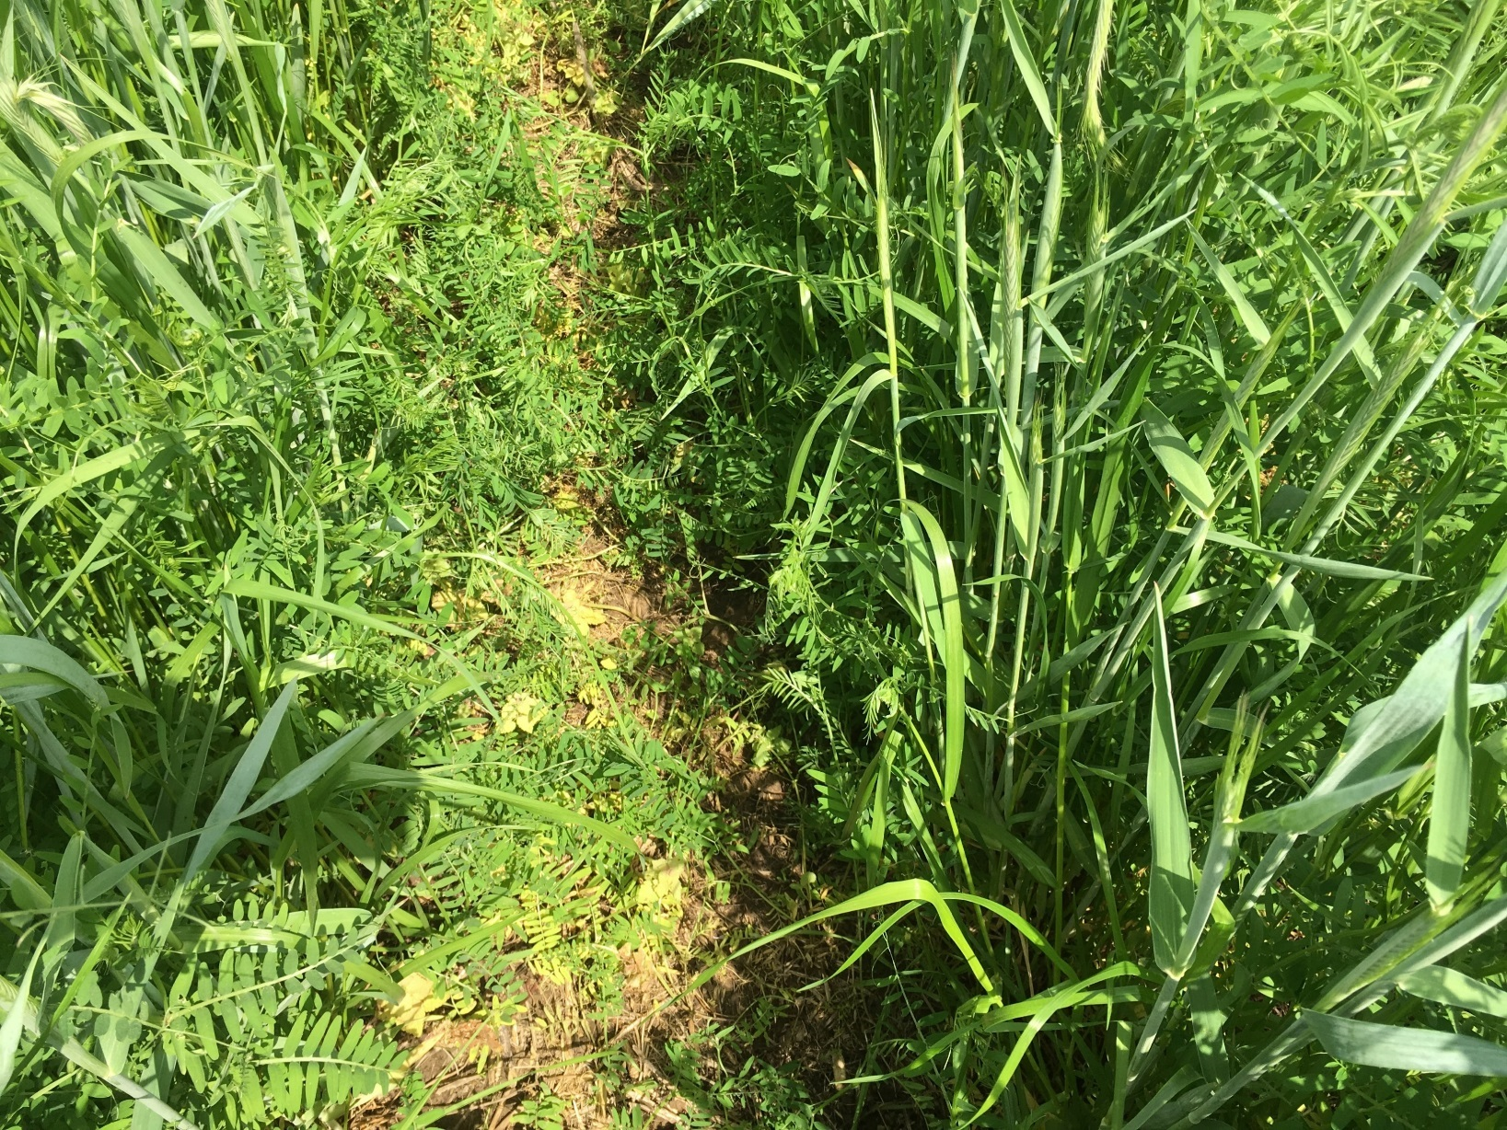
Planting zone for corn rows

