Slide 1
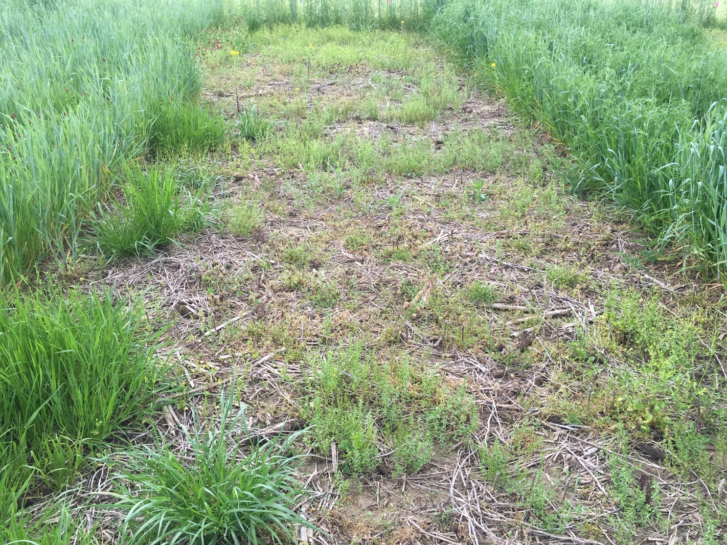
Control/Check with winter annual weeds not present in cover crop plots

Slide 2
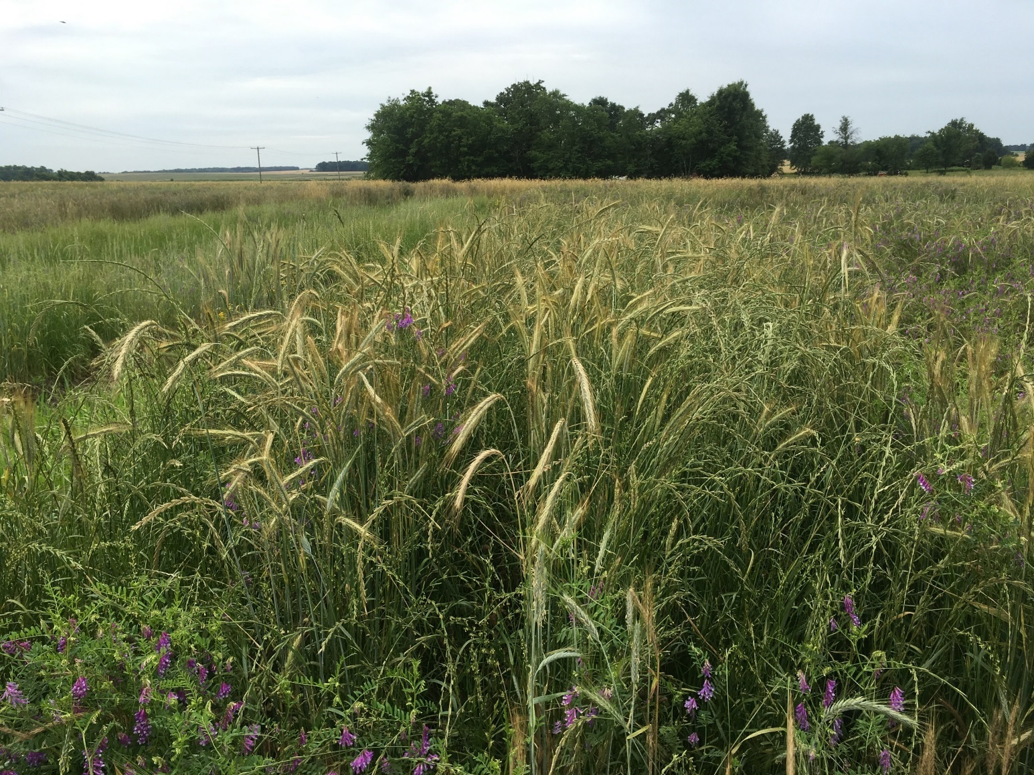
Planting Day

Slide 3
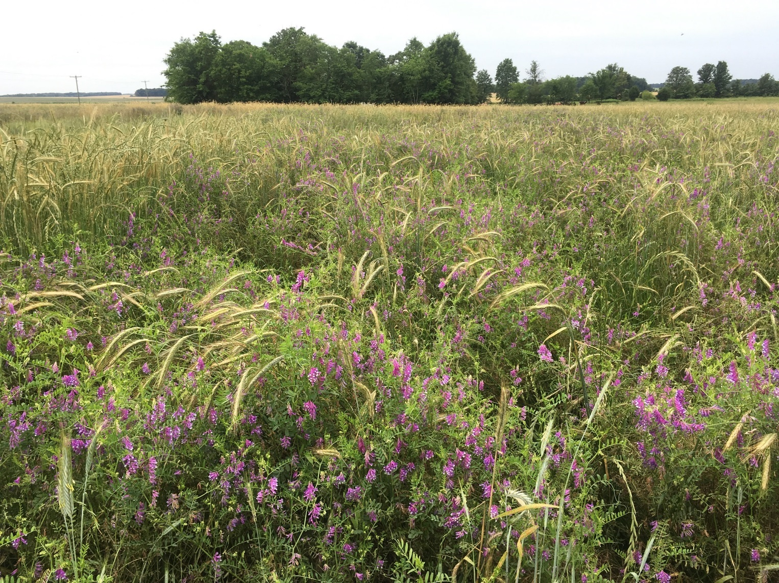
Planting Day

Slide 4
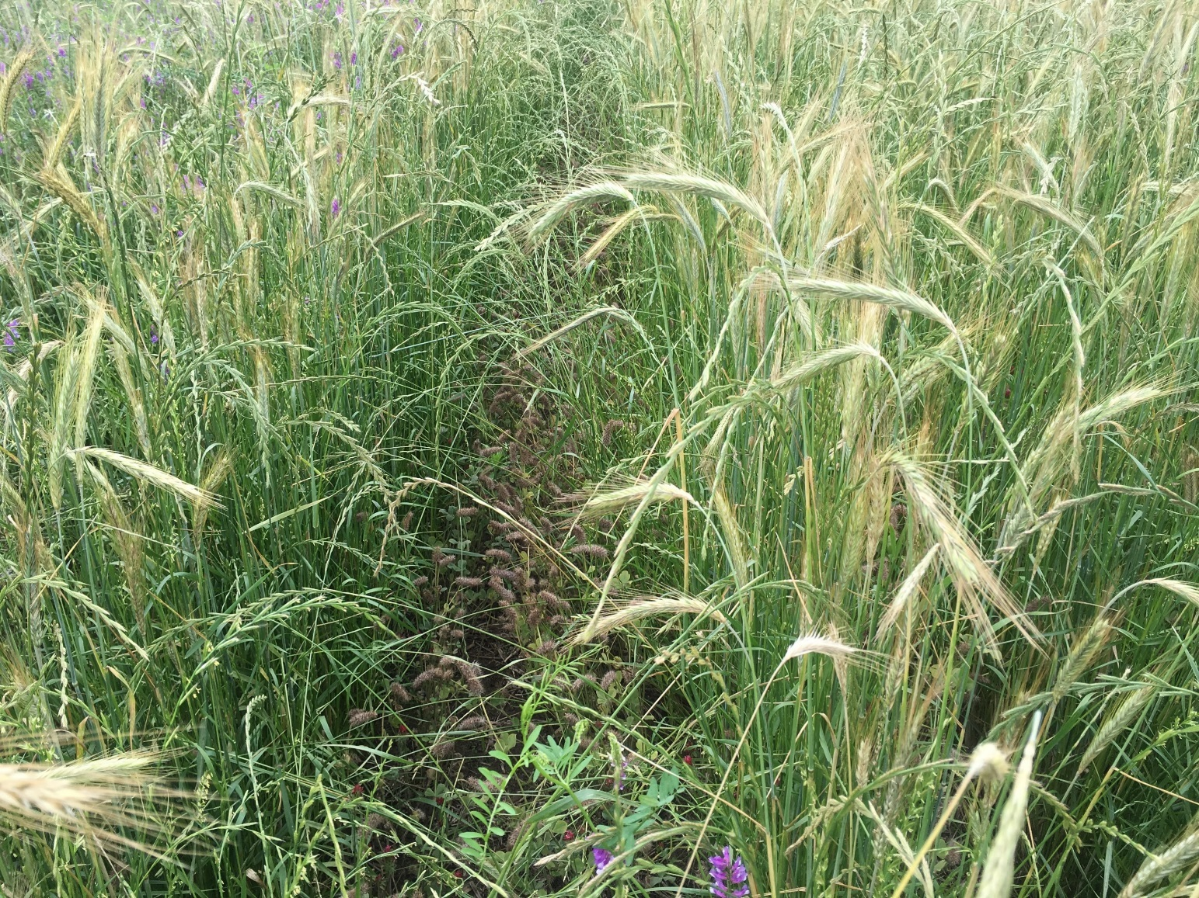
Open spacing for corn row

Slide 5
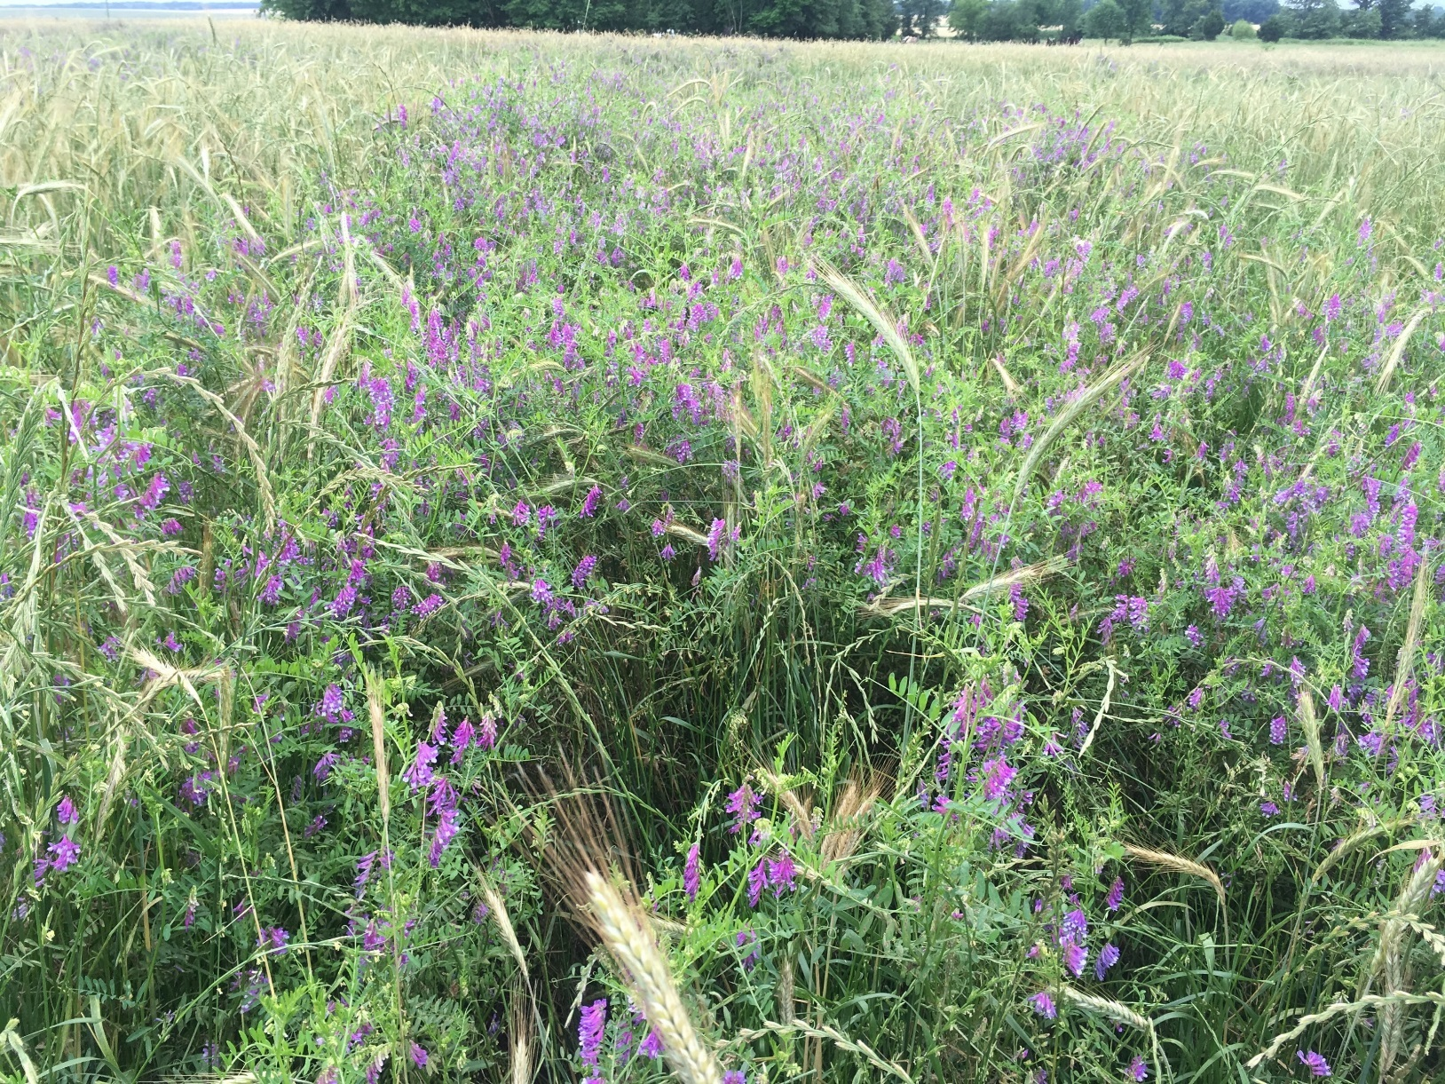
Advanced Vetch Development

Slide 6
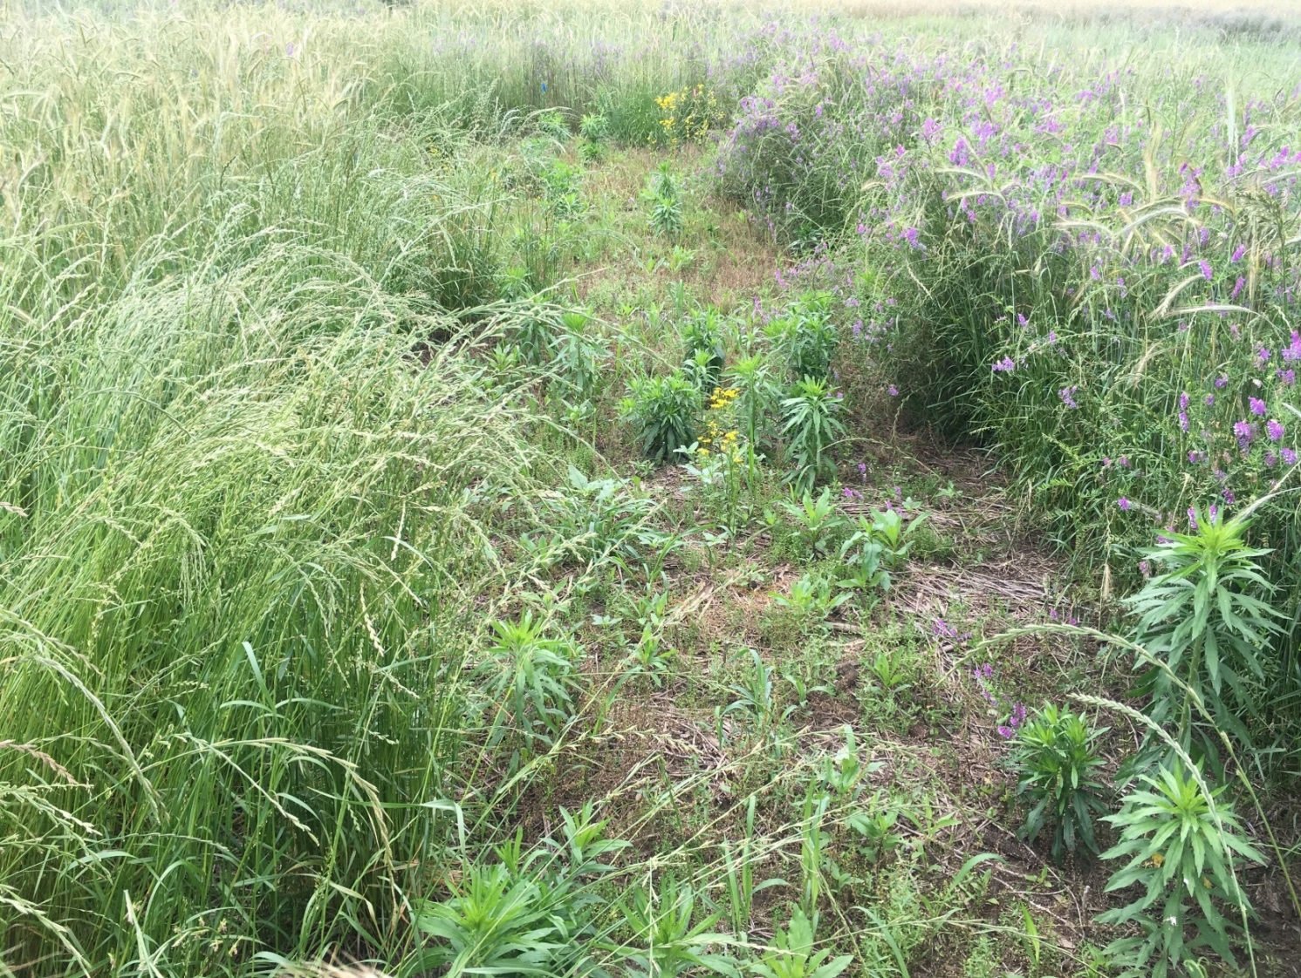
Weed Pressure in no cover crop check

Slide 7
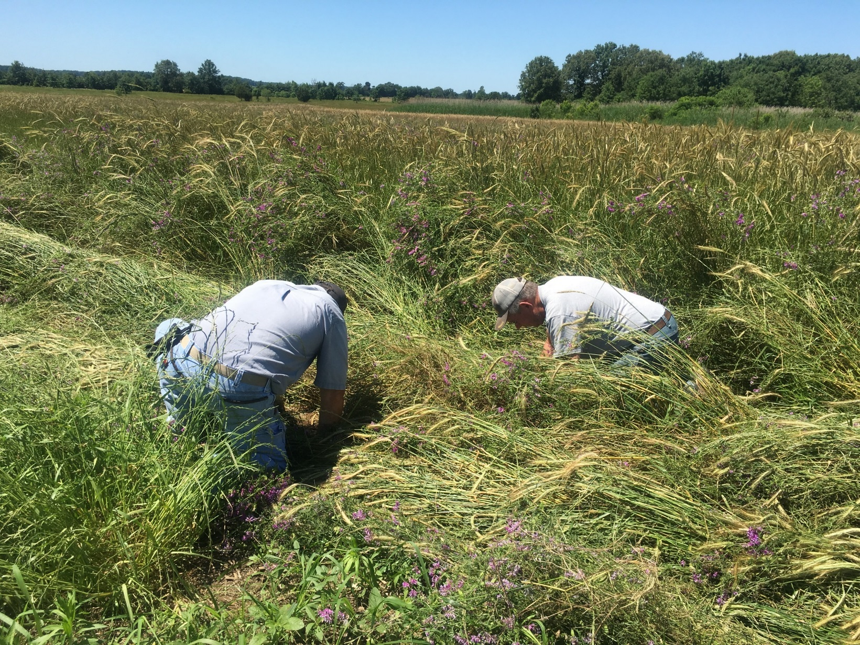
Checking Seeding Depth at Planting

Slide 8
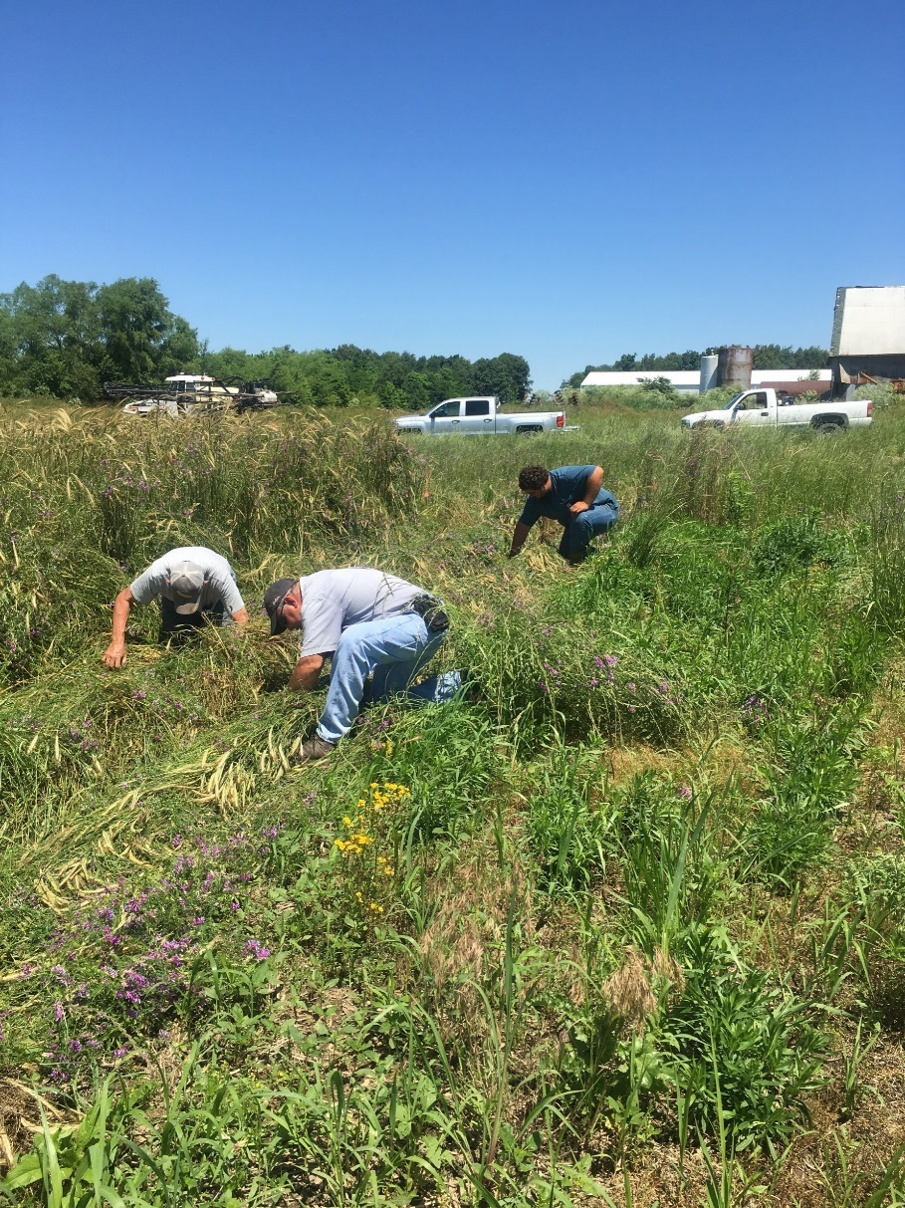
Help on Planting Day

Slide 9
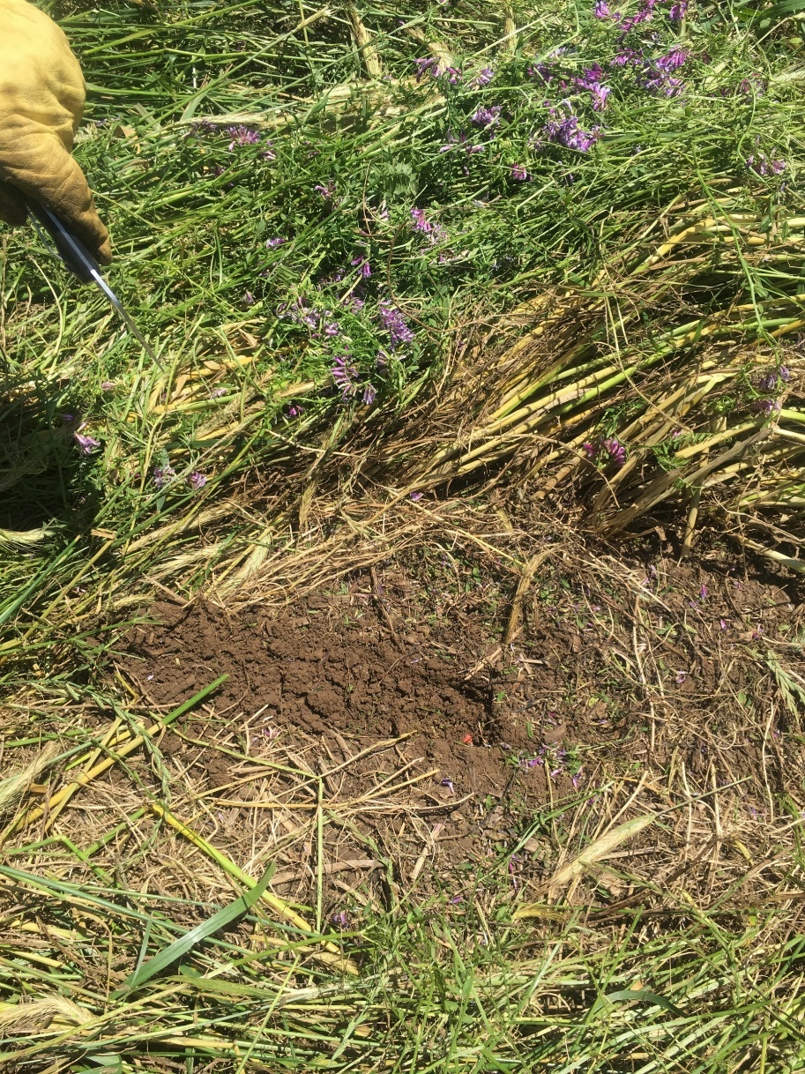
Seeding Depth

Slide 10
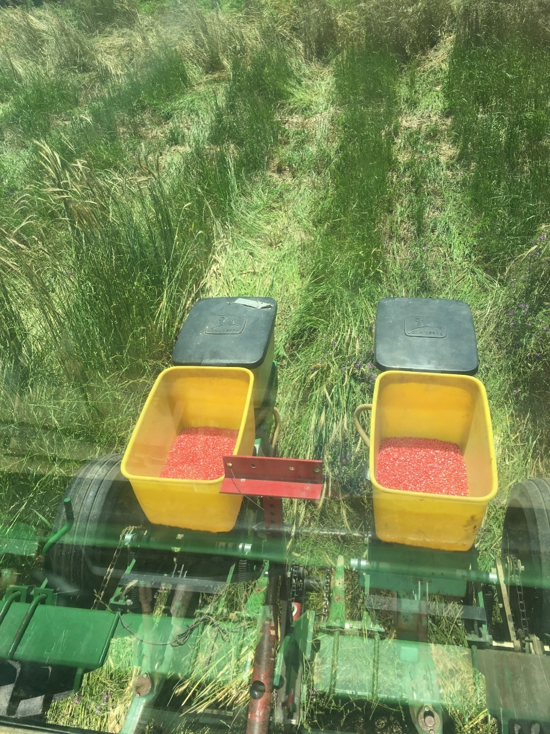
Plot Planter

Slide 11
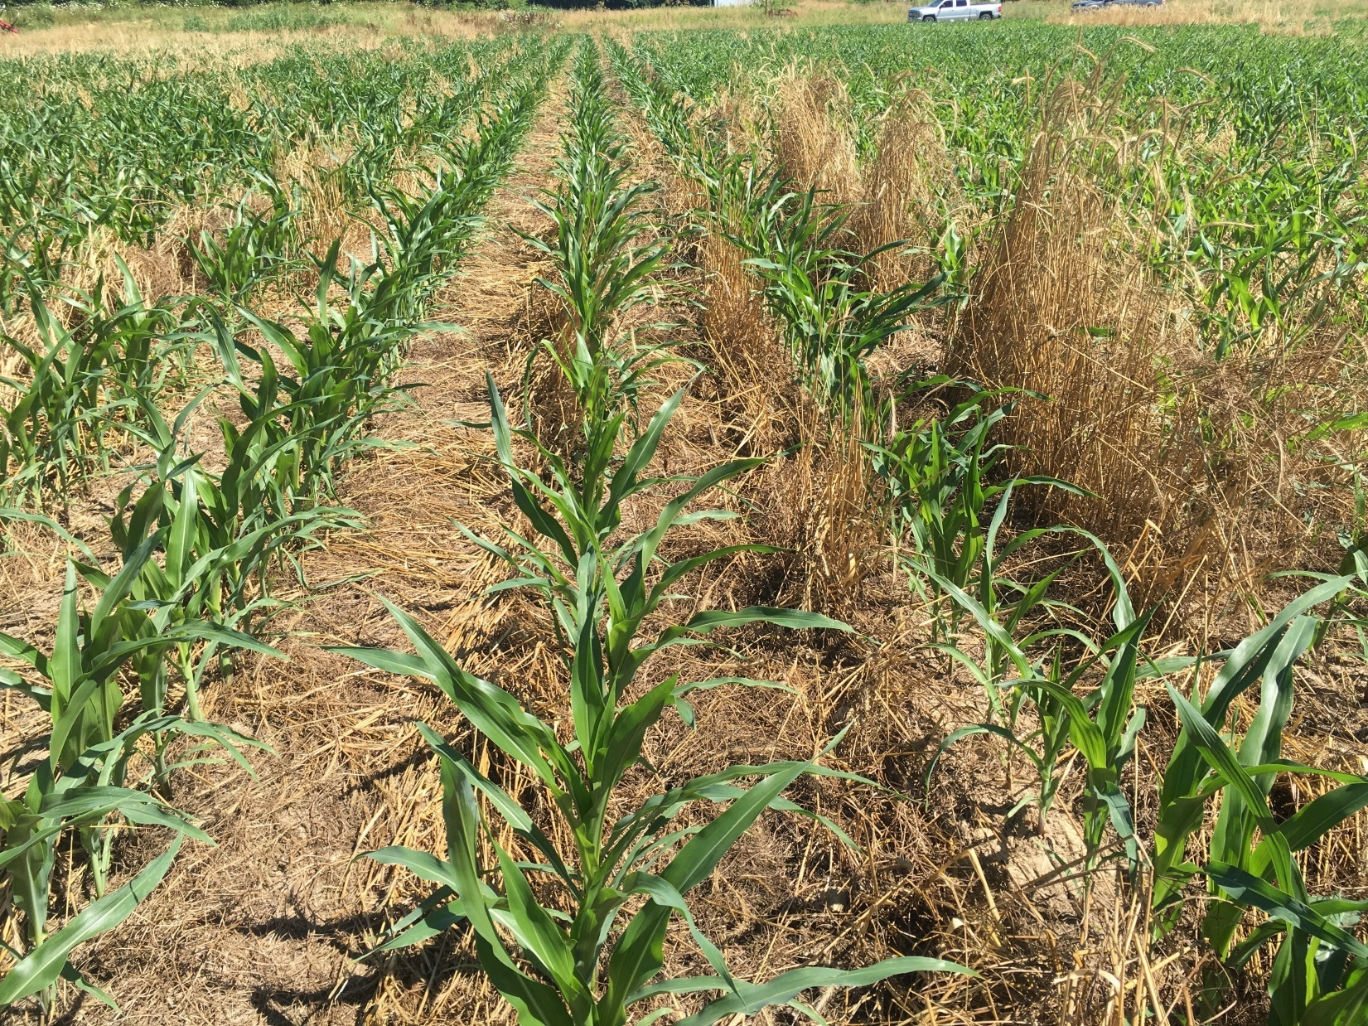
Corn stand established

Slide 12
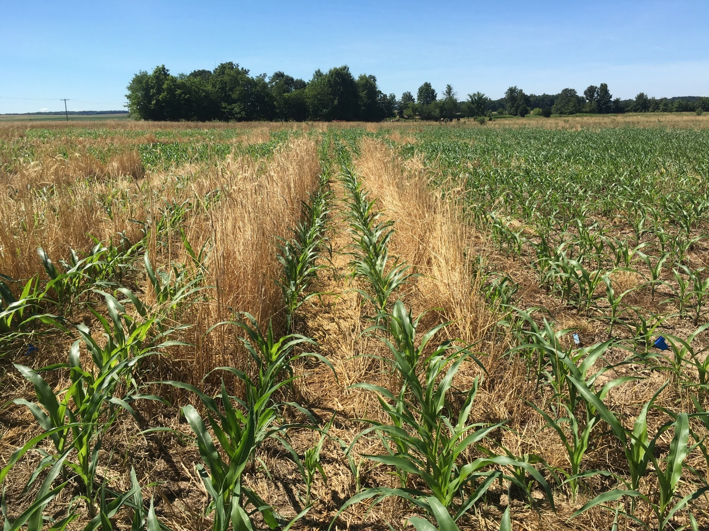
Improved Corn Stand In Precision Planted Plot vs. Drilled Mixed Cover Crop

Slide 13
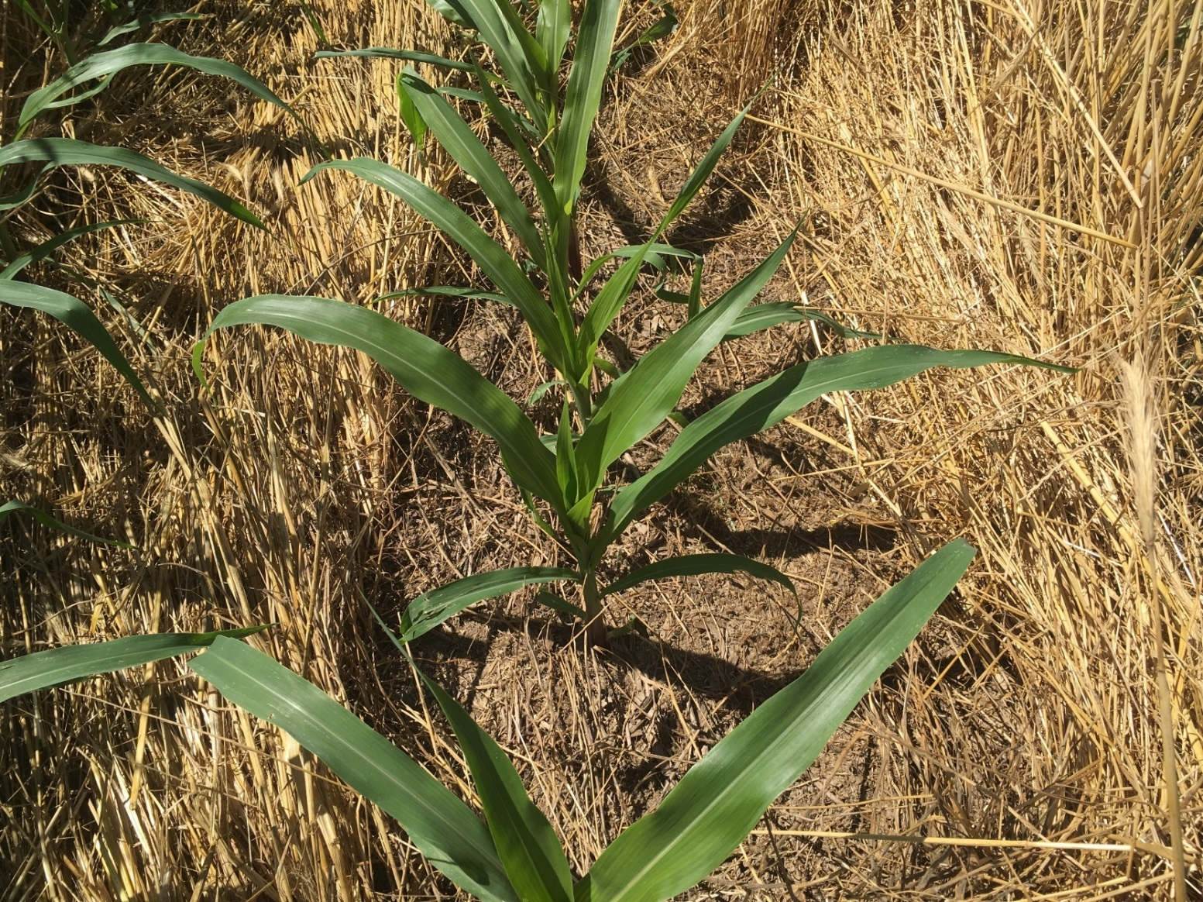
Reduced Residue in the corn row, heavier cover in row middles

Slide 14
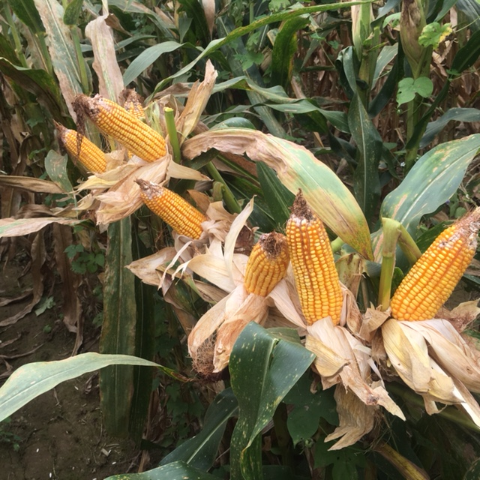
Even ear size showing uniform stand and emergence timing

Slide 15
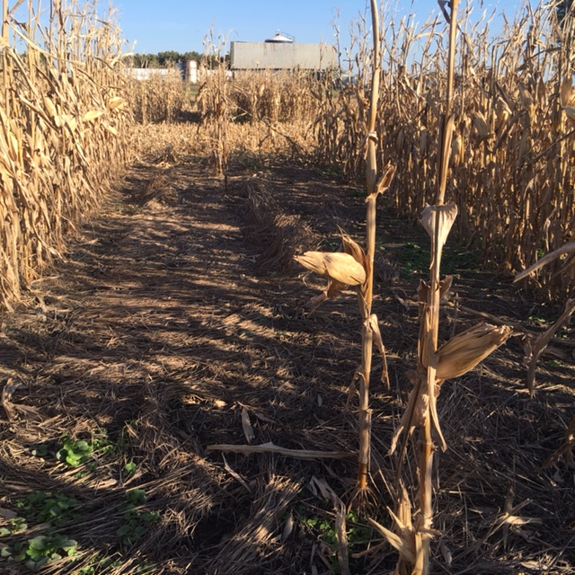
Cover Crop impact on weed control in unplanted corn check. Clean with only burndown herbicide treatment

Slide 16
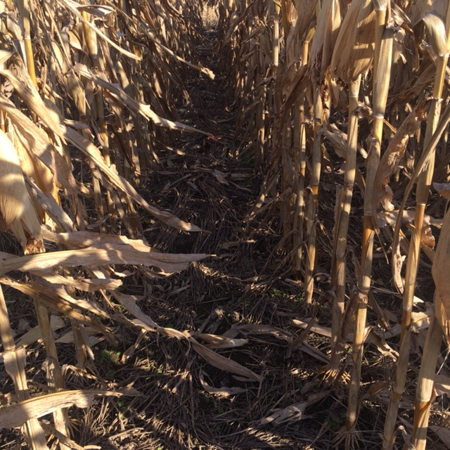
Corn stand and weed control at harvest

