Slide 1


Information for W-SARE project
January 12, 2017

Slide 2
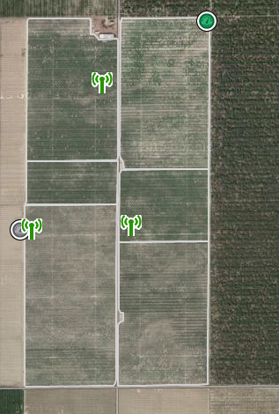
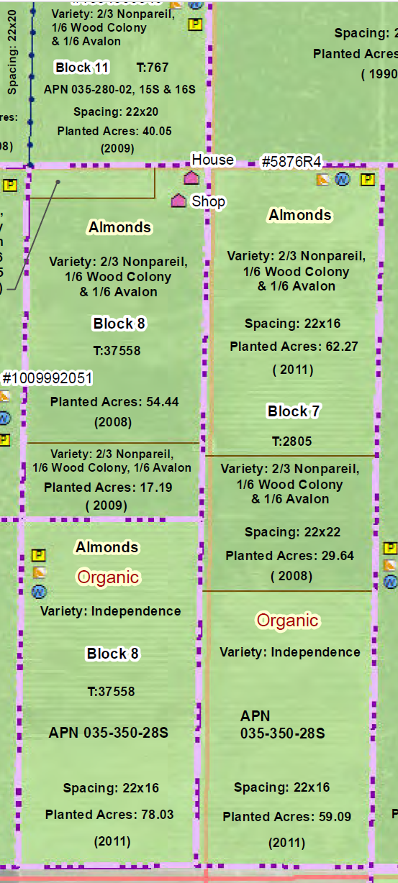
Fields under project
Conventional and organic blocks
Pumps converted from diesel to electric in June 2016
Soil probes installed in 2014 under NRCS-EQIP grant

Slide 3
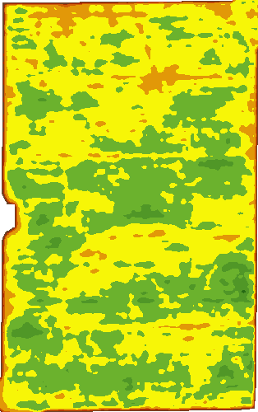
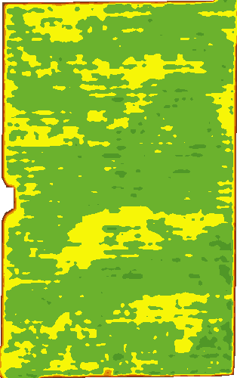
Soil and variability analysis
Example of Ranch 12 Block 7. Irrigation schedule was changed as a result of study: shorter and more frequent irrigation sets because of sandy and sandy loam areas. Green is high vigor.
June 2015
June 2016

Slide 4
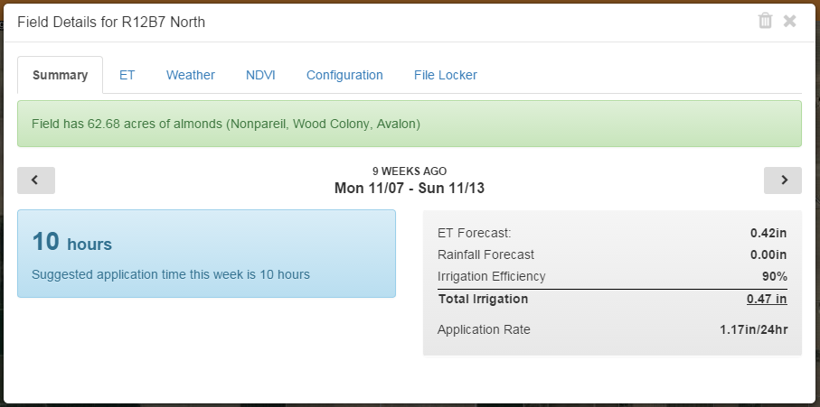
Implementation of ET-based schedule

Slide 5
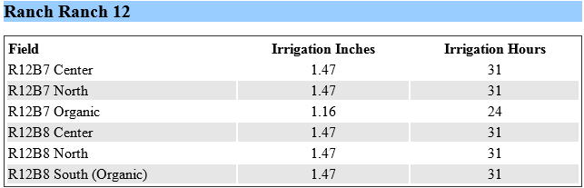
Implementation of ET-based schedule

